Slide 1
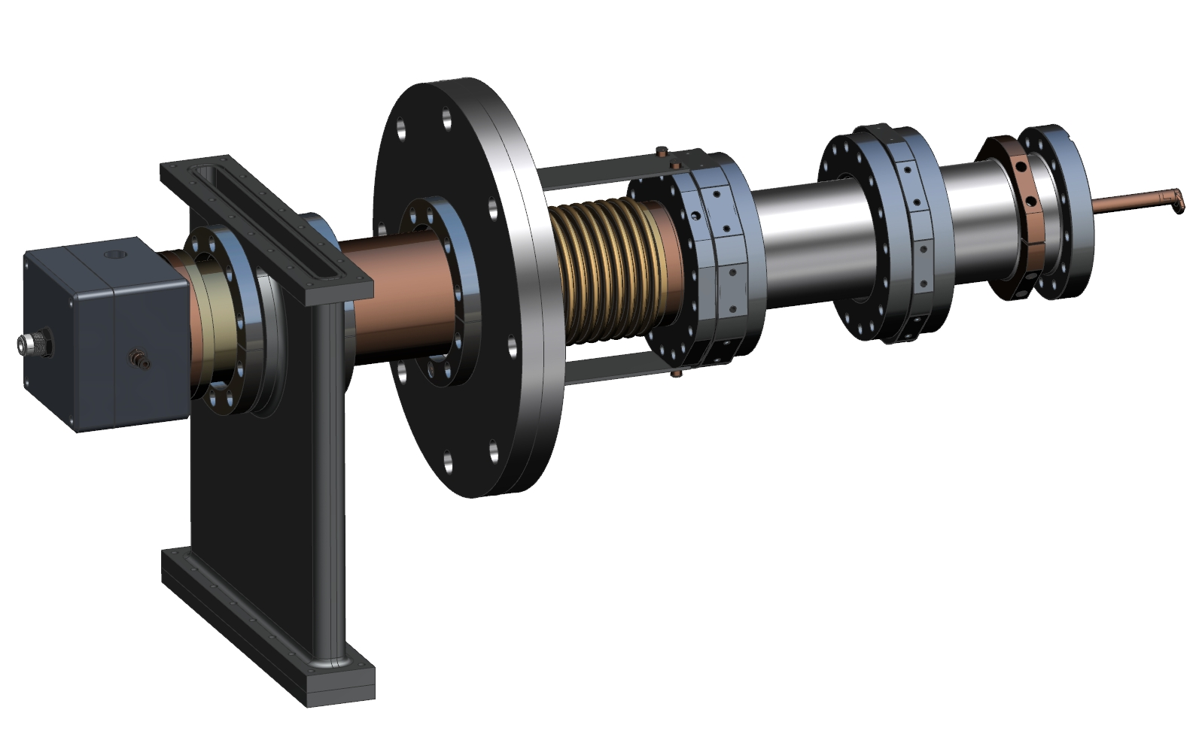
650 MHz coupler
S. Kazakov
10/31/2017

Slide 2
Functional requirement specification (FRS) of 650 MHz coupler
Parameter | Value
Frequency | 650 MHz
Pass band (S₁₁<0.1) | > 2 MHz
Operating power (CW, any reflection) | > 110 kW
HV bias | ~ 4 kV
Parameter | Value
Input | Waveguide
Output | 3-1/8'' coaxial, LB650/HB650 flange
RF window | Single, room temperature
Cold flange relative displacement | +-3 mm
Vibration and shock | Up to 3 g in any direction
Parameters | Value
Thermal intercepts (nominal) | 5 K and 80 K
Temperature at 5 K intercept | < 15 K
Temperature at 80 K intercept | < 125 K
2K heat load (110 kW) | < 1 W
5K heat load (110 kW) | < 6 W
80K heat load (110 kW) | < 11 W
Antenna tip temperature (110 kW) | < 340 K
Antenna cooling media | Air
Air flow rate (110 kW) | < 3 g/s
Max cooling air pressure drop | < 1.5 bar

Slide 3
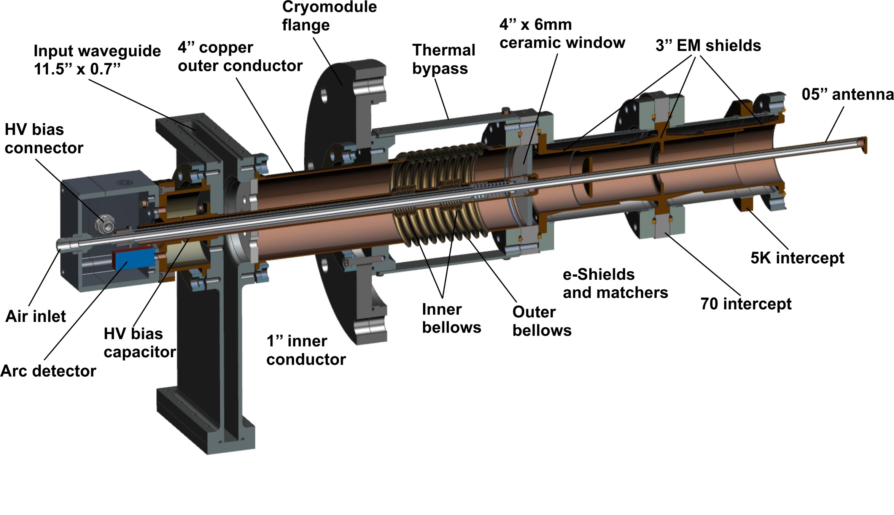
Structure of 650 MHz coupler, new design.

Slide 4
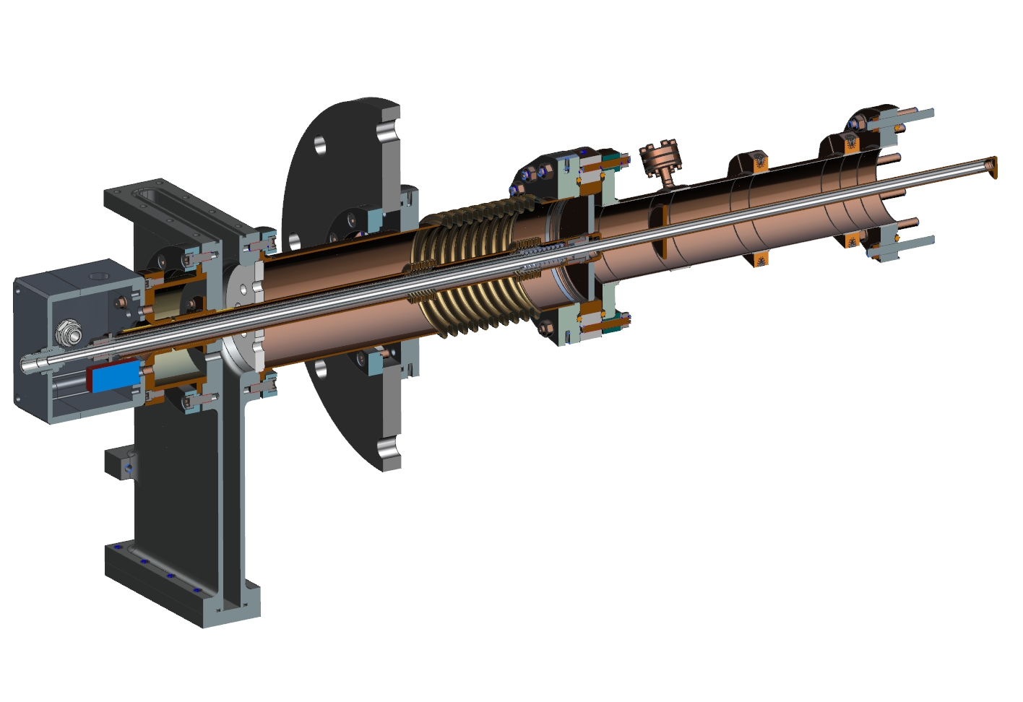
Backup design, 650 MHz coupler.

Slide 5
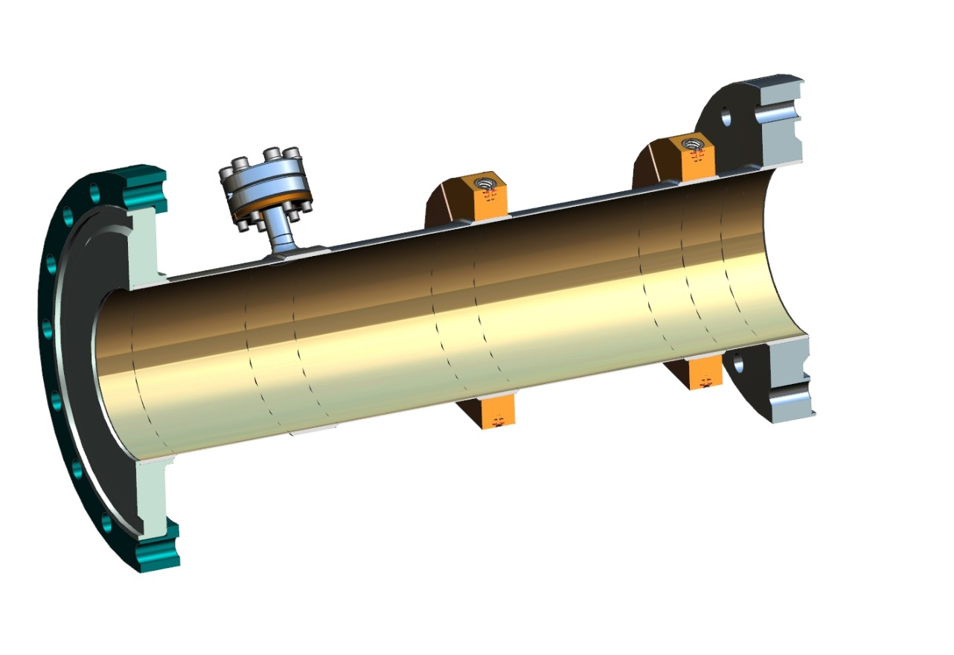
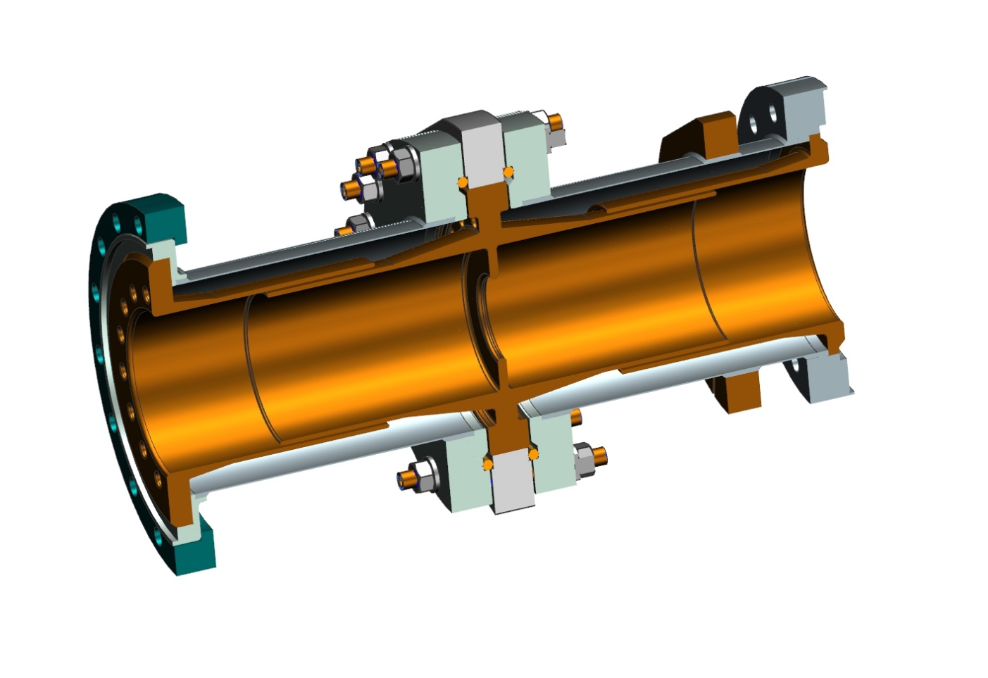
To move from “new” to “backup” ( and contra versa) we need to change only the outer conductors of vacuum part. It is not expensive.

Slide 6
Main features of mechanical design:
Window: AL₂O₃, 4’’ x 6 mm
Antenna: 0.5’’ copper pipe
Antenna cooling: Air (3 g/s for 100 kW)
Outer conductor (new design): stainless steel 4’’ x 0.6 mm, no copper coating
Outer conductor (back up design): stainless steel 3’’ x 0.6 mm, copper coating 15 µm
Input: waveguide WR-1150
Multifactor suppression: High voltage bias, up to 5 kV
Diagnostics: Arc detector (e-pick up, back up design)

Slide 7
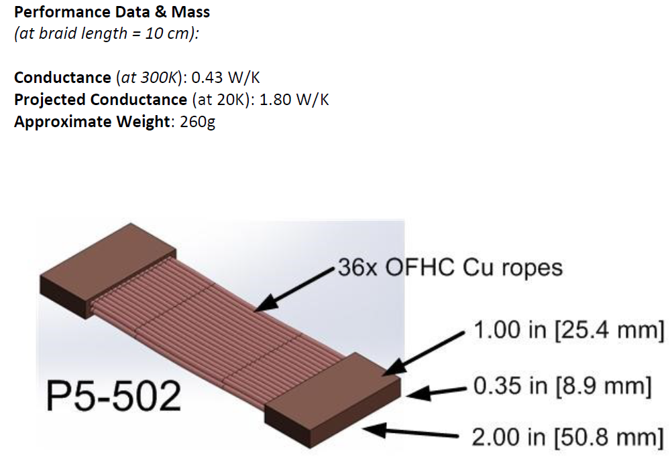
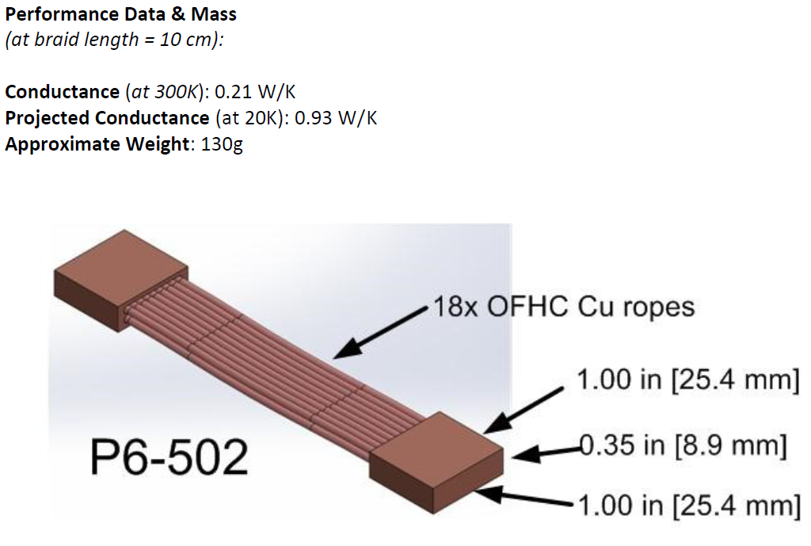
In simulations all thermo-intercepts are connected trough copper straps like these:
15 cm
30 cm

Slide 8
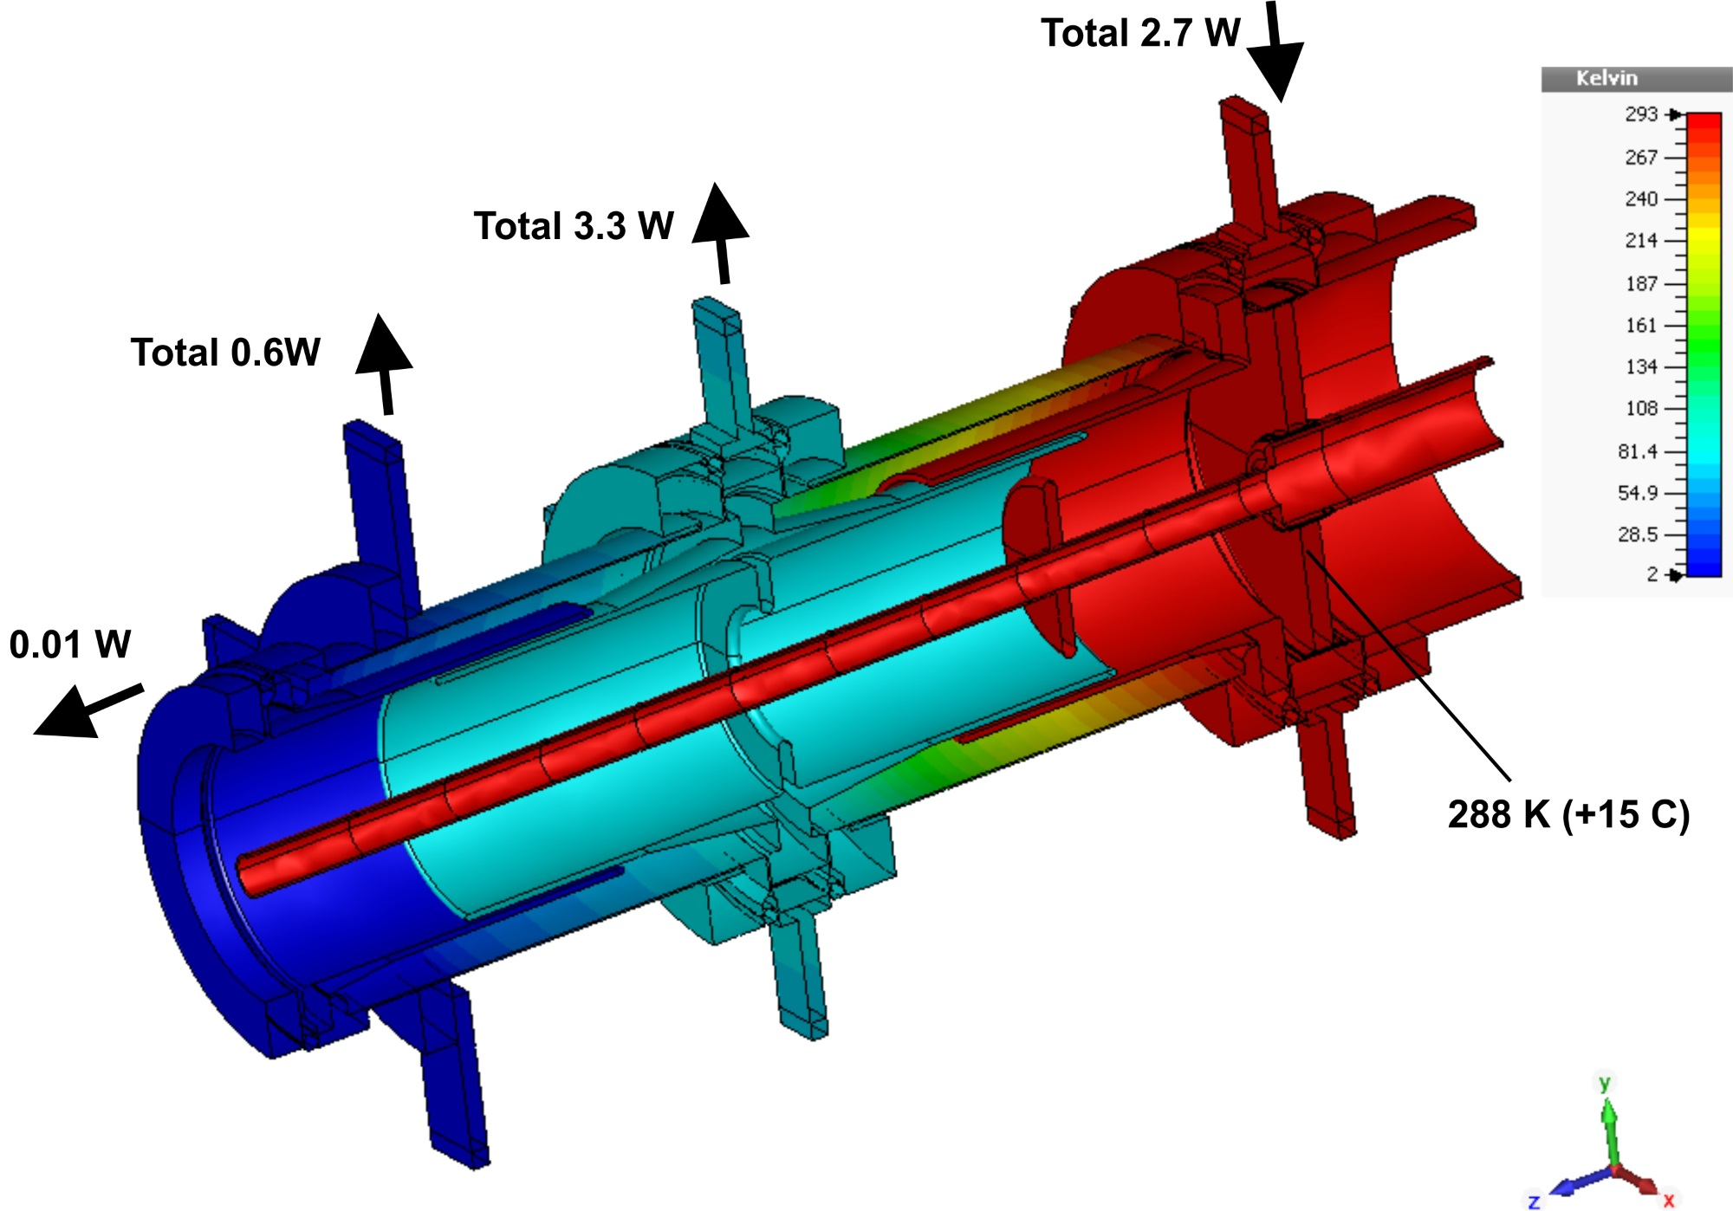
Static thermal loading , RF power = 0 kW
T_tip ≈ 20 C
P_rad ≈ 0.14W (Polished copper ε = 0.05)

Slide 9
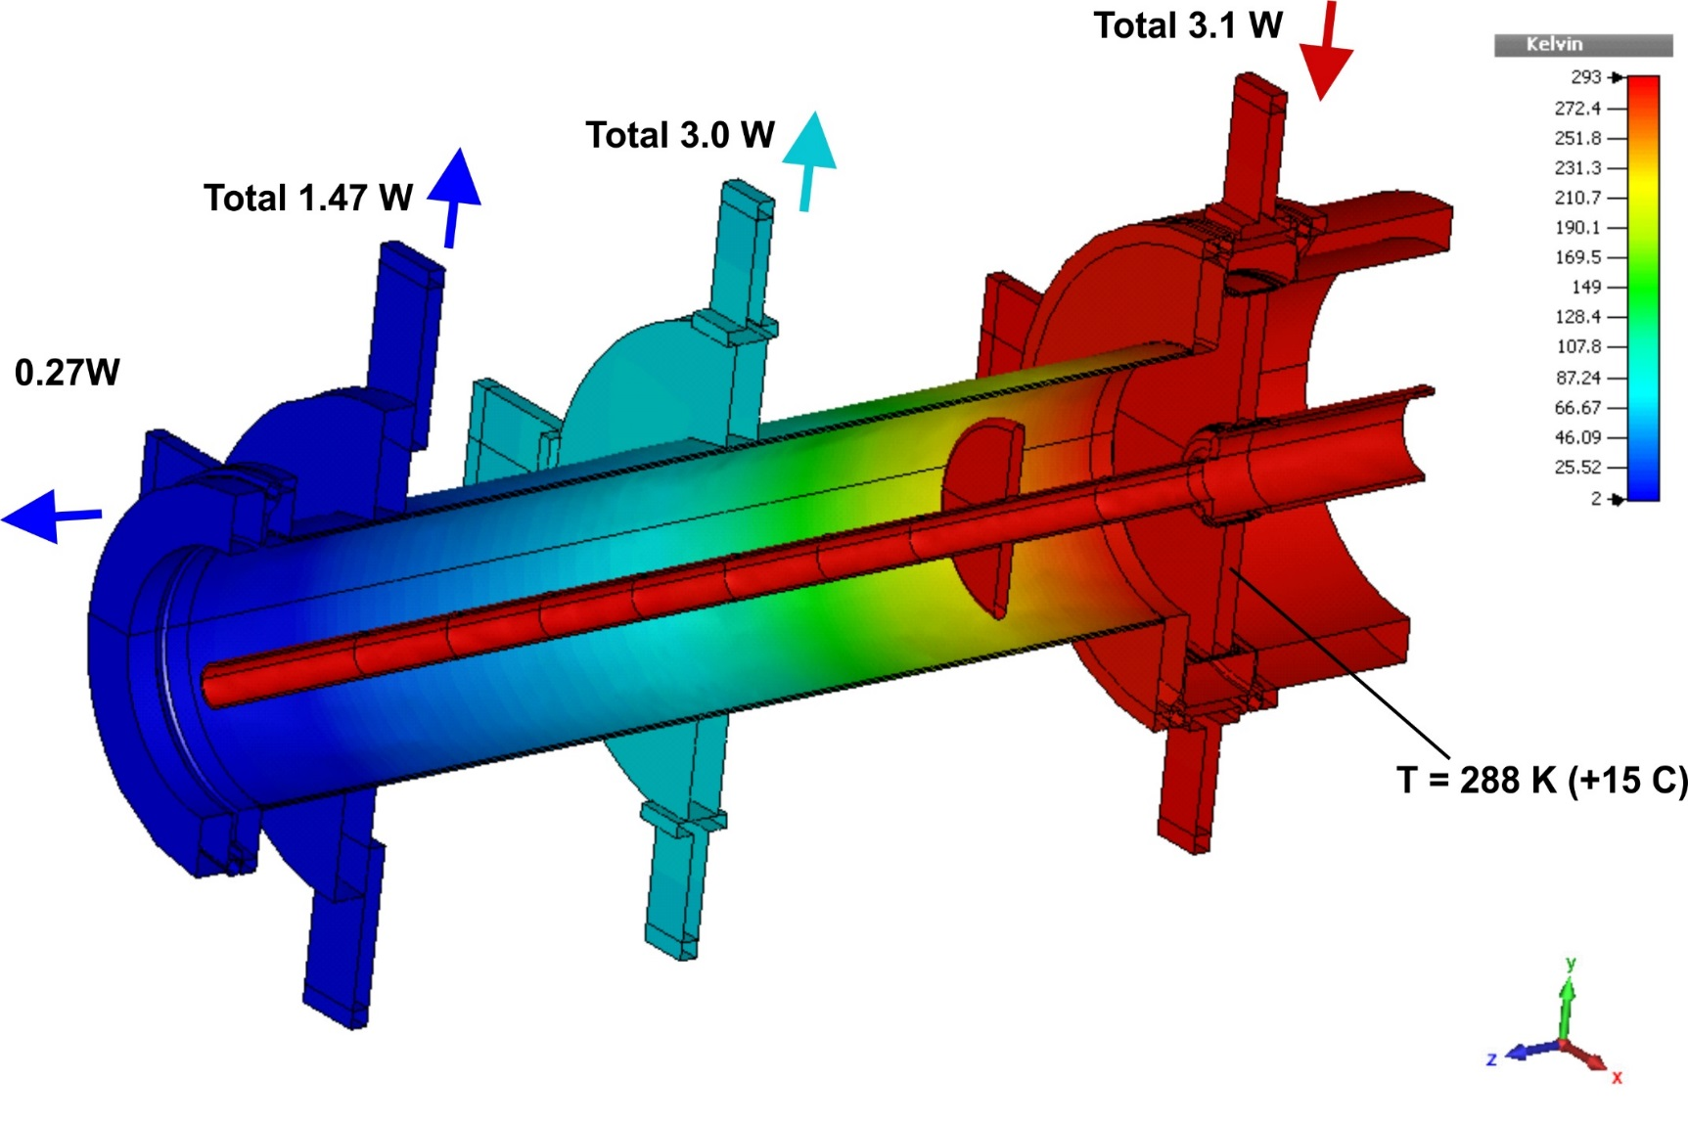
Static thermal loading, RF power = 0
Tip ≈ 20 C
P_rad ≈ 0.14W

Slide 10
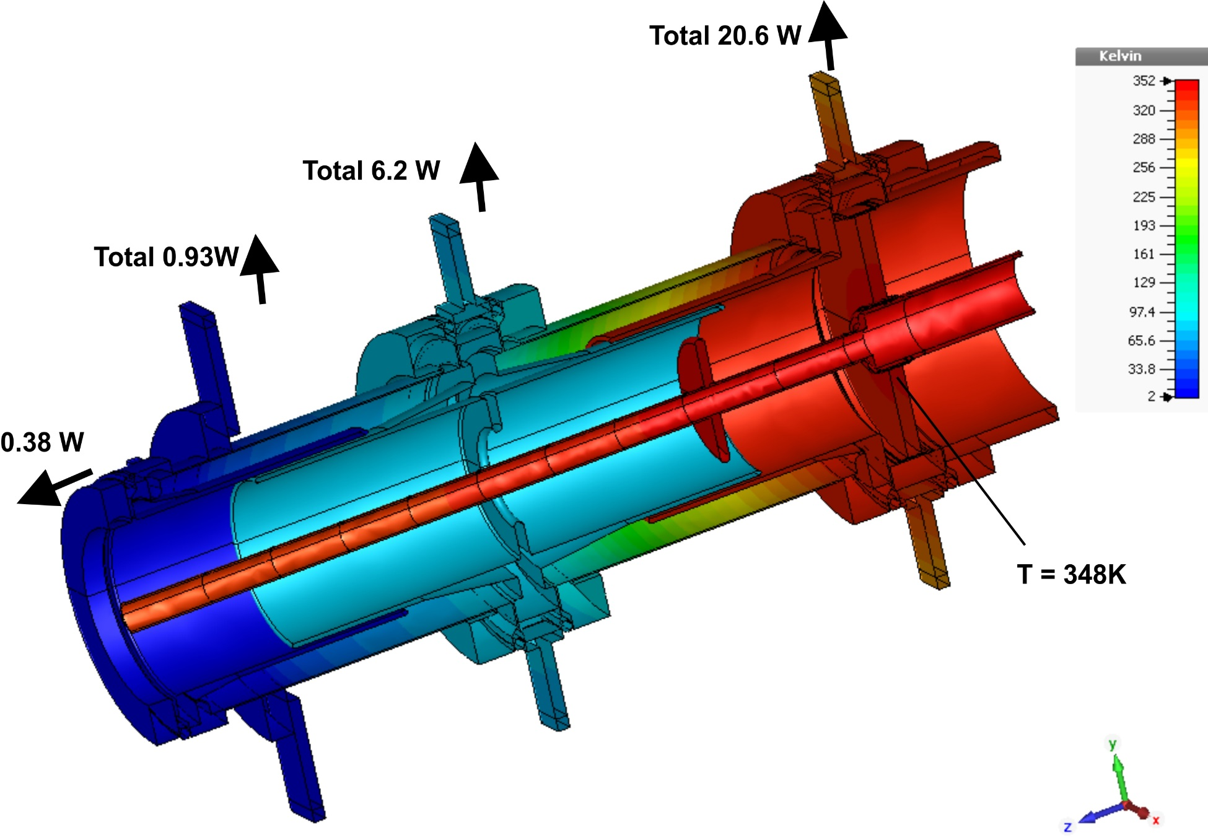
P = 100 kW, TW, Air = 3.0g/s
Loss in antenna = 77W +20W = 97W
ΔT_air ≈ 38C
T_tip ≈ 34C
P_rad = 0.17W

Slide 11
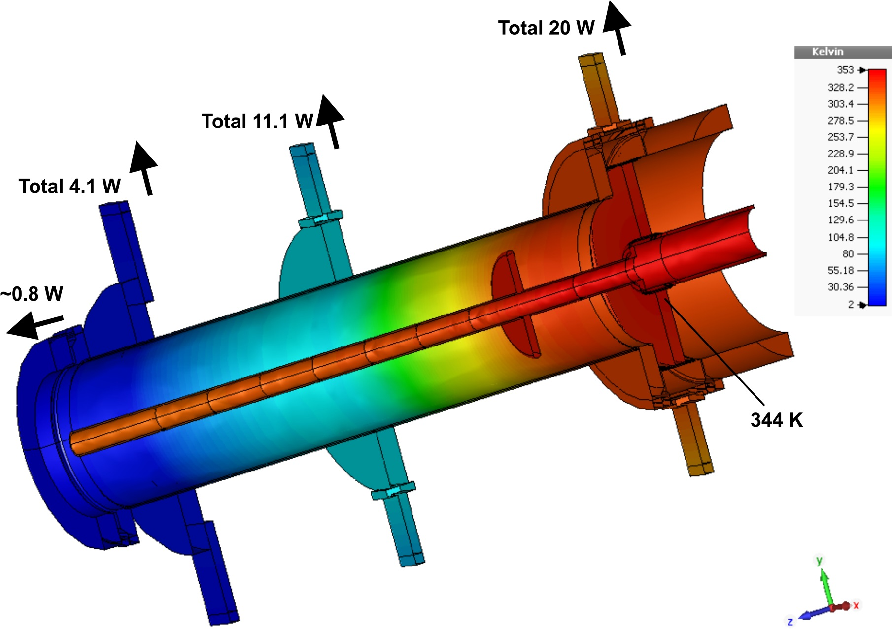
P = 100 kW, TW, Air = 3.0 g/s
Loss in antenna = 73W+20W = 93W
ΔT_air ≈ 37C
T_tip ≈ 34C
P_rad ≈ 0.17W

Slide 12
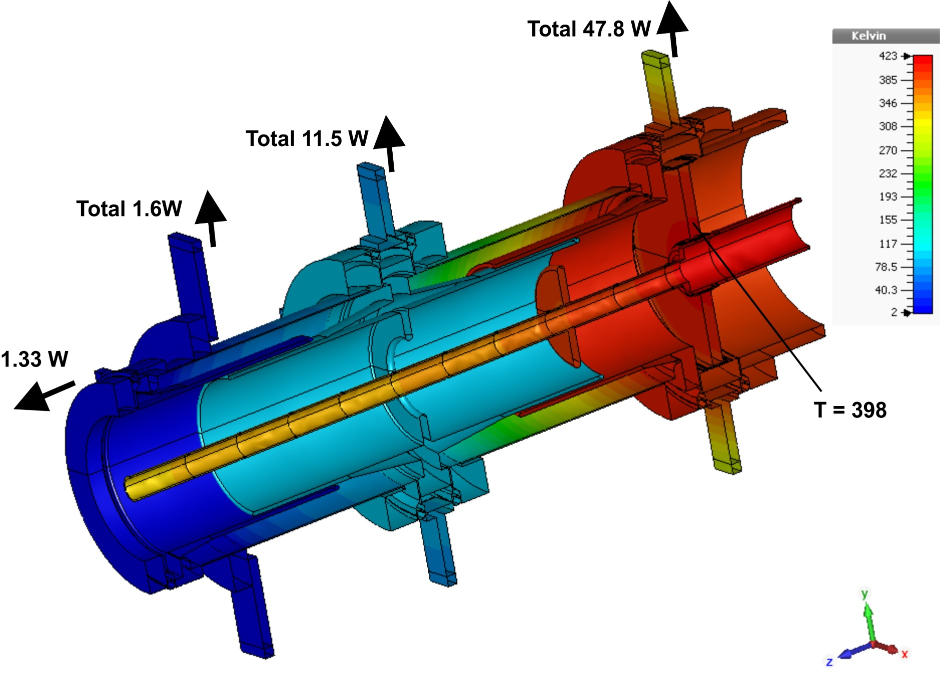
P = 300 kW, TW, Air = 5 g/s
Loss in antenna = 230W+58W = 288W
Δ_Tair ≈ 72C
T_tip ≈ 44C
P_rad = 0.19W

Slide 13
Summary of thermal properties:
Input power, kW | Load to 2K, W | Load to 5K, W | Load to 70K, W | Load to 300K, W
0, new | 0.15 | 0.6 | 3.3 | -2.7
0, back up | 0.41 | 1.47 | 3.0 | -3.1
100, new | 0.55 | 0.93 | 6.2 | 20.6
100, back up | 0.97 | 4.1 | 11.1 | 20.0
100, FRS | 1.0 | 6.0 | 11.0 | -

Slide 14
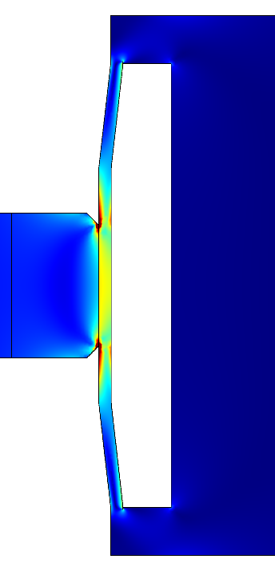
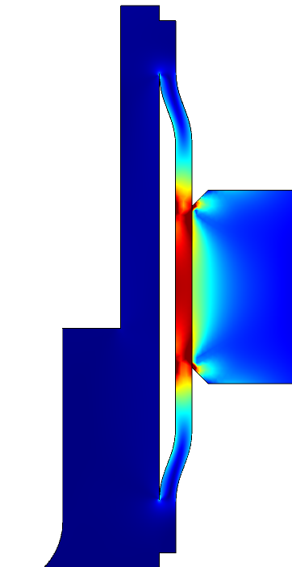
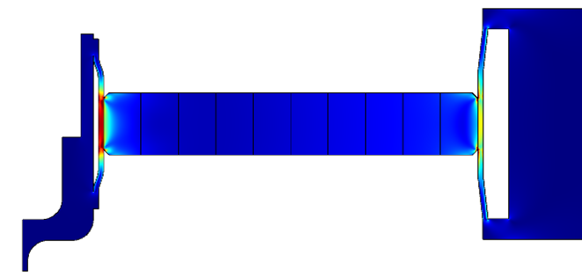
Typical pictures of stresses (linear scale). Maximal stresses are localized in place of ceramic-metal brazing. Stresses caused by temperature gradient in ceramic are noticeably smaller.
Points of max. strength
(values are in the table)

Slide 15
Stresses in copper and ceramics for 100kW and 300kW, TW, CW
Power, Air rate | Inner, Cu | Inner, Cer | Outer, Cu | Outer, Cer
100 kW, TW, 3g/s | 87 MPa, T = 74C | 100 MPa | 125 MPa, T = 60C | 160 MPa
100 kW, TW, 4g/s | 65 Mpa, T = 65C | 92 MPa | 97 Mpa, T = 55C | 128 MPa
300 kW, TW, 5g/s | 160 Mpa, T = 124C | 220 MPa | 280 Mpa, T = 112C | 250 MPa
Design is good for 100 kW, TW, CW.
For 300 kW it has to be improved.
For 300 kW we need to improve cooling of window (water?) or/and use material with a lower coefficient of thermal expansion. Smaller power - the price for simplicity.

Slide 16
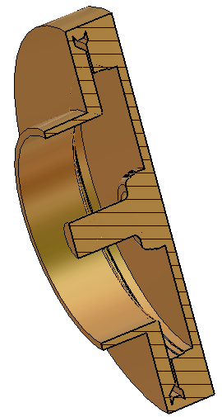
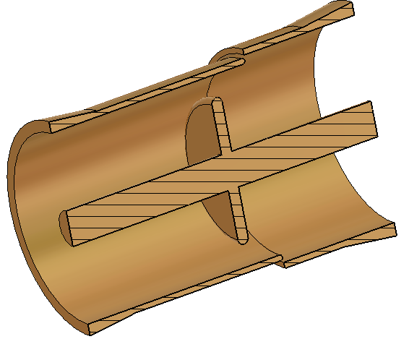
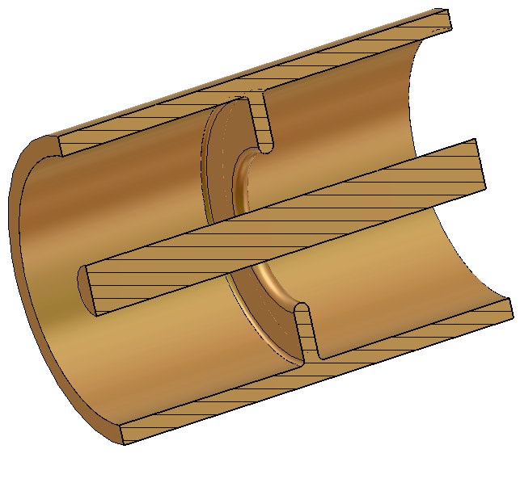
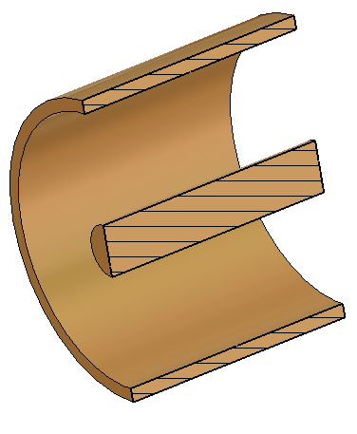
Multipactor near shielding disk:
Multipactor near the window:
Multipctor exists (no bias) at P ≥ 100 kW, TW
-5 kV suppresses multipactor up to 300 kW, TW
+5 KV does not suppress multipactor (300 kW, TW)
Multipactor exists (no bias) P > 20 kW, TW
Bias ±4 kV suppresses multipactor for P < 700 kW, TW
This is true for Port 1 and Port 2 excitation
(both directions of TW)
Multipctor near shielding iris:
Multipactor in regular part:
Multipactor exists (no bias) at P > 50 kW, TW
Multipactor exists (no bias) at P > 40 kW, TW
± 5 kV bias suppresses multipactor up to 300 kW, TW
+2 kV and – 3.6 kV bias suppresses
multipactor up to 300 kW, TW

Slide 17
Conclusion:
-5kV bias suppresses multipactor in all parts of coupler up to 300 kW, TW

Slide 18
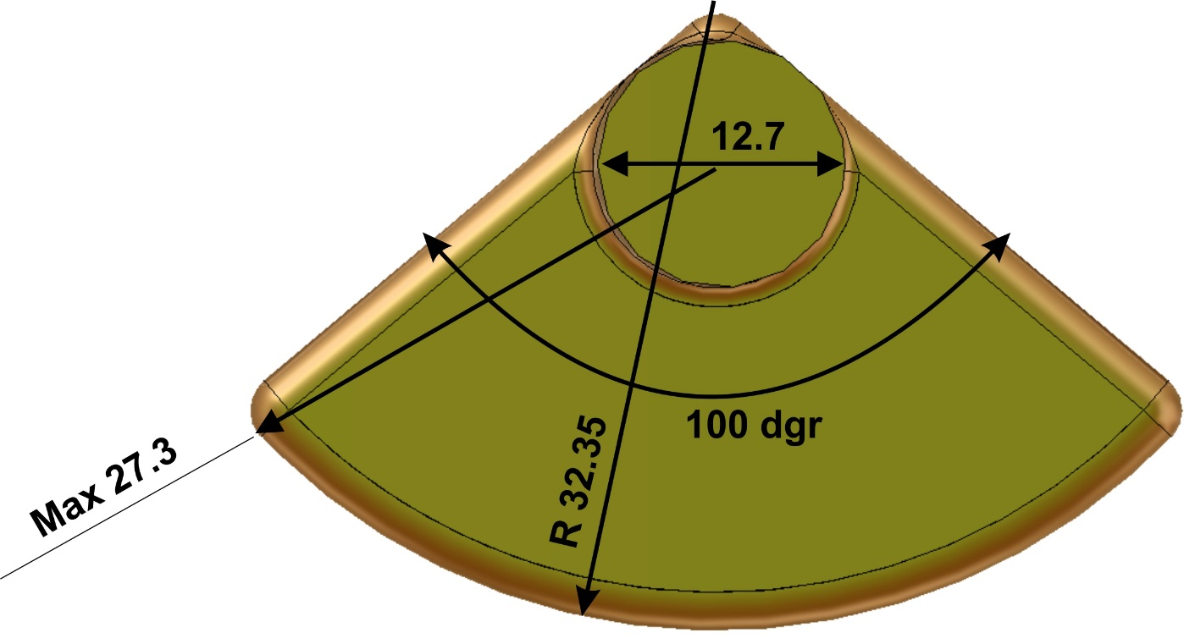
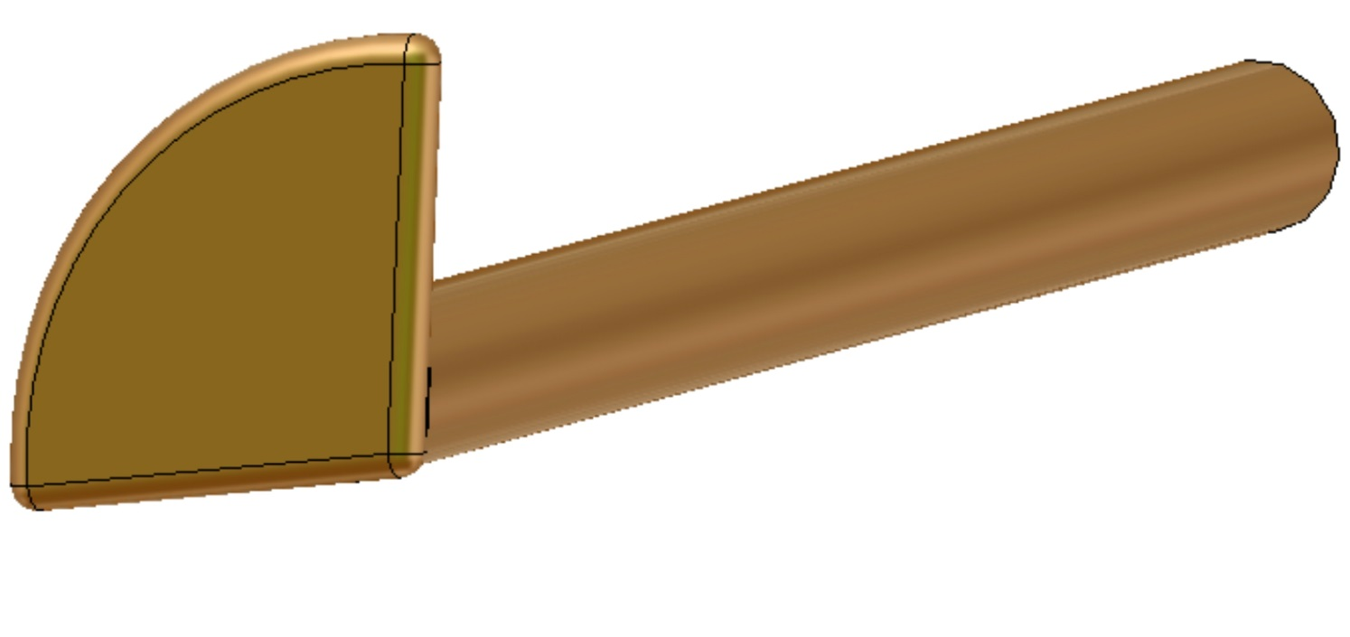
Antenna tip and coupling.
“Goose foot” shape improves a coupling and allows to change coupling by rotation of antenna

Slide 19
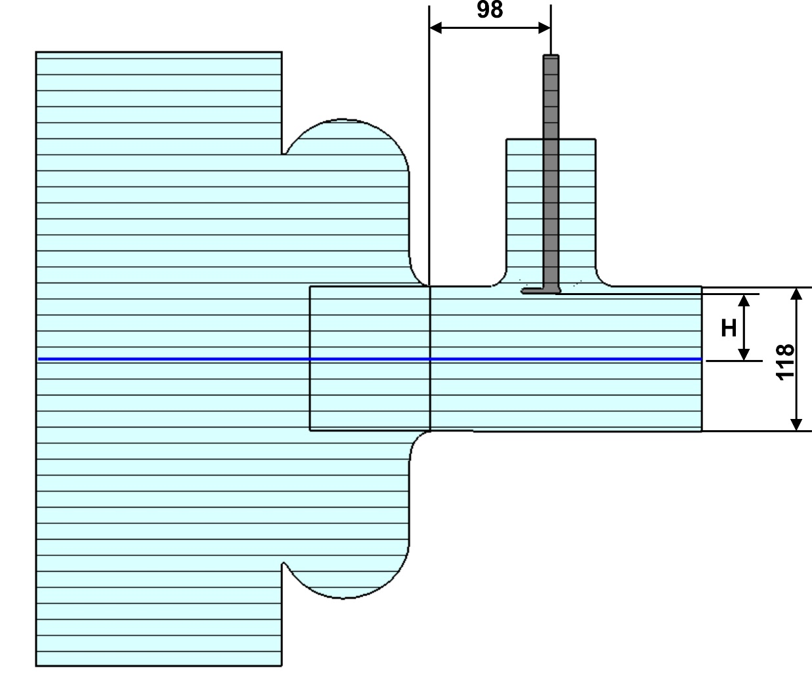
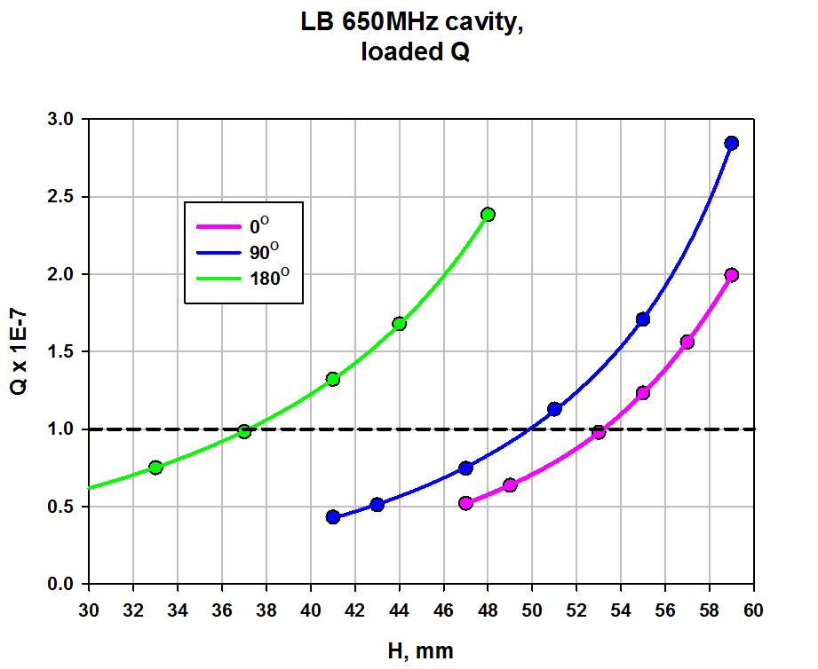
LB 650 MHz cavity coupling:

Slide 20
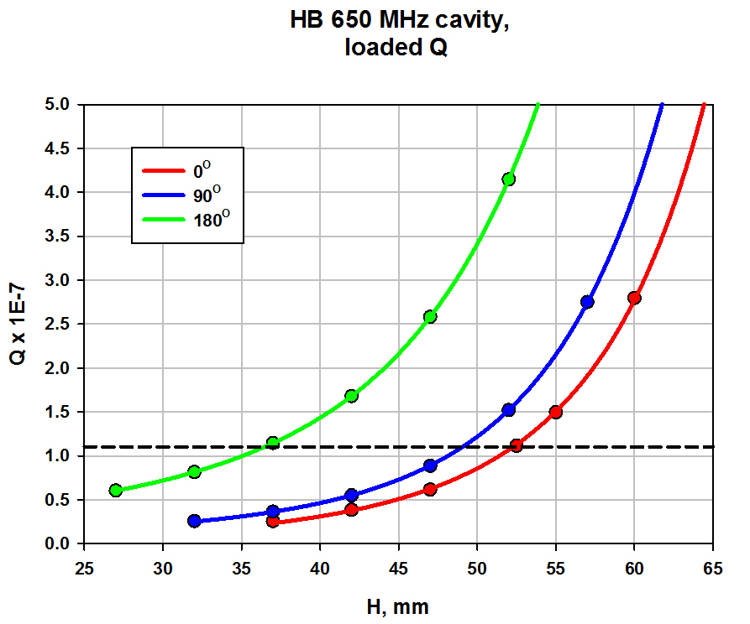
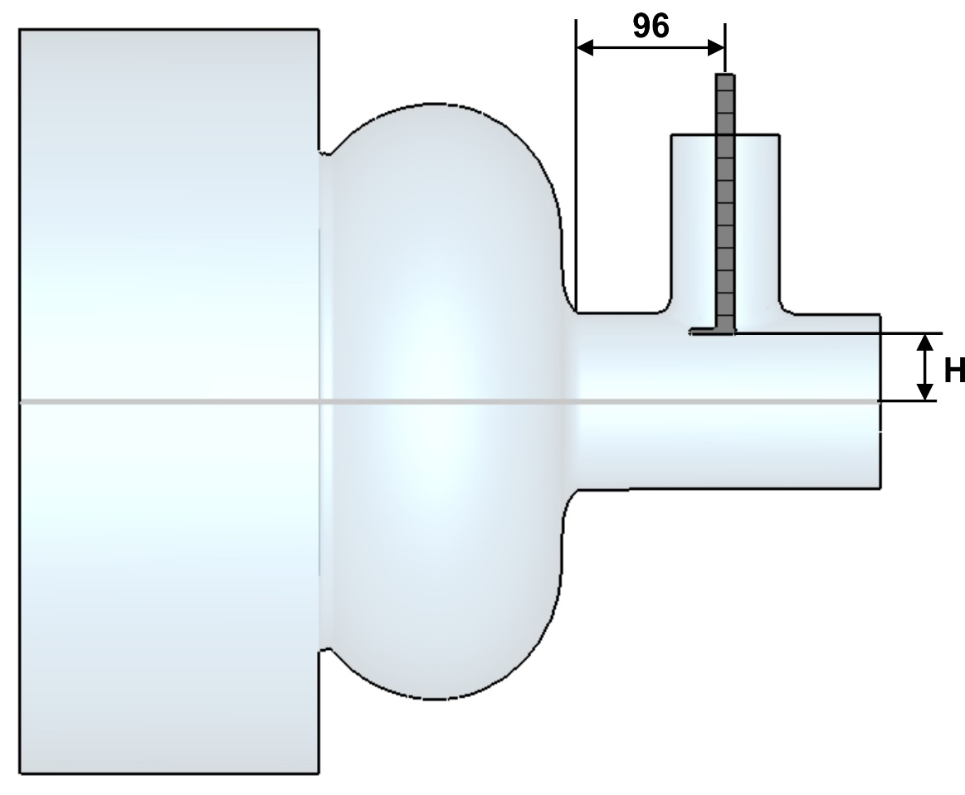
HB 650 MHz cavity coupling:

Slide 21
Air part of coupler

Slide 22
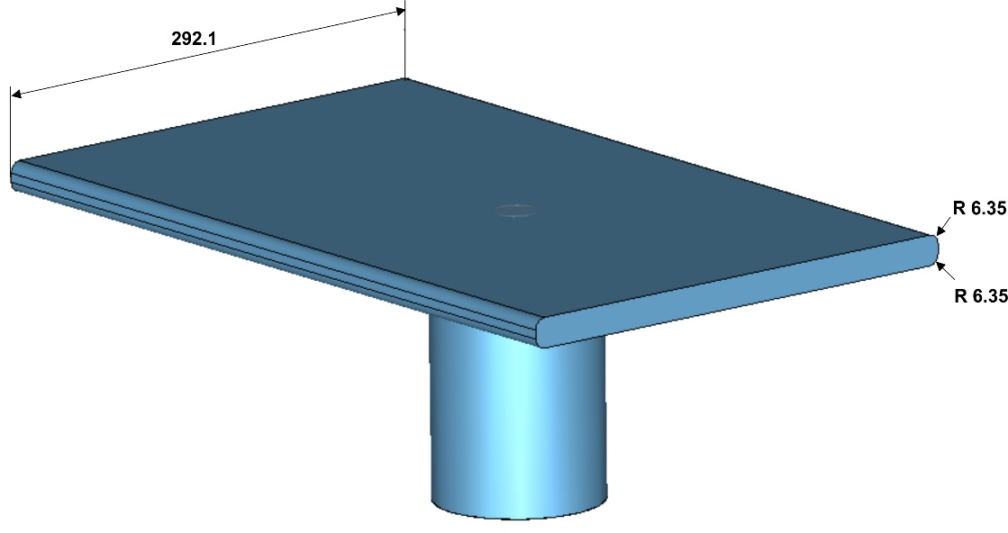
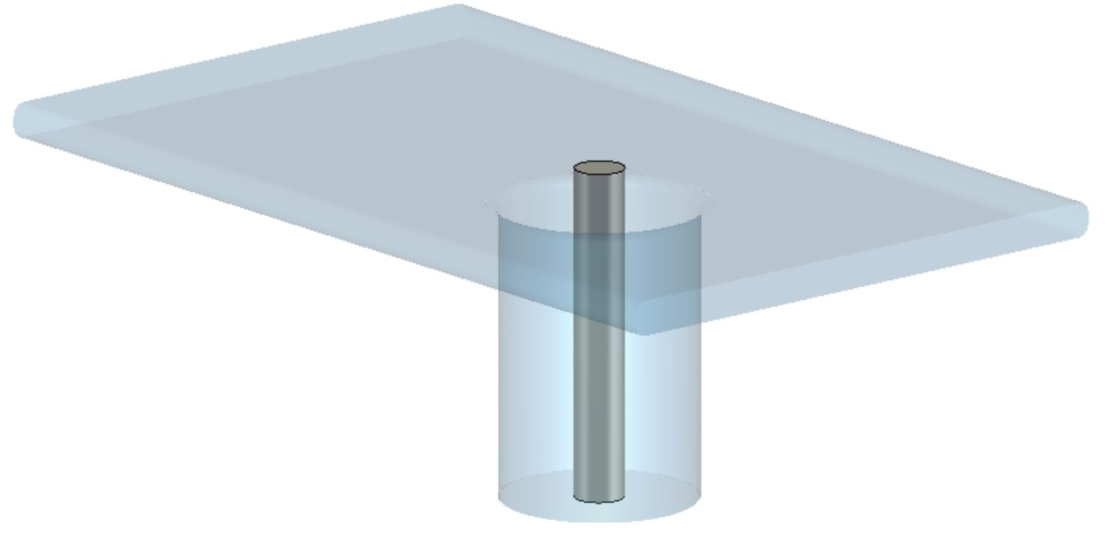
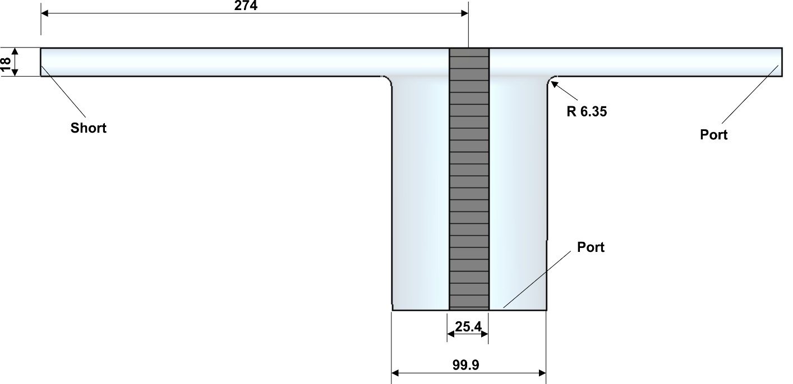
Coaxial – waveguide adapter
Input of coupler will be waveguide type. Width of waveguide was chosen as 11.5 inch (292.1mm) –standard width of WR1150. To match with coaxial and keep geometry simple the height should be 18mm. Coupler will include adapter to standard waveguide size. It is simple thing and it is not included in to review.

Slide 23
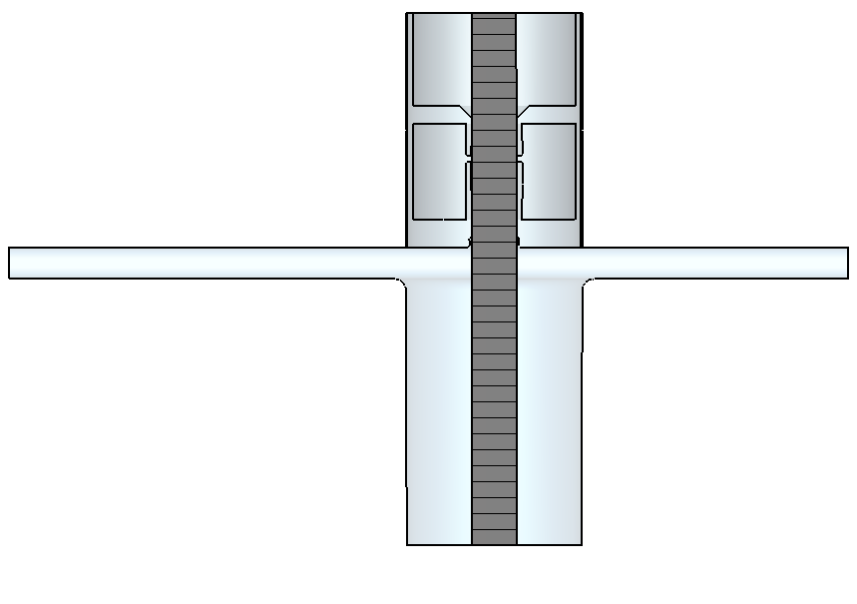
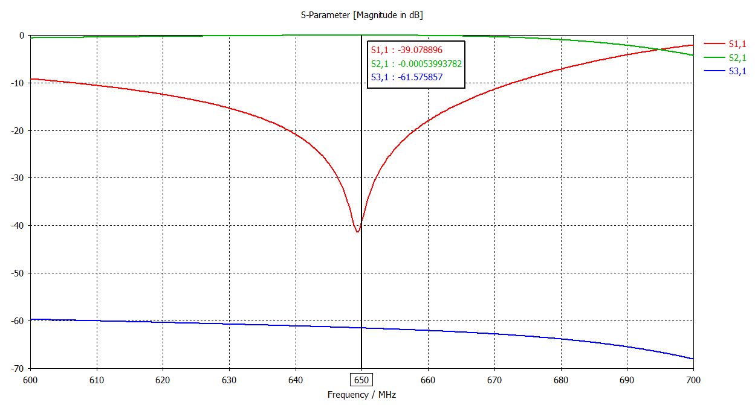
Coaxial – waveguide adapter with capacitive (with Kapton)
Model with Kapton,
Kapton = 0.127mm air gap = 0.073mm
Isolation = -61.6 dB

Slide 24
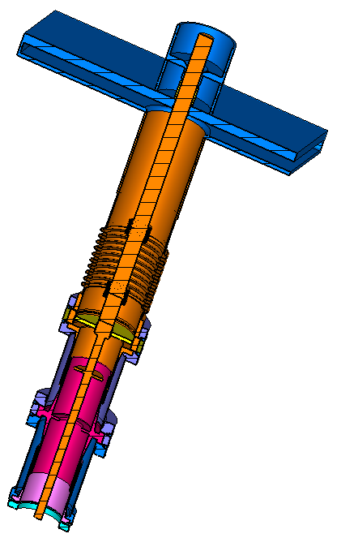
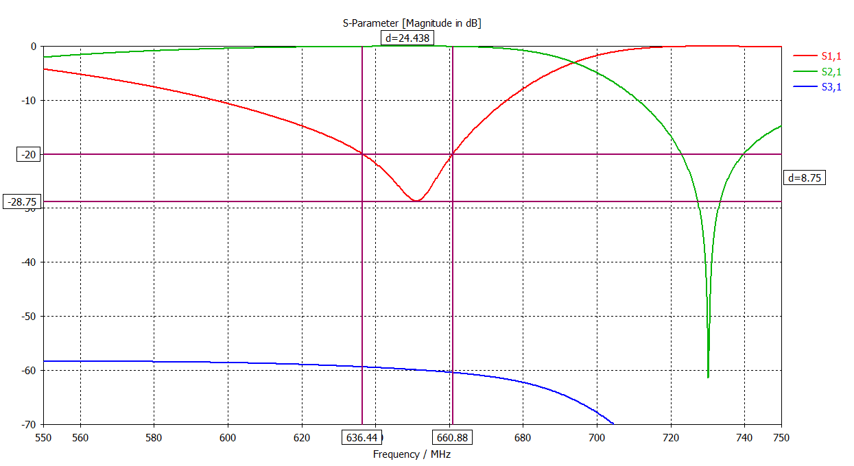
Passband and losses of total coupler
Total losses = 4.0E-3 (0.4%)
Losses:
~ 50% -aluminum waveguide
~ 25% - antenna
100 kW <-> 400 W
300 kW <-> 1.2 kW

Slide 25
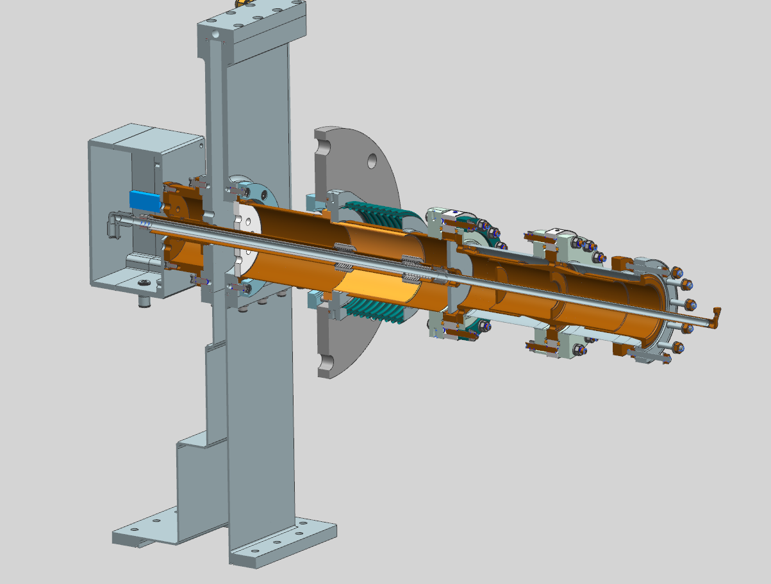
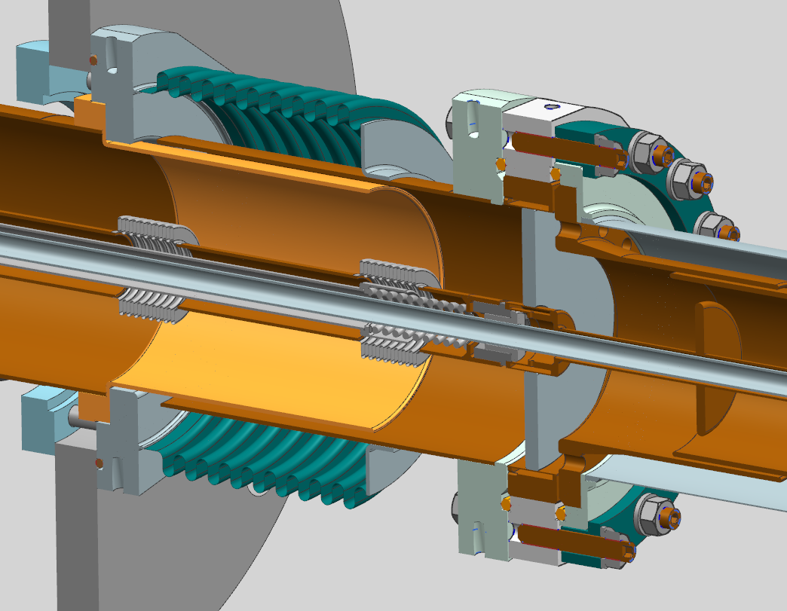
Presently we changed the design of bellows at air part of coupler. We preplaced Nickel bellows (coated with copper) with “standard” stainless steel bellows with copper electromagnetic shields.

Slide 26
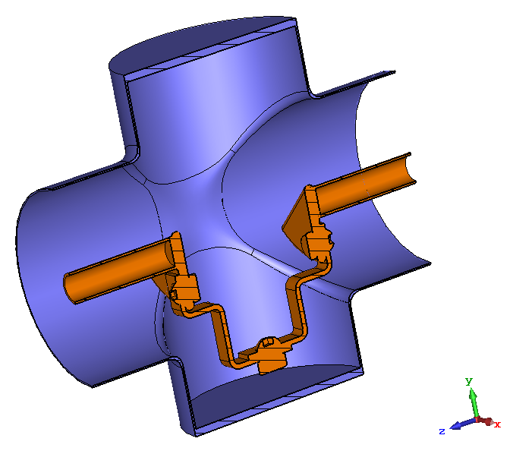
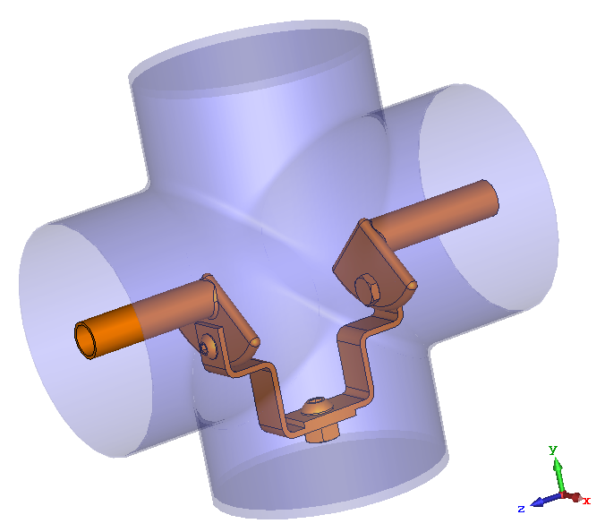
Test stand
Stainless steel chamber
coated with copper.
Antenna tips
Flexible copper
Strips.

Slide 28
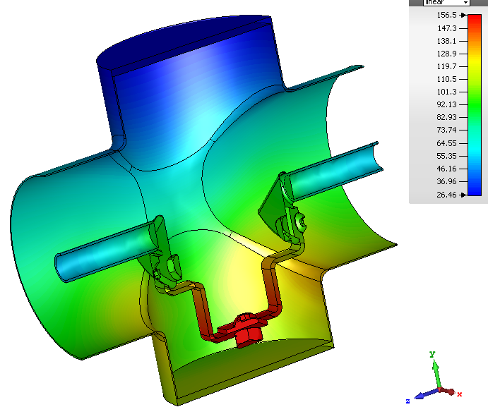
Thermal simulation for 100 kW, CW, TW.

Slide 29
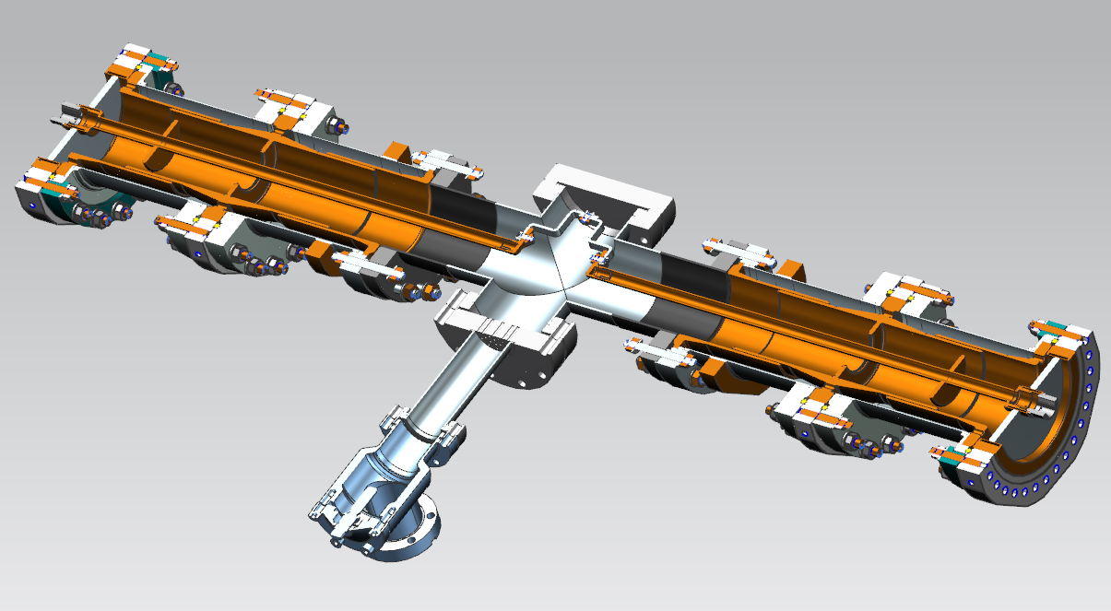
HB 650 MHz Main Coupler Test cavity with Coupler vacuum ends
Vacuum end
Assembly
F10056896
Copper coated test cavity
F10077234
Right angle valve

Slide 30
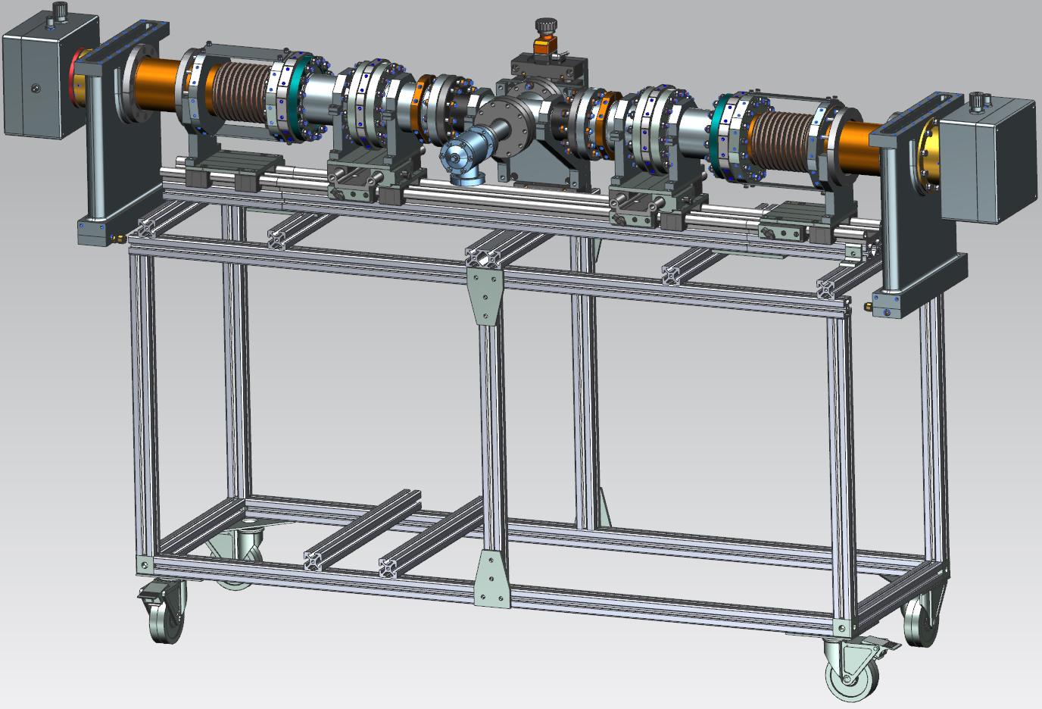
HB 650 MHz Main Coupler Test cavity with Coupler Air Sides, assembly step 2
650 MHz Coupler
F10056895
8020 Cart
Copper coated test cavity
F10077234

Slide 31
Test facility
Test faculty will be based on 650 MHz, 30-40 kW, CW, IOT.
Test will be done in resonance mode. It will allow to increase power by several times.
IOT exists and installed in MDB building.
Infrastructure (waveguide line, interlocks, etc.) has to be developed.
Current status:
Four vacuum parts are ordered:
Two new design and two back up design.
Delivery time ~ April, 2018.
Two air parts and test stand will be ordered soon.
Delivery time ~ April, 2018.

