Slide 1
Operations and Coordination

Slide 2
Study distribution total 75 shifts: scheduled
Almost half of the phase space study, at least 40% of flatbeam and all of Auralee is using the evening and weekend hours.

Slide 3
Down time: 86 hours, about 9.2% of the total shift time

Slide 4
Comparision of down time for 2 runs
86 hours total
54 hours total

Slide 5
Comments on downtime
Compares to last year downtime is more. Part of this is due to 3 long downtime.
  Gun voltage undershoot total is about 28 hours. We do find the cause later in the run. A bad cable is replaced.
  Cryo is down for 17 hours. The problem is the lack of communication between cryo people and us. They open nitrogen valve to release the pressure but that lead to the malfunction of gun water valve.
  NML LCW distribution unregulated due to broken regulation valve. That leads to 22 hours downtime. We will need to get spare if possible.
However most of the study went more smoothly compare to last year. Big part of reason is due to the improvement of new synoptic interface developed by Chip. However more work still is planned to make it more robust. Chip will explain in his instrumentation part.
Magnet power supply is also one of the frequently issues for downtime. Darren and Kermit is going to cover this part.

Slide 6
Comments on Coordinate
I really underestimate the difficulty of HE beam line tuning.
  Nobody did this before
  The phase tuner is put into a bad position to begin with.
Users need to let us know the time preference as early as possible
With MCR personel’s involvement it will be a big boost for our program.
  Less burden on our side in terms of operating
  More time can be arranged with night or weekend shift.

Slide 7
Comment on the study
Most of the study went pretty well.
Some suggestions for shift plan
  Studier need to be very specific about the initial condition. Beam is pretty stable if you make the same requirement, i.e., cavity phase, charge, magnet etc.
  It is Ok to spend 1-2 shift to figure out what beam condition you will need for your study
  It is not OK you need to retuned the beam every time before your study even after 3-4 studies. We may want to take a look at why beam condition is not stable.

Slide 8
Individual part
Laser
RF
Magnet: cover by Darren and Kermit
MPS: Arden
Instrumentation: Chip and Nathan

Slide 9
Laser
Pros:
  No downtime cause by the laser
Cons:
  Beam shape is not good
  Intensity is not enough for high charge studies
  VC image can not be taken, especially when iris fully open
  Possible double pulse transversely and longitudinally

Slide 10
Laser Longitudinal
This is range 4 image, we do not see longitudinal structure as Flatbeam studies showed in their streak camera image. So that structure is not related to longitudinal structure of the beam

Slide 11
Laser transverse
Beginning of run
end of run
Correlation is there all the time, but overall shape did not change much

Slide 12
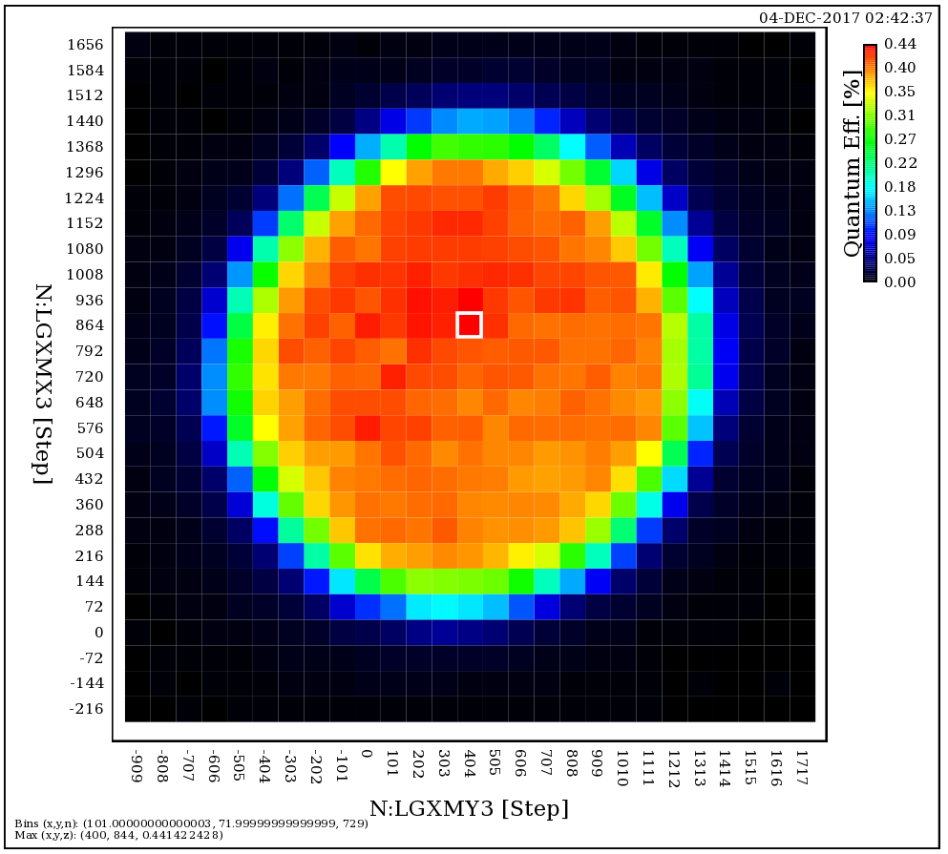
Cathode Quantum Efficiency
QE map looks pretty smooth, No obvious bad spot visible
Real QE number is still in discussing. It may be doubled according to our calibration

Slide 13
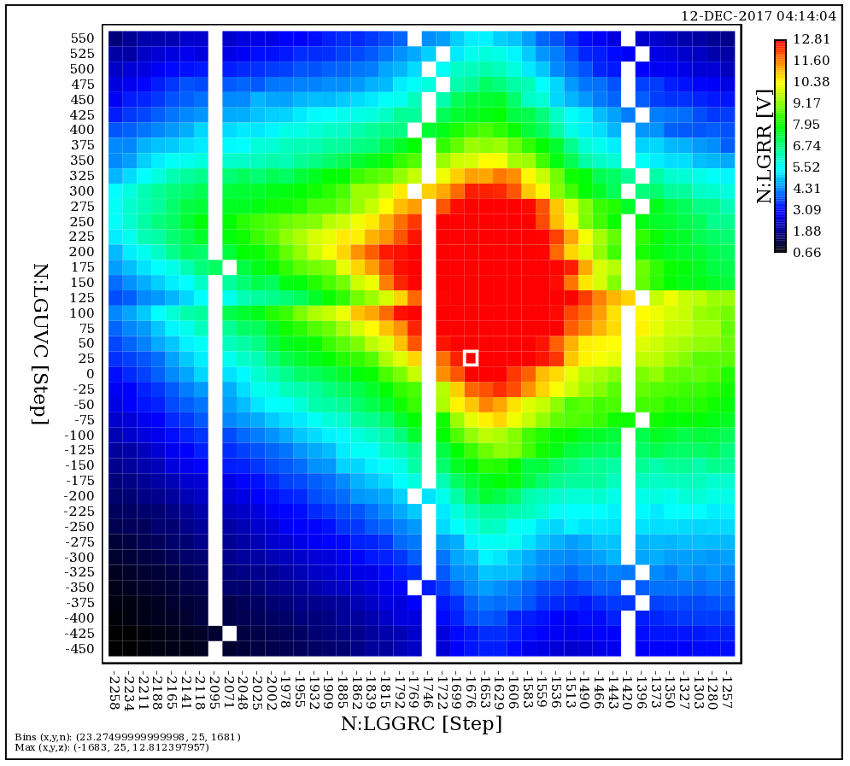
Some improvement we could have done
Inside laser room after optimization with 2 crystal

Slide 14
Lesson learned for next run
We need to understand where the correlation comes from.
  Check the transport system, maybe a bad mirror?
  Check the cave optics box
Once a while crystal scan need to be performed to make sure beam is optimized.
We probably need to redo the transport system anyway for ICS IR laser transfer.
Need to make sure green laser is not shown inside the cave anymore.
Bottom line laser need to be ready at the end of April.

