Slide 1
Long-range Wakefields and HOMs at FAST
Alex Lumpkin, Chip Edstrom, Jinhao Ruan, Randy Thurman-Keup, Peter Prieto, Nathan Eddy, Olivier Napoly (TD), Kip Bishofberger (LANL), Frank Krawczyk (LANL), Bruce Carlsten (LANL)
FAST Retreat
21 December 2017

Slide 2
Outline
I. Introduction
II. Lessons learned and proposed future studies
-Transverse wakes and HOMs.
III. Examples of 11/20 and 11/29 studies results
IV. Lessons learned and proposed future studies
- Longitudinal wakes (Bruce, Kip, et al.)
V. Summary-1
VI. Other Observations (Randy Thurman-Keup).
VII. Beam-based cavity alignment proposed (Olivier Napoly)

Slide 3
Introduction
Primary goal is to reduce beam steering offsets and possible emittance dilution by monitoring and minimizing higher order modes (HOMs) in the cavities.
Two HOM couplers are installed in both CC1 and CC2: upstream (US) and downstream (DS).
Signals can be processed for TM110 dipole modes using 1.6-1.9 GHz filters covering first two dipole passbands.
Filters also used to reject 1.3 GHz and >2.2 GHz.
Used scripts for stepping corrector currents while tracking HOM signals, rf BPMs, beam images, framing camera, etc. and MATLAB script for 100-shot BPM array acquisitions.
Searched for sub-macropulse effects on beam centroids related to transverse position and to energy.

Slide 4
Nominal FAST Electron Beam Parameters for Studies
Beam Parameter | Units | Value
Micropulse Charge | pC | 100-1000
Micropulse rep. rate | MHz | 1,3
Beam sizes, σ | µm | 100-1200
Emittance, norm | mm mrad | 1-5
Bunch length,σ Compressed | ps ps | 4-8 1-3
Energy | MeV | 32-34
PC gun grad. | MV/m | 40-45
CC1 grad. | MV/m | 12-15
CC2 grad. | MV/m | 12-15
Table 1.

Slide 5
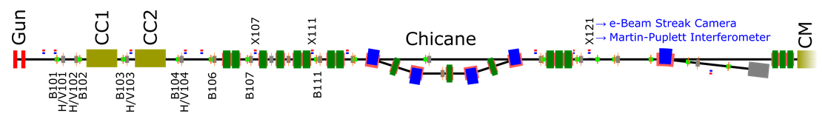
FAST 50-MeV Beamline Schematic
FAST beamline up to CM2. Photocathode rf Gun, two capture cavities, BPMs (B1xx), correctors (H/V1xx), and imaging station beamline crosses (X1yy) are indicated.

Slide 6
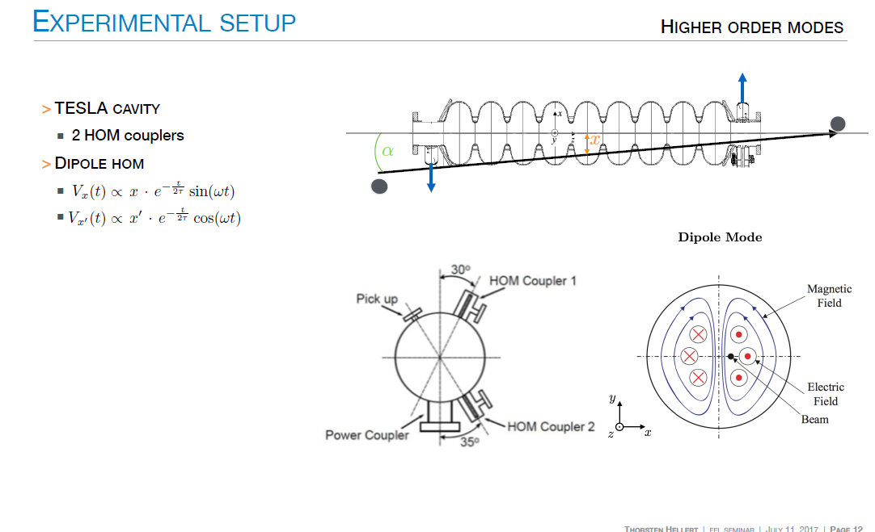

Slide 7
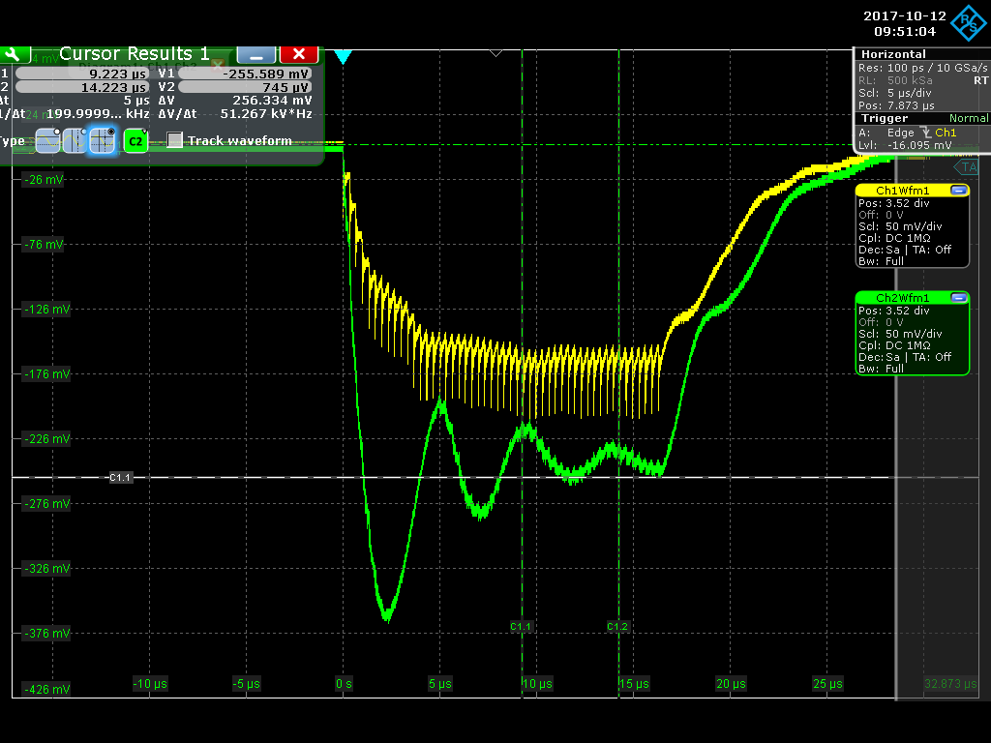
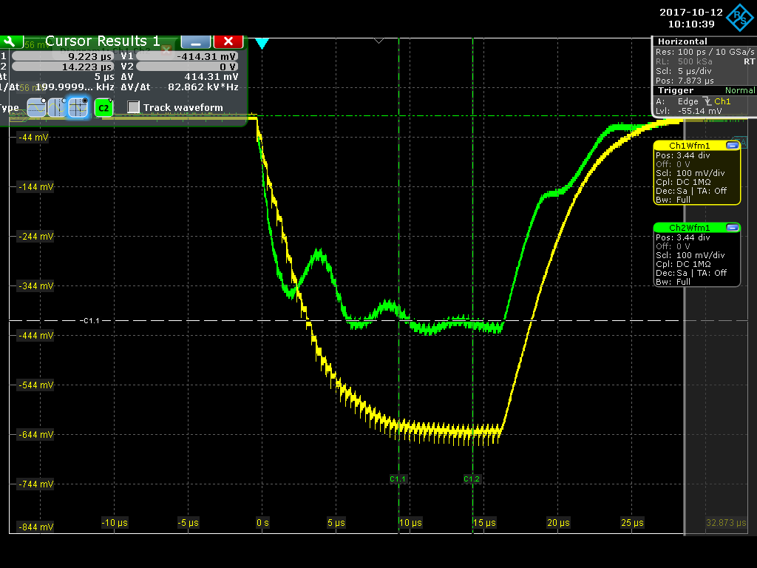
Initial looks at HOM signals on Oscilloscope
Beam: 500 pC/b, 50 b,31 MeV
H101=0.75 A, V101=0.89A H101=1.25 A
CC1 US=-173 mV, DS=-256 mV
CC1 US=-628 mV, DS=-415 mV
US detector-yellow, DS detector-green

Slide 8
V101 scan 4, HOMs
Example of HOM peak signals at 500 pC/b, 50 b during V101 scan.

Slide 9
Lessons Learned -1
HOM detectors after commissioning worked well in support of our wakefield studies. Scripts worked well in most cases.
Minimized HOMs for the long range longitudinal wakes studies reasonably well. Need to properly set correctors.
We controlled HOM strength over two orders of magnitude with charge variation and beam offsets into CC1.
X107 Multi-slits emittance technique showed some effects but not deemed robust by some against beam steering.
X107 imaging camera only functional for 500 pC/b on last shift. Small correlation with HOMs probably detected (6%) with +-150-µm centroid oscillations seen in B107.
X111 images showed a probable shoulder effect with corrector polarity consistent with HOM buildup on one side.
.

Slide 10
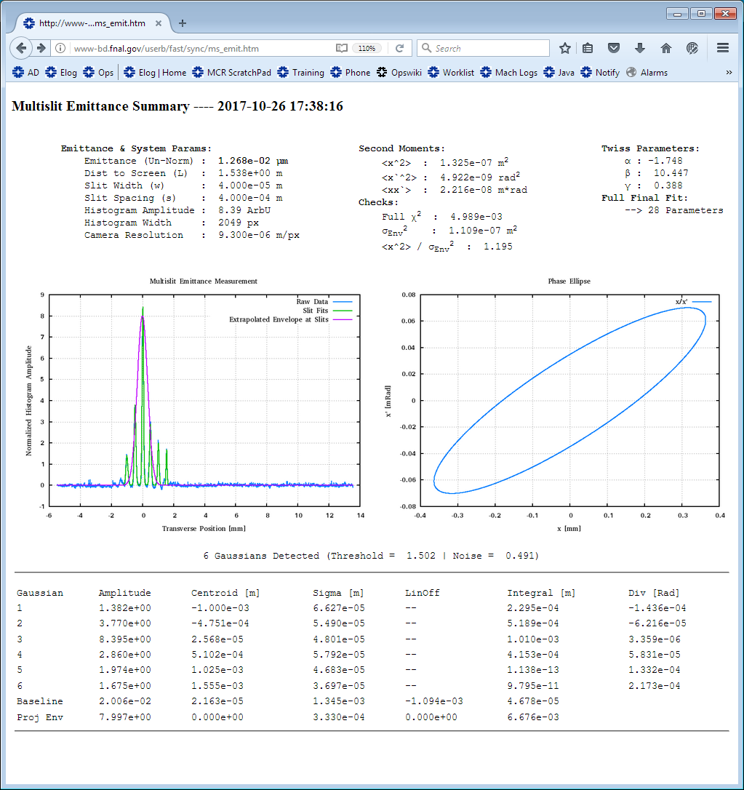
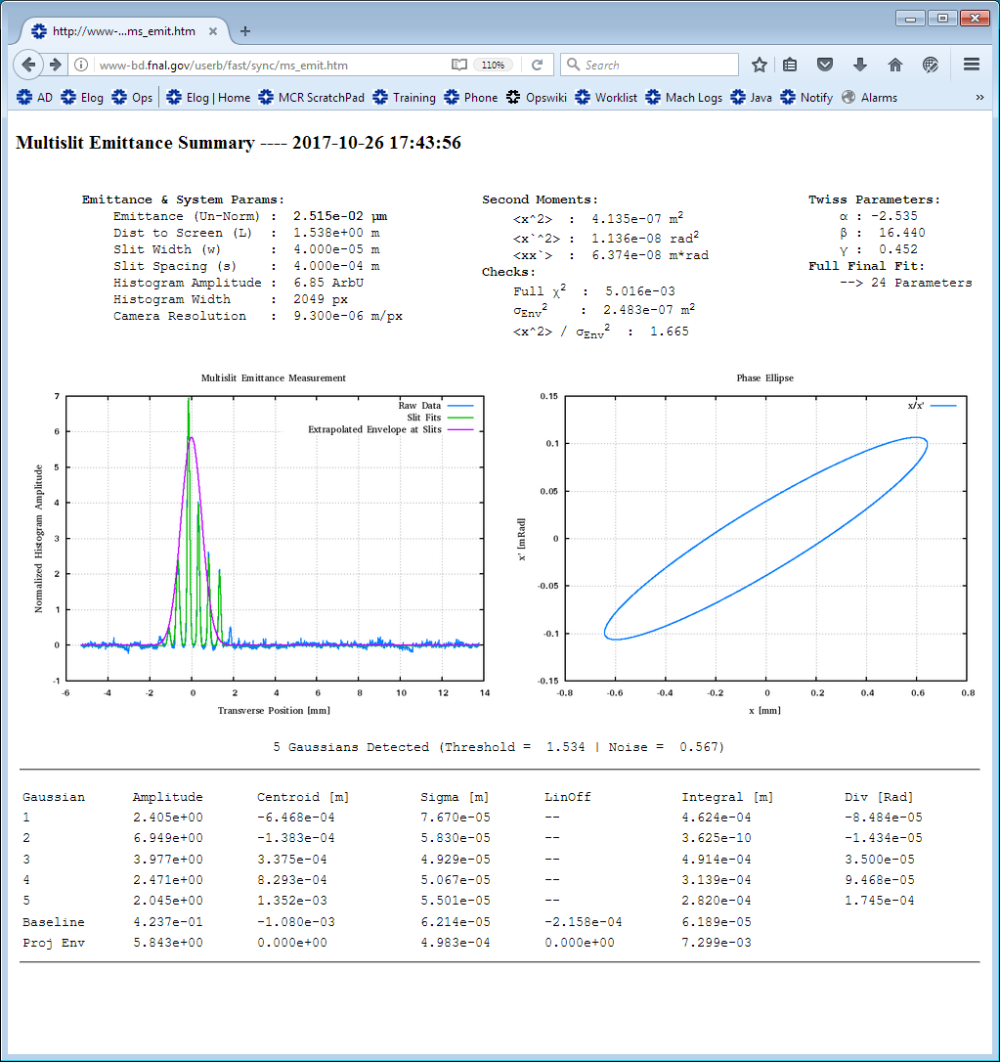
X107 Multi-slits Emittance Measurements Tests 10-26-17
Technique in commissioning. 100 pC/b Delta-V101=+1A
Prel. calc. eps-y= 0.8 mm mrad eps-y= 1.7 mm mrad
Projected Sigma=333 µm
Projected Sigma= 498 µm

Slide 11
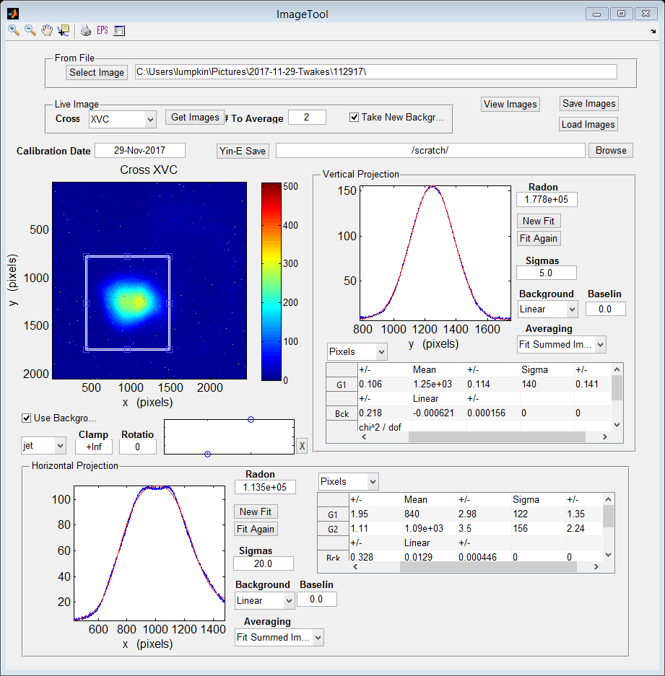
X107 Images and Possible HOM correlation 11-29-17
Images and V101 scan using HOM sums for correlation.
σ_{y}=140 pix.

Slide 12
Lessons Learned -2
X121 images for framing camera showed reduced centroid motion effects when Q118-120 powered on. Needed post processing to see in 3-image averages. Probably should consider averaging more images and higher charges of 2,3 nC/b. Single micropulses observed successfully with OTR.
Bunch-by-bunch rf BPM capability was useful in experiments as foreseen, but 100- to 1000-shot averages proved critical.
Using the 10 BPMs after CC2 in a 12-m drift was quite useful in deducing kick angles and the estimated source points.
Effects on beam energy seen from CC2 LLRF feedback circuit. (Randy’s talk)
Understanding of the beam-driven modes in the cavities benefited from Olivier Napoly’s assessments. (Talk follows)
.

Slide 13
X121 Framing Camera Practical Issue with Beam Focus
Focus beam at X121 to match into framing camera, but this results in smaller beta function and beam centroid motion.
Still about 30 µm effect with 7 µm resolution at 1000 pC/b.

Slide 14
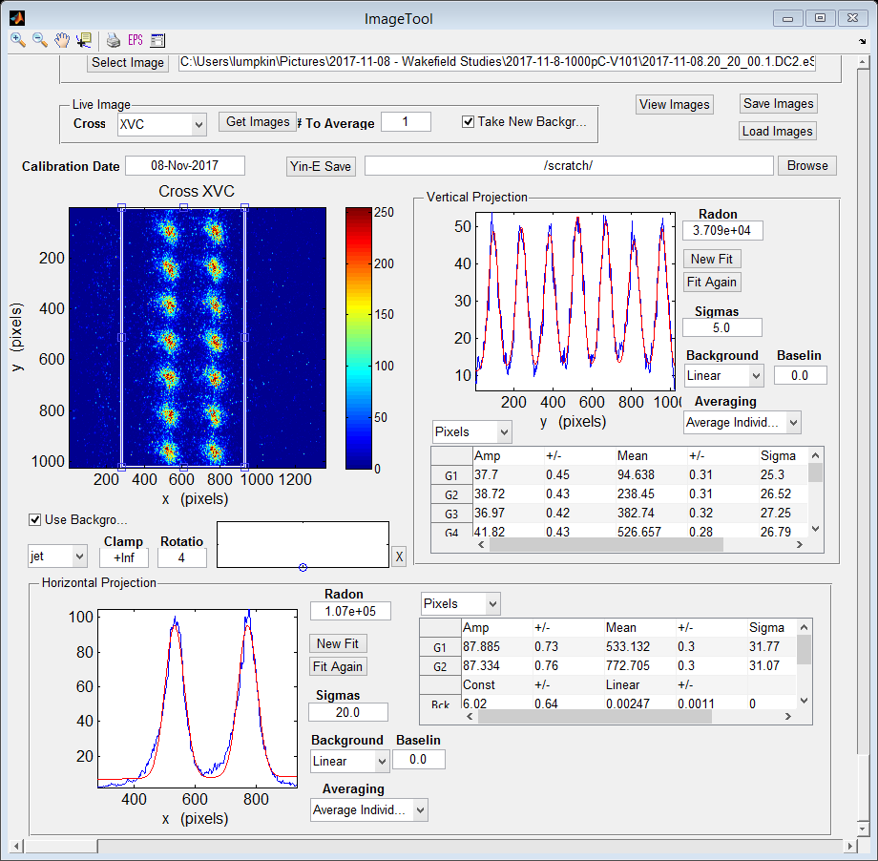
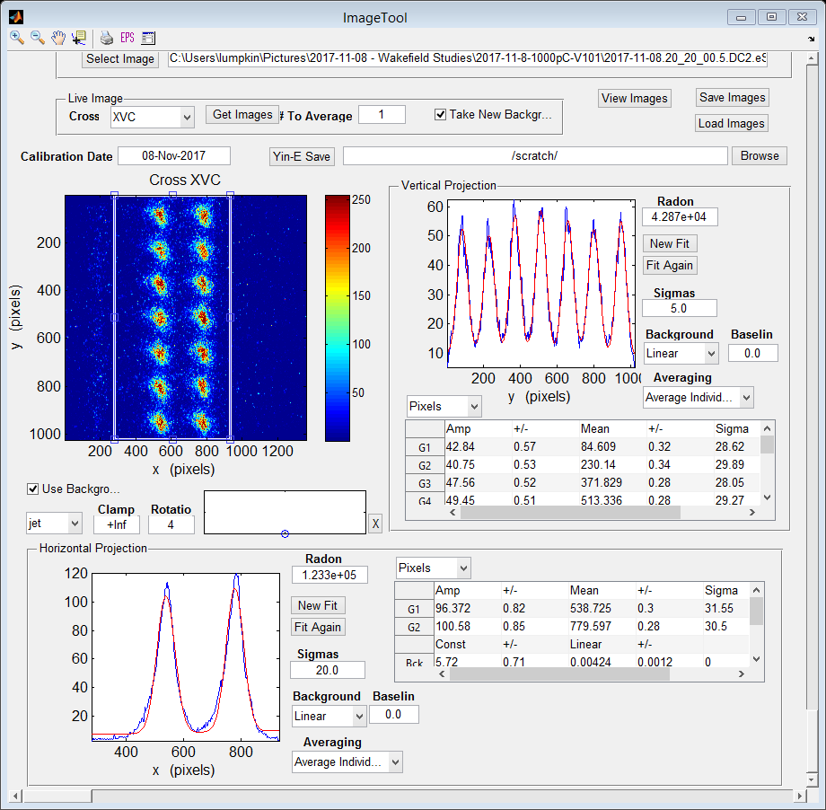
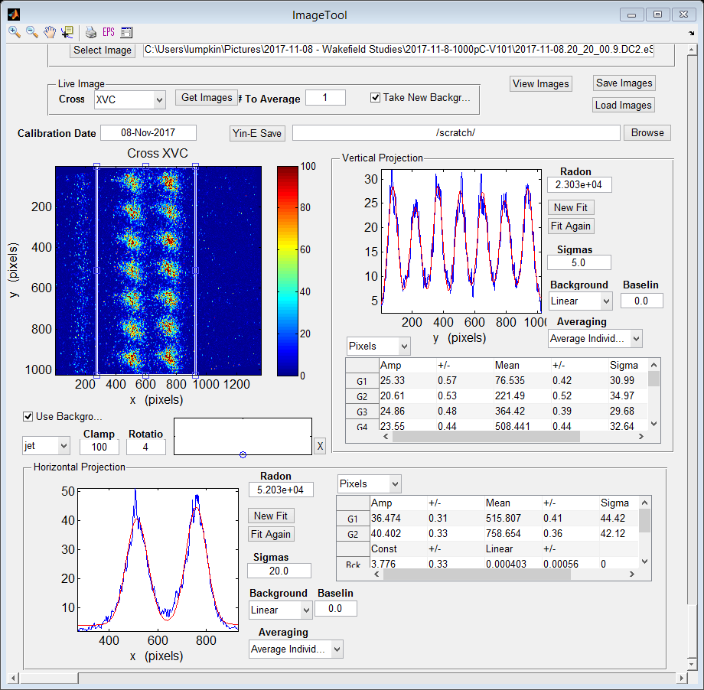
V101 Scan: Framing Camera Mode Test 11-08-17
61b, 1000 pC/b, 2 µs vertical, 100 µs Horiz., ~16 µs gap.
Bunches 3-9, 55-61. Later time is down and leftward on axes.
-1.0 A 0.0 A 1.0 A

Slide 15
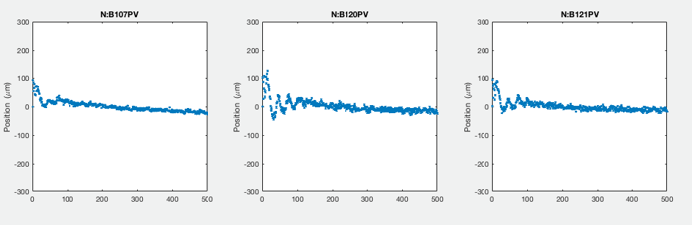
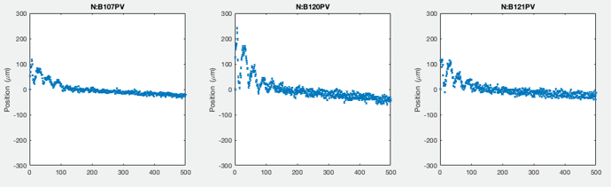
V101 Scan, 500b, Vert. BPMs Show Damping Effect 11-09-17
Centroid oscillation seen in first ~100 b, then damps out.
V101= -1A (T) and 1A (B), but HOMs are different. 500 pC/b.
Bunch Number
Bunch Number
Bunch Number

Slide 16
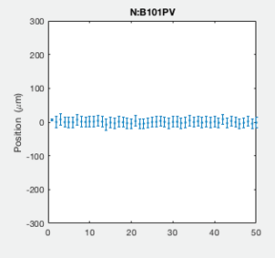
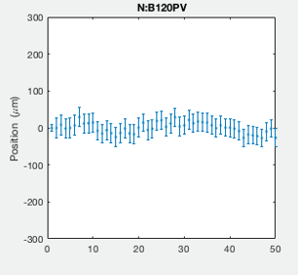
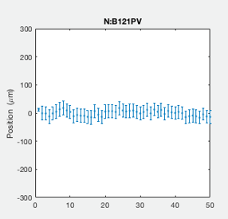
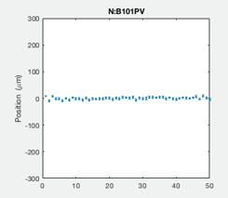
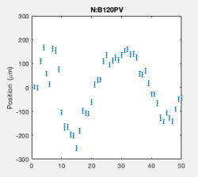
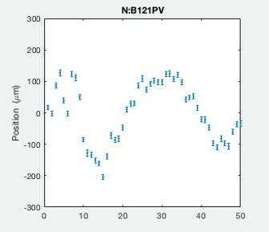
Comparison at V101=1A 11-08,09-17: Dramatic Effects Seen
100 pC/b,1000 shots (Top row) 500 pC/b,50b,100sh (Bottom)
Bunch Number
Bunch Number
Bunch Number

Slide 17
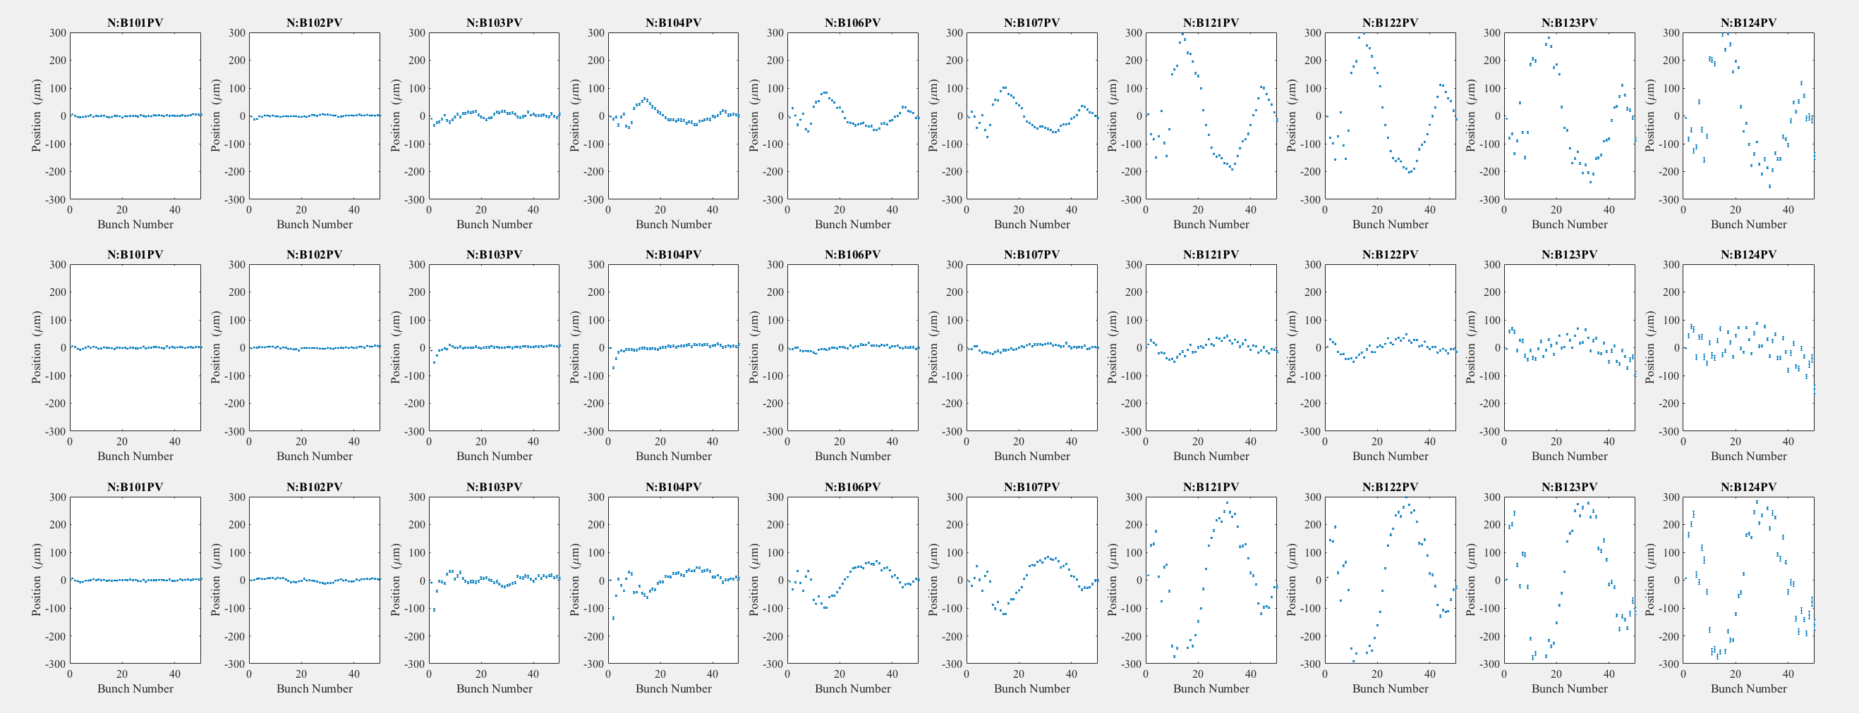
V101 Scan, 1000 pC/b, 50 b B101-124 11-20-17
BPMs Vertical, -1,0,1 A Top to bottom rows. Note flip of first oscillation. Quads off.

Slide 18
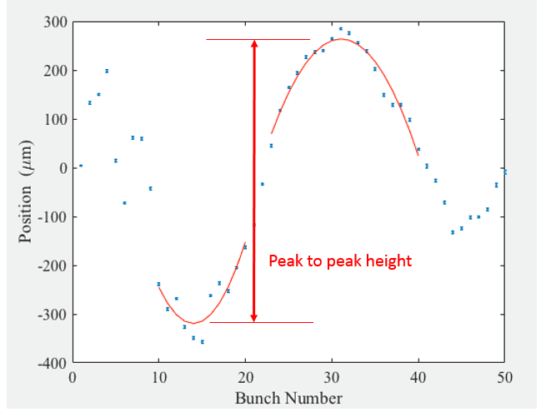
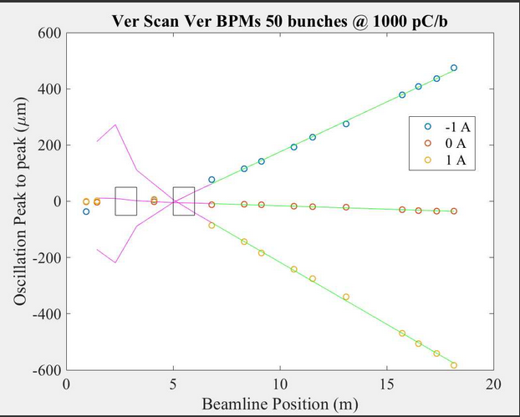
Evaluation of HOM Vertical Kick Angles 11-20-17
V101 scan results with drift to B122. Kick deduced 84 µrad from CC2.
CC1 CC2
100 kHz

Slide 19
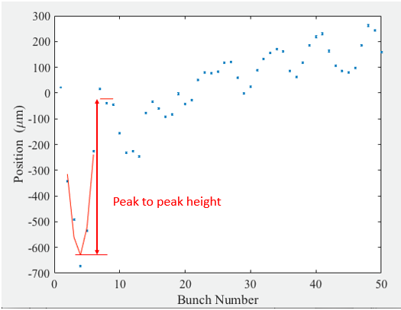
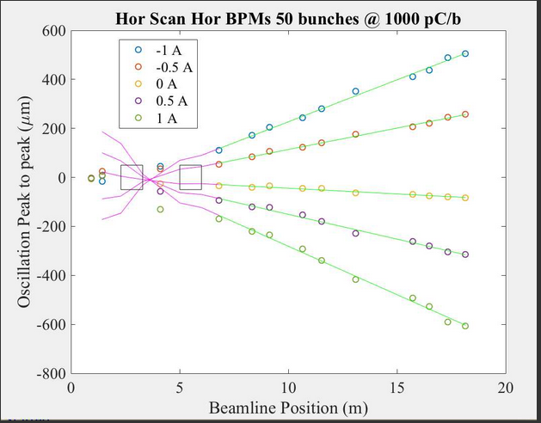
Evaluation of HOM Horizontal Kick Angles 11-29-17
H101 scan results with drift to B122. Deduced kick ~40 µrad
from CC1 for largest input offset.
CC1 CC2
440 kHz

Slide 20
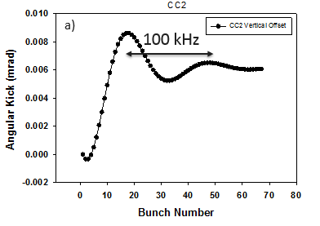
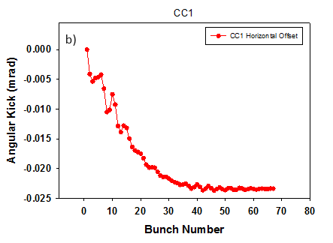
CC2 and CC1 Generated Dipole HOM Kicks (Preliminary)
312 kHz
O. Napoly

Slide 21
Lessons Learned -3
These techniques should be applied to CM2 in next run.
BPMs and long drift already in place in 300-MeV line.
Propose the 16 HOM coupler lines should be instrumented with detectors similar to those of CC1 and CC2.
Studies could continue up to 3.2 nC/b, the ILC specification.
The corrector values used to minimize HOMs indicate CC1 and CC2 are not well aligned to reference axis. Also CC2 DS does not reach as low of a minimum as other 3 channels?
Olivier proposes efforts to determine HOM field centers in all ten cavities at FAST. (More details in his talk)
Propose to check arrival time of HOM detector signals to determine US and DS couplers in each cavity.

Slide 22
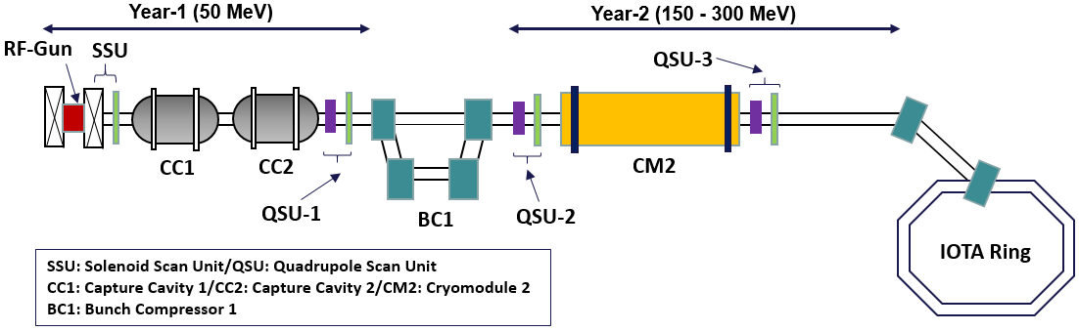
FAST beamline – CC1 and CC2 are the TESLA superconducting cavities
Slide 22
Notes:
22

Slide 23
Lessons Learned -4
Longitudinal effects are difficult to diagnose with present diagnostics and effect magnitude, but upper limits set.
Even 100-shot data did not reveal a distinct effect. Propose 2,3 nC/b data still needed. Also 9-MHz micropulse rep. rate.
Potential to augment diagnostics by using framing camera viewing X124 screen in the spectrometer. Minimal Beta-y OK.
Option to use YAG:Ce screen with ~100x more light emitted per electron than OTR.
Mirror boxes and mirrors in hand, need beam splitter and Thorlabs holder. Need 80-20 frame to hold hardware.
May need image rotator in the optical hut for streak camera so energy direction is mapped along the entrance slit axis.
Both ACL and MATLAB scripts were critical to our studies.

Slide 24
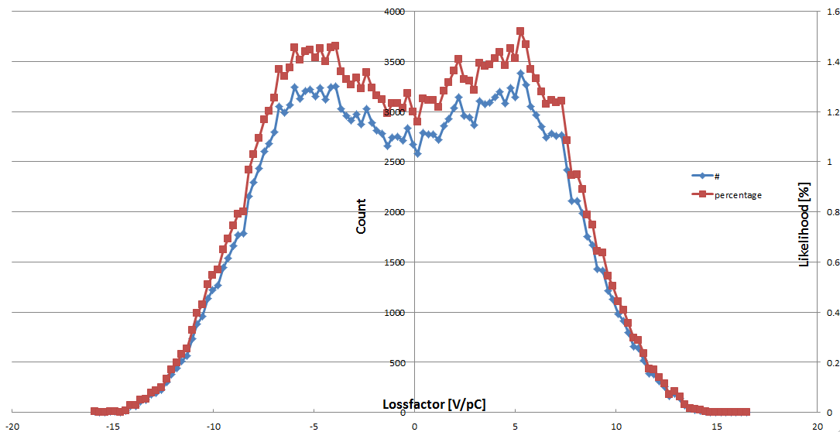
Scoping simulations
The longitudinal wake has a stochastic appearance (top). Binning of the loss-factors over a distance of 5 bunches at 9 MHz rep rate (bottom), max/min are -15.9 V/pC to +16.5 V/pC. The most likely loss-factors are in the range of -8V/pC to +8V/pC. Not clear why this isn’t a normal distribution; we still based analysis on RMS approximation
The single-bunch wake is 19.6 V/pC for comparison
Count
Likelihood (%)
Loss Factor (V/pC)
Slide 24
Notes:
24

Slide 25
Estimates on how many bunches sum before HOM damping saturates effect
Q ext | damping be-tween bunches | n where damping dominates
1e5 | 0.995 | 715
1e4 | 0.956 | 41
5e3 | 0.913 | 15
1e3 | 0.635 | 1
9 MHz rep rate
Our plan was to expect a nominal 100 keV longitudinal wake over ~50 bunches at 3 nC (0.2% effect at 50 MeV)
Q ext | damping be-tween bunches | n where damping dominates
1e5 | 0.986 | 193
1e4 | 0.873 | 7
5e3 | 0.762 | 2
1e3 | 0.256 | 1
3 MHz rep rate
Slide 25
Notes:
25

Slide 26
Estimate of energy spread effect of longitudinal space charge may lead to competing effect
Longitudinal space-charge force
Work on particles due to LSC for first 7 m (dγ/dz ~ 10 m⁻¹): 10 to 20 keV rms
Work on particles due to LSC for next 10 m:
about 5 keV rms
Note: Longitudinal wakes shift the energy centroids within the pulse train.
LSC affects the energy spread of the individual micropulses.
Slide 26
Notes:
26

Slide 27
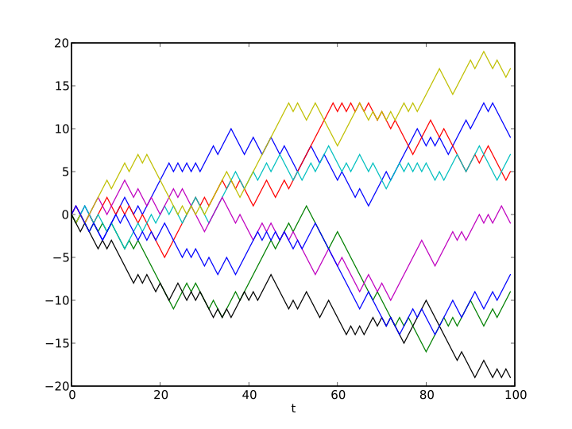
What we expected to see
Considering at the bunch-to-bunch energies, we expected to see a random walk ~ 5 keV/100 pC * sqrt(bunches)
δ
Bunch Number
However, we have learned from the TWs that we should expect the LWs are also going to be deterministic and not stochastic as one or a couple high-Q modes will dominate. Contributions sum at regularly spaced phases and may cancel out; every bunch will see the same net wake
V_{sum}=NW₁sin(θ₀)sinc(Nδ/2)
Slide 27
Notes:
27

Slide 28
Measurement 1: Measure bunch-to-bunch energy centroid shifts from change of angle in spectrometer
Measure vertical bunch angle before dipole with B121 and B122 and after dipole D122 with B123 and B124 (all circled in red below). The difference in bend angle is attributed to a different in bunch centroid energy due to longitudinal wakefields in CC1 and CC2.
Distance between B121 and B122 is 811.6 mm
Distance between B123 and B124 is 440.3 mm
Energy normalization: 22.5º deflection for 32.6 MeV electron
Slide 28
Notes:
28

Slide 29
Original data was very noisy (due to several effects including 858 kHz oscillation)
 | RMS energy deviation
1. 1000 pC at 1 MHz | 25.4 keV
2. 1000 pC at 3 MHz | 26.1 keV
3. 500 pC at 3 MHz | 39.3 keV
4. 250 pC at 3 MHz | 79.1 keV
RMS deviation decreases with increasing charge due to decreased noise
Results at best brackets longitudinal wakefield; noise swamps expected wakefield, especially at the lower charges. Cannot infer bunch-to-bunch data
BPM angular noise was significantly lower in B121/B122 than in B123/B124 because of longer separation
Needed: Either increase charge (ideally 3 nC) or decrease BPM noise in B123 and B124
Slide 29
Notes:
29

Slide 30
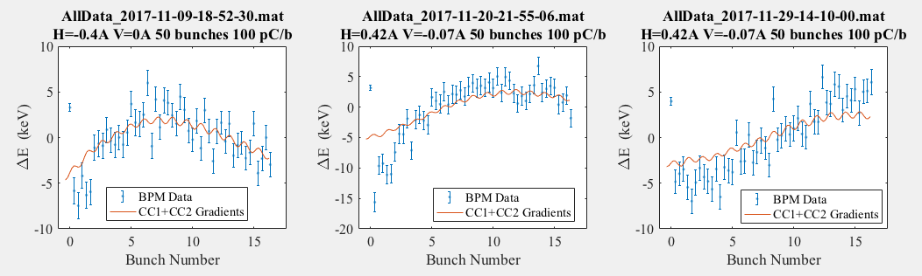
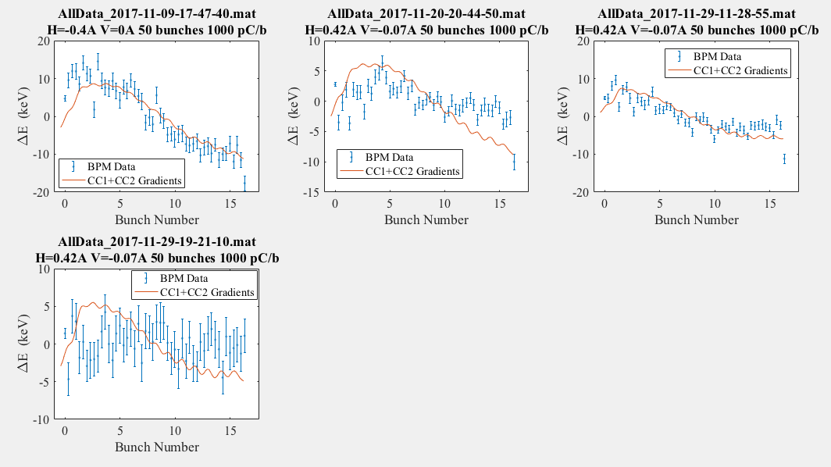
Data with 858 kHz removed – 100 pC and 1000 pc comparison
Time (µs)
Slide 30
Time (µs)
Slide 30
Notes:
30

Slide 31
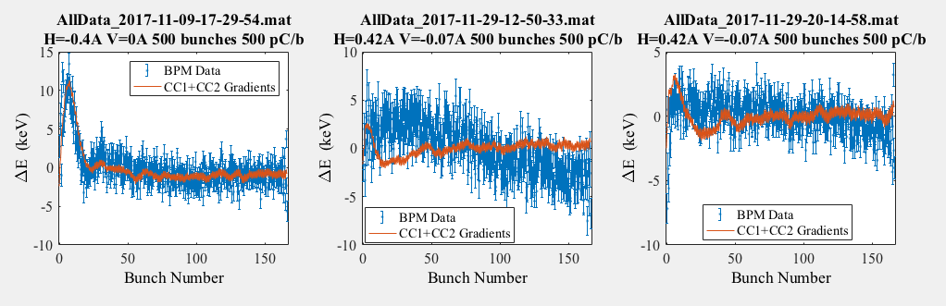
Data with 858 kHz removed – long term behavior at 500 pC
Time (µs)
Slide 31
Slide 31
Notes:
31

Slide 32
Integrated energy spread is consistent with LSC
effects, but may contain longitudinal wake info also.
At each bunch charge, the rms energy spread was calculated. An error bar is also included to show the bunch-to-bunch fluctuations.
We are currently reducing the data for integrated energy spread with fewer bunches to see if there is a measurable difference.
Slide 32
Notes:
32

Slide 33
Summary-1
Transverse wakefield studies’ results are consistent with a sub-macropulse centroid motion correlated to HOM strength.
Vertical position bunch-by-bunch data show 100 kHz oscillation whose amplitude increases with charge and offset.
Effect seems to be related to CC2 dipole HOM and directional with beam offset.
Horizontal position bunch-by-bunch data with 100-shot averages show centroid oscillation at about 440 kHz (CC1).
Longitudinal wakefield effects at these charges are not seen.
Complementary data with X107 YAG images, emittances, framing camera are being processed. Small effects.
Both ACL and MATLAB scripts were critical to studies.
Relevant data set for benchmarking HOM calculations and simulations in Tesla-type cavities remains objective.

Slide 34
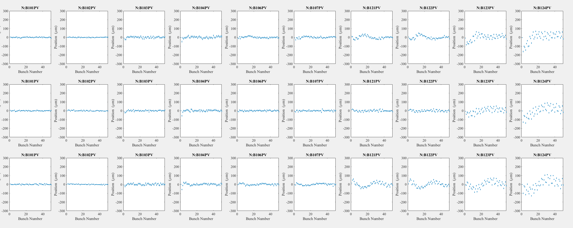
V101 Scan, 100 pC/b, 50 b 1000 shots B101-124 11-20-17
BPMs Vertical, -1,0,1 A Top to bottom rows. Note flip of first oscillation. Quads off.

Slide 35
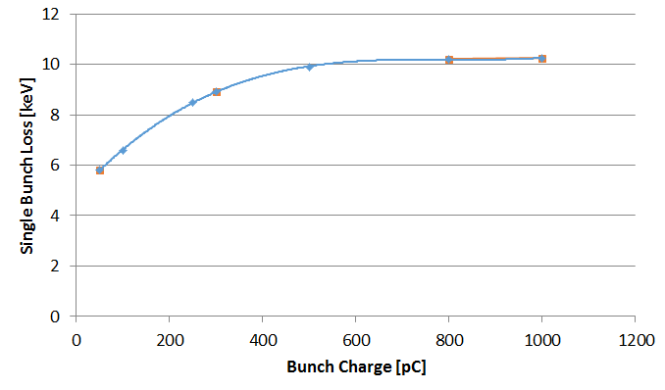
Energy spread from short-range wakefields should be relatively small
Centroid energy loss if ~ 10 keV at 1 nC; rms energy spread should be a few keV
Charge [pC] | σ [ps] | dE [keV]
50 | 5.8 | 0.80
100 | 6.6 | 1.54
250 | 8.5 | 3.50
300 | 8.9 | 4.13
500 | 9.9 | 6.60
800 | 10.2 | 10.43
Slide 35
Notes:
35

Slide 36
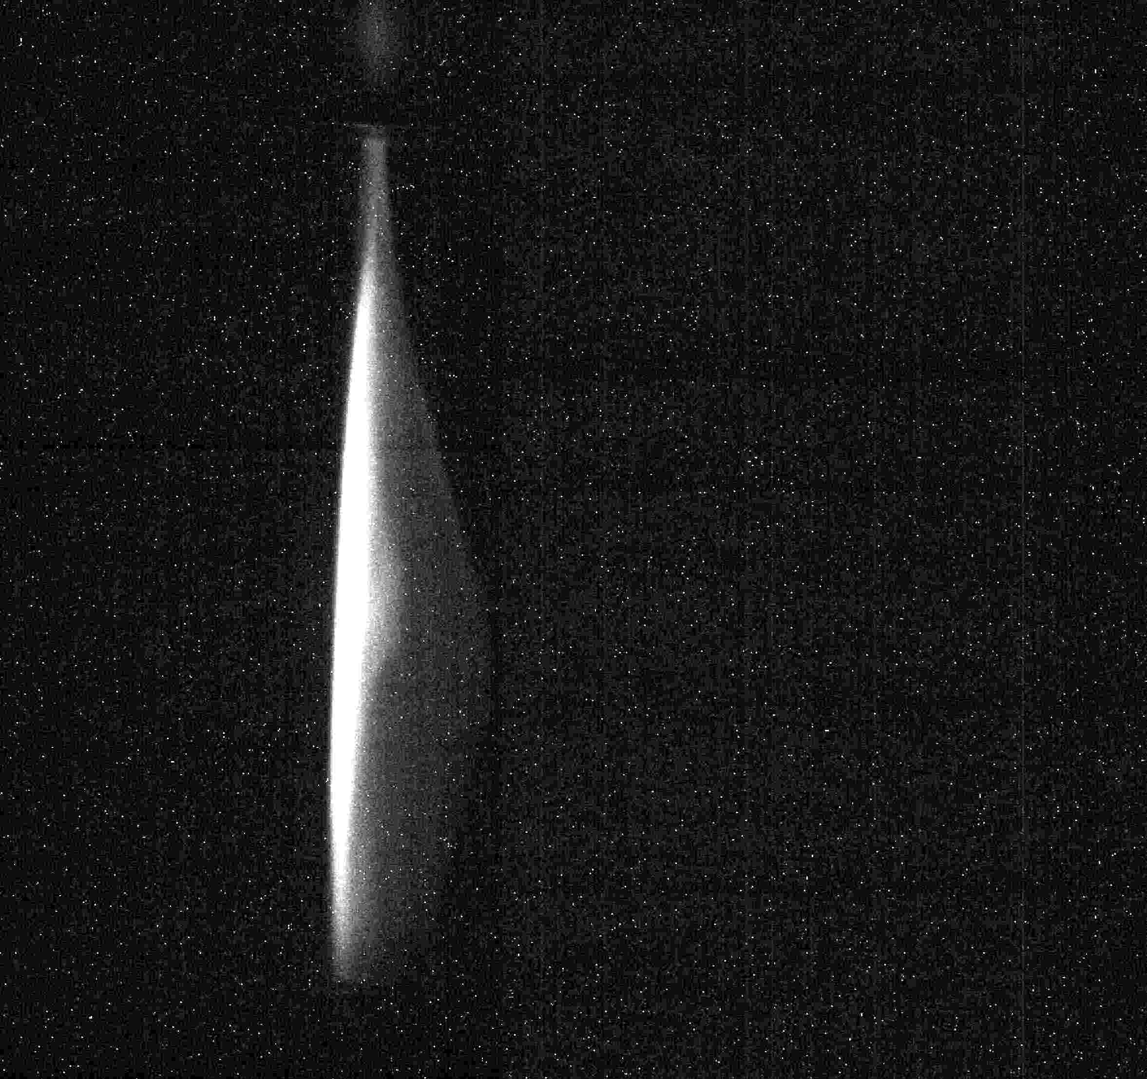
Measurement 2: Measure integrated energy spread of bunch
We calibrated and used an energy spectrometer to measure the macropulse's energy spread. We took data over a wide range of charges, and multiple beam shots to quantify variations.
At left is a typical raw image on spectrometer.
The camera's gain was adjusted for lower-charge levels, and for each image, a background image was subtracted. The image's tilt was adjusted, and a slice from the central portion was analyzed.
Slide 36
Notes:
36

Slide 37
Real differences in energy profile at different charges
As the bunch charge varies, the beam energy fluctuated, but is not a significant problem.
Some structure became apparent (and charge dependent), at lower charges. Nevertheless, the energy spread is easily calculable.
Slide 37
Slide 37
Notes:
37

Slide 38
V101 Scan 4, BPMs 10-27-17
Tracking of beam trajectories around CC1 and CC2.

Slide 39
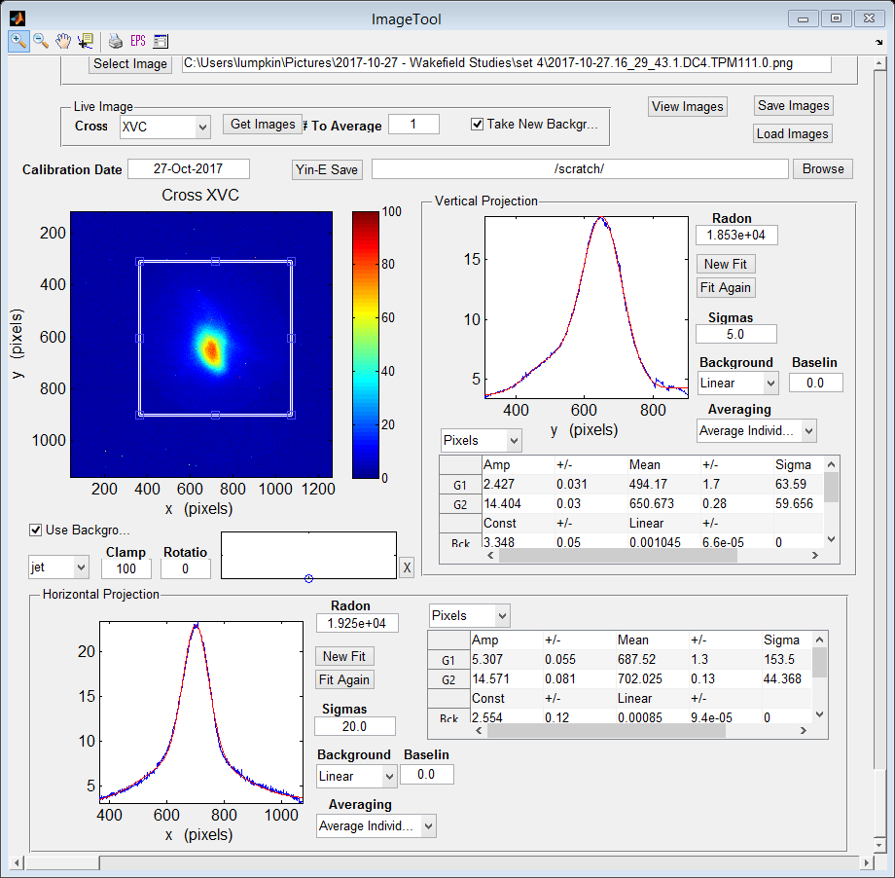
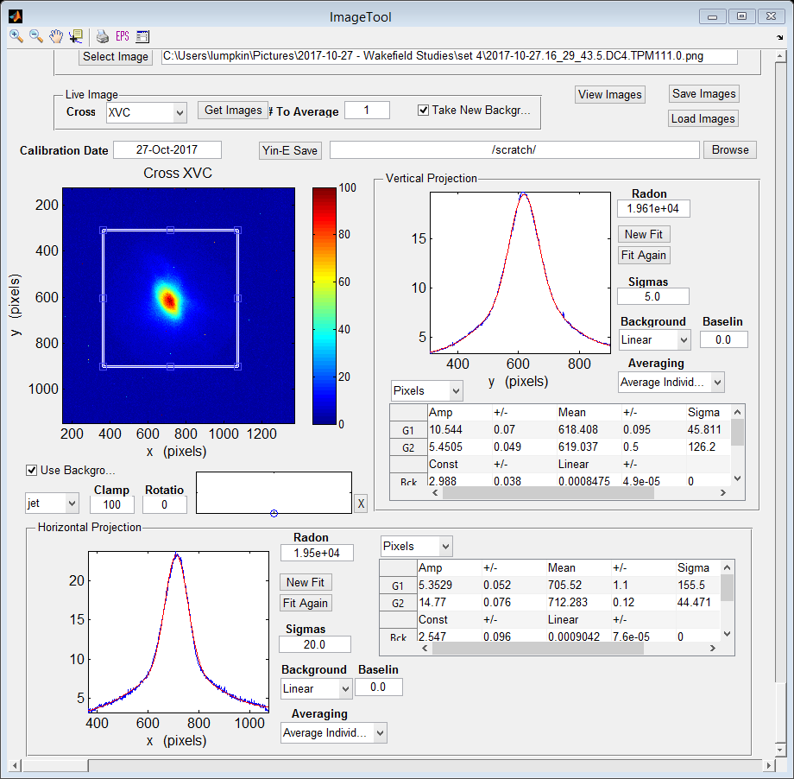
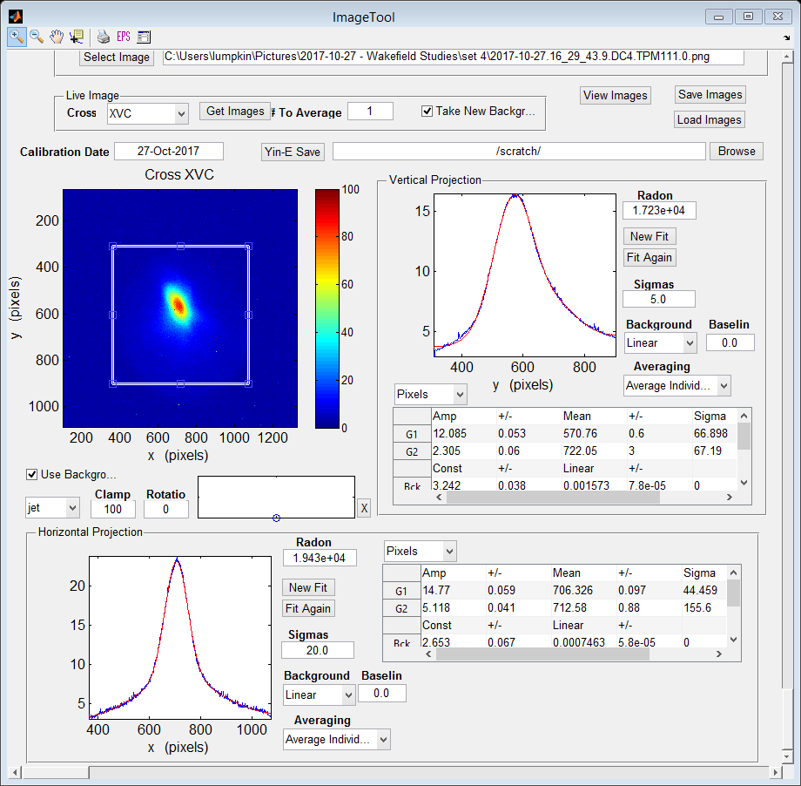
V101 Scan 4a, X111 images Show Profile Shoulder Shift
50b, 500 pC/b, nominal V101 at 0.0 A. 10-27-17
-1.0 A, 0.0 A, 1.0 A

