Slide 1

IARC’s use of ERDC Funds I1708
Spend Plans and Purchase Requisitions
Michael Geelhoed
IARC’s use of ERDC Funds I1708
12th December 2017

Slide 2
Contents
Purpose
Planning
  Submit Spend Plans
  Michael and Sarah’s Assistance
Process
  Signature Authority
  Technical Review
  Financial Review
Methods of procuring items
  eMarketplace
  Procard
  Purchase Requisition form
Template Form
Example
QAs

Slide 3
Purpose
Strongly encouraged within our Finance and Budget office that we maintain a tight control on spending these funds for M&S along with labor
Purpose of the spend plan is to ensure we coordinate our efforts to produce results for ERDC

Slide 4
Planning
Submit a Spend Plan for each task
A spend plan shall be a high level overview of subtasks in chronological order to accomplish the task
Each subtask should include the amount of estimated costs of both labor and M&S
For Labor, use the PAMS spreadsheet to estimate, per year, the labor requested
Please contact Michael and Sarah for assistance

Slide 5
Planning

Slide 6
Planning
For example:
Once the Spend Plan are submitted, we will be integrating them into a planning software package (P6)
ERDC Nb3Sn Multicell Coating
 | M&S Cost | 1 | 2 | 3 | 4 | 5 | 6 | 7 | 8 | 9 | 10 | 11 | 12 | 13 | 14 | 15 | 16 | 17 | 18 | 19 | 20 | 21 | 22 | 23 | 24 | 25 | 26
Procure Heater Aux | $ 20,000.00
Test new Heater Aux
650 Cavity Prep Baseline
650 Furnance Accesories/Connections | $ 26,000.00
650 Single Cell Coating
650 Single Cell Testing
Furnace Support Structure for SC 650 w/ rings | $ 10,000.00
Procure 650 SC Cavity w/ rings | $ 45,000.00
650 SC Cavity w/ rings Not coated Prep |  |  | arbitrary start ->
650 SC Cavity w/ rings Not coated Testing VTS
650 SC Cavity w/ rings Not coated Testing HAB
650 SC Cavity w/ rings Coating
650 SC Cavity w/ rings Testing VTS
650 SC Cavity w/ rings Testing HAB
MultiCell sample Host cavity
MCSHC Fabrication | $ 12,000.00
MCSHC Coating
MCSHC Micropory (SC)

Slide 7
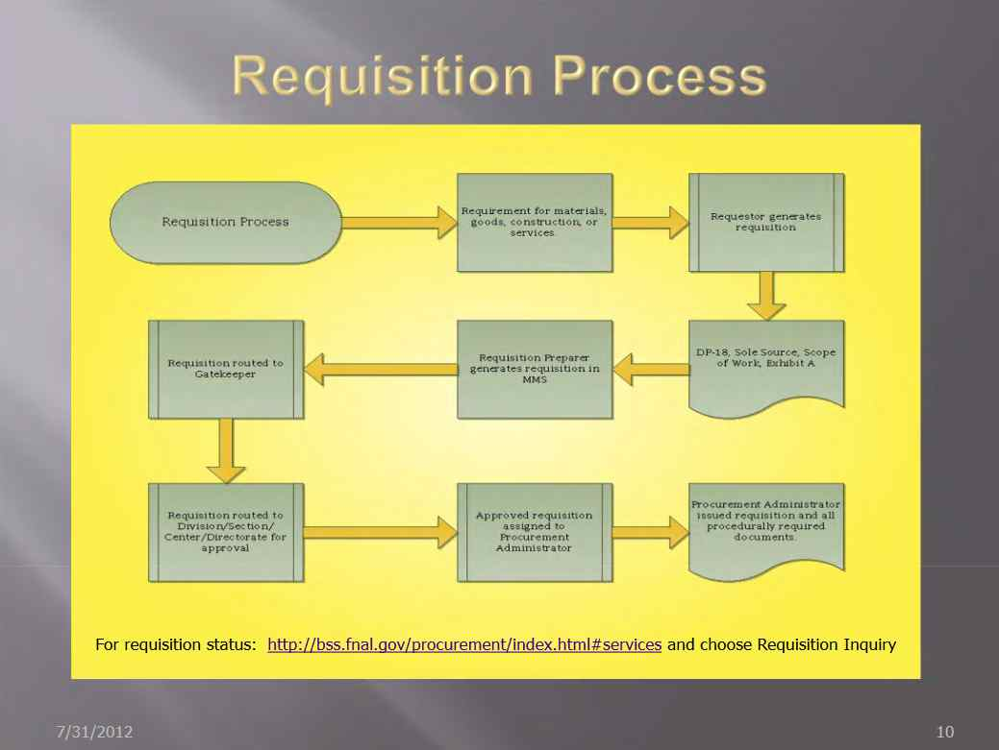
Process
CFO Procurement Department Requisition Process

Slide 8
Process
Since the majority of the technical leads are from Technical Division, we have tried to accommodate the process geared towards the TD process
Differences include:
  Field Financial Manager
    TD - Melonie Hays
    ERDC - FFM Sarah Grimsley
  Gate Keeper
    TD - Beth Karau
    ERDC - Michael Geelhoed, Ram Dhuley, and Sarah Grimsley
  Purchase Requisition Form
Similarities include:
  Use of IB4 delivery system
  Quality Assurance (optional)

Slide 9
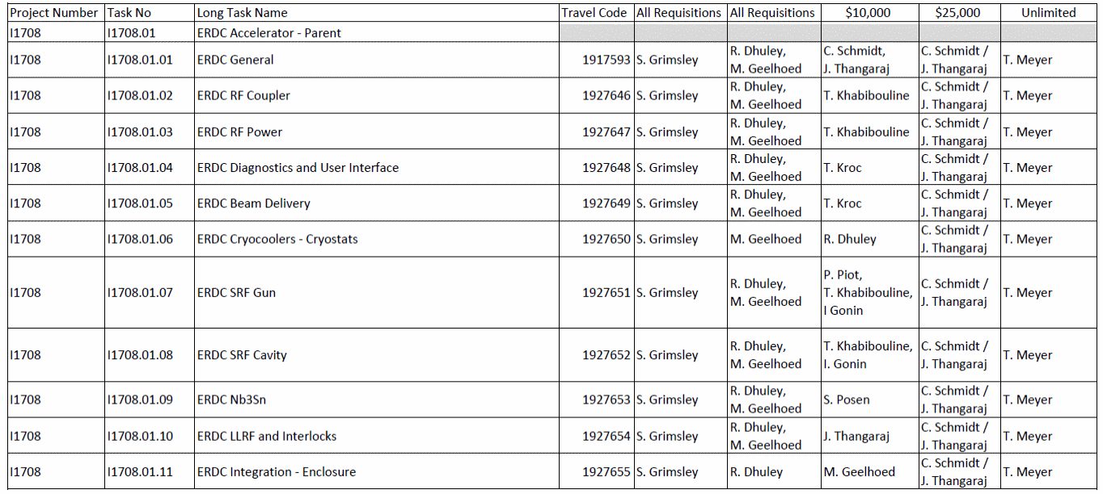
Process
Signature Authority
  Sarah has already send out the ERDC I1708 sheet
  Each subtask has the technical lead(s) associated with each
  All technical leads have a signature authority of $10,000, Charles and Bob (Cherri) have a signature authority of $25,000, and Tim Meyer has an unlimited signature authority for all I1708
Technical Review - ensure the proper code is being applied
Financial Review – ensure the proper code has enough funds

Slide 10
Process
CFO Procurement Department Requisition Process

Slide 11
Methods of Procuring items
Stock room first
eMarketplace (top vendors)
  Grainger
  McMasterCarr
  MSC
  Swaglock
Procard
Purchase Requisition

Slide 12
Purchase Requisition Template Form

Slide 13
Questions?
Answers…
All documents are located here on the Indico page
Copies will be emailed to you

