Slide 1
Accelerator Division Status
Daniel Johnson
All Experimenters’ Meeting/Lab Status Meeting
18 December 2017

Slide 2
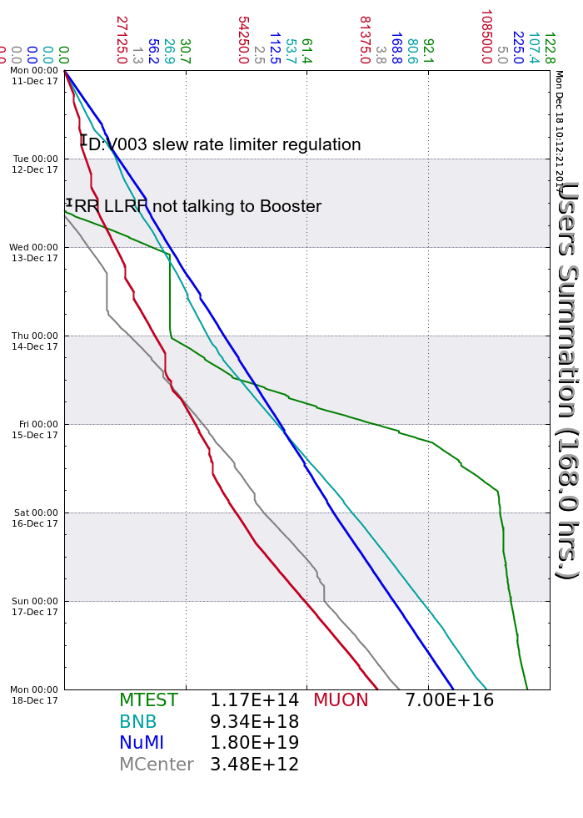
Accelerator Operations Summary
From: December 11, 2017 (0000 hours)
To: December 18, 2017 (0000 hours)
Calendar Week # 50
NuMI Weekly Integrated Intensity 1.80 E19 protons
Beam Hours To NuMI 158.5 hours
BNB Weekly Integrated Intensity 9.34 E18 protons
Beam Hours To BNB 161.1 hours
Muon Weekly Integrated Intensity 7.00 E16 protons
Beam Hours To Muon 132.4 hours
MTest Weekly Integrated Intensity 1.17 E14 protons
Beam Hours To MTest 87.6 hours
MCenter Weekly Integrated Intensity 3.50 E12 protons
Beam Hours To MCenter 102.1 hours

Slide 3
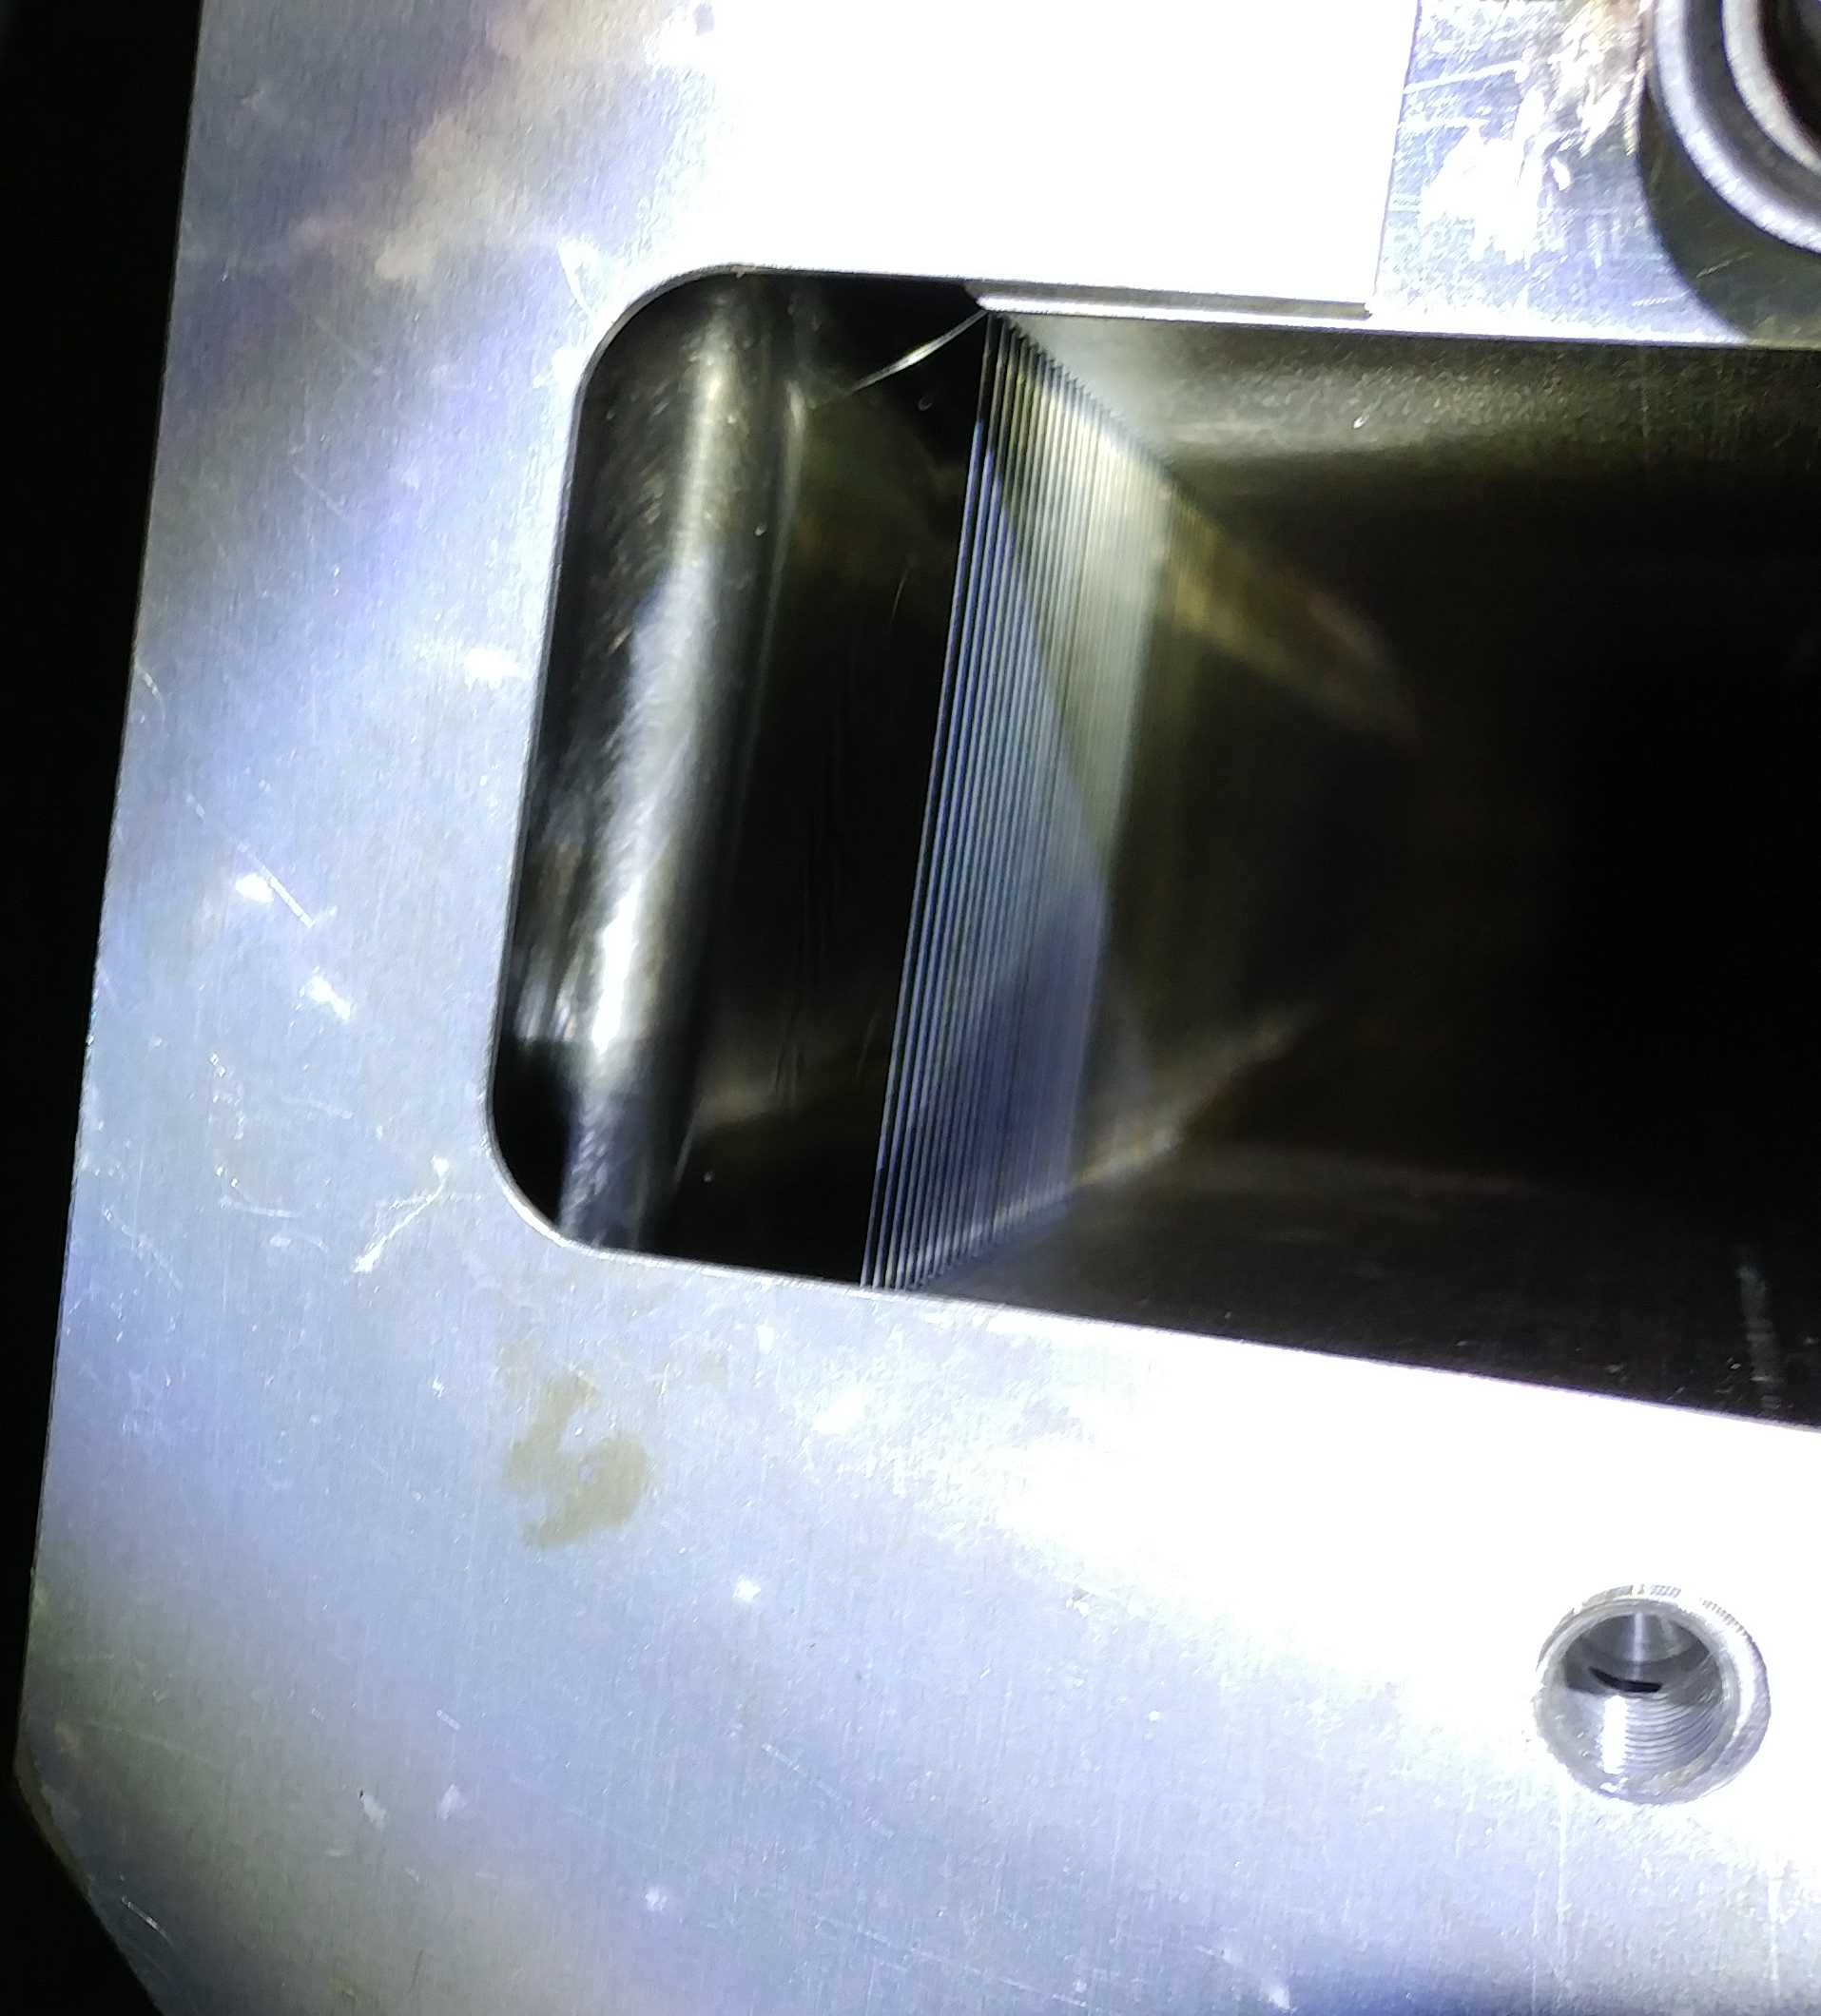
Broken A Septum Wire
Wire shorted on Tuesday
Access Wednesday to fix
  Found 1 shorted wire and 2 broken wires at D/S end of tank A
Back on Thursday afternoon

Slide 4
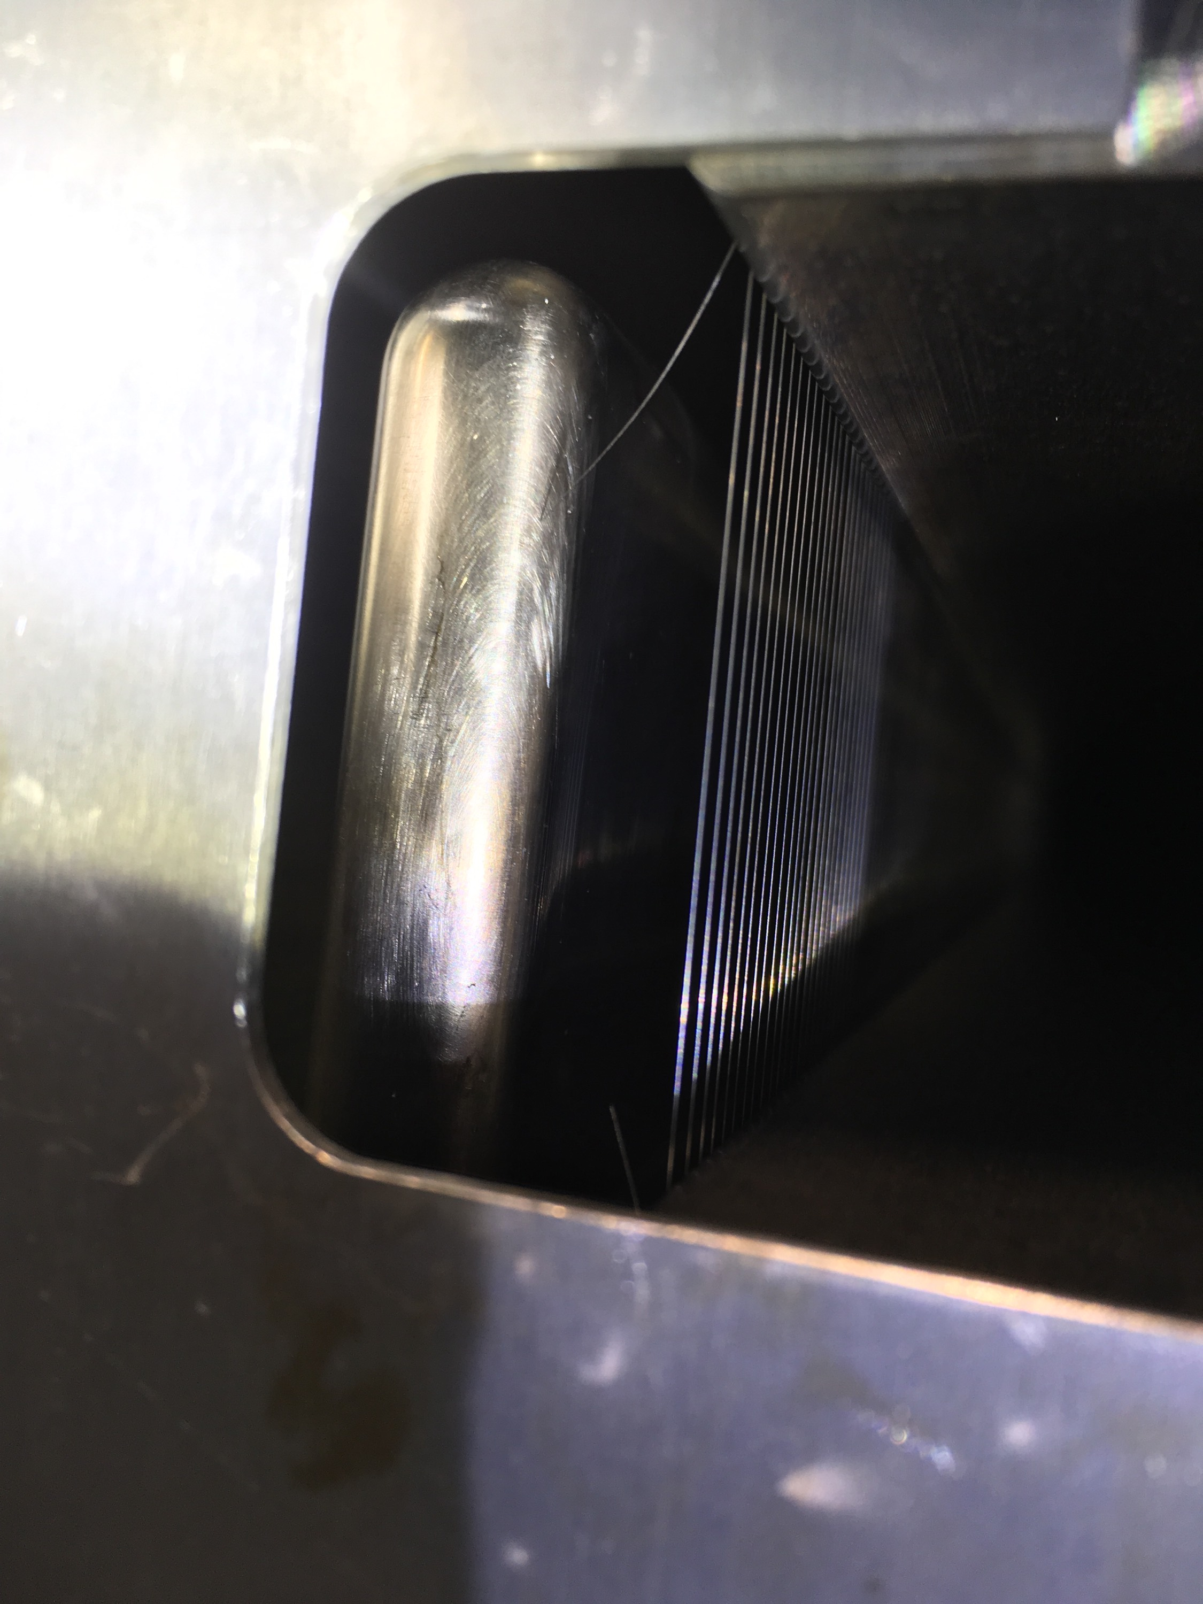
MI52 Septum
We have a total of 3 broken wires on the downstream end of tank 1, two from last week and one this week.
We would like to scrub the gas out of this septum before turning on the high voltage (Below 1E-7) => Monday.
We will preform a stretched wire measurement on a spare septum next week to look for cavity modes.

Slide 5
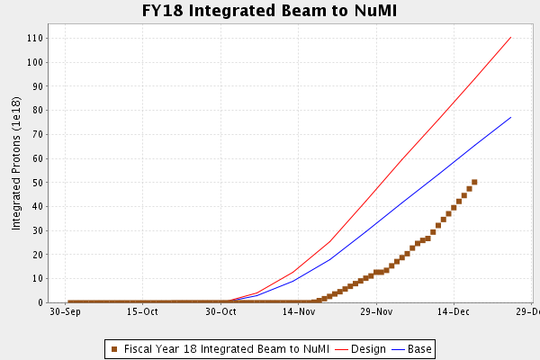
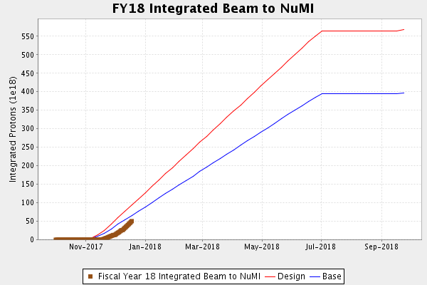
NuMI Operation

Slide 6
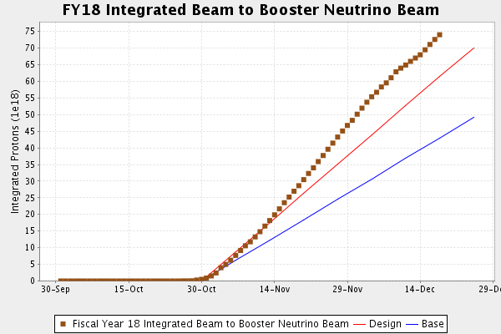
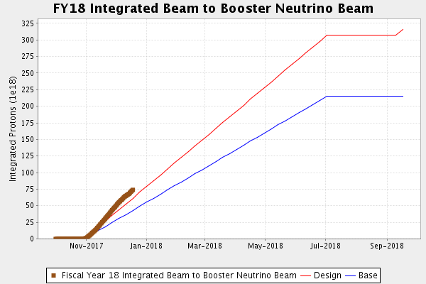
BNB Operation

Slide 7
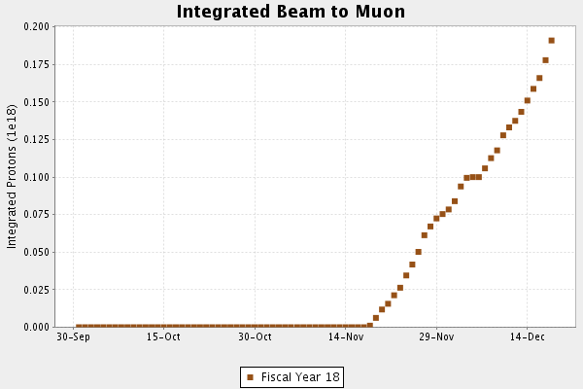
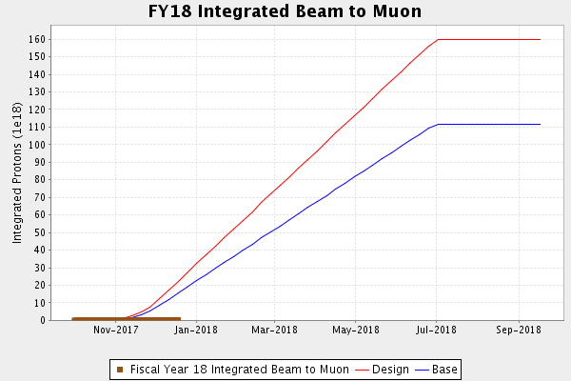
Muon Operation

Slide 8
Complex Status
LINAC
  Investigating LRF3 MARX trips
Booster
  Tuning continues
MI/RR
  Tuning continues
NuMI
  Running at ~640kW (with switchyard)
Booster Neutrino Beamline (BNB)
  Stable operation
  Running at 5 Hz
Switchyard
  Meson Test Operating
  Meson Center Operating
Muon Campus
  Tuning & studies
General
  Tuesday, December 19th access
    Beam off at 0600 all areas
    Keys at 0700
    Access 4 hours
    MI compressed air leak

Slide 9
PIP-II Injector Test & FAST Status
PIP-II Injector Test
  Studies
    Beam through new differential pumping section with low losses
    Buncher cavity phasing checks
    Scans and measurements
    Beam size measurements
FAST
  300 MeV Commissioning Run Successful
      IOTA Installation underway

Slide 10
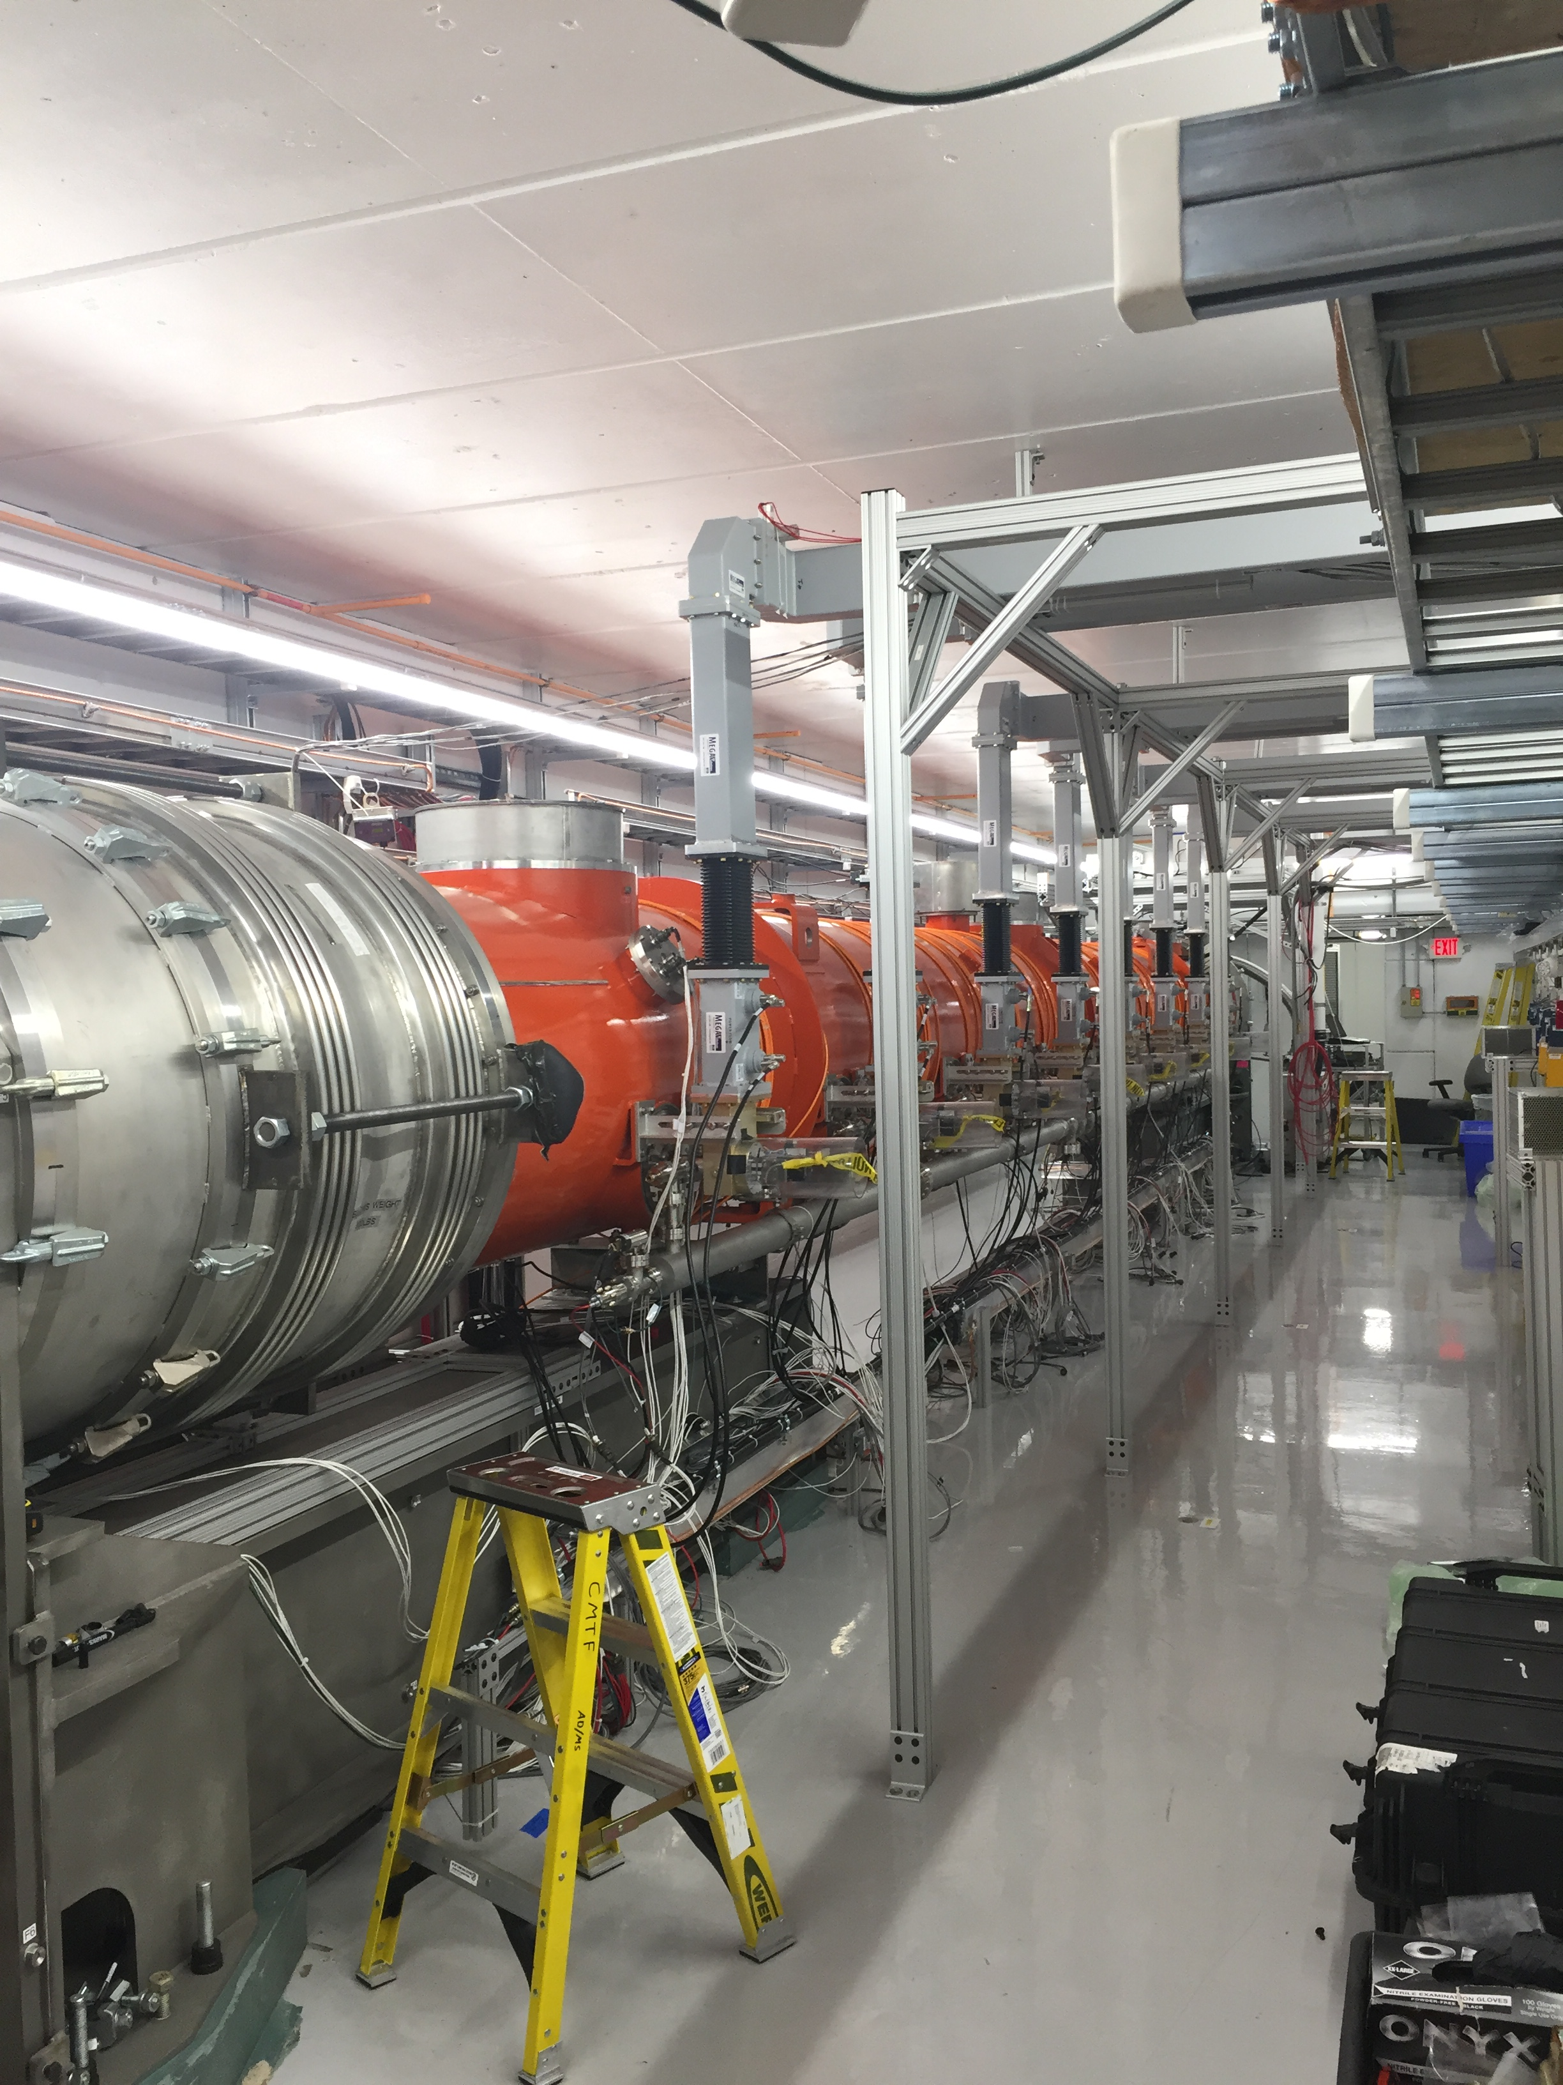
CMTS1 Status
LCLSII Cryomodule F1.3-05
  Testing complete
  Warmup and deinstallation progress
  Next cryomodule F1.3-07 due to arrive on December 20th

Slide 11
Schedules and Links
Schedule can be accessed from the Operations Department Home Page
  Schedules -> Operations Schedule
Direct link to schedule
  http://www-ad.fnal.gov/ops/schedule.html

