Slide 1
Introduction and Charge
Giorgio Ambrosio
Magnets L2
U.S. HL-LHC Accelerator Upgrade Project
Review of BNL VTF plans to address high pressure issue after MQXFAP1 quenches
December 19, 2017

Slide 2
Introduction
MQXFAP1, the first HL-LHC Q1/Q3 magnet prototype, is under test at BNL Vertical Test Facility. During the first training quench, the burst disk on the top plate of the test facility raptured. The helium recovery line was partially changed in the attempt of reducing peak pressure after quench. Nonetheless the burst disk on the top plate raptured again during the following two training quenches.
The BNL team developed three options for resuming testing in the short (options #1† and #2†) and long term (Option #3†), based on updated assumptions for computing peak pressure after magnet quench.
The goal of this review is to assess that assumptions and computations used to develop the three options are adequate to avoid overpressure issues when MQXFAP1 testing is going to resume, and that the short-term technical solutions are adequate to prevent burst risk rupturing after quenching.
†Options are available at: https://indico.fnal.gov/event/15873/

Slide 3
CHARGE
The committee is requested to answer the following questions:
Are the assumptions and computations used to develop the three options adequate to avoid overpressure issues when testing MQXFAP1?
Are the plans for implementation adequate to assure high probability of success?
Do you have any other comment or recommendation to assure successful resuming of MQXFAP1 testing?

Slide 4
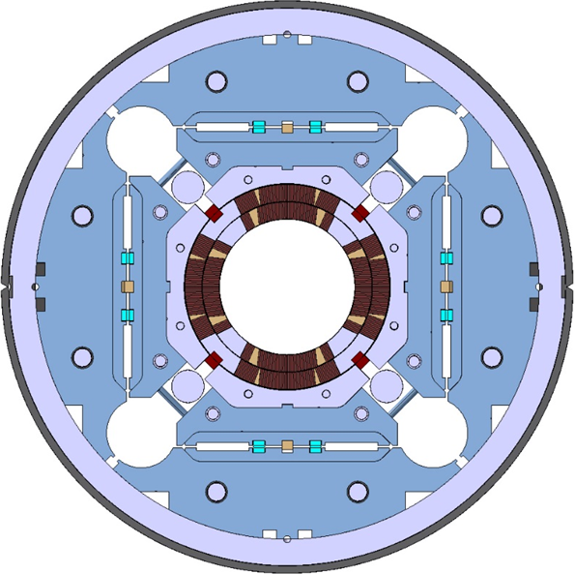
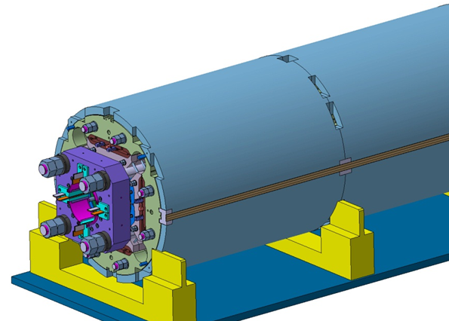
MQXFA Main Parameters
Parameter | Unit | MQXFA
Coil aperture | mm | 150
Magnetic length | m | 4.2
N. of layers |  | 2
N. of turns Inner-Outer layer |  | 22-28
Operation temperature | K | 1.9
Nominal gradient | T/m | 132.6
Nominal current | kA | 16.5
Peak field at nom. current | T | 11.4
Stored energy at nom. curr. | MJ/m | 1.2
Diff. inductance | mH/m | 8.2
Strand diameter | mm | 0.85
Strand number |  | 40
Cable width | mm | 18.15
Cable mid thickness | mm | 1.525
Keystone angle |  | 0.4
P. Ferracin et al., “Development of MQXF, the Nb₃Sn Low-β Quadrupole for the HiLumi LHC ” IEEE Trans App. Supercond. Vol. 26, no. 4, 4000207
G. Ambrosio et al., “MQXFS1 Quadrupole Design Report” LARP DocDB 1074

Slide 5
MQXFA Magnets Functional Test Requirements
DocDB: US-HiLumi-doc-137-v2
 | MQXFA
Magnet Type | Quadrupole
Aperture | 150 mm
Overall Length | 4961 mm
Max Support Structure OD (without He vessel) | 614 mm
Magnet Weight | 6758 kg
Operating Temperature | 1.9 K
Operating Current | 16471 A
Operating Gradient | 132.6 T/m
Peak Field at Operating Current | 11.41 T
Magnetic Length | 4200 mm
Stored Energy at Operating Current | 4.91 MJ
Inductance at Operating Current | 34.5 mH
Ultimate Op. Gradient | 143.2 T/m
Ultimate Op. Current | 17890 A
Short Sample† Gradient @ 1.9 K | 168.1 T/m
Short Sample† Current @ 1.9 K | 21240 A
Short Sample† Peak Field @ 1.9 K | 14.5 T
Maximum Coil MIITs | 33.8
†Short Sample Limit based on conductor specifications [3].

