Slide 1
Welcome to EDIT2018
Who are we?
Where did we come from?
What do we want?

Slide 2
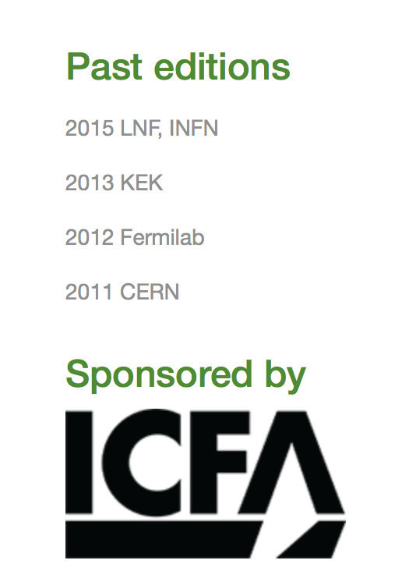
EDIT == “Excellence in Detector and Instrumentation Technology”
A periodic symposium to educate young researchers on the techniques and capabilities of particle detectors
From the beginning, in 2011 at CERN, the emphasis has been hands-on training. That tradition has been carried through today. See previous versions of EDIT:
Note: there is another ICFA instrumentation school that essentially interleaves with EDIT. That typically serves students from regions where technological support has been lesser (e.g. 2017 school held in Cuba last year.
Opportunities should be maximized for detector R&D by young researchers

Slide 3
Our syllabus
Hour long lectures on a different subject each day.
Hands on demonstrations and activities reside within 4 “tracks”:
Photodetection (PMT’s, SiPM, muon telescope, chemistry of scintillation)
Test Beam (Triggering on beam, Cherenkov radiation, Pb-Glass calorimeter, time-of-flight
Neutrino detection (Liquid and gaseous Argon, High voltage characteristics, Nitrogen contamination)
Silicon Tracking (Diode characteristics, simulation of diodes, response from laser, wire bonding)

Slide 4
Plenary talks for EDIT 2018
History of Particle Detection
Photodetectors
Calorimetry
CCD’s
Gas Detectors
Medical Imaging
Silicon Tracking Detectors
Noble element detectors
Signal Processing
Superconducting detectors
Triggering and DAQ
X-ray detection
Nuclear processes
The future for particle detectors

Slide 5
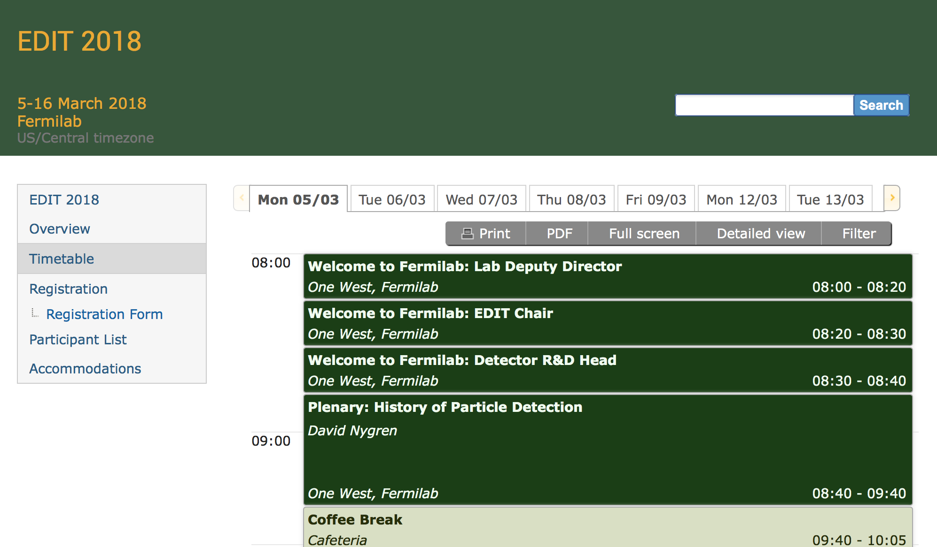
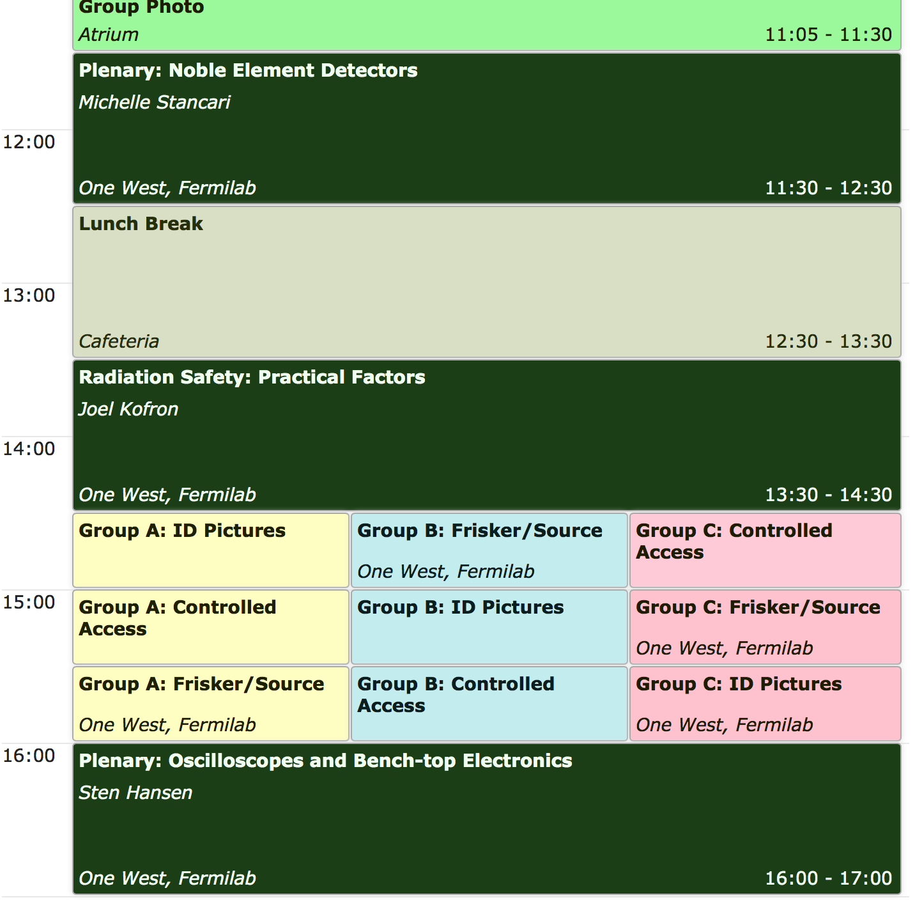
Our Timetable for today:

Slide 6
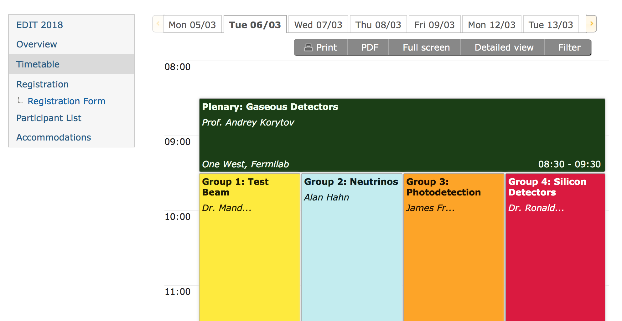
For training March 6 through March 16, groups are identified by color, with 12 students per group.
Friday, March 16th will be another special format, with industry booths to visit and a tour of the D0 experiment, which co-discovered the top quark.

Slide 7
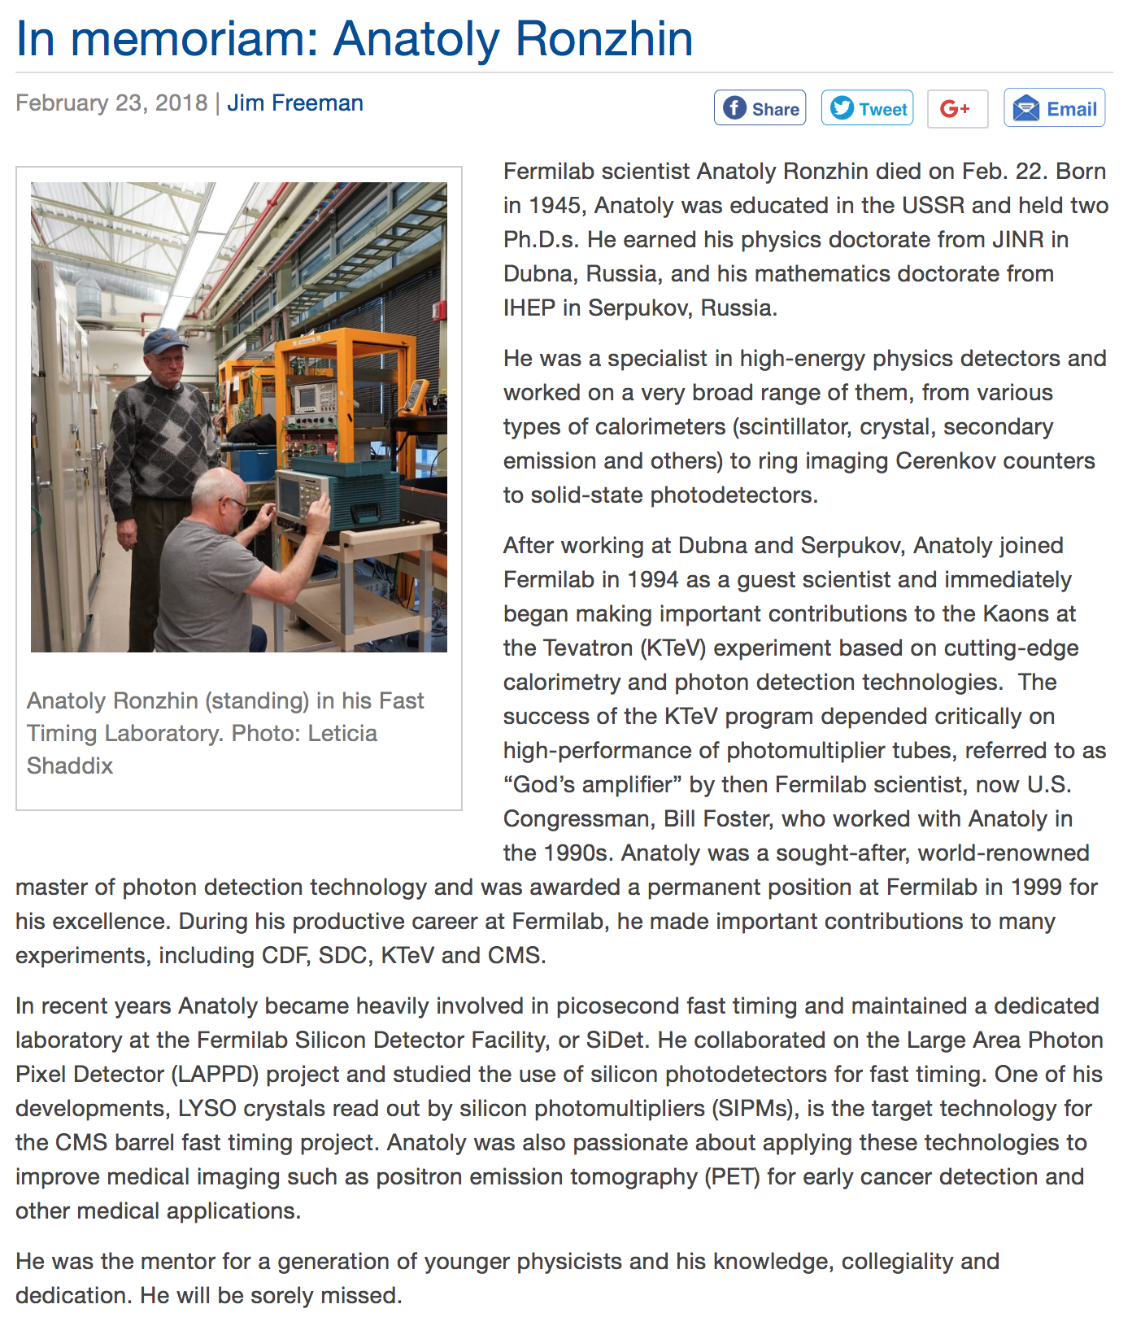
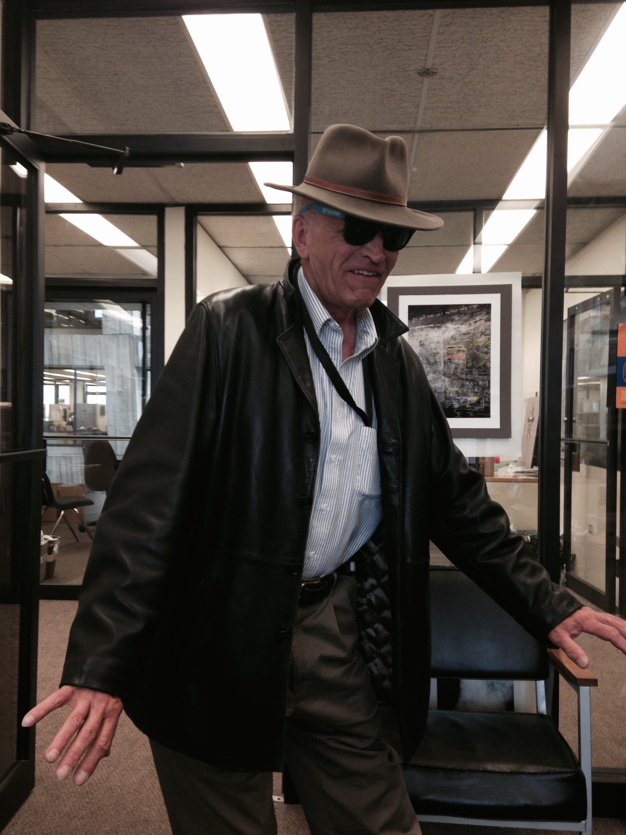
A Sad Day for detector R&D at Fermilab
We dedicate this EDIT symposium to our good friend and colleague – Anatoly Ronzhin

Slide 8
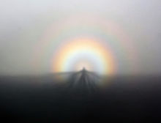
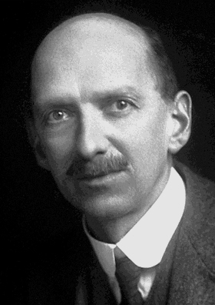
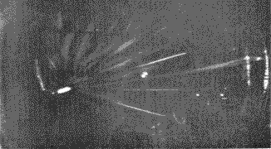
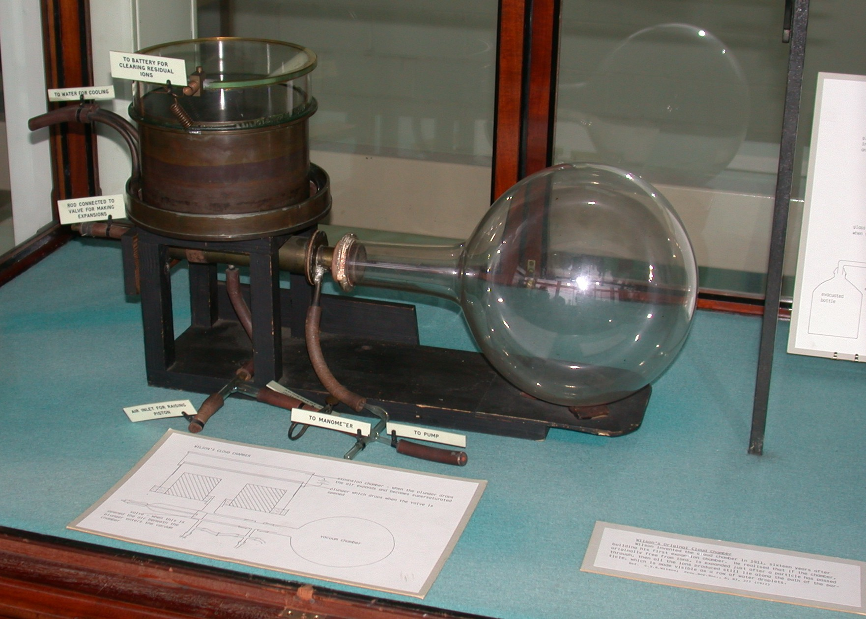
C.T.R. Wilson and his Cloud Chamber
Wilson was a Scottish meteorologist at the Cavendish Labs
Fascinated by clouds in the Highlands, especially the ‘Brocken Spectre’
Built a chamber to play with purified air, with changes in dust, pressure , temp, etc.
Found that vapors condense around ionization when pressure is lowered and volume becomes supersaturated

Slide 9
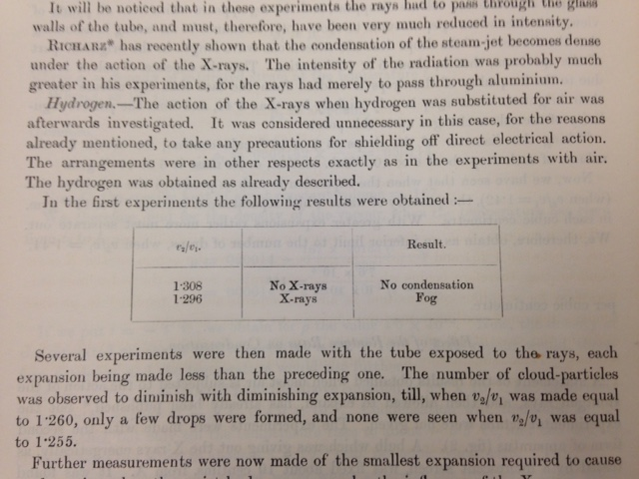
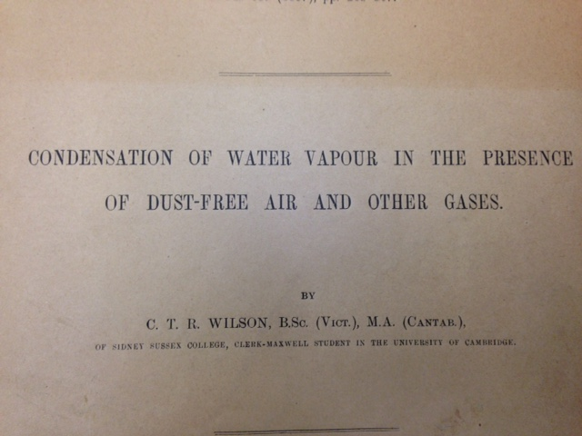
The birth of particle detector R&D
After discussions with Thomson, Wilson brought in a ‘Rontgen Ray’ tube and put it in front of his cloud chamber. His table of results is one of the most beautiful that I’ve ever seen. Here it is:
Let us all strive for such innovation, simplicity, and consequence

