Slide 1
Introduction to Silicon Detectors
EDIT 2018

Slide 2
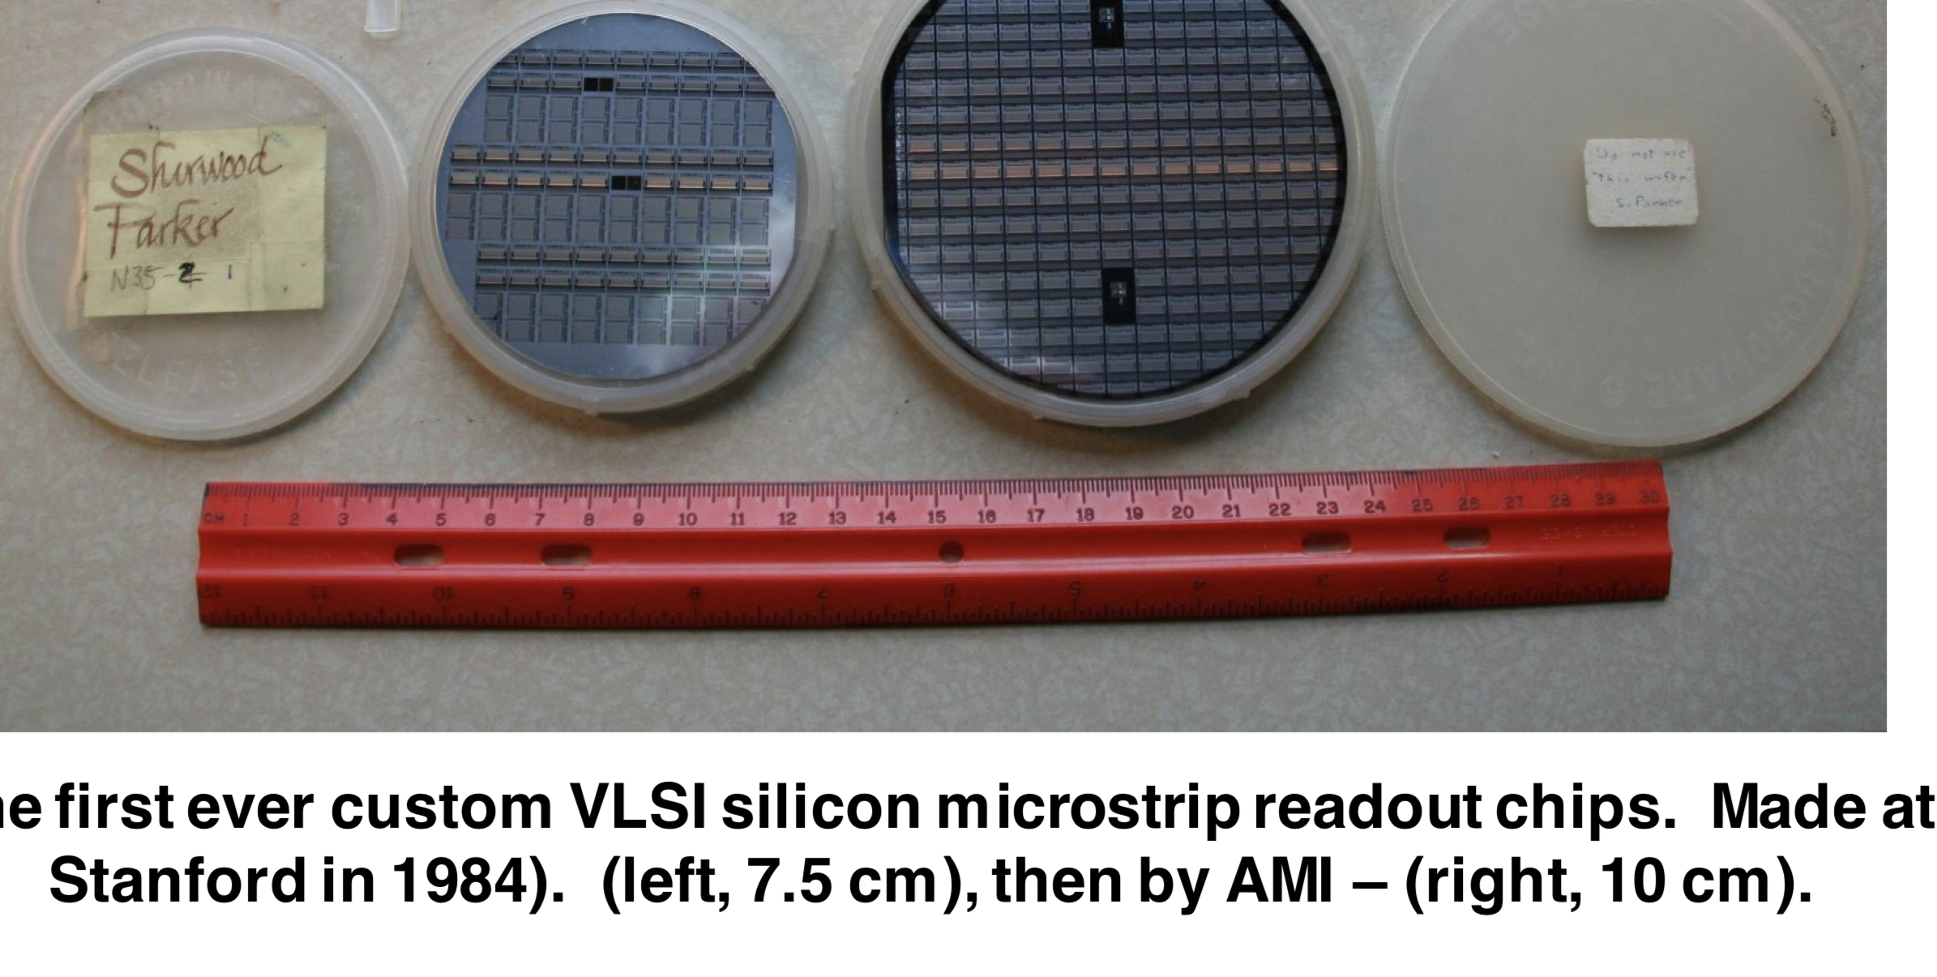
An Aside
This week Sherwood Parker passed away
He was a crucial figure in the development of silicon detectors for particle physics
Developed the first readout integrated circuit for HEP
The first collider vertex detector
Invented 3D sensors
Invented active edge technology
Spearheaded fast timing in silicon
and was a lifelong railroad enthusiast

Slide 3
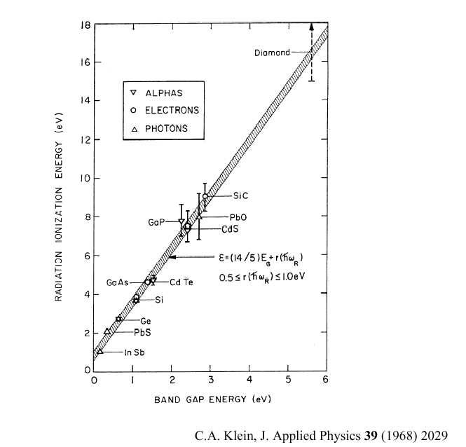
Silicon Basics
Silicon is wonderful stuff
Low energy to create e-hole pair (3.6 eV)
Long mean free path
High mobility (fast charge collection)
Low Z (low multiple scattering)
Well-developed technology
  Fine lithography of structures
  “native” oxide

Slide 4
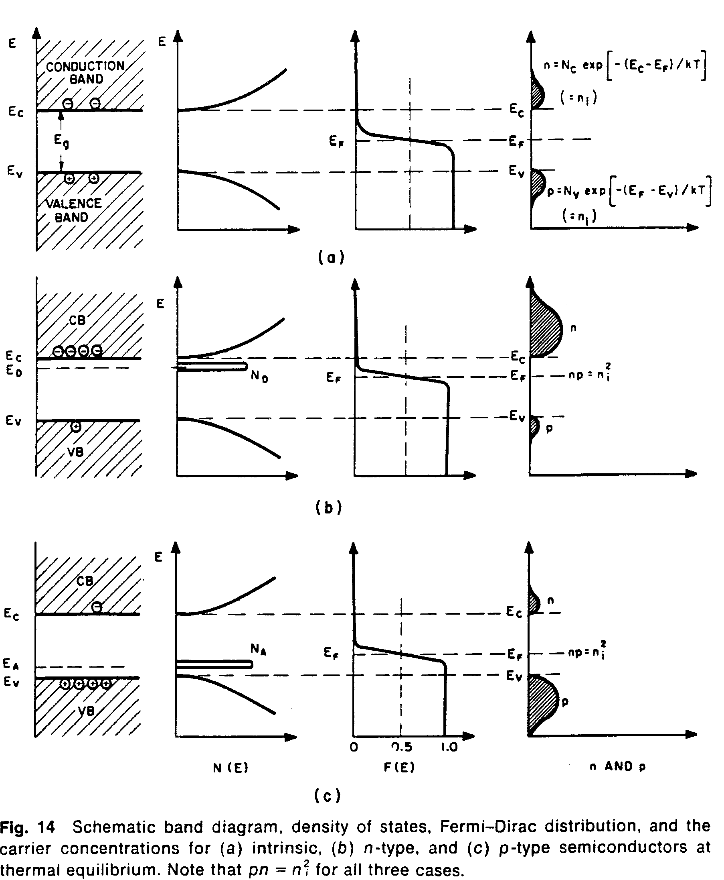
Silicon Basics
band
diagram
density of
states
Fermi-dirac
distribution
carrier
concentrations
Silicon detectors are typically high resistivity >1 KW-cm “float zone” silicon
The small energy gap between impurity “donor” or “acceptor” levels means most mobile electrons and holes are due to dopants (at RT)
This is why we are not overwhelmed with current when a bias is applied
Intrinsic
n-type
p-type

Slide 5
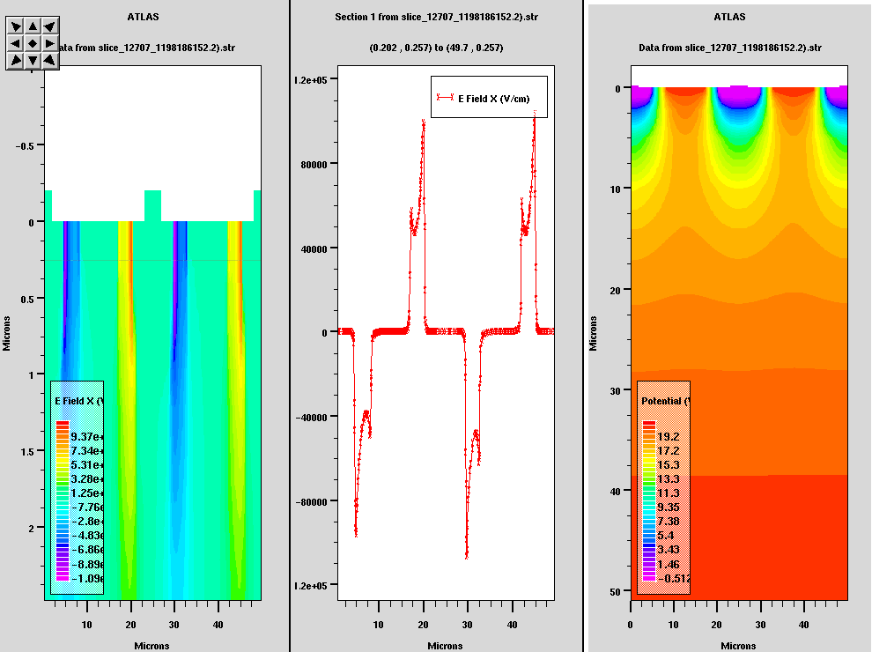
n, p and junctions
Silicon can be doped with donor or
acceptor impurities. This
corresponds to n (usually
phosphorus) or p (boron) type
silicon.
The contact between the heavily
doped and lightly doped regions
provide the junction (p-n) and ohmic (n-n⁺ or p-p⁺) contacts
Junction contacts are high field (possible breakdown) regions
Ohmic contacts need to be heavily doped for a proper metal- semiconductor contact

Slide 6
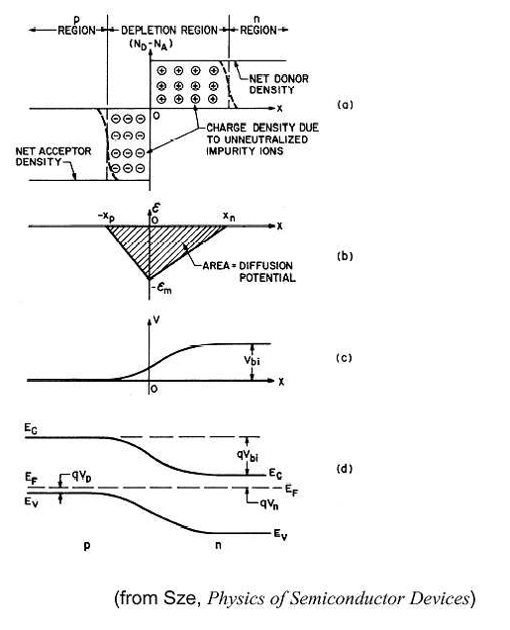
Charge Drift and Collection
Very asymmetric doping in
our devices
Diode depletion
Silicon detectors have lightly doped bulk (usually n) and heavily doped contacts. Unusually large depleted area.
Diffusion of charge carriers will form a local depleted region with no applied voltage
As we apply external bias the depletion region (and the internal field) grows until it hits the bottom.
pn junction
no external
fields

Slide 7
Device Characteristics
Resistivity:
Depletion :
electron, hole mobility
Electric Field:
Effective carrier concentration
x = distance from junction D = silicon thickness

Slide 8
Device Testing - CV
There are a few standard tests which measure the basic properties of silicon detectors
Detectors are normally operated fully depleted – all impurities ionized. This leaves a “space charge” region depleted of charge carriers that acts like a dielectric in the junction/ohmic capacitor
Assume this acts as a parallel plate capacitor (diode test structures):
C=εA/D
For a parallel plate diode

Slide 9
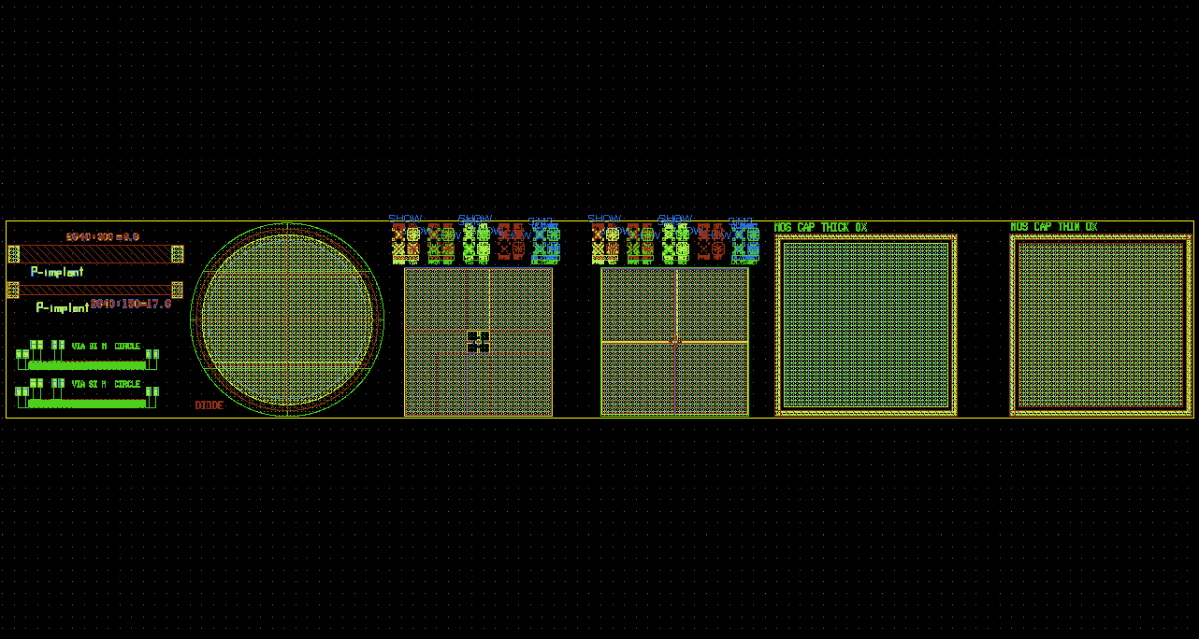
Device Testing - IV
Test structures
A high quality detector will also have low leakage current – current driven by carrier generation in the depleted bulk.
Strongly temperature dependent
Avalanche breakdown at 3x10⁵ V/cm
Measure V_{bias} vs I curves
Look for anomalous currents
Breakdown voltage
Current can be affected by surface defects, problems with the ohmic contact, cut edge currents, impurities (especially metals), and physical
damage
Rapid rise until
depletion

Slide 10
Charge Drift, diffusion
A ~300 micron thick piece of silicon with initial doping concentration of 1x10¹² has V_{d} of 68 V – operate at ~100 V
In p(n) type silicon electrons (holes) are collected at the junction
As carriers drift they diffuse
As carriers drift they move due to Lorentz forces from the magnetic field
As carriers drift electrons can recombine with holes
As carriers drift they may be “eaten” by traps in the silicon
Carriers in field-free regions can still diffuse to collection electrodes
μ_{e} = 1.5x10⁻¹ m²/Vsec
μ_{h} = 4.5 x10⁻² m²/Vsec
(affected by temperature, doping concentration and the magnitude of the applied field)
Drift time to an electrode:

Slide 11
Carrier Drift
Electron, hole drift:
Drift time to an electrode:

Slide 12
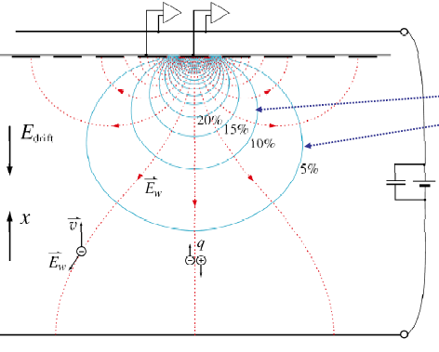
Signal Development
(Radeka – from Ramo and Shockley)
Signal induced by moving charges depend on work done by circuit. The charge induced on an electrode depends on the coupling between the moving charge and the electrode
In a multi-electrode system the induced current on an electrode depends on the velocity of the charge and the value of the effective “weighting” field
Weighting field - determined by putting 1V on strip, grounding all other electrodes

Slide 13
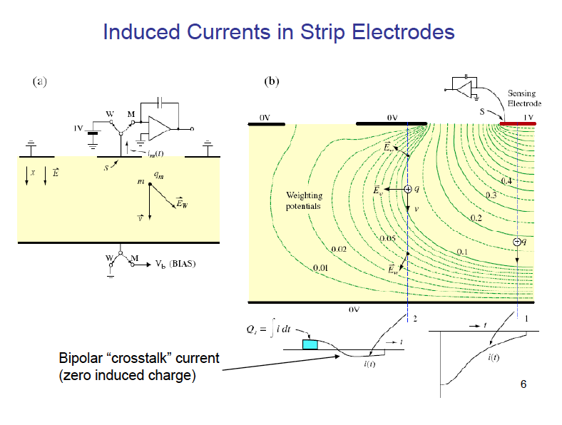
Strip Detector
(Radeka)

Slide 14
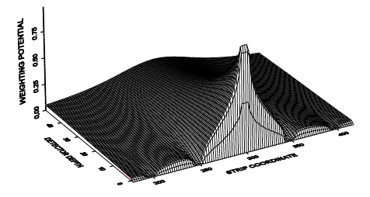
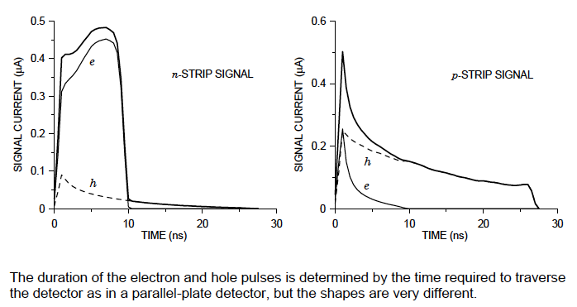
Signal Shapes
Weighting potential for a 300 μm thick strip detector 50μm pitch
Spieler

Slide 15
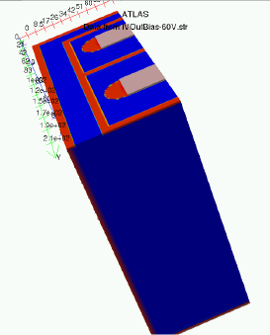
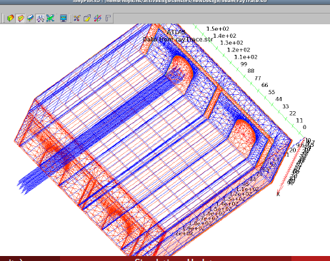
Simulation
A silicon detector is rather complex. There are commercial “TCAD” packages that can simulate silicon-based devices utilizing finite element analysis using the detailed semiconductor equations:
Internal fields
Coupling to electrodes
Charge diffusion and drift
Traps
Surface effects

Slide 16
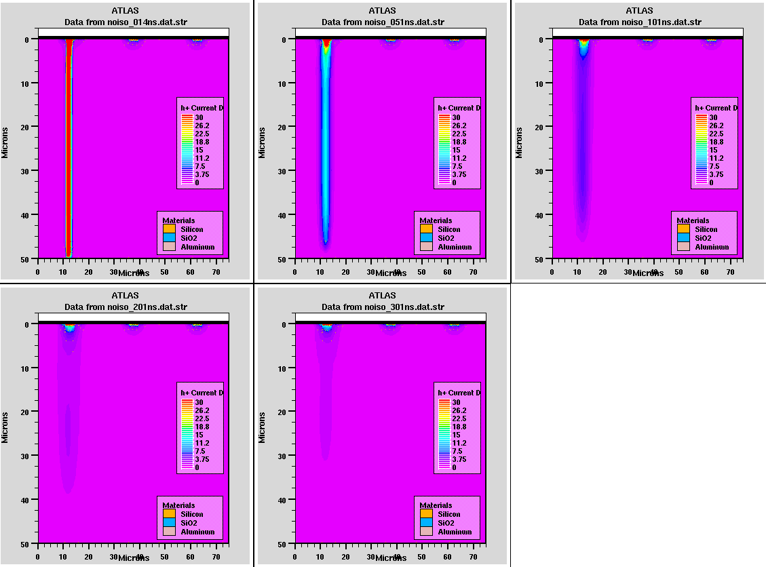
TCAD simulation of hole currents due to a track impact in a n-bulk 50 micron thick pixel detector

Slide 17
Strip Detector
Bias resistor integrated on each strip usually implanted polysilicon resistor
Coupling capacitor formed by very thin (2500 A) dielectric. The dielectric is usually a “grown thermal” oxide supplemented with deposited layers formed by CVD (chemical vapor deposition)
In addition there are “guard rings” which keep the field from reaching the damaged silicon near cut edges.
“Microdischarge” breakdown can occur when fields near the implant increase due to charges in the oxide and potential of the coupling aluminization
junction
Ohmic
contact
oxide
p+
Si
n-
n+

Slide 18
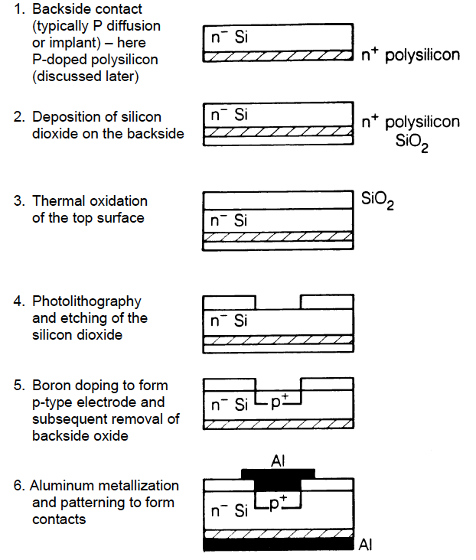
Detector Fabrication
(Spieler)
To fabricate silicon detectors the basic process is similar to IC fabrication
Lithography utilizing masking and exposure of photoresists
Growth and deposition of silicon dioxide layers (glass)
Implantation or diffusion of dopants
Thermal annealing to incorporate dopants into the silicon lattice
We deal with micron-level features where ICs are at ~14 nm

Slide 19
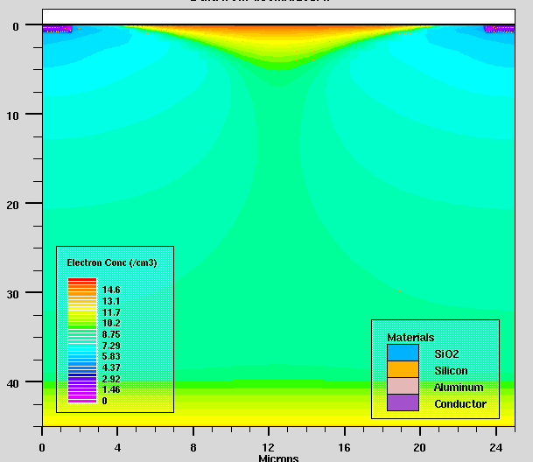
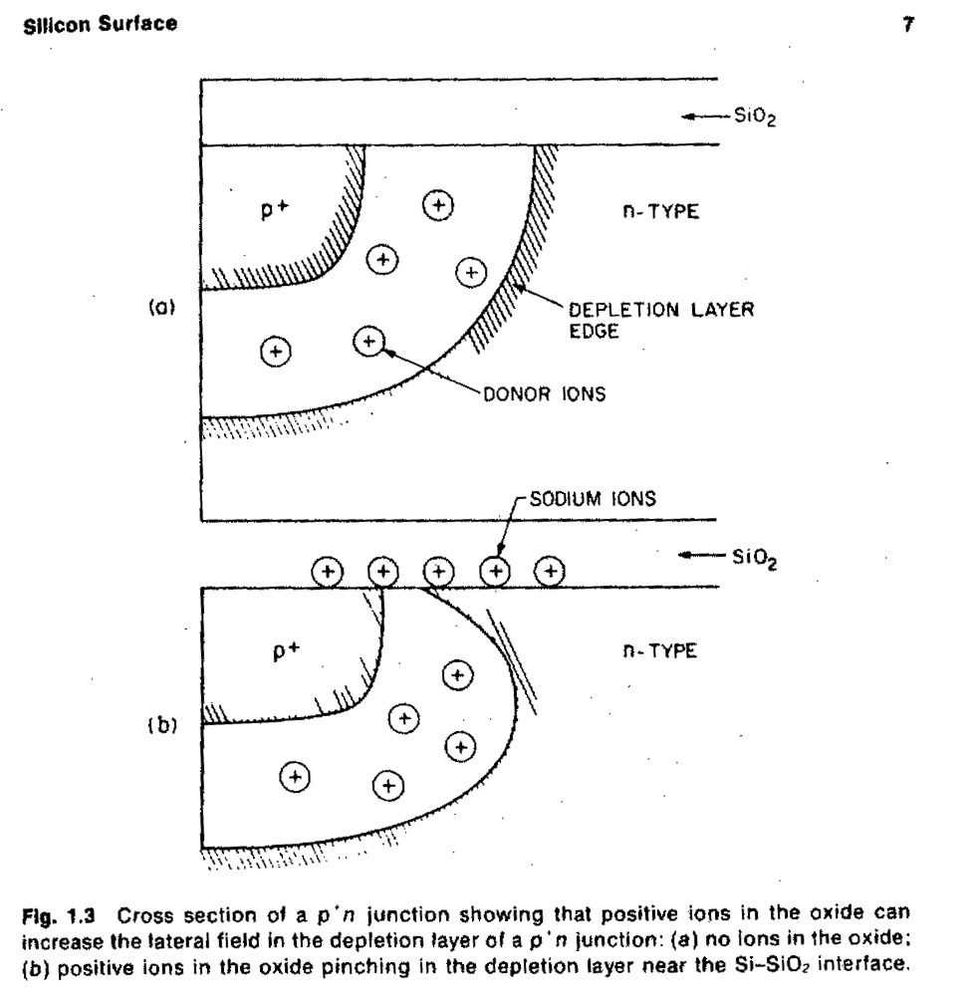
Semiconductor Surface
The surface is a crucial part of the detector design
Junction side must be polished and defect-free
Field must be ~0 at damaged cut edge
Silicon dioxide used as insulator and passivation can accumulate charge (usually positive)
An electron accumulation layer builds up near the positively charged silicon/silicon dioxide interface – this acts as an insulator on a p+/n or a conductor on a n+/p junction – need an additional “p-stop” to electrically isolate n strips on p conductor
Detectors can also be sensitive to charge attracted to the surface – affected by humidity
Electron concentration
1e11 oxide charge
n-type

Slide 20
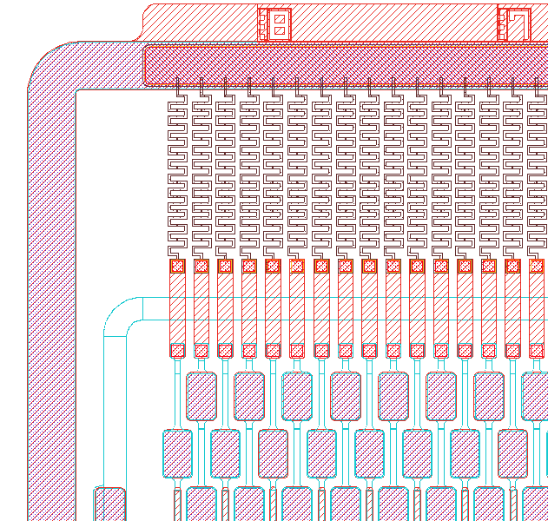
Detector
Layout
Bias line
bias
resistor
Guard
ring
DC test
pad
coupling
capacitor
aluminization
100μm
bond
pad
strip
implant

Slide 21
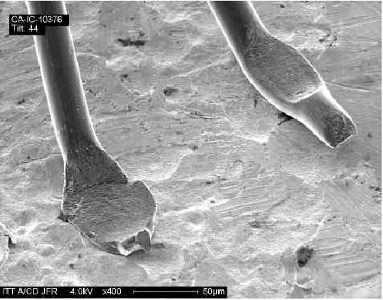
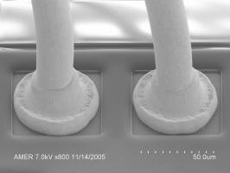
Wirebonding
Aluminum ultrasonic welding or gold thermocompression
Aluminum wedge bonding achieves the finest pitch and does not need elevated temperature
This is a bit of an art – getting good bonds depends on machine, operator, and especially the surface properties of the materials

Slide 22
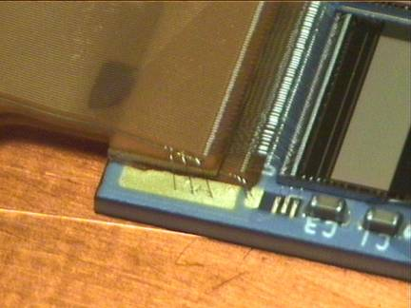
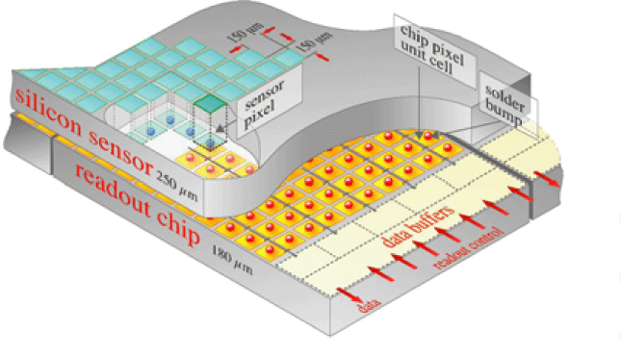
Interconnect
Analog
cable
Analog
cable
How we connect the detectors to the electronics, cool them, and mount them is increasingly important
Interconnect is a common point of failure
Determines pitch
Can be expensive
Adds capacitance and inductance
Can determine geometry
SVX4
SVX4
hybrid
hybrid
Hybrid Pixel Interconnect using bump bonds

Slide 23
Stations
Lab D – wirebond a diode structure, measure feature sizes, inspection with probe stations and microscopes, infrared inspection
Laser – Measure charge collection and shape from several diodes
CV/IV – Measure basic detector parameters, extract device thickness and effective doping concentration (Neff)
TCAD – Device simulation. You will simulate the pulse and static measurements in the Laser and CV/IV stations. Examine the internal structure of the diodes. Tune the simulations to match measurements. Simulate more complex structures if time allows.

Slide 24
Schedule
 |  | GROUP 1 | GROUP 2 | GROUP 3 | GROUP 4
Day 1
9:45 | 10:30 | Introductory lecture/discussion
10:30 | 11:15 | Lab D | LASER | TCAD | CV
11:15 | 12:00 | Lab D | LASER | TCAD | CV
LUNCH
13:00 | 15:00 | TCAD | CV | Lab D | Laser
15:00 | 17:00 | LASER | TCAD | CV | Lab D
Day 2
9:30 | 10:30 | CV | Lab D | LASER | TCAD
10:30 | 12:00 | CV | Lab D/TCAD | LASER | TCAD
LUNCH
13:00 | 14:30 | SIDet Tour
15:00 | 17:00 | TCAD Analysis/Retest/Seminar

Slide 25
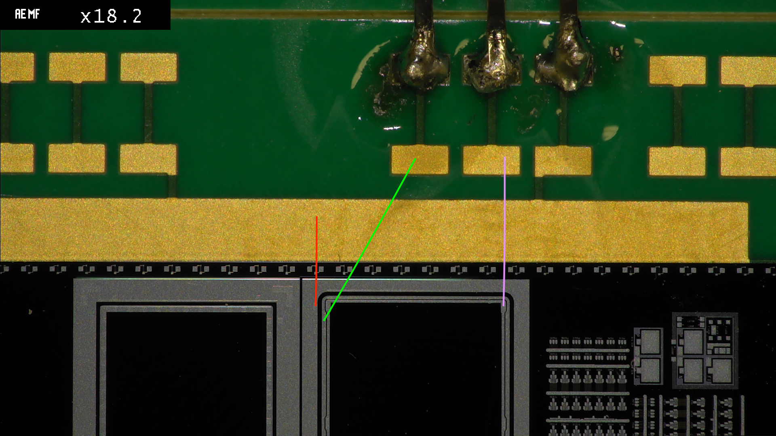
Test Diodes
Much of your study will use test diodes from sensor test structures
These are large area p-n or n-p diodes with guard ring structures
Michelle will bond them in the Lab D part of your
schedule.
guard
diode
Back bias (HV)

