Slide 1
Noble Element Detectors
Michelle Stancari
EDIT 2018

Slide 2
Why Noble Elements?
Abundant ionization and scintillation light
No electronegativity, free electrons travel large distances (if no impurities)
Radiation hard
Excellent dielectric properties accommodate very large voltages
High density
Low cost (well, sometimes)
Drawbacks
Low wavelength light
Nuclear effects
Cryogenic infrastructure
Boiling point (K) @ 1 atm | 4.2 | 27.1 | 87.3 | 120.0 | 165.0
Density (g/cm³) | 0.125 | 1.2 | 1.4 | 2.4 | 3.0
Radiation length (cm) | 755.2 | 24.0 | 14.0 | 4.9 | 2.8
dE/dx (MeV/cm) | 0.24 | 1.4 | 2.1 | 3.0 | 3.8
Scintillation (γ/MeV) | 19,000 | 30,000 | 40,000 | 25,000 | 42,000
Scintillation λ (nm) | 80 | 78 | 128 | 150 | 175
ppm in air | 0 | 12 | 9500 | 1 | 0.1
Notes:
Argon is cheap and conveniently close to LN2 temperatures. Ggamma/MeV numbers are at zero field

Slide 3
Signal Production in liquid nobles

Slide 4
Signal Production in liquid nobles
How much of each depends on the electric field

Slide 5
Where are these detectors in use today?
High energy calorimeters MeV-TeV
Neutrino beams ~0.1-10 GeV
Direct detection of dark matter keV
Neutrino-less double beta decay searches
. . And many more
Neutrino Energy Spectrum
M. Messier
Notes:
Order by energy of detected particles

Slide 6
Calorimeters in one slide
Calorimeters consist of
Dense absorber to fully absorb the energy of the incident particle and
Active material to produce an output signal proportional to the input energy
Incident
particles
Output signal
to electronics
Homogeneous Calorimeters (EM only)
Same material is both absorber and active
liquid Kr (NA48), liquid Xe (MEG)
Crystals: PbWO₄ (CMS), NaI (Crystal Ball), CsI (Babar) or lead glass
Sampling Calorimeters
Alternating layers of absorber (e,g, lead, tungsten) and active material (e.g. scintillator, liquid argon )
Works for both EM and hadrons
Notes:
Only charge is detected with the noble liquids. Homogeneous means better energy resolution if contained.

Slide 7
Noble Liquid Calorimeters for high energy
All collect the ionization charge signal to measure energy, ignore scintillation light.
Pros:
High density active material
Radiation hard
Finer segmentation both longitudinal and transverse
Cons:
Cryogenic infrastructure contributes to material budget, and is a pain
Inferior resolution to some crystals, ”quasi-homogenous”
Examples:
NA48 LKr: quasi-homogenous, finely spaced electrodes for charge collection.
D0 and ATLAS LAr: sampling calorimeter, both EM and hadronic. Absorber type and thickness varies with η (angle w.r.t. beam axis) and r (distance from beam axis) – you should see more on the D0 tour!
Notes:
Homework: look at physics goals of these experiments and ask why this choice of calorimeter technology was made. In particular, was the CMS or ATLAS resolution better for the H-gg discovery channel? WHy? What would have been different if the HIggs mass was 170 GeV/c2 instead?

Slide 8
Noble Liquid Calorimeters for high energy
Homework:
Compare these calorimeters with those of competing experiments that employed different technologies. D0-CDF, ATLAS-CMS, NA48-KTeV
Consider energy resolution, position resolution, size and ???
Ask which technology performed better for which measurements
Ask why a particular technology was chosen.
For CMS-ATLAS, how do the answers change if mass of the Higgs Boson is 175 GeV/c² instead of 125 GeV/c²
Find an expert who was around during the design phase. Ask what they understood about these detectors then, and what the surprises were after they built them.
All collect the ionization charge signal to measure energy, ignore scintillation light.
Pros:
High density active material (less total volume)
Radiation hard
Finer segmentation both longitudinal and transverse
Cons:
Cryogenic infrastructure contributes to material budget, and is a pain
Inferior resolution to some crystals, ”quasi-homogenous”
Examples:
NA48 LKr: quasi-homogenous, finely spaced electrodes for charge collection.
D0 LAr: sampling calorimeter, both EM and hadronic. Absorber type and thickness varies with η (angle w.r.t. beam axis) and r (distance from beam axis)
ATLAS LAr: sampling calorimeter, EM only
Notes:
Homework: look at physics goals of these experiments and ask why this choice of calorimeter technology was made. In particular, was the CMS or ATLAS resolution better for the H-gg discovery channel? WHy? What would have been different if the HIggs mass was 170 GeV/c2 instead?

Slide 9
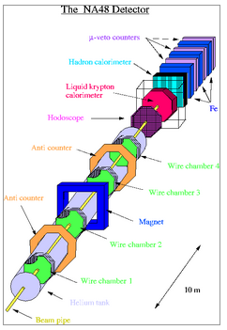
NA48 LKr Calorimeter – quasi homogeneous
Fixed target experiment studying rare kaon decays and CP violation.
Calorimeter optimized for photon and π⁰ energy resolution
1997-2002
Notes:
Look up CP violation physics of NA48 and understand why resolution helps reject background. Look up competing experiment KTeV and contrast the two calorimeter choices.

Slide 11
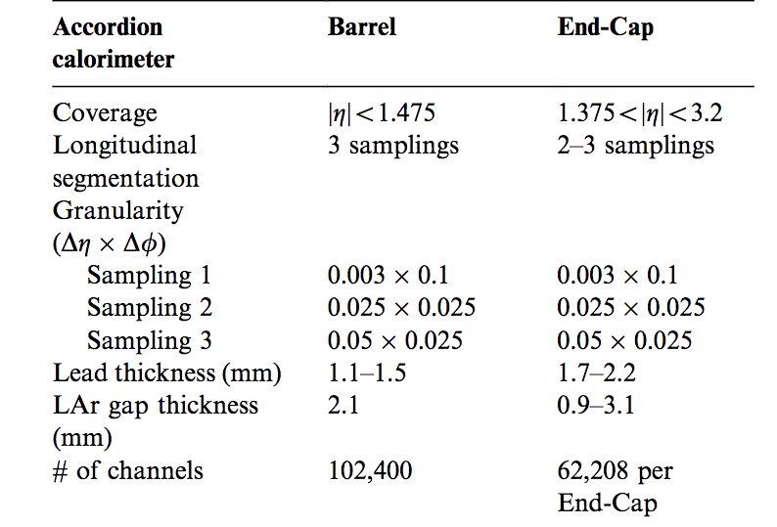
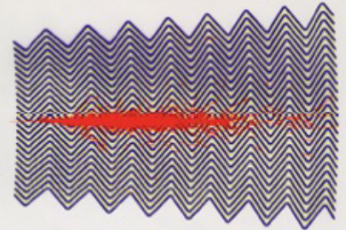
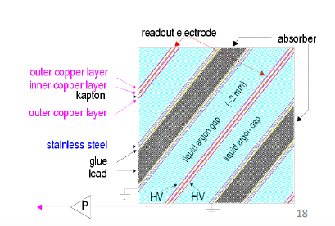
ATLAS LAr EM Calorimeter
Copper/kapton strip electrodes
Honeycomb spacer
Lead absorber plates
1 GeV energy deposit produces 5x10⁶ e⁻s
~450 ns drift time for 2.1 mm gap
Notes:
Accordian structure chosen to ensure azimuthal uniformity (no cracks. LAr for rad hardness, segmentation and speed 450 ns drift time, but read out only first 50 ns of signal, use peak height

Slide 12
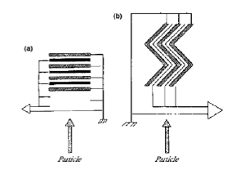
ATLAS LAr EM Calorimeter
Homework:
This ECAL has a 2.1 mm layer of LAr and 1.1-1.5 mm layer of absorber. If the LAr were replaced with plastic scintillator of the same thickness, how would the performance be affected?
~450 ns drift time (total charge collection time) is slow compared to the 50 ns (?) between bunch crossings at the LHC
How did ATLAS handle this?
What cost, if any, did their solution have?
What was the charge collection time for the NA48
LKr calo (1 cm gap) and was that an issue or not?
Why the crazy accordion geometry (b) instead of a
simpler geometry like (a) ?
Find at least two reasons.
Copper/kapton strip electrodes
Honeycomb spacer
Lead absorber plates
1 GeV energy deposit produces 5x10⁶ e⁻s
~450 ns drift time for 2.1 mm gap
Notes:
Accordian structure chosen to ensure azimuthal uniformity (no cracks. LAr for rad hardness, segmentation and speed 450 ns drift time, but read out only first 50 ns of signal, use peak height

Slide 13
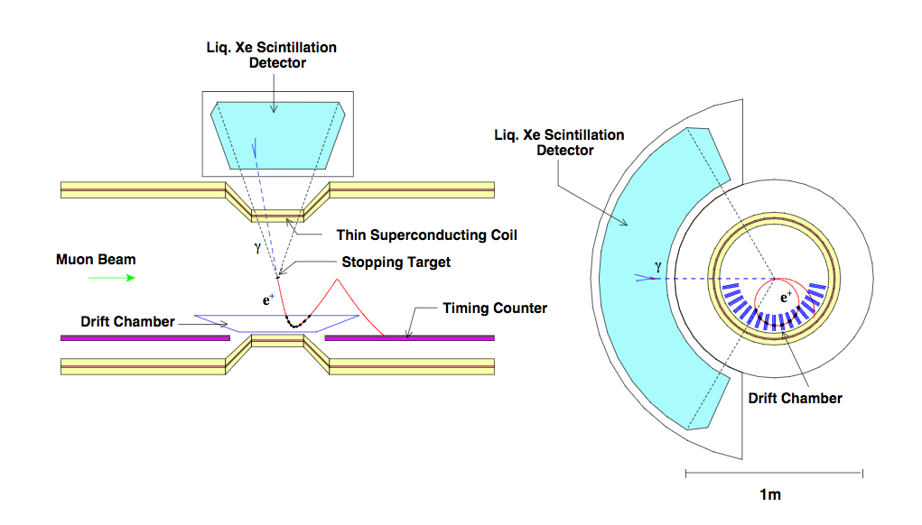
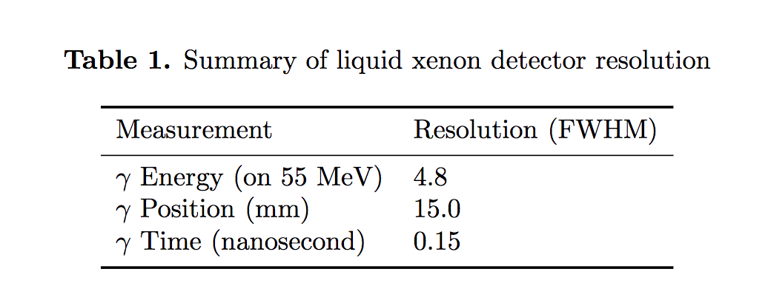
MEG – Search for μ->e+γ (decay at rest CLFV)
52.8 MeV photon back to back with 52.8 MeV positron. Backgrounds from accidental photon on top of normal muon decay. Requires precise measurement of 4-vector of photon plus timing.
Eur Phys J. C 76 434 (2016)
Homogeneous EM calorimeter:
900 liters (2.7 tons) of LXe
Measures light only (no field) with 846 2” PMTs on the inner surface.
Why LXe?
High light output
Fast timing
Short radiation length
175 nm VUV light
Notes:
40 cm thick

Slide 14
Where are these detectors in use today?
High energy calorimeters MeV-TeV
Neutrino beams ~0.1-10 GeV
Direct detection of dark matter keV
Neutrino-less double beta decay searches
. . And many more
Neutrino Energy Spectrum
M. Messier
Notes:
Order by energy of detected particles

Slide 15
Acclerator Beam Neutrino Detectors
The detector IS the target: neutrino cross section are tiny.
SBN: “short-baseline” - 1 neutrino interaction every 10-600 beam spills depending on detector size and distance from the target. O(100) ton detectors
DUNE: ~5 neutrino events per day in 40 kTon LAr at 1300 km baseline and 4850 feet deep
Neutrino beam energy ~0.5-10 GeV
Golden channel: CCQE ν_{l}+n->l+p (nuclear effects add hadrons, neutrons)
Single phase and dual phase LAr time projection chambers (TPC).
Image the event to select neutrino interactions (topology)

Slide 16
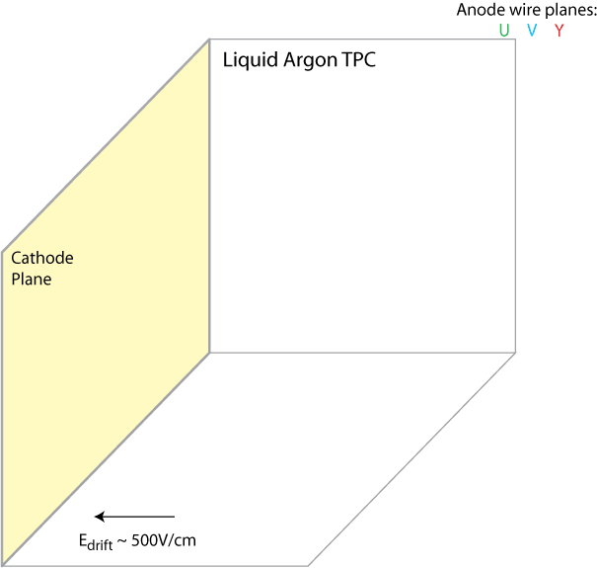
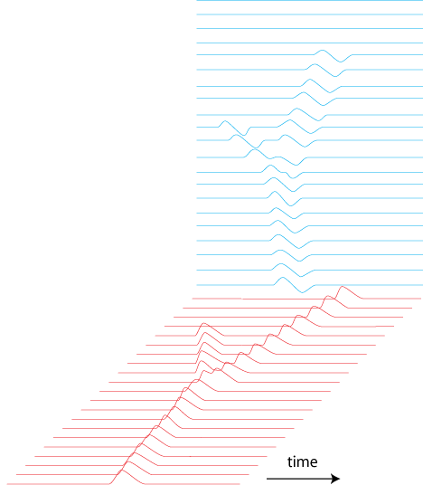
How does a single phase LarTPC work . . . .
Bubble Chamber (1964)
Anode Wire Planes
U V Y
V
Energy loss by charged particles:
Ionization and Excitation of Ar
Prompt light emission by Ar₂⁺ starts clock
Electrons drift to anode
(Ar⁺ ions drift to cathode)
Moving electrons induce currents on wires
Tracks are reconstructed from wire signals
PMT
Y
t₀

Slide 17
Cheat

Slide 18
TPC basics
Tracker that also does calorimetry. “Pixelized” charge collection
Two dimensional anode. Third dimension is measured by charge arrival time, therefore an independent measurement of “interaction time” or t₀ is needed
Neutrino beam gate
Scintillation light
In old-fashioned photography terms: TPCs require a long exposure to capture the image of an instantaneous neutrino event
Example: MicroBooNE “exposure time” is 2.6 ms: drift distance is 2.56 m and electron drift velocity is ~1 m/ms at 273 V/cm.
Cosmic rays and radiological decays (e.g. ³⁹Ar) will photobomb your beautiful image many times over.

Slide 19
Notes:
2 min here – explain event display: time vs wire number

Slide 20
Credit: M. Toups

Slide 21
Detectors past, present and future
 |  | Approximate active volume | 2006-2010 | 2011-2015 | 2016-2020 | 2020- beyond
ICARUS | Pavia/Gran Sasso/FNAL | 480 ton
ArgoNeuT/LArIAT | FNAL | small
35ton | FNAL | 30 ton
MicroBooNE | FNAL BNB | 70 ton
mini-Captain | LANL neutron beam | 1700 liters
1x1x3 WA105 DP | CERN NP | 30? ton
protoDUNE SP | CERN NP | 300 ton
protoDUNE DP | CERN NP | 300 ton
SBND | FNAL BNB | 112 ton
DUNE (SP+DP) | FNAL/SD | 4*10 kTon 60mX12mX15m
Neutrino beam
Cosmic Rays
Test beam

Slide 22
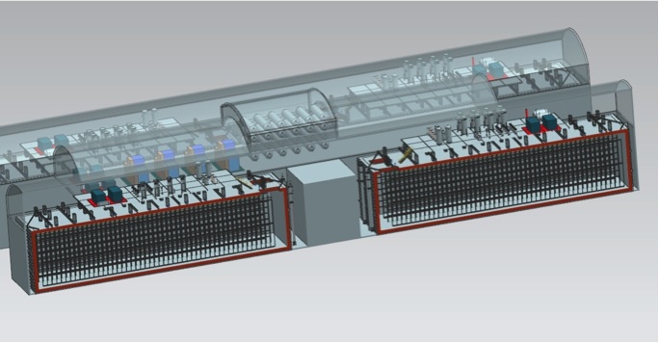
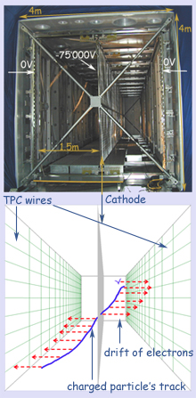
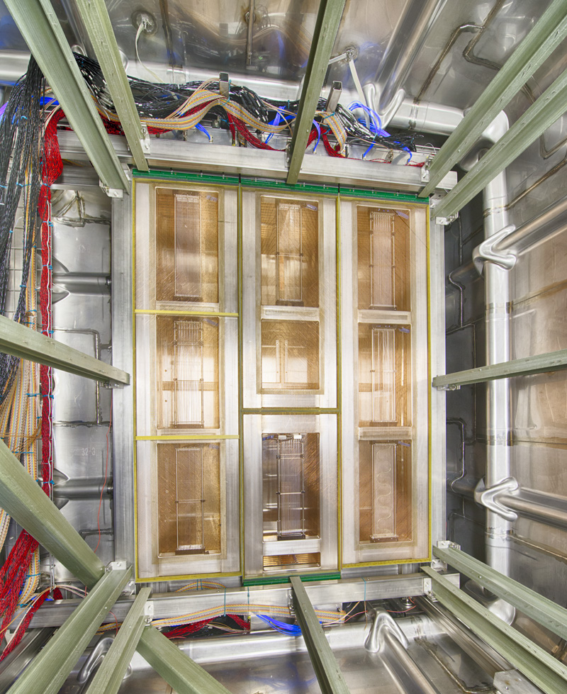
Some photos . . .
60 m
DUNE: 2025-2040?
4850 feet underground
4*10 kTon active volume
1300 km from target

Slide 23
What about scintillation light?
A little scintillation light can provide the interaction time for non-beam events (remember the third coordinate needs t0).
Those we wish to study: supernova neutrinos, atmospheric neutrinos, proton decay
And those we wish to reject: cosmic ray events masquerading as neutrino events, radiological backgrounds like ³⁹Ar
Active R&D on shifting from VUV to higher wavelengths more efficiently AND collecting and focusing this light onto the photocathodes.
A lot of scintillation light can improve the energy measurement BUT these are huge detectors
The photocathode coverage required is prohibitive (cost and channels)
Rayleigh scattering defocuses the light image, nitrogen impurities absorb it, most surfaces absorb the VUV light.
In other words, it’s easy to measure when the light appeared, but extremely difficult to measure enough light for calorimetry in massive detectors

Slide 24
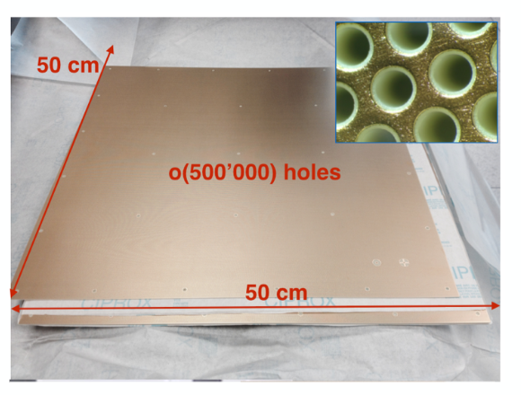
Dual phase TPC
DUNE/WA105 3x1x1 prototype
Drift “upwards” toward gas layer at the top
Amplify signals with LEM
Readout strips on anode
Notes:
Signal amplification and accessible readout electronics. Small it works well, scaling up is the challenge.

Slide 25
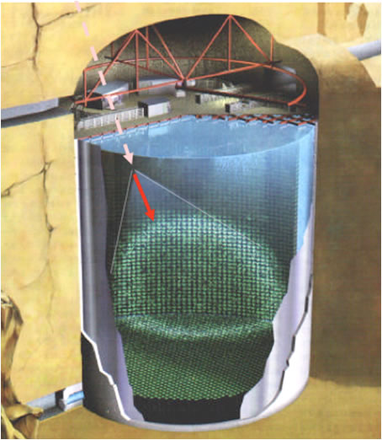
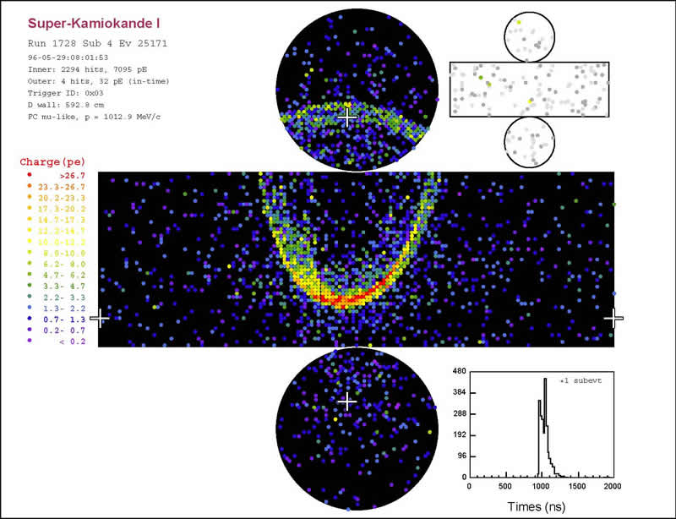
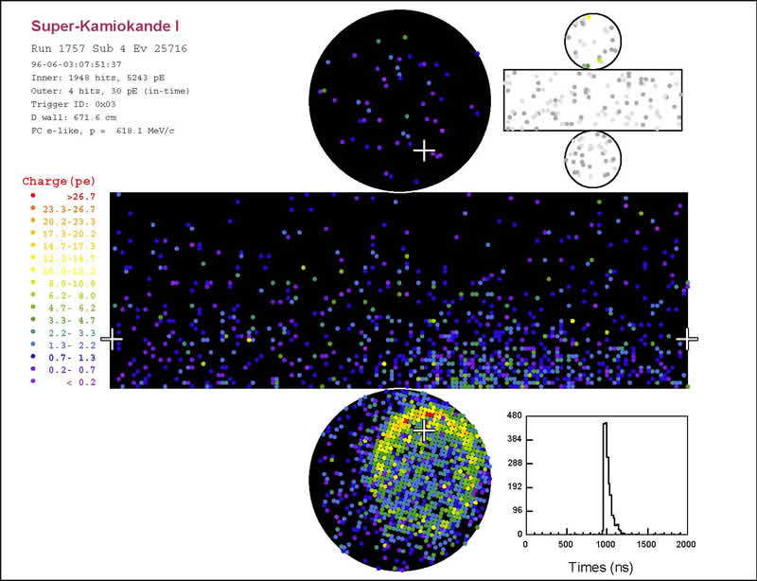
Competing technology – Water Cerenkov (SuperK)

Slide 26
Technology comparison (incomplete)
LArTPC advantages
Higher density
Lower thresholds for electron detection
Potentially better π⁰ rejection
Sensitive to kaon channels for proton decay searches
Can detect protons and pions in the final state
Water Cerenkov advantages
Nuclear effects are smaller
Fast detector response
Mature detector technology
Smaller data volume per event
Notes:
Smaller data volume is fewer channels and fast detector response

Slide 27
Where are these detectors in use today?
High energy calorimeters MeV-TeV
Neutrino beams ~0.1-10 GeV
Direct detection of dark matter keV
Neutrino-less double beta decay searches
. . And many more
Neutrino Energy Spectrum
M. Messier
Notes:
Order by energy of detected particles

Slide 28
Review of Particle Physics
Section 27 – Dark Matter
Chin. Phys. C,40, 100001 (2016), rev 2017
WIMP (dark matter) searches
Notes:
To push down, need to reduce backgrounds, increase volume, and increase exposure. To push left, need to lower detection thresholds. Liquid nobles are constrained to the right . . .

Slide 29
Review of Particle Physics
Section 27 – Dark Matter
Chin. Phys. C,40, 100001 (2016), rev 2017
WIMP (dark matter) searches
Homework . . . .
Covering the lower WIMP masses requires a different technology.
Research the basic principles for the proposed detectors for these experiments
PICO250-C3F8
SuperCDMS
How did CDMSlite already push into this lower mass region?
Notes:
To push down, need to reduce backgrounds, increase volume, and increase exposure. To push left, need to lower detection thresholds. Liquid nobles are constrained to the right . . .

Slide 30
Review of Particle Physics
Section 27 – Dark Matter
Chin. Phys. C,40, 100001 (2016), rev 2017
WIMP (dark matter) searches
Notes:
To push down, need to reduce backgrounds. To push left, need to lower detection thresholds. Liquid nobles are constrained to the right . . .

Slide 31
New DarkSide 50 result
arXiv:1802.07198v1
Feb 20, 2018
532.4 days with underground argon, factor of 1400 reduction in ³⁹Ar contamination

Slide 32
Dark Matter detectors in one slide
Rejecting backgrounds is the game:
All located deep underground
All are surrounded by shielding and active veto
All exploit the timing of the scintillation light
Contamination in the liquid nobles: ³⁹Ar and ⁸⁵Kr. Developing ever better methods of removing Kr before filling vessel. Underground Ar has very little if any ³⁹Ar
Dual phase TPCs: Dark Side-50 (50 kg UAr, LGNS), LUX/LZ (370 kg Xe, SURF), Xenon1T(1000 kg Xe, LNGS), and PANDAX-II(500 kg, CJPL)
“Just light, no charge” – DEAP-3600 (3600 kg Ar, SNOLAB), XMASS (835 kg Xe, Kamioka) The DM community calls this “single-phase”, very confusing ;)
Note 1000 kg=1 metric ton

Slide 33
LZ experiment under construction at SURF
Notes:
1.5m diameter, 1.5 m height, 50 kV on cathode, 310 V/cm drift field

Slide 34
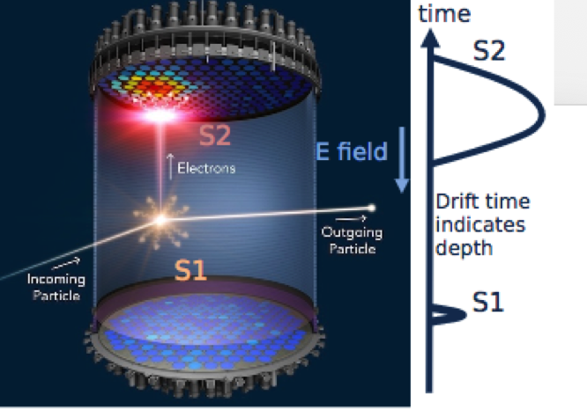
Dual phase TPCs
Best resolution on nuclear recoil energy, and thus the WIMP mass, would come from light-only-no-field.
However, the ratio of the charge and light production (S2/S1) is a good variable for rejecting many backgrounds because “electron recoil” interactions generate more light and less charge than “nuclear recoil” interactions.
Graphic from LZ
Notes:
Give credit. Simulation or data in scatter plot?? WHY is the ratio different for nuclear recoil vs electron recoil?
1.5m diameter, 1.5 m height, 50 kV on cathode, 310 V/cm drift field 10.2 kV/cm e-lum field, 11.5 kV voltage difference.

Slide 35
Scintillation light in Argon (Xenon similar)
S2: Delayed electroluminescence signal from ionization charge
S1-singlet: “fast” or “prompt” light
S1-triplet: “slow” or “late” light
Notes:
Excited atoms and ionized molecules 25% prompt 75% slow

Slide 36
DEAP-3600
3.6 tons of LAr underground at SNOLAB
Spherical shaped vessel, inner surface coated with TPB to shift VUV to visible blue light. 255 8″ PMTs at the end of light guides
Use the ratio of prompt (6ns) and late (1300 ns) light to reject electron recoil backgrounds including ³⁹Ar decays
DEAP-50ton proposed 2nd generation
Notes:
More prompt charge for nuclear recoil

Slide 37
DEAP-3600
3.6 tons of LAr underground at SNOLAB
Spherical shaped vessel, inner surface coated with TPB to shift VUV to visible blue light. 255 8″ PMTs at the end of light guides
Use the ratio of prompt (6ns) and late (1300 ns) light to reject electron recoil backgrounds including ³⁹Ar decays
DEAP-50ton proposed 2nd generation
There is also a LXe version of “light-only-no-charge” or “single phase” called XMASS at Kamioka
Notes:
More prompt charge for nuclear recoil

Slide 38
Homework
What kind of backgrounds are rejected by the layers of veto and shielding?
Both the LUX/LZ series of experiments and the Xenon-100/1T/nT/DARWIN series of experiments are dual phase LXeTPCs deep underground.
What is done differently between the two?
Which has produced better limits to date and why?
How does DarkSide obtain the underground argon? What are the main contaminants and how are they removed?
XMASS is a single phase “light-only” LXe detector that searched for DM 2013-2015 by studying the annual modulation caused by the earth’s rotation around the sun. How big is this modulation expected to be?

Slide 39
Where are these detectors in use today?
High energy calorimeters MeV-TeV
Neutrino beams ~0.1-10 GeV
Direct detection of dark matter keV
Neutrino-less double beta decay searches
. . And many more
Neutrino Energy Spectrum
M. Messier
Notes:
Order by energy of detected particles

Slide 40
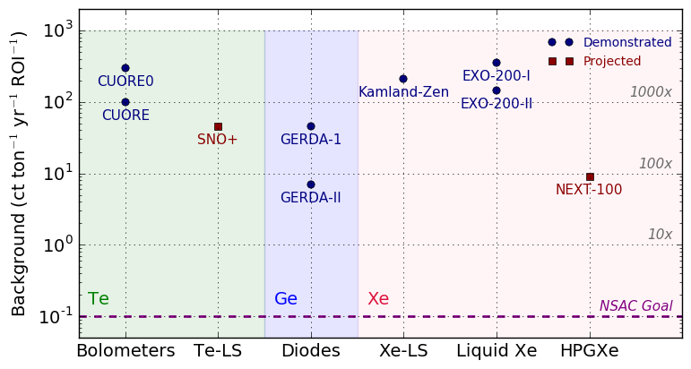
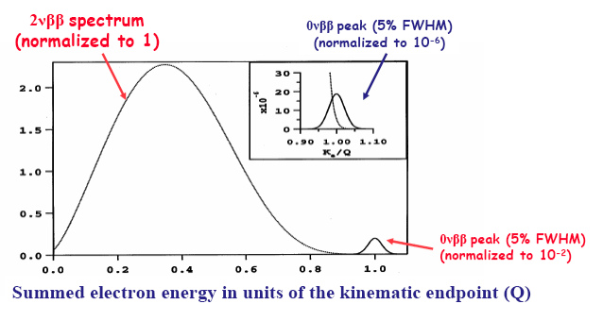
Neutrinoless Double Beta Decay Searches (0νββ)
Carefully select candidate isotope with high Q value to stay above gamma lines from naturally-occurring radioactive isotopes like uranium
Requires precise energy resolution to reject 2 neutrino mode
Requires very low background rates to push limits lower. (<0.1 count per ton per year in ROI). Precise timing resolution reduces ROI width.

Slide 41
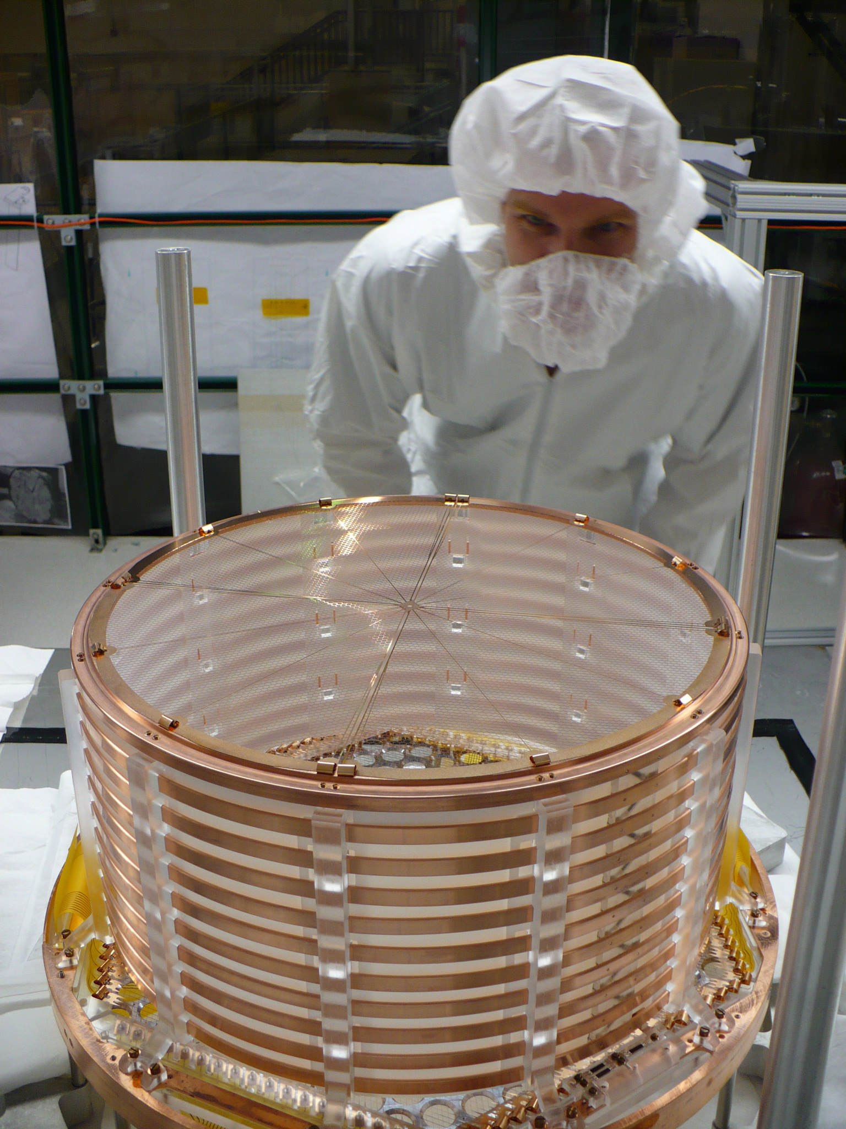
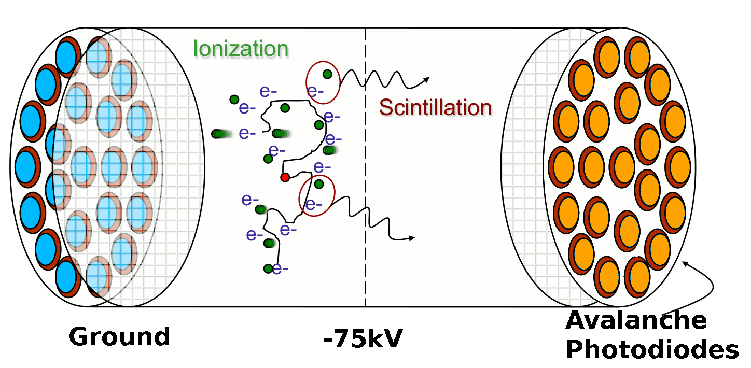
EXO-200 experiment
Single phase TPC with wire readout and APDs to detect scintillation light.
200 kg of LXe, enriched to 80% ¹³⁶Xe content. (Q=2.6 MeV)
Started running in 2016 in Carlsbad NM 1600 m underground
Use special resolution (~1cm) to reject gamma backgrounds which have multiple spatially-separated energy deposits
Next generation “tonne-scale” being discussed.
Two drift volumes ~18 cm diameter and ~20 cm drift length each
-12 kV

Slide 42
Basics in one slide
Noble liquids provide a large homogeneous detector volume with high density.
Energy deposited by charged particles through ionization is ”visible” as a combination of free charge and scintillation light.
How much of each depends on the electric field. No field, no charge.
Light is fast, charge is slow. Both wander as they travel.
Impurities are bad: nitrogen, water and oxygen. They absorb photons and electrons.
Scintillation light has VUV wavelength, thus it is challenging to collect and to detect efficiently.
Neutrino Oscillations: Large TPCs rely on imaging to classify neutrino interactions and reject backgrounds. Calorimetry for neutrino energy. Timing (light) to reject bkgds.
Detecting sufficient light for timing is challenging in a large detector without breaking the budget, but looks achievable
DM and 0νββ : Combine light and charge to lower detection thresholds and improve energy resolution. Background rejection is critical, and results in slightly different detector designs for each physics.

Slide 43
Backups

Slide 44
Charge collection is painfully slow
Think of one gas diffusing in another.
The free electrons thermalize to the low temperature and are pulled toward the anode by the electric field.
Thermal velocity of electrons: 1/2kT=1/2mv2 –> v=xx m/s
Drift velocity = 1.6 m/ms at E=500 V/m
2m of drift, diff smearing FWHM = 2sigma
Example:
Spacial resolution is limited to ~3 mm wire spacing both by diffusion and S/N
Purity is very important

Slide 45
Boiling point (K) @ 1 atm | 4.2 | 27.1 | 87.3 | 120.0 | 165.0
Density (g/cm³) | 0.125 | 1.2 | 1.4 | 2.4 | 3.0
Radiation length (cm) | 755.2 | 24.0 | 14.0 | 4.9 | 2.8
dE/dx (MeV/cm) | 0.24 | 1.4 | 2.1 | 3.0 | 3.8
Scintillation (photons/MeV) | 19,000 | 30,000 | 40,000 | 25,000 | 42,000
Scintillation wavelength(nm) | 80 | 78 | 128 | 150 | 175
ppm in air | 0 | 12 | 9500 | 1 | 0.1
Notes:
W-value for ionization/scintillation. Ar 19.5 and 23.6

Slide 47
Places we find noble liquid detectors
Hadron Collider experiments GeV-TeV particles
LFV searches in the muon sector 50 MeV photons
Neutrino Beam Experiments 100 MeV-GeV leptons
Direct detection of dark matter 1-50 keV nuclear recoil
Neutrino-less double beta decay searches 1 MeV electrons
Notes:
Order by energy of detected particles

Slide 48
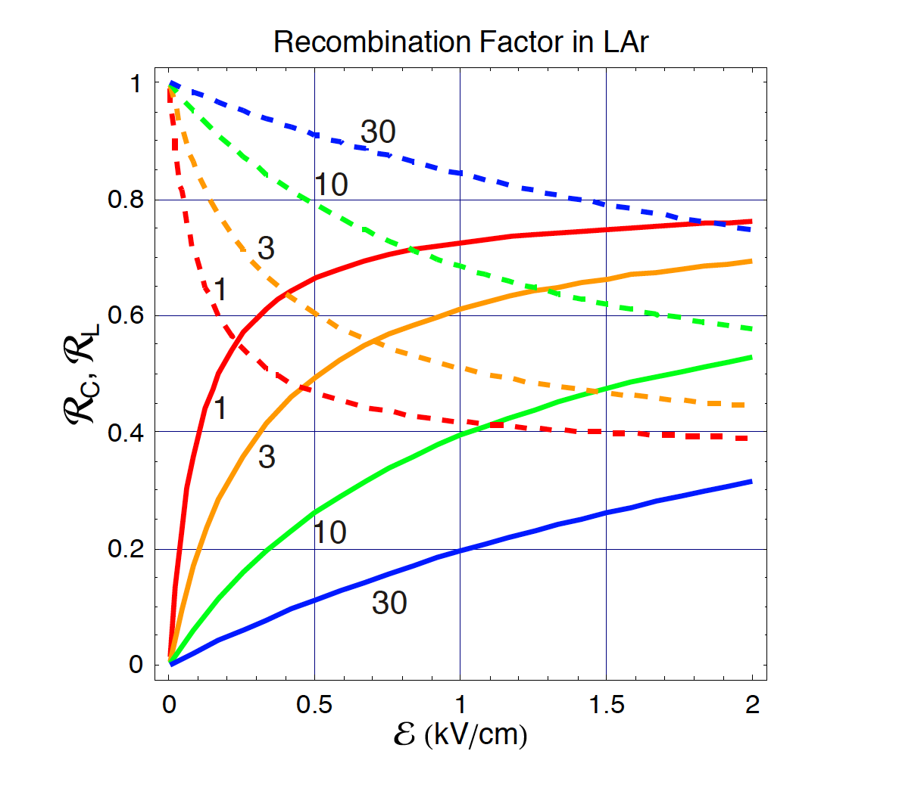
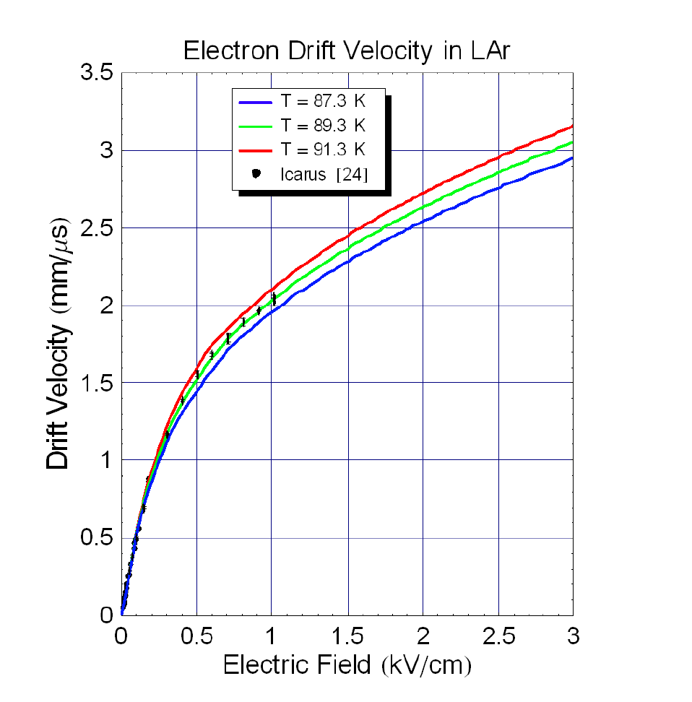
Everything depends on the Electric field
Light for 1 MIP deposit
Charge for 1 MIP deposit
Notes:
Backto the basic – collection charge from ionization. Without field, those ions and electrons will recombine.

Slide 49
Why is charge collection painfully slow?
Think of one gas diffusing in another – it is more of a random walk to the anode than a straight arrow.
The free electrons thermalize to the low temperature (88K) and are pulled toward the anode by the electric field between random walk collisions with Ar atoms.
HOMEWORK:
Calculate the thermal velocity of electrons at LAr temperature (88K). Compare with the drift velocity of 1.6 m/ms at 500 V/cm
Diffusion spreads out the electrons that originate at a single point. 1 m of drift is a spread of xx mm transversely and xx mm longitudinally (both FWHM)
Spatial resolution is limited to ~3 mm wire spacing (single phase) both by diffusion and S/N considerations.
Probability for an electron to be absorbed by an impurity depends on the concentration of impurities (aim for < 100 ppt) AND the drift time.

