Slide 1
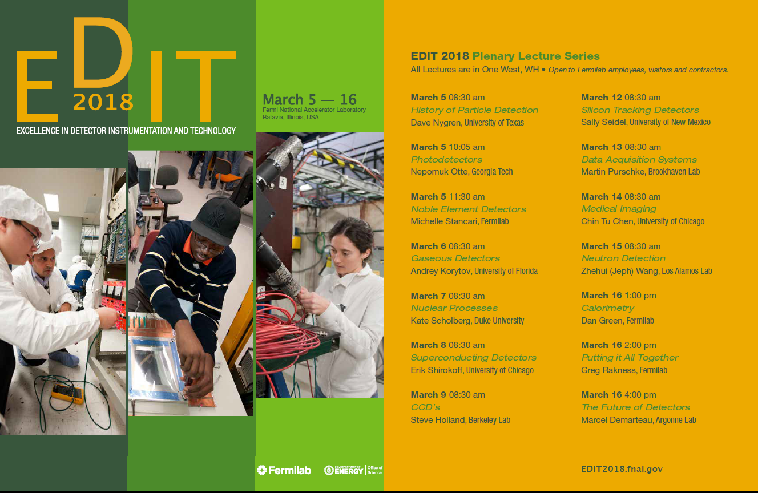
Charge-Coupled Devices
Steve Holland / Lawrence Berkeley National Laboratory

Slide 2
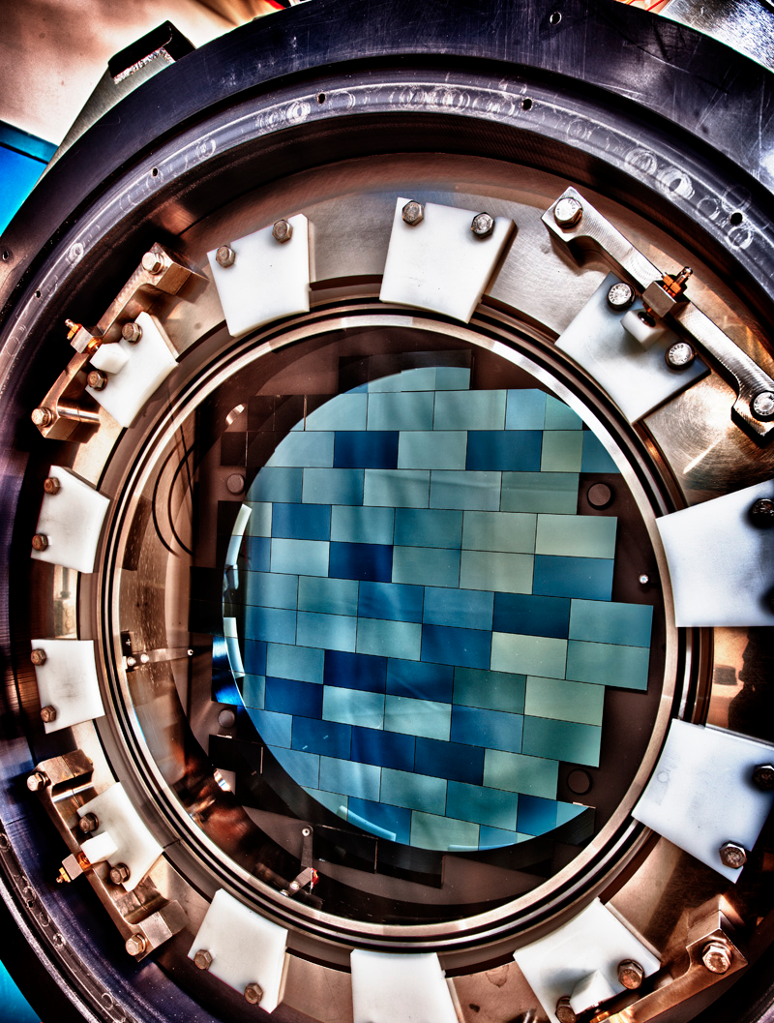
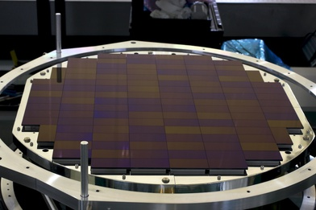
Examples of astronomical CCD cameras
520 Mpixels
870 Mpixels
HyperSuprimeCam – 116 2k x 4k, (15 µm)²-pixel CCDs
CCDs from Hamamatsu Corporation
Subaru 8-m Telescope
FermiLab Dark Energy Survey Camera (DECam)
62 2k x 4k, (15 µm)²-pixel CCDs
CCDs from DALSA Semiconductor / LBNL
NOAO Cerro Tololo Blanco 4-m Telescope
Both use fully depleted CCDs, and have been operating since 2012

Slide 3
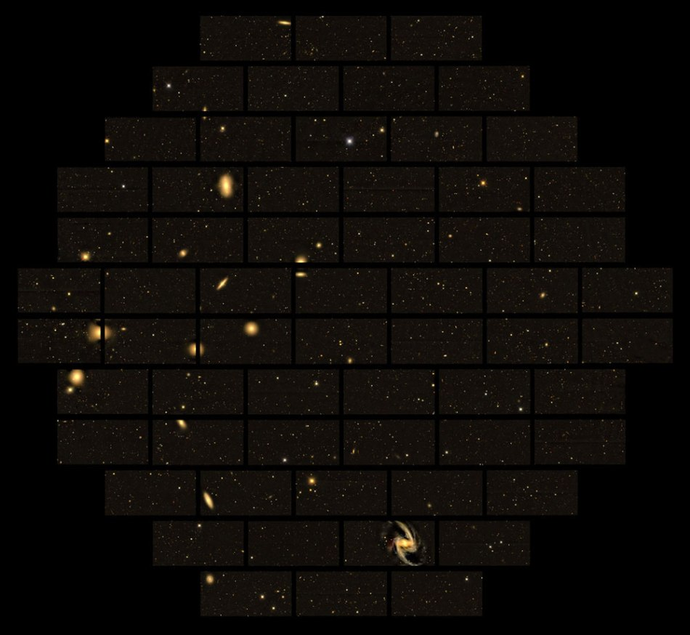
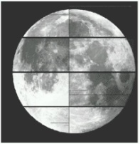
Astronomical cameras with fully depleted CCDs
Full moon for scale
FermiLab Dark Energy Survey Camera (DECam)
62 2k x 4k, (15 µm)²-pixel CCDs (520 Mpixels)
CCDs from DALSA Semiconductor / LBNL

Slide 4
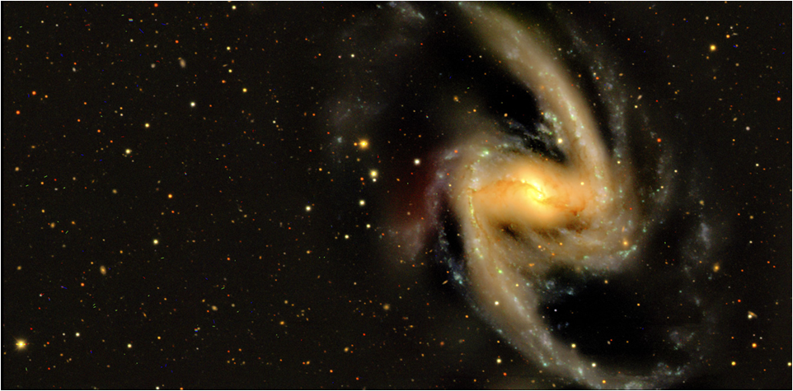
Astronomical cameras with fully depleted CCDs
Full moon for scale
Roughly 50k galaxies per image
~ Goal is 300M galaxies studied during the Dark Energy Survey
FermiLab Dark Energy Survey Camera (DECam)
62 2k x 4k, (15 µm)²-pixel CCDs (520 Mpixels)
CCDs from DALSA Semiconductor / LBNL

Slide 5
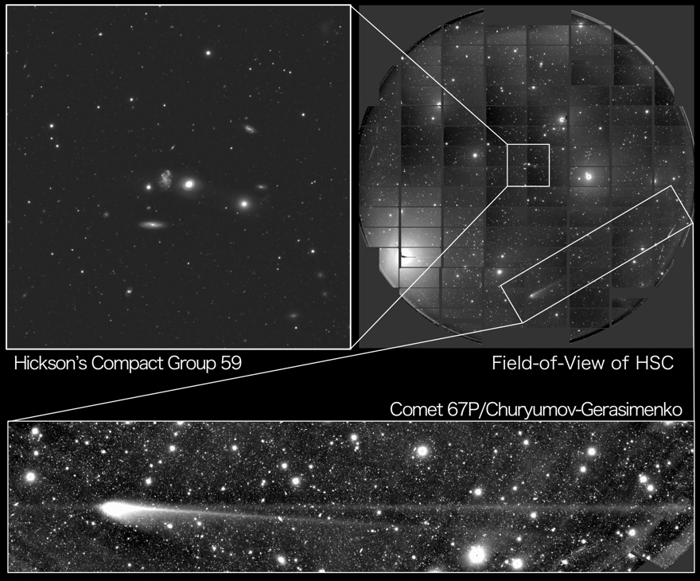
Astronomical cameras with fully depleted CCDs
Full moon for scale
HyperSuprimeCam – 116 2k x 4k, (15 µm)²-pixel CCDs (870 Mpixels)
CCDs from Hamamatsu Corporation / Subaru 8-m Telescope
http://subarutelescope.org/Topics/2016/05/12/

Slide 6
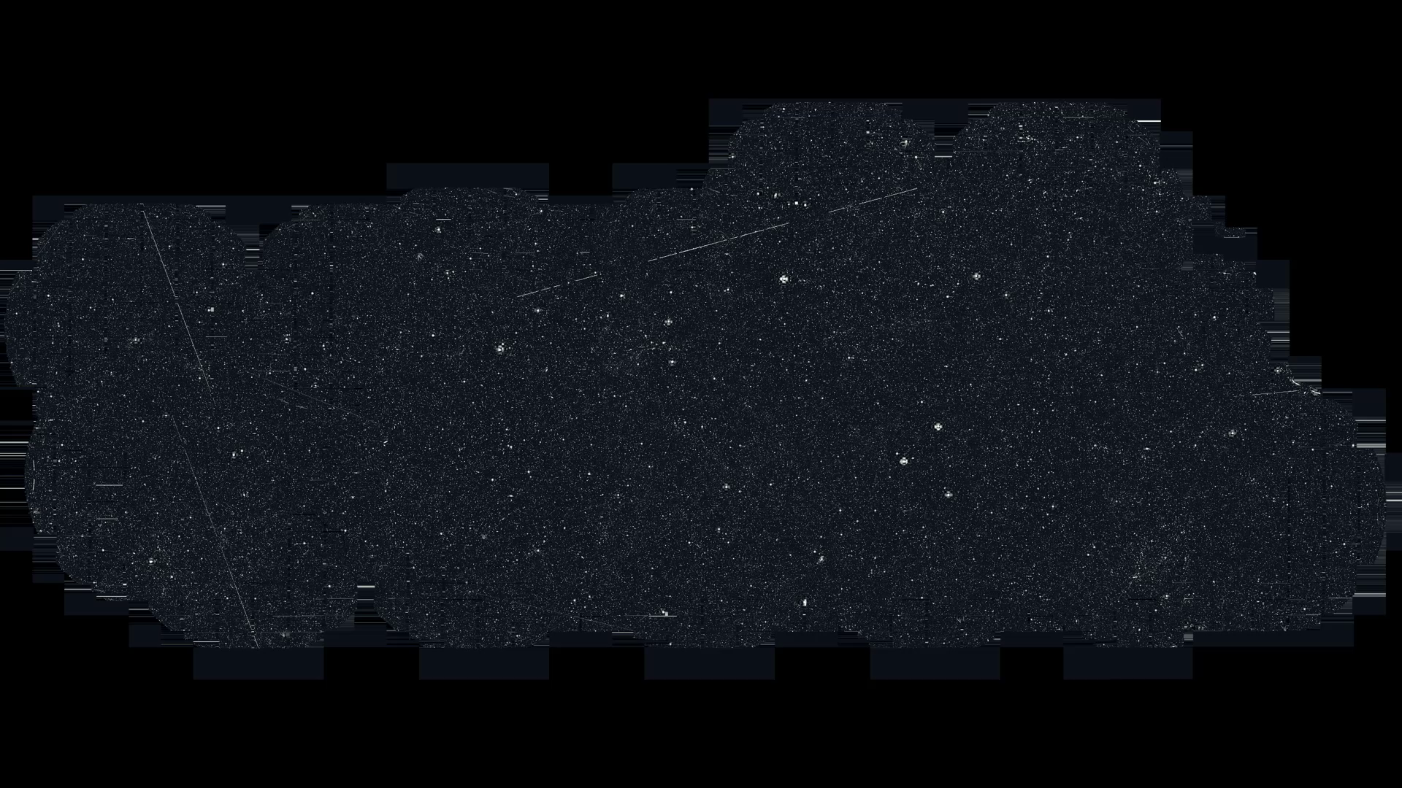
Astronomical cameras with fully depleted CCDs
HyperSuprimeCam – 8 degrees x 3 degrees field of view
Video courtesy of Satoshi Miyazaki / Subaru Telescope

Slide 7
DESI CCDs (in production)
DESI CCDs are 16 Mpixel imagers with
  Dark currents at -140C of about ~1 e-/pixel-hr (limited by 300K blackbody radiation)
  Noise levels approaching 1 e- rms at slow readout speeds
  PSF ~ 4 – 5 μm rms
  150 mm wafers
    DALSA Semiconductor
    Finishing at LBNL
DESI: Dark Energy Spectroscopic Instrument

Slide 8
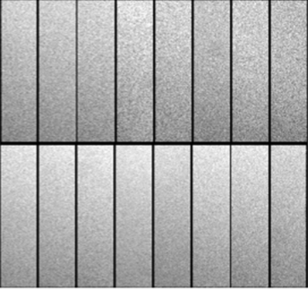
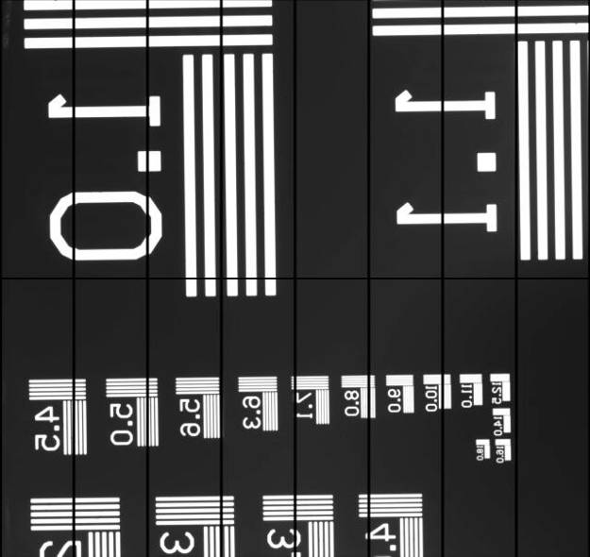
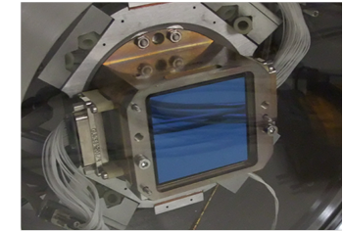
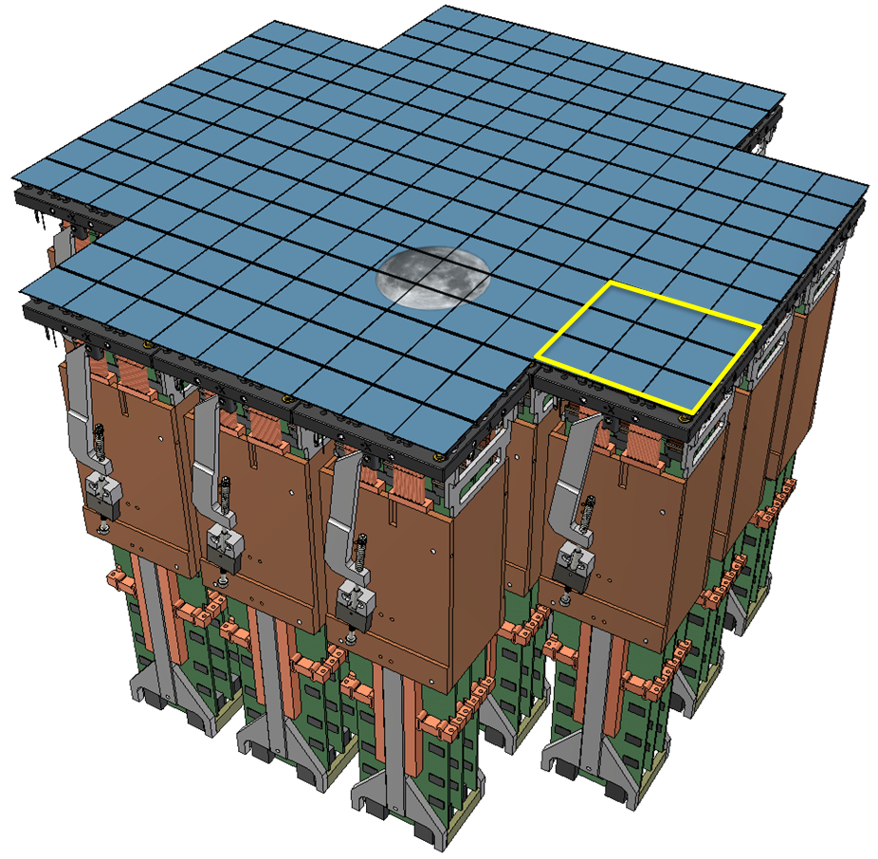
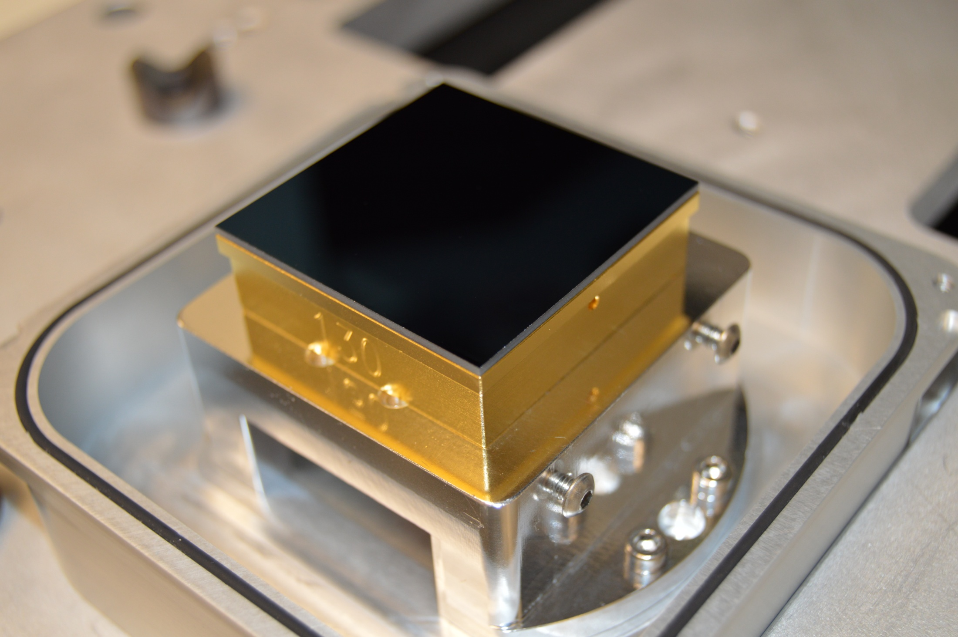
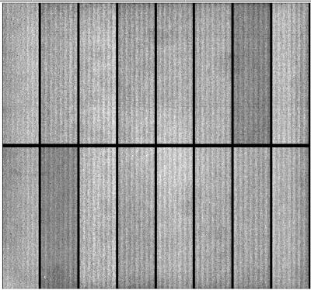
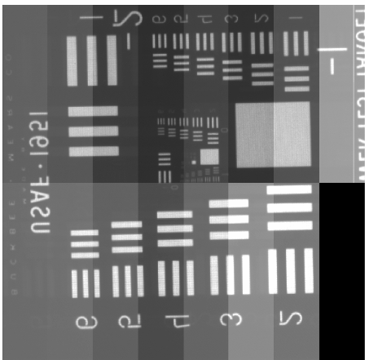
LSST CCDs (in production)
CCD in test fixture
Uniform illumination
Test target image
100 μm thick
Fully depleted
4k x 4k
10 μm pixels
16 amplifiers
189 CCDs
3.2 Gpixels
T-E2v CCD250
T-DALSA/ITL STA3800C
Courtesy of Paul O’Connor of Brookhaven National Laboratory

Slide 9
Invention (Innovation meets need)
Brief history of the CCD follows as well as innovations from the early era (1970’s) that have led to where we are today
  CCD invention
  Polysilicon gate electrodes
  Correlated double sampling

Slide 10
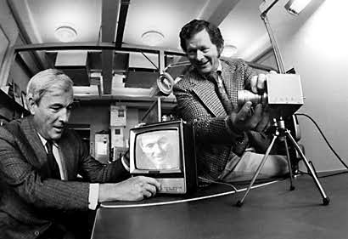
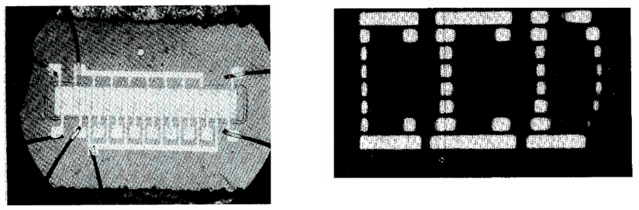
Invention (Innovation meets need)
Invented by Boyle and Smith (Bell Laboratories) on September 8th, 1969 (Nobel Prize in Physics 2009)
Tasked to find a semiconductor analogy to the magnetic “bubble memory”
The basic concepts were conceived in a discussion session between Boyle and Smith “lasting not more than an hour” ^{1,2}
[1] W.S. Boyle and G.E. Smith, “The inception of charge-coupled devices,” IEEE Trans. Elec. Dev., 23, 661, 1976.
[2] G.E. Smith, “The invention of the CCD”, Nucl. Instrum. Meth. A, 471, 1, 2001.

Slide 11
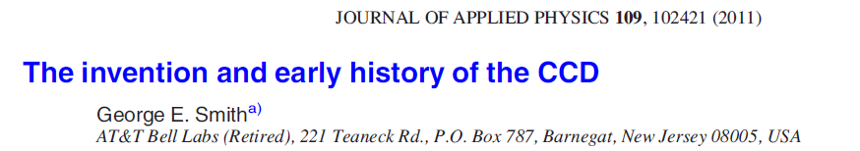
Motivating Innovation
“To understand the atmosphere at the time, one must look at the structure of the Electronics Division at Bell Labs which was under Vice President Jack Morton. This was split into two divisions, one for semiconductor devices and one for all others. Bill Boyle was Executive Director of the semiconductor part and I was a department head under him. Jack Morton was anxious to speed up the development of magnetic bubbles as a major memory technology and there was talk of transferring resources from Bill’s division to the other where the bubble work was being done. For this not to happen, Morton demanded that Bill’s division come up with a semiconductor device to compete with bubbles. To address this demand, on 17 October 1969, Bill and I got together in his office. In a discussion lasting not much more than an hour, the basic structure of the CCD was sketched out on the blackboard, the principles of operation defined, and some preliminary ideas concerning applications were developed.”
http://aip.scitation.org/doi/full/10.1063/1.3578638

Slide 12
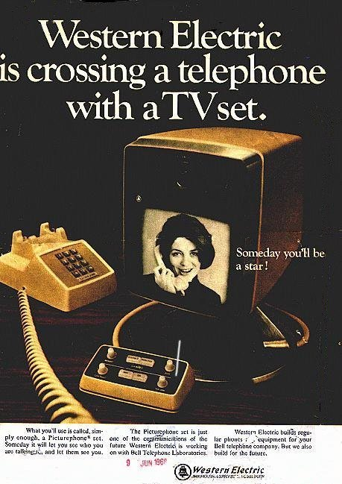

Recollections of Willard Boyle
“Picturephone” (1970’s Facetime) conversation: Jack Morton / Bell Labs VP, W. Boyle
"Boyle?"
"Hello Jack."
"So what happened yesterday?" came the familiar refrain.
Boyle shifted a little more in his chair.
"I can't see you, Bill," said Morton.
"Right here, Jack."
"So what'd you guys do yesterday?"
"You know, more of the same. We're still working on those new transistors," said Boyle.
"Look Bill, the other guys are doing great stuff with magnetic bubbles. It's terrific. What are you semiconductor guys doing? The hell with transistors. Try and come up with something different. I'll call tomorrow." And he hung up.

Slide 13
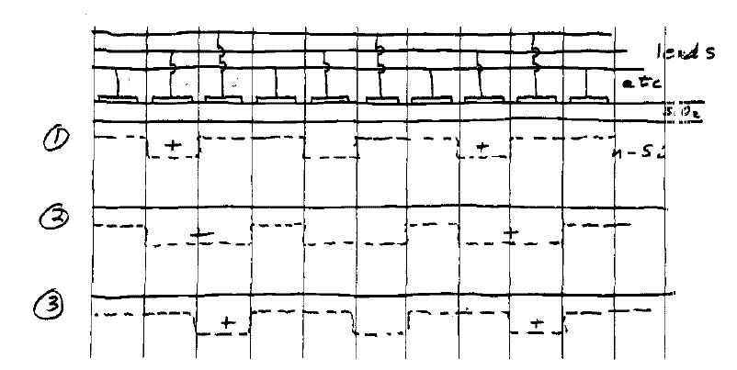
Boyle/Smith notebook entry
Relies on collection, storage and transport of photogenerated electrons or holes in potential wells formed by depletion regions under closely-spaced MOS¹ capacitors
Φ1
Φ2
Φ3
Φ2 low
Φ1 low
Φ2 low
Φ2 high
Φ1 low
3-phase CCD diagram (lab notebook drawing Sept. 1969)
¹Metal oxide semiconductor

Slide 14
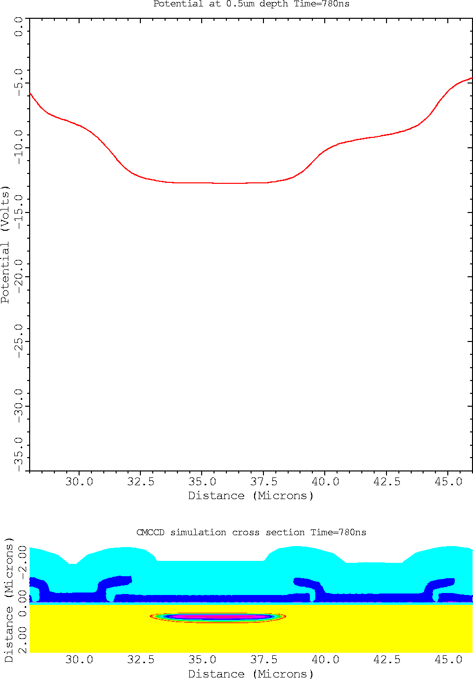
2-D simulation of charge transfer

Slide 15
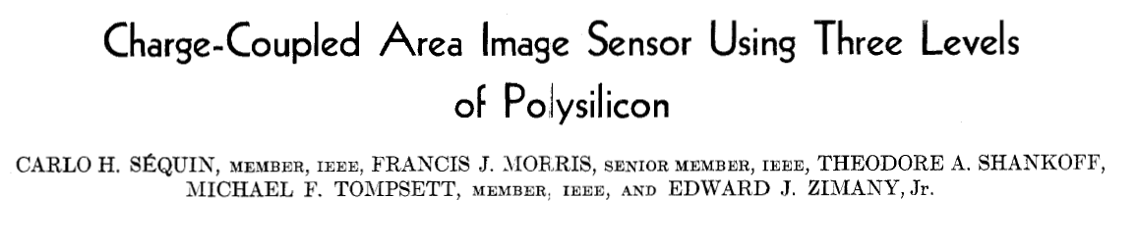
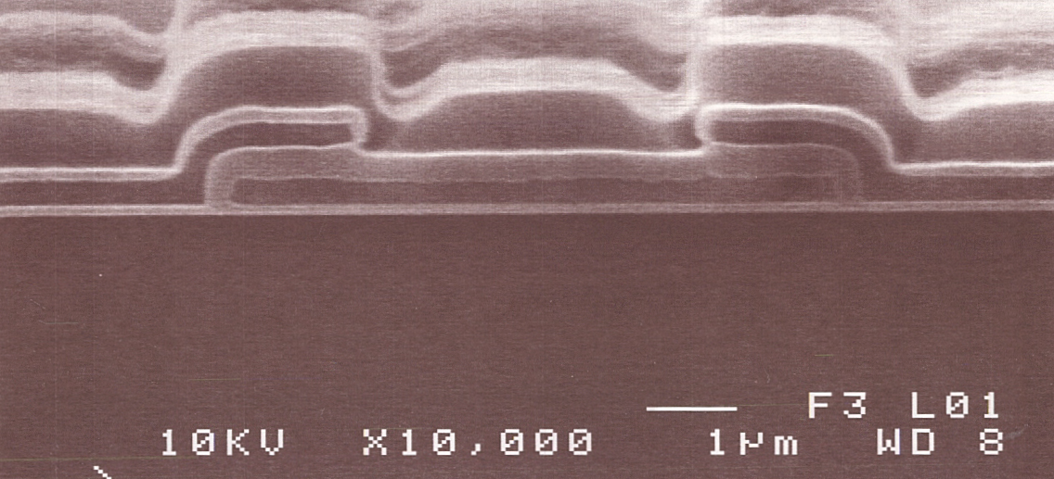
Triple polysilicon CCD pixel
Overlapping polysilicon gates used in modern scientific CCDs
Also invented at Bell Labs
Sequin et al, 1974
Prof. Emeritus UC-Berkeley EECS
Poly 2
Poly 3
Poly 1

Slide 16
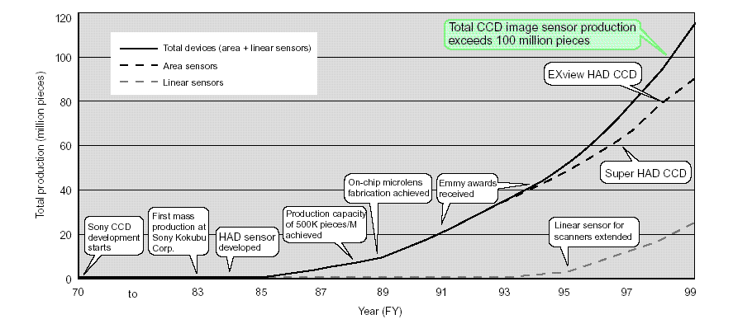
CCD early history
Early adopters of CCDs were Sony (commercial manufacturing) and the Jet Propulsion Laboratory (scientific applications for NASA)
  JPL effort with Texas Instruments for Hubble
Sony CCD production through 1999

Slide 17
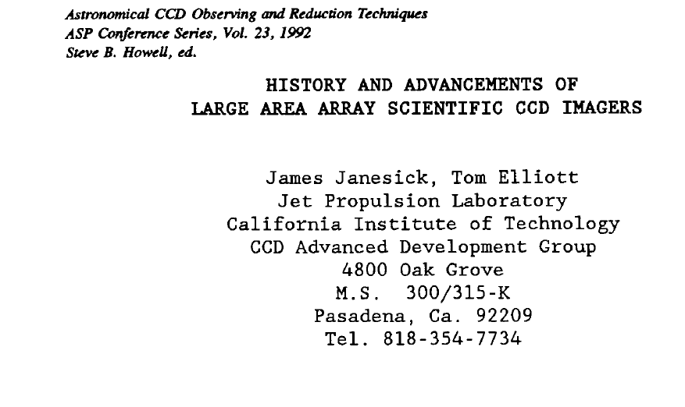
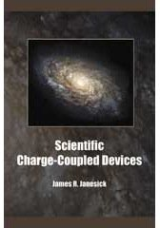
Early CCD development at JPL
Link to book
Link to paper

Slide 18
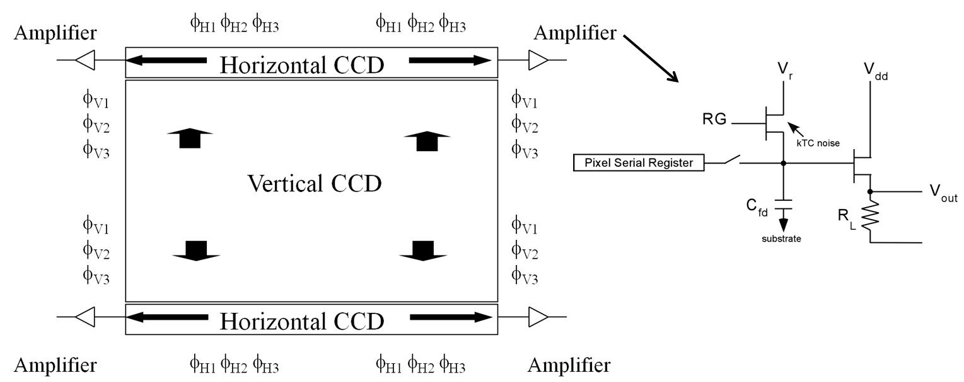
Scientific CCD typical operation
Charge is transferred from the imaging area a row at a time into serial registers where the charge is shifted to source follower amplifiers that convert the charge to voltage (noise determined at this step)
Diode sense node
“Floating diffusion”

Slide 19
Correlated double sampling
Another key invention from the 1970’s:
  Correlated Double Sampling:
  Eliminate kTC noise from the reset switch
10 μV/e- conversion factor implies 15 fF
kTC noise would be about 49 electrons!
Scientific CCDs achieve a few e- noise
  Method:
1) Measure reset level
2) Transfer charge to the sense node
3) Measure signal
4) Subtract reset from signal
¹M.H. White, D.H. McCann, I.A.G. Mack, F.C. Blaha, U.S. Patent 3,781,574, Dec. 1973
Link to patent and paper

Slide 20
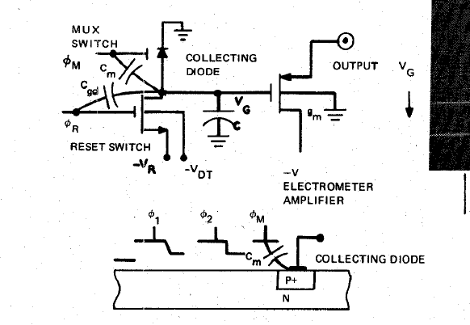
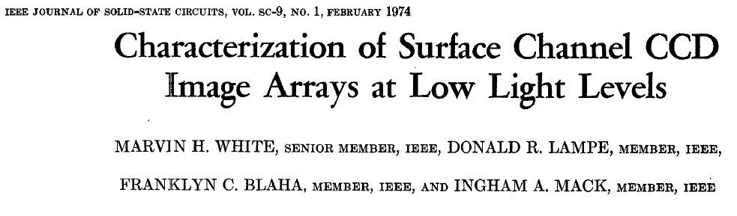
Correlated double sampling
Presently
Ohio State
ECE Prof.

Slide 21
EDIT 2018 CCD talk
Remainder of the talk
  Thinned and fully depleted CCDs
  CCD performance parameters
  Future prospects

Slide 22
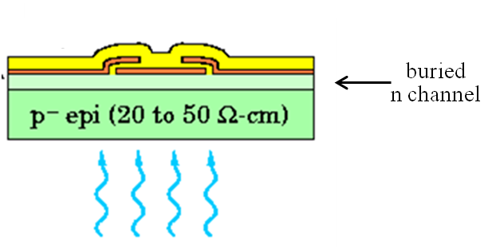
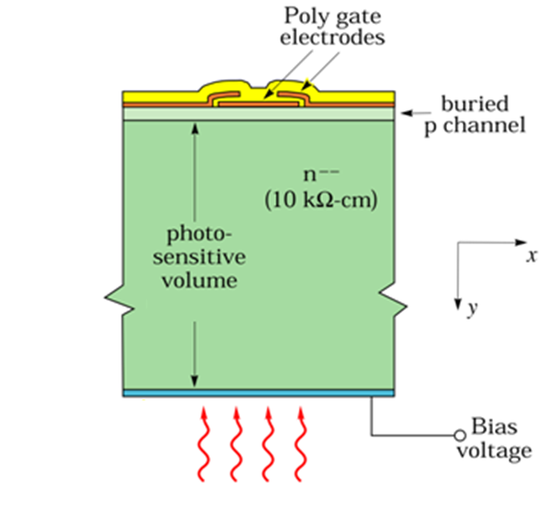
CCDs for Astronomy
Two main types of astronomical CCDs
  Thinned and back-illuminated
    10 – 20 microns thick
  Thick and fully depleted
    250 – 650 microns thick
    Fully depleted with bias voltage
  Spectrographs often use thin CCDs for the blue wavelengths and FD CCDs for the red wavelengths
  Imaging cameras use fully depleted CCDs when red response is important, DECam, HyperSuprime CAM, LSST

Slide 23
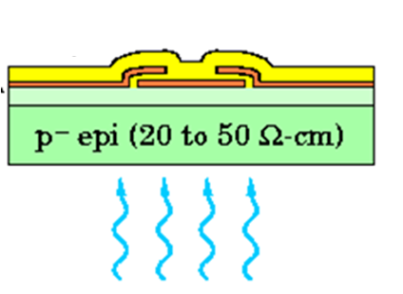
CCDs for Astronomy
Thinned CCDs
  Selective etch stops on the lightly doped epitaxial layer
  Backside treatment for high blue quantum efficiency
  Depletion depth limited by resistivity
    10 – 20 μm typically, “Deep depletion” ~ 50 μm
  Drawbacks include poor QE and fringing at red wavelengths, and possible spatial resolution degradation due to field-free (undepleted) region at the back surface

Slide 24
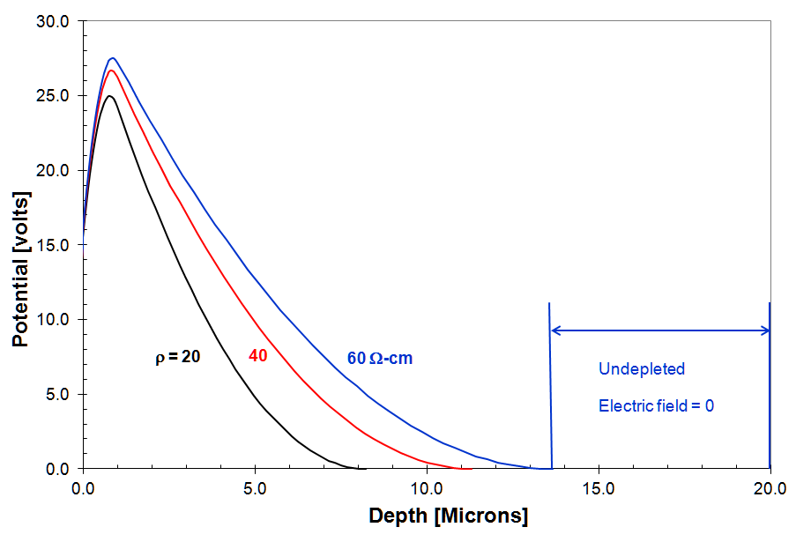
CCDs for Astronomy
Thinned CCDs: Electrostatic potential at surface
  1-D simulation of the Poisson Eq (depletion approx)
Potential maximum some distance into the silicon bulk and away from trapping sites at the surface / due to the buried channel that is doped opposite to that of the substrate

Slide 25
CCDs for Astronomy
Fully depleted CCDs
  Merging of CCD / pin diode from High-Energy Physics
    See Sally Seidel’s talk next week describing HEP tracking detectors based on fully depleted, pin diodes
  Excellent red response due to thickness
  Spatial resolution a tradeoff between thickness and substrate bias voltage
  Drawbacks include long tracks from cosmic rays and background radiation, and exacerbated effects due to lateral electric fields that affect precision measurements

Slide 26
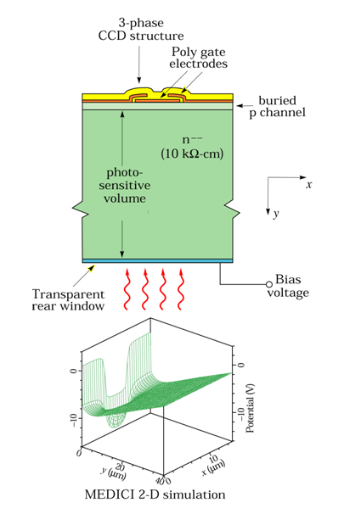
Fully depleted CCDs / 2D simulations
V_{sub} = 80V
V_{sub} = 30V
MEDICI simulations
Potential minimum (collecting phase)

Slide 27
Fully depleted CCDs / 2D simulations
V_{sub} = 80V
V_{sub} = 30V
MEDICI simulations
Potential minimum (collecting phase)
Relatively insensitive to V_{sub}
Wide range of V_{sub} possible
Capacitor voltage divider effect

Slide 28
CCD performance
Key CCD performance parameters
    Quantum efficiency
    Dark current
    Noise

Slide 29
Optical properties of Si / Ge
Absorption in semiconductors
  Si and Ge are indirect gap semiconductors
  Valence band maximum and conduction band minimum do not correspond to the same “crystal” momentum
    Quantum mechanics calculations for an electron in a periodic potential
  For photon energies less than the direct bandgap, phonons (lattice vibrations) are required to conserve momentum
    Inefficient and temperature-dependent

Slide 30
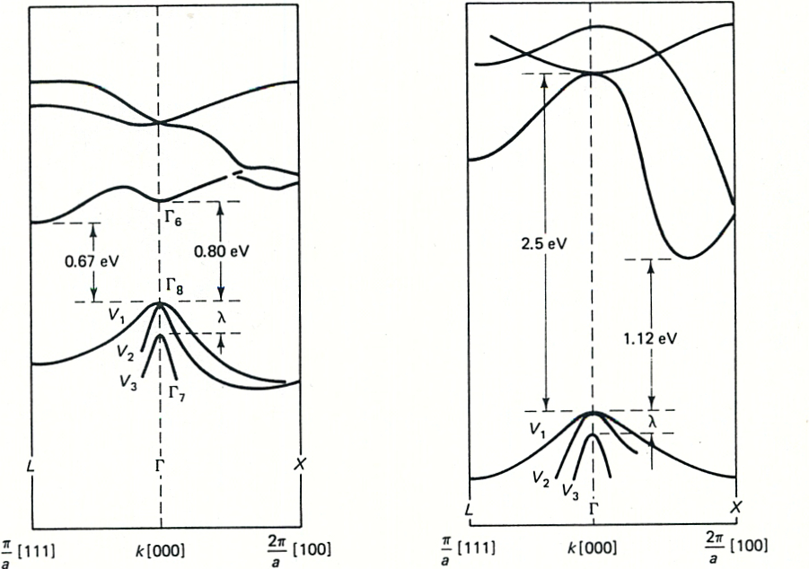
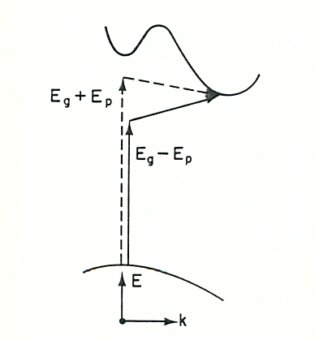
Optical properties of Si / Ge
Absorption in semiconductors cont’
Indirect
absorption
process
Germanium
Silicon
Strong absorption for E_{ph} > E_{g,direct} (λ = 0.5 and 1.55 μm for Si, Ge)
Becoming transparent for E_{ph} ≅ E_{g,indirect} (λ ~ 1.1 and 1.85 μm for Si, Ge)
Realistic cutoff for Ge more like 1.5 um
T.S. Moss, “Optical properties of semi-conductors,” Butterworths Scientific Publications, 1959 and J.I. Pankove, “Optical processes in Semiconductors,” Prentice-Hall, Inc., 1971.

Slide 31
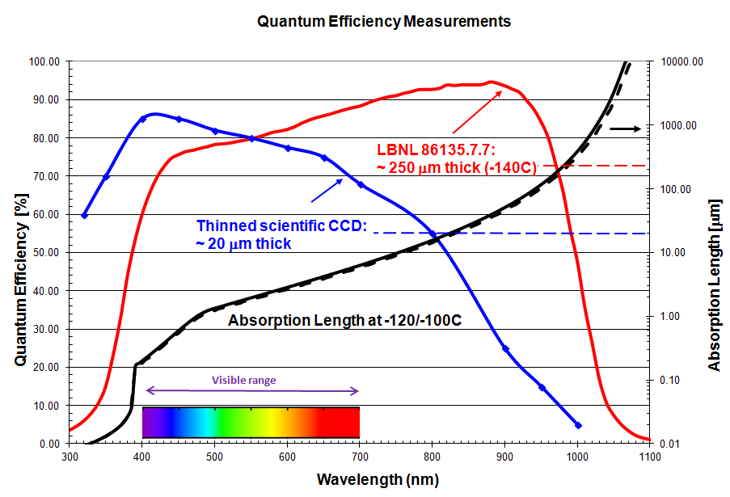
Quantum efficiency
Near IR – Silicon becoming transparent, E_{ph} ≅ Si bandgap (~ 1.1 eV)
Blue end – Strong absorption in dead layers (n⁺ of p-i-n structure)

Slide 32
Quantum efficiency
When the absorption length is > the CCD thickness,
multiply reflected light results in “fringing”

Slide 33
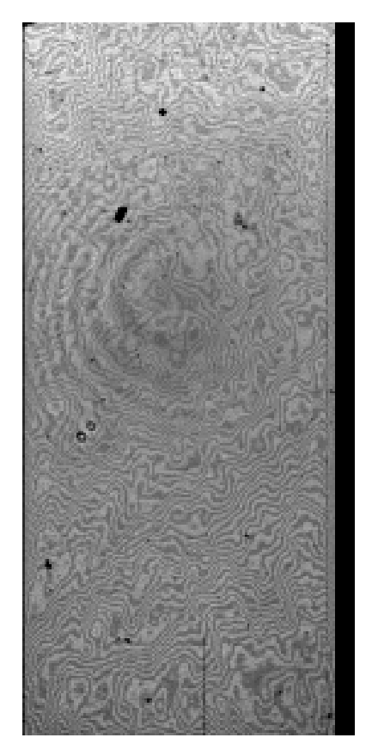
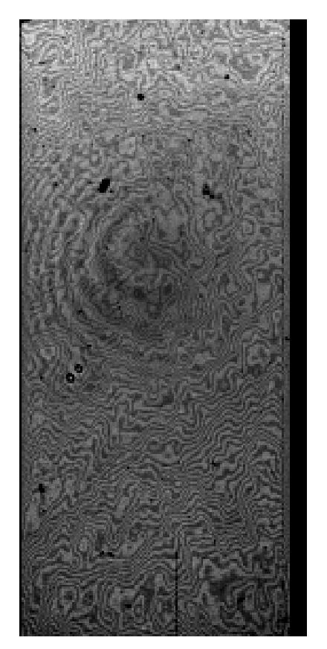
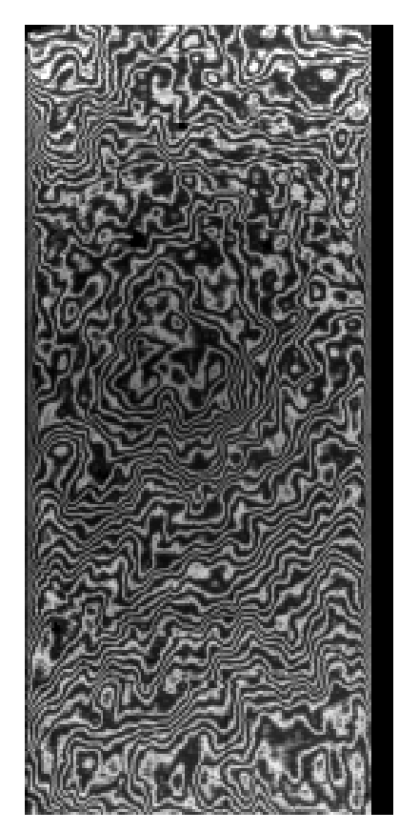
Fringing in thinned CCDs
~ ± 40%
(Laboratory)
For 250 μm thick DECam CCDs, the fringing is negligible
λ = 8000A 9000A 10,000A
Fringing – Multiply reflected light in 10 – 20 µm thick CCDs
Uniform illumination (R. Stover / M. Wei Lick Observatory)

Slide 34
CCD performance
Key CCD performance parameters
    Quantum efficiency
    Dark current
    Noise

Slide 35
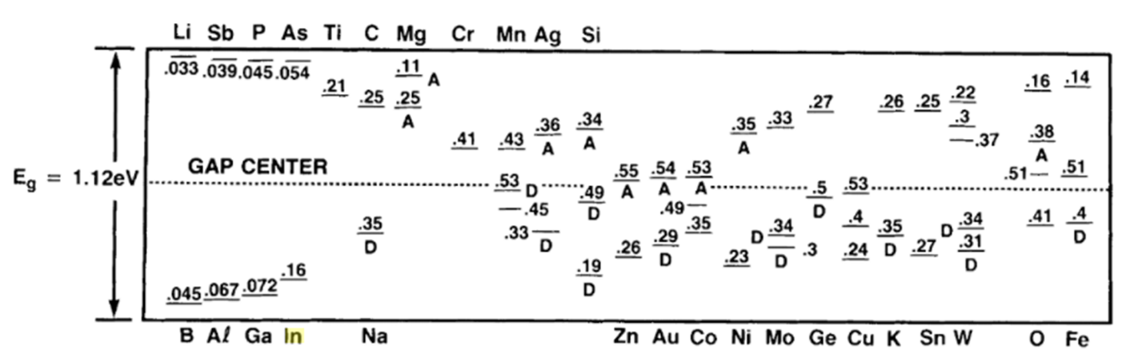
Dark Current
Dark current from the substrate is determined by extremely low levels of unwanted impurities that have energy states near the center of the bandgap
10⁻⁵ of a monolayer is too much contamination!
Special fabrication steps to maintain low dark current

Slide 36
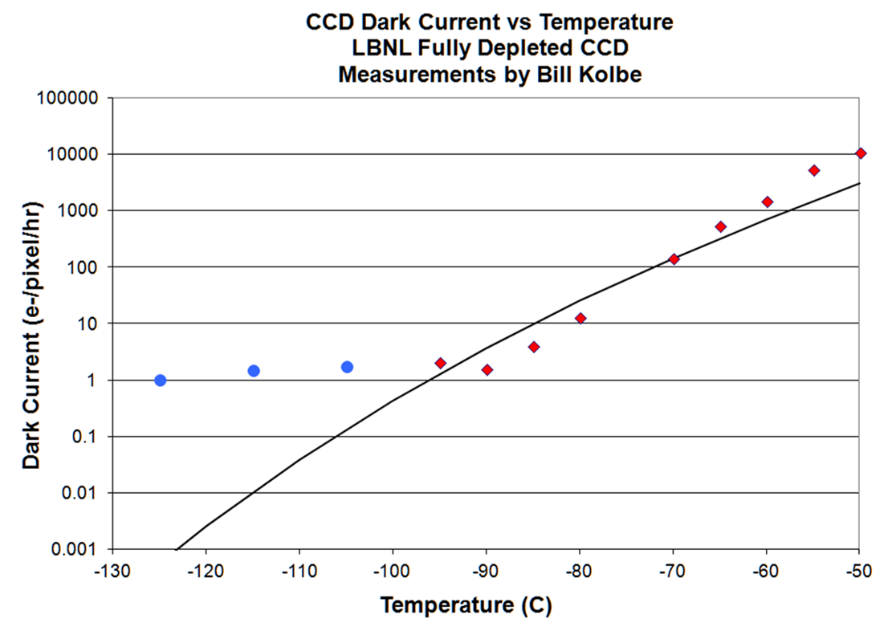
Dark Current
Dark current measurements on a fully depleted LBNL CCD / line is the Shockley-Read-Hall model

Slide 37
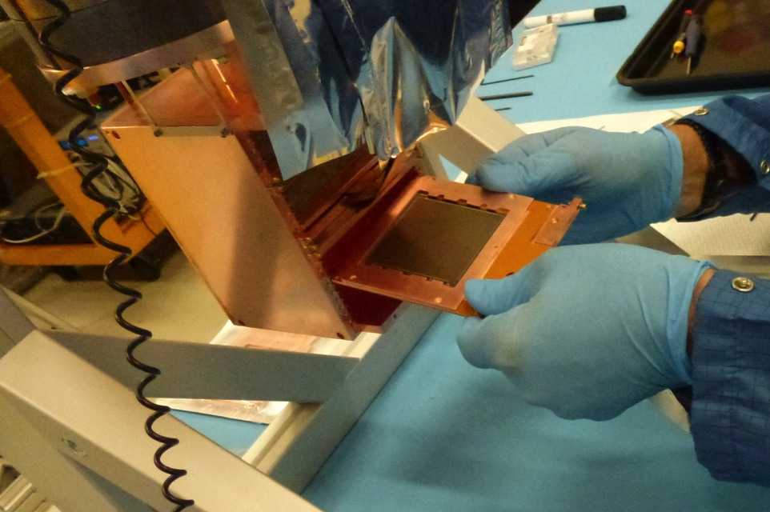
Dark Current
Leveling off at low temperatures is likely due to 300K blackbody radiation
  FermiLab innovation¹: Direct dark matter detection with CCDs / ~ 0.001 e-/pixel-day at 120K with the CCDs in a cold enclosure
¹Juan Estrada and others

Slide 38
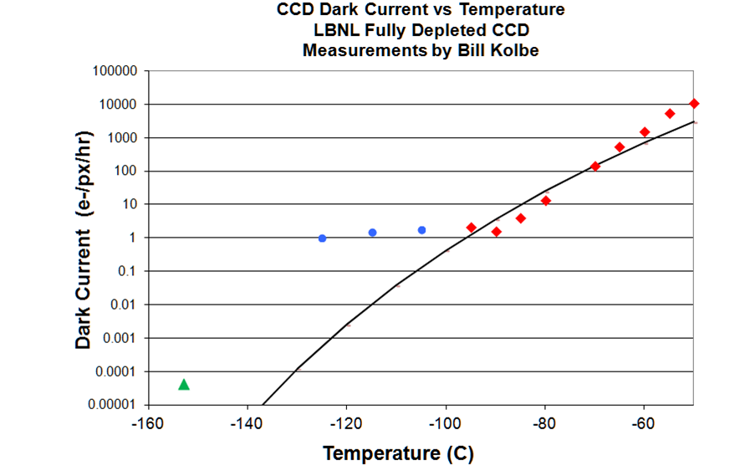
Dark Current
DAMIC roughly here with their cooled Cu box enclosure
0.001 e- / pixel-day at 120K (4 x 10⁻⁵ e- / pixel-hr)

Slide 39
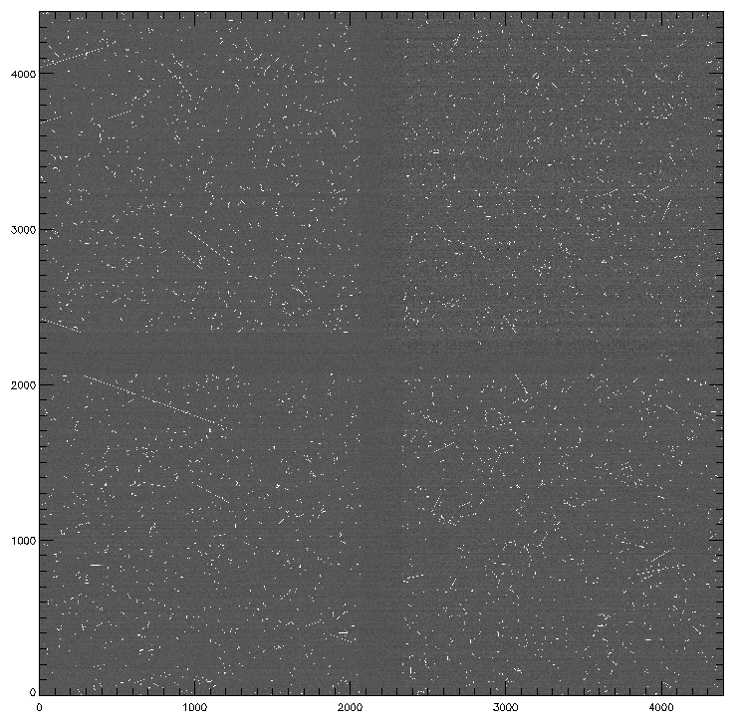
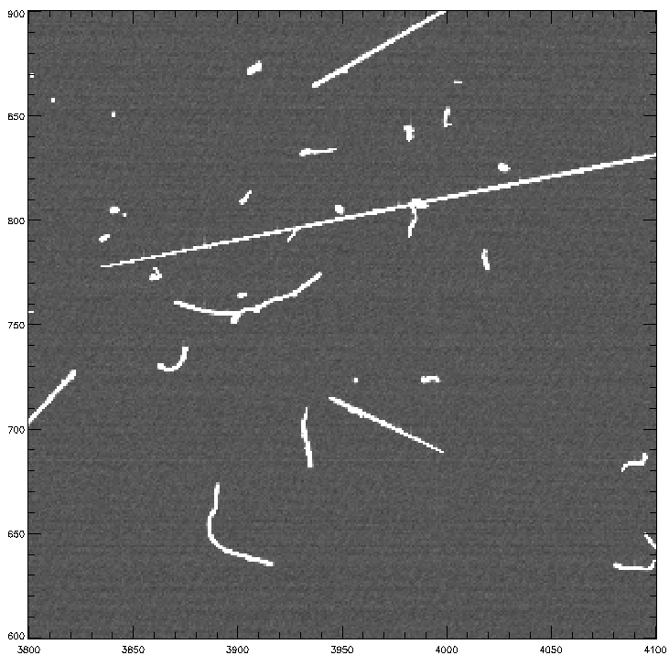
30 minute dark at -140C / 80V V_{SUB}
Tracks are cosmic ray muons and Compton electrons from U / Th in the background environment
Ability to achieve ultra-low dark current and low noise being exploited in direct dark matter detection (DAMIC and SENSEI)
169186.22.4/M1-28/dark1800s_Vsub80V_03.fits-f

Slide 40
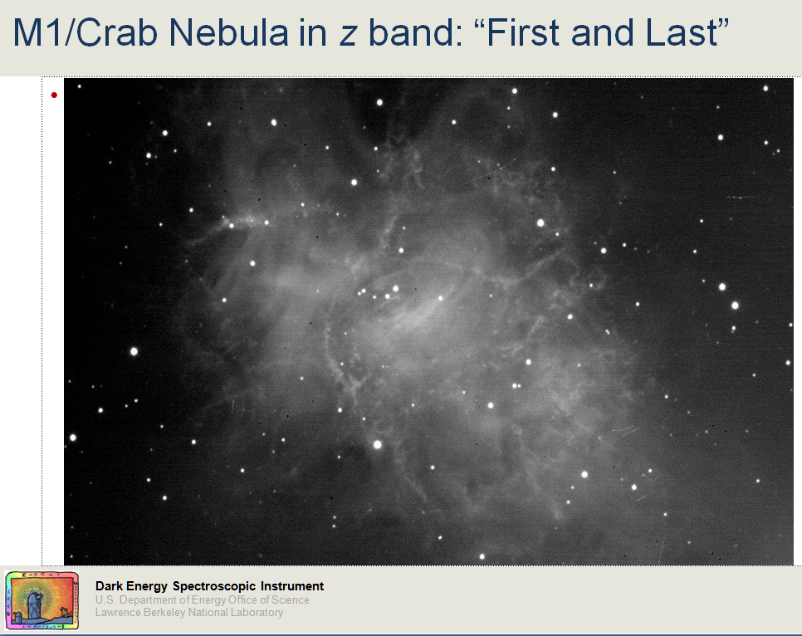
Cosmic rays
MOSAIC 3 Camera / 500 μm thick CCDs

Slide 41
CCD performance
Key CCD performance parameters
    Quantum efficiency
    Dark current
    Noise

Slide 42
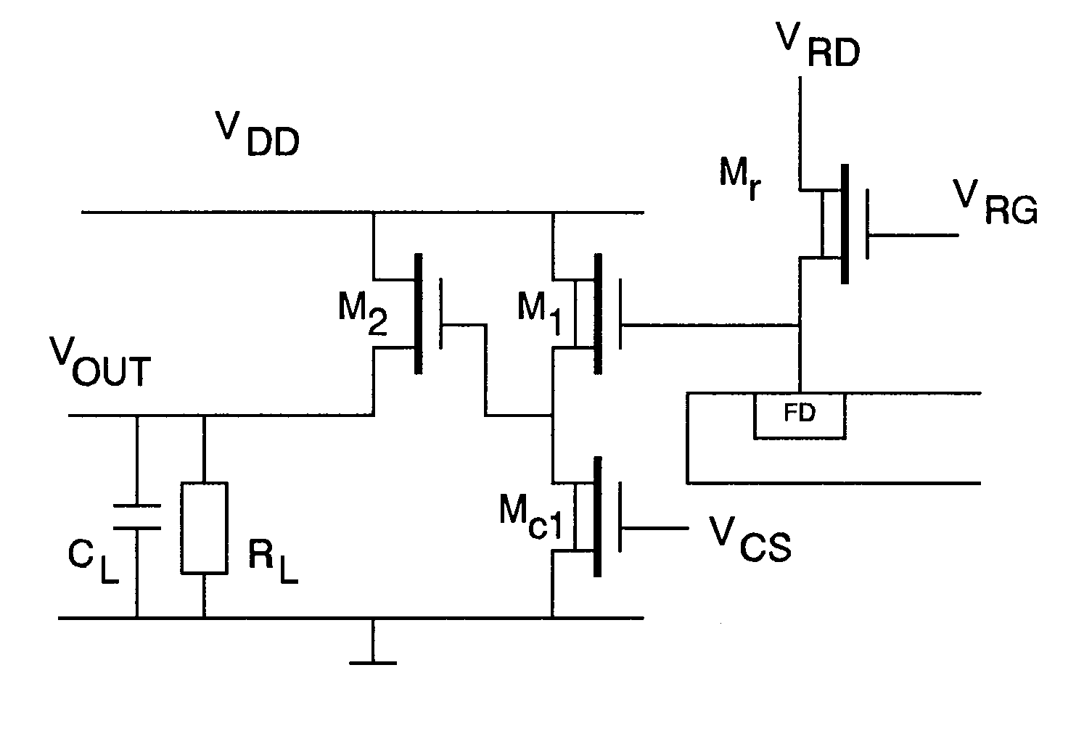
CCD amplifier noise
V_{R}
V_{RG}
M_{R}
V_{DD}
C_{gd,M1}
M₁
C_{gd,MR}
C_{P}
C_{M}
V_{OUT}
p-channel
FD
C_{FD}
R_{L}
V_{SUB}
GND
Floating diffusion
Diode sense node
Output transistor M1

Slide 43
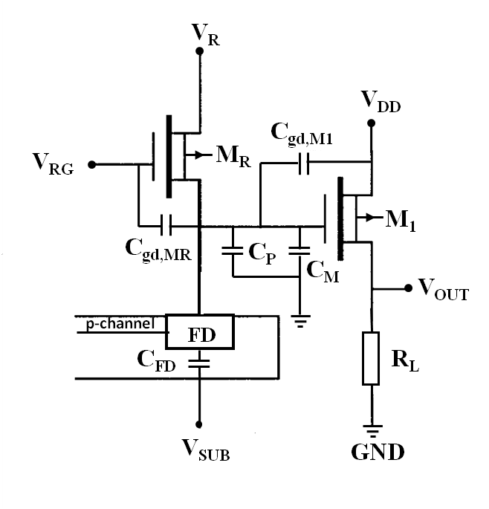



CCD amplifier noise
Noise in electrons Q_{n} depends on
1) SF transistor M1 noise
2) Total capacitance at the floating diffusion
White noise in M1 is given by
Reduce C_{T} and/or improve the transistor (g_{m}) to reduce noise

Slide 44
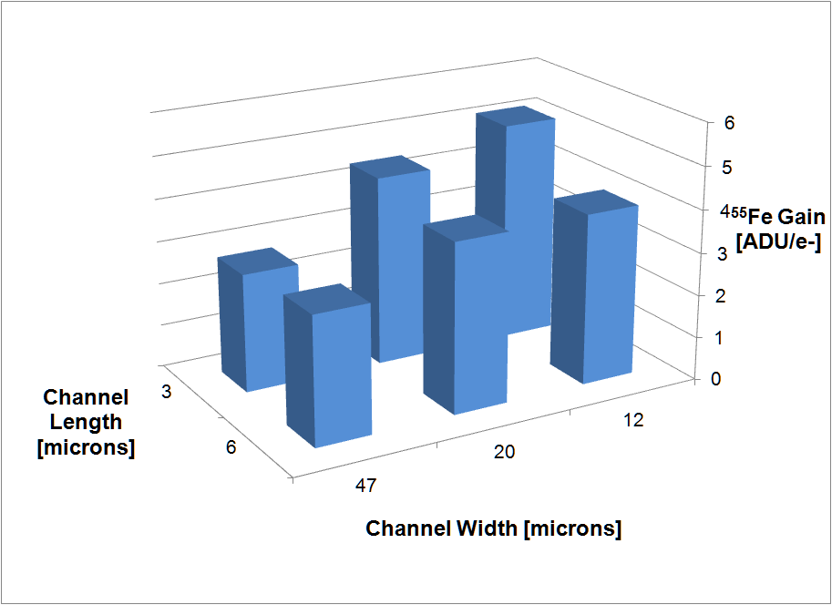
CCD amplifier noise
Measured conversion gain versus transistor dimensions

Slide 45

CCD amplifier noise
Measured read noise versus transistor dimensions (70 kpixels/sec, -140°C)
Transistor used in LBNL CCDs for DESI has W/L = 20/6

Slide 46


Transistor amplifier size study
R&D transistor with 22 nm gate insulator (SiO₂) thickness
Conversion gain in ADU/e-
⁵⁵Fe x-rays
Read noise in e- rms
70 kpixels/sec, -140C
JFET buffers

Slide 47

CCD Noise
DESI CCD noise (Production lot #1)
  Noise vs Integration Time

Slide 48
Skipper CCDs / sub-electron noise
Conventional CCDs nearing 1 e- read noise
Skipper CCDs take advantage of multiple sampling of the signal charge by use of a non-destructive readout amplifier (floating-gate)
  The noise is reduced by the square root on the number of samples
0.5 e- noise reported in 1990
  Chandler et al, SPIE 1242, 238, 1990 (Link)
  Janesick et al, SPIE 1242, 223, 1990 (Link)
  Field was dormant for about 20 years
  FermiLab / LBNL collaboration for dark matter

Slide 49

Skipper CCDs / sub-electron noise
From Chandler et al, SPIE 1242, 238, 1990
Floating Gate sense node

Slide 50

Skipper CCDs / sub-electron noise
Implementation on LBNL fully depleted CCD
Source follower transistor
Floating Gate sense node

Slide 51


Skipper CCDs
Results from the SENSEI group based at FermiLab
0.068 e- rms after 4000 samples
Used for direct dark matter detection

Slide 52

Skipper CCDs
Link to paper

Slide 53

Future directions
Increase wavelength reach to ~ 1.4 μm Germanium CCDs
  Cosmic Visions 2016 and 2018 reports
  Work underway at Lincoln Laboratory
  LDRD effort started at LBNL
J band

Slide 54


Ge CCD effort at LBNL
  Mask design / partially processed Ge wafer shown
Fabrication efforts at LBNL and UC-Berkeley
Not nearly as straightforward as silicon
Ge wafer after 4 masks / 2 implants

Slide 55

Future directions
  CMOS image sensors
    Have been back-illuminated since iPhone4
    Commercial CCDs are on the endangered list with the exception of compact digital cameras (20 Mpixel version shown)
Picture taken Jan 2018 with a back illuminated CMOS image sensor (iPhone6)

Slide 56


4T CMOS image sensor
CMOS image sensors have an source follower amplifier in each pixel
A transfer gate is included to take advantage of kTC noise reduction via double-correlated sampling
A. Theuwissen, IEEE Solid-State Circuits Magazine, 22, Spring 2010

Slide 57


Front vs back illumination – CMOS
CMOS image sensors with small pixels need back illumination simply to get the light into the pixel
IBM front illuminated CMOS image sensor
2.2 µm pixel
2006 IDEM (Gambino et al)
Sony back illuminated CMOS image sensor
1.65 µm pixel
2010 ISSCC (Wakabayashi et al)

Slide 58

4T CMOS image sensor
Sony back-illuminated CMOS image sensor used in the Samsung Galaxy S7 (microlens at top of image)
Link to article

Slide 59

CMOS image sensors
There is R&D underway in single-photon detection in CMOS image sensors
  Extremely low capacitance achievable in the advanced CMOS technologies, sub-electron noise possible
  Link to special issue of “Sensors” journal

Slide 60

CMOS image sensors
2015 publication shows “golden” pixel with 0.22 e- noise, 423 μV/e- conversion gain
  Ma et al, J. Elec. Dev. Soc., 3, 472, 2015 (link)

Slide 61

CMOS image sensors
2017 publication from the same group
  Ma et al, Optica., 4, 1474, 2017 (link)
  NSF SBIR Phase I awarded (link)

Slide 62

CMOS image sensors
R&D on fully depleted CMOS image sensors
  Stefanov et al, Sensors, 18, 118, 2018 (link)

Slide 63
Summary
The invention of the CCD in 1970 by Boyle and Smith has had enormous impact on society and in scientific applications, particularly astronomy and astrophysics
Clever researchers continue to find new applications, e.g. direct dark matter detection and direct detection of x-rays for light sources
We look forward to innovations from the next generation of instrumentation experts

Slide 64







Acknowledgements
R. Stover / M. Wei / W. Brown / C. Rockosi
A. Dey / R. Reed
DECam staff
B. Flaugher / T. Diehl / J. Estrada / D. Kubik / J. Tiffenberg
H. Padmore / P. Denes
R. Groulx / R. Frost / F. Dion
CCD group leaders – C. Bebek / N. Roe / M. Levi / S. Perlmutter

Slide 65



Acknowledgements
Early grant from the NSF
  Award #9876605 (1999 – 2003)
Lawrence Berkeley National Laboratory
  MSL equipment upgrades / LDRD
Other support
  Keck Telescope / USAF / NNSA / NASA
Long term funding from the U.S. Department of Energy for sustained R&D

