Slide 1
Space Charge Issues in DUNE DP
Bo Yu
March 15, 2018

Slide 2
Positive ion space charge in SP vs DP FD
DP: ion feedback
Negative ion build up

Slide 3
Assumptions
Ar39 rate: 1bq/kg
Mean energy: 220keV
Ionization potential: 23.6eV
Initial recombination fraction: 2/3
No e lifetime attenuation
Max. drift time: 463s (3.7m)
→ Max charge density @ cathode: 0.65nC/m³

Slide 4
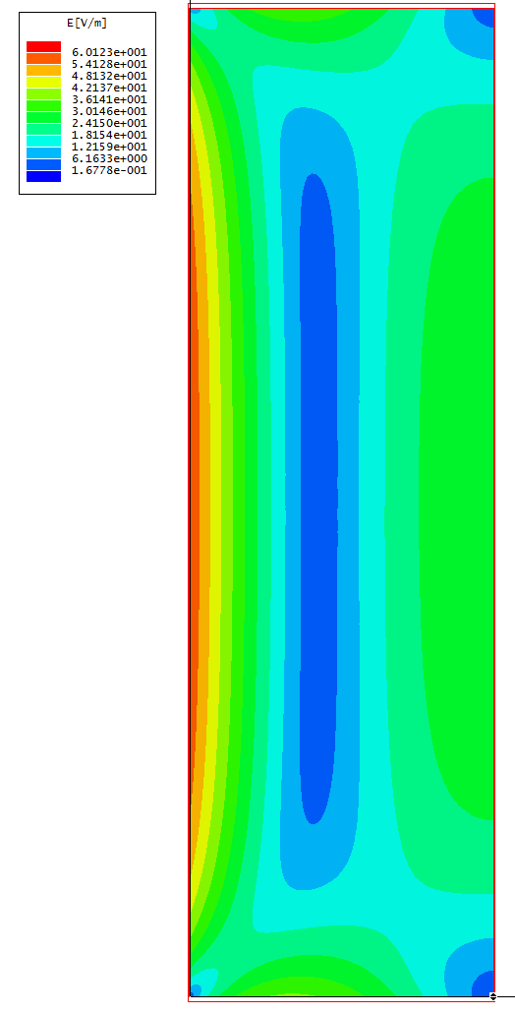
DUNE Single Phase E Field Profile from the Positive Ions Only
This is the E amplitude distribution in a 2D cross section of a DUNE drift volume of 3.7m wide and 12m high. The 4 walls are set to be grounded conductors, and a triangular charge distribution is placed inside. So this demonstrates the contribution of the space charge only.

Slide 5
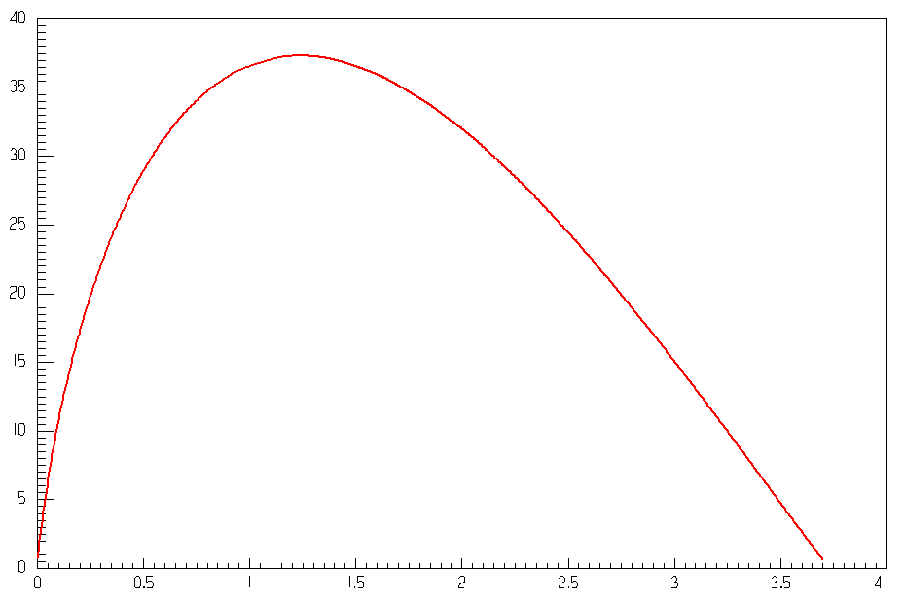
E_{Transverse} at the Surface of the Field Cage
Ey [V/m]
Distance from Cathode [m]
The maximum Ey is 0.08% of drift field. Maximum deflection is 1.8mm.

Slide 6
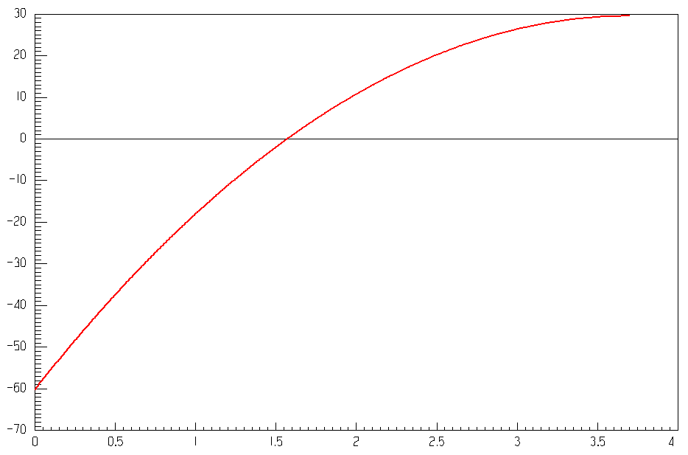
E_{Longitudinal} in the Center of the TPC
Ex [V/m]
Distance from Cathode [m]
The maximum Ex is 0.12% of drift field. Maximum delay is 0.2us.

Slide 7
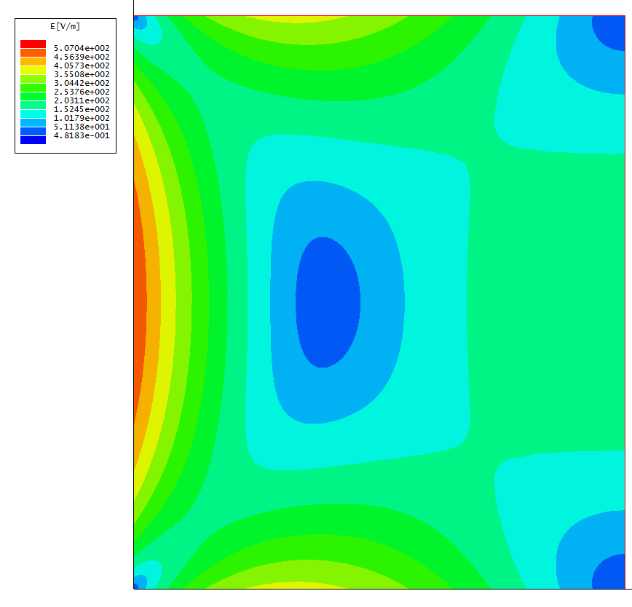
DUNE 2 Phase 12m drift Ar39 only
Same Ar39 ion creation rate
Maximum ion drift time: 25min
Peak charge density @ cathode: 2.1 nC/m³
E_{drift}

Slide 8
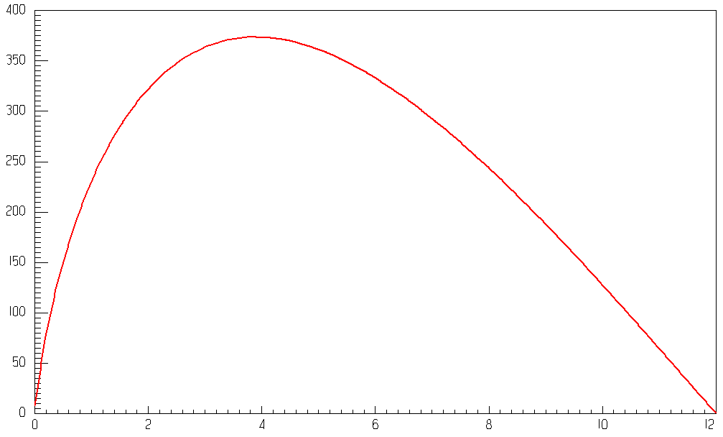
E_{Transverse} at the Surface of the Field Cage
Ey [V/m]
Distance from Cathode [m]
The maximum E_{T} is 0.7% of drift field. Maximum deflection is 58mm.

Slide 9
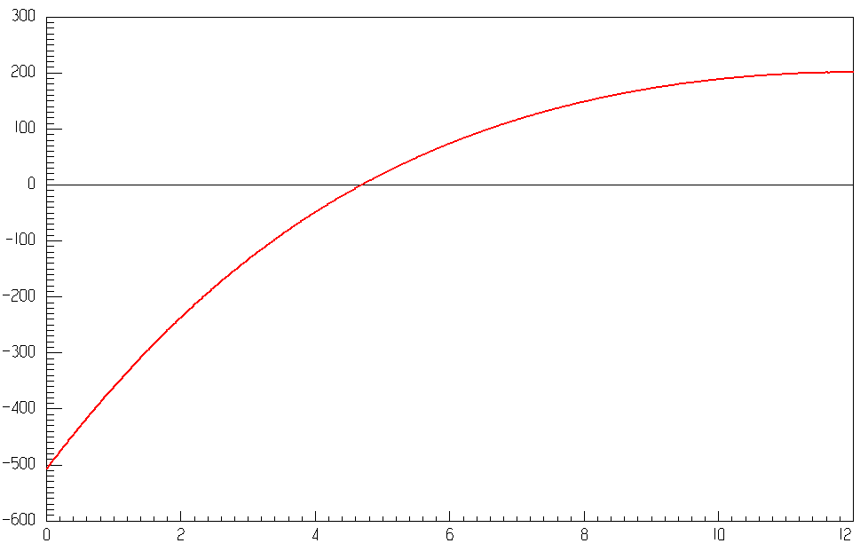
E_{Longitudinal} in the Center of the TPC
Ex [V/m]
Distance from Cathode [m]
The maximum Ex is 1% of drift field. Maximum delay is 5.7us.

Slide 10
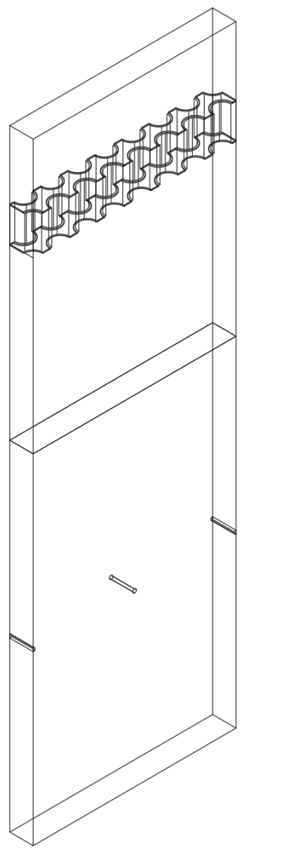
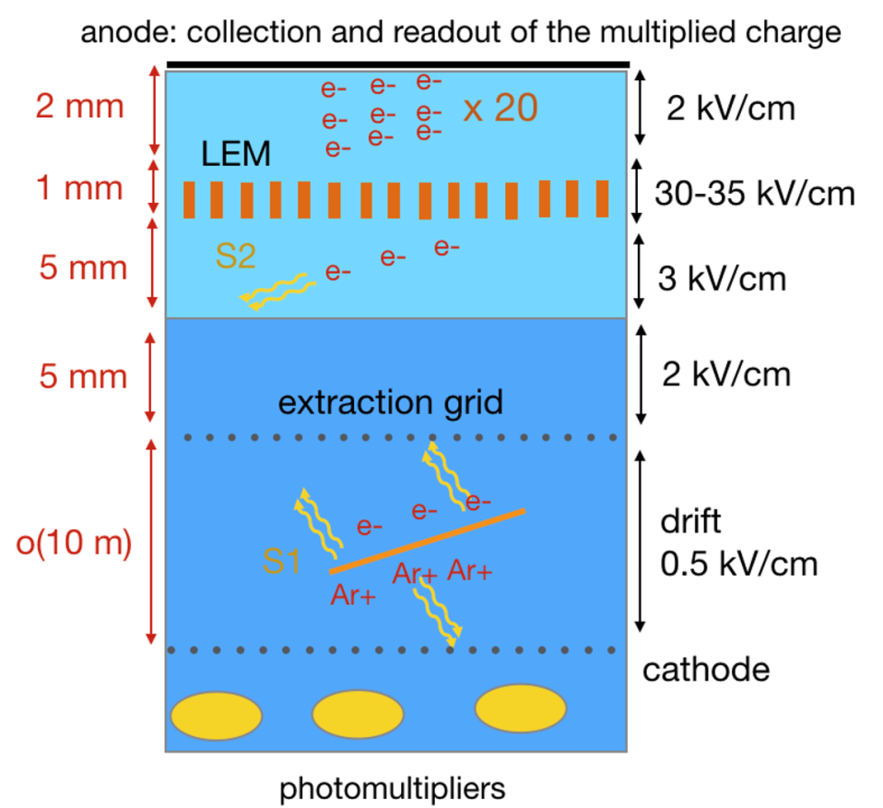
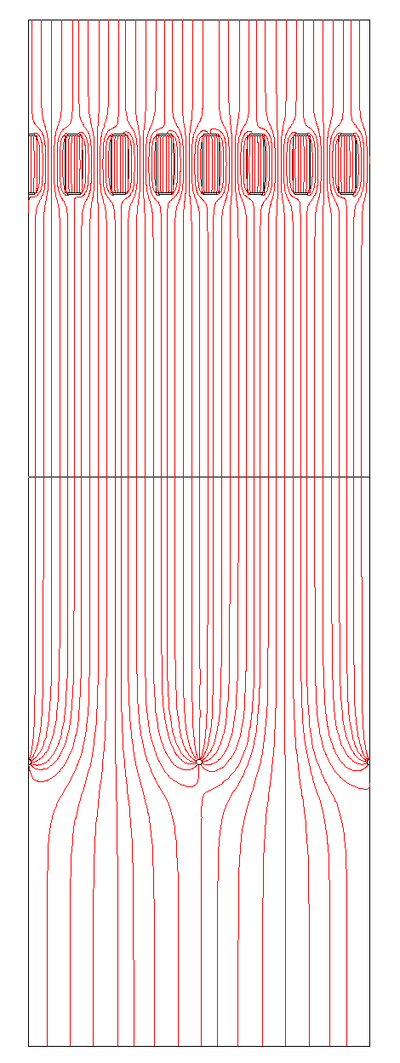
Field Lines Around the DP LEM
A 3D model of a small section of the drift, extraction, LEM, CRP region.
A 2D cut plane near the front face of the model is plotted in the following slides.
DP cross section view
CRP
2kV/cm
LEM (0.5mm holes @ 0.8mm pitch, 1mm thick)
30kV/cm
3kV/cm
Liquid gas interface
2kV/cm
Extraction grid (10mm below LEM)
0.5kV/cm
From S. Murphy

Slide 11
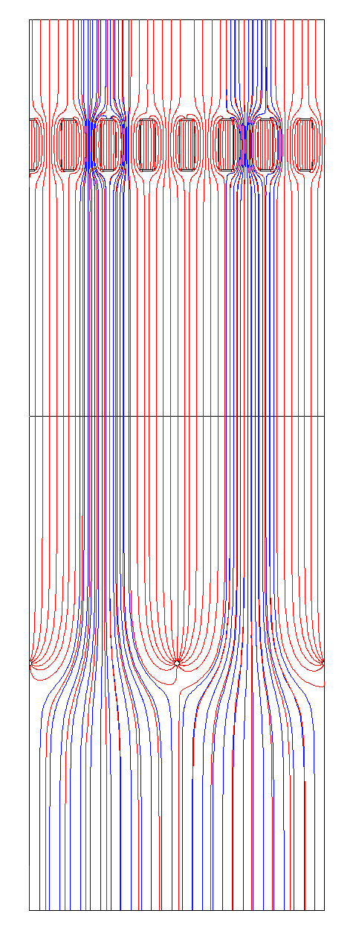
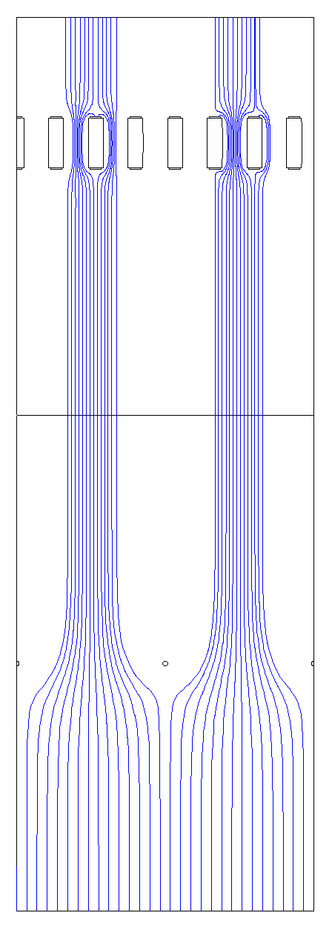
Field Lines Around the DP LEM
About ½ of the LEM holes never see electrons coming from the drift region.
Primary ionization electron paths superimposed on the overall field lines
Electron drift lines coming from the drift region

Slide 12
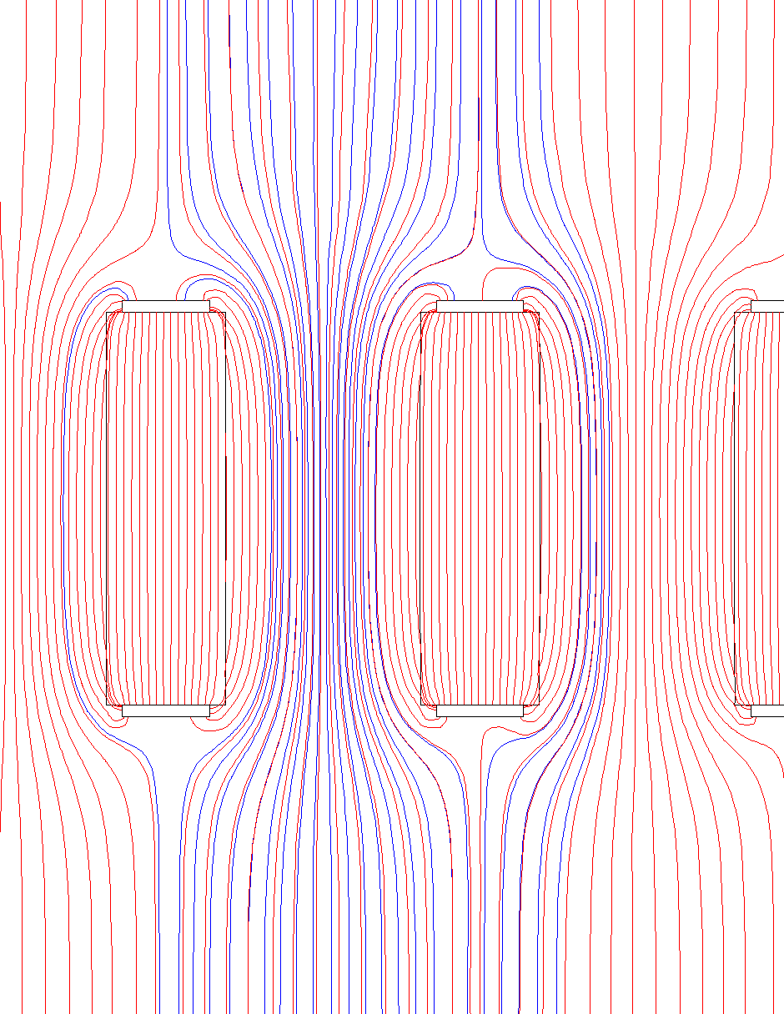
Field Lines Around the DP LEM
Due to the unfavorable collection to extraction field ratio (2:3), a fraction (1/3?) of the electrons lands on the upper surface of the LEM, therefore not contributing to the CRP signal.
Electron multiplication occurs mostly in the blue region. The positive ions created drift down following the same paths as the incoming electrons.
Diffusion of electrons and ions will alter their actual drift paths from these ideal lines (much less effective for ions).
Assuming the gain of the LEM is defined by the collected electrons on the CRP, the ions created by these electrons are not near the outer layer of the “blue waist” inside the holes and they are most likely drift back to the cathode.

Slide 13
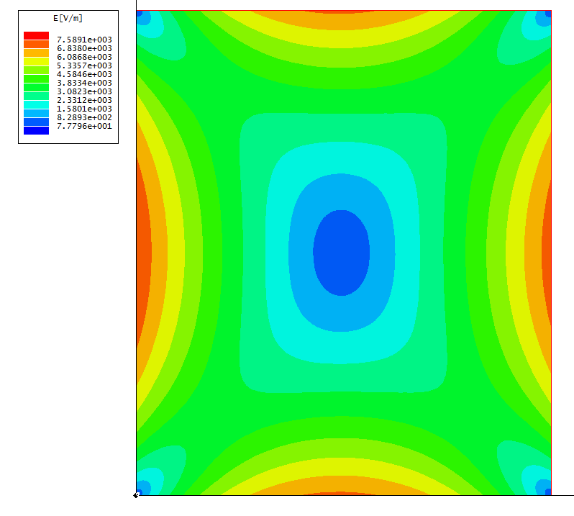
DUNE 2 Phase 12m drift Ar39 + LEM ion feedback
Assuming all electrons drift to LEM (infinite e lifetime).
Gain of LEM: 100
10% of ions drift back to the LAr
These ions create a constant term in the charge density distribution, which is about 10x greater than the peak primary ion density
The flux of positive ion feedback decreases as the primary electrons are being captured by impurities. However, the negatively charged impurity ions will most likely be trapped at the liquid/gas interface and causing other problems.
E_{drift}

Slide 14
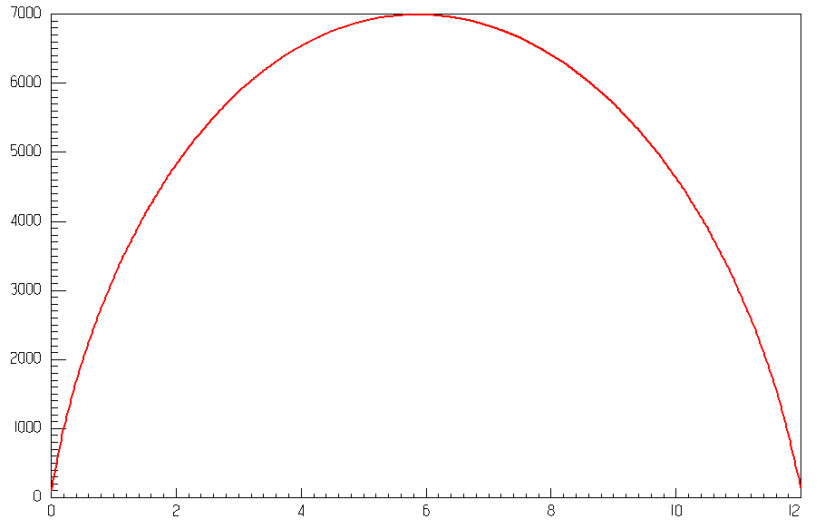
E_{Transverse} at the Surface of the Field Cage
Ey [V/m]
Distance from Cathode [m]
The maximum E_{T} is 14% of drift field. Maximum deflection is 1.2m.
Due to the significant distortion in the E field, the uniform (+ triangular term) ion charge distribution is less accurate. Further iterations are needed.

Slide 15
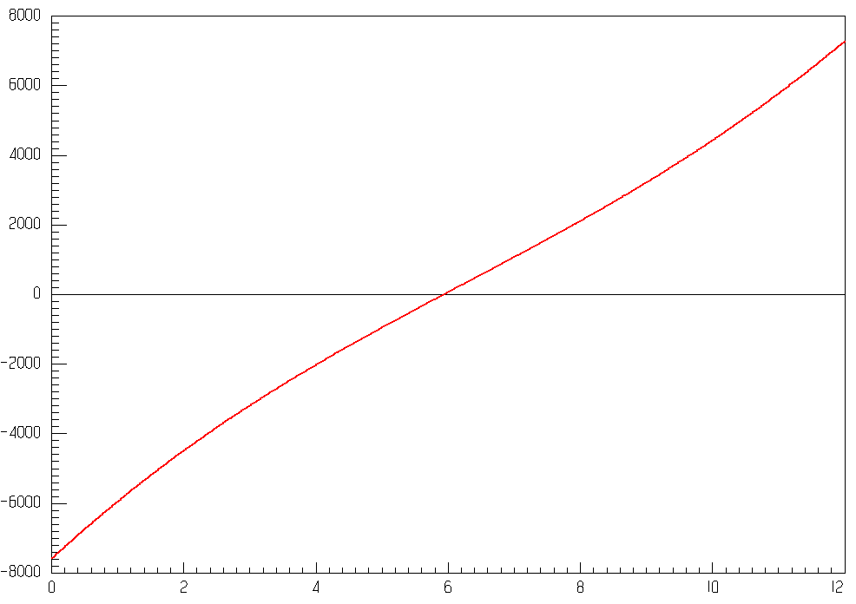
E_{Longitudinal} in the Center of the TPC
Ex [V/m]
Distance from Cathode [m]
The maximum Ex is 15% of drift field. Maximum delay is 0.1ms.

Slide 17
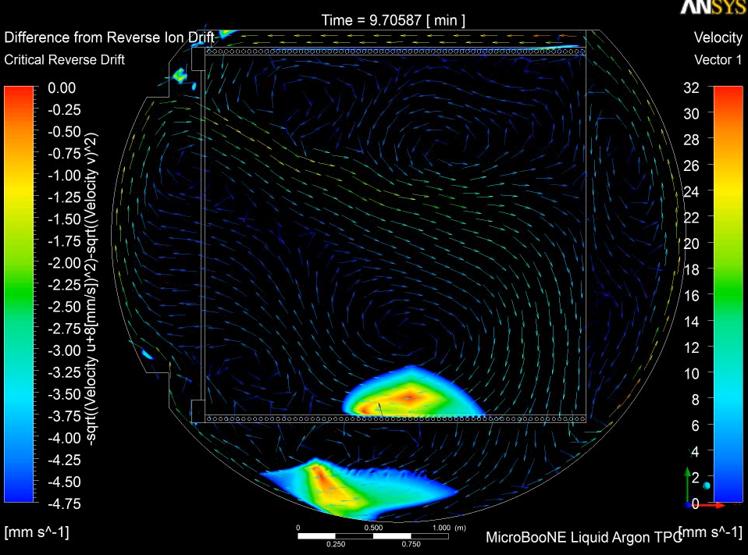
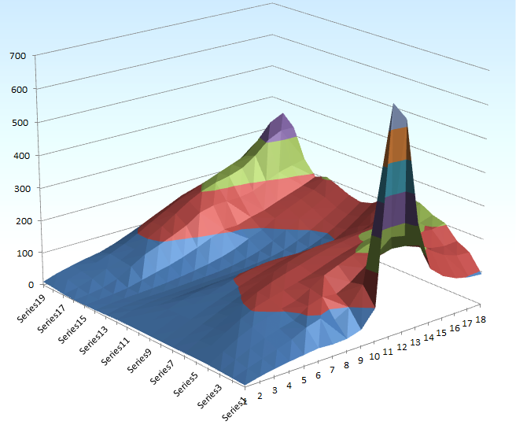
Space Charge with LAr Convection Example 1: MicroBooNE original configuration
CFD (computational fluid dynamic) simulation shows the presence of a large, and relatively stable eddy in the lower half of the TPC active volume. This eddy causes the LAr flow to cancel the ion drift in a small region of the TPC. The color contoured overlay shows the region inside the TPC where ions are stalled.
If the convection pattern is stable, near the bottom eddy, some ions are trapped indefinitely. The program stops tracking them after 1000 seconds. The spike would have been very high (diffusion/repulsion limited) otherwise.
Ion dwell time [s]
Anode wires
Cathode plane
Cathode plane
Anode wires
Erik Voirin, MicroBooNE docdb 1895
MicroBooNE docdb 1931

Slide 18
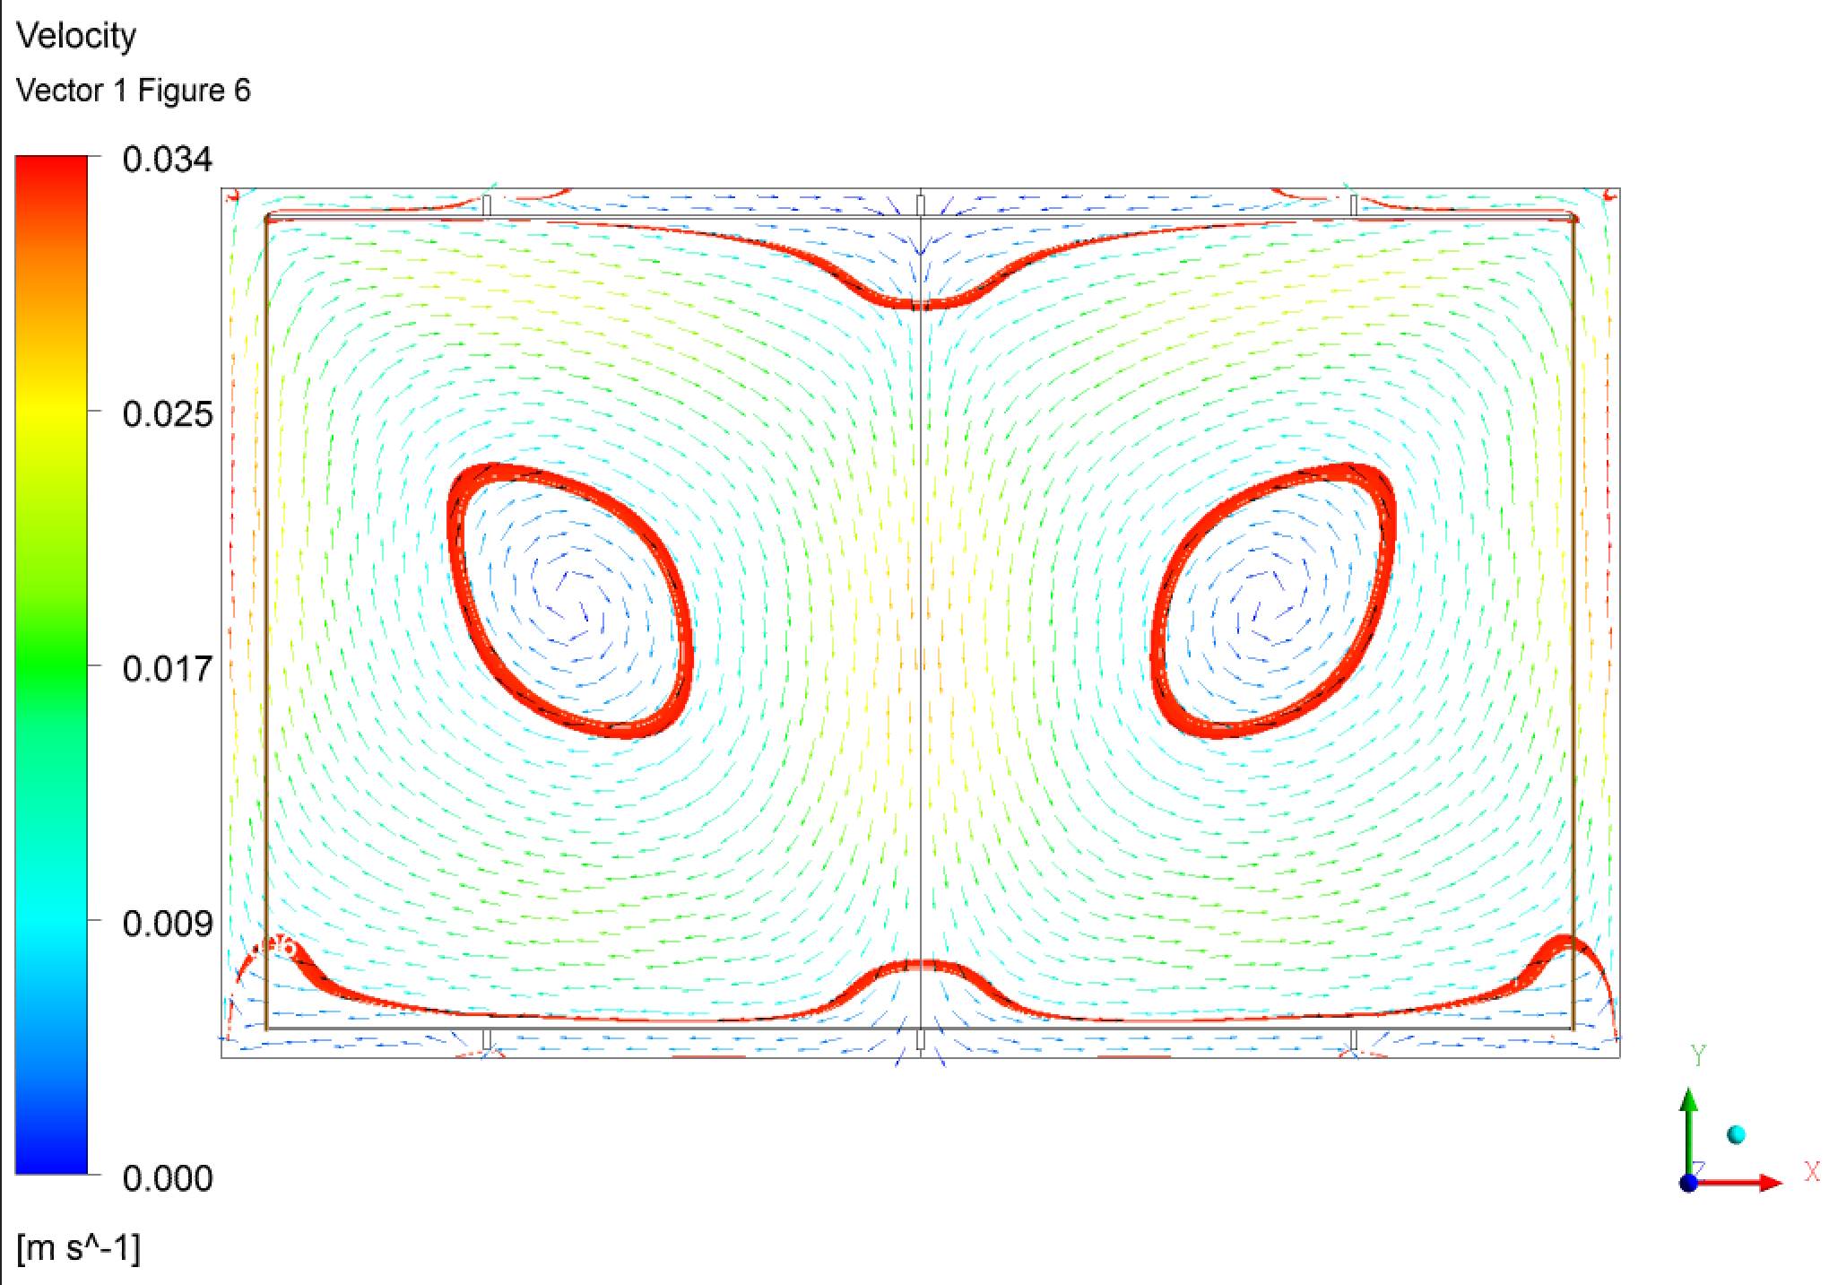
Space Charge and Liquid Flow
I have not seen a CFD of the DP FD cryostat. The closest study I can find is this plot from Erik Voirin on a LBNE 33kt design, in which the cathodes are wire mesh with little impact on the liquid flow. The red bands represents regions where the liquid flow velocity is close to 8mm/s, the ion drift velocity @ 500V/cm field. The two blue circles indicate the region with possible stalled ion movement. On the other hand, the center of the cryostat should have reduced space charge build up due to the downward flow of the liquid.

Slide 19
What Happen to the Negative Ions?
Impurities in the LAr capture a fraction of the primary electrons. If the electron life time is poor, most of the electrons will be captured and form negative ions. These negative ions drift up toward the LEM.
But can the negative ions be extracted into the gas phase by the 3kV/cm extraction field? Or can the electron be striped off the ion and pulled into the gas by the extraction field?
If the answers are NO for both questions, we have a problem:
The negative ions will build up at the liquid surface until their self repulsive force push them to the field cage/cryostat wall. An equilibrium is reached, but the surface charge density will likely to be very non-uniform over the liquid surface.
This non-uniform negative surface charge will distort the electron drift path, change the extraction field (reduce the field in the liquid, increase the field in the gas), alter the gas gain in the LEM.
This effect has not been reported. Possibly because it is not obvious in a small detector.

Slide 20
Other Calibration Needs for the DP
The LEM gain is sensitive to the hole size, copper rim offset, board thickness, hole inner surface conductivity, extraction/collection field (gap between electrodes).
A gain map of the entire LEM surface is needed. And if the gain drifts with time, periodic re-mapping of the gain may be needed.
We have seen report of gain drift (due to hole surface charging) on surface detector. If there is a finite discharge mechanism (e.g. finite resistivity on the LEM hole surface), will we see competing charge/discharge cycles in an underground detector? Could a vertical 12m cosmic track dump enough charge to a small region of the LEM to cause immediate charge up, and then slowly decay away, resulting in unstable gain?

