Slide 1
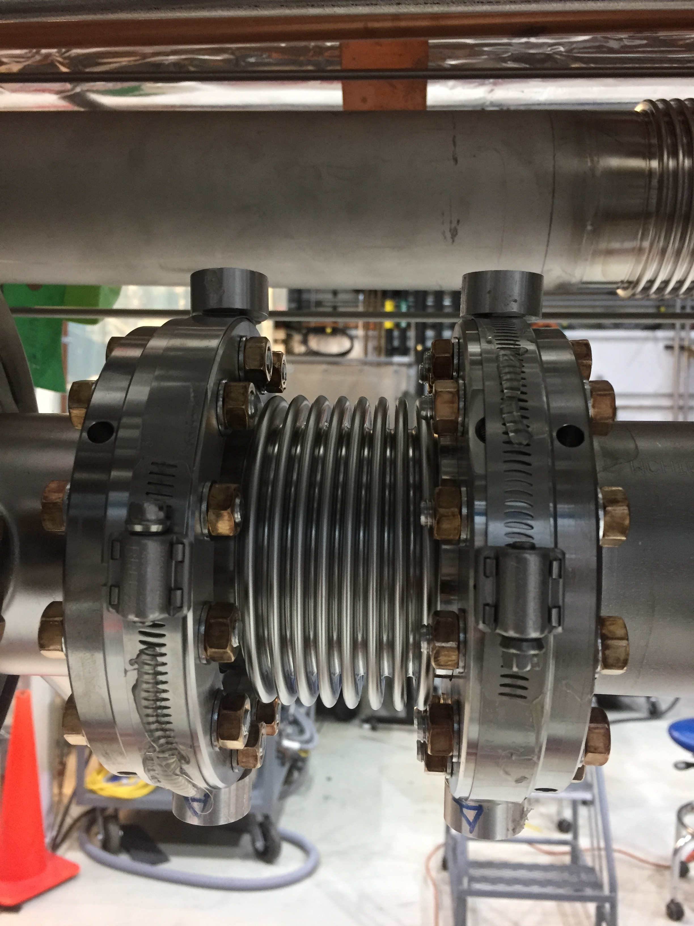
Cavities from vendors
LCLS-II cavities that we purchase from RI and Zanon have alignment fiducial holes machined on the beampipe flanges outer perimeter
These fiducials are not exactly the same configuration as the XFEL cavities (V shape hole for XFEL versus Cylinder shape hole for LCLS-II)
The electrical center (aka eccentricity of 9 cells) with respect to these fiducials need to be reported in a single data sheet by these 2 vendors
Data sheet provided by both vendors are ambiguous, do not make any sense
These sheets are not used by neither Fermilab nor JLab

Slide 2
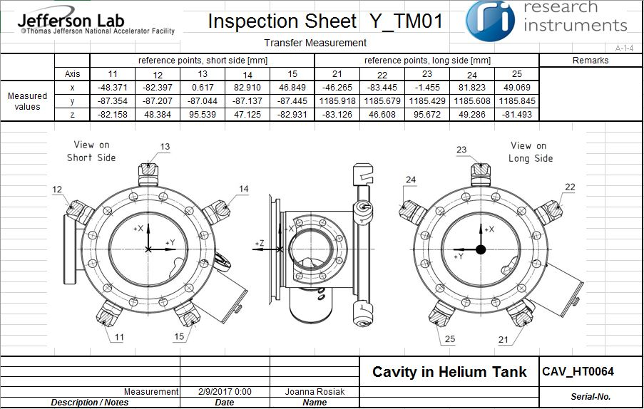
Data Sheet provided by RI

Slide 3
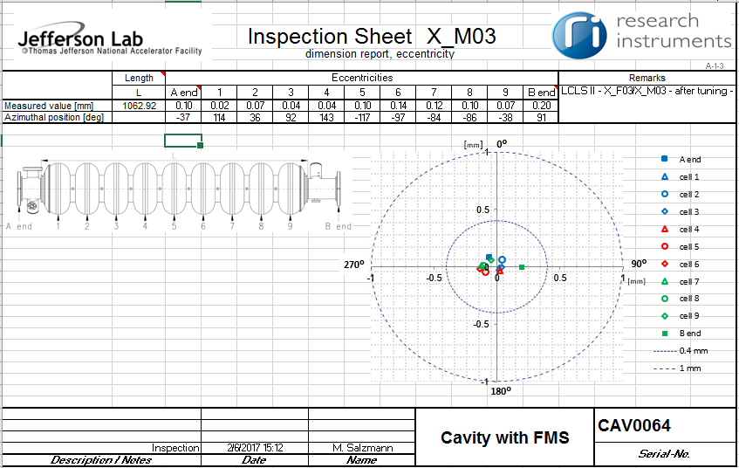
Data from Cavity Tuning Machine
Both vendors provide data files with measurement cavity alignment of bare cavity after RF tuning just before tank welding

Slide 4
Alignment process at WS3
At Fermilab, Alignment group SME reaches out to RF engineering group lead to ask for the eccentricity offsets to be used with respect to the beampipe flanges center. RF engineer extract this data from the bare cavity measurements provided by vendor and provided to the alignment group

Slide 5
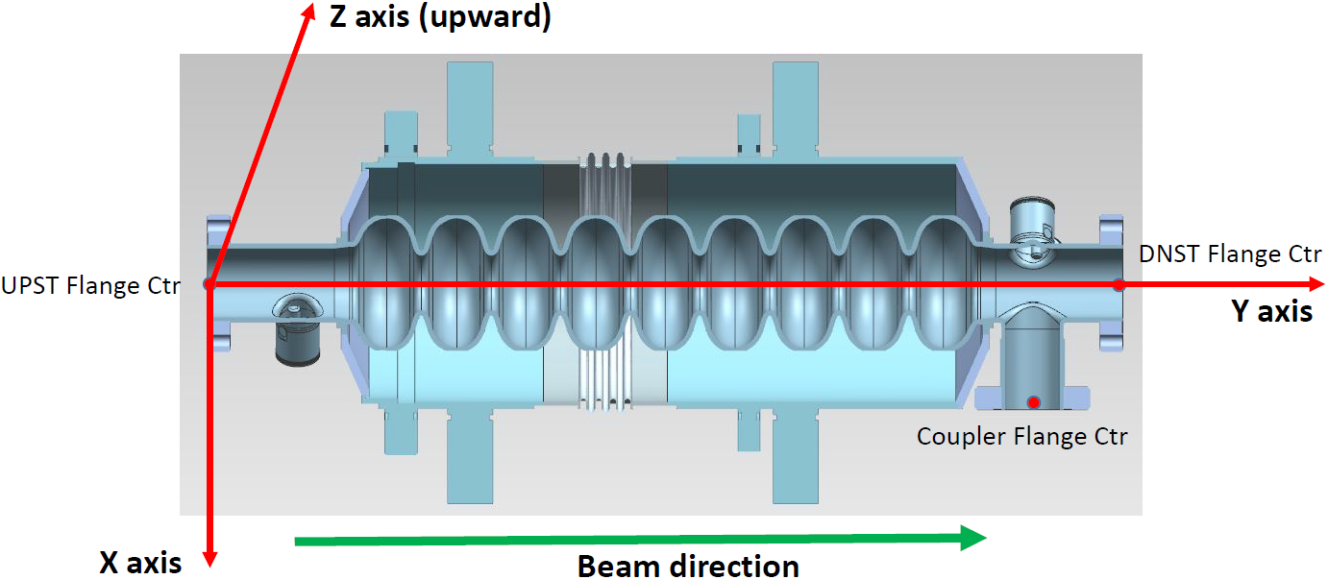
Cryomodule CM

Slide 6
Cryomodule CM10
CM10 cavity eccentricity data
new |  | On beam pipe flange plane
 |  | SideA (coupler), DnSt flange |  | SideB (pick up), UpSt flange
Position | Cavity | X, mm | Z, mm | X, mm | Z, mm
1 | CAV0312 | -0.17 | 0.14 | 0.20 | 0.29
2 | CAV0302 | 0.21 | -0.06 | 0.13 | 0.00
3 | CAV0292 | 0.03 | -0.13 | 0.50 | 0.22
4 | CAV0294 | 0.13 | 0.04 | 0.35 | 0.05
5 | CAV0296 | 0.12 | 0.44 | 0.58 | 0.16
6 | CAV0136 | -0.10 | -0.01 | 0.30 | 0.17
7 | CAV0267 | 0.14 | -0.02 | 0.28 | -0.16
8 | CAV0311 | 0.11 | 0.31 | 0.29 | 0.20

Slide 7
Alignment process at WS3 (cont.)
At Fermilab, during cavity string alignment at WS3, beampipe flanges of 8 cavities are measured with laser tracker first to fiducialize the cavities with respect to the center of the cavity beampipe flanges and then to measure the as-is position of the cavities in the assembled cavity string (married to upper cold mass)
At Fermilab, we cannot use properly the fiducial holes (machined on the beampipe flanges) even to hold rigidly laser tracker SMR nests. These holes are cylindrical, sitting on the curved surface on the outer diameter and very close to the female bellows flanges which interconnect the cavities. Therefore, we use temp nest configuration to mark the as-is location of the cavities and then move then as-needed to achieve the required alignment
Temp SMR nest holder used during alignment

Slide 8
Summary
We believe that not being able to use the vendor provided data and the fiducial holes already machined on the beampipe flanges add additional time to the alignment process at WS3 (1~2 days). These 2 days can be eliminated if we can better understand the fiducial holes data provided by the vendors.

