Slide 1
NbTi “Hair” and Burst Disc
G. Wu
Cryomodule Assembly QA/QC Workshop II
January 25, 2018

Slide 2
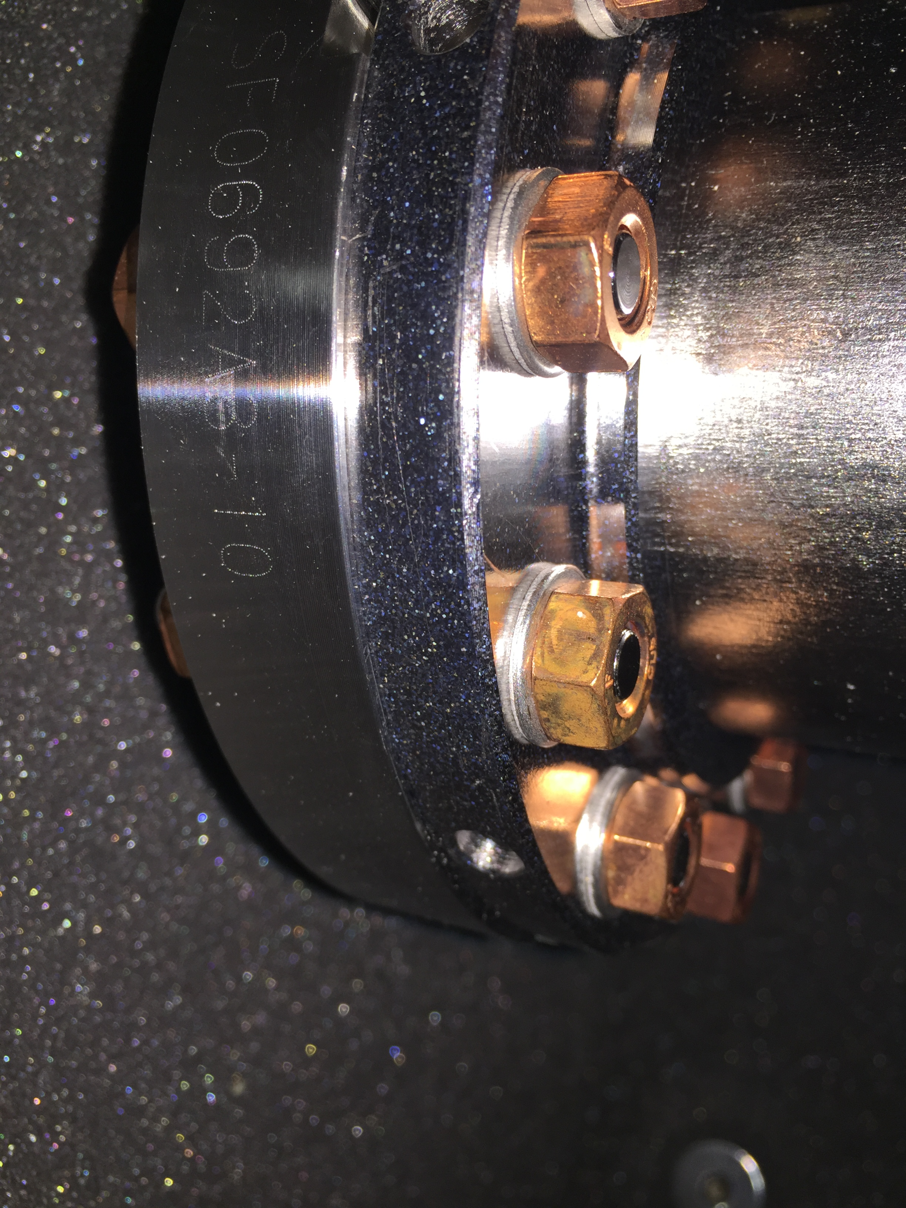
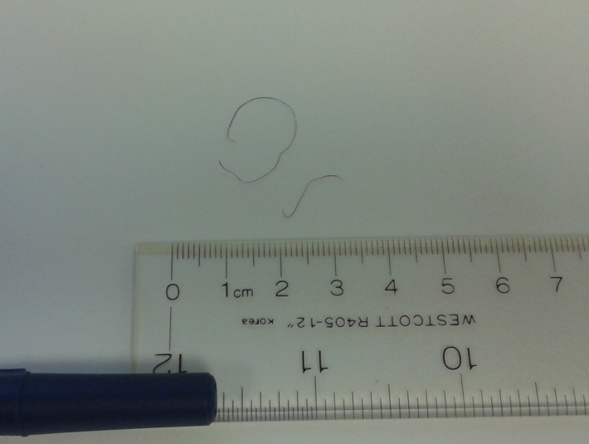
NbTi “Hair” during String Assembly at Fermilab
Tolerance of cavity NbTi flange and stainless steel mating flange are small.
Nbti “hair” can be generated by stainless steel flange scraping the NbTi flange

Slide 3
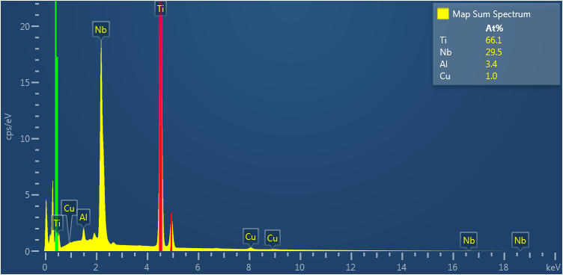
Material Composition
Results by Yulia Trenikhina

Slide 4
NbTi “Hair” Statistics at Fermilab
Cryomodule | CAV1 | CAV2 | CAV3 | CAV4 | CAV5 | CAV6 | CAV7 | CAV8
CM01
CM02 |  |  |  |  | Guessed by bag |  | CAV0011 US before CS
CM03 |  |  |  | Guessed by bag
CM04 |  |  | Guessed by bag
CM05 |  |  |  |  | CAV0071 DS before CS
CM06
CM07
CM08 |  |  |  | CAV0274 DS after CS Assy
CM09 |  |  |  | CAV0126 US after CS Assy | CAV0107 DS before CS | CAV0275 DS before CS (not sure) |  | CAV0277 DS before CS
CM10 |  |  |  |  |  | CAV0136 DS before CS
FE
FE
FE
FE
FE
FE
FE
FE
However, no direct correlation with FE

Slide 5
NbTi “Hair” Statistics at Fermilab
Cavity Names | Vendor | FNAL reprocess | FNAL String assembly | Note
CAV0011 | x |  |  | Very first sighting.
Unknow Cavity |  |  |  | Not recorded at the time
Unknow Cavity |  |  |  | Not recorded at the time
Unknow Cavity |  |  |  | Not recorded at the time
CAV0071 | x |  |  | CM05 started to take note
CAV0274 |  |  | x | Found after string assembly. Does not mean it was generated during bellows assembly
CAV0126 |  |  | x | Found after string assembly. Does not mean it was generated during bellows assembly
CAV0107 | x
CAV0275 | x |  |  | String assembly did not show record, suspected from WS0
CAV0277 | x
CAV0136 | x

Slide 6
Recommendations
Remove the mating flange lip
“This design will help centering the two flanges and facilitate an easier assembly.” –Axel Matheison
Alignment at cavity vendor facility

Slide 7
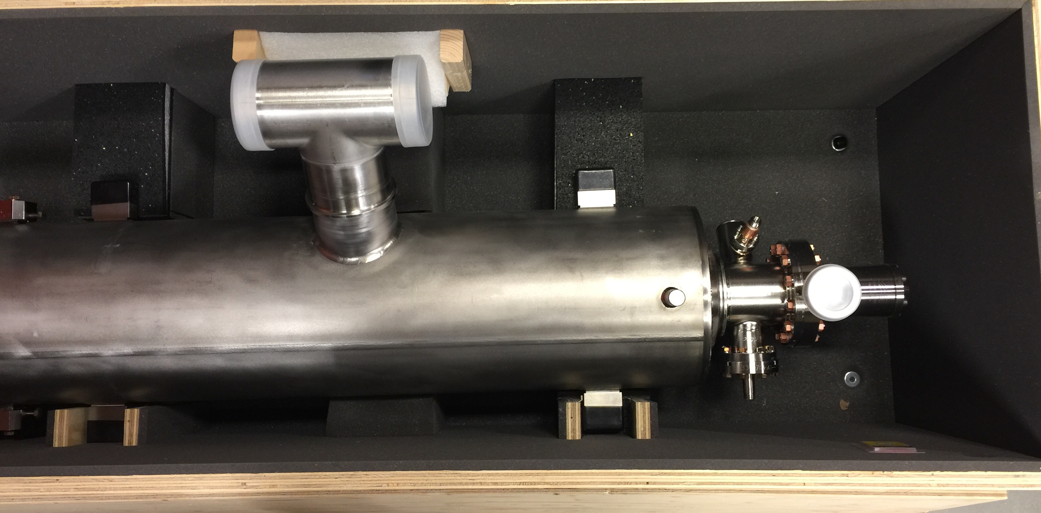
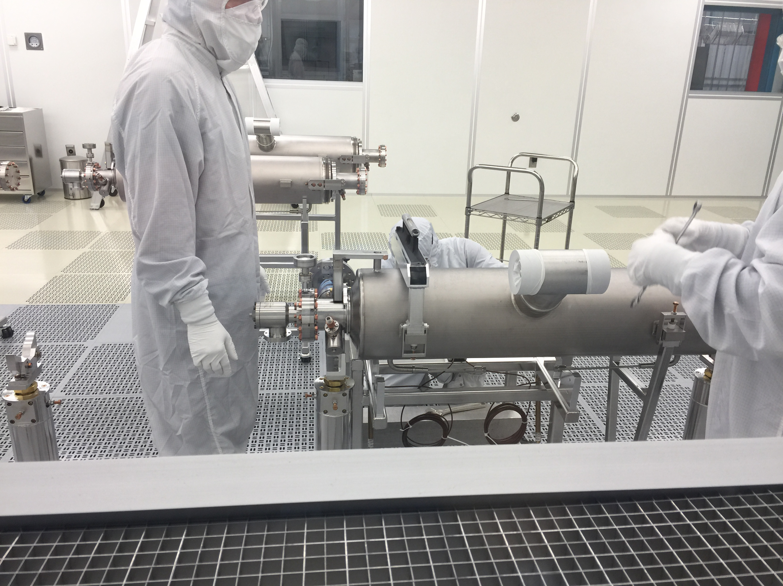
Burst Disc Orientation
Switch burst disc orientation 90-degree away from power coupler port.
  Compatible with String assembly, HOM tuning, VTS assembly and shipping
This new configuration helps Fermilab string assembly
Minimizes particle falling from burst disc to beam pipe
Minimizes turbulent flow during flange dis-assembly
No benefit to JLAB procedure
1/25/2018
7

Slide 8
Summary
Change request #1:
  Remove flange lips for parts in circulation and/or
  Align better at vendor facility
  String bellows?
Change request #2: change burst disc orientation

