Slide 1
FNAL QA/QC Summary
LCLS-II QA/QC Workshop @ JLab
Jamie Blowers
25-Jan-2018

Slide 2
Outline
A few statistics
QCR/DR trend analysis findings
New Vector feature
Experience with document/data transfer process

Slide 3
Incoming Inspection – Receipts, Inspections, QCRs

Slide 4
Travelers Issued by Month

Slide 5
DRs Issued by Month

Slide 6
Discrepancy Reports – By the Numbers
417 Discrepancy Reports issued
5M | # of DRs
Measurement | 147
Method | 127
Material | 98
(TBD) | 41
Machine | 2
Manpower | 2
Cryomodule | # of DRs
RFCG001 | 43
RFCG002 | 48
RFCG003 | 17
RFCG004 | 19
RFCG005 | 14
RFCG006 | 10
RFCG007 | 13
RFCG008 | 18

Slide 7
DR Counts by Cryomodule and 5M
Notes:
CM07 and CM08 “measurement” was: cavities, magnet, BPM incoming inspection

Slide 8
Incoming Inspection Trend Analysis
160 different part numbers have had QCRs generated
11 of them had 3 or more QCRs
5 of these 11 the QCR is the mechanism for the CMM or optical comparator data to be reviewed and dispositioned by the SOTR
3 of the 11 were for dimensional issues with Nb
1 of the 11 is for leaking connectors in the instrumentation flange assembly
  Known issue with these connectors

Slide 9
Incoming Inspection Trend Analysis
F10022642 – current leads flange
  4 QCRs for knife edge damage and/or failed leak check, one supplier
  Second supplier performed much better
F10023125 – weldment reducer tee
  3 QCRs for scratches on sealing surface (but passed leak check)
  Ironically the first supplier’s parts passed QC without any issues; “lowest qualified bidder”
F10048351 – 2-phase heat sink kit
  3 QCRs for forming process, parts not made correctly, or wrong material for the hardware
  Some parts returned to supplier, some reworked in-house
  This one was 2 POs to the same company; company should have learned from first PO since we sent parts back (best way to send message that they need to do better)

Slide 10
Discrepancy Report Trend Analysis
Reviewed the DRs for each workstation, looking for repeat issues
There were repeat issues, but they were “normal startup” issues, e.g. interferences, missing or incorrect hardware, poor surface finish or copper plating
  Feedback provided through the supply chain, and additional inspections put in place
  Drawings and travelers revised
89 DRs to date for cavity VTS
  Q_{ext2} out of spec, FE, quench, etc
  First glance at data indicate it’s not trending down (or up)

Slide 11
VTS Testing Travelers and DRs

Slide 12
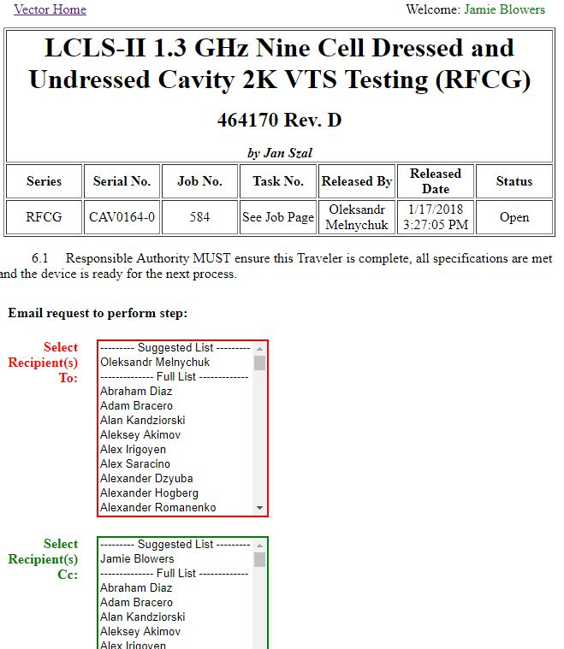
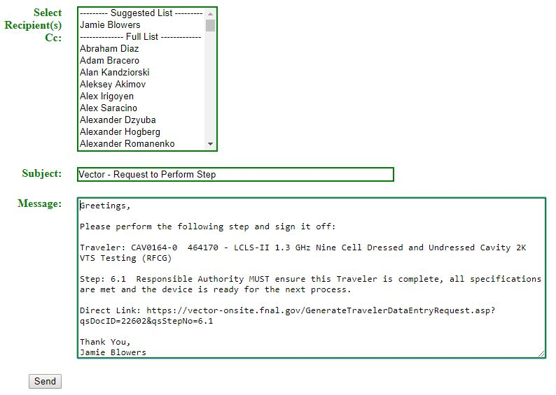
New Vector Feature
E-mail notification to sign step off (e.g. Responsible Authority OK to proceed)

Slide 13
Document/Data Transfer Experience
First document/data transfer is ~ 99% complete
Pre-shipment review went smoothly
Process is straightforward, and centers around the SLAC-defined “master traveler”
  A summary file of CM performance, RF, and alignment data
  Uploaded to the SLAC Sharepoint space
The effort to pull all these data together is not trivial
  ~2-3 days over a couple of weeks
  Expect the second one to take less time
The result is SLAC receives the lion’s share of the data they need in a format that is easy to digest

Slide 14
Document/Data Transfer Experience
We tried to consider what SLAC operations would need
  We included more alignment data than was requested
  Instrumentation layouts and calibration files were not specifically requested, but we included them
Included references to the travelers from which the data were extracted
Included notes regarding environmental conditions at the time the RF measurements were taken

Slide 15
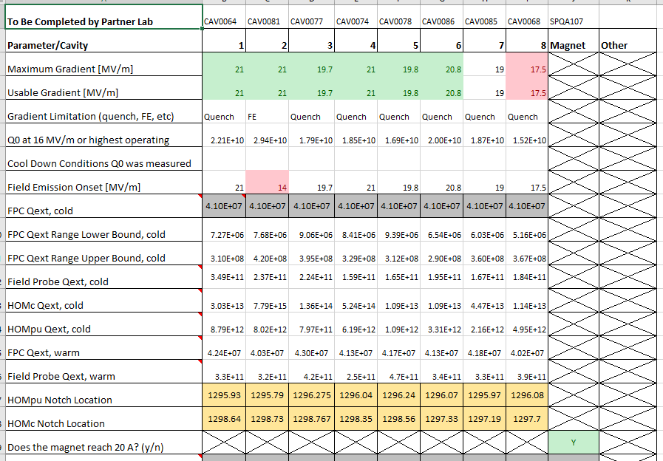
“Master Traveler” for F1.3-06

