Slide 1
JLAB QA/QC for Cryomodule
LCLS-II QA/QC Workshop
Anne McEwen / Valerie Bookwalter
25- Jan- 2017 (R11)
Notes:
DRAFT

Slide 2
Outline & Introduction
Introduction
  JLAB overall Quality Management System managed by EHS&Q
    Significant Non Conformances are reported by EHS&Q (S. Smith) per LCLS-II-1.1-QA-0563
  SRF Quality is reviewed monthly with SRF Management
Travelers / NCR Status , Pareto on Parts & Assembly
  Traveler Status – number Open/Closed
  NCR (Non Conformance) – number Open/Closed
  NCRs Pareto of types of quality issues
  Data Mining Tools & New Reports available in Pansophy
      Example CM-04 documentation Status
Note : Specific examples of Lessons Learned will be covered later in the Workshop to show how issues are closed and lessons learned integrated to Procedures & Processes for specific Parts/Issues

Slide 3
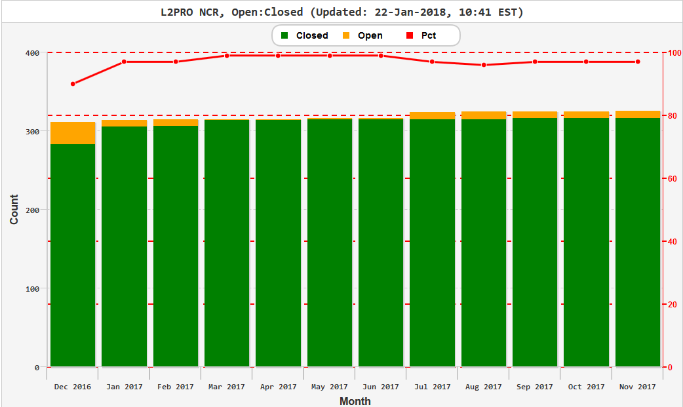
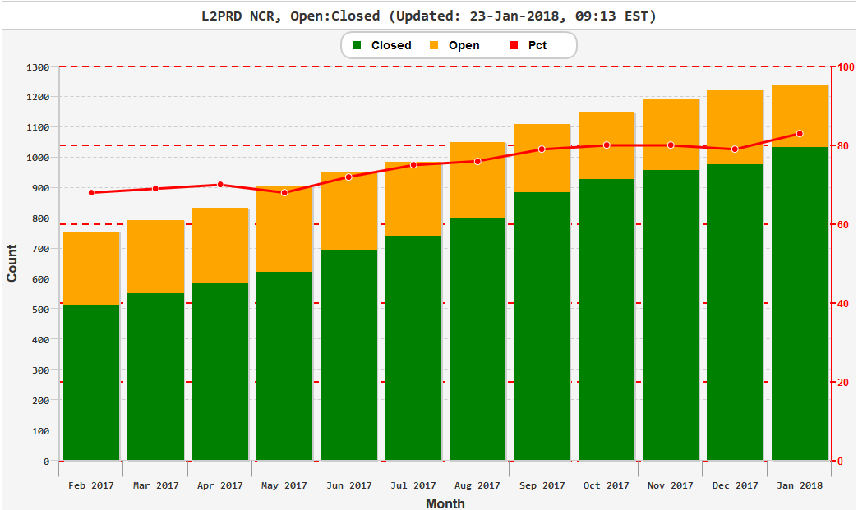
Total * NCR Status by month (22 Jan2018)
* all Cryomodules as of date of report
pCM – no change since November
97%
Closed
83%
Closed
Production NCRs
% NCRs closed continues to increase

Slide 4
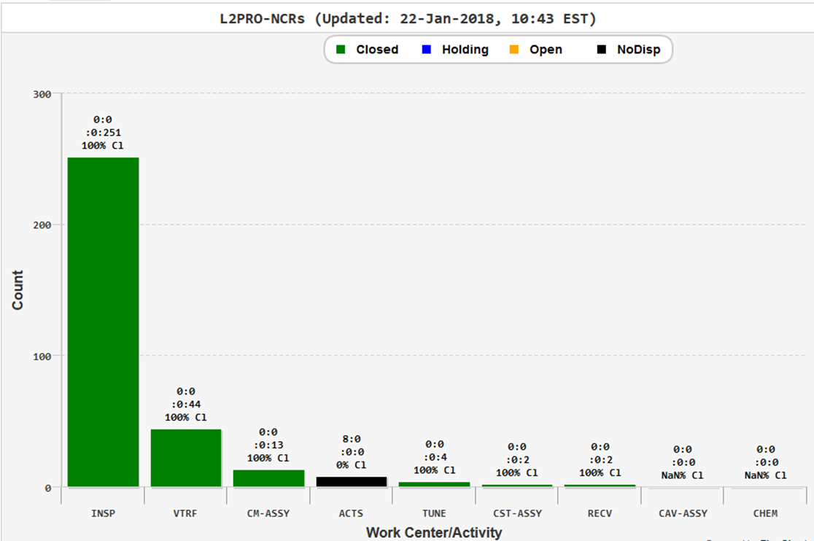
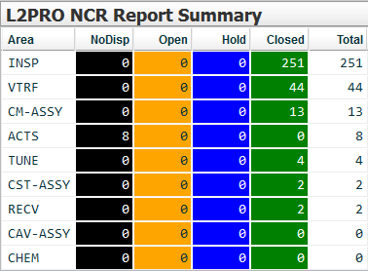
L2 pCM NCR Open/Closed by Work center
L2 pCM - 8 Open NCRs (details in Appendix)
Cavity FE Onset at 12 MV/m
Couplers cannot be adjusted to proper Qext setting (4.0E7)
HOM A Couplers < 5E11
HOM B Couplers < 5E11
CM Performance
L2PRO-CM-ACTS
(CMTF Test)

Slide 5
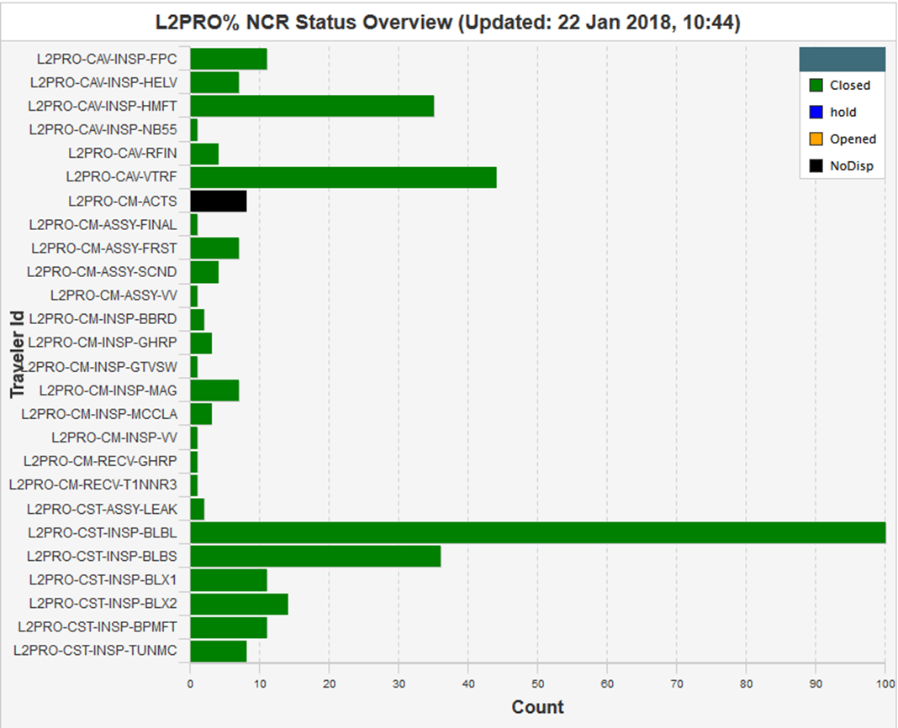
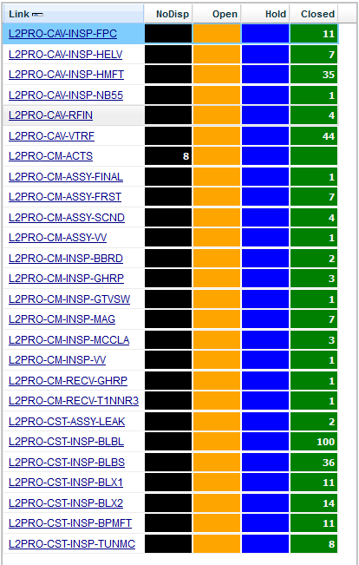
pCM NCR Status (listed by Traveler )

Slide 6
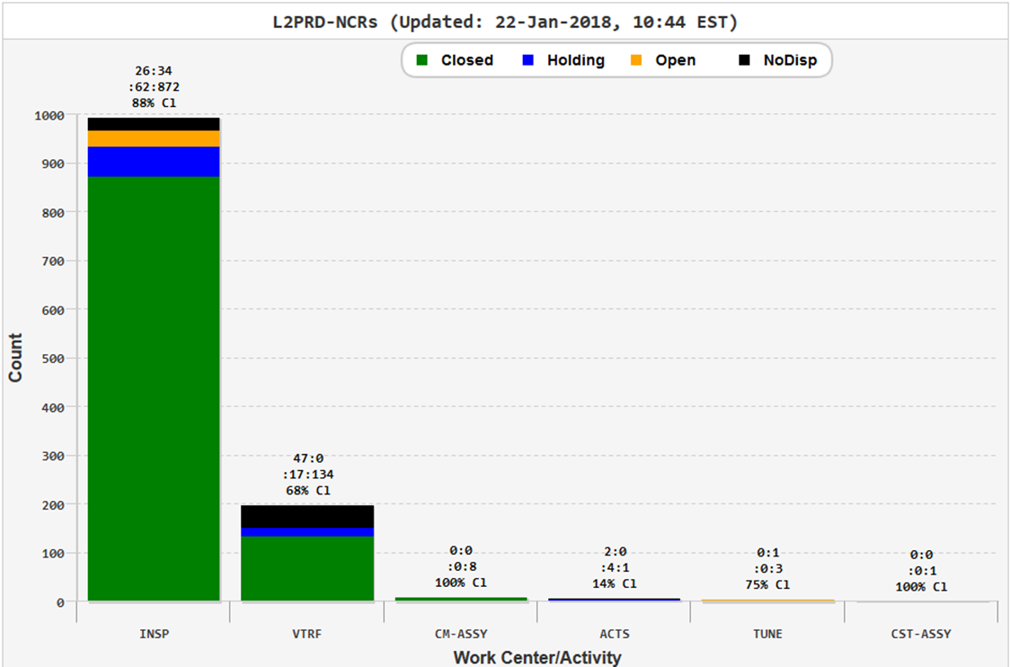
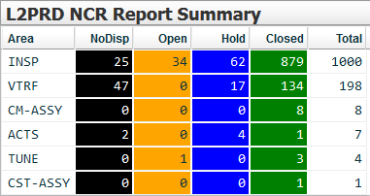
L2 PROD’N Open/Closed by Work center
* all Production Cryomodules as of date of report
L2 Prd’n NCR * details in Appendix
Cavity 14 NCRs, Shock Watch
Cavity 14 NCRs various
Cavity VTRF - 64 NCRs
FPC – 6 NCRs
FPC Warm– 22 NCRs
Feed Thru – 3 NCRs
BLBP – 22 NCRs
Bellows - 68 NCRs
Tuners -7 NCRs
Instrumentation (seal) 1 NCR
* Note that a part can have more than one NCR

Slide 7
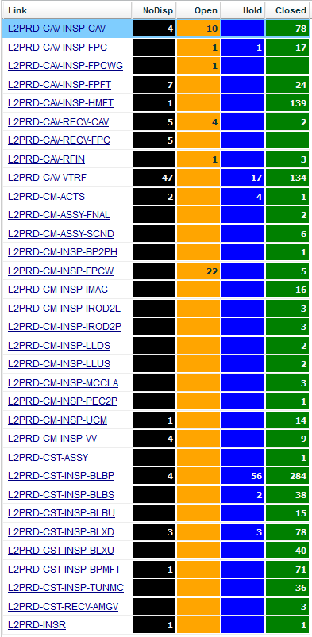
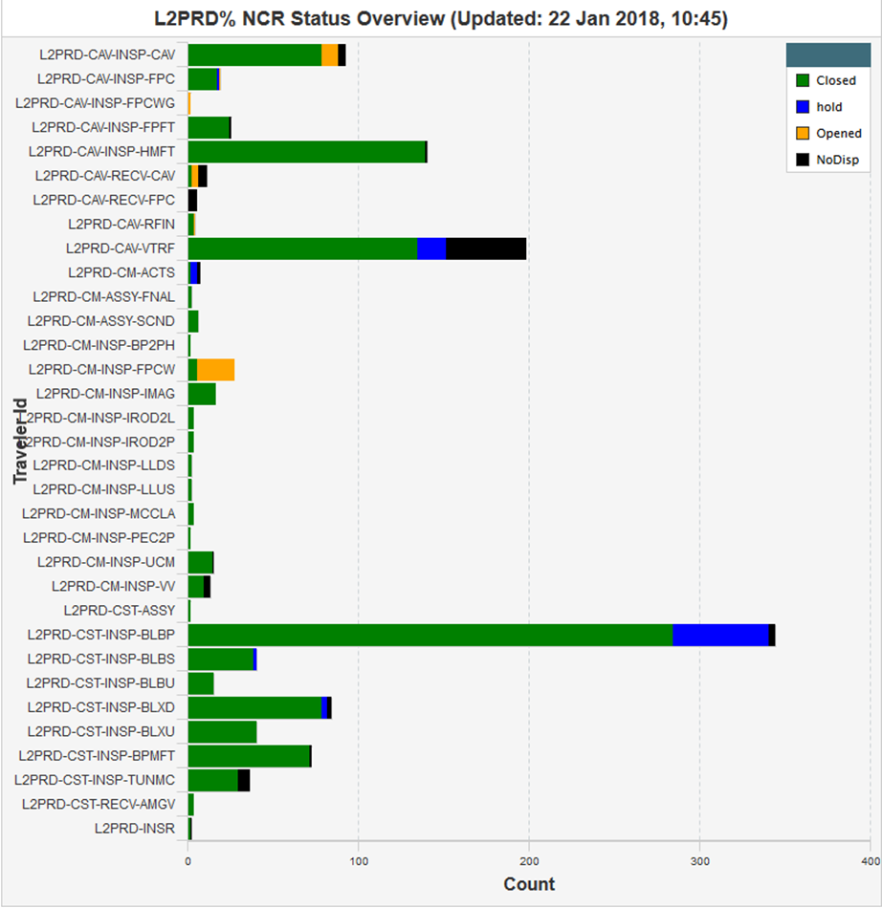
Prod’n NCR (listed by Traveler )

Slide 8
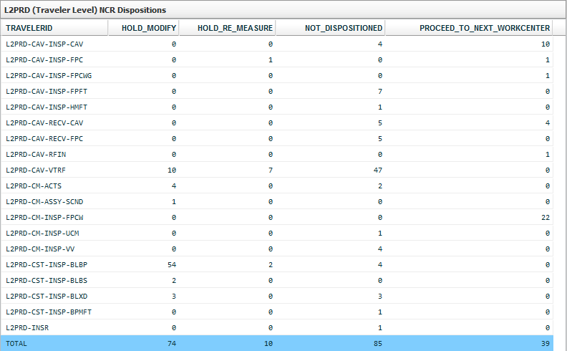
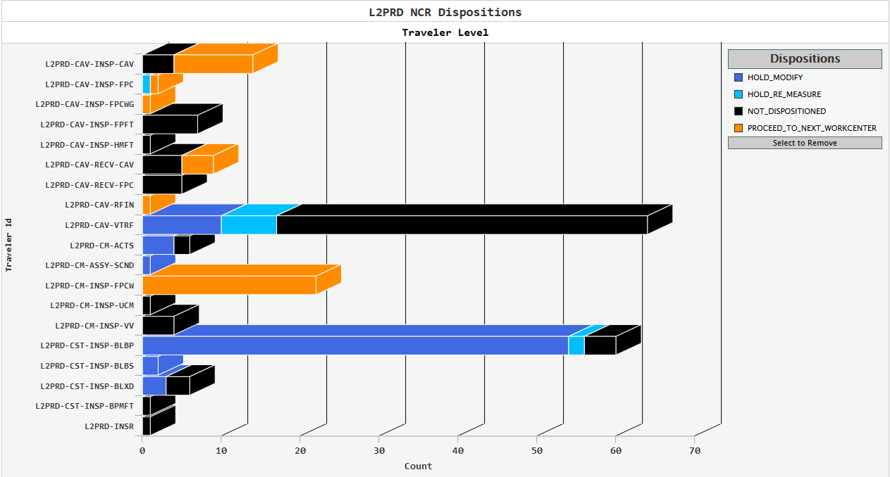
Open Production NCRs – Blue are on Hold
Parts “on Hold” (Blue) are typically often waiting until needed for re-work

Slide 9
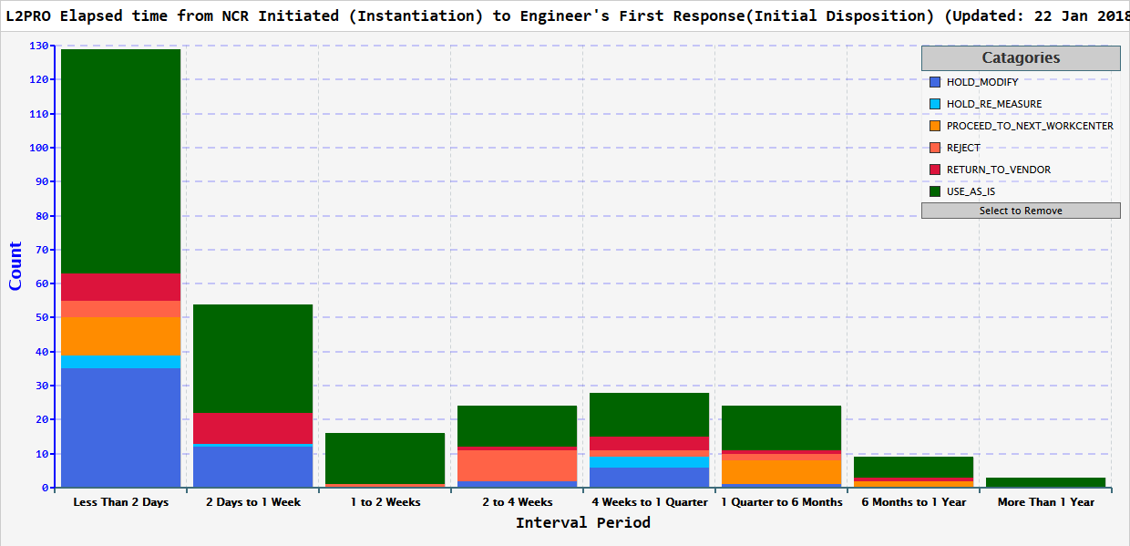
Example – Production NCRs Initiated to First Response
129
54
16
24
28
24
9
3
Last Wk
129
54
16
24
28
24
9
3

Slide 10
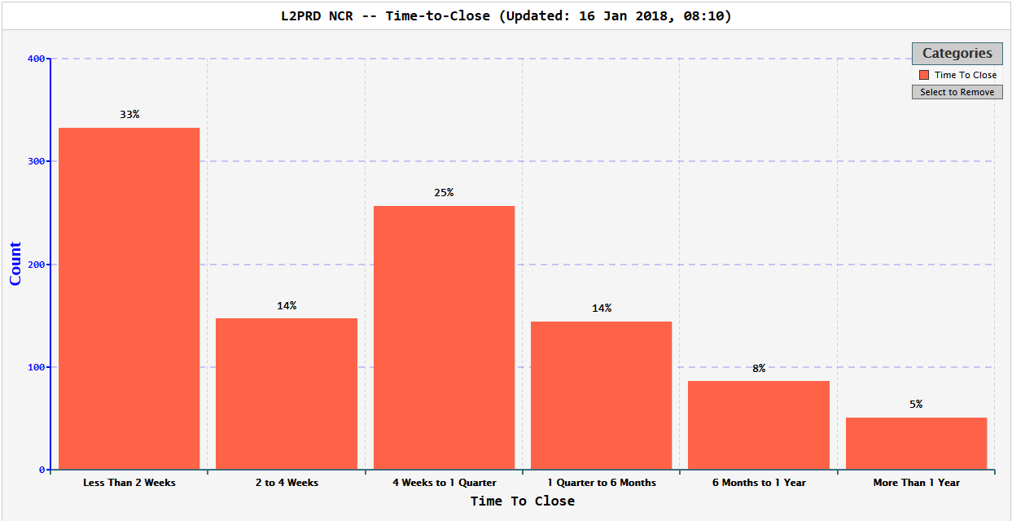
NCRs Time to Closure (includes NCRs on HOLD)
Last Month
33%
15%
26%
14%
8%
4%

Slide 11
Traveler Status
LCLS-II JLAB Cryomodule QA/QC Workshop 25Jan2018

Slide 12
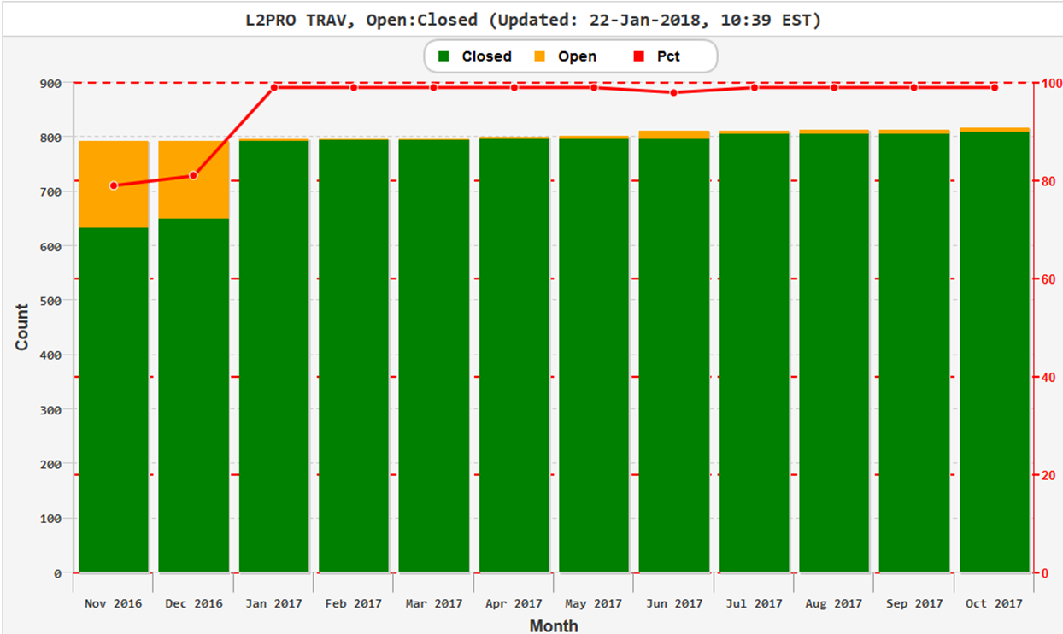
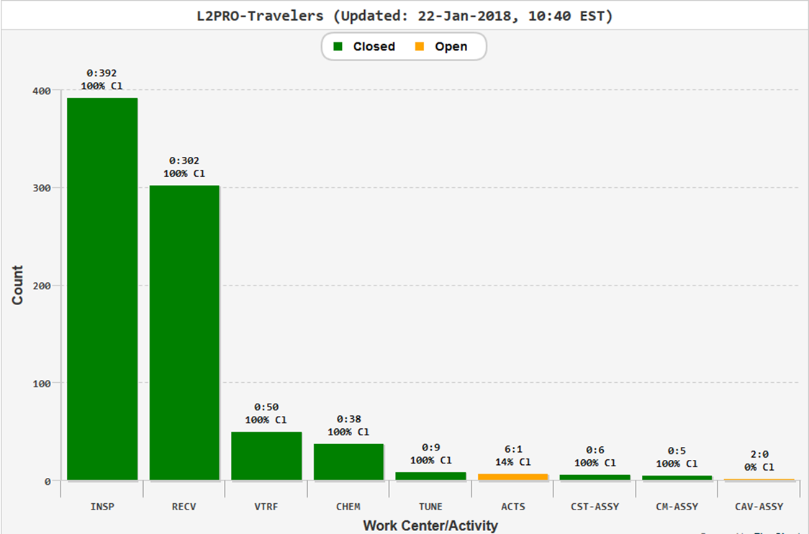
pCM Travelers - by Month &work Center
pCM Travelers closed except
ACTS = Acceptance Test (CMTF) , no change since November

Slide 13
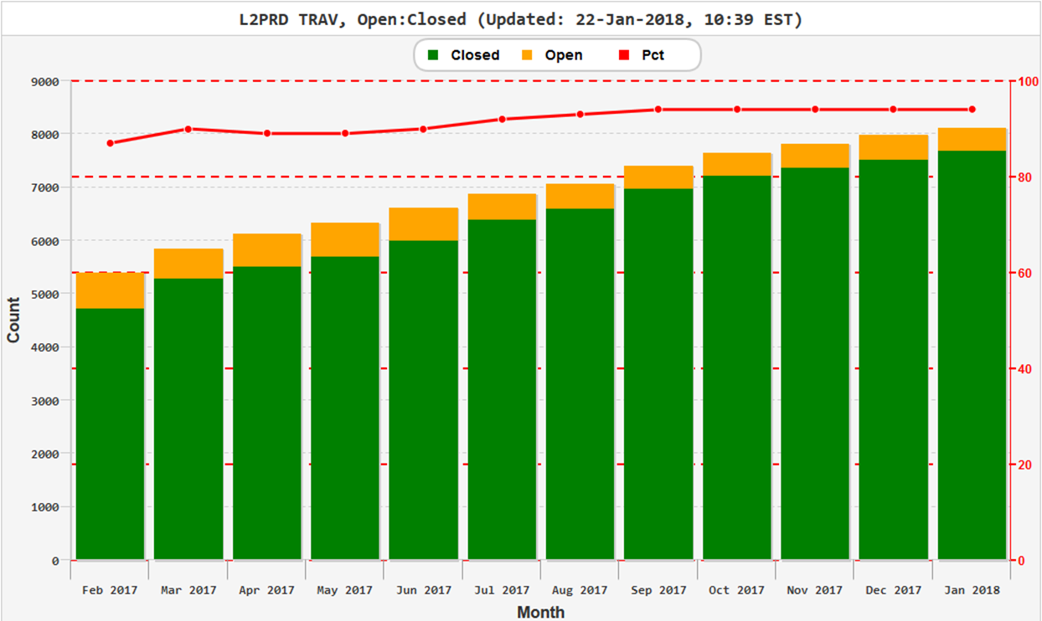
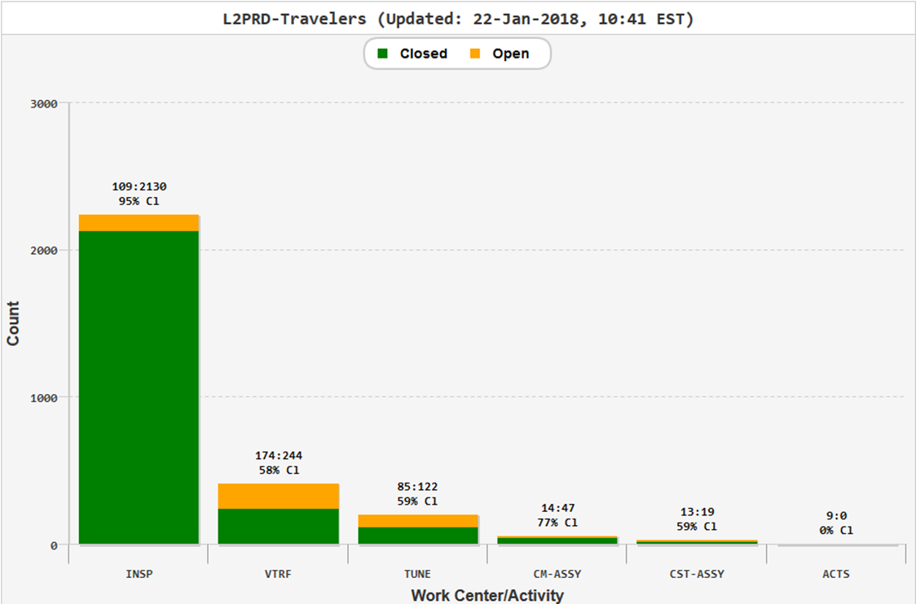
Production Travelers by month& work center
Travelers being closed as work is completed

Slide 14
Pansophy Tools & Reports
LCLS-II JLAB Cryomodule QA/QC Workshop 25Jan2018

Slide 15
Drill Down & New reports in Pansophy
Preparation for shipping
  Key Performance Summary Reports (similar to XFEL)
  By Cavity
  By String Assembly
  By Cryomodule
Tool for Traveler & NCR status by CM (example CM04)
  Status with “traffic Lights “ and option to drill down
Continuing Supporting Production, SOTRs and Quality
  Cryomodule Location in JLAB
  Vendor Hold point Data and Cavity Processing
  Cavity Performance listing
  CM Construction Status Board
  NCR Status and drill down reports

Slide 16
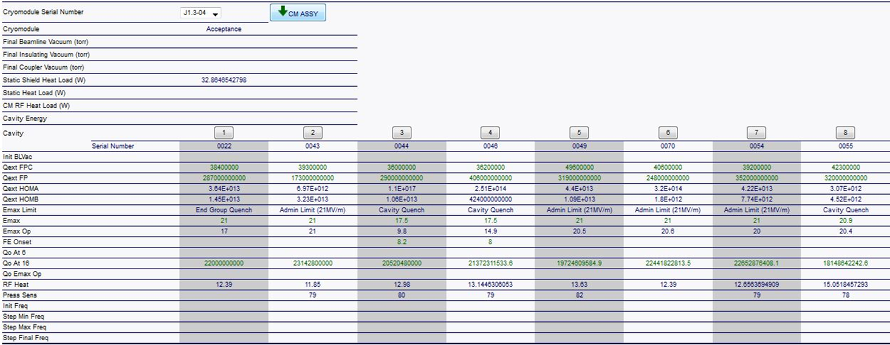
Drill-Down : CMTF Test Report J1.3-04
Cryomodule J1.3-04
Not yet shipped
Data shown in process
As of 22Jan2018
Where to find L2 Prod’n Test Report https://pansophy.jlab.org/pansophy/
Main Menu
Data Mine
Drilldown
L2PRD
ACTS
  Select Cryomodule of interest

Slide 17
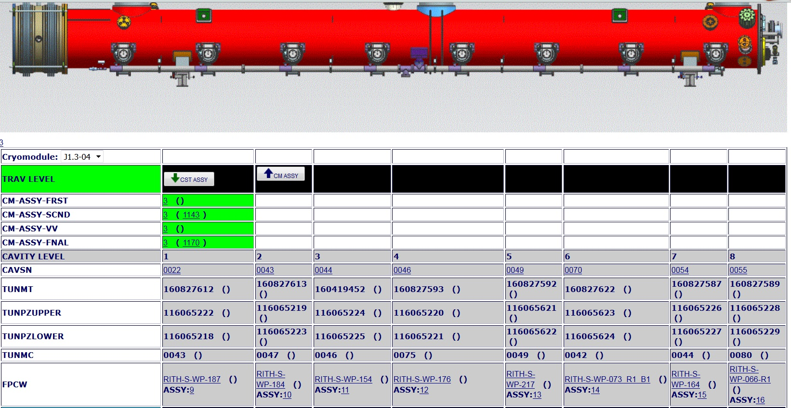
Drill-Down: J1.3-04 (Part 1)
Cryomodule J1.3-04
Not yet shipped
Data shown in process
As of 22Jan2018
Shows Serial number traceability & status where available at the Cryomodule level

Slide 18
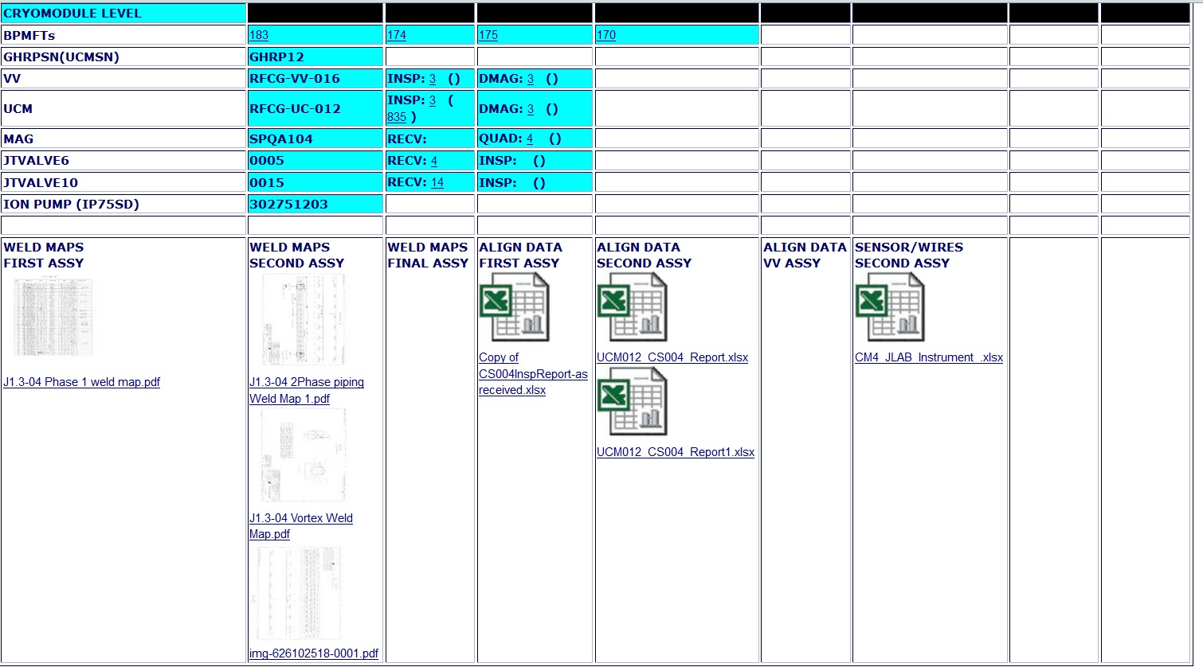
Drill-Down: J1.3-04 (Part 2)
Cryomodule J1.3-04
Not yet shipped
Data shown in process
As of 22Jan2018
Shows Drill down with Weld Maps - Material Certs in SOTR folders (M Drive)

Slide 19
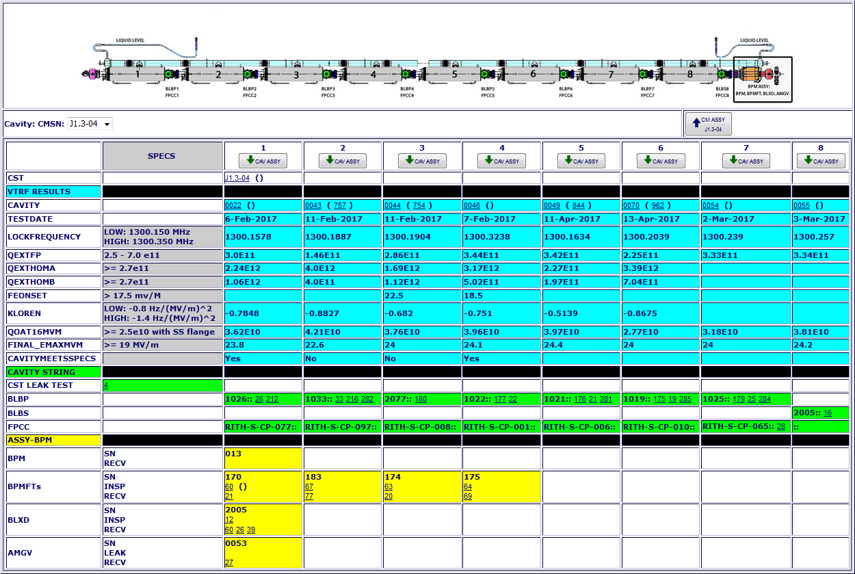
Drill-Down: Cavity String used in J1.3-04
Cryomodule J1.3-04
Not yet shipped
Data shown in process
As of 22Jan2018
Report shows Cavity String
Serial No. , Traceability
Cavity Data & Status

Slide 20
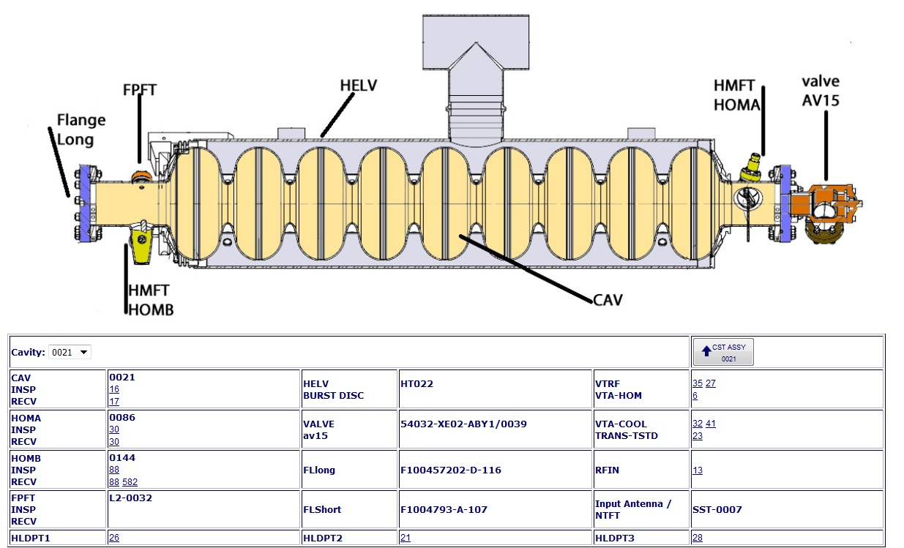
Drill-Down Cavity (Example Cavity 021 from J1.3-04)
Cryomodule J1.3-04
Not yet shipped
Data shown in process
As of 22Jan2018
Report Shows Cavity level traceability serial number & status

Slide 21
Drill Down by Cryomodule Traveler /NCR Status
Cryomodule J1.3-04
Not yet shipped
Data shown in process
As of 22Jan2018
Traveler/NCR status – Example for CM04 (Planned to ship soon )
J1.3-04 | Open | Closed | Total | % closed | % open
Travelers * | 9 | 243 | 252 | 96% | 4%
NCRs * | 3 | 22 | 25 | 88% | 12%
* Quantity of Travelers /NCRs listed is the number instantiated
Total in table above does not include the following
Travelers still in “Draft”
  Revised HOM Traveler & Procedure (in Draft)
  Shipping & Re-Work Travelers for CMs (in Draft)
Additional Supplier docs. from SOTRs on the M Drive (i.e.. Certs)
Also not included are following (no data in travelers )
  Tuners (spread sheet)
  JT Valves (10% are inspected)
  FPC Cold
  HOM (short & long vs A&B)
Where to find L2 Traveler & NCR Status https://pansophy.jlab.org/pansophy/
Main Menu
Data Mine
Reports
L2PRD
CM Traveler 2
  Select Cryomodule of interest
Through Interactive “traffic lights” in the documents Status Report , the user can “drill down” to the documents in question.
Example for J1.3-04 in the 3 pages to follow…….

Slide 22
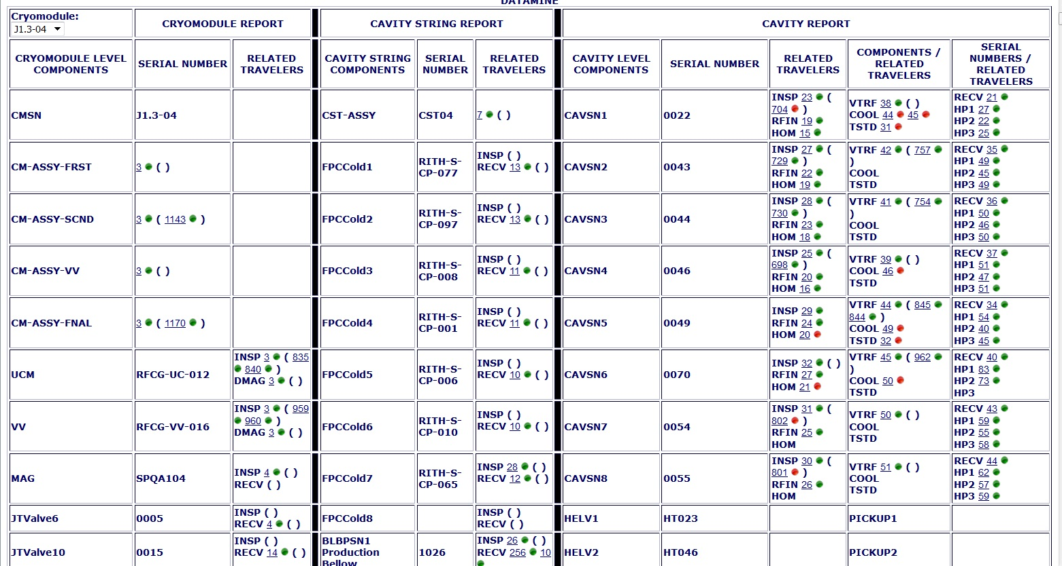
Drill Down - CM04 Travelers/NCRs Status (Page 1)
This interactive tool is intended to assist the Project in identifying what remains to be closed for any one CM
KEY::
XX (YY )
Where
XX = Traveler sequence number
YY = NCR sequence number
: Traveler/ NCR OPEN
: Traveler/NCR CLOSED
XX & YY are links to Travelers and NCRs

Slide 23
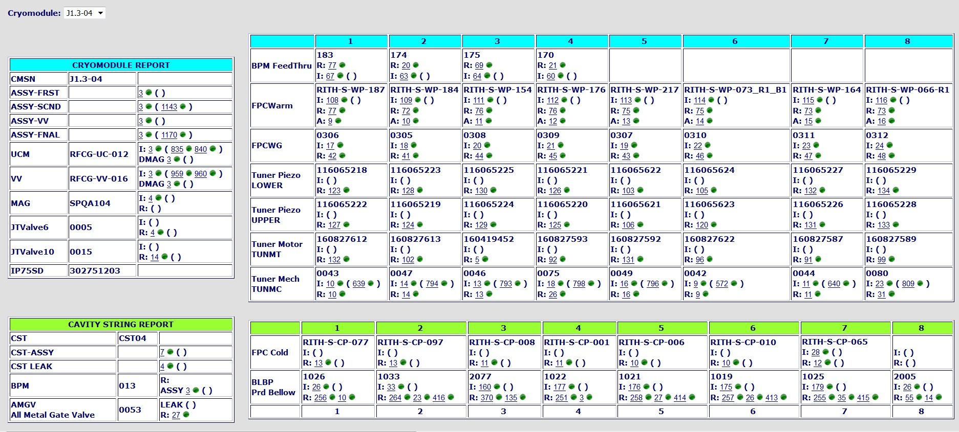
Drill Down - CM04 Travelers/NCR Status (Page 2)
Cryomodule J1.3-04
Not yet shipped
Data shown in process
As of 22Jan2018
KEY::
XX (YY )
Where
XX = Traveler sequence number
YY = NCR sequence number
: Traveler/ NCR OPEN
: Traveler/ NCR CLOSED
XX & YY are links to Travelers and NCRs

Slide 24
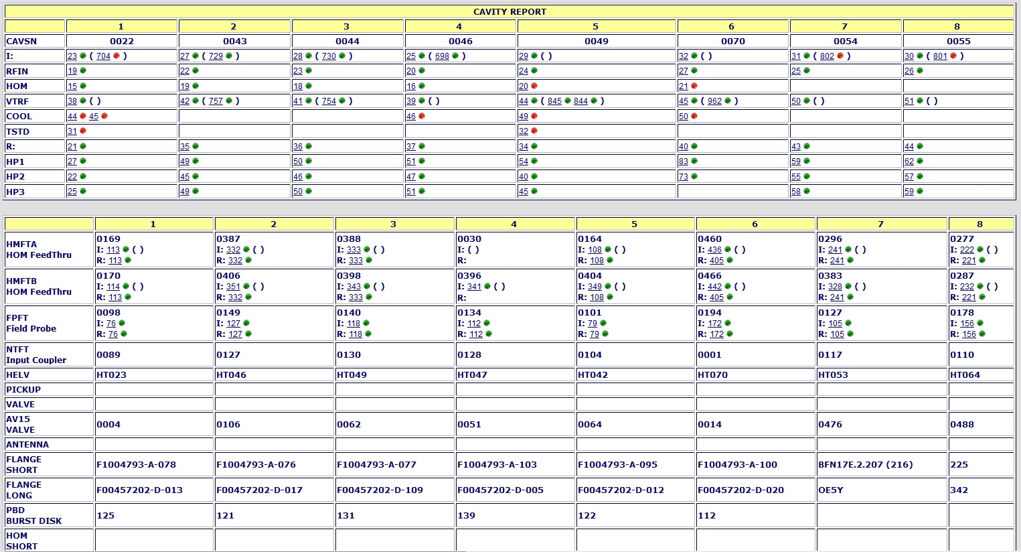
Drill Down - CM04 Travelers/NCR Status (Page 3)
Cryomodule J1.3-04
Not yet shipped
Data shown in process
As of 22Jan2018
KEY::
XX (YY )
Where
XX = Traveler sequence number
YY = NCR sequence number
: Traveler/ NCR OPEN
: Traveler/ NCR CLOSED
XX & YY are links to Travelers and NCRs

Slide 25
Drill Down - CM04 Travelers/NCR Status DEMO
Demonstration by Valerie
(Time permitting)

Slide 26
Tools & Reports to Support Production
LCLS-II JLAB Cryomodule QA/QC Workshop 25Jan2018

Slide 27
Pansophy Tools & Reports (incl. all CMs for Project)
Cryomodule Location in JLAB
Vendor Hold point Data and Cavity Processing
Cavity Performance listing
CM Construction Status Board
NCR Status and drill down reports

Slide 28
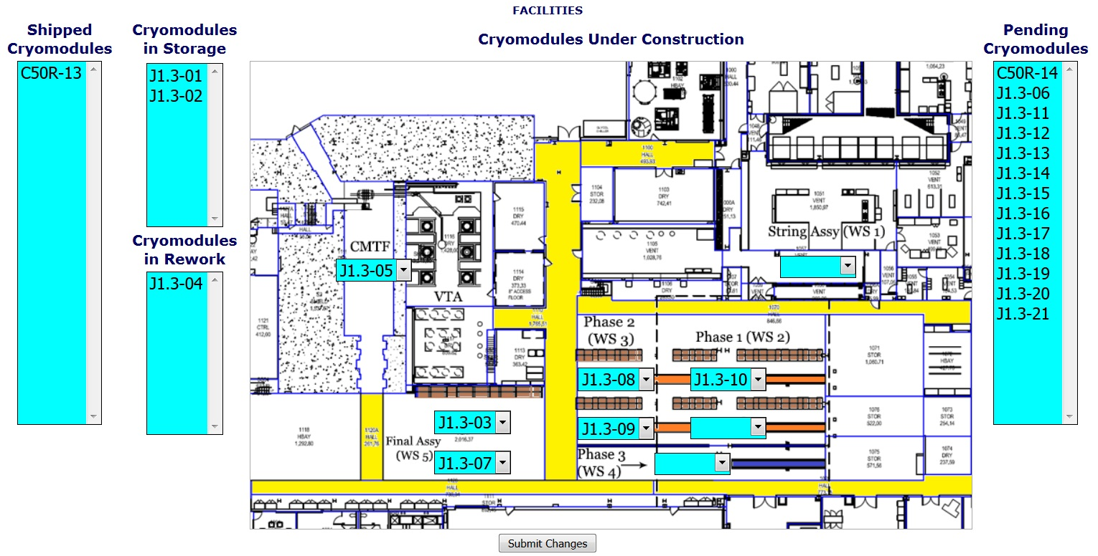
CM Locations and Work Centers
Where to find L2 CM Locations Report https://pansophy.jlab.org/pansophy/
Main Menu
Facilities
CM Locations

Slide 29
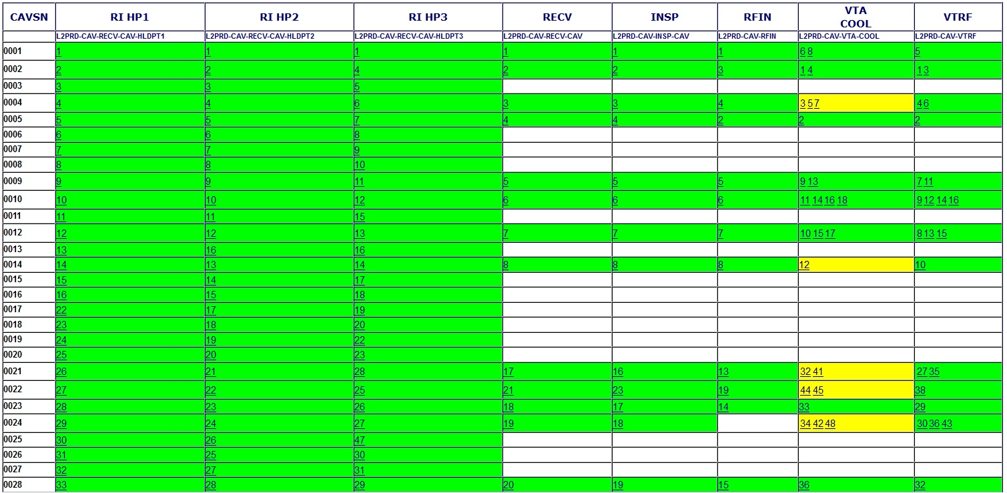
Vendor Hold Point Data & Cavity Processing Status
Note: blank space usually means this cavity went to FNAL

Slide 30
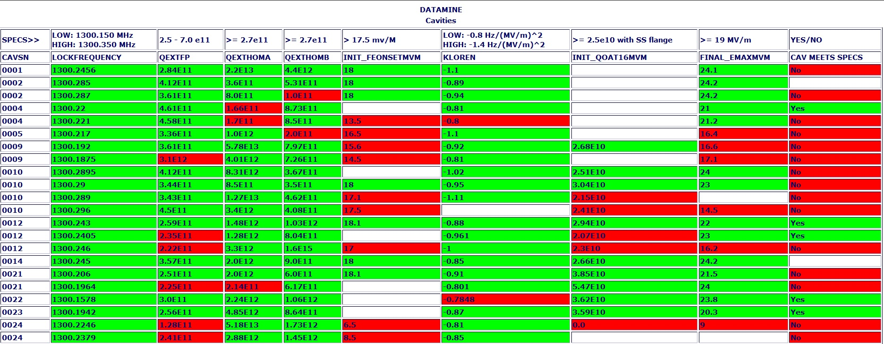
Cavity Performance Listing
Where to find L2 Cavity Performance Report https://pansophy.jlab.org/pansophy/
Main Menu
Data Mine
Reports
Cavity Specification

Slide 31
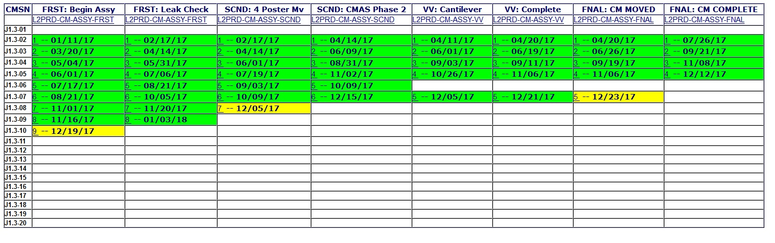
CM Construction Status Board
Where to find L2 CM Construction Status https://pansophy.jlab.org/pansophy/
Main Menu
Data Mine
Drilldown
SRF Reports
L2 CM PRD
Will be adding a column for ship traveler & date

Slide 32
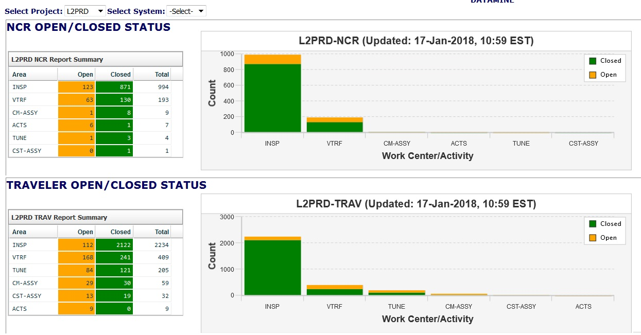
Project Overview (part 1- all Cryomodules to date)

Slide 33
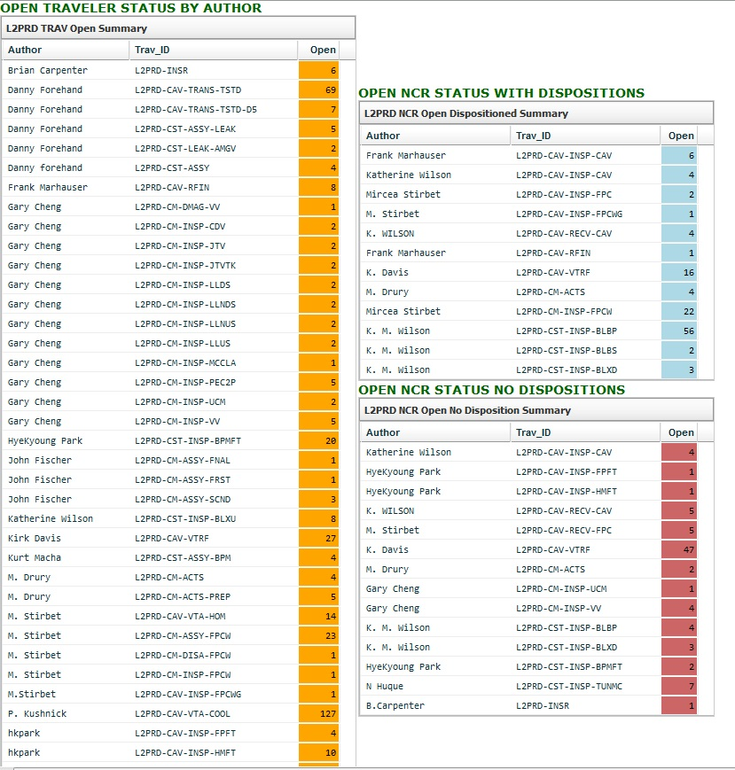
Project Overview (part 2 all cryomodules to date)
Status by Author &Traveler

Slide 34
Summary
LCLS-II JLAB Cryomodule QA/QC Workshop 25Jan2018

Slide 35
Summary
Quality Tools are supporting the Project
  Continuously improving the Reporting functions
QC Results
  NCRs are being addressed and closed

Slide 36
Drill Down - CM04 Travelers/NCR Status DEMO
Demonstration by Valerie
(Time permitting)

Slide 37
Back – UP Slides
LCLS-II JLAB Cryomodule QA/QC Workshop 25Jan2018

Slide 38
For reference - List of Travelers
 | Traveler Name | Traveler ID | AUTHOR | REVIEWER | PROJ MNGR |  | DRAFT DUE | FINAL DUE | DRAFT DONE | FINAL DONE | NCR list | Traveler (Hold point) Closer list | NOTES
 | Inspection travelers
 | Cavity
 | Helium Vessel Inspection | L2PRD-CAV-INSP-CAV | Marhauser | Dickey | Daly |  | 1-May-16 | 15-May-16 | 9-May-16 | 9-May-16 | marhause,edaly,carpente,forehand,overtonr | marhause,edaly,carpente,forehand,overtonr
 | Coupler (pairs) | L2PRD-CAV-INSP-FPC | Stirbet | Reilly | Daly | Wilson | 16-Jul-16 | 30-Jul-16 | 9-Sep-16 | 9-Sep-16 | areilly,edaly,macha,kwilson,stirbet
 | Cavity Field Probe Feedthru Receiving Inspection | L2PRD-CAV-INSP-FPFT | Park | Carpenter | Daly |  | 26-Feb-16 | 11-Mar-16 | 26-Feb-16 | 26-Feb-16 | hkpark | hkpark,areilly
 | Cavity HOM Feedthru Receiving Inspection | L2PRD-CAV-INSP-HMFT | Park | Carpenter | Daly |  | 26-Feb-16 | 11-Mar-16 | 26-Feb-16 | 26-Feb-16 | hkpark | hkpark,areilly
 | Cavity RF Inspection | L2PRD-CAV-RFIN | Marhauser | Forehand | Davis |  | 10-Jun-16 | 24-Jun-16 | 17-Jun-16 | 17-Jun-16 | marhause,forehand,overtonr,edaly,carpente
 | Cavity String
 | Cavity Beam Line Bellows PRCM | L2PRD-CST-INSP-BLBP | Wilson | Carpenter | Daly |  | 6-May-16 | 20-May-16 | 6-May-16 | 6-May-16 | kwilson | kwilson
 | Cavity Beam Line Bellows Short | L2PRD-CST-INSP-BLBS | Wilson | Carpenter | Daly |  | 26-Apr-16 | 10-May-16 | 26-Apr-16 | 26-Apr-16 | kwilson | kwilson
 | String Beam Line Extension Downstream | L2PRD-CST-INSP-BLXD | Wilson | Carpenter | Daly |  | 12-Apr-16 | 26-Apr-16 | 12-Apr-16 | 12-Apr-16 | kwilson | kwilson
 | String Beam Line Extension Upstream | L2PRD-CST-INSP-BLXU | Wilson | Carpenter | Daly |  | 12-Apr-16 | 26-Apr-16 | 12-Apr-16 | 12-Apr-16 | kwilson | kwilson
 | BPM FeedThrus Receiving Inspection | L2PRD-CST-INSP-BPMFT | Park | Carpenter | Daly | Wilson | 24-Jun-16 | 8-Jul-16 | 21-Jun-16 | 24-Jun-16 | hkpark
 | 300K Current Leads CF Flange Inspection | L2PRD-CST-INSP-CFL | Hiatt | Wilson | Daly |  | 22-Aug-16 | 5-Sep-16 | 26-Aug-16 | 26-Aug-16 | hiatt
 | End Lever Tuner Mechanical Frame Inspection | L2PRD-CST-INSP-TUNMC | Huque | Carpenter | Daly |  | 15-Jun-16 | 29-Jun-16 | 15-Jun-16 | 15-Jun-16 | huque,edaly
 | End Lever Tuner Moto | L2PRD-CST-INSP-TUNMT | Huque | Carpenter | Daly |  | 15-Jun-16 | 29-Jun-16 | 13-Sep-16 | 13-Sep-16 | huque,edaly
 | Tuner Piezo Actuatir Assembly Inspection | L2PRD-CST-INSP-TUNPZ | Huque | King | Daly |  | 18-Feb-16 | 3-Mar-16 | 18-Feb-16 | 18-Feb-16 | huque,edaly
 | Qquadrapole Magnet SPQA002 Inspection | L2PRD-CST-MAG-QUAD | Hiatt | Beck | Daly |  | 29-Aug-16 | 12-Sep-16 | 7-Sep-16 | 7-Sep-16 | hiatt,edaly
 | Cryomodule
 | Bellows 2-Phase Pipe | L2PRD-CM-INSP-BP2PH | Cheng | Carpenter | Daly |  | 11-May-16 | 25-May-16 | 11-May-16 | 13-May-16 | cheng,fischer,areilly,edaly | cheng,edaly,areilly
 | Cryomodule Cool Down Cryogenic Valve (CDV) | L2PRD-CM-INSP-CDV | Cheng | Carpenter | Reilly |  | 14-Feb-17 | 28-Feb-17 | 20-Feb-17 | 20-Feb-17 | cheng,fischer,areilly,edaly
 | Receiving Inspection CM Disk 2-Phase Support | L2PRD-CM-INSP-DK12P | Cheng | Carpenter | Reilly |  | 12-Sep-16 | 26-Sep-16 | 12-Sep-16 | 13-Sep-16 | cheng, fischer, areilly, edaly
 | Receiving Inspection CM Disk 2-Phase Support | L2PRD-CM-INSP-DK22P | Cheng | Carpenter | Reilly |  | 12-Sep-16 | 26-Sep-16 | 12-Sep-16 | 13-Sep-16 | cheng, fischer, areilly, edaly
 | Shipping End Cap Inspection | L2PRD-CM-INSP-EDCP | Huque | Fischer | Reilly |  | 2-Nov-16 | 16-Nov-16 | 3-Nov-16 | 4-Jan-17 | huque,edaly
 | Shipping Feed Cap Inspection | L2PRD-CM-INSP-FDCP | Huque | Fischer | Reilly |  | 2-Nov-16 | 16-Nov-16 | 3-Nov-16 | 4-Jan-17 | huque,edaly
 | Warm FPC Inspection | L2PRD-CM-INSP-FPCW | Stirbet | Reilly | Daly | Fischer | 28-Sep-16 | 12-Oct-16 | 28-Sep-16 | 28-Sep-16 | areilly,edaly,stirbet,fischer
 | FPC Waveguide Inspection | L2PRD-CM-INSP-FPCWG | Stirbet | Reilly | Daly | Fischer | 28-Sep-16 | 12-Oct-16 | 28-Sep-16 | 28-Sep-16 | edaly,stirbet,fischer,mdickey
 | Receiving Inspection CM Magnetic Shield Assembly | L2PRD-CM-INSP-IMAG | Cheng | Carpenter | Reilly |  | 12-Sep-16 | 26-Sep-16 | 12-Sep-16 | 13-Sep-16 | cheng, fischer, areilly, edaly
 | Receiving Inspection CM Rod Invar 2-Phase Long | L2PRD-CM-INSP-IROD2L | Cheng | Carpenter | Reilly |  | 12-Sep-16 | 26-Sep-16 | 12-Sep-16 | 13-Sep-16 | cheng, fischer, areilly, edaly
 | Receiving Inspection CM Rod Invar 2-Phase | L2PRD-CM-INSP-IROD2P | Cheng | Carpenter | Reilly |  | 12-Sep-16 | 26-Sep-16 | 12-Sep-16 | 13-Sep-16 | cheng, fischer, areilly, edaly
 | Receiving Inspection CM Assembly, JT Cryogenic Valve | L2PRD-CM-INSP-JTV | Cheng | Carpenter | Reilly |  | 10-Oct-16 | 24-Oct-16 | 10-Oct-16 | 10-Oct-16 | cheng, fischer, areilly, edaly
 | Receiving Inspection CM Assembly, JT Valve Tube Kit | L2PRD-CM-INSP-JTVTK | Cheng | Carpenter | Reilly |  | 12-Sep-16 | 26-Sep-16 | 12-Sep-16 | 13-Sep-16 | cheng, fischer, areilly, edaly
 | Receiving Inspection CM Assembly, Liquid He Level-DS | L2PRD-CM-INSP-LLDS | Cheng | Carpenter | Reilly |  | 12-Sep-16 | 26-Sep-16 | 12-Sep-16 | 13-Sep-16 | cheng, fischer, areilly, edaly
 | Receiving Inspection of CM Weldment Line Liquid Level DS | L2PRD-CM-INSP-LLNDS | Cheng | Carpenter | Reilly |  | 12-Sep-16 | 26-Sep-16 | 12-Sep-16 | 13-Sep-16 | cheng, fischer, areilly, edaly
 | Receiving Inspection CM Weldment Line Liquid Level US | L2PRD-CM-INSP-LLNUS | Cheng | Carpenter | Reilly |  | 12-Sep-16 | 26-Sep-16 | 12-Sep-16 | 13-Sep-16 | cheng, fischer, areilly, edaly
 | Receiving Inspection CM Assembly, Liquid He Level-US | L2PRD-CM-INSP-LLUS | Cheng | Carpenter | Reilly |  | 12-Sep-16 | 26-Sep-16 | 12-Sep-16 | 13-Sep-16 | cheng, fischer, areilly, edaly
 | LCLS-II Cryomodule MC Coupling Line Assembly Inspection | L2PRD-CM-INSP-MCCLA | Cheng | Carpenter | Reilly |  | 27-Jun-16 | 11-Jul-16 | 27-Jun-16 | 27-Jun-16 | cheng,fischer,areilly,edaly | cheng,edaly,areilly
 | Receiving Inspection CM Weldment 2-Phase Pipe End Cap | L2PRD-CM-INSP-PEC2P | Cheng | Carpenter | Reilly |  | 12-Sep-16 | 26-Sep-16 | 12-Sep-16 | 13-Sep-16 | cheng, fischer, areilly, edaly
 | Upper Cold Mass Inspection | L2PRD-CM-INSP-UCM | Cheng | Carpenter | Reilly |  | 30-Sep-16 | 14-Oct-16 | 13-Sep-16 | 13-Sep-16 | cheng,fischer,areilly,edaly
 | Receiving Inspection CM Vacuum Vessel | L2PRD-CM-INSP-VV | Cheng | Carpenter | Reilly |  | 12-Sep-16 | 26-Sep-16 | 12-Sep-16 | 13-Sep-16 | cheng, fischer, areilly, edaly

Slide 39
For Reference List of Travelers (cont)
 | Traveler Name | Traveler ID | AUTHOR | REVIEWER | PROJ MNGR |  | DRAFT DUE | FINAL DUE | DRAFT DONE | FINAL DONE | NCR list | Traveler (Holdpoint) Closer list | NOTES
 | Processing Travelers
 | Cavity
 | Cavity Heat Treatment & Nitrogen Doping | L2PRD-CAV-ASSY-HEAT | Forehand | Palczewski | Davis
 | Cavity Cleaning / Ultrasonic Cleaning | L2PRD-CAV-CHEM-USC | Zhao | Follkie | Reilly
 | First HPR | L2PRD-CAV-CHEM-HPR1 | Follkie | Harris | Reilly
 | Second HPR (COMBINE WITH HPR1) | L2PRD-CAV-CHEM-HPR2 | Follkie | Harris | Reilly
 | Cavity String
 | Cryomodule
 | Upper Cold Mass Magnetic Hygiene Control | L2PRD-CM-DMAG-UCM | Cheng | Legg | Reilly |  | 1-Feb-17 | 15-Feb-17 | 8-Feb-17 | 8-Feb-17
 | Cryomodule Vacuum Vessel Demagnetization | L2PRD-CM-DMAG-VV | Cheng | Legg | Reilly |  | 3-Jan-17 | 17-Jan-17 | 10-Jan-17 | 10-Jan-17
 | Assembly Travelers
 | Cavity
 | Cavity 1st Assembly | L2PRD-CAV-ASSY-FRST | Forehand | Palczewski | Reilly
 | Cavity 2nd Assembly | L2PRD-CAV-ASSY-SCND | Forehand | Palczewski | Reilly
 | Cavity Evacuation & Leak Test | L2PRD-CAV-ASSY-LEAK | Forehand | Palczewski | Reilly
 | Cavity String
 | Cavity String Assembly | L2PRD-CST-ASSY | Macha | Forehand | Reilly |  | 3-Oct-16 | 17-Oct-16 | 4-Oct-16 | 4-Oct-16 | forehand,kdavis,areilly,edaly,fischer
 | BPM Magnet sub-assembly | L2PRD-CST-ASSY-BPM | Macha | Forehand | Reilly |  | 3-Oct-16 | 17-Oct-16
 | String Pump down, leak test and transfer to phase 1 | L2PRD-CST-ASSY-LEAK | Macha | Forehand | Reilly |  | 3-Oct-16 | 17-Oct-16 | 27-Feb-17 | 27-Feb-17
 | Cryomodule
 | CM Assembly First | L2PRD-CM-ASSY-FRST | Fischer | Worland | Reilly |  | 1-Dec-16 | 15-Dec-16 | 11-Nov-16 | 11-Nov-16
 | CM Assembly Second | L2PRD-CM-ASSY-SCND | Fischer | Worland | Reilly |  | 1-Dec-16 | 15-Dec-16 | 10-Feb-17 | 10-Feb-17
 | CM Assembly Final | L2PRD-CM-ASSY-FINL | Fischer | Worland | Reilly |  | 1-Dec-16 | 15-Dec-16 | 8-Mar-17 | 8-Mar-17
 | Cryomodule Vacuum Vessel Assembly | L2PRD-CM-ASSY-VV | Fischer | Worland | Reilly |  | 1-Dec-16 | 15-Dec-16 | 1-Mar-17 | 1-Mar-17
 | Testing Travelers
 | Transfer of L2PRD 9-cell cavities to Test Stands | L2PRD-CAV-TRANS-TSTD | Forehand | Davis | Daly |  | 23-Jul-16 | 6-Aug-16 | 23-Jul-16 | 25-Jul-16 | forehand,marhause,kdavis,areilly
 | Cavity Cooldown | L2PRD-CAV-VTA-COOL | Kushnick | Reece | Reilly | Davis | 26-Jul-16 | 9-Aug-16 | 26-Jul-16 | 26-Jul-16 | kdavis,areilly,edaly
 | Cavity Production VTA HOM Survey | L2PRD-CAV-VTA-HOM | Stirbet | Reilly | Daly | Marhause | 19-Aug-16 | 19-Aug-16 | 8-Sep-16 | 8-Sep-16
 | Cavity VTA Test | L2PRD-CAV-VTRF | Davis | Ari | Reilly | Marhause | 22-Jul-16 | 5-Aug-16 | 22-Jul-16 | 22-Jul-16 | kdavis,marhause,ari | marhause,ari,kdavis,stirbet,edaly,areilly
 | Cryomodule Acceptance Test | L2PRO-CM-CMTF-ACTS | Drury | Humphry | Reilly
 | Cryomodule Acceptance Test | L2PRO-CM-CMTF-LPRF | Drury | Humphry | Reilly
 | Cryomodule Acceptance Test | L2PRO-CM-CMTF-HPRF | Drury | Humphry | Reilly
 | Installation Travelers
 | Standard Project Travelers
 | D3 Report | L2PRD-D3 | Bookwalter | Reilly | Daly |  | 1-Jan-15 | 15-Jan-15 | 16-Feb-15 | 16-Feb-15 | bookwalt,areilly,edaly | bookwalt,areilly,edaly
 | Cavity Non-conformance Report | L2PRD-NCR | Bookwalter | Carpenter | Daly |  | 1-Jan-15 | 15-Jan-15 | 16-Feb-15 | 16-Feb-15 | bookwalt,areilly,edaly | bookwalt,areilly,edaly
 | Inspection Summary Report | L2PRD-INSR | Carpenter | DeKerlegand | Reilly |  | 21-Mar-16 | 4-Apr-16 | 21-Mar-16 | 21-Mar-16 | areilly,carpente

Slide 40
Level of Inspection by Traveler
Traveler ID | Inspection Travelers Started/Complete
 | No Data | Started | Complete
 | pCM | CM2 | CM3 | CM4 | CM5 | CM6 | CM7 | CM8 | CM9 | CM10 | CM11 | CM12 | CM13 | CM14 | CM15 | CM16 | CM17 | CM18 | CM19 | CM20 | CM21
L2PRD-CAV-INSP-CAV
L2PRD-CAV-INSP-FPC
L2PRD-CAV-INSP-FPFT
L2PRD-CAV-INSP-HMFT
L2PRD-CAV-RFIN
L2PRD-CST-INSP-BLBP
L2PRD-CST-INSP-BLBS
L2PRD-CST-INSP-BLBU
L2PRD-CST-INSP-BLXD
L2PRD-CST-INSP-BLXU |  |  |  |  |  |  |  |  |  |  |  |  |  |  |  |  |  |  |  |  |  | no longer used starting with CM7
L2PRD-CST-INSP-BPMFT |  |  |  |  |  |  |  |  |  |  |  |  |  |  |  |  |  |  |  |  |  | 3 strings worth in CR
L2PRD-CST-INSP-CFL
L2PRD-CST-INSP-TUNMC
L2PRD-CM-INSP-BP2PH
L2PRD-CM-INSP-CDV | no pCM traveler |  |  |  |  |  |  |  |  |  |  |  |  |  |  |  |  |  |  |  |  | 10% needed
L2PRD-CM-INSP-DK12P |  |  |  |  |  |  |  |  |  |  |  |  |  |  |  |  |  |  |  |  |  | 10% needed
L2PRD-CM-INSP-DK22P |  |  |  |  |  |  |  |  |  |  |  |  |  |  |  |  |  |  |  |  |  | 10% needed
L2PRD-CM-INSP-EDCP | no pCM traveler
L2PRD-CM-INSP-FDCP | no pCM traveler
L2PRD-CM-INSP-IMAG
L2PRD-CM-INSP-IROD2L | Done as one traveler |  |  |  |  |  |  |  |  |  |  |  |  |  |  |  |  |  |  |  |  | 10% needed
L2PRD-CM-INSP-IROD2P |  |  |  |  |  |  |  |  |  |  |  |  |  |  |  |  |  |  |  |  |  | 10% needed
L2PRD-CM-INSP-JTV |  |  |  |  |  |  |  |  |  |  |  |  |  |  |  |  |  |  |  |  |  | 10% needed
L2PRD-CM-INSP-JTVTK |  |  |  |  |  |  |  |  |  |  |  |  |  |  |  |  |  |  |  |  |  | 10% needed
L2PRD-CM-INSP-LLDS |  |  |  |  |  |  |  |  |  |  |  |  |  |  |  |  |  |  |  |  |  | 10% needed
L2PRD-CM-INSP-LLNDS |  |  |  |  |  |  |  |  |  |  |  |  |  |  |  |  |  |  |  |  |  | 10% needed
L2PRD-CM-INSP-LLNUS |  |  |  |  |  |  |  |  |  |  |  |  |  |  |  |  |  |  |  |  |  | 10% needed
L2PRD-CM-INSP-LLUS |  |  |  |  |  |  |  |  |  |  |  |  |  |  |  |  |  |  |  |  |  | 10% needed
L2PRD-CM-INSP-MCCLA |  |  |  |  |  |  |  |  |  |  |  |  |  |  |  |  |  |  |  |  |  | 10% needed
L2PRD-CM-INSP-PEC2P |  |  |  |  |  |  |  |  |  |  |  |  |  |  |  |  |  |  |  |  |  | 10% needed
L2PRD-CM-INSP-UCM
L2PRD-CM-INSP-VV
Courtesy Brian Carpenter

Slide 41
Back-Up pCM Detailed reports
LCLS-II JLAB Cryomodule QA/QC Workshop – 25Jan2018

Slide 42
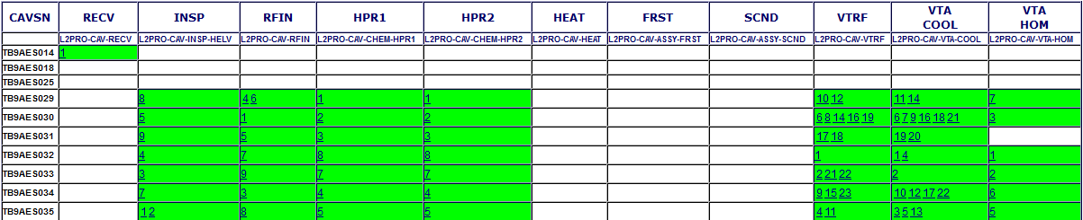
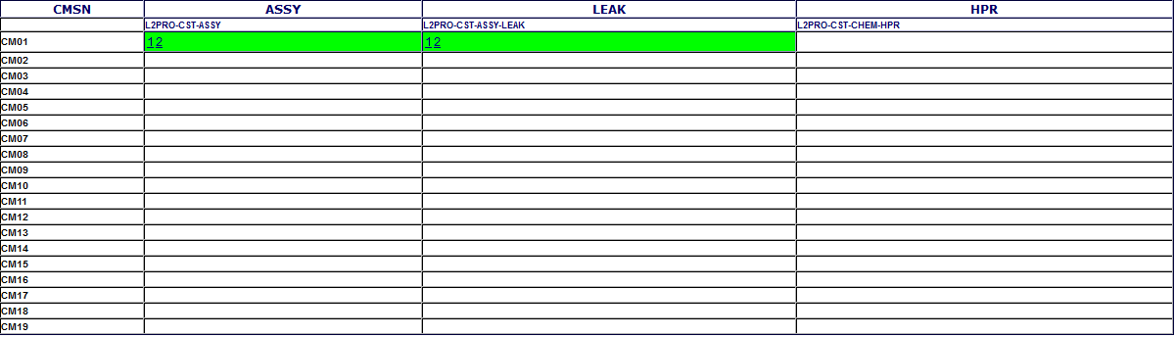
Cavity Status Board
Cavity String Status

Slide 43
pCM- Open NCRs
Status Report for L2PRO-NCR on 22-Jan-18
TRAV_SEQ_NUM | TRAV_OPEN_DATE | PARTDESCRIPTION | DESCRIBECOMMENT | SN | TRAVELERID | TRAVSEQNUMBER | DISPOSITION | REWORKDATE
324 | 24-Jul-17 | CAVITY | Field Emission Onset at 12.0 MV/m Document Number: LCLSII-4.5-PP-0670-R1, 1.3 GHz Cryomodule Performance Requirements and Minimum Acceptance Criteria states Onset must be 14.0 MV/m or greater | TB9AES034 | L2PRO-CM-ACTS | 1
325 | 24-Jul-17 | CRYOMODULE | Coupler for Cavity 2 cannot be adjusted to proper setting (4.0E7) | CM01 | L2PRO-CM-ACTS | 1
326 | 24-Jul-17 | CRYOMODULE | Cavity 6 coupler cannot be adjusted to proper Qext setting (4.0E7) | CM01 | L2PRO-CM-ACTS | 1
327 | 24-Jul-17 | CRYOMODULE | Cavity 7 coupler cannot be adjusted to proper Qext setting (4.0E7) | CM01 | L2PRO-CM-ACTS | 1
328 | 24-Jul-17 | CRYOMODULE | Cavity 86 coupler cannot be adjusted to proper Qext setting (4.0E7) | CM01 | L2PRO-CM-ACTS | 1
329 | 24-Jul-17 | CRYOMODULE | HOM A couplers Qext's on cavities 1, 5, 6 and 7 were measured to be lower than 5E11. | CM01 | L2PRO-CM-ACTS | 1
330 | 24-Jul-17 | CRYOMODULE | HOM B couplers Qext's on cavities 5, 7 and 8 were measured to be lower than 5E11 | CM01 | L2PRO-CM-ACTS | 1
331 | 25-Aug-17 |  | This NCR is intended to be a summary NCR listing out the major performance issues found on the LCLSII prototype cryomodule (serial # J1.3-01). This NCR could be used for submission to the SLAC Project QA as part of the significant NCR Dashboard reporting. Performance testing of the pCM was conducted in the JLab CMTF using Traveler ID L2PRO-CM-ACTS. Seven itemized issues (shown below) were reported, each having its own regular NCR recorded in the traveler database. Cavities 1, 5, 6 & 7 HOM A lower than 5E11 (NCR 329) Cavities 5, 7 & 8 HOM B lower than 5E11 (NCR 330) Cavity 6 FE Onset @ 12MV/m (NCR 324) Cavity 6 coupler could not be adjusted to proper setting 4.0E7 (NCR 326) Cavity 2 coupler could not be adjusted to proper setting 4.0E7 (NCR 325) Cavity 7 coupler could not be adjusted to proper setting 4.0E7 (NCR 327) Cavity 8 coupler could not be adjusted to proper setting 4.0E7 (NCR 328) | J1.3-01 | L2PRO-CM-ACTS | 1

Slide 44
Back Up Prod’n Detailed reports
LCLS-II JLAB Cryomodule QA/QC Workshop 25Jan2018

Slide 45
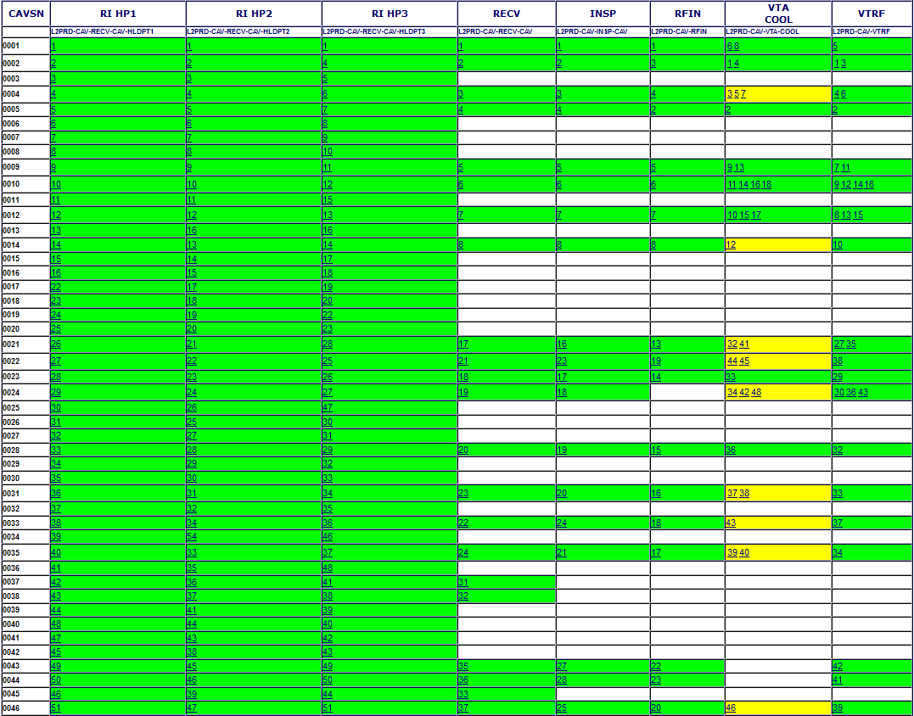
Cavity Status Board – RI

Slide 46
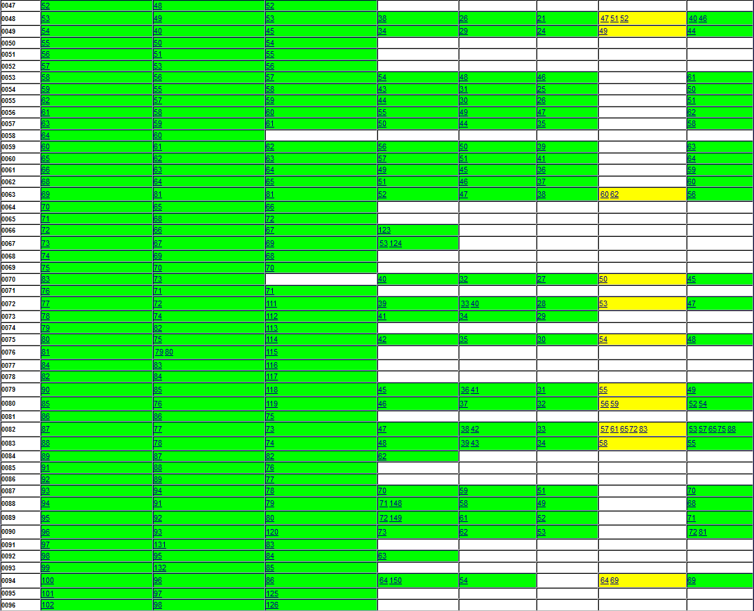
Cavity Status Board – RI

Slide 47
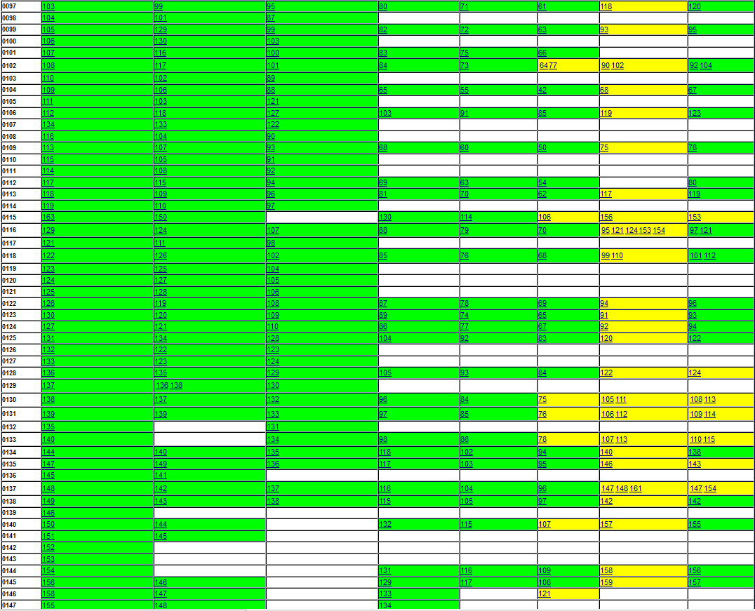
Cavity Status Board – RI

Slide 48
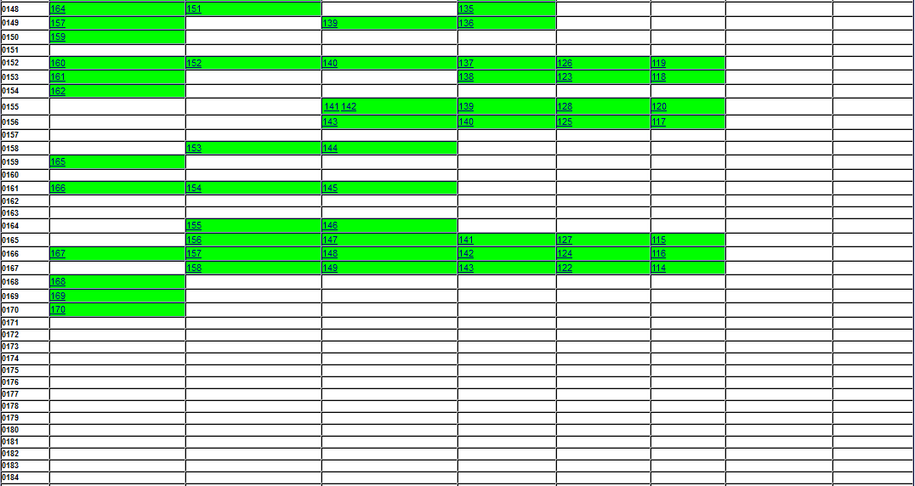
Cavity Status Board – RI

Slide 49
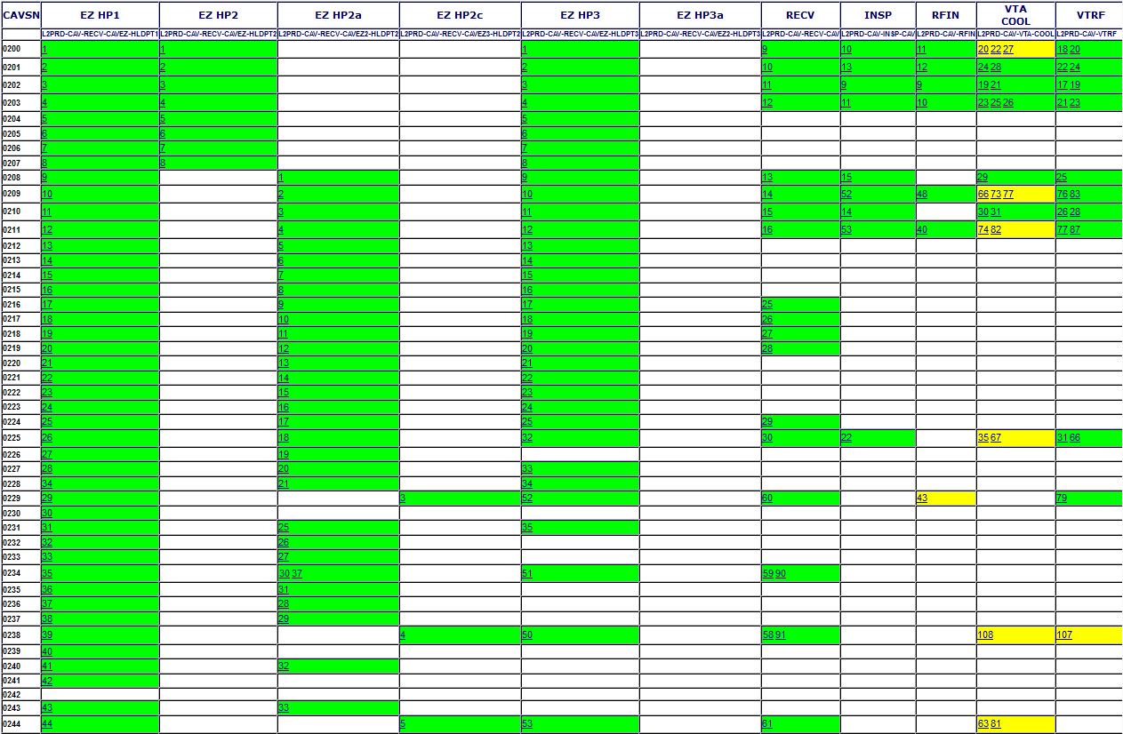
Cavity Status Board - EZ

Slide 50
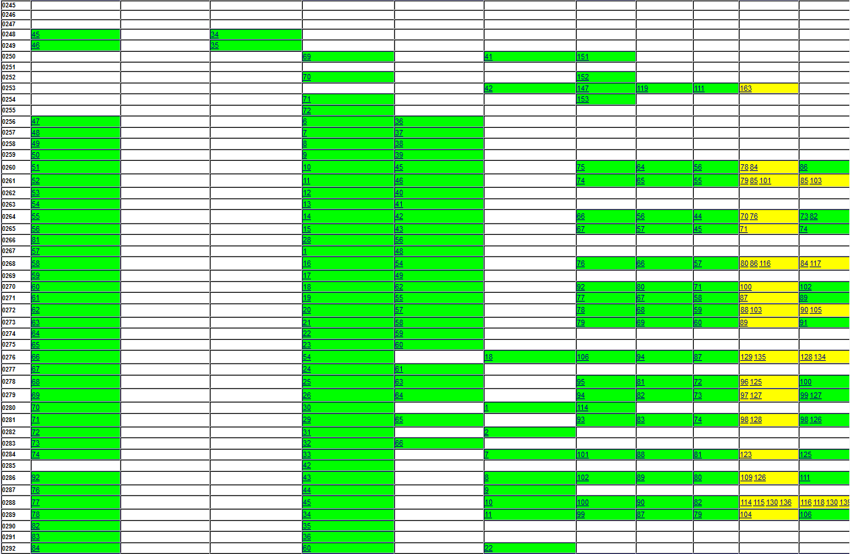
Cavity Status Board - EZ

Slide 51
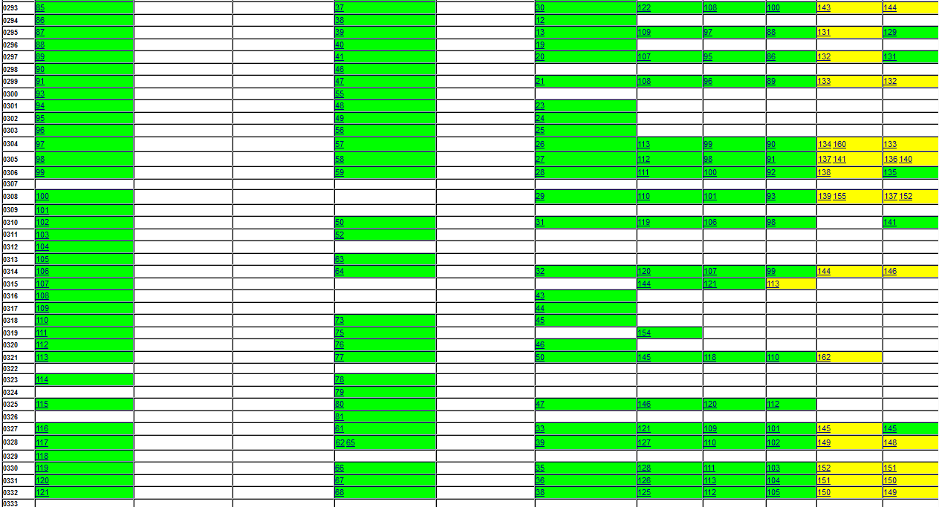
Cavity Status Board - EZ

Slide 52
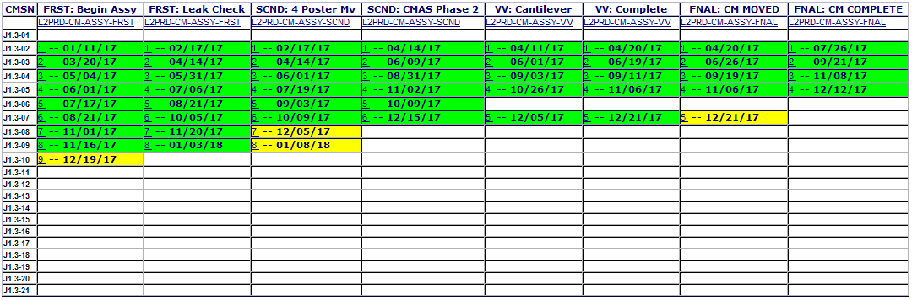
Status Board - CM

Slide 53
Open NCRs: Cavity
Status Report for L2PRD-NCR on 22-Jan-18
TRAV_SEQ_NUM | TRAV_OPEN_DATE | PARTDESCRIPTION | DESCRIBECOMMENT | SN | TRAVELERID | TRAVSEQNUMBER | DISPOSITION | REWORKDATE
522 | 14-Oct-16 |  | On bellows restraint block, input coupler side, 1 bolt is stripped and hole needs to be re-tapped. This can be ID'd by the missing bolt. All HOMs, FP, and BL flanges are under torqued. Right angle valve rotation 50 degrees beyond what is shown on sketch in insp. traveler. | 202 | L2PRD-CAV-INSP-CAV | 9 | Proceed to next WorkCenter
528 | 18-Oct-16 |  | Torque less than 30 Nm on beam tube flange (short side). Sharp edge on weld near dish. Beam tube flange (long side) exceeds 30 Nm. HOM flange bolts (short side) less than 5 Nm. HOM flange bolts (long side) less than 5 Nm. Input antenna flange bolts torqued more than 10 Nm. 12 of 24 washers present. One side missing washers on beam tube (long side). | 200 | L2PRD-CAV-INSP-CAV | 10 | Proceed to next WorkCenter
583 | 18-Nov-16 |  | HV demag un -successful, 4G on one location | 210 | L2PRD-CAV-INSP-CAV | 14 | Proceed to next WorkCenter
614 | 2-Dec-16 |  | Threads bad on bellows restraint bracket. Please see attached. | 24 | L2PRD-CAV-INSP-CAV | 18 | Proceed to next WorkCenter | 5-Dec-16
617 | 5-Dec-16 |  | Nicks on corner of helium vessel tank bracket. Please see attached. | 28 | L2PRD-CAV-INSP-CAV | 19 | Proceed to next WorkCenter
618 | 5-Dec-16 |  | Threads bad on bellows restraint bracket. | 28 | L2PRD-CAV-INSP-CAV | 19 | Proceed to next WorkCenter
704 | 27-Jan-17 | CRYOMODULE | (1) attaching bolt for the bellows restraint bracket sheared off as it was being removed for a CMM measurement of the tuner attachment block. It appears that the bolt was rubbing on one side of the slot in the bracket. | Â 0022 | L2PRD-CAV-INSP-CAV | 23 | Proceed to next WorkCenter
801 | 4-Apr-17 |  | No burst disk installed | 55 | L2PRD-CAV-INSP-CAV | 30
802 | 4-Apr-17 | Cavity | Burst Disc not present. | 54 | L2PRD-CAV-INSP-CAV | 31
810 | 7-Apr-17 | Cavity | 650 +/-1 checks 651.5. | 73 | L2PRD-CAV-INSP-CAV | 34
881 | 10-May-17 |  | Reminate magnetic field is 2.0G. Demagnetized (14) cycles, no change. | 61 | L2PRD-CAV-INSP-CAV | 45 | Proceed to next WorkCenter
876 | 10-May-17 |  | Reminate magnetic field is 6G. De-magged (12) cycles. Field at start was 14G | 62 | L2PRD-CAV-INSP-CAV | 46 | Proceed to next WorkCenter
890 | 17-May-17 | Cavity | Small damage spot on Support Block. | 53 | L2PRD-CAV-INSP-CAV | 48
917 | 12-Jun-17 |  | Bolt cross threaded in bellows restraint bracket. Bolt won't come out of bracket. | 264 | L2PRD-CAV-INSP-CAV | 56 | Proceed to next WorkCenter
548 | 21-Oct-16 | LCLS-II PRODUCTION CAVITY ASSEMBLY | External shock watch activated or damaged (See photos in traveler). No Accelerometer. Extra parts missing. Documentation missing. | 200 | L2PRD-CAV-RECV-CAV | 9
549 | 21-Oct-16 | LCLS-II PRODUCTION CAVITY ASSEMBLY | External shock watch activated or damaged (See photos in traveler). No Accelerometer. Extra parts missing. Documentation missing. | 201 | L2PRD-CAV-RECV-CAV | 10
550 | 21-Oct-16 | LCLS-II PRODUCTION CAVITY ASSEMBLY | External shock watch activated or damaged (See photos in traveler). No Accelerometer. Extra parts missing. Documentation missing. | 202 | L2PRD-CAV-RECV-CAV | 11
551 | 21-Oct-16 | LCLS-II PRODUCTION CAVITY ASSEMBLY | External shock watch activated or damaged (See photos in traveler). No Accelerometer. Extra parts missing. Documentation missing. | 203 | L2PRD-CAV-RECV-CAV | 12
582 | 17-Nov-16 | LCLS-II PRODUCTION CAVITY ASSEMBLY | Accelerometer LED blinking triple RED, which indicated memory full. The last mission record was time stamped at 11/14/2016 00:53:59 UTC. Note: This NCR applies to this shipment of cavities from RI. Serial numbers are 0021, 0023, 0024, & 0028. | 21 | L2PRD-CAV-RECV-CAV | 17
1150 | 23-Oct-17 | LCLS-II PRODUCTION CAVITY ASSEMBLY | Accelerometer is flashing red. | 138 | L2PRD-CAV-RECV-CAV | 115 | Proceed to next WorkCenter
1151 | 23-Oct-17 | LCLS-II PRODUCTION CAVITY ASSEMBLY | Accelerometer is flashing red. | 137 | L2PRD-CAV-RECV-CAV | 116 | Proceed to next WorkCenter
1153 | 23-Oct-17 | LCLS-II PRODUCTION CAVITY ASSEMBLY | Accelerometer is flashing red. | 135 | L2PRD-CAV-RECV-CAV | 117 | Proceed to next WorkCenter
1152 | 23-Oct-17 | LCLS-II PRODUCTION CAVITY ASSEMBLY | Accelerometer is flashing red. | 134 | L2PRD-CAV-RECV-CAV | 118 | Proceed to next WorkCenter
582 | 17-Nov-16 | LCLS-II PRODUCTION CAVITY ASSEMBLY | Accelerometer LED blinking triple RED, which indicated memory full. The last mission record was time stamped at 11/14/2016 00:53:59 UTC. Note: This NCR applies to this shipment of cavities from RI. Serial numbers are 0021, 0023, 0024, & 0028. | 21 | L2PRD-CAV-RECV-CAV | 17
1150 | 23-Oct-17 | LCLS-II PRODUCTION CAVITY ASSEMBLY | Accelerometer is flashing red. | 138 | L2PRD-CAV-RECV-CAV | 115 | Proceed to next WorkCenter
1151 | 23-Oct-17 | LCLS-II PRODUCTION CAVITY ASSEMBLY | Accelerometer is flashing red. | 137 | L2PRD-CAV-RECV-CAV | 116 | Proceed to next WorkCenter
1153 | 23-Oct-17 | LCLS-II PRODUCTION CAVITY ASSEMBLY | Accelerometer is flashing red. | 135 | L2PRD-CAV-RECV-CAV | 117 | Proceed to next WorkCenter
1152 | 23-Oct-17 | LCLS-II PRODUCTION CAVITY ASSEMBLY | Accelerometer is flashing red. | 134 | L2PRD-CAV-RECV-CAV | 118 | Proceed to next WorkCenter

Slide 54
Open NCRs: FPC & RFIN
Status Report for L2PRD-NCR on 22-Jan-18
TRAV_SEQ_NUM | TRAV_OPEN_DATE | PARTDESCRIPTION | DESCRIBECOMMENT | SN | TRAVELERID | TRAVSEQNUMBER | DISPOSITION | REWORKDATE
413 | 9-Sep-16 | FUNDAMENTAL POWER COUPLER PAIR | Only found packing list / inventory sheet, no certification or acceptance report. | CPI-LPA-003 | L2PRD-CAV-RECV-FPC | 1
414 | 9-Sep-16 | FUNDAMENTAL POWER COUPLER PAIR | Only found packing list / inventory sheet, no certification or acceptance report. | CPI-LPA-013 | L2PRD-CAV-RECV-FPC | 2
415 | 9-Sep-16 | FUNDAMENTAL POWER COUPLER PAIR | Only found packing list / inventory sheet, no certification or acceptance report. | CPI-LPA-014 | L2PRD-CAV-RECV-FPC | 3
416 | 9-Sep-16 |  | Only found packing list / inventory sheet, no certification or acceptance report. | CPI-LPA-015 | L2PRD-CAV-RECV-FPC | 4
417 | 9-Sep-16 |  | Only found packing list / inventory sheet, no certification or acceptance report. | CPI-LPA-016 | L2PRD-CAV-RECV-FPC | 5
1221 | 11-Dec-17 | LCLS-II PRODUCTION CAVITY ASSEMBLY | Field flatness 12.17% FM: This is not field flatness, but M-parameter in kHz, <= 10 kHz is specified. Wrong reference data have been used for vendor. M-Parameter in fact 3.47 kHz | 115 | L2PRD-CAV-RFIN | 106 | Proceed to next WorkCenter

Slide 55
Open NCRs: FPCW
Status Report for L2PRD-NCR on 22-Jan-18
TRAV_SEQ_NUM | TRAV_OPEN_DATE | PARTDESCRIPTION | DESCRIBECOMMENT | SN | TRAVELERID | TRAVSEQNUMBER | DISPOSITION | REWORKDATE
499 | 10-Oct-16 |  | Missing sapphire window. | CPI-LPA-020 | L2PRD-CM-INSP-FPCW | 17 | Proceed to next WorkCenter
643 | 6-Jan-17 |  | SMA electron probe instead of optical view port near to warm ceramic window | CPI-WP-013 | L2PRD-CM-INSP-FPCW | 44 | Proceed to next WorkCenter
644 | 6-Jan-17 |  | SMA connector for electron probe instead of optical view port near to the warm ceramic. Will be replaced during assembly on cryomodule. | CPI-WP-007 | L2PRD-CM-INSP-FPCW | 45 | Proceed to next WorkCenter
645 | 6-Jan-17 |  | Feed through with SMA connector instead of optical view near to the warm ceramic. Will be replaced during warm coupler assembly on cryomodule. | CPI-WP-028 | L2PRD-CM-INSP-FPCW | 46 | Proceed to next WorkCenter
657 | 18-Jan-17 |  | Electron probe installed on instrumentation ports near to the warm ceramic. It will be replaced with optical view poprt during CM assembly. | CPI-WP-015 | L2PRD-CM-INSP-FPCW | 47 | Proceed to next WorkCenter
658 | 18-Jan-17 |  | Electron probe near to the warm ceramic. Will be replaced with optical view port during CM assembly. | CPI-LPA-013 | L2PRD-CM-INSP-FPCW | 48 | Proceed to next WorkCenter
667 | 19-Jan-17 |  | Electron probe installed on instrumentation port near to the warm ceramic. Will e replaced with optical view port during CM assembly | CPI-LPA-013 | L2PRD-CM-INSP-FPCW | 49 | Proceed to next WorkCenter
668 | 19-Jan-17 |  | Electron probe installed on instrumentation port near to the warm ceramic. Will replace this with an optical view port during CM assembly. | CPI-LPA-016 | L2PRD-CM-INSP-FPCW | 50 | Proceed to next WorkCenter
669 | 19-Jan-17 |  | Electron probe installed on the instrumentation port near to the warm ceramic. Will be replaced with an optical view port during CM assembly. | CPI-LPA-016 | L2PRD-CM-INSP-FPCW | 51 | Proceed to next WorkCenter
670 | 19-Jan-17 |  | Electron probe installed on the instrumentation port near to the warm window. Will be replaced with optical view port during CM assembly. | CPI-LPA-015 | L2PRD-CM-INSP-FPCW | 52 | Proceed to next WorkCenter
671 | 19-Jan-17 |  | Electron probe installed on instrumentation port near to the warm ceramic. Will be replaced with an optical view port during CM assembly. | CPI-LPA-008 | L2PRD-CM-INSP-FPCW | 53 | Proceed to next WorkCenter
672 | 19-Jan-17 |  | Electron probe installed on instrumentation port near to the warm ceramic. Will be replaced with optical view port during CM assembly. | CPI-LPA-014 | L2PRD-CM-INSP-FPCW | 54 | Proceed to next WorkCenter
673 | 20-Jan-17 |  | Electron probe installed on the instrumentation port near to the warm ceramic window. Will be replaced with an optical view port during CM assembly. | CPI-LPA-007 | L2PRD-CM-INSP-FPCW | 55 | Proceed to next WorkCenter
674 | 20-Jan-17 |  | Electron probe installed on instrumentation port near to the warm window. Will be changed with an optical view port during CM assembly. | CPI-LPA-015 | L2PRD-CM-INSP-FPCW | 56 | Proceed to next WorkCenter
675 | 20-Jan-17 |  | Electron probe installed on instrumentation port near to the warm ceramic. Will be replaced with an optical view port during CM assembly | CPI-LPA-003 | L2PRD-CM-INSP-FPCW | 57 | Proceed to next WorkCenter
740 | 9-Feb-17 | UNKN | Electron probe installed on port near to the warm ceramic. Will be replaced with optical view port during CM assembly. | CPI-LPA-019 | L2PRD-CM-INSP-FPCW | 58 | Proceed to next WorkCenter
741 | 9-Feb-17 | UNKN | Brass nitrogen admission valve, non UHV compatible. | CPI-LPA-019 | L2PRD-CM-INSP-FPCW | 58 | Proceed to next WorkCenter
742 | 9-Feb-17 | UNKN | SMA eprobe installed on port near to the warm ceramic. Will be replaced wit optical view port during CM assembly | CPI-LPA-003 | L2PRD-CM-INSP-FPCW | 59 | Proceed to next WorkCenter
743 | 9-Feb-17 | UNKN | SMA feedthrough instead of optical view on port near to warm ceramic window. Will be replaced with optical view port during CM assembly. | CPI-LPA-020 | L2PRD-CM-INSP-FPCW | 60 | Proceed to next WorkCenter
745 | 9-Feb-17 | UNKN | eprobe with SMA connector instead of optical view port near warm ceramic. Will be replaced with optical view port during CM assembly. | CPI-LPA-004 | L2PRD-CM-INSP-FPCW | 61 | Proceed to next WorkCenter
752 | 13-Feb-17 | UNKN | eprobe with SMA connector installed on port near to the warm ceramic. Will e replaced with optical view port during CM assembly. | CPI-LPA-024 | L2PRD-CM-INSP-FPCW | 62 | Proceed to next WorkCenter
753 | 13-Feb-17 | UNKN | Found eprobe with SMA connector on the port near to the warm ceramic. Will replace with optical view port during CM assy. | CPI-LPA-024 | L2PRD-CM-INSP-FPCW | 63 | Proceed to next WorkCenter

Slide 56
Open NCRs: FeedThrus
Status Report for L2PRD-NCR on 22-Jan-18
TRAV_SEQ_NUM | TRAV_OPEN_DATE | PARTDESCRIPTION | DESCRIBECOMMENT | SN | TRAVELERID | TRAVSEQNUMBER | DISPOSITION | REWORKDATE
25 | 16-Mar-16 | Field Probe Feedthru | Roughness/machined tear out on probe surface. See traveler for photos. | 76 | L2PRD-CAV-INSP-FPFT | 54
2 | 15-Mar-16 | HOM Feedthru | Surface roughness on probe diameter;RA measures 1.8 Surface nick on probe diameter See traveler for photos. | 61 | L2PRD-CAV-INSP-HMFT | 5
419 | 13-Sep-16 | BPM Feedthru | Gap measurement slightly out of tolerance. | 134 | L2PRD-CST-INSP-BPMFT | 44

Slide 57
Open NCRs: VTRF
Status Report for L2PRD-NCR on 22-Jan-18
TRAV_SEQ_NUM | TRAV_OPEN_DATE | PARTDESCRIPTION | DESCRIBECOMMENT | SN | TRAVELERID | TRAVSEQNUMBER | DISPOSITION | REWORKDATE
588 | 22-Nov-16 | LCLS-II PRODUCTION CAVITY ASSEMBLY | Final 2K run, FE onset 15MV/m, lower than spec (17.5MV/m) | 201 | L2PRD-CAV-VTRF | 24
589 | 22-Nov-16 | LCLS-II PRODUCTION CAVITY ASSEMBLY | Final 2K run, Emax 16.6MV/m, lower than spec (19MV/m). | 201 | L2PRD-CAV-VTRF | 24
604 | 1-Dec-16 |  | Initial 2K run, FE onset at 11.6MV/m, lower than spec(>17.5MV/m) | 210 | L2PRD-CAV-VTRF | 26 | Hold/Modify
605 | 1-Dec-16 |  | Initial 2K run, Q0 at 16MV/m was 2.41e10, lower than spec(>=2.5e10). | 210 | L2PRD-CAV-VTRF | 26 | Hold/Re-measure
622 | 12-Dec-16 |  | Initial 2K run, FE onset at 8.5 MV/m, lower than spec which is 17.5 MV/m. | 24 | L2PRD-CAV-VTRF | 30 | Hold/Modify
823 | 12-Apr-17 | CAVITY | FE onset at 6.5MV/m, lower than spec which is >17.5MV/m. This was the third attempt to pass Cavity-0024 at the VTA. After the field emissions in the first attempt, the cavity went through the UPW rinse to remove any potential FE sources. Following the second attempt, the cavity was disassembled and an internal inspection was conducted. A scratch on the iris at the end cell was discovered. A light EP was used to recover the cavity, which then proofed to be unsuccessful. The vendor has claimed responsibility of this cavity and as a result the cavity will be dis-positioned as Return-to-Vendor (RTV). | 24 | L2PRD-CAV-VTRF | 43
916 | 2-Jun-17 |  | Initial Q0(16) measured 1.8700e+10, below the specification of 2.5e10 | 83 | L2PRD-CAV-VTRF | 55
893 | 18-May-17 |  | Q0(16MV) was 2.1e10, below the specification of 2.5e10 | 63 | L2PRD-CAV-VTRF | 56 | Hold/Re-measure
928 | 15-Jun-17 |  | Field probe cable on test stand opened during cooldown. HOMs were mistuned. | 82 | L2PRD-CAV-VTRF | 65 | Hold/Modify
926 | 15-Jun-17 |  | Cavity FE onset was 15.5 MV/m, below the specification of 17.5 MV/m. | 225 | L2PRD-CAV-VTRF | 66 | Hold/Modify
927 | 15-Jun-17 | CAVITY | Cavity Q0(16MV) was 1.90e+10, below the specification of 2.5e10 | 225 | L2PRD-CAV-VTRF | 66 | Hold/Modify
930 | 16-Jun-17 |  | Q0(16)Measured 2.2000e+10, below spec 2.5e10 | 104 | L2PRD-CAV-VTRF | 67
965 | 11-Jul-17 |  | Final FE onset was 11.7 MV/m, below the specification of 17.5 MV/m | 264 | L2PRD-CAV-VTRF | 73 | Hold/Modify
948 | 27-Jun-17 |  | Cavity Emax was 15.2 MV/m, below the specification of 19 MV/m | 265 | L2PRD-CAV-VTRF | 74 | Hold/Re-measure | 27-Jun-17
954 | 28-Jun-17 |  | FE onset at 8.67MV/m, lower than spec which was > 17.5MV/m. | 209 | L2PRD-CAV-VTRF | 76 | Hold/Re-measure | 25-Jul-17
955 | 28-Jun-17 |  | FE onset at 10.7MV/m, lower than spec which is > 17.5MV/m. | 211 | L2PRD-CAV-VTRF | 77 | Hold/Re-measure | 25-Jul-17
956 | 28-Jun-17 |  | Q0 at 16MV/m was 1.2800e+10, lower than spec which is 2.5e10. | 211 | L2PRD-CAV-VTRF | 77 | Hold/Re-measure | 25-Jul-17
950 | 28-Jun-17 |  | Q0 at 16MV/m was 2.38e10, lower than spec which is 2.5e10. | 109 | L2PRD-CAV-VTRF | 78
974 | 19-Jul-17 |  | Q0(16) = 2.0000e+10, below spec of 2.5e10 | 209 | L2PRD-CAV-VTRF | 83
976 | 19-Jul-17 | LCLS-II PRODUCTION CAVITY ASSEMBLY | Emax = 17.9 MV/m, below spec of 19 MV/m. Also, Qo(16)=2.00e10, below spec of 2.5e10. This is captured under NCR974. | 209 | L2PRD-CAV-VTRF | 83

Slide 58
Open NCRs: VTRF (cont.)
Status Report for L2PRD-NCR on 22-Jan-18
TRAV_SEQ_NUM | TRAV_OPEN_DATE | PARTDESCRIPTION | DESCRIBECOMMENT | SN | TRAVELERID | TRAVSEQNUMBER | DISPOSITION | REWORKDATE
983 | 24-Jul-17 |  | initial Q0(16) = 2.3000e+10, below spec | 268 | L2PRD-CAV-VTRF | 84 | Hold/Re-measure
985 | 24-Jul-17 |  | Initial Q0(16) = 2.3000e+10, below spec | 261 | L2PRD-CAV-VTRF | 85 | Hold/Modify
980 | 23-Jul-17 |  | Q0(16) = 1.8e10, below specification of 2.5e10 | 211 | L2PRD-CAV-VTRF | 87
999 | 3-Aug-17 | UNKN | Onset of FE at 15.2MV/m, below specification of 18MV/m. | 272 | L2PRD-CAV-VTRF | 90 | Hold/Modify
1024 | 21-Aug-17 |  | Q0(16) 2.1700e+10, below spec of 2.5e10 | 281 | L2PRD-CAV-VTRF | 98
1023 | 21-Aug-17 |  | Q0(16MV/m)= 2.1000e+10, below spec of 2.5e10 | 279 | L2PRD-CAV-VTRF | 99
1027 | 22-Aug-17 |  | Q0(16) was 2.4000e+10, below spec of 2.5e10 | 118 | L2PRD-CAV-VTRF | 101
1028 | 22-Aug-17 |  | FInal FE onset was 11 MV/m, below the spec of 17.5 MV/m | 118 | L2PRD-CAV-VTRF | 101 | Hold/Modify
1035 | 25-Aug-17 |  | Qextfp was <2.5e11 | 261 | L2PRD-CAV-VTRF | 103
1064 | 1-Sep-17 |  | FE onset limit below 17.5MV/m. Field Emission onset at 10.2MV/m. | 238 | L2PRD-CAV-VTRF | 107
1075 | 6-Sep-17 |  | Cavity Cavity Q below spec at 2.15e10 at 16MV/m | L2-133 | L2PRD-CAV-VTRF | 110
1076 | 6-Sep-17 |  | Cavity had Low Qo | L2-131 | L2PRD-CAV-VTRF | 110
1077 | 6-Sep-17 |  | Cavity had low Qo | L2-130 | L2PRD-CAV-VTRF | 110
1079 | 7-Sep-17 |  | Qext2 was 1.6200e+11, lower than the spec of 2.5-7.0 e11 | 286 | L2PRD-CAV-VTRF | 111
1093 | 13-Sep-17 |  | Failure in Field probe cable connection. | 288 | L2PRD-CAV-VTRF | 116
1097 | 18-Sep-17 |  | Q2 is below specification. | L2-268 | L2PRD-CAV-VTRF | 117
1099 | 18-Sep-17 | Cavity | Cavity max gradient 17.3MV/m. | L2-268 | L2PRD-CAV-VTRF | 117
1098 | 18-Sep-17 | UNKN | Field Probe Q was low at 1.8e11 | 288 | L2PRD-CAV-VTRF | 118
1116 | 26-Sep-17 |  | Field probe Q was below spec at 1.89e11 | 128 | L2PRD-CAV-VTRF | 124
1117 | 26-Sep-17 |  | Quench at 17.85 MV/m | 128 | L2PRD-CAV-VTRF | 124
1120 | 29-Sep-17 | Cavity | Cavity quenched at 15MV/m. | L2-284 | L2PRD-CAV-VTRF | 125
1136 | 11-Oct-17 |  | Dewar pressure during test was 18 or 19 Torr | 276 | L2PRD-CAV-VTRF | 128
1137 | 11-Oct-17 |  | field probe Q was low at 1.25e11 | 276 | L2PRD-CAV-VTRF | 128
1161 | 2-Nov-17 |  | Field probe Q slightly high. We should edit the traveler if we are going to increase this value in the long term. | 299 | L2PRD-CAV-VTRF | 132
1165 | 2-Nov-17 |  | FE onset at 3.5MV/m during decay measurement. | 304 | L2PRD-CAV-VTRF | 133
1173 | 9-Nov-17 |  | Qext2 was 1.9500e+11, out of spec which is 2.5-7.0 e11 | 305 | L2PRD-CAV-VTRF | 136
1174 | 9-Nov-17 |  | Q0 at 16MV/m was 2.28e10, out of spec which is >= 2.5e10 | 305 | L2PRD-CAV-VTRF | 136
1172 | 9-Nov-17 |  | Qext2 was 1.9900e+11, out of spec which is 2.5-7.0 e11. | 308 | L2PRD-CAV-VTRF | 137
1180 | 16-Nov-17 |  | Qext2 was 2.3800e+11, out of spec which is 2.5-7.0 e11. | 305 | L2PRD-CAV-VTRF | 140
1181 | 16-Nov-17 |  | Final FE onset at 11.4MV/m, lower than spec which is > 17.5 MV/m. | 305 | L2PRD-CAV-VTRF | 140
1203 | 30-Nov-17 |  | Field probe Q is low at 2.13e11 | 135 | L2PRD-CAV-VTRF | 143
1212 | 5-Dec-17 |  | Emax was 13.6MV/m, lower than spec which is >19MV/m. | 293 | L2PRD-CAV-VTRF | 144
1213 | 5-Dec-17 |  | Qext2 was 2.1700e+11, out of spec which is 2.5-7.0 e11. | 293 | L2PRD-CAV-VTRF | 144
1214 | 5-Dec-17 |  | FE onset 11.2MV/m, lower than spec which is >17.5MV/m. | 314 | L2PRD-CAV-VTRF | 146
1215 | 5-Dec-17 |  | Q0 at 16MV/m was 2.35e10, lower than spec which is 2.5e10 | 314 | L2PRD-CAV-VTRF | 146
1216 | 5-Dec-17 |  | Qext2 was 2.4100e+11, out of spec which is 2.5-7.0 e11 | 314 | L2PRD-CAV-VTRF | 146
1218 | 6-Dec-17 |  | Cavity pressure was 5.3e-5 mBar at the beginning of the test | 137 | L2PRD-CAV-VTRF | 147
1219 | 6-Dec-17 |  | field probe Q was low at 2e11 | 137 | L2PRD-CAV-VTRF | 147
1222 | 15-Dec-17 |  | KLorentz was -2.3828 Hz/(MV/m)^2, out of spec which is -0.6~-1.2 Hz/(MV/m)^2 | 328 | L2PRD-CAV-VTRF | 148
1223 | 15-Dec-17 |  | Qext2 was 2.4300e+11, slightly lower than spec which is 2.5-7.0 e11 | 328 | L2PRD-CAV-VTRF | 148
1231 | 21-Dec-17 |  | Qext2 was 2.4300e+11, slightly out of spec which is 2.5-7.0 e11. | 332 | L2PRD-CAV-VTRF | 149
1232 | 21-Dec-17 |  | Qext2 was 2.1700e+11, out of spec which is 2.5-7.0 e11 | 331 | L2PRD-CAV-VTRF | 150
1233 | 21-Dec-17 |  | Initial Q0 at 16MV/m was 1.7500e+10, out of spec which is >= 2.5e10 | 331 | L2PRD-CAV-VTRF | 150
1240 | 19-Jan-18 |  | final FE onset 16 MV/m | L2-144 | L2PRD-CAV-VTRF | 156 | Hold/Modify

Slide 59
Open NCRs: Cryomodule
Status Report for L2PRD-NCR on 22-Jan-18
TRAV_SEQ_NUM | TRAV_OPEN_DATE | PARTDESCRIPTION | DESCRIBECOMMENT | SN | TRAVELERID | TRAVSEQNUMBER | DISPOSITION | REWORKDATE
1101 | 19-Sep-17 |  | Qext value for HOM1 (cplr side) Cavities 1, 2, 3, 5, 6 do not meet the Acceptance criteria | J1.3-02 | L2PRD-CM-ACTS | 1 | Hold/Modify
1102 | 19-Sep-17 | Cryomodule | Qext's of HOM2 for cavities 2 and 4 do not meet Acceptance criteria | J1.3-02 | L2PRD-CM-ACTS | 1 | Hold/Modify
1103 | 19-Sep-17 | LCLLS II 1.3 GHz Cavity | Cavity 4 in this cryomodule has a FE Onset gradient of 3.7 MV/m. This does not meet Acceptance criteria | J1.3-02 | L2PRD-CM-ACTS | 1
1104 | 19-Sep-17 |  | Cavity 4 in this cryomodule is limited by quench at 8.0 MV/m and does not meet Acceptance criteria | J1.3-02 | L2PRD-CM-ACTS | 1
1106 | 19-Sep-17 | HOM 1 Coupler | HOM1 Qext's for Cavities 2,4,5,7,8 do not meet Acceptance criteria | J1.3-03 | L2PRD-CM-ACTS | 2 | Hold/Modify
1107 | 19-Sep-17 |  | HOM 2 Qext's do not meet Acceptance criteria for cavities 2,4,5,6, and 8. | J1.3-03 | L2PRD-CM-ACTS | 2 | Hold/Modify
1138 | 11-Oct-17 | Upper Cold Mass Assembly | Flange "A" DS End: Small nick in conflat knife edge.(marked) | RFCG-UC-020 | L2PRD-CM-INSP-UCM | 6
1134 | 10-Oct-17 | Vacuum Vessel | Paint residue/scratches found on flange face: Items listed below are marked with permanent marker where concerns exist for further review. F10018083:Top end ports light scratches on flange. F10020935 Centerline Port:Paint and minor nicks on knife edge. F10023641 Fixed Flange US: Paint in seal area. F10023655 Coupler Instrumentation Port:Paint/Over spray on flange face/most of entire surface. (8 flanges) F10023650 Coupler Ports:Minor scratches/oxidation,dings. Flange 1,5,6,7,8. F10023643 Sliding Flange US:Paint present in O-ring grooves. (both) F1006622 Body Side Port: Small paint spot on flange face. F10030285 Instrumentation Flange:Small paint spot on flange face 1,3. F10030301 Instrumentation Flange: Small paint spots on flange face Flange 1,2. F10026614 Tuner Motor Ports: Minor paint spots on flange face 6,7,8 See attached inspection report for detail of inspection results. | RFCG-VV-008 | L2PRD-CM-INSP-VV | 8
1135 | 10-Oct-17 | Vacuum Vessel | F10023636 Fixed Flange (DS):Damage to edge of flange causing some surface irregularity to flange face. Some minor scratches.(See photo attached) | RFCG-VV-008 | L2PRD-CM-INSP-VV | 8
1149 | 20-Oct-17 | Vacuum Vessel | See attached inspection report and inspection photos above for detail of inspection results. Paint residue/scratches found on flange face: Items listed below are marked with permanent marker where concerns exist for further review. F10018068 Middle Port: Scratches on flange(marked) F10020935 Centerline Port: Paint on flange and knife edge.(marked) F10023650 Coupler Port: Light scratches on flange. (marked) F10023643 Sliding Flange: Generally good. Two small areas of discoloration/paint residue in O-ring Grooves.(marked) F10030285 Instrumentation Flange: Paint on flange. (marked) F10030301 Instrumentation Flange: Scratches.(marked) F10026614 Tuner Motor Flanges: Light paint spots on flange.(marked) F10030811 Relief Port Flange: Paint spot in O-ring groove.(marked) | RFCG-VV-018 | L2PRD-CM-INSP-VV | 9
1236 | 8-Jan-18 | Vacuum Vessel | See attached inspection report above for detail of inspection results. Paint residue/light scratches found on flange face: Items listed below are marked with permanent marker where concerns exist for further review. Fixed Flange (US):F10023641 Paint found on flange surface.(marked) Coupler Instrumentation Port: F10023655 Paint and minor scratches found on flange 4,5,6,8.(marked) Tuner Motor Ports: F10026614 Light scratches on flange face; 3,4,5,7. (marked) | RFCG-VV-022 | L2PRD-CM-INSP-VV | 10

Slide 60
Open NCRs: Bellows - BLBP
Status Report for L2PRD-NCR on 22-Jan-18
TRAV_SEQ_NUM | TRAV_OPEN_DATE | PARTDESCRIPTION | DESCRIBECOMMENT | SN | TRAVELERID | TRAVSEQNUMBER | DISPOSITION | REWORKDATE
88 | 18-May-16 | unkn | Scratches present in seal groove. | 1010 | L2PRD-CST-INSP-BLBP | 10 | Hold/Modify
90 | 18-May-16 | Bellow Long | Scratches present in seal groove. | 1012 | L2PRD-CST-INSP-BLBP | 12 | Hold/Modify
92 | 18-May-16 | Bellow Long | Scratches present in seal groove. Tool chatter present in seal groove. Contamination present in seal groove. | 1013 | L2PRD-CST-INSP-BLBP | 13 | Hold/Modify
93 | 18-May-16 | Bellow Long | Contamination spots in seal groove. Scratches present in seal groove. | 1014 | L2PRD-CST-INSP-BLBP | 14 | Hold/Modify
95 | 18-May-16 | Bellow Long | Scratches present in seal groove. | 1015 | L2PRD-CST-INSP-BLBP | 15 | Hold/Modify
96 | 18-May-16 | Bellow Long | Scratches present in seal groove.Contamination spot in seal groove. | 1016 | L2PRD-CST-INSP-BLBP | 16 | Hold/Modify
98 | 18-May-16 | Bellow Long | Scratches present in seal groove.Contamination spots in seal groove.Tool chatter present in seal groove. | 1017 | L2PRD-CST-INSP-BLBP | 17 | Hold/Modify
99 | 18-May-16 | Bellow Long | Scratches present in seal groove. | 1018 | L2PRD-CST-INSP-BLBP | 18 | Hold/Modify
102 | 31-May-16 | Bellow Long | Scratches on rotatable flange at 11:00. Scratches on non-rotatable flange at 10:00. | 1020 | L2PRD-CST-INSP-BLBP | 20 | Hold/Modify
103 | 31-May-16 | Bellow Long | Scratches on non-rotatable flange at 12:00. | 1023 | L2PRD-CST-INSP-BLBP | 23 | Hold/Modify
219 | 25-Jul-16 | Bellow Long | Remnant magnetic field measurement exceeds requirement. Checks .040-.140 at welds. | 2002 | L2PRD-CST-INSP-BLBP | 37 | Hold/Modify
220 | 25-Jul-16 | Bellow Long | Remnant magnetic field measurement exceeds requirement. Checks .050-.190 at welds. | 2003 | L2PRD-CST-INSP-BLBP | 38 | Hold/Modify
221 | 25-Jul-16 | Bellow Long | Remnant magnetic field measurement exceeds requirement. Checks .035-.075 at welds. | 2004 | L2PRD-CST-INSP-BLBP | 39 | Hold/Modify
222 | 25-Jul-16 | Bellow Long | Remnant magnetic field measurement exceeds requirement. Checks .054-.080 at welds. | 2005 | L2PRD-CST-INSP-BLBP | 40 | Hold/Modify
225 | 25-Jul-16 | Bellow Long | Remnant magnetic field measurement exceeds requirement. Checks .065-.190 at welds. | 2010 | L2PRD-CST-INSP-BLBP | 45 | Hold/Modify
226 | 25-Jul-16 | Bellow Long | Remnant magnetic field measurement exceeds requirement. Checks .100 at welds. | 2011 | L2PRD-CST-INSP-BLBP | 46 | Hold/Modify
227 | 25-Jul-16 | Bellow Long | Remnant magnetic field measurement exceeds requirement. Checks .130-.145 at welds. | 2012 | L2PRD-CST-INSP-BLBP | 47 | Hold/Modify
228 | 25-Jul-16 | Bellow Long | Remnant magnetic field measurement exceeds requirement. Checks .075-.260 at welds. | 2013 | L2PRD-CST-INSP-BLBP | 48 | Hold/Re-measure
229 | 25-Jul-16 | Bellow Long | Remnant magnetic field measurement exceeds requirement. Checks .050-.145 at welds. | 2014 | L2PRD-CST-INSP-BLBP | 49 | Hold/Re-measure
230 | 26-Jul-16 | Bellow Long | Remnant magnetic field measurement exceeds requirement. Checks .075-.150 | 2015 | L2PRD-CST-INSP-BLBP | 50 | Hold/Modify
232 | 26-Jul-16 | Bellow Long | Remnant magnetic field measurement exceeds requirement. Checks .065-.255 | 2017 | L2PRD-CST-INSP-BLBP | 52 | Hold/Modify
234 | 26-Jul-16 | Bellow Long | Remnant magnetic field measurement exceeds requirement. Checks .070-.280 | 2019 | L2PRD-CST-INSP-BLBP | 54 | Hold/Modify

Slide 61
Open NCRs: Bellows - BLBP (cont.)
Status Report for L2PRD-NCR on 22-Jan-18
TRAV_SEQ_NUM | TRAV_OPEN_DATE | PARTDESCRIPTION | DESCRIBECOMMENT | SN | TRAVELERID | TRAVSEQNUMBER | DISPOSITION | REWORKDATE
253 | 1-Aug-16 | Bellow long | Remnant magnetic field checks .080-.280. | 2021 | L2PRD-CST-INSP-BLBP | 56 | Hold/Modify
258 | 1-Aug-16 | Bellow long | Remnant magnetic field checks .288-.298. | 2026 | L2PRD-CST-INSP-BLBP | 61 | Hold/Modify
1008 | 14-Aug-17 | Bellow PRD | Blister. Pitting. Dark spots/stains. | 2034 | L2PRD-CST-INSP-BLBP | 69 | Hold/Modify | 15-Nov-17
1036 | 25-Aug-17 | Bellow PRD | Blister,dark stains. | 2035 | L2PRD-CST-INSP-BLBP | 70 | Hold/Modify
1039 | 25-Aug-17 | Bellow PRD | Pitts in plating at cuff ID. | 2041 | L2PRD-CST-INSP-BLBP | 76
386 | 19-Aug-16 |  | Weld protrudes out of cuff. Please see attached. Surface finish out of tolerance, NR flange measured 0.9 microns | 2047 | L2PRD-CST-INSP-BLBP | 82 | Hold/Modify
553 | 21-Oct-16 |  | Scratches present. | 2053 | L2PRD-CST-INSP-BLBP | 88 | Hold/Modify
554 | 21-Oct-16 |  | Scratches present in seal area. | 2059 | L2PRD-CST-INSP-BLBP | 96 | Hold/Modify
555 | 21-Oct-16 |  | Scratches present in seal area. | 2061 | L2PRD-CST-INSP-BLBP | 98 | Hold/Modify
423 | 19-Sep-16 | Bellow long | Part was returned to supplier for rework; these are re-inspection results after rework. Edge burrs corrected. Light scratches still present in seal groove NR flange. Slight tool chatter still present in seal groove NRF. | 2001 | L2PRD-CST-INSP-BLBP | 100 | Hold/Modify
424 | 19-Sep-16 | Bellow long | Part was returned to supplier for rework; these are re-inspection results after rework. Edge burrs corrected. Light scratches still present in seal groove NR flange. Slight tool chatter still present in seal groove NRF. | 2002 | L2PRD-CST-INSP-BLBP | 101 | Hold/Modify
427 | 19-Sep-16 | Bellow long | Part was returned to supplier for rework; these are re-inspection results after rework. Edge burrs corrected.Light scratches still present in seal groove NRF. | 2011 | L2PRD-CST-INSP-BLBP | 108 | Hold/Modify
429 | 19-Sep-16 | Bellow long | Part was returned to supplier for rework; these are re-inspection results after rework. Edge burrs corrected. Light scratches still present in seal groove NRF. | 2012 | L2PRD-CST-INSP-BLBP | 109 | Hold/Modify
435 | 19-Sep-16 | Bellow long | Part was returned to supplier for rework; these are re-inspection results after rework. Edge burrs corrected.Light scratches still present in seal groove NRF. | 2017 | L2PRD-CST-INSP-BLBP | 114 | Hold/Modify
436 | 19-Sep-16 | Bellow long | Part was returned to supplier for rework; these are re-inspection results after rework. Edge burrs corrected. Light scratches still present in seal groove NRF. | 2019 | L2PRD-CST-INSP-BLBP | 116 | Hold/Modify
443 | 21-Sep-16 | Bellow long | Part was returned to supplier for rework; these are re-inspection results after rework. Edge burrs corrected.Very light scratches still present RF. | 2026 | L2PRD-CST-INSP-BLBP | 122 | Hold/Modify
468 | 23-Sep-16 |  | Light scratches in seal groove on rotatable flange. Surface finish out of tolerance. Rotatable flange measured 1.0 microns | 2069 | L2PRD-CST-INSP-BLBP | 139 | Hold/Modify

Slide 62
Open NCRs: Bellows - BLBP (cont.)
Status Report for L2PRD-NCR on 22-Jan-18
TRAV_SEQ_NUM | TRAV_OPEN_DATE | PARTDESCRIPTION | DESCRIBECOMMENT | SN | TRAVELERID | TRAVSEQNUMBER | DISPOSITION | REWORKDATE
469 | 23-Sep-16 |  | Scratches in seal groove on NR flange. Surface finish measured 1.0 microns on RF. | 2070 | L2PRD-CST-INSP-BLBP | 140 | Hold/Modify
472 | 23-Sep-16 |  | Light scratches in seal groove on NR flange. Finish measured 1.0 microns on rotatable flange. | 2073 | L2PRD-CST-INSP-BLBP | 143 | Hold/Modify
473 | 23-Sep-16 |  | Light scratches in seal groove of rotatable flange. Surface finish = 1.0 rotatable flange. | 2074 | L2PRD-CST-INSP-BLBP | 144 | Hold/Modify
1155 | 24-Oct-17 | WELDMENT BELLOWS PRCM | Blisters.Irregular spot in plating.Light water spots. | 2063 | L2PRD-CST-INSP-BLBP | 145 | Hold/Modify
466 | 22-Sep-16 |  | Scratches on NR flange. Surface finish out of tolerance. Rotatable flange measured 1.0 microns | 2067 | L2PRD-CST-INSP-BLBP | 149 | Hold/Modify
574 | 14-Nov-16 | Bellow PRD | Contamination spots in seal groove. | 1001 | L2PRD-CST-INSP-BLBP | 173 | Hold/Modify | 5-Oct-17
1060 | 31-Aug-17 | Bellow PRD | Blisters,Dark stains/spots. | 2131 | L2PRD-CST-INSP-BLBP | 230 | Hold/Modify
1158 | 24-Oct-17 | Bellow PRD | One small blister. Otherwise good. | 2189 | L2PRD-CST-INSP-BLBP | 303
1182 | 21-Nov-17 | Bellow PrCM | Multiple dark spots and stains. | 2191 | L2PRD-CST-INSP-BLBP | 305 | Hold/Modify
1183 | 21-Nov-17 | Bellow PrCM | Multiple dark spots and stains. | 2192 | L2PRD-CST-INSP-BLBP | 306 | Hold/Modify
1184 | 21-Nov-17 | Bellow PrCM | Multiple dark spots and stains. | 2193 | L2PRD-CST-INSP-BLBP | 307 | Hold/Modify
1185 | 21-Nov-17 | Bellow PrCM | Multiple dark spots and stains. | 2194 | L2PRD-CST-INSP-BLBP | 308 | Hold/Modify
1186 | 21-Nov-17 | Bellow PrCM | Multiple dark spots and stains. | 2195 | L2PRD-CST-INSP-BLBP | 309 | Hold/Modify
1194 | 27-Nov-17 | Bellow PRD | Dark spots,Pitting,irregular spot in plating, | 2197 | L2PRD-CST-INSP-BLBP | 311
1195 | 27-Nov-17 | Bellow PRD | One blister,multiple dark spots and stains. | 2198 | L2PRD-CST-INSP-BLBP | 312 | Hold/Modify
1196 | 27-Nov-17 | Bellow PRD | Blister, minimum dark spots. | 2199 | L2PRD-CST-INSP-BLBP | 313 | Hold/Modify
1197 | 27-Nov-17 | Bellow PRD | Multiple dark spots and stains. | 2201 | L2PRD-CST-INSP-BLBP | 315 | Hold/Modify
1199 | 28-Nov-17 |  | Many dark spots present on plating. | 2207 | L2PRD-CST-INSP-BLBP | 321 | Hold/Modify
1200 | 29-Nov-17 |  | Dark spots on plating. | 2210 | L2PRD-CST-INSP-BLBP | 324 | Hold/Modify
1201 | 29-Nov-17 |  | Dark spots on copper plating. | 2211 | L2PRD-CST-INSP-BLBP | 325 | Hold/Modify
1171 | 7-Nov-17 | WELDMENT BELLOWS PRCM | Heavy oxidation on plated surfaces.Plating is dull as compared to earlier inspections. Stains present. This bellows has been issued and assembled to a cavity and HPR'd. Inspection is after dis-assembly. | 2068 | L2PRD-CST-INSP-BLBP | 345

Slide 63
Open NCRs: Bellows – BLBS, BLXU & BLXD
Status Report for L2PRD-NCR on 22-Jan-18
TRAV_SEQ_NUM | TRAV_OPEN_DATE | PARTDESCRIPTION | DESCRIBECOMMENT | SN | TRAVELERID | TRAVSEQNUMBER | DISPOSITION | REWORKDATE
73 | 2-May-16 | unkn | Scratches present in seal groove. | 1002 | L2PRD-CST-INSP-BLBS | 2 | Hold/Modify
74 | 2-May-16 | unkn | Scratches present in seal groove. | 1003 | L2PRD-CST-INSP-BLBS | 3 | Hold/Modify
53 | 22-Apr-16 | unkn | scratch in seal area on rotatable flange. | 1003 | L2PRD-CST-INSP-BLXD | 3 | Hold/Modify
494 | 6-Oct-16 | Weldment Extension DS | Scratches present in seal groove NRF.Scratches present in seal area RF. Interior of pipe very rough surface.(Required 3.2 checks 2.5-2.7) Roughness required .8 in seal. (checks 1.3-2.0)NRF | 2003 | L2PRD-CST-INSP-BLXD | 10 | Hold/Modify
725 | 6-Feb-17 | Weldment Extension DS | Dark spot in plating.Minor pitting/roughness in plating surface. | 2007 | L2PRD-CST-INSP-BLXD | 15
1010 | 14-Aug-17 |  | Weld splatter. Approximately 25 places. | 2008 | L2PRD-CST-INSP-BLXD | 16
1126 | 3-Oct-17 | Weldment Extension DS | Dark stains. | 2020 | L2PRD-CST-INSP-BLXD | 43 | Hold/Modify | 3-Oct-17
1208 | 4-Dec-17 | Weldment Extension DS | Base metal defects. | 2023 | L2PRD-CST-INSP-BLXD | 45

Slide 64
Open NCRs- TUNMC & INSR
Status Report for L2PRD-NCR on 22-Jan-18
TRAV_SEQ_NUM | TRAV_OPEN_DATE | PARTDESCRIPTION | DESCRIBECOMMENT | SN | TRAVELERID | TRAVSEQNUMBER | DISPOSITION | REWORKDATE
1224 | 18-Dec-17 | End lever tuner | Missing F10031141 Qty.2 Item 4 drawing F10008766. Note: Rod are being modified per Naeem. New configuration rods not available for this tuner at this time. | 138 | L2PRD-CST-INSP-TUNMC | 62
1225 | 18-Dec-17 | End lever tuner | Missing F10031141 Qty.2 Item 4 drawing F10008766. Note: Rod are being modified per Naeem. New configuration rods not available for this tuner at this time. | 140 | L2PRD-CST-INSP-TUNMC | 63
1226 | 18-Dec-17 | End lever tuner | Missing F10031141 Qty.2 Item 4 drawing F10008766. Note: Rod are being modified per Naeem. New configuration rods not available for this tuner at this time. | 142 | L2PRD-CST-INSP-TUNMC | 65
1227 | 19-Dec-17 | End lever tunner | Missing F10031141 Qty.2 Item 4 drawing F10008766. Note: Rod are being modified per Naeem. New configuration rods not available for this tuner at this time. | 143 | L2PRD-CST-INSP-TUNMC | 66
1228 | 19-Dec-17 | End lever tuner | Missing F10031141 Qty.2 Item 4 drawing F10008766. Note: Rod are being modified per Naeem. New configuration rods not available for this tuner at this time. | 144 | L2PRD-CST-INSP-TUNMC | 67
1229 | 20-Dec-17 | End lever tuner | Angle 5+/-1 degree checks 6.2 on F10006870 Tuner support motor side. | 145 | L2PRD-CST-INSP-TUNMC | 68
1230 | 20-Dec-17 | End lever tuner | Missing F10031141 Qty.2 Item 4 drawing F10008766. Note: Rod are being modified per Naeem. New configuration rods not available for this tuner at this time. | 145 | L2PRD-CST-INSP-TUNMC | 68
1237 | 10-Jan-18 | UNKN | Lot 1: Sn: B01-B10 Flange seal groove inspection shows tool marks which may present a leak path. Drawing specifies concentric tool lay. Does not comply with this requirement. Appears to be a milled surface. See attachment for inspection results summary. Lot 2: Sn:B11-B20 Flange seal groove inspection shows scratches which may present a leak path. Sn: B11,B13,B15,B16,B18,B20 Surface finish requirement exceeds requirement of .4 RA. SN:B14,B17,B19 Scratch outside seal zone. OK See attachment for inspection results summary. | ?NA | L2PRD-INSR | 11

