Slide 1
CMTF Q0 extrapolation to 2.0K
Ari Palczewski for QAQC workshop
Additions from R.L. Geng, M. Drury, C. Reece
25-Jan-18

Slide 2
Outline
  Introduction Q0 measurement JLab - CMTF
  Initial temperature extrapolation calculations – AES035 baseline calculations
  VTA ratio calculations correction
  Expectations
  Path forward

Slide 3
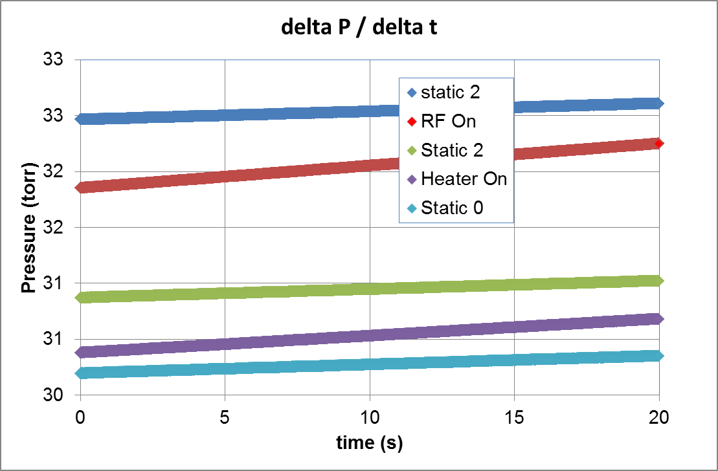

Calorimetric Method
  Isolate the cryomodule from refrigerator
    Close JT and RT valves
  Perform a series of measurements of ΔP /Δt
    No input heat (other than static)
    Known heat load from heater
    RF on at desired gradient
  ΔP /Δt linear with heat load over the operating temperature range
$${Heat}_{RF}={Pwr}_{Htr}\frac{{∆P}_{RF}−{∆P}_{static}}{{∆P}_{htr}−{∆P}_{static}}$$

Slide 4
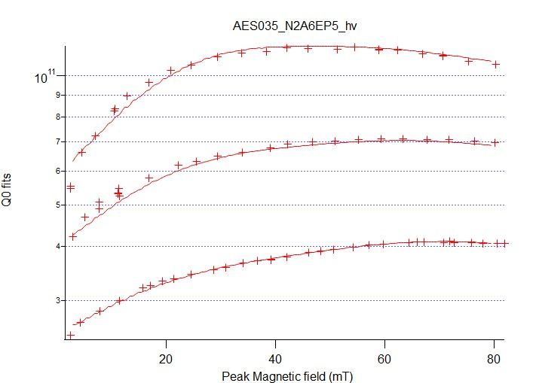
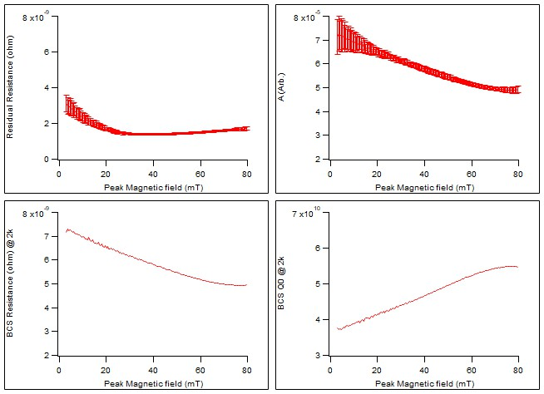
Baseline calculation – AES035 (2N6 prototype)
Actual RF data vs fit, 1.6K 1.8K and 2.0K*
*Flange loss removed before calculation
17.02* fixed during fit to force scaling into A(B)
*17.02 is mostly arbitrary, forces all scaling into A(B)

Slide 5
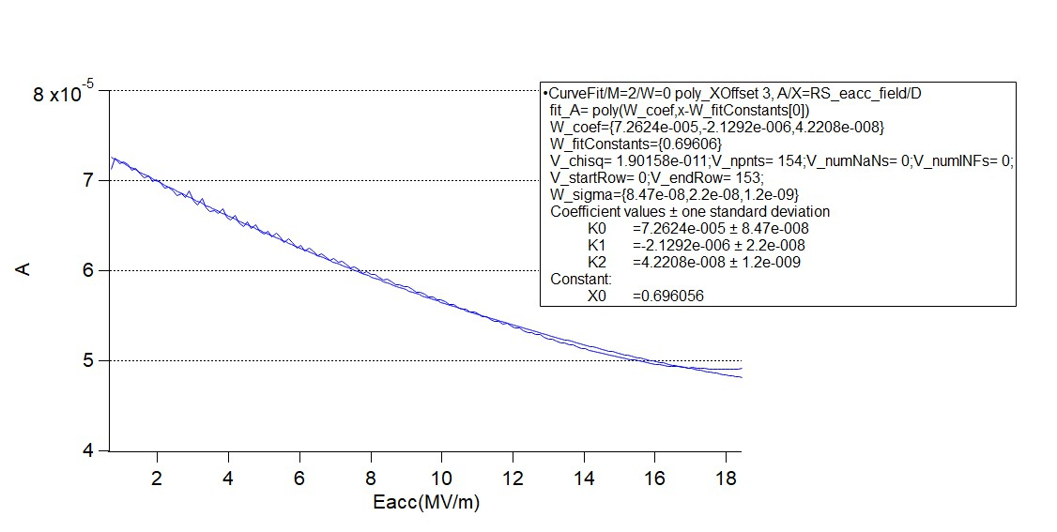
Baseline calculation – AES035 (2N6 prototype)
Fit a gradient dependent A to use for temperature extrapolation
- Consistent with other 2N6 JLab doped 9 cell prototype cavities with flange corrections
Q0 @ 2K=271/((((0.0000726-0.00000214*(Eacc-0.7)+0.000000043*(Eacc-0.7)^2))/2)*EXP(-17.02/2)+271/Q0cavity-(((0.0000726-0.00000214*(Eacc-0.7)+0.000000043*(Eacc-0.7)^2))/Tcavity)*EXP(-17.02/Tcavity))
Changes the Q0 @ any gradient between 1MV/m and 16MV/m and any temperature to Q0 @ 2.0K
Converts Q0 to surface resistance
Subtracts out residual from the temperature dependent resistance
Extrapolates the temperature correction
Adds the residual back in and calculates Q0 @ 2K

Slide 6
Current extrapolation vs VTA data
AES035 VTA

Slide 7
Modify calculation expectations
We expect at 9% change Max in total wattage for a 2K extrapolation @ 2.0e10 taken @ 2.07K (1W)
Or a 14% Max change @ 3.0e10 (1W)
Or a 7% Max change @ 1.5e10 (1W)
Q0@ 2.07K measured = 2e10
Q0@ 2K current calculation = 2.2e10 (12.2nΩ/W)
Q0@ 2.0K A=9.8e-5 line = 2.3e10 (11.7nΩ/W)
Q0@ 2.0K A=1.35e-4 line = 2.42e10 (11.2n/ΩW)

Slide 8
Path forward
A new gradient dependent extrapolation will be developed using Q vs Eacc Vs T from the production cavities using existing data. Fitting the first 16 cavities (data taken at 1.6, 1.8 and 2.0K, but on mostly TD material)
These will be cross checked with CAV116 (NX-900) as well as new data if necessary
A universal correction for the 2N6 doping may not be possible; material and vendor differences my dominate correction
New Extrapolated 2K equation at JLab is not excepted to change heat loss calculation by a large amount (7-15% Max) nominally 0-8 Watts total for each module depending on the actual measurement tempeature

Slide 9
Backup example
Data From C. Reece

