Slide 1
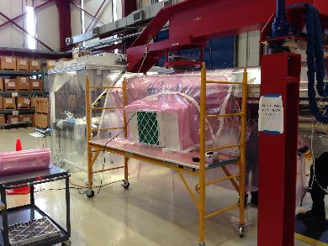
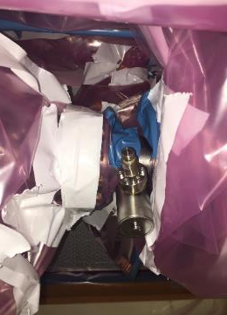
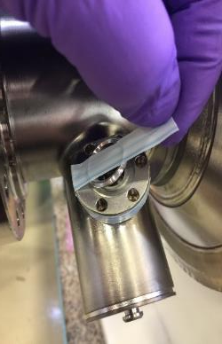
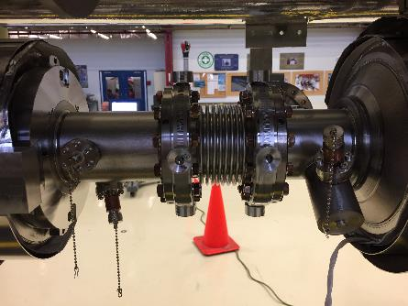
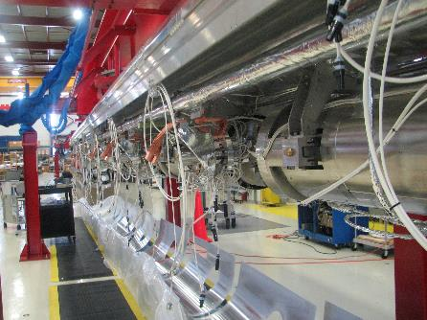
F1.3-5 Cav#1 HOM connector replacement
During final HOM notch frequency tuning at WS3, when the RF cable was removed, RF engineer noticed that Cav#1 FPC end HOM feedthrough pin is broken
Local cleanroom tent was built. Nitrogen fogger was used to optimize the location and rotation speed of the fan filter unit
Procedures were developed, tested on a the bench with a spare cavity
HOM connector with broken pin was replaced and leak checked successfully. CM is assembled at tested at CMTS
This is a one time incident. Official root cause analysis is not done
Mitigation Strategy:
  Ensure that protection caps are installed throughout the cold mass assembly.
  RF group changed the procedure for HOM notch frequency tuning:
    Skip intermediate RF measurements involving installation of cables on HOM feedthrough.
    Connect CM RF cable just before HOM notch frequency tuning at WS3 and keep connected afterwards.
  During CM assembly, only field probe feedthrough is used for RF measurement. For this particular feedthrough a connector saver adapter is installed to protect the pin
Broken feedthrough was leak checked on the bench and it is leak tight

Slide 2
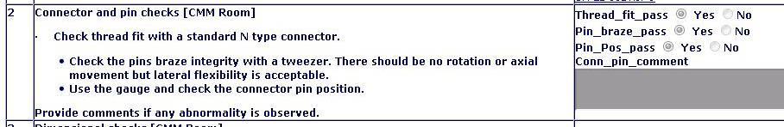
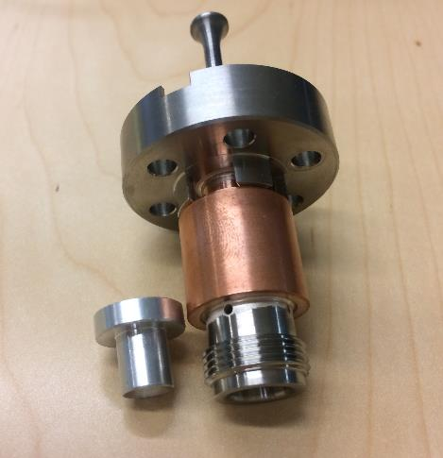
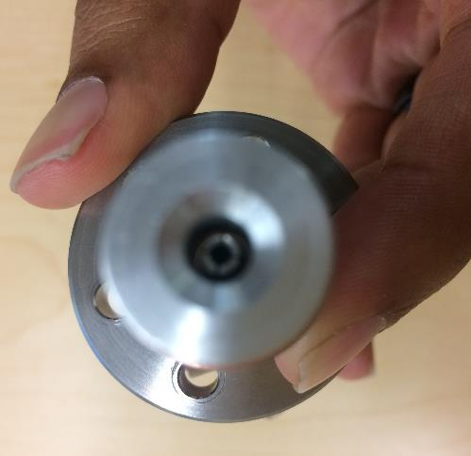
Feedthrough Inspection at JLab
  Incoming inspection includes pin check and results recorded in traveler. Both connector and gage are used to check.

Slide 3
F1.3-05 (CM05) Field Emission
 | VTS |  |  | CMTF Test
Cavity | Eacc* [MV/m] | FE onset | Q0@16MV/m | Max** Gradient [MV/m] | Usable Gradient*** [MV/m] | FE onset [MV/m] | Q0 @16MV/m 2K @ 30 G/s
CAV0045 | 22 | 1.97E+01 | 3.30E+10 | 21 | 20.6 | 15.2 | 3.49E+10
CAV0038 | 28.2 | No | 3.30E+10 | 20 | 15.2 | 11 | 3.16E+10
CAV0047 | 19.7 | no | 3.65E+10 | 19.6 | 19.6 | 16.5 | 3.57E+10
CAV0050 | 23 | no | 3.20E+10 | 19.5 | 19.0 | none | 3.95E+10
CAV0071 | 20 | no | 2.50E+10 | 21 | 21.0 | none | 2.28E+10
CAV0223 | 19.2 | no | 2.85E+10 | 18.5 | 18.5 | none | 2.42E+10
CAV0069 | 19 | no | 2.92E+10 | 18.4 | 18.4 | none | 2.53E+10
CAV0037 | 20 | 20.0 | 3.25E+10 | 19.9 | 19.9 | none | 3.57E+10
Average | 21.4 |  | 3.12E+10 | 19.7 | 19.0 |  | 3.12E+10
Total Voltage | 177.6 |  |  |  | 158.0

