Slide 1
Quality of Copper Plated Beamline Bellows and Spools
Katherine M. Wilson with Ken Premo and Liang Zhao
Photos courtesy of Brian Carpenter and John Ogle
LCLS-II QA/QC Review
22 January 2018

Slide 2
Parts Received and Inspected
Total Parts Ordered (JLab + FNAL)
 | Initial Order | Production Order | Add’l Order
PrCM Bellows | 35 | 224 | 52
Short Bellows | 6 | 31 | 10
DS Long Spool | 6 | 31 | 21
US Short Spool | Replaced with US Bellows
US Bellows | 14
Additional parts ordered:
As spares for existing CMs
For 5 additional/spare CMs

Slide 3
Quality Control
Inspection steps at JLab include:
Visual inspection (borescope for internal surfaces)
Careful inspection of seal surfaces
Leak check
Cleaning (bake if needed)
Inspection steps at FNAL are similar, except for bake
JLab QC Results
 | BLBP | BLBS | BLBU | BLXD | BLXU
HOLD MODIFY | 68 | 5 | 0 | 4 | 14
HOLD REMEASURE | 2 | 0 | 0 | 0 | 0
NOT DISPOSITIONED | 4 | 0 | 0 | 3 | 0
PROCEED TO NEXT WCA | 0 | 0 | 1 | 0 | 0
REJECT | 9 | 2 | 0 | 0 | 0
RETURN | 51 | 4 | 0 | 16 | 1
USE AS IS | 210 | 29 | 14 | 61 | 25

Slide 4
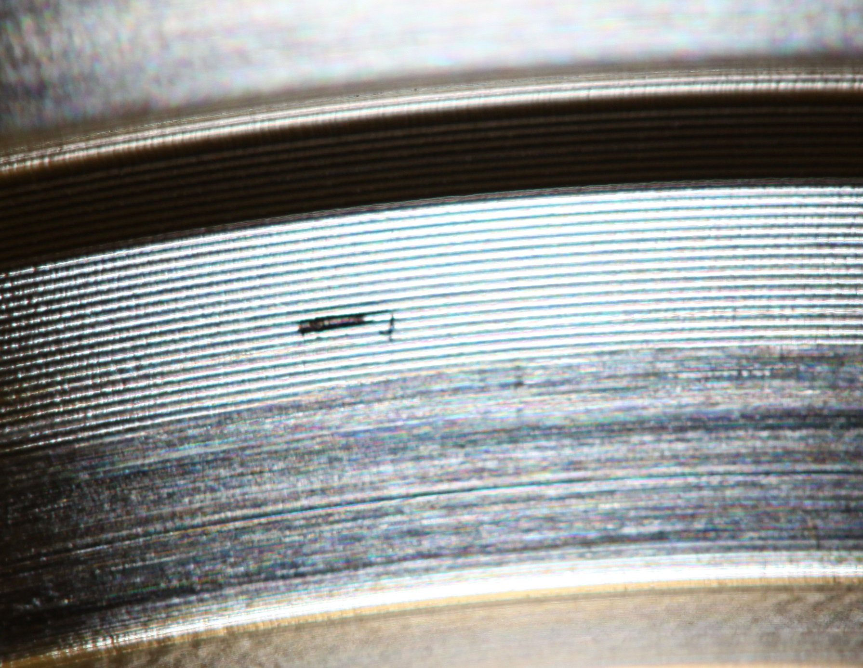
Seal Surfaces
Scratches/nicks
Surface finish

Slide 5
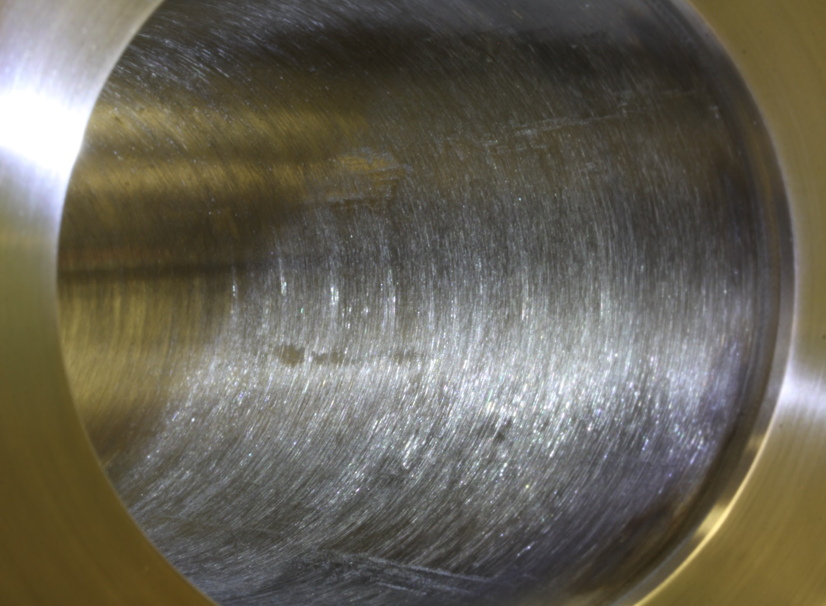
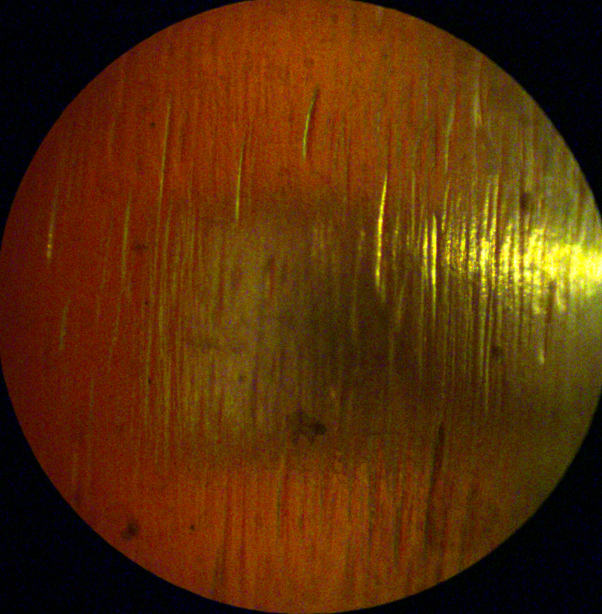
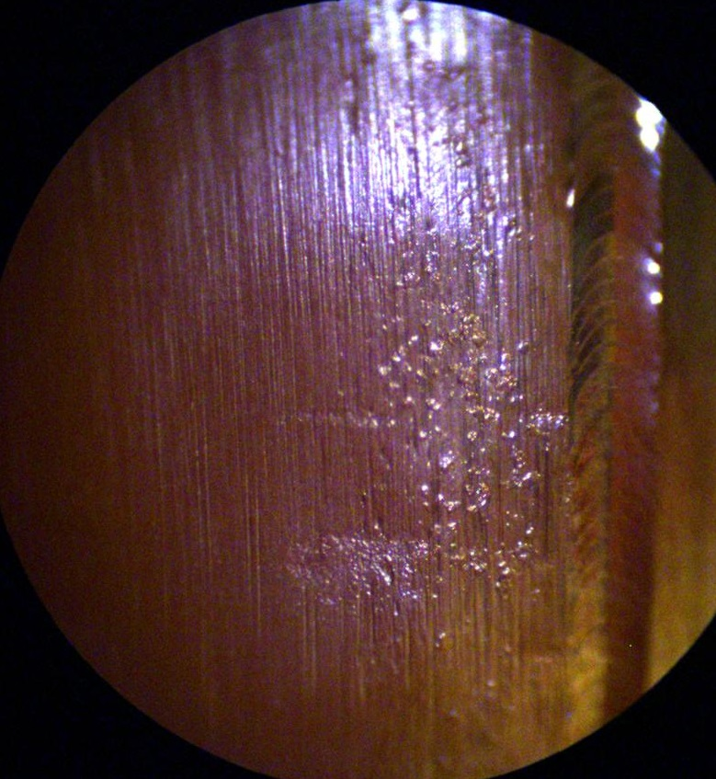
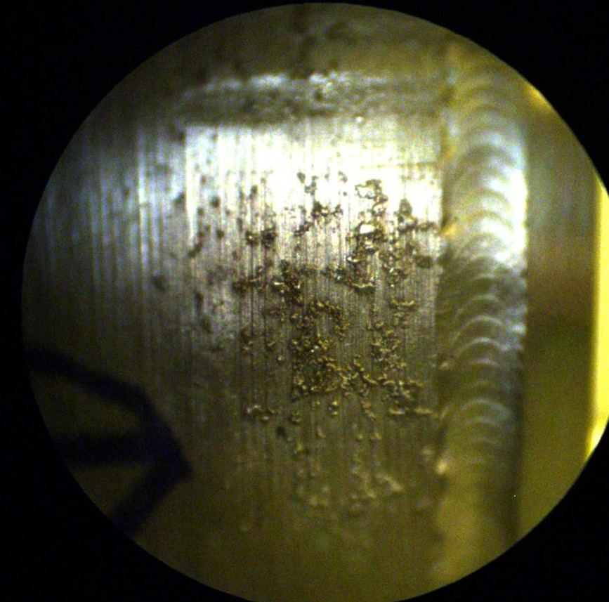
Quality Problem – Spools Surface Finish
Drawing originally called out Ra = 3.2 um = 125 u-in. Revised to 32 u-in

Slide 6
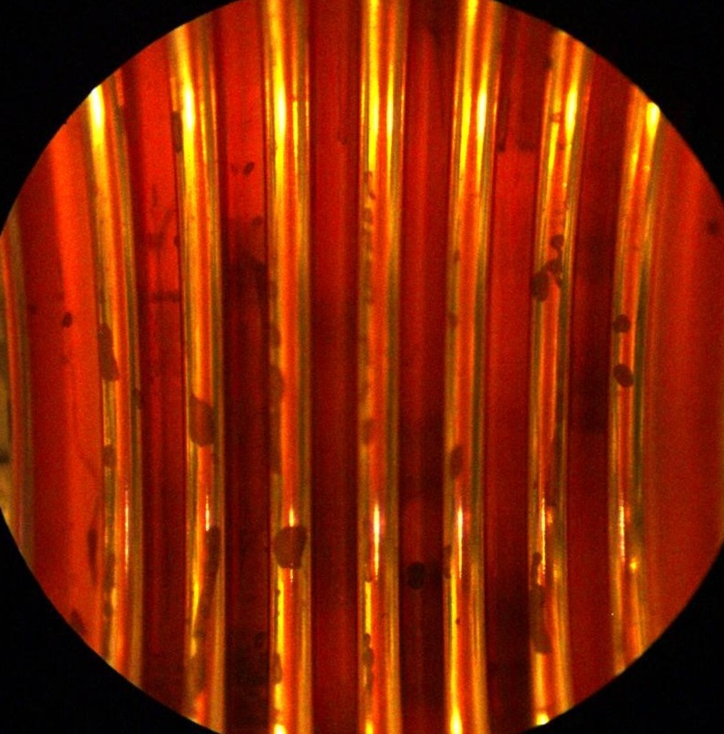
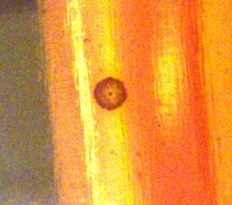
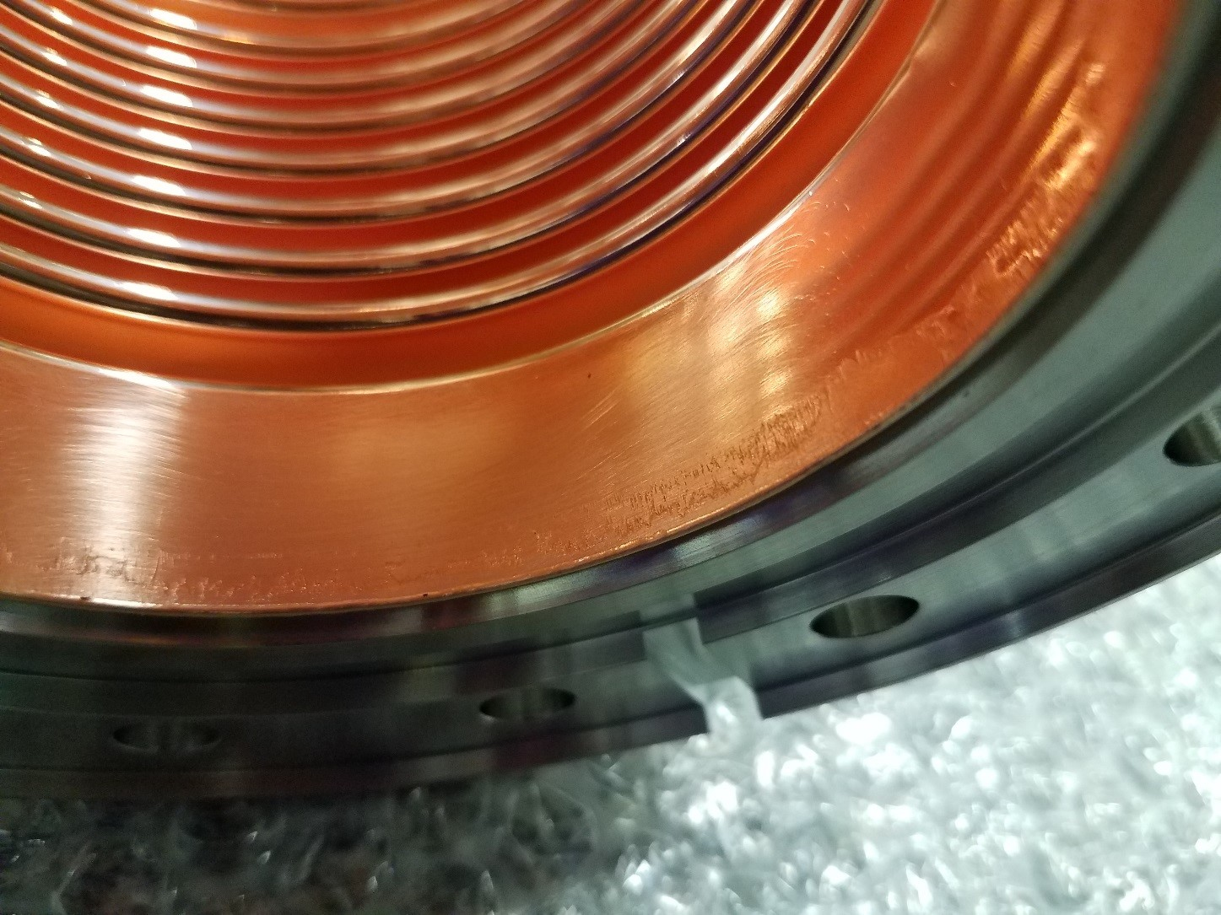
Quality Problem – Plating

Slide 7
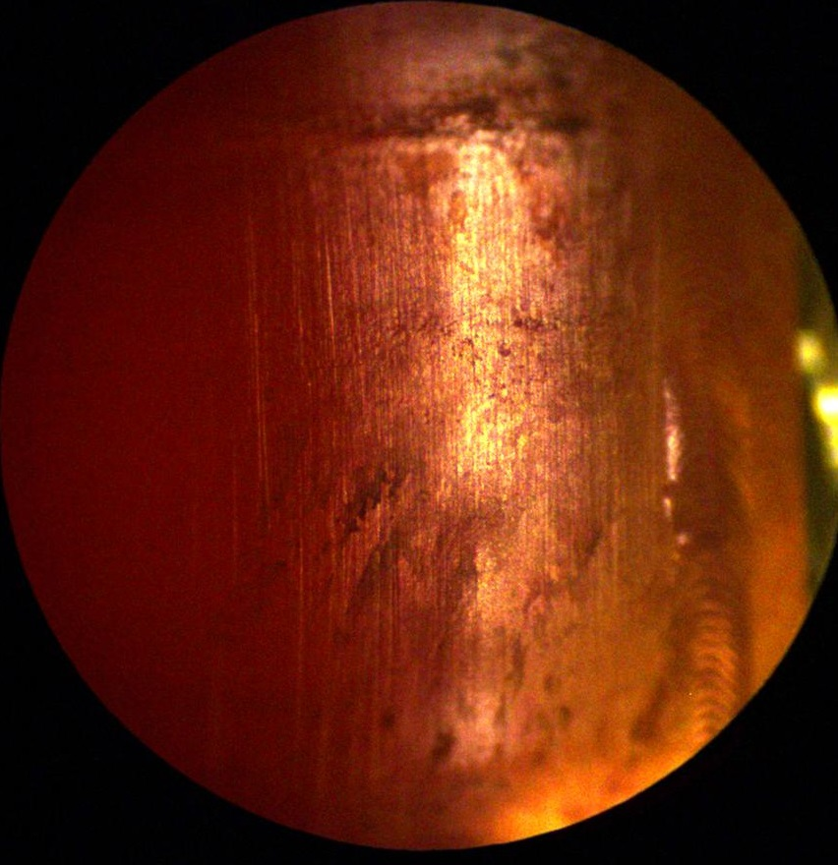
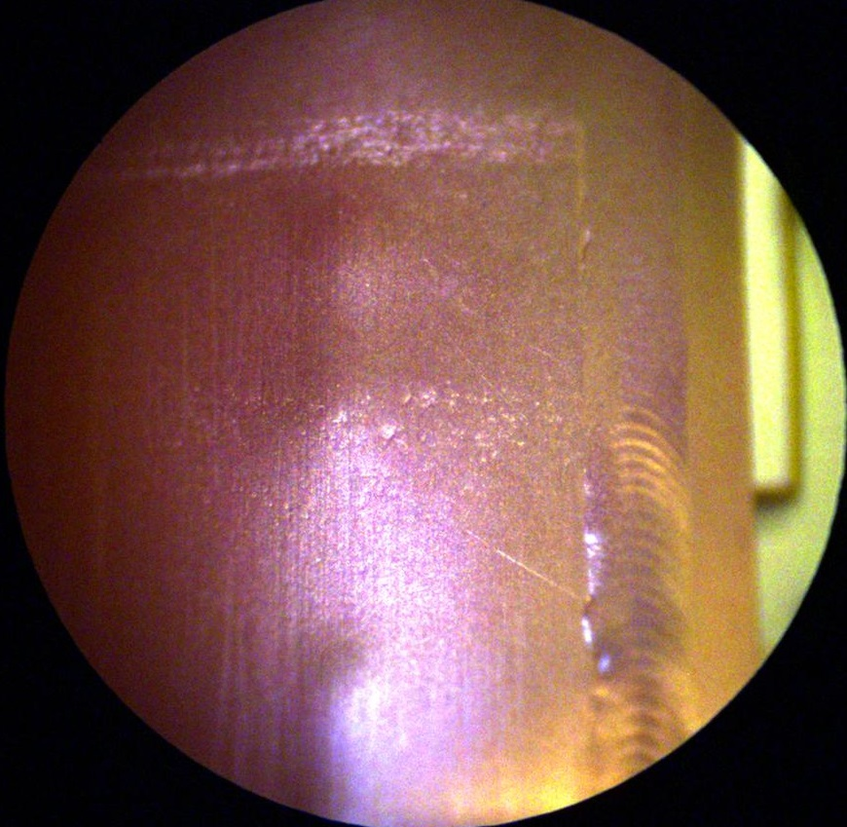
Cleaning of Plating
800 C for 3h
After baking
Before
After cleaning

Slide 8
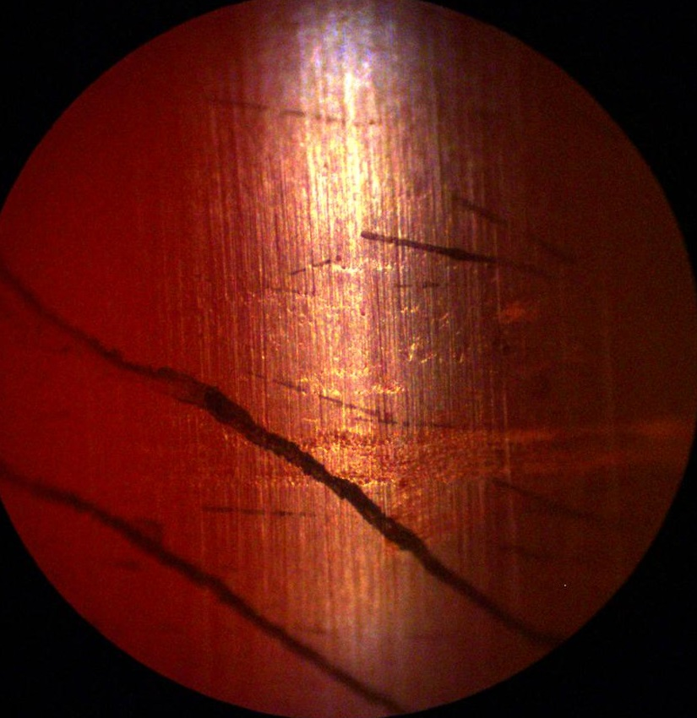
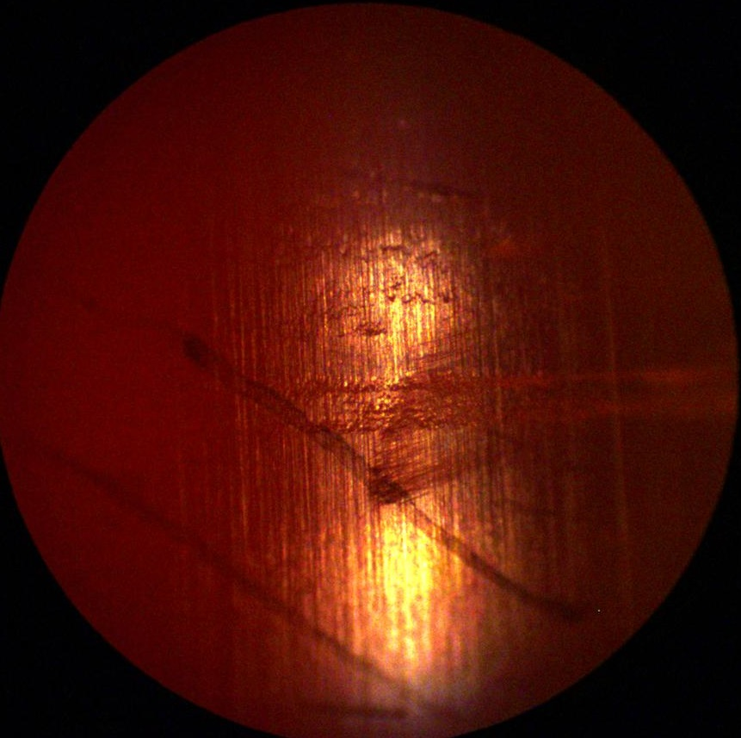
Cleaning of Plating
After baking
Before
After cleaning

Slide 9
Quality Problem – Possible Flaking
What causes FE in CM?
Series of experiments to quantify particulate from bellows - possibly released during flexing (See Liang Zhao for details.)
Flexing bellows with particle count
HPR and VTA test
Clean room-grade bottle brush
Assembly mock-ups
Production changes made to improve cleanliness
Bellows are cycled and blown clean prior to assembly
Bottle brush used during cleaning to remove loose debris
Cleaning procedure approved during clean room audit

Slide 10
Particulate Sampling/Material Analysis
Bellows were wiped at different locations at various stages of assembly/flexing
SEM was used to analyze particulate
Copper was seen, but also other materials
A failed bellows was cut up to facilitate material studies. It will be used to improve our understanding of plating in a beamline
Surface characterization
Mechanical deformation
Water test
HPR test

Slide 11
Conclusions / Lessons Learned
Plater should review design and specifications
Surface finish
Interface with tooling plating (weld bead issue)
Many plating problems can be overcome with cleaning. (Baking is essential.)
Flexing of bellows causes shedding of particles. Unclear so far if this causes FE or how to improve. Studies underway.
Conclusion: Issues with bellows/spools generally understood, and we have procedures for resolving issues. Studies of possible flaking of plating continue, but mitigations have been implemented.

Slide 12
Backup

Slide 13
Beamline Bellows and Spools
1.3 GHz Cryomodule
Long Spool
Short
Bellows
PrCM “Long” Bellows
Short Spool

