Slide 1
HOM Q_{ext} tuning update
Anna Solopova for QAQC workshop
25-Jan-18

Slide 2
Outline
Introduction
CM02 and CM03 refresher
Investigation
Lessons learned
CM04 and CM05 results
Documentation
Path forward
Summary

Slide 3
CM02 Qext
Cavity | QxtFPC | Qprobe | QHOMA | QHOMB
1 | 4.14E+07 | 3.46E+11 | 1.03E+11 | 1.76E+12
2 | 3.94E+07 | 2.86E+11 | 4.81E+11 | 1.03E+11
3 | 4.25E+07 | 3.50E+11 | 1.34E+11 | 2.96E+11
4 | 4.17E+07 | 3.80E+11 | 4.67E+11 | 8.25E+10
5 | 3.99e+07 | 3.70E+11 | 7.16E+10 | 2.35E+11
6 | 4.07E+07 | 3.99E+11 | 6.23E+11 | 2.06E+11
7 | 3.91E+07 | 3.36E+11 | 6.86E+11 | 2.34E+11
8 | 3.96E+07 | 3.03E+11 | 2.19E+13 | 5.05E+11
Cryo heat loads assumes < 0.5 W per HOM (LCLSII-4.1-PR-0146
Q_{ext} HOM 1 – 5 below spec; Q_{ext} HOM 2 – 6 below spec

Slide 4
CM03 investigation
Original results on CM03 were also not great
Five Q_{ext} HOM 1 and five Q_{ext} HOM 2 below spec
Collected data using FNAL software
Cross-checked measurements and calculations
Same notch frequency results in 10² difference in Q_{ext}
Close Q_{ext} have different notch frequency.
Average frequency shift warm under vacuum 0.8-1MHZ vs ~0.4MHz at Fermi.
Decided to tune to different frequencies
HOM 1 to 1296.6MHz
HOM 2 to 1296.3MHz
QHOM1 CMTF | QHOM2 CMTF
4.1E+12 | 2.9E+11
4.7E+10 | 9.4E+10
4.1E+11 | 4.6E+11
9.0E+10 | 8.5E+10
4.2E+10 | 1.6E+10
3.4E+12 | 1.6E+11
7.8E+10 | 3.5E+11
3.4E+10 | 1.7E+11

Slide 5
CM03 testing round 2 results
Measurements taken at ~8 MV/m
Preliminary Results
 | Tuned HOM 1 notch | Tuned HOM 2 notch | HOM 1 Cold notch | HOM 2 Cold notch | Notch 1 shift, MHz | Notch 2 shift, MHz | Power HOM 1 | Power HOM 2 | Qext 1 | Qext 2
1 | 1296.8 | 1296.3 | 1299.5 | 1300.5 | 2.7 | 4.2 | 0.2 | 0.9 | 4.90E+12 | 3.50E+11
2 | 1296.5 | 1296.4 | 1304.8 | 1300.8 | 8.3 | 4.4 | 2.1 | 0.8 | 7.50E+10 | 4.70E+11
3 | 1296.5 | 1296.2 | 1300.9 | 1300.2 | 4.4 | 4.0 | 0.6 | 0.3 | 1.70E+12 | 5.30E+12
4 | 1296.4 | 1296.2 | 1303.3 | 1301.3 | 6.9 | 5.1 | 1.2 | 1.3 | 1.90E+11 | 1.50E+11
5 | 1296.4 | 1296.1 | 1304.8 | 1300.9 | 8.4 | 4.8 | 1.3 | 0.9 | 1.50E+11 | 4.70E+11
6 | 1296.8 | 1296.4 | 1300.0 | 1300.4 | 3.2 | 4.0 | 0.2 | 0.5 | 8.00E+12 | 1.50E+12
7 | 1296.4 | 1296.3 | 1300.9 | 1300.6 | 4.5 | 4.3 | 1.5 | 0.5 | 1.30E+11 | 1.84E+11
8 | 1296.7 | 1296.4 | 1300.9 | 1300.9 | 4.2 | 4.5 | 1.2 | 0.8 | 1.70E+11 | 5.10E+11
Better than last time
Notch target appears to be good
HOM tuner side is more stable
No pattern in the notch shift
No obvious reason for a large shift

Slide 6
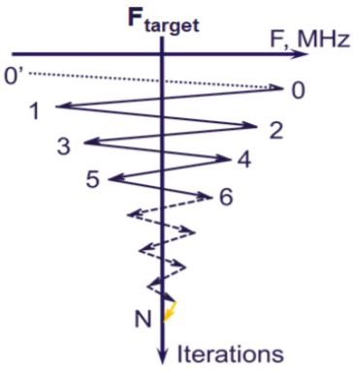
Lessons learned and applied to CM04
Studied and applied XFEL HOM tuning technique – iterative tuning.
Removes mechanical stress from the HOM can end plate and hardens niobium
HOM tune is extremely sensitive to cable motion and external movement like torqueing nuts and bolts
Must be the absolutely last thing done on the string before installation of a lower magnetic shield
Leave enough slack on each cable for thermal contraction

Slide 7
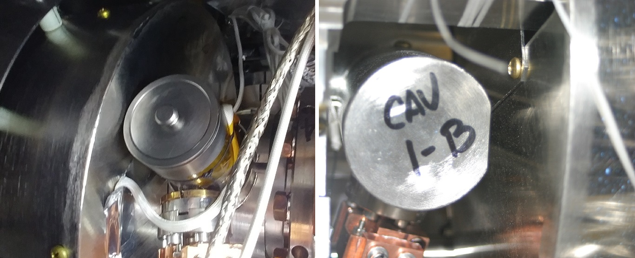
Mu metal magnetic shield interference
Found interference between magnetic shields of the helium vessel and HOM cans
Multiple dimensions of the dressed cavity and shields are possibly causing unforeseen interferences – currently under investigation for root causes other than installation
Quick solution in the mean time: trim HOM mag shields.

Slide 8
CM04 Qext HOM results
Cavity | Tuned HOM 1 notch | Tuned HOM 2 notch | HOM 1 notch after test | HOM 2 notch after test | HOM1 (mW) | HOM2 (mW) | Q_HOM1 | Q_HOM2
1 | 1296.5 | 1296.2 | 1296.4 | 1296.2 | 7.4 | 19 | 3.6E+13 | 1.5E+13
2 | 1296.5 | 1296.2 | 1296.6 | 1296.3 | 41 | 88 | 7.0E+12 | 3.2E+13
3 | 1296.8 | 1296.4 | 1296.8 | 1296.4 | 0.04 | 16 | 4.7E+15 | 1.1E+13
4 | 1296.6 | 1297.3 | 1296.6 | 1297.4 | 1.1 | 646 | 2.5E+14 | 4.2E+11
5 | 1296.6 | 1296.2 | 1296.6 | 1296.6 | 5.6 | 25 | 4.7E+13 | 1.1E+13
6 | 1296.6 | 1296.4 | 1296.6 | 1296.4 | 1.8 | 175 | 1.5E+14 | 1.6E+12
7 | 1296.6 | 1296.4 | 1296.6 | 1296.3 | 8.3 | 35 | 3.2E+13 | 7.7E+12
8 | 1297.1 | 1296.3 | 1297.1 | 1296.3 | 88 | 66 | 3.2E+12 | 4.1E+12
Almost no frequency shift before and after test.
Iterative tuning is a success!
All Q_{ext} HOM are above spec, Cavity 4 HOM 2 has an unfixable tight cable
Cavity 4 HOM 2 was bumped after tuning, power out at ~13.3MeV is 0.97W
Notes:
13.3MeV, limited by FE

Slide 9
CM05 Qext HOM results
Cavity | Tuned HOM 1 notch | Tuned HOM 2 notch | HOM 1 notch cold | HOM 1 notch cold | HOM1 (mW) | HOM2 (mW) | Q_HOM1 | Q_HOM2
1 | 1296.6 | 1296.3 | 1299.9 | 1300.1 | 0.09 | 0.09 | 4.2E+13 | 4.6E+12
2 | 1296.7 | 1296.3 | 1300.1 | 1300.2 | 0.07 | 0.13 | 5.7E+11 | 1.2E+13
3 | 1296.6 | 1296.3 | 1299.8 | 1300.3 | 0.09 | 0.32 | 2.9E+13 | 2.5E+12
4 | 1296.5 | 1296.3 | 1299.9 | 1300.1 | 0.23 | 0.23 | 3.4E+12 | 1.5E+13
5 | 1296.5 | 1296.3 | 1299.7 | 1300.0 | 0.26 | 0.26 | 5.6E+12 | 1.9E+15
6 | 1296.6 | 1296.3 | 1299.9 | 1300.4 | 0.04 | 0.39 | 5.4E+13 | 2.1E+12
7 | 1296.6 | 1296.3 | 1299.9 | 1300.2 | 0.02 | 0.16 | 3.2E+14 | 8.8E+12
8 | 1296.7 | 1296.4 | 1300.1 | 1300.2 | 0.12 | 0.19 | 2.4E+13 | 6.1E+12
All Q_{ext} HOM exceed spec.
Notch frequency shift is consistent across all cavities

Slide 10
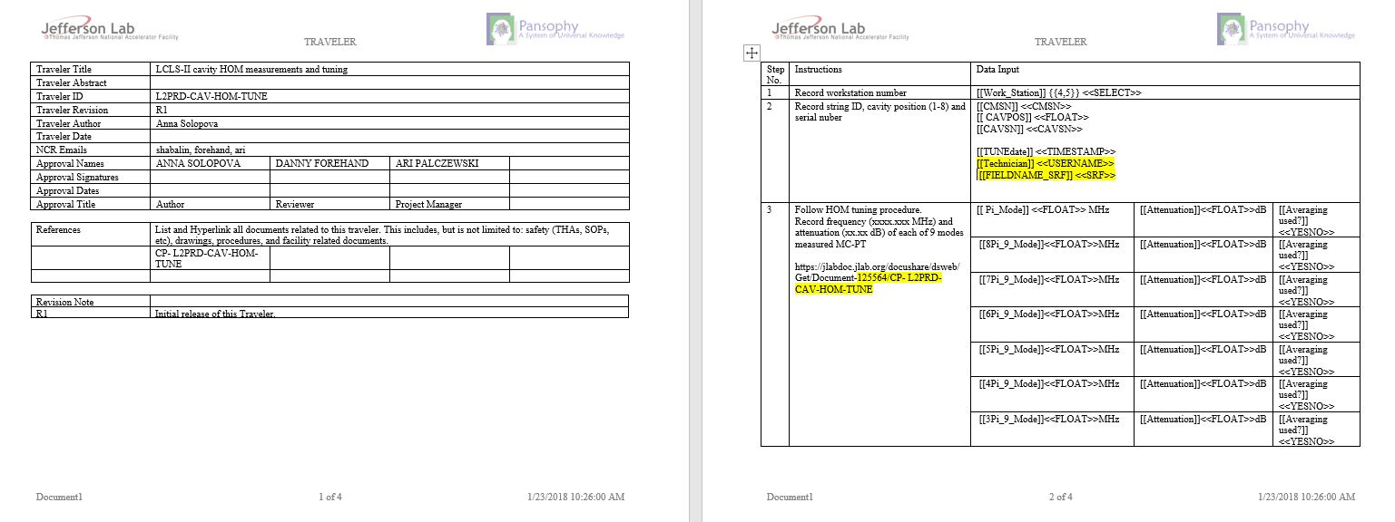
Documentation
Procedure and traveler are a work in progress. Draft versions available.

Slide 11
Path forward
Rework CM02 and CM03
Test CM07, revise procedure if needed
Improving procedure to reduce time required to tune one cavity
Finalize documentation
Find a better solution than cutting off magnetic shielding.

Slide 12
Summary
Took time to experiment with CM03
Iterative tuning removes mechanical stress from HOM end plate and hardened the niobium can
Mag shield interference due to floating cavity dimensions and installation issues of the first couple modules
Average notch position shift from warm to cold module is larger than at Fermi and different for HOM 1 and 2.
CM04 meets HOM specs
CM05 exceeds HOM specs – our best result yet.
Procedure and traveler are being finalized, drafts available

