Slide 1
Leica Absolute Laser Tracker operation in magnetic field environment
Dr. Angelika Lippitsch
Hexagon Manufacturing Intelligence
Leica Geosystems AG / Metrology Products

Slide 2
Motivation
Topic of operation of Leica Laser Trackers in magnetic field environment raised by users of accelerator community
Previous investigations by Laser Tracker users*
Application: Magnetic field mapping
Magnetic fields ≤ 200G
Scope
Experiment in house
  @ Hexagon MI / Leica Metrology Products
  Switzerland
Leica Absolute Laser Tracker AT930/AT960 & AT403
3D mode only – measurements to 1.5"CCR
Give recommendation to users
No hardware modifications / changes
* Friedsam H., "Alignment Aspects of the Mu2e Magnetic Field Mapping System", IWAA 2016, ESRF, Grenoble, (2016); https://indico.cern.ch/event/489498/contributions/2217442/

Slide 3
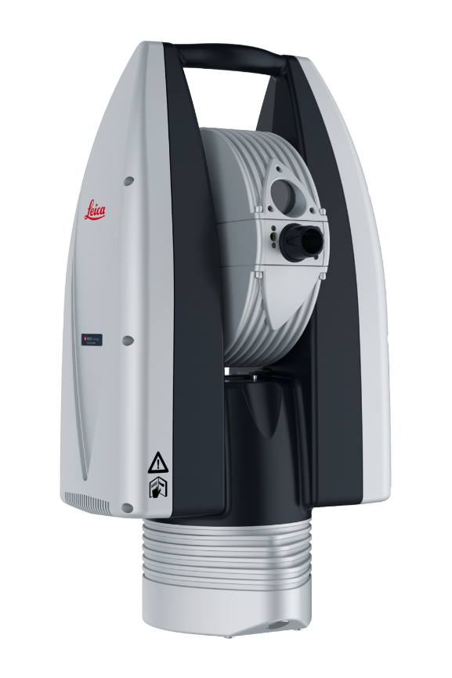
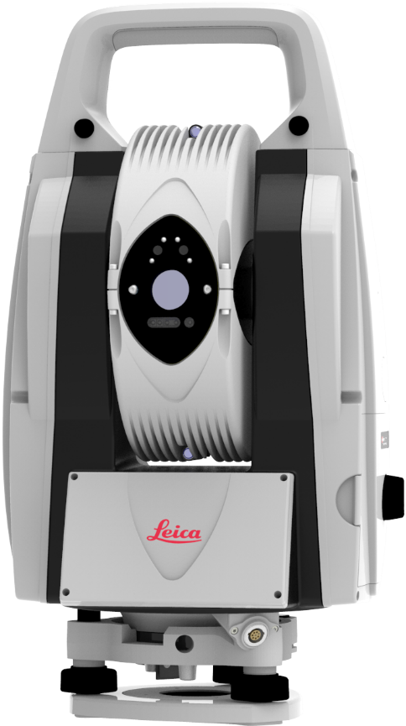
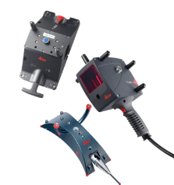
Leica Absolute Laser Trackers
AT930 & AT960
ADM & IFM
Highly dynamic (1kHz)
Range up to 60m
AT930: 3D Measurements
AT960: 3D & 6DoF Measurements (Range up to 25m)
6DoF: T-Probe / T-Scan / LAS / T-Mac
AT403
ADM only
Quasi dynamic (5Hz)
Range up to 160m
B-Probe

Slide 4
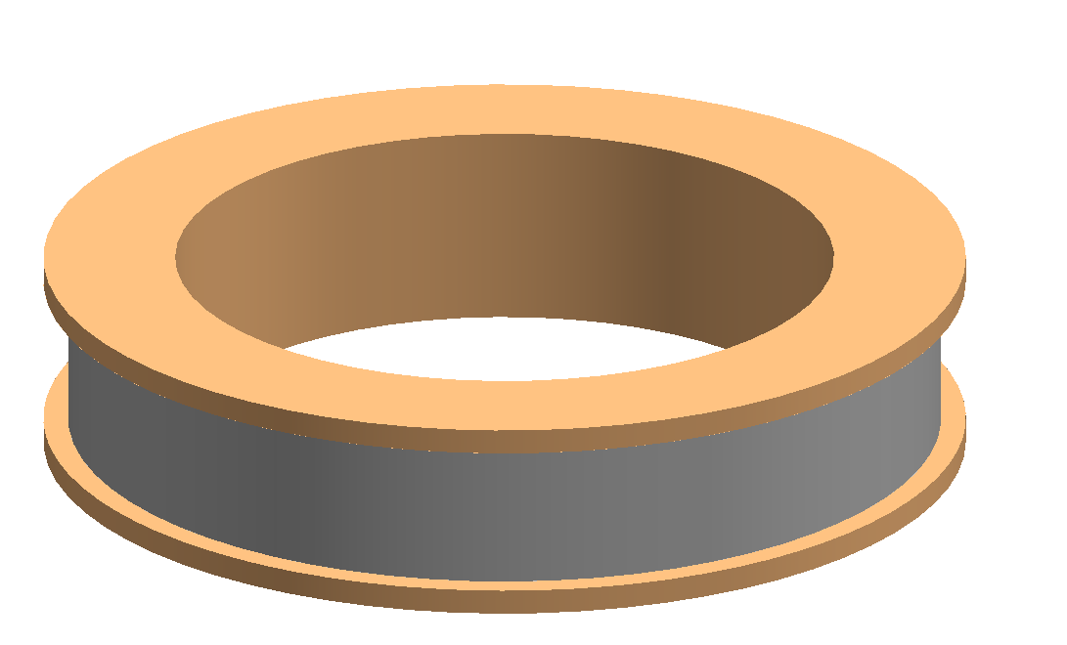
Test Setup - Magnetic Field
Copper Coil
160 Windings
Ø = 0.482 m
Height of coil cylinder l = 0.1 m
Copper cable diameter: 5 mm
Resistance R_{DC} @22°C: 0.21 Ω
Inductance L (100Hz) @22°C: 16.7 mH (measured)
Magnetic flux density B: 4.2 Gauss / A

Slide 5
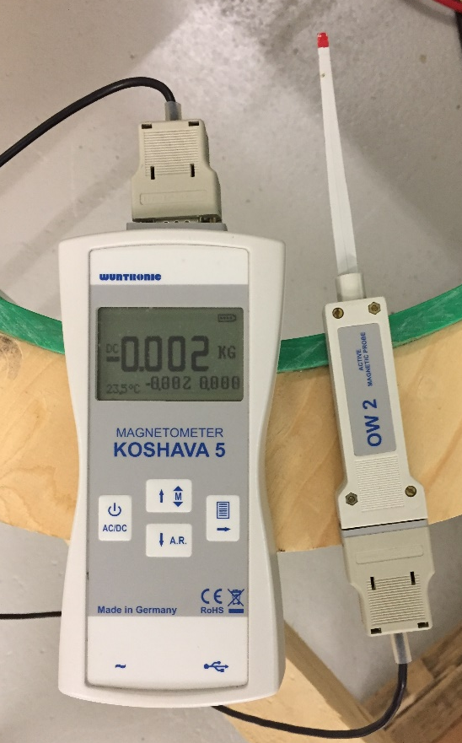
Test Setup - Magnetic Field Measurement
Coil without Laser Tracker Sensor
Magnetic field measured with Hall Sensor probe

Slide 6
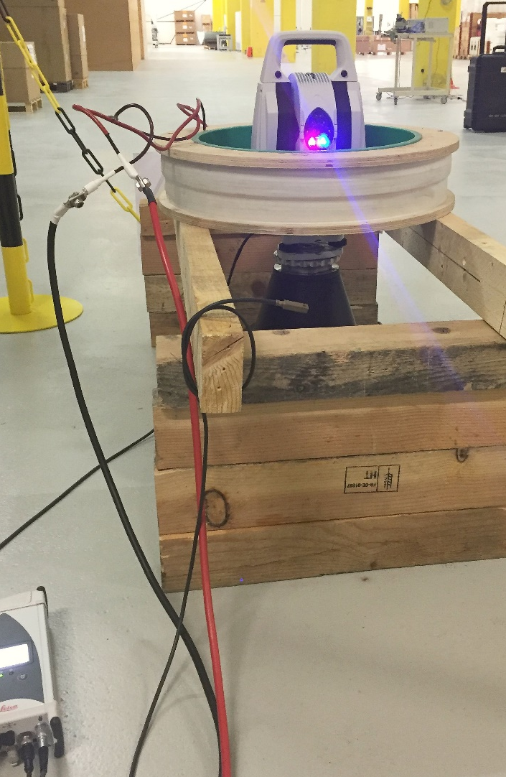
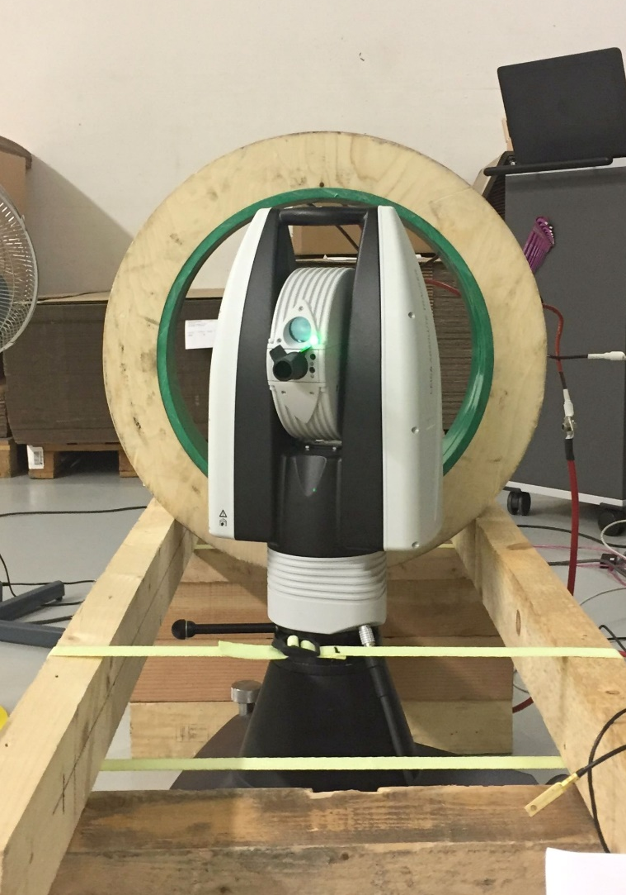
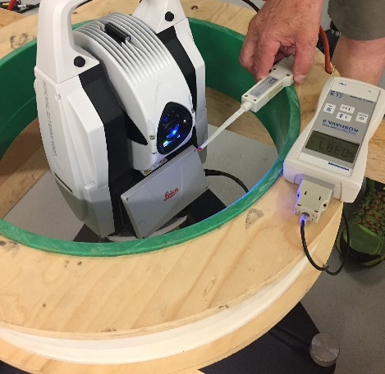
Test Setup – Laser Tracker Position
Magnetic field checked with Hall Sensor probe
Controller outside of test zone
Short time magnetic field (gated) to limit atmospheric disturbances
Analysis of effects on system by analysing continuous data
Overall system accuarcy verified before and after experiment (standard Sensor Checks)
Coil in horizontal setup
Coil in vertical setup

Slide 7
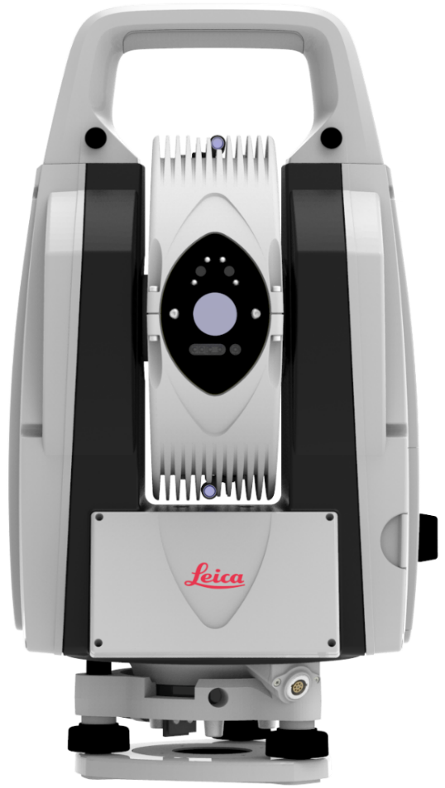
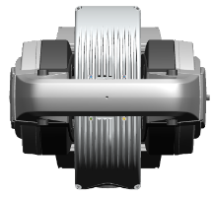
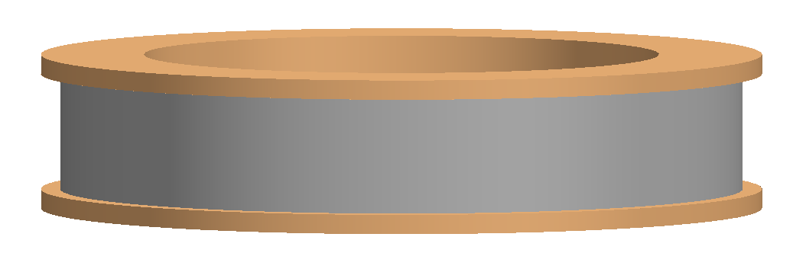
Measurement Setup – Coil in horizontal Position
Observation of Target at 10m / tilting axis height
Short time magnetic fields (2-3 sec)
~10m
Top View
Front View

Slide 8
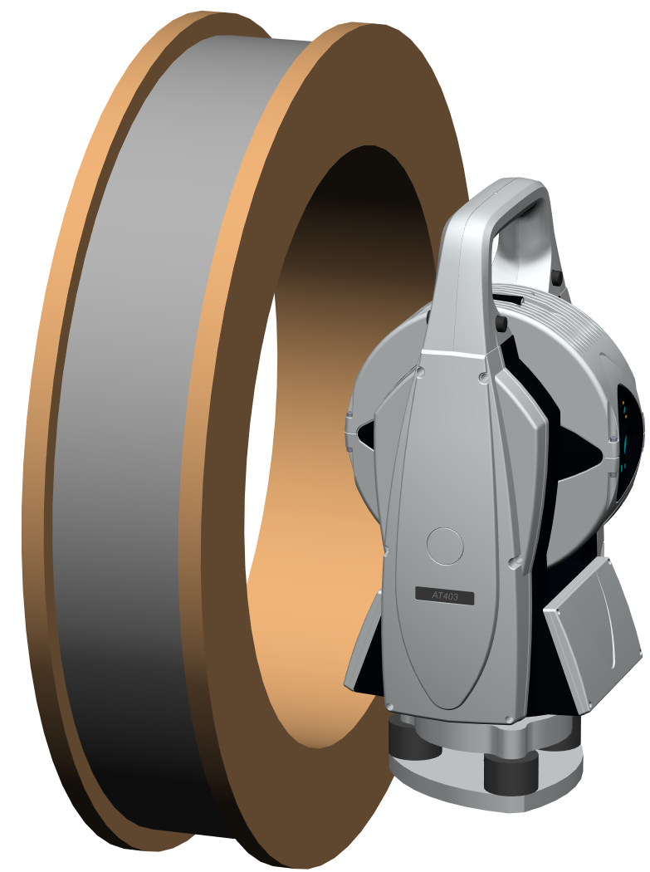
Measurement Setup – Coil in vertical Position
Observation of Target at 3m / tilting axis height
Short time magnetic fields (2-3 sec)
Orientation #1
~3m
Top View
Side View

Slide 9
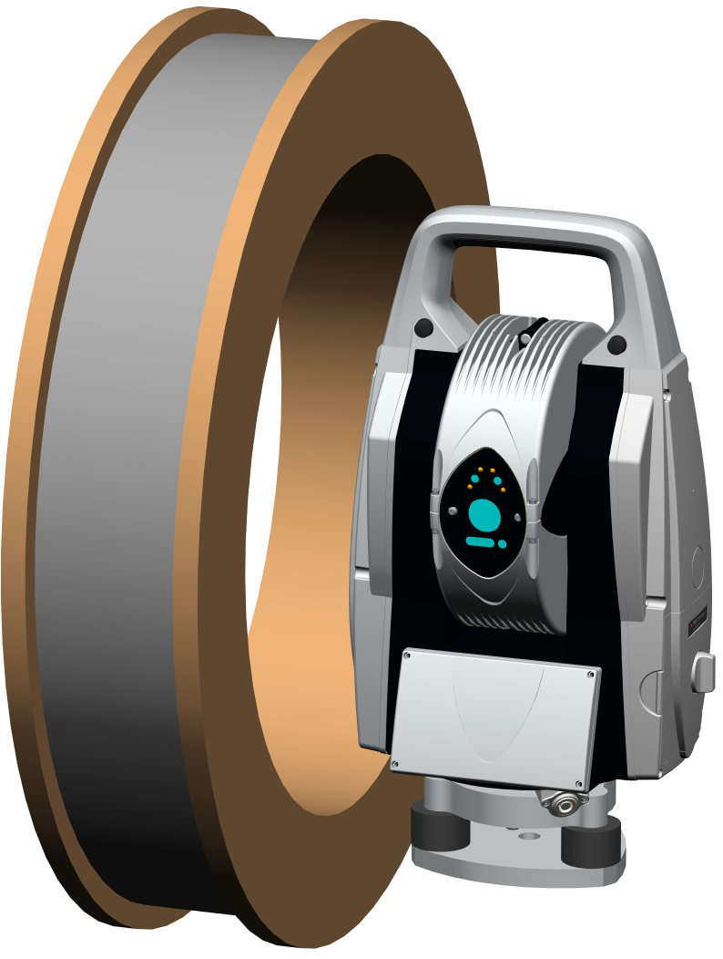
Measurement Setup – Coil in vertical Position
Observation of Target at 3m / tilting axis height
Short time magnetic fields (2-3 sec)
Orientation #2
~3m
Top View
Side View

Slide 10
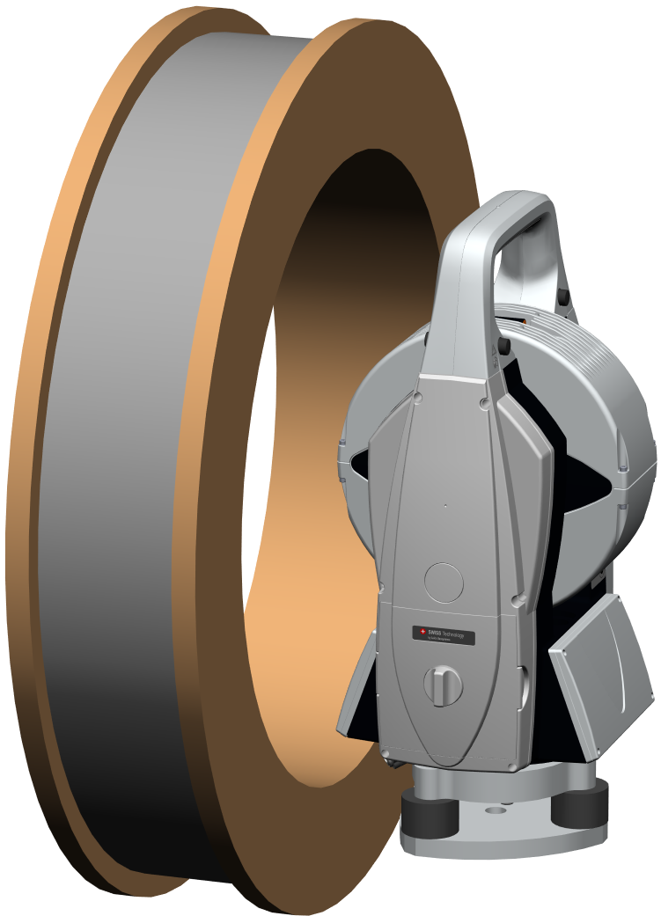
Measurement Setup – Coil in vertical Position
Observation of Target at 3m / tilting axis height
Short time magnetic fields (2-3 sec)
~3m
Orientation #3
Top View
Side View

Slide 11
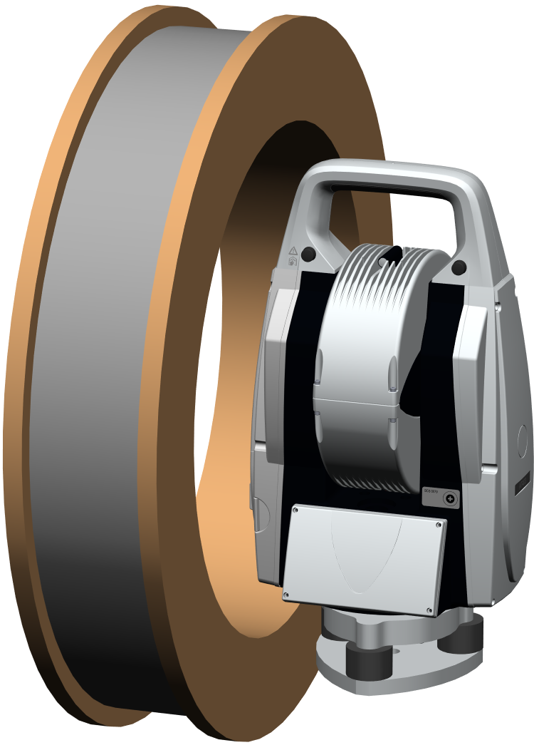
Measurement Setup – Coil in vertical Position
Observation of Target at 3m / tilting axis height
Short time magnetic fields (2-3 sec)
Orientation #4
~3m
Top View
Side View

Slide 12
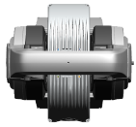
Measurement AT403 – Coil in horizontal Position
Continuous Measurement of 1.5"CCR @10m
Short time magnetic fields (3-5 sec) up to 420G
~10m
ADM stops measuring at ≥400G
System recovers
No other significant effects

Slide 13
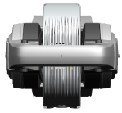
Measurement AT403 – Coil in vertical Position – Orientation #1
Continuous Measurement of 1.5"CCR @3m
Short time magnetic fields (3-7 sec) up to 500G
~3m
1x ADM dropout at ~190G, not reproducable, too fast change of field
System recovers autonomously
Effects in angles visible from 200G
Significant effects in V angles at max change of field
ADM deviations up to 400G within tolerance

Slide 14
Measurement AT403 – Coil in vertical Position – Orientation #1
Continuous Measurement of 1.5"CCR @3m
Magnetic field (10 sec) ~350G
~3m
Significant effect in angles and distance at max change of field
Effect of Induction

Slide 15
Measurement AT403 – Coil in vertical Position – Orientation #2 - 4
Continuous Measurement of 1.5"CCR @3m
Short time magnetic fields (3 - 5 sec) ≤ 350G
~3m
~3m
~3m
Orientation #2
Orientation #3
Orientation #4
No effect in Orientation #2
Significant V angle differences in Orientation #3 but small compared to Orientation #1
Similar effect in V Angle – sensitivity to maximum change of field
Very little effect seen in Orientation #4 (motors in max exposure)
No ADM dropouts

Slide 16
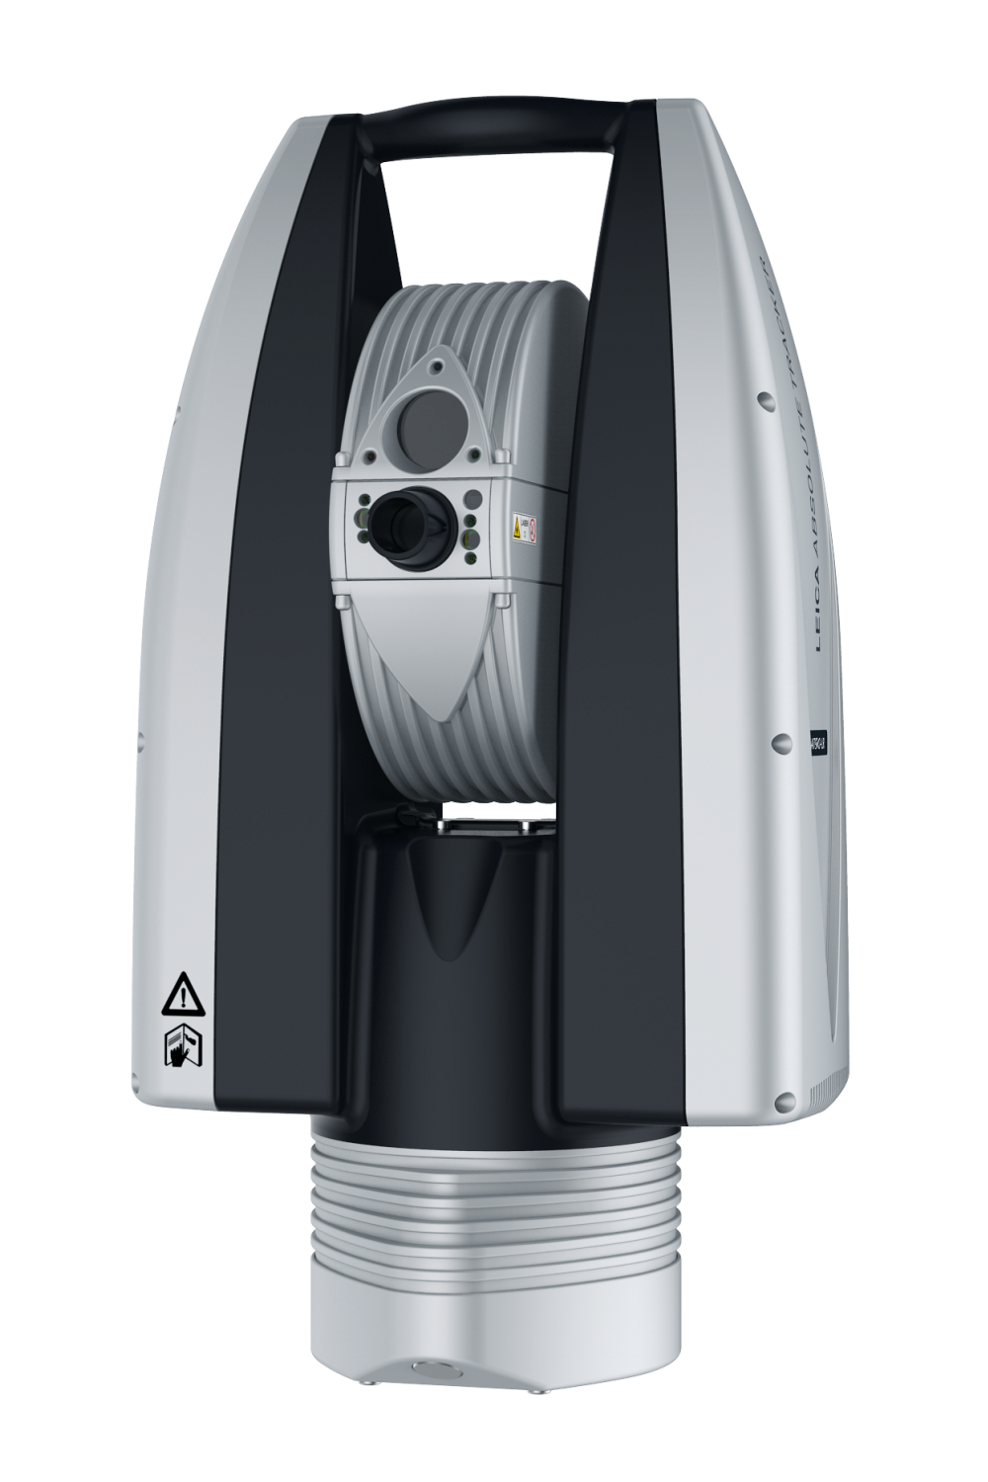
AT930 / AT960
Interferometer
He-Ne (ionized gas) Lasertube
Inherently sensitive to magnetic fields
Especially along field lines of tube (vertical, i.e. coil in horizontal position here)
Large variation between individual sensors (i.e. laser tubes)

Slide 17
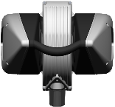
Measurement AT960 – Coil in horizontal Position
Continuous Measurement of 1.5"CCR @10m
Short time magnetic fields (2-3 sec) up to 70G
~10m
IFM Lasertube Stabilization interfered at 70G
System recovers (several minutes)
No effects before incident

Slide 18
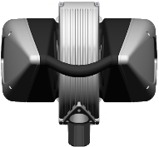
Measurement AT960 – Coil in vertical Position – Orientation #4
Continuous Measurement of 1.5"CCR @3m
Short time magnetic fields (3-5 sec) up to 150G
~3m
IFM Lasertube Stabilization interfered at 150G
System recovers (several minutes)
No effects before incident

Slide 19
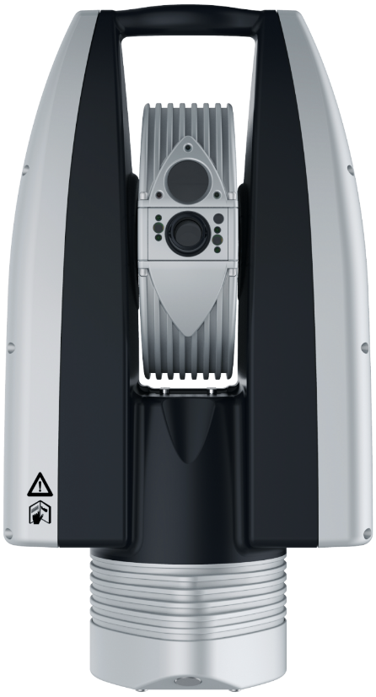
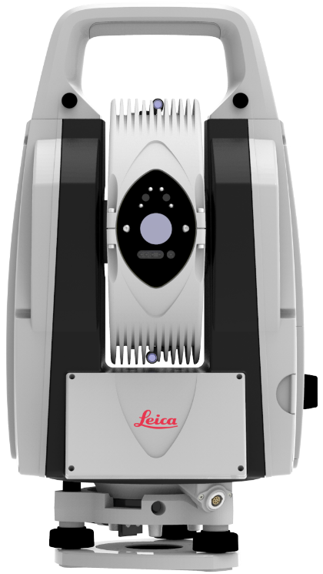
Conclusion
AT403
System reacts more sensitive when magnetic field is orthogonal to standing axis, especially when the field changes
Initialisation tested up to 350G, ADM stops at some point, influence of atmospheric effects on stationary measurements as time magnetic field had to be longer (coil heats up)
Recommendation (verified with other AT403)
  ≤ 200G
    Full functionality
    Full accuracy
    No damage
  200 – 300G
    Full functionality
    Accuracy begins to decrease
    Probably no damage
  > 300G
    ADM stops measuring at some point
    System recovers quickly if field is stopped
No tests with AT401 / AT402 or B-Probe
No tests for long term exposure to magnetic field
AT930 / AT960
Sensitivity of laser tubes to magnetic fields inherent
Magnetic fields orthogonal to laser tube have less effect
Large variations in sensitivity of individual laser tubes
Assumption (from experience of two AT960)
  ≤ 50G
    Full functionality
    Full accuracy
    No damage
  > 50G
    Laser stabilization becoming interfered
    Need for laser to restabilise if field is stopped
    Accuracy: small deviations in distance
      before laser stabilization interfered
    Probably no damage up to 200-300G
No tests regarding 6DoF / T-Products
No tests for long term exposure to magnetic field

Slide 20
THANK YOU!

