Slide 1
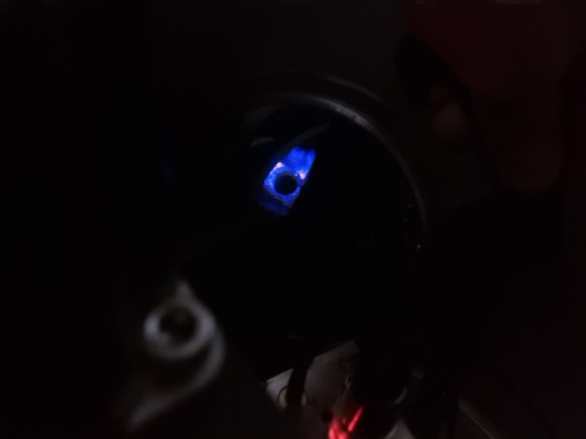
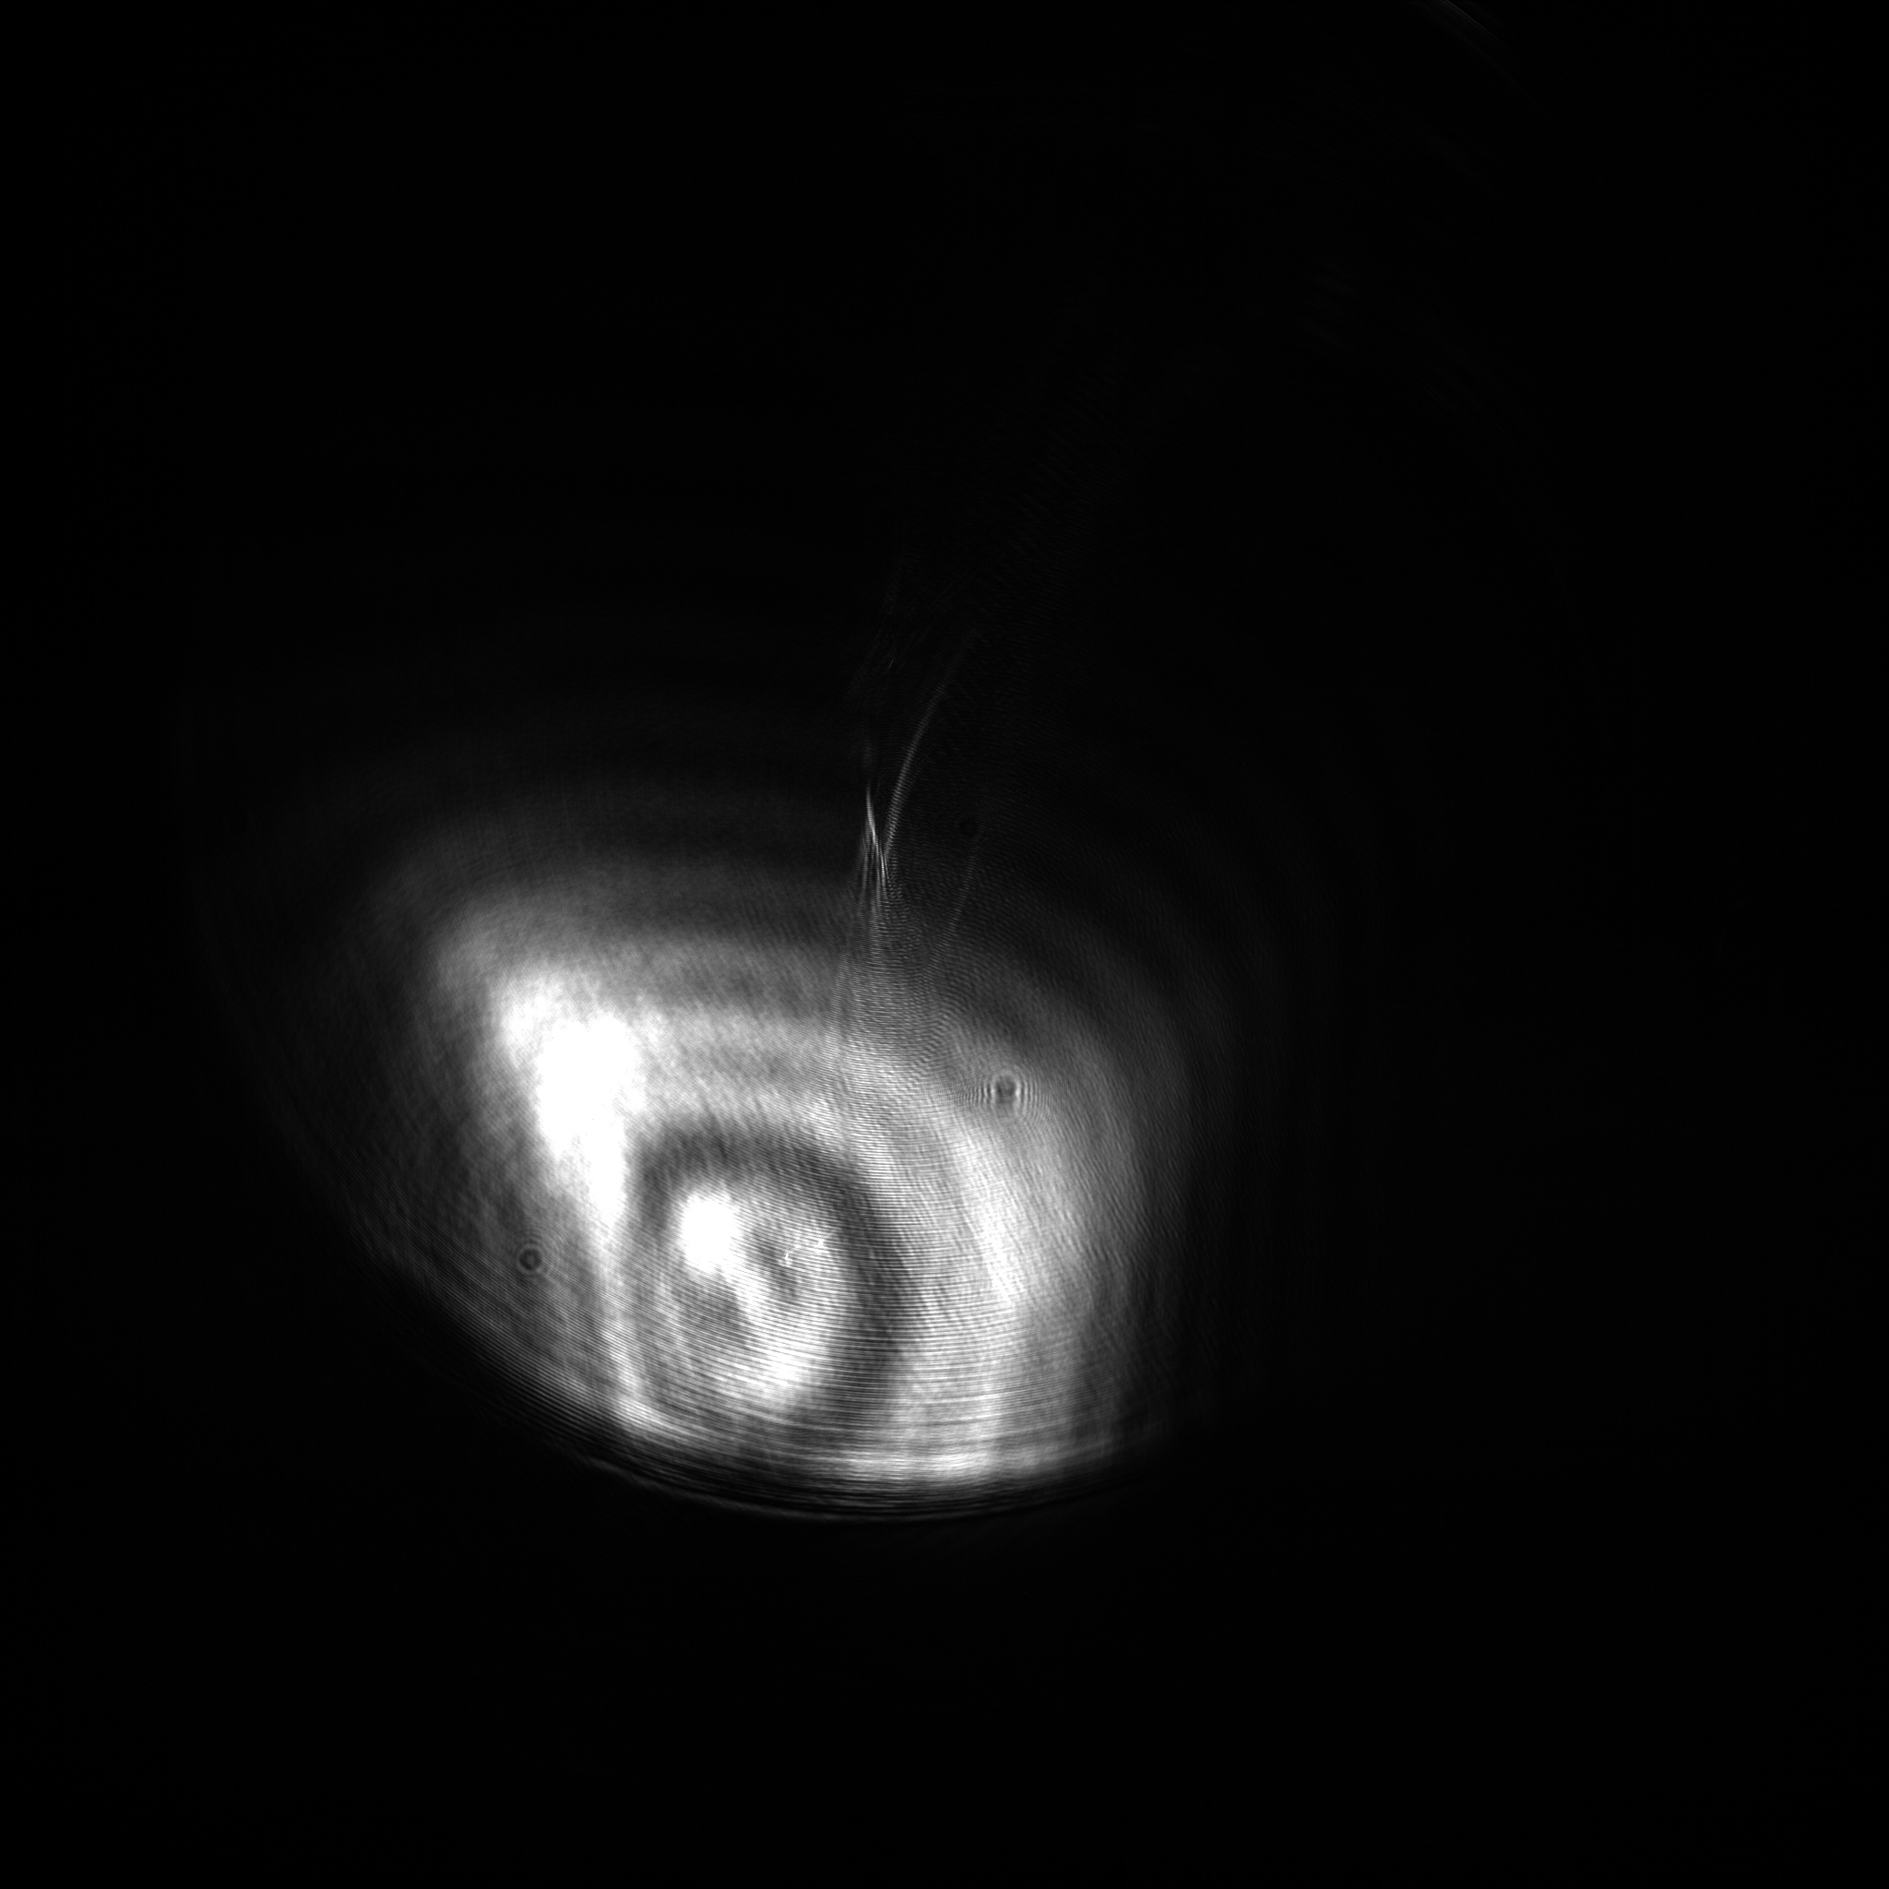
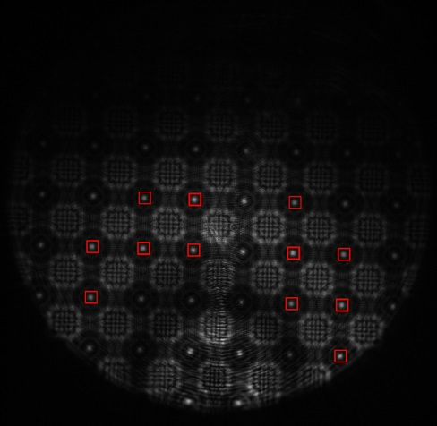
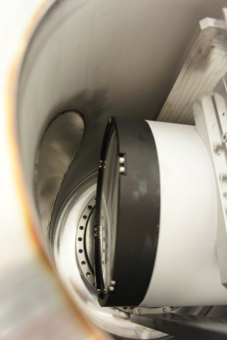
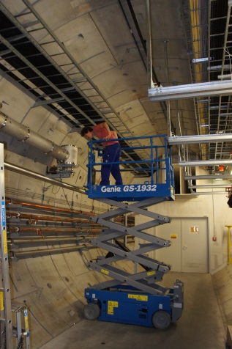
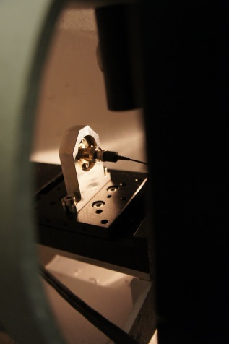
SLRS Revisited
…is the Straight Line Reference System still working ?
Dr. Johannes J. Prenting
SLRS put to 2nd test
FNAL, October 2018

Slide 2
System setup
System Integration
The SLRS (Straight Line Reference Surveyor) is a refraction free alignment system
It uses a collimated laser beam within an ISO200 vacuum tube
SLRS is used like a ruler put into the seemingly bent (refraction) tunnel network
There is no direct connection between the SLRS and machine components
SLRS provides correction parameters (dx, dz) for the geodetic network
Calibrated transfer pieces are used to connect the SLRS measurements
with the tunnel network
Dx, Dz
Dx, Dz
Dx, Dz

Slide 3
System setup
Principle of the SLRS:
A laser light source emits coherent light
A fiber end, aperture and a plano convex lens are used to expand and collimate the beam
Spheres (or disks) put into the beam along the measuring section originate a poisson spot behind the centre of the sphere which can be viewed with a ccd camera
The centre of the target and the centre of its poisson spot in the image generate a straight line
A lens system focuses the expanded beam to the dimensions of the CCD sensor
Correlation algorithms are used to calculate the poisson centres in the image
CCD Camera
Plano-convex lenses
Targets
Plano-convex lens
Aperture
Laser Point Source

Slide 4
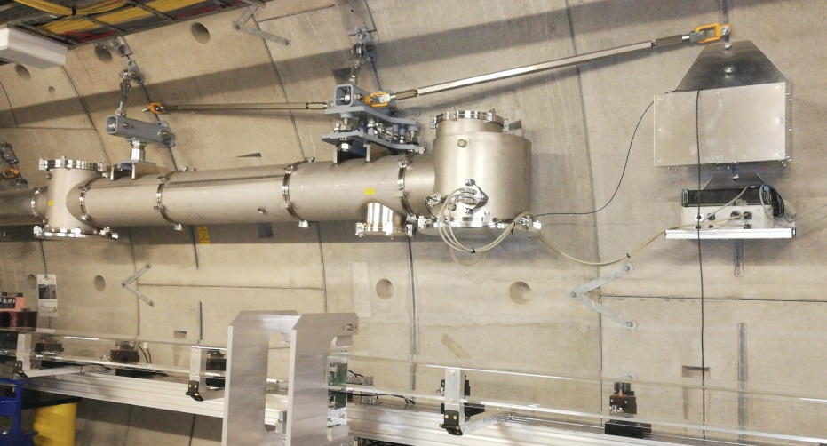
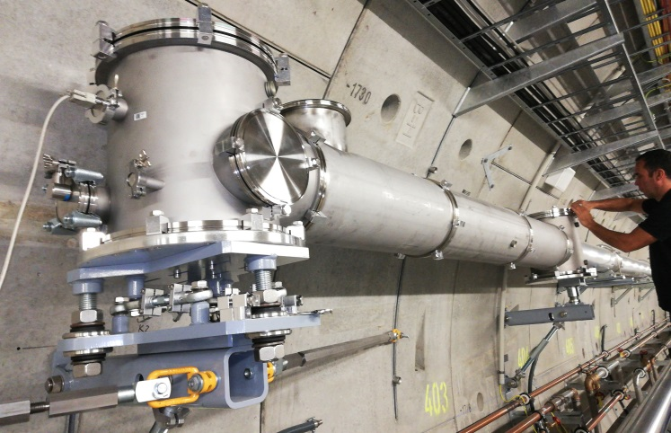
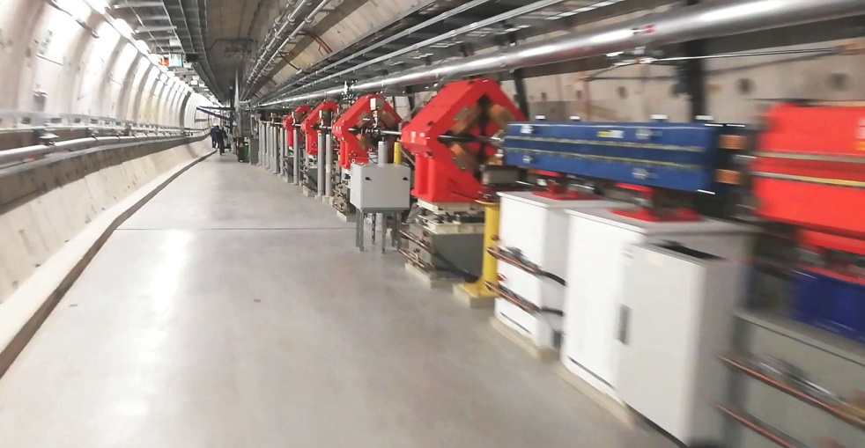
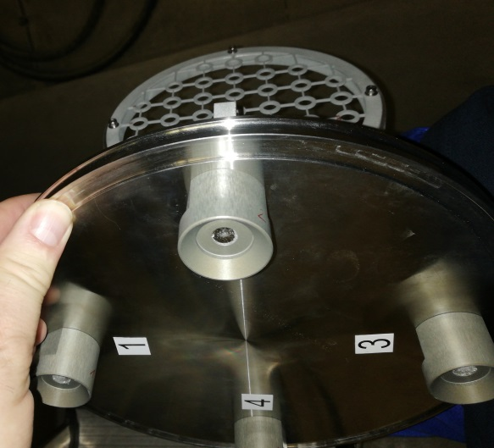
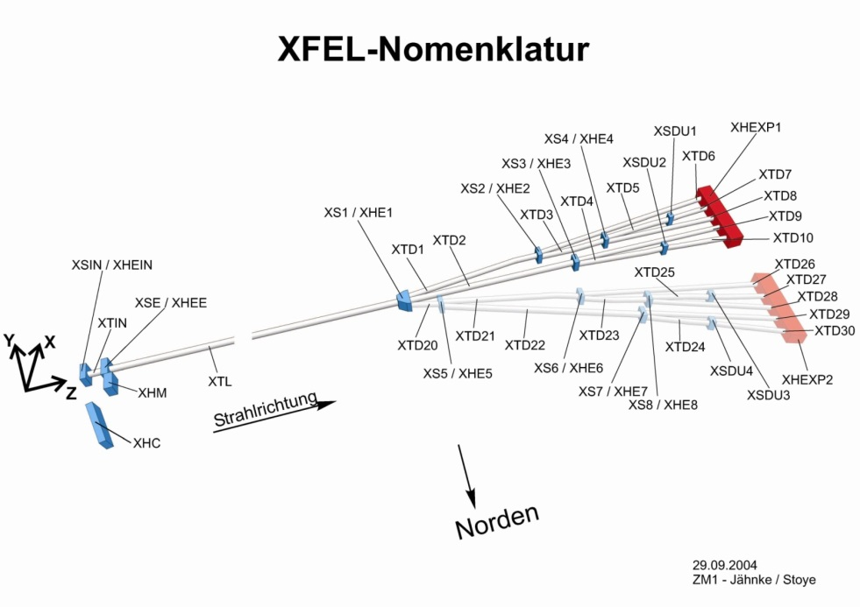
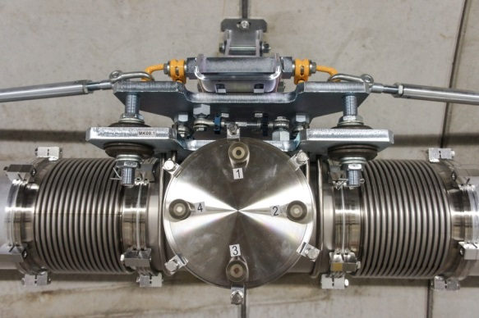
System setup
housing for laser, aperture, lens
camera housing
SLRS@SASE2
Actual setup:
Aluminum pipes, 7.73m/3.87m long, 200mm diameter. Supports are placed every 3 to 4.5m with fixed point and floating point mounts.
special housings for (laser, aperture, lenses) and (lenses & camera)
Tee piece connector with bellows, every 24m, every 2nd is
equipped with adapted measurement targets (aka target boxes)
blue laser (wavelength = 405nm) allows for small targets and provides fine interference patterns
revised plano convex lenses for minimal spherical aberration
GigE-Camera with 2048x2048 pix. resolution
Oerlikon/Leybold Trivac D 65 B Vacuum pumps
Tee piece connector & bellows
SASE2: 555m
SASE3: 443m
SASE1: 535m

Slide 5
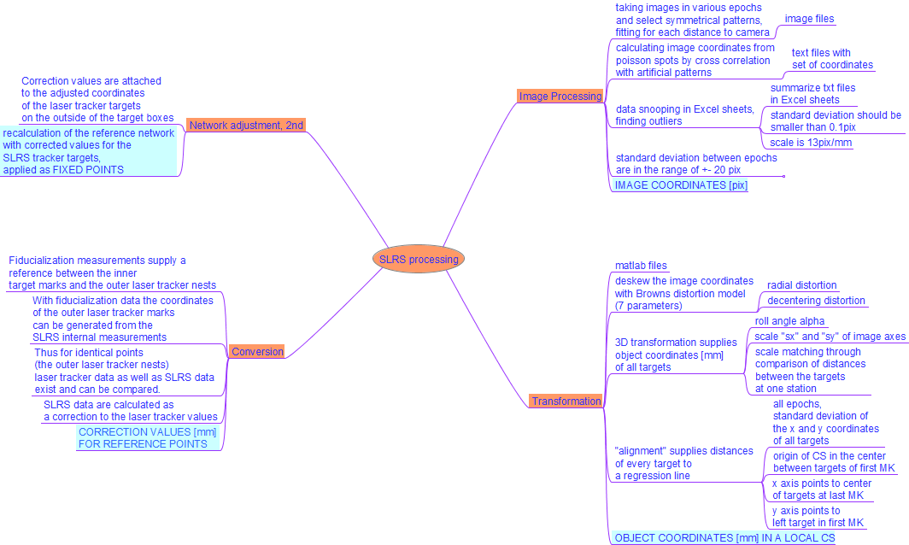
SLRS, Processing of the measurement results

Slide 6
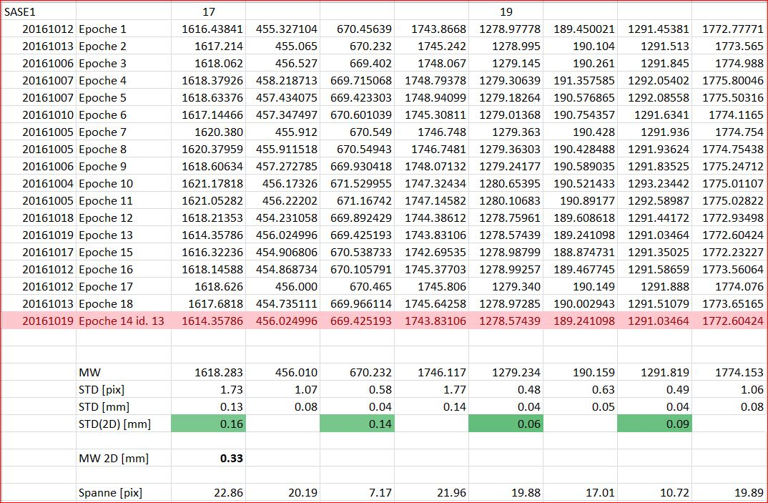
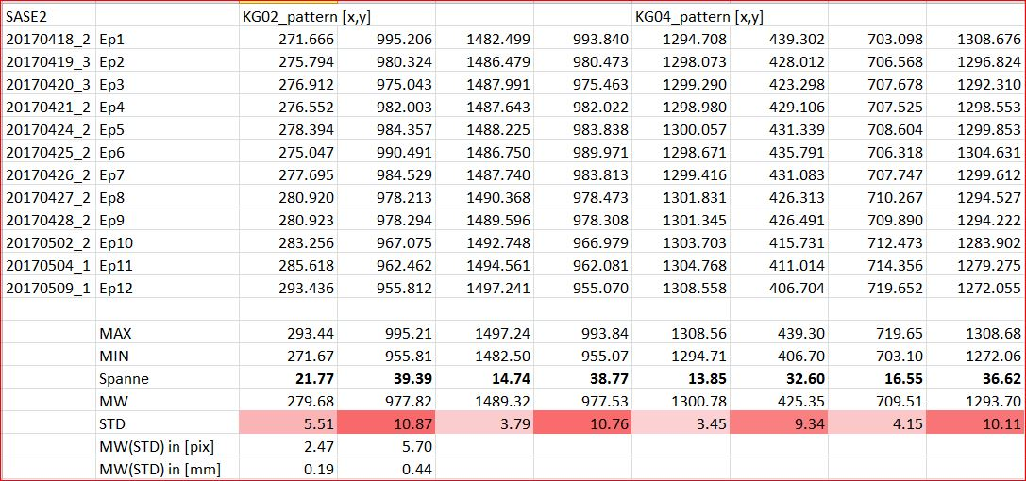
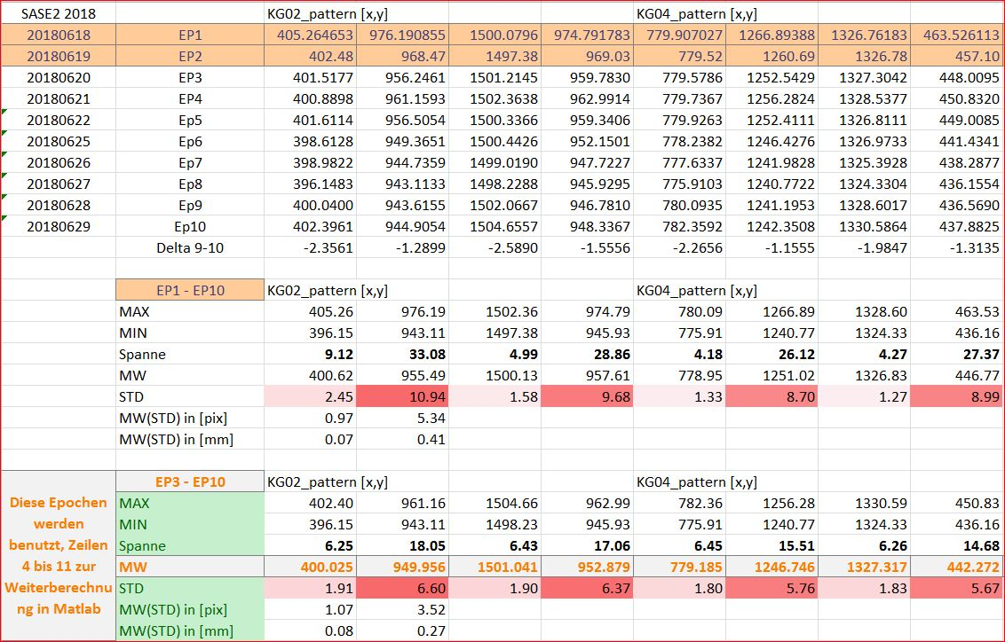
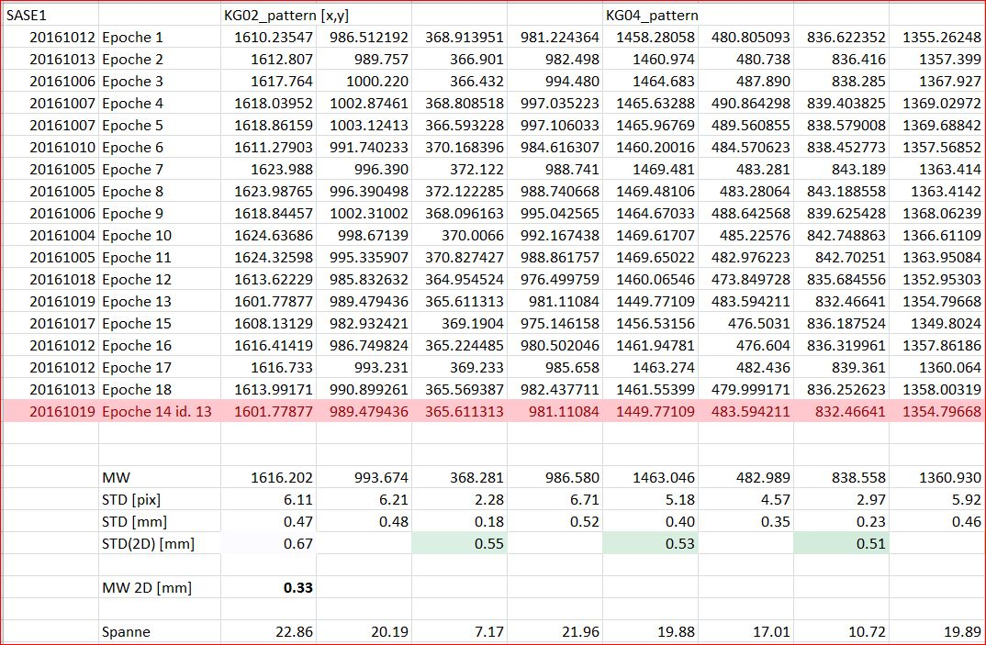
SLRS Image processing
taking images in various epochs at the time of network measurements
image files
calculating image coordinates from poisson spots by cross correlatiopn with artificial, symmetrical patterns
text files with set of coordinates
Image Processing
summarize text files in excel sheets
IMAGE COORDINATES [pix]
data snooping in excel sheets, finding outliers
standard deviation should be smaller than 0.1 pix
scale is 13pix/mm
technical resolution is 8 µm
but variance of 6pix
gives only 0.5 mm

Slide 7
Transformation
matlab files
deskew the image coordinates with browns distortion model (7 parameters)
radial distortion
decentering distortion
scale matching done by comparison of distances between the targets (from fiducial. measurements) and their poisson spots in the image
3D transformation supplies object coordinates [mm] of all targets
roll angle alpha
Transformation
scales „sx“ and „sy“ of the image axes
OBJECT COORDINATES [mm] IN A LOCAL COORDINATE SYSTEM
all epochs, standard deviation of the x and y coordinates of all targets
procedure „alignment“ supplies distances of every target to a regression line
x axis points to center of targets at last box
origin of the CS is in the center of first target box
y axis points to left target in first box

Slide 8
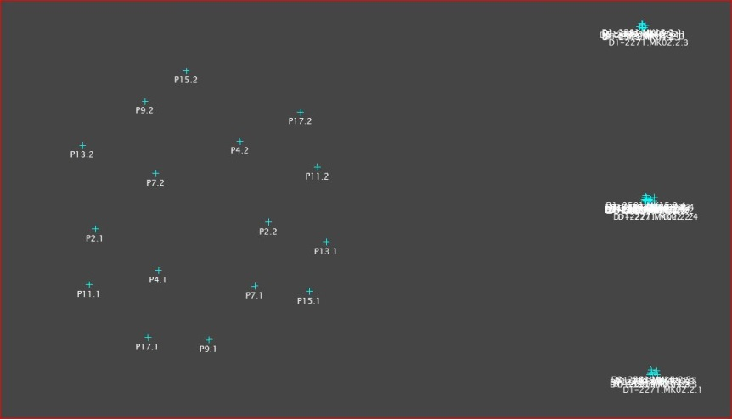
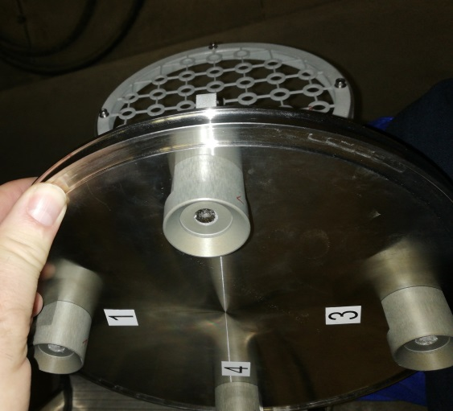
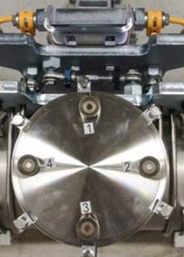
Conversion
Fiducialization measurements supply a reference between the inner target marks and the outer laser tracker nests
With fiducialization data the coordinates of the outer laser tracker marks can be generated from the SLRS internal measurements
Conversion
Thus for identical points (outer laser tracker nests) laser tracker data as well as SLRS data exist and can be compared
CORRECTION VALUES [mm] FOR REFERENCE POINTS
SLRS data are calculated as a correction to the laser tracker values.
The mean value of the two targets is added to all 4 laser tracker nests.

Slide 9
Network Adjustment, 2nd run
Correction values are attached to the adjusted coordinates of the laser tracker targets on the outside of the target boxes
Network adjustment, 2nd run
Recalculation of the reference network with corrected values for the SLRS tracker targets applied as FIXED POINTS
REFERENCE GRID STRUCTURE HAS BEEN STRAIGHTENED

Slide 10
Results, Corrections, SASE 1, XTD 2, 2016 Results, Corrections, SASE 3, XTD 4&10, 2017
SASE 1, XTD 2, November 2016
SASE 3, XTD 4 & 10, January 2017

Slide 11
Results, Corrections, SASE 2, XTD 1&6, 2017 Results, Corrections, SASE 2, XTD 1, 2018
SASE 2, XTD 1 & 6, May 2017
SASE 2, XTD 1, August 2018
Gib einen Untertitel durch Tippen ein.

Slide 12
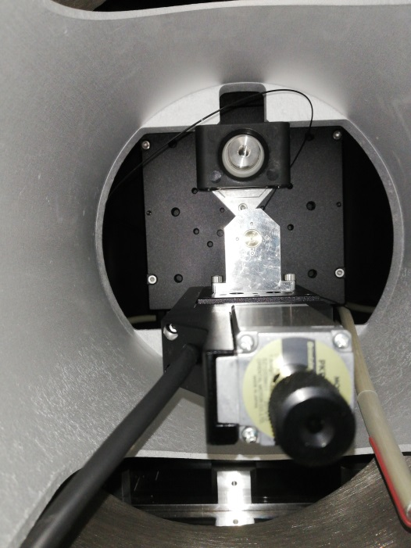
SASE 2 tasks
Accuracy of the SLRS for SASE_2 is worse than the two others
System seems less stable, variations in measurements are bigger
No errors found on principle
Done: cleaning of laser fiber, adjustment of laser fibre head, cleaning of lenses
To be done: alignment of all target boxes, moving of camera housing from XTD6 to XS2 (to simplify interlock procedure)
Conversion to a remotely operable system.
More frequent measurements to learn more about the long term stability of the system
Enhance adjustability of the laser source

Slide 13
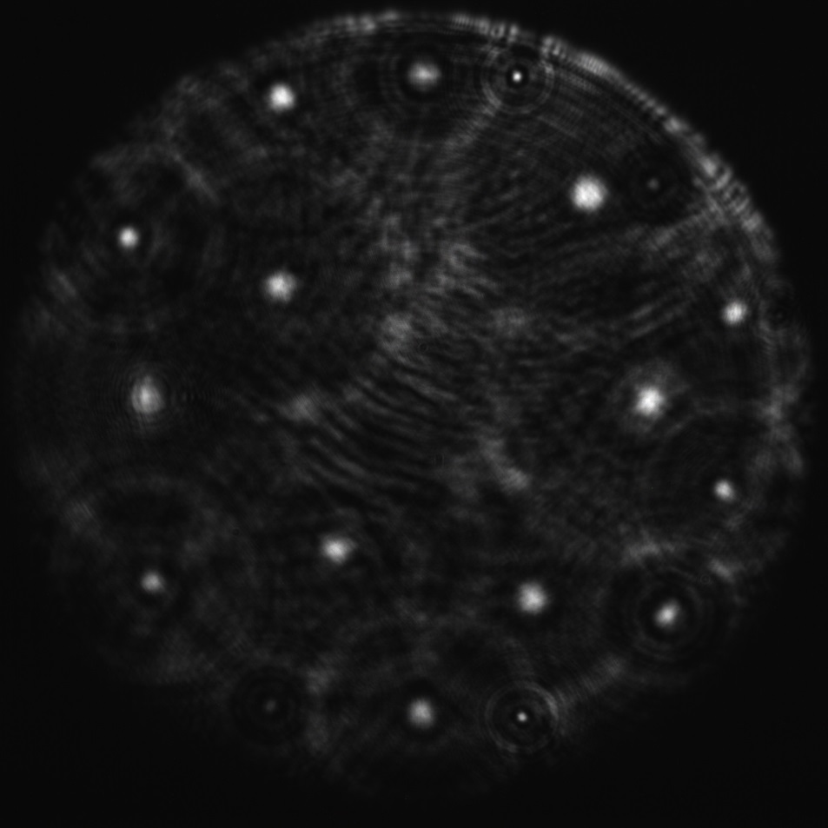
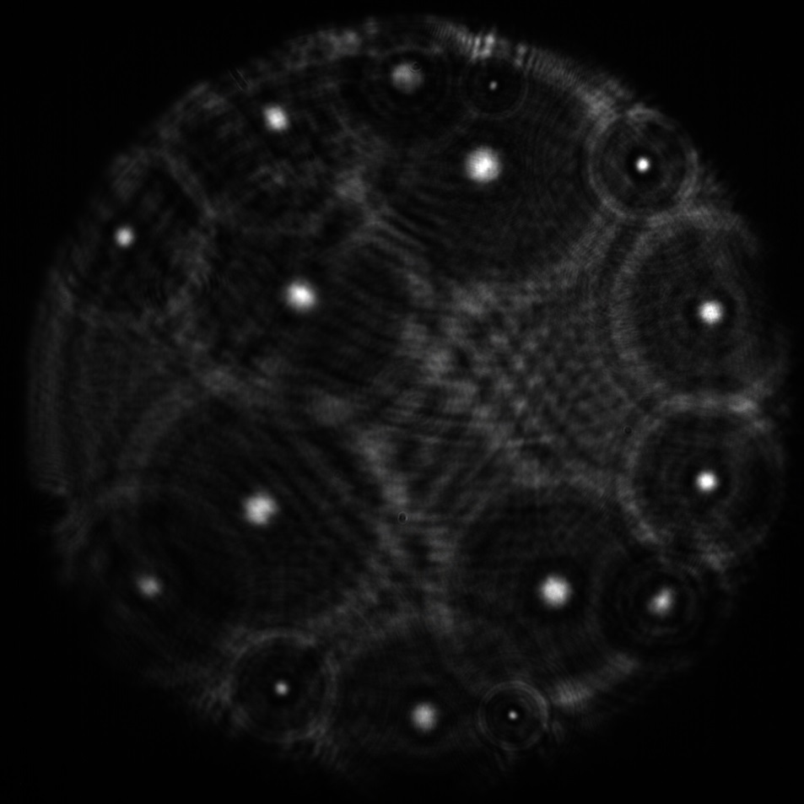
Images seen by camera, SASE1 and SASE3, 2016 / 2017
Measurement image from SASE_1 2016-11
Measurement image from SASE_3 2017-01

Slide 14
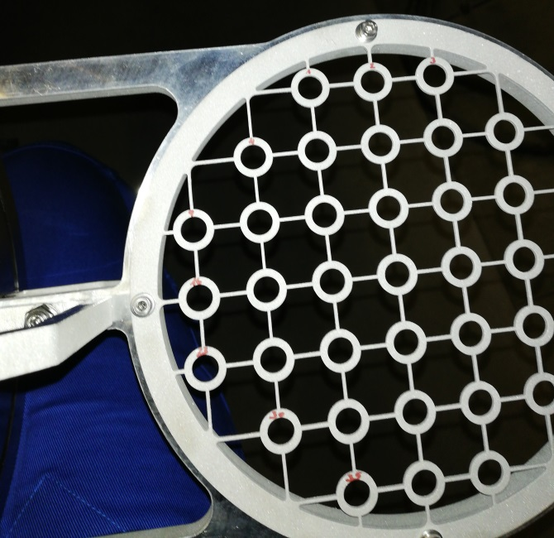
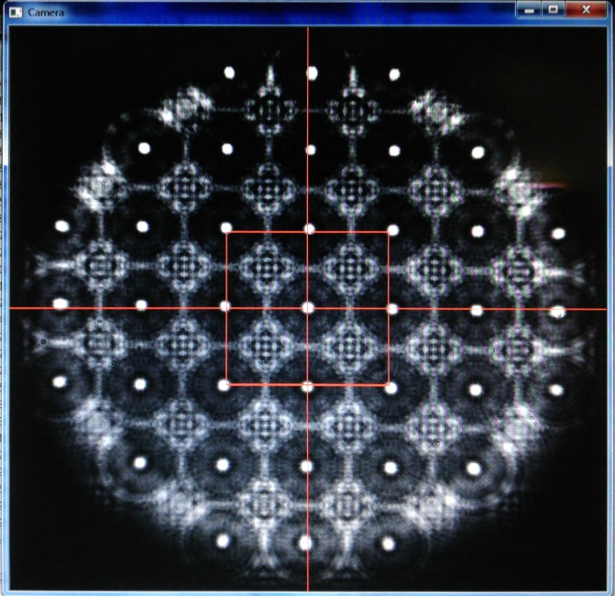
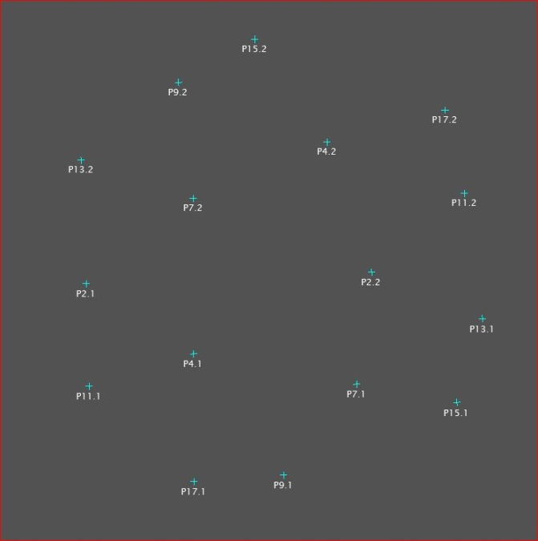
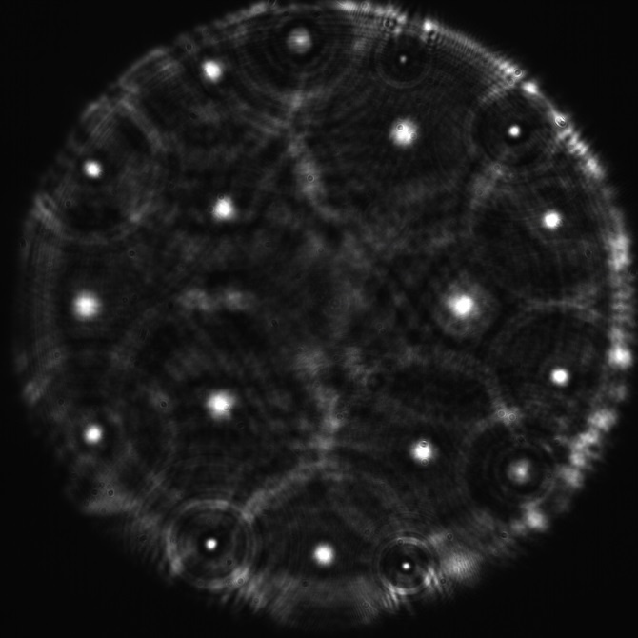
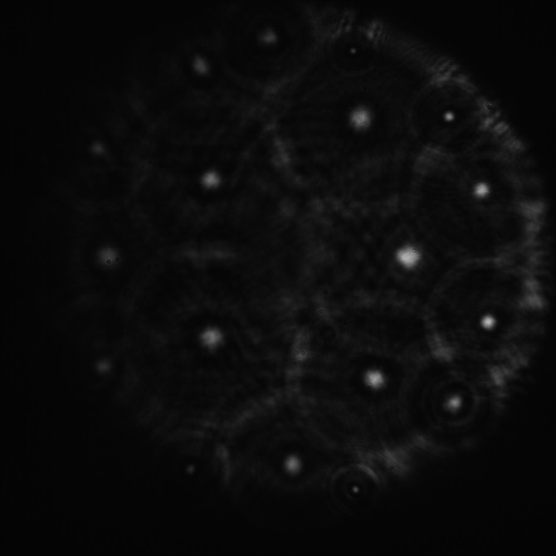
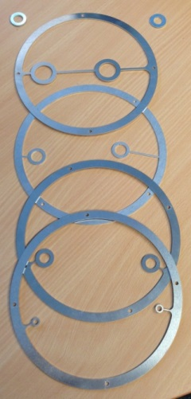
Images seen by camera, SASE2, 2017 and 2018
Image of calibration targets from targetbox 17
Image of camera during alignment of targetbox, Sept. 2018 (screenshot)
measurement targets designed for different positions
good measurement image of SASE2 from May 2017
bad quality measurement image of SASE2 from July 2018
targets viewed in Spatial Analyzer
1
2
3
4
5/6

Slide 15
Conclusions
The SLRS system worked fine up to now (at least in 2 cases).
Machine sections have been aligned to the measurement outcomes of the SLRS. Fine alignment has been done after a bba (as planned).
The SLRS for SASE2 is less stable than the other 2 systems.
The calculation process overall consists of too many single steps and is confusing. This is the work of several persons in successive contracts.
The calculation process has to be simplified and integrated by means of software witchcraft. First step has been the changeover from excel sheets to matlab files. More steps are to follow.

Slide 16
Conclusions
Due to time restrictions the collection of measurement data has been limited to a few days. We need a greater extend of measurement samples in order to learn more about the system behaviour. Therefore the system is changed to a remotely operable system in the next few maintenance periods.
The adjustability of the inner components of the laser box has to be improved. Some maintenance is required in given periods (cleaning of laser fibre & lenses).
Mechanical stability of the system has to be enhanced.
The variances of the measurement outcomes have to be minimized.
In order to pass the final acceptance all SLRSs have to be delivered within specs:
initial alignment to 0,5 mm wrt 500 m length.
Again, like at last IWAA: …to be continued
THANK YOU FOR YOUR ATTENTION.

