Slide 1
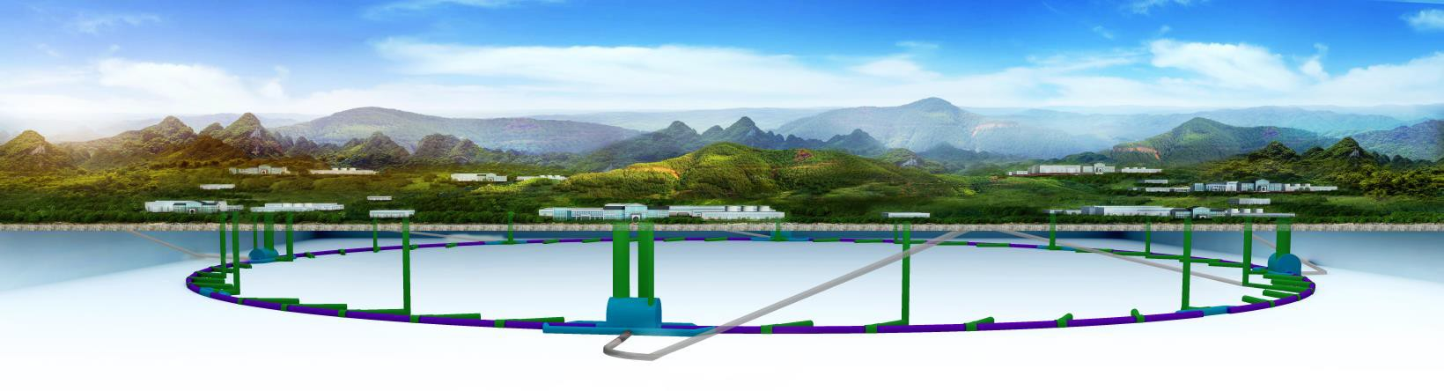

CEPC Survey and Alignment
INSTITUTE OF HIGH ENERGY PHYSICS
Xiaolong Wang, Lan Dong Na Ma, Zhu Hongyan
Oct. 9-12, 2018, IWAA2018 Fermilab

Slide 2
Outline
1、Introduction
2、CEPC Control Network Design
3、Component fiducialization and alignment
4、Alignment precision requirement 5、Workload estimate
6、Researches
7、Summary

Slide 3
1、Introduction
Circular Electron Positron Collider (CEPC) is a huge particle collider aim to measure the precise properties of the Higgs boson which was discovered at CERN by LHC.
First proposed in 2012, after several times argumentation and modification its conceptual design report is finished in June 2018.
CEPC is designed to run at beam energy 120GeV for seven years to generate over a million Higgs bosons then it will be operated at 45.5GeV for two years to generate ten billion Z bosons as well as run at 80GeV for a year to produce around 15 million pairs of W+ and W-.

Slide 4
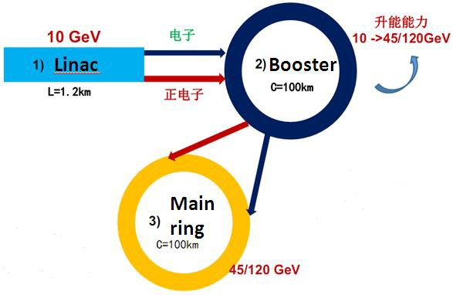
The ideal construction schedule is from 2022 to
2030.
Following a decade of studying the Higgs, Z and W bosons, it is hoped to begin construction a proton- proton collider inside the existing tunnel in 2040.

Slide 5



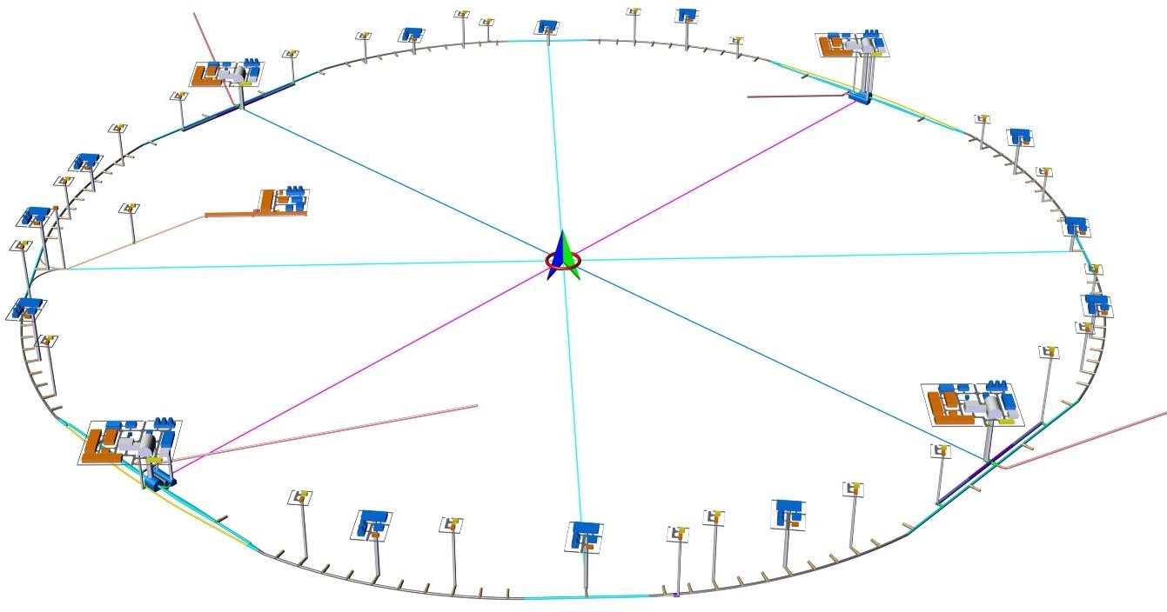

CEPC General Layout
RF regions
Interaction regions
3.24km
3.32km
LSS4
1.20km
IP4
IP1
1.6km
LINAC
1.20km
BTL LSS3
LSS1
1.20km
straight section regions
IP3
3.32km
IP23.24km
Arc region
10.2km
ring=99.67km
_{LSS2}1.20km

Slide 6
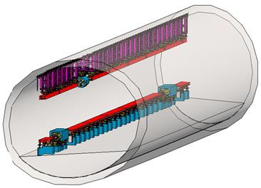
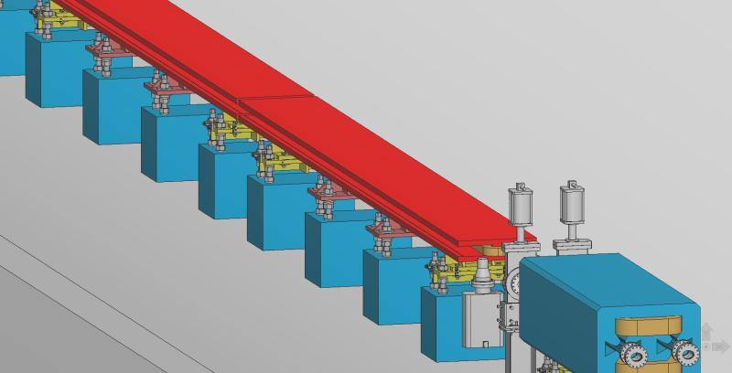
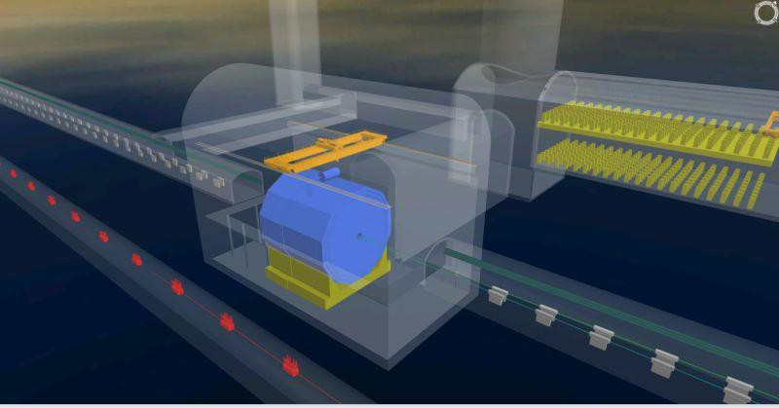
Ring tunnel has a double-ring
and a booster.
Booster is hung on the top of tunnel about 3.2m above floor.
Booster
Double-ring
Ring tunnel model
Double aperture magnets
Interaction region
In interaction region there are two tunnels one is for booster the other is for main ring.
Main ring
Detector
booster

Slide 7
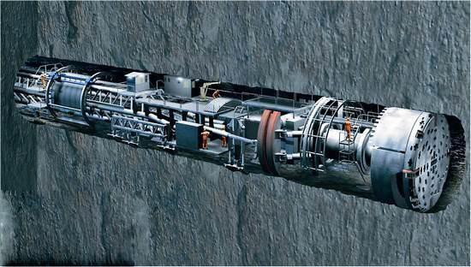

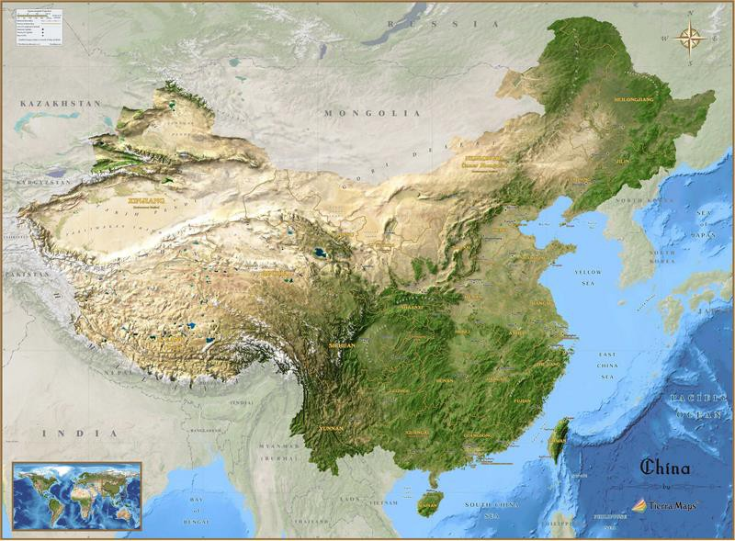





Site selection
Drill & Blast
Changchun, Jilin
Qinhuangdao, Hebei
Huangling, Shaanxi
Huzhou Zhejiang Shenshan, Guangdong
Where to build CEPC is decided by what kind of support from the local government we will receive in terms of ,for example, laboratories, living conditions, roads and power supply.

Slide 8
S&A Overview
Survey and Alignment group(S&A) is responsible for CEPC components position alignment and maintenance.
work will be carried out in two phases.
The first phase is carried out in CEPC construction period. Align all of the components to the designed geometric positions within a certain precision， provide an initial orbit for CEPC commissioning.
The second phase is in CEPC stop periods, the beam will be a benchmark and according to the beam requirement to do orbit smooth alignment.

Slide 9
Ultra-long CEPC circumference brings two challenges to S&A
Improve working efficiency: put in more work teams and instruments, R&D advanced technologies.
Accidental error accumulation of ultra-long narrow tunnel control network and its accuracy control.
S&A work can be divided into 4 parts:
Alignment control networks survey
Components fiducialization and pre-alignment
Tunnel installation alignment
Components segmentally smooth alignment

Slide 10
2、CEPC Control Network Design
Control networks provide an unified location reference frame for the whole accelerator and control the error accumulation of survey and alignment.
For the ultra-long CEPC we designed a 3 levels control network.
Surface control network
Backbone control network
Tunnel control network

Slide 11
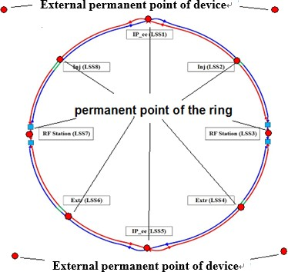
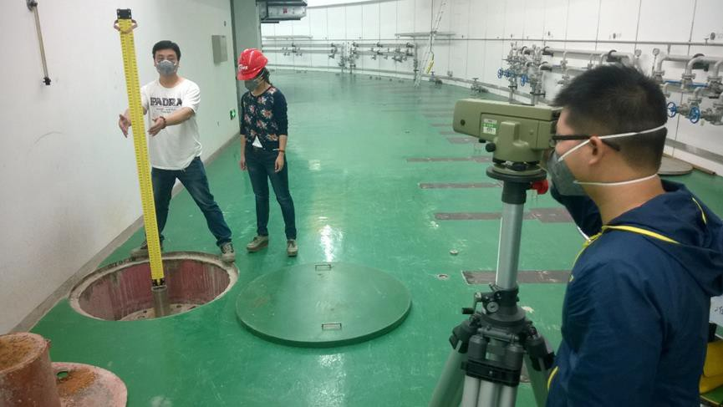
Surface control network provides the absolute position control for CEPC and high precision constraint datum for tunnel control network.
Y
Composed of 16 permanent points (4 external points and 12 internal points)
2 points locate Linac, 2 points
locate LTB, 8 points locate ring.
These 12 internal points will be built in CEPC tunnel, they are a part of the tunnel control network.
Tunnel permanent point
Z
X

Slide 12
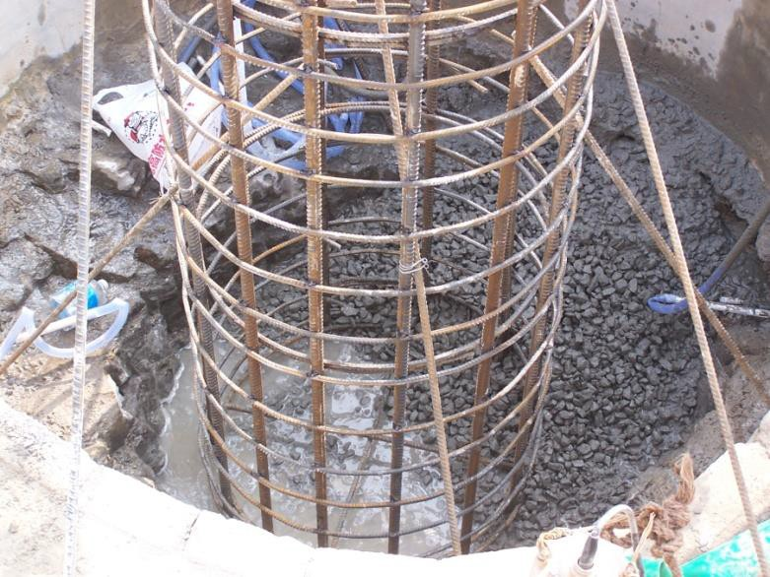
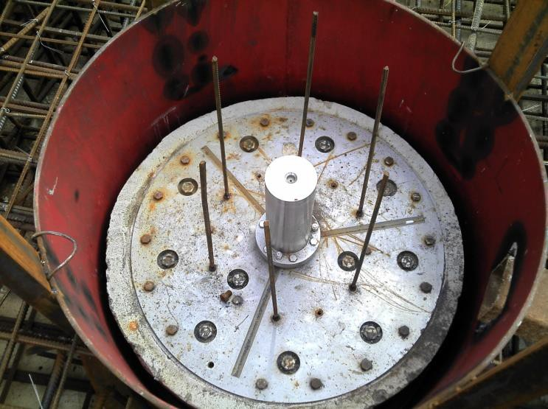
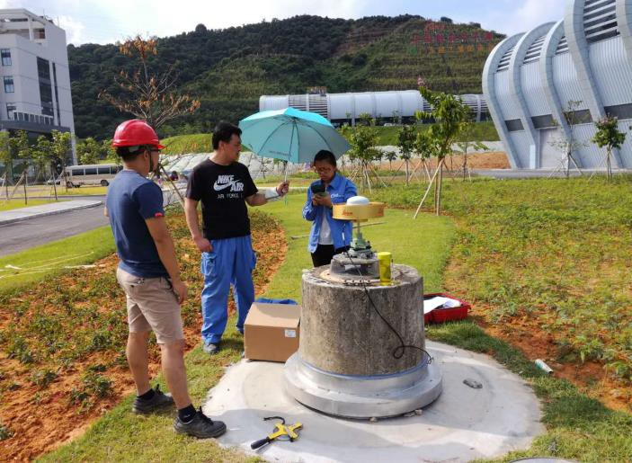
The pillars of tunnel permanent points are built on the base rock
Shield from soil with steel tube.
Monument can hold 1.5’’ half ball target/ reflector
External control point can
be measured by GPS

Slide 13
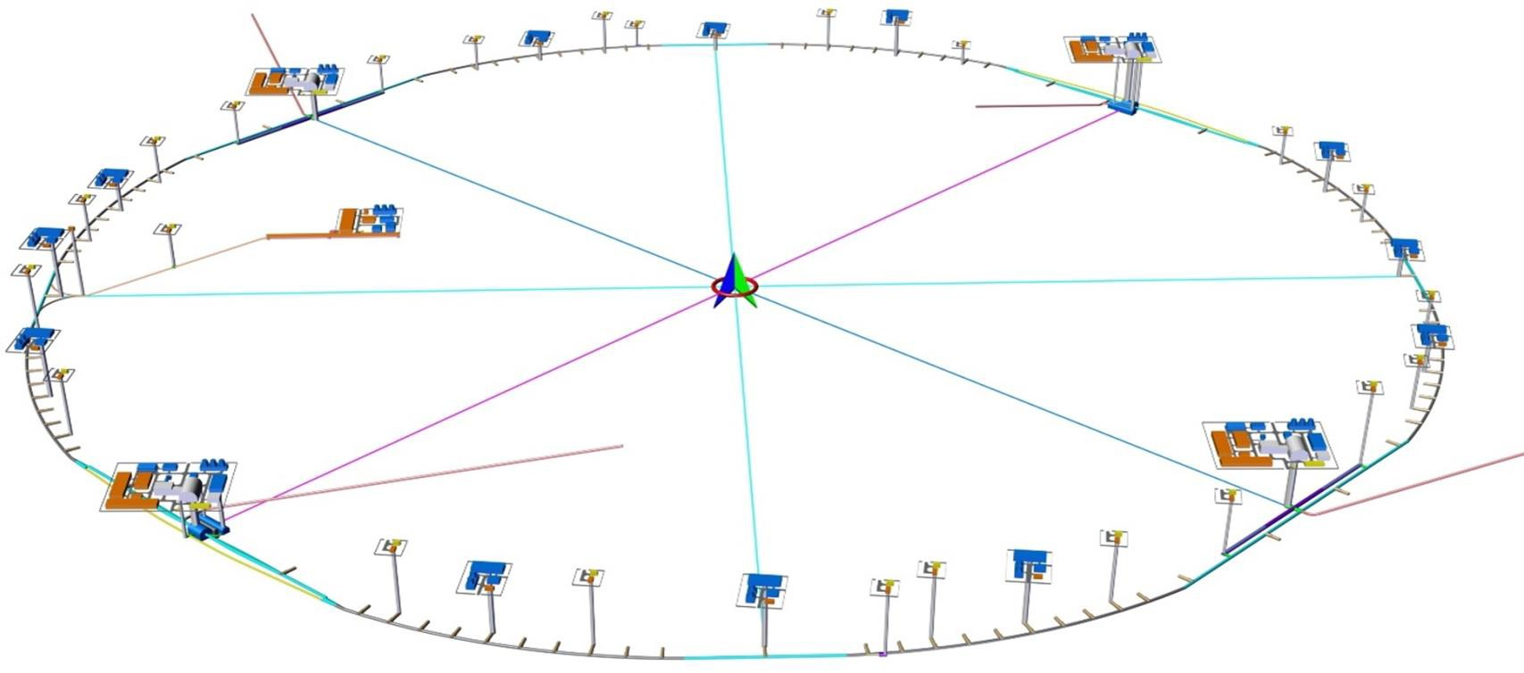
There are many shafts link the tunnel and ground surface, we can use these shafts to measure the tunnel permanent points from ground
Shafts

Slide 14
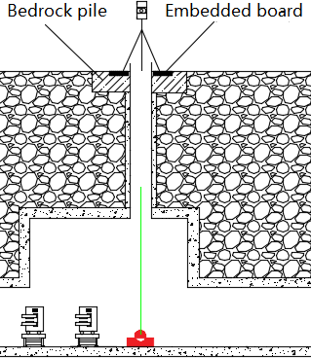
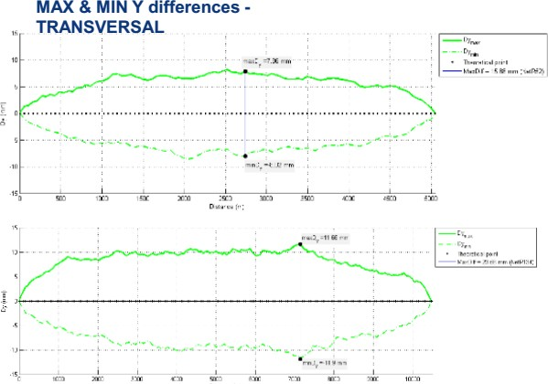
Use GPS and level measure the surface network
Permanent point in tunnel can be plumbed to a cast point on the ground through the shaft.
The measurement accuracy of surface network is about 10mm in horizontal direction and about 7mm in vertical direction.
Component absolute accuracy depends on the distance between two adjacent permanent points.
CSNS 210m Linac transversal maximum deviation is 0.15mm.
CERN simulation result shows 8mm for 5km
and 12mm for 10km.
GPS receiver
cast point
Permanent poin

Slide 15
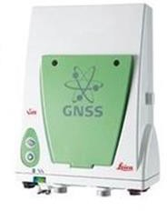
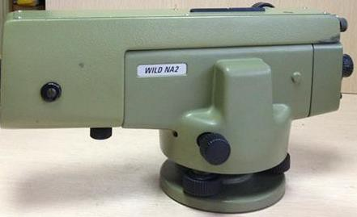
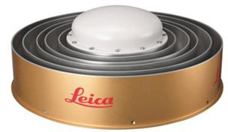
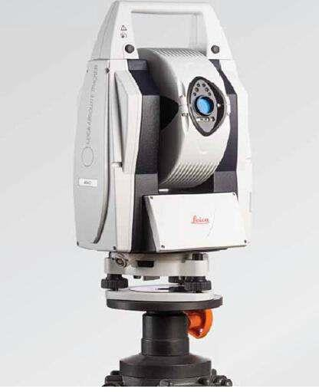
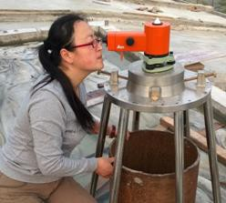
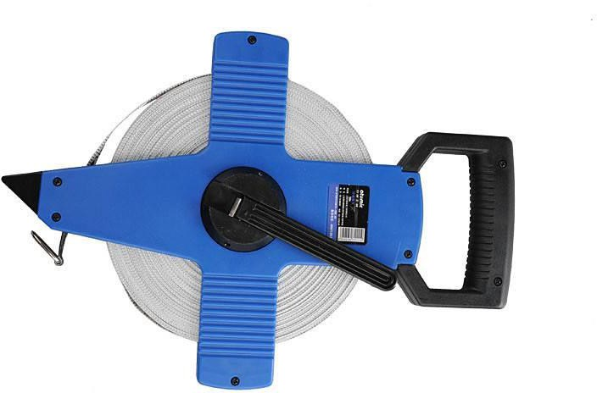
Instruments and software for Surface network survey
LEICA GS10
AR20
+ LGO software
LEICA NA2 + SHANWEI software
LEICA Wild NL
Tape
LEICA AT401

Slide 16
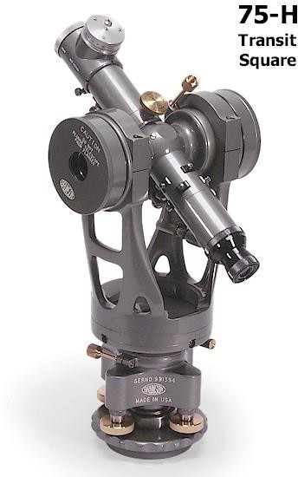
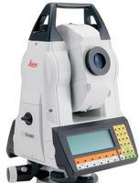
The height between GPS and tunnel permanent point can vary from tens of meters to two hundred meters depends on where CEPC will be built.
According to our experience of CNSN, where the biggest height is 30 meters, using Wild NL, the plumb accuracy is 0.5mm. The height can be measured by AT401.
If the height is too big, we plan to use a transit square to plumb point and use a total station to measure the height.
Total station

Slide 17
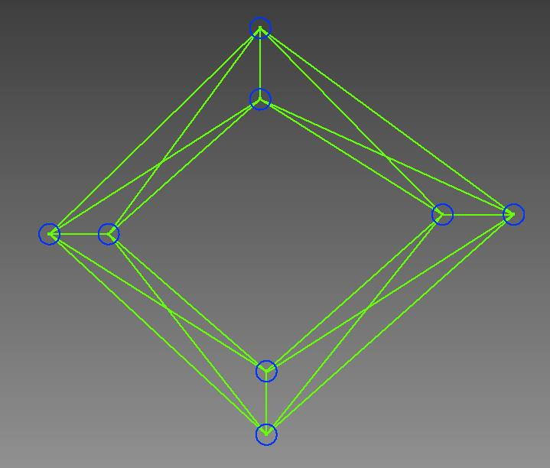
Backbone control network
Strengthen the tunnel control network，
reduce error accumulation.
It is a kind of large span double- traverse structure control network.
tunnel control point
Points of adjacent sections must be intervisible and the distance should be as long as possible
Use total stations to carry out backbone network survey.
Backbone control network

Slide 18
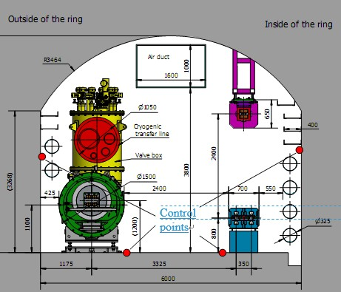
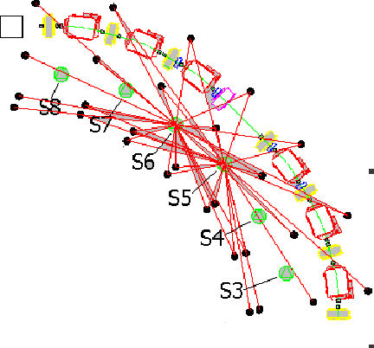
Future
upgrade to
Tunnel control network is aa Proton
Booster
position reference of
accelerator
components installation and
alignment.
tunnel control network along CEPC tunnel will be evenly distributed with an interval of 6 meters, each section there are 4 control points, two on the floor, one on the outer wall and one on inner wall.
Use laser trackers and levels carry out tunnel network survey
Tunnel cross-section view _{Double-ring}

Slide 19
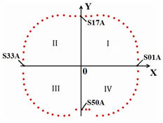
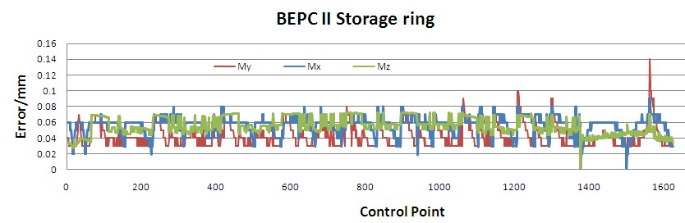
BEPCII
BEPCII 237.53m ring the point measure error is better than 0.08mm.(2006,2008,2010,2012)
Control points much denser than CEPC
The point measure accuracy of CEPC is about 0.12mm

Slide 20
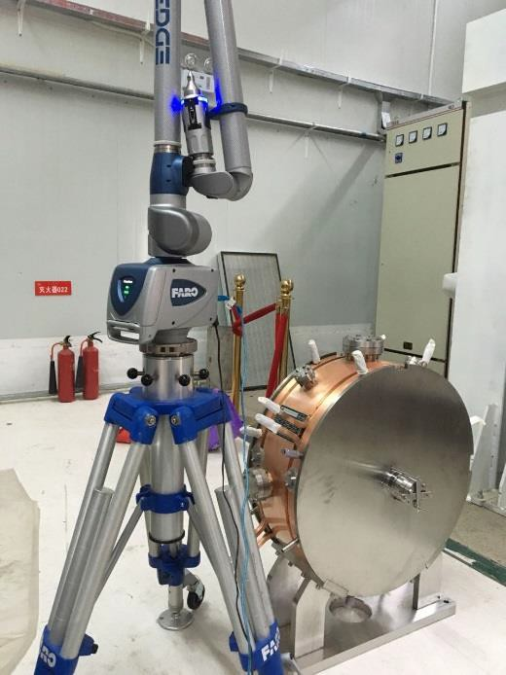

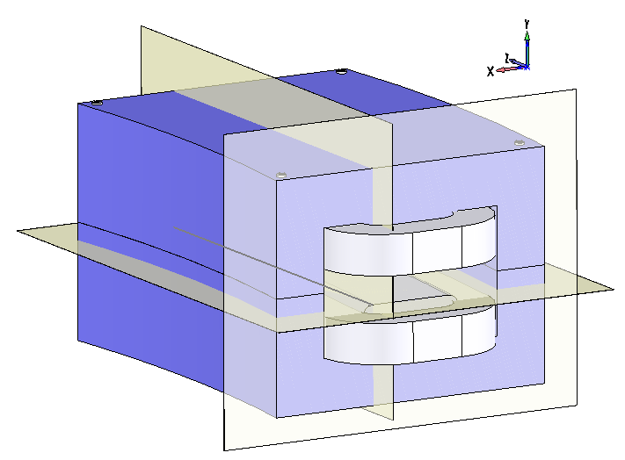
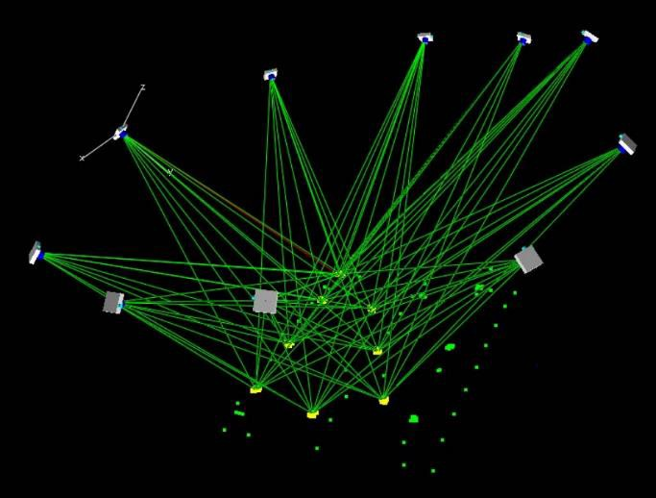
3、Component fiducialization and alignment
Component fiducialization is to draw the beam center to its fiducial points, then the fiducial points coordinates can be transferred to CEPC global coordinate system and used for component tunnel alignment
Laser tracker
Articulated arm
The precision of components’ fiducialization is about 0.05-0.10 mm.
Photogrammetry
Get boundary dimensions Reference features
Camera
Dipole Magnet Fiducialization Datum Planes
Photogrammetry
measurement
Bunching cavity Fiducialization
with Articulated flexible arm

Slide 21
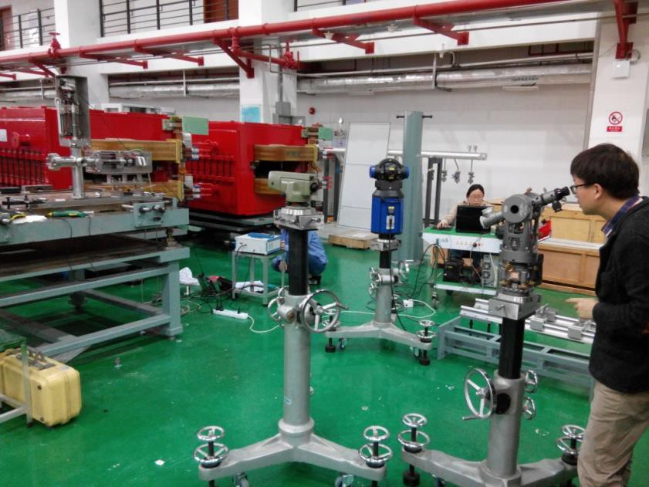
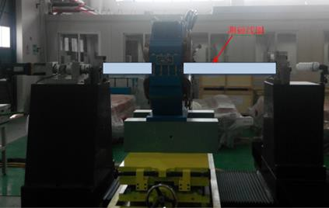
Optical instruments Level, Transit square, electronic gradienter are also necessary.
Rotating coil
To improve magnet fiducialization accuracy, we will use magnetic center measurement substitute mechanical center measurement.

Slide 22
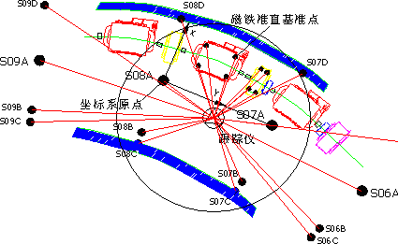
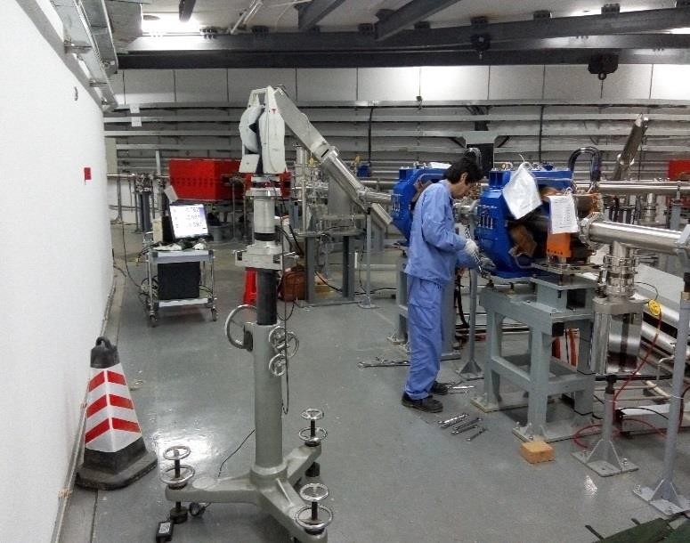
We use the tunnel control network and laser trackers to perform tunnel components alignment.
Measure the tunnel control network and through best-fit to determine the laser tracker position in CEPC global coordinate system.
Using laser tracker measure the component fiducial points to obtain the component position.
Adjust the component to the required tolerance.
After the initial installation, we will carry out an overall survey, best-fit the result with the nominal coordinates to find the large deviations then do smooth adjustment.
Components tunnel alignment accuracy
is about 0.15~0.25mm.

Slide 23
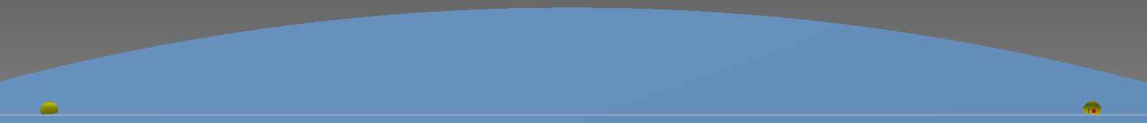
The earth is an ellipsoid, its gravity directions along the CEPC
tunnel are not parallel with the Z.
CEPC should be built on a plane, its normal direction is Z.
Z
The earth tunnel
R=6374km
CEPC ring center
D=32km
The angle between Z and tunnel local gravity direction is about 4.6″
  In tunnel components will be not perpendicular to the ground.
CEPC plane
z
4.6″
Gravity direction

Slide 24
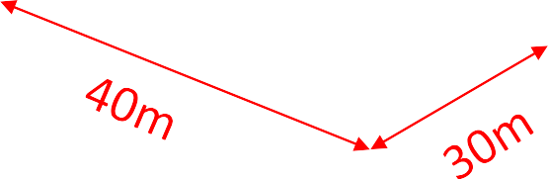
Interaction region alignemnt
Alignment in the interaction region will be much more demanding than in the Arcs due to the extremely low β- functions.
At present we have not detailed structure design of interaction region. The detector hall is 40mX30m, the detector is about 14mX15m.

Slide 25
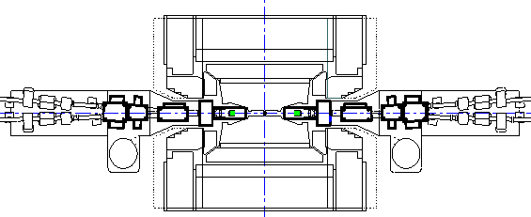

The basic strategy is using laser trackers to do a rough alignment first, then use a laser collimator system to carry out the refined alignment, which can reach high precision and suitable for straight section alignment.
We will install a laser collimator system beside the detector . Using laser trackers and control network align the laser parallel with the nominal beam orbit. Then we can use the laser as a reference align all the components to the beam orbit. The accuracy we want to achieve is better than 0.1mm.
Laser
collimator system
Laser tracker

Slide 26
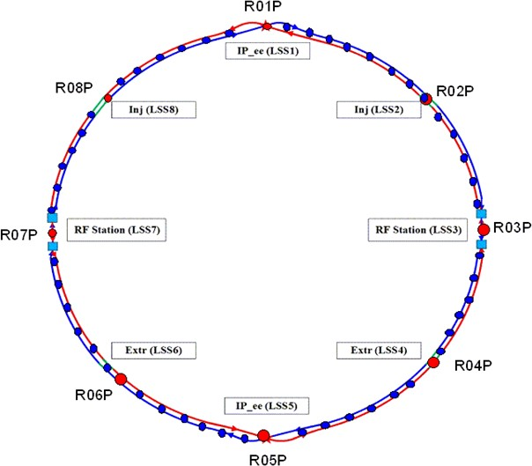
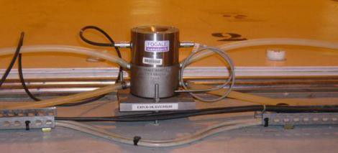
Monitoring system
Settlement monitor
Hydrostatic Levelling System(HLS)
HLS sensors will be installed on the ground near the
components.
Every 300-500m will be equipped with a sensor along the
tunnel
Accuracy ±0.01mm
Component transversal and vertical monitor
Wire Positioning System (WPS)
HLS Sensor
HLS

Slide 27
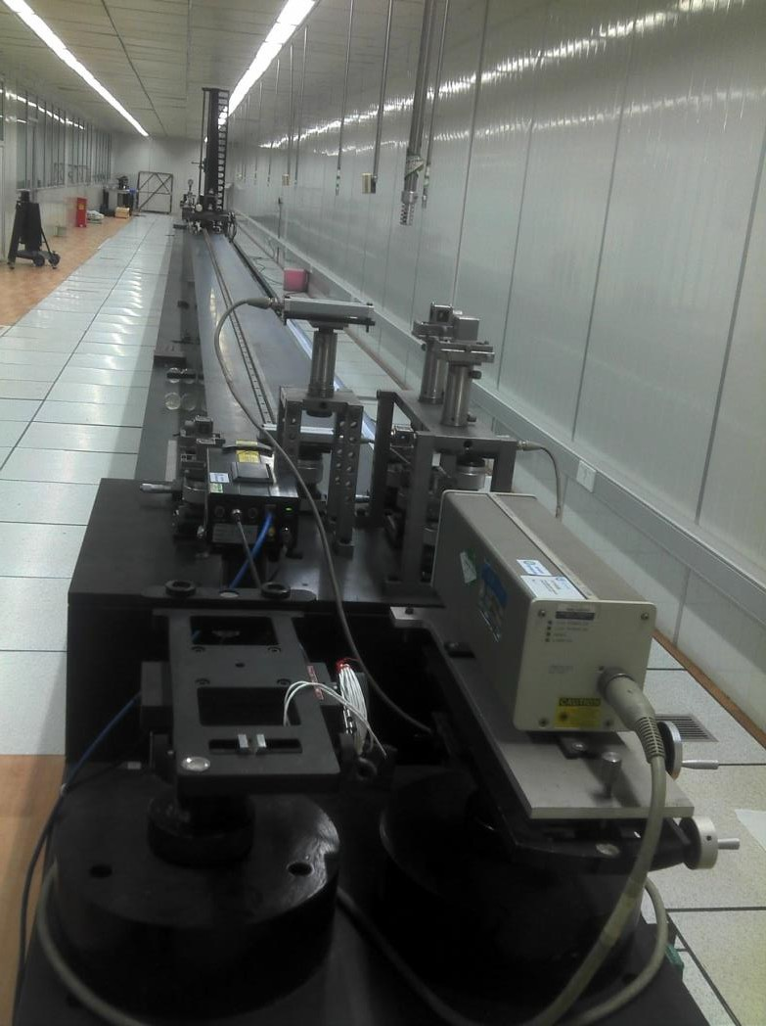
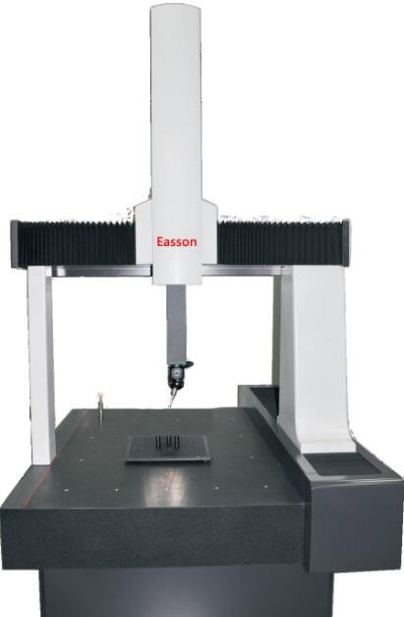
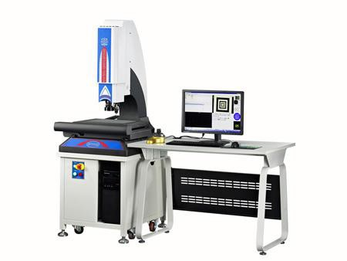
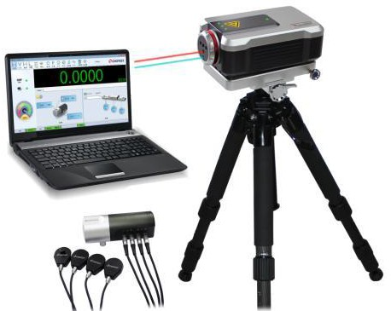
Calibration facilities
Temperature & Humidity laboratory
60m calibration bench
Laser interferometer
Coordinate Measuring Machine
Tool microscope

Slide 28
4、 Alignment precision requirement
Provide by physics group
Component | Transversal /mm | Vertical /mm | Longitudinal /mm | Pitch /mrad | Yaw /mrad | Roll /mrad
Dipole | 0.1 | 0.1 | 0.15 | 0.2 | 0.2 | 0.1
Quadrupole | 0.1 | 0.1 | 0.15 | 0.2 | 0.2 | 0.1
Sextupole | 0.1 | 0.1 | 0.15 | 0.2 | 0.2 | 0.1
Corrector | 0.1 | 0.1 | 0.15 | 0.2 | 0.2 | 0.1
Alignment precision statistic
 | Fiducialization /mm | Control network /mm | Measurement /mm | Adjustment /mm | Totall /mm
Component | 0.05~0.1 | 0.12 | 0.05 | 0.05~0.1 | 0.15~0.2
To meet the requirement, it needs to do some improvements
Fiducialization, use Coordinate Measuring Machine, magnetic field measuring equipment →0.015~0.03mm
After the initial installation alignment, we need to spend more
time to do smooth alignment.
Develop new alignment technique.

Slide 29
5、Workload estimate
Component quantity preliminary statistics (incomplete)
Component | Collider Ring | Booster | Linac& BT | Total
Dipole | 2546 | 16320 | 184 | 19050
Quadrupole | 3524 | 2036 | 533 | 6093
Sextupole | 1864 | 448 | 24 | 2336
Corrector | 5808 | 1206 | 149 | 7163
Superconducting Cavity | 240 | 96 |  | 456
Superconducting Cavity Assembly | 40 | 12 |  | 72
Superconducting quadrupole | 8 |  |  | 8
Superconducting sextupole | 32 |  |  | 32
Septum Magnet |  | 144 |  | 144
Kicker |  | 22 |  | 22
Solenoid | 4 |  | 37 | 41
Accelerating structure |  |  | 285 | 285
Cavity |  |  | 6 | 6
BPM | 4900 |  | 240 | 5140
Detector | 2 |  |  | 2
Total | 21484 | 20284 | 1458 | 40710

Slide 30
If dipoles longer than 10 meters are divided by 6 meters
Component | Collider Ring | Piece | Total
Dipole（93.4m） | 4 | 16 | 64
Dipole（67m） | 20 | 12 | 240
Dipole（61m） | 4 | 11 | 44
Dipole（50m） | 2 | 9 | 18
Dipole（45m） | 16 | 8 | 128
Dipole（44.2m） | 20 | 8 | 160
Dipole（34.1m） | 16 | 6 | 96
Dipole（31.8m） | 32 | 6 | 192
Dipole（28m） | 2400 | 5 | 12000
Dipole（9.7m） | 32 | 2 | 64
Total | 2546 | 83 | 13006
The number of components need to be aligned will be 51170

Slide 31
1 group 1 day can alignment 2 difficulty components / 4 common components.
If 1 group 1 day alignment 3 components, it will take 1 group 17057 days to finish 51170 components alignment
The total length of tunnel control network is about 101610m.
1 group 1 day can measure 4 stations+4 stations repeat measurement, the length of 4 stations is about 24m.
It will take 1 group 4234 days to finish tunnel control
network survey.
How many time spend for alignment depends on how many groups we can have.

Slide 32
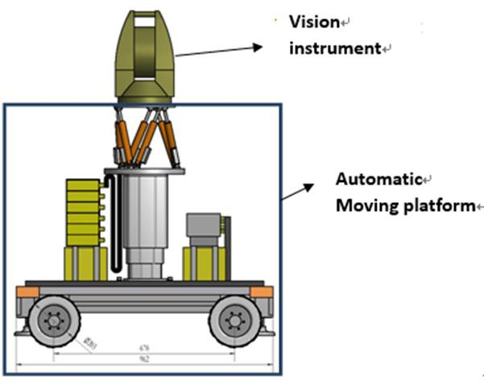
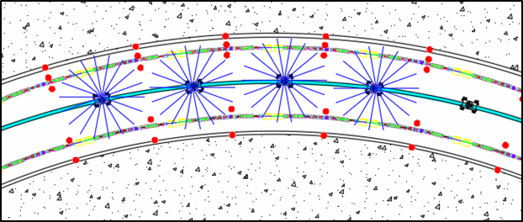
6、Researches
Develop automatic observation system to improve tunnel survey efficiency
Integrates an automatic mobile platform and an photogrammetry instrument.
The automatic mobile platform can be guided by a reflective stripe on the tunnel ground and provides a suitable position for vision instrument measurement.
Automatic observation system
Trace

Slide 33
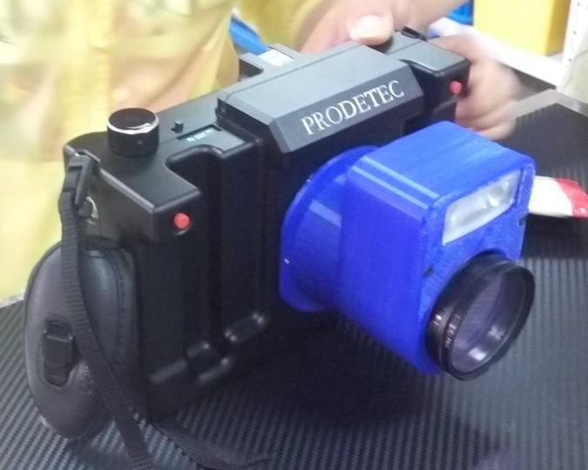
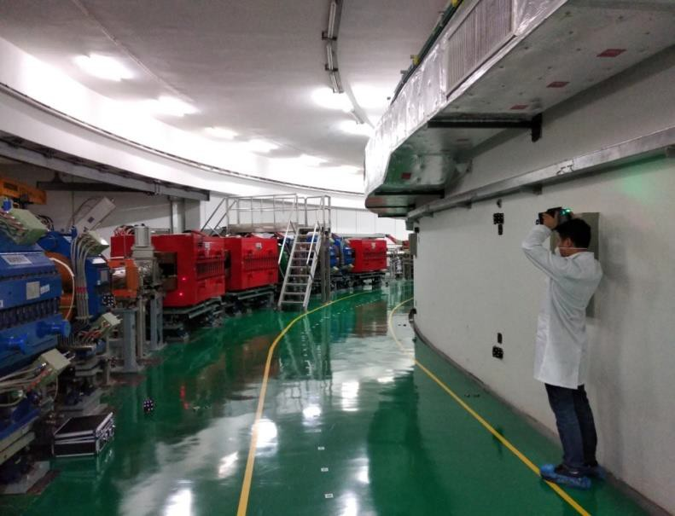
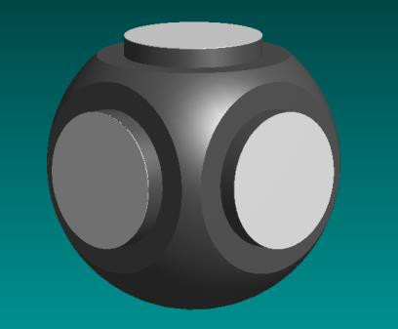
Cooperated with a company, we have developed a 3+3μm camera.
Designed a five faces target for photogrammetry which can be observed from different directions.
One million capacity coded object has been developed and the recognition software has been tested.
We have carried out 3 times measurement experiment to explore the accelerator photogrammetry survey method.
Result shows, photogrammety is more efficient and convenient than laser
tracker, but the precision still need to be improved.
3μm+3ppm Camera
Five-face target
Photogrammetry experiment

Slide 34



CEPC
plane
Geoid refining:
Level measurement is based on the local geoid which gravity direction is not same with the CEPC global coordinate system Z axis.
When we transfer the level measurement data to the global coordinate system the difference need to be considered.
The geoid is an irregular surface because of earth
density variance and the ground’s undulation.
We need to get a precise geoid model for CEPC alignment.
Using gravity, GPS and level instruments measure
a certain density points within CEPC area.
Use gravitational field data to establish the grid- based geiod model .
Further researches need to be carried out and
invite experts help us to make detailed schemes.

Slide 35
7、Summary
Alignment strategy is introduced.
Surface network will be measured by GPS. How to plumb accurately for long distance need further research.
Component fiducialization is mainly carried out by laser tracker, articulate arm and photogrammetry. Detailed component fiducialization scheme will be made in future.
Tunnel alignment is based on control network and laser tracker.
A laser collimator system will be applied to decrease the alignment errors in interaction region.
HLS and WPS will be used for stability monitoring.
A preliminary workload estimate is made.
The biggest challenges are how to increase tunnel survey efficiency and smooth alignment accuracy.
To improve tunnel survey efficiency an automatic observation system base on photogrammetry is put forward.
Geoid refining is essential, the detailed schemes need to be researched.

Slide 36
Thanks！

