Slide 1



Advanced Dielectric Wakefield Accelerator Structures
G. Andonian
May 10, 2018
FAST/IOTA Collaboration Meeting
Fermilab

Slide 2
Outline
DWA background
Relevant Issues & research directions
Advanced structures & applications
  Bragg boundary
  Planar geometry
  Woodpile
  Beam phase space manipulations
Conclusion

Slide 3
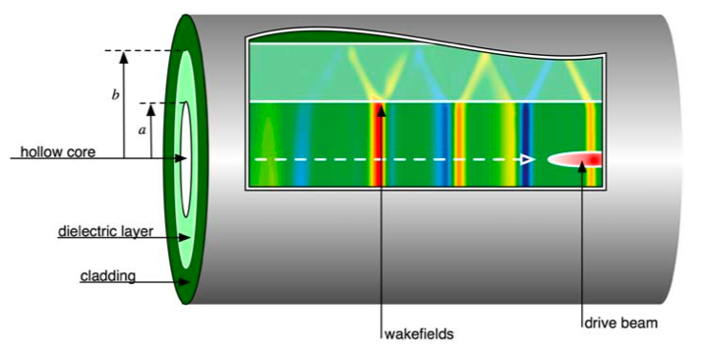
Dielectric Wakefield Accelerator
Candidate for next-gen adv. Accelerator (GV/m field)
Simple geometry
Relativistic beam drives wake in material
Dependent on structure geometry
Present day beams naturally scale to sub-mm (THz) structures
Design parameters:
Peak field
Fundamental mode
On-axis Ez
(single mode structure)

Slide 4
DWA Applications & Research
High gradient applications
  HEP: future machine (GV/m fields)
    Thompson PRL 100, 214801 (2008)
    O’Shea Nat Comm 7, 12763 (2016)
  Light Source
    A. Zholents Proc FEL14, 993 (2014)
  Phase Space manipulation
  Relativistic e-beam diagnostics
  THz source
Relevant Research Issues
  Practically achievable field gradients
    Breakdown & High field damping
    Joule heating at high rep rate
  Beam break up – transverse modes
  Efficiency, TR
  Materials/cladding composition
  Alternate geometries (slab, woodpile)

Slide 5
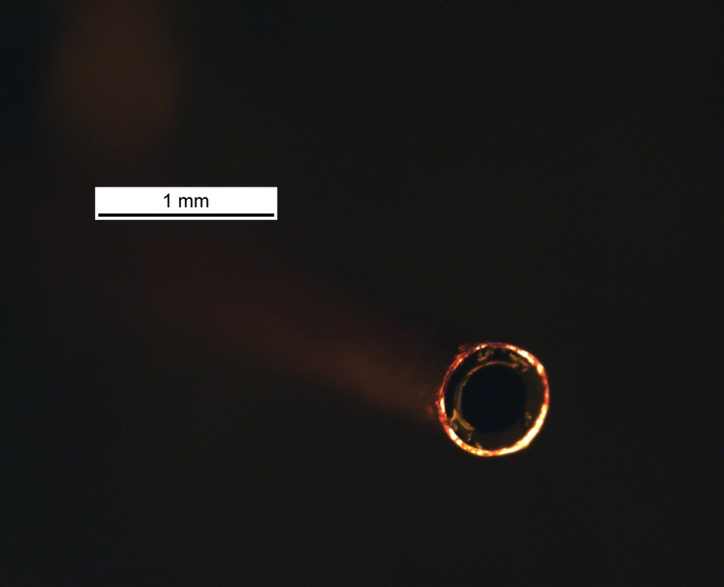
Recent High gradient DWA results
High field DWA demonstrated (>GV/m) at SLAC FACET
  3nC, σz=20µm
  Cylindrical geometry
  In long (>15 cm) structures
  Damping effects (reversible) before reaching breakdown due to high field
Motivation to explore alternative geometry
Wake
100µm
Beam
    O’Shea Nat Comm 7, 12763 (2016)

Slide 6
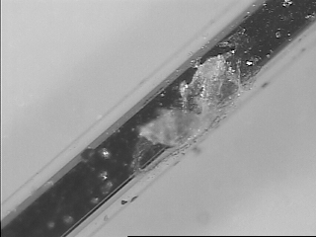
Bragg boundary DWA
Motivation:
  Metal ablation at high fields in first tests
  Explore alternate geometry with no metal
Concept:
  Bragg arrays
  Alternating multilayer stack (high/low ε)
  Constructive interference
  Modal confinement in channel
Test at BNL ATF
Bragg DWA
  SiO₂ (ε=3.8) matching layer
  Bragg layers: SiO₂, ZTA (ε=10.6), 12 periods
  L = 1cm
  Gap = 240 µm
Metal ablation
Photo of Bragg array

Slide 7
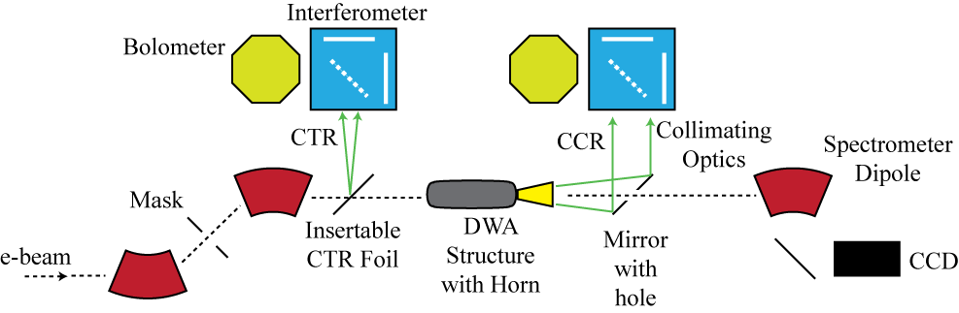
BNL ATF experimental layout
CTR interferometer for bunch length/profile reconstruction
CCR interferometer for spectral characterization
Out-coupling antenna
Dipole spectrometer for energy modulation
Similar setup to FACET experiments and techniques can be used at FAST

Slide 8
Bragg-boundary DWA
Experiment:
  Characterize structure modes
BNL ATF experiment
  57MeV, 100pC, σt~1ps
  CCR spectral analysis
  Reconstruction algorithm
  Energy modulation measured
  Agreement with theory/simulation (3D Vorpal, CST)
Results:
  Bragg reflector performance
  Modal purity for THz source apps
210GHz
CCR Autocorrelation
G. Andonian, et al., PRL 113, 264801 (2014)

Slide 9
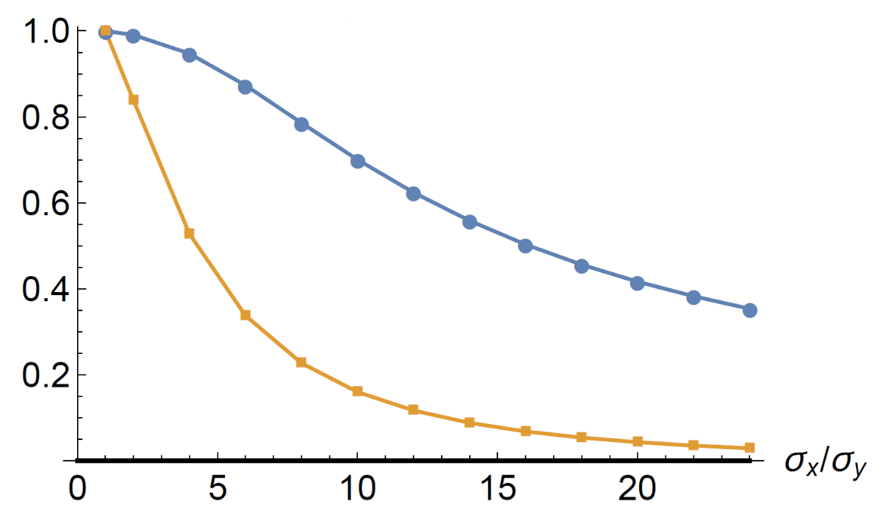
Beam Break up
DWA can sustain GV/m for future machine, but may be limited by BBU
BBU stems from growth of transverse modes
Suggested to use external FODO channel
  C. Li et al., PRSTAB 17, 091302 (2014)
Suggested to use flat beams with planar structures to mitigate the effect
  A. Tremaine et al., PRE 56, 7204 (1997)
  D. Mihalcea et al., PRSTAB 15, 081304 (2012)
  S. Baturin in prep (2018)
E_{z}
“Trade-off” curves
as function of beam ellipticity
F_{y}

Slide 10
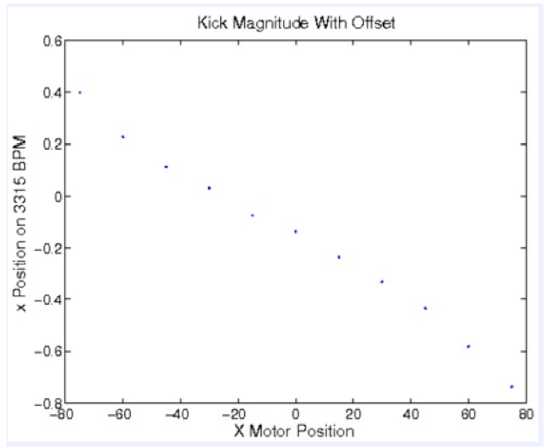
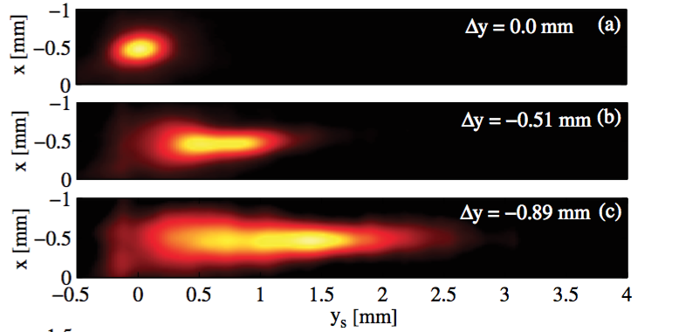
Deflection modes in cylindrical DWA
Experiment to study effects of deflection modes at SLAC FACET
HEM modes seen in spectrum + integrated effect on screen (“kick”)
e⁻
30µm
TM₀₁
“deflection” vs offset
TM₀₁
Offset [µm]
HEM₁₁
HEM₂₁
TM₀₂
Observed at low energy @ PSI
“Passive streaker”
Bettoni, et al., PRAB 19, 021304 (2016)
Notes:
a/b =400/600µm, L=10cm, Q = 1.4nC,σ_{x,y} = 30µm, σ_{z} = 40µm

Slide 11
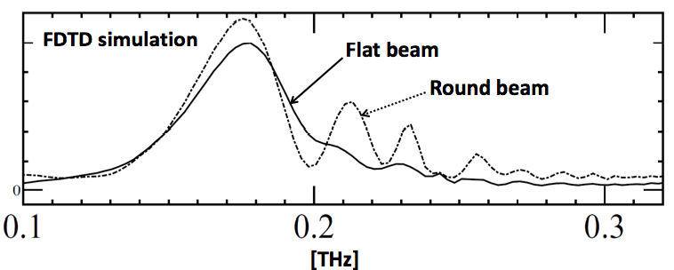
Slab DWA with asymmetric beams
Experiment:
  Drive slab geometry with elliptical beams
  measure effects of deflection modes
Reproducible results across different materials (SiO₂,ZTA, CVD)
Results: Suppression of effects from transverse wakes for flat beams
Beam Off-axis injection
vs observed “kick”
“round”
FDTD simulation
“flat”
SiO2

Slide 12
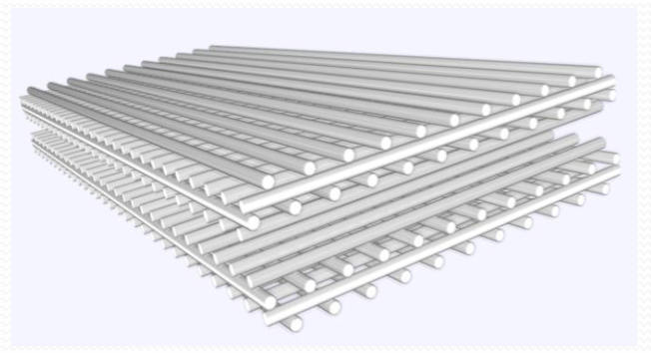
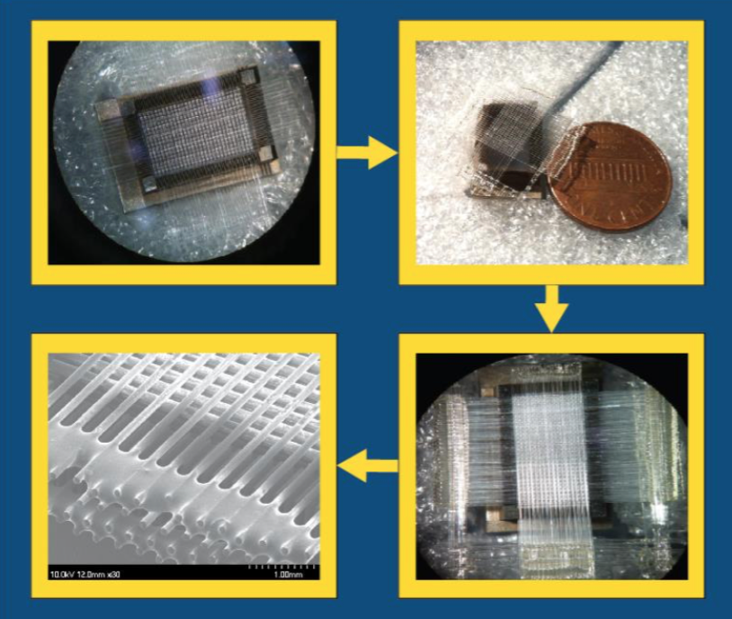
Advanced DWA Structure: woodpile
Build off Bragg and slab results
  Advanced DWA structures
  No metals (excessive dissipation into heat)
Tailor spectrum for reduced coupling to transverse modes (enhance longitudinal)
Familiar from DLA
  Extend to DWA
Engineer spectral content
  3D-periodicity gives more control
  Modes, v_{g}, ratios
  Excited modes in bandgap are confined
Woodpile assembled at UCLA
  For experiment at BNL ATF
  125µm Sapphire rods x 2cm
  by hand (P. Hoang)

Slide 13
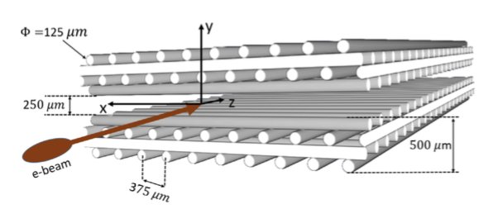
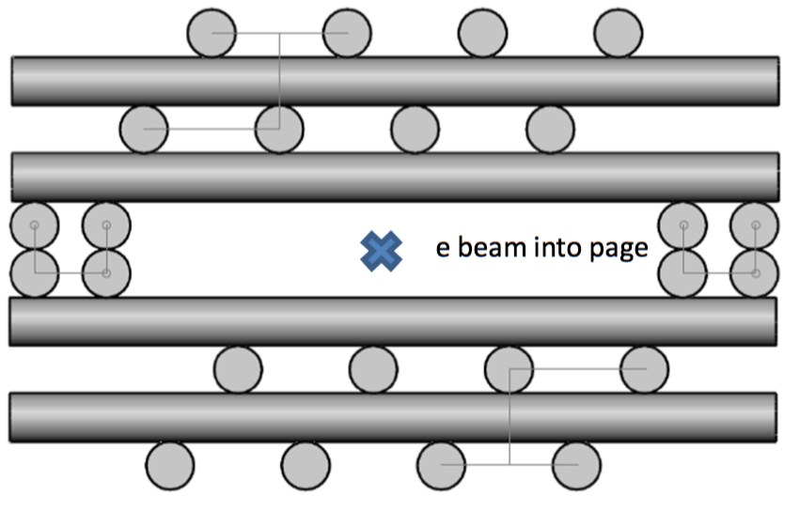
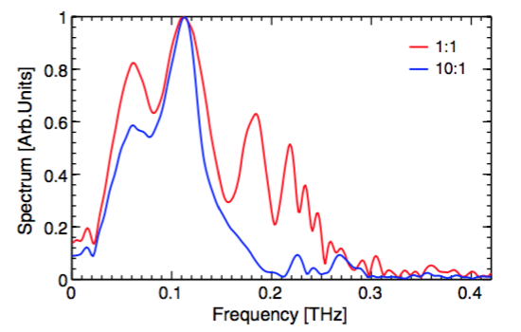
Woodpile simulations
Woodpile parameters
  125µm x 2cm sapphire rods
  375µm periodicity in x, and z
  250µm gap
  Single period structure to understand dynamics
BNL ATF Beam parameters
  57 Mev, ε_{Ν} =2 mm-mrad, σ_{z} = 250µm
  “round beam”: 50:50 µm, 150 pC
  “elliptical beam” 50: 500 µm, 235 pC
Many modes in spectra for round beam
  Boundary conditions require computation
  Flat beam shows only fundamental
Cross section (beam perspective)
Spectrum of woodpile (simulations)

Slide 14
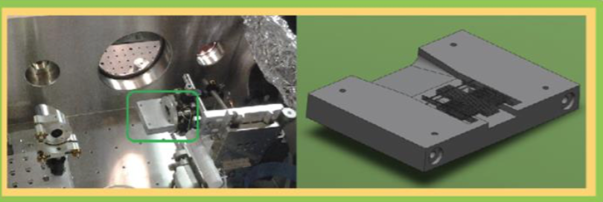
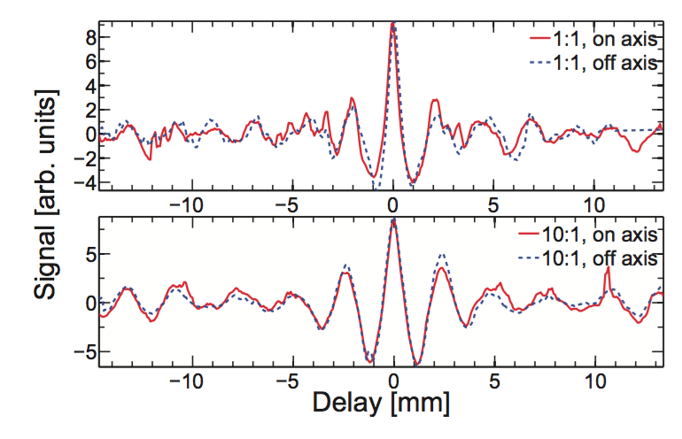
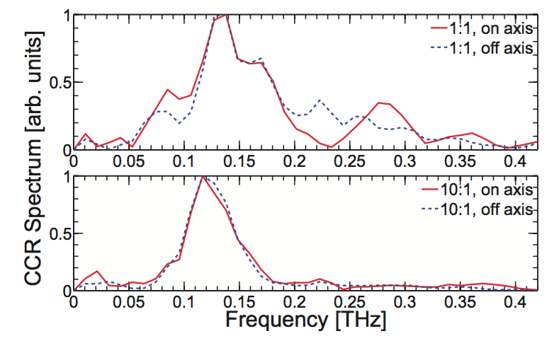
DWA Woodpile experiment
Experiment at BNL ATF
  CCR spectral characterization methods
  Round beam vs elliptical
  Shows suppression of spectra
  agreement with simulations
Results important
  Design spectrum
  Use bunch length to couple to desired longitudinal modes
  Use beam shape to reduce coupling to transverse modes
Interferograms
FFT
round
round
elliptical
elliptical
P. Hoang PRL 120, 164801 (2018)

Slide 15
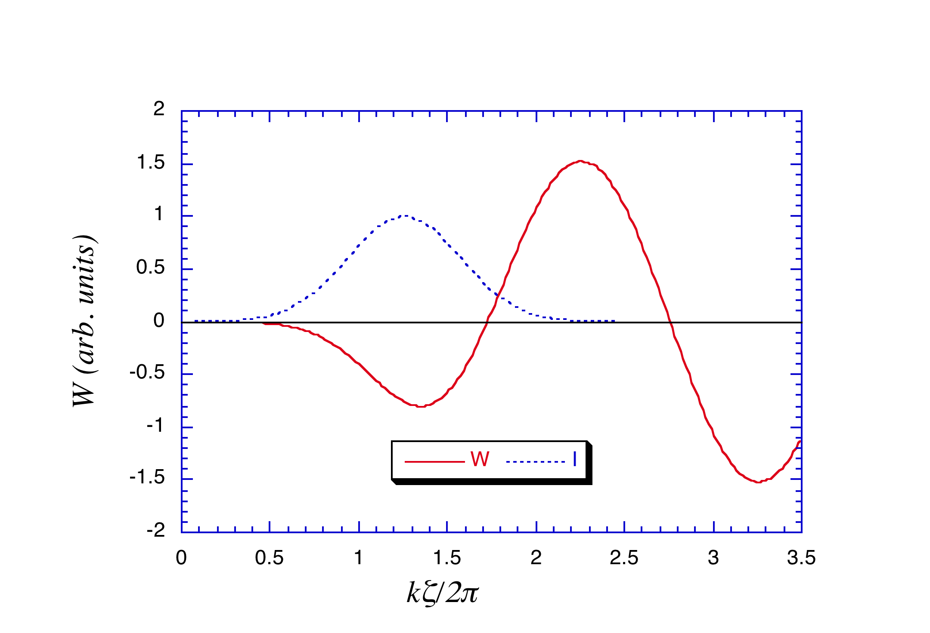
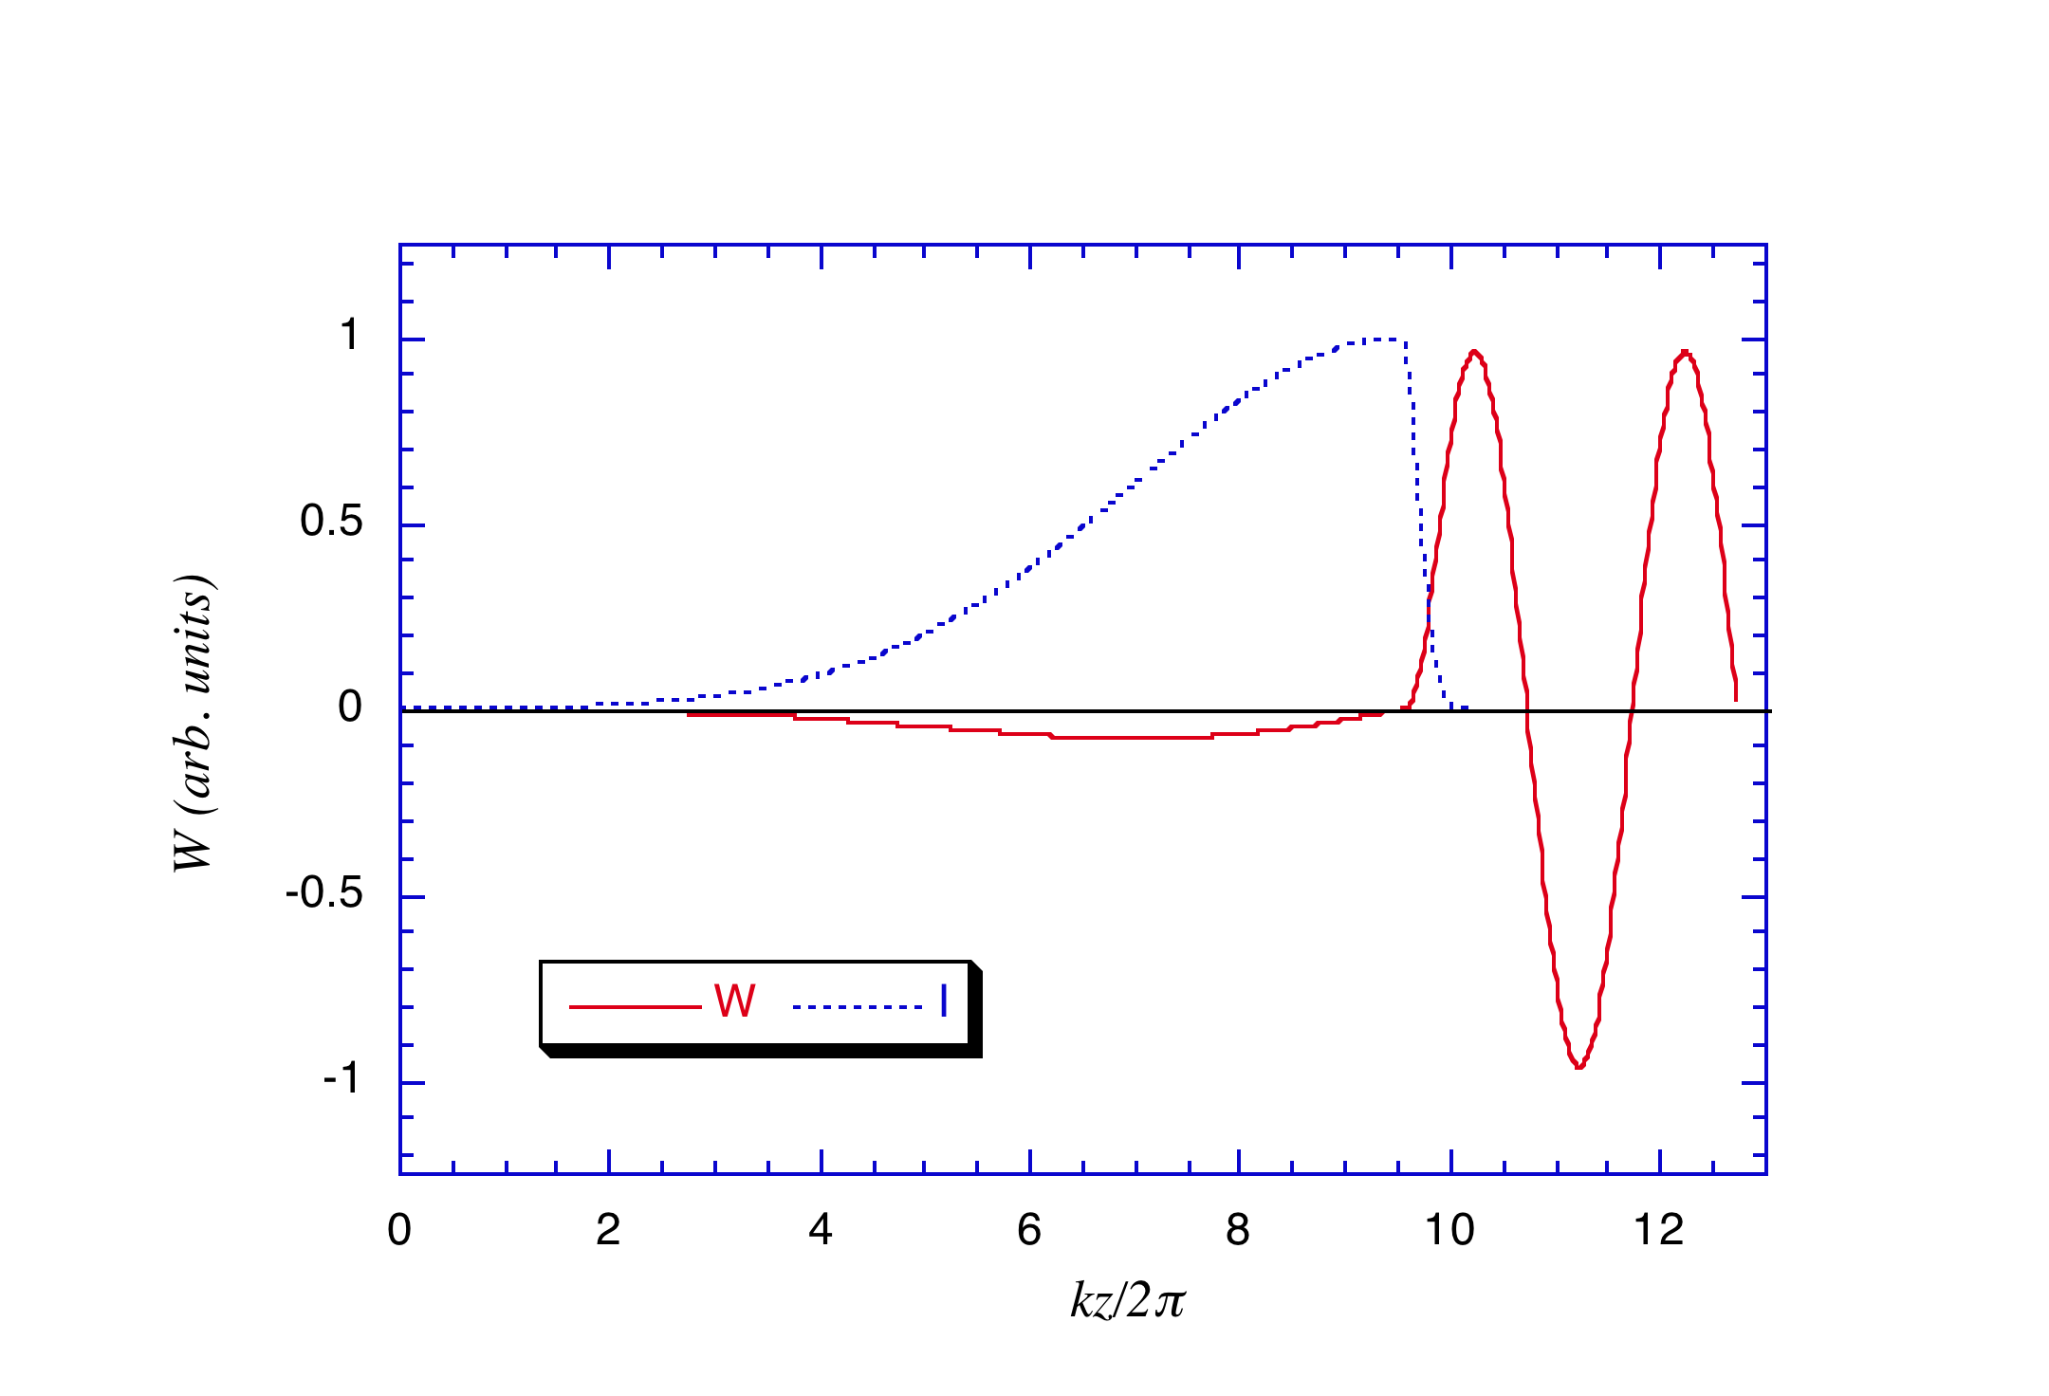
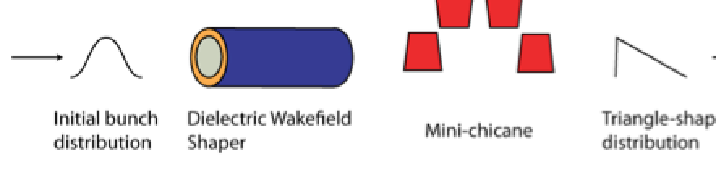
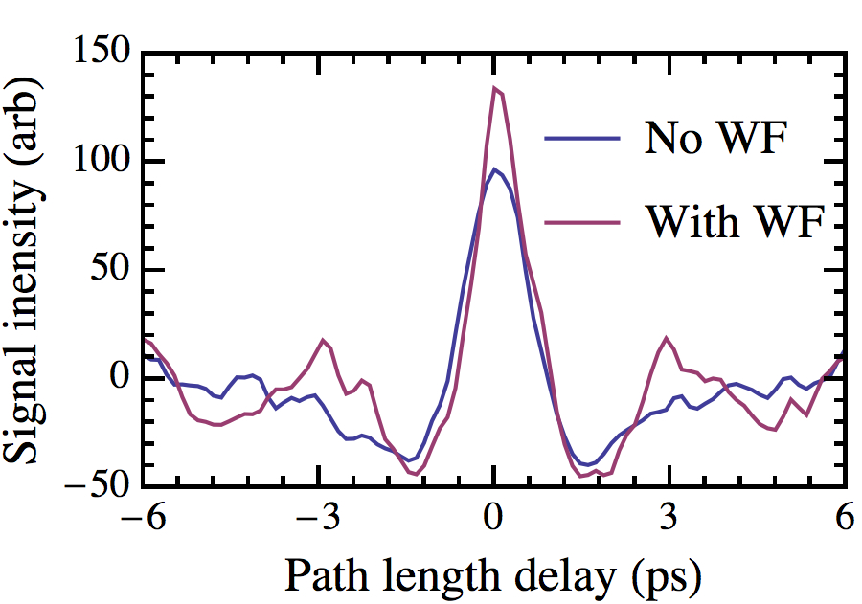
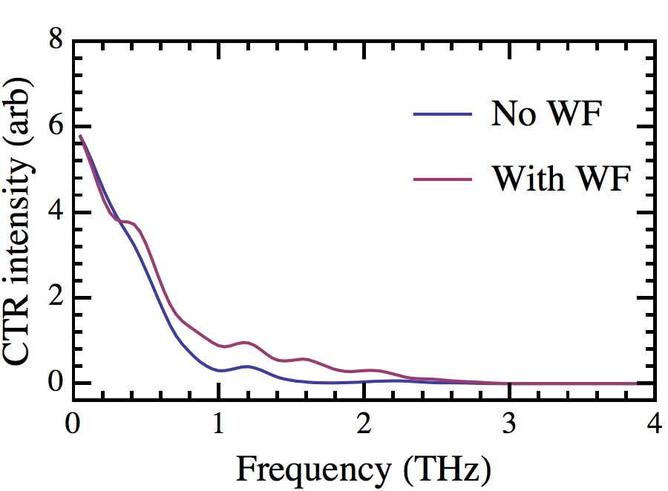
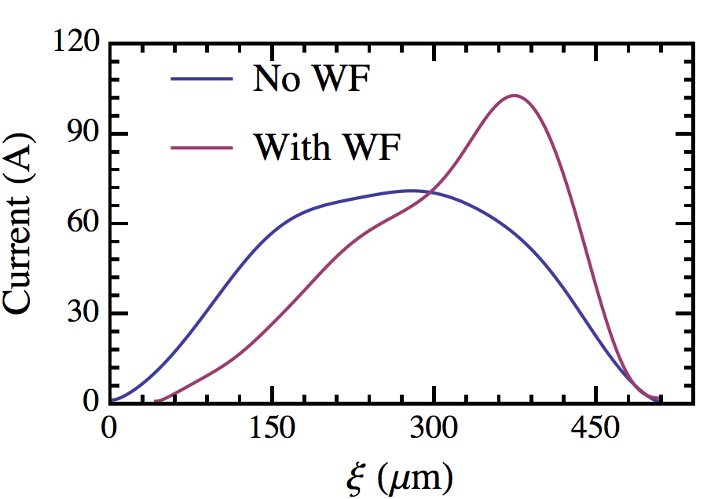
Pulse shaping: High Transformer Ratios
Symmetric beam R<2
Ramped beam R>>2
Efficiency of DWA
TR enhancement from ramped beams
  Triangle distribution
  Novel: doorstep, double triangles
Techniques:
  EEX, laser shaping, mask in dispersive section
Shaping with self wakes
  Analogous to bunch train with DWA
    Antipov PRL 111, 134801 (2013)
Shaping capabilities essential for TR studies
Experiment at BNL ATF:
  “Ramped” beam observed
  CCR autocorrelation
  Deflecting cavity
G. Andonian, et al., PRL 118, 054802 (2017)

Slide 16
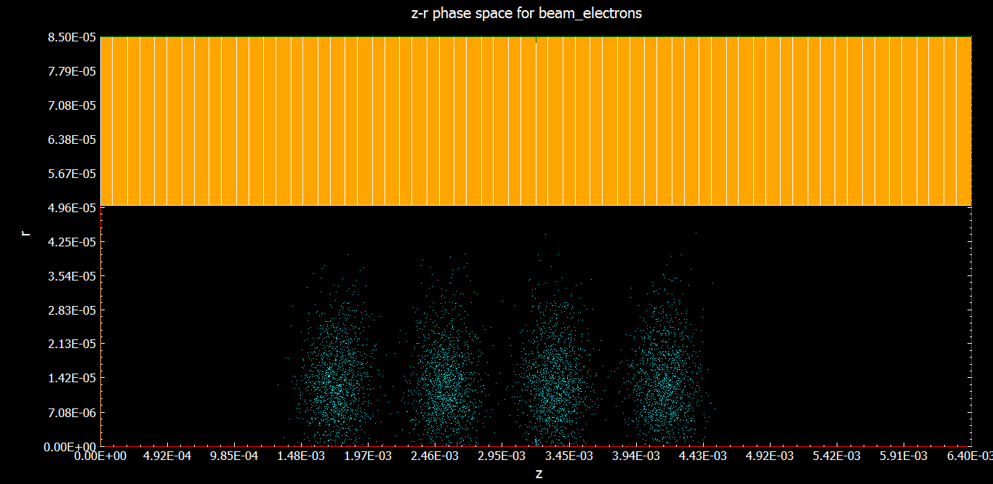
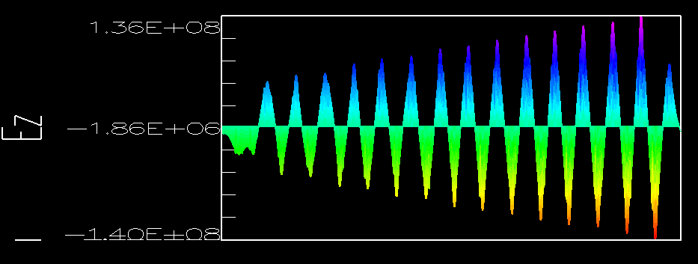
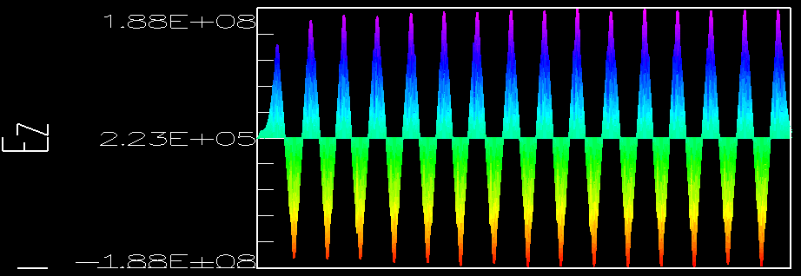
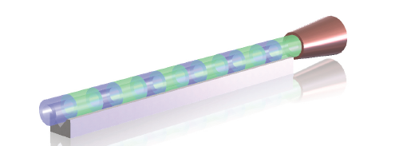
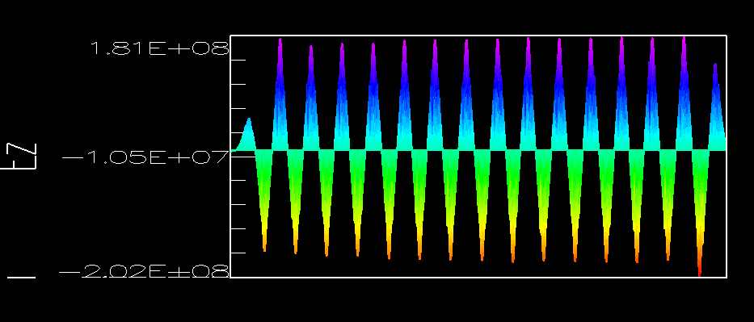
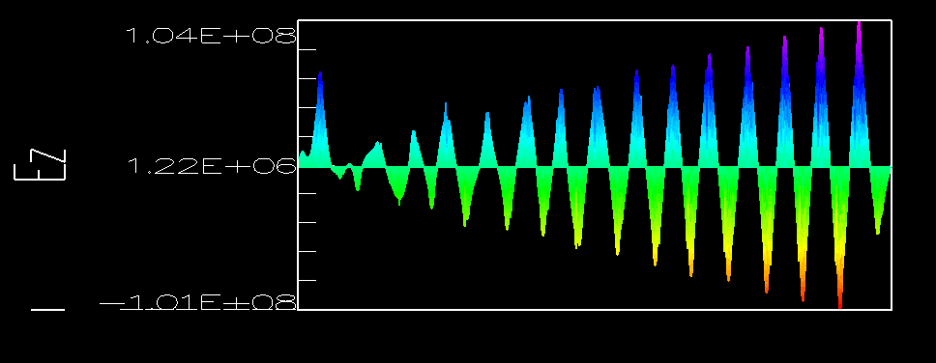
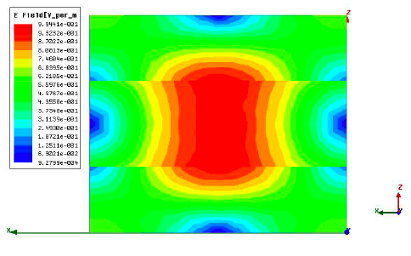
Pulse trains + Longitudinally periodic structures
Motivation:
  Confine energy of mode inside structure
  Near zero group velocity
  Longitudinal periodicity - ε(z)
OOPIC and HFSS Simulations
  a = 50 µm, b = 126 µm
  Periodicity = 300 µm
  Used both sinusoidal variance of ε and step
  Base materials SiO2, diamond (ε=3.8, 10.6)
500 GHz structure
  Mode confinement
Excite mode with 4-pulse train - OOPIC
DWA with horn antenna
Standing wave structure seen in sims after beam has passed through structure (OOPIC)
Mode confinement of Ez (HFSS)
  J. B. Rosenzweig, G. Andonian, D. Stratakis, X. Wei
Notes:
-For high efficiency : don’t throw away stored E after beam loading w single pulse
Difficult to maintain phase space and high R when extracting large energy w single pulse
- ZGV so the EM does not exit structure
Periodic e

Slide 17
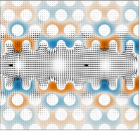
Summary & Future Work
DWA useful tool for accelerator applications
  Advanced accelerator, THz source
  Phase space manipulation, beam diagnostic
FAST allows opportunity to study in new regime
  High average current : Charging/ Heating questions
  High quality bunches : Small/long structures
  RTFB transform: Flat beam driven planar DWA
FAST is unique facility for advanced DWA studies
  Designer structures for fundamental physics
  Spectra by design + Beam by design
  Explore limits and possibilities
P. Hoang, “Toothed woodpile”
Acknowledgements: UCLA: S. Barber (LBNL), A. Fukusawa, P. Hoang, B. Naranjo, N. Sudar, O. Williams, J. Rosenzweig, et al. RadiaBeam: F. O’Shea, M. Harrison, A. Murokh, et al., FACET: B. O’Shea, C. Clarke, M. Hogan, V. Yakimenko, et al. U. Chic: S. Baturin, ATF: M. Fedurin, C. Swinson, et al.,
Work Supported by US DOE HEP

