Slide 1
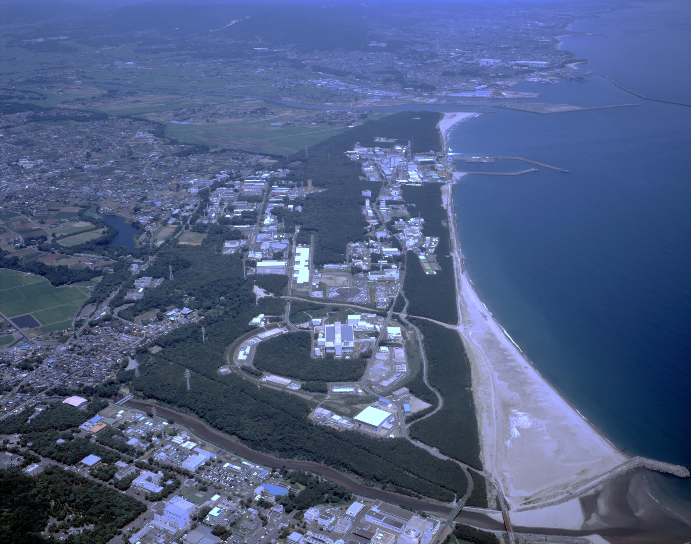
Beam Instability Issues and Measures at High Intensity Operation of J-PARC RCS
Pranab K. Saha
J-PARC
Fermilab Workshops at MW Rings & IOTA/FAST Collaboration Meeting
7-10 May, 2018

Slide 2
Outline:
1. Brief Introduction of J-PARC and the 3-GeV RCS
2. Impedance sources in the RCS
3. Beam instability due to the Kicker Impedance
4. Space Charge effect on the Beam Instability
5. Beam instability mitigation at 1 MW beam
power and beyond
6. Summary and Outlook

Slide 3
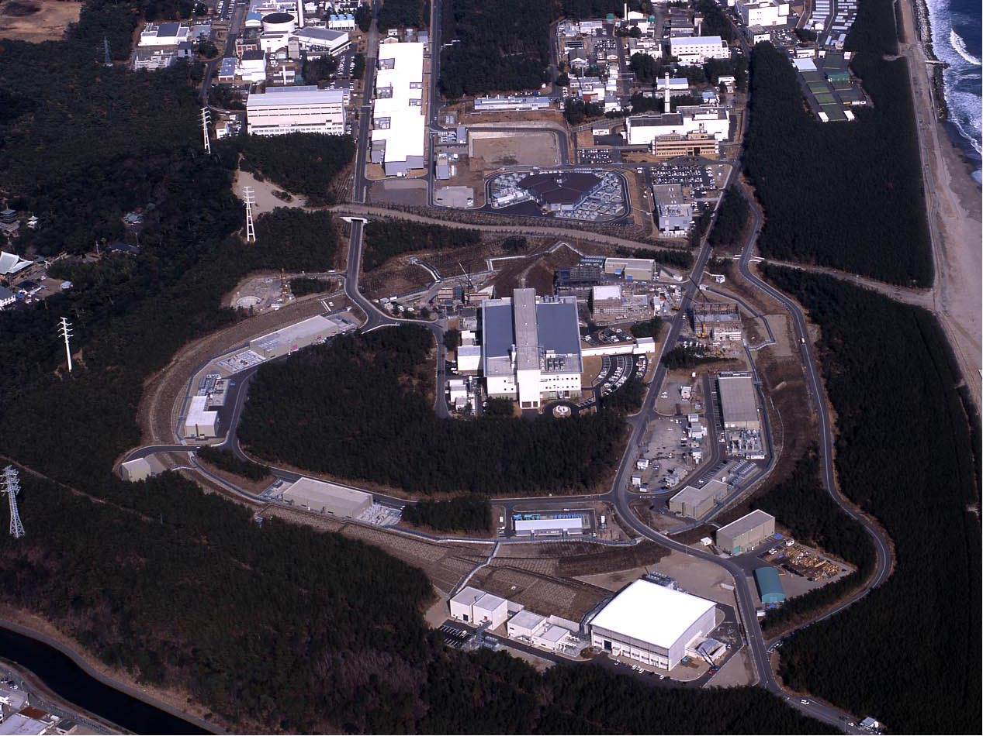
J-PARC
KEK & JAEA)
400 MeV H⁻ Linac
Transmutation Experimental Facility (TEF)
H⁻ →p
3 GeV Rapid Cycling Synchrotron (RCS)
Fast Extraction
Neutrino experiment (NU)
50 GeV Main Ring Synchrotron (MR) [30 GeV at present]
Materials & Life Science Facility (MLF)
Slow Extraction
Hadron experiments (HD)

Slide 4
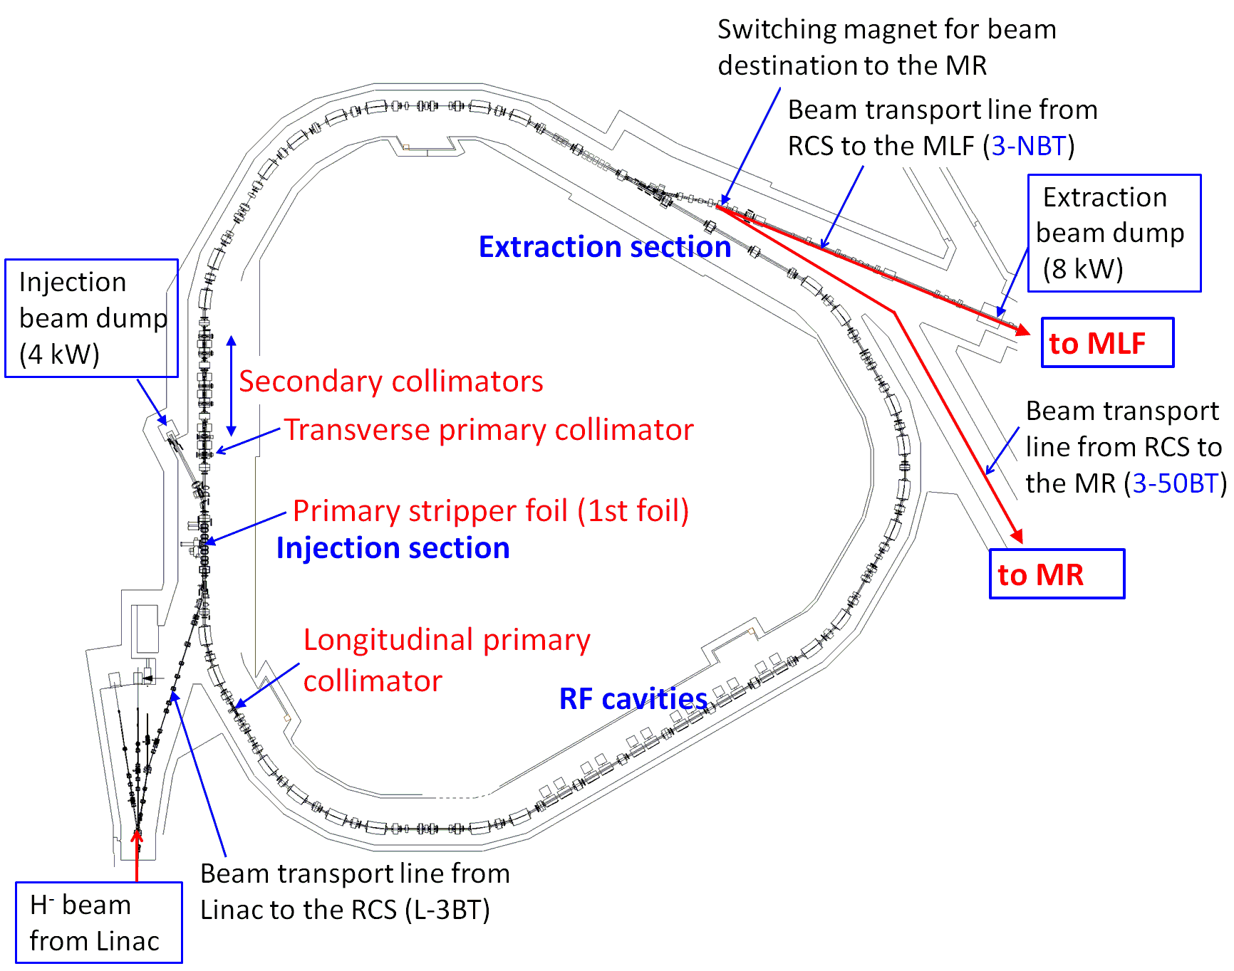
1. Introduction of 3-GeV RCS
Parameter | Value
Circumference [m] | 348.333
Repetition [Hz] | 25
Harmonic no, bunches | 2, 2
Protons/pulse (PPP) | 8.33E13
Beam power [MW] | 1
 | Injection | Extraction
Energy [GeV] | 0.4 | 3
f₀ [MHz] | 0.614 | 0.84
Δp/p （99%）[%] | 0.8 | 0.4
τ_{z} (bunch length) [m] | 160 | 60
ν_{s} (synchrotron tune) | 0.006 | 0.0005
ν_{x}, ν_{y} (betatron tune) | 6.45, 6.42 | Variable
ξ_{x}, ξ_{y} (Nat. chromaticity) | -10, -7 | Variable
B_{f} (Bunching factor) | 0.47 | 0.21
Δν_{incoh}, Δν_{coh} | -0.3, -0.03 | -0.05, -0.005
To reduce the SC effect longitudinal painting (LP) and transverse painting (TP) at injection are adopted.
ε_{tp} = 100π mm mrad in this work
RCS Beam power at present:
To MLF: 0.5 MW
To MR: ~0.8 MW-eqv.

Slide 5
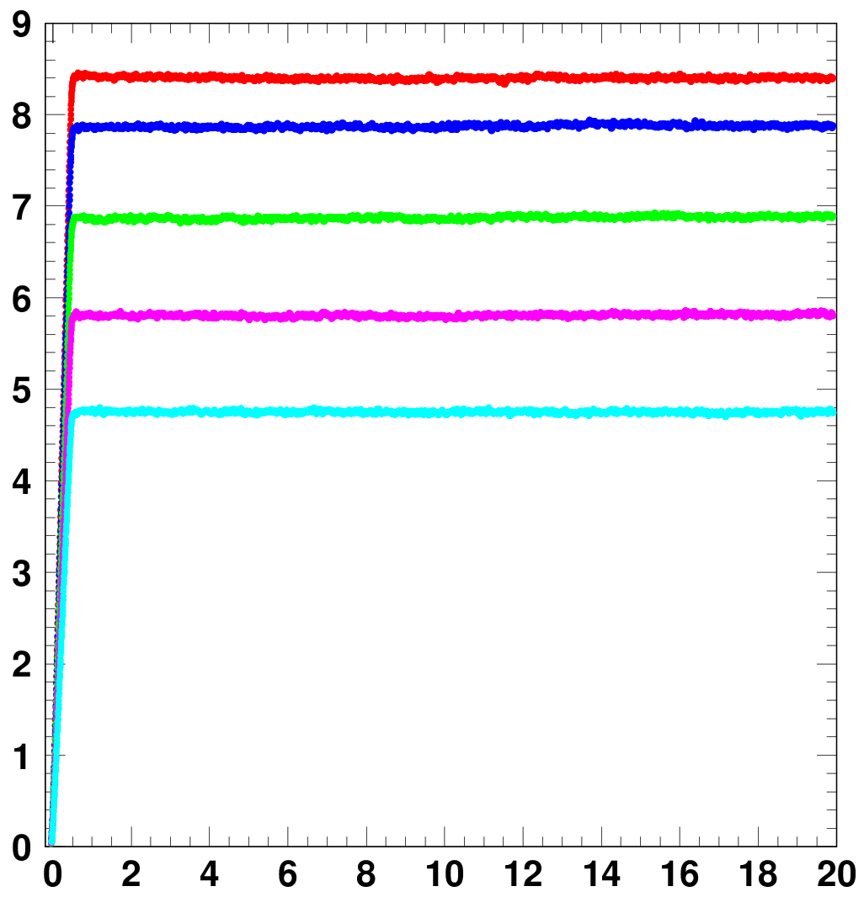
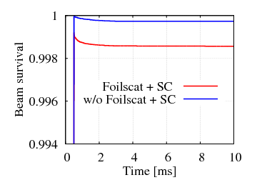
Demonstration of 1 MW beam power
● Successfully demonstrated
acceleration of the designed
1 MW beam power.
● Beam loss at 1 MW: <0.2% and
only at injection energy
-- mostly due to the foil scattering.
8.41 x 10¹³ ppp : 1.01 MW-eq.
7.86 x 10¹³ ppp : 0.944 MW-eq.
6.87 x 10¹³ ppp : 0.825 MW-eq.
5.80 x 10¹³ ppp : 0.696 MW-eq.
Particles /pulse (x 10¹³)
4.73 x 10¹³ ppp : 0.568 MW-eq.
0.15%
Experimental results:
Circulating beam intensity measured by a CT
Simulation
Injection
Time (ms)
Extraction
We have also established RCS parameters for
operation at the 1 MW beam power.

Slide 6
Impedance sources in the RCS
● Acceleration of 1 MW power beam was not that much simple.
● We had to do a lot of works to mitigate the beam instability caused by the transverse Impedance of the extraction kicker magnets.
● The Impedance sources in the machine were carefully addressed, but unfortunately the KM impedance remained untouched.
RCS Vacuum chambers types
and their parameters.
Titanium flanged alumina
ceramics vacuum chambers
with RF shields were
developed.
Courtesy: M. Kinsho

Slide 7
Notes:
Unit duct length ~0.8m. Joined 4 ducts for bending magnets. Cu stripes (rf shields) are 0.5 mm thickness and 5 mm width. In ISIS, these stripes are inside of the chamber. The segments are joined Mo-Mn metalizing the ends and brazing with Cu-Ag eutectic alloy.

Slide 8
Ceramic duct properties
The temperature for dipole magnet was measured at various point
with ramping and at 25 Hz.
◎ The Eddy current heating of the Ti Sleeve and flange was not high.
The longitudinal impedance was measured by single wire method.
◎ The impedance at low frequency was very small.
◎ The impedance at higher frequency was also not so big.

Slide 9
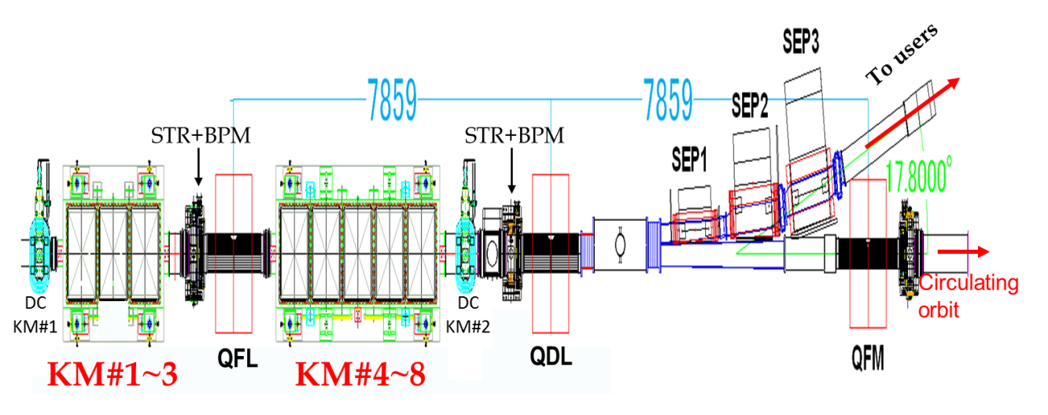
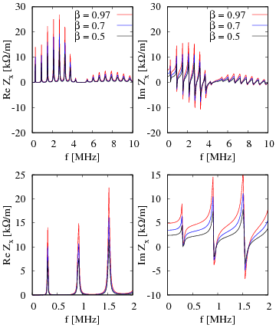
RCS Kicker Impedance
Horizontal impedance of one KM
Y. Shobuda et al., NIMA 713, 52 (2013)
×10 of SNS
KM impedance!
The KM impedance is the most
significant beam instability
source in the RCS.
Beam instability occurs even at a beam power exceeding 0.25 MW!
Expanded view
(0-2 MHz)

Slide 10
Beam Instability simulations and mitigation methods
■ R&D studies to reduce the KM impedance are in progress,
but long way to go for realistic implementation.
■ Theoretical works provide overview (threshold) of the beam instability, but realistic strategy for the beam instability suppression should be determined by detailed simulation studies.
■ The space charge effect (SC) on the beam instability should
be considered seriously.
-- ORBIT 3D SC code is used. We should determine realistic parameters to accomplish 1 MW beam power.
◎ We enhanced ORBIT by implementing all realistic time dependent machine parameters:
Injection process, transverse & longitudinal injection paintings, error sources,
PS ripples, . . . . and also the KM impedance.

Slide 11
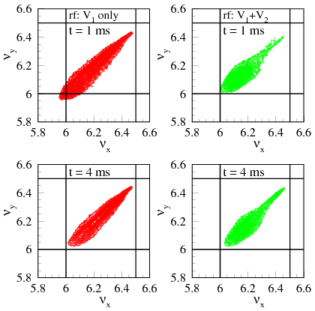
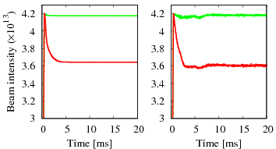
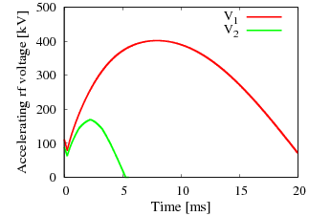
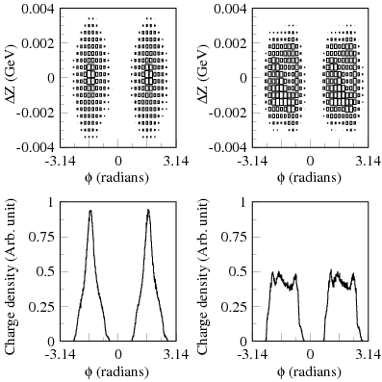
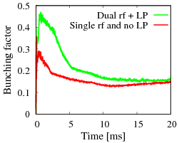
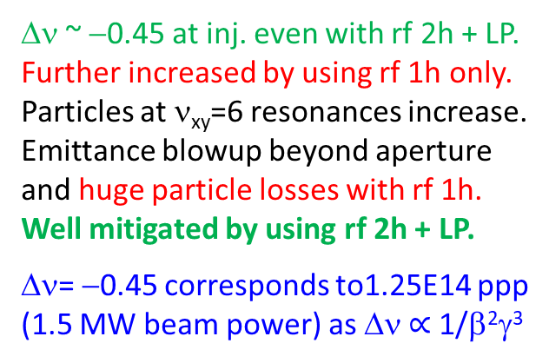
Space charge simulation results
The space charge force is controlled by the
choice of Einj., rf pattern and LP
Einj: 0.181 GeV
TP= 100π mm mrad
PPP: 4.2E13 (0.5 MW)
V_{rf} = V₁sinφ +
V₂sin{2(φ-φ_{s}) + φ₂}
Dual rf + LP
Single rf, no LP
15%
Simulation
Measurement
Simulation (0.375 kW)
Δν ~ −0.45 at inj. even with rf 2h + LP.
Further increased by using rf 1h only.
Particles at ν_{xy}=6 resonances increase.
Emittance blowup beyond aperture
and huge particle losses with rf 1h.
Well mitigated by using rf 2h + LP.
Δν= −0.45 corresponds to1.25E14 ppp
(1.5 MW beam power) as Δν $∝$ 1/β²γ³
ｒf 1h, no LP
Measurement
ｒf 2h + LP

Slide 12
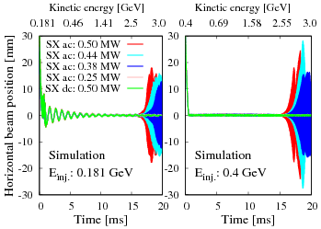
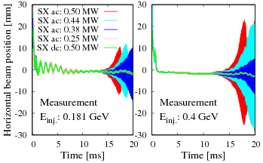
Beam instability up to 0.5 MW
■ Beam instability occurs even for a beam power exceeding 0.25 MW when the ξ is fully corrected for the entire acc. cycle by SX ac fields.
■ No instability occurs for ξ fully corrected only at inj. by SX dc fields
Simulation results are well
reproduced in the measurements.
Beam instability occurs at relativistic energy.
-- Beam is stabilized by the SC at lower energy.
The growth rate is higher for Einj. is higher.
--The Landau damping effect of the nonlinear
SC force is smaller for higher injection energy.
Simulation
Measurement

Slide 13
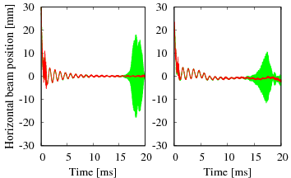
Beam instability suppression by the SC
Dual rf + LP
Single rf, no LP
Einj. = 0.181 GeV, SX ac (ξ =0)
PPP: 4.2E13 (0.5 MW)
Δν/ν_{s} >> 1 (strong space charge)
Simulation
Measurement
■ Beam instability occurs when the
SC effect is reduced by applying dual
harmonic rf voltage and also the LP.
■ However, beam is stable when SC
is stronger by omitting 2nd harmonic
rf voltage and also the LP.
Simulation
Measurement

Slide 14
Beam instability suppression by the SC
How about at lower beam intensity?
Beam power: 0.375 MW (3.1E13). ξ = 0, Beam loss with rf 1h: 3%
P.K. Saha et al.,
PRAB 21, 024203 (2018)
The Landau damping effect of the non-linear
SC force becomes more effective to stabilize
the beam.

Slide 15
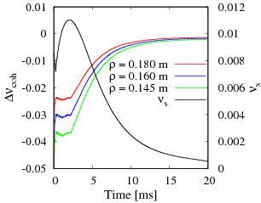
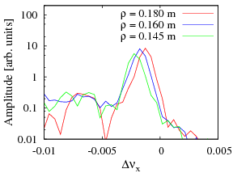
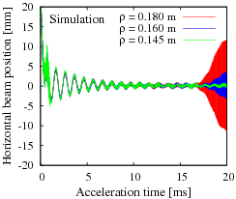
The ORBIT code takes indirect SC into account, which is
important to study the beam instability with SC.
Circular shape perfect conducting wall boundary is defined
with radius ρ = 0.145 m.
Einj. = 0.181 GeV, SX ac (ξ =0)
0.375 MW, single rf
Δν/ν_{s} >> 1
Estimated Δν_{coh}
and ν_{s}
Betatron frequency spectra
at beam instability onset.
0.375 MW
■ The beam tends to unstable and
more destabilized as ρ is increased.
■ The Landau damping effect
vanishes earlier as ρ is increased
so as the growth rates.
P.K. Saha et al.,
PRAB 21, 024203 (2018)

Slide 16
Beam Instability suppression at 1MW beam power
At 1 MW beam power, the SC effect, especially at lower energy should be sufficiently reduced to mitigate the beam losses.
→ Wider Δp/p of the injected beam, apply LP and TP (100π mm mrad)
→ Choice of the betatron tunes, ξ correction, ......
However, reduction of the SC enhance the beam instability
at higher energy.
We consider following 3 measures:
(1) Manipulation of the betatron tune (ν_{x}) during acceleration.
(to avoid characteristics (resonances) of the KM impedance)
(2) Further reduction of the DC ξ correction.
(to enhance the Landau damping)
(3) Smaller Δp/p of the injected beam (should be <0.1% )
(same as (2) )

Slide 17
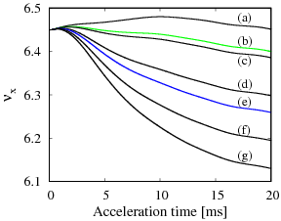
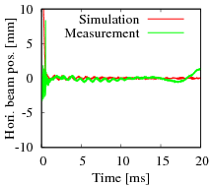
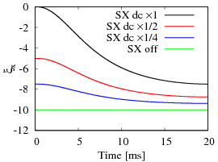
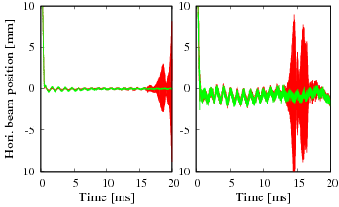
Suppression of Beam Instability at 1MW beam power
SX dc x1
Δp/p = 0.18%
Simulation
Δp/p = 0.08%
ν_{x} mani: None
Measurement
Even at 0.75 MW beam power:
■ Beam instability w/o ν_{x} manipulation, but
A proper ν_{x} manipulation stabilizes the beam.
A narrower Δp/p (inj. beam) gives no instability.
ν_{x} no mani (a)
ν_{x} mani (b)
Δp/p = 0.18%
SX OFF
However, at 1 MW,
A partial ξ correction is desired.
Growth rate further increases!
Detail tune survey done.
1 MW
Simulation
Measurement

Slide 18
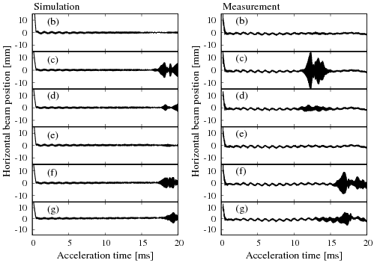
Betatron tune dependence 1 MW beam power
Simulation
SX dc x 1/4
Measurement
◎ Choice of betatron tunes are very limited.
◎ Simulation results are well reproduced in the measurements.

Slide 19
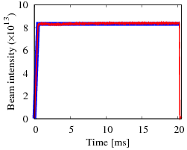
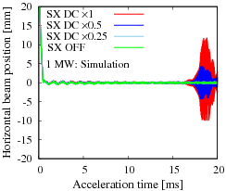
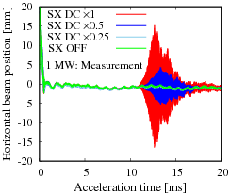
ξ dependence at 1 MW
P.K. Saha et al., PRAB 21, 024203 (2018)
Beam survival
Simulation
Measurement (DCCT)
Simulation
Measurement
In addition to a proper betatron tune manipulation,
the ξ correction of 1/4 or less at injection and almost
no ξ correction at extraction were utilized to accomplish
1 MW beam power.

Slide 20
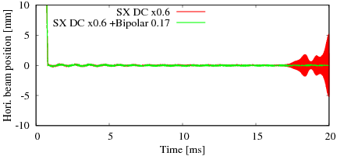
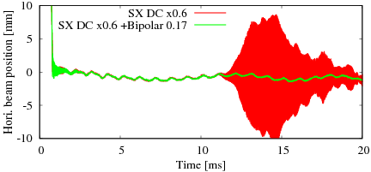
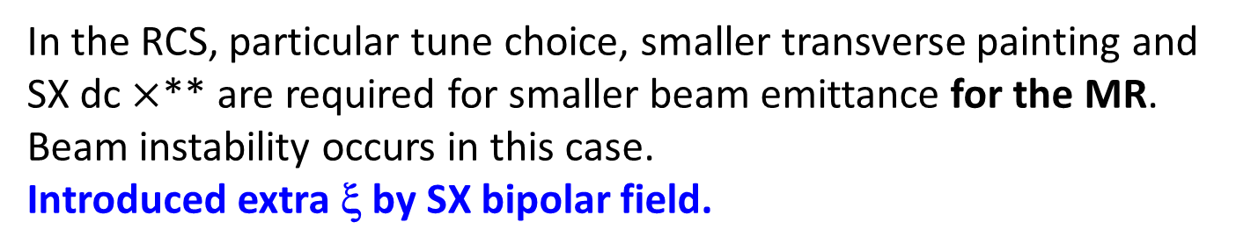
Recent results
In the RCS, particular tune choice, smaller transverse painting and
SX dc $×$** are required for smaller beam emittance for the MR.
Beam instability occurs in this case.
Introduced extra ξ by SX bipolar field.
Simulation
Measurement

Slide 21
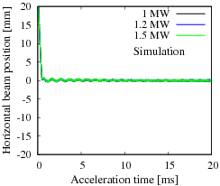
Beyond 1 MW beam power
In order to make sure 1 MW beam power to the MLF, even if MR
cycle is upgraded from 2.48s to ~1s and also when a 2nd target
station at the MLF is constructed, RCS beam power upgrade is
planned to be 1.5 MW.
However, beam instability occurs even if ξ is not corrected at all.
R&D studies to reduce the KM is in progress. The impedance can
be reduced by at least a half (Y. Shobuda, IPAC18).
The given reduced impedance is used in
the simulation.
Beam is stable up to 1.5 MW even if ξ is
fully corrected at injection by SX dc.
SX bipolar field for 20% extra ξ at the later
half cycle also stabilizes the beam.

Slide 22
Summary and outlook
■ Transverse Impedance of the KM is a significant beam instability
source in J-PARC RCS.
■ The ORBIT code was enhanced to cope with all time dependent
Parameters for realistic beam instability studies with SC.
The beam instability suppression by the SC has been studied in detail.
■ A proper ν_{x} manipulation and minimal ξ corrections were applied
to accomplish the designed 1 MW beam power successfully.
The simulation results are well reproduced in the measurements.
● KM impedance restricts RCS flexible parameter choice for multi-user
operation. R&D studies to reduce the KM impedance are in progress.
● We can achieve 1.5 MW beam power, if the KM impedance is
reduced by even a half.
Acknowledgement
We acknowledge many of our colleagues for continuous support and encouragement.
M. Kinsho, N. Tani, Y. Watanabe, M. Yamamoto, K. Yamamoto, Y. Irie..
We thank Dr. J.A. Holmes of SNS for continuous support on the ORBIT code development.

Slide 23
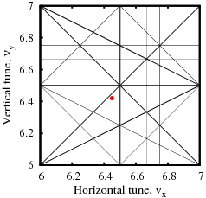
RCS tune diagram and the operating point
at injection.

Slide 25
Courtesy: Y. Shobuda (IPAC18, Vancouver)

Slide 26
Courtesy: Y. Shobuda (IPAC18, Vancouver)

