Slide 1
Single Electron Experiments in IOTA
Sergei Nagaitsev (Fermilab/UChicago)
May 09, 2018

Slide 2
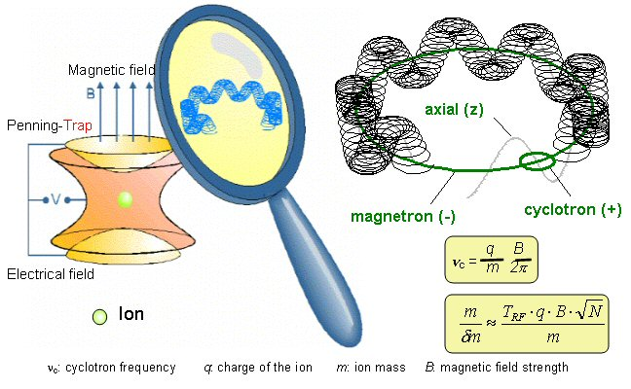
We are preparing several experiments to study a single electron in a large trap (IOTA) and its quantum nature of photon emission
Similar to a single-electron
Penning trap

Slide 3
Collaborations
Quantum effects in undulator radiation
  SN (PI/UChicago), H. Frisch (UChicago), K.-J. Kim (UChicago/ANL), Z. Huang (Stanford/SLAC), T. Shaftan (BNL), RadiaBeam (A. Murokh), I. Lobach (UChicago grad. student)
Single Electron Optical Stochastic Cooling
    Fermilab (lead), NIU, UChicago, ANL, LBNL
Single Electrons Emission Diagnostics (SEED) – an SBIR (Phase I) proposal by RadiaBeam

Slide 4
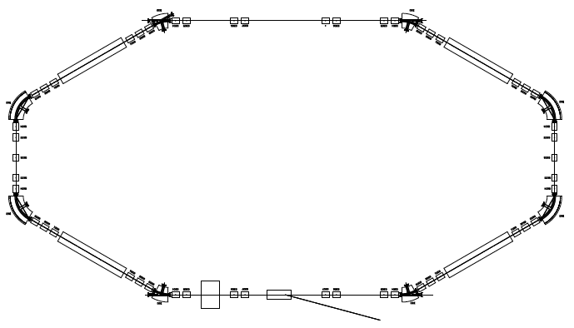
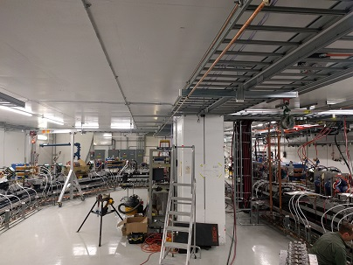
The experimental setup
photons
~0.5 - 1 μm
Undulator(s)
detector
counter
IOTA
Electron energy: 100-150 MeV
γ ~ 200-300

Slide 5

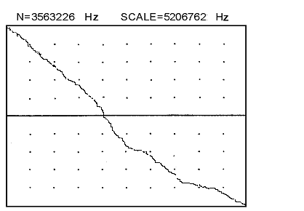
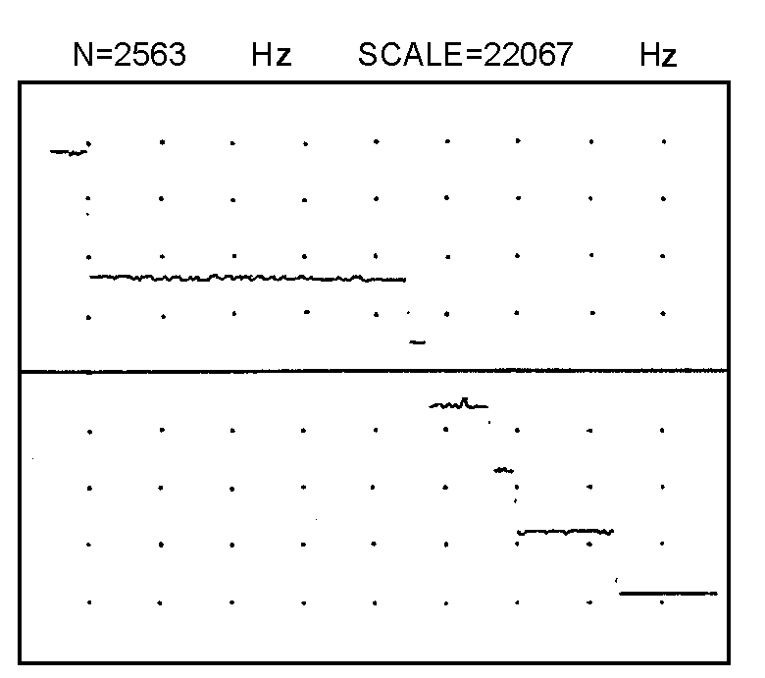
How to register a single electron?
Photocounts
K ~ 1, N >>1
t
Undulators
Discriminator
PMT
Amplifier
Counter
Expected photon rate: ~10 kHz
Previous experiments
in VEPP-3 (BINP)
7
6
1200 e-
5
A single
electron
1000 e-
4
800 e-
Photocounts per
Second = Hz
3
2
600 e-
BKGD
Time (many seconds)
Time (many seconds)

Slide 6
Two-photon emission (second order in α)
Δτ
PMT1
Localization
length
γ1
PMT2
γ2
γ1
γ2
e
e
undulator
Coincidence
scheme
Storage ring
Time-to-digital Converter
START
STOP
Number of events
Δτ
Hanbury-Brown-Twiss Int.
Time = Delays between START and STOP

Slide 7
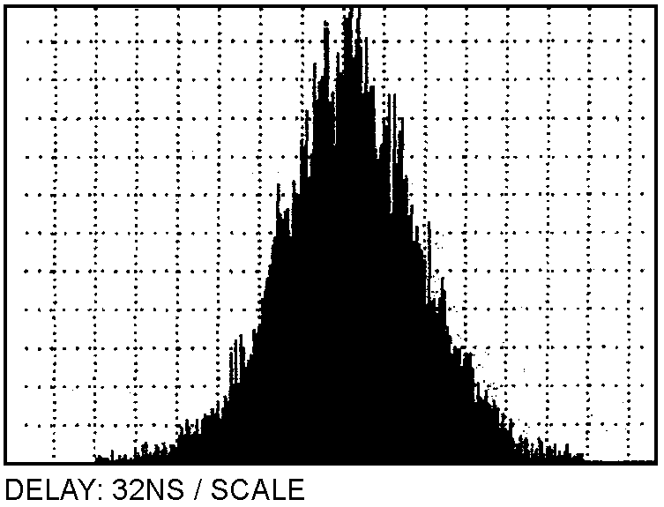
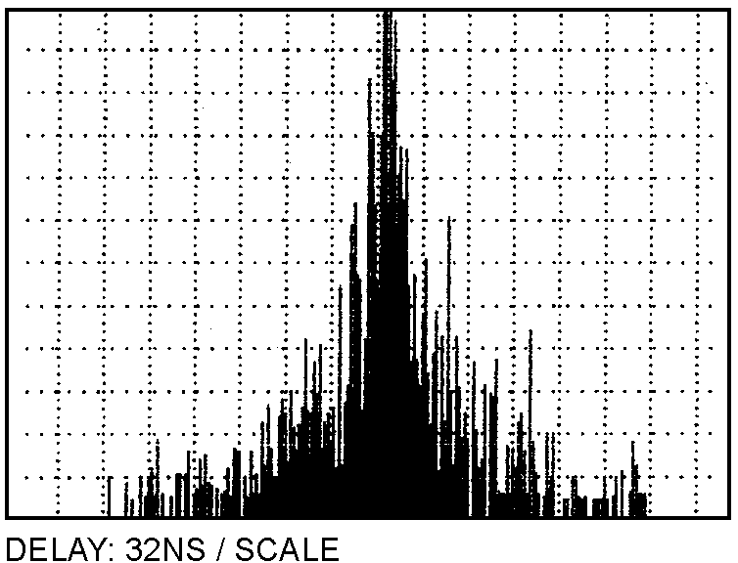
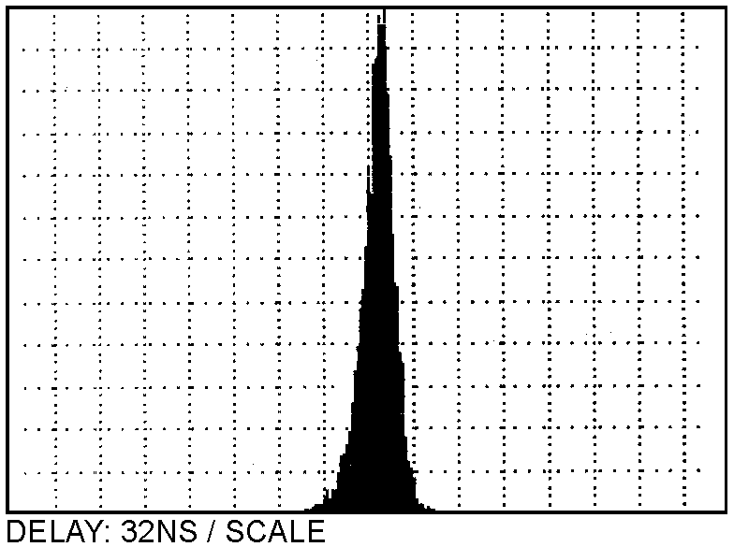
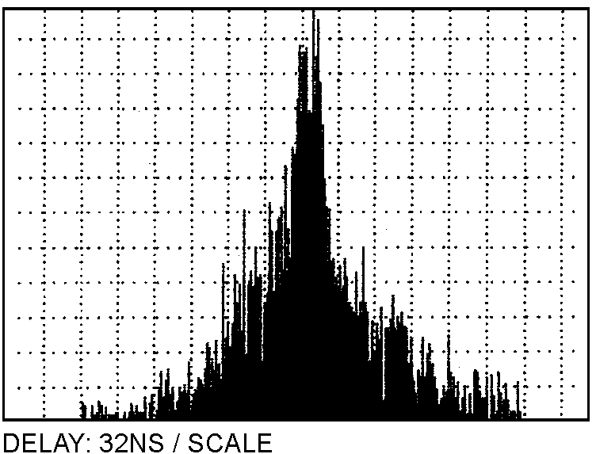
Results of experiments at VEPP-3 (~1990)
Bunch
length
Distributions of intervals between photocounts from PMT A and PMT B for different number of electrons
Many electrons
1 electron
Width ~1 ns
Bunch
length
5 electrons
~1 ns – PMT timing resolution
at the time
2 electrons

Slide 8
What is the science case?
So far, the undulator radiation (for hν << E₀) is completely consistent with a quasi-classical description, i.e. if one sets h to zero, classical (dipole) radiation is recovered.
  Obviously the radiation is quantized. The quasi-classical model works in the first order in α – the fine structure constant
The question we would like to address: is the quasi-classical model true also in α² and α³ orders?
  These are two- and three-photon processes in the undulator radiation
The point is that in an undulator (K < 1), the radiation formation length is long (~undulator length). This seem to suggest that multiple photons generated by one electron should be correlated.
  We would like to test this experimentally…

Slide 9
Proposed experiments
Two-photon and three-photon rates
  Expected ~100 Hz and ~1 Hz
Two-photon and three-photon time correlations
Two-photon transverse and angular correlations, and photon polarization correlations.
  Are photons in a quantum-entangled or a quantum-correlated state?
Two-color two-photon measurements …
Electron quantum wave-function localization

Slide 10
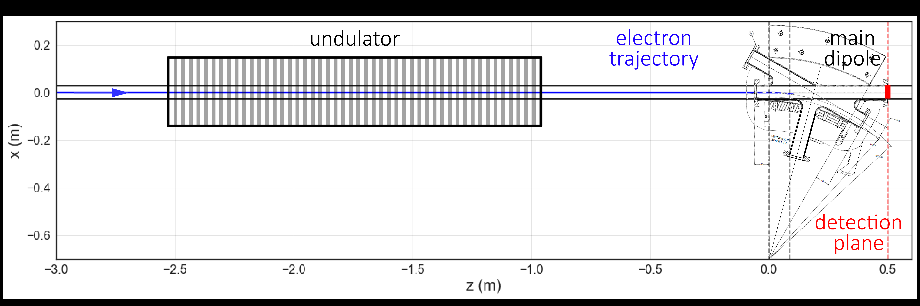
Proposed setup
IOTA experimental system parameters
Ring circumference 40 m
Electron energy 150 MeV
Nominal bunch length, rms 10-30 cm
Undulator length 1.8 m
Undulator period 7 cm
Photon wavelength (forward) 500 nm

Slide 11
Photon rate as a function of cone angle
10 mrad
2 mrad
1
Anticipated single-photon rate: 20 kHz in a 1-mrad cone

Slide 12
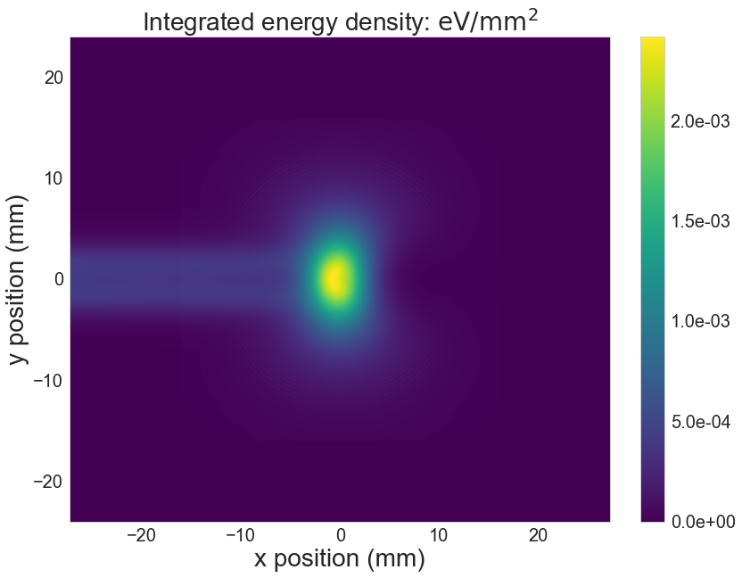
Photon transverse distribution (undulator+dipole)
At the dipole viewport window (50mm x 50 mm)

Slide 13
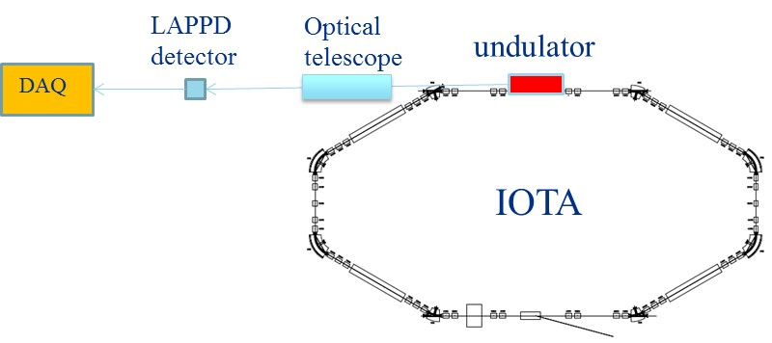
Experiments with an LAPPD
LAPPDs are large pixelated single-photon detectors capable of ~10-ps rms time resolution.
200 mm x 200 mm active area, ~200 x 200 “pixels”
Each pixel has a single photon detection efficiency of ~30 % (at 500 nm).

Slide 14
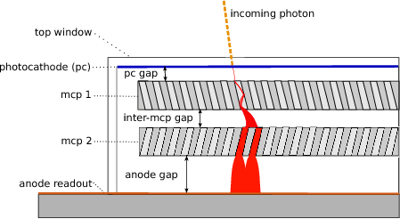
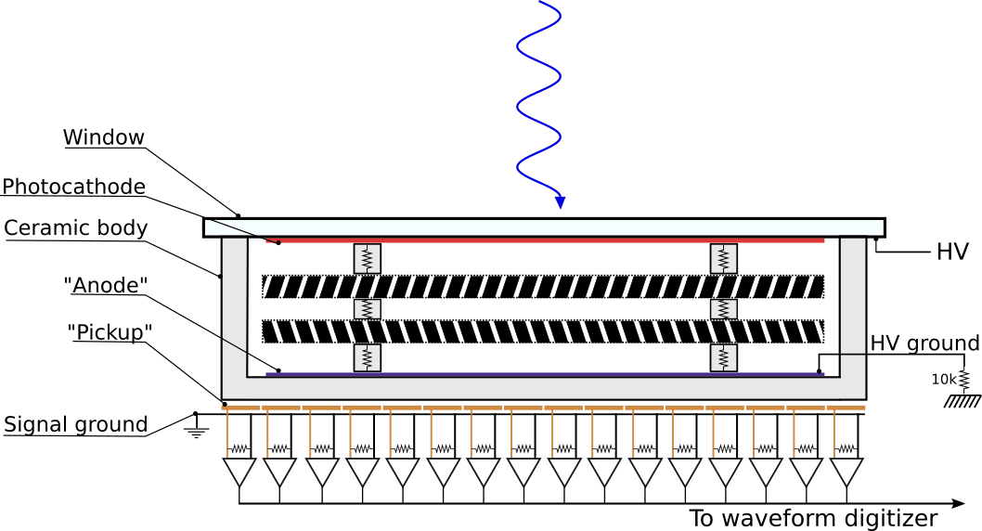
LAPPD “pixels”, ~ 1 mm x 1 mm

Slide 15
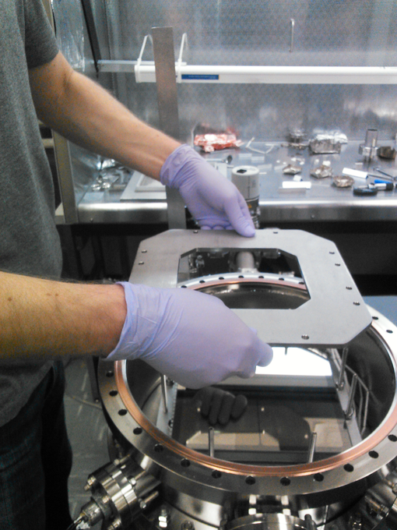
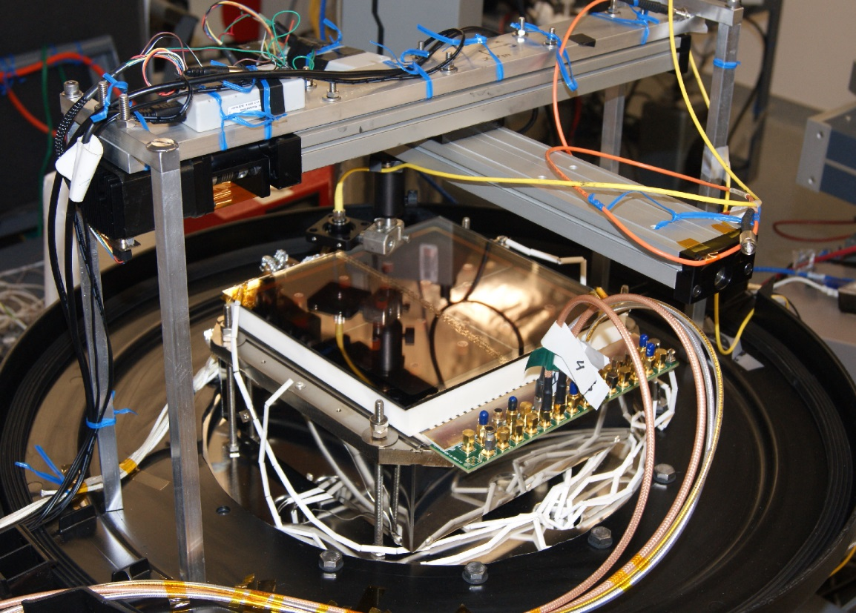
LAPPD assembly and testing at UChicago
See also: arXiv:1603.01843
A Brief Technical History of the Large-Area Picosecond
Photodetector (LAPPD) Collaboration

Slide 16
Multi-photon spectrometer (example)
A single-photon sensitive spectrometer, utilizing gratings and an array of 32 temporally- and spatially-resolved single-photon avalanche diodes (SPADs).

Slide 17
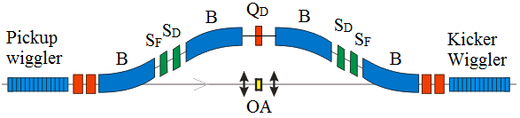
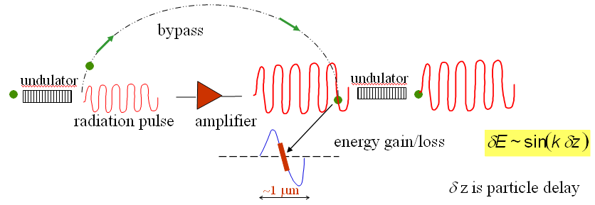
Optical Stochastic Cooling
Electron beam bypass delay ~2 mm
Photon wavelength ~ 1 um

Slide 18
OSC experiments
From the quantum perspective, the OSC process changes the photon emission/absorption rate (in the second undulator) as a function of electron energy. The estimated effect is about ~30% (measurable!).
Single electron OSC requires single photon detectors (challenging!) in the wavelength range of ~1 um.
We are now developing a list of possible experiments in this area as well.
Single-photon
detector
1-um photons

Slide 19
Summary
This talk is an “expression of interest”
We are developing the capability to store, manipulate and observe a single electron in the IOTA ring.
We have an emerging experimental program focused on a single electron in the IOTA and a number of experiments focused on the QED and a single-photon detectors.

