Slide 1
High-field, high-repetition
rate Dielectric Wakefield
Acceleration Experiments
Brendan O’Shea, Gerard Andonian, Sam Barber, Christine Clarke, Phuc Hoang
Mark Hogan, Brian Naranjo, Oliver Williams, James Rosenzweig

Slide 2
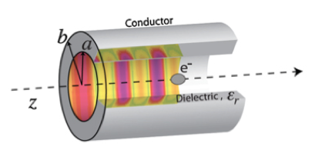
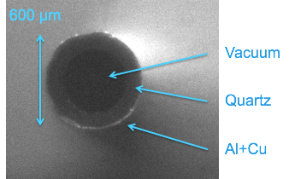
Dielectric Wakefield Acceleration
Cook et al., Phys. Rev. Lett. 103 095033 (2009)
Cerenkov Wakefield Accelerator
GV/m gradients measured at FACET
Source of THz
High Energy (100 + mJ)
Narrow bandwidth (<5%)
B. O’Shea, FAST/IOTA Workshop, May 10th 2017

Slide 3
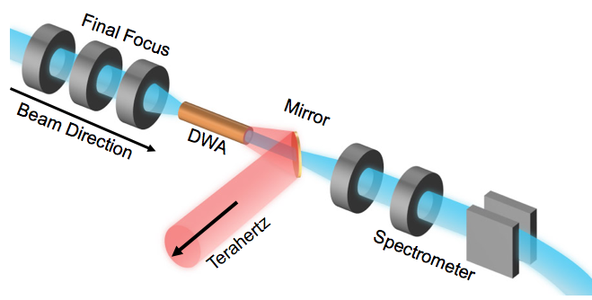
Experimental Setup @ FACET
O’Shea et al., Nat. Commun. 7 (2016)
Parameter | Value
Beam Energy | 20.35 GeV
Charge | 1.1-2.4 nC
Beam Size @ IP | 30x30 μm
β-function | 0.3x3.0 m
Bunch Length | 40 μm
B. O’Shea, FAST/IOTA Workshop, May 10th 2017

Slide 4
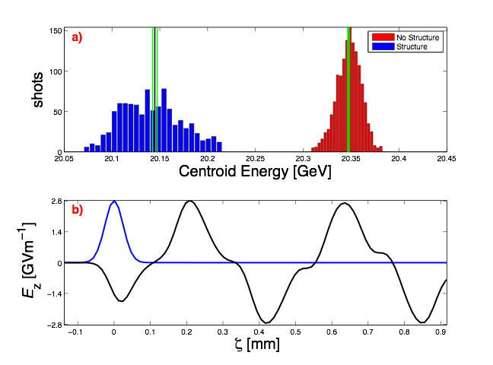
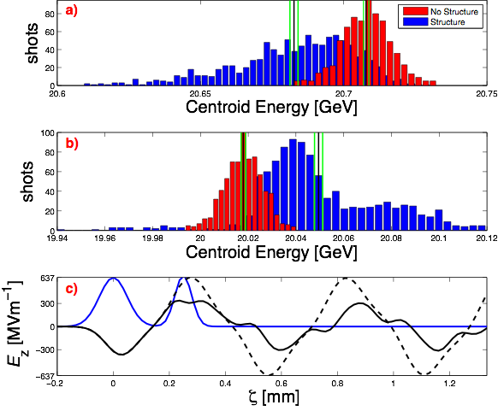
High Gradient Result
Two bunches
Witness bunch gradient of 320 MV/m
~80% efficiency
Single bunch
Energy change of 200 MeV, in 15 cm.
Measured average decelerating gradient of 1.35 GV/m
Deduced maximum accelerating gradient of 2.8 GV/m
B. O’Shea, FAST/IOTA Workshop, May 10th 2017

Slide 5
THz generation in DWA
Wakefield is phase locked to the velocity of the beam
The group velocity is a fraction of the speed of light, here 0.31c
At the moment the particle leaves the DWA there is a wakefield of length (1-𝛽g)LDWA
Blue is the electron beam
Red is the wakefield
Dashes line the wakefield region determined by the group velocity
B. O’Shea, FAST/IOTA Workshop, May 10th 2017

Slide 6
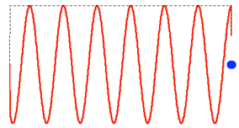
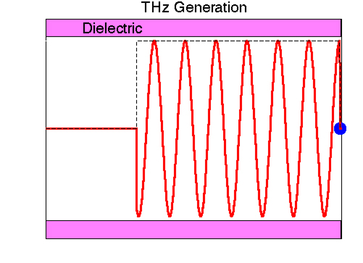
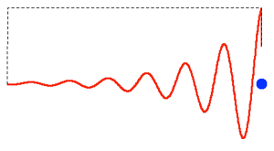
THz generation in DWA
No Losses
Losses
B. O’Shea, FAST/IOTA Workshop, May 10th 2017

Slide 7
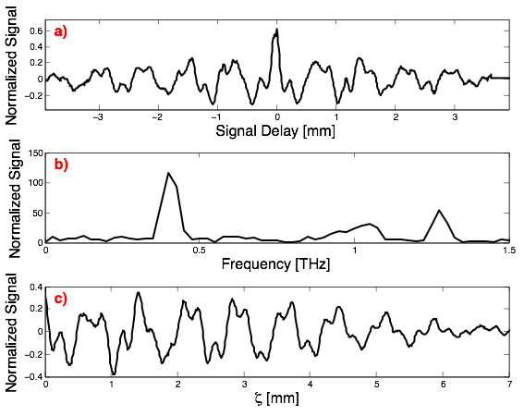
The High gradient CCR Information was interesting…
200 MeV shift -> 640 mJ of energy
Beam run at 10 Hz
Expected a wave train that was
30 cm
Was: ~1 cm
B. O’Shea, FAST/IOTA Workshop, May 10th 2017

Slide 8
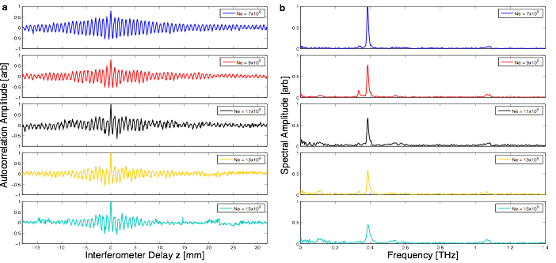
High-field induced conductivity in SiO2
Low Charge -> 500 MV/m
High Charge -> 1100 MV/m
B. O’Shea, FAST/IOTA Workshop, May 10th 2017

Slide 9
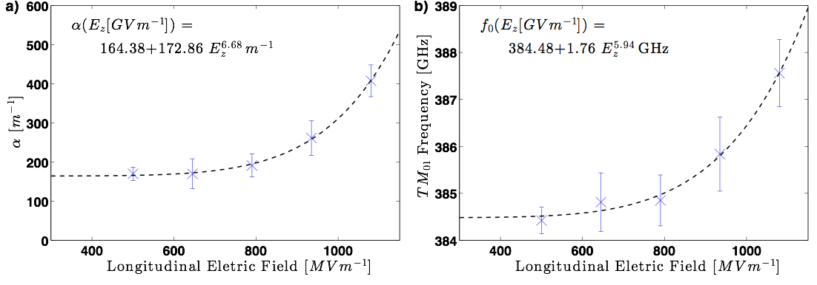
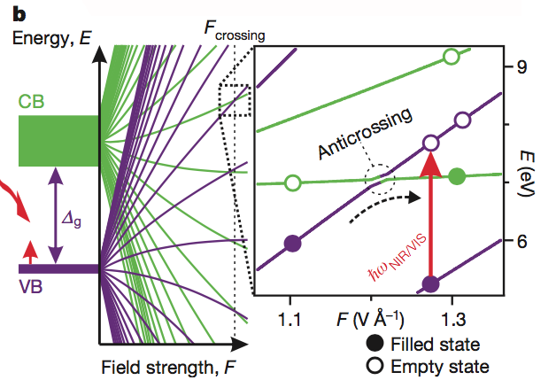
Induced Conductivity Quantification and Description
Schiffrin et al., Nature 70, 493 (2013)
Durach et al., PRL 105, 086803 (2010)
Strong fields induce band-gap collapse which frees electrons
Strong terahertz fields drive keV electron energies
Collisional ionization ensues, avalanche
Effect reverses on 100s picosecond time scale, no long term damage
Conductivity results in energy absorption - dielectric heating
Energy conservation suggests ~100 ºC increase
B. O’Shea, FAST/IOTA Workshop, May 10th 2017
Notes:
Others have calculated the band gap collapse in SIO2 at ~1 GV/m

Slide 10
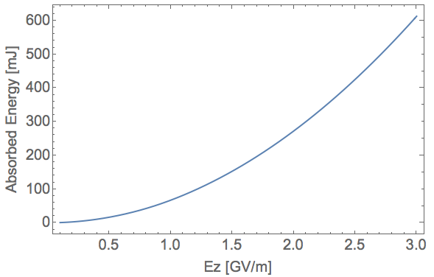
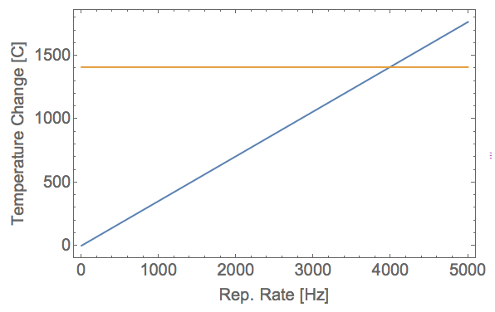
Dielectric Heating
SiO2 melting point: ~ 1710°C
FACET
2.8 GV/m, 10 Hz -> 6.4 W
ΔT = M/(Cp*𝜌*Volume) = 114 °C
FAST
500 MV/m, 1 MHz
ΔT = 352,000 °C
For SiO2 should not exceed ~4 kHz without cooling
SiO2 Melting Point - Room Temp
B. O’Shea, FAST/IOTA Workshop, May 10th 2017

Slide 11
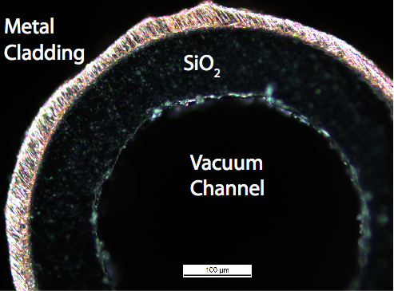
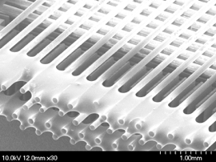
What can be studied at FAST
Should examine ~4 kHz limit of SiO2
Fabrication of tubes and slabs a known process
Material Science Opportunities
diamond - smaller band gap and 10% the heat capacity, very good thermal conductivity
aluminum oxide - large band gap, 10 times larger heat capacity
Exotic structures that have less field in the dielectric
Woodpile Structure
B. O’Shea, FAST/IOTA Workshop, May 10th 2017
Notes:
We know the dielectric returns to normal on the scale of milliseconds, but 1 MHz has a spacing of 1 microsecond!
Aluminum oxide appears to have a POWER loss alpha of 10 1/m, so already better than SiO2.

Slide 12
OLD SLIDES
B. O’Shea, FAST/IOTA Workshop, May 10th 2017

