Slide 1
Booster Beam Simulations
Yuri Alexahin*, Alex Macridin
Fermilab Workshop on Megawatt Rings
7-8 May 2018

Slide 2
Issues & Goals
stage | E_inj (MeV) | Np/batch (e12) | ΔQx/ΔQy
PIP-I | 400 | 4.5 | 0.25/0.31
PIP-I+ | 400 | 5.6 | 0.31/0.38
PIP-II | 800 | 6.5 | (0.36/0.44)*
*) would be with 400MeV injection
Losses at nominal (PIP-I) intensity are ~8%, will increase at high intensity operation (especially with 20Hz reprate)
Simulations goals:
• understand experimental observations
• offer ways of improvement
Tools used:
• Synergia (A. Macridin, E. Stern)
• MADX-SC (Y.A., A. Valishev with a lot of help from F. Schmidt)

Slide 3
HEP Optics Measurements
Measurements performed by K-modulation definitely confirm HEP Optics model (MADX)

Slide 4
Optics Perturbation
The source of the optics perturbation is well-known: the extraction dogleg created by DC magnets – the strongest effect @ injection.
A number of solutions considered:
• modify the extraction dogleg using pulsed magnets (expensive)
• half-integer resonance correction using quadrupole harmonic circuits
• “flat” optics (Tan)

Slide 5
Optics Functions w/o SC
Fourier Sectra of β -functions
|F(β)|
“HEP Optics”
Red: hor
Blue: ver
dogleg
n
|F(β)|
“Pseudo-Flat Optics 1”
dogleg
n
“Pseudo-Flat Optics 2”
|F(β)|
dogleg
n

Slide 6
Tracking Simulations
Beam parameters (A. Macridin):
ε_{⊥N}^{(r.m.s.)}=2.34μm (ε_{⊥N}^{(95%)}=14π mm⋅mrad)
σ_{z}= 0.831532m, σ_{p}/p= 0.00185,
Longitudinal profile is not Gaussian, corrections were made that reduced space charge tuneshifts to 0.28, 0.38 for Np=7.e10/bunch
Synergia simulations w/o dogleg bump
⇒ still losses due to longitudinal shift in SXL03 position by 4.75m
⇒ excitation of Qx+2Qy=20
⇒ can be compensated by tuning other sextupoles
I [A]
used for correction of Qx+2Qy in sims
real currents (not used in sims)
SXL #

Slide 7
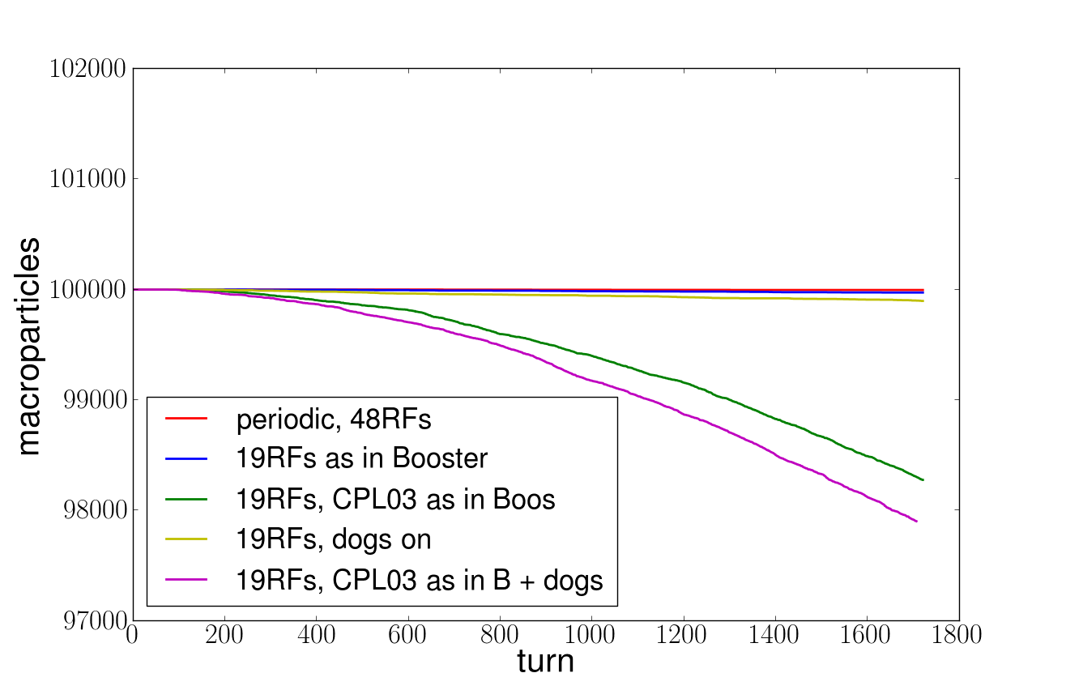
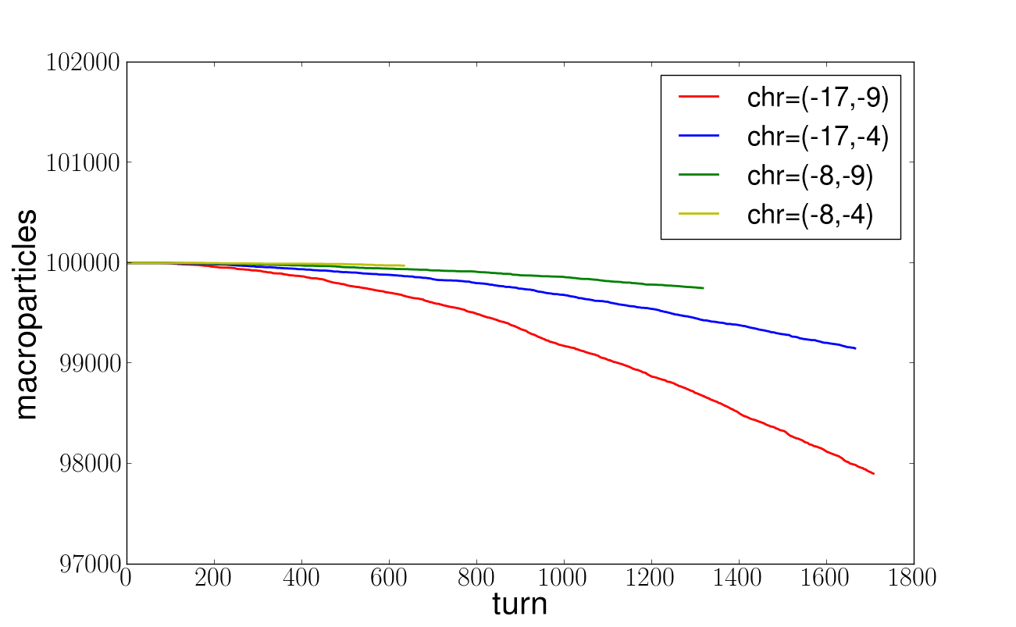
Synergia Simulations
Q_{x}=0.734,
Q_{y}=0.824
n=7e10 pp bunch
Chr=(-17,-9)
CPL03 and dogs as in Booster
Position of the CPLO3 corrector package is the main culprit for beam loss
horizontal chromaticity has a large influence on loss

Slide 8
MADX-SC Simulations for HEP Lattice
no Qx+2Qy correction
with Qx+2Qy correction
Loss %%
Qy
Qy
Qx
Qx
Losses over 2000 turns as function of bare lattice tunes at nominal Np.
Little improvement at Qx=6.7, Qy=6.8: 4.3% → 3.8%

Slide 9
MADX-SC Simulations for Flat Lattice 2
Np=5.6e10/bunch
Np= 8.1e10/bunch
Loss %%
Qy
Qy
Qx
Qx
Losses over 2000 turns as function of bare lattice tunes at nominal and PIP-II intensities. Qx+2Qy corrected.
At Qx=6.7, Qy=6.8 losses are negligible: 0% → 0.07%

Slide 10
(low intensity)
Pseudo-Flat Optics 2 looks like a victory, but there is no better working point than with HEP lattice at high intensity!

Slide 11
Effect of Image Charges*
*) the interest renewed by S. Machida at 2nd SC collaboration meeting (CERN, March 2018)

Slide 12
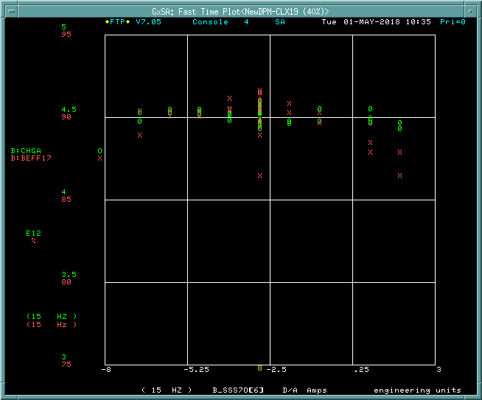
Skew Sextupole Studies
Bending magnets have small (half) apertures:
F-magnets h=2.1 cm, L=2.9 m x 48, ks2^{(image)}=0.001m⁻³ for y=1mm, Np=7.e10 ⇒ can drive 2Qx+Qy
D-magnets h=2.9 cm ⇒ can drive 3Qy
The image charges were simulated as skew sextupoles components in F- and D-magnets ~ y ~ β_{y}^{1/2}cos(n⋅s/R) with n=20
Losses [%%]
y_{max}[mm]
MADX-SC simulations show that vertical offset should be ~0.3σ_{y} to produce a noticeable effect in 2000 turns – too large?
Booster measurements show little effect (if any) of SSS located close to F-magnets (K. Seiya)

Slide 13
Summary
• From the standpoint of transverse dynamics with space charge there should be no problem with PIP-II intensity at the present injection energy when using “flat” optics.
• However, we could not reduce losses with these apparently better optics
We tried:
• injection orbit and optics matching
• aperture scans
• decoupling (though Qx+Qy has not been looked at since 2011)
• correction of the 3rd order using upright and skew sextupoles
• reduced chromaticity
• to see head-tail instability
• to detect dipole noise using TBT data
(quad noise seems unlikely)
- all to no or very limited success.
Had we missed anything important?
TBT spectra
V
H
1 – Q⊥

Slide 14
Outlook
• Can RF phase errors that C.-Y. Tan and Chandra Bhat are looking at now be the reason for increased losses with improved optics?
Even if so, the explanation must be found – studies necessary.
• Simulations studies ongoing or planned:
- longitudinal dynamics with wakes and SC
- Effects of RF and quadrupole noise
- 6D dynamics during RF capture with 3DoF SC
- coherent (envelope) oscillations with MADX-SC
- …

