Slide 1
Beam Optics:
Optimization and Tuning for Optical Stochastic Cooling in the IOTA Ring
Aleksandr Romanov
IOTA/FAST collaboration meeting
9 May 2018

Slide 2
Overview
Introduction and common description of OSC
Design objectives
Linear lattice design
Chromaticity correction and dynamic aperture
Magnets design

Slide 3
Introduction
IOTA will be a unique machine dedicated to accelerator physics research, capable of working with electrons and protons. Its research status and inherent flexibility makes it optimal for many experiments including Optical Stochastic Cooling proof of principle experiment with electrons:
  Optimal energy range
  Long straight section
  Perfect vacuum conditions
  Individual elements controls
  Comprehensive beam instrumentation
  Advanced lattice correction capabilities
  Reliable and flexible injection system

Slide 4
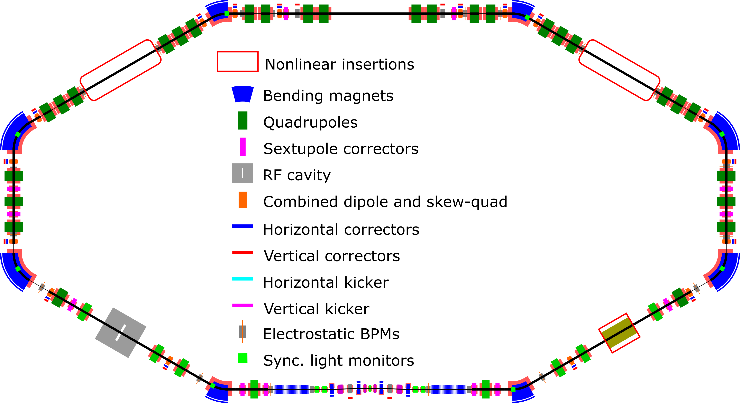
IOTA layout with OSC

Slide 5
Magnets of OSC insertion
Undulators |  | 2
Chicane dipoles |  | 4
Quads |  | 5
Sextupoles |  | 4
Trims | Hor. | 0(4)
 | Vert. | 4
Pickups |  | 4

Slide 6
Main parameters of IOTA with OSC
Momentum | 100 MeV
Circumference | 39.97 m
Vacuum | 1x10⁻¹⁰ torr
Number of particles | 10⁶ e, 5 µA
Chicane delay | 0.65 mm | 2.000 mm
Chicane offset | 20.09 mm | 35.12 mm
OSC light wavelength | 950 nm | 2200 nm
Optical instrumentation | Off the shelve | Challenging
Passive cooling | Yes | Yes
Active cooling | No (space) | Yes
RMS emittances at full coupling (ε_{x}=ε_{y}) | 0.5, nm | 1.43, nm
Betatron tunes (x,y) | (5.41, 2.41) | (5.41, 3.41)

Slide 7
Constraints for OSC lattice
Beam parameters in the middle of OSC insertion are defined:
Small central β_{x} and ε_{x} for high cooling range
Big dispersion in the middle for high cooling range and rate, and for bigger cooling rate mixing
Central quad is responsible for cooling rates ratio
Sextupoles compensate second order effects of path lengthening
Pickup to kicker transport matrix should match that for light
Rest of the ring should close the lattice:
Arc design should provide smallest possible emittances
Coupling resonance (ν_{x} - ν_{y} = N)
Reasonable beta-functions
Full explanation:
V. Lebedev, “OPTICAL STOCHASTIC COOLING” in Beam Dynamics Newsletter, No. 65

Slide 8
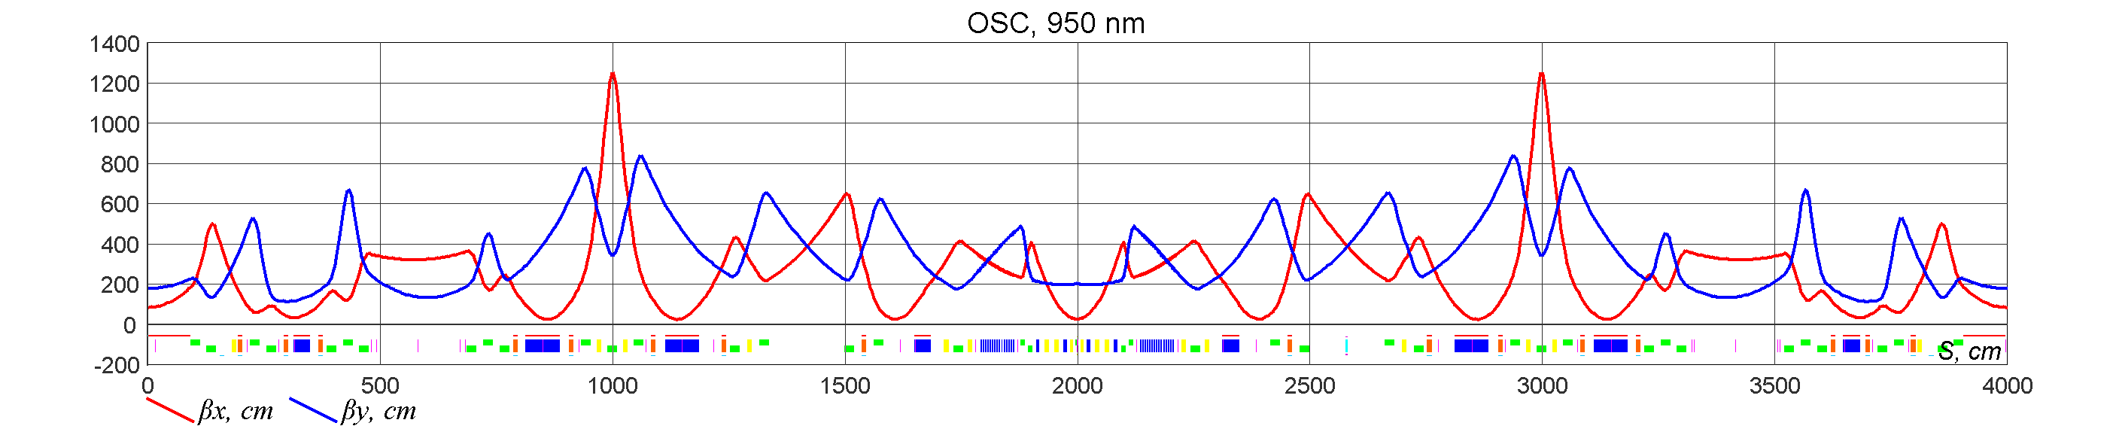
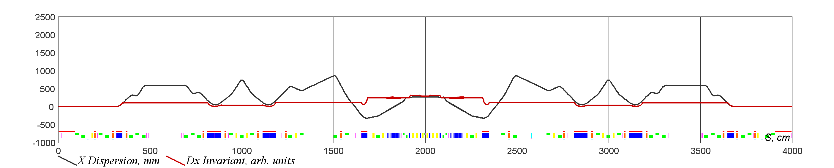
Linear lattice design for 950 nm
Betas start, x,y | 25, 200 cm
D_{x} start | 27 cm
Tunes, x,y | 5.42, 2.42
Mom. comp. | 0.0025
Emittances, x,y | 0.5 E-7 cm
Energy drop | 13.4 eV
Bunch length @30V | 7.6 cm
Energy spread | 1.00 E-4
Sync. Tune @30V | 2.05 E-5
Damp. times (x,y,s) | (2.0,2.0,0.985) s

Slide 9
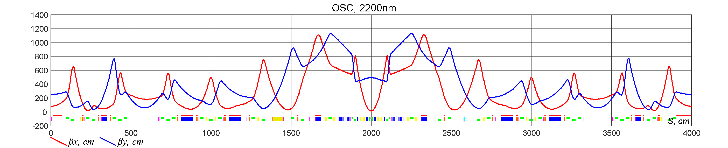
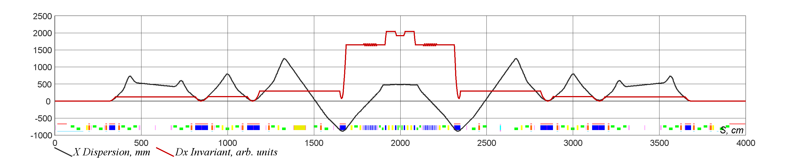
Linear lattice design for 2200 nm
Betas start, x, y | 12, 500 cm
D_{x} start | 48 cm
Tunes, x, y | 5.42, 3.42
Mom. comp. | -0.0165
Emittances, x, y | 1.44 E-7 cm
Energy drop | 13.25 eV
Bunch length @30V | 19.9 cm
Energy spread | 1.06 E-4
Sync. Tune @30V | 5.6 E-5
Damp. times (x, y, s) | (1.9, 1.9, 1.1) s

Slide 10
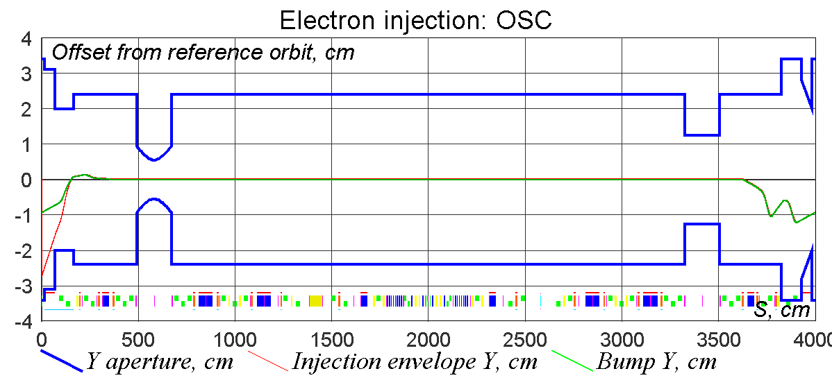
Injection
Clearance (Y): | 5.5 mm

Slide 11
Second order path lengthening
Two families of sextupoles are necessary to compensate second order path lengthening, to keep high amplitude electrons in phase with radiation when they receive cooling kick:
Necessary gradients produce strong nonlinearities and chromaticity that must be corrected
Regions with small betas are the main contributors to the integral
For the stability, path lengthening should satisfy:
|Δs*k|<2.4 rad

Slide 12
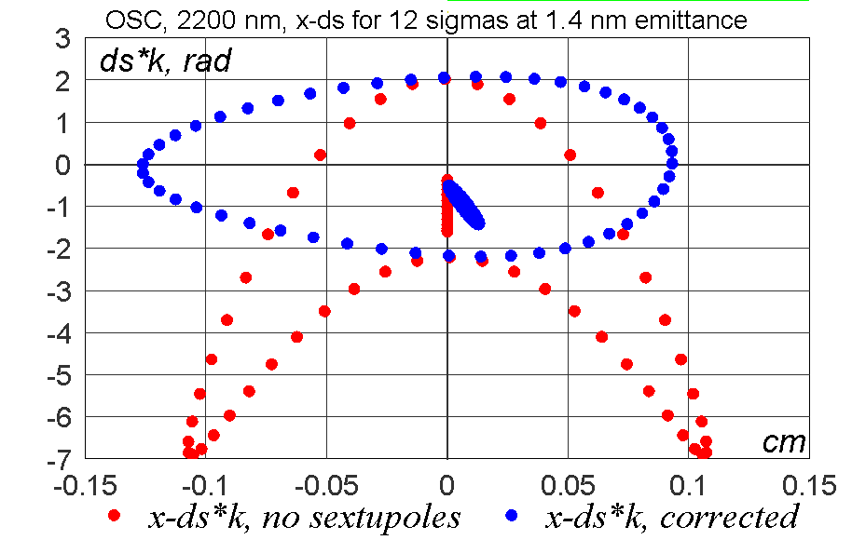
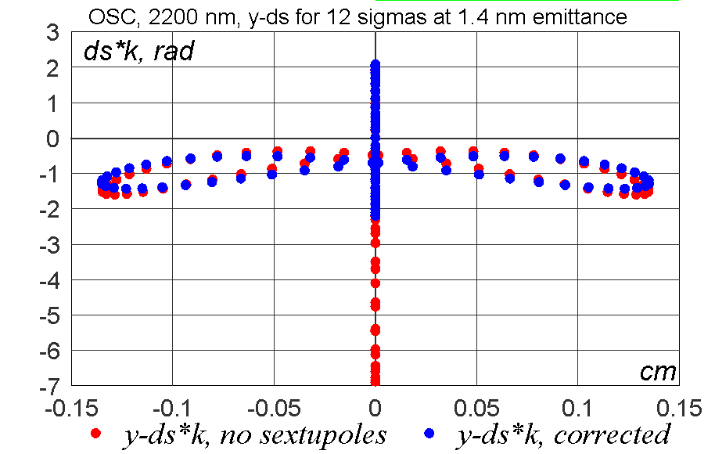
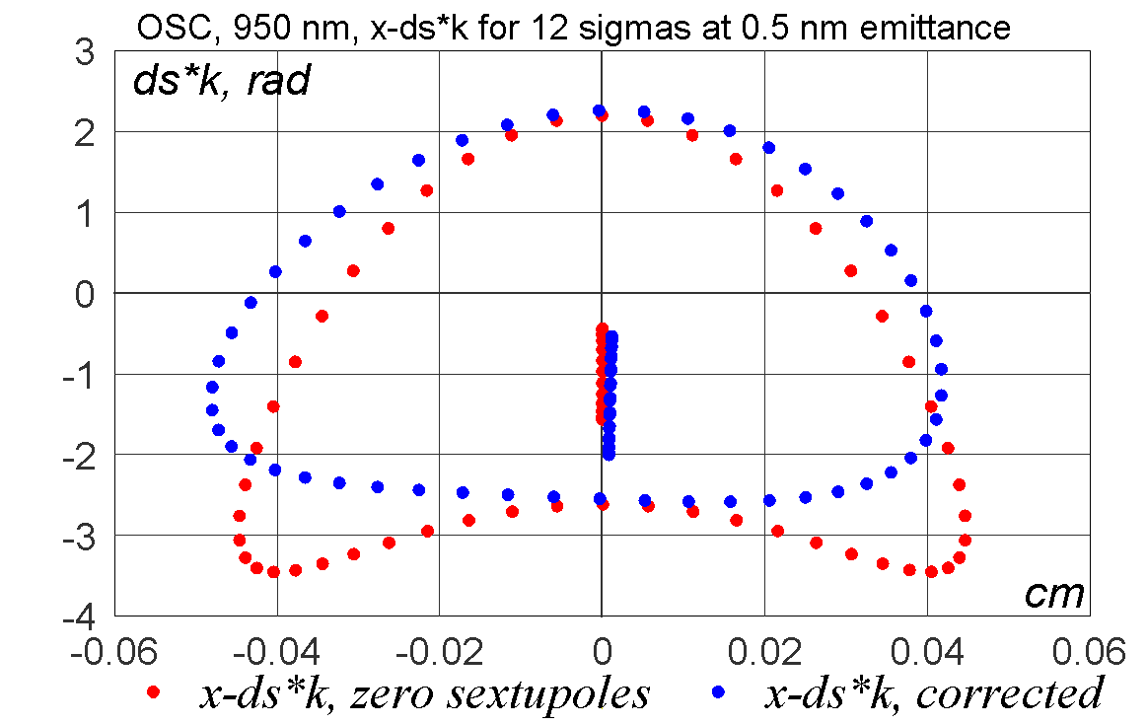
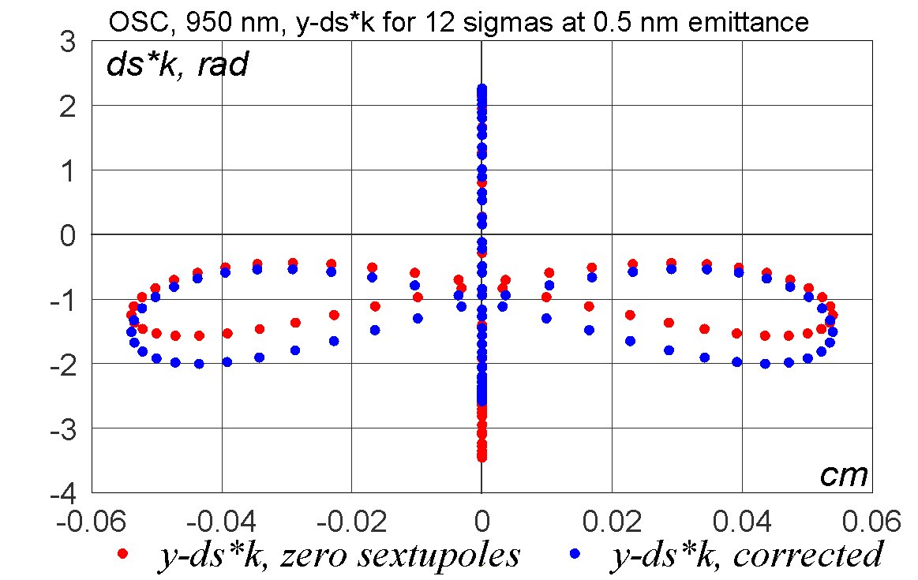
Second order path lengthening for 12 sigmas
Need of sextupoles for 950nm version is not so obvious

Slide 13
Dynamic aperture optimization
SODD module from MADX was used to minimize second order driving terms using all 6 families of IOTA’s sextupoles
Lifetrac software was used to estimate resulting dynamic aperture with Frequency Map Analysis

Slide 14
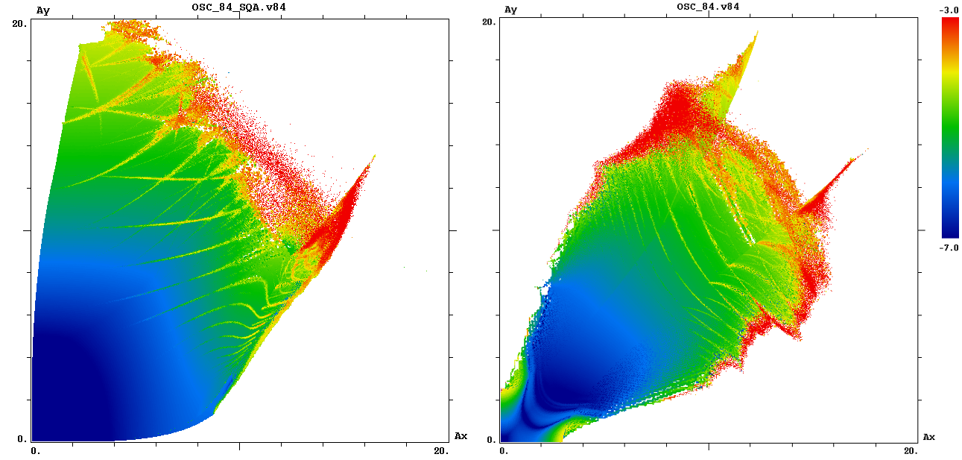
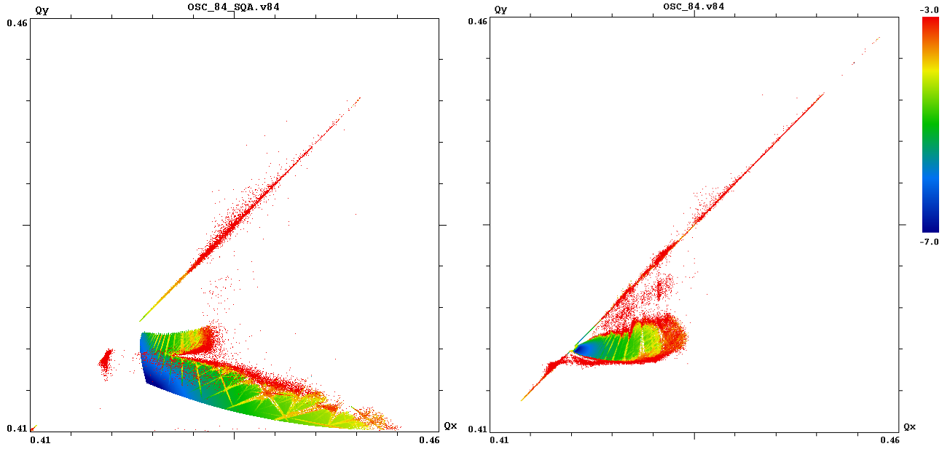
Dynamic aperture for zero chromaticity: 950 nm
Natural chromaticity
X: -9.4 Y: -6.0
Chromaticity after second order path lengthening compensation
X: 32.2 Y: -4.5
Lifetrac
FMA based on 1024 turns

Slide 15
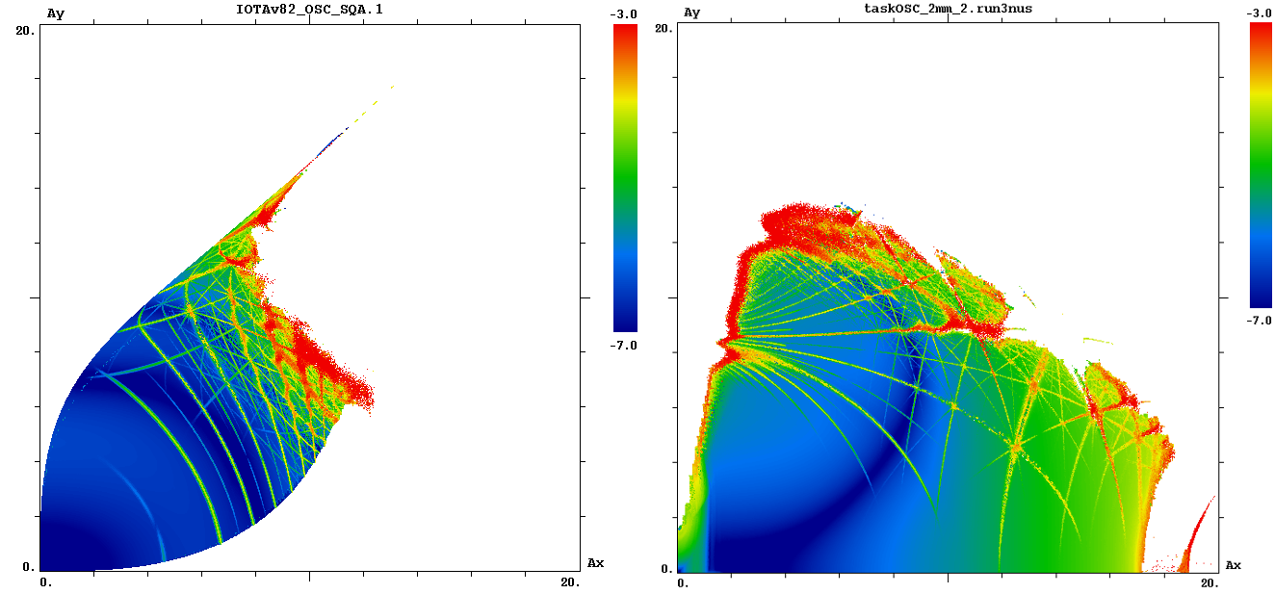
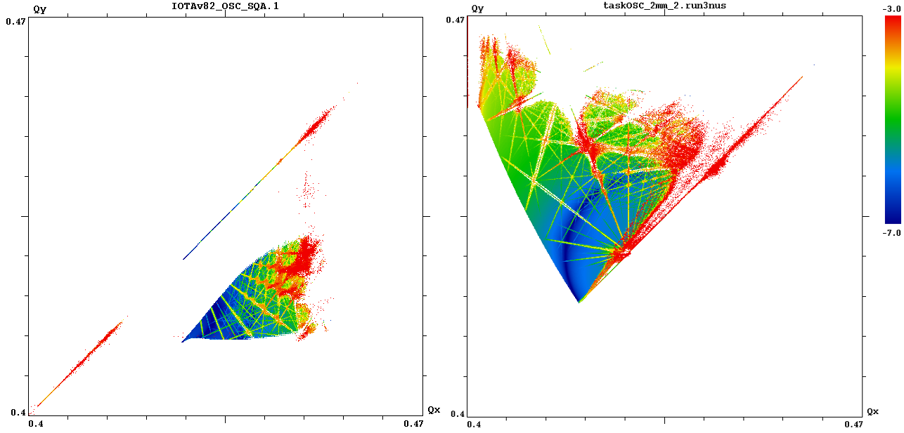
Dynamic aperture for zero chromaticity: 2200 nm
Natural chromaticity
X: -10.4 Y: -6.4
Chromaticity after second order path lengthening compensation
X: 95.9 Y: -77.6
Lifetrac
FMA based on 1024 turns

Slide 16
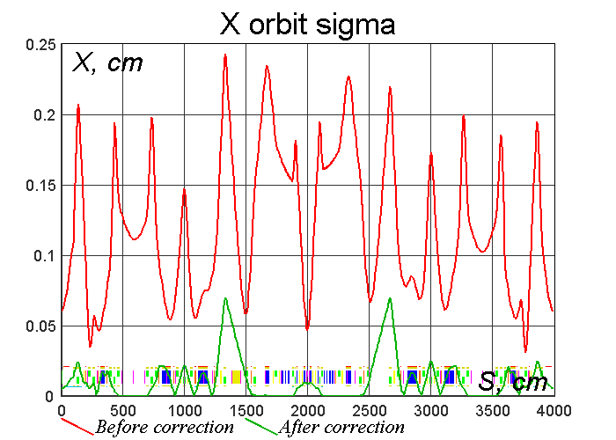
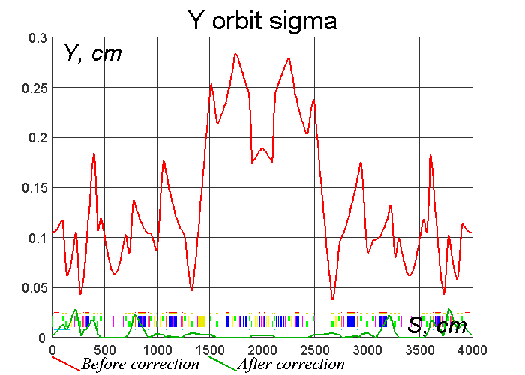
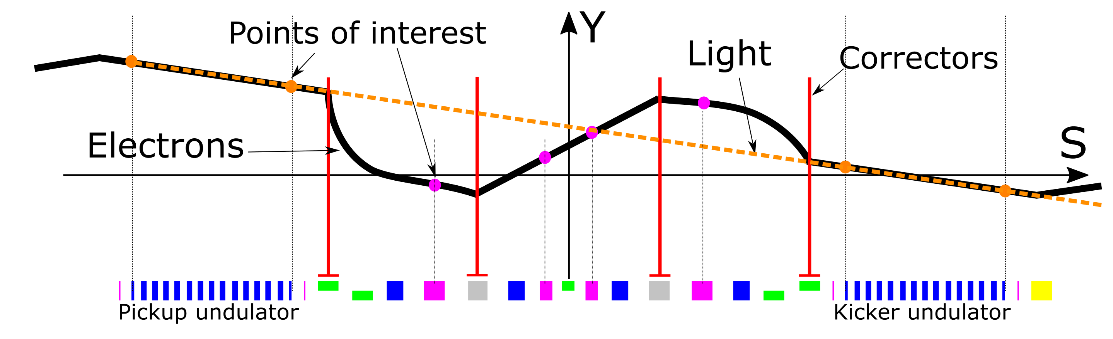
Trajectory correction analysis (2200nm)
Orbit should be corrected in sextupoles to within 50 um to avoid unwanted gradients and keep desired cooling mixing ratio
Matching of the light and electrons should be within
5% of the spot size or 25 um
Statistical orbit correction analysis: error seeding > correction > summary of corrected orbit
  Quads X and Y shifts: 0.1mm
  Bends X and Y shifts: 0.1mm
  Bends tilt errors 0.0006 mm/mm

Slide 17
Lattice correction
Extended LOCO method of beam based model dependent analysis will be used for lattice errors reconstruction and correction.
  Fit model so that it best describes measured experimental data using multiple iterations of SVD based inverse task solver.
Simulations shows that with BPMs precision of 1um and better lattice can be corrected to required levels.
Recent work demonstrated that it
should be possible to correct lattice
parameters to required precision
(THPOA24, NAPAC 2016)
Parameter | Max error
Betas at the insertion | 1%
Beta beating | 3%
Dispersion | 1 cm
Phase adv in T-ins | 0.001

Slide 18
Magnets design
Magnets must meet several requirements:
  Good integrated fields in aperture with R > 5mm
  Allow enough room for light optics (in vacuum)
    C-shape, asymmetrical, special cutouts or wide aperture
  Have low longitudinal stray fields to allow compact placement
    Magnetic screens
To meet all requirements careful 3D optimization for particular type of alloy is needed
Challenging magnets:
  Chicane dipoles
  Sextupoles
  Undulators (for 950nm option)

Slide 19
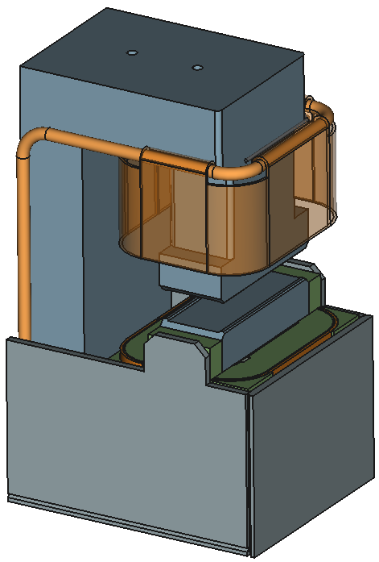
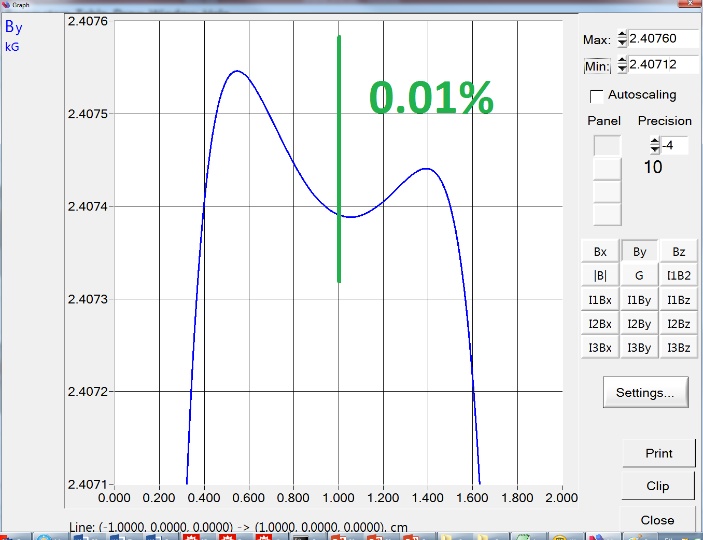
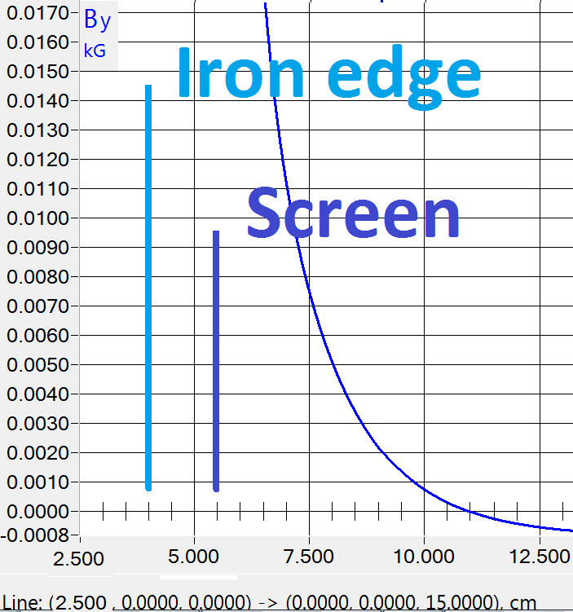
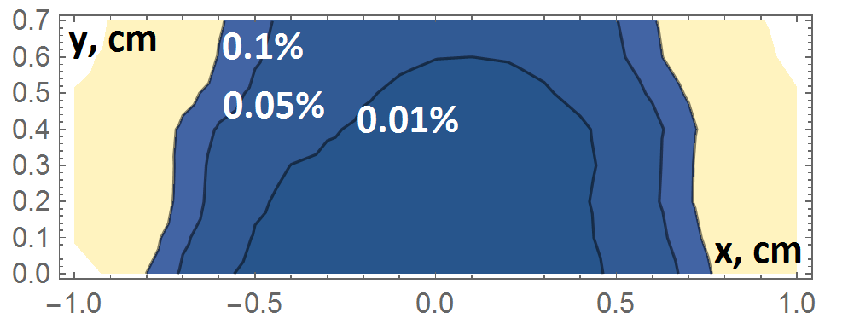
Chicane dipoles
Single piece core machined with EDM
  10 um tolerance
Integrated and local field quality is 0.01% within R=5mm
Midplane Hy
Longitudinal extent
Integrated field quality

Slide 20
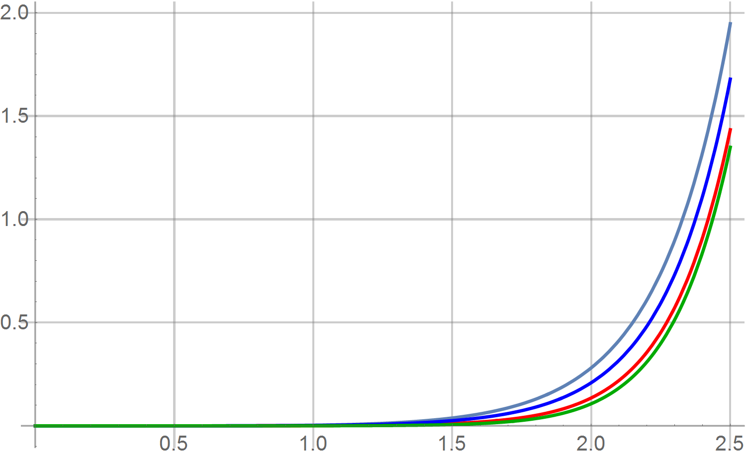
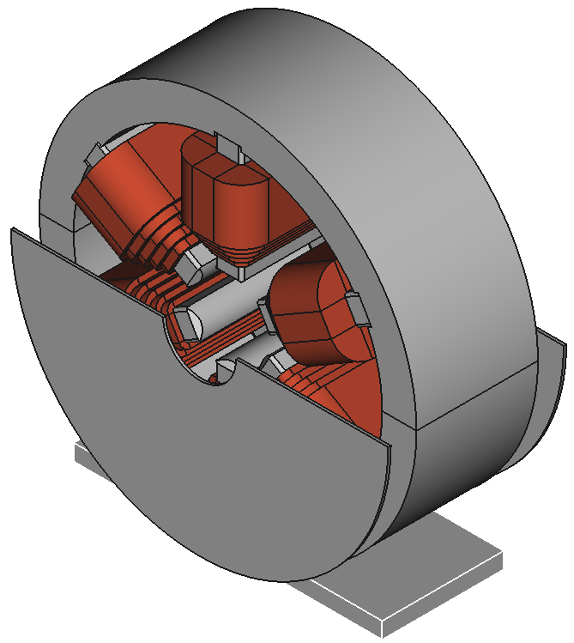
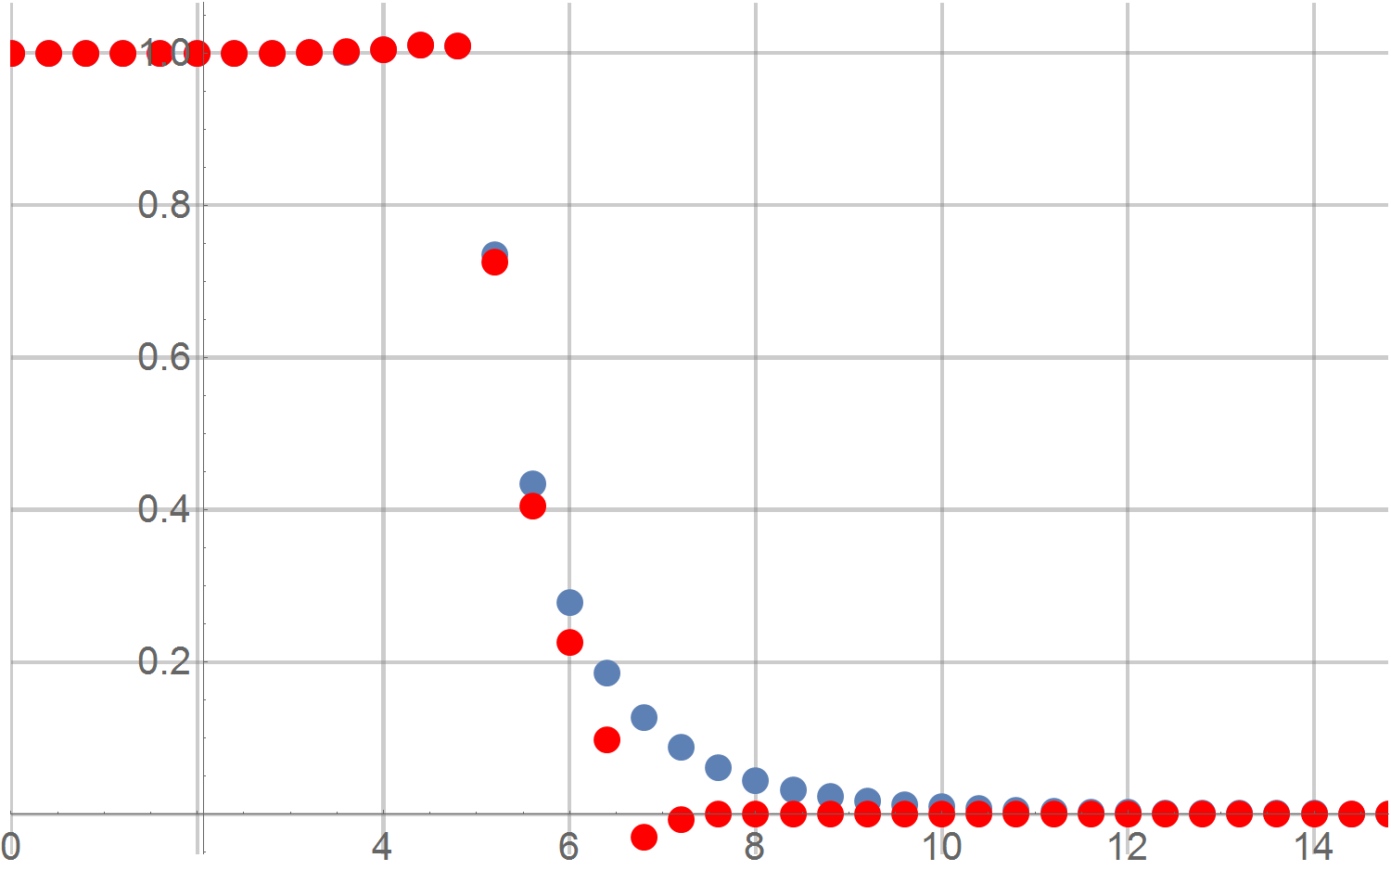
Sextupoles for 950 nm
Lower gradients allow to use shortened version of IOTA’s sextupoles
Max err, %
r, cm
Tan(a)=1
2D
Tan(a)=0.5
Rectangle
3-d harmonic
Shield
No shield

Slide 21
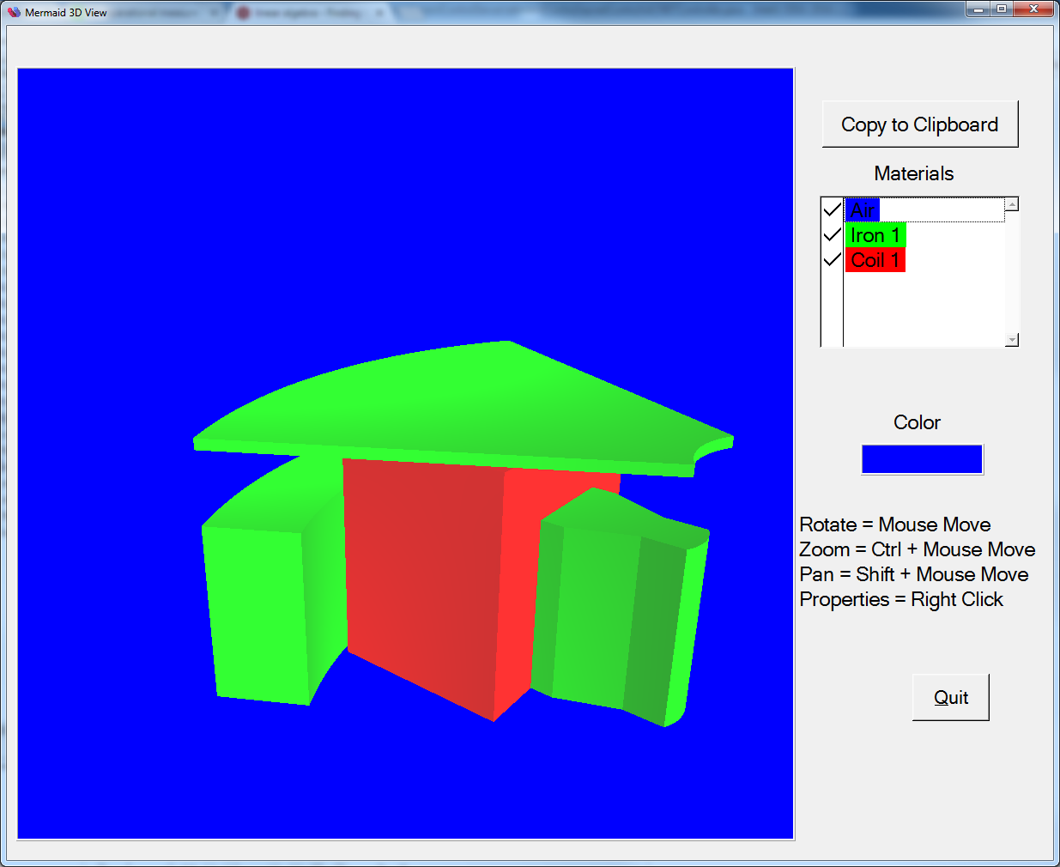
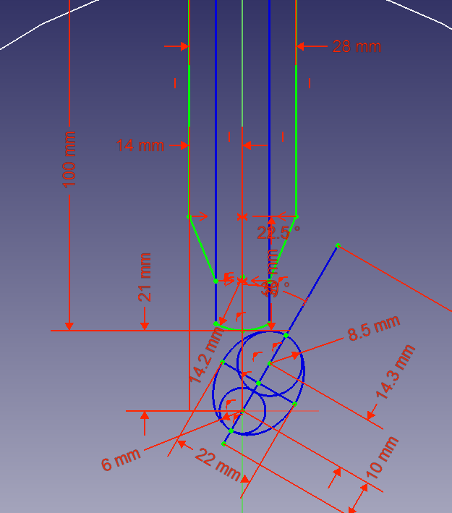
Outer sextupole for 2200 nm
Max error
%
R, cm

Slide 22
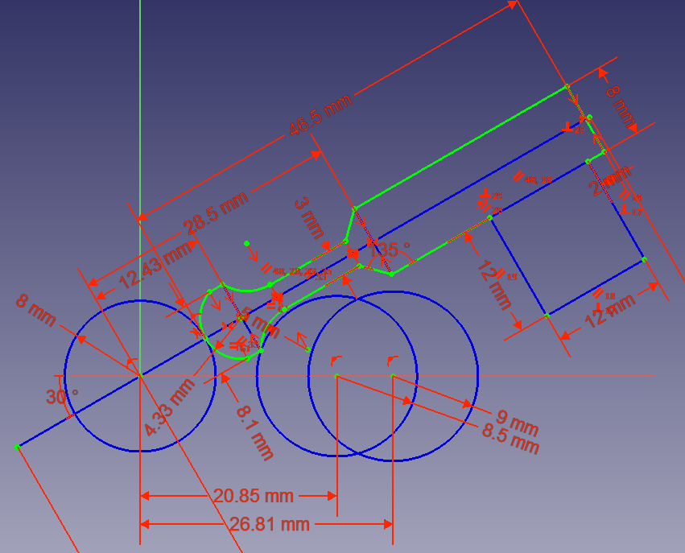
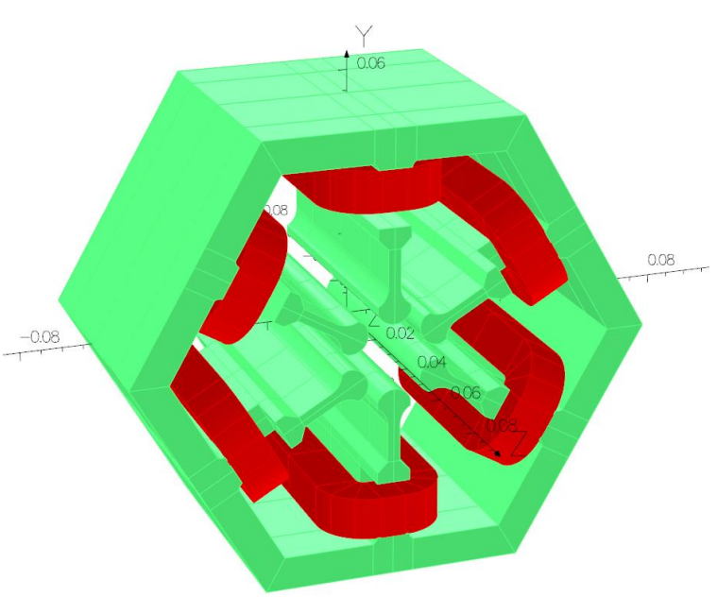
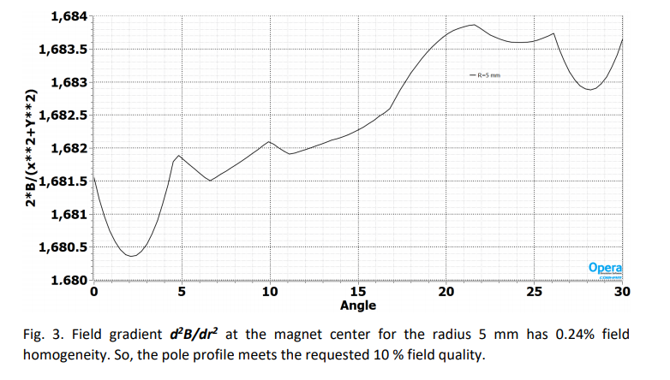
Inner sextupole for 2200 nm
3D modeling by Vladimir Kashikhin

Slide 23
Conclusion
IOTA ring meets all requirements of OSC experiment
Passive OSC experiment is well understood and ready for implementation
Ongoing work:
  Mechanical design
  Risk analysis and minor optimizations
  Documentation

