Slide 1
Simulations of the Electron Column in IOTA
Ben Freemire
Northern Illinois University
May 9, 2018

Slide 2
Electron Lens vs Column
Electron Lenses successful in compensating beam-beam effects & increasing beam lifetime
  Two operated at Tevatron with good effect
Relies on external source of electrons, injection & extraction systems
Simpler source of electrons is ionization of residual gas by beam
  Ions must be contended with
Electric & magnetic fields then used to shape plasma electrons

Slide 3
Space-Charge Force
Start with Lorentz force equation
Radial component of force
Net space-charge force is repulsive, proportional to charge density and relativistic parameter
The space-charge force of a proton beam can be compensated by accumulating electrons so that electron charge with respect to proton charge is
$\vec{F} = q \left(\vec{E} + c \vec{β} × \vec{B}\right)$
$F_{r} = q \left(E_{r} − β_{z}cB_{θ}\right) = qE_{r}\left(1 − β^{2}\right) ∝ \frac{n_{p}}{γ^{2}}$
$\left\langle η\right\rangle = \frac{1}{γ^{2}}$

Slide 4
Space-Charge Compensation with Electron Columns
Electron charge can be spread homogeneously around a ring, or more practically, in short sections
Fraction of ring circumference needed for complete compensation
For 8 GeV Main Injector, R ≈ 1.2%
For IOTA, R = 100%
  Only 1 out of 40 m occupied by Electron Column → electron charge would have to be 40x proton charge for full compensation
$R = η = \frac{1}{γ^{2}}$

Slide 5
Past Electron Column Experiment
1984, Institute of Nuclear Physics, Novosibirsk
1 MeV, 8 mA proton beam, >10⁻³ torr residual gas pressure
(Dimov & Chupriyanov, Part. Acc. 14, 1984)
Achieved ~10 increase in beam current vs. higher vacuum
Beam lifetime very short & electron distributions not well controlled

Slide 6
Electron Column at IOTA
Solenoid provides magnetic field
  Strong enough to prevent electrons from escaping transversely, suppress e-p instabilities
  Weak enough to allow ions to escape
Electrodes provide electric field to prevent electrons from escaping longitudinally
Plumbing and pumping to provide variable gas pressure in column region

Slide 7
Electron Column Generation
Electrons are created through ionization
Number of electrons (and ions) produced per beam particle dependent on ionization cross section, gas number density, & length of gas traversed
Secondary ionization by electrons possible as well
$p + H_{2} → p + e^{− } + H_{2}^{+ }$
$\tilde{N} = σ n_{g} l$
(Rudd, et al, Phys. Rev. A 1983)

Slide 8
Hydrogen Cluster Formation
Hydrogen ions quickly form clusters
Density of clusters comes into equilibrium with some constant, dependent on hydrogen density and temperature
Density of H₃⁺:
$H_{2}^{+ }+H_{2}→H_{3}^{+ }+H$
$H_{n}^{+ }+2H_{2}⇔H_{n+2}^{+ }+H_{2} n=3,5,7,...$
(Johnsen, Huang & Biondi, J. Chem. Phys 1974)
$\left[H_{3}^{+ }\right] = k \left[H_{2}^{+ }\right] \left[H_{2}\right]$
$k = forward reaction rate$

Slide 9
Recombination
Electrons recombine with hydrogen ions
Recombination rate well known for H₃⁺
Limits density growth of plasma
  Along with diffusion out of ends of Column
  Ionization & recombination competing effects
$e^{− } + H_{3}^{+ } + H_{2}→H_{3} + H_{2}$
$e^{− } + H_{3}^{+ }→3H$
$e^{− } + H_{3}^{+ }→H_{2} + H$
(Glosik, et al, Plasma Sources Sci. Tech. 2003)
Density distribution of H₃⁺ important
  Electrons trapped by B-field, ions migrate out radially

Slide 10
Simulations of the Electron Column
PIC code Warp used for simulations
Many effects to be included in an accurate simulation
  Gas ionization
  Forces on particles from
    Beam EM fields
    Plasma EM fields
    External EM fields
  Plasma oscillation
  Electron-Ion Recombination
  Plasma-gas scattering/collisions
Many correlated effects
  For example, gas density affects number of electrons produced, which affects strength of electrodes needed to ensure desired longitudinal distribution

Slide 11
Past Parameter Optimization
Studies performed beginning with basic model, working toward “complete” model
Strength of electric & magnetic fields studied
Reasonable transverse profile match for 5x10⁻⁴ torr, -5 V, 0.1 T
Park, et al, NAPAC’16, THA3CO04

Slide 12
Current Simulation Parameters
2.5 MeV protons
8 mA beam current, 8.85E10 protons
Gaussian distribution with σ = 4.47 mm
1.77 μs beam pulse length
1.83 μs revolution period
100 cm column length
45.8 ns column traversal time
5 cm diameter beampipe
Electrodes 10 cm long and 4.5 cm in diameter, -5 V bias
0.1 T solenoidal magnetic field
Grid spacing 0.05 cm in x and y, 1.0 cm in z (100 x 100 x 120 grid)
500 macroparticle protons injected every time step (7,000 protons per macroparticle, 7 electrons or ions per macroparticle)
  10 cm upstream of column

Slide 13
Plasma Parameters
Hydrogen gas density 1.65E13 cm⁻³ (5.0e-4 torr at 293 K)
Plasma processes included
  Single ionization of hydrogen by protons
Proton on hydrogen cross section 1.82E-17 cm²
Electron energy 45 eV, energy spread 19 eV (ion energy 0)
54 ns plasma period assuming homogeneous electron density
0.46 ns z grid travel time for protons
0.36 ns cyclotron period
0.07 ns time step
0.15 cm traveled by beam in 1 time step
25,286 time steps for full beam pulse
26,200 time steps (1.834 μs) simulated
$p + 2H_{2}→p + H_{3}^{+} + H + e^{−}$

Slide 14
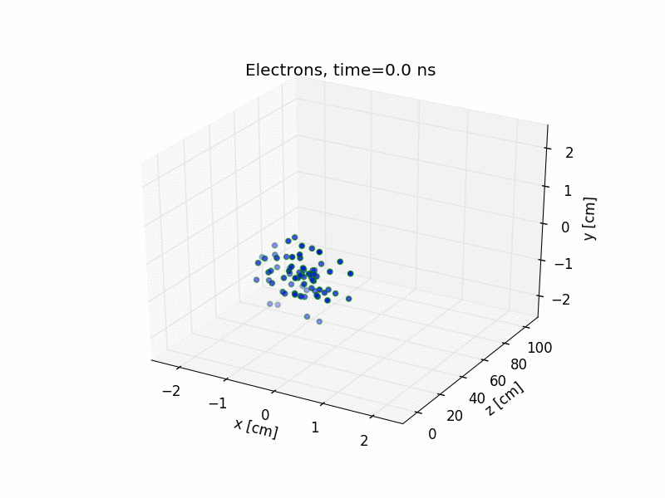

Plasma Animation

Slide 15
Number of Particles
Number of macroparticles produced – black curve
Number of macroparticles present – protons, electrons, ions

Slide 16
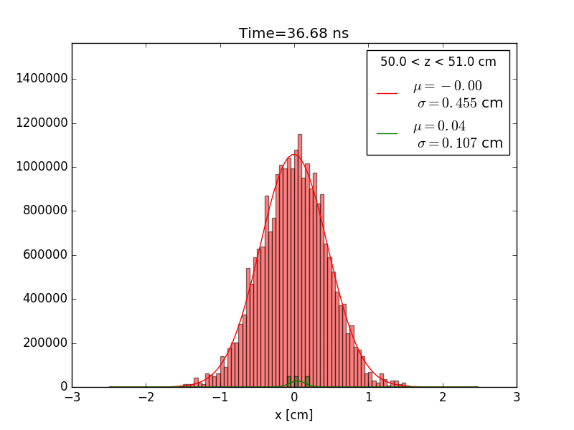
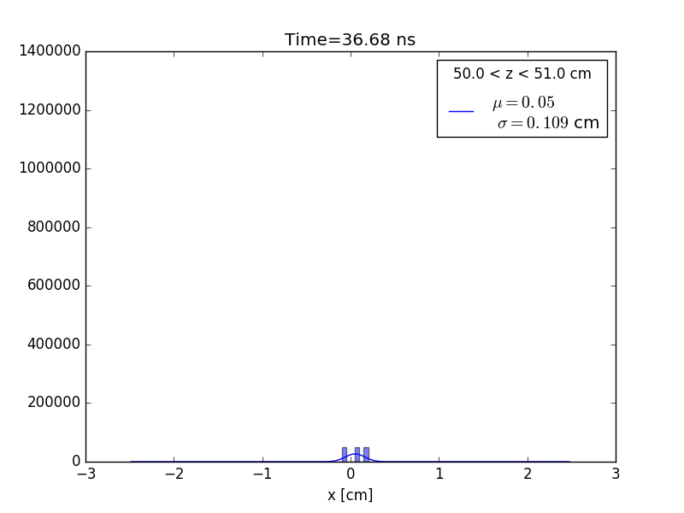
Transverse Profile Comparison
Center of the column (z = 50 cm)
Protons, electrons – left, ions – right

Slide 17
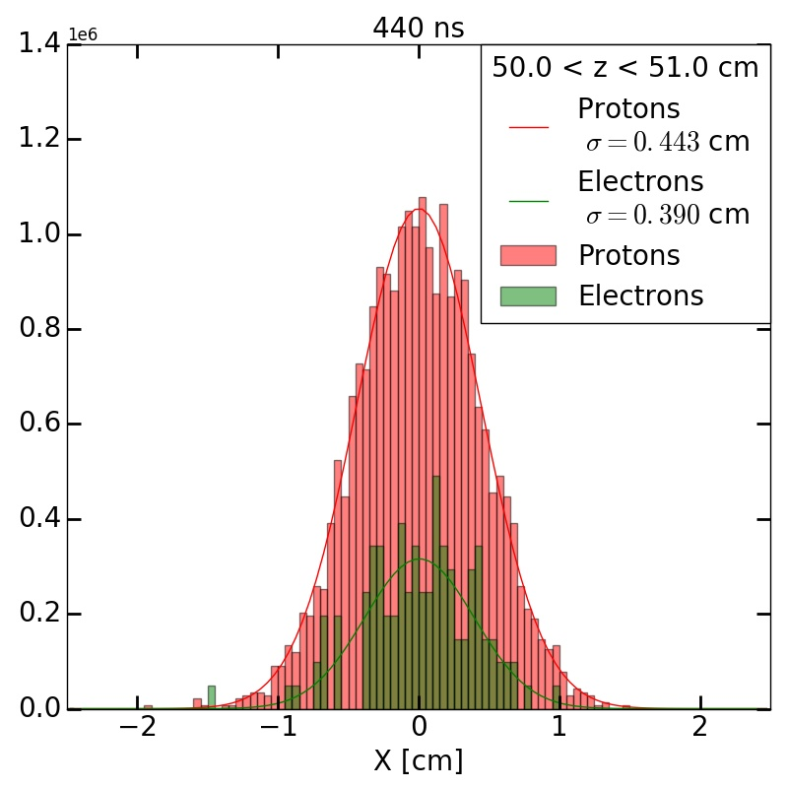
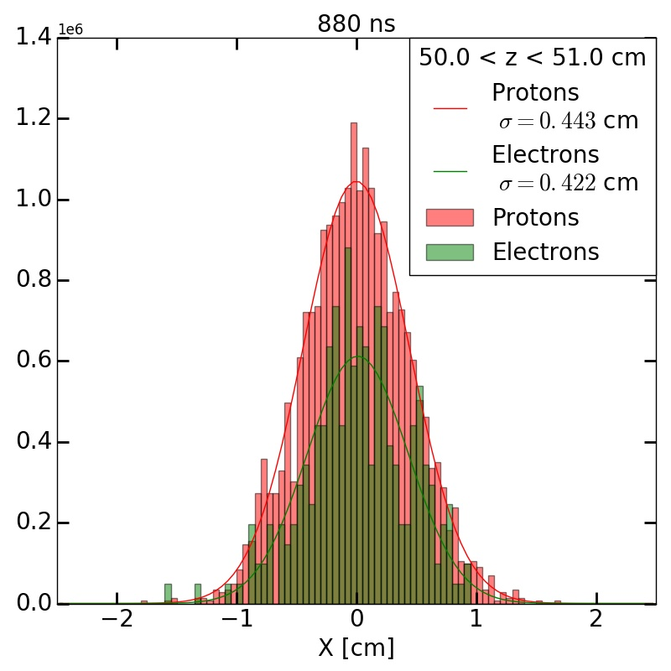
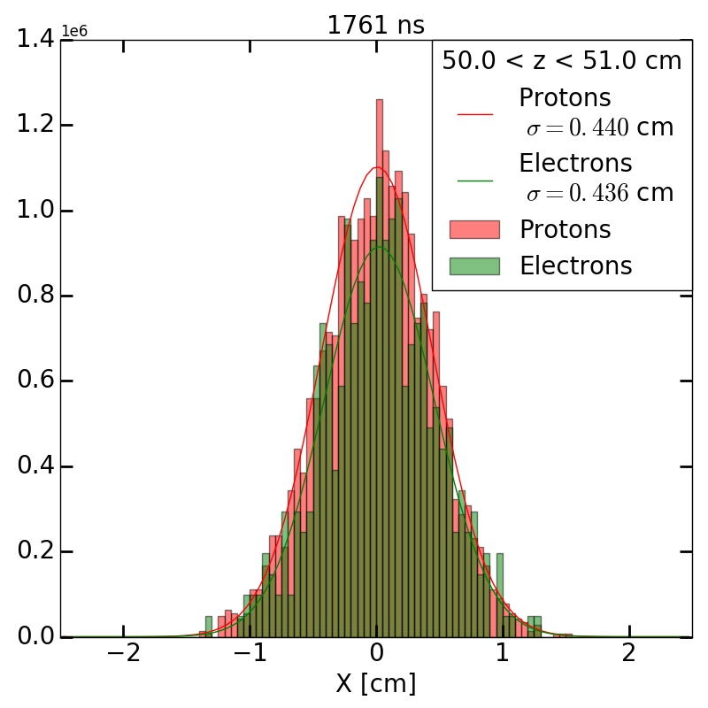
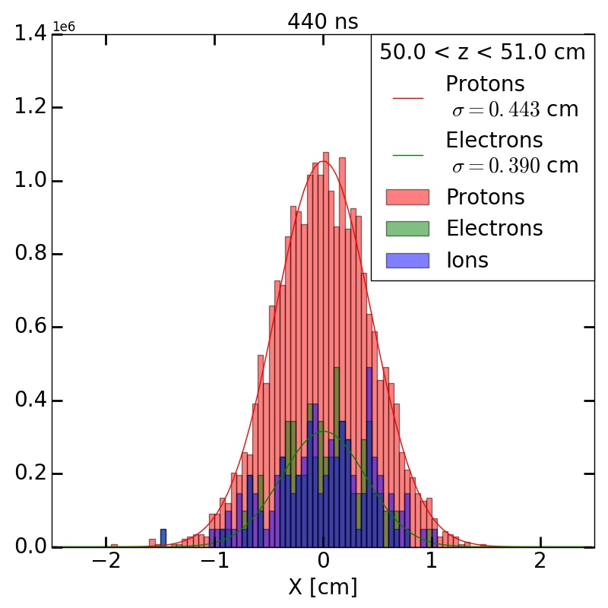
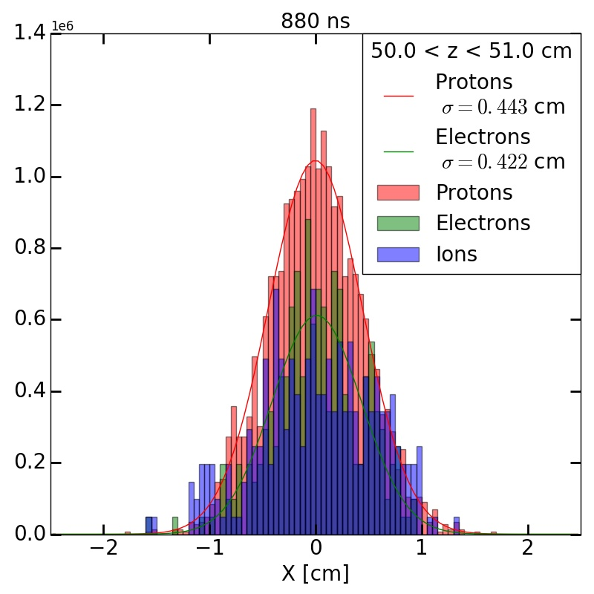
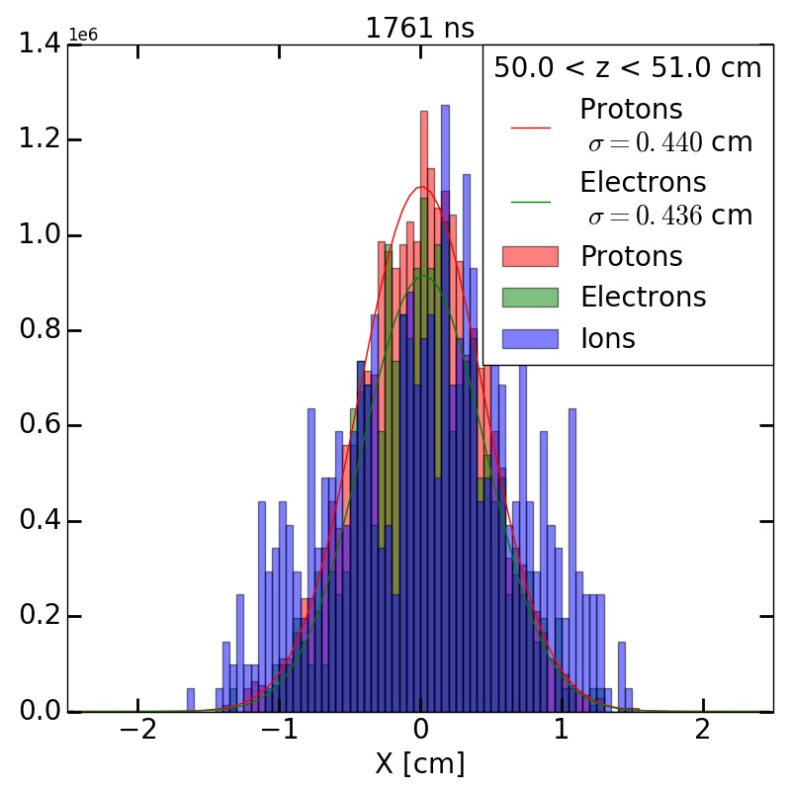
Transverse Profile Snapshots – Center

Slide 18
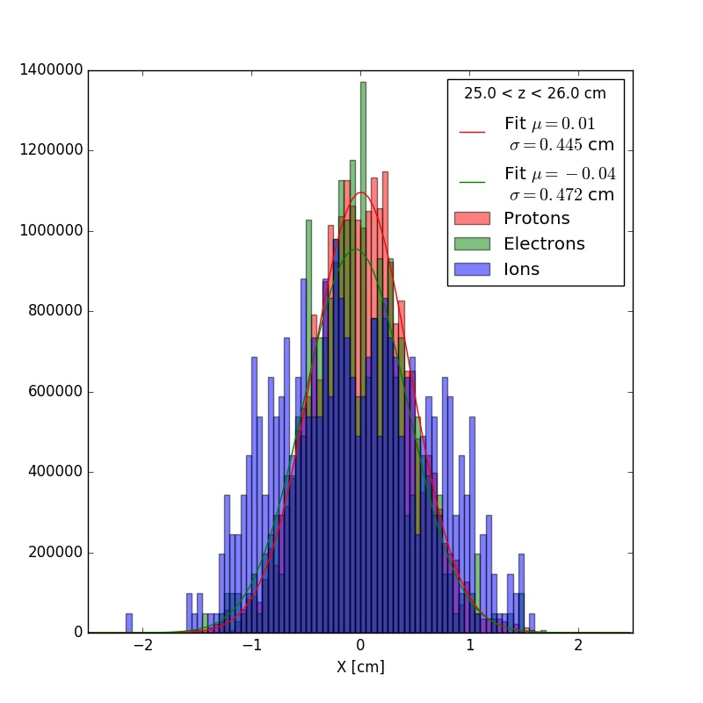
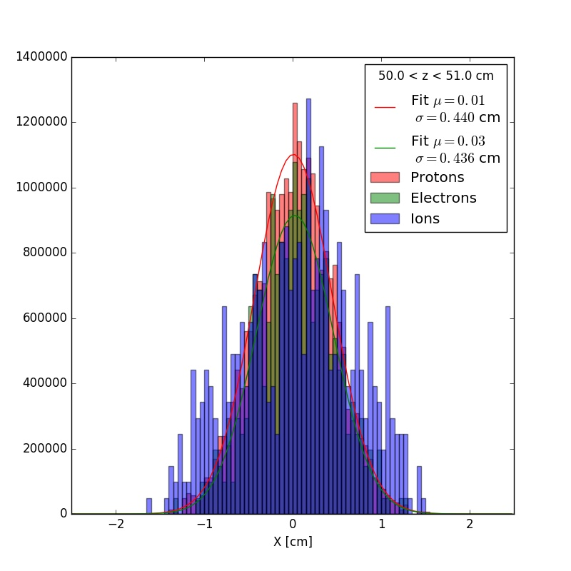
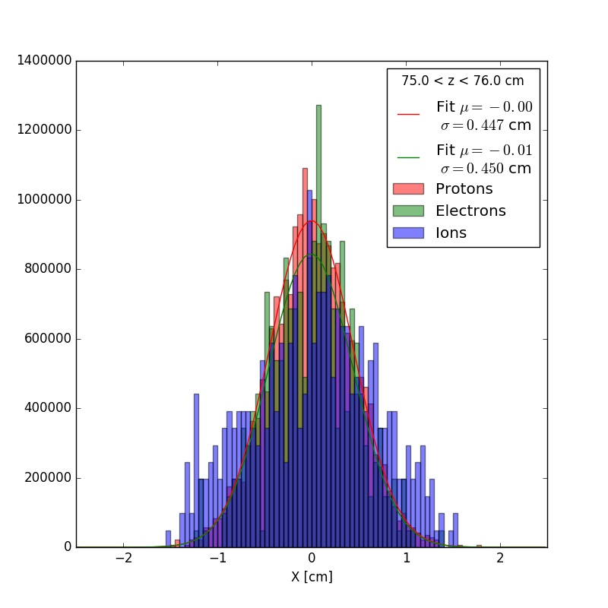
Transverse Profile Snapshots – 1.76 μs

Slide 19
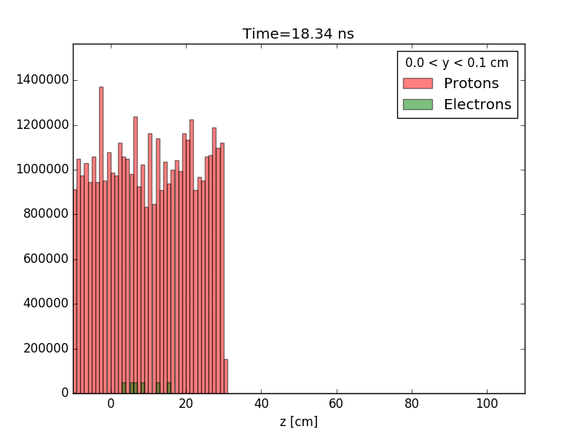
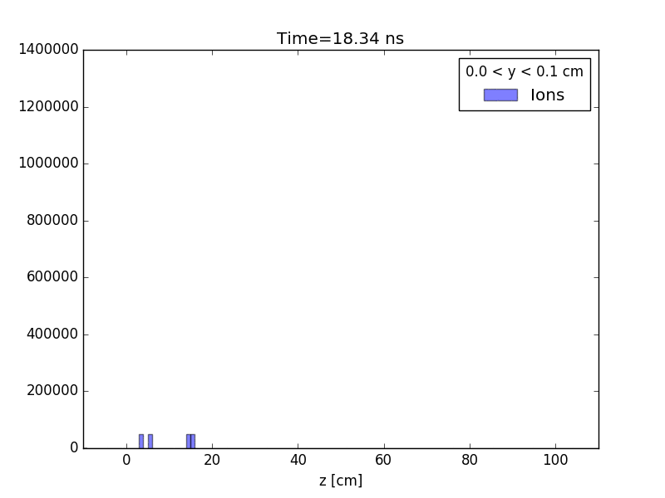
Longitudinal Profile Comparison
Center of the column (y = 0 cm)
Protons, electrons – left, ions – right

Slide 20
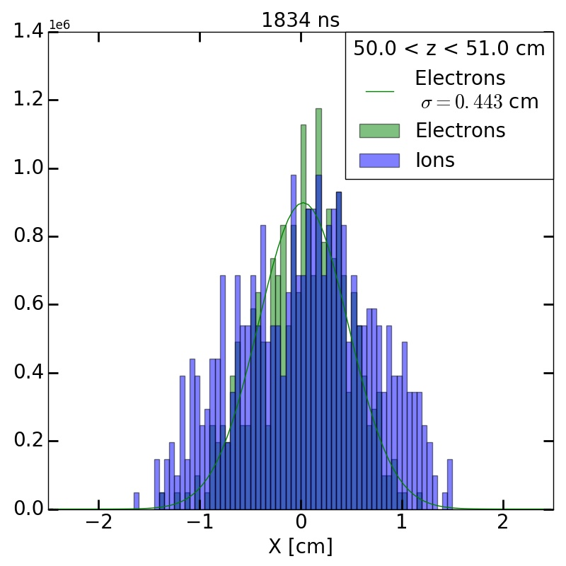
Distribution Before Next Beam Pulse
Electrons still well matched to beam
Ions diffuse radially slightly

Slide 21
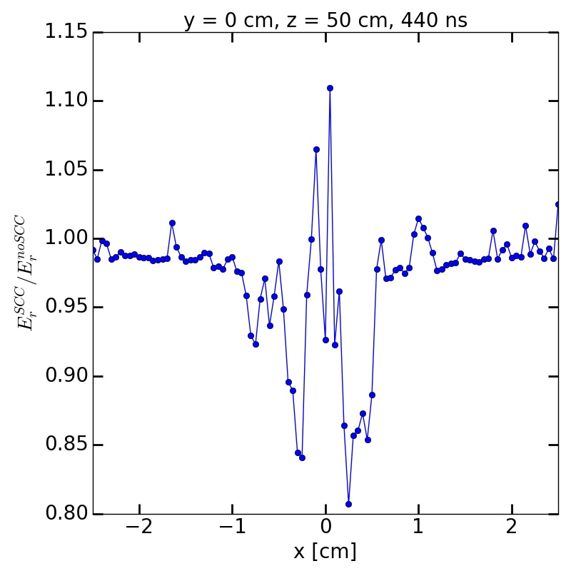
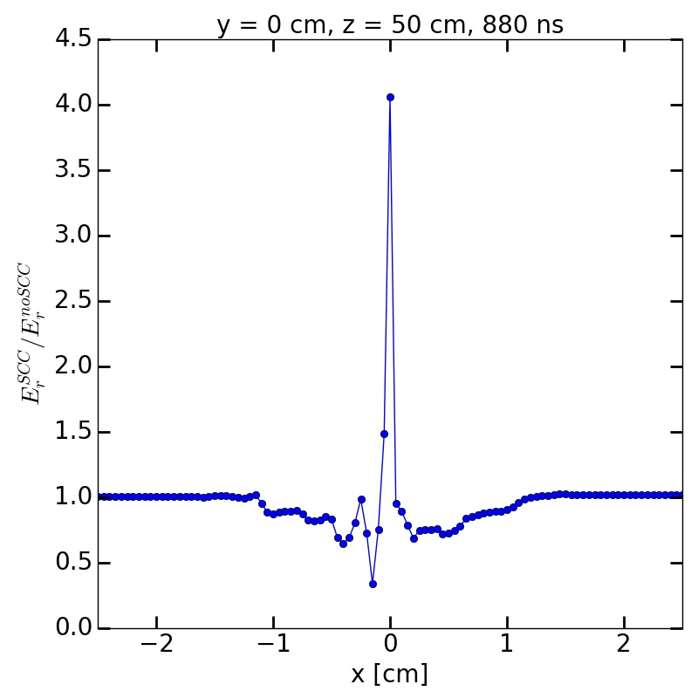
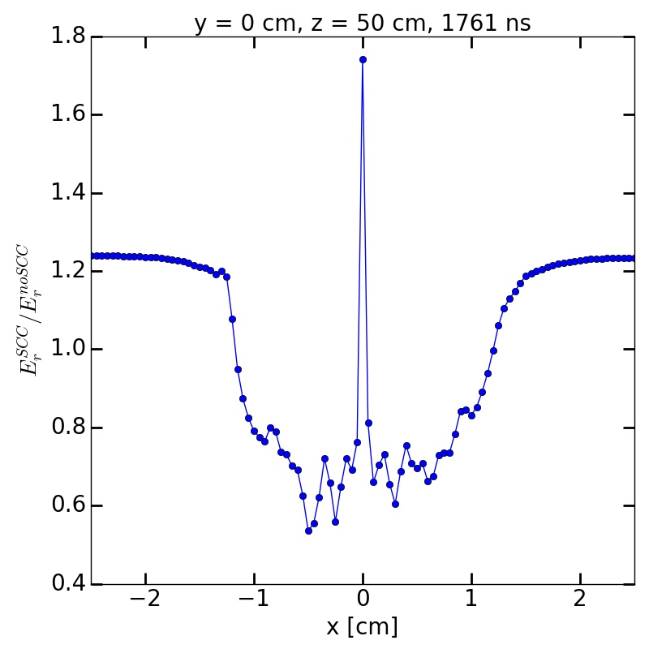
Space-Charge Compensation
Radial component of electric field at center of column (y = 0, z = 50 cm)
  With ionization (i.e. SCC) and without (i.e. no SCC)
Ratio of field with SCC to without SCC plotted
Average field over width of column shows reduction in space-charge force
  ~5% at end of beam pulse

Slide 22
Beam Lifetime
Low energy protons easy to kill
  Not a concern for higher energy machines, but major consideration for IOTA
Beam lifetime defined as time it takes to fall to 1/e of original population
Lifetime determined by Coulomb scattering, nuclear scattering, and intrabeam effects
  Coulomb scattering dominant loss mechanism
$N\left[t\right] = N_{0}e^{\frac{−t}{τ}}$
$\frac{1}{τ} = \frac{1}{τ_{CS}} + \frac{1}{τ_{NS}} + \frac{1}{τ_{IB}}$

Slide 23
IOTA Proton Beam Lifetime
Estimates for residual gas pressure ~1E-10 torr
  Partial pressures in table
  Baseline beam lifetime ~30 minutes
Effect of hydrogen gas pressure in 1 m electron column on beam lifetime
Lifetimes on the order of tenths to tens of seconds correspond to 10⁵ – 10⁷ turns
Sufficient for space-charge compensation studies
Gas | Pressure [10⁻¹¹ torr]
H₂ | 4.6
H₂O | 3.8
CO₂ | 1.8
CO | 0.7
CH₄ | 0.17
Ar | 0.023
Other | 0.21
Region of
interest

Slide 24
Summary / Future Work
Electron profile matches beam profile reasonably well after 1 pass
Radial electric field reduced by ~5% on average after only 1 pass
Simulate multiple passes
  Save beam & plasma distributions after one pass, reload beam at beginning of Column for second pass
  Incorporate rest of IOTA lattice
Tweak knobs for gas density, electrode strength

Slide 25
Backup Slides

Slide 26
Lifetime Contributions
Lifetime from Coulomb scattering:
Lifetime from intrabeam scattering (Touschek effect):
$\frac{1}{τ_{ES}} = \frac{\left\langle β\right\rangle }{π β c k_{B} T ϵ_{A}}{\left(\frac{q}{2 ϵ_{0} γ m β c}\right)}^{2}\sum{P_{i}} Q_{i}^{2}$
$\begin{aligned}γ, β = relativisticfactors \\ c = speedoflight \\ k_{B} = Boltzmann'sconstant\end{aligned}$
$\begin{aligned}m = protonmass \\ T = gastemperature \\ ϵ_{0} = vacuumpermittivity\end{aligned}$
$\begin{aligned}\left\langle β\right\rangle = averagebetafunction \\ ϵ_{A} = ringacceptance\end{aligned}$
$\begin{aligned}q = electriccharge \\ P_{i} = pressureofithgasspecies \\ Q_{i} = atomicnumberofithgasspecies\end{aligned}$
$\frac{1}{τ_{IB}} = \frac{r^{2} c N_{b} λ^{3}}{8 π γ^{2} σ_{x} σ_{y} σ_{z}} D\left(ϵ\right)$
$\begin{aligned}r = classicalprotonradius \\ N_{b} = numberofbeamparticles \\ λ = momentumacceptance \\ σ_{x,y,z} = beamx,y,z \\ D\left(ϵ\right) = Touschekfunction\end{aligned}$

