Slide 1
Plans for ramping up the complex before PIP-II
Mary Convery
Fermilab Workshop on Megawatt Rings & IOTA/FAST Collaboration Meeting
8 May 2018

Slide 2
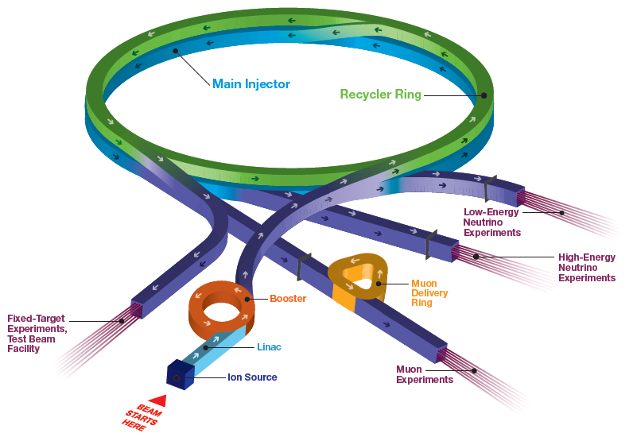
Fermilab accelerator complex
Beam power refers to beam from Main Injector (120 GeV)
Future LBNF
→ Future DUNE
Future PIP-II
→ NOvA

Slide 3
Fermilab long baseline neutrino experiments
FNAL accelerator complex now provides 700 kW proton beam to the NOvA experiment in the NuMI beamline
PIP-II will provide 1.2 MW to DUNE in the LBNF beamline

Slide 4
Increasing beam power keeps NOvA competitive

Slide 5
How could we increase beam power to NOvA?
Shorten Main Injector (MI) cycle time to 1.2s
  11% increase from design (1.33s→1.2s)
  This capability is close to being available, but…
  Cuts rate to Muon Campus experiments in half unless also increase repetition rate to 20 Hz
Increase intensity from Proton Source
  28% increase (4.3 E12 → 5.5 E12 protons per pulse)
  Requires improvements to keep beam quality up and reduce losses even further than achieved by PIP
Increase rep rate from 15 Hz to 20 Hz
  Requires significant control system changes
  Requires RF upgrades in Linac, Booster and MI/Recycler
All of these require a target station that is robust at 1 MW

Slide 6
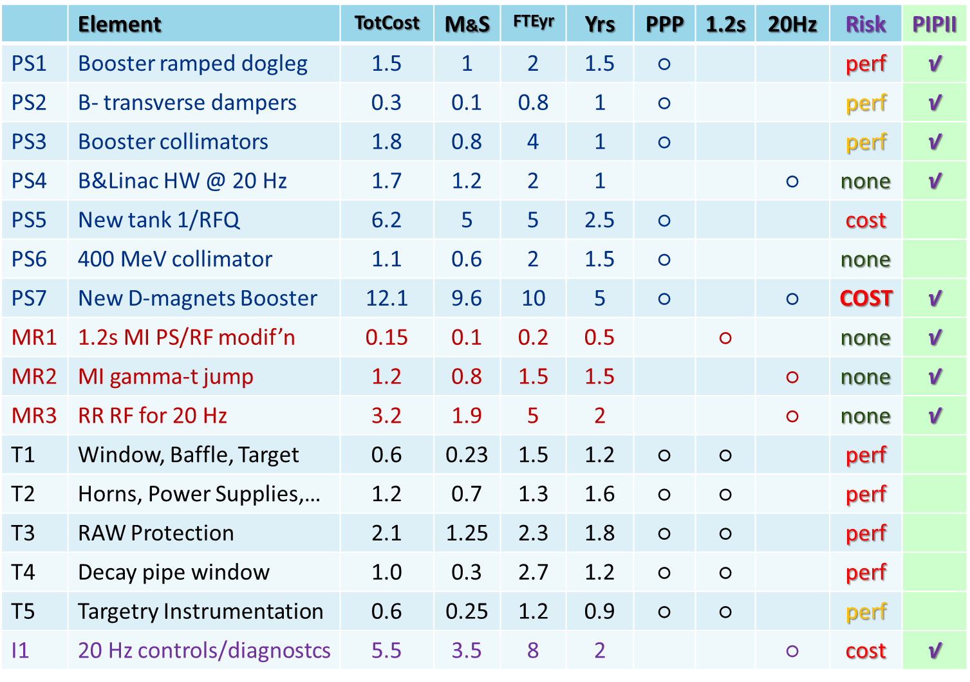
Task force led by Vladimir Shiltsev looked at options
Evaluated cost, duration, risk, compatibility with PIP-II
V Shiltsev 2016 Task Force Report beams-doc-5948

Slide 7
Selected items based on guidance from DOE
No investment in existing Linac → no 20 Hz
Compatible with PIP-II (except target station)
V Shiltsev 2016 Task Force Report beams-doc-5948
Booster Intensity AIP
Booster Magnet AIP
Main Injector AIP
NuMI Target Systems AIP

Slide 8
Selected strategy to increase beam power to NOvA
Shorten Main Injector (MI) cycle time to 1.2s
  11% increase from design (1.33s→1.2s)
  This capability is close to being available, but…
  Cuts rate to Muon Campus experiments in half unless also increase repetition rate to 20 Hz
Increase intensity from Proton Source
  28% increase (4.3e12→5.5e12 protons per pulse)
  Requires improvements to keep beam quality up and reduce losses even further than achieved by PIP
Increase rep rate from 15 Hz to 20 Hz
  Requires significant control system changes
  Requires RF upgrades in Linac, Booster and MI/Recycler
All of these require a target station that is robust at 1 MW

Slide 9
Plan for upgrades for 900kW
Series of independent Accelerator Improvement Projects
Includes production and installation of new Booster RF cavities which were prototyped on PIP
  Larger aperture, 20-Hz capable for PIP-II
 | FY18 | FY19 | FY20 | FY21 | FY22 | FY23 | FY24
NuMI Target Systems
Booster Intensity
Booster Magnets
Main Injector
Booster RF

Slide 10
NuMI Target Systems AIP
Temperatures and stresses due to beam heating
  Pre-target beam window
  Target core and baffle
  Horn stripline cooling and horn power supplies
  Radioactive water systems, target chase air handling, chiller
  Hadron absorber temperature monitoring
Increased radioactivation
  Add shielding to the RAW room and target chase
  Review NuMI shielding and tritium production assessment for 1MW
  Retrofit or expand existing tritium mitigation systems
  New radiation-hard Hadron Monitors
Aging infrastructure (in radioactive environment)
  Decay pipe window spare and replacement mechanism
  Target/horn module positioning drives

Slide 11
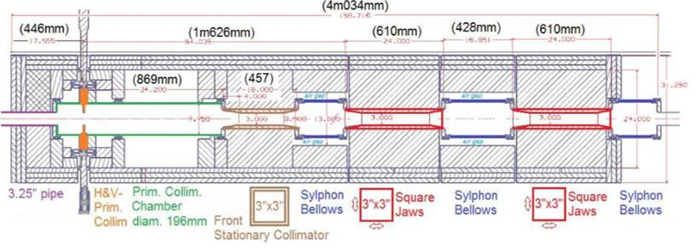
Booster Intensity AIP
Booster dampers
  Lower chromaticity at injection to reduce losses
Booster collimators
  Capture losses (reduce tunnel activation and need for shielding)
Booster beam physics studies
  Lattice, aperture scans, high-intensity studies

Slide 12
Booster Magnets AIP
New Booster defocusing-type combined function magnets, shorter with larger aperture
Design could also benefit PIP-II injection
cross section of existing D-magnets

Slide 13
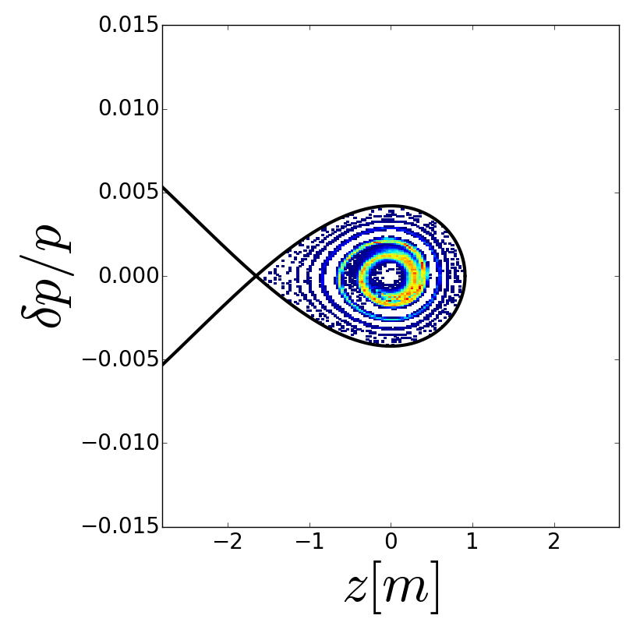
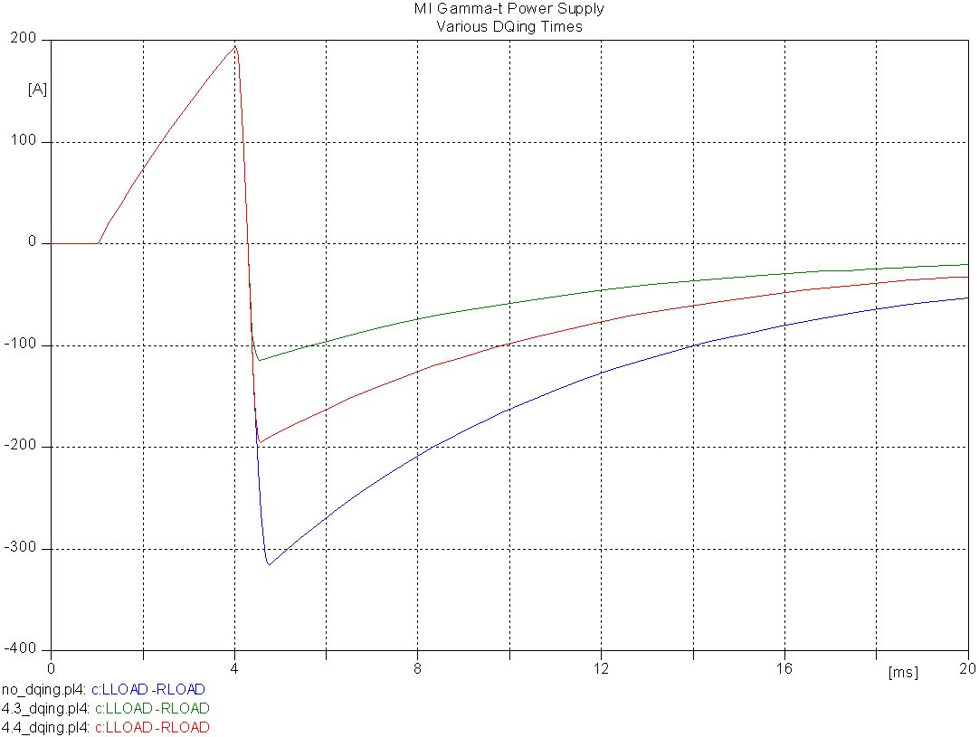
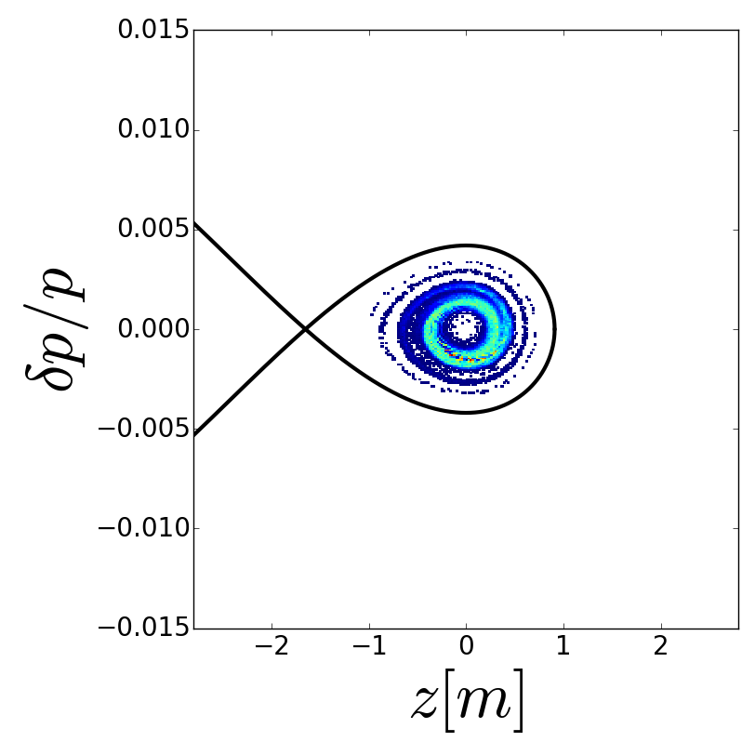
Main Injector AIP
γ_{t} jump
  Design, build, and install new quadrupole magnets to cross transition more quickly to reduce transition losses
Longitudinal Distributions at 40 GeV
SYNERGIA Simulations
R. Ainsworth et al.
Quad current
∆I ∝ ∆γ_{T}
Time

Slide 14
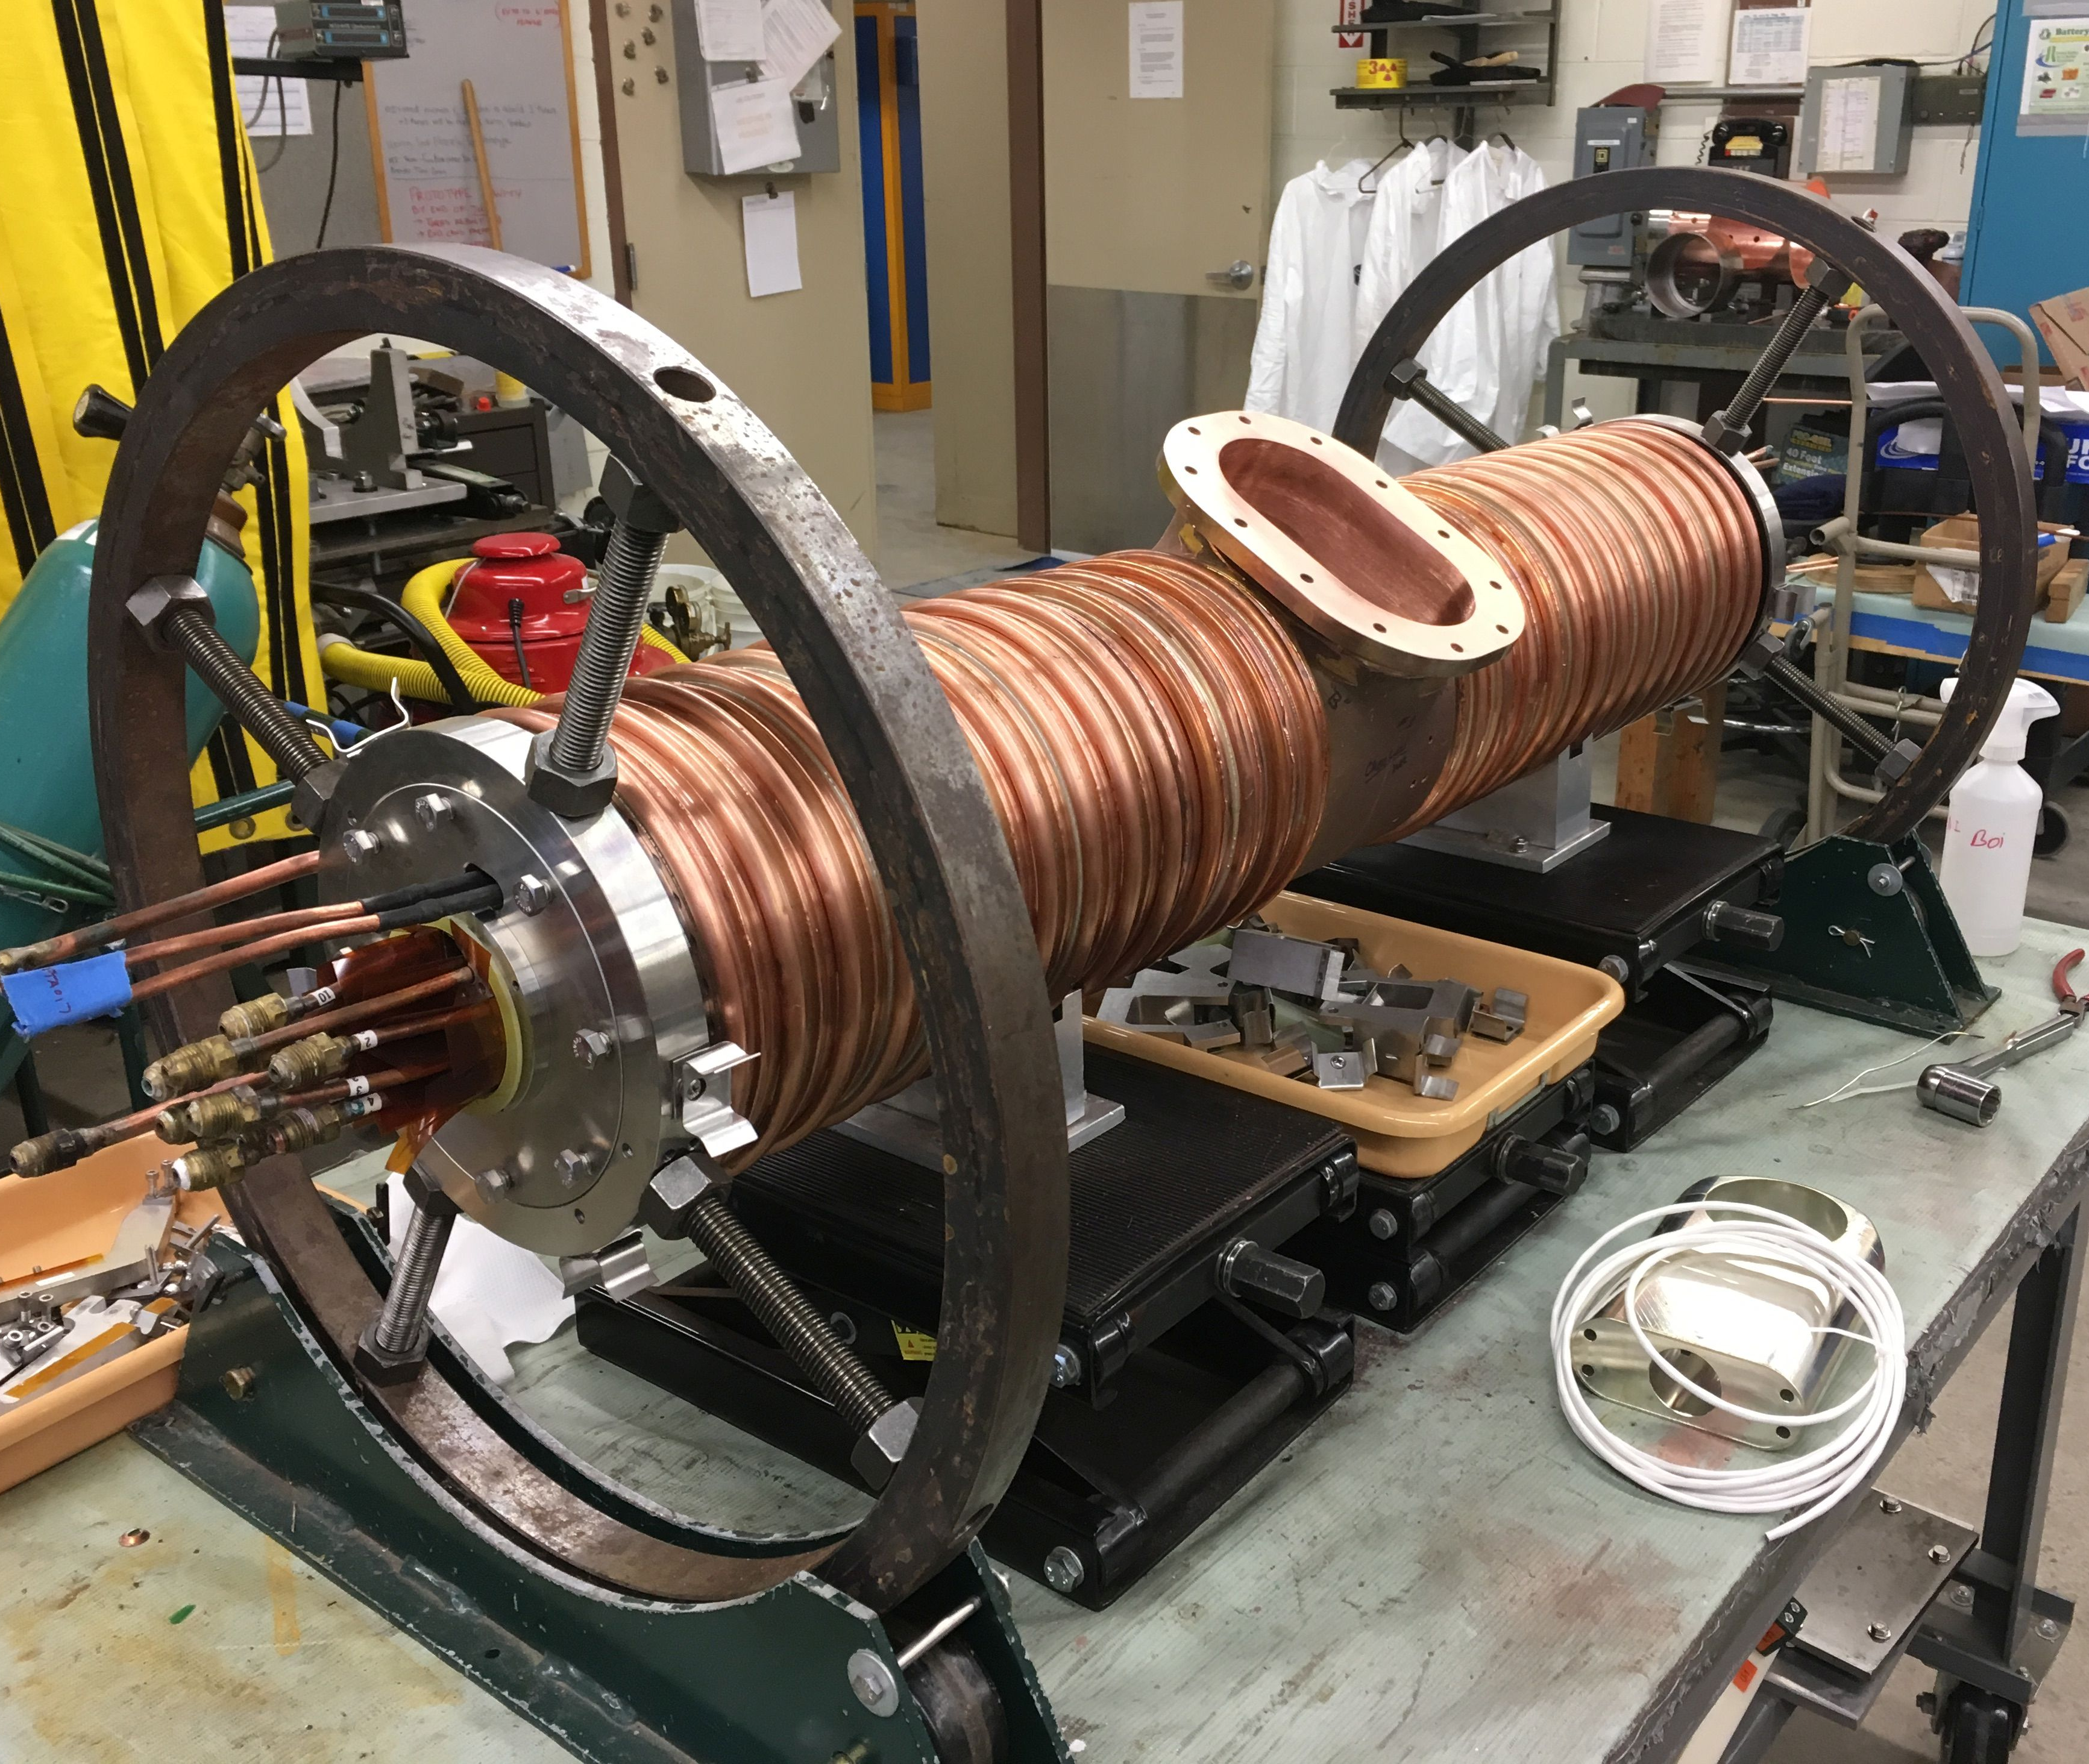
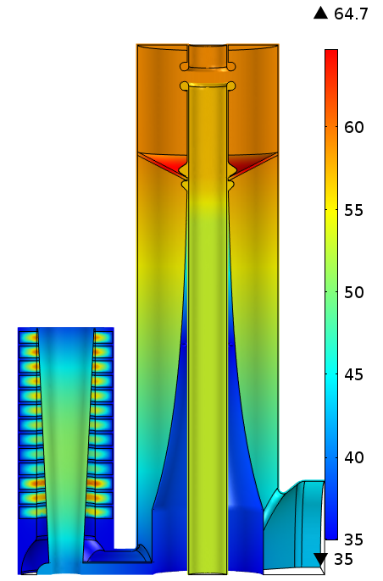
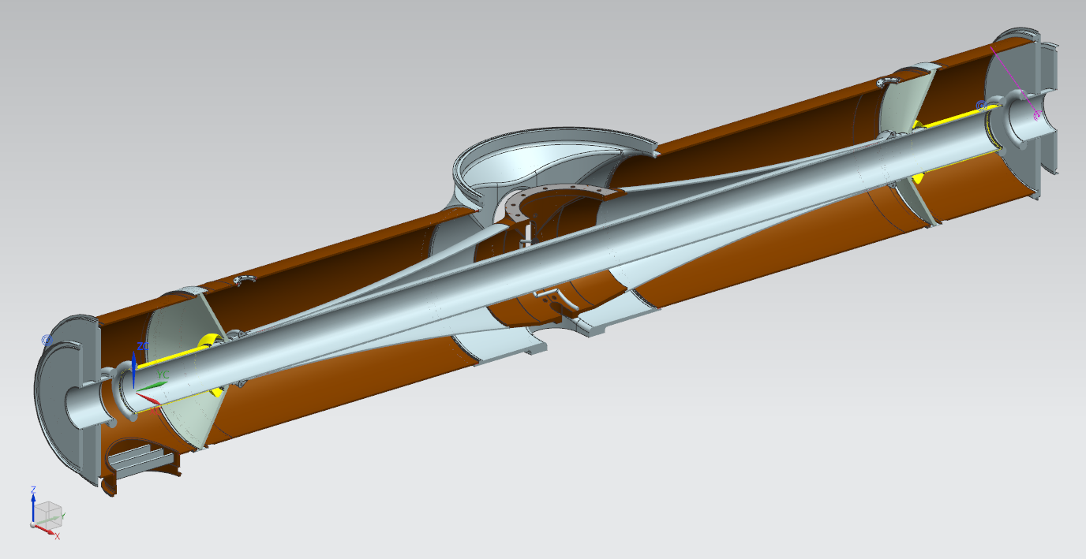
Booster RF AIP
20 new cavities, 60 kV, also larger aperture
Was on PIP, but delayed to get benefits of 900 kW sooner
  Complete prototyping on PIP this year
Needed for 20 Hz running with PIP-II
Could support running at 15 Hz as refurbished cavities continue to age

Slide 15
Conclusions
Have a plan to increase beam power to 900 kW
Many of the improvements are needed for PIP-II
Expect funding to start the NuMI Target Systems AIP and the Intensity AIP this month
Will step up intensities periodically if possible as improvements are made
Expect target station to be ready for up to 1 MW after 2020 shutdown and Booster ready to send higher intensity beam on same timescale
Other improvements will continue beyond 2020 which may be needed to reach highest beam power

