Slide 1
PIP-II: An International Accelerator Project
Lia Merminga
Fermilab Workshop on Megawatt Rings & IOTA/FAST Collaboration Meeting
7-10 May 2018
In partnership with:
India/DAE
Italy/INFN
UK/STFC
France/CEA/Irfu, CNRS/IN2P3
Notes:
.

Slide 2
Outline
The PIP-II Project
International Partnerships
FY18 Goals
Summary

Slide 3

P5- Particle physics is global… and so is PIP-II
Recommendation 14: Upgrade the Fermilab proton accelerator complex to produce higher intensity beams. R&D for the Proton Improvement Plan II (PIP-II) should proceed immediately, followed by construction, to provide proton beams of >1 MW by the time of first operation of the new long-baseline neutrino facility.
From 2014 P5 Report: “The PIP-II project at Fermilab is a necessary investment in physics capability, enabling the world’s most intense neutrino beam, providing the wideband capability for LBNF, as well as high proton intensities for other opportunities, and it is also an investment in national accelerator laboratory infrastructure. The project has already attracted interest from several potential international partners.”

Slide 4
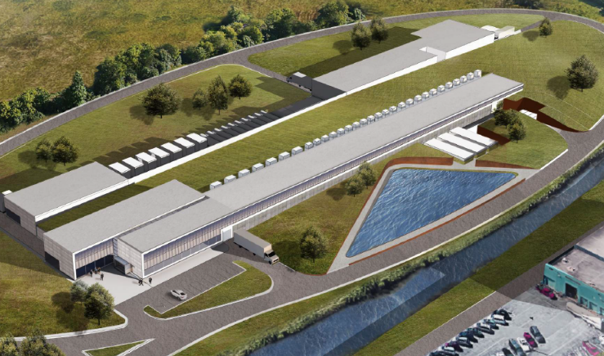
The PIP-II Project
Mission
PIP-II will deliver the world’s most intense beam of neutrinos to the international LBNF/DUNE project, and enable a broad physics research program, powering new discoveries for decades to come.
Goals
  Deliver 1.2 MW of proton beam power from the Main Injector over the energy range 60 – 120 GeV, at the start of LBNF ops
    Provide a platform for extension of beam power to LBNF to >2 MW
  Provide a platform for extension of capability to high duty factor/higher beam power and reliable beam operations
    Support the ongoing 8 GeV program, including an upgrade path for Mu2e
Building the world’s most powerful neutrino beam cost-effectively

Slide 5
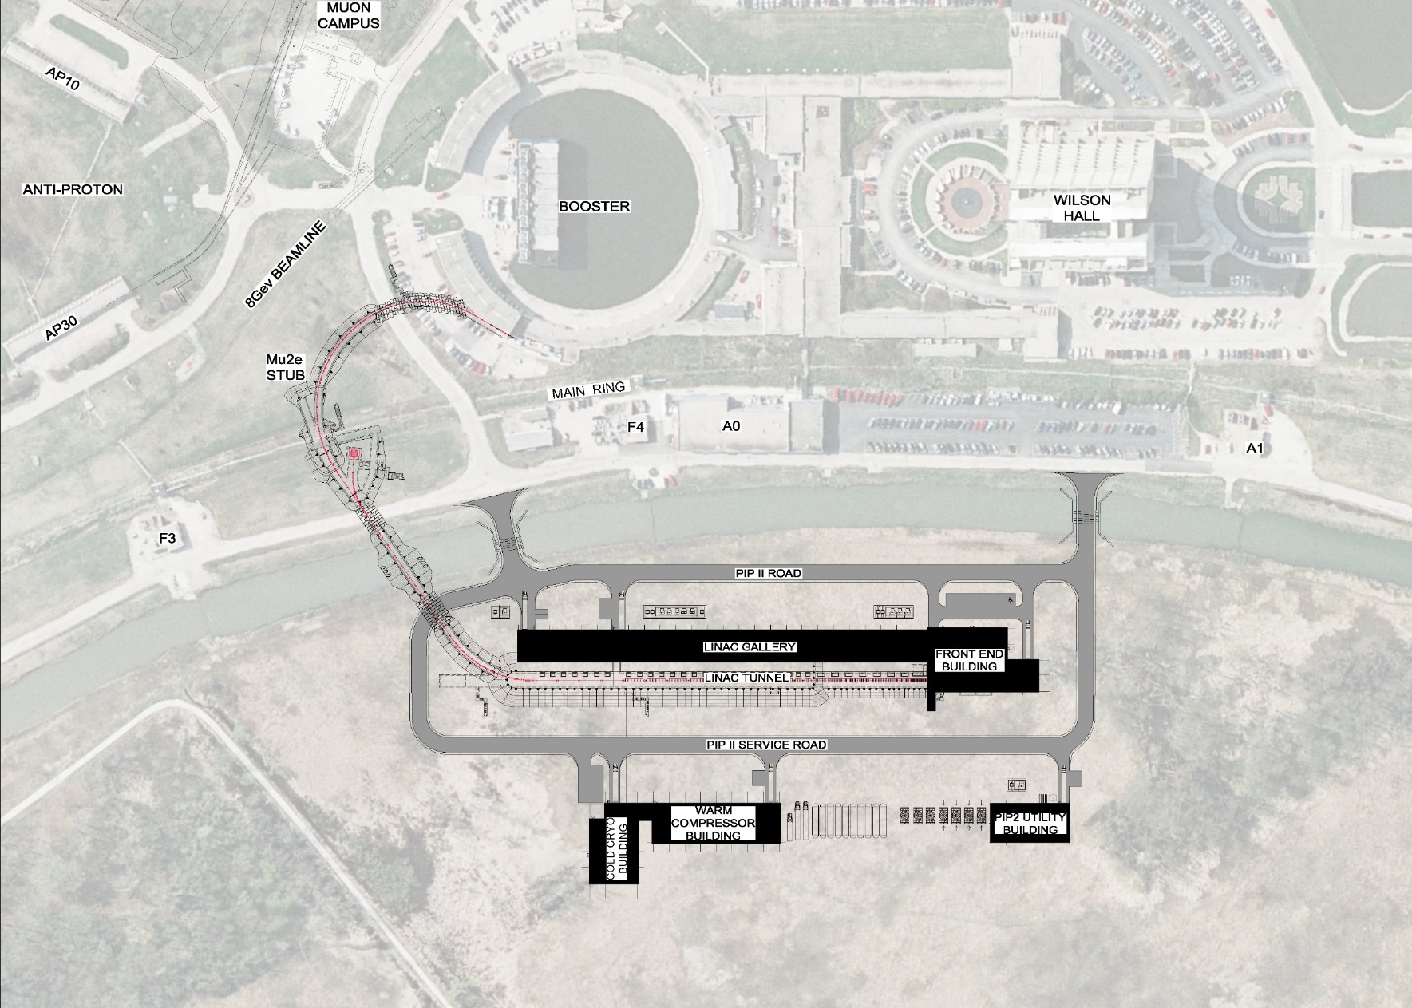





PIP-II Scope
Rings Upgrades
BTL
Linac
Conventional Facilities

Slide 6
PIP-II Main Features
A modern SRF cw-compatible H- linac
  1.6 MW at 800 MeV, upgradable energy
  The H- beam allows stripping injection as well as various laser-based beam manipulations
  Arbitrary bunch-by-bunch chopping capability
  Future rf beam splitter would allow multiple users receive beam concurrently
Main Injector and Booster upgrades allowing for 1.2 MW and multi-MW beam power in the future
First step towards upgrading Fermilab aging accelerators

Slide 7

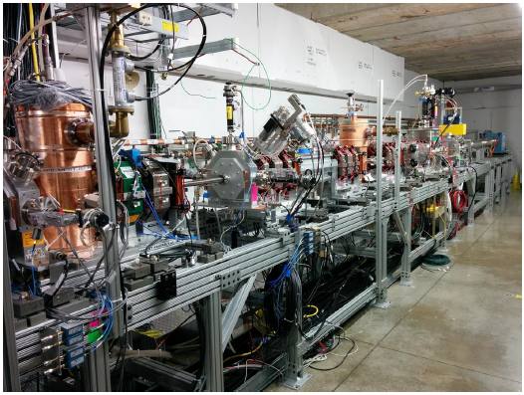
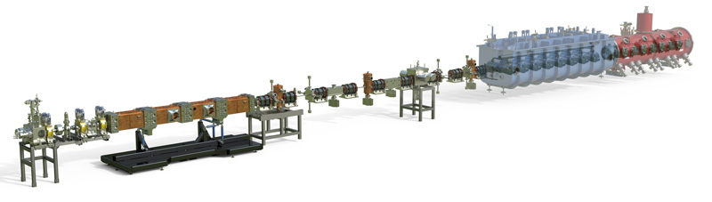
PIP-II has a mature, validated technical design
PIP2IT
PIP2IT is a complete systems-integration of the PIP-II Front End - coming to completion in FY21

Slide 8
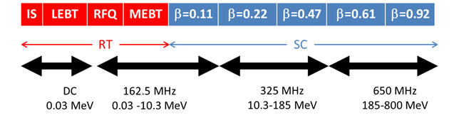
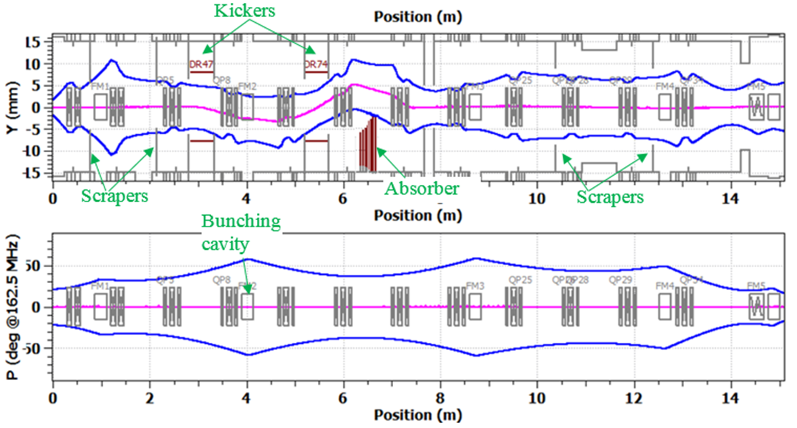
Warm Front End
15 mA, 30 kV ion source
2 m LEBT (chopper, dif. pumping, envelope match to RFQ)
2.1 MeV, 162.5 MHz RFQ
14 m MEBT (bunch-by-bunch chopper, shielding wall, envelope match)
Successful integration of magnets from DAE/BARC.

Slide 9
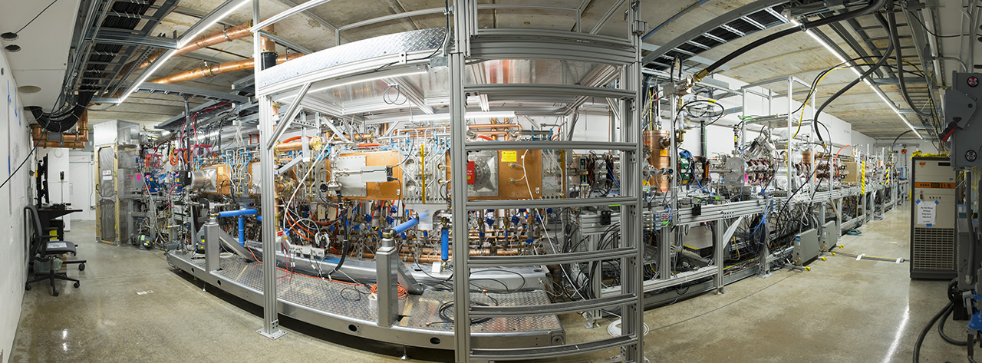
PIP-II Injector Test Facility (PIP2IT)
A collaboration of Fermilab, LBNL, ANL, SNS and Indian partners

Slide 10
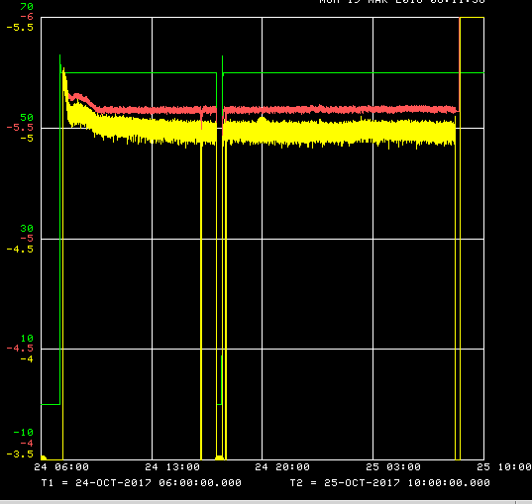
Beam through full length MEBT
Demonstrated transporting the beam at “CDR parameters” through the final-length PIP2IT MEBT for 24 hours
  5 mA ×0.55 ms×20 Hz×2.1 MeV
Long run demonstration at CDR parameters (24-25 Oct-17)
Ran by Operators from the Main Control Room
“Booster injection” chopper waveform
2 interruptions (1 hour total)
  Beam availability ~96%
RFQ
DCCT
Dump
J.-P. Carneiro
B. Hanna
V.L.S. Sista
A. Saini
A. Shemyakin
24 hours
0.5 mA/div for currents
Notes:
It

Slide 11
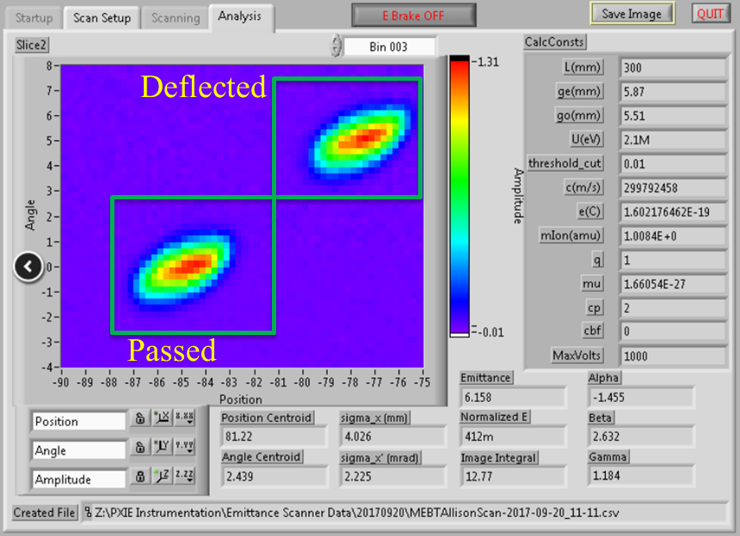
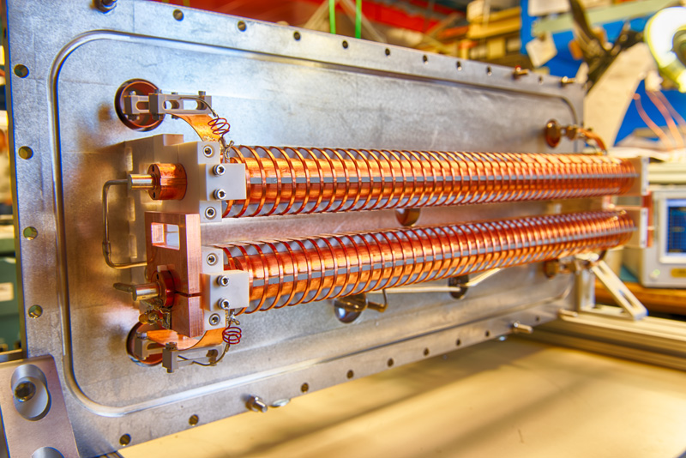
Bunch-by-bunch chopper
5 mA beam collimated to 1.5 mA and deflected by the 200-Ohm kicker
Kickers do not significantly
deteriorate the transverse
emittance of the beam
Kickers were successfully
operated together in sync
Down selected a 200-Ohm
kicker as baseline
Mu2e Collaboration interested in extinction measurements at PIP2IT for Mu2e-II

Slide 12
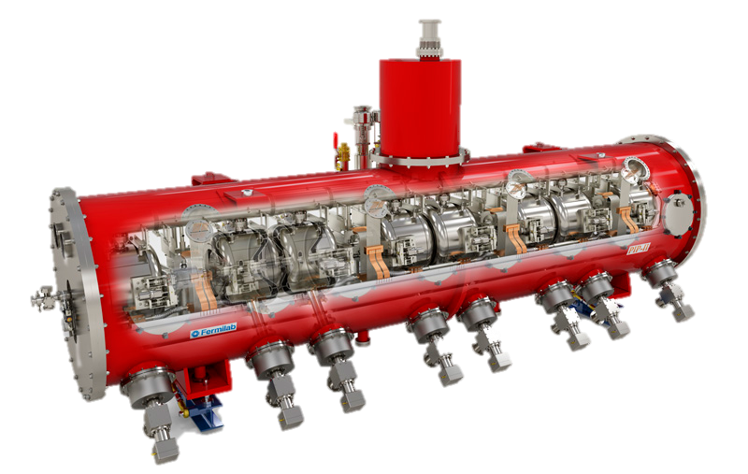
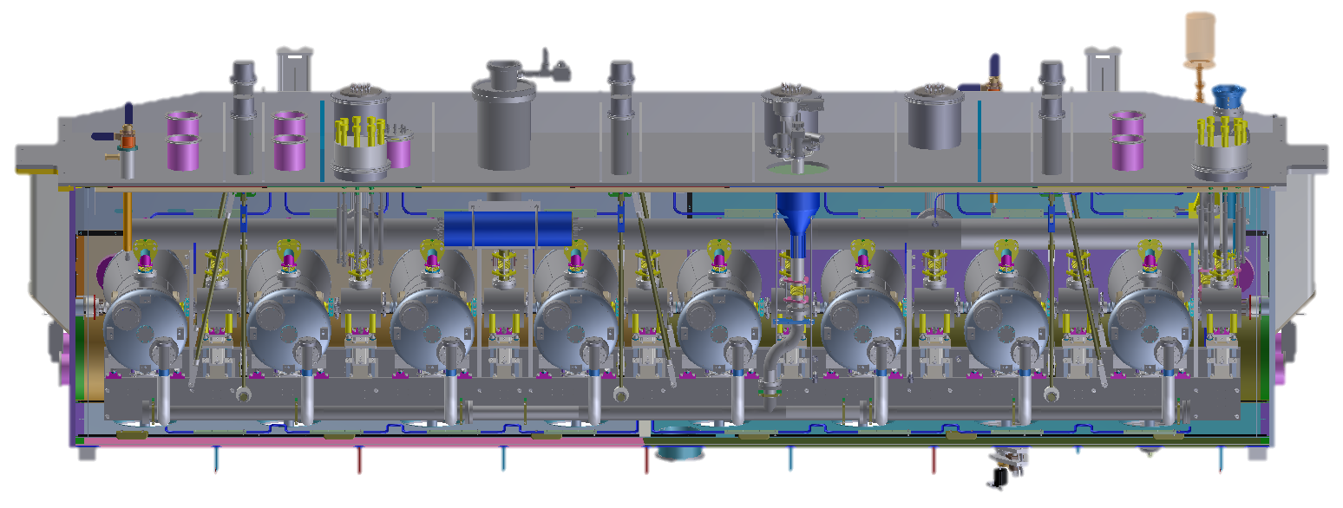
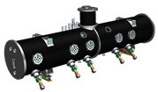
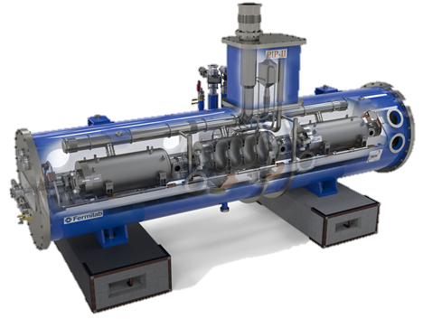
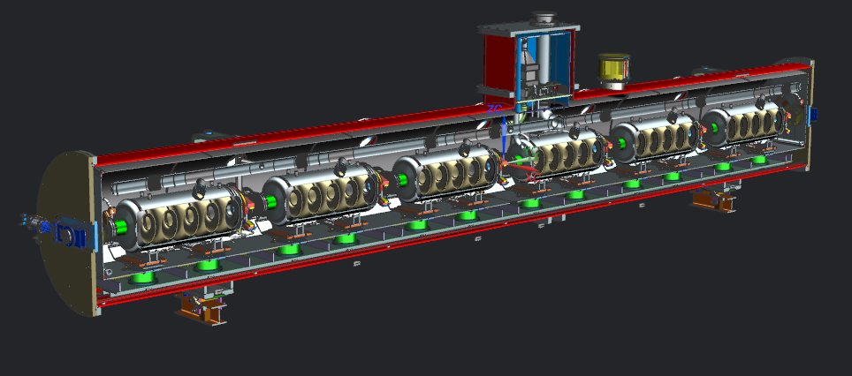
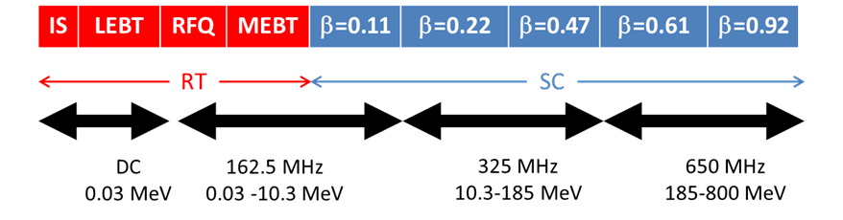
PIP-II SRF Linac & Areas of International Interest
HWR X 1
SSR1 X 2
SSR2 X 7
LB650 X 11
HB650 X 4
PIP-II is the first Accelerator Project in the U.S. with substantial International Contributions

Slide 13
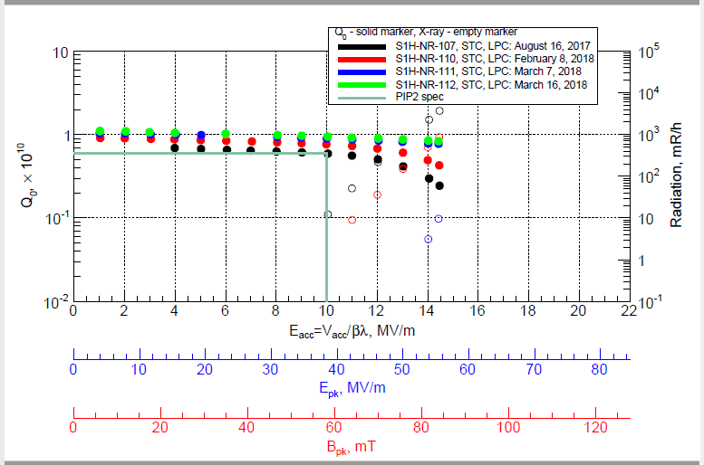
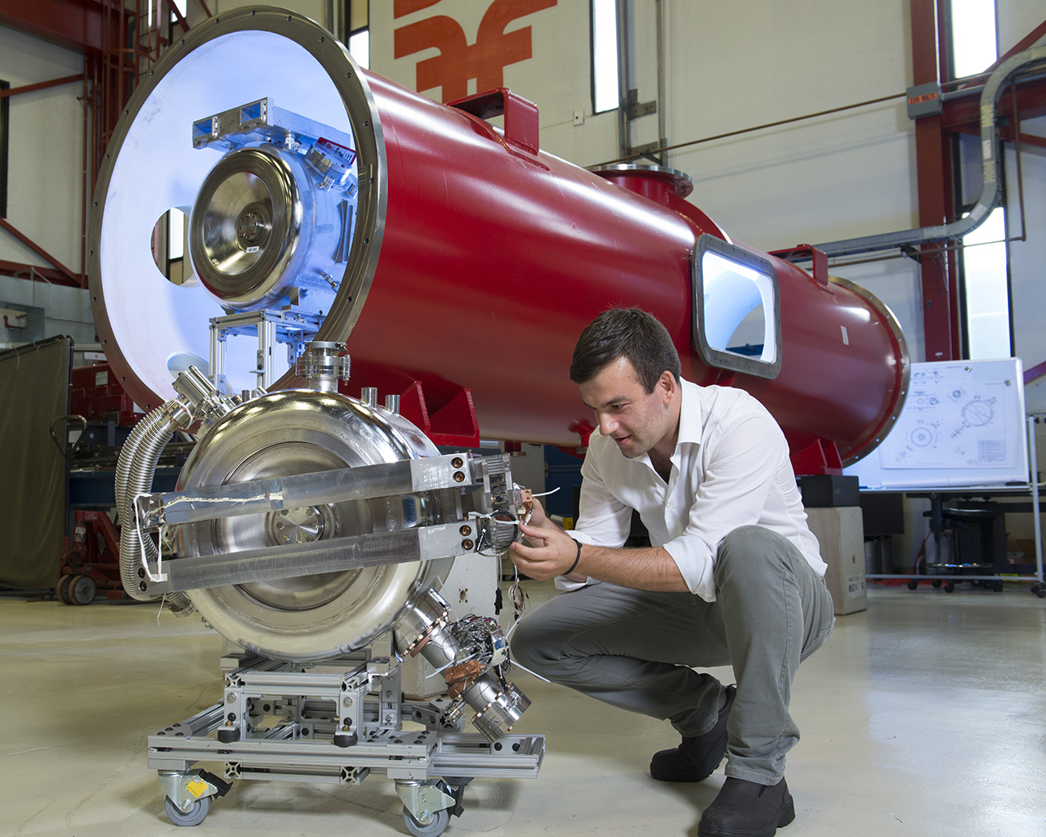
SSR1 Cryomodule being assembled for the test

Slide 14
International Partner Deliverables / Agreement Status
Subsystem (count) | Cavities | CM | RF Systems
HWR (1) | US (ANL) | US (ANL) | US
SSR1 (2) | 12.5% DAE 87.5% US | US | DAE
SSR2 (7) | France | US | DAE
LB650 (11) | 50%-100% Italy 0%- 50% DAE | France | DAE
HB650 (4) | 50% DAE 50% UK | 75% UK 25% US | DAE
Cryoplant (1) | NA | DAE | NA

Slide 15
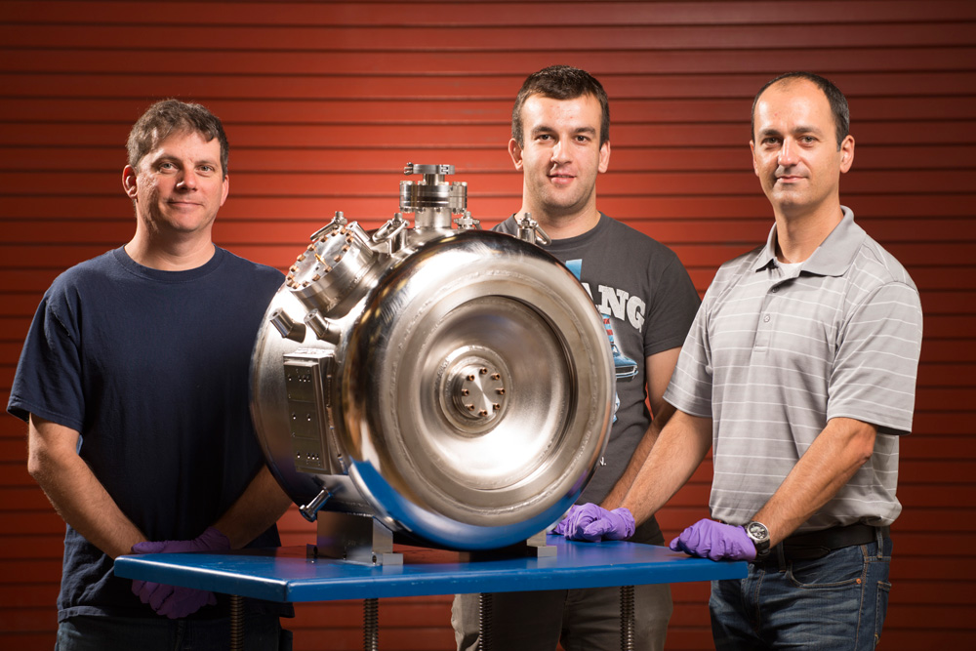
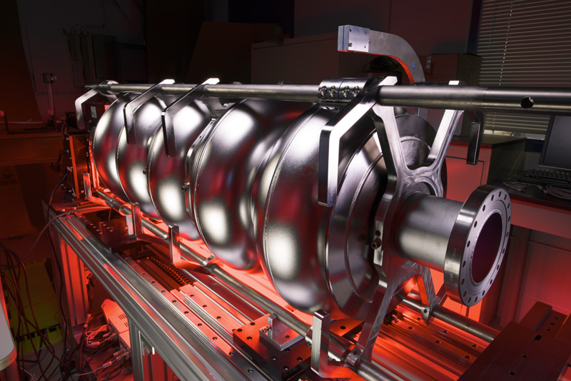
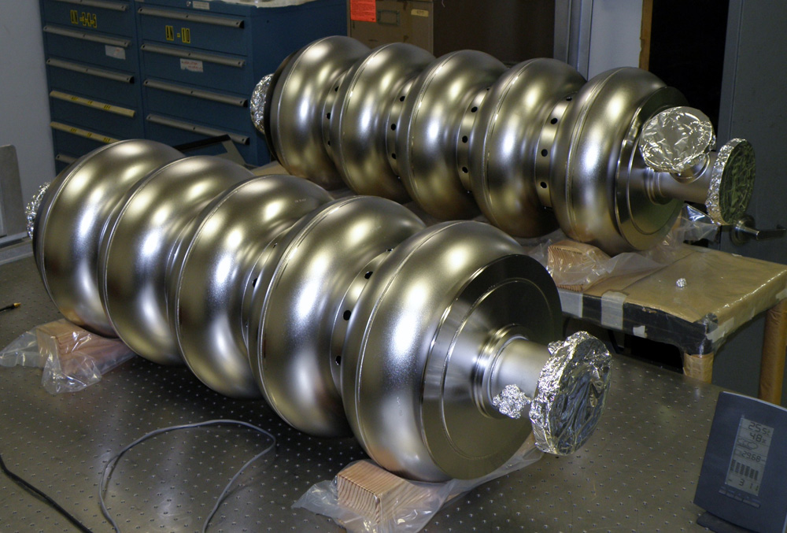
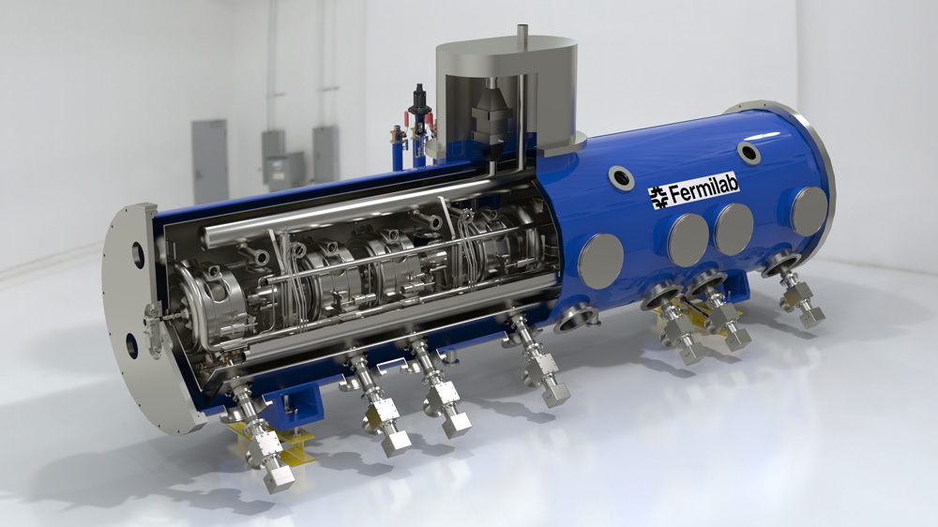
PIP-II leverages FNAL leadership in SRF technology – pushes state of the art in high gradient, high Qo, CW designs
Single Spoke Cavity Prototype
Elliptical Cavity β=0.90 Prototype at FNAL
Elliptical Cavity β=0.90 Prototype at FNAL
SSR1 Cryomodule Prototype
PIP-II driven SRF technology development has broad applications

Slide 16
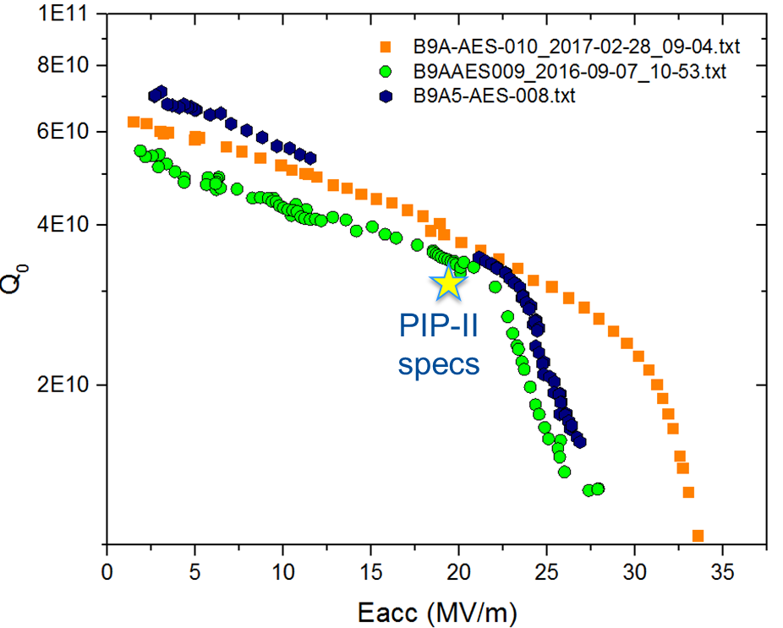
R&D Challenges in SRF
High Q₀ and High Gradient → 3 x10¹⁰ and 20 MV/m
  Nitrogen-doping evolved from discovery
  to proven technology for LCLS-II
  Tests at 650 MHz show that an
  additional doping optimization is
  desirable (relative to doping
  developed for 1.3 GHz)
Suppression of Microphonics
  Maximum detuning < 20 Hz (σ<3 Hz)
    Passive means
      Cryomodule design
    Active means
      Adaptive Detuning Control Algorithm
1E10
Vertical test results for 5-cell HB cavity

Slide 17
Key Performance Parameters
# | Description of Scope | Threshold KPP | Objective KPP
1 | SRF linac | 700 MeV beam delivered to the Booster Injection Region | 800 MeV beam delivered to Booster Injection Region
2 | Booster/RR/MI upgrades | L11 Booster injection region, Recycler RF upgrades, and MI RF upgrades, hardware installed in respective machines. Linac beam injected and circulated in the Booster. | 8 GeV beam transmitted through Recycler and Main Injector, delivered to MI dump.
3 | Cryogenic Infrastructure | Cryogenic plant and distribution lines ready to support pulsed RF operation, and operated to 2 K. | Cryogenic plant and distribution lines ready to support CW RF operation, and operated to 2 K.
4 | Civil Construction | Tunnel enclosures and service buildings ready to support 700 MeV SRF linac and transfer line to the Booster | Tunnel enclosures to support 1 GeV SRF linac and transfer line to the Booster. Service buildings to support 800 MeV SRF linac and transfer line to Booster.
TPC estimate of $721M is based on Objective KPPs

Slide 18
PIP-II schedule
CD Dates
CD-1
CD-2
CD-3a
CD-3
CD-4
HWR Fab/Assembly
DOE Activity
SSR1 1st Cryomodule Fab/Assembly
DOE and/or International Partners
PIP2IT Program
Cryoplant Final Design & Fabrication
Engineering/Development w/International partners
Cryoplant Building Construction
SSR2 Engineering/Design Verification
SSR1 Production
SSR2 Production
LB650 Engineering/Design Verification
LB650 Production
HB650 Engineering/Design Verification
HB650 Production
Installation & Commissioning
Remaining Conventional Facilities Construction
FY17
FY18
FY19
FY20
FY21
FY22
FY23
FY24
FY25
FY26
FY27
FY28
FY29
FY 30
PDR Complete
PIP-II ready to power future discoveries
Retirement of several high technical risks
Beneficial Occupancy of the Linac Tunnel
Receipt of Cryo plant

Slide 19
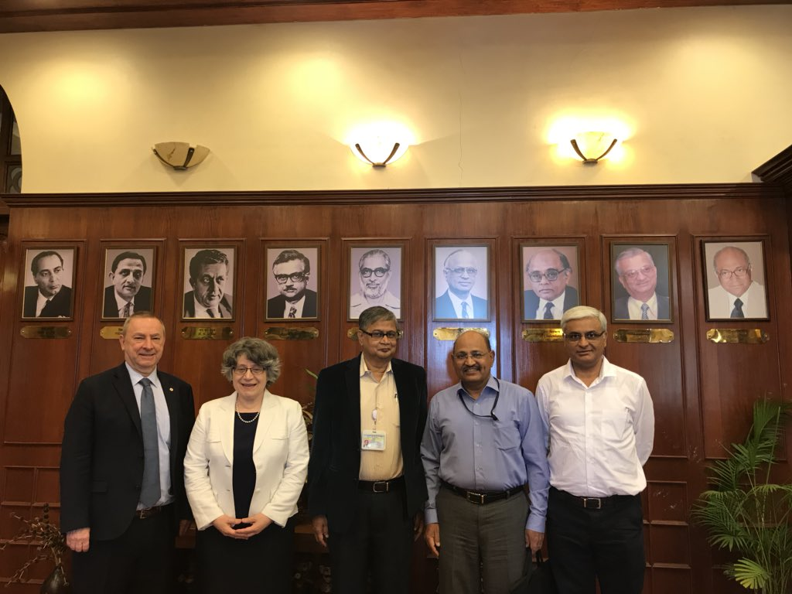
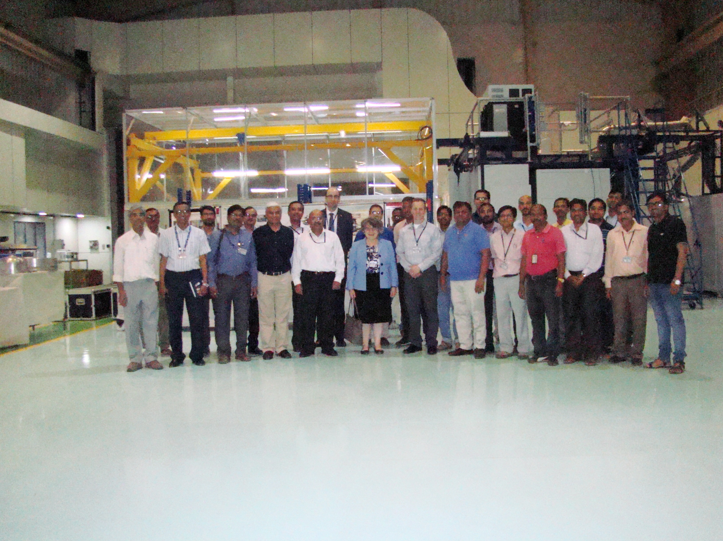
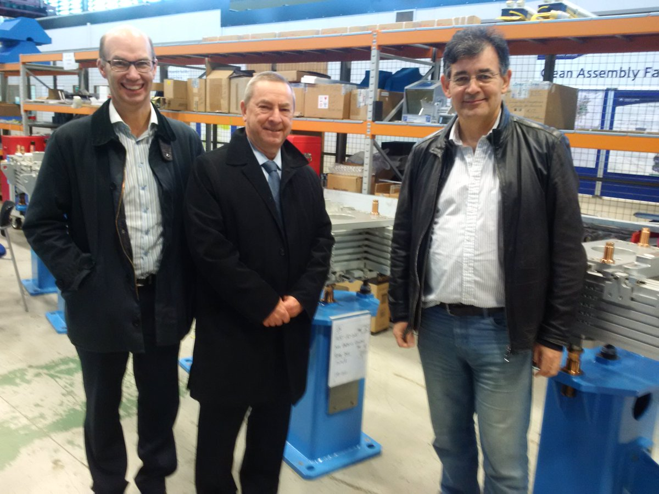
Progress on International Partnerships
International partnerships forming to support development and construction
PIP-II team visited partners in India – DAE, BARC, RRCAT
  2nd round of highly successful DAE visitor program to start in summer
  Cryoplant contribution currently in bid evaluation in DAE
CEA/IN2P3 scope under discussion – June Workshops
UK & Italy proposals under review at agency level
Additional possibilities for collaboration on PIP-II, including graduate research topics
“International collaboration is a contact sport”

Slide 20
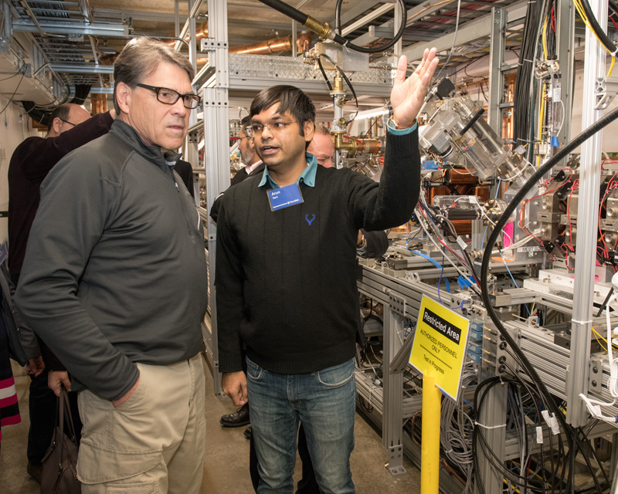
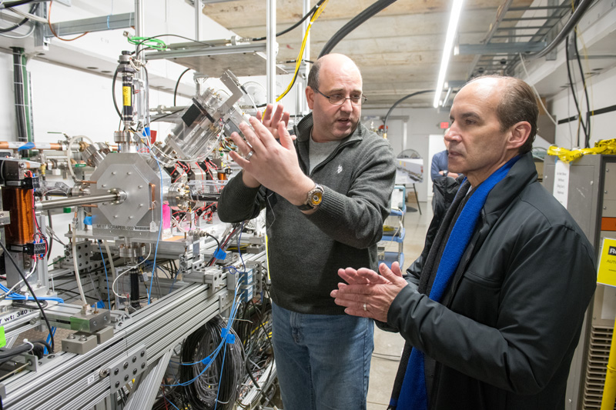
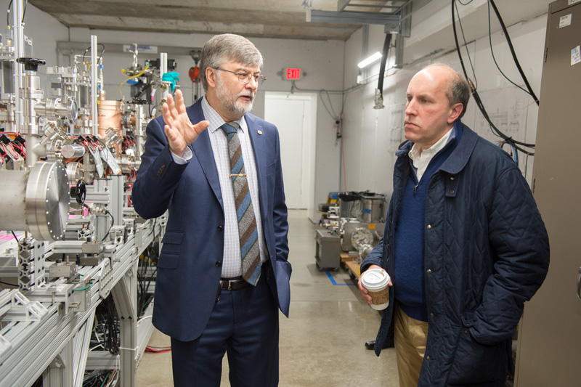
PIP-II is Building Momentum
Strong FY18 funding:
Line item was created
Construction start
Enthusiasm and strong support from FNAL, OHEP, Office of Science, DOE, Congress
Successfully completed DOE ICR and IPR reviews – Dec 2017
Project is ready for CD-1 – scheduling of review is imminent
Launched CD-2/3a process: Goal is baseline end of 2018
New organization and team members with focus on execution
DOE Secretary of Energy Rick Perry
DOE Under Secretary of Energy Mark Menezes
DOE Under Secretary for Science Paul Dabbar

Slide 21
New Project Management Structure effective 1 March 2018
ADVISORY COMMITTEES
PIP-II Machine Advisory Committee R. Garoby
PIP-II Project Management Group R. Tschirhart
PIP-II Project
Lia Merminga
PROJECT DIRECTOR
US TECHNICAL COORDINATOR
TECHNICAL DIRECTOR Arkadiy Klebaner
PROJECT MANAGER Marc Kaducak
SPECIAL ADVISOR Steve Holmes
ANL SENIOR TEAM LEAD TBD
LBNL SENIOR TEAM LEAD TBD
ENVIRONMENTAL, SAFETY & HEALTH John Anderson Jr.
DOCUMENT SYSTEM MANAGER Traci Langford
EXECUTIVE ADMINISTRATION Traci Langford
ADMINISTRATION SUPPORT Tatiana Hamilton
FNAL SUPPORT
ACCELERATOR DIV M. Lindgren
TECHNICAL DIV S. Belomestnykh
CFO OFFICE V. Peoples
WDRS K. Van Vreede
CSO OFFICE M. Michels
COO OFFICE K. Gregory
CPO OFFICE R. Tschirhart
TECHNICAL INTEGRATION
Technical Director - A. Klebaner
PROJECT ENGINEER Allan Rowe
DEPUTY PROJ ENGINEER Jim Steimel
ENGINEERING DATA MGR TBD
PROJECT SCIENTIST Paul Derwent
INTEGRATION COORDINATOR TBD
PROJECT OFFICE
Project Manager - M. Kaducak
Deputy Project Manager – L. Lari
PROJECT CONTROLS MANAGER TBD
Project Controls Specialists J. Randall, M. Bossert
OPSS Consultant D. Hoffer
FINANCIAL MANAGER C. Jacobsen
PROCUREMENT MANAGER T. Powers (acting)
RISK MANAGER L. Lari (acting)
QUALITY ASSURANCE MGR J. Adetunji (acting)
INTERNATIONAL COORDINATION
IIFC TECHNICAL COORDINATORS S. Krishnagopal
S. Joshi
UK/STFC SENIOR TEAM LEAD P. McIntosh
ITALY/INFN SENIOR TEAM LEAD C. Pagani
FRANCE/CEA SENIOR TEAM LEAD O. Napoli
FRANCE/IN2P3 SENIOR TEAM LEAD J.-L. Biarrotte
PROJECT MANAGEMENT
M. Kaducak
System Manager
SRF & CRYO SYSTEMS
G. Wu
System Manager
ACCELERATOR SYSTEMS
P. Derwent
System Manager
LINAC INSTALLATION & COMMISSIONING
F.G. Garcia
System Manager
ACCELERATOR COMPLEX UPGRADES
I. Kourbanis
System Manager
CONVENTIONAL FACILITIES
S. Dixon
System Manager
PIP-II is building a strong, experienced, highly motivated team

Slide 22
Goals for FY18
Achieve CD-1 in Q2FY2018
ES&H Goals
  Complete Environmental Assessment
R&D & Technical Integration Goals
  Implement and Follow Systems Engineering Process
  Complete PDR
  Install PIP2IT cryogenic distribution system
  Keep HWR and SSR1 on track for late CY2018/early 2019 delivery/installation
CF Goals
  Design site prep
  Initiate Cryoplant building design
International Collaboration Goals
  Meet 2018 IIFC deliverable milestones
  Determine scope of deliverables from all partners
  Support DAE Cryoplant procurement
Management Goals
  Prepare for CD-2 (Feb 2019)
  Implement post-CD-1 organization
  Train/Appoint CAMs
  Prepare to initiate EVMS reporting in late FY18

Slide 23
Summary
PIP-II is the first accelerator project in the US built with substantial international contributions
PIP-II is the “heart and soul” of Fermilab, and critical to the success of the U.S. neutrino program
PIP-II technical design is mature and being validated
  Warm Front End is operational
Anticipating a June DOE ESAAB for CD-1
Preparing for baselining review at the end of this year
In process of defining roles for international partners
There is an international and in-house momentum building up and we need to keep it going!

Slide 24
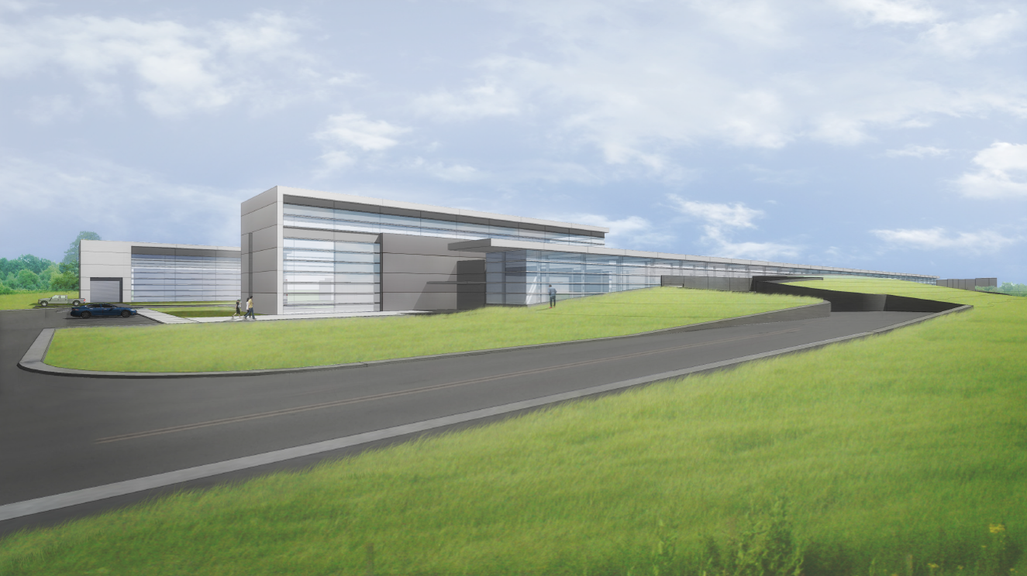
Thank you for your attention

Slide 25
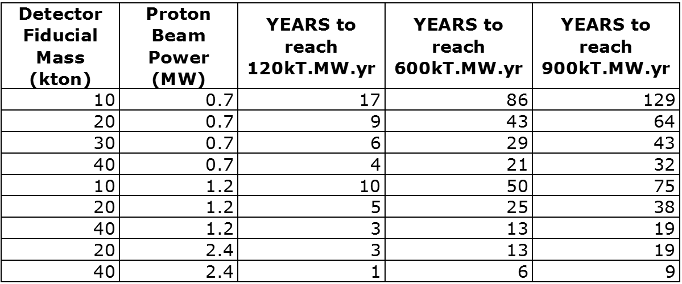
Neutrino research & beam power
Due to the rarity of a neutrino interaction, the experiments require massive detectors and high neutrino flux (intense beams)… in other words you increase the number of observed interactions by sending more neutrinos and installing a larger target.
Neutrino Experiments Need: Mass * Power * Time
PIP-II provides 1.2 MW w/ upgrade potential to multi-MW
Working w/ partners to build up to 40kT
Increasing the other two factors reduces the time to discovery; we want to achieve our scientific missions in a timely manner!

