Slide 1
MI and Recycler in 1MW+ era
Rob Ainsworth
Megawatt Rings
8th May 2018

Slide 2
Outline
Accelerator complex
Slip-stacking
PIP and beyond
Synergia
Simulations
Resonance compensation
Summary

Slide 3
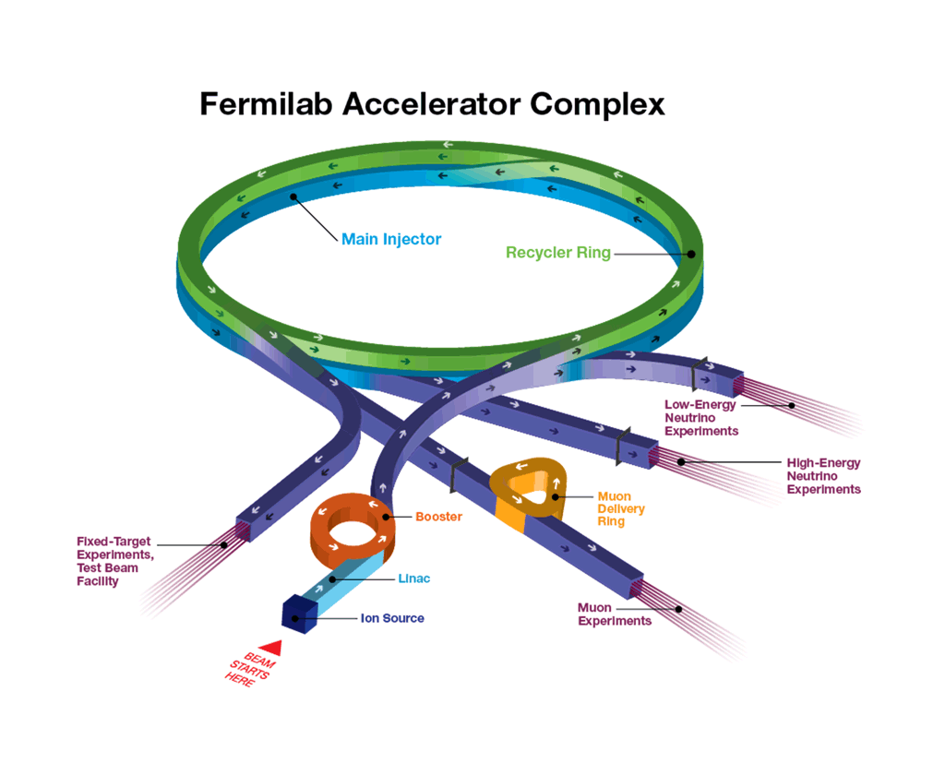
Accelerator complex
H⁻ linac
Booster
h = 84
15 Hz
400 MeV -> 8 GeV
Recycler
h = 588
Slip-stack 12 batches (double bunch intensity)
Main Injector
8 GeV -> 120 GeV

Slide 4
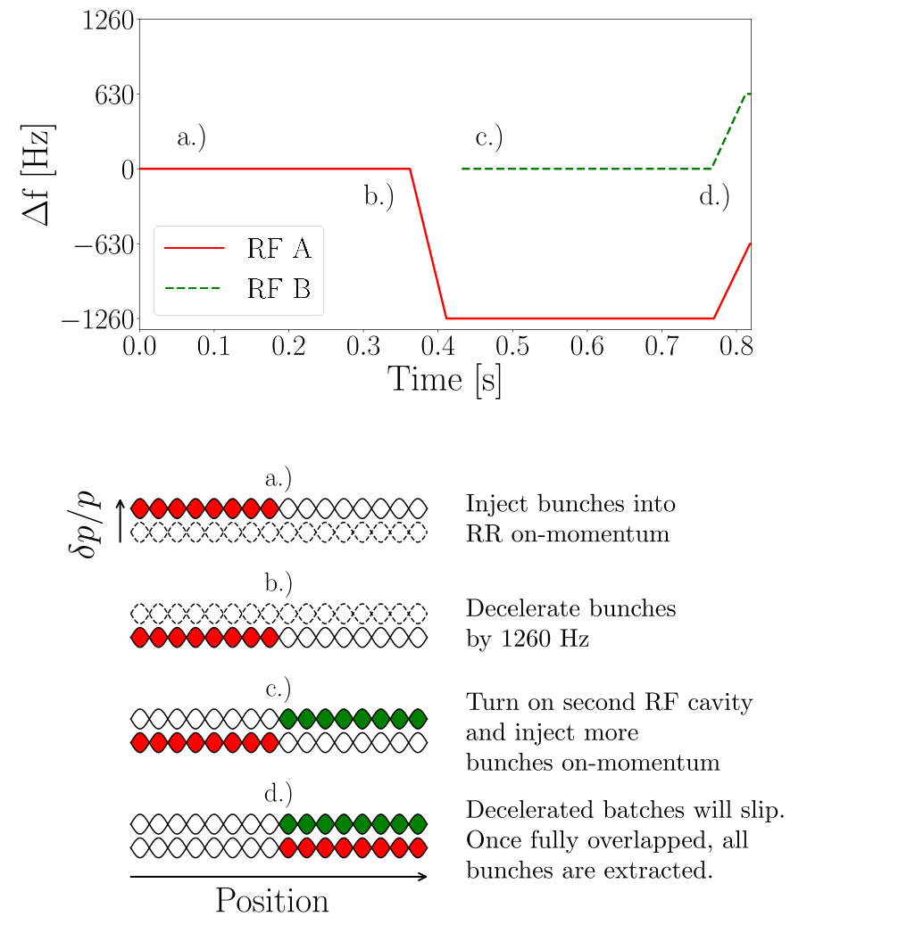
Slip-stacking
Slip-stacking allows us to double the intensity of the bunches in the Recycler

Slide 5
Power evolution
PIP
700 kW (~0.5 x 10¹¹ ppb)
15 Hz Booster
80 kV RF for recycler
1260 Hz separation for slip-stacking
PIPII
1.2 MW (~0.8 x 10¹¹ ppb)
20 Hz booster
140 kV RF for recycler
1680 Hz separation for slip-stacking
PIPIII
2.4 MW
No more slip-stacking, most likely replace booster with new RCS

Slide 6
Do space charge effects during slip stacking
at high intensity cause problems?
If so, what are the sensitivities and how best
to mitigate them?

Slide 7
Synergia
Self-consistent 3D Particle-in-cell accelerator simulation C++ code
Specifically to simulate collective effects in accelerators
Designed from the beginning to run on large parallel computing systems (but it doesn't have to)
Library of Objects which are combined to create a simulation
Lattice, Bunch(es), Diagnostics (bunch measurements), Collectives, Propagation scheme, all under programmatic control
One or two co-propagating single bunch or multi-bunch beams
Collective effects included with split-operator formalism:
Space Charge (validated with GSI space charge benchmark, multiple models)
Impedance (per-element) within bunch and bunch-to-bunch, γ < ∞ for boosters
Synergia contains an internal test suite that verifies the correct operation of most modules. Particle tracking is verified with MAD-X/PTC and analytic calculations. Space charge kicks are verified with analytic calculations. Particles are labeled.
Synergia is actively used to model all of our circular machines:
Recycler, Main Injector, Booster, IOTA, Debuncher
Synergia is developed by the Acceleration Simulations Group within Fermilab’s Scientific Computing Division and is publicly available.
J. Amundson, P. Lebrun, Q. Lu, A. Macridin, L. Michelotti, C. S. Park, E. Stern, T. Zolkin.
https://web.fnal.gov/sites/synergia

Slide 8
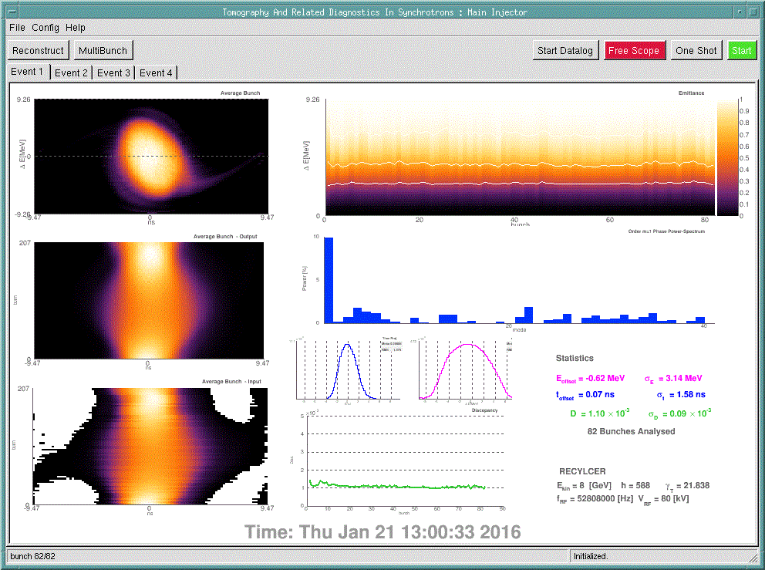
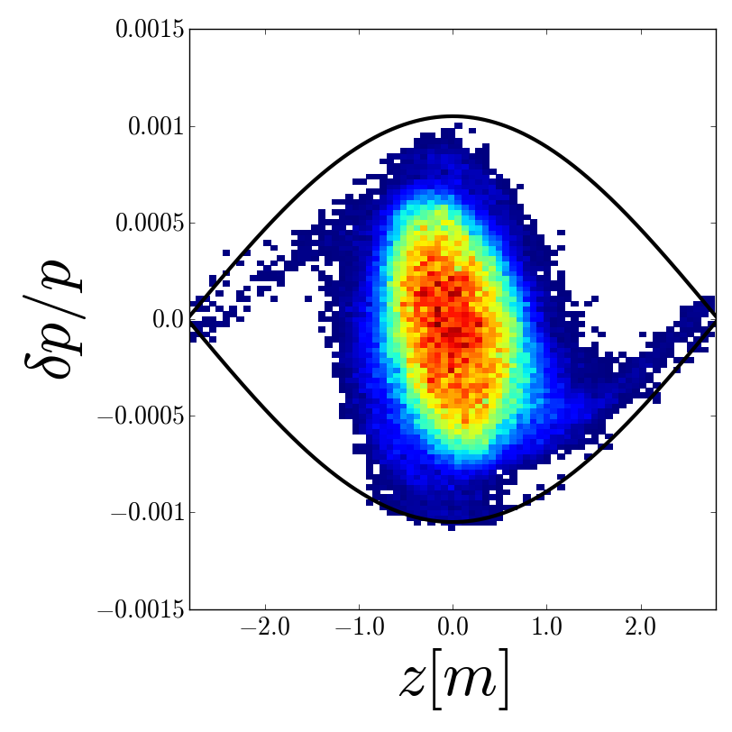
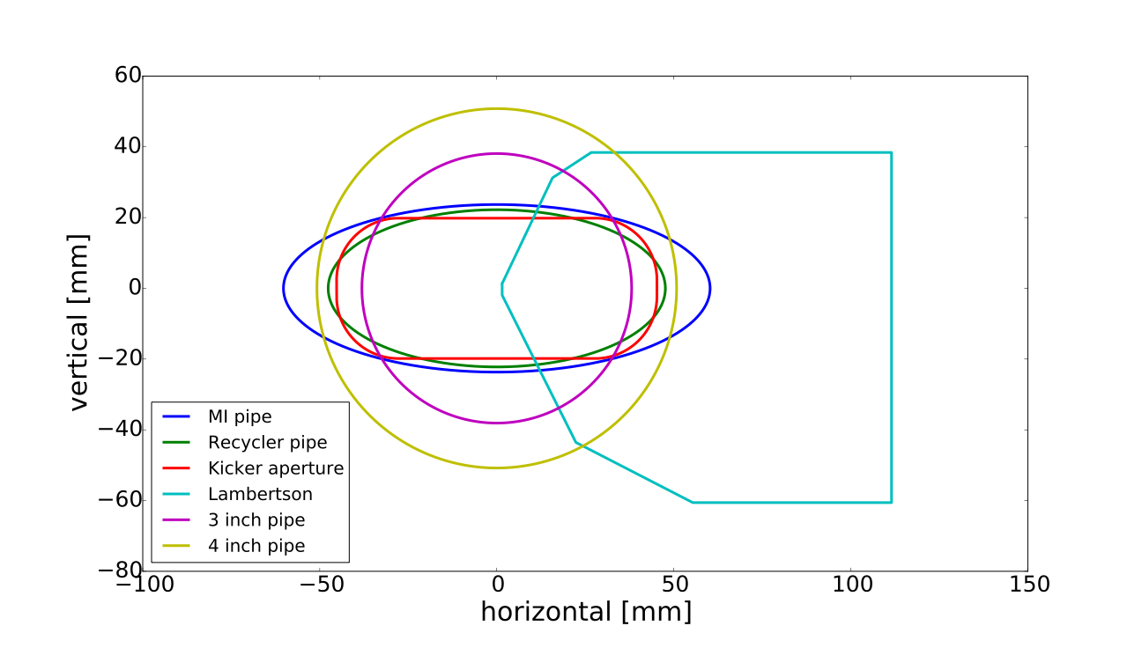
Recycler simulations - inputs
Realistic longitudinal distribution from tomography
Transverse distribution matched but using measured beam sizes
MAD8 input file
Using apertures, orbit bumps,

Slide 9
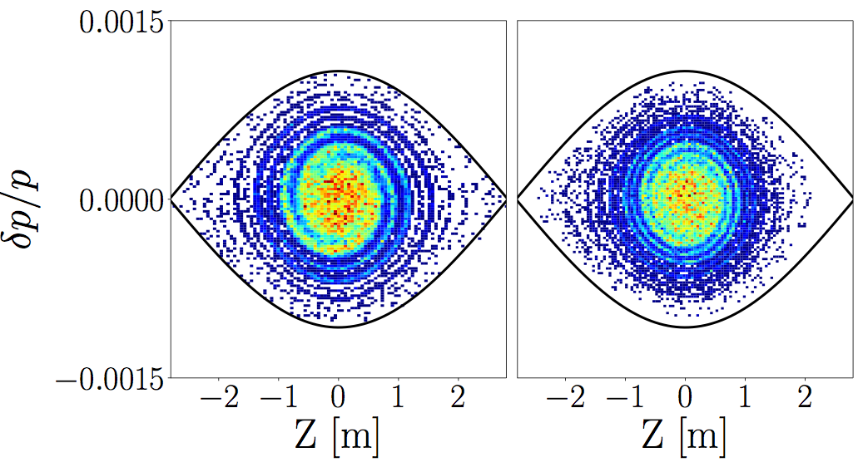
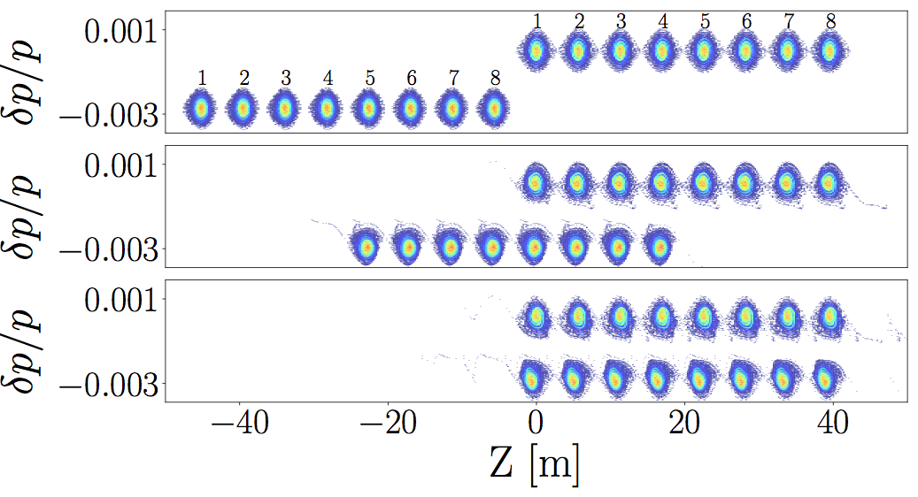
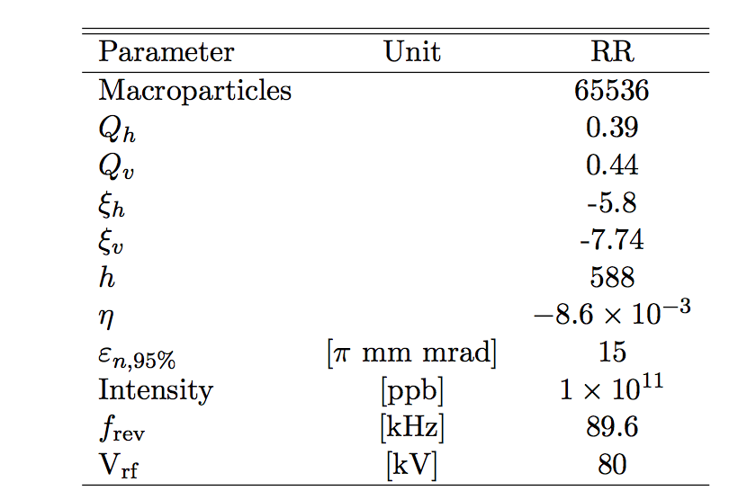
Recycler simulations - 1E11 ppb
Filament
50ms
Decelerate
1260Hz
50ms
HMB
LMB

Slide 10
Space charge footprint

Slide 11
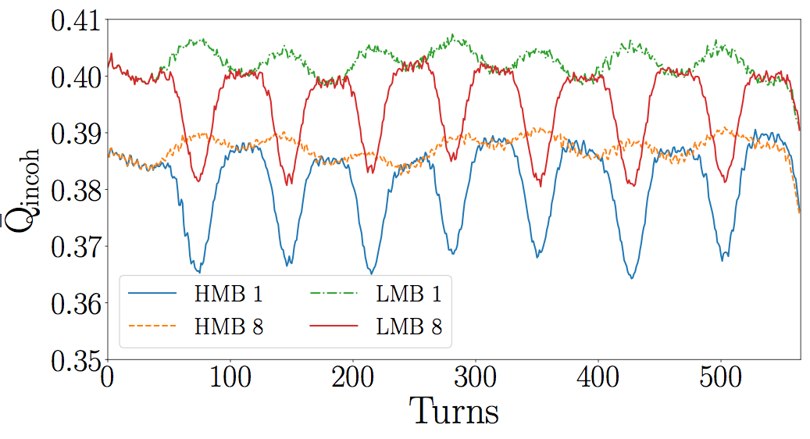
Footprint vs turn
Mean of the footprint

Slide 12
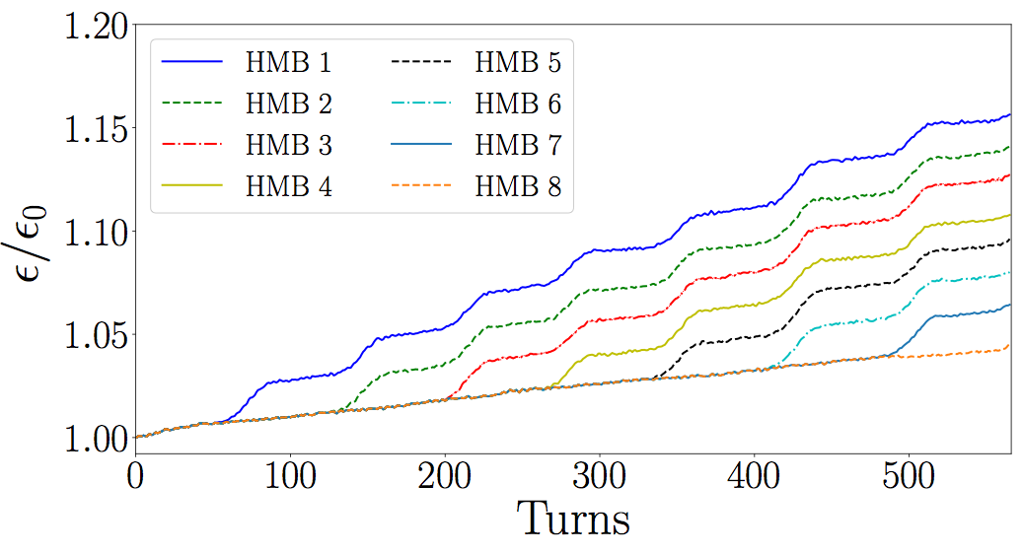
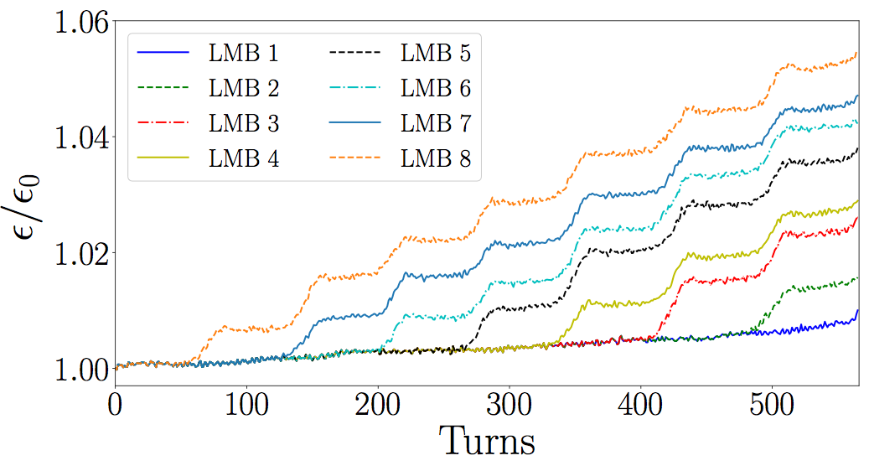
Effect on emittance

Slide 13
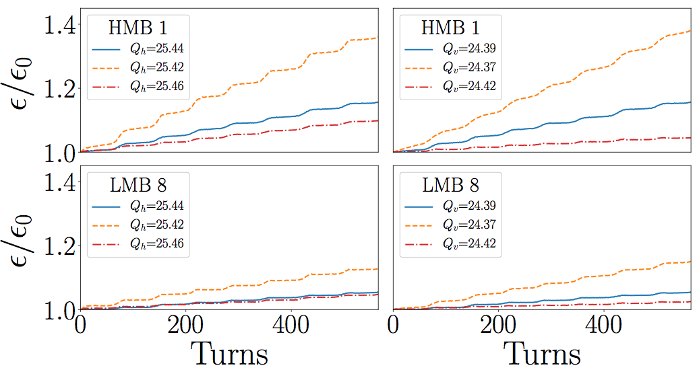
Tunes
Lower tunes -> larger growth

Slide 14
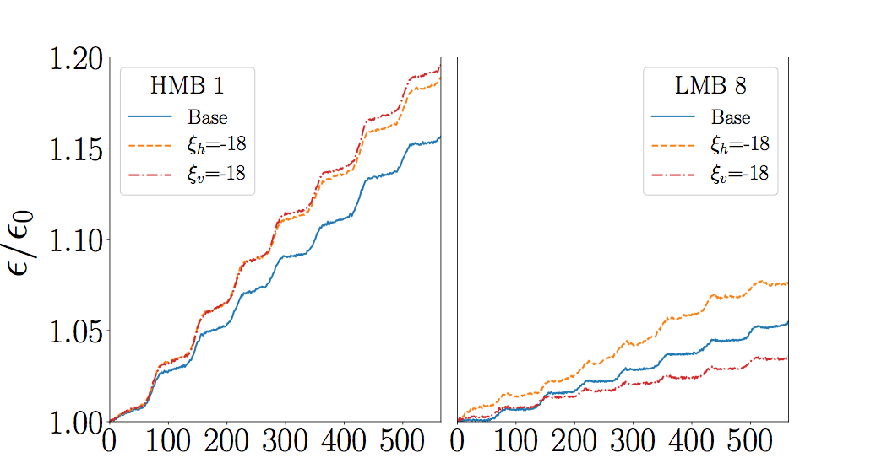
Chromaticity
Higher Chromaticity
also increases growth
in general
Off-Momentum sees
slight improvement due
shift from chromaticity

Slide 15
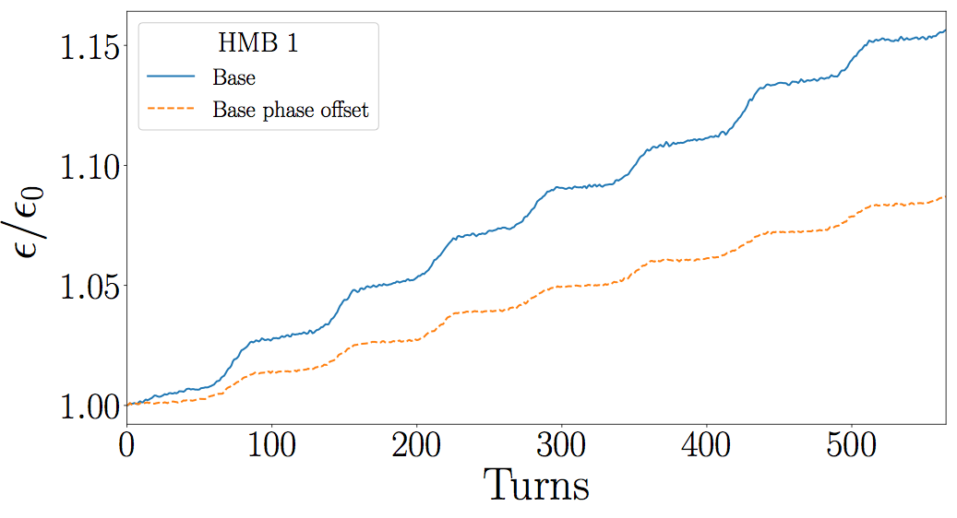
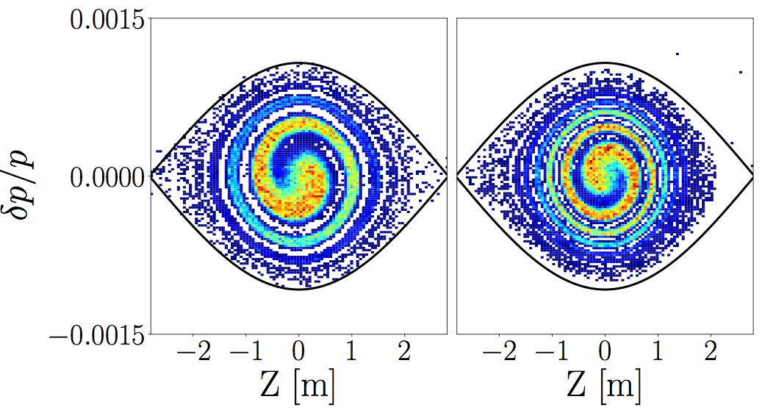
Phase-offset
Base case
with
1.5ns
injection
offset

Slide 16
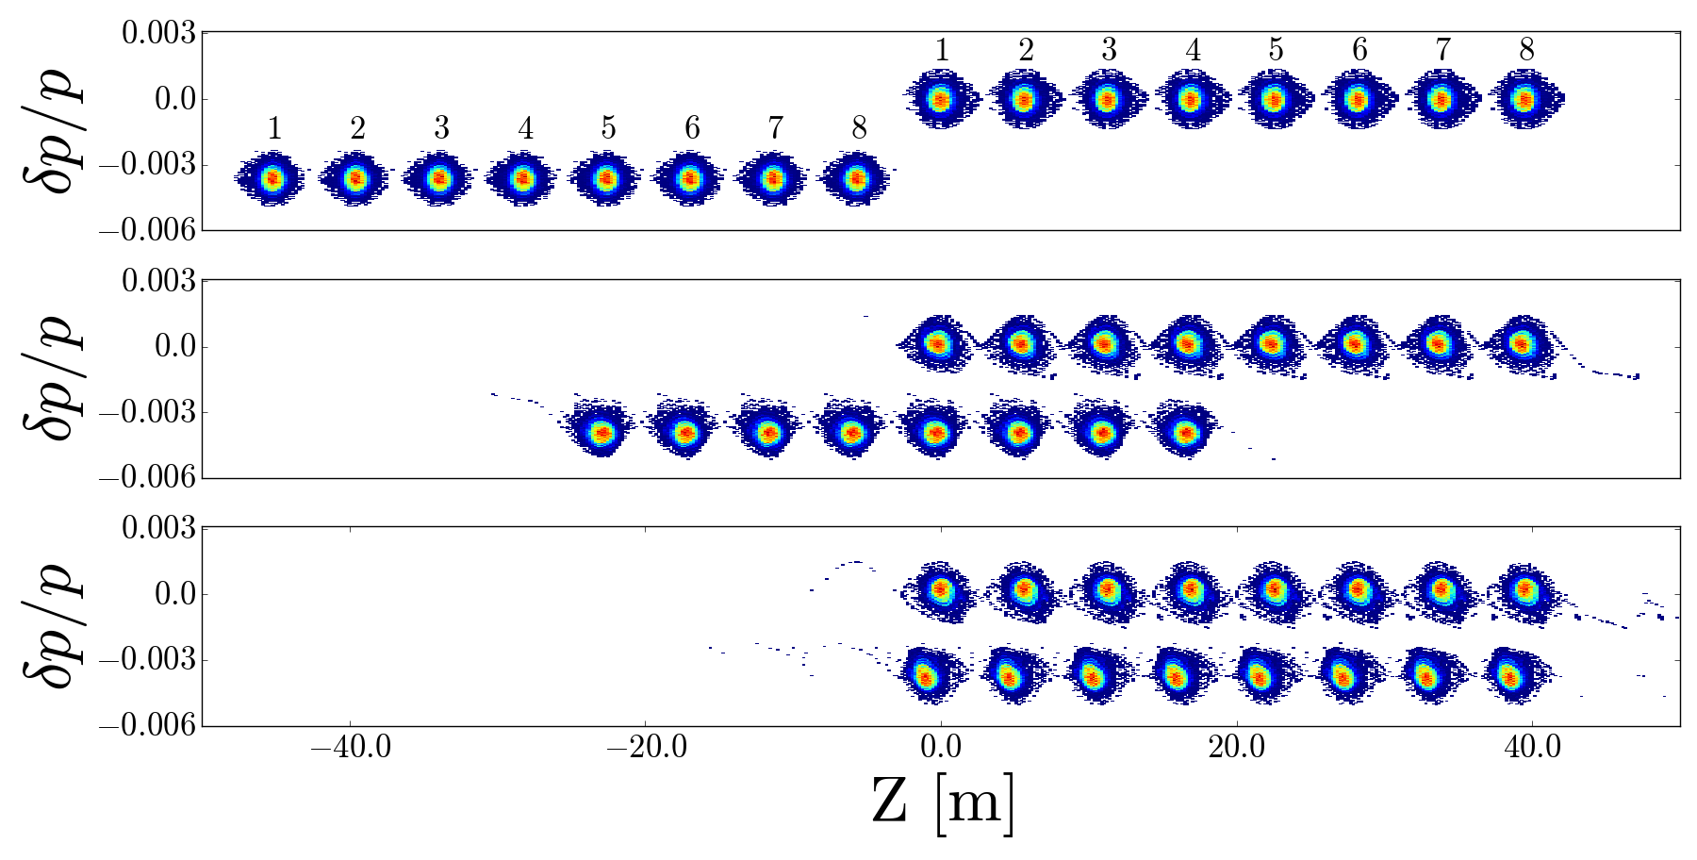
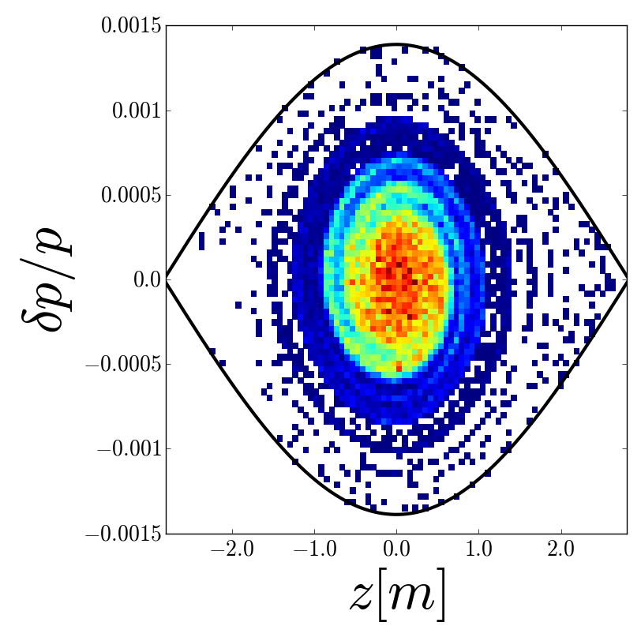
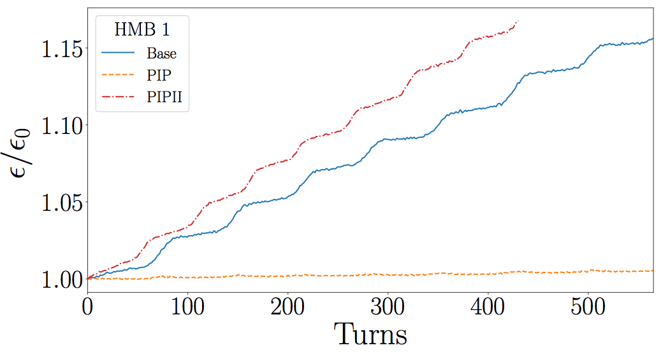
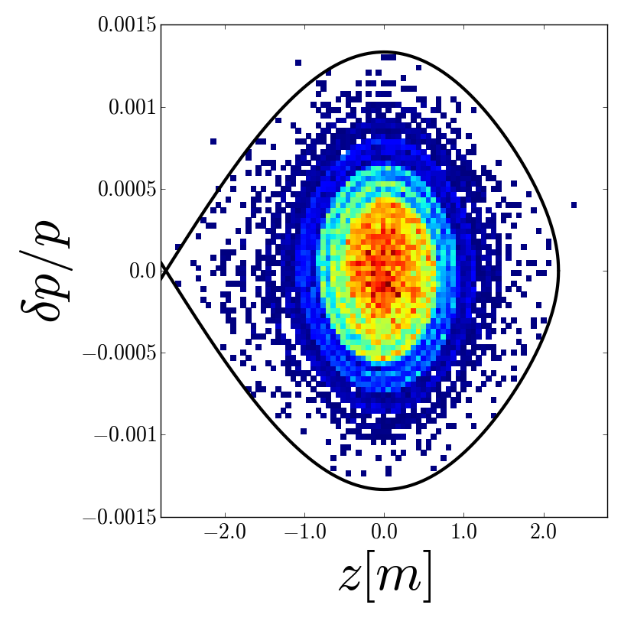
PIPII
Separation
increased
from 1260
to 1680 Hz
80 to 140 kV
15 Hz to 20 Hz

Slide 17
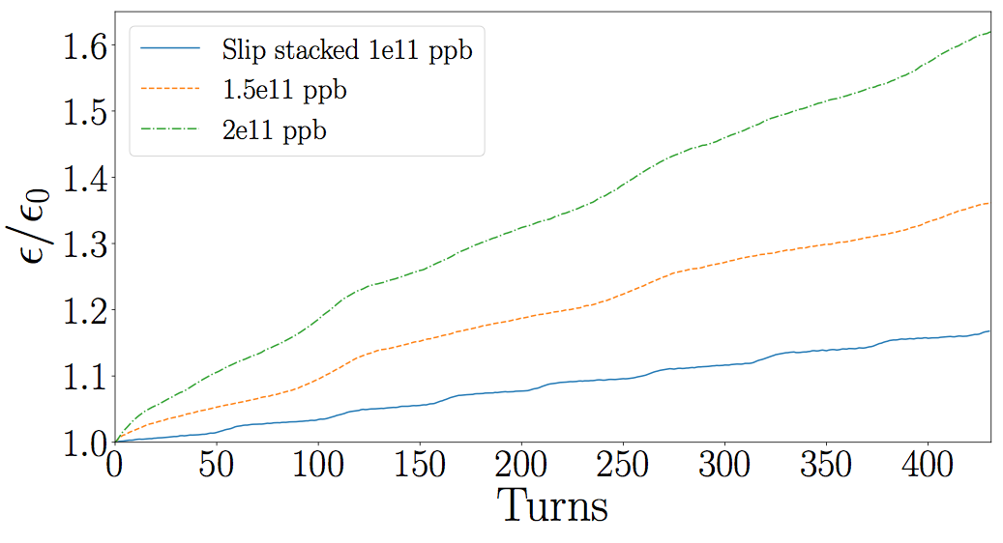
Single bunch vs Slip-stacking

Slide 18
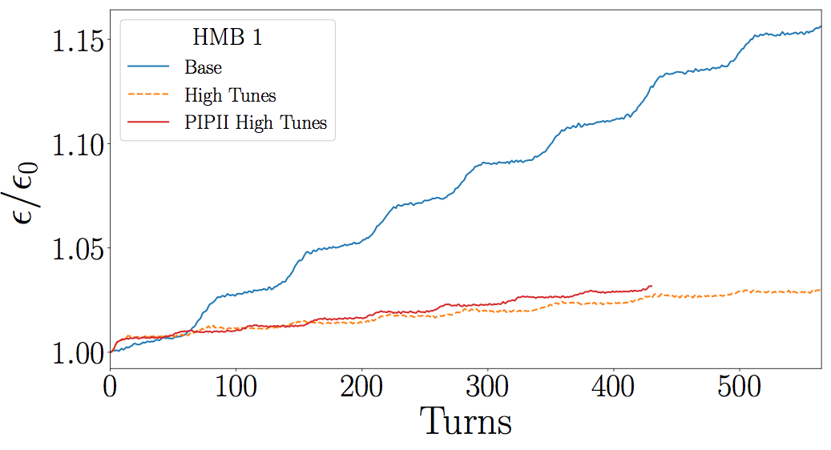
Slip stacking Simulation Conclusions
As intensity increases, the space charge effects from slip-stacking result in emittance growth during the overlaps
The effects can be minimized by optimizing the tunes and using an injection phase offset

Slide 19
Tune space
If the emittance growth comes from hitting a resonance,
can we compensate to widen the tune space?

Slide 20
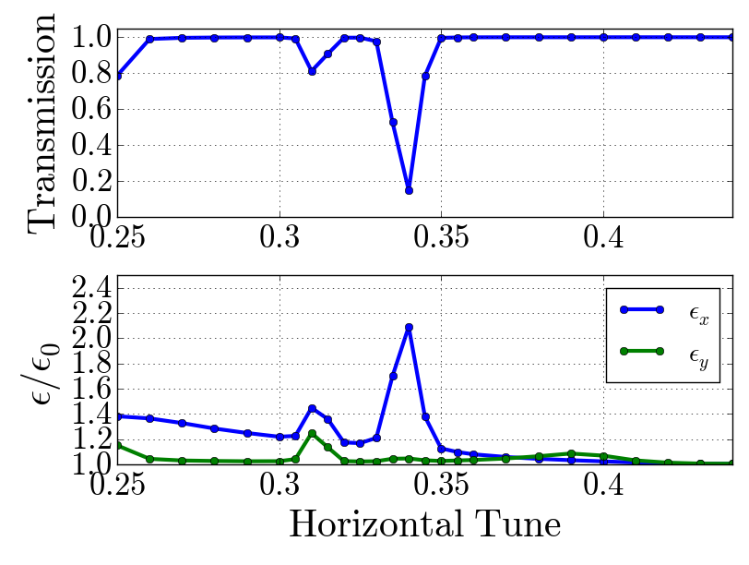
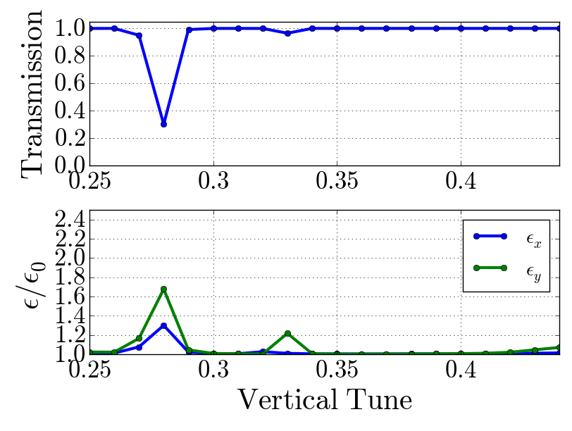
1D tune scans - no space charge

Slide 21
Third order Resonance Compensation
Use sextupoles to make the numerator zero
Need two 90 degrees apart as f3000 is complex
Need a further two 180 deg from the other 2 to compensate the chromaticity change

Slide 22
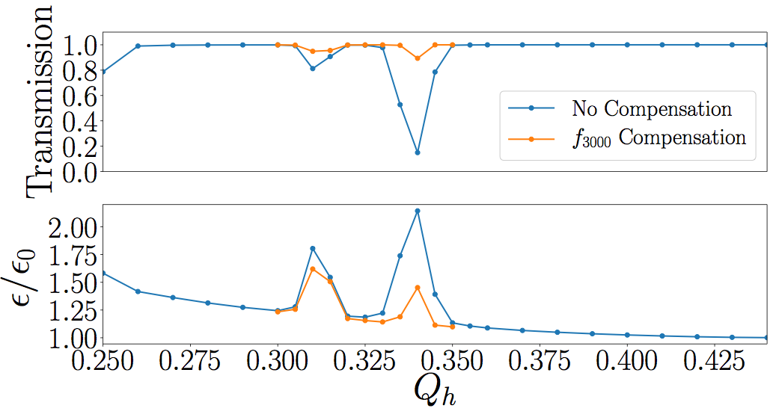
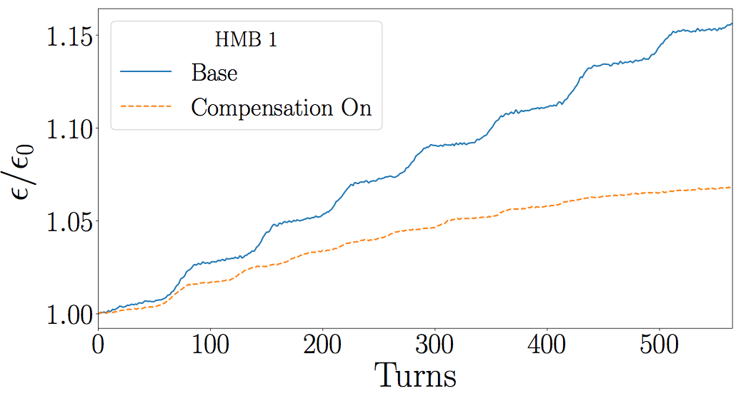
Resonance Compensation
Transmission is improved!
Not 100%, higher order terms
are not compensated
Slip-stacking case shows
saturation within 8 overlaps

Slide 23
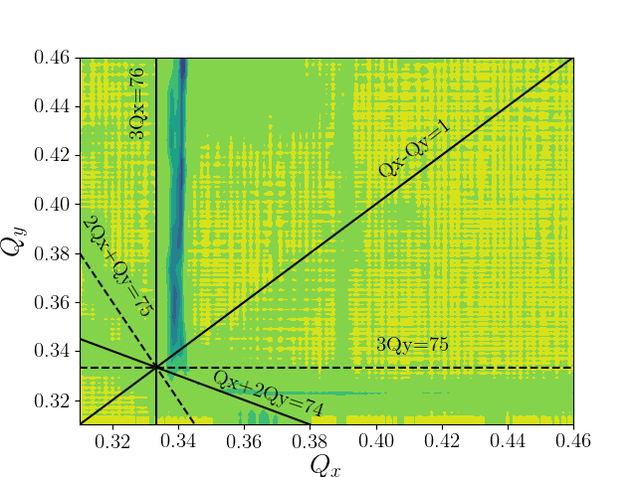
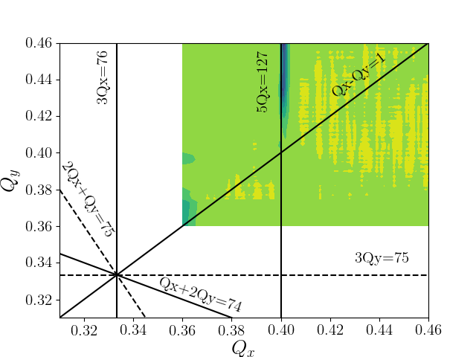
2D Tune Scan - Measured - low intensity

Slide 24
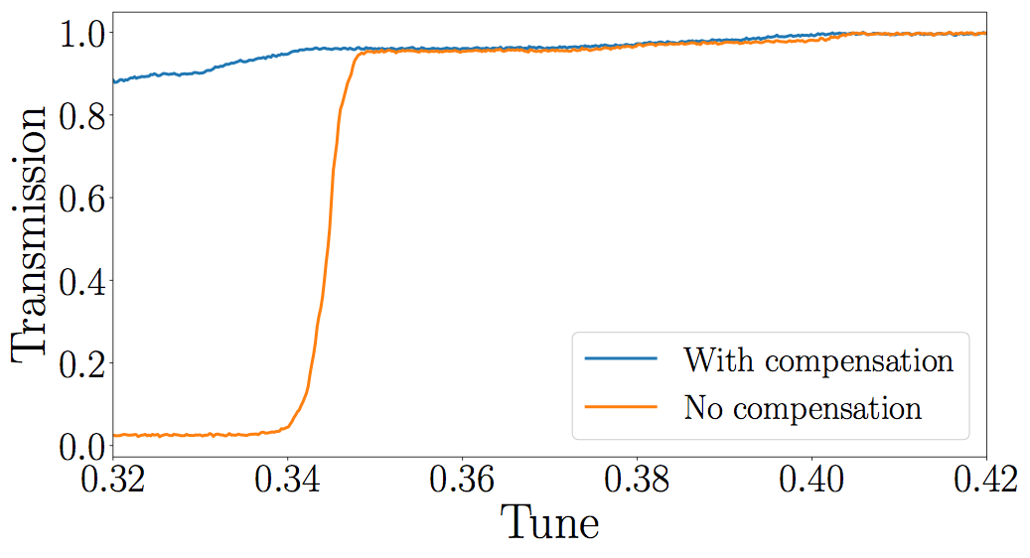
Resonance compensation - Measurements
Attempted to use sextupoles for chromaticity correction to
compensate 3Qx resonance
7.6,-7.6 A on S202,s128
2,-2 A on s412,s116

Slide 25
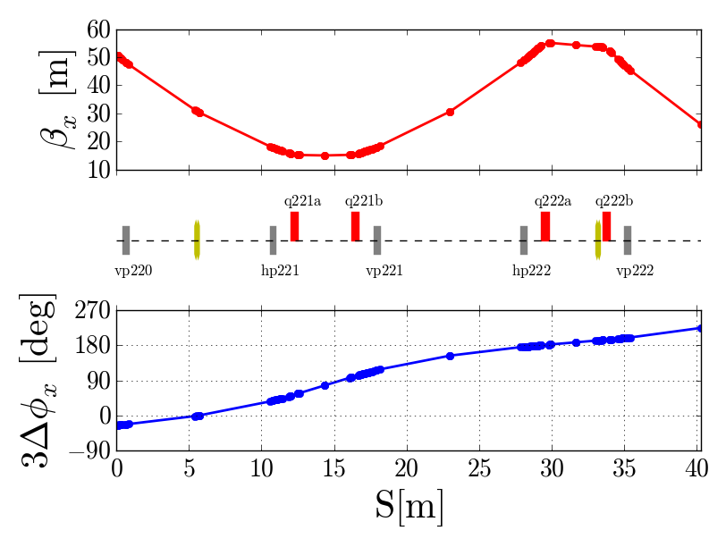
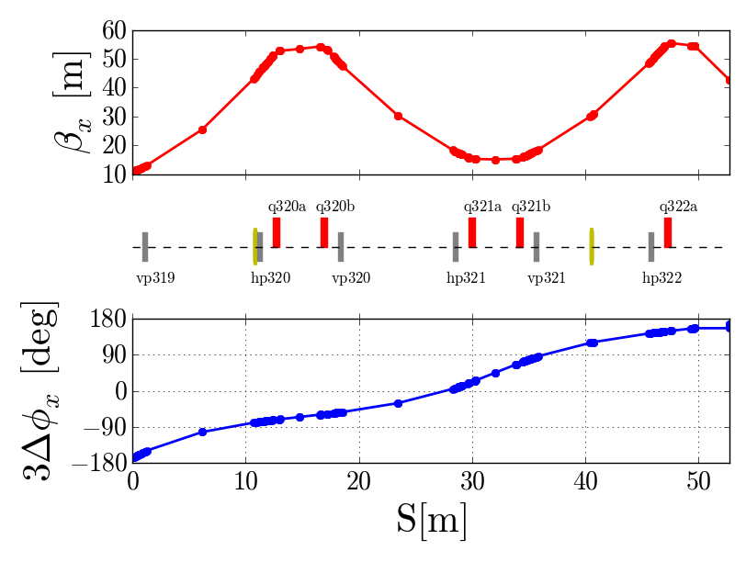
Dedicated scheme
Install 8 sextupoles at 4 locations
2 at each location
High beta
Low dispersion
Less effect on chromaticity
Less orbit diff for slip-stacking
Correct phase advance relationship
So far best options are:
220,222 ~ 3 A
320,322 ~ 5 A

Slide 26
Conclusions
At PIPII intensities and beyond, the large space charge tune shifts caused when bunches overlap result in significant emittance growth as the individual particles tunes cross the third order resonance.
Effect can be minimized by moving working point or by compensating the resonance
Dedicated compensation scheme to be installed this summer

Slide 27
Back-up

Slide 28
Uncaptured beam

Slide 29
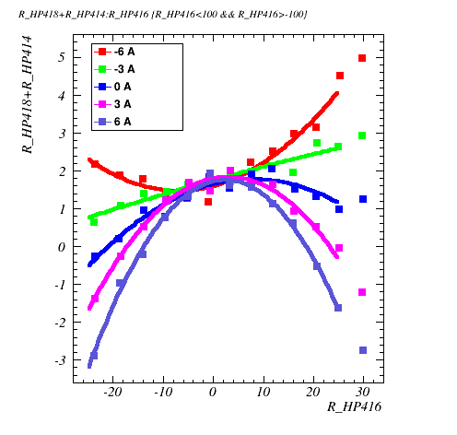
Sextupole scans

