Slide 1
RCS for Multi-MW Facility at Fermilab
Jeffrey Eldred
MW Rings Workshop at Fermilab
May 2018

Slide 2
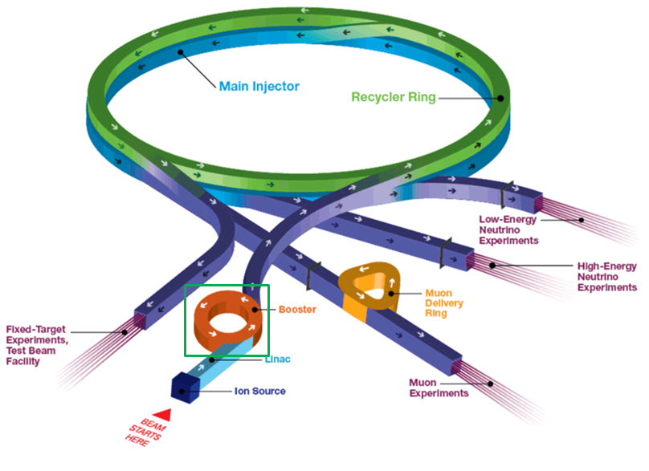
2
2
Fermilab Proton Accelerator Facility
Jeffrey Eldred | RCS for Multi-MW Facility at Fermilab
Notes:
2
2
2
2
2
2

Slide 3
3
Booster Performance
Booster improvement is an ongoing effort
Yesterday’s talks provide a good overview.
Known challenges include:
Transition crossing.
Impedance effects from dipole laminations.
Space-charge forces at injection.
Lattice optics correction.
3
Jeffrey Eldred | RCS for Multi-MW Facility at Fermilab
Notes:
3
3
3

Slide 4
4
4
New RCS for
Multi-MW Facility
4
Jeffrey Eldred | RCS for Multi-MW Facility at Fermilab
Notes:
4
4
4
4
4
4

Slide 5
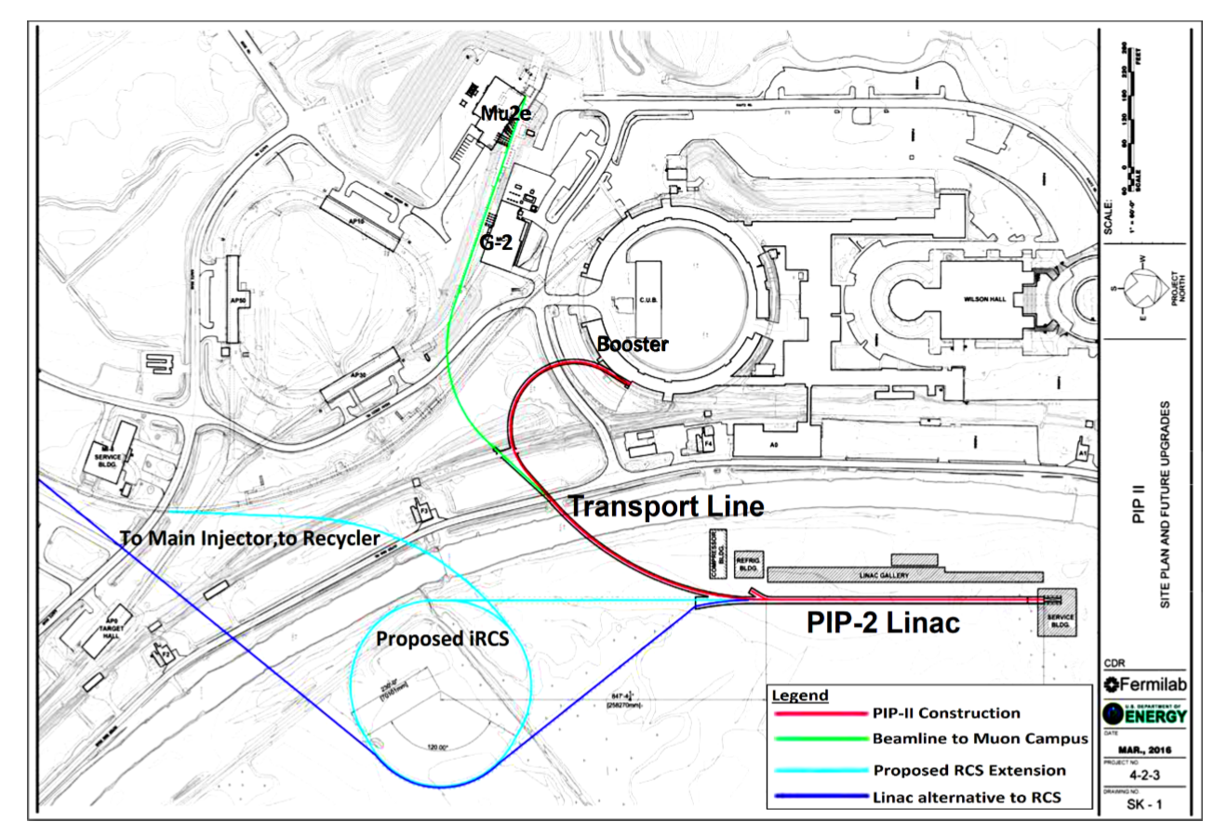
5
5
(Proposed) RCS Intensity Upgrade
5
Jeffrey Eldred | RCS for Multi-MW Facility at Fermilab
Notes:
5
5
5
5
5
5

Slide 6
6
Benefits of Modern RCS Design
Eliminate Transition Crossing
Lattice Improvements for Injection Intensity
Higher periodicity, for suppression of harmonic resonances.
Lower maximum beta functions, for greater beam acceptance.
Well-characterized separate-function magnets, for better optics.
Other Improvements
Reduce sources of impedance.
Dispersion-free RF acceleration.
Perpendicular-bias RF cavities.
Low-SEY coating for mitigation of electron cloud.
6
Jeffrey Eldred | RCS for Multi-MW Facility at Fermilab
Notes:
6
6
6

Slide 7
7
Basic Scenario – Intense Boxcar Stacking
PIP-II for 1.2 MW at 120 GeV:
Booster intensity of 6.5e12 with 20Hz ramp-rate.
Slip-stacking in Recycler.
12 batches in Main Injector with 1.2 sec ramp.
RCS for 2.4 MW at 120 GeV:
RCS intensity of 36e12 with 20Hz ramp-rate.
Boxcar stacking in Recycler (no slip-stacking)
5 batches in Main Injector with 1.4 sec ramp.
To achieve 2.4 MW, we need to quadruple the linear charge density.
If we can do that, an RCS opens options for even higher power.
7
Jeffrey Eldred | RCS for Multi-MW Facility at Fermilab
Notes:
7
7
7

Slide 8
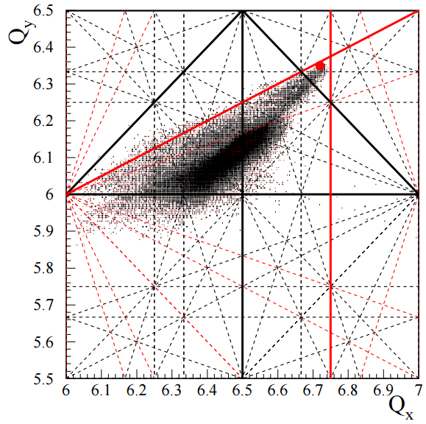
8
Laslett Tune Shift
Laslett tune-shift:
Space-Charge Limit:
ν = 6.5 half-integer resonance constrains Booster to 0.3-0.35
JPARC RCS: Hotchi et. al.
8
Jeffrey Eldred | RCS for Multi-MW Facility at Fermilab
Notes:
8
8
8

Slide 9
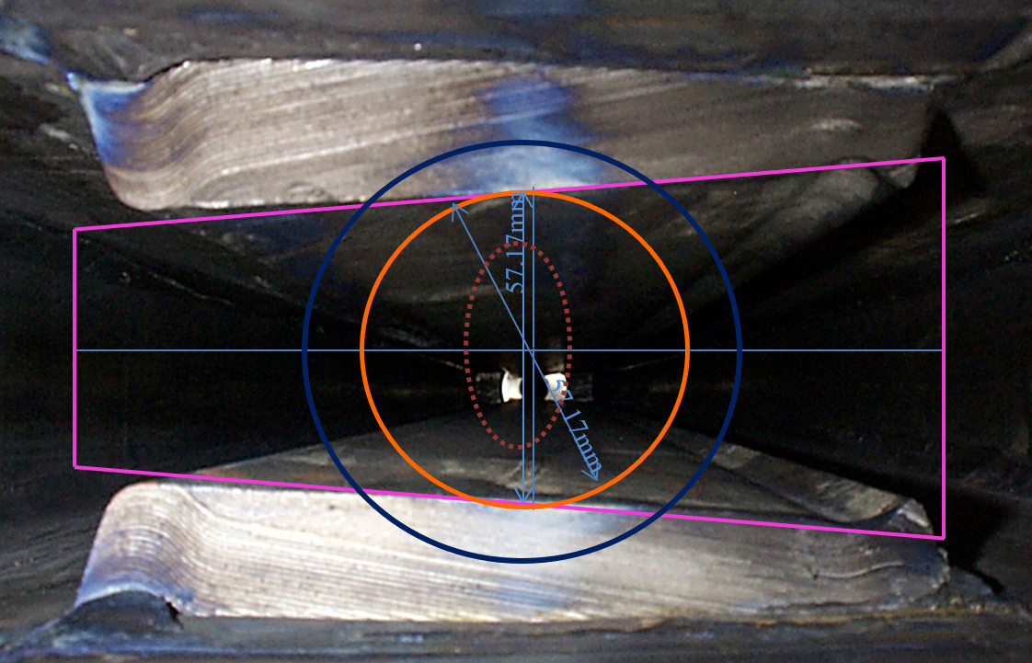
9
Aperture and Emittance
The vertical gap in the Booster is 5.72 cm (2.25’’) at the location where β_{y} = 35 m.
This determines the Booster 95% normalized emittance of 15 mm mrad.
An RCS with smaller betas or higher injection energy can reach a 95% normalized emittance of 30 mm mrad at the same aperture.
T.K. Kroc
Space-Charge Limit:
9
Jeffrey Eldred | RCS for Multi-MW Facility at Fermilab
Notes:
9
9
9

Slide 10
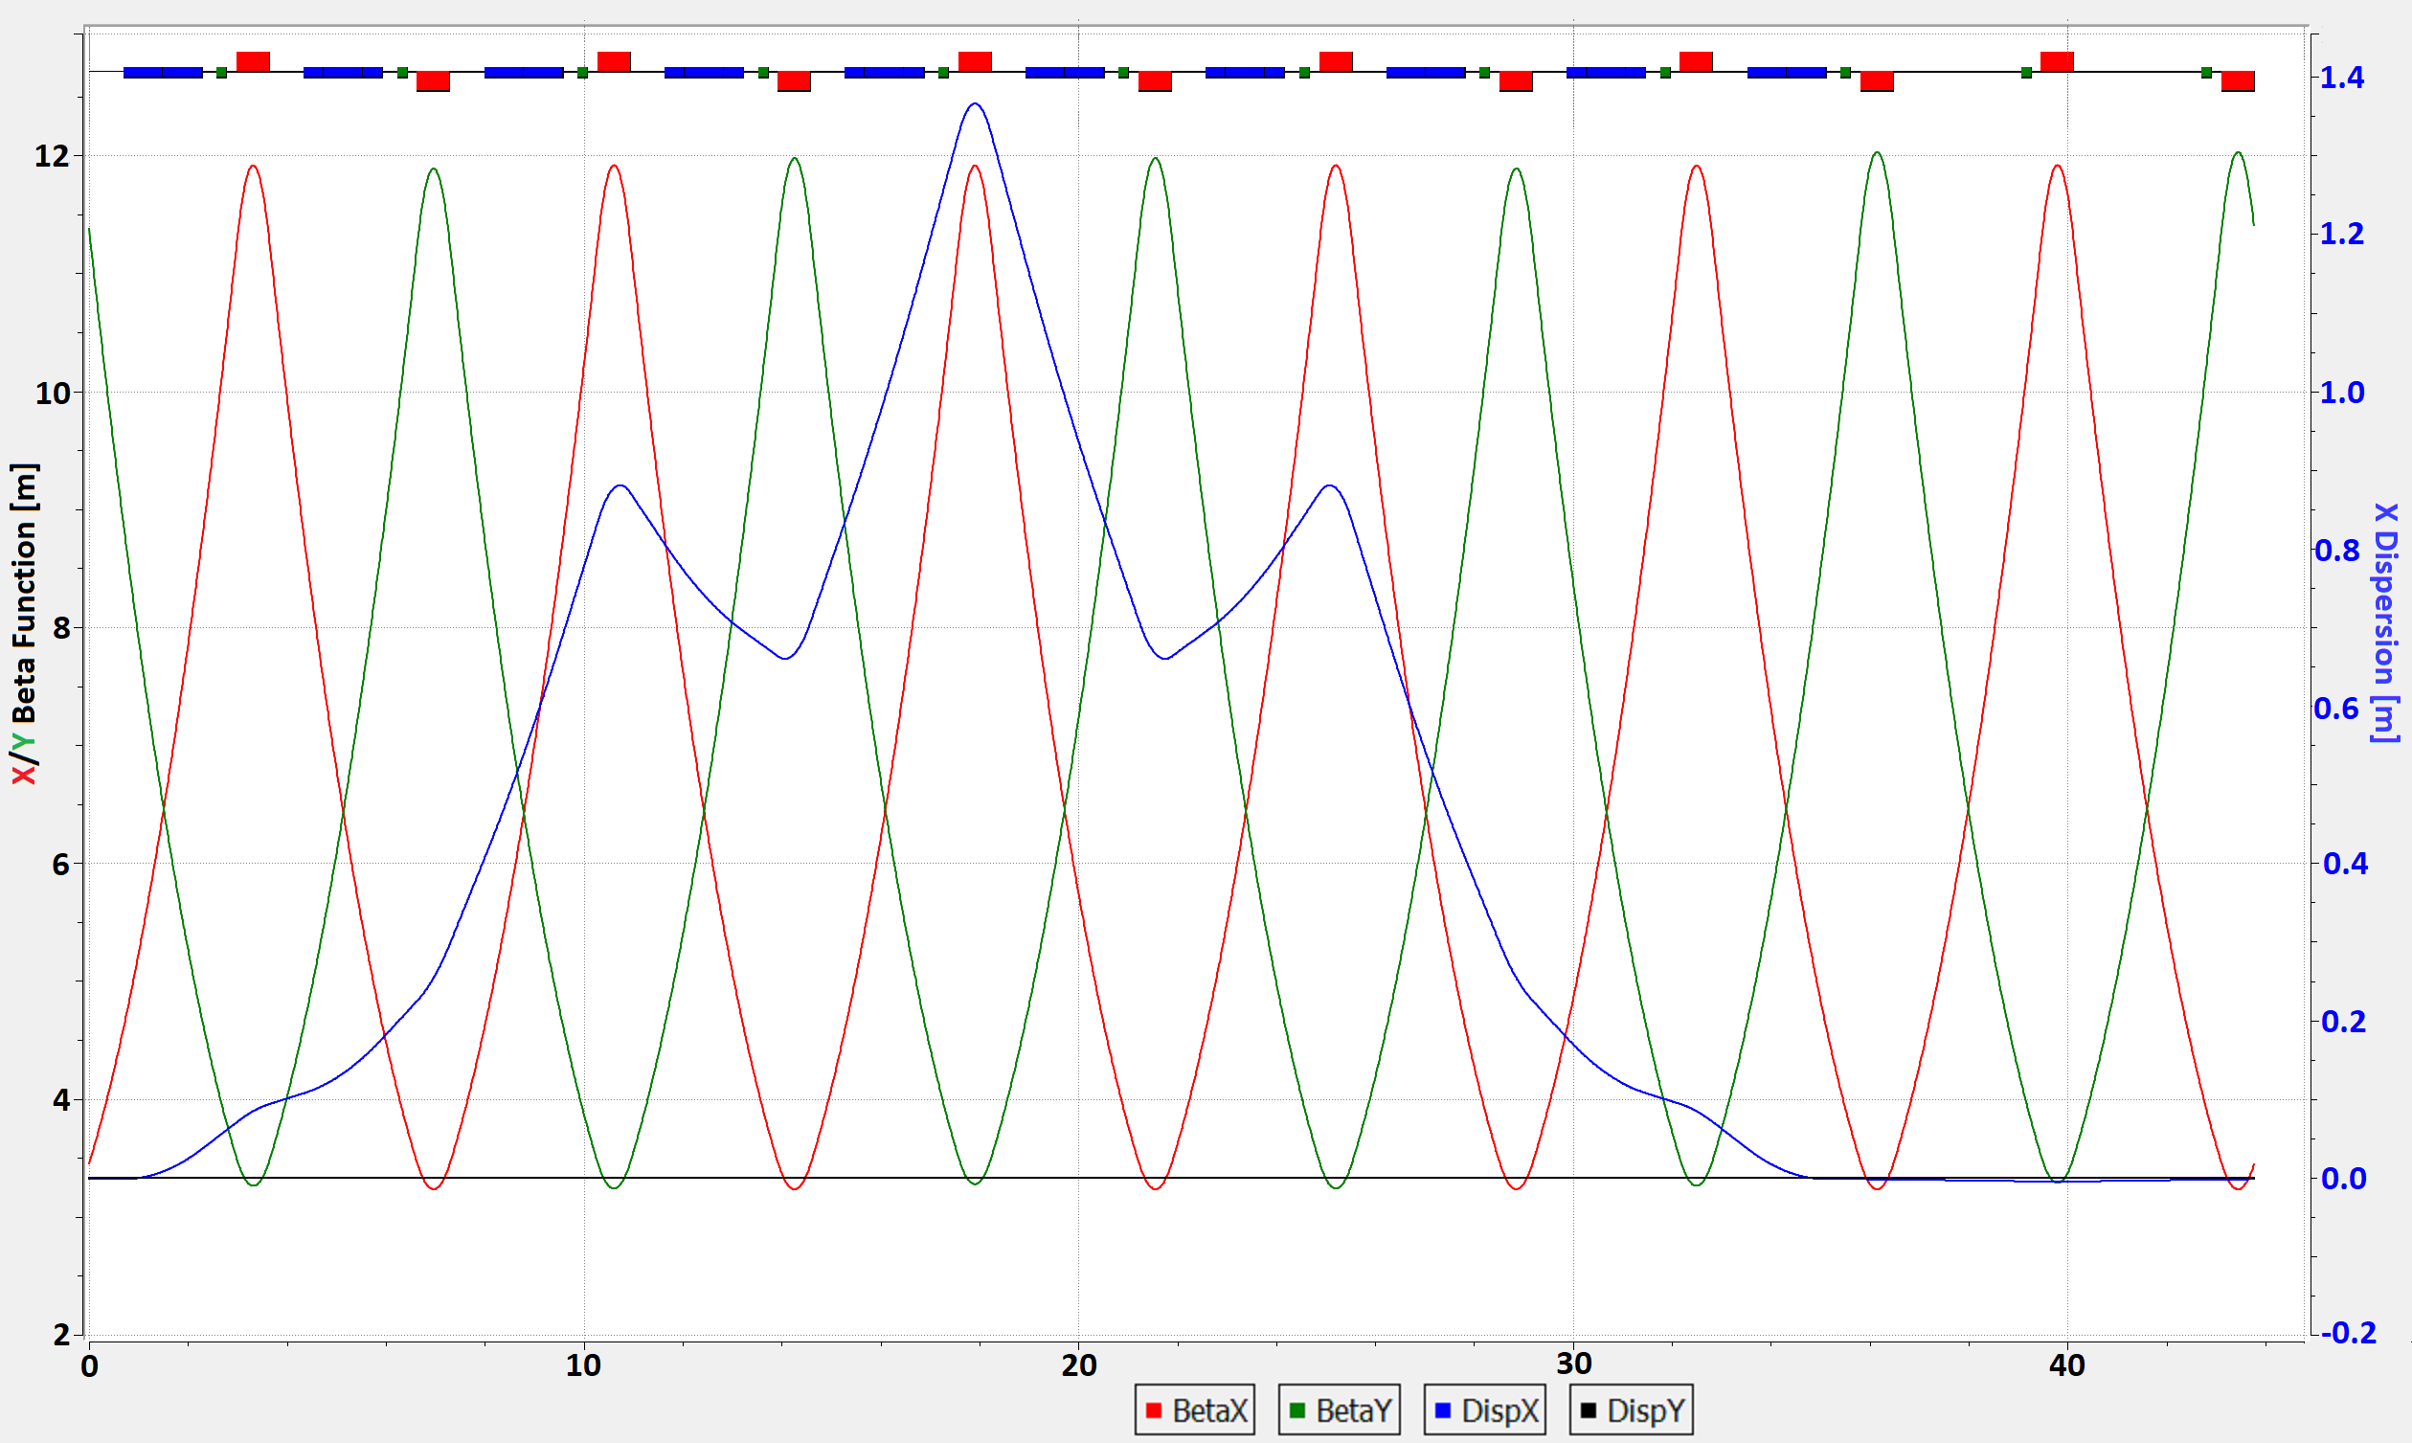
10
Baseline RCS Lattice
Simple FODO Lattice
Avoids Transition
Dispersion-free Arcs
Low Max Beta
Circumference 553 m
Backup slides give additional details.
V. Lebedev
10
Jeffrey Eldred | RCS for Multi-MW Facility at Fermilab
Notes:
10
10
10

Slide 11
11
J-PARC RCS as Precedent
The J-PARC RCS shows intensity of 83e12 protons, 1 MW extracted beam power, 0.30 tune-shift. Hotchi et al. PRAB 2017.
This design has a large aperture (x12 Booster) and goes to 3 GeV. Our ring needs higher energy and cannot benefit from that aperture.
Ring Scaling Exercise:
Scale up injection energy, scale up circumference, scale down aperture, scale down max beta, scale up bunching factor
Keep the ratios between beampipe acceptance, collimator acceptance, and geometric emittance fixed. Keep maximum space-charge tune-shift fixed.
Extraction energy 10 GeV, normalized emittance is 30 mm mrad, dipole gap 5.4 cm, beam intensity 36e12, tune-shift 0.30 .
11
Jeffrey Eldred | RCS for Multi-MW Facility at Fermilab
Notes:
11
11
11

Slide 12
12
Eddy Currents in Vacuum Chamber
Vacuum chamber radius a: 2.8 cm.
Ramp rate: 20 Hz
Vacuum chamber heating power by eddy currents
1.28mm Steel-316: 108 W/m
0.75mm Inconel-625: 36 W/m
Conservative air cooling estimate of convective cooling
heat transfer coefficient 10⁻³ W/cm²/K
1.28mm Steel-316: ΔT = 60 K
0.75mm Inconel-625: ΔT = 20 K
12
Jeffrey Eldred | RCS for Multi-MW Facility at Fermilab
Notes:
12
12
12

Slide 13
13
Integrable RCS Design
An RCS based on demonstrated design principles can reach the performance we need based to achieve 2.4 MW at Fermilab.
The RCS upgrade scenario is not contingent on integrable design.
But integrable RCS lattice designs are worth studying. Strong nonlinear focusing offers a way to suppress halo formation and enhance Landau damping.
13
Jeffrey Eldred | RCS for Multi-MW Facility at Fermilab
Notes:
13
13
13

Slide 14
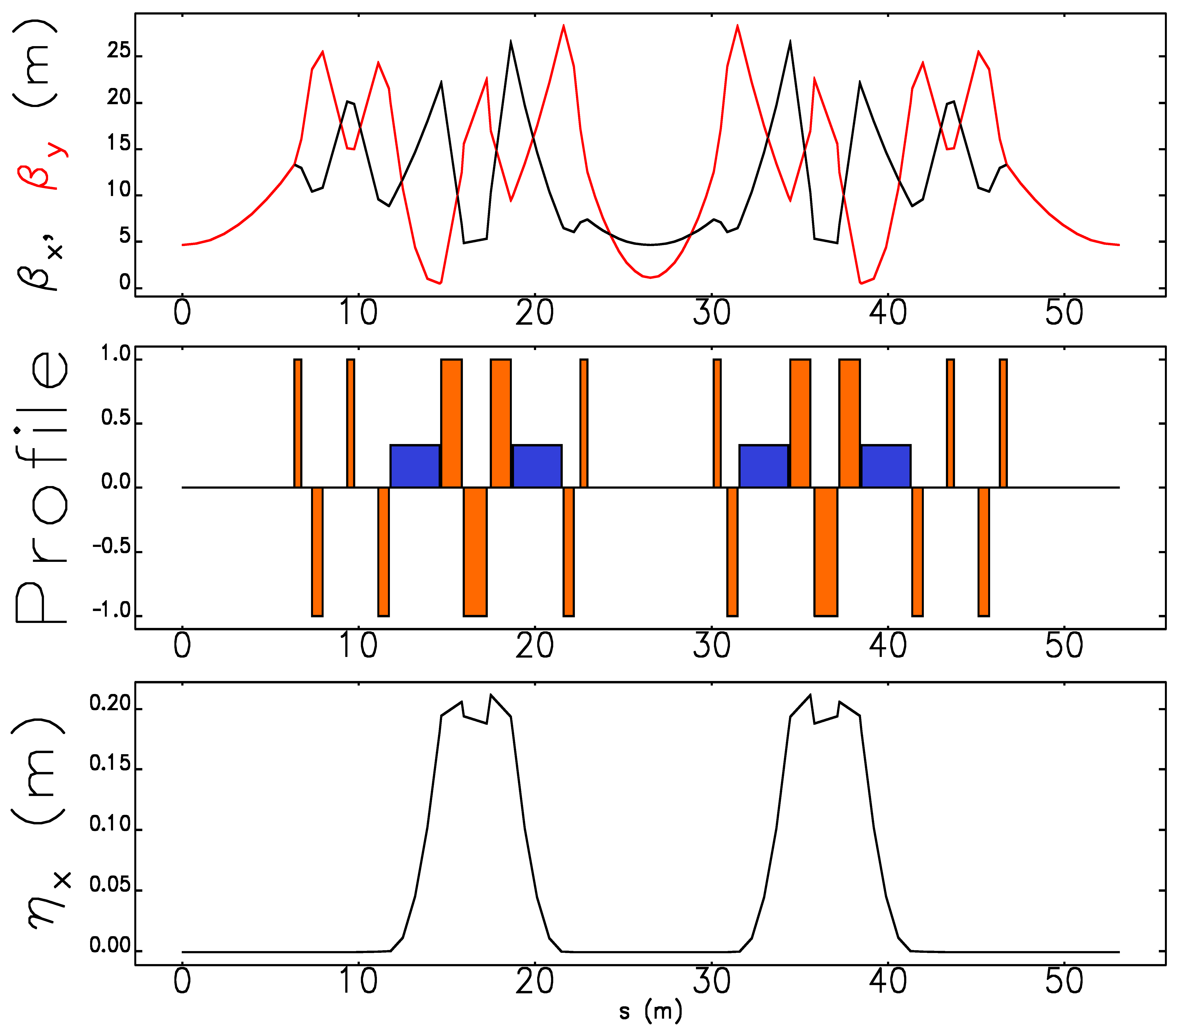
14
Integrable RCS Lattice design
Periodicity: 12
Circumference: 636 m
Bend-radius rho: 15.4 m
Max Beta x,y function: 25 m
Max Dispersion function: 0.22 m
RF Insertion length: 7.2 m, 4x 1.3m
NL Insertion length: 12.7 m
Insert Phase-Advance: 0.4
Minimum c-value: 3 cm
Beta at insert center: 5 m
Betatron Tune: 21.6
Natural Chromaticity: -79
Second-order Chromaticity: 1600
Synchrotron Tune: 0.08
Eldred, Valishev IPAC 2018
14
Jeffrey Eldred | RCS for Multi-MW Facility at Fermilab
Notes:
14
14
14

Slide 15
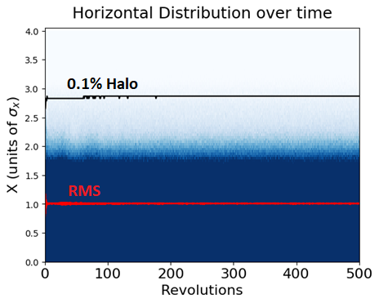
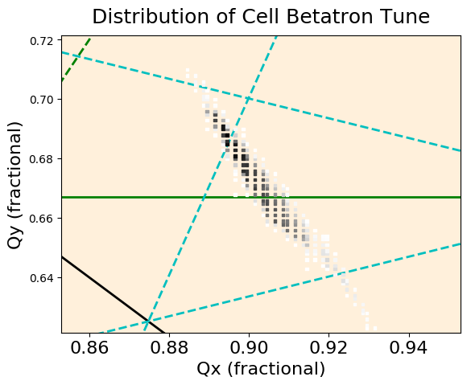
15
Space-charge Simulation of iRCS
Beam injected with 20% mismatch
Laslett tune-shift of 0.4, corresponding to 32e12 protons.
Beam stable 5000 revolutions, halo strongly suppressed.
Caveat: Perfect lattice with no errors.
Eldred,
Valishev
IPAC 2018
15
Jeffrey Eldred | RCS for Multi-MW Facility at Fermilab
Notes:
15
15
15

Slide 16
16
16
Implications for Linac, Recycler and Main Injector
16
Jeffrey Eldred | RCS for Multi-MW Facility at Fermilab
Notes:
16
16
16
16
16
16

Slide 17
17
PIP-II Linac for new RCS
PIP-II Linac
MEBT chops 5 mA RFQ current to 2 mA,
chops two out of five 650MHz bunches.
Delivers 2 mA current every 20 Hz for 0.6 ms.
Linac Intensity Upgrade
RCS intensity of 36e12 with 20Hz ramp-rate.
Fill time with 5 mA current every 20 Hz for 1.3 ms.
Preferable to 2 mA current for 3 ms.
This fill rate requires a power-amplifier upgrade to PIP-II Linac.
17
Jeffrey Eldred | RCS for Multi-MW Facility at Fermilab
Notes:
17
17
17

Slide 18
18
Boxcar Stacking from Booster and Future RCS
Booster Circumference 474 m, 84 buckets.
MI/RR Circumference 3318 m, 7x84 buckets.
MI extraction kicker gap, 24 buckets
Assume the same integrated dipole field per length as the Booster, but consider a larger circumference:
Circumference | N Batches | Max Energy
474 – 530 m | 6 | 8.0 – 9.0 GeV
569 – 656 m | 5 | 9.6 – 10.7 GeV
711 – 796 m | 4 | 12.0 – 13.4 GeV
18
Jeffrey Eldred | RCS for Multi-MW Facility at Fermilab
Notes:
18
18
18

Slide 19
19
Should we use the Recycler?
8-GeV stacking with Recycler
5 batches injected at 20-Hz requires 0.2 seconds.
Using the Recycler for accumulation, MI cycle time goes from 1.4 s. to 1.2 s, for a 1.17 factor improvement in beam power.
10-GeV MI Injection
Laslett tune-spread reduced by factor 1.50 at injection.
Beam size reduced by factor 1.22 at injection.
Incompatible with 8-GeV Recycler.
The RCS should be capable of 10-GeV
We can keep both options open
19
Jeffrey Eldred | RCS for Multi-MW Facility at Fermilab
Notes:
19
19
19

Slide 20
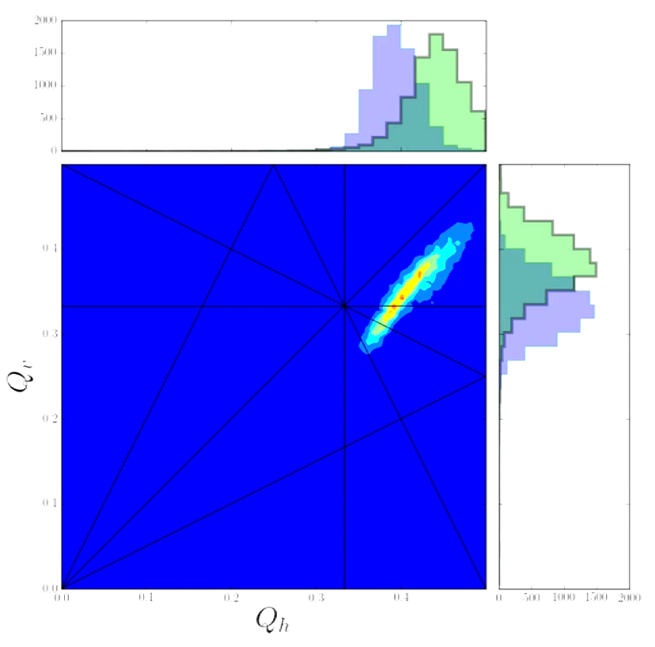
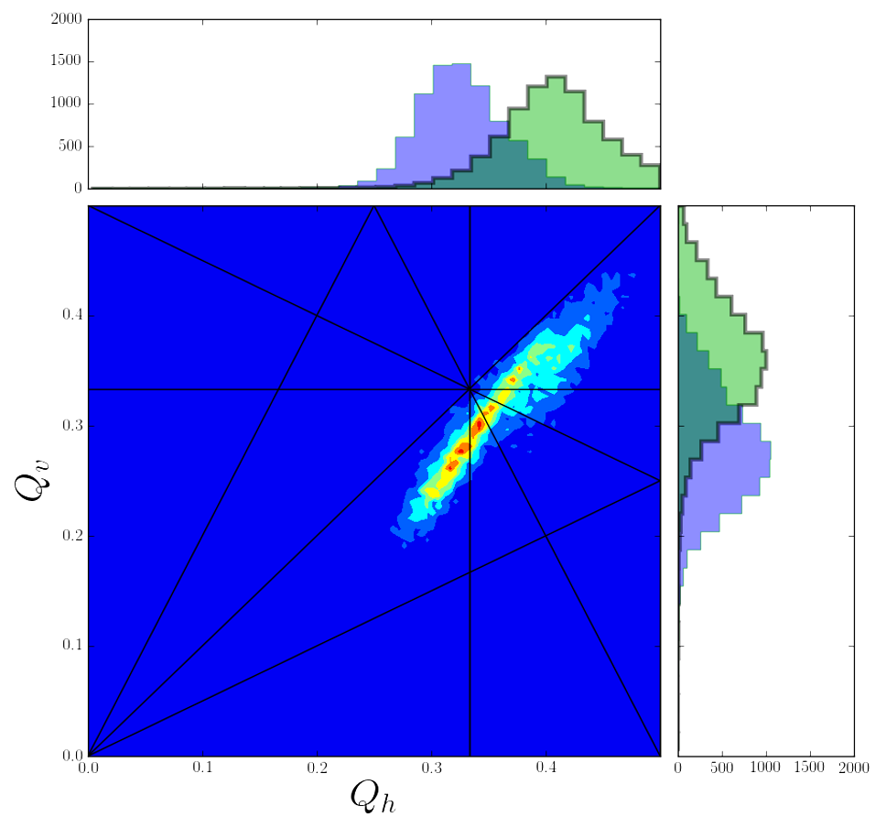
20
Recycler Intensity Limits
Space-charge Tune-spread Losses:
If we go to higher than PIP-II intensity, but without a momentum separation between the beams, we will cross the same res. lines.
How well can we compensate the resonances lines?
Current Tune-Spread
PIP-II Tune-Spread
R. Ainsworth
20
Jeffrey Eldred | RCS for Multi-MW Facility at Fermilab
Notes:
20
20
20

Slide 21
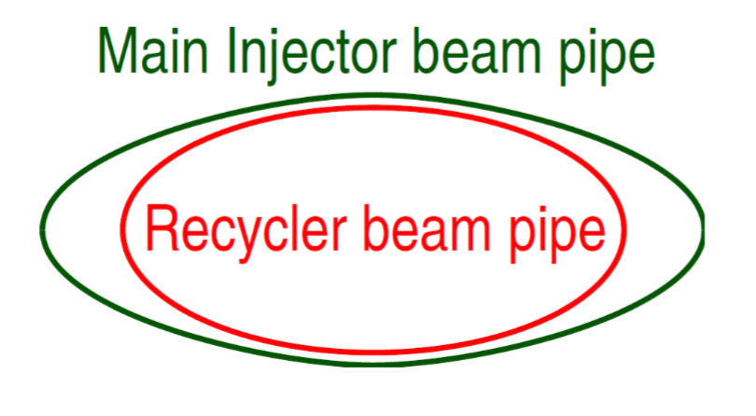
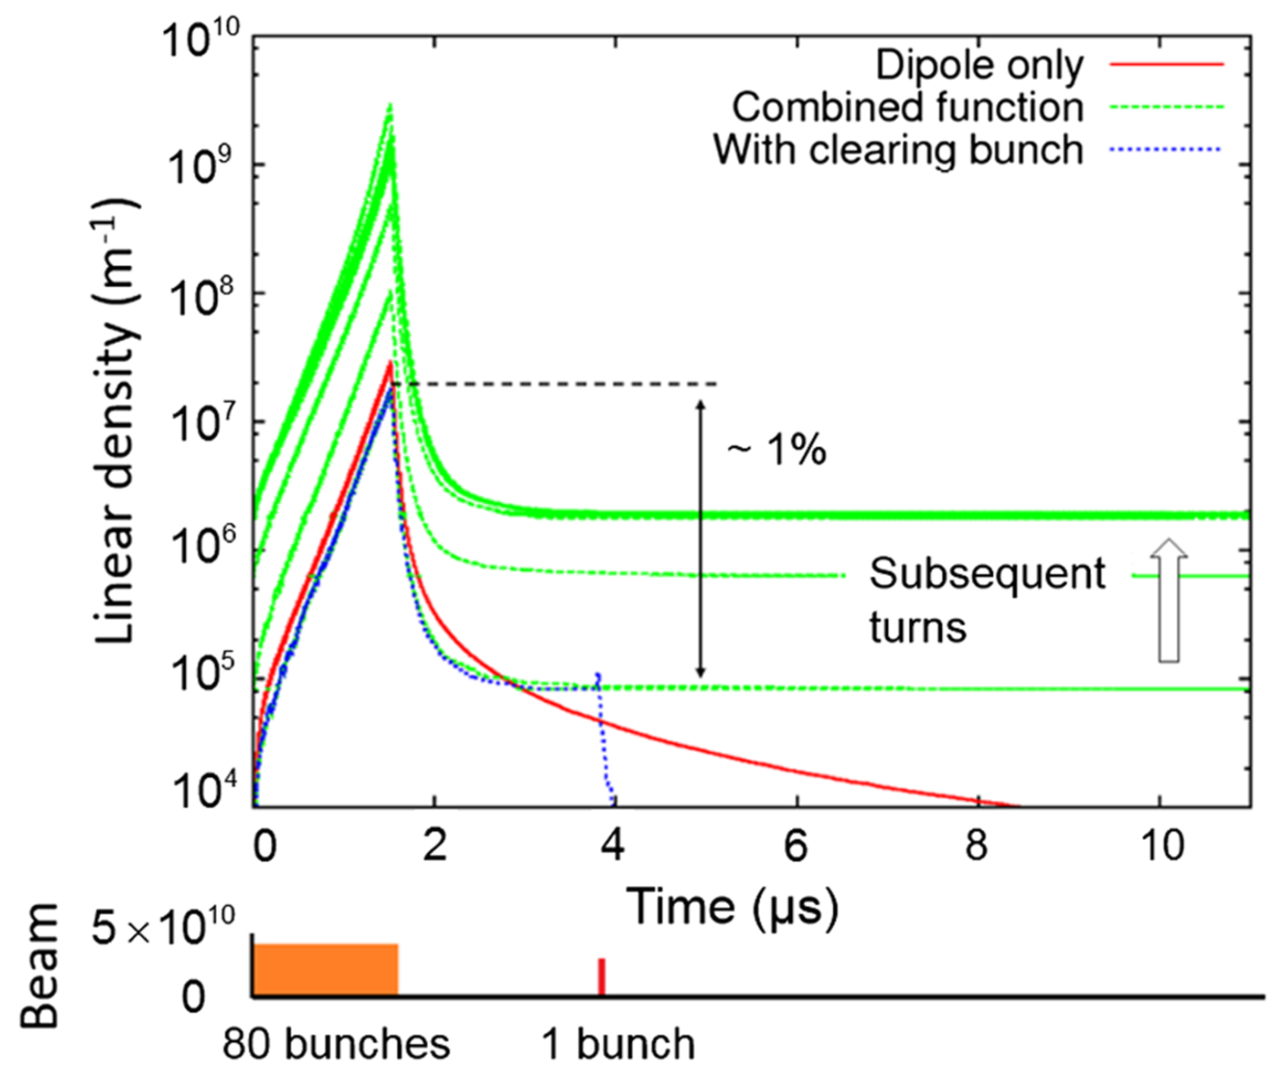
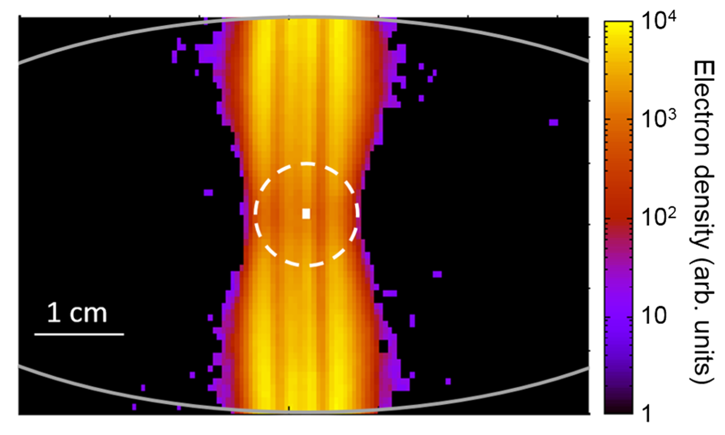
21
Recycler Intensity Limits
Tight Aperture Losses:
For PIP-II era, smaller cleaner beam.
For RCS, limited by RR/MI apertures.
Electron Cloud Instability:
S. Antipov et al. PRSTAB 2017
21
Jeffrey Eldred | RCS for Multi-MW Facility at Fermilab
Notes:
21
21
21

Slide 22
22
Main Injector Intensity Upgrade
Aperture and Space-charge Tune-spread
4.3 mm mrad aperture restriction for MI
40 mm mrad normalized admittance at 8 Gev or 50 mm mrad at 10 GeV.
Alleviated by injecting into MI at higher energy.
Lattice correction of harmonic betatron resonances.
Reactive power needed to drive RF cavities
For PIP-II we can add new power amplifiers to existing RF cavities.
For 2.4 MW, we need to replace RF cavities and PAs.
γ_{T}-Jump for MI Transition Crossing
High-Power Neutrino Target
22
Jeffrey Eldred | RCS for Multi-MW Facility at Fermilab
Notes:
22
22
22

Slide 23
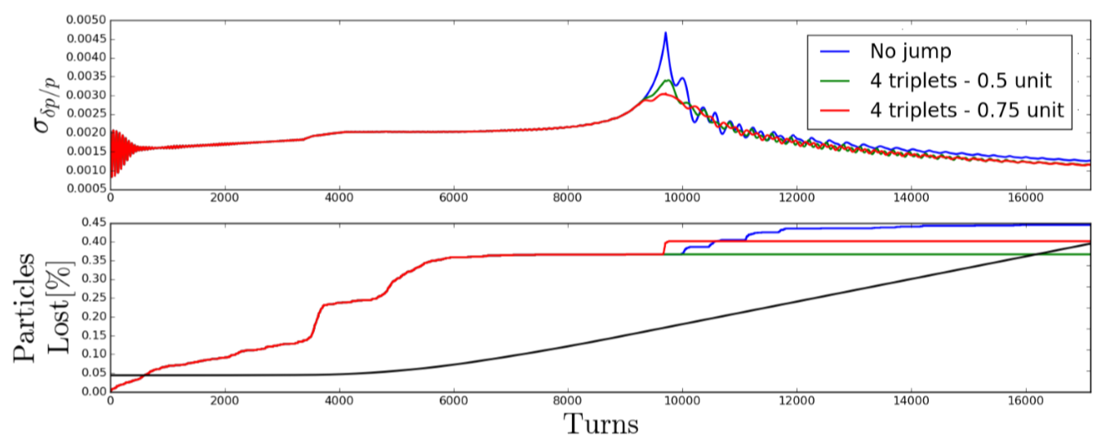
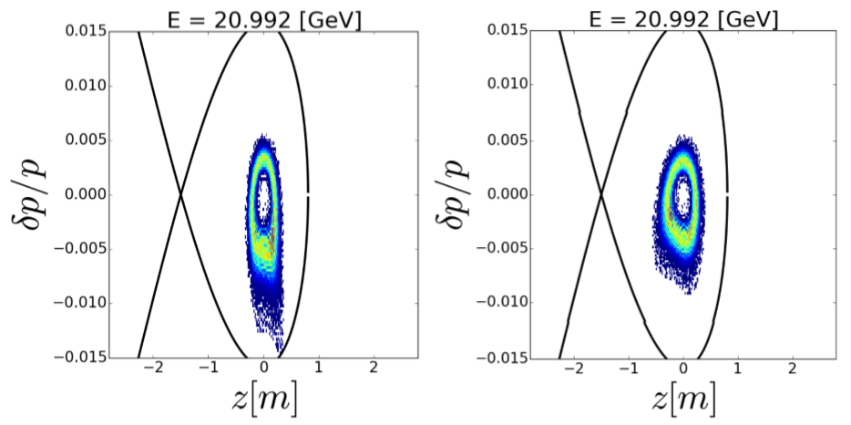
23
Main Injector Intensity Upgrade
γ_{T}-Jump for MI Transition Crossing
Pulsed quads for γ_{T}-jump to be installed for PIP-II.
For 2.4 MW, consider going from negative to positive chromaticity at transition crossing.
R. Ainsworth et al. IPAC 2017
23
Jeffrey Eldred | RCS for Multi-MW Facility at Fermilab
Notes:
23
23
23

Slide 24
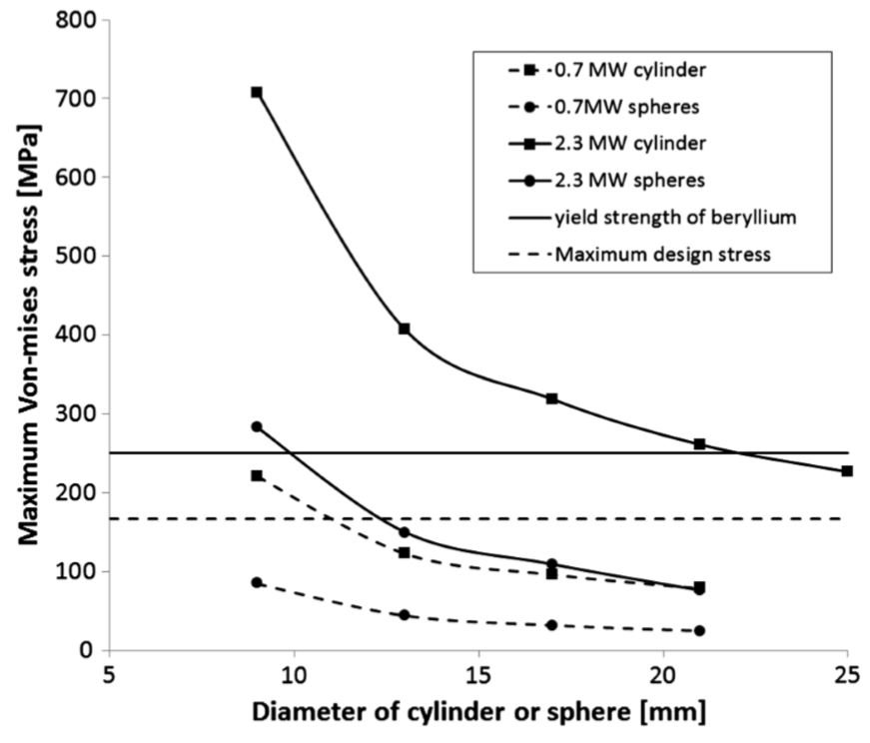
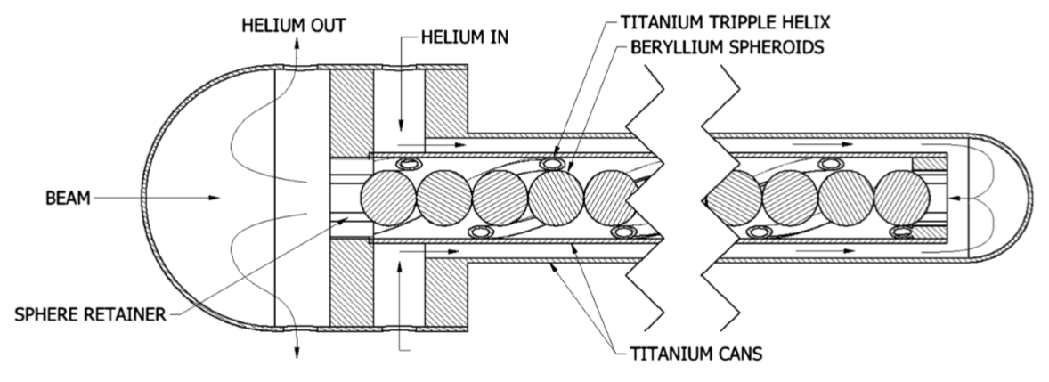
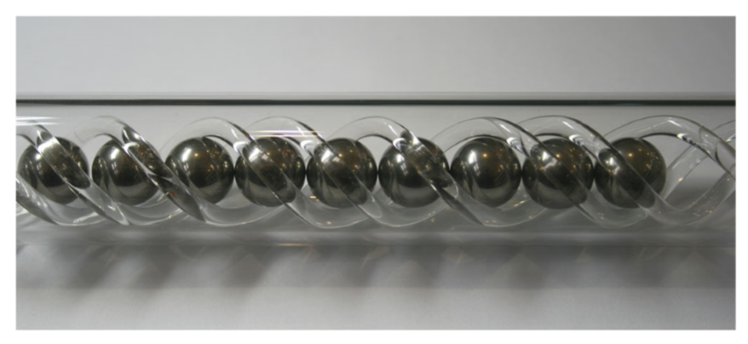
24
Main Injector Intensity Upgrade
High-Power Neutrino Target
Detailed design of 2.3 MW Be target for neutrino beams.
Active area of R&D development – shock test, radiation damage, target design, flux optimization etc.
T. Davenne et al. PRSTAB 2015
24
Jeffrey Eldred | RCS for Multi-MW Facility at Fermilab
Notes:
24
24
24

Slide 25
25
25
Beyond 2.4 MW
25
Jeffrey Eldred | RCS for Multi-MW Facility at Fermilab
Notes:
25
25
25
25
25
25

Slide 26
26
Options for Intensity Beyond 2.4 MW
If future physics experiments need even higher power proton beams at 120 GeV, how can that be accomplished?
Options:
1) Better performance from the new RCS
IOTA technologies such as integrable optics or electron lenses?
2) Extend PIP-II linac to raise RCS injection energy
An upgrade to a 1.4 GeV Linac could double the RCS intensity.
3) Reduce MI ramp time
Add magnet power supplies, RF stations, replace RF cavities
4) Use 4+5 Slip-Stacking with a harmonic cavity
Use harmonic RF to improve stability and bring RF buckets closer.
Stack in the Main Injector, +50% beam power
Or build a new Recycler, +80% beam power.
26
Jeffrey Eldred | RCS for Multi-MW Facility at Fermilab
Notes:
26
26
26

Slide 27
27
Conclusions
A new RCS can quadruple intensity per unit length by avoiding transition crossing, reducing betas, increasing periodicity, and improving lattice correction.
To fill the RCS at 5 mA, the PIP-II Linac would require a power amplifier upgrade.
It may be preferable to inject directly into the MI at 10-GeV and eliminate the use of the Recycler.
At 2.4 MW, the Main Injector would need to new RF cavities and PAs to provide the reactive power for the beam loading.
An RCS also opens up good options beyond 2.4 MW.
27
Jeffrey Eldred | RCS for Multi-MW Facility at Fermilab
Notes:
27
27
27

Slide 28
28
28
Backup
28
Jeffrey Eldred | RCS for Multi-MW Facility at Fermilab
Notes:
28
28
28
28
28
28

Slide 29
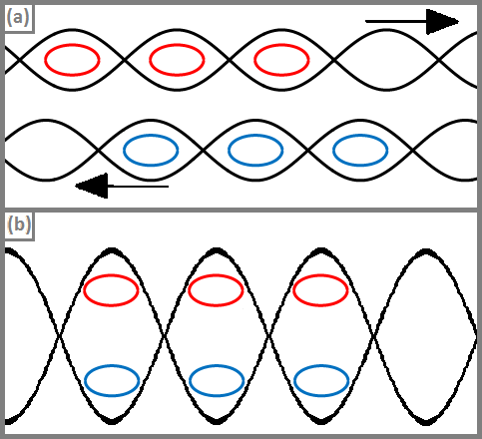
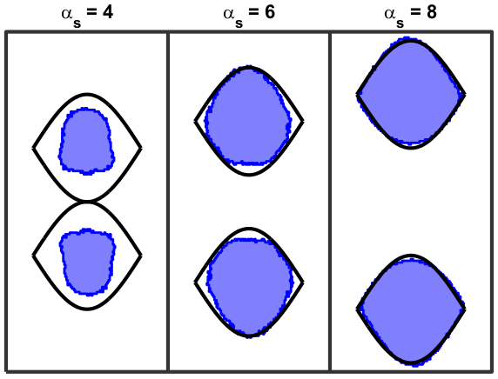
29
Eldred, Zwaska PRAB 2016
Harmonic Slip-stacking
29
Jeffrey Eldred | RCS for Multi-MW Facility at Fermilab
Notes:
29
29
29

Slide 30
30
30
Backup
Lebedev RCS Design
30
Jeffrey Eldred | RCS for Multi-MW Facility at Fermilab
Notes:
30
30
30
30
30
30

Slide 31
31
31
31
Jeffrey Eldred | RCS for Multi-MW Facility at Fermilab
Notes:
31
31
31
31
31
31

Slide 32
32
32
32
Jeffrey Eldred | RCS for Multi-MW Facility at Fermilab
Notes:
32
32
32
32
32
32

Slide 33
33
33
33
Jeffrey Eldred | RCS for Multi-MW Facility at Fermilab
Notes:
33
33
33
33
33
33

Slide 34
34
34
34
Jeffrey Eldred | RCS for Multi-MW Facility at Fermilab
Notes:
34
34
34
34
34
34

Slide 35
35
35
35
Jeffrey Eldred | RCS for Multi-MW Facility at Fermilab
Notes:
35
35
35
35
35
35

Slide 36
36
36
36
Jeffrey Eldred | RCS for Multi-MW Facility at Fermilab
Notes:
36
36
36
36
36
36

Slide 37
37
37
37
Jeffrey Eldred | RCS for Multi-MW Facility at Fermilab
Notes:
37
37
37
37
37
37

Slide 38
38
38
38
Jeffrey Eldred | RCS for Multi-MW Facility at Fermilab
Notes:
38
38
38
38
38
38

Slide 39
39
39
39
Jeffrey Eldred | RCS for Multi-MW Facility at Fermilab
Notes:
39
39
39
39
39
39

Slide 40
40
40
40
Jeffrey Eldred | RCS for Multi-MW Facility at Fermilab
Notes:
40
40
40
40
40
40

