Slide 1
Space Charge Effects in CERN Machines
F. Schmidt convener of the SC WG
The present and former members of the SC working group are: S. Albright, Y. Alexahin, J. Amundson, F. Antoniou, F. Asvesta, H. Bartosik, E. Benedetto, N. Biancacci, M. Carla', C. Carli, S.M. Cousineau, E. Forest, V. Forte, G. Franchetti, S. Gilardoni, J. Holmes, A. Huschauer, V. Kapin, M.A. Kowalska, J.B. Lagrange, S. Machida, M. Martini, E. Métral, L.P. Michelotti, A. Molodozhentsev, C. Montag, D. Moreno, A. Oeftiger, J. Qiang, H. Rafique, A. Saa Hernandez, F.Schmidt,
M. Serluca, A.P. Shishlo, G. Sterbini, E.G. Stern, M. Titze, R. Wasef, E. Wildner, P. Zisopoulos, M. Zampetakis.

Slide 2
Contents
Some relevant SC Issues at the CERN Machines
Tune Ripple & Transmission Line ➔ Do here?!?
Resonance Analysis & Plans ➔ Know our Tools!
SC Code Bench-Marking & Noise

Slide 3
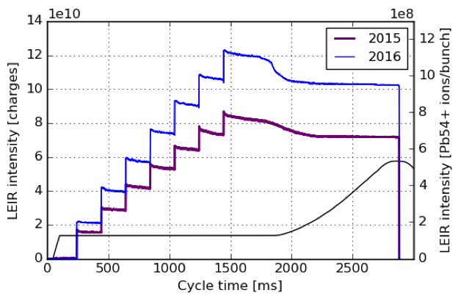
LEIR I A. Huschauer et al.
Periodic resonance crossing induced by SC ➔ Losses
Incoherent SC tune spread easily exceeds 0.2 after RF capture
Solution: Flattening the longitudinal bunch profile; optimizing the machine settings
Resonances due space charge potential

Slide 4
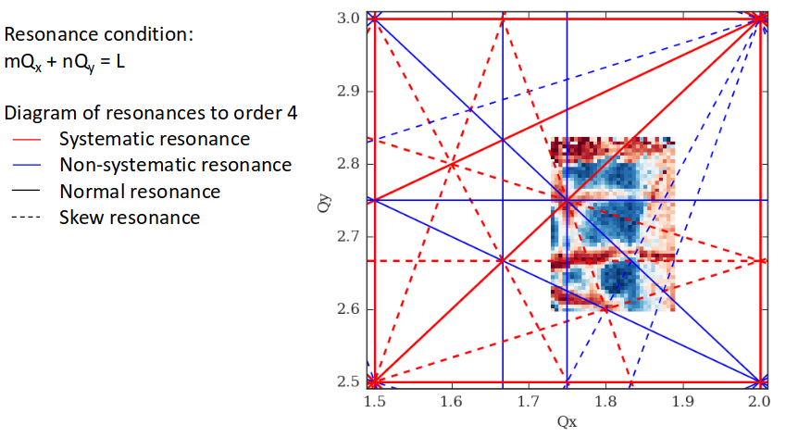
LEIR II: Space charge studies on current WP N. Biancacci 2nd CERN SC Collaboration Meeting
Extensive measurement campaign performed from 2015 to now:
Static and dynamic tune scans
Maps of losses and emittance blowup
Resonance compensation with chromatic and harmonic sext.
Identified:
$Q_{y}=2.75$: possibly related to:
4th order from lattice (4Qy=11)
8th order from SC (8Qy=22)
$Q_{y}=2.66$: possibly related to:
3rd order from lattice (3Qy=8)
6th order from SC (6Qy=16)
${Q_{x}+2Q}_{y}$: possibly related to:
3rd order from lattice (Qx+2Qy=7)
6th order from SC (2Qx+4Qy=14)
$$Q_{y}=2.75$$
WP
$$Q_{y}=2.66$$
$${Q_{x}+2Q}_{y}$$
A.Saa Hernandez IPAC18

Slide 5
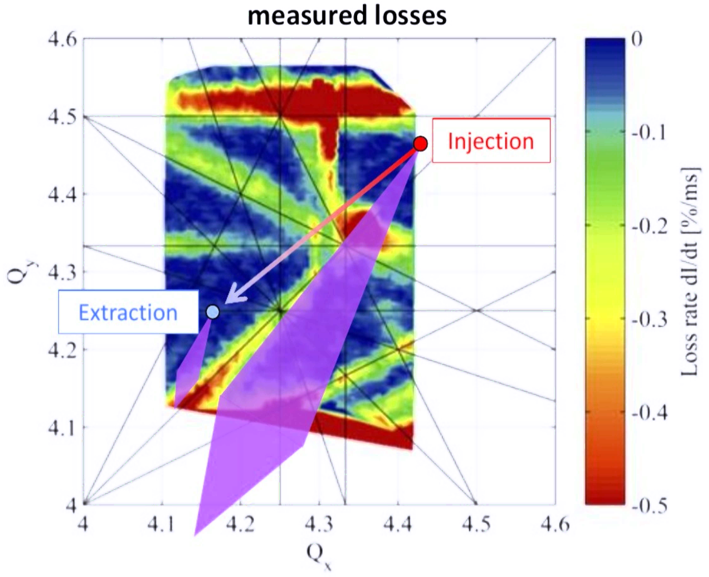
PSB I
PSB Tune diagram showing the losses measured in a dynamic tune scan with a low brightness beam together
with a schematic representation of the space charge tune spread at injection and extraction in the PSB for the high
brightness LHC beams.

Slide 6
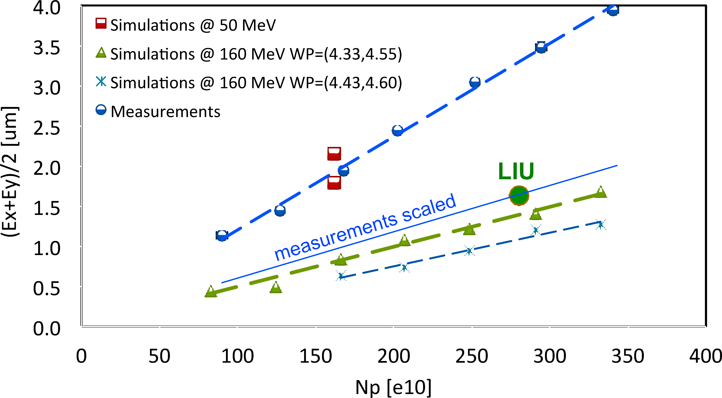
PSB II E. Benedetto
2016 PSB brightness curves including measurements at the present injection energy of 50 MeV and extrapolations to the new 160 MeV injection energy based on scaling laws or simulations. Shown is the average normalized emittance versus number of protons per ring. The LIU target parameters are indicated by the green marker.

Slide 7
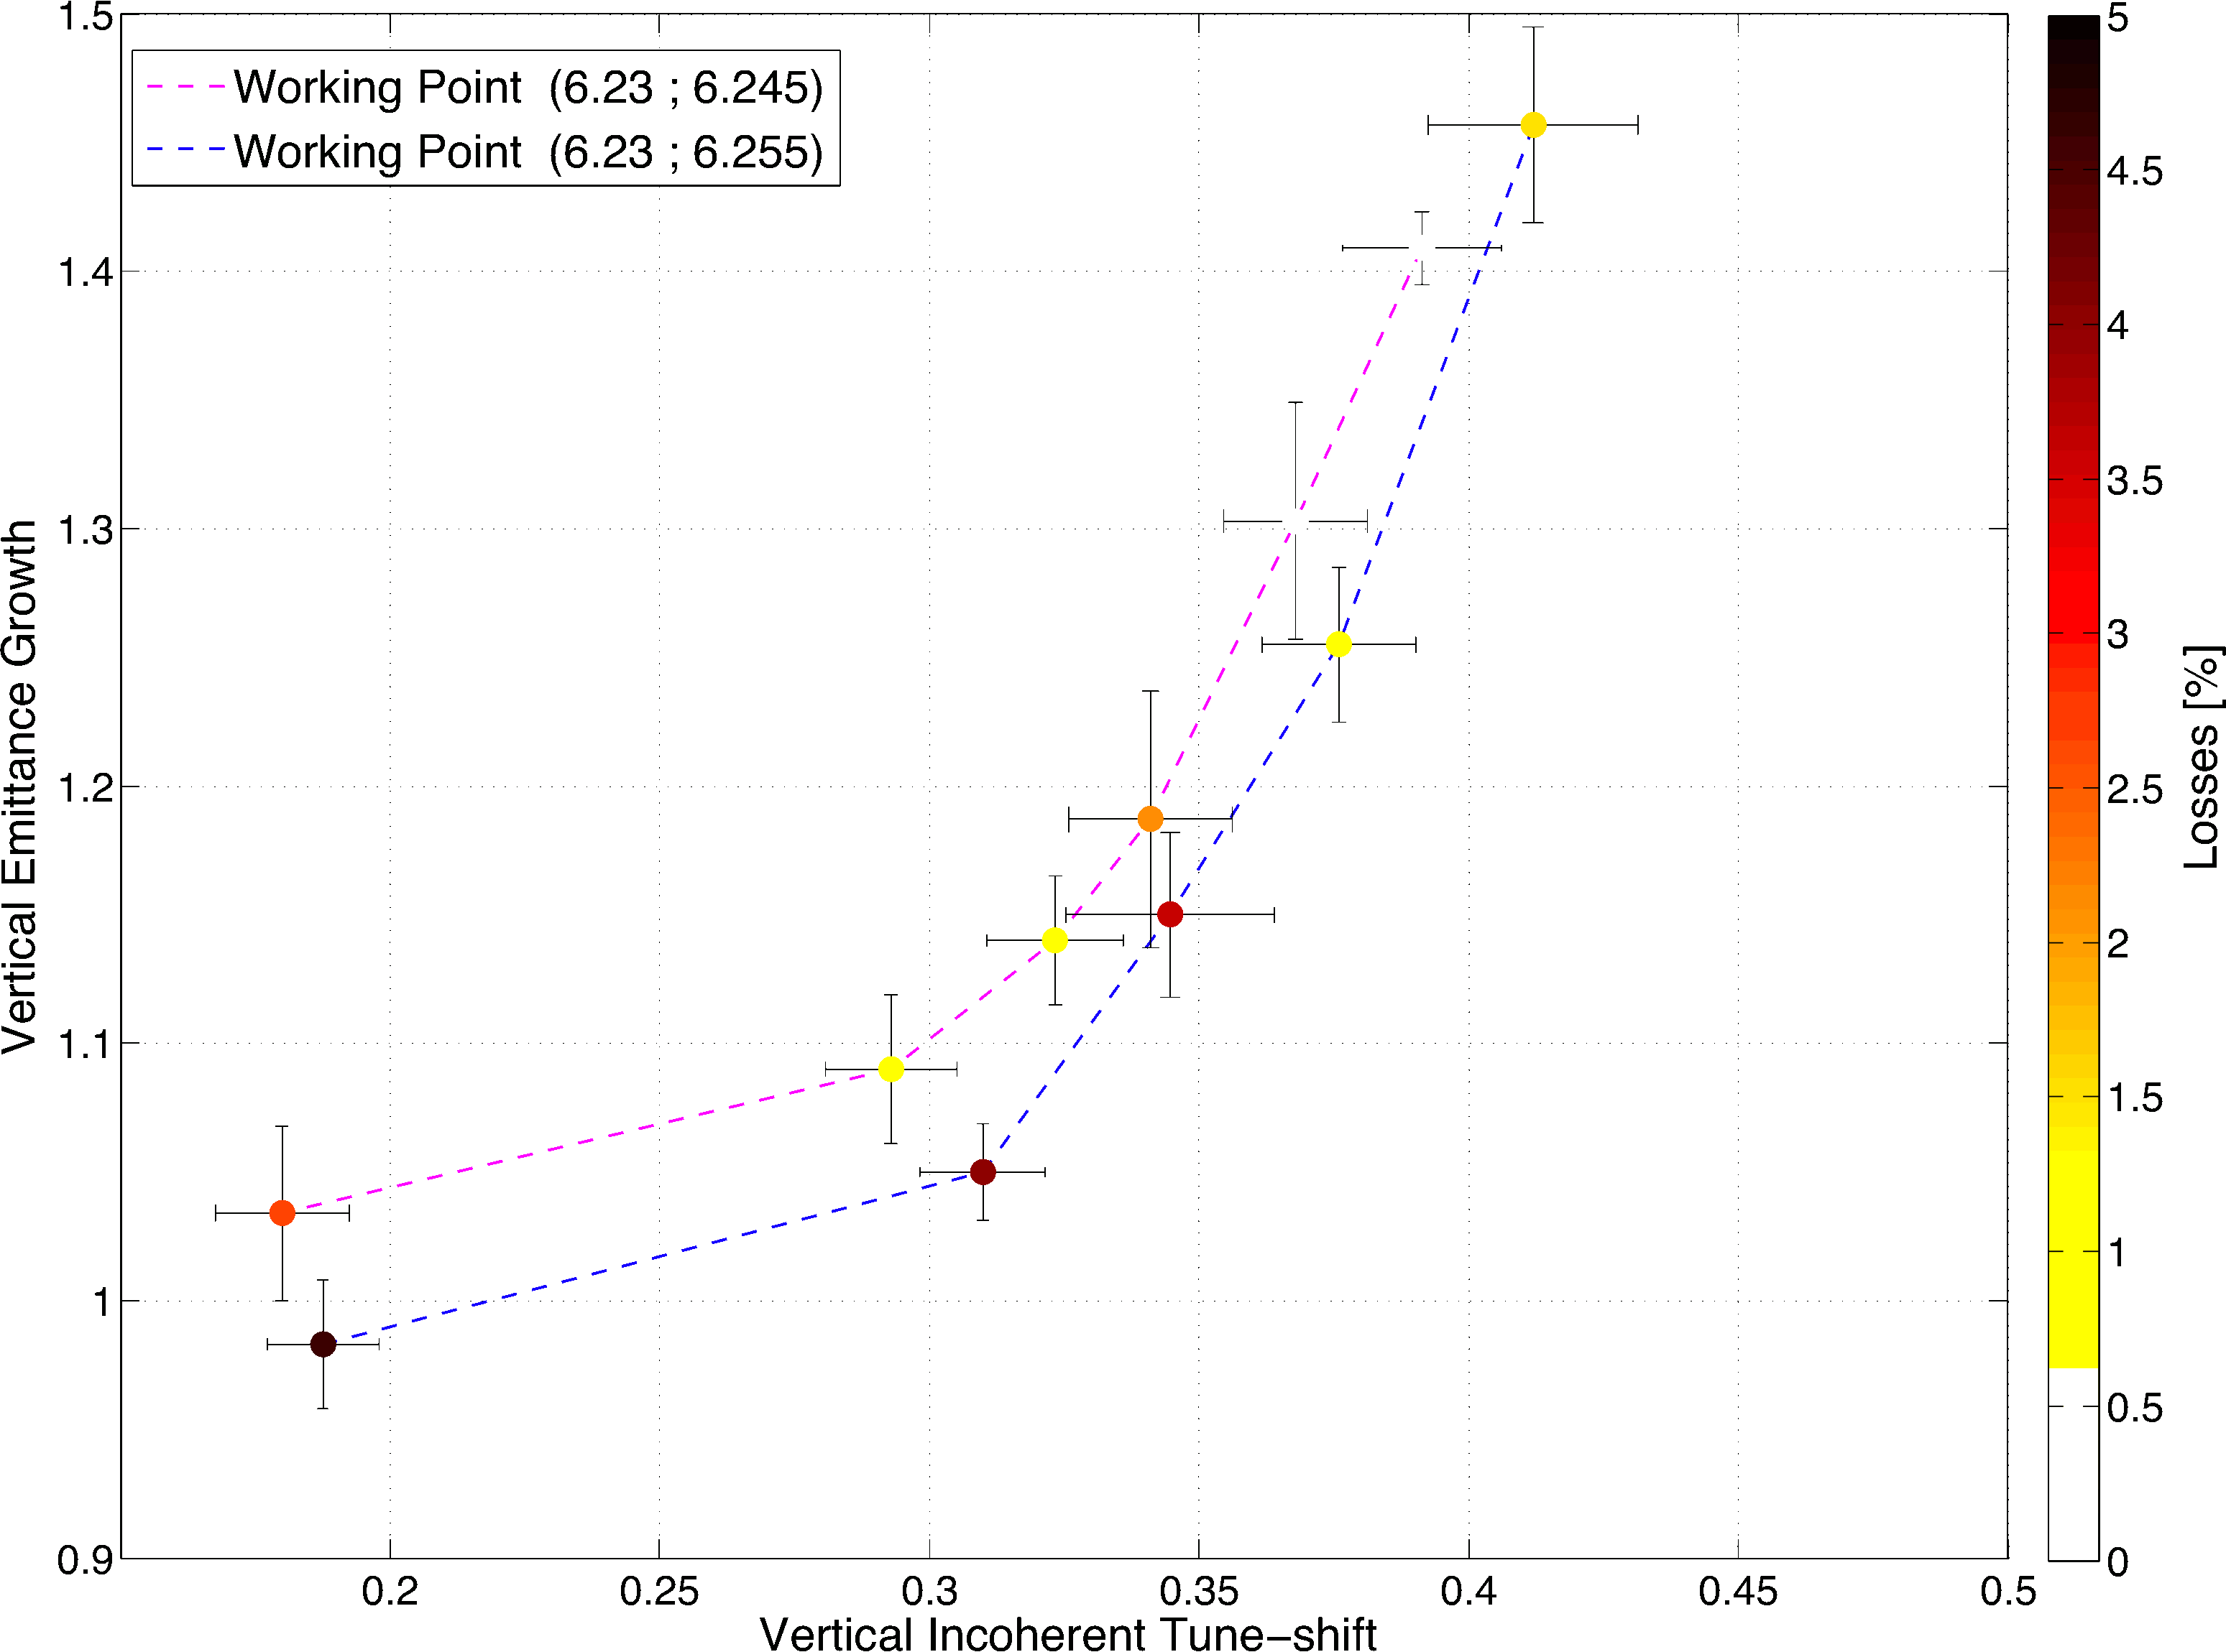
PS I R. Wasef
PS blow-up and losses as a function of the intensity dependent incoherent space
charge tune spread in the PS for two different working points [16]. Losses are caused
by the 8th order structure resonance 8Qx = 50 excited by the modulation of the
Gaussian space charge potential with the dominant harmonic of the PS lattice functions
(which is 50)

Slide 8
PS II Magnet model A. Huschauer
MAD-X/PTC: use of an effective non-linear model (beam-based)
Modeling of the combined-function magnets
Thin multipoles in-between to match non-linear chromaticity measurements and build an effective model
Collaboration with magnet group to increase knowledge of the higher-order magnetic components
DRIFT
SBEND + F
SBEND + D
DRIFT
3D magnetic model in OPERA
Sextupole component in main magnet obtained with OPERA
F. Sperati
B₃ [Tm]
s [m]

Slide 9
PS III Resonance Driving Terms F. Asvesta
The Hamiltonian in the presence of the space charge force becomes
$$H=\frac{1}{2}\left(K_{1}x^{2}+K_{2}y^{2}+p_{x}^{2}+p_{y}^{2}+V_{sc}\right)$$
Assuming Gaussian beam the space charge potential is:
$$V_{sc}\left(x,y\right)=\frac{K_{sc}}{2}\int_{0}^{∞}{\frac{−1+e^{−\frac{x^{2}}{2σ_{x}^{2}+t}−\frac{y^{2}}{2σ_{y}^{2}+t}}}{\sqrt{\left(2σ_{x}^{2}+t\right)\left(2σ_{y}^{2}+t\right)}}dt}$$
Expanding this potential all even orders are present
Up to 4th order it yields:
$$−\frac{K_{sc}}{2}\left[\left(\frac{x^{2}}{σ_{x}\left(σ_{x}+σ_{y}\right)}+\frac{y^{2}}{σ_{y}\left(σ_{x}+σ_{y}\right)}\right)−\left(\frac{\left(2σ_{x}+σ_{y}\right)x^{4}}{12σ_{x}^{3}{\left(σ_{x}+σ_{y}\right)}^{2}}+\frac{\left(2σ_{y}+σ_{x}\right)y^{4}}{12σ_{y}^{3}{\left(σ_{x}+σ_{y}\right)}^{2}}+\frac{x^{2}y^{2}}{{2σ_{x}σ_{y}\left(σ_{x}+σ_{y}\right)}^{2}}\right)\right]$$
Magnetic fields gradients
Perturbing potential

Slide 10
PS IV Resonance Driving Terms F. Asvesta
fggggggff
➔ Plan: New MAD-X Module

Slide 11
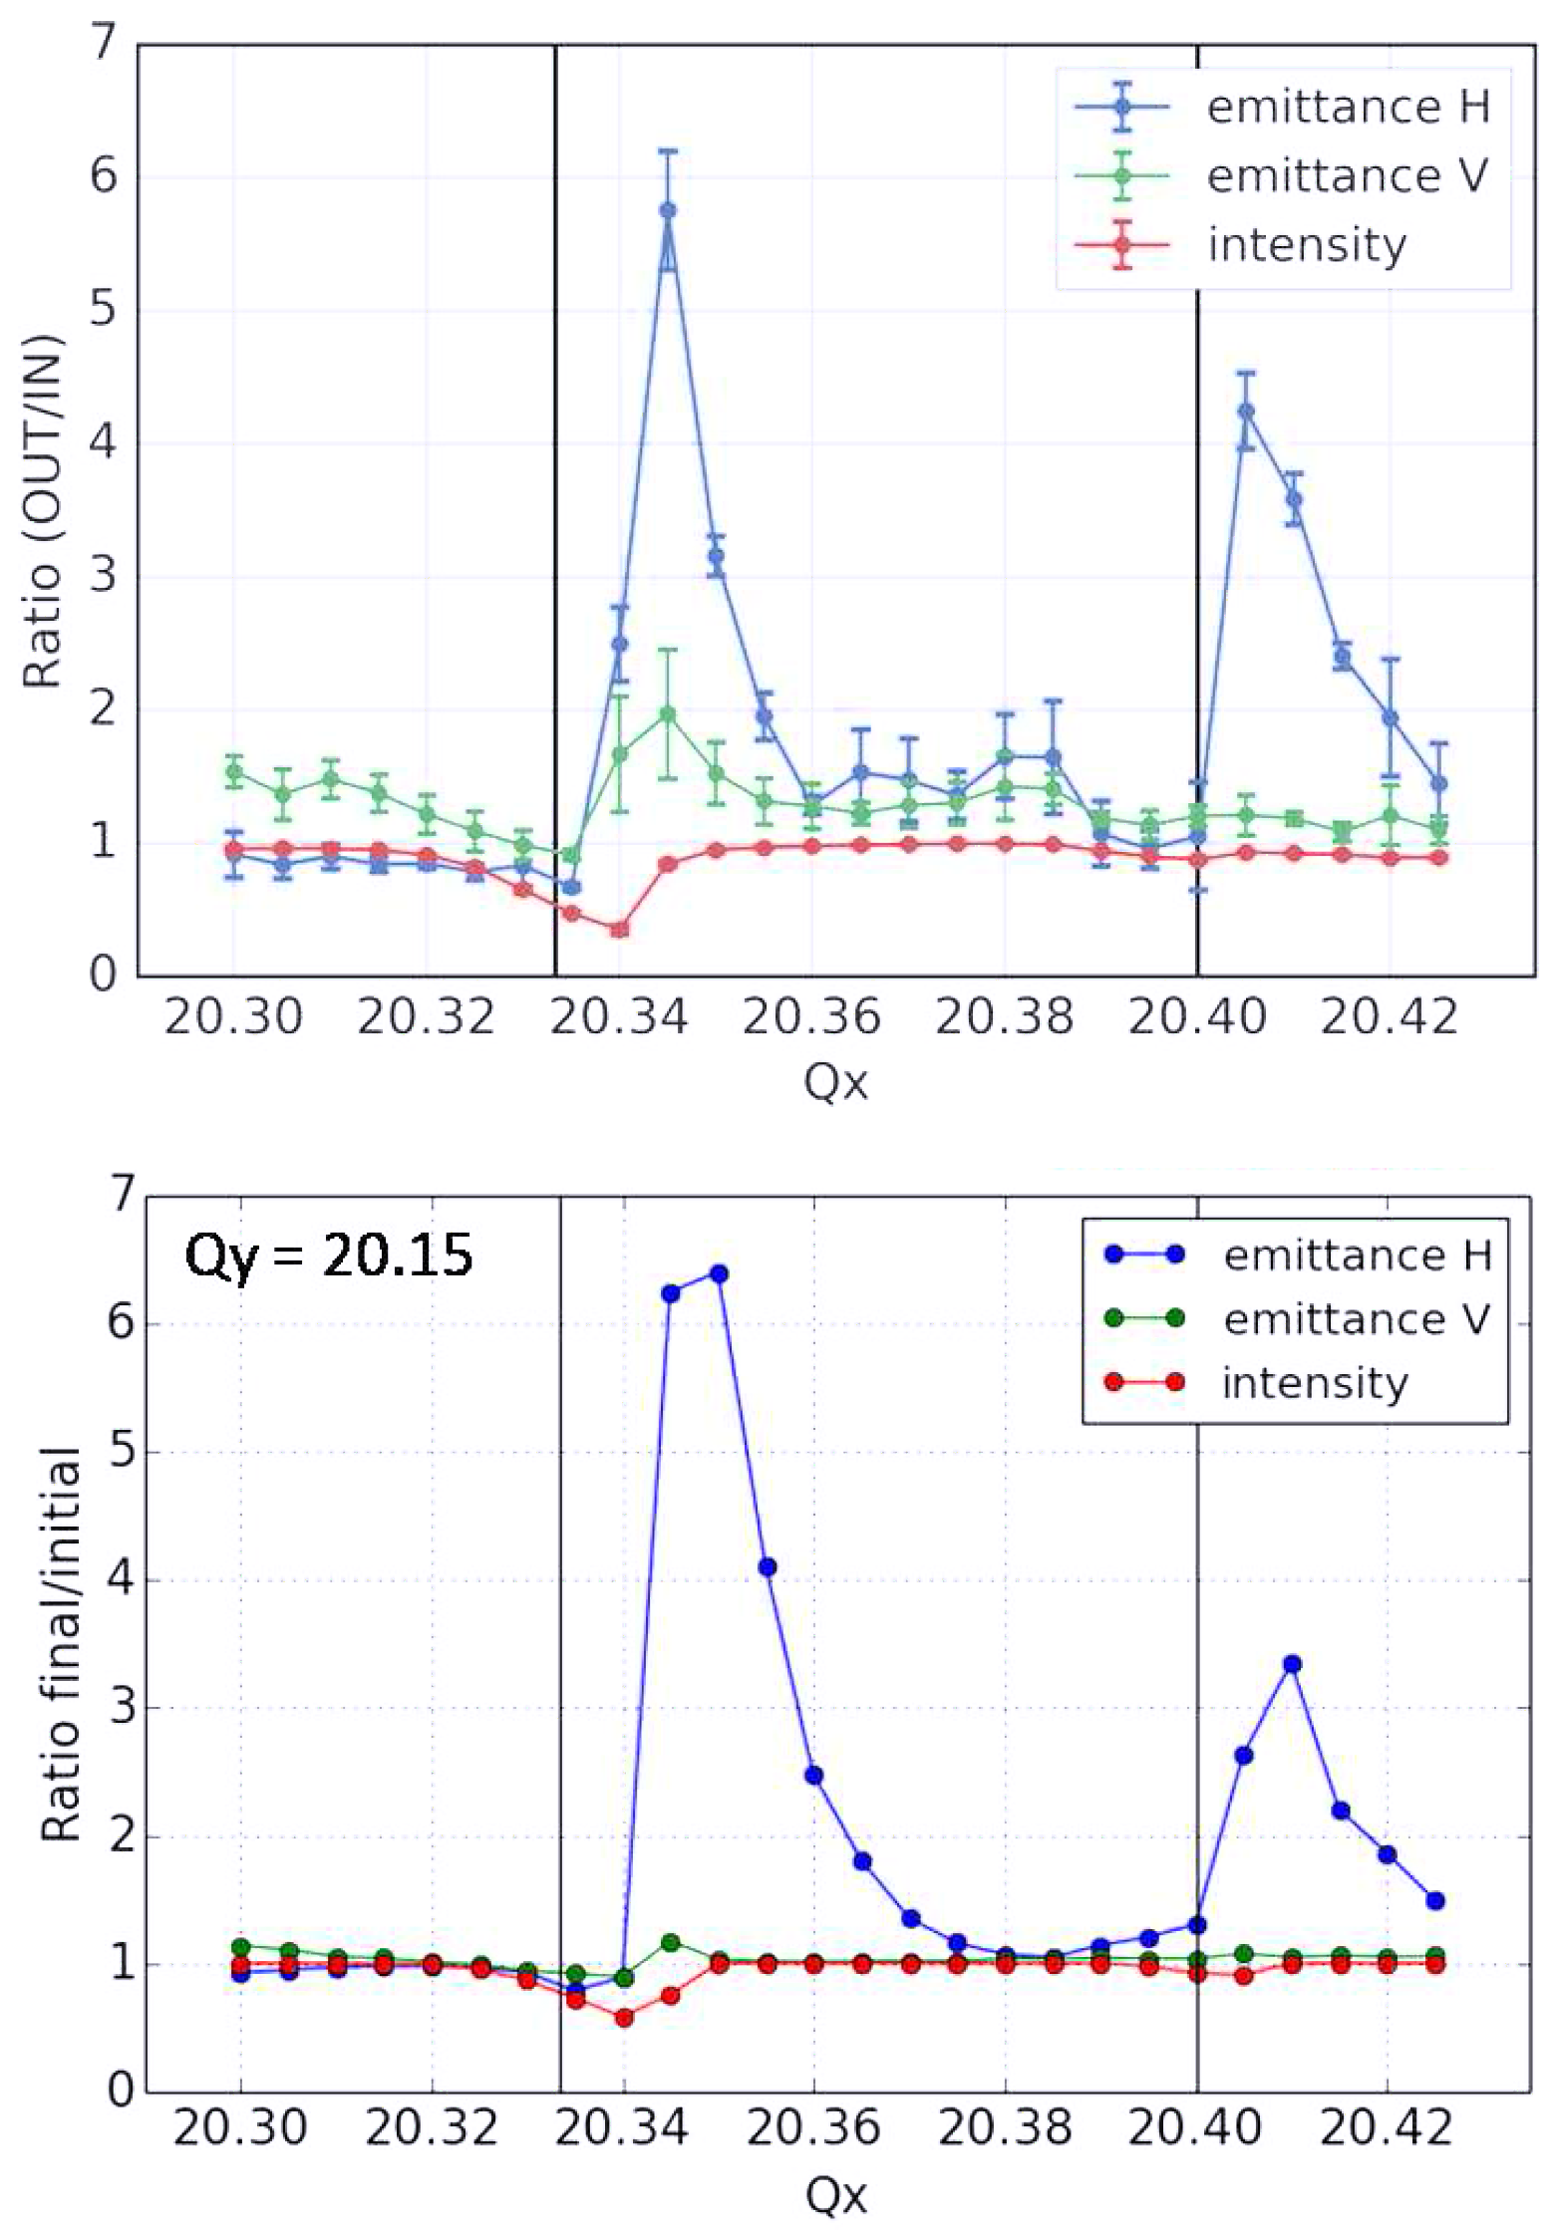
SPS H. Bartosik & F. Schmidt
Measurements
Relative emittance growth and
intensity as a function of the
working point in the SPS as obtained
from experimental studies (top) and
from simulations using a frozen SC
model including the tune ripple from
power converters (bottom).
Simulation WITH Ripple

Slide 12
Tune Ripple

Slide 13
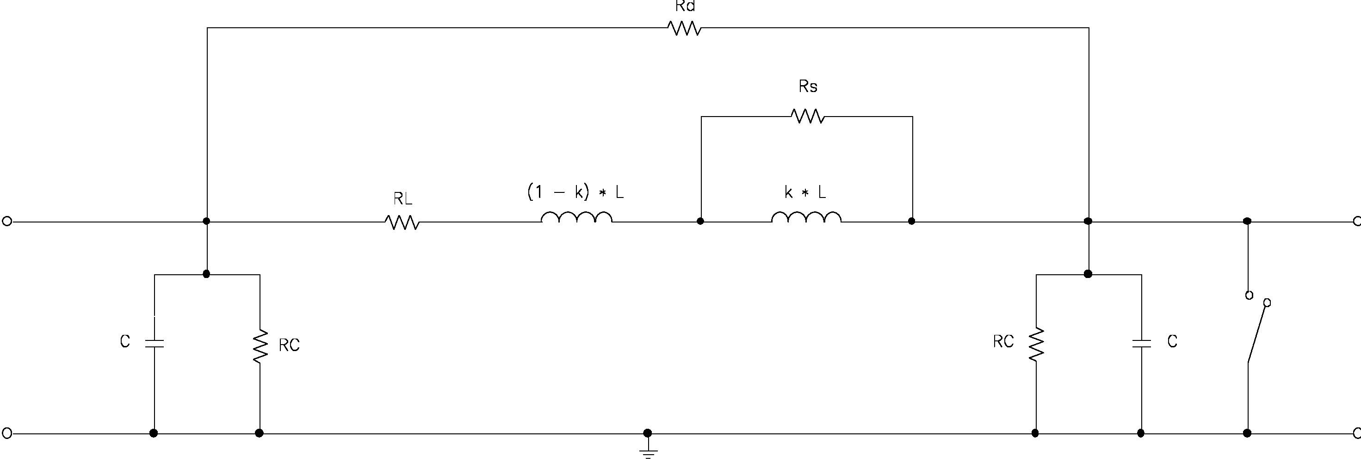
4-Pole Model of a Magnet

Slide 14
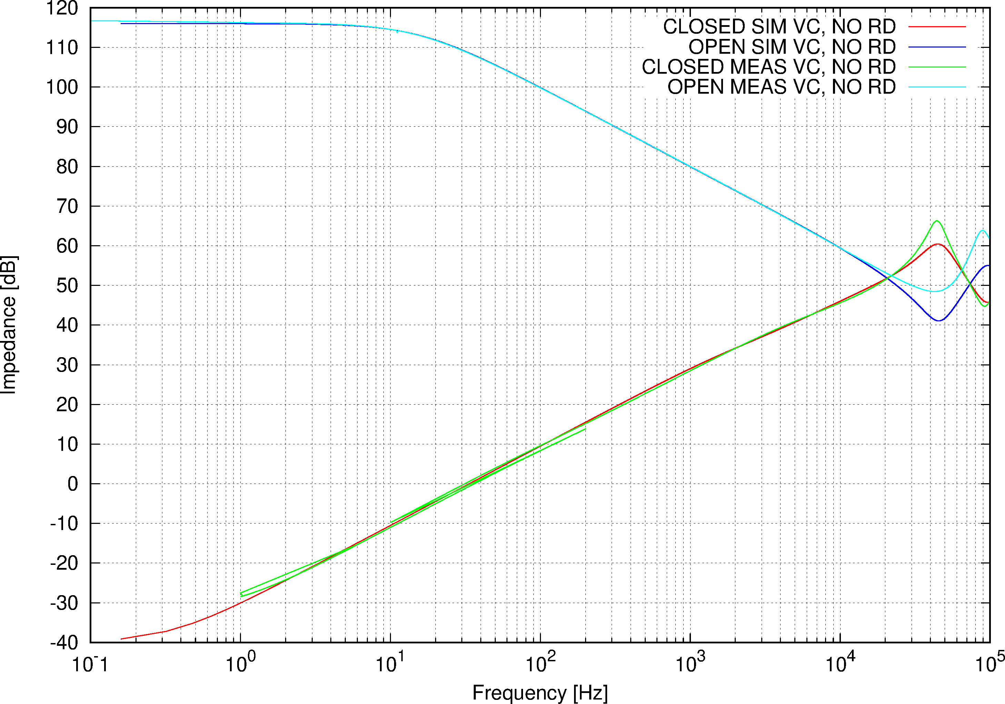
Dipole, VC RD = ∞

Slide 15
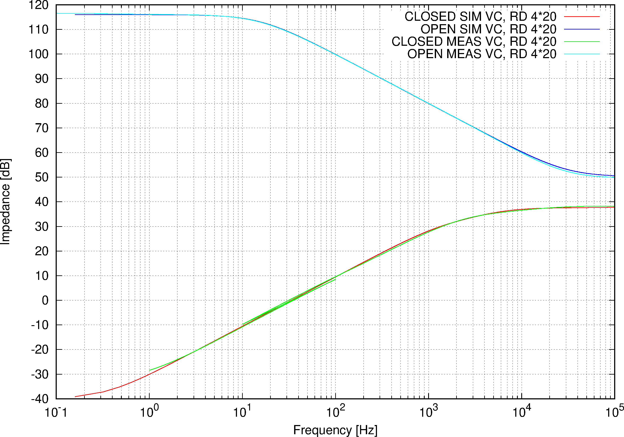
Dipole, VC RD = 4*20 Ω

Slide 16
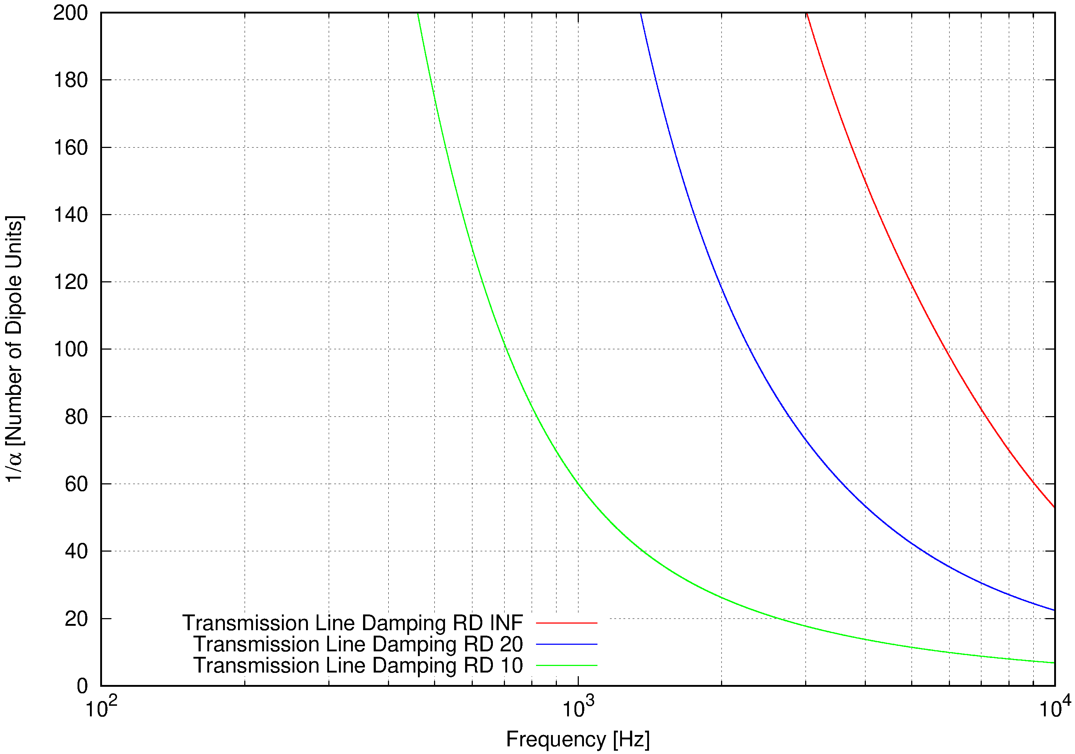
Dipole, VC Damping

Slide 17
Resonance Analysis
Analytical Perturbation Method
Lie Alebra
One Turn Map & NormalForm
Fourier Analysis
Tasks

Slide 18
Resonance Analysis I/V
Analytical Perturbation Method
J. Moser (1955)
R. Hagedorn (1957)
A. Schoch (1957)
G. Guignard (1978) ➔ CAS
(Implementation in SixTrack Code (1985) Schmidt)
n₁ Q₁ + n₂ Q₂=p; n₁, n₂, p Integer
Limits:
Close to a resonance
Regard only slowly varying terms

Slide 19
Resonance Analysis II/V
Lie Algebra
Theory: A. Dragt ~1980
Implementation:
- J. Irwin & J. Bengsston (1992) SSC 232
- F. Schmidt: SODD (1999) as a module of MAD-X (2004)
(D & F in first and second order)
- Element by Element (or pairs)
- Radius of Convergence

Slide 20
Resonance Analysis III/V
One Turn Map & NormalForm
A.Dragt, M. Berz & E. Forest ~1988 (Turchetti, Michelotti and Others)
- 6D
- Any Order
- Code for tracking and Maps identical, but…
- Global(!) local difficult through parameters
- Same problem with convergence

Slide 21
Resonance Analysis IV/V
Fourier Analysis
J. Bengtsson (1988) LEAR
J. Laskar (~1980)
R. Bartolini, F. Schmidt ➔ NormalForm
- Simulation or Real Data Approach
- 6D
- Any Order
- Lines can be related to F
- Global & Local(!)
- NO problem with convergence at any amplitude ➔ even in chaotic regime some value

Slide 22
Resonance Analysis V/V
Tasks
SC Resonances in MAD-X ➔ CERN effort
BB/SC element has to be modified for MAP production
Fast symplectic 3D SC KICK for MAD-X must be accompanied by: (maybe) Slow but “smooth” description for MAP production (Y. Alexahin & F. Schmidt)
Co-moving transformations to “jump” convergence limit
Issue of “Higher” order “closed” orbit

Slide 23
Fix-Line & Frequency Analysis

Slide 24
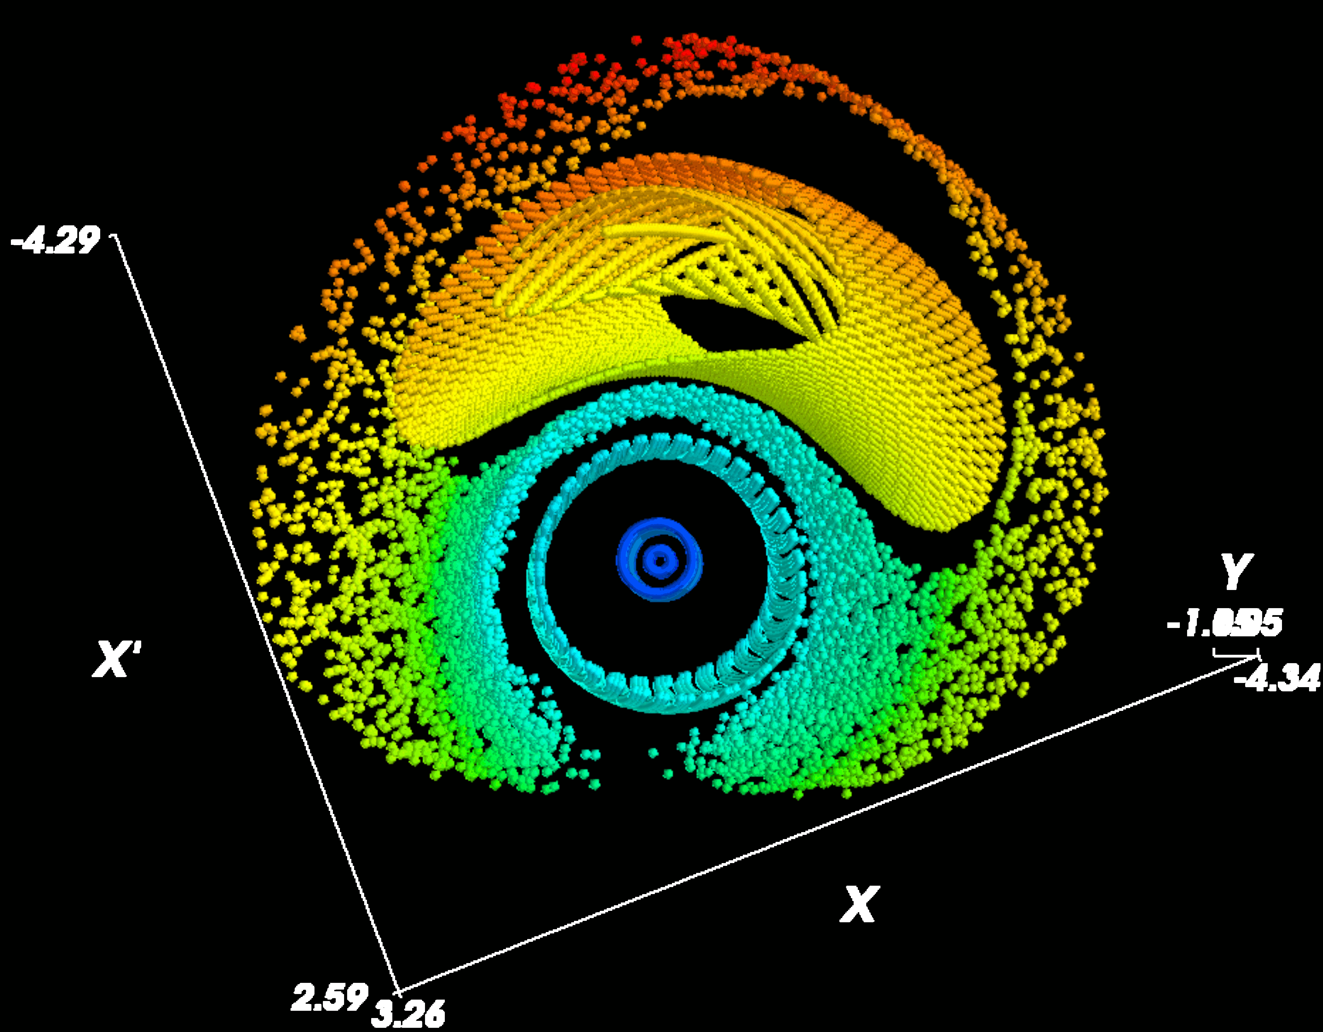
Fix-Line Genrics
Generics of the Qx + 2 Qy = p coupled Resonance
Stable Fix-line
Unstable Fix-line

Slide 25
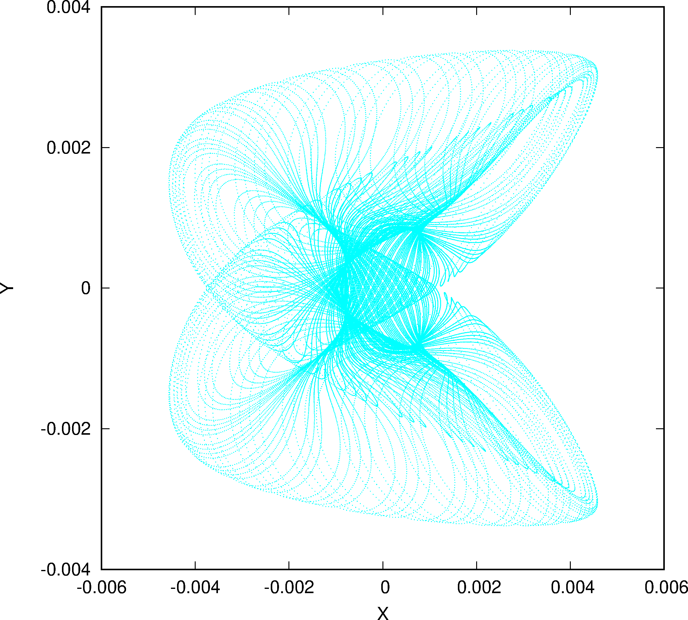
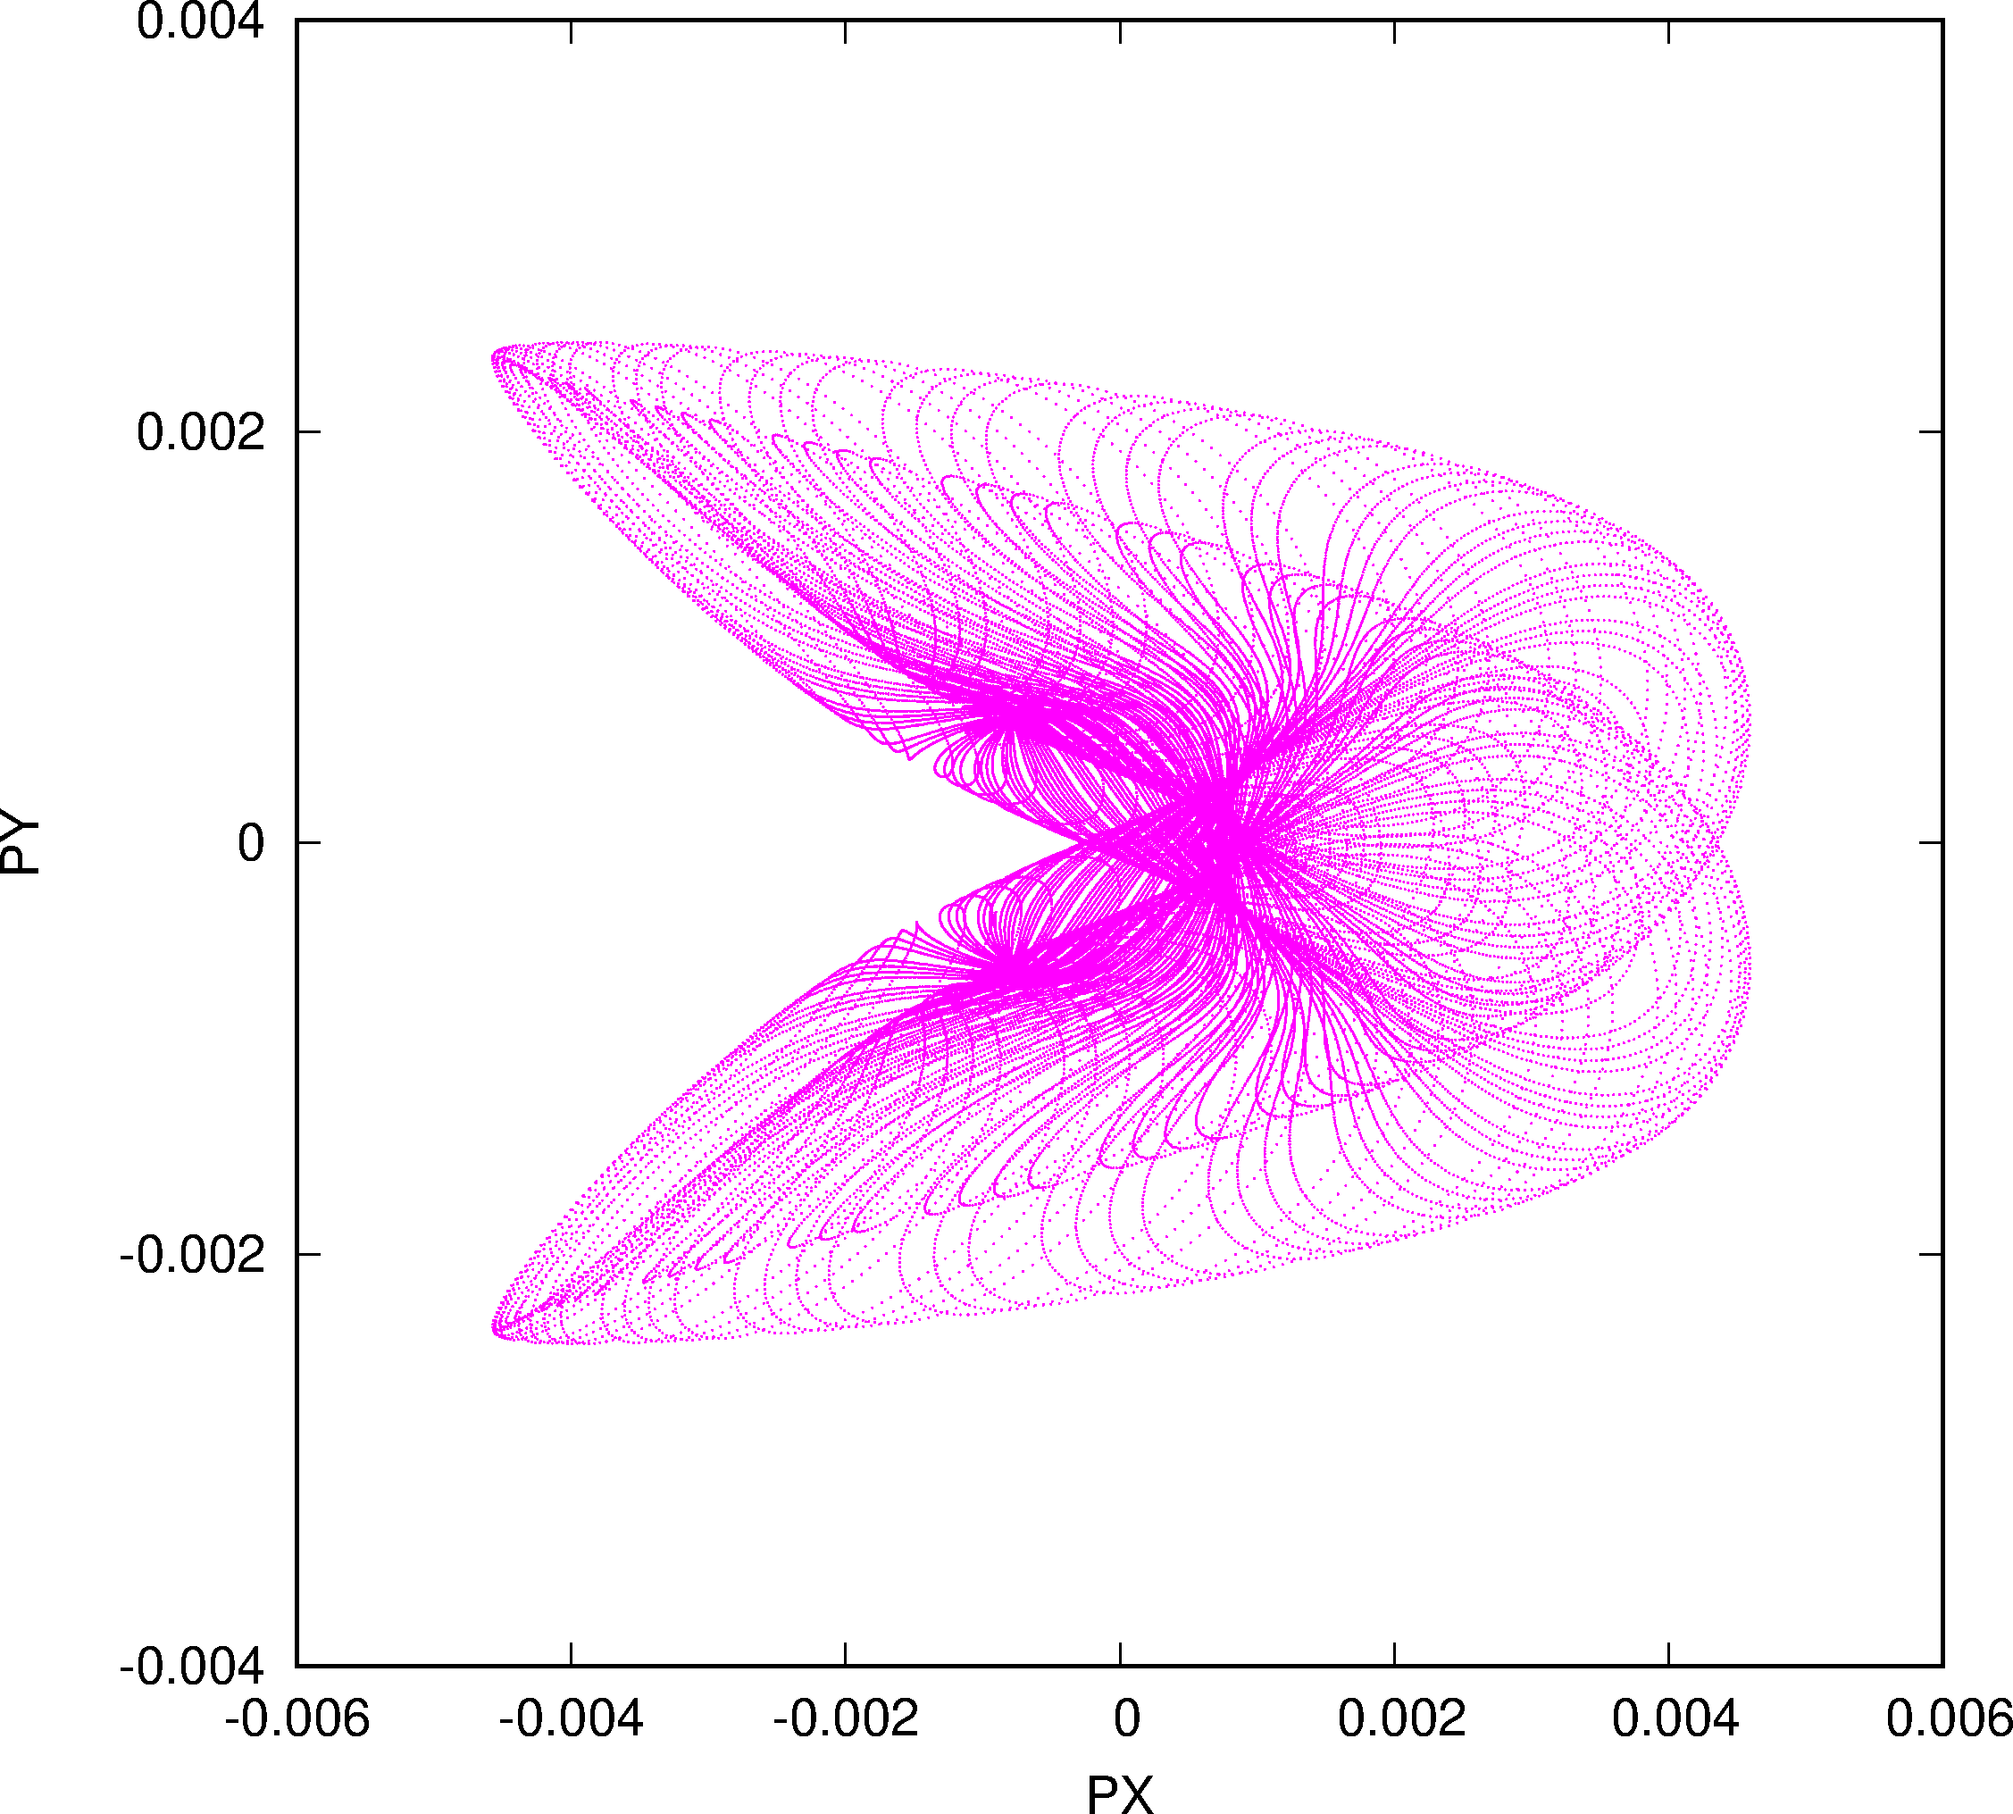
Phase Space of Large Fix-line Structure Q_{x} + 2 Q_{y} = p

Slide 26
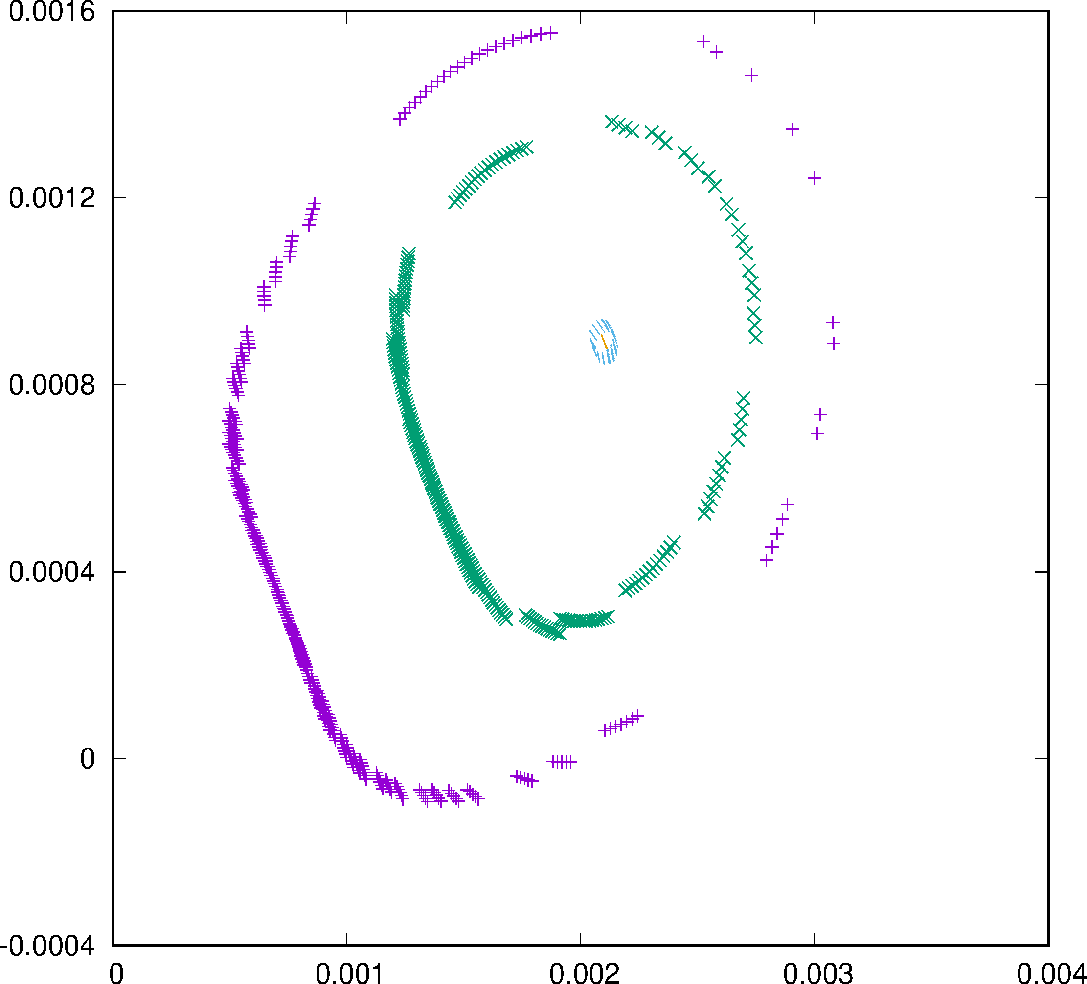
Fix-Line Search (“Higher” order “closed” orbit)
PY
Fixline Search
Average
“Damping” like in electron machines like LEP (Verdier & Schmidt)
Y

Slide 27
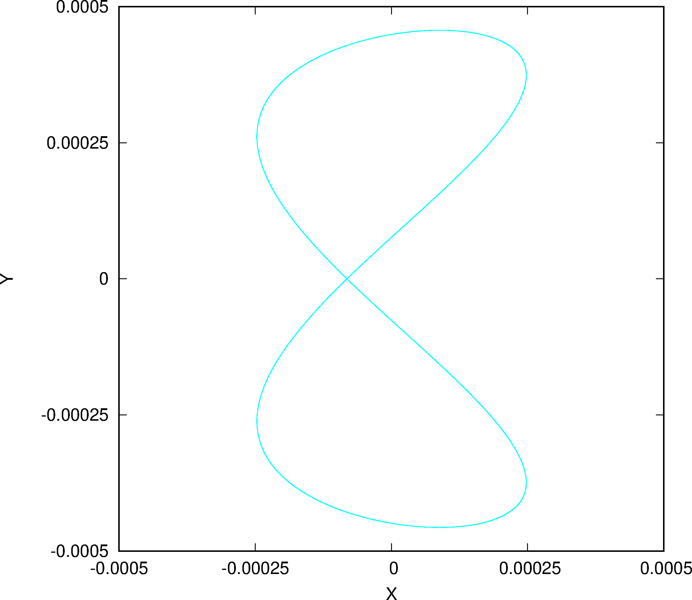
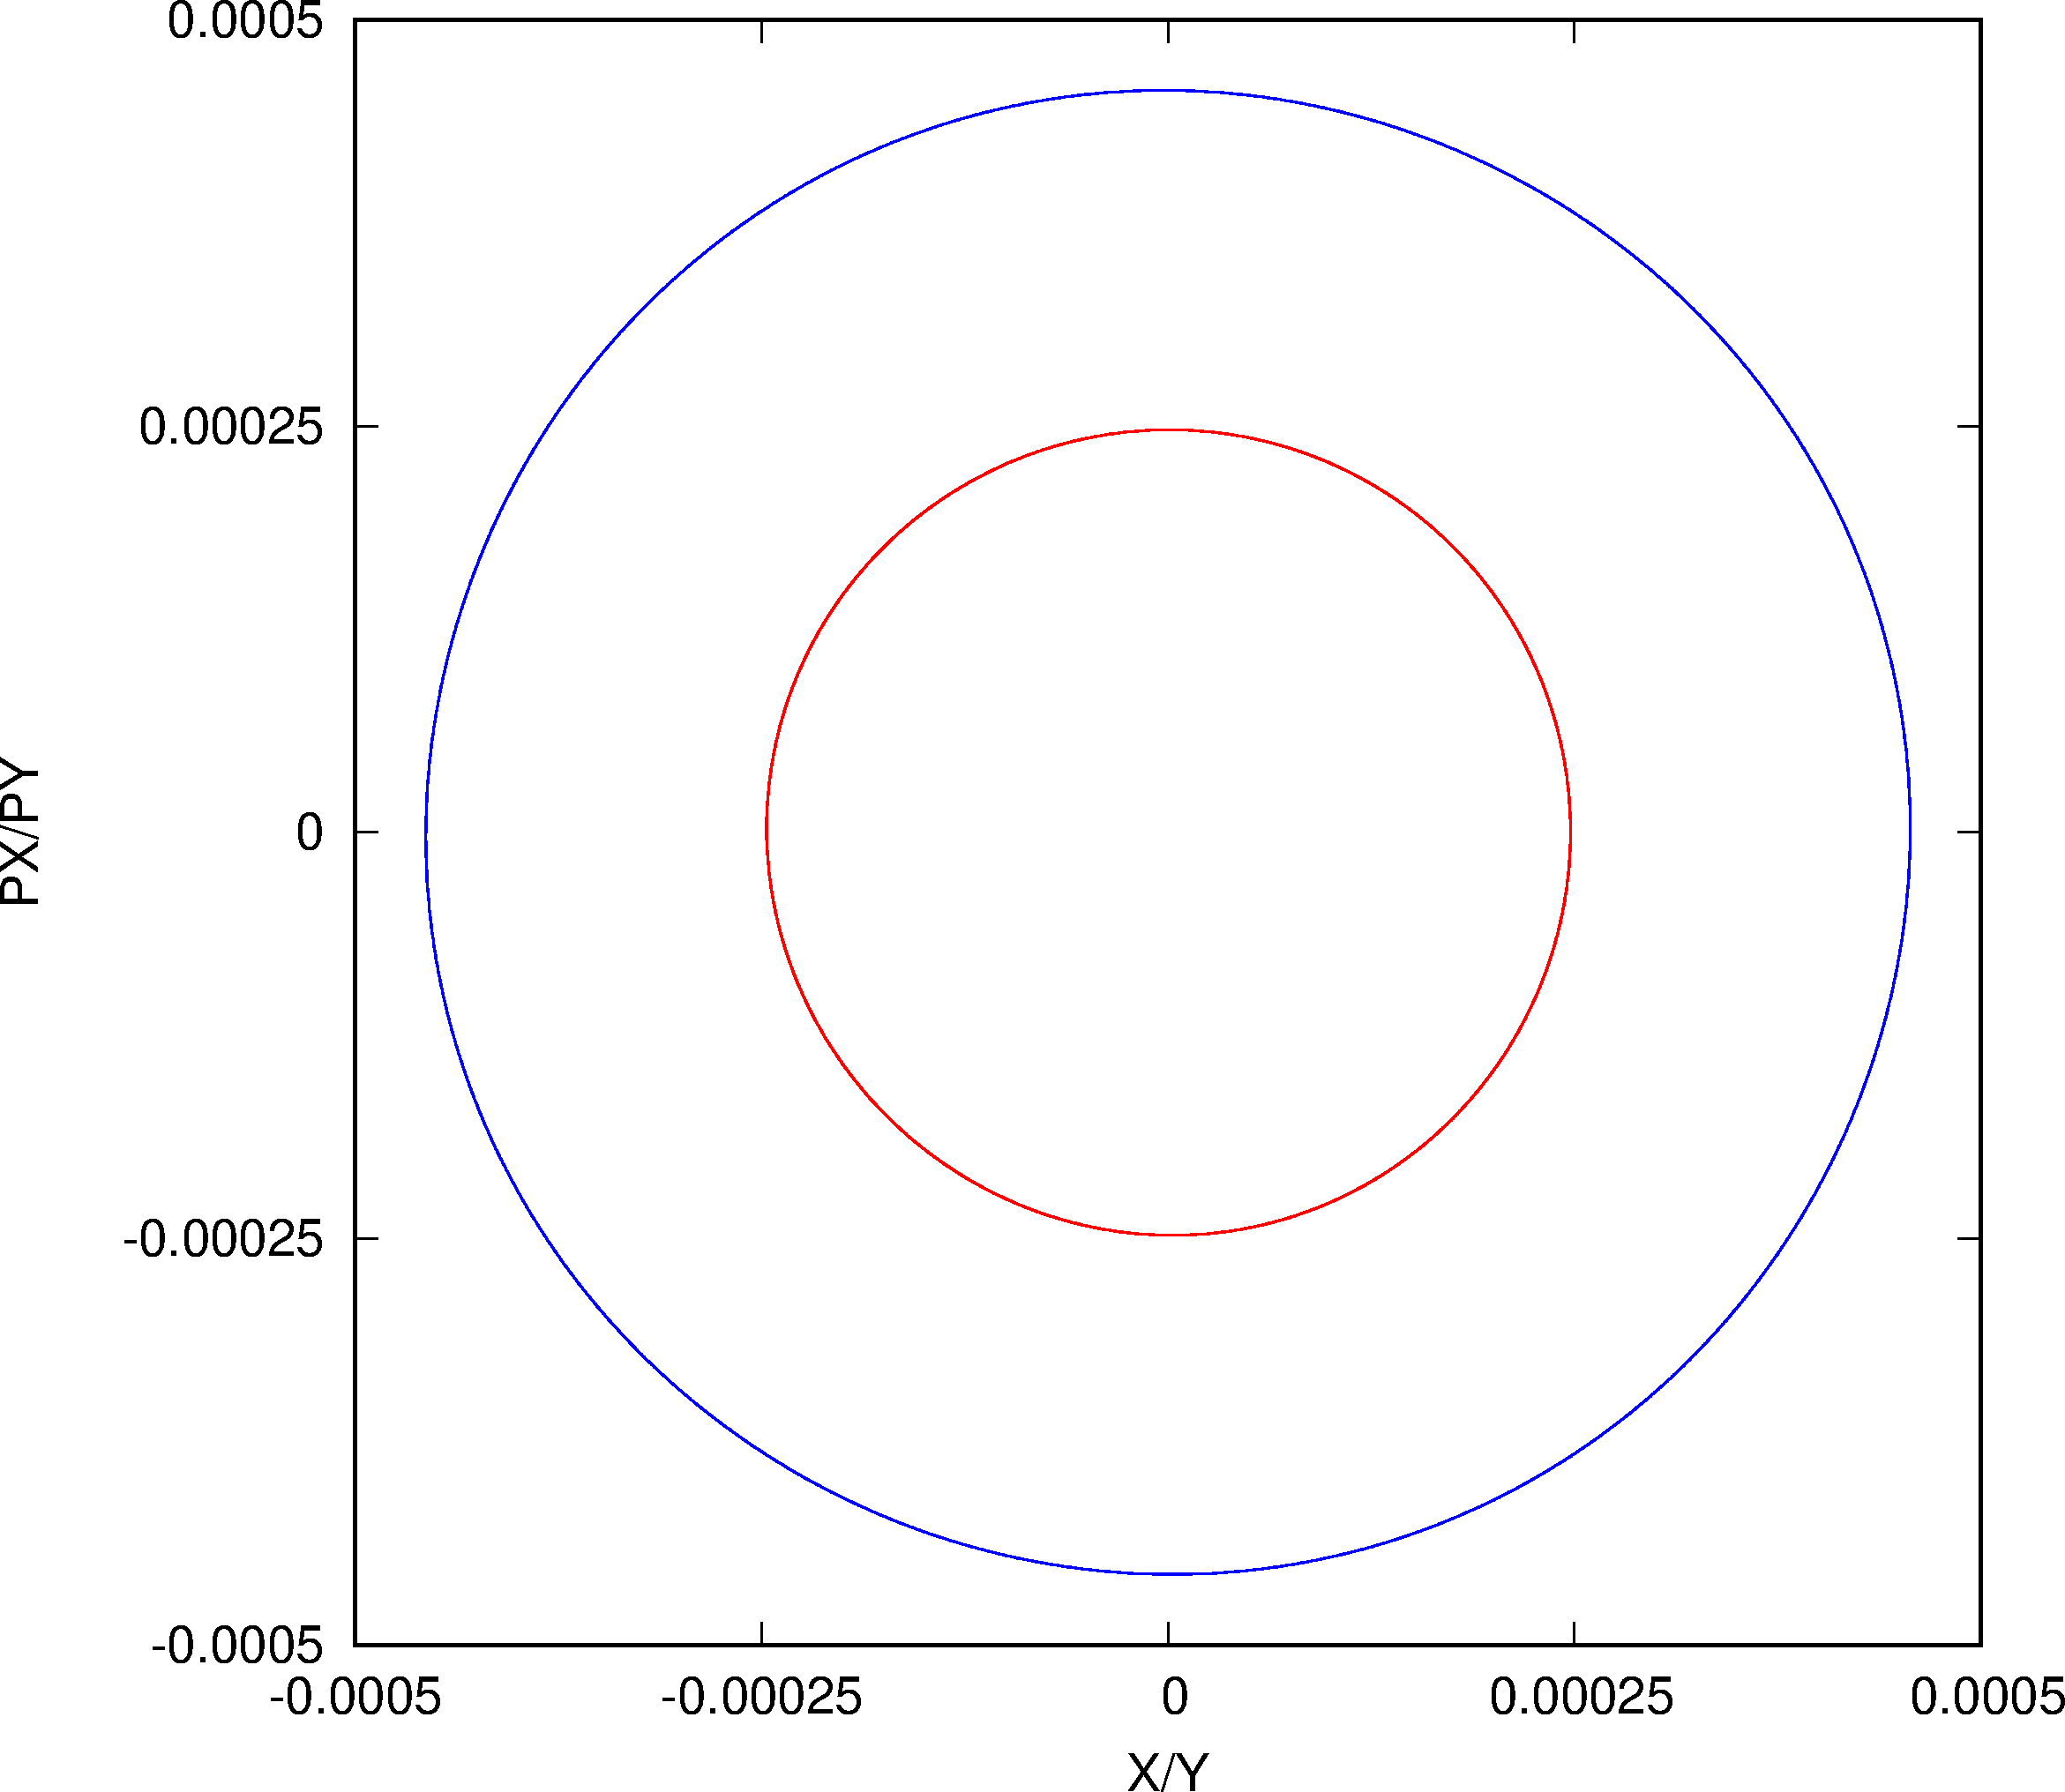
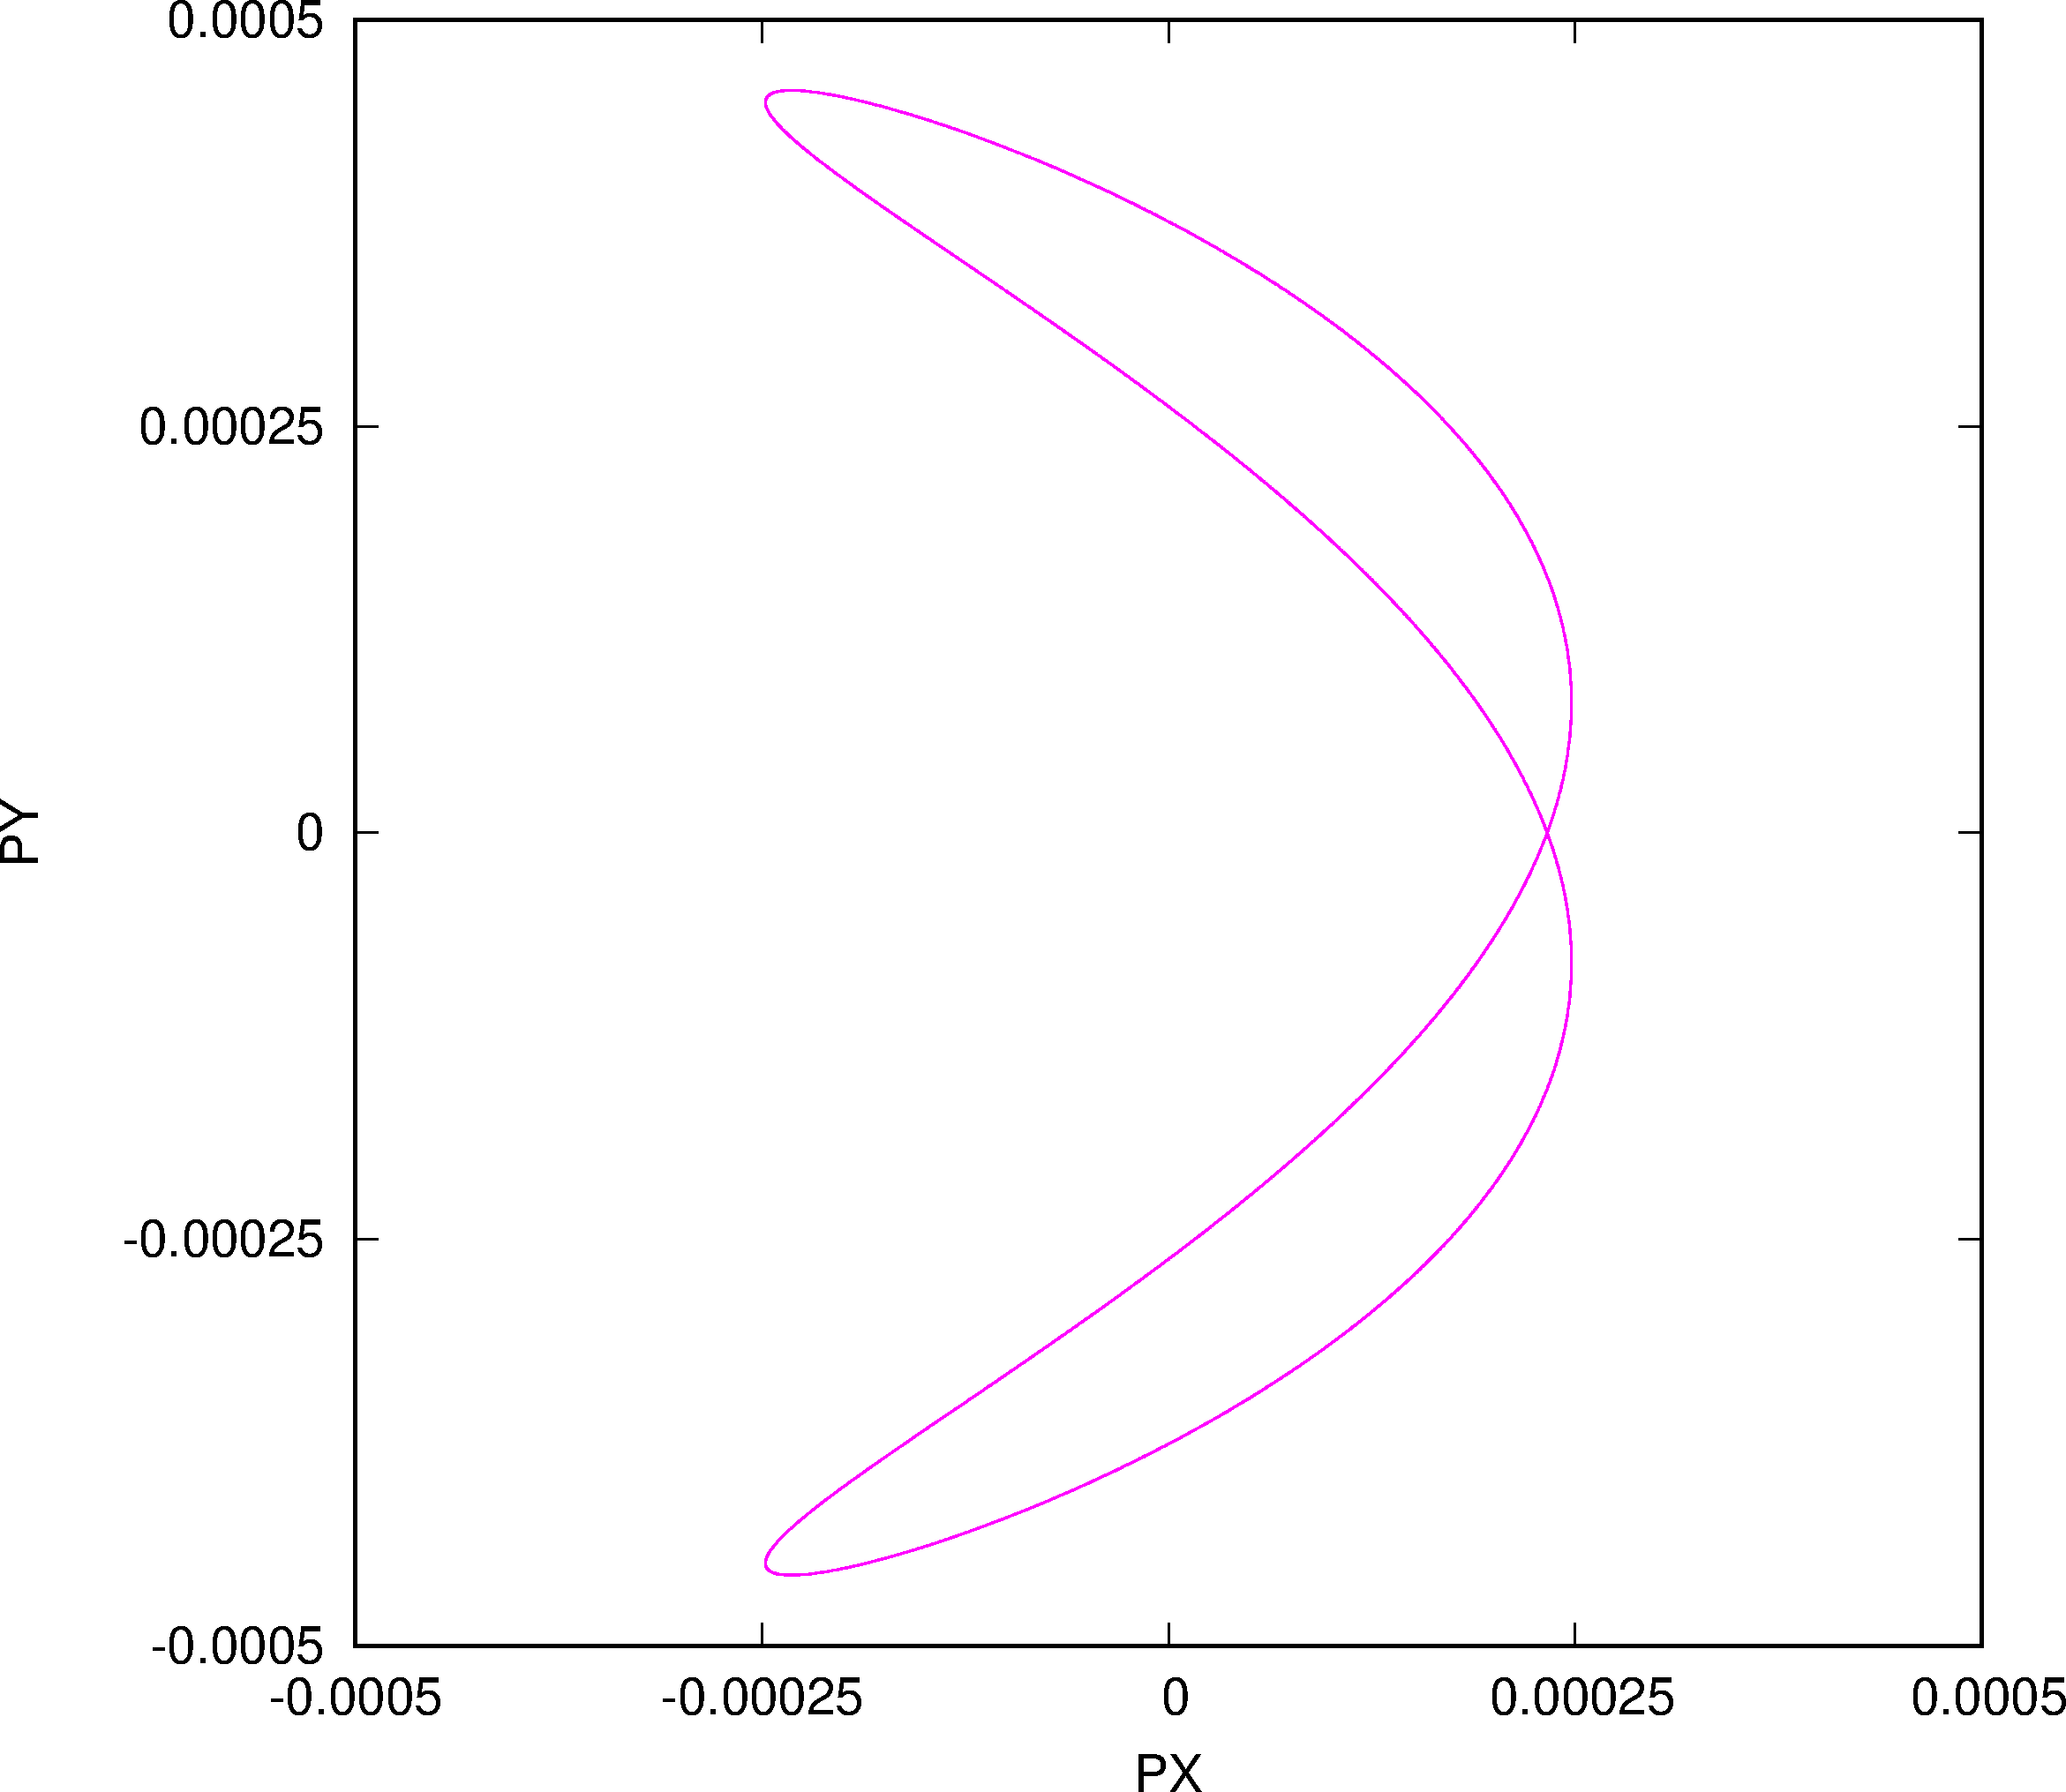
“Fix-Line” Phase Space
V
H

Slide 28
“Fix-Line” Frequency Analysis I
ANALYSIS OF X SIGNAL, CASE: 1 TUNE X = 0.111180834145734 Line Frequency Amplitude Phase mx my
1 0.1111808341457E+00 0.247512794360E-03 0.672457580217E+02 1 0 2 0.3783426764684E-11 0.174249489697E-05 -.457347870401E+02 0 0 3 0.2223616682915E+00 0.110388913387E-05 0.150753314898E+02 2 0 4 -.1111808341460E+00 0.589011814331E-06 0.519872394860E+02 -1 0 5 -.2223616682916E+00 0.532465227870E-06 0.930856270353E+02 -2 0 6 0.1116055036254E+00 0.539366197950E-07 0.101885132342E+03 7 0.1107561645136E+00 0.233487160303E-07 0.324682911396E+02 8 -.3335425024437E+00 0.647694102064E-08 -.150532254600E+03 -3 0 9 0.3335425024345E+00 0.569663731770E-08 -.389777082870E+02 3 0

Slide 29
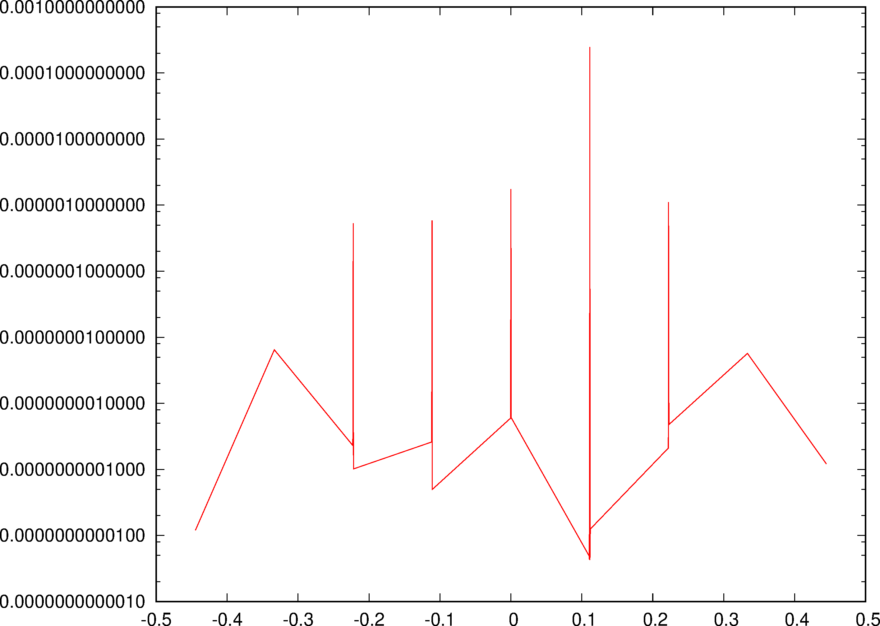
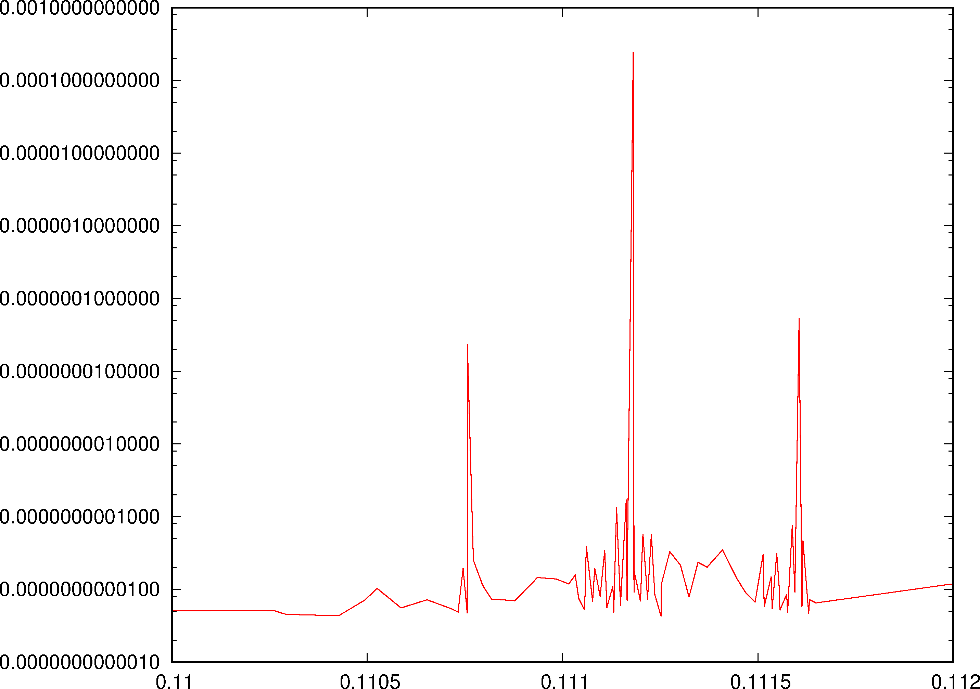
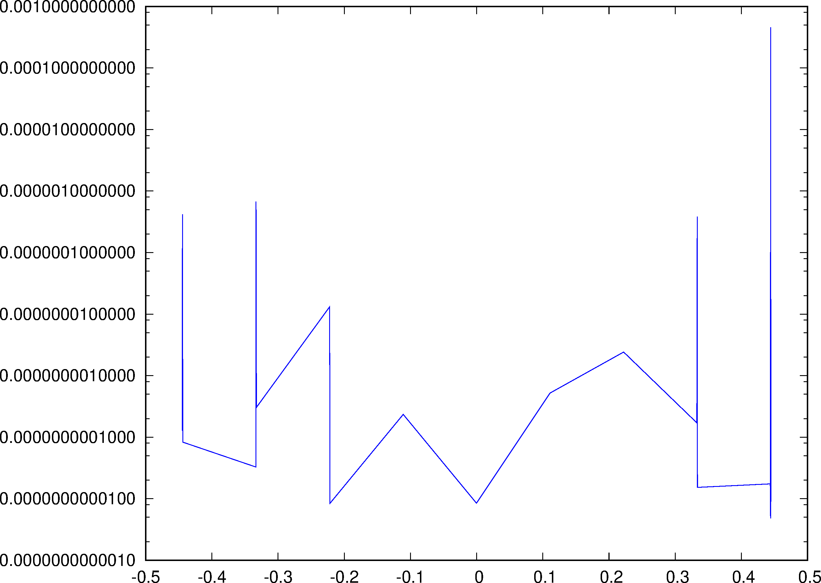
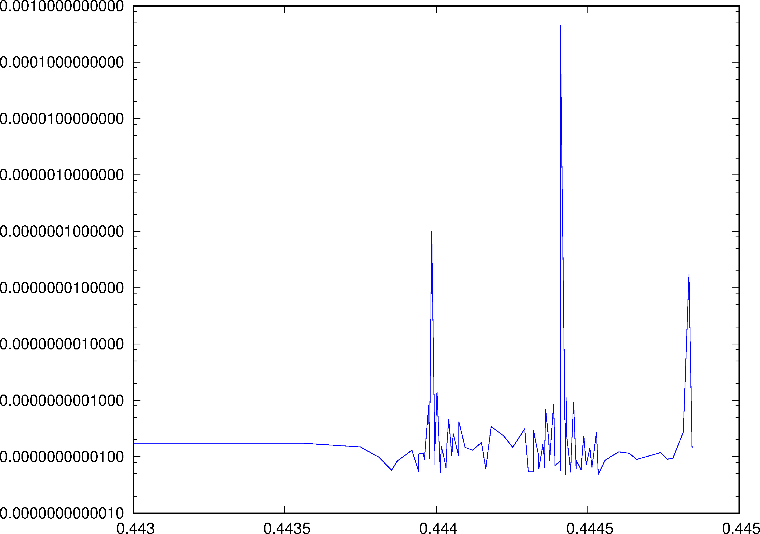
“Fix-Line” Frequency Analysis II

Slide 30
Synergia Bench-Marking I: Long-Term

Slide 31
Synergia Bench-Marking II: Tune Jitter

Slide 32
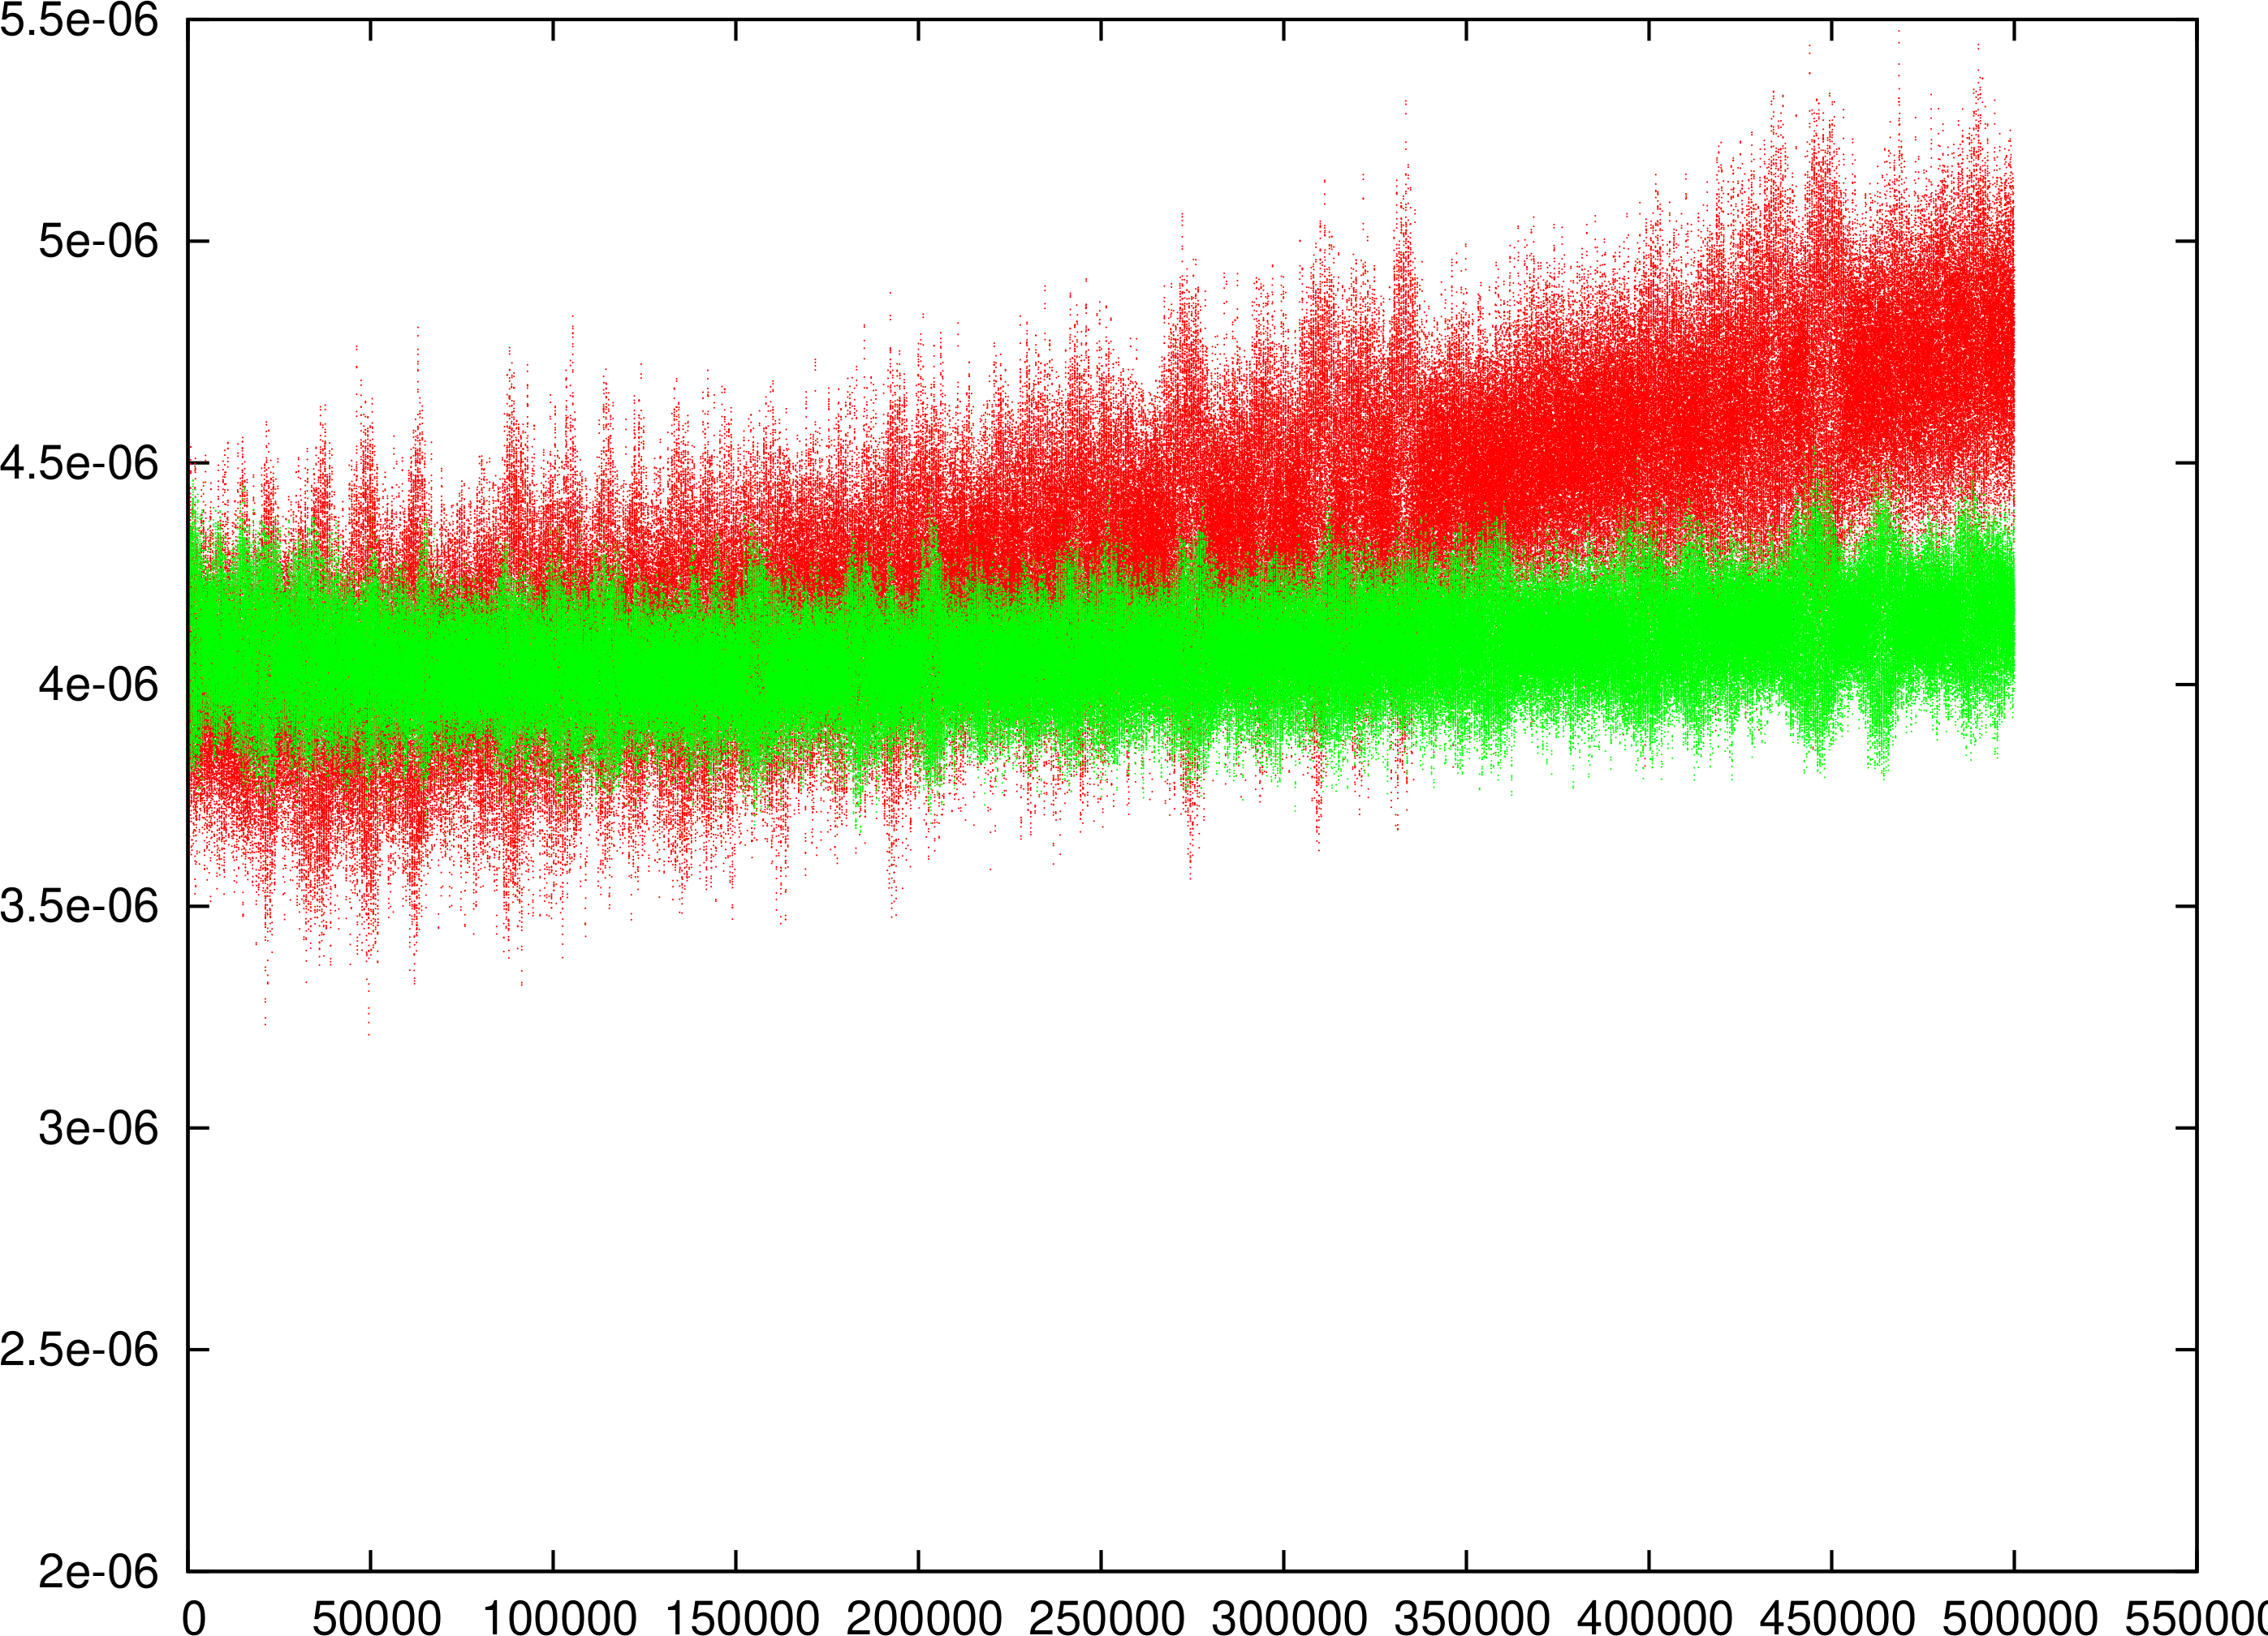
Noise in Adaptive Frozen Mode in MAD-X: PS 500K Turns
Adaptive Mode only Transverse
Not too small Number of Particles ➔ Artificial Emittance Growth gone!
RED: 1000 Particles
Green: 4000 Particles

Slide 33
Reserve

Slide 34
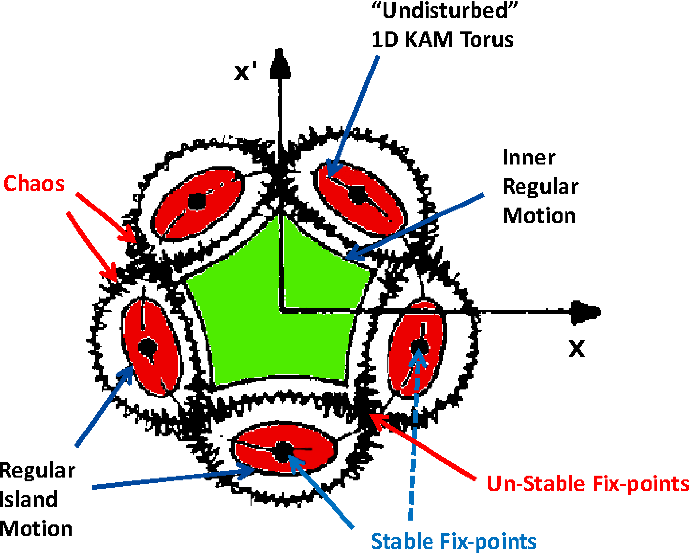
Motivation I: Boring 1D

Slide 35
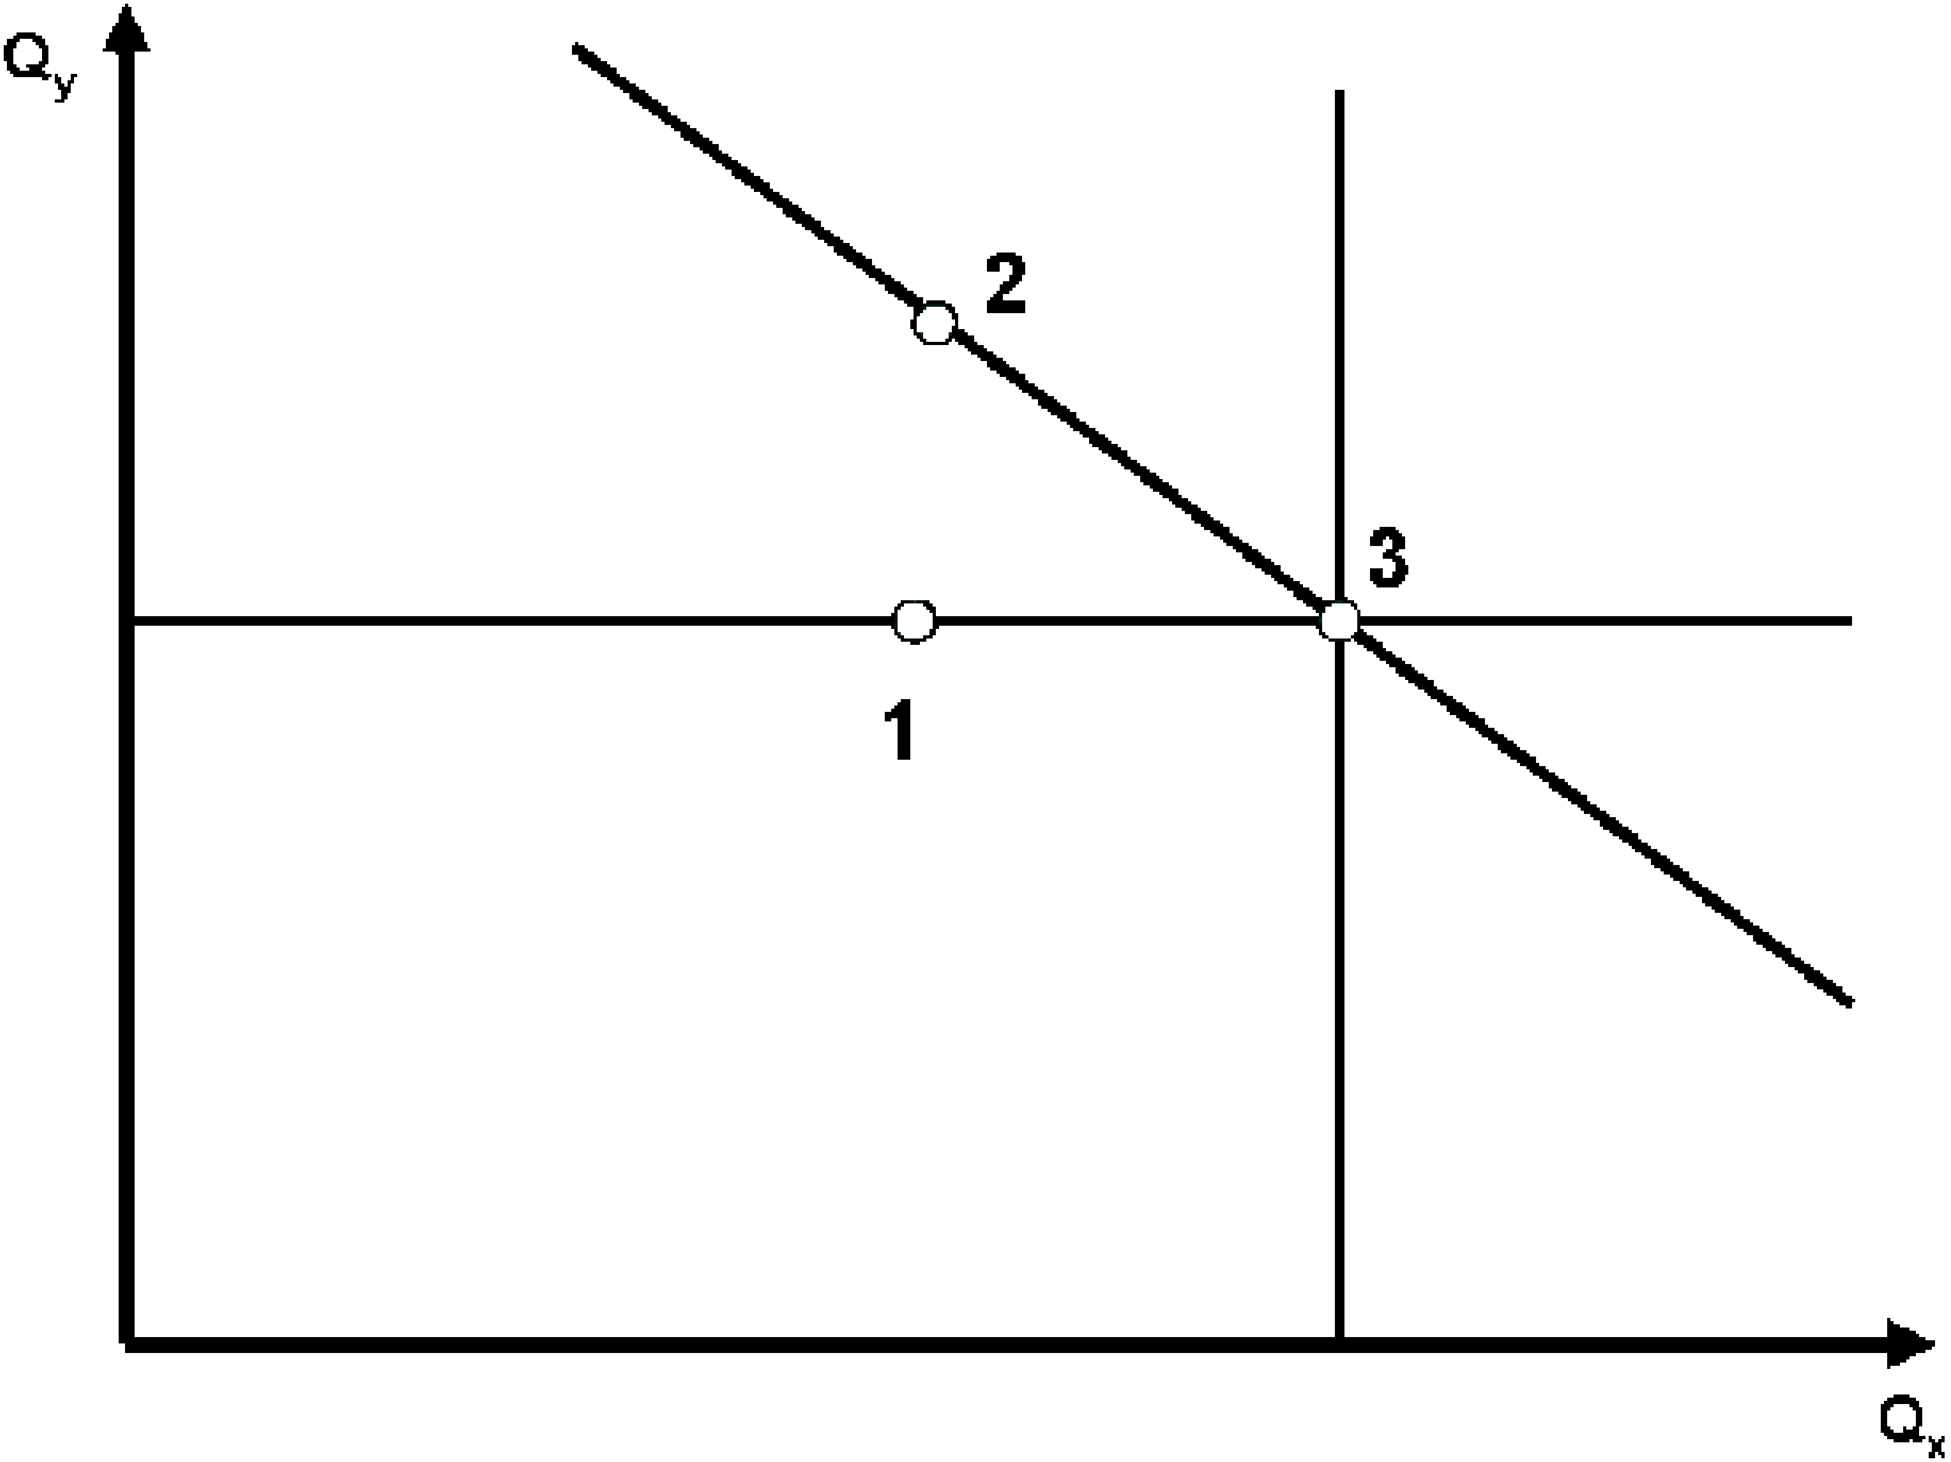
Motivation II: 2D Resonance Types
“Double” 2D Resonance
Coupled 2D Resonance
Single Resonance ➔ like “Boring 1D”

Slide 36
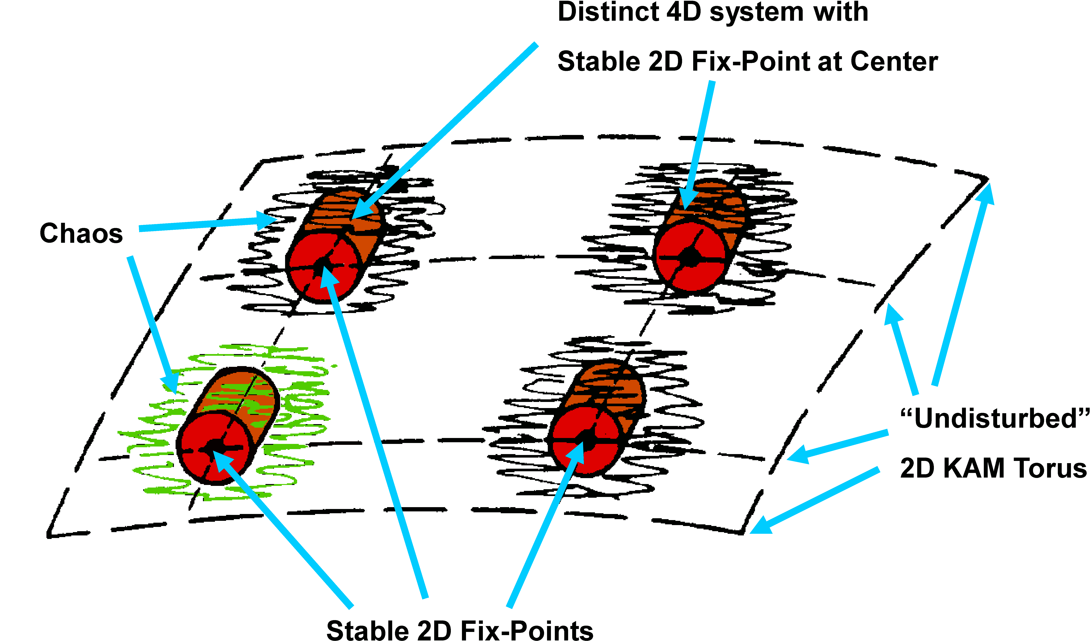
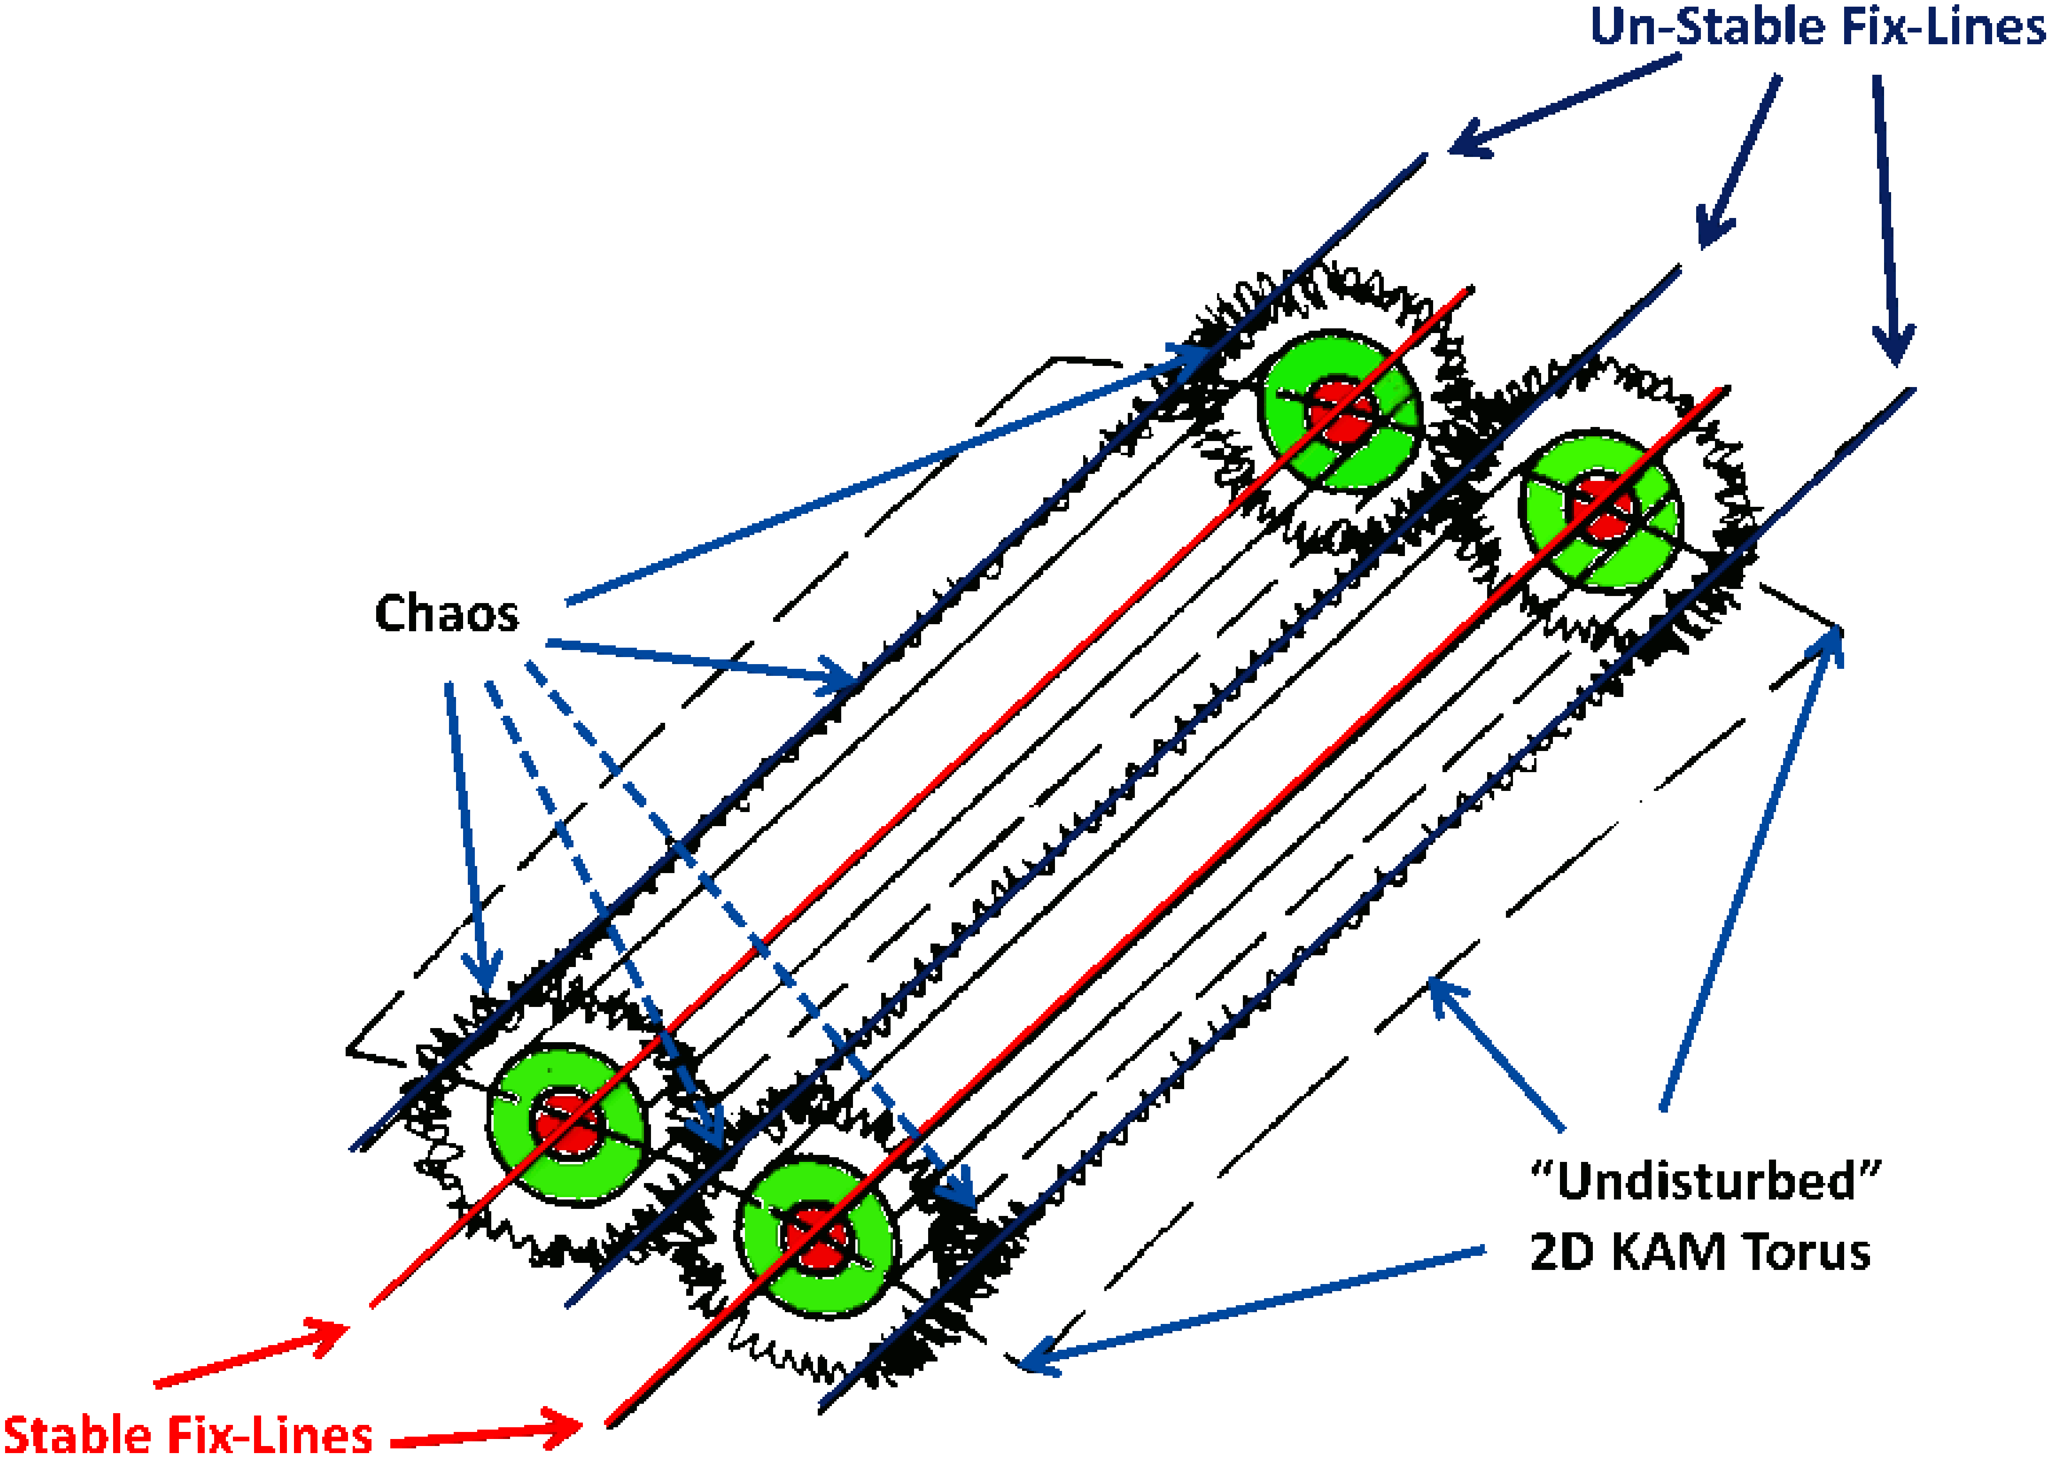
Motivation III: Double versus Coupled

Slide 37
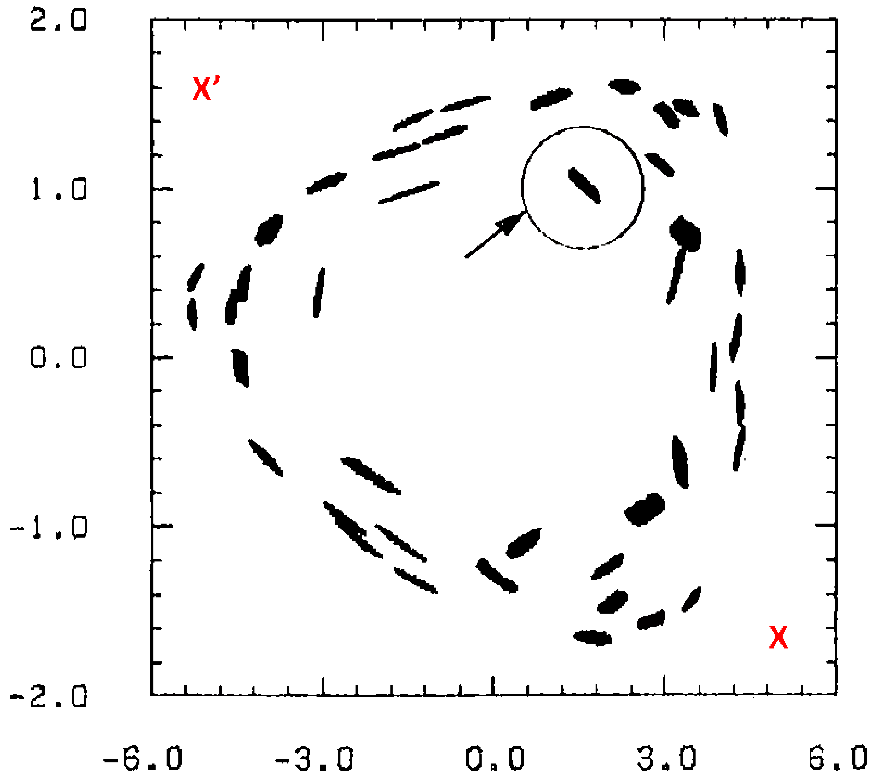
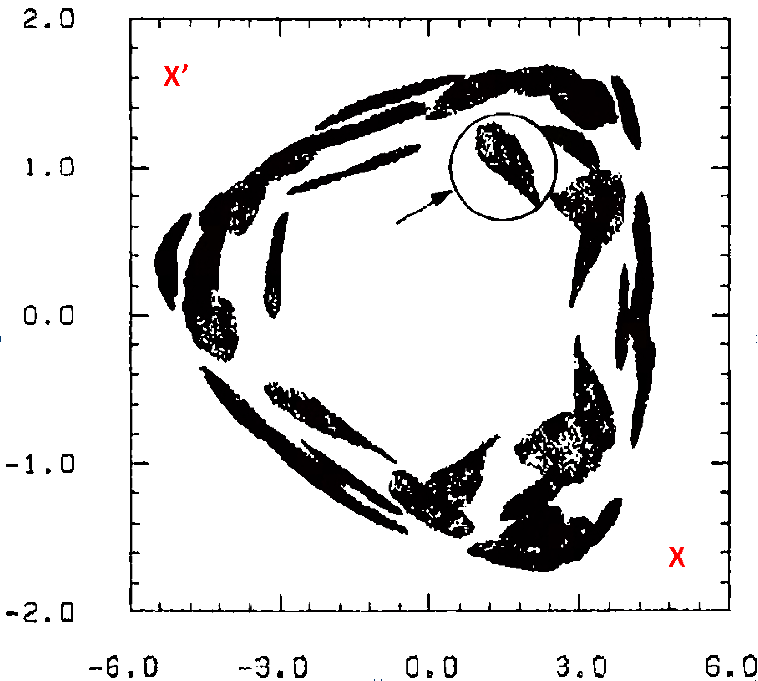
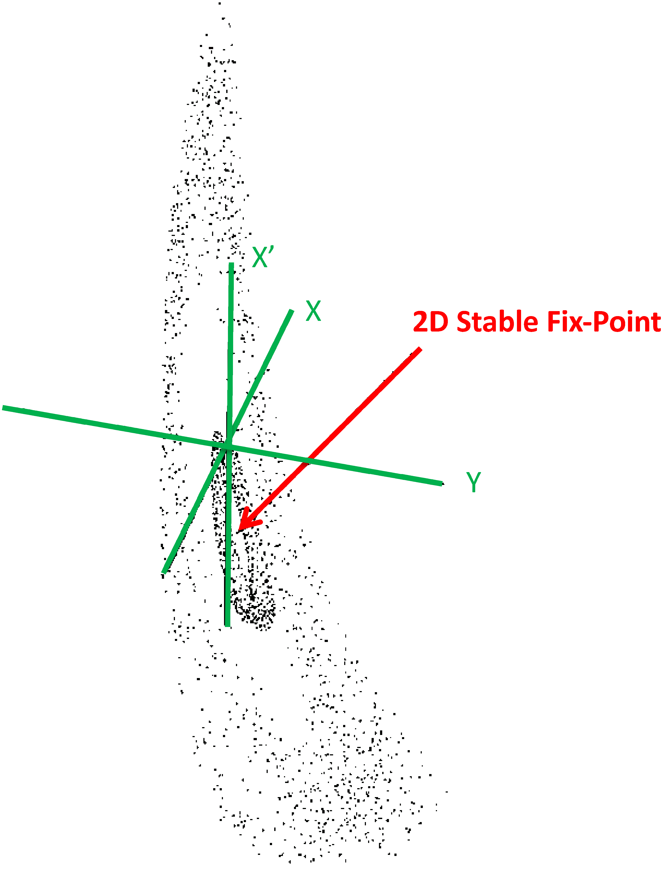
Motivation IV: Double Resonance, Simulation

Slide 38
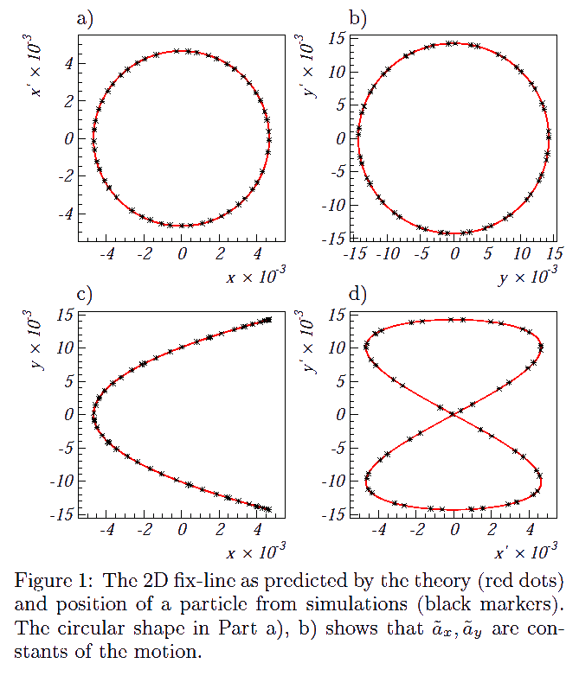
Motivation V: 2D Coupled, Theory
Shown are the results at a particular s location. The theory includes a α parameter that controls the rotation of the projections along the machine.

Slide 39
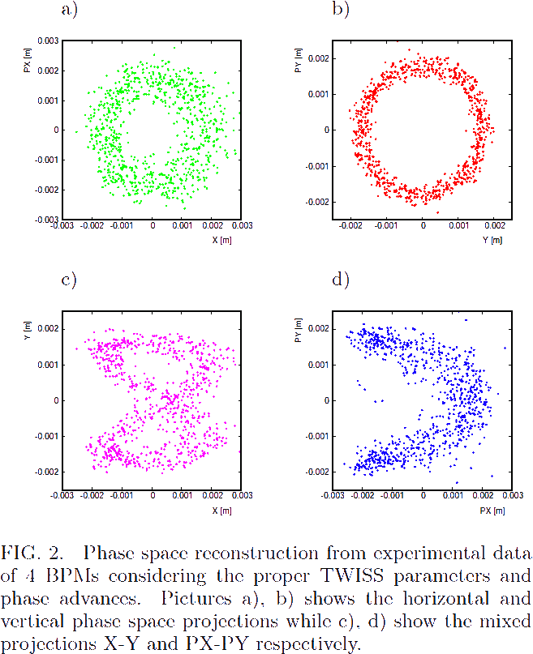
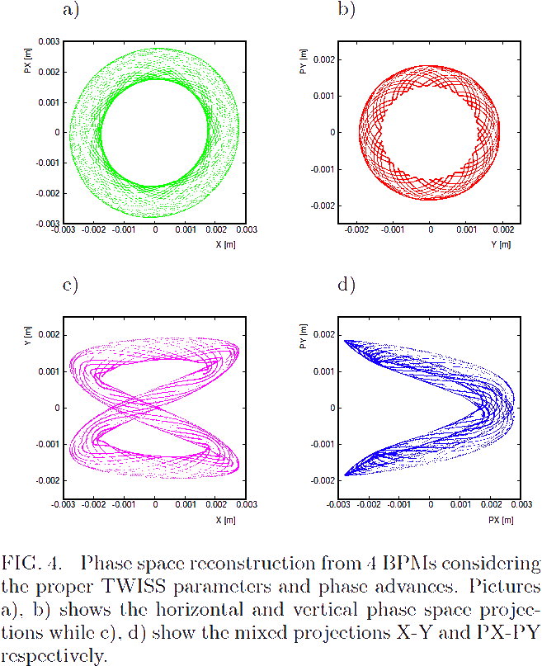
SPS Phase Space Reconstruction BPM1 LSE106
Experiment
Simulation
LSE106

Slide 40
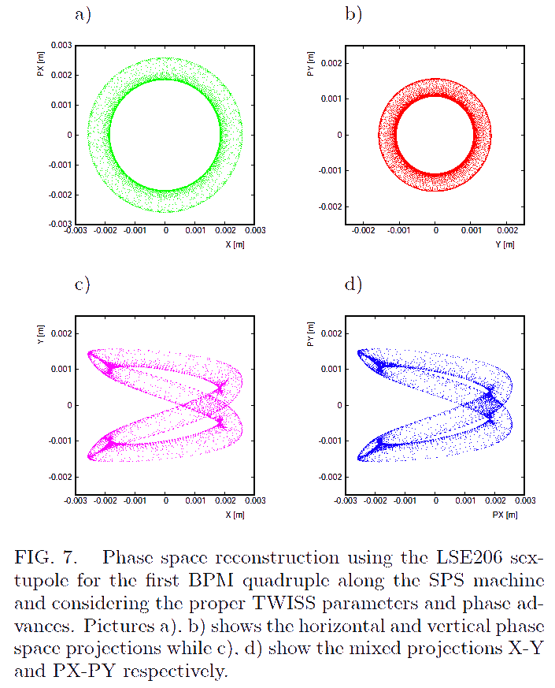
SPS Phase Space Reconstruction BPM1 LSE206
Experiment
Simulation
LSE206

Slide 41
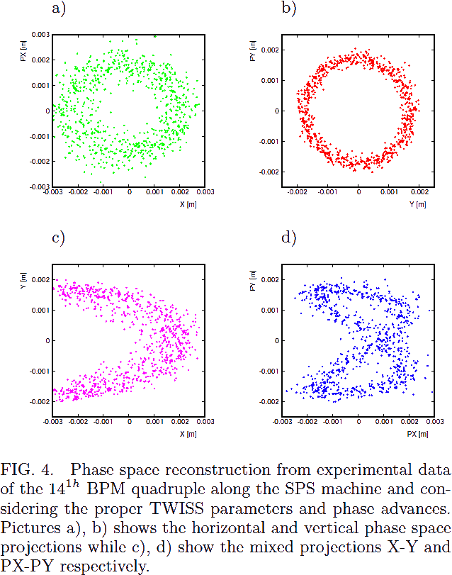
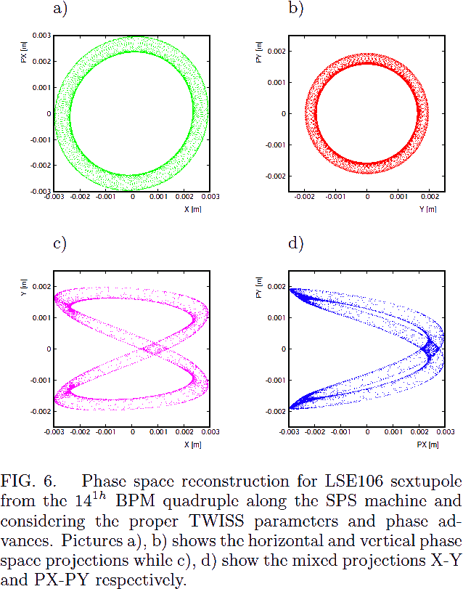
SPS Phase Space Reconstruction BPM14 LSE106
S Location shifted by one Sextant
Experiment
Simulation
LSE106

Slide 42
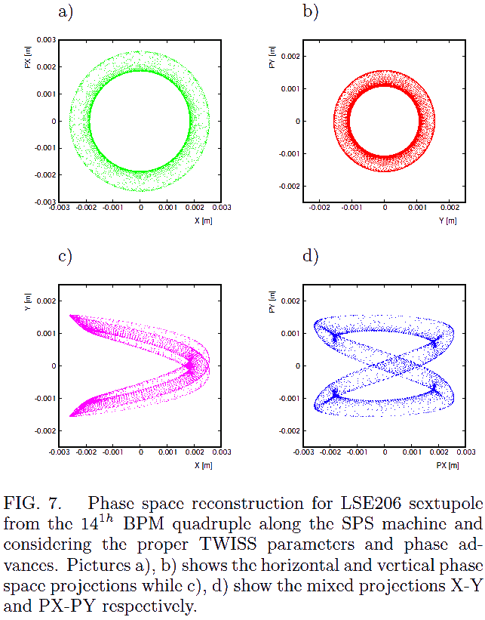
SPS Phase Space Reconstruction BPM14 LSE206
S Location shifted by one Sextant
Experiment
Simulation
LSE206

Slide 43
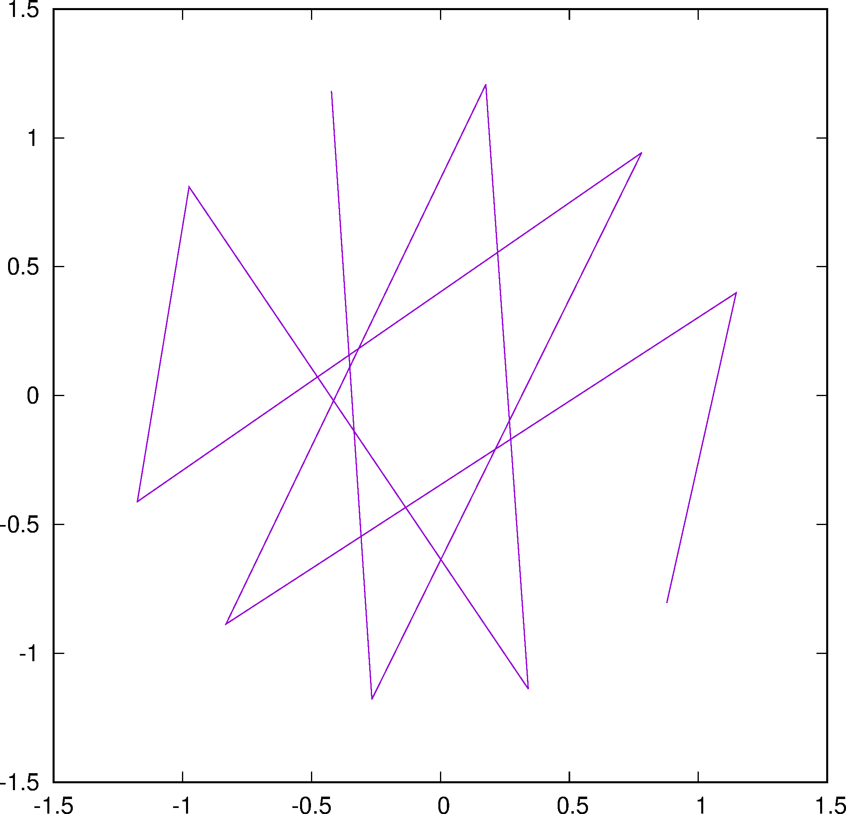
Driving Term (1, 2) for the 10 SPS Sextupoles
DT-S
LSE106
LSE424
LSE324
LSE206
LSE524
LSE224
LSE506
Expected negative!
LSE624
LSE124
LSE406
DT-C

Slide 44
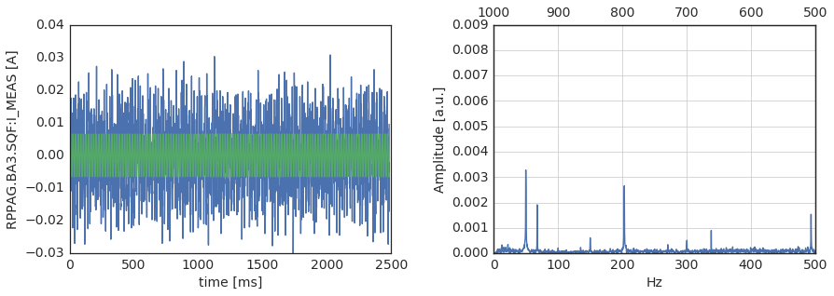
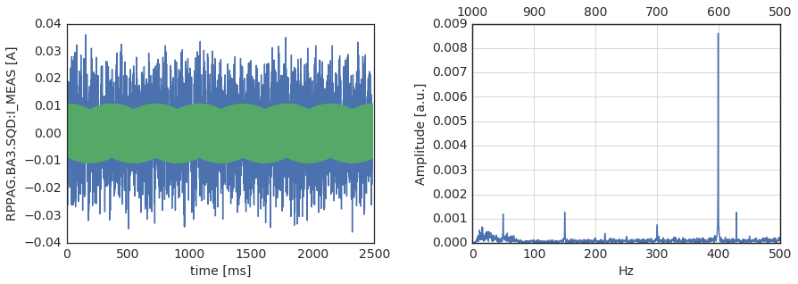
Ripple Spectrum 2017
Horizontal
600 Hz
Vertical

Slide 45
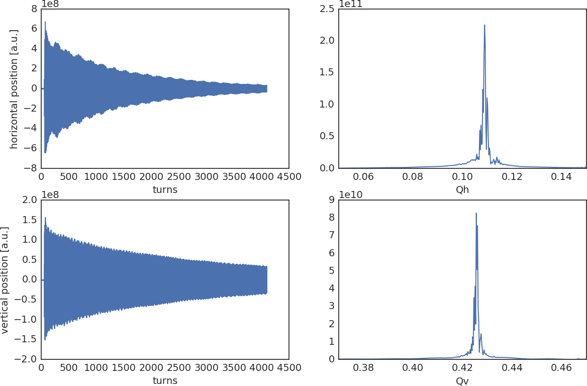
Tune Spectrum 2015

Slide 46
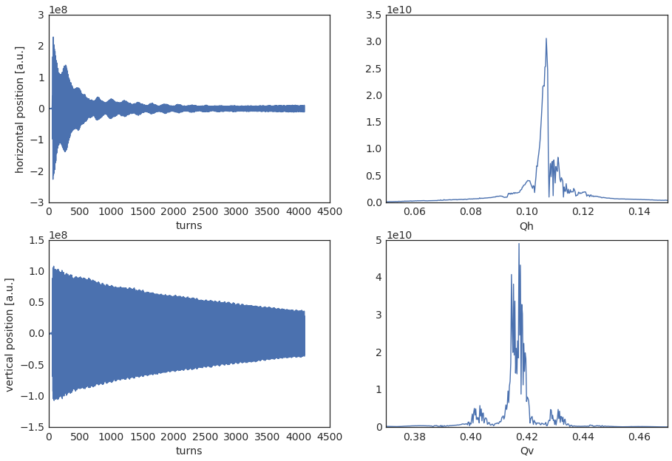
Tune Spectrum 2017
Double Peaks
600 Hz
Sidebands

Slide 47
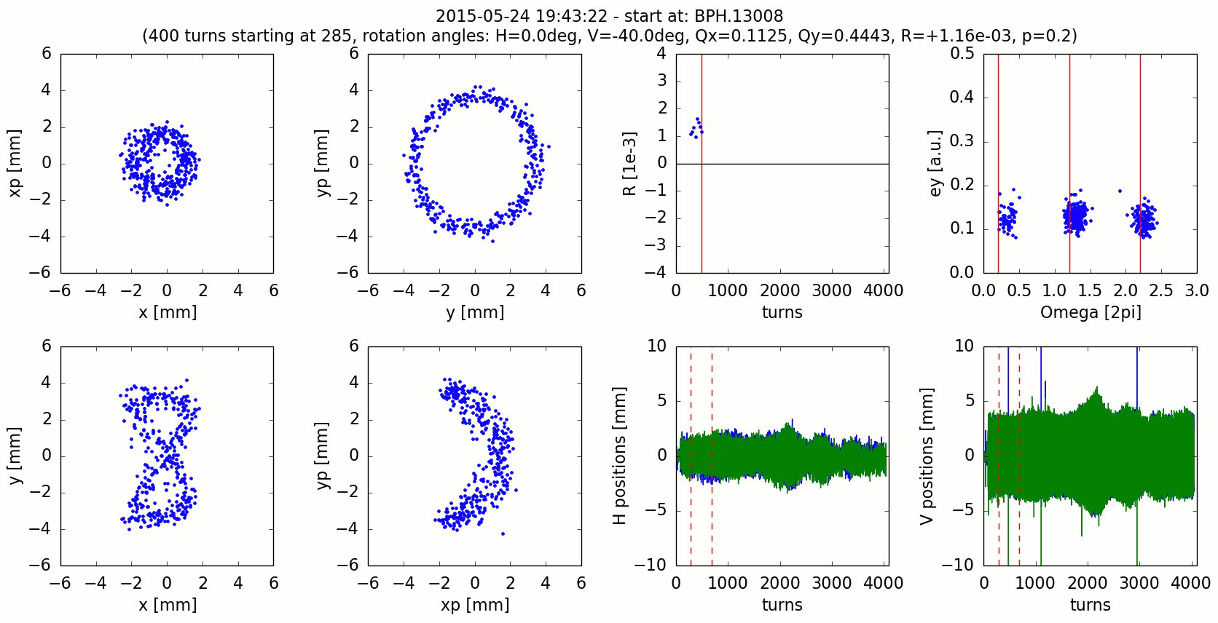
Preliminary SPS Experimental Evidence of Fix-Line 2015
R=φ_{x}+2 φ_{y}- N
Ω=φ_{x}+2 φ_{y}

Slide 48
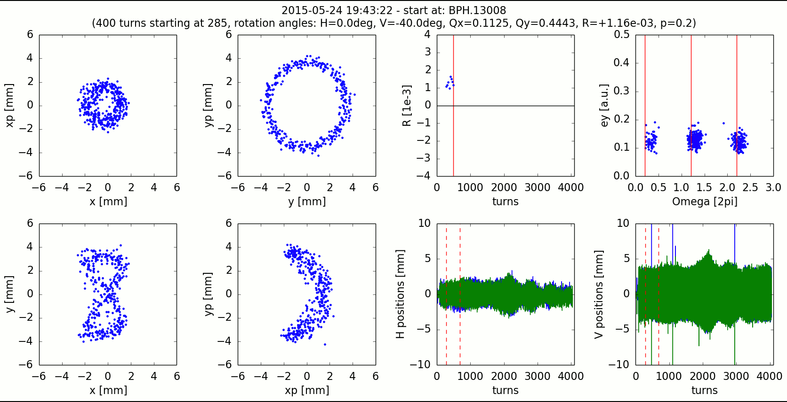
Time Evolution of Motion in the SPS close to Fix-Line 2015

Slide 49
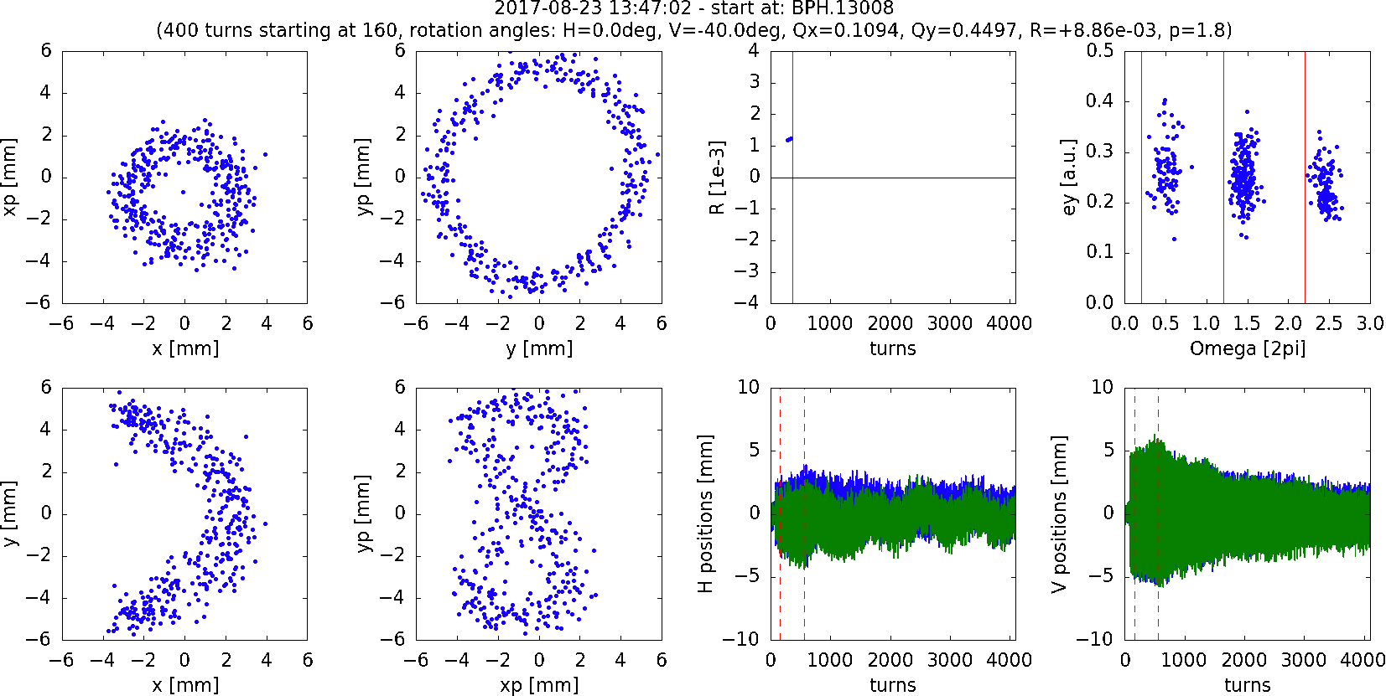
Best Case 2017

Slide 50
Plan of action for the SPS 2018 Fix-Line Experiment
We have first signs in the SPS experiments of the existence of the fix-line structure as expected from theory and simulations.
However, the present level of power supply ripple and potentially drifts does not yet allow to conclude that the particle distribution is locked onto this fix-line structure.
We have started to collaborate with the SPS power supply experts to improve the power supply ripple spectrum down to a level where a stable fix-line can verified beyond any doubt.
Furthermore, we will investigate if we can perform this experiment at an 4 times larger beam energy where the SPS is much better controlled and with a much lower power supply ripple spectrum.
We are confident that we can perform several MDs during the year of 2018 and we hope that we continue to get the support from our external collaborators.

Slide 51
Transmission Line Model

Slide 52
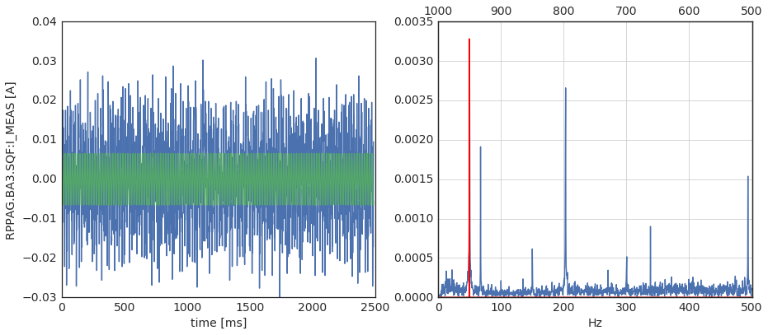
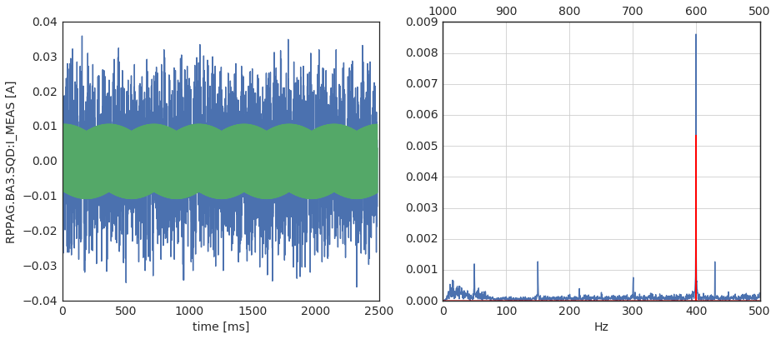
Ripple Spectrum 2017
Horizontal
Vertical

Slide 53
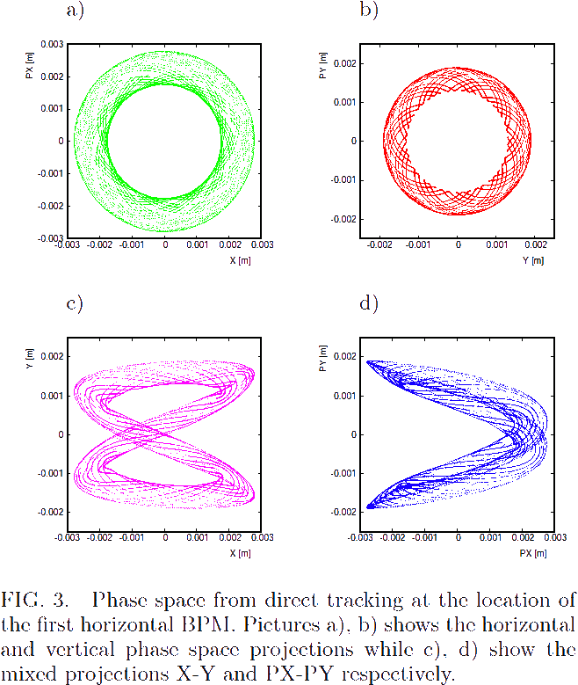
SPS Phase Space Simulation
Reconstruction
LSE106
Direct Tracking
LSE106

Slide 54
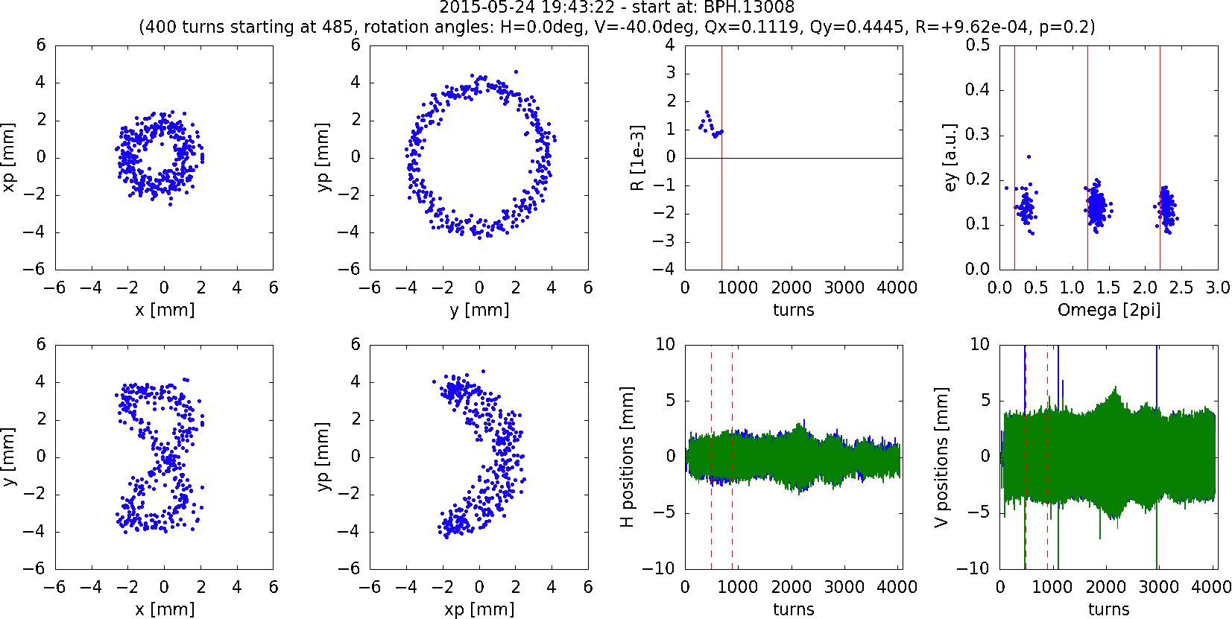
Best Case 2015

