Slide 1
Investigating Nonlinear Integrable Optics with Space Charge in IOTA Using IMPACT-Z
Fermilab Workshop on Megawatt Rings & IOTA/FAST Collaboration Meeting
Fermilab, Batavia, IL
May 7-10, 2018
Chad Mitchell
Lawrence Berkeley National Laboratory

Slide 2
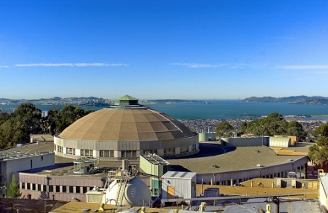
Outline
Introduction and single-particle tracking algorithm
Generation of zero-current matched distribution types
Self-consistent symplectic integration with space charge
Beam stability and invariant preservation (ΔQ=-0.03)
- approach to Vlasov near-equilibrium (through turn 700)
- dynamics within a near-equilibrium beam
- long-term stability behavior (through turn 3K)
Conclusions

Slide 3
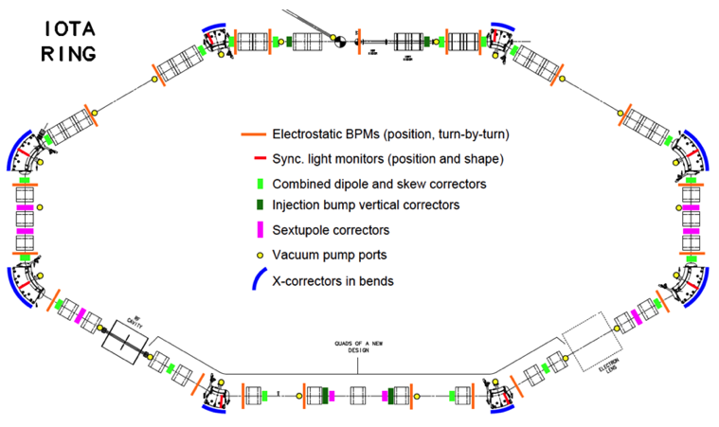
A very brief review of single-particle nonlinear integrable optics in IOTA
Dynamics inside the nonlinear magnetic insert:
first invariant
Courant-Snyder transformation, scaling
D&N give in [1] a realizable potential U
such that H_{N} admits a second invariant I_{N} :
.
drift space for
nonlinear insert
Dynamics in the arc external to the nonlinear magnetic insert:
β_{x} = β_{y} , D = 0 across the nonlinear drift space
nπ phase advance from nonlinear drift space
exit to nonlinear drift space entrance
Assumed linear with a map R_{N} given by:
Thus, the phase advance must be nπ.
(4x4 identity)
H_{N}, I_{N} are invariant under the one-turn map.
[1] V. Danilov and S. Nagaitsev, PRAB 13, 084002 (2010)

Slide 4
Tracking in the nonlinear insert is implemented in
IMPACT-Z using a second-order symplectic integrator.
The ideal 2D magnetic field within the nonlinear insert at location s is given by
, where the potentials are given in terms of dimensionless quantities:
Field lines of the nonlinear insert in the
transverse plane (blue)
using the complex function:
Convergence with stepsize in tracking through the nonlinear insert
.
First invariant
Second invariant
s-Dependent symplectic tracking is performed using:
global error
global error
global error
global error
The map for a single numerical step of size h is:
τ – dimensionless insert strength
c – transverse scale parameter [m^{1/2}]
Bρ – magnetic rigidity [T-m]
β – betatron amplitude [m]
C. E. Mitchell, THPAK035, IPAC 2018 and LBNL Report LBNL-1007217 (2017)

Slide 5
Generation of zero current matched distribution types

Slide 6
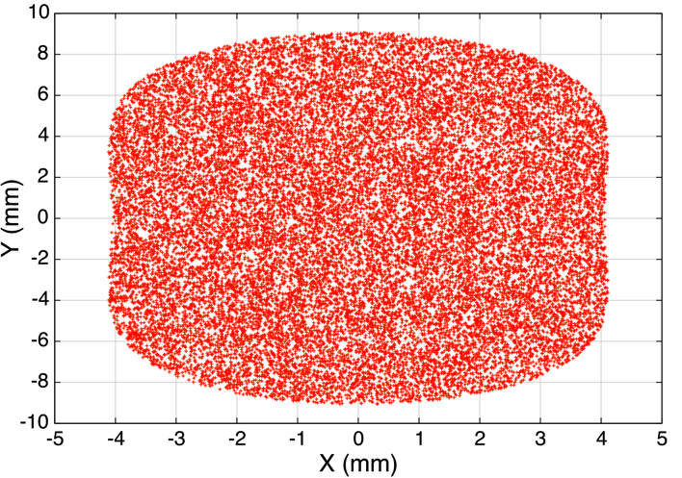
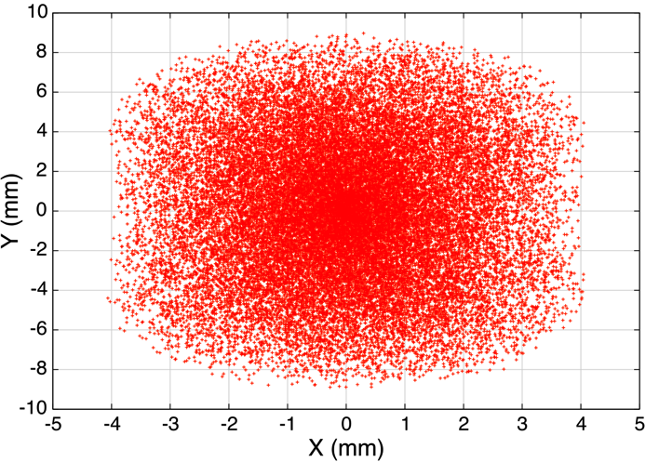
General procedure for the generation of an initial beam distribution matched to the nonlinear lattice
normalized phase space
variables (x_{N} , p_{xN} , y_{N} , p_{yN})
physical phase space variables (x, p_{x}, y, p_{y})
“nonlinear KV distribution” [1]
Courant-Snyder
transformation
- Hamiltonian is s-dependent
- distribution varies periodically in s
- parameter ε₀ plays the role of emittance
“nonlinear waterbag distribution”
- Hamiltonian is s-independent
- distribution function is stationary
Nonlinear KV
ε₀ = 8 mm-mrad
Nonlinear waterbag
ε₀ = 8 mm-mrad
boundary = equipotential curve
of the nonlinear potential
Python script developed by the RadiaSoft team is used for matched KV beam generation - populates uniformly a fixed level set of H.
[1] S. Webb et al, p. 3099, IPAC 2013.

Slide 7
Generation of matched distribution types with general Hamiltonian dependence
Given a probability density f on the phase space M (of dimension 2N) and a smooth Hamiltonian H, the probability density P_{H} describing the values of H is given by the co-area formula as:
where the surface integral on the right is over the 2N-1 dimensional level set of H with value h.
(This integral is defined and finite for almost all values of h.)
If f is taken to be uniform on the level sets of H, then for some function G, and so:
A numerical procedure for generating the beam is to first sample values of H from P_{H} and then to populate uniformly each level set of H, so the resulting density on the phase space is given by:
This Jacobian factor depends on h.

Slide 8
Numerical evaluation of the Jacobian factor for the
Danilov & Nagaitsev Hamiltonian
The Jacobian κ is evaluated using a numerical Monte Carlo method, as follows:
sample 10M points uniformly within the 2D domain A_{h} for the value h = ½ (dimensionless)
compute the dimensionless potential value Φ(x,y) at each point (x,y)
compute the histogram of Φ values to produce κ_{Φ} P_{Φ}, valid for h ≤ 1/2
compute the cumulative distribution function of Φ to give κ
Hamiltonian
Jacobian factor
Dependence on τ
is weak but nonzero.
Almost exactly linear
in h for all τ.
line integral
τ=0.00
τ=0.40
τ=0.45
τ=0.49
Jacobian factor
2D area

Slide 9
Definition of a two-parameter family of matched distribution types - smooth (except at the beam edge)
Nonlinear waterbag distribution:
Truncated nonlinear Gaussian (thermal) distribution:
Distribution Horizontal Profiles
τ = 0.4
c = 0.01 m^{1/2}
Λ=0
Λ=1
Λ=3
Λ=5
temperature parameter
cutoff parameter
as
as
as
as .
<H> = 4 mm-mrad
α = 1.4082
β = 1.9065 m
Reduce to traditional waterbag and Gaussian distributions, respectively, when insert is off.
The nonlinear Gaussian reduces to the nonlinear waterbag as Λ goes to zero with the quantity <H> held fixed, and provides the ability to control (matched) halo extent.

Slide 10
Examples of nonlinear Gaussian (thermal) distributions with cutoffs at Λ = 1, 3, 5 (shown at entrance to NLI)
Distribution parameters are selected to give: with identical Twiss values.
waterbag
distribution
waterbag
waterbag
waterbag

Slide 11
Self-consistent symplectic integration with space charge

Slide 12
Theory of a symplectic spectral space charge solver for coasting 2D beams (1)
Collective N-particle Hamiltonian:
Symplectic map for a single step:
single-particle Hamiltonian
w/o space charge (“external”)
2D space charge Green function in a rectangular conducting pipe
y
2D Poisson equation
continuum limit
(0, b.)
x
generalized perveance
(0,0)
(a , 0)
J. Qiang, Phys. Rev. ST Accel. Beams 20, 014203 (2017).

Slide 13
Theory of a symplectic spectral space charge solver for coasting 2D beams (2)
Spectral approximation of G using N_{l} , N_{m} Fourier modes in x and y, respectively:
(★)
for mode (l,m):
The symplectic map associated with is given for particle i as:
Computed directly from particle data in the laboratory frame using (★).
Note: Momenta are normalized by the design momentum p₀.
Computational complexity scales as . See also [1] and the talk by N. Cook.
[1] S. Webb, Plasma Phys. Control. Fusion 58, 034007 (2016).

Slide 14
Benchmark 1: Expansion in free space of a cold uniform cylinder beam (1).
Beam size evolution
Emittance evolution
× 2.03
× 2.04
doubling
distance
Linear drift (kinematic nonlinearities off)
KE = 2.5 MeV p (equal to IOTA benchmark value)
R₀ = 3.905 mm (equal to IOTA benchmark value)
I = 4.113 mA (10 × IOTA benchmark value)
a = b = 5 cm (chosen to be >> R₀)
Measures of numerical resolution:

Slide 15
Benchmark 1: Expansion in free space of a cold uniform cylinder beam (2): Hamiltonian preservation
Evolution of the N-particle Hamiltonian
Initial value of H :
Numerical resolution:
× 4.00
Relative change in H × 10⁶
125 SC kicks
250 SC kicks
500 SC kicks
The error in H scales as expected:

Slide 16
Benchmark 2: A matched waterbag beam in the linear
IOTA lattice.
IOTA lattice retuned for space charge
tune depression of ΔQ = -0.03
Nonlinear insert turned OFF (linear lattice)
Waterbag beam, 1.024 M particles
I = 0.4113 mA, <H> = 4 mm-mrad
Final beam phase space
Convergence of phase advance across the arc
2D PIC Poisson
solver
Relative emittance growth over 1K turns
Convergence of phase advance across the arc
2D PIC solver
2D Symplectic solver
mean particle value
horizontal
vertical
horizontal
vertical
2D symplectic
spectral solver
increasing number of modes
increasing number of modes
mean particle value
Emittance evolution:
Emittance evolution:

Slide 17
Beam stability and invariant preservation

Slide 18
Tracking in the IOTA Lattice with Space Charge - Assumptions and Simulation Parameters
Objective: To isolate and understand the perturbative effects of space charge on the ideal
integrable single-particle dynamics at moderate space charge tune depression.
Elements external to the nonlinear insert are sliced longitudinally and treated as symplectic
maps alternating with space charge momentum kicks (split-operator approach): linear order.
Space charge is included self-consistently throughout the lattice using the symplectic spectral
solver with a rectangular boundary of large aperture to emulate free-space boundary conditions.
We consider a long, unbunched beam with zero energy spread to remain near the ideal
integrable working point.
Quadrupole settings are retuned to provide nπ phase advance across the arc after including
the linearized space charge fields at the desired value of beam current (A. Romanov, [1]).
Twiss functions with linearized space charge included must be appropriately matched to the
nonlinear insert. See also [2].
Tune advance footprint for 0.4113 mA
(waterbag beam, <H> = 4 mm-mrad)
SC induced
tune spread
Settings designed for
a space charge tune
depression of -0.03.
Insert parameters: τ = 0.4, c = 0.01 m^{1/2}, μ₀ = 0.30345, L = 1.8 m
Beam parameters: KE = 2.5 MeV, I = 0.4113 mA, <H> = 4.0 mm-mrad, ΔQ_{x} = ΔQ_{x} = -0.03
[1] A. Romanov et al, THPOA23, NAPAC 2016. [2] C. Hall et al, WEA4CO02, NAPAC 2016.

Slide 19
Tracking in the IOTA Lattice with Space Charge –
First 700 Turns (1)
Evolution of the standard deviation of the two invariants of single-particle motion for 700 turns.
First invariant
Second invariant
nonlinear
Gaussian (Λ=5)
nonlinear
Gaussian (Λ=5)
nonlinear
Gaussian (Λ=3)
nonlinear
Gaussian (Λ=3)
nonlinear
waterbag (Λ=0)
nonlinear
waterbag (Λ=0)
In all cases, <H> = 4 mm-mrad. Growth during the initial period of nonlinear mixing and phase space filamentation (turns 1-100) appears to depend only weakly on the cutoff parameter Λ.
The time scale for this initial mixing decreases with increasing Λ, as larger-amplitude particles in the tail contribute to stronger nonlinear damping.

Slide 20
Tracking in the IOTA Lattice with Space Charge –
First 700 Turns (2)
Evolution of the horizontal density profile showing stability of low-density tail
Waterbag (Λ=0)
Gaussian (Λ=3)
after 700 turns
after 700 turns
initial beam
initial beam
Gaussian (Λ=5)
All three spatial profiles appear quite stable.
Perhaps a minor change in the curvature of the profile near the outer beam edge in the waterbag case?
1.024 M particles, 64 x 64 spectral modes
480 steps through the nonlinear insert
after 700 turns
initial beam

Slide 21
Tracking in the IOTA Lattice with Space Charge –
First 700 Turns (3)
Evolution of the first invariant (Hamiltonian) profile showing the effects of space charge
Waterbag (Λ=0)
Gaussian (Λ=3)
initial beam
after 700 turns
after 700 turns
initial beam
Gaussian (Λ=5)
Redistribution of the single-particle invariants occurs primarily near the outer beam edge through profile smoothing near the discontinuity at H=H_{max}.
Similar behavior is apparent in the evolution of the
profile of the second invariant.
after 700 turns
initial beam

Slide 22
Dynamics within a near-equilibrium nonlinear waterbag beam –
Invariant profiles are well-preserved across the arc
First invariant profile
Second invariant profile
Arc entry
Arc exit
Turn 350
Beam distribution is
nearly stationary
H, I are here expressed
in dimensionless units
Arc entry
Arc exit
Turn 700

Slide 23
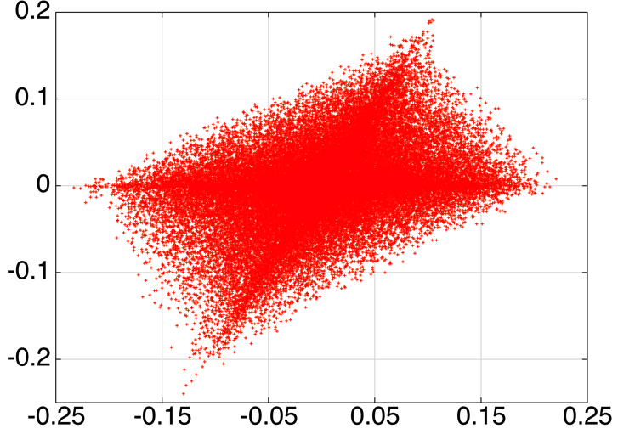
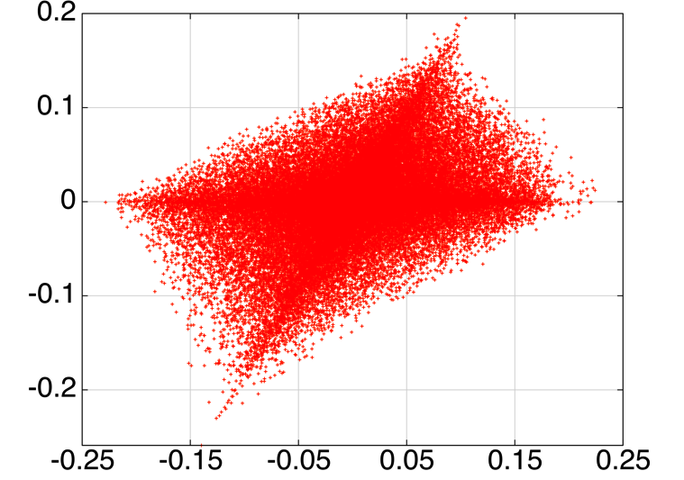
Dynamics within a near-equilibrium nonlinear waterbag beam –
Advance of invariant values across the arc
Individual particle changes in H and I are as large as 20%
Turn 350
Turn 700
Footprint is
stable over
350 turns
high
density
high
density
Turn 350
Turn 700

Slide 24
Smooth focusing waterbag model of equilibrium in the linear IOTA lattice (action advance across the arc)
Linear IOTA lattice
Smooth focusing model¹
Arc entry
Arc exit
Distribution of
action values
stationary
Turn 700
Turn 350
Turn 700
Distribution in the
change of action
across the arc
Well-described
by a smooth
focusing model.
¹Assuming a stationary waterbag beam with emittance, phase advance, and tune depression used in the IOTA lattice.

Slide 25
Tracking in the IOTA Lattice with Space Charge –
First 3,000 Turns
Long-term tracking over 3,000 turns showing sensitivity of diffusion rates to distribution details.
First invariant
Second invariant
nonlinear
waterbag (Λ=0)
nonlinear
waterbag (Λ=0)
nonlinear
Gaussian (Λ=3)
nonlinear
Gaussian (Λ=3)
In both cases, <H> = 4 mm-mrad. The beams are well-matched in horizontal and vertical rms beam sizes, but the current density differs by >10% at the beam center differences in tune advance for particles in the core. Greater nonlinearity in the space charge fields for the Gaussian
beam does not appear to result in more rapid diffusion in this case.

Slide 26
Convergence of the Standard Deviation of Single-Particle Invariants with Numerical Resolution of Space Charge
Dynamics of initial mixing and phase space
filamentation are well-resolved using ~100K
particles and 16x16 spectral modes.
Rates of diffusion (above) are computed using
linear interpolation of data taken over 200 turns.
Due to particle noise, ~1M particles are
required to begin to approach convergence of
the diffusion rates. This could potentially be
improved using higher-order macroparticle shapes.
1.4
1.2
Varying Nmode
Np = 1.024 M
Nsteps fixed

Slide 27
Traditional rms emittance growth and beam size evolution for the nonlinear waterbag beam
Emittance is well-preserved after initial
redistribution due to space charge.
Growth in the outer beam edge at the 10%
level over 3K turns (stable beyond turn 350).
Matched nonlinear waterbag beam
I = 0.4113 mA, <H> = 4.0 mm-mrad
τ = 0.4, c = 0.01, μ₀ = 0.30345, L = 1.8 m
Traditional emittance growth
Beam size evolution on turn 3K
no losses
σ_{x} (turn 3K)
x_{max} (turn 1)
x_{max} (turn 3K)
64x64 modes, 1.024 M particles
rectangular boundary a=b=5 cm
X and Y are strongly coupled by the nonlinear insert. We show the change in .
Change in rms beam size: 3% (0.1 mm)
Change in maximum x-deviation: 11% (1.0 mm)

Slide 28
Conclusions
A family of initial beam distribution types controlled by two parameters <H> (generalized emittance) and Λ (cutoff) allows us to investigate sensitivity to distribution details while remaining matched to the (ideal) nonlinear lattice.
Tracking is performed using a symplectic integrator within the nonlinear magnetic insert, coupled with a symplectic spectral solver for self-consistent space charge tracking to avoid non-Hamiltonian sources of numerical noise. Particle noise has a significant impact on the observed stochatic diffusion. Here 1.024M particles are used.
We focus on isolating the perturbative effects of space charge for moderate tune depression (ΔQ=-0.03).
Initial nonlinear mixing leads to a near-matched equilibrium by turn 350. The largest visible effect is smoothing of the hard outer beam edge. The distribution of invariants is well-preserved both 1) across the nonlinear insert and 2) across the arc. However, the single-particle invariants along each orbit fluctuate significantly (~20%). Nevertheless, the invariants provide a sensitive measure of beam quality.
There remains evidence of slow stochastic diffusion, while both rms beam sizes remain well-controlled. An 11% increase in maximum horizontal particle amplitude is visible, and a larger number of spectral modes may be needed to verify that the space charge fields at the beam edge are well-resolved.
The dynamics appear robust in the presence of nonlinear space charge fields caused by the presence of a matched, low-density tail, which also results in more rapid nonlinear damping.

Slide 29
Backup material

Slide 30


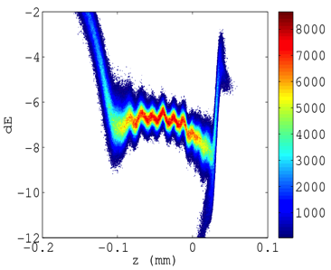
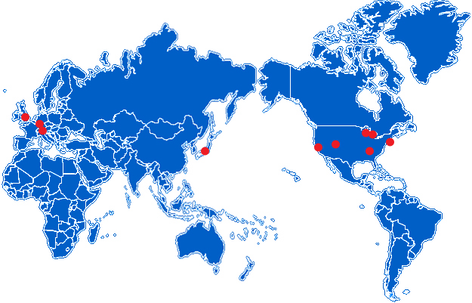
Overview of advanced computing/modeling using
IMPACT-Z
The IMPACT-Z code & physics model
  s-based symplectic particle tracking using maps
  Poisson solvers for 6 distinct boundary conditions
  standard beamline elements, RF and RW wakefields
  field, misalignment, and rotation errors
  multi-turn tracking with simulation restart
  efficient parallelization, access to NERSC
The IMPACT code suite is used by > 40
institutes worldwide
  successfully applied to both electron & proton
  machines:
    CERN PS2 ring
    LCLS-II linac
  unprecedented resolution: ~2B macroparticles
> 100, 000 cores
Δ γ
final longitudinal
phase space
z (mm)
Collaboration with teams at RadiaSoft and FNAL, who are modeling IOTA using SYNERGIA.

Slide 31
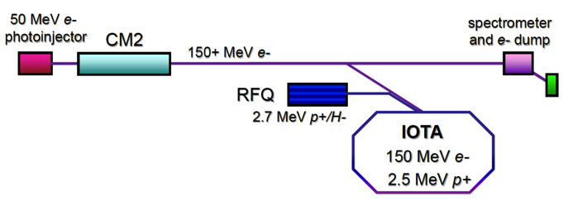
The IOTA ring : a test bed for strategies designed to mitigate space charge-induced beam halo.
Possible strategies: electron lenses/columns, nonlinear integrable lattices
Integrable Optics Test Accelerator (IOTA)
- Novel accelerator physics: strongly nonlinear design
- Experimental test bed for SC mitigation schemes
- Run first with electrons, then low-energy protons
Fermilab
halo
nonlinear decoherence¹
nonlinear magnetic insert
using conventional linear design
using nonlinear integrable design
Nonlinearity tune spread “washes out” coherent space charge instabilities
Integrability ensures orbits are regular and remain bounded (no chaos)
¹S. Webb et al, p. 2961, IPAC 2012

Slide 32
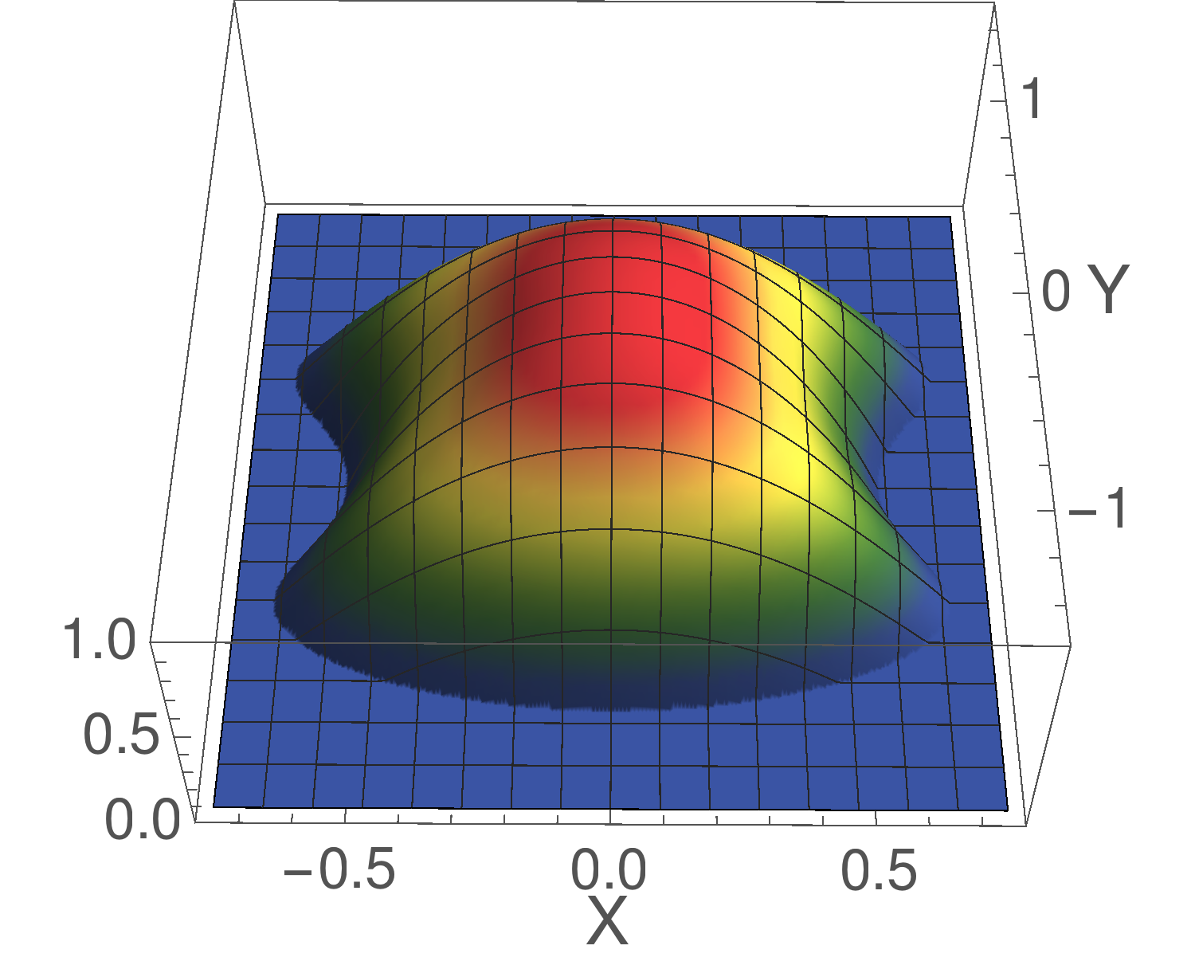
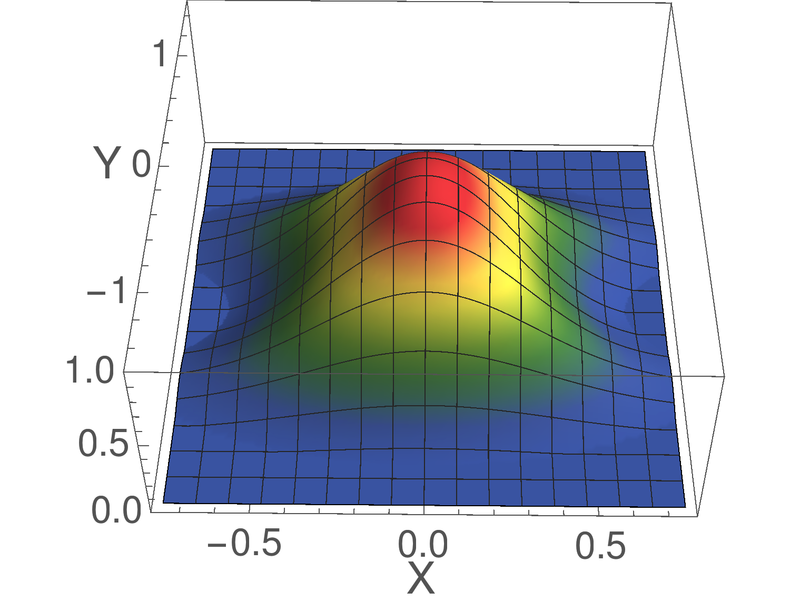
Summary of spatial projections for revised matched distributions in the D&N potential
Nonlinear KV
Potential (dimensionless form)
Nonlinear Waterbag
Waterbag (Λ=0)
Shown for
τ = 0.4,
<H> = 0.2
(dimensionless)
Nonlinear Gaussian
Gaussian (Λ=3)

Slide 33
Nonlinear Waterbag Beam in the IOTA Lattice –
Spatial profiles are well-preserved across the arc
Horizontal profile
Vertical profile
Arc entry
Arc exit
Turn 350
X, Y are dimensionless;
singularities located
at (X,Y)=(±1,0)
Y
Arc entry
Arc exit
Turn 700
Y

Slide 34
Smooth focusing waterbag model of equilibrium in the linear IOTA lattice
Hamiltonian:
self-consistent
space charge
potential
Due to symmetry under rotation, H is integrable with a second invariant given by .
Distribution function:
Spatial density:
Self-consistent potential:
Generalized space charge perveance:

Slide 35
Smooth focusing waterbag model of equilibrium in the linear IOTA lattice
Hamiltonian expressed using zero-current action-angle variables:
normalized
coordinates
B
insert gap
1.8 m
A
Input parameters:
rms emittance: ε_{x} = 2 mm-mrad
undepressed tune advance A to B: Q_{x} = 5.03
space charge tune depression: ΔQ_{x} = -0.03
length of arc A to B: L_{arc} = 38.1682 m
Model parameters:
k₀ = 0.828 m⁻¹, k₁ = 66.355 m⁻¹
a = 3.817 mm, H_{max} = 4.995 mm-mrad
Checks: σ_{x} = 3.118 mm, I = 4.85 mA
Matched to an rms equivalent KV beam.¹
Examine the evolution of the zero-current invariants (actions).
arc
L_{arc}
¹S. M. Lund et al, Phys. Rev. ST – Accel. Beams 12, 114801 (2009)

