Slide 1
A new approach to calculating dynamic friction for magnetized electron coolers – relevance to future IOTA experiments and to EIC designs
David Bruhwiler,
Stephen Webb, Dan T. Abell & Yury Eidelman
Fermilab Workshop on Megawatt Rings & IOTA/FAST Collaboration Meeting
9 May 2018 – Batavia, IL
This work is supported by the US DOE, Office of Science, Office of Nuclear Physics, under Award # DE-SC0015212.

Slide 2
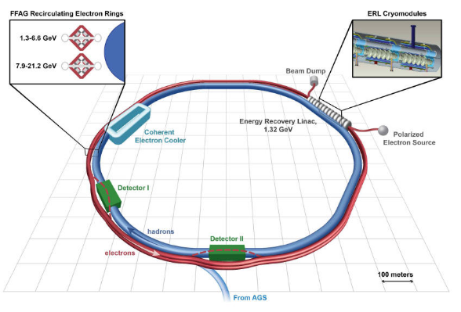
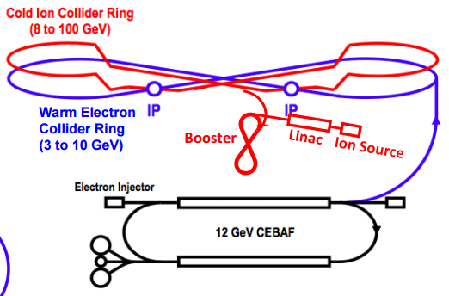
Motivation – Nuclear Physics
Electron-ion colliders (EIC)
high priority for the worldwide nuclear physics community
Relativistic, strongly-magnetized electron cooling
may be essential for EIC, but never demonstrated
eRHIC concept from BNL
JLEIC concept from Jefferson Lab

Slide 3
Idea for Electron Cooling is 50 Years Old
Budker developed the concept in 1967
G.I. Budker, At. Energ. 22 (1967), p. 346.
Many low-energy electron cooling systems:
continuous electron beam is generated
electrons are nonrelativistic & very cold compared to bunches
electrons are magnetized with a strong solenoid field
suppresses transverse temperature & increases friction
Fermilab has shown cooling of relativistic p-bar’s
S. Nagaitsev et al., PRL 96, 044801 (2006).
~5 MeV e-’s (γ ~ 9) from a DC source
The electron beam was not magnetized
Relativistic magnetized cooling not yet demonstrated
electron cooling at γ ~ 100 has not been demonstrated
a non-magnetized concept was developed for RHIC
Fedotov et al., Proc. PAC, THPAS092 (2007).

Slide 4
Risk Reduction is Required for Relativistic Coolers
eRHIC, JLEIC both need cooling at high energy
100 GeV/n → γ ≈ 107 → 55 MeV bunched electrons, ~1 nC
Electron cooling at γ~100 requires different thinking
friction force scales like 1/γ² (Lorentz contraction, time dilation)
challenging to achieve the required dynamical friction force
not all of the processes that reduce the friction force have been quantified in this regime → significant technical risk
normalized interaction time is reduced to order unity
τ = tω_{pe} >> 1 for nonrelativistic coolers
τ = tω_{pe} ~ 1 (in the beam frame), for γ~100
violates the assumptions of introductory beam & plasma textbooks
breaks the intuition developed for non-relativistic coolers
as a result, the problem requires careful analysis

Slide 5
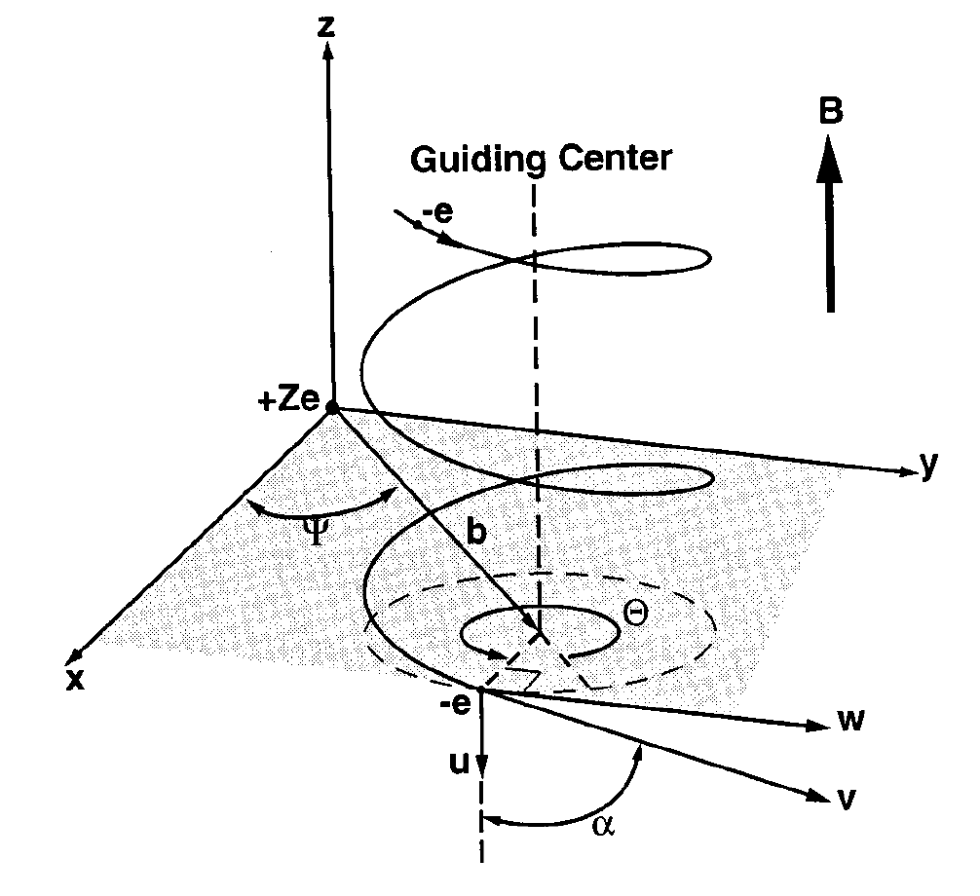
Goals
Simulate magnetized friction force
include all relevant real world effects
e.g. incoming beam distribution
include a wide range of parameters
cannot succeed via brute force
improved understanding is required
Include key aspects of magnetized e- beam transport
imperfect magnetization
space charge
field errors
from Geller & Weisheit, Phys. Plasmas (1977)
from Zhang et al., MEIC design, arXiv (2012)

Slide 6
Asymptotic model for cold, strongly magnetized electrons
Ya. S. Derbenev and A.N. Skrinsky, “The Effect of an Accompanying Magnetic Field on Electron Cooling,” Part. Accel. 8 (1978), 235.
Ya. S. Derbenev and A.N. Skrinskii, “Magnetization effects in electron cooling,”
Fiz. Plazmy 4 (1978), p. 492; Sov. J. Plasma Phys. 4 (1978), 273.
I. Meshkov, “Electron Cooling; Status and Perspectives,” Phys. Part. Nucl. 25 (1994), 631.

Slide 7
Including thermal effects
V.V. Parkhomchuk, “New insights in the theory of electron cooling,” Nucl. Instr. Meth. in Phys. Res. A 441 (2000).
Integrating D&S calculation over thermal electron population:
D.V. Pestrikov, (2002), preprint.
A.V. Fedotov, D.L. Bruhwiler and A.O. Sidorin, “Analysis of the magnetized friction force,” Proc. High Brightness (Tsukuba, 2006).

Slide 8
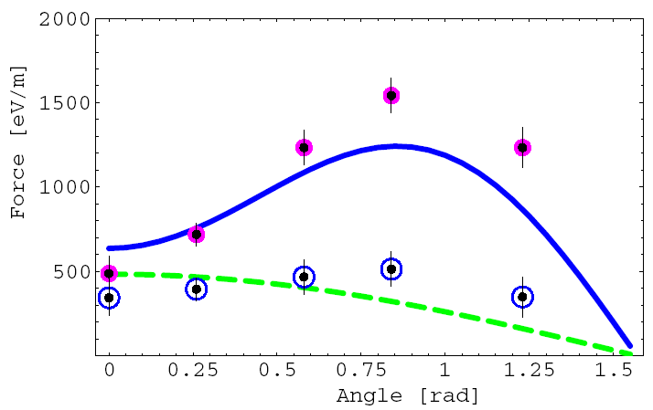
VORPAL modeling of binary collisions clarified differences in formulae for magnetized friction
pink circles: VORPAL, cold e-
blue circles: VORPAL, warm e-
blue line: Derbenev & Skrinsky
green line: Parkhomchuk
A.V. Fedotov, D.L. Bruhwiler,
A.O. Sidorin et al., “Numerical study of the magnetized friction force,” Phys. Rev. ST/AB 9, 074401 (2006).
D&S asymptotics are accurate for ideal solenoid, cold electrons – not warm
Parkhomchuk formula often works for typical parameters, but not always
3D quad. of D&S with e- dist. works better (modified r_{min}, ideal solenoid)
In general, direct simulation is required

Slide 9
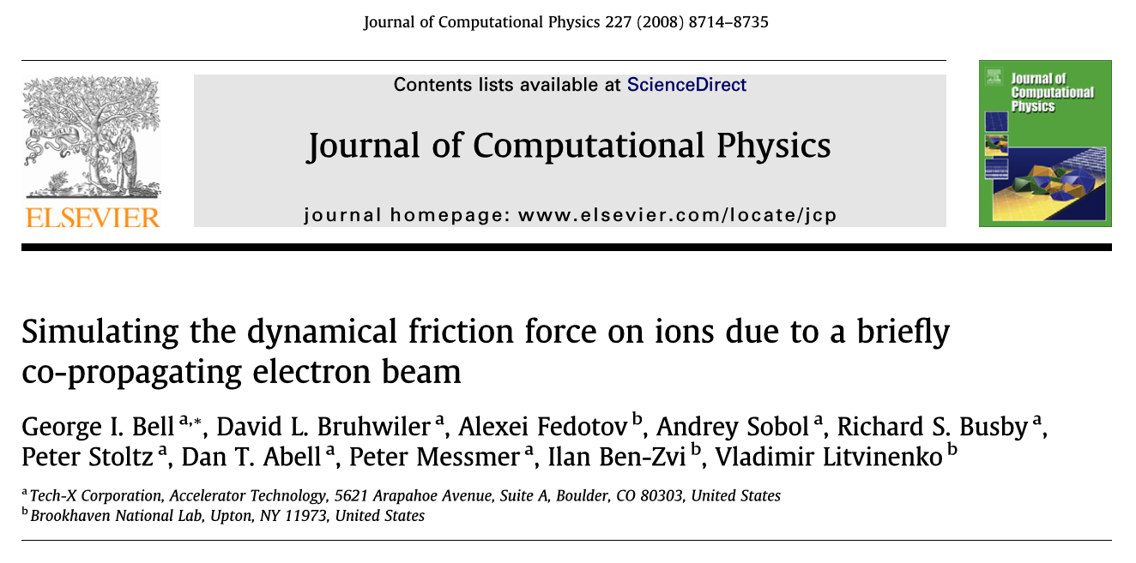
Detailed simulations of magnetized friction:

Slide 10
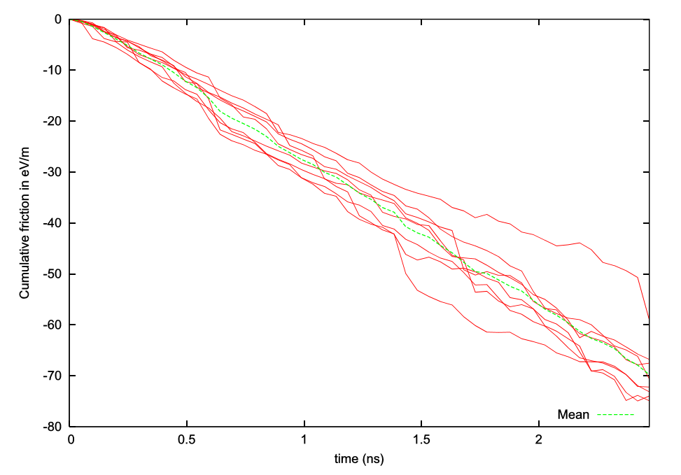
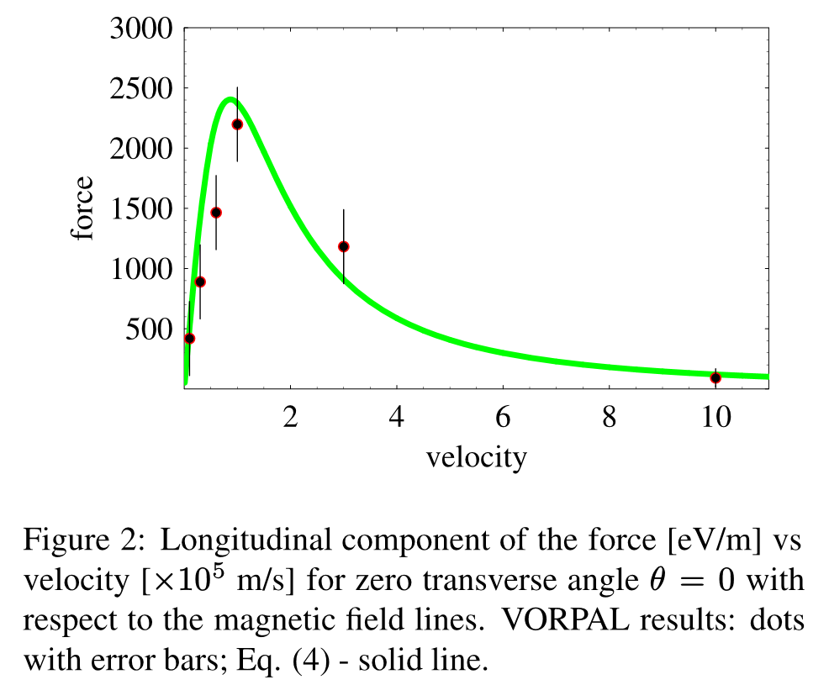
Detailed simulations of magnetized friction:
A.V. Fedotov, D.L. Bruhwiler,
A.O. Sidorin et al., “Analysis of the magnetized friction force,” Proc. HB2006, WEAY04 (2006).
Parkhomchuk formula (green)
VORPAL/VSim (dots)
VORPAL/VSim results
G.I. Bell, D.L. Bruhwiler,
A. Fedotov et al., “Simulating the dynamical friction force on ions due to a brieﬂy co-propagating electron beam,” J. Comp. Phys. 227, 8714 (2008).

Slide 11
JLab EIC Design:
Images courtesy of Jefferson Lab.
Ion Beam
1 Tesla Cooling Solenoid
Chirper
De-chirper
50 MeV Linac Cryomodule
Magnetized Gun
Booster
Beam dump

Slide 12
Can we quantify the required solenoidal field quality?
No, we cannot
Parkhomchuk formula provides a parametric knob
Derbenev and Skrinsky do not offer quantitative guidance
Can we quantify the effects of space charge forces?
No, we cannot
Can we quantify the effects of non-Gaussian e- beam phase space distributions?
No, we cannot

Slide 13
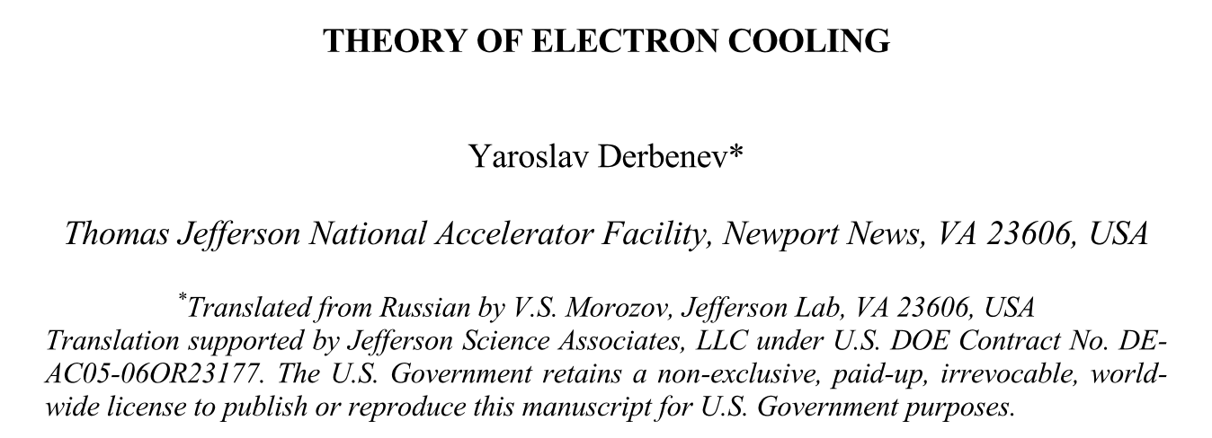
A new dynamical friction calculation is underway…
We follow the approach described by Y. Derbenev
However, we begin from a new starting point
analytic momentum transfer between ion and magnetized e-
proceed step by step with calculation
Calculation is defined by the following considerations:
Y. Derbenev, “Theory of Electron Cooling,” arXiv (2017);
https://arxiv.org/abs/1703.09735

Slide 14
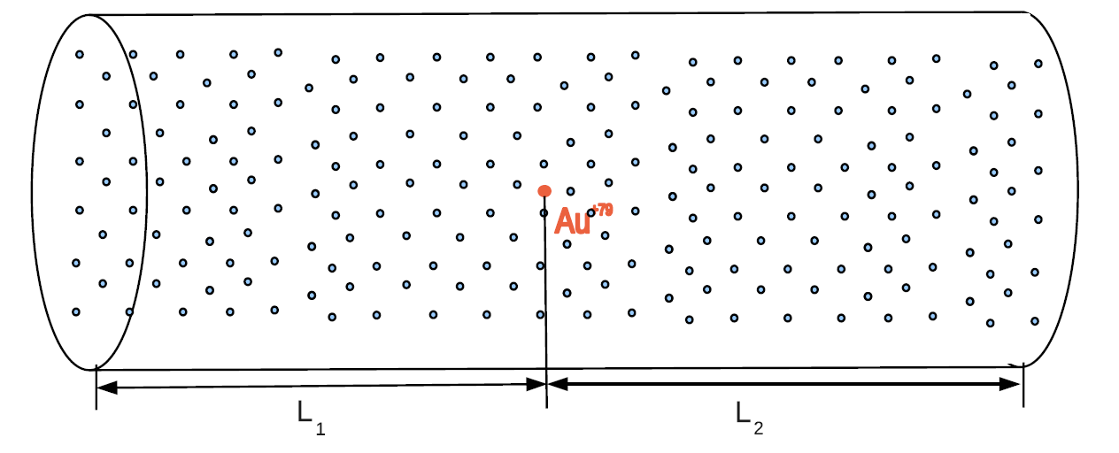
Directly integrate Δp_{ion} to obtain friction force?
Straightforward integration includes space charge, etc.
this approach worked for VORPAL/VSim simulations (w/ effort)
Problematic, so we follow Derbenev et al.

Slide 15
The required steps are straightforward in principle:
Calculate the perturbed e- velocities
due to a single ion
initially, we consider purely longitudinal motion
Obtain time-derivative of perturbed E-field
via Poisson and continuity equations
Integrate in time to get δE
initially, this is for only a single value of e- velocity
it is necessary to integrate over thermal e- velocities
Integrate δE along ion trajectory to obtain <F>
hence, this is a 2nd-order effect, ~(Ze²)² xx
Present efforts:
find best way to integrate <F> over e- distribution functions
consider transverse ion motion
numerical approaches, testing, etc.

Slide 16
Hamiltonian for 2-body magnetized collision:
Resulting equations of motion, in the standard drift-kick symplectic form:
D.L. Bruhwiler and S.D. Webb, “New algorithm for dynamical friction of ions in a magnetized electron beam,” in AIP Conf. Proc. 1812, 050006 (2017); http://aip.scitation.org/doi/abs/10.1063/1.4975867

Slide 17
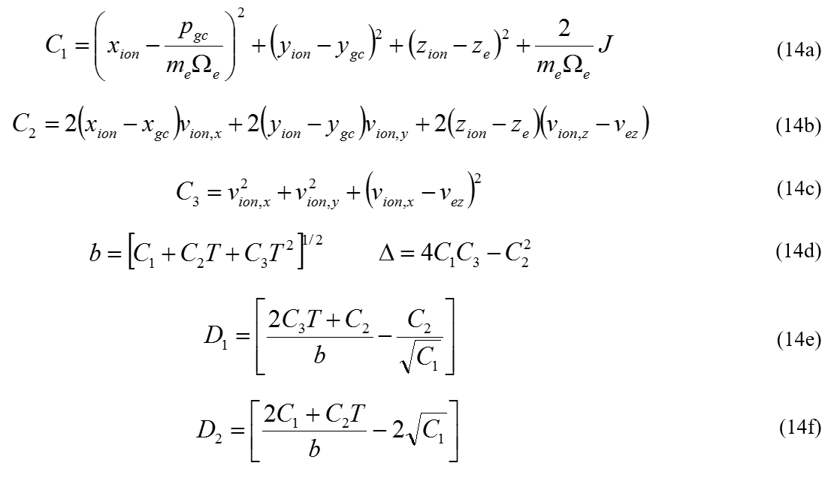
Analytic calculation of Δp_{ion} (1)

Slide 18
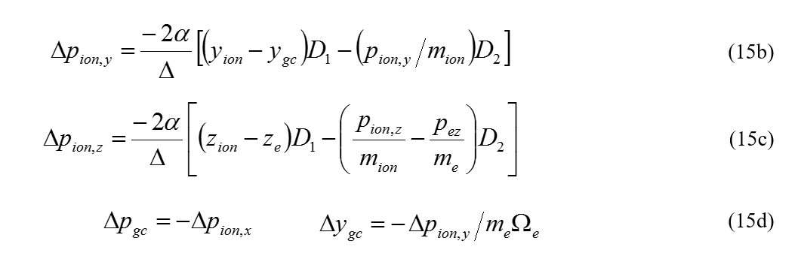
Analytic calculation of Δp_{ion} (2)

Slide 19
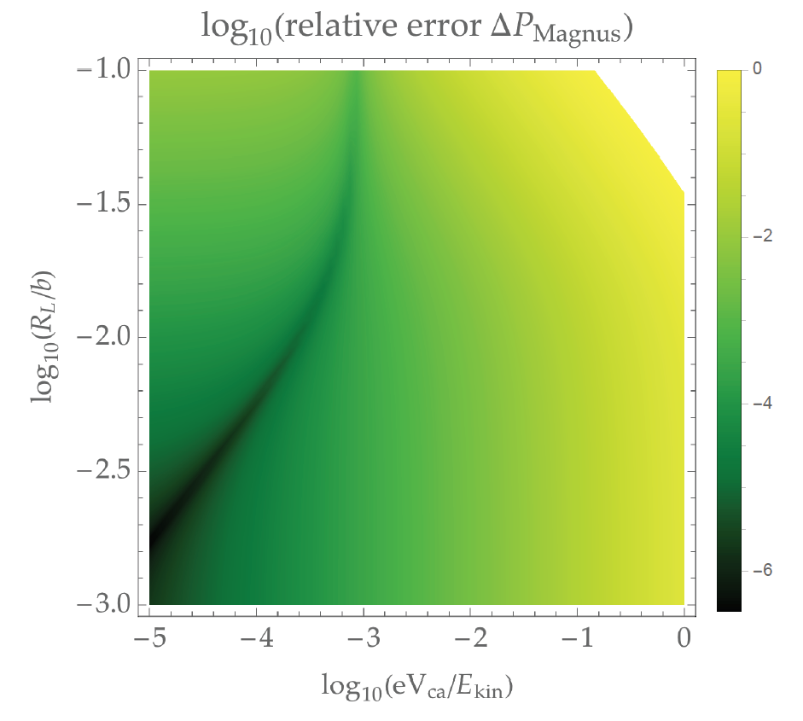
Time-explicit vs analytic shows agreement:
Two small parameters are required:
Larmor radius must be small compared to impact param.
averaging
Kinetic energy must be large compared to max potential energy
perturbative

Slide 20
Choice of coordinate system is important:
$$∆v_{e,z}=\frac{Ze^{2}}{m_{e}}\left\{{\left[x_{gc}^{2}+y_{gc}^{2}+ρ_{gc}^{2}+z_{e}^{2}\right]}^{−1/2}−{\left[x_{gc}^{2}+y_{gc}^{2}+ρ_{gc}^{2}+{\left(z_{e}−v_{rel}T\right)}^{2}\right]}^{−1/2}\right\}$$
$v_{rel}=v_{i,z}$- $v_{e,z}$
$$\frac{∂\vec{E}}{∂T}=−\vec{J}$$
$$r^{2}=x_{gc}^{2}+y_{gc}^{2}$$
$${\frac{∂E_{z}}{∂T}}_{r=0}=\frac{Ze^{2}}{m_{e}}\left\{{\left[ρ_{gc}^{2}+z_{e}^{2}\right]}^{−1/2}−{\left[ρ_{gc}^{2}+{\left(z_{e}−v_{rel}T\right)}^{2}\right]}^{−1/2}\right\}$$

Slide 21
Integrate twice to obtain friction force:
$$E_{z}\left(r=0\right)=\left(n_{0}e\right)\frac{Ze^{2}}{m_{e}v_{rel}}\left\{{T\left[ρ_{gc}^{2}+z_{e}^{2}\right]}^{−1/2}+\frac{1}{v_{rel}}ln\left[\frac{{\left[ρ_{gc}^{2}+z_{e}^{2}\right]}^{1/2}+z_{e}}{{\left[ρ_{gc}^{2}+{\left(z_{e}−v_{rel}T\right)}^{2}\right]}^{1/2}+\left(z_{e}−v_{rel}T\right)}\right]\right\}$$
Let $z_{e}=v_{i,z}T and then integrate over T to obtain:$
$$<F>=\left(n_{0}e\right)\frac{{n_{0}\left(Ze^{2}\right)}^{2}}{m_{e}v_{rel}T}\left\{\frac{T}{v_{rel}}ln\left({\left[ρ_{gc}^{2}+{\left(v_{i,z}T\right)}^{2}\right]}^{1/2}+v_{i,z}T\right)−\frac{v_{e,z}}{v_{i,z}^{2}v_{rel}}\left({\left[ρ_{gc}^{2}+{\left(v_{i,z}T\right)}^{2}\right]}^{\frac{1}{2}}−ρ_{gc}\right)−\frac{T}{v_{rel}}ln\left({\left[ρ_{gc}^{2}+{\left(v_{e,z}T\right)}^{2}\right]}^{1/2}+v_{e,z}T\right)−\frac{1}{v_{e,z}v_{rel}}\left({\left[ρ_{gc}^{2}+{\left(v_{e,z}T\right)}^{2}\right]}^{\frac{1}{2}}−ρ_{gc}\right)\right\}$$
There is an integrable singularity for cold electrons.
The challenge now is to integrate over thermal velocities

Slide 22
Long-term goals: Include other effects in Magnus Expansion
Quantitative treatment of space charge & field errors?
space charge should work
field errors are more challenging
Requires generalization of Magnus expansion
we are optimistic this can be done

Slide 23
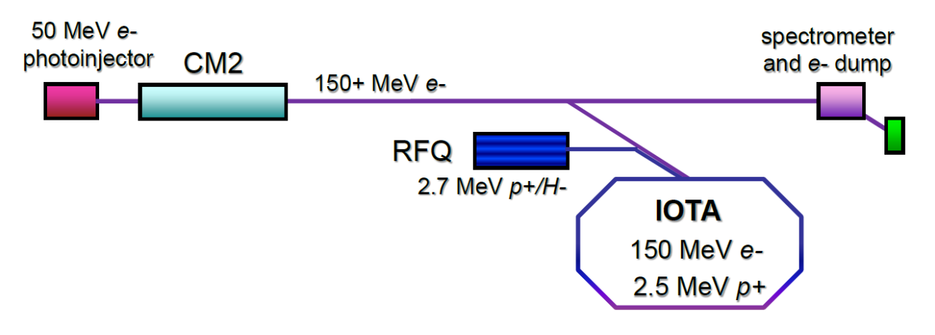
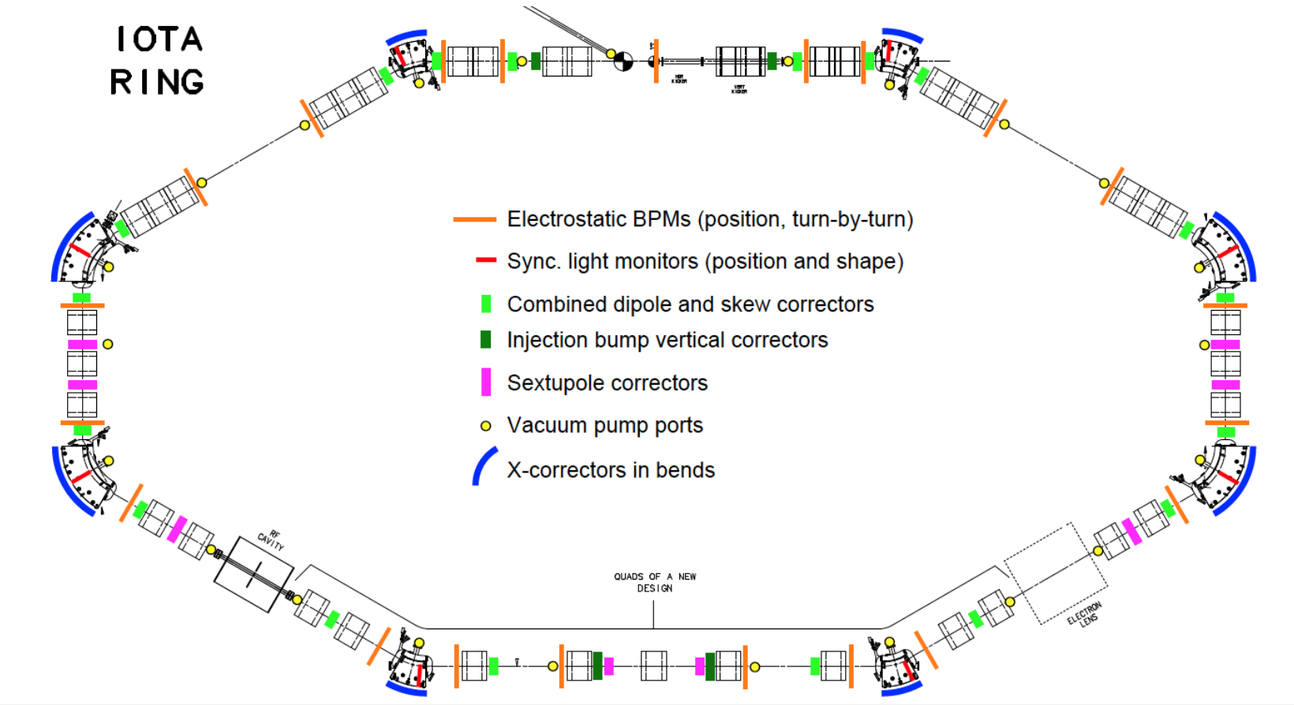
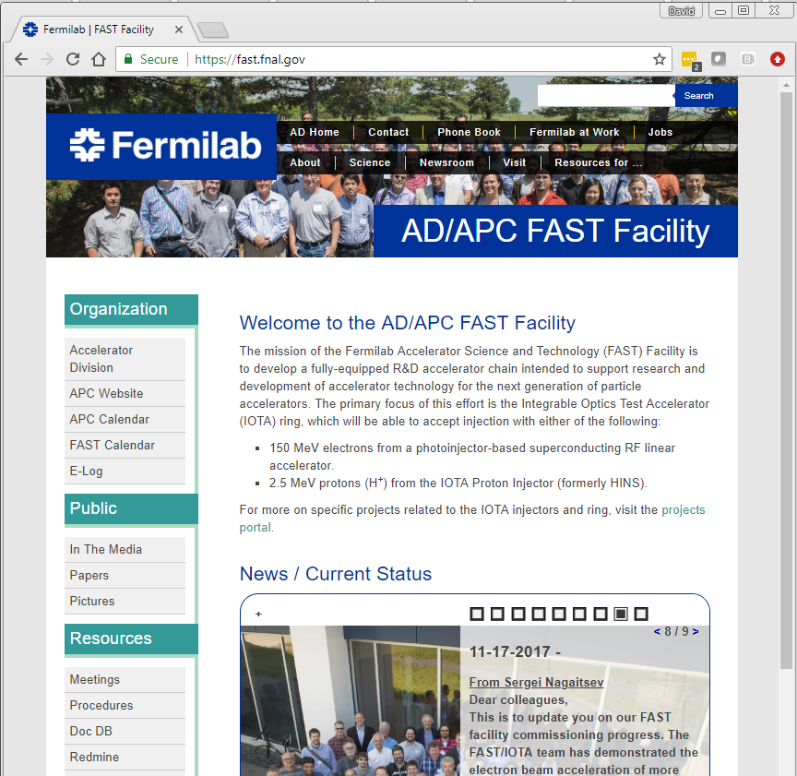
Future Electron cooling experiments in IOTA
Could be used to test friction force equations…?
RadiaSoft is interested to collaborate

Slide 24
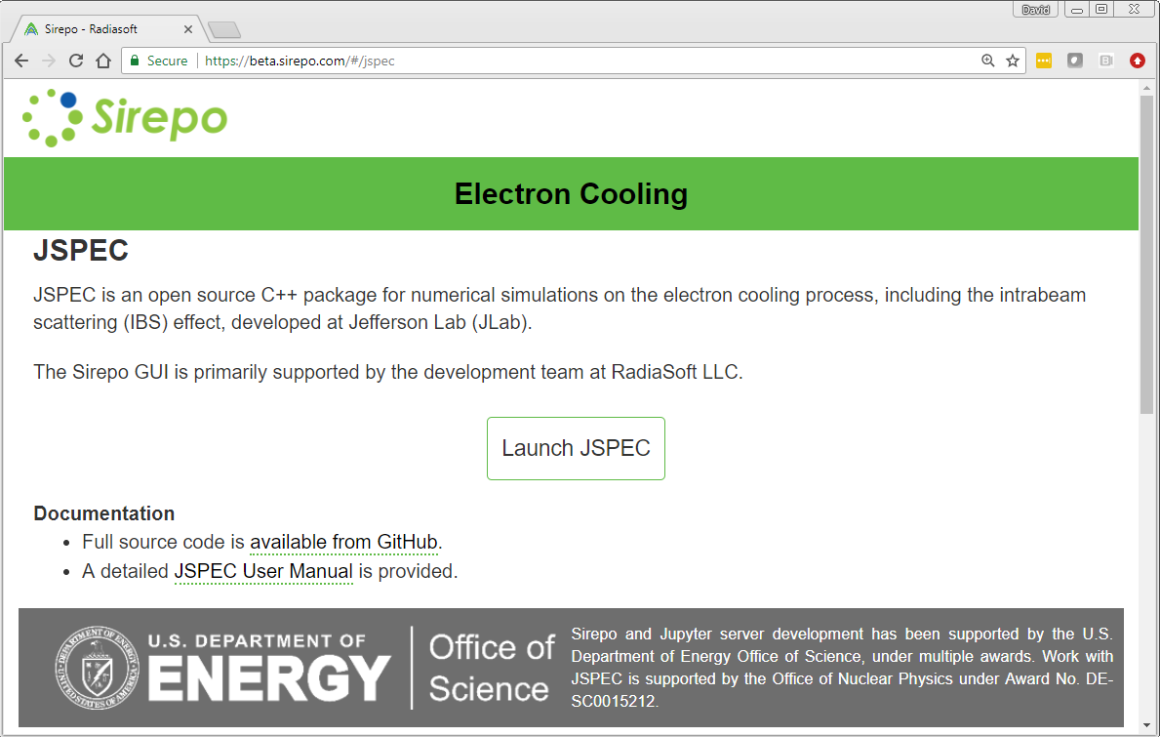
JSPEC – new software for IBS and e- cooling
JSPEC on GitHub, https://github.com/zhanghe9704/electroncooling
Primary developer is He Zhang of JLab
A new GUI for JSPEC is under development, as part of the open source cloud computing initiative, Sirepo http://sirepo.com

Slide 25
Thank You! Questions?

