Slide 1
PIP Booster Upgrades
Salah Chaurize
Fermilab Workshop on Megawatt Rings & IOTA/FAST Collaboration Meeting
7 May 2018

Slide 2
PIP Booster upgrades highlights :
The Fermilab Booster has seen over 40yrs of operation and various upgrades along the way. The following are just some but not all systems addressed by PIP.
High Level RF system upgrades
  Anode supply replacement
  BRF cavity refurbishment
  Solid State drive system (removal of cascode tubes)
  Cavity 21 and 22 installed
Digital Longitudinal Damper System
  Brings better mode damping diagnostics and control, modern components.
TLM Loss monitoring and safety system integration
  Robust complete ring coverage, less maintenance, lower part count and cost.

Slide 3
PIP Booster upgrades highlights :
The Fermilab Booster has seen over 40yrs. of operation and various upgrades along the way. The following are just some but not all systems addressed by PIP.
Magnetic Beam cogging
  Dipole Magnet based beam position control, lower energy notch time
New Magnets Kicker systems cooling improvements
  Enhanced cooling and temperature management
  New short kicker system for notching
Aperture enhancements
  Aperture scans and magnet moves open aperture
Horizontal beam notching
  New kicker system, Dedicated Notch Absorber

Slide 4
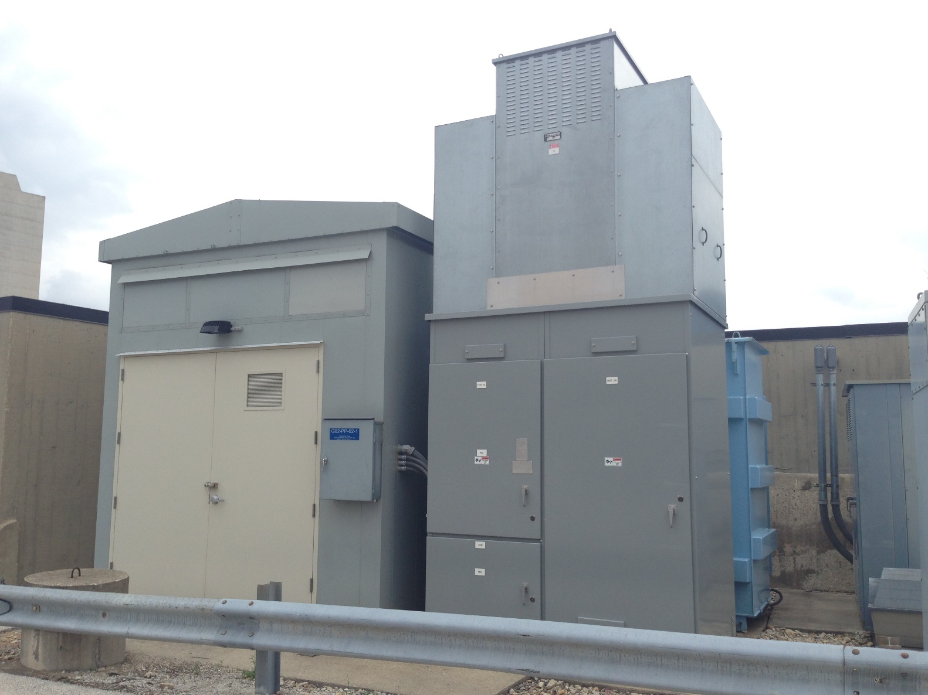
BRF Anode Supply and Transformer Upgrade
New wiring also pulled to RF stations from this new anode supply.
New anode supplies and transformer replaces 40+ years old system

Slide 5
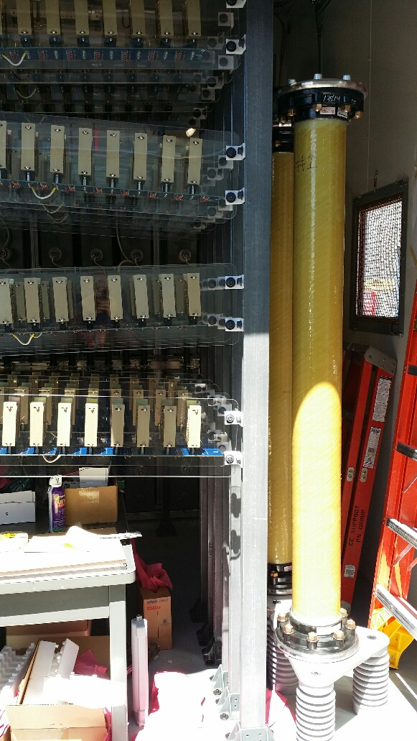
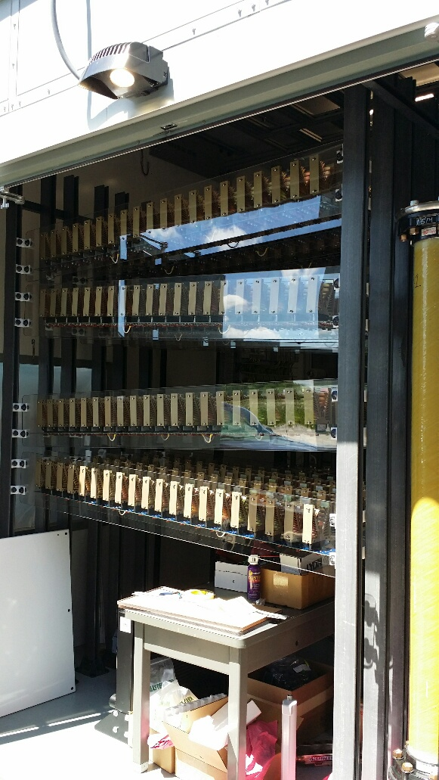
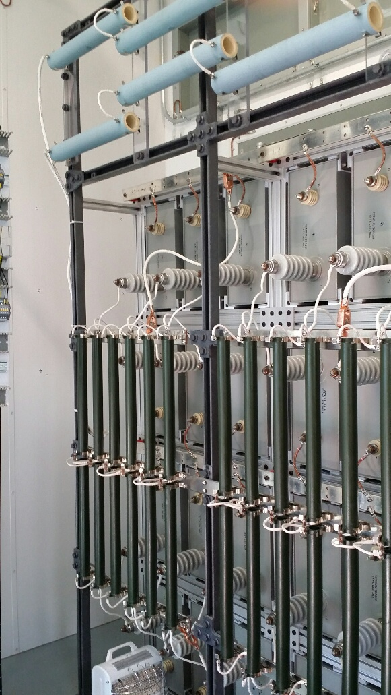
New BRF Anode Supply Diode bridges and cap banks
BRF Anode Supply and Transformer Upgrade

Slide 6
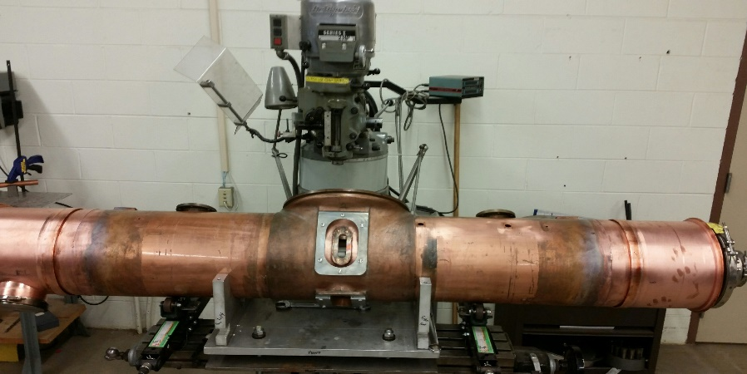
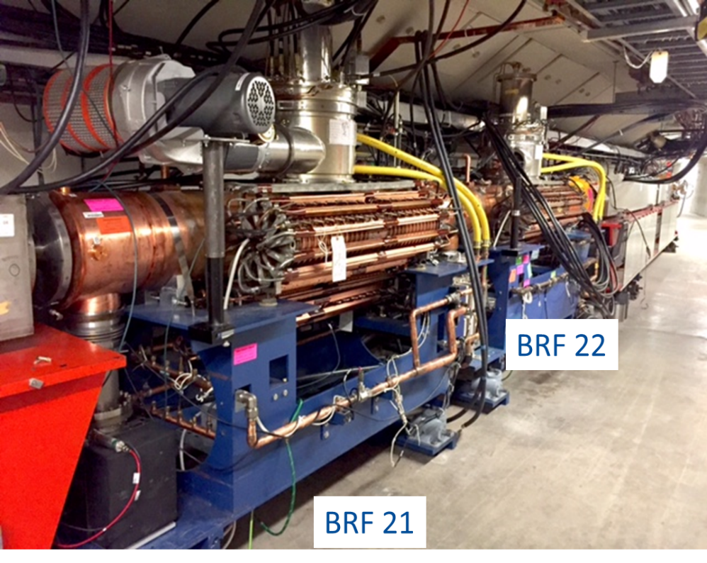
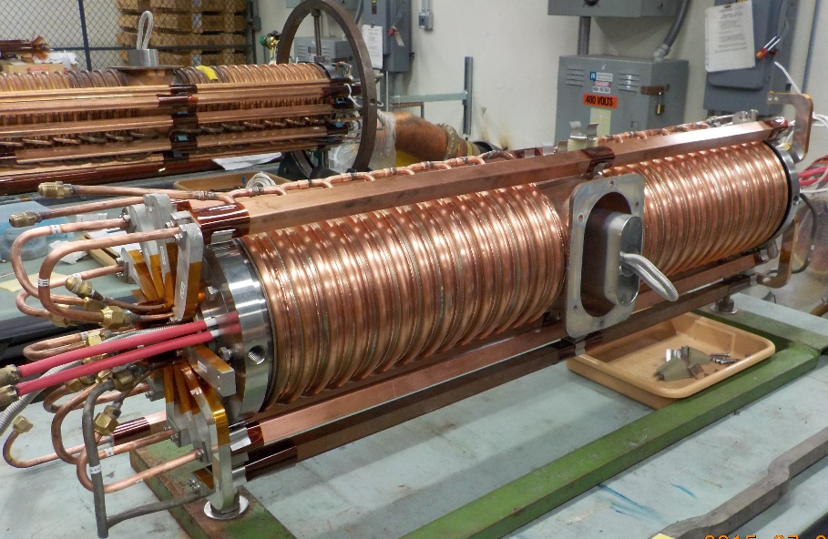
Booster – Cavity 21 & 22 installed at Long 20 Region
Refurbished Cavity and tuner assemblies.
Solid state driver in gallery connects to PA amp in tunnel. Improved PA lifetimes and reliability.

Slide 7
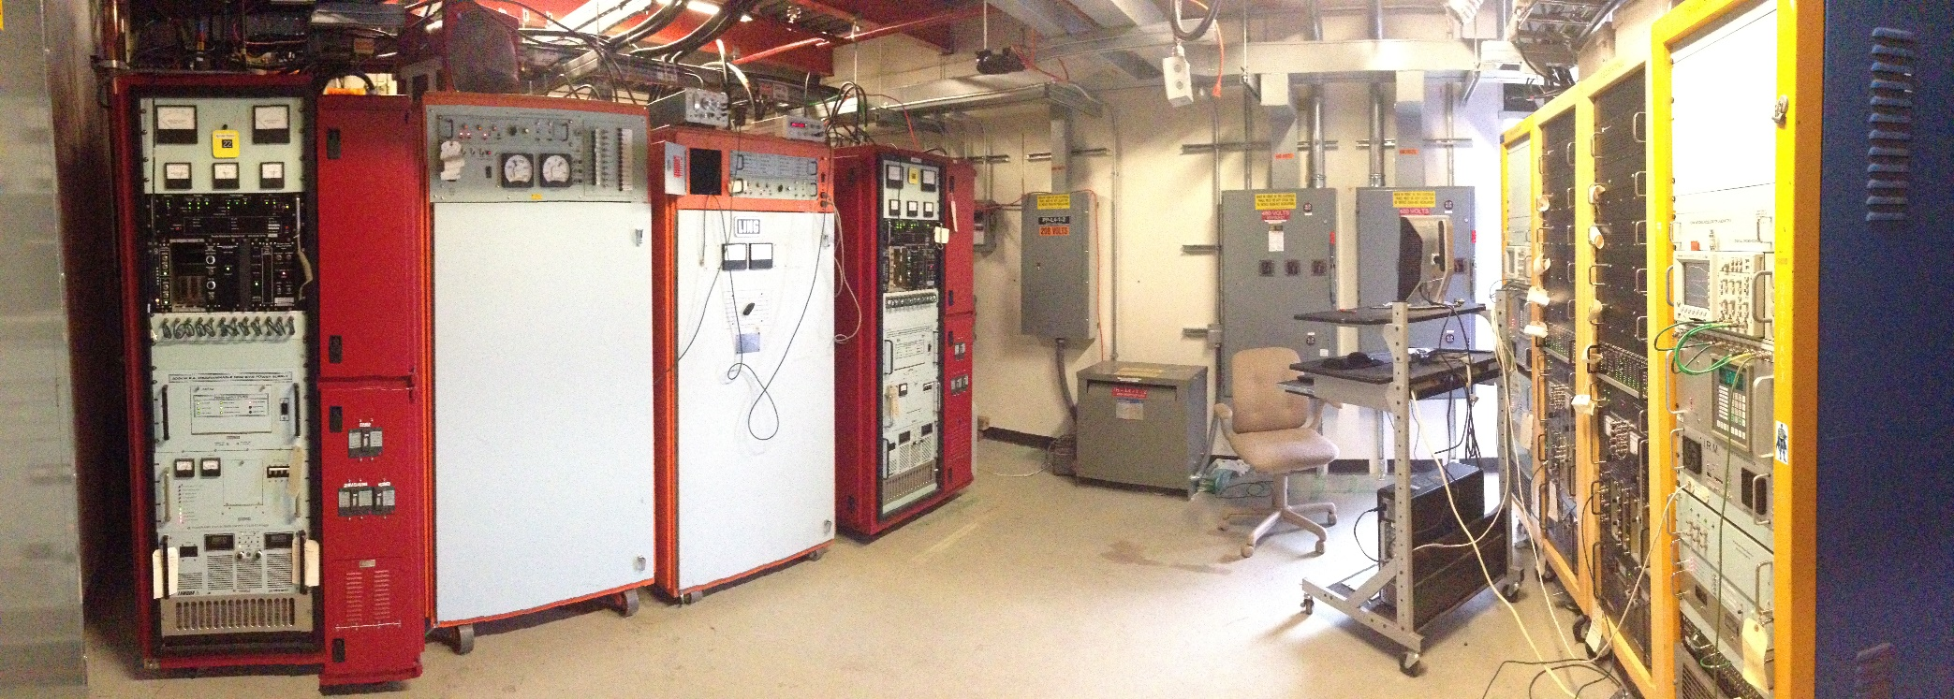
BRF Stations 21 and 22 RF Room
RF Modulators, Bias Supplies and Solid State Driver racks
Gallery space repurposed for the addition of 2 RF stations.

Slide 8
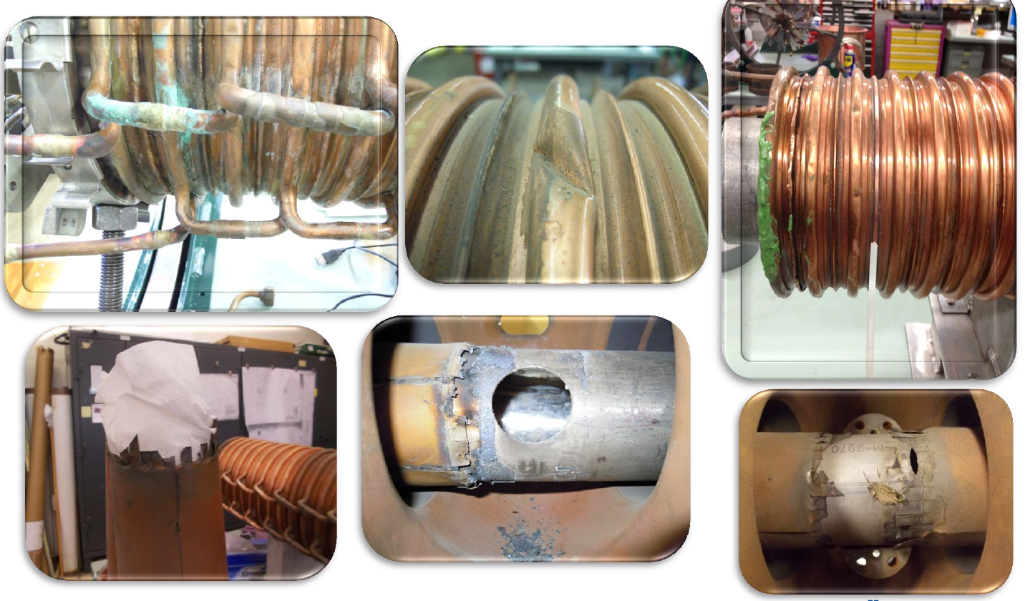
BRF Cavity and Tuner Refurbishment
K. Gollwitzer
Obvious and hidden problems were found and fixed during the
refurbishment process. This allowed reliable operation at 15Hz

Slide 9
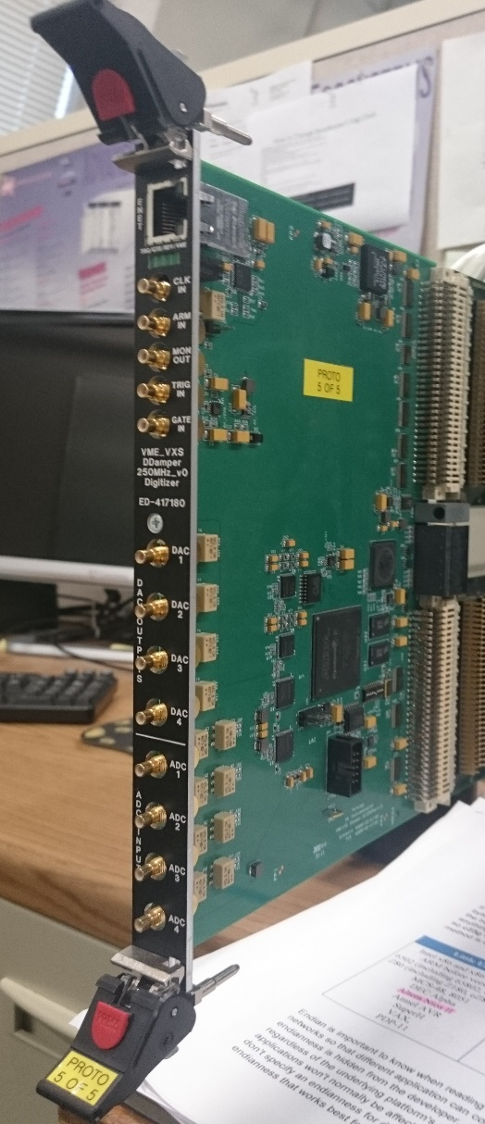
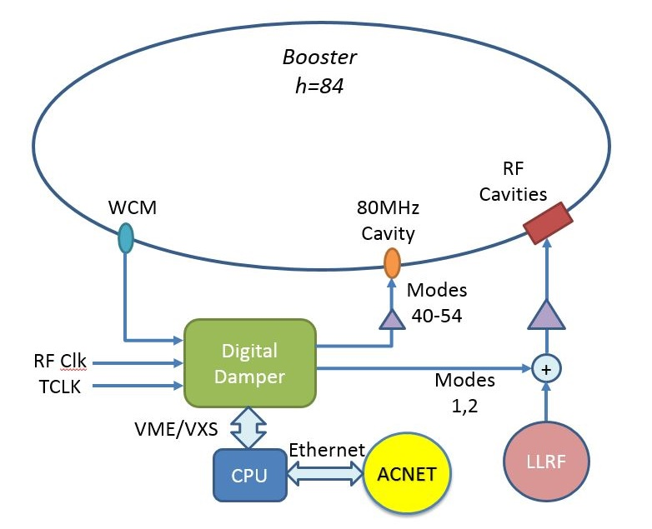
Longitudinal Digital Damper System
10 MHz
N. Eddy

Slide 10
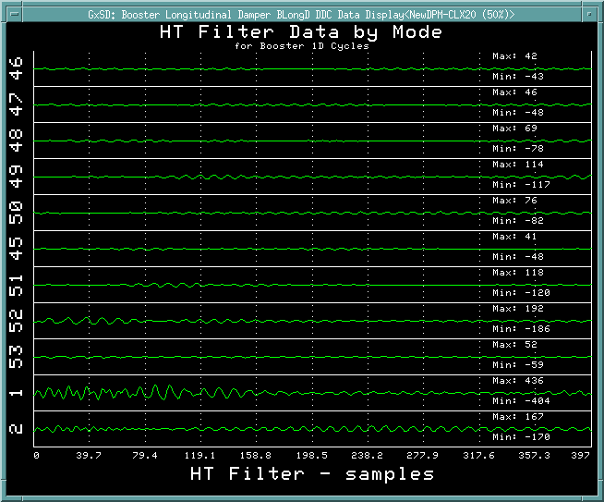
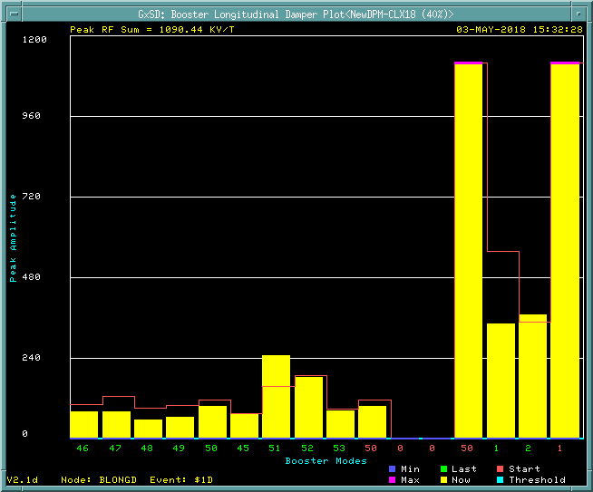
Longitudinal Digital Damper Diagnostics
See changes in mode error amplitude
Error signals for various modes

Slide 11
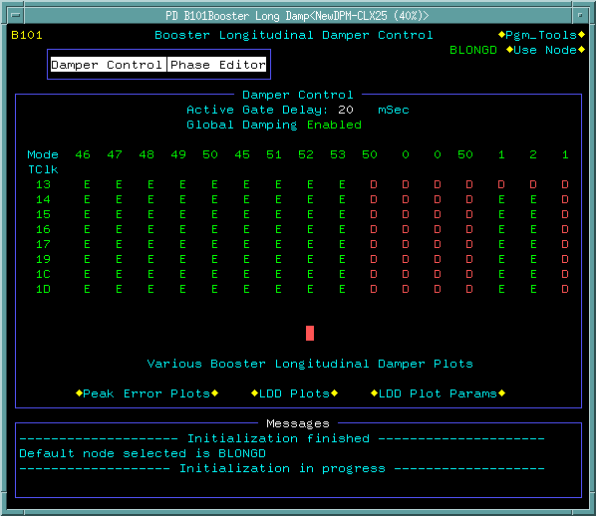
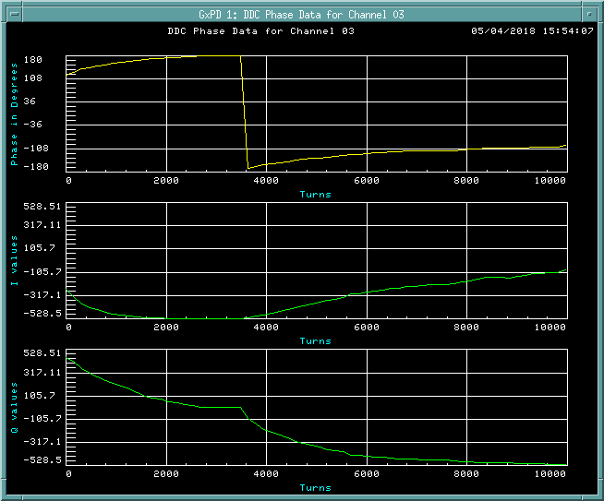
Longitudinal Digital Damper Controls
Control Phase and amplitude via tunable curves
Turn mode damping ON/Off
Control based per beam cycle

Slide 12
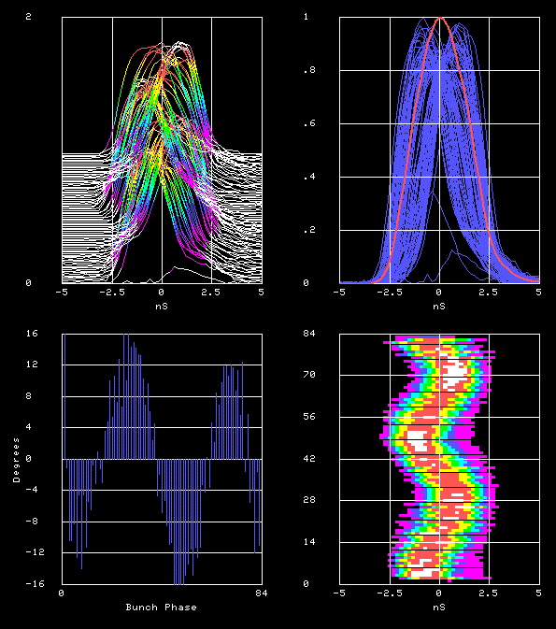
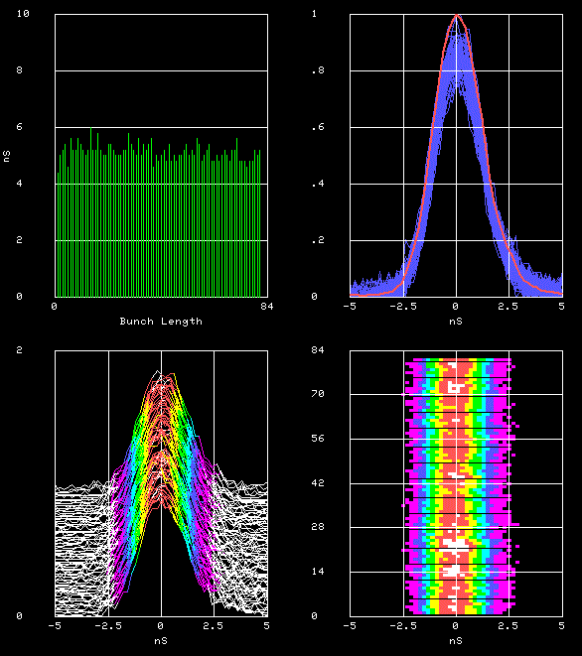
Digital Longitudinal Damper System
Bunches
16
-16
Bunches
Phase error
Bunch Phase
Beam measurements in the MI-8 line which show amplitude and phase of extracted Booster bunches.
With the new digital dampers working – phase errors look excellent and should help reduce loses in downstream machines.

Slide 13

Motivation for TLM:
Booster TLM System
Large numbers of additional interlocked detectors (chipmunks) would be required for some installations, e.g.,
  Muon campus (42->200 - mu2e experiment)
  Booster (48->? – PIP/PIP-II)
AD received encouragement from the Fermilab ESH&Q Section in May 2011 to pursue development of a long detector system
A. Leveling

Slide 14
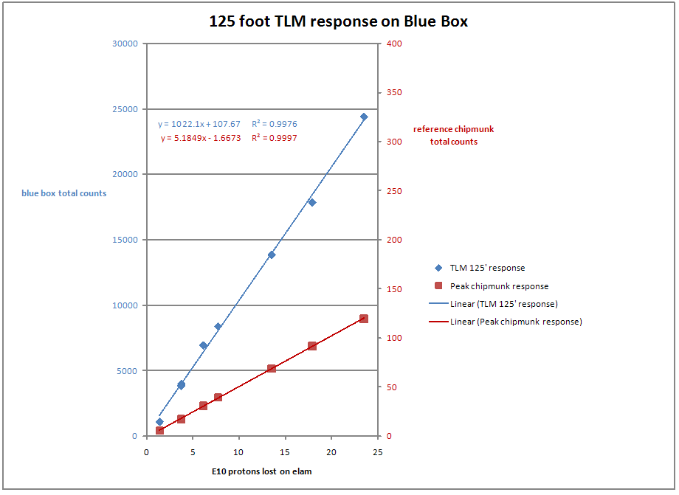
Good correlation between TLM and chipmunk
A. Leveling

Slide 15
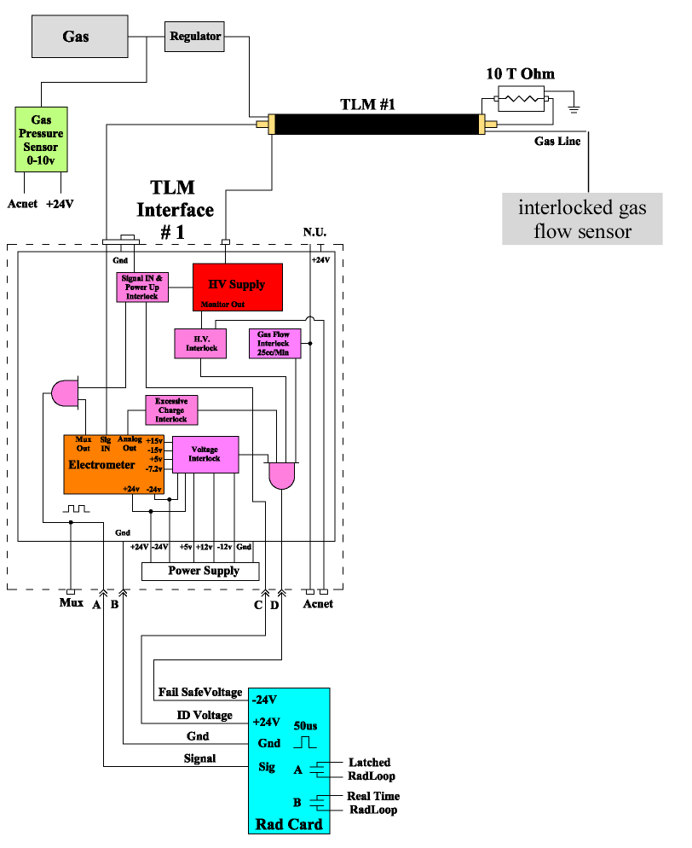
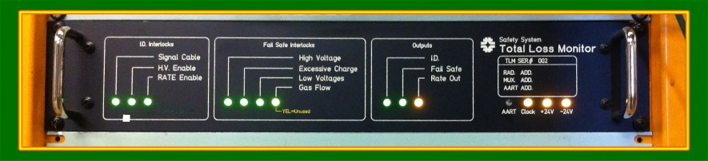
TLM system diagram
Detector works in ion chamber mode
  800 volt detector bias
Argon/CO₂ detector gas
  Nominally 25 cc/min
Electrometer output is calibrated in units of nC/TTL pulse
Heartbeat provided by 10 Tohm resistor (83 pA = 5 nC/min)
A. Leveling

Slide 16
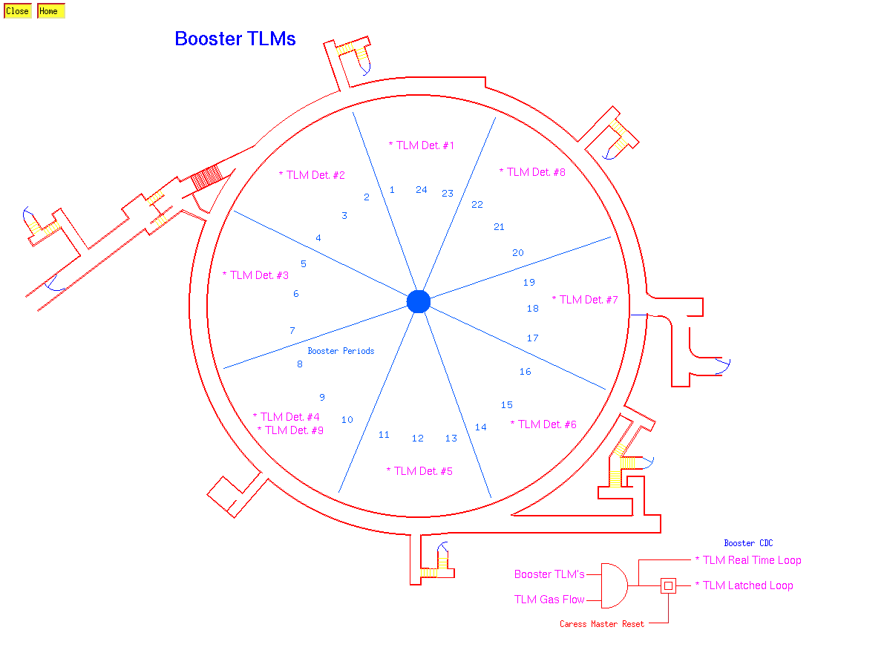
Booster TLM Tunnel Layout

Slide 17
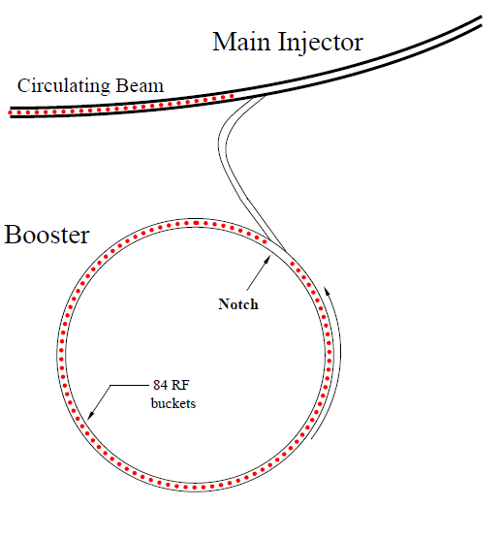
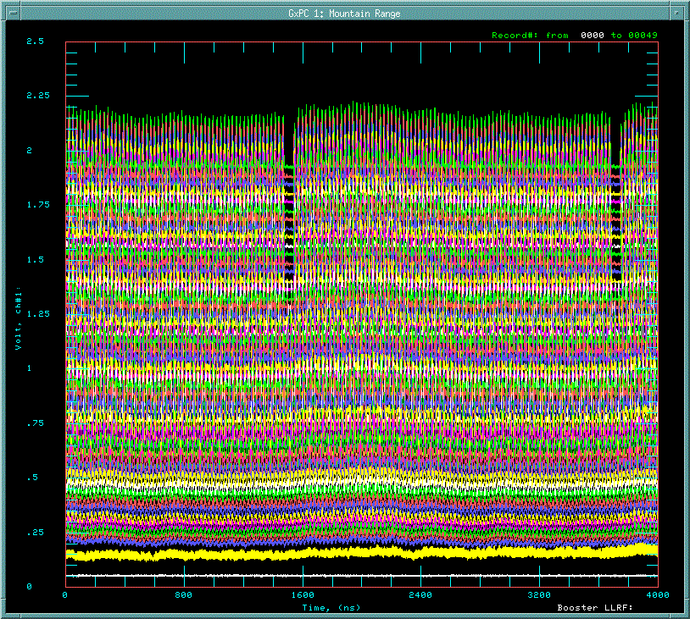
Development of New Cogging System (Magnetic Cogging)
Longitudinal profile monitor
@ Booster injection
h=588
Main Injector / Recycler
1 Booster revolution
Notch
81 bunches
+ 3 empty bkts
Gap
for the extraction kicker
capture with
37MHz RF
→ 84 bunches
h=84
Time
Injection
200MHz
81 bunches + 3 empty buckets
Notch(extraction kicker gap) – Booster extraction kicker –MI/RR injection kicker
Notch has to be created at LOW energy
K. Seiya (Fermilab Booster)

Slide 18
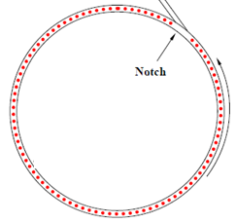


Magnetic Cogging using 48 new dipole corrector magnets
RF Cogging
Path length (radial position) of the beam
Magnetic Cogging
Fixed with RPOS feedback
Keeps beam on central orbit and preserves aperture.
Create notch anytime after injection( sync/w LINAC notch)
→ reduce beam power loss by 40%.
K. Seiya (Fermilab Booster)

Slide 19
Notch Beam energy reduced from 700MeV to 400MeV
700MeV
400MeV
Previous system
Notch at 700 MeV
New cogging system
Notch at 400 MeV
Reduced beam energy loss at the Notch creation by 40 % and the total cycle loss by 15%.
K. Seiya (Fermilab Booster)

Slide 20
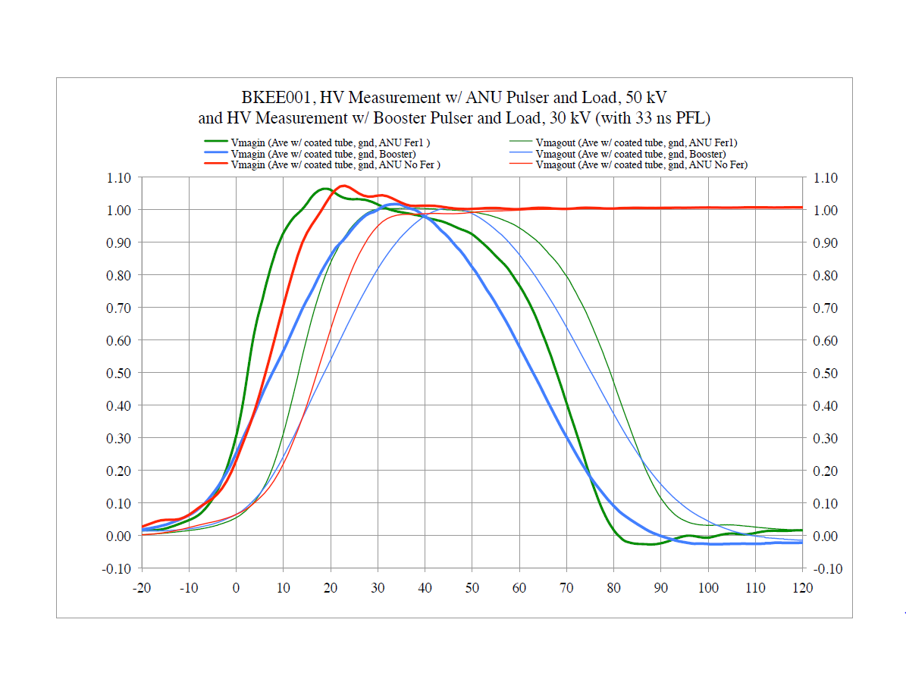
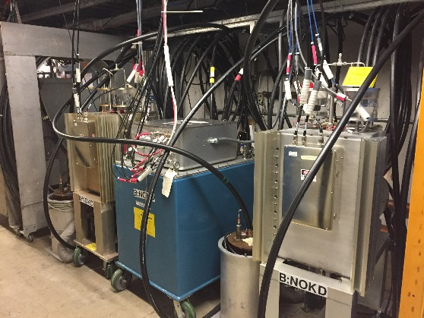
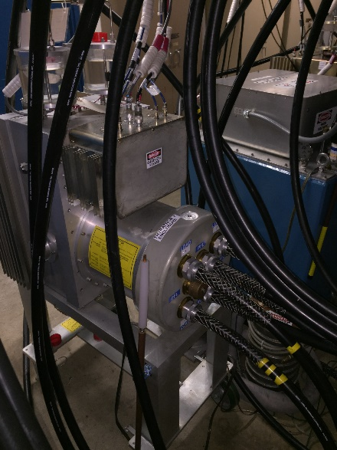
Kicker systems improvements
C. Jensen
8-15 ns difference between ANU pulser and
Operational Booster pulser(Slower)

Slide 21
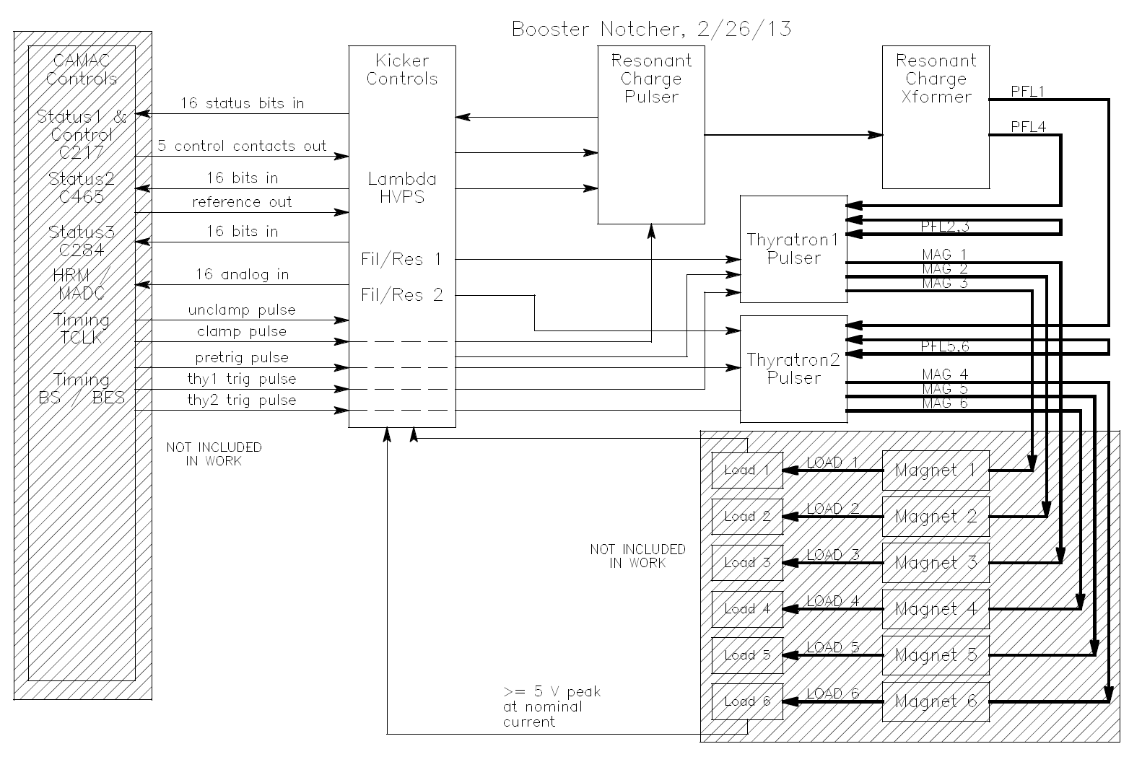
New Booster Notching Kicker System
Click to add caption text [16pt Bold]
C. Jensen

Slide 22
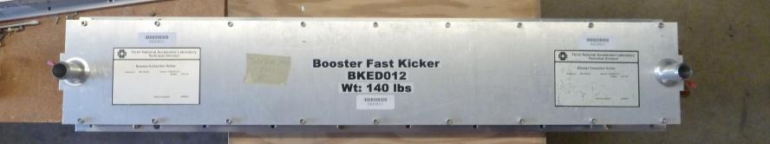
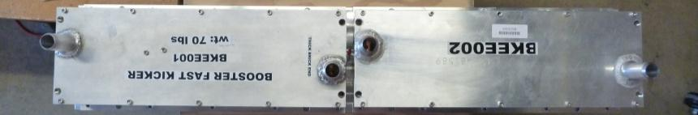
New short notching magnets
Standard 1.1m extraction style long kicker
Half meter short notching kickers
Fit on same beam tube footprint and base plate as long kicker

Slide 23
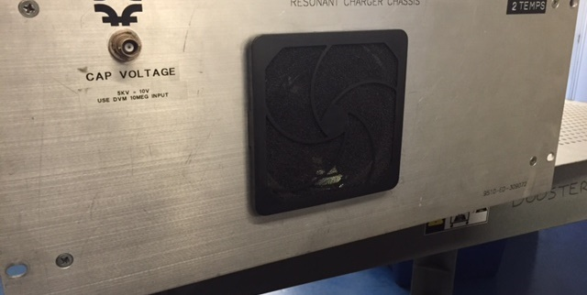
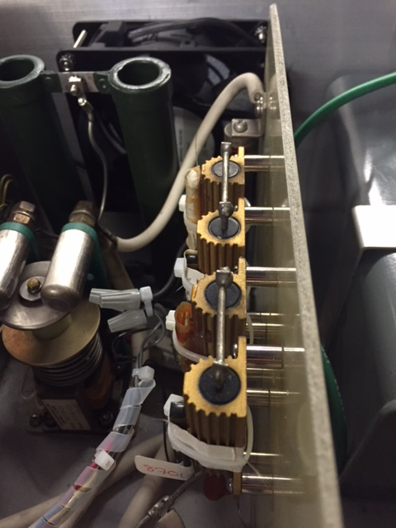
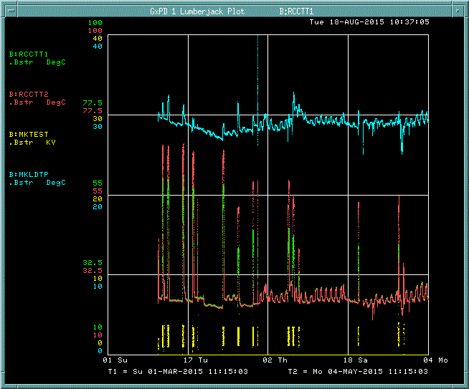
15Hz
20Hz
Enhanced Cooling for Extraction kicker
RCC Chassis for cooler running at 15Hz
To allow cooling overhead.

Slide 24
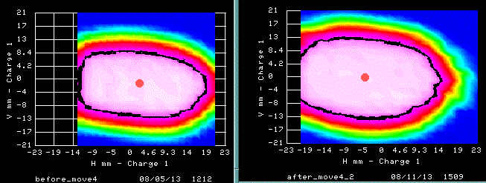
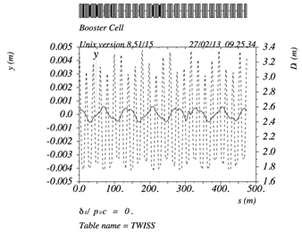
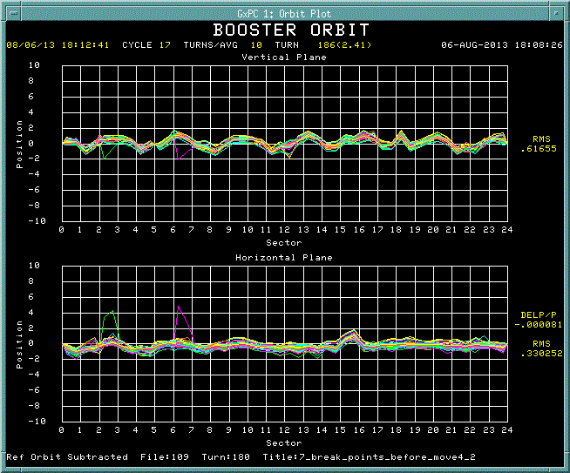
Aperture scan and magnet move
Before Move4
After Move4
Vertical
+/-0.8mm
Horizontal
+/-0.6mm
Orbit difference between before and after Move4
K. Seiya (Fermilab Booster)

Slide 25
Vertical aperture (90%) before and after alignment
Long
Short
Collimators
Collimators

Slide 26
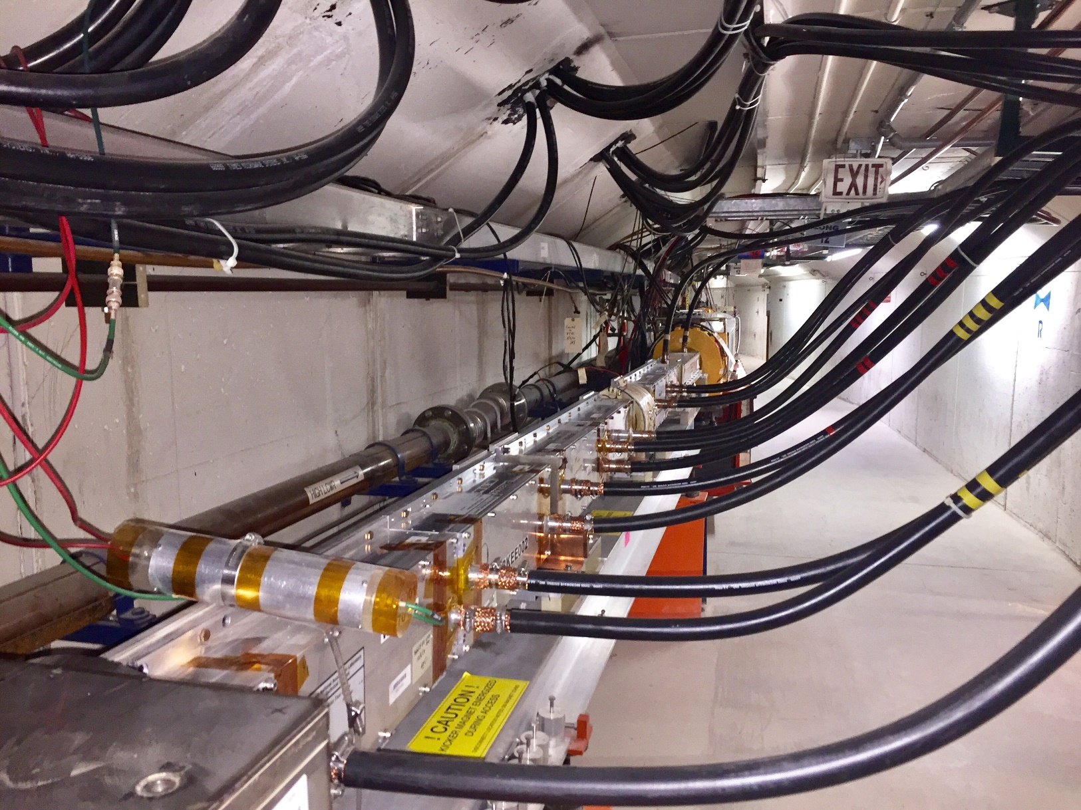
Horizontal Plane Beam Notching
Faster Short notching Magnets

Slide 27
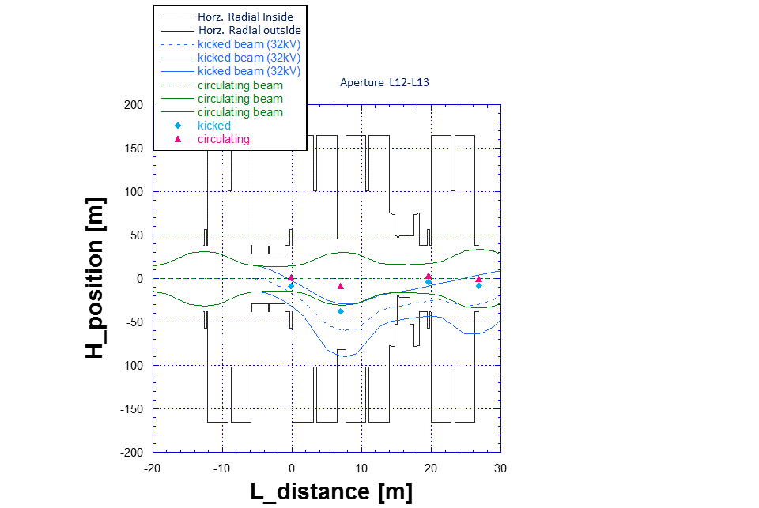
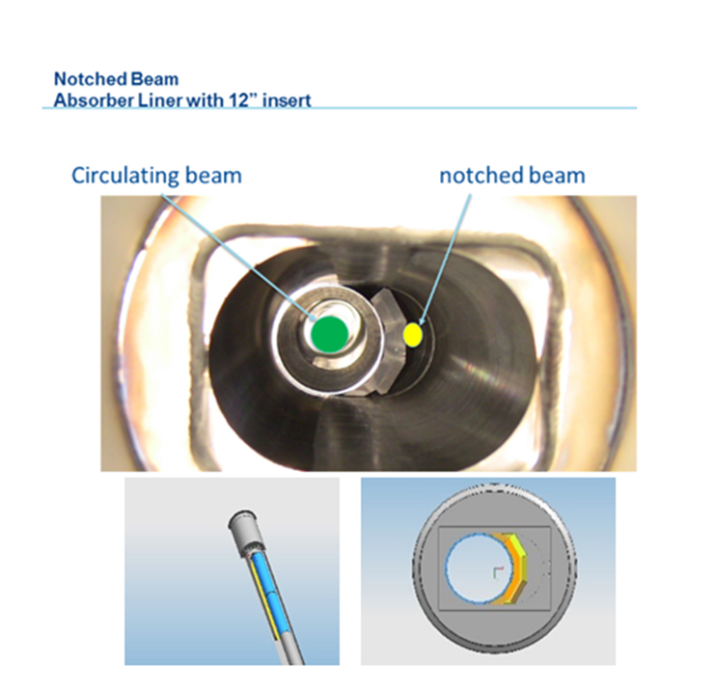
Horizontal Plane Beam Notching
[mm]
K. Seiya (Fermilab Booster)
V. Sidorov (absorber design)
Simulated and measured beam orbit of notched bunches

Slide 28
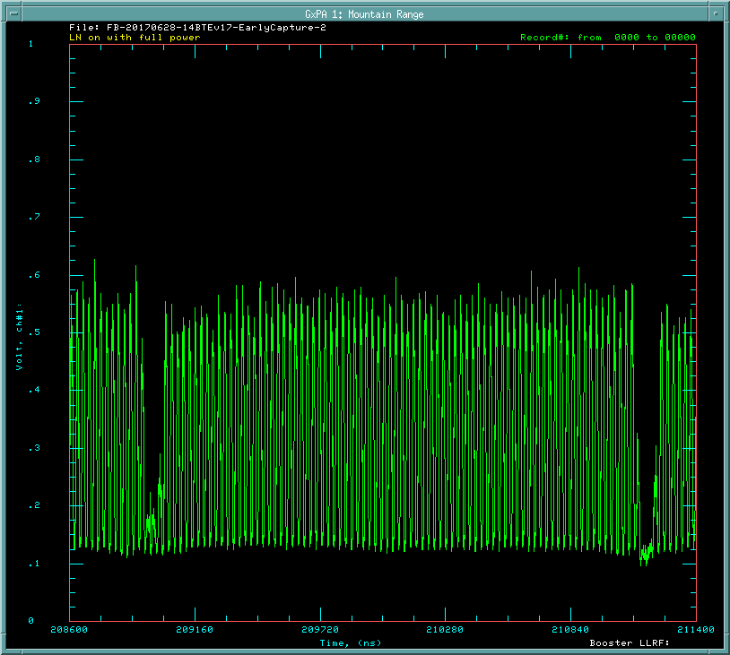
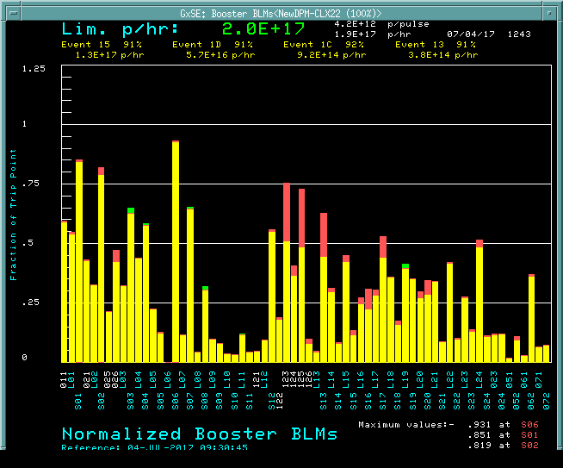
Initial Linac Laser Notching
Booster Notch loss profile
Laser Off (Red – higher loss)
One Revolution 2.2 usec
Two Notches in the pulse train
First notch is laser only
Second is laser + Booster Notcher

Slide 29
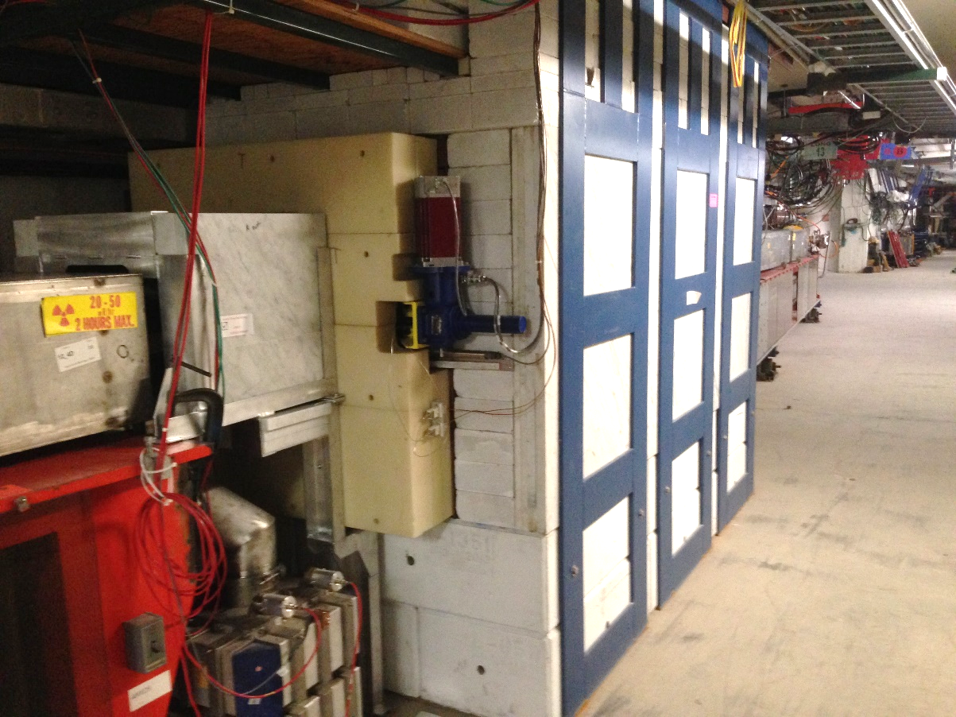
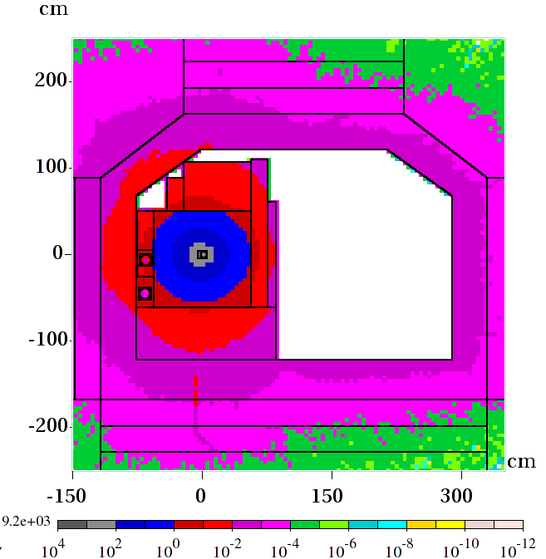
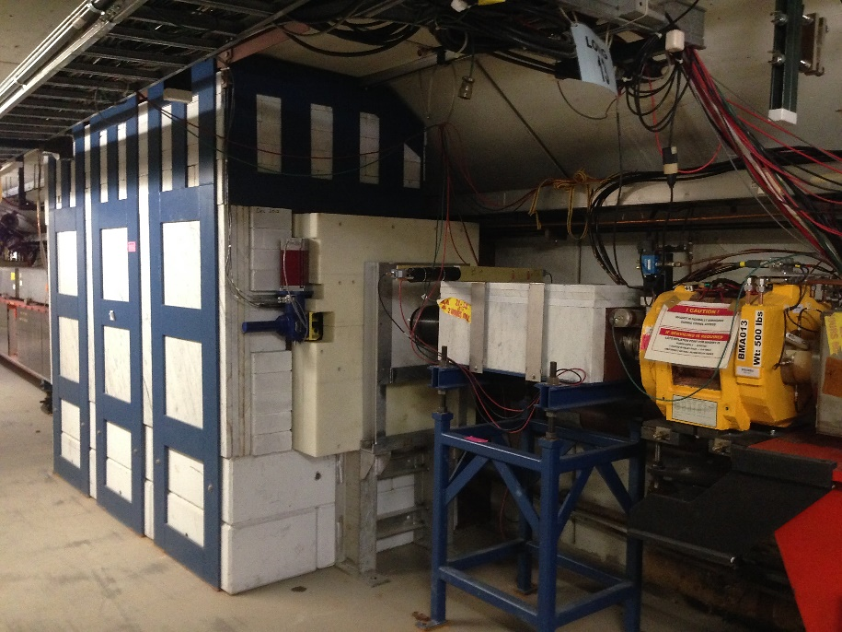
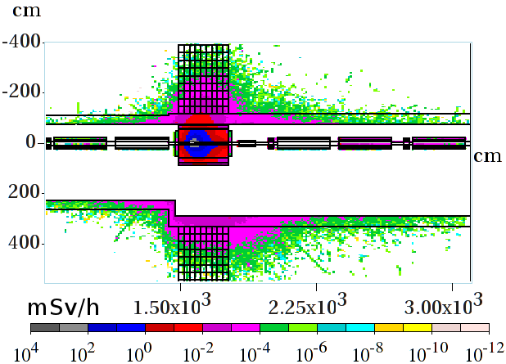
Horizontal Plane Beam Notching
Notch Absorber
Simulation December, 2011 I.Tropin
V. Sidorov (absorber design)

Slide 30
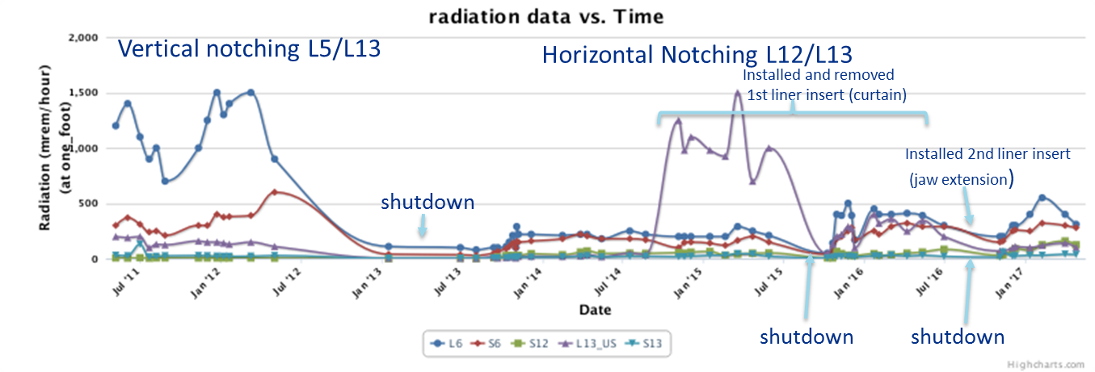
Horizontal Plane Beam Notching

Slide 31
Summary of Booster upgrades
Improvements are incremental and build on one another.
Multi-faceted approach provided success based on a system wide understanding vulnerabilities.
Stagger resources over time to allow measurable improvements. Bring new systems on-line incrementally allowing less downtime with phased improvements.
Other upgrades and efforts not mentioned also contributed to reaching PIP goal of 2.4E17 p/hr.
Many people and groups where indispensable to the success of PIP.

