Slide 1
Fermilab Linac Laser Notcher: Motivation, Method, and First Operational Experience
David Johnson, Todd Johnson, David Slimmer, Kevin Duel, Pat Karns, Brian Schupbach, Kiyomi Seiya, Salah Chaurize, Chandra Bhat, Bill Pellico
Fermilab Workshop on Megawatt Rings & IOTA/FAST Collaboration Meeting
7 May 2018

Slide 2
Acknowledgements
Bob Zwaska
Fernanda Garcia
Bill Pellico
Matt Gardner
Chandra Bhat
Pat Karns
Brian Schupbach
Dan Bollinger
Drew Feld
Ben Ogert
Jason Kubinski
Justin Briney
Jeff Larson
Fred Mach
Katrina Hunden
Mike Kucera
Bobby Santucci
Tom Boes
Jinhao Ruan
Jamie Santucci
Andrea Saewert
Vic Scarpine
Randy Keup
Alex Lumpkin
Matt Quinn & Dave Baird (LSO)
ES&H Interlock Group
Alignment crew
KV Reddy & Sreenivas Patel of PriTel
Don Sipes & Jason Tafoya of Optical Engines
Jay Doster & Dennis Lockwood Grumman
Plus many others

Slide 3
Motivation
Proton Improvement Plan Intensity Goals
Ultimate goal: 2.3E17 protons delivered/hr @ 15 HZ
>85% acceleration availability
Booster runs at Administrative loss limit
Notching in the Booster ring deposits the removed bunches into dedicated Absorbers. This accounts for ~30% of Booster beam power loss ( few % of beam intensity).
We would like to remove this loss from the ring and safely dispose of the notched ions.
Ultimately one needs about 80 ns notch in the beam at extraction time for the extraction kicker rise time and the 8 GeV Recycler injection kicker
In the 200 MHz beam structure this would correspond to ~16 200 MHz bunches every 2.2 us and for 16 turns this would be a total of about 256 bunches or about 1-2% of injected beam.
When we started in 2011, it was 10-12 bunches and 10 turns
Now, we’re at 16 bunches and 16 to 18 turns and there’s talk of more…
Techniques developed here may be applicable in other projects such as laser stripping, laser chopping, laser collimation

Slide 4
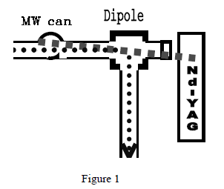
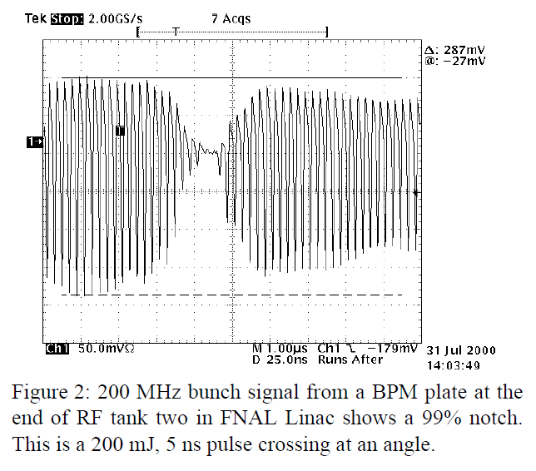
Laser Notching of Linac H- at Fermilab
First Laser Notching Experiment
In 2001, Ray Tomlin reported on a successful experiment to create notches in the CW linac beam in the H- 750 keV beam line and have this notch survive at Booster injection.
He created a 25 ns notch utilizing a 200 mJ 5 ns laser pulse.
To create multiple notches in the linac pulse he
proposed a
“4 pass bow-tie cavity some 665 meters
long (with a storage time of 2.22 μs)”. Large Pockels
cells would shuttle the laser to and from the delay line.
A disk gain section would restore optical losses.
Average laser pulse energy of 103 mJ
Peak power of ~20 MW to strip 99.9% of the ions.
This was not implemented.

Slide 5
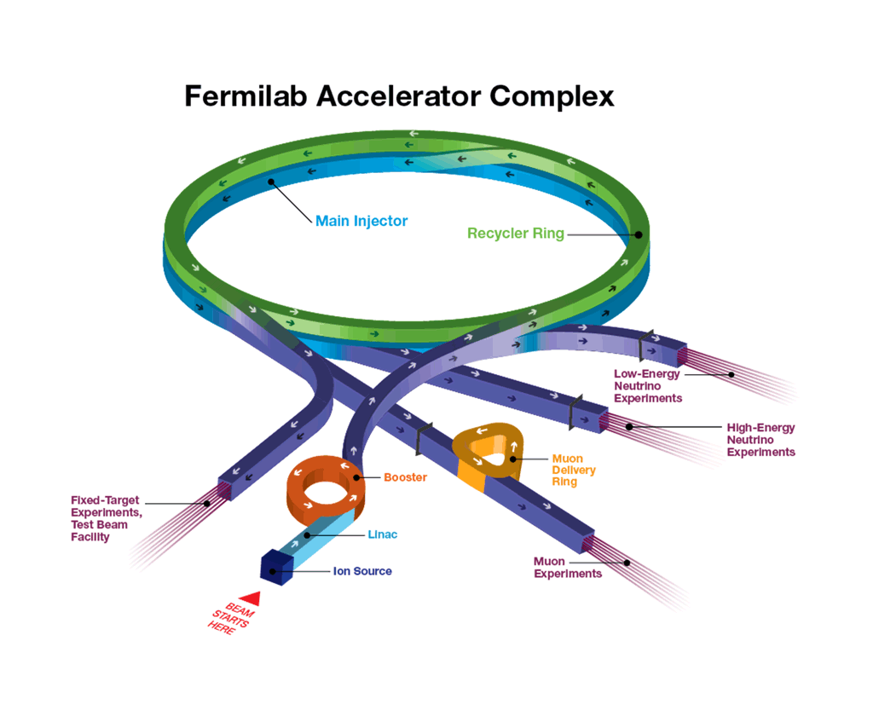
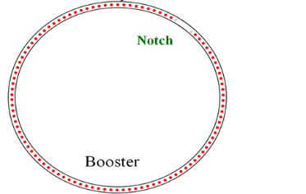
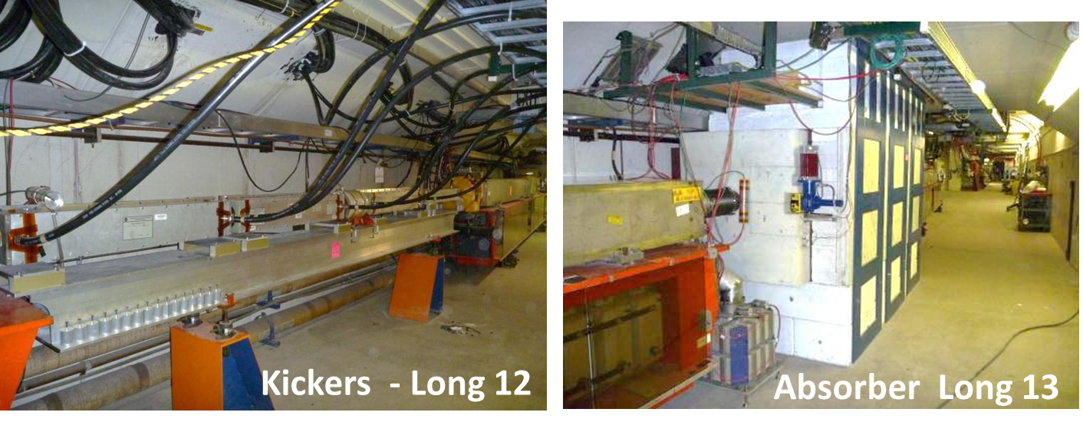
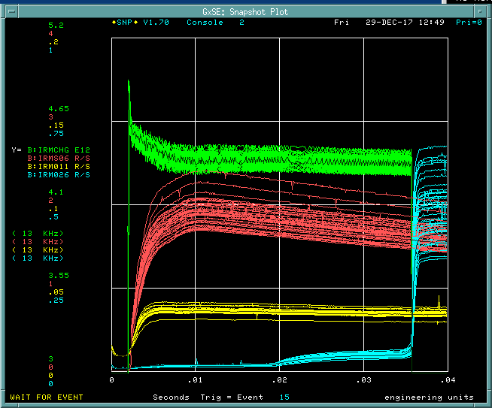
A Little Background: The Proton Source
Linac
201.25 MHz
MEBT
RFQ
Ion
Source
400 MeV
750 keV
Laser
Notcher
Notch created in Booster @ 400 MeV
-> 30% total power loss
τ_{REV} ~ 2.21 μs
Loss from Booster Notcher
Booster
8 GeV
F_{RF} (injection) 38 MHz
Move this process out of the Booster tunnel
→ Create Notch in linac at 750 keV
LINAC PULSE
~35.5 us (~ 16 Booster turns)

Slide 6
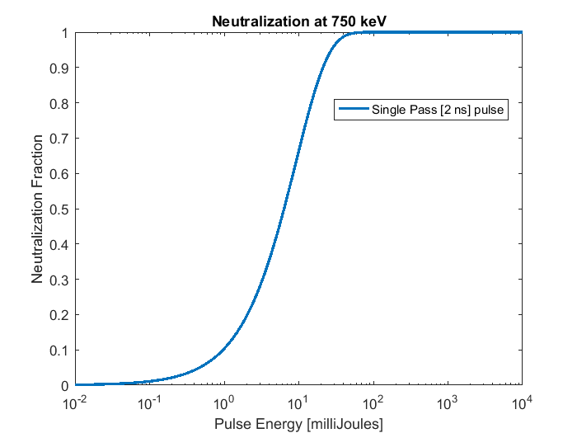
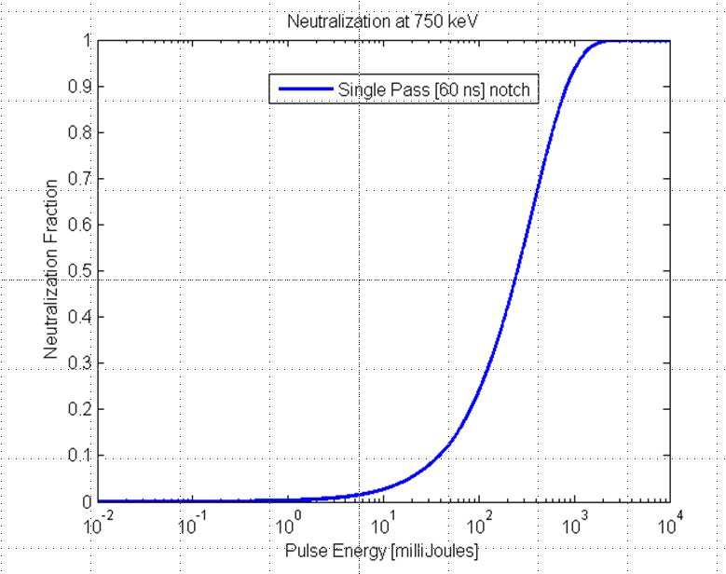
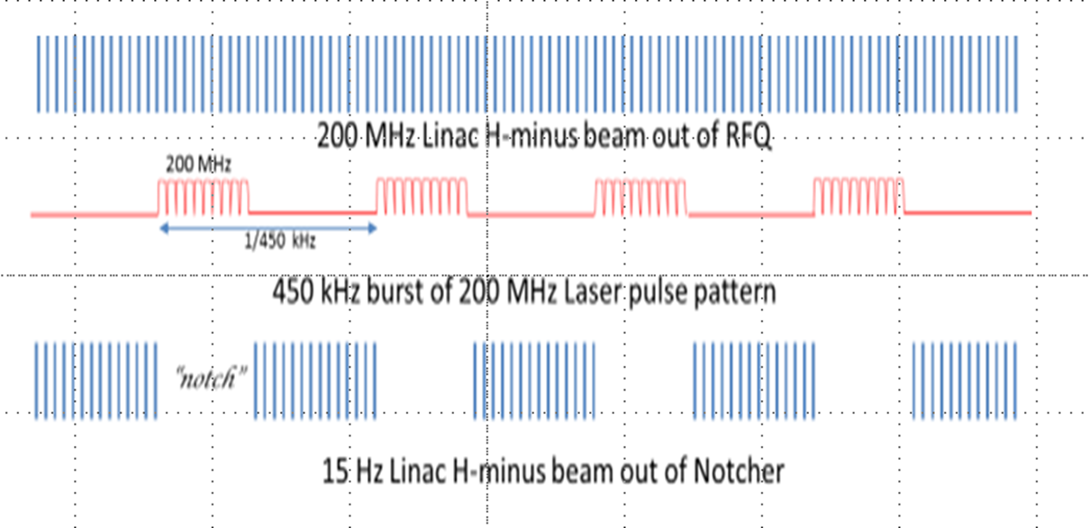
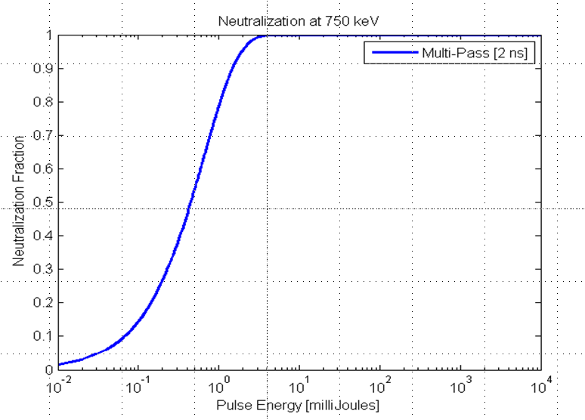
Technique: Photoneutralization
1 micron laser- near peak of cross section
Want to make process efficient
-> minimize required laser pulse energy/average power
Match laser pulses to bunch parameters
43 mJ/bunch
1 J
~0.5J/notch
Non-resonant optical cavity (we call a zig-zag cavity)
2 mJ/pulse
32 mJ/notch
H-
Need to develop 2 components: interaction cavity & laser system
Notes:
When the neutralization probability does not depend on the electron intensity
The fraction of neutralized ions is given by… where….
Select 1 micron
3) Laser flux -> reduce area and size
cross section -> constant
interaction time -> maximize
If we create a single laser pulse for each notch (SINGLE PASS …show plot 4)
Rather than a sledge hammer, Create a scalpel. tailor the laser to the bunch…5)
6) To further reduce pulse intensity increase time by increasing the number of interactions -- zig-zag cavity
Ultimately, 2mJ /bunch-> 32 mJ/notch

Slide 7
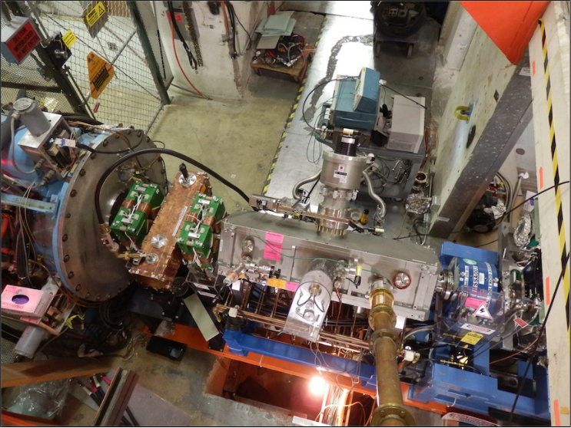
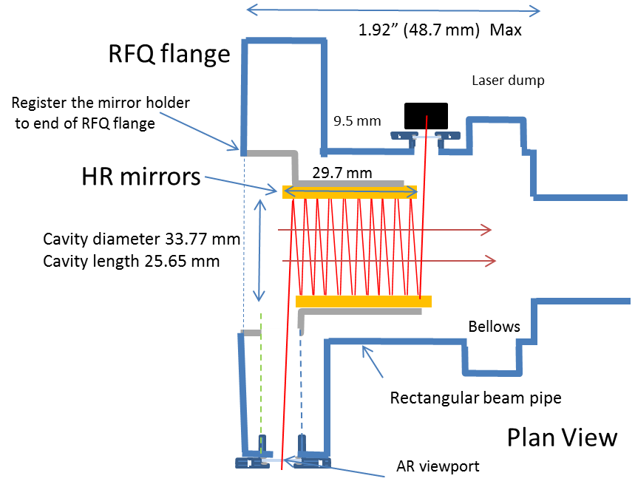
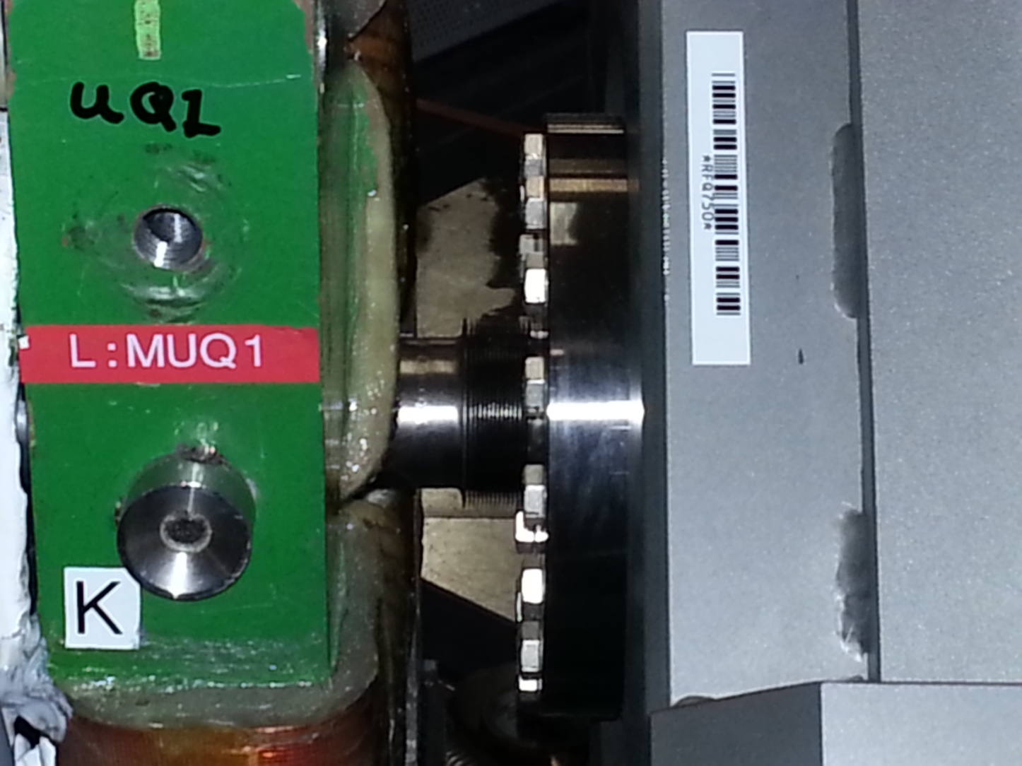
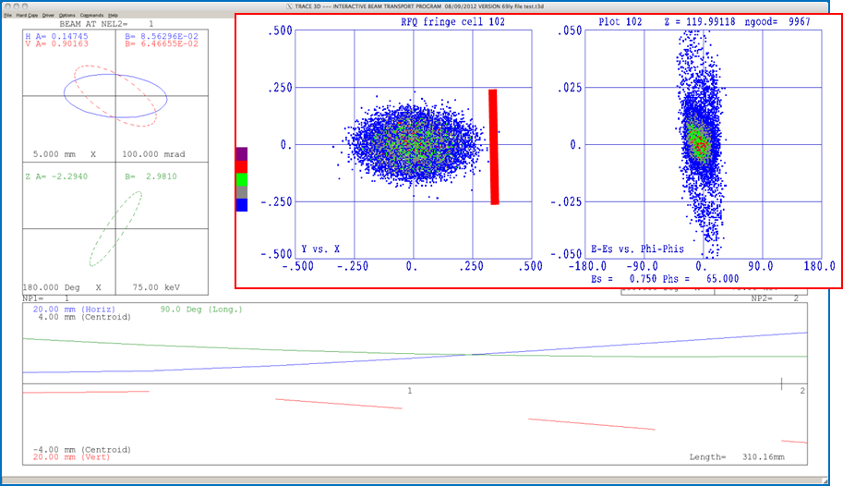
New 750 keV RFQ Injection Line (RIL)
Must fit in this space

Slide 8
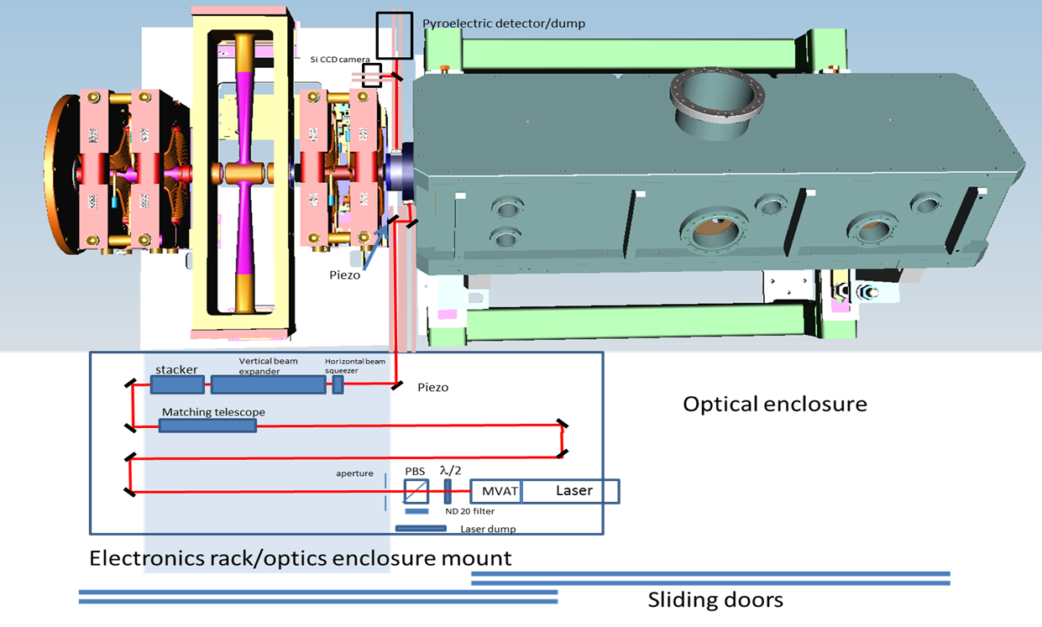
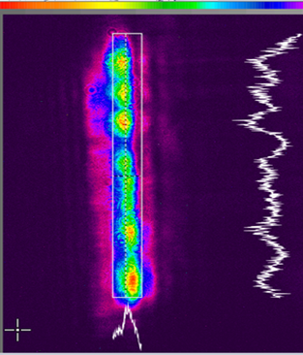
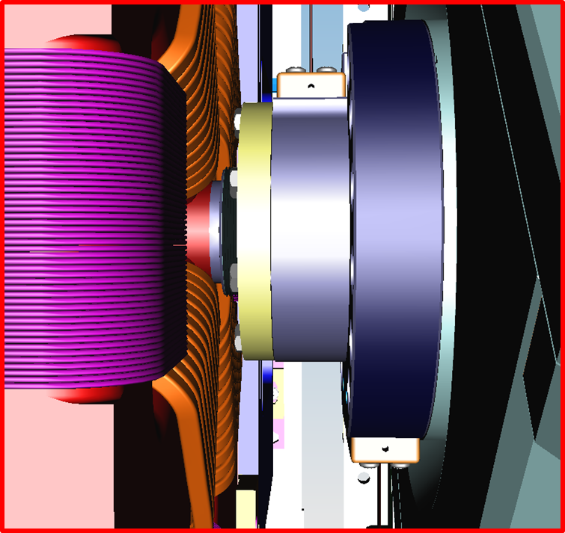
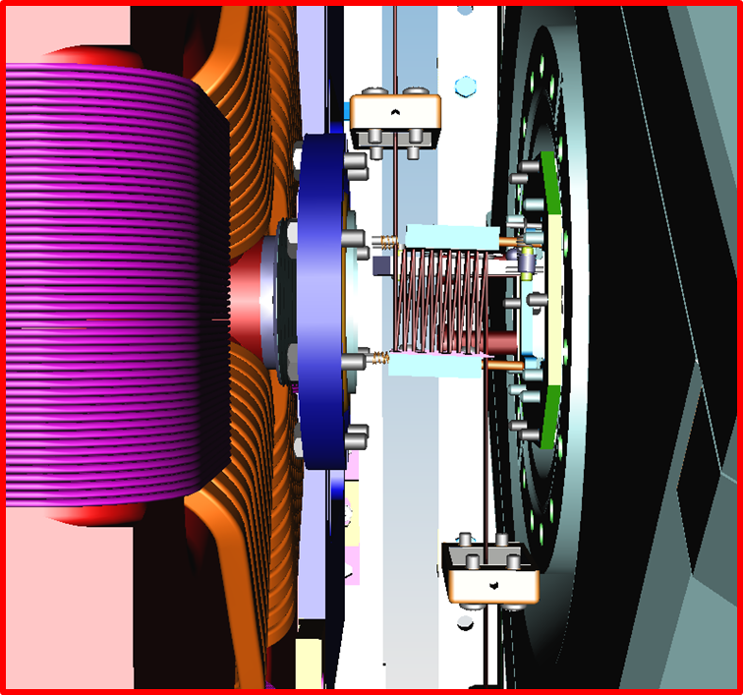
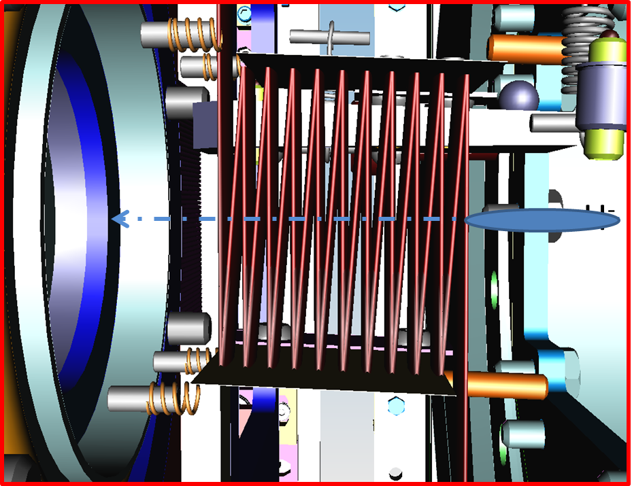
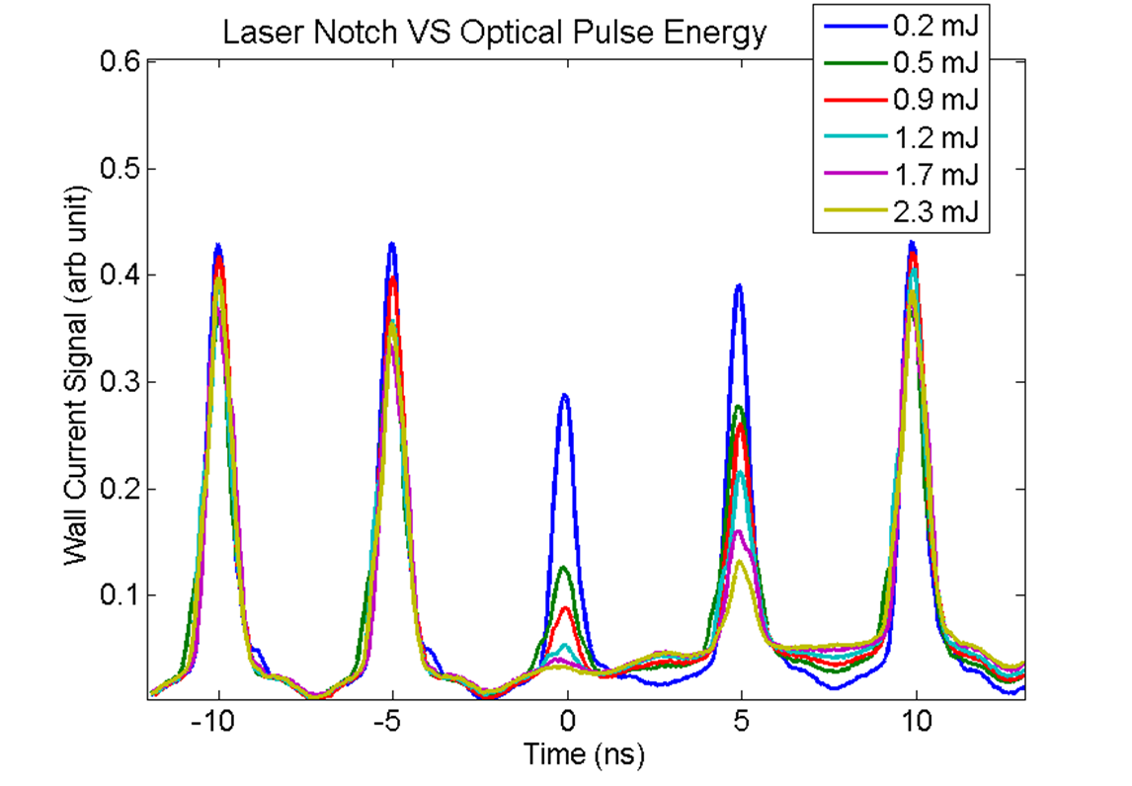
Optical Cavity Test -- Demonstration Experiment (January 2015)
Use zig-zag Optical Cavity with Q-switch laser
Quantel 100 mJ Q-switch laser

Slide 9
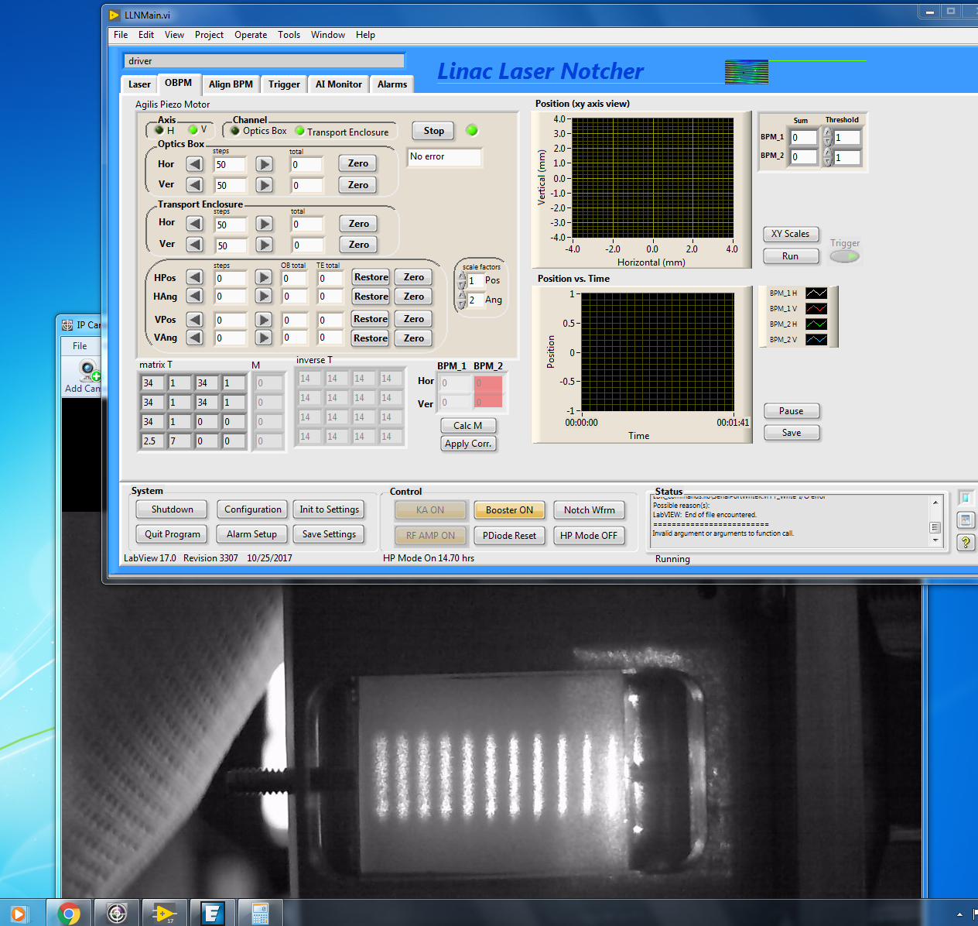
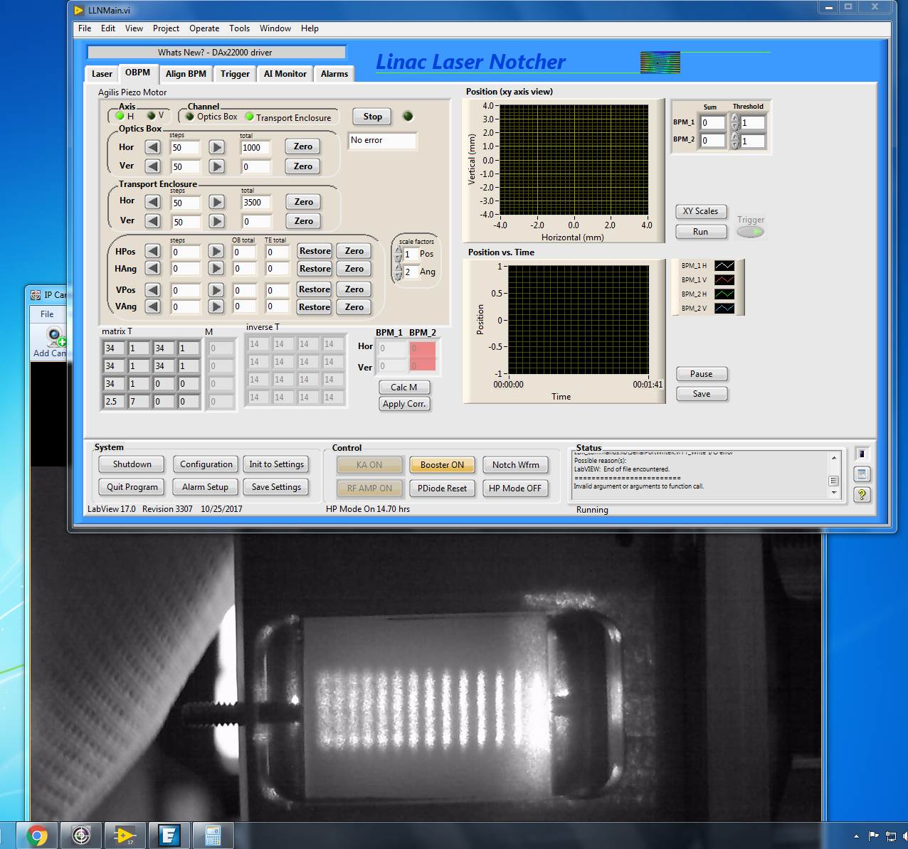
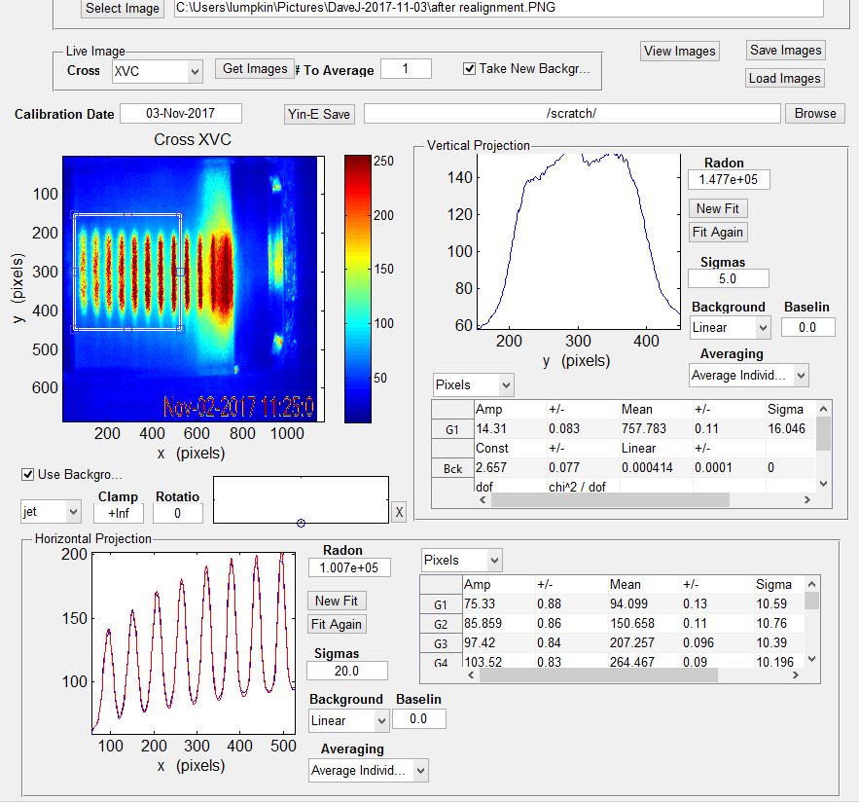
Change number of bounces by adjusting input angle into cavity
Use a video camera looking at the back of the frosted fixed mirror to look at the leakage through the mirror

Slide 10
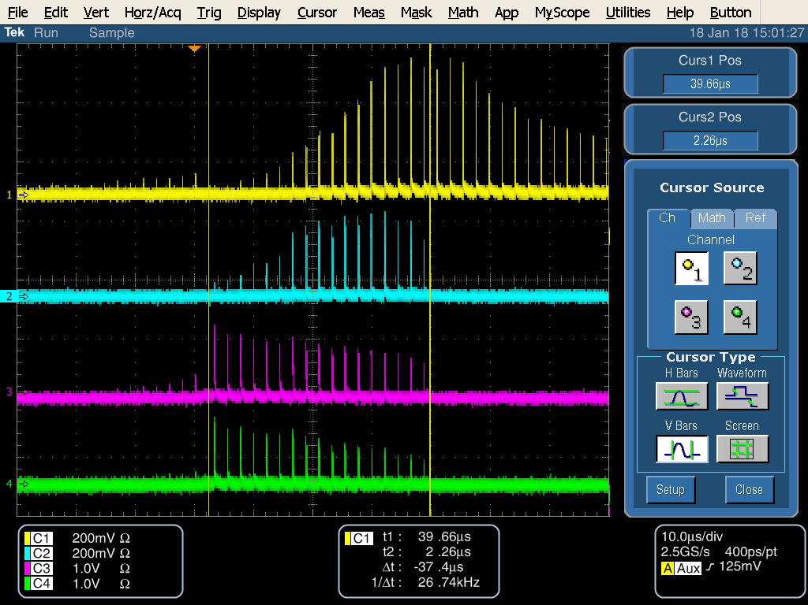
Operational Laser System Block diagram
Pulsed fiber Amp
1st DPSS
2nd DPSS
Dump
Integrating spheres
photodiode

Slide 11
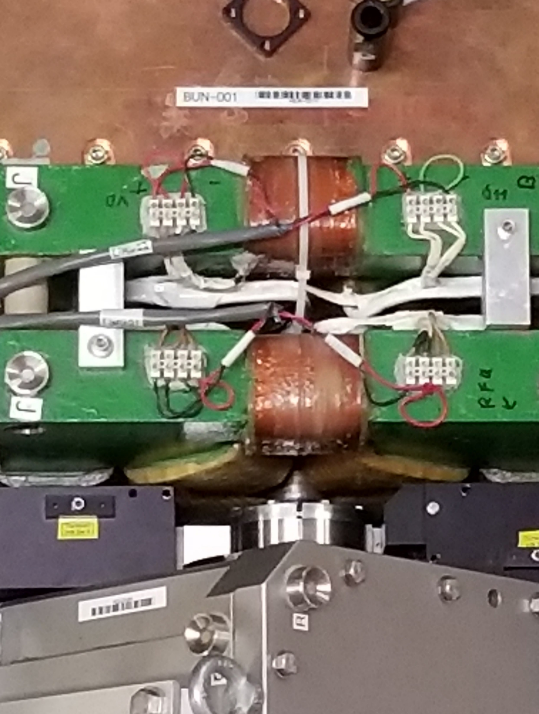
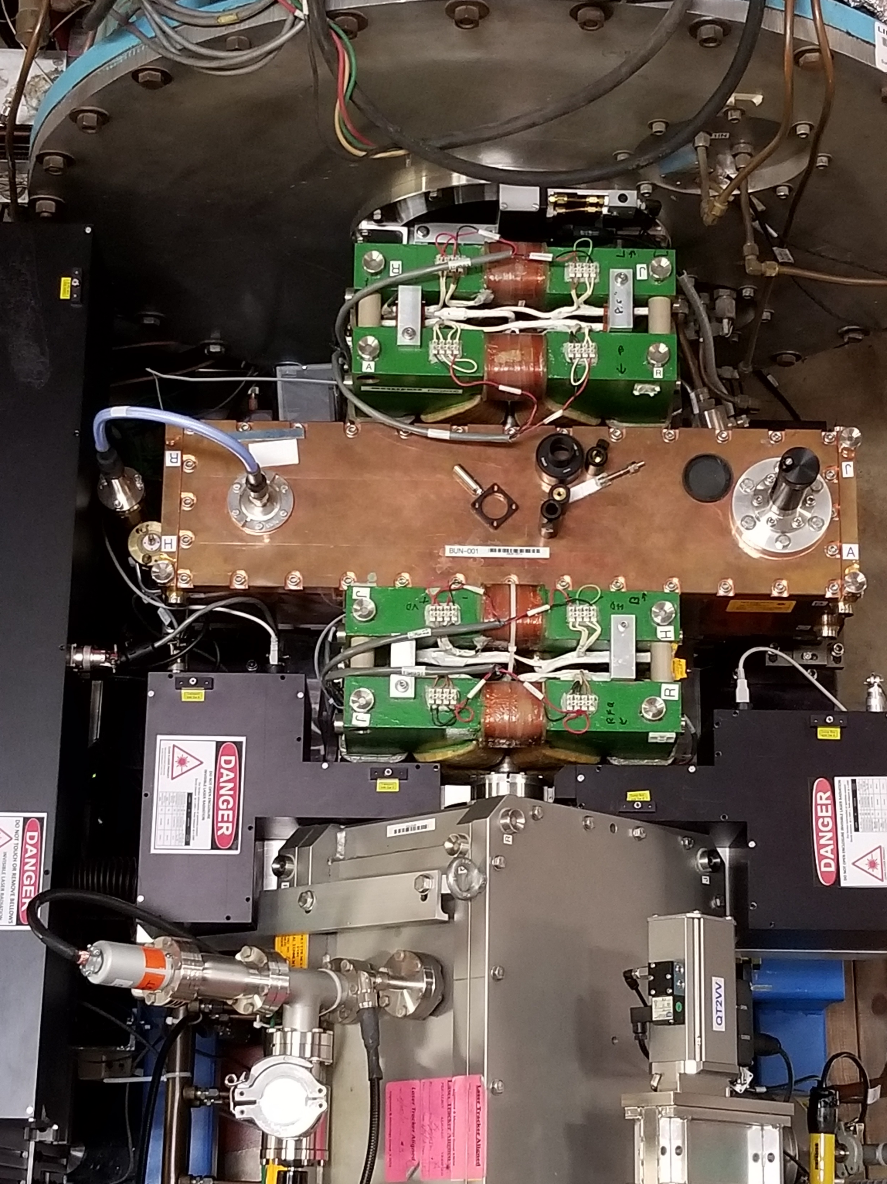
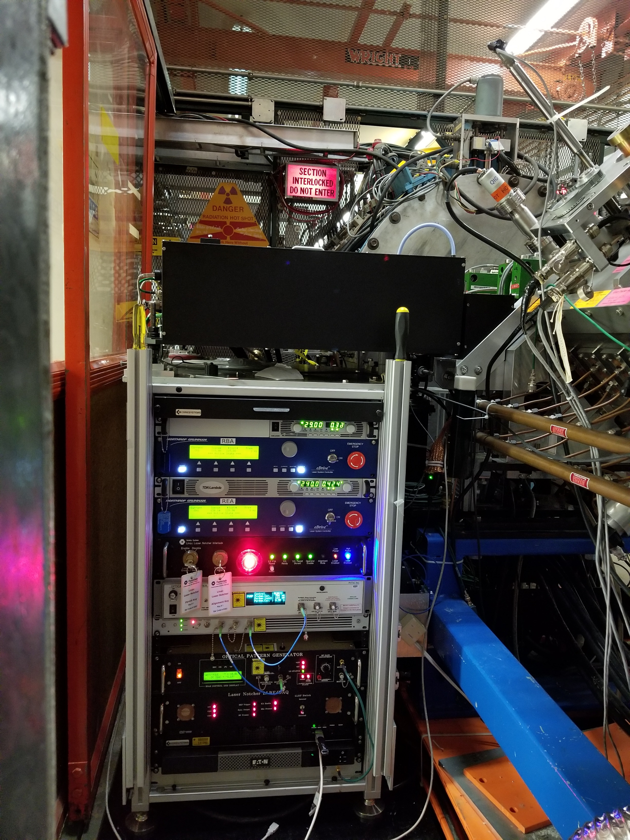
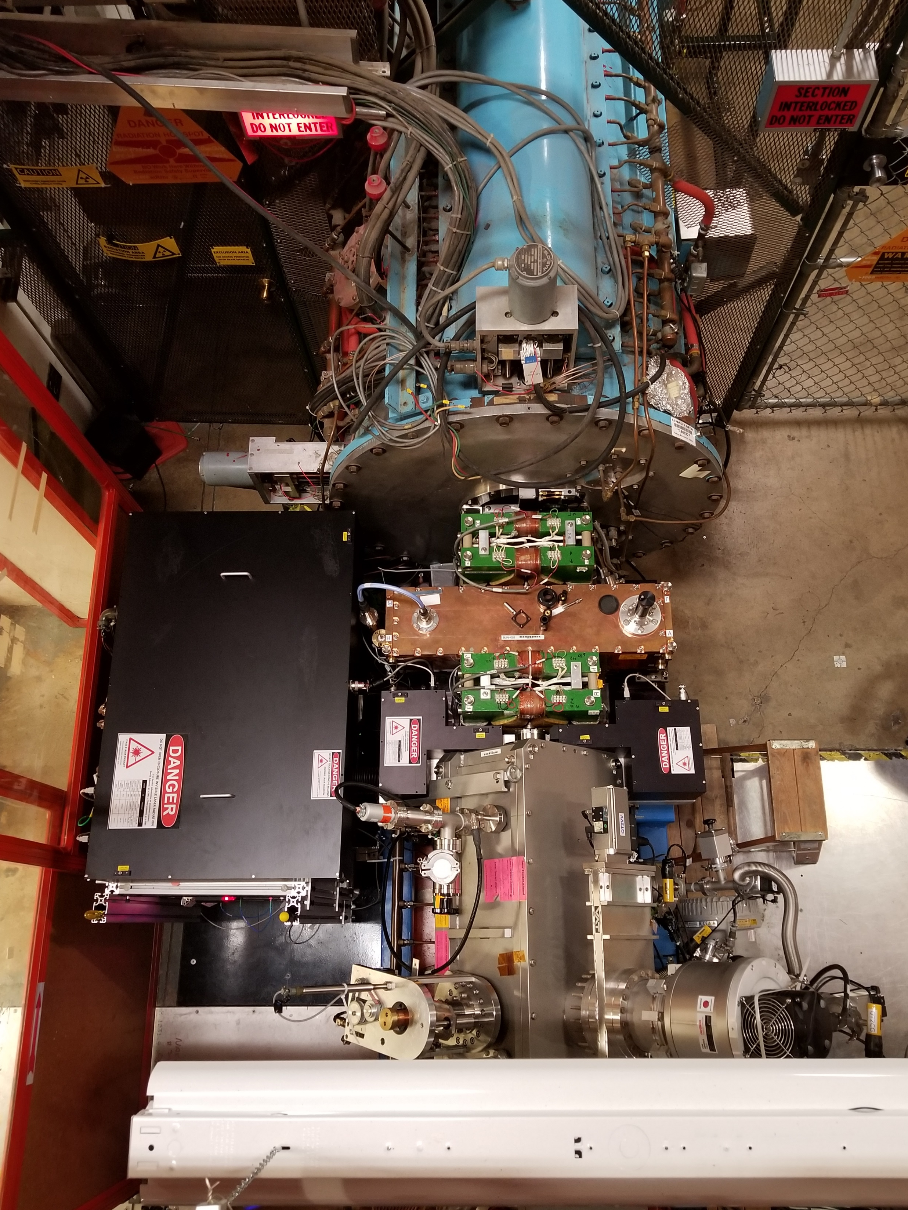
Operational Laser System Installed in Linac
Buncher
Quad doublet
Interaction Cavity
Dump
Transport
RFQ

Slide 12
Controls
Laser seed
Intensity Modulator
MWave Booster fiber Amp
PriTel Pre-amp
PriTel Power amp
Optical Engines fiber amp
TDK Lambda RBA
TDK Lambda REA
Chiller
RBA e-Drive
REA e-Drive
Ophir Energy Meter
Piezo-electric mirror mounts
Video cameras
USER Interface
Parameter page
Web Monitor
Alarms
Logging
Scope/Camera
TV Channels
USB Hub
ACNET
Local Computer
Front End
UPS
Photodiodes
Optical BPM’s
Temperature sensors
Digital control
Digital status
NI DAQ
80 analog channels
24 digital I/O channels

Slide 13
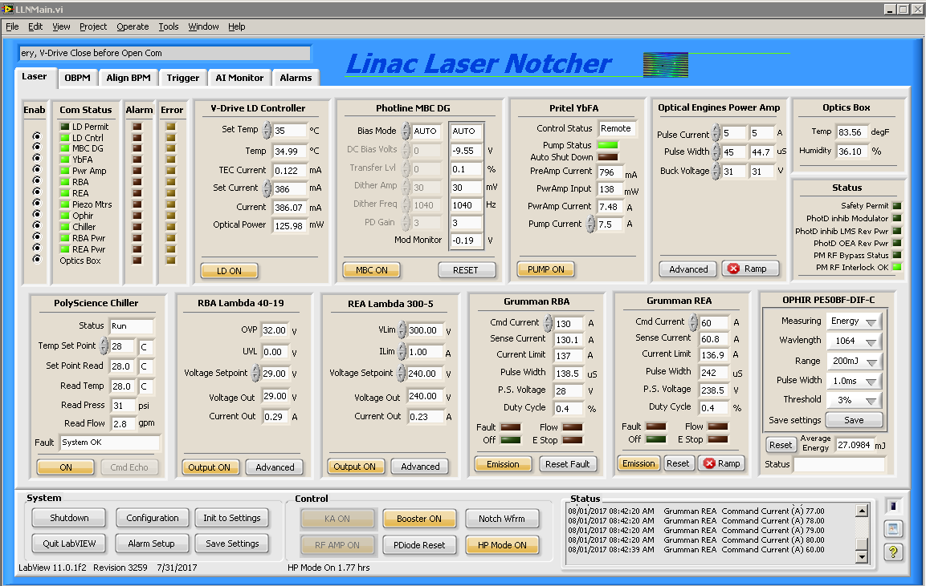
Controls: LabView Front-end
Flexible que driven state machine
GUI interface, ACNET communication, hardware monitoring, and state machine – ALL INDEPENDENT tasks
Real time configurable alarms
Robust setting, monitoring(configuration and communication) display and logging
Configurable mail reports
Settable range constraints for all control inputs
Very flexible waveform creation
Main Operations interface through ACNET parameter page and JAVA web monitor page

Slide 14
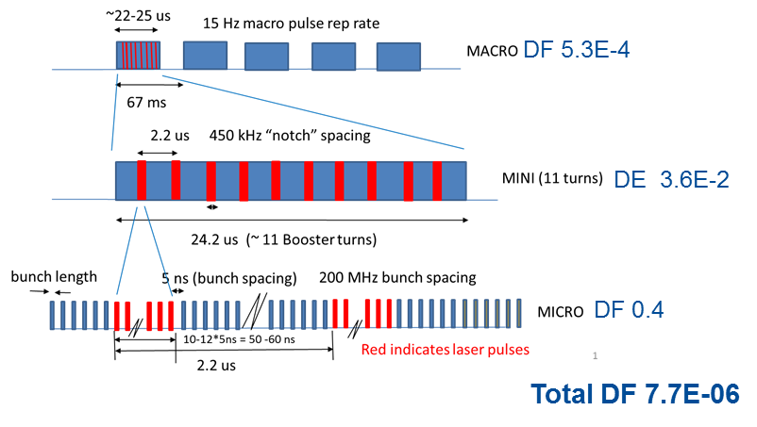
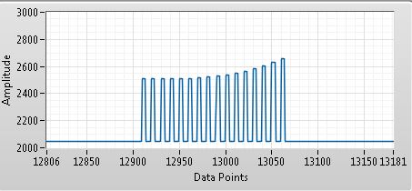
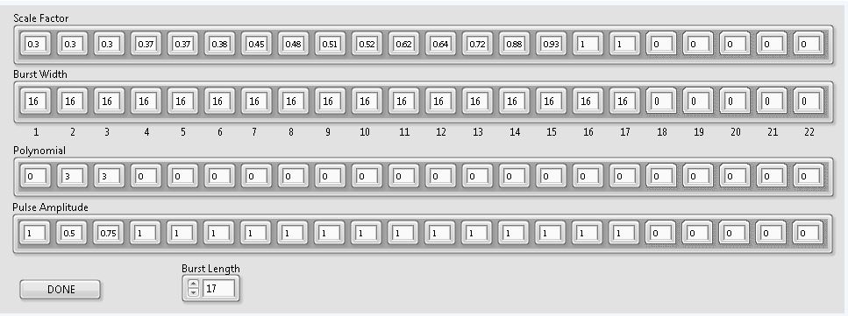
Waveform Generation 1
Waveform creation very flexible.

Slide 15
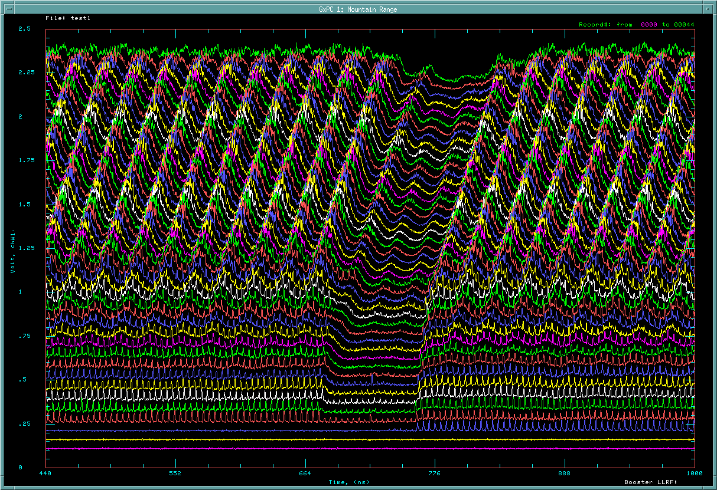
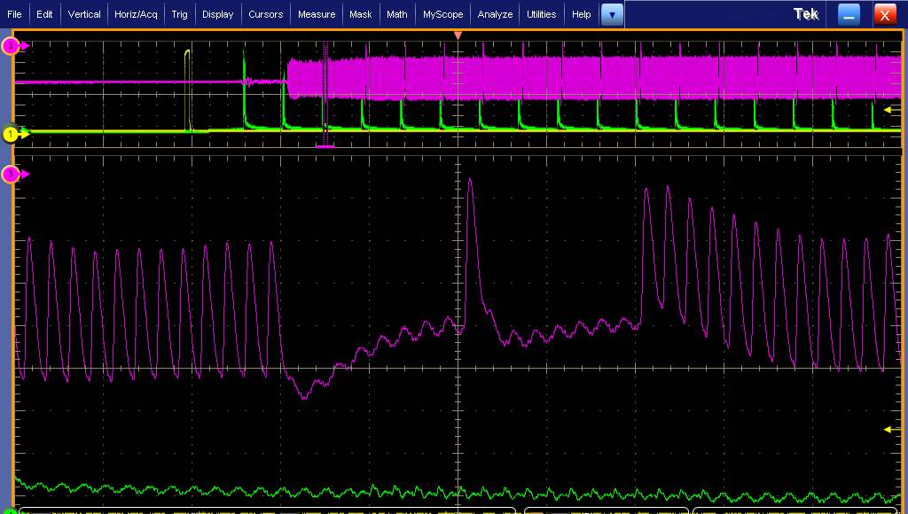
Waveform Generation 2

Slide 16
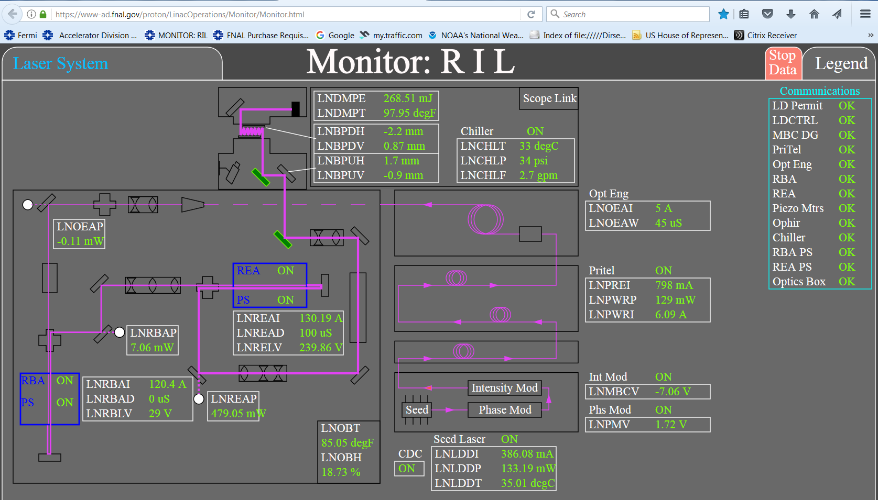
Laser System Monitor

Slide 17
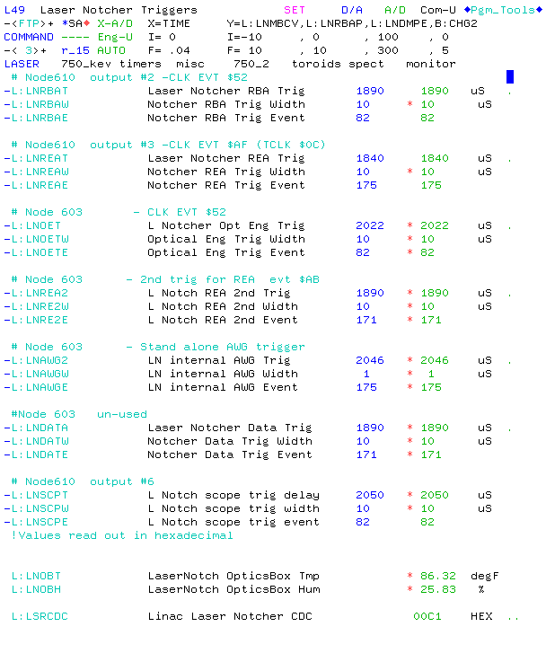
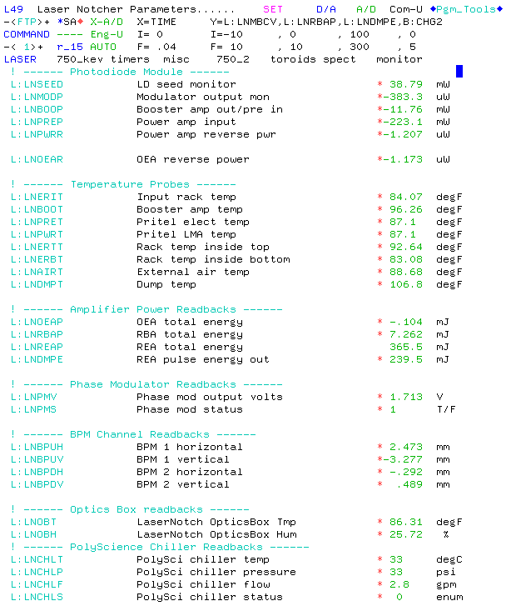
Operational ACNET Interface
Use inconjunction with monitor page and

Slide 18
WCM & Output Photodiode from Scope in Pre-Acc

Slide 19
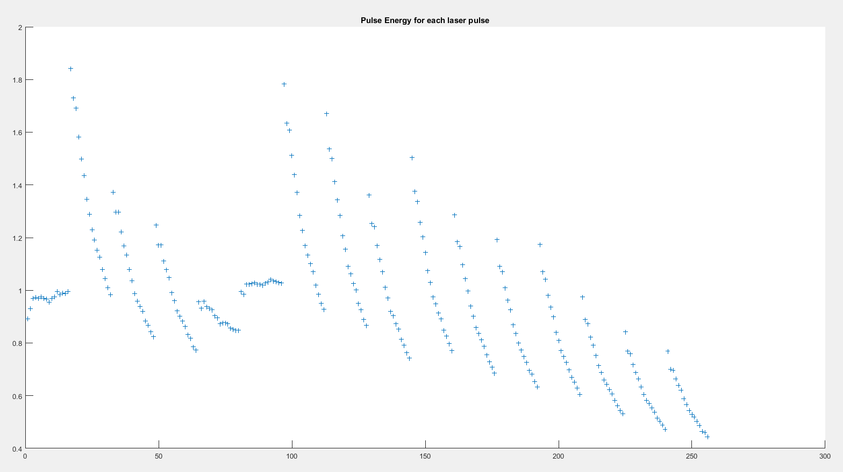
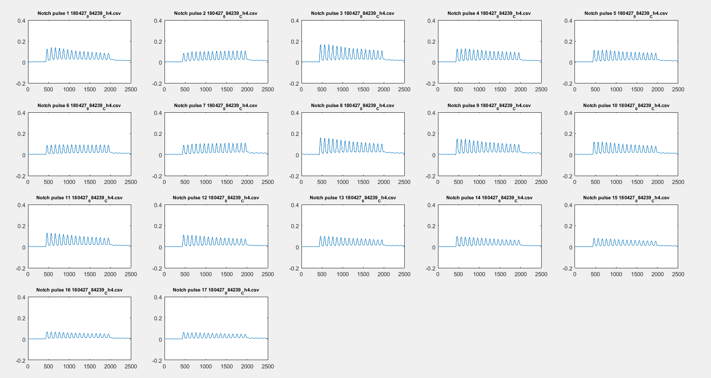
Output Photodiode response

Slide 20
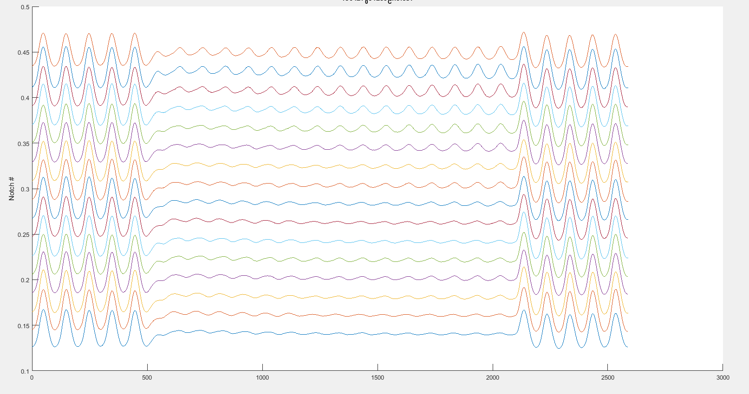
Linac Wall Current Monitor

Slide 21
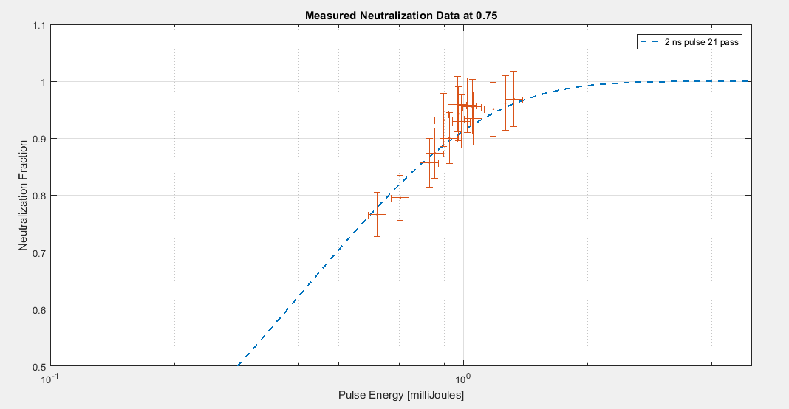
Preliminary bunch and notch neutralization

Slide 22
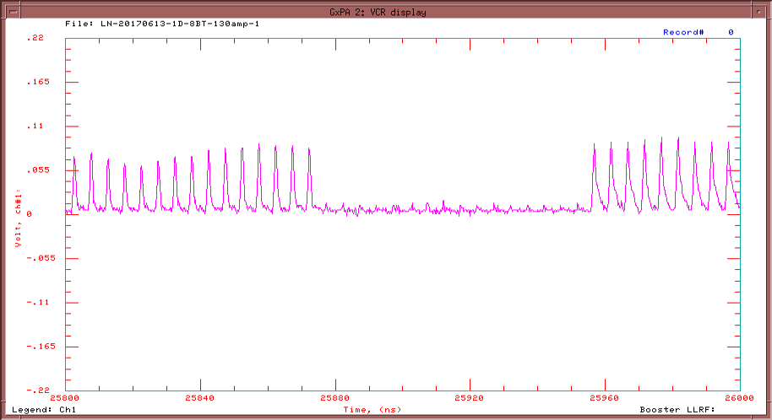
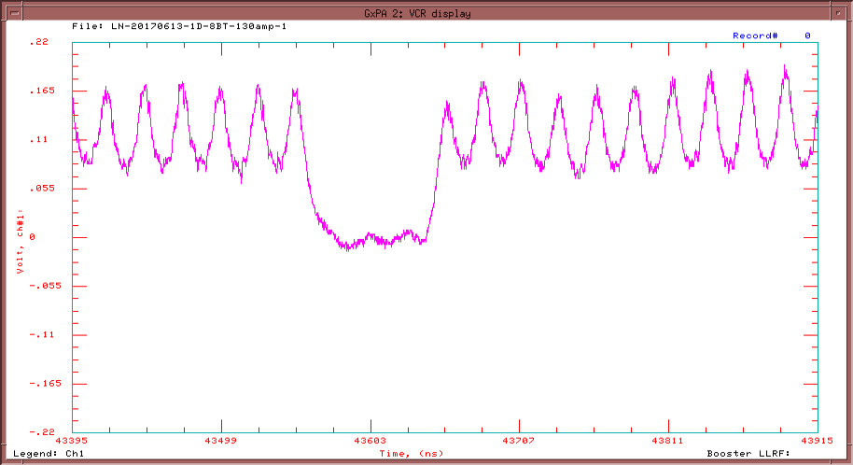
Booster Wall current monitor
200 MHz bunches
80ns notch
38 MHz bunches
80ns notch

Slide 23
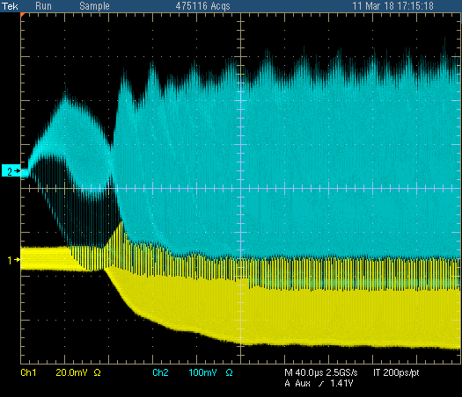
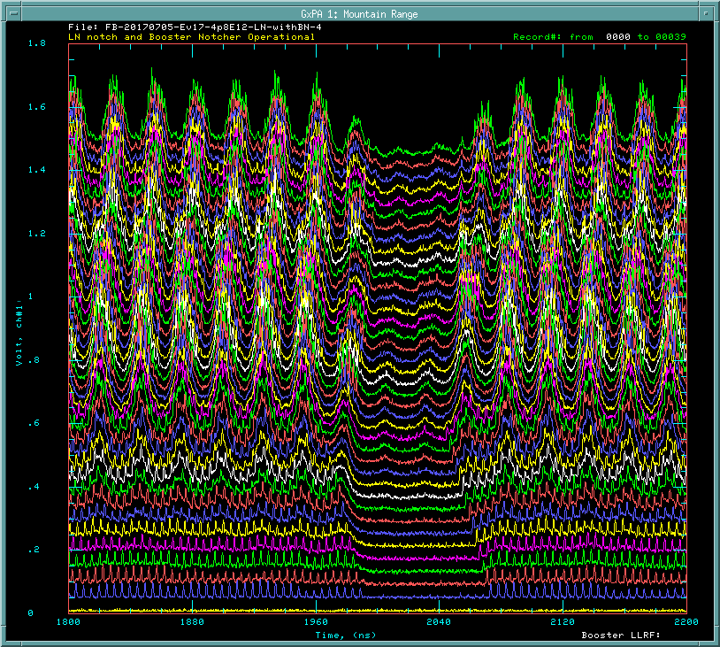
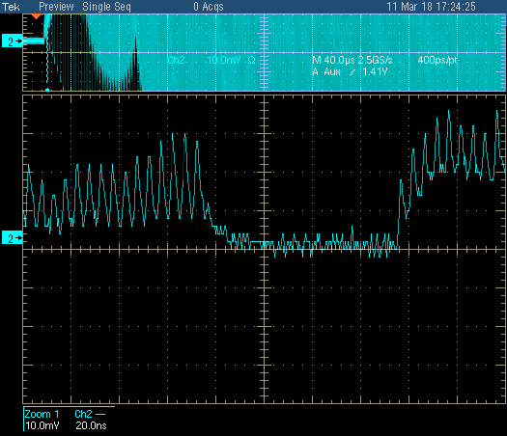
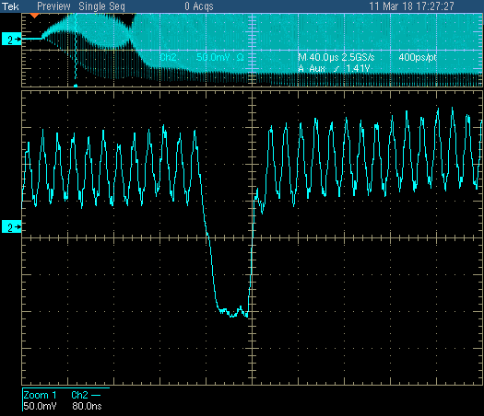
Notch survival in Booster
End of injection
acceleration
200 MHz bunch
38 MHz bunch

Slide 24
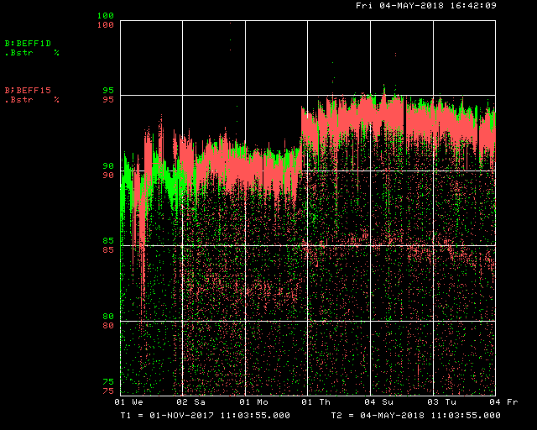
What is the impact on the program (1)
We can provide MORE beam !
Increase Acceleration Efficiency !
Laser Notcher installed
Laser Notcher installed
PIP design goal

Slide 25
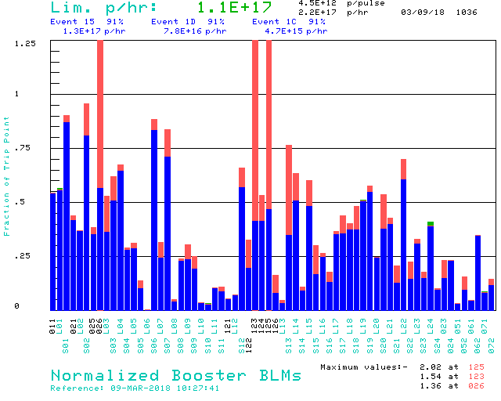
What is the impact on the program (2)
Lower losses !
4.5E12 p/pulse
2.2E17 p/hr up to 2.4E17/hr
Laser on
Extraction
Collimators
Absorber for
Booster notching
Laser off
Administrative Limit
Injection

Slide 26
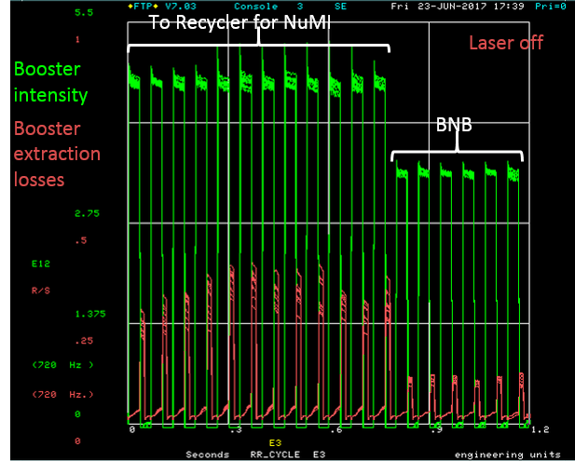
What is the impact on the program (3)
More Beam to experiments and lower extraction losses !

Slide 27
Current Activities and Issues
Operations
Working on improving the laser and ion beam diagnostics
Reducing the impact of electrical noise in communication system
Improving the Operational interface with the MCR and learning how to monitor operate the system
Flattening the laser pulse energy
Puzzles
Understanding the laser energy loss from the output of last amplifier to the laser dump (some of the 99.9% reflective mirrors appear to have 6-10% loss)
Understanding the damage to the optical cavity mirrors

Slide 28
Optical Cavity Mirror Damage

Slide 29
Optical Cavity Mirror Damage
Add mask

Slide 30
Damage after mask

Slide 31
Development going forward
The Laser Notcher laser system is a burst-mode, bunch-by-bunch, H- neutralization system that can be tailored for many application.
The final amplifier stage of the laser system was developed specific ion bunch structure which has limitations on average power/duty factor.
Many of the suggested applications require a system capable of higher duty factor and average power
Transverse collimation in one or two planes (in combination with notching)
Creation of four beam sections in Booster for the g-2 experiment
Longitudinal collimation in a linac where the head and/or tail of a bunch is removed
Extinction measurement for the PIP-II mu2e experiment
Cleaning the 900 ns no-beam section in the PIP-II mu2e experiment
As a potential component for J-PARC laser stripping experiment
Each may require a potential different final amplification stage, but can use the infrastructure and technology for the laser notcher.

Slide 32
Adjusted our transverse laser profile and collimated the H- in vertical

Slide 33
Near term
Current waveform generator has single table for all resets.
Create an array of waveform generators to be triggered by different beam cycles

Slide 34
Examples of PCF Amplifiers
Version built for MIT runs at ~1 mJ/pulse (3-4 ns)
300 kW peak power 200W average power sustained

Slide 35
Longitudinal collimation
w
w = 50 us
prf = 15 Hz
DF = 7.5E-4
Linac
prf_{MACRO}
pw
pw = 100 ps each
pE = 15 uJ each
ps = 2 ns
prf = 201.25 MHz
DF = 0.016
Laser produces 201.25E6*50e-6 = 10,000 pulses /cycle
For 30 uJ/pulse*10,000 pulses = 0.3 J /pulse
ps
prf_{micro}
Peak Power = E/pulse/pulse width
=30 uJ/0.1 ns = 300 kW
Split amplified pulse→ OPTICAL delay line → recombine
temporally with adjustable spacing (ps)
Create head/tail out of single amplified laser pulse
Average power = Peak power*DF
= 300 kW* 3E-5 = 9W
Spot size 1mm x 7.5mm
50 passes, 0.59 mm separation, 1.19mm at mirror
cavity length 2.9 cm, laser path 0.73 m,
neutralization 96% with 15 uJ pulse

Slide 36
Longitudinal collimation
PIP-II Momentum collimation
w
w = 500 us
prf = 15 Hz
DF = 7.5E-3
prf_{MACRO}
pw
pw = 100 ps
ps = 1 ns
prf = 162.5 MHz
DF = 0.016
ps
prf_{micro}
Split amplified pulse→ delay line → recombine
temporally with adjustable spacing (ps)
Create head/tail out of single amplified laser pulse
Peak Power = E/pulse/pulse width
=10 uJ/0.1 ns = 100 kW
Spot size 1mm x 1.6mm
100 passes, 1.1 mm separation, cavity length 10.9 cm
Laser path 1.6m, neutralization 99.7% with 5 uJ pulse
Average power = Peak power*DF
= 100 kW* 1E-4 = 10W

Slide 37
Summary
We have developed a prototype burst mode bunch-by bunch neutralization laser system.
This prototype system is now operational (since end of January)
Has allowed for a ~30% increase beam delivered to BMB
Reduced extraction losses and losses in the Booster notcher absorber
Increased acceleration efficiency
Booster running at record throughput
We are learning how to operate the system and working on optimization
We continue development to move toward a laser system capable of higher average power capable of additional applications
We want to thank all those whom have supported and contributed to the development and installation of the Laser Notcher… it really does take a village !

Slide 38
Thank you for your attention
Questions ?

