Slide 1
2nd Harmonic Cavity for the FNAL Booster
Robyn Madrak for the 2nd Harmonic Cavity task group
Fermilab Workshop on Megawatt Rings & IOTA/FAST Collaboration Meeting
7 May 2018

Slide 2
People Involved
John Kuharik (Accelerator Division, Masters Student)
C. Y. Tan, Bill Pellico (Acclerator Division, Proton Source)
Gennady Romanov, Yuri Terechkine, Sasha Makarov (Technical Division)
Kevin Duel, Matt Slabaugh (Accelerator Division, Mechanical)
Joe Dey, Robyn Madrak (me), Rene Padilla, John Reid, Ding Sun (Accelerator Division, RF)
Technicians, to name a few: Daren Plant, Bob Scala, Ryan Montiel, En Sukkert, Gerik Wysocki, Jeff Larson, Drew Feld, Ken Koch
Many thanks to National Magnetics for the manufacture of our garnet and the assembly of the tuner rings with our required consistency and precision.

Slide 3
2nd Harmonic Cavity: ~ 76 – 106 MHz
Works at double the frequency of the fundamental cavities
Purposes
  Main purpose: to increase capture at injection by flattening the RF bucket
    Must have at least 100 kV gap voltage
  Can also be used at transition and extraction
The cavity will be turned on only for a few ms of the 33 ms Booster ramp
  Only necessary to be on at these times to achieve the goal
  This decreases duty factor and helps with any cooling issues
Available tunnel space required small footprint
  One good reason for pursuing the perpendicular bias option

Slide 4
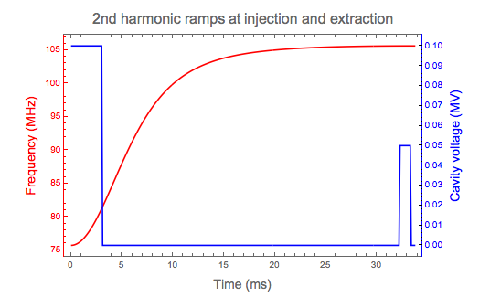
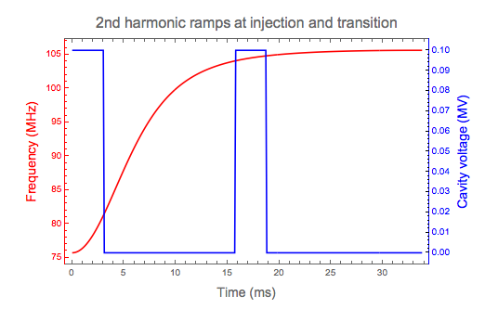
Example (possible) ramps

Slide 5
Perpendicular Bias
Some wideband cavities tune using parallel biased ferrite
  The bias magnetic field is parallel to the RF magnetic field
Some prototype cavities have been developed showing that the perpendicular bias method is advantageous due to lower losses
This comes down to choice of material.
  In general, the lower the bias the higher the losses
  “newer” materials (garnet) have a lower saturation magnetization (M_{s}) and can be biased into saturation (low losses)
    But in order to maintain tuneability, bias must be perpendicular
    When the bias is perpendicular, μ varies as B/H instead of dB/dH (parallel case), which is small when the ferrite is near saturation

Slide 6
Early Perpendicular Bias Cavity with tuner on-axis
From R. L. Poirier, “Perpendicular Biased Ferrite-Tuned Cavities”

Slide 7
Various parameters of tuners with perpendicular bias
 | TRIUMF | SSC | FNAL
 | Booster | LEB | cavity
Min f(MHz) | 46.1 | 47.5 | 75.7
Max f(MHz) | 60.8 | 59.8 | 105.6
Peak Gap V (kV) | 62.5 | 127.5 | 100
Accelerating time (ms) | 10 | 50 | 33*
Rep Rate (Hz) | 50 | 10 | 15
Ferrite Material | TT-G810 | TT-G810 | NM-AL-800
~ Min μ(ferrite) | 1.48 | 1.4 | 1.2
~ Max μ(ferrite) | 3.94 | 3.2 | 3.2
Cavity Q | 2200 - 3600 | 2800 - 3420 | 3200 - 5700
* Cavity is turned on for only a few ms

Slide 8
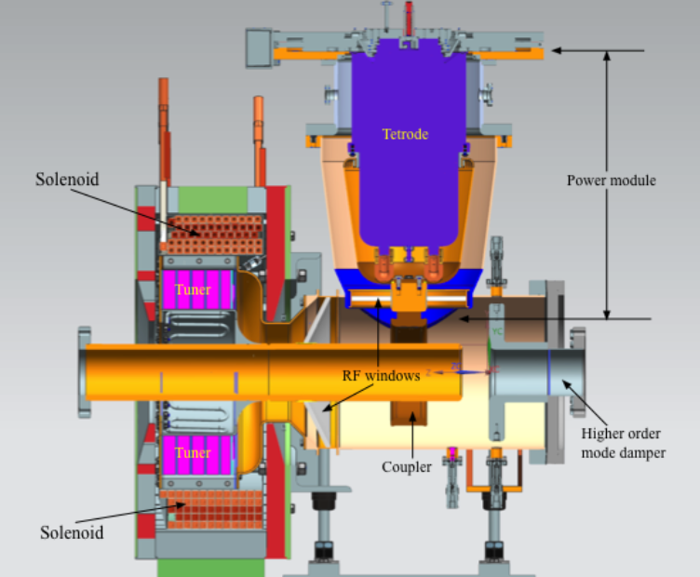
Cavity Model
Length flange-to-flange:
844 mm
Aperature:
76 mm
P = V²/2 R_{sh}
76 MHz, R_{sh} = 96 kΩ
106 MHz: R_{sh} = 180 kΩ

Slide 9
Challenges
Achieving the large tuning range with realistic magnetic field
High values of local permeability and associated high losses in regions of low magnetic field
  Keeping the magnetic field in the tuner as uniform as possible
Transfer and removal of heat with non-toxic materials
  BeO transfers heat well but is a toxicity concern
  Oil cooling generates mixed waste
Eddy currents
Including the power tube in the RF model
  Strong coupling effects cavity frequency
Avoiding air bubbles in any materials used such as epoxy and thermal grease
  Could cause sparking
Choosing assembly techniques and materials to minimize RF losses without compromising heat transfer

Slide 10
Tuner
Garnet rings are constructed by epoxying together 8 sectors
  Size limitation at vendor
Each ring is epoxied to an Al203 ring which transfers heat to tuner outer shell, which is water cooled
Outer shell is stainless steel Cu plated on the inside; thicknesses chosen to reduce eddy currents
  Outer shell is divided into 4 azimuthal segments to reduce eddy currents
Specially shaped shim ring at the end of the tuner improves magnetic field uniformity where it is most non-uniform
  Transition from garnet filled section to air
  Flux return cannot be right next to it (inside RF volume)

Slide 11
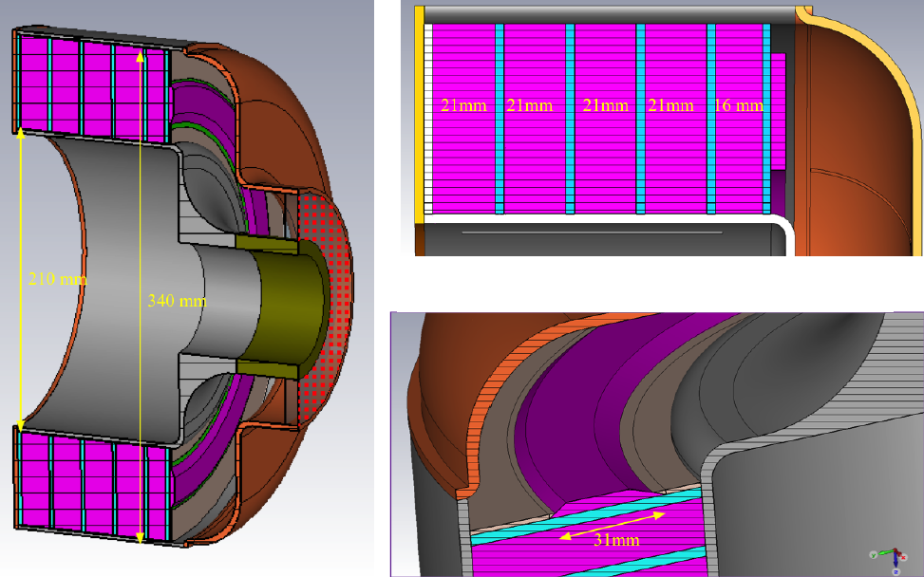
Tuner
Garnet rings
Al₂0₃ rings epoxied to garnet
Magnetic shim at end
Cu plated (inside) stainless steel shell

Slide 12
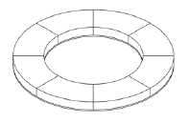
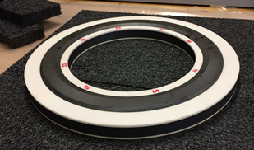
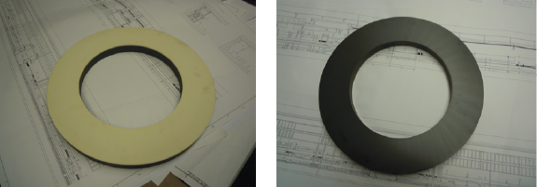
Garnet Rings
Standard Rings (4)
Shim (End) Ring (1)
Alumina side
Garnet side

Slide 13
Garnet Properties
To accurately model the cavity, need to understand the garnet properties:
  μ’ vs bias field for frequency
  μ’’ vs bias for losses
No published data existed
Measurements subject to uncertainties and nonuniformity of magnetic field in the material
Performed measurements by assembling sample garnets
  Stack of ten 0.5” thick garnets with 3” OD, 0.65” ID
  Used a spare solenoid on-hand from another project

Slide 14
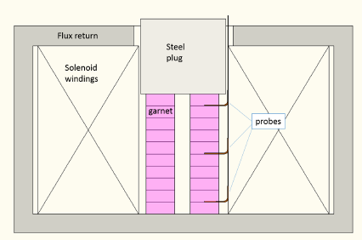
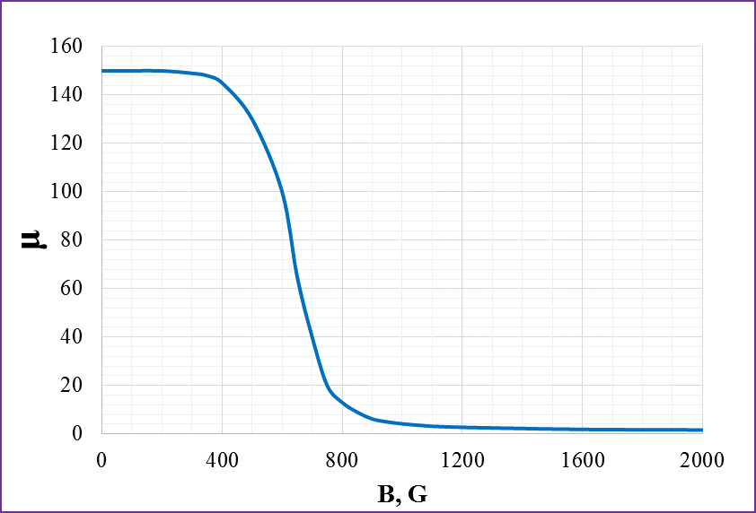

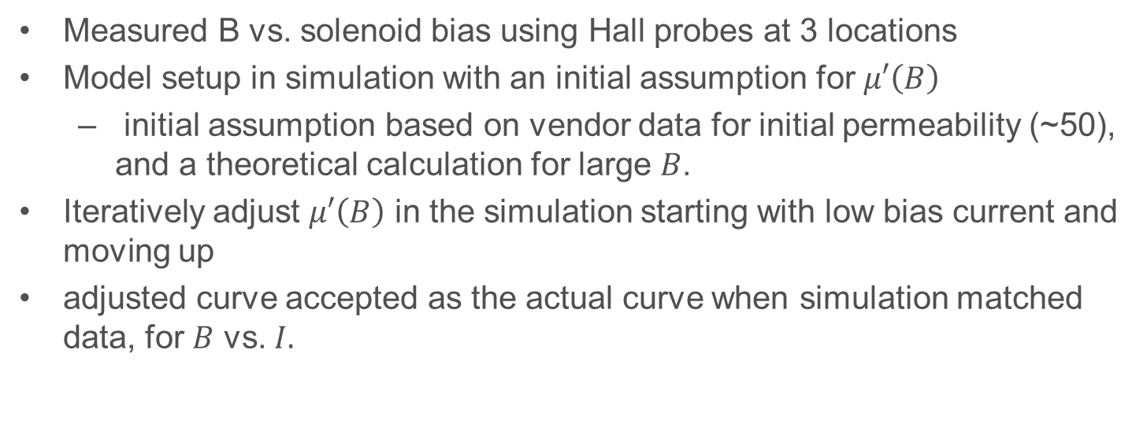
Permeability measurements: $μ′\left(B\right)$
Extracted curve $μ′\left(B\right)$
Measured B vs. solenoid bias using Hall probes at 3 locations
Model setup in simulation with an initial assumption for $μ′\left(B\right)$
  initial assumption based on vendor data for initial permeability (~50), and a theoretical calculation for large $B$.
Iteratively adjust $μ′\left(B\right)$ in the simulation starting with low bias current and moving up
adjusted curve accepted as the actual curve when simulation matched data, for $B$ vs. $I.$

Slide 15

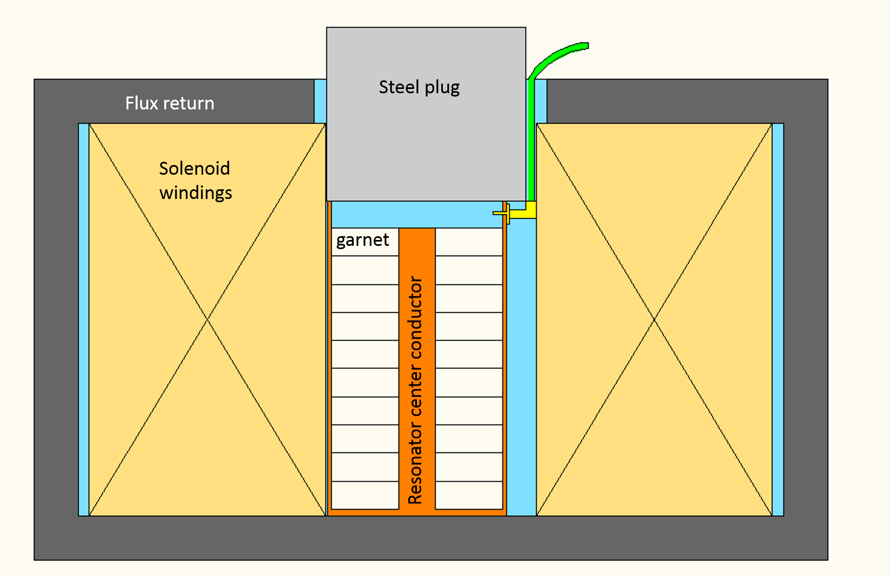
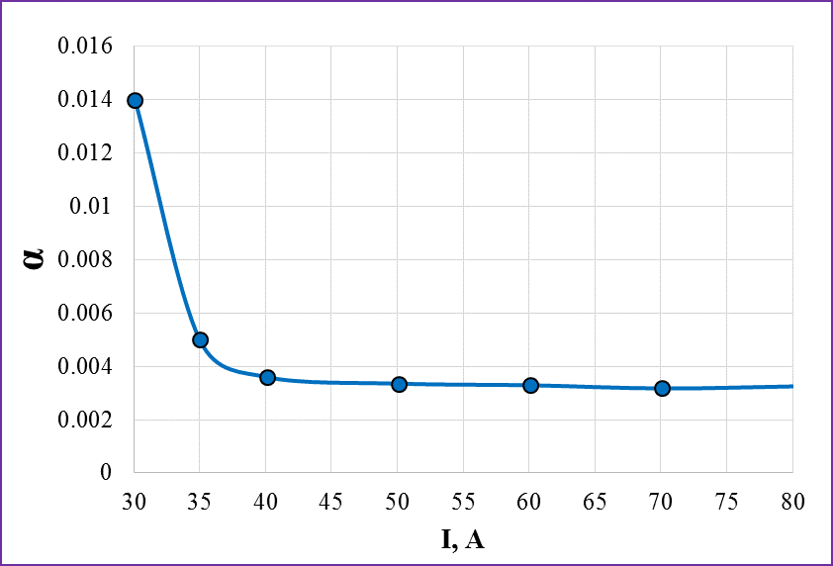

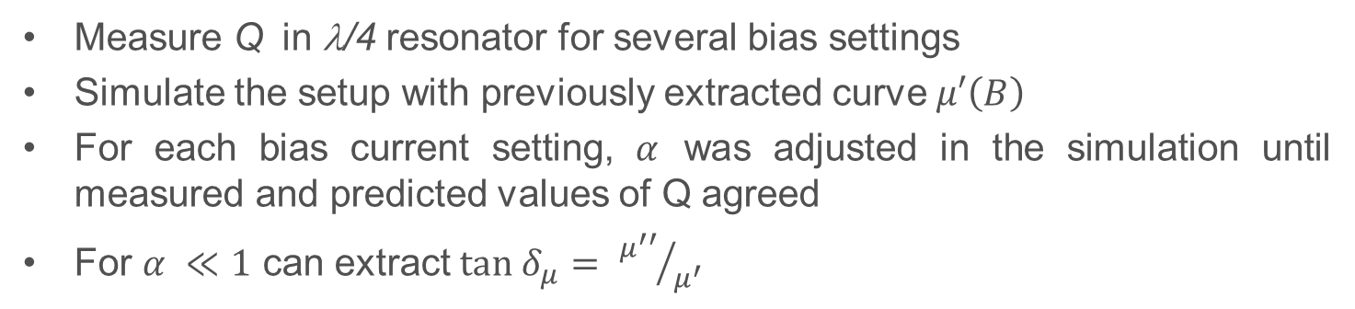


Permeability measurements: $μ′′\left(B\right)$ ($\tan{δ_{μ}}$)
Qtr wv
Resonator
With garnet
$$ω_{0}=μ_{0}γH_{0}$$
$$ω_{m}=μ_{0}γM_{s}$$
$$ω=2 π f$$
Measure Q in λ/4 resonator for several bias settings
Simulate the setup with previously extracted curve $μ′\left(B\right)$
For each bias current setting, $α$ was adjusted in the simulation until measured and predicted values of Q agreed
For $α ≪1$ can extract $tan δ_{μ}= {μ^{′′}}/{μ^{′}}$

Slide 16
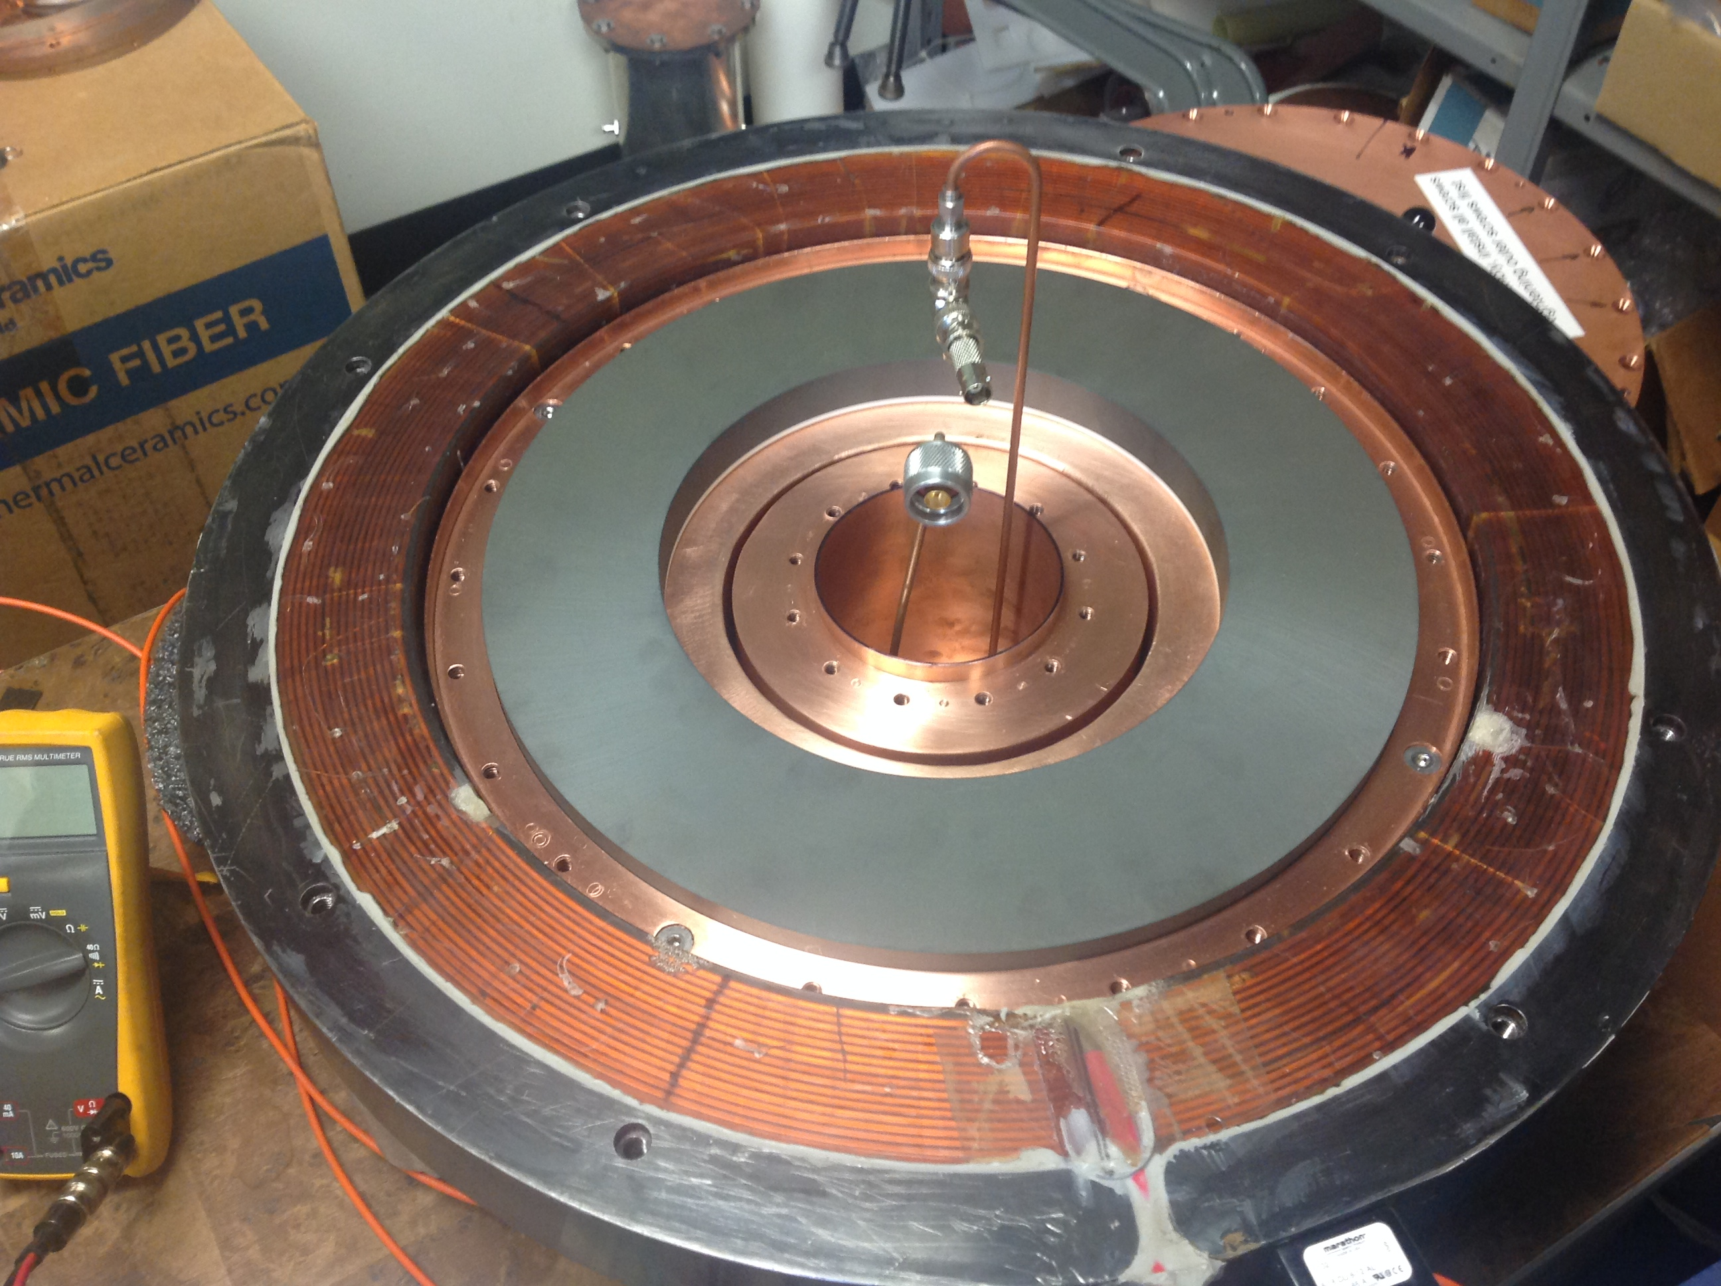
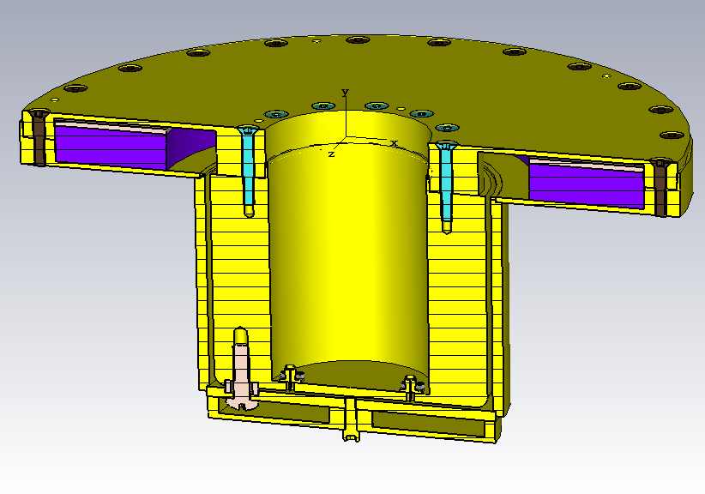
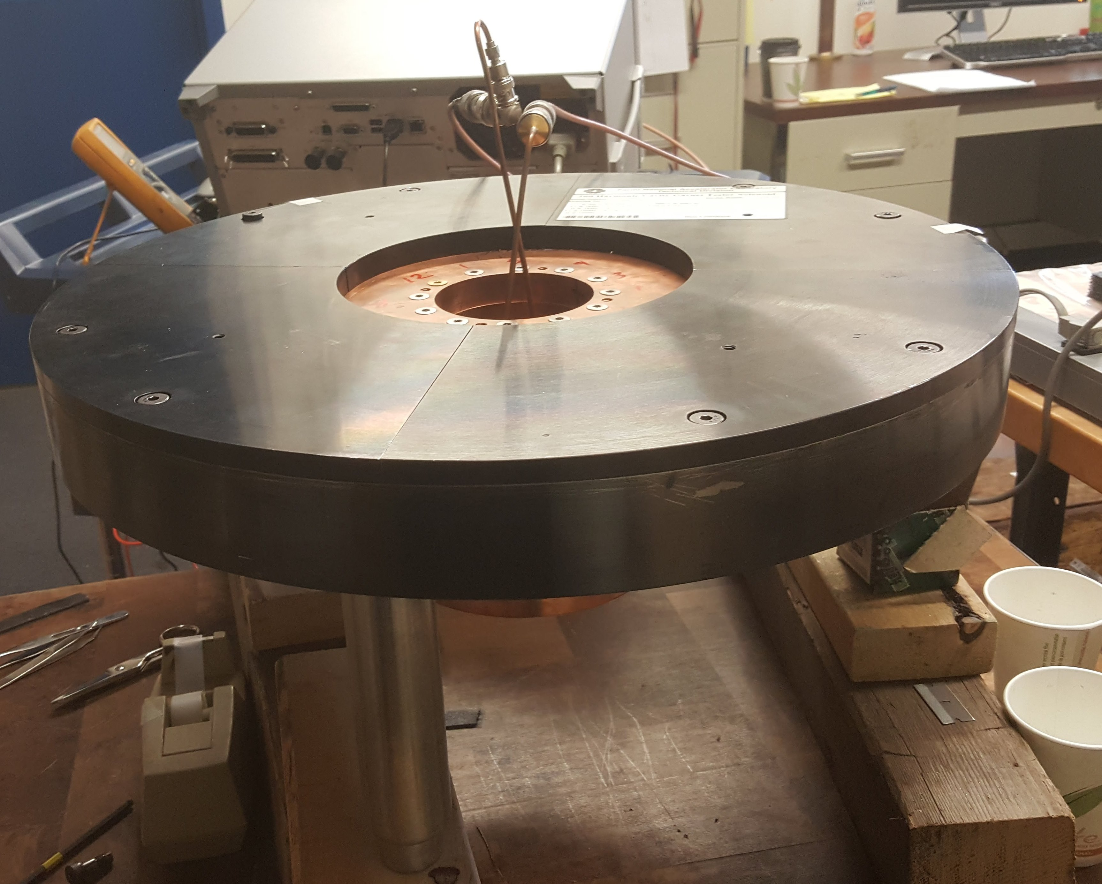
QC fixture for actual rings
Fixure with top removed and solenoid shown
RF volume: λ/4 resonator with large
gap capacitance
garnet
solenoid
Fixture with top on and flux return shown

Slide 17
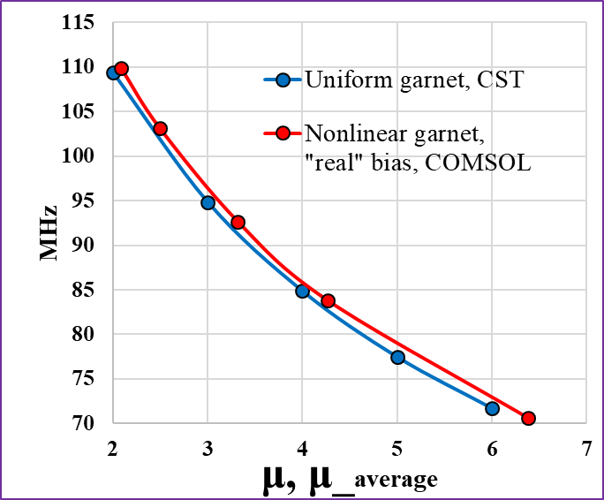
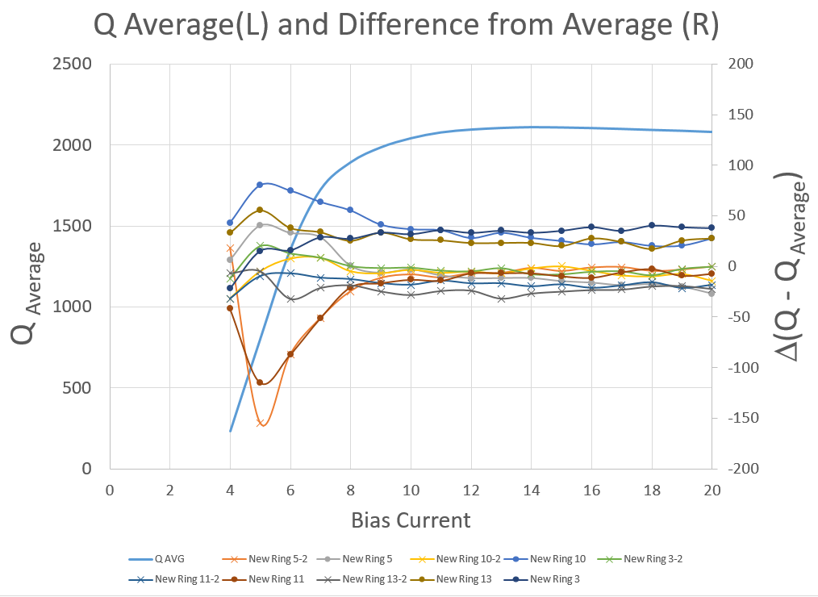
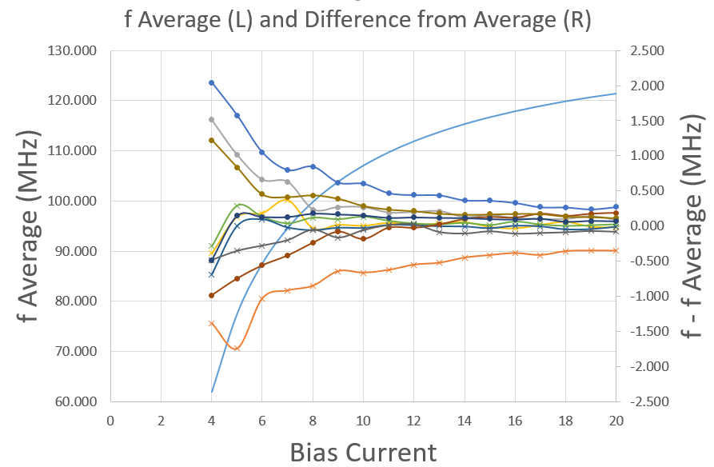
Results for Five cylindrical rings
Within measurement accuracy, rings are uniform in frequency (μ’) and Q (μ’’)

Slide 18
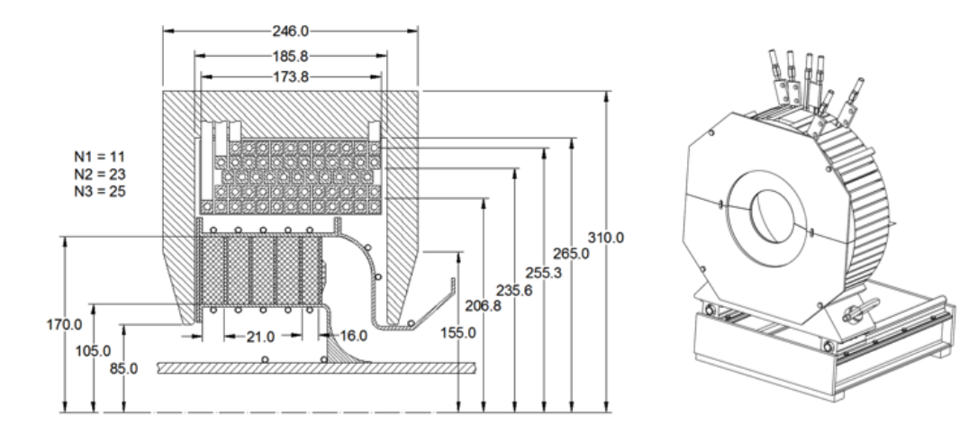
Bias Solenoid
Flux
return
windings
garnet
Booster cycle 15 Hz -> solenoid yoke made from laminations to reduce eddy currents
Three separate coils, total of 59 turns. Will be connected in series
Bias current is 139 A at injection to ~600 A at extraction
Coil inductance varies between ~3.5 and 4.7 mH

Slide 19
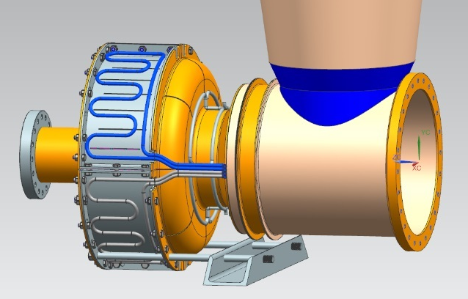
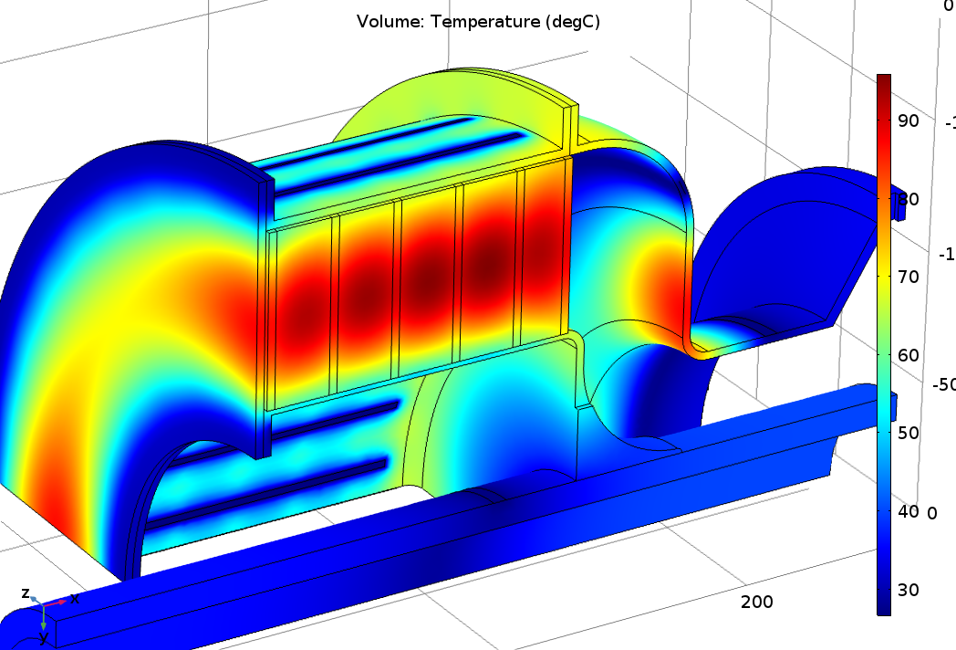
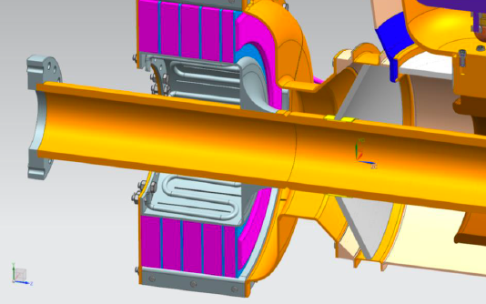
Cooling
RF power loss: ~ 3 kW
  Eddy current loss ~ 600W
Max temp ~ 100 ° C
Curie temp 200° C
Add 1 alumina ring
alumina
Alumina transfers the bulk of the heat. An extra ring will be added on the end

Slide 20
Power Amplifier tests
We will use the Y567B (Fermilab version of Eimac 4CW150000) power tetrode
  Rated to 150 kW anode dissipation
We only expect to need ~55 kW at 76 MHz, even less at higher frequency
Still needed to test at 76 and 106 MHz to verify operation at these higher frequencies
Redesigned fundamental Booster PA cathode drive resonator to work at higher frequency
Tetrode exceeded 100 kW output at both 76 and 106 MHz

Slide 21
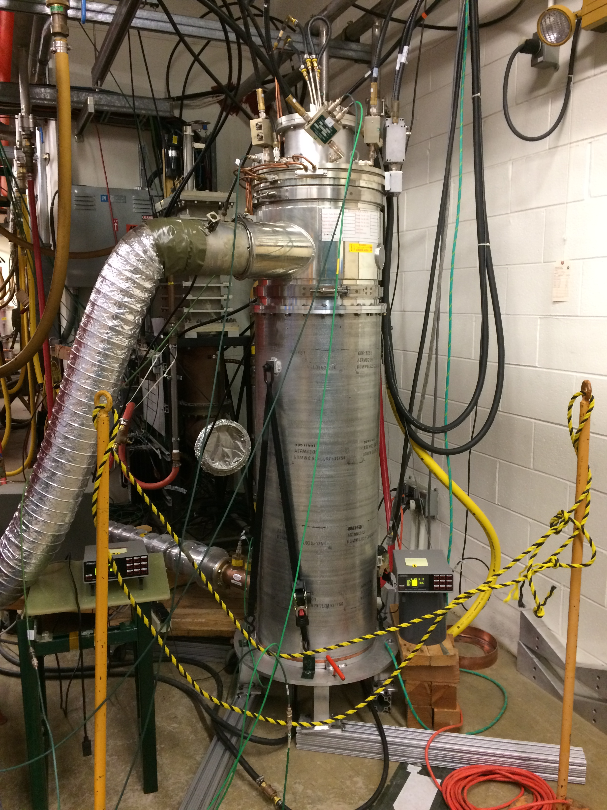
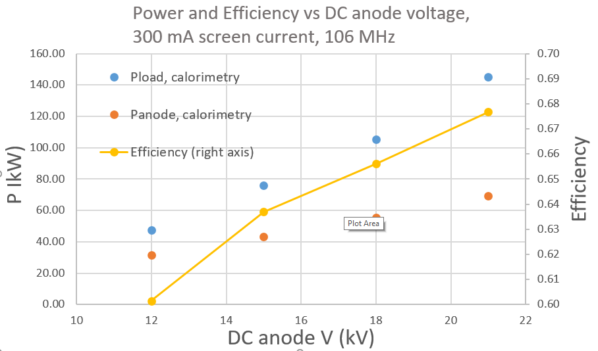
Power Amplifier tests
cathode
drive
resonator
Pload = output power
Tetrode
In here
106 MHz
resonator
load

Slide 22
Status
Design was finalized in Sept.
All parts have arrived
We are building the cavity!
Solenoid is being constructed in parallel

Slide 23
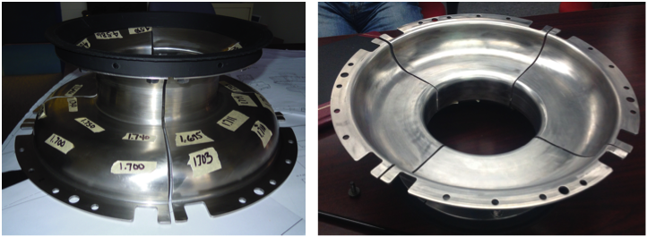
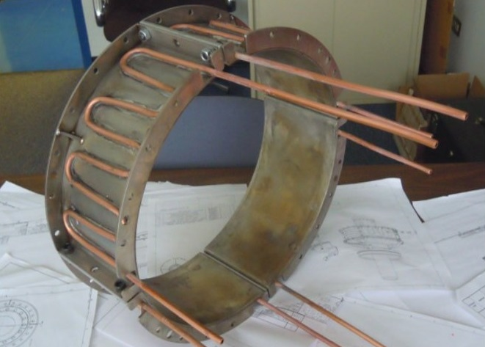
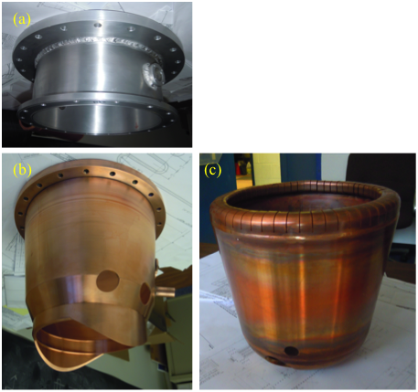
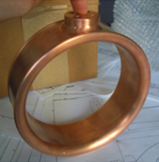
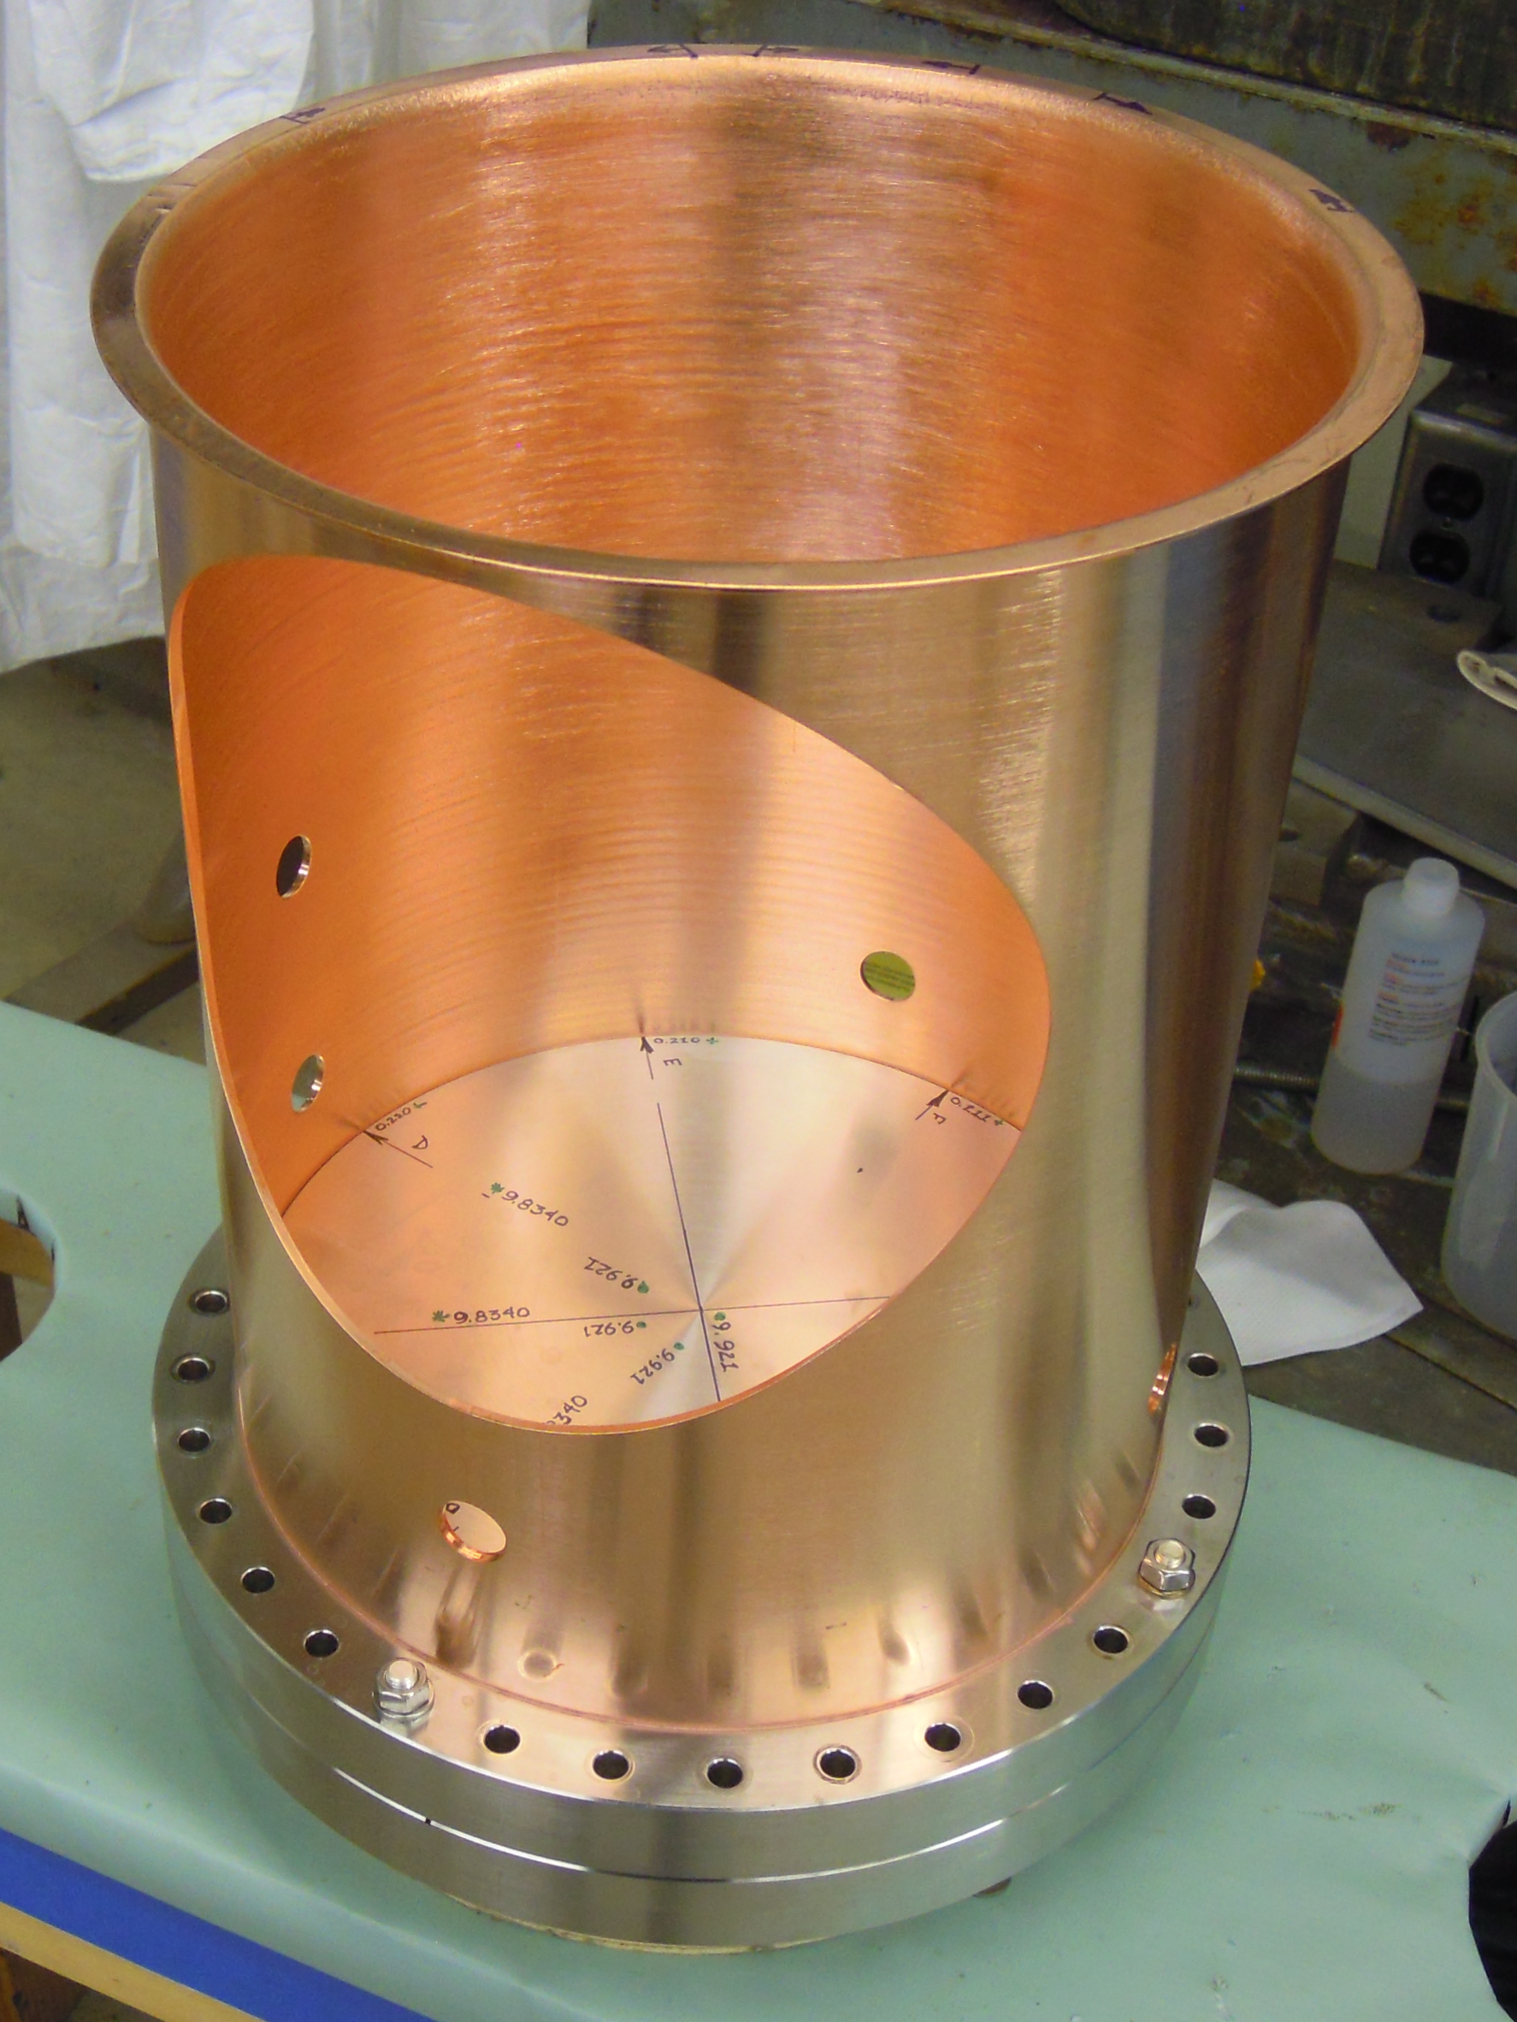
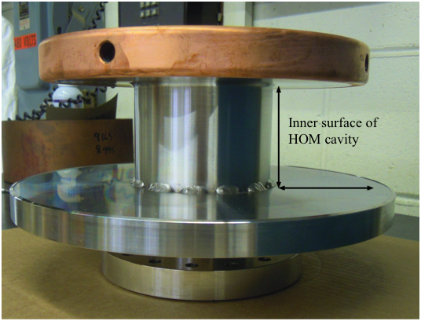
Cavity Parts
Outer conductor vacuum-> garnet region
inner conductor garnet region
Outer conductor,
Vacuum region
PA outer, top
Coupling ring
inner conductor garnet region
Tetrode connection
HOM damper
PA outer, bottom

Slide 24
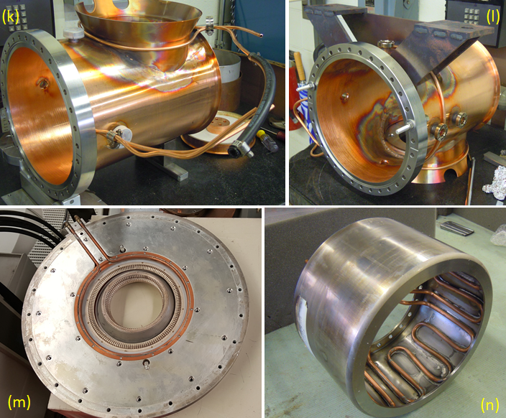
Cavity Parts
feet
Neck for PA welded
Garnet center conductor
Tube socket from Tevatron PA

Slide 25
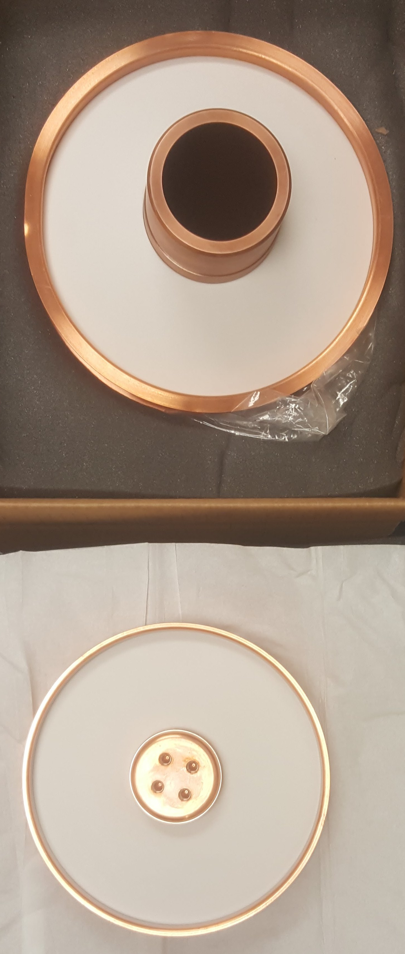
Windows
9.842”
7.48”
Conical tuner window
Flat PA window

Slide 26
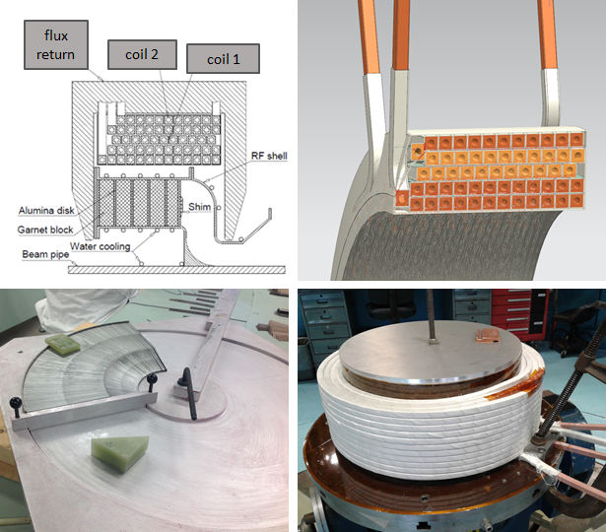
Solenoid

Slide 27
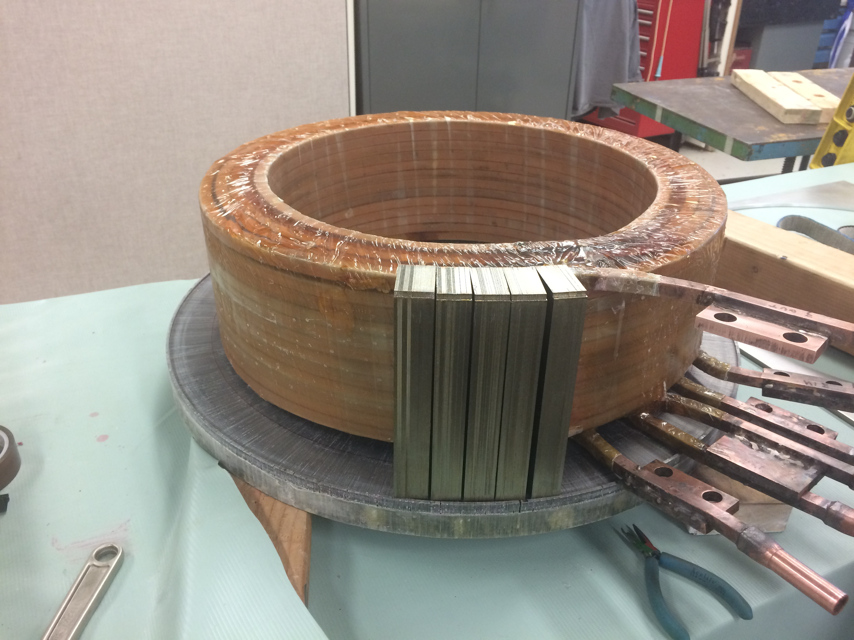
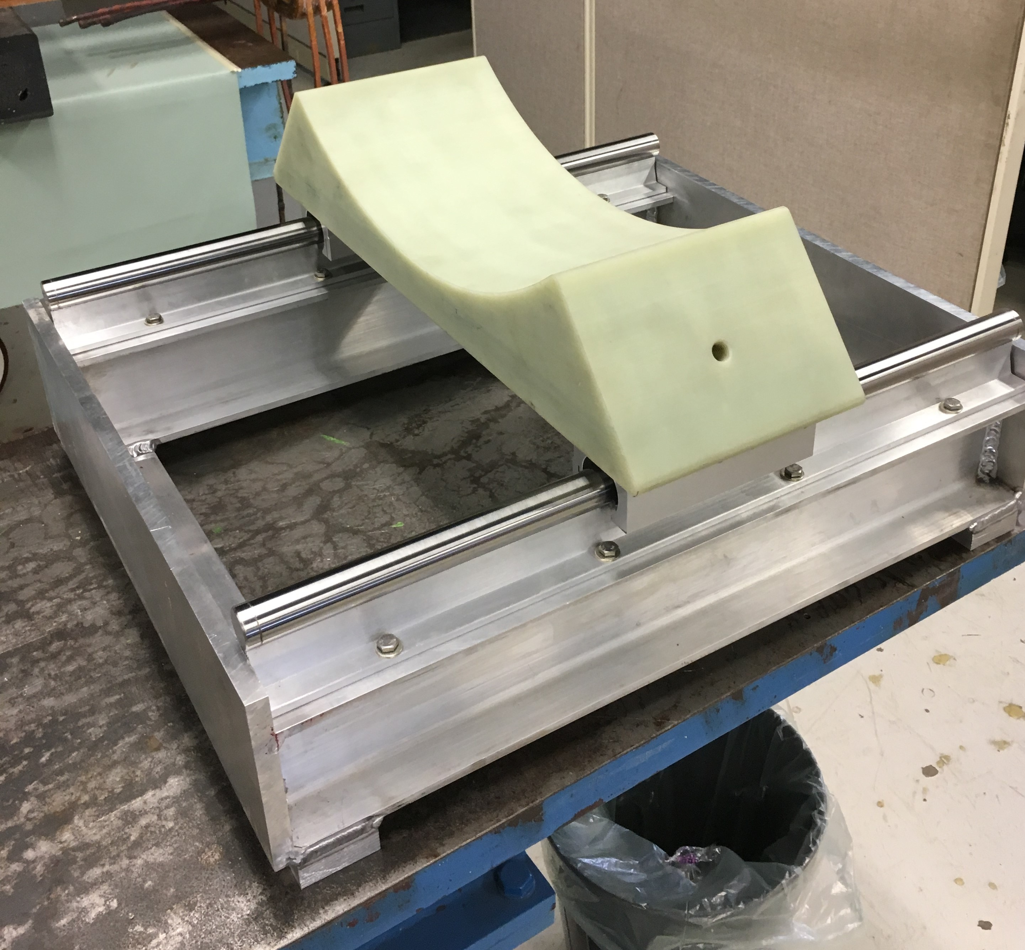
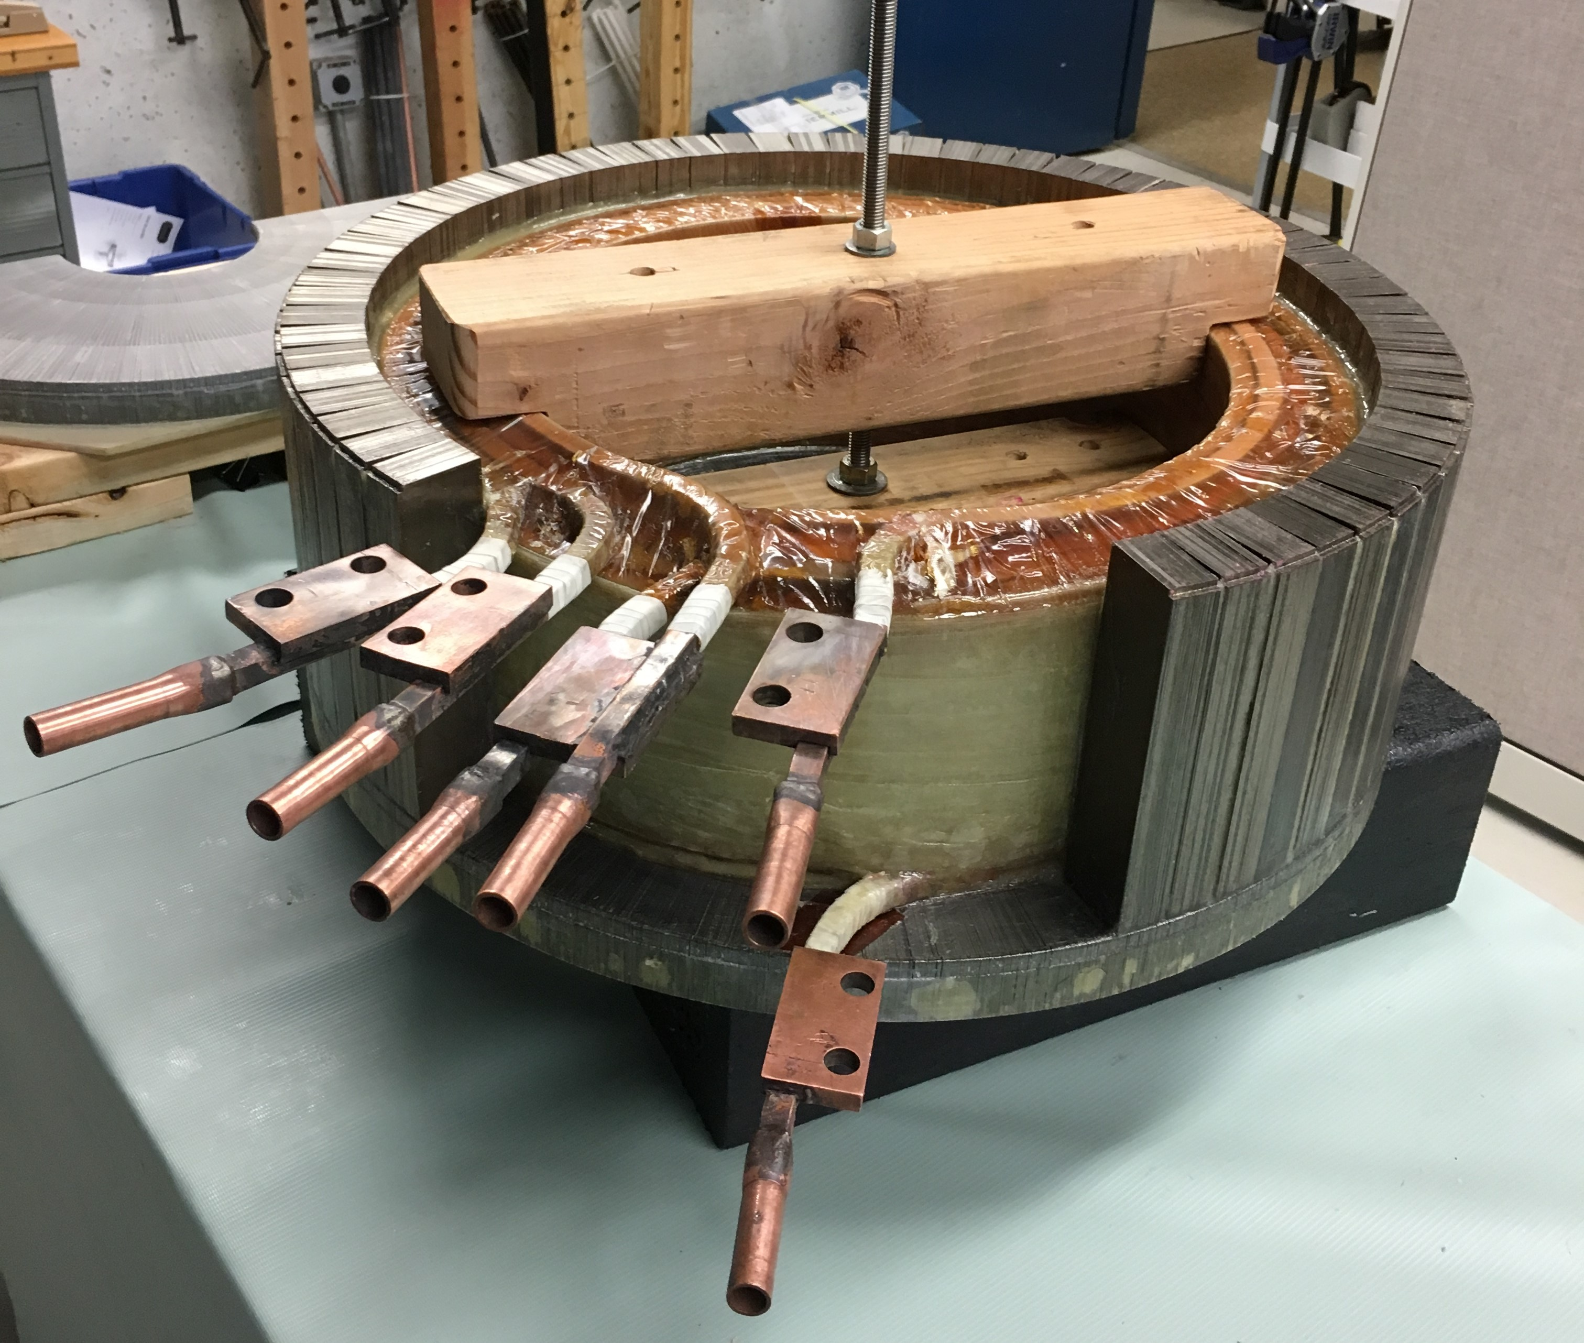
Solenoid

Slide 28
Status/Conclusions
Still need to do some welding, brazing, and Cu plating
Plan to install in summer shutdown
  Will high power test the cavity first
Initial operation will be only at injection due to lack of a powerful enough bias supply
A description of the work done so far may be found at: http://beamdocs.fnal.gov/AD-public/DocDB/ShowDocument?docid=6113
Questions?

Slide 29
Cavity Model
Length flange-to-flange:
844 mm
Aperature:
76 mm
P = V²/2 R_{sh}
76 MHz, R_{sh} = 96 kΩ
106 MHz: R_{sh} = 180 kΩ

