Slide 1
Proton Improvement Plan
Overview of Linac Upgrades
Fernanda G. Garcia
Fermilab Workshop on Megawatt Rings & IOTA/FAST Collaboration Meeting
7 May 2018

Slide 2


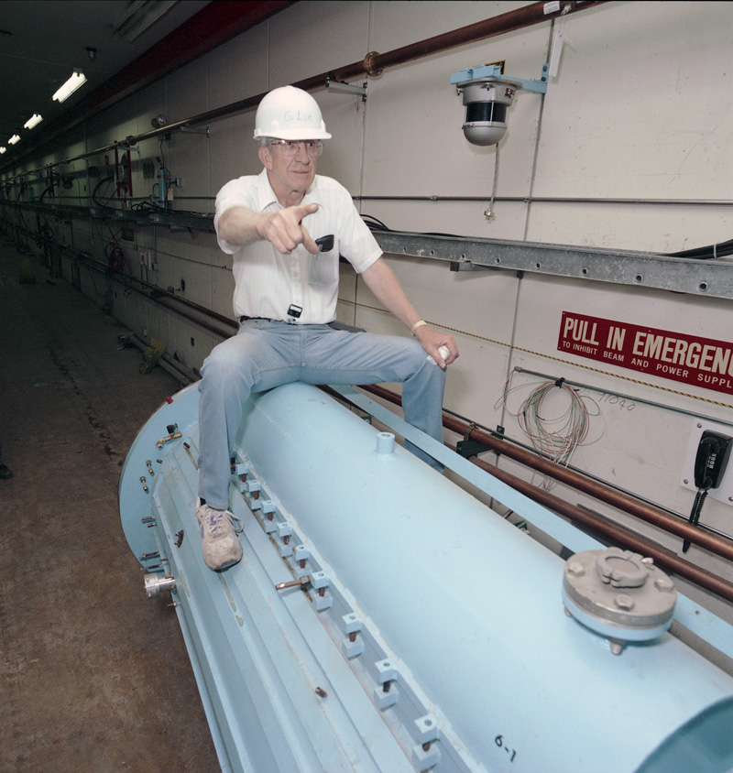
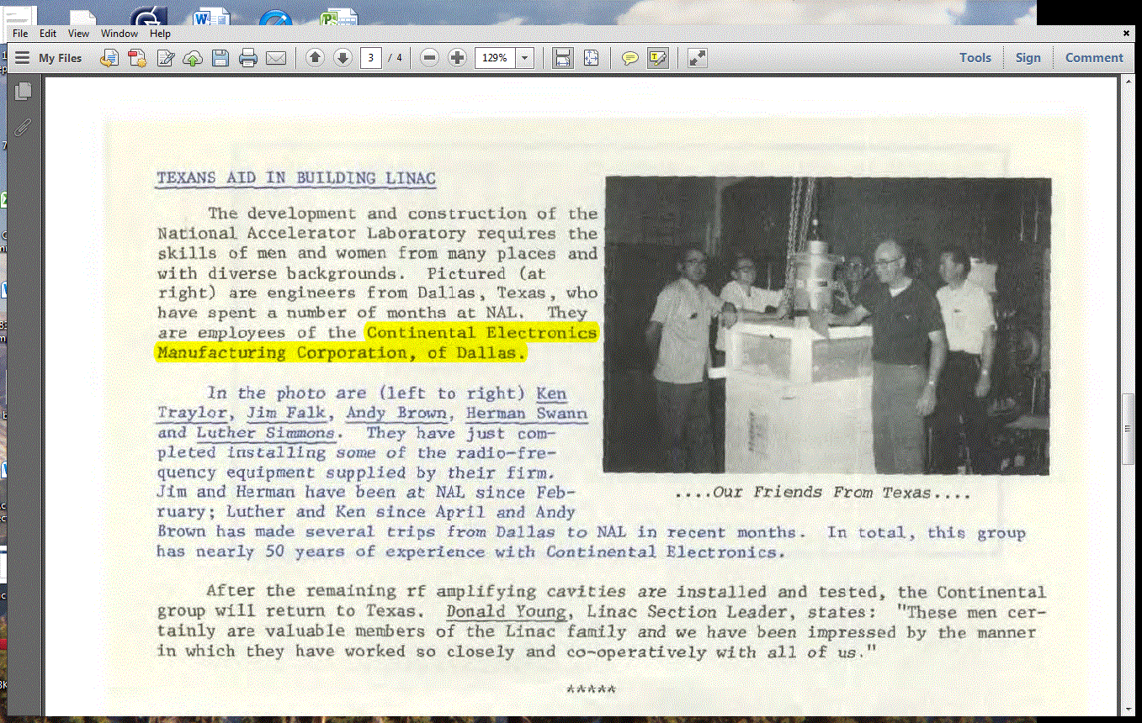
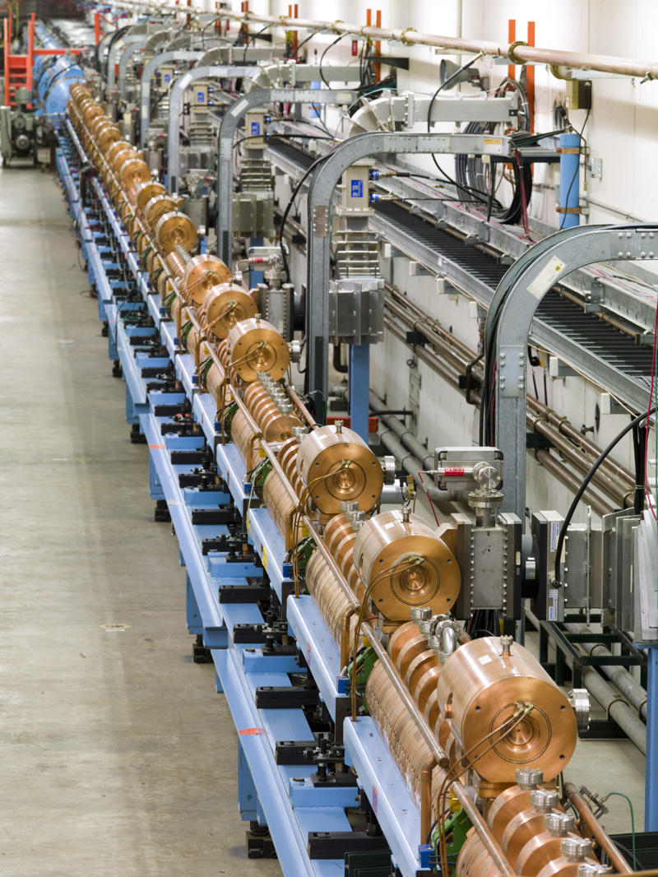
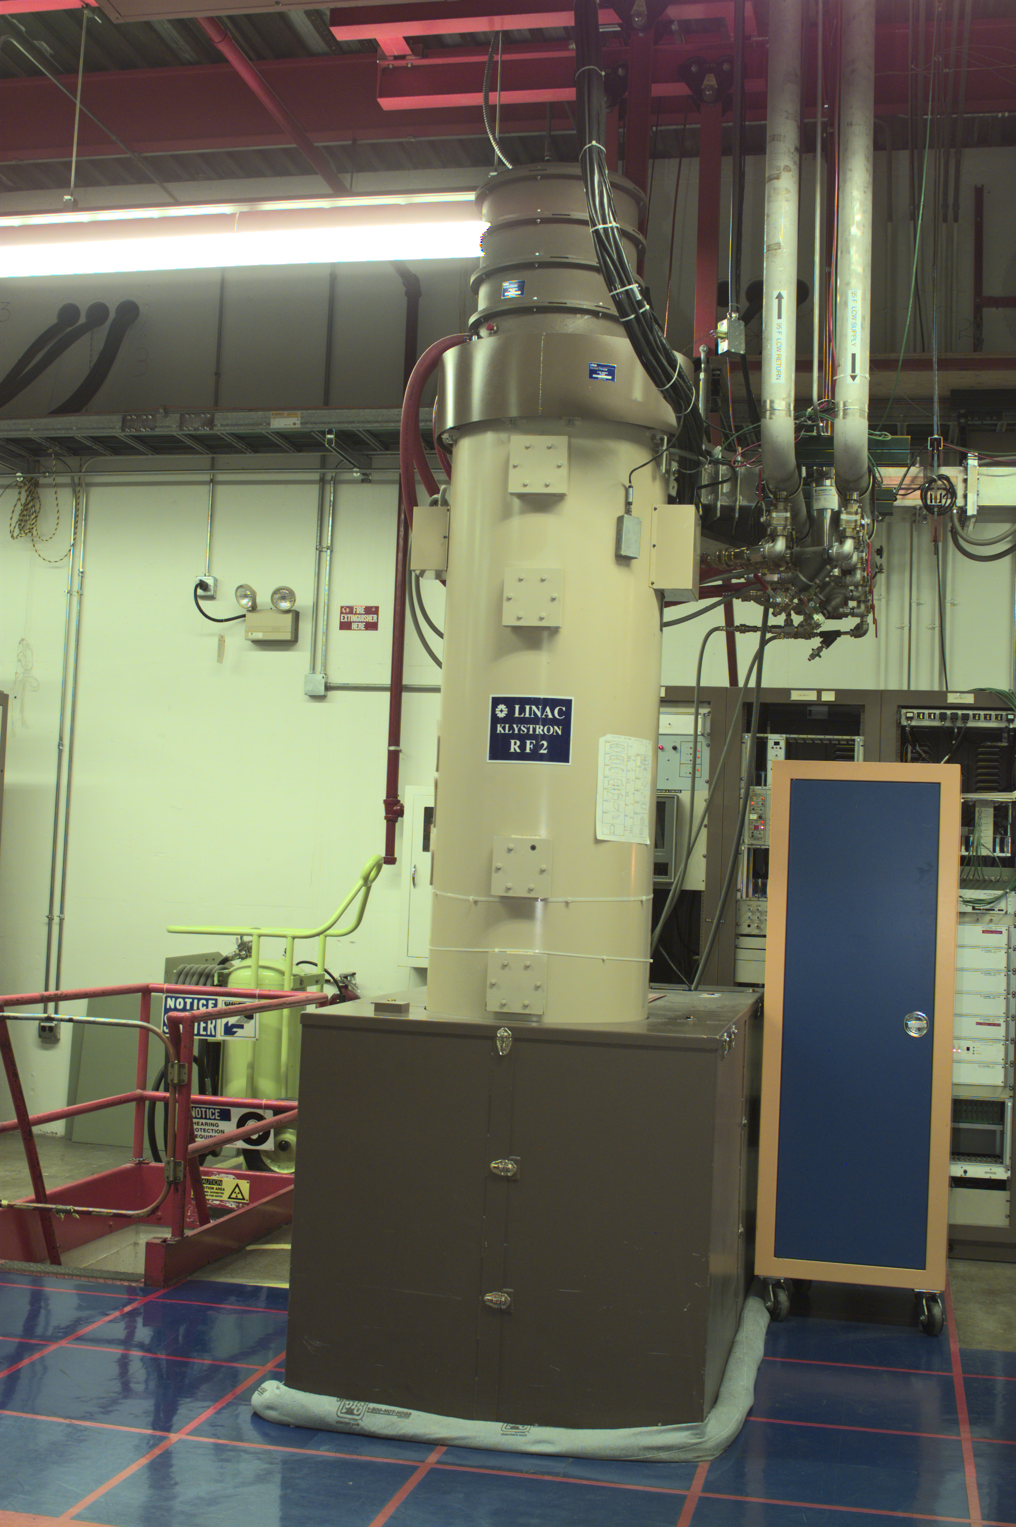
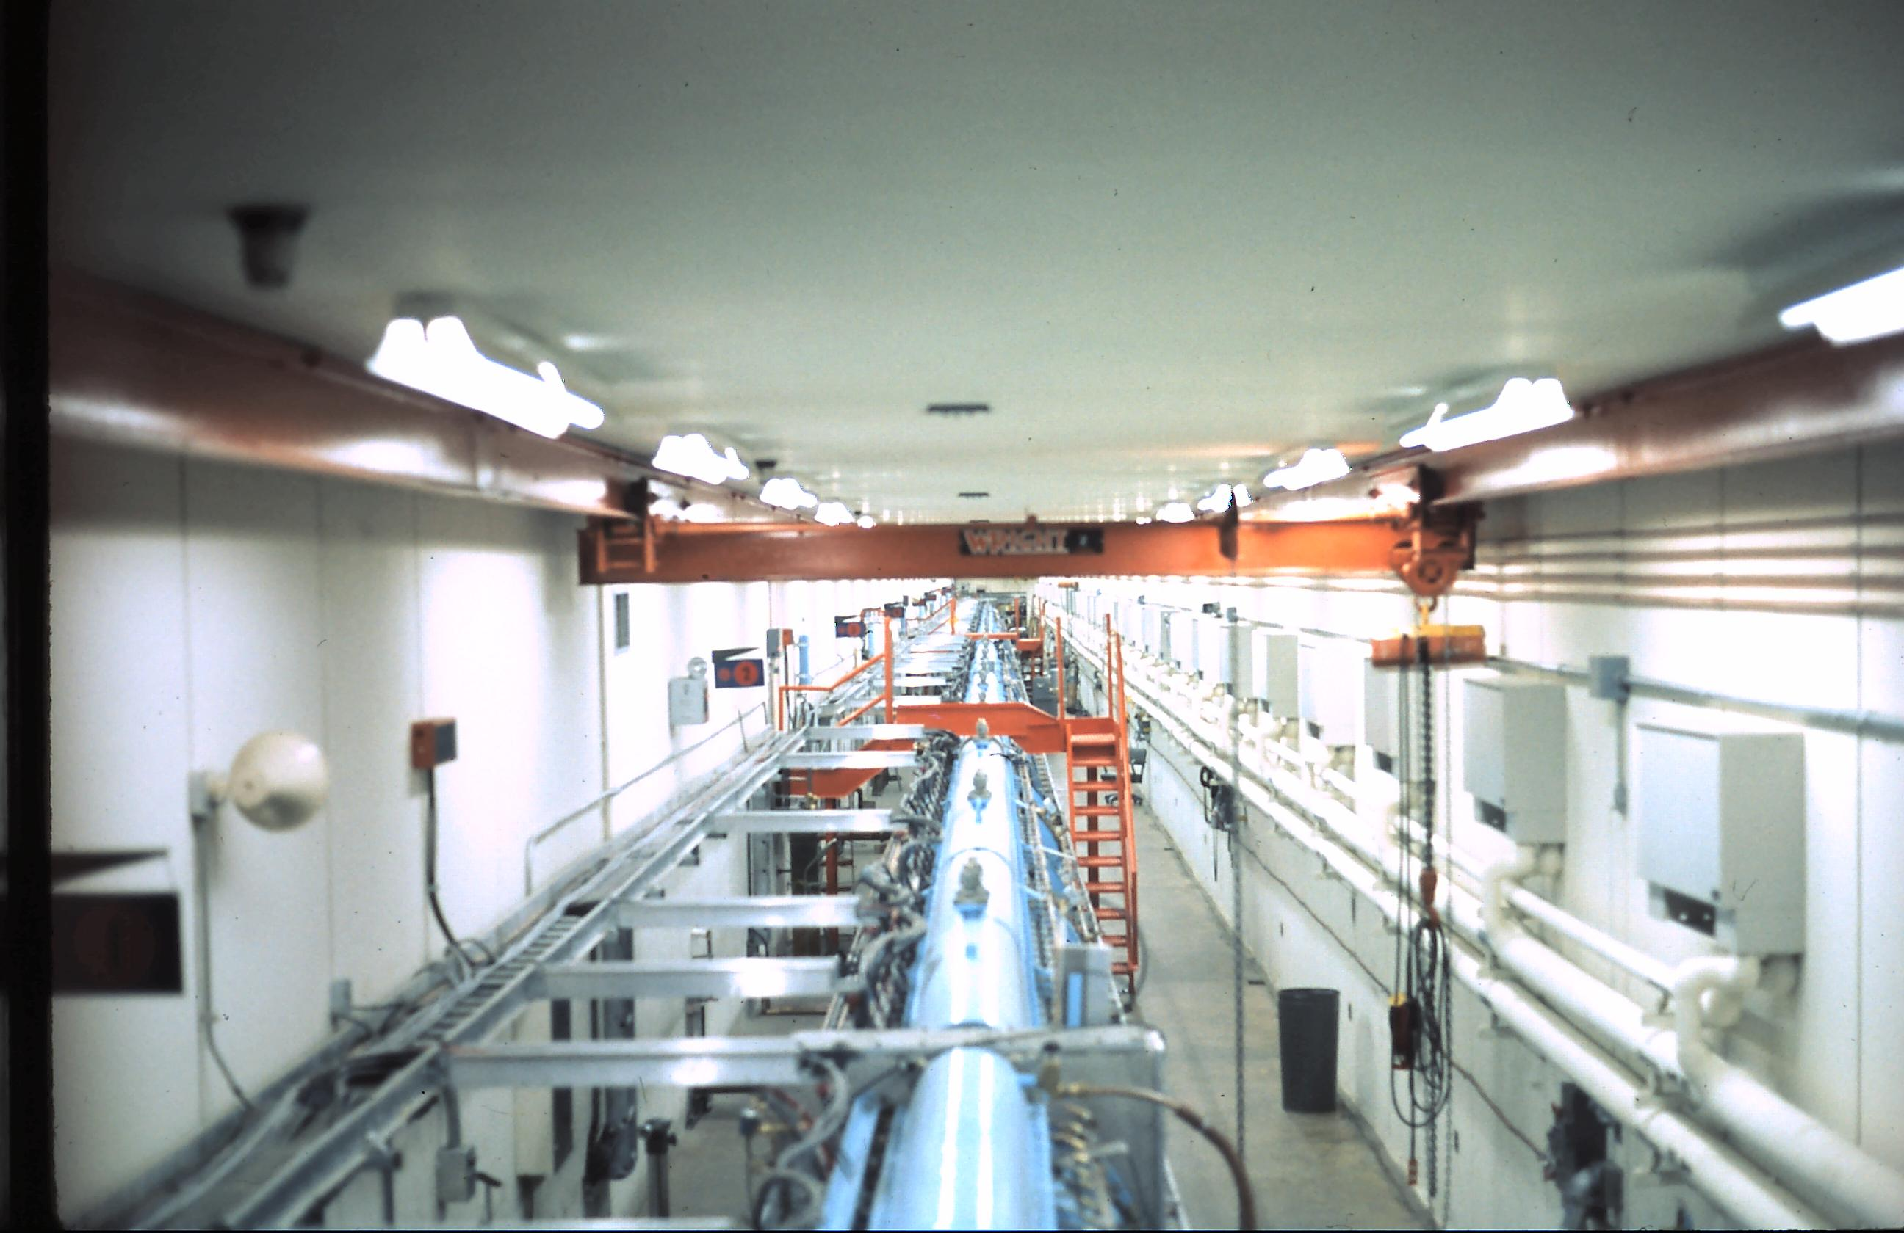
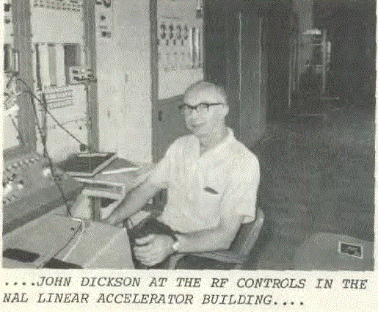
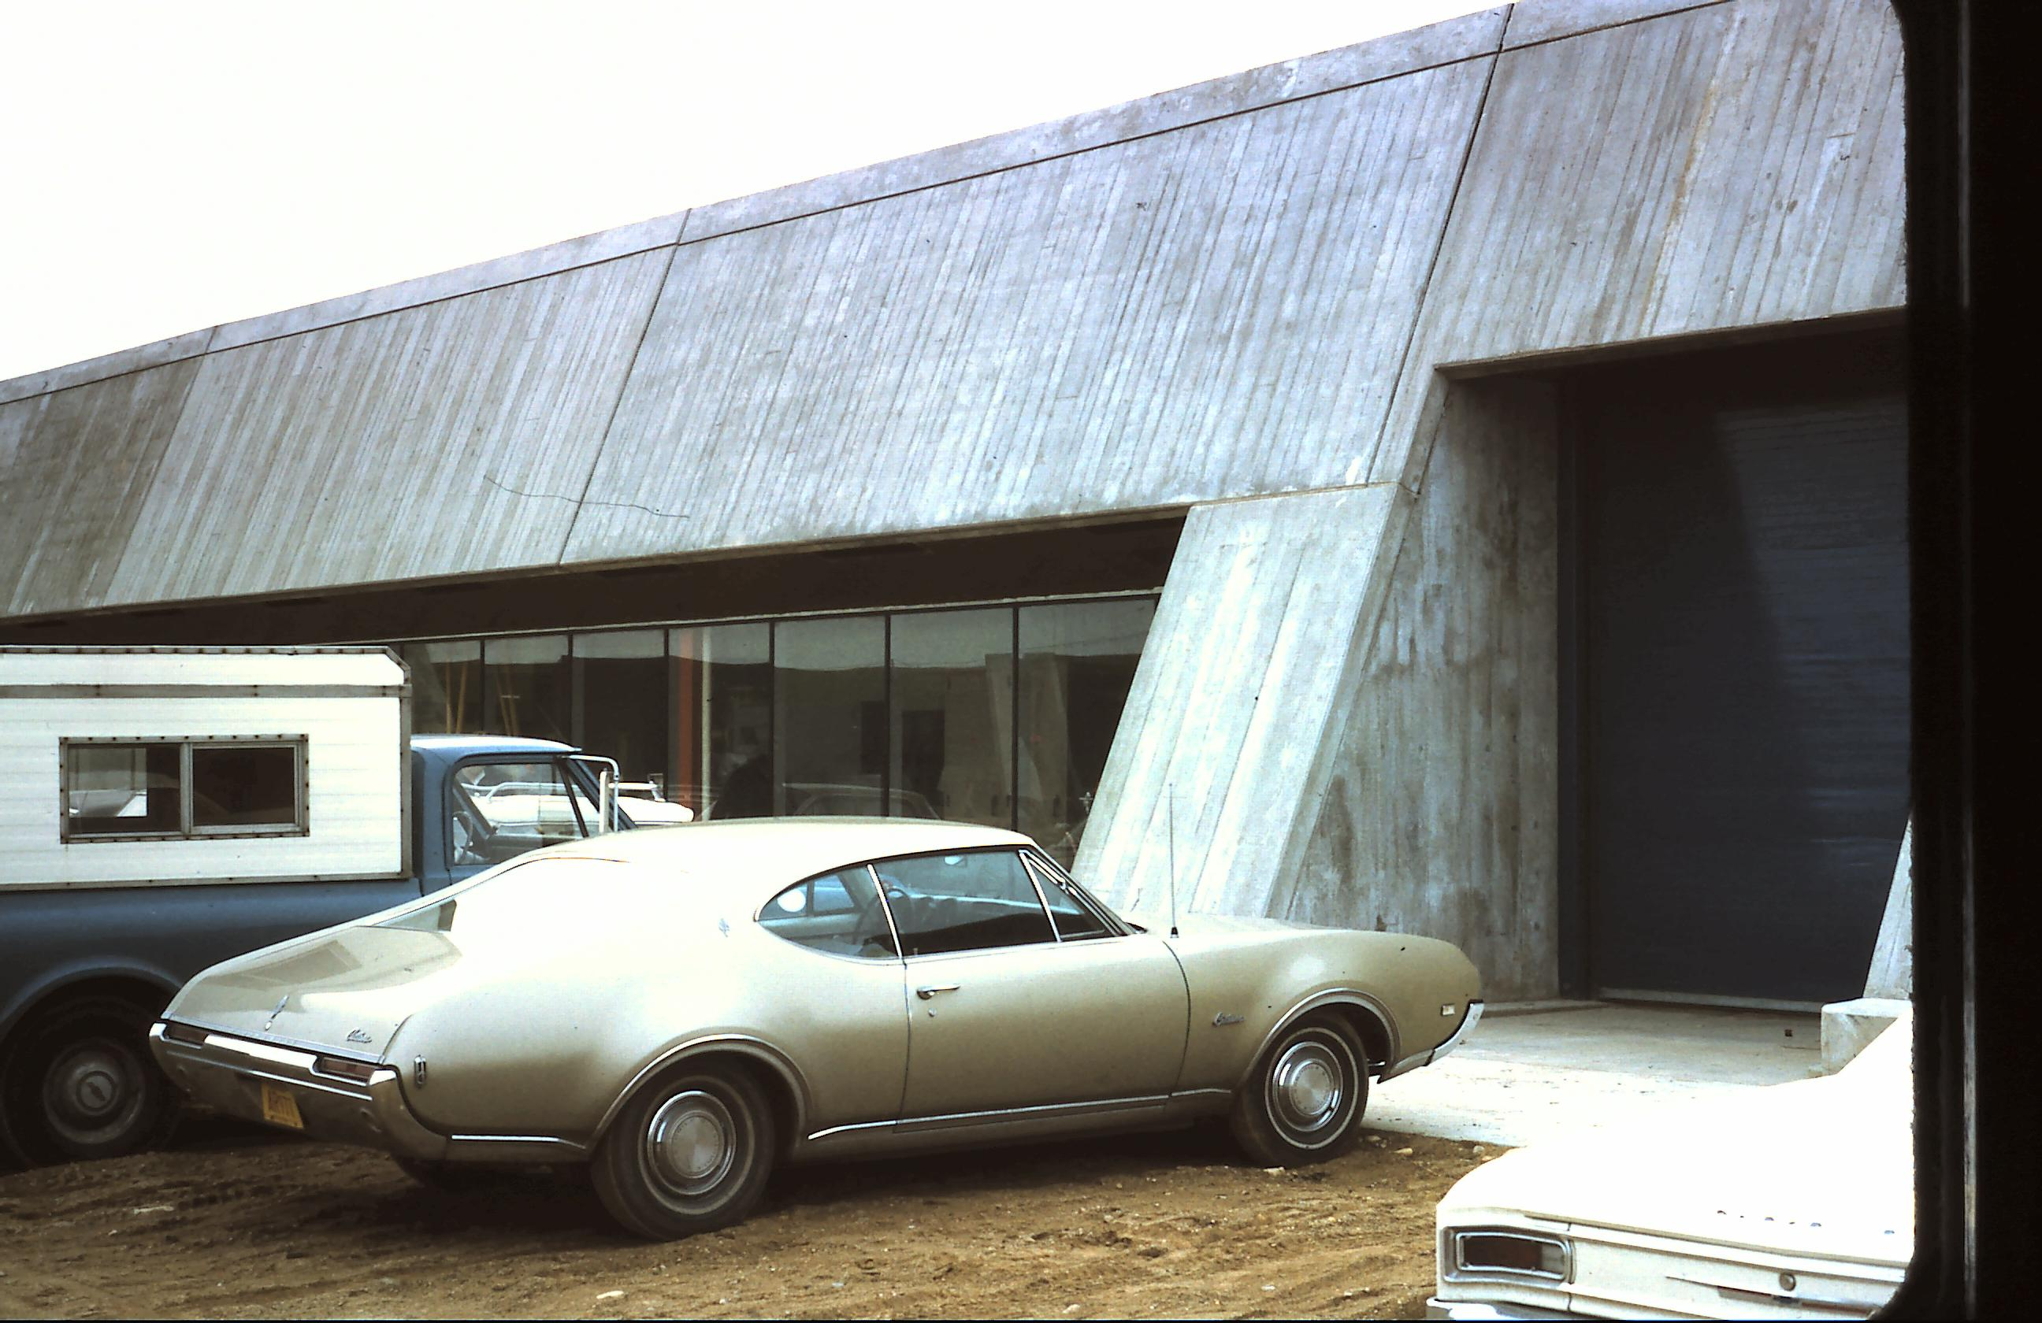
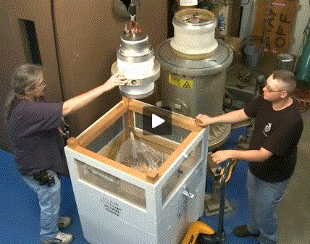
FNAL Linac Timeline
1960 1970 1990
Linac ground breaking
Dec 1968
Linac 200 MeV DTL
1970
Linac 400 MeV Upgrade
1993
Linac 1st NAL permanent building
Dec 1969
Linac RF equipment
installation & commissioning
April-Aug 1970
2000 2010 2020 2030

Slide 3
Outline
Introduction to FNAL/LINAC
LINAC within PIP
Highlights of each LINAC tasks
LINAC performance after PIP

Slide 4
FNAL Linac topology
35 keV
750 keV
750 keV
116 MeV
400 MeV
H-
RFQ
buncher
DTL
SCCL transition
SCCL
Magnetron ion
source
35 kV
extractor
Radio
Frequency
Quadrupole
201.25 MHz
1.2 m
1 tetrode
185 kW
Buncher
dual-gap
cavity
201.25 MHz
0.2 m
1 SSA
7 kW
Drift Tube
Linac
201.25 MHz
73 m
5 tanks
5 triodes
5 MW
200 EQM
Side-Coupled Cavity
Linac
805 MHz
4 m
2 modules
2 klystrons
200 kW
4 EMQ
Side-Coupled Cavity
Linac
805 MHz
65 m
7 modules
7 klystrons
12 MW
28 EMQ
Duty cycle:
0.5% RF
0.04% beam
3 different structures
(RFQ, DTL, SCCL)
2 frequencies
Total Linac: 145 m
5 triodes
9 klystrons
Beam current:
25 mA (avg. in pulse)

Slide 5
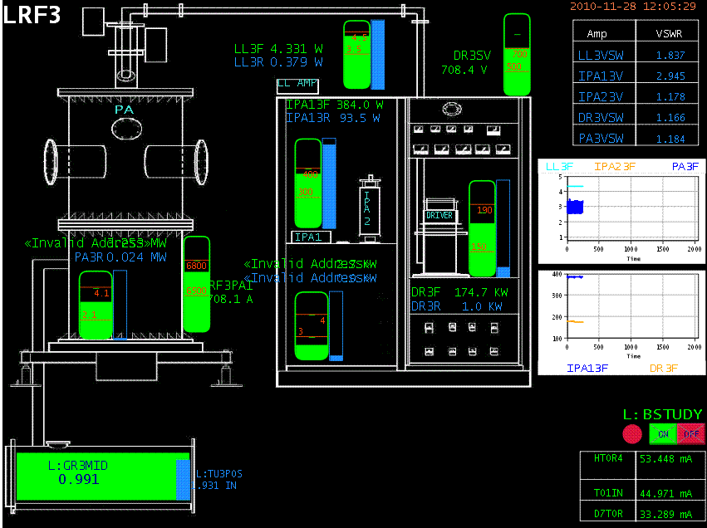

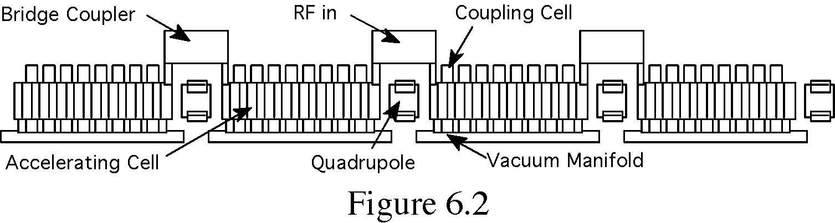
Introduction to Linac – DTL & SCC
DTL Section
5 cylindrical, electrical resonant, OFHC cavities,
  ~ two thirds of 200 DTs are located at the low-b region,
Each cavity is powered by a single 5MW PA @ 201.25 MHz
  ~ 1.5 MV/m with an average power 20 KW
Space between tanks are occupied either by beam valves, dipole trim packages or beam position monitors.
SCC Section
7 805 MHz SCL modules,
4 sections with 16 accelerating cells,
independent 12 MW Klystrons @ ~7.0 MV/m

Slide 6
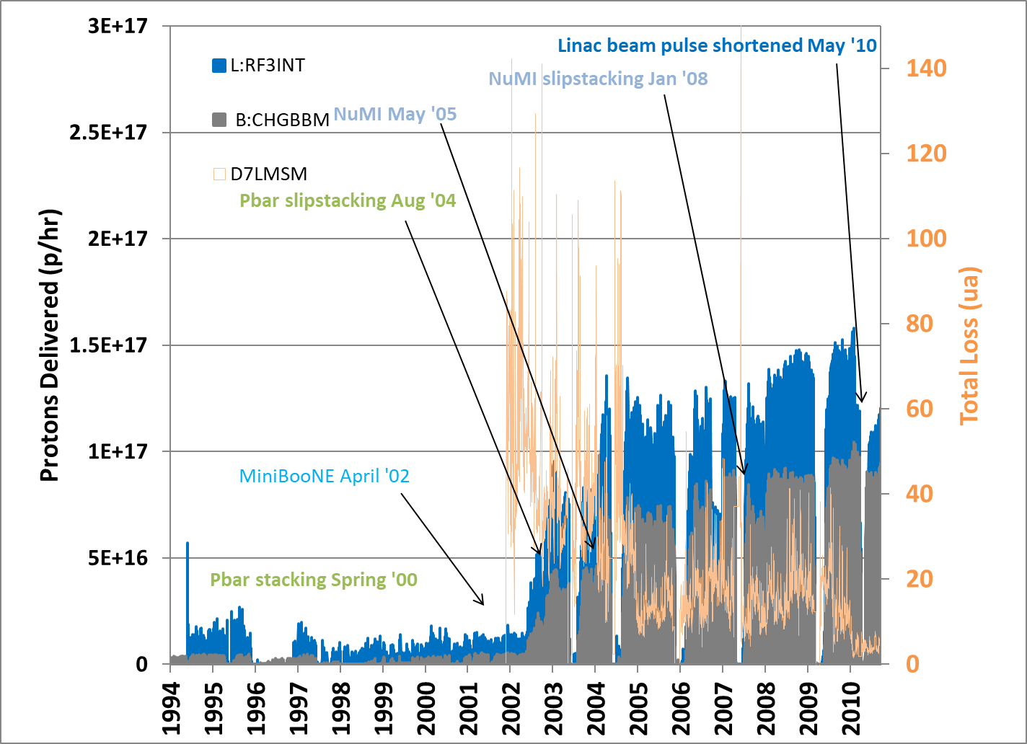
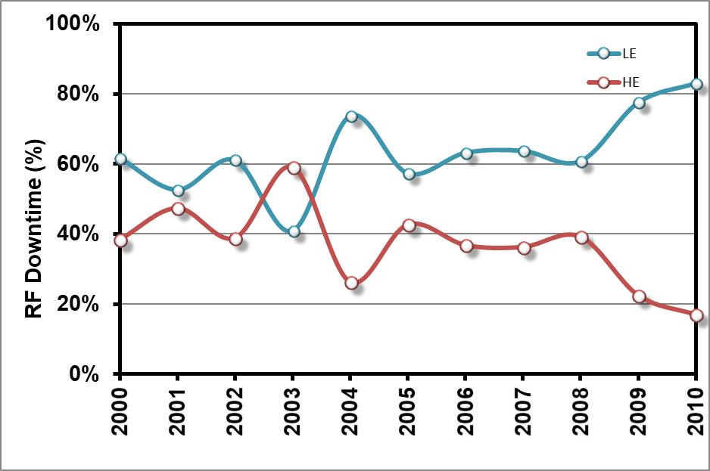
Beam throughput & Downtime - First decade of 2000’s
Prior PIP
Two 750 keV C-W injectors (I⁻/H⁻)
      80 msec beam pulse @ ~ 50 mA peak current
Accelerates beam upon request
      Normal op.: 34 mA macropulse average current
      HEP: 400 MeV, ~7.0 Hz, 22 μsec macropulse length
      NTF: 66 MeV, 15 Hz, 64.0 μsec macropulse length
      Linac Studies: 400 MeV up to 15 Hz, 20 μsec macropulse length
      MTA: variety of beam demands
Efficiency | ~ 75%
Linac Output | ~ 36.5 mA
HE losses | ~ 21.5 mV
Improvements - Proton Plan:
FY07 LE QPS control cards
FY08 LE LLRF upgrade
Downtime:
~ 60% 200 MHz system
~ 40% 805 MHz system

Slide 7
Significant Elements of the Linac Plan
Within PIP, the main concern for Linac is to preserve dependable operation
40+ years old 750-keV Cockroft-Walton generator and an ion source.
  Original 200MHz RF power plant system
    Modulator was a major source of downtime
      Original power supplies and various electrical components.
      Vacuum tube base technology, hard to maintain (point-to-point connections)
      Production of new SWTB (3/modulator) ceased ~10+ years ago
    Final Power Amplifier (FPA) supplied by a single vendor with limit market
  Original machine infrastructure (power distribution and vacuum components)
  Outdated and inadequate instrumentation along the machine
WBS 1.1.3
Instrumentation
WBS 1.1.2
Accelerator & Studies
NTF
201 MHz DTL
800 MHz SCC
RIL
Booster
E_{out} (MeV) 0.75 116 400
MTA
WBS 1.1.1
200 MHZ RF power system

Slide 8
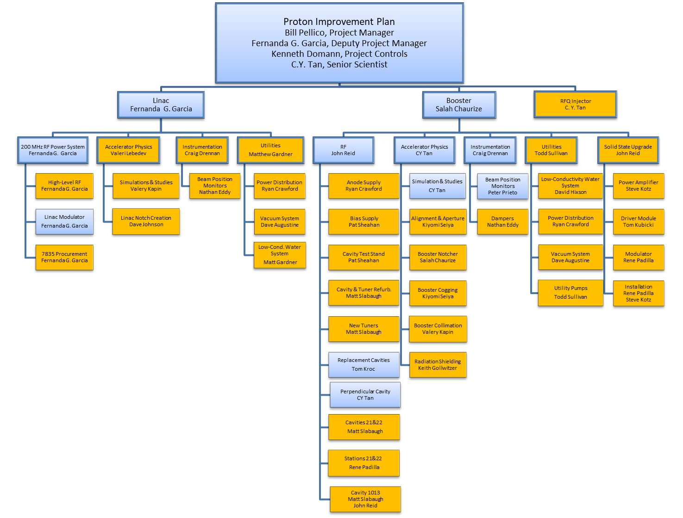
PIP Organization
3 L2 tasks
9 L3 tasks
35 L4 tasks
30% Linac
70% Booster
Ongoing
Complete

Slide 9
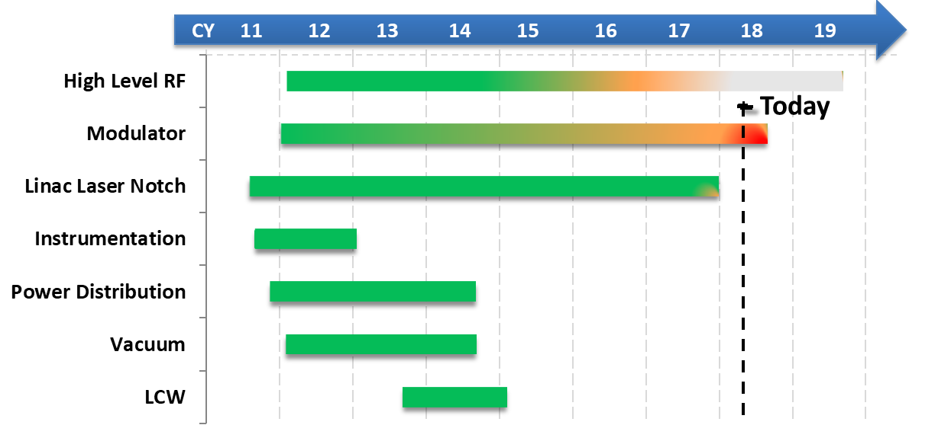
PIP – Linac tasks summary
Linac tasks

Slide 10
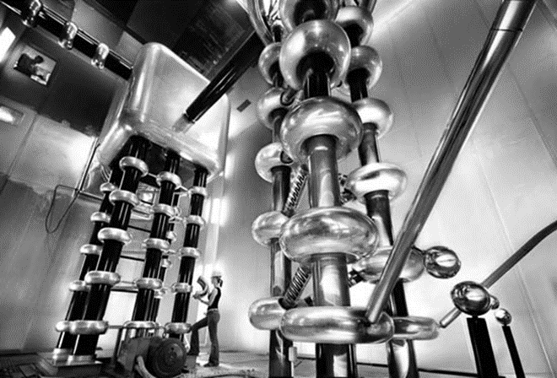
Injector

Slide 11
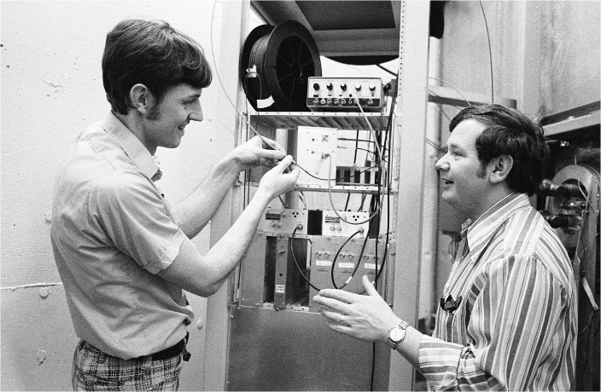
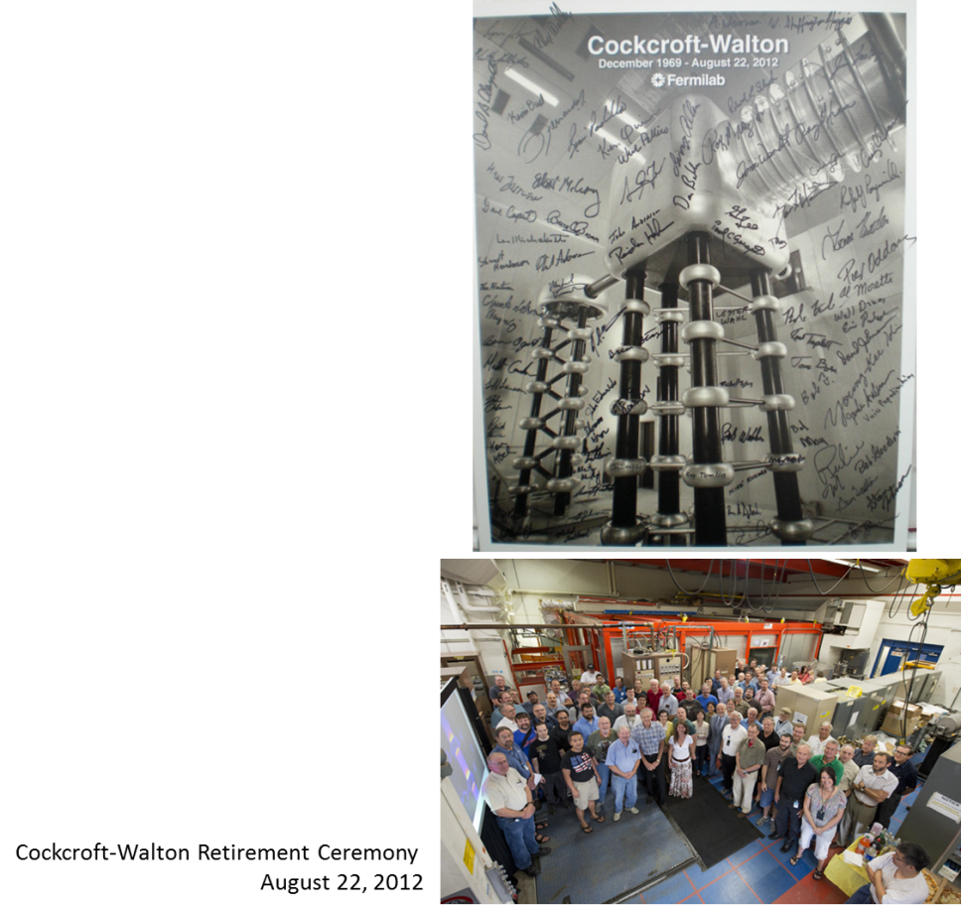
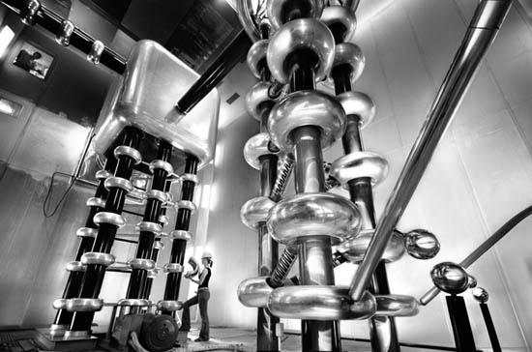

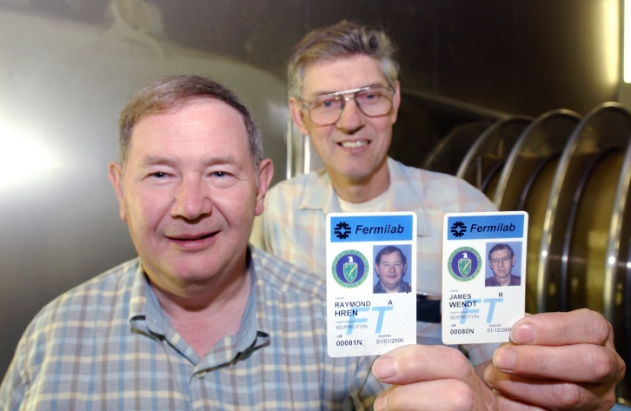
RFQ Injector Upgrade (1968-2012)
Jim and Ray (late 60’s)
Jim and Ray (2010)

Slide 12
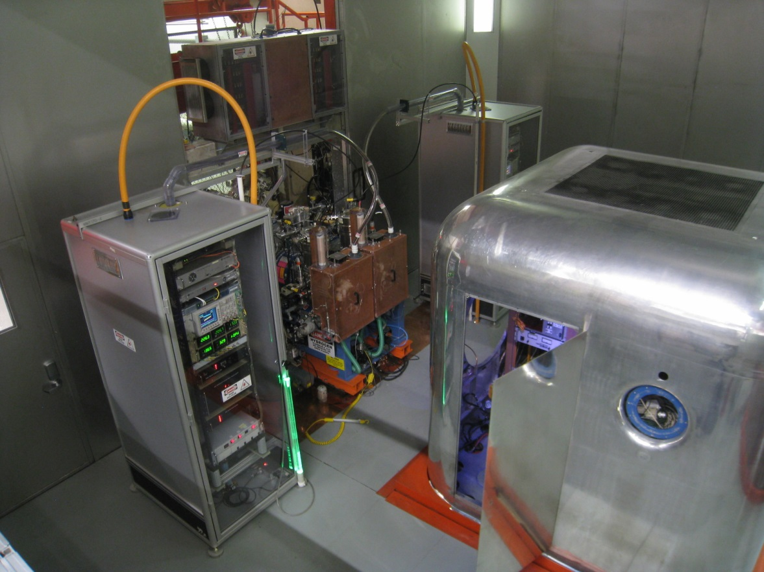
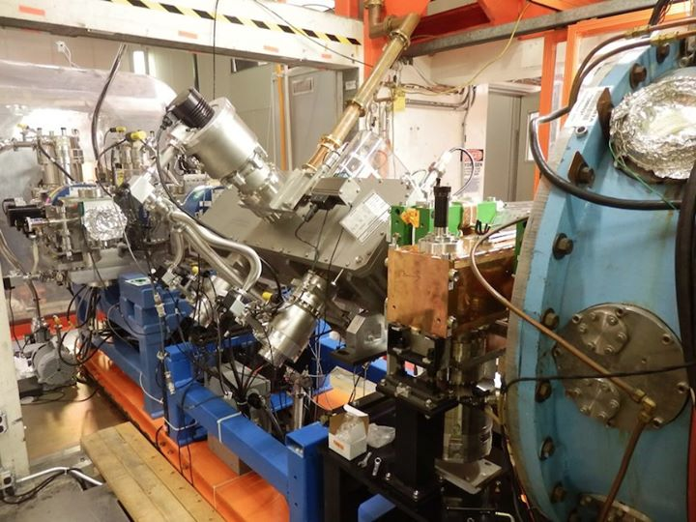
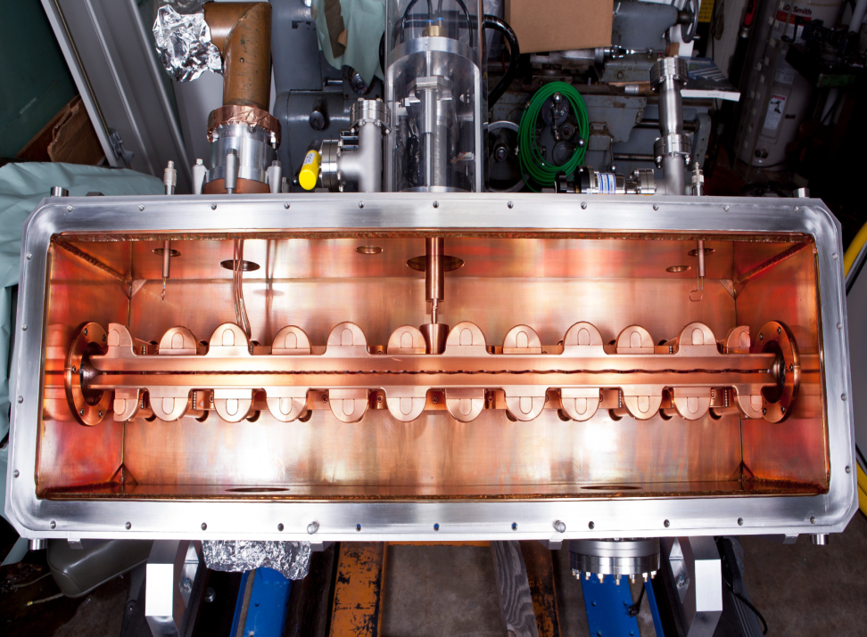
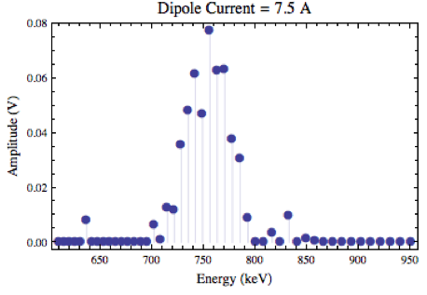
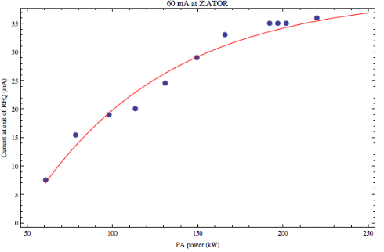
RFQ Injector (FY13)
2 sources
Upgrade started prior PIP and was incorporated after its establishment
Design based upon BNL injector
  LEBT
      2 solenoids to transport beam from the IS to the entrance of RFQ
  Einzel lens chopper
      Running at 30 kV
  200 MHz 750keV RFQ 4-rod
      Length 1.2 m, peak cav. power: 140 kW – Op. 185 kW
      Eff: 98% -- Op. 48%
  MEBT
      2 sets of doublets and buncher cavity
      Gate valve before DTL #1

Slide 13
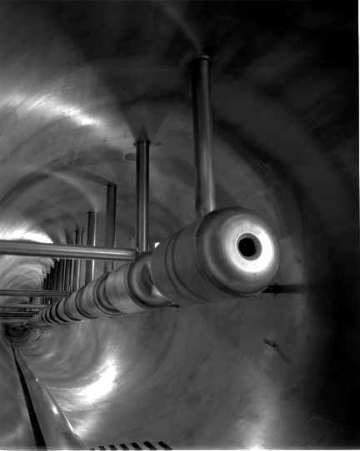
200 MHz RF system

Slide 14
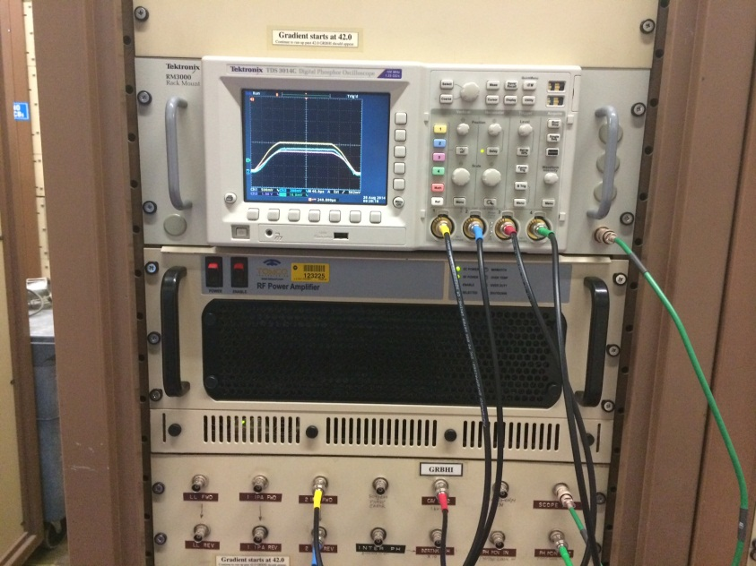
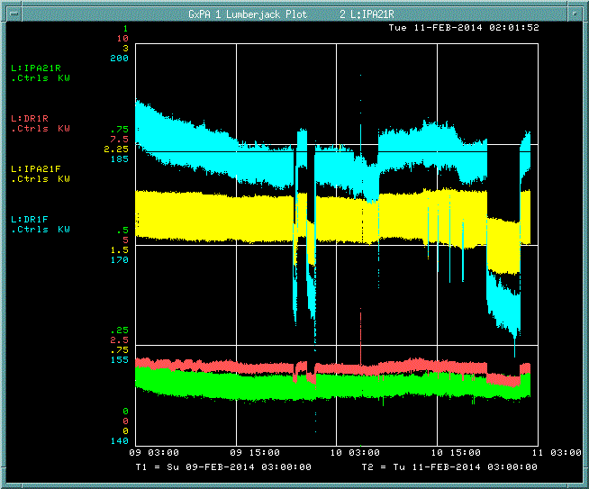
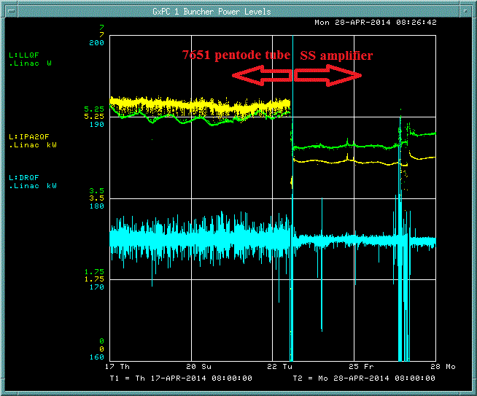
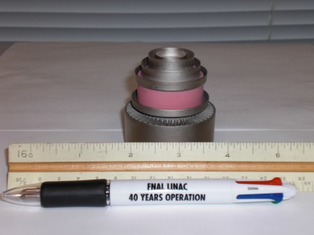
PIP – 200 MHz RF Power System
RF drive chain – consists of variety of solid state amplifiers,
pentode, tetrode and triode vacuum tubes
DTL system requires 75 tubes with 10 different types
68 9
Solid State Amplifier
Driver Fwd.
(kW)
7651
Fwd.
(kW)
200
3
185
2.25
170
1.5
155
0.75
140
0
Solid state amplifier – max. power 6kW, 60dB gain.
Significant improvement in power level stability.
Driver Fwd.
(kW)
7651
Fwd.
(kW)
200
7
180
5.25
170
3.5
160
1.75
150
0
PA 2nd stage required regular adjustment in order to maintain adequate power levels

Slide 15
PIP – Linac 200 MHz RF system: issues & risks
The 201.25 MHz RF power system has been a major concern for over a decade in regards long term operational reliability and viability
The issue of retaining the 201.25 MHz RF system is
  specialized maintenance required and extensive downtime generated by the hard tube modulator
    F1123 discontinued production for over 15 years
  short lifetime, high-cost & limited market of the final power amplifier
The risk of retaining the 201.25 MHz RF system is that
  power tubes could become unobtainable to support operations until 2023
  additional vacuum tubes could become obsolete in the modulator
    F1123 no longer being rebuilt -> years of operation ~ 6 years
PIP plan to address these issues is
  build-up 4 year in-house inventory of the 7835
  develop a workable plan to replace the final amplifier in case tube line production is discontinued
  replace the high voltage modulator with present day technology

Slide 16
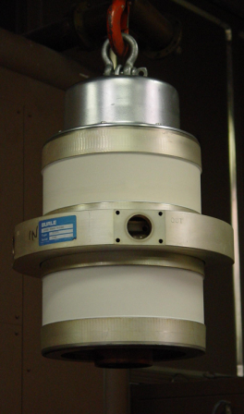
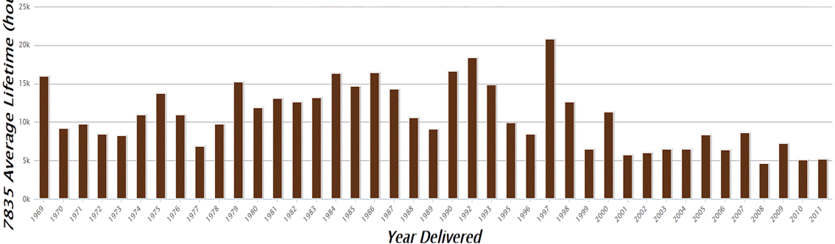
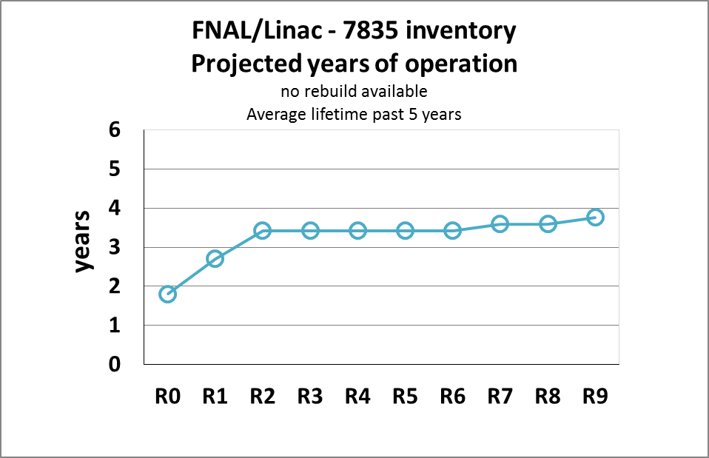
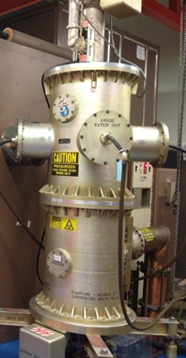
PIP – Linac 200 MHz RF system: FPA
201.25 MHz final power amplifier
  Single vendor: Photonis USA (former Burle)
  National laboratories are the only users (FNAL,BNL,LANL*)
  Typical delivery time: 200 days
  Operation needs: 5 tubes
  Lifetime: ~ 8-10 months
*LANL upgraded one tank to diacrode Jul/2014
12k -15k
7.5k
There is no RF conditioning at the vendor site
  Typical 15 days/tube for 2 techs
  6 tubes conditioned annually
  Time consuming effort
  (4-5 months)

Slide 17
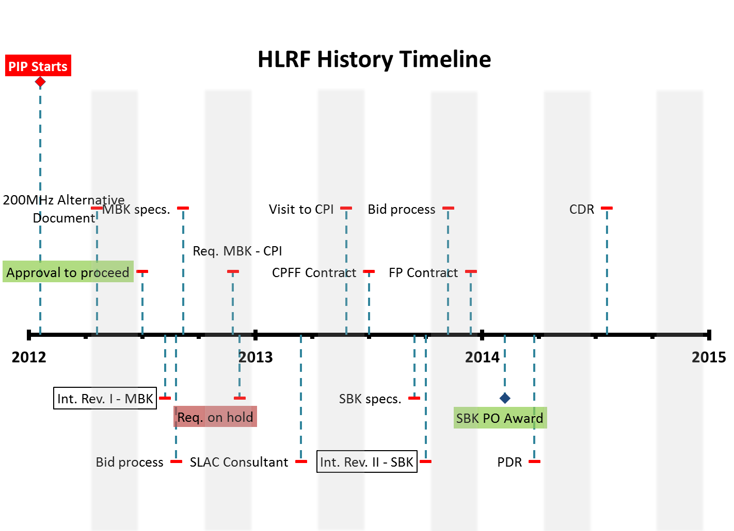
PIP – Linac 200 MHz RF system: HLRF
Study conducted in 2012 discussed alternatives to the triodes
  Tetrodes (LANL design)
  Klystron-based 200 MHz RF
  “SNS-like” 400 MHz Linac
  Decision took in consideration series of criteria evaluated against over the expected lifetime of the Linac
    Criteria: supply chain, technical risk, M&S/labor construction, upgrade time, maintenance cost and program interruption time
After careful consideration,
the 201.25MHz klystron-based
RF power system was chosen as
a plausible replacement for the
7835 triode
Funding issues followed by long contract negotiations contributed to a significant delay on the start-up of the prototype

Slide 18

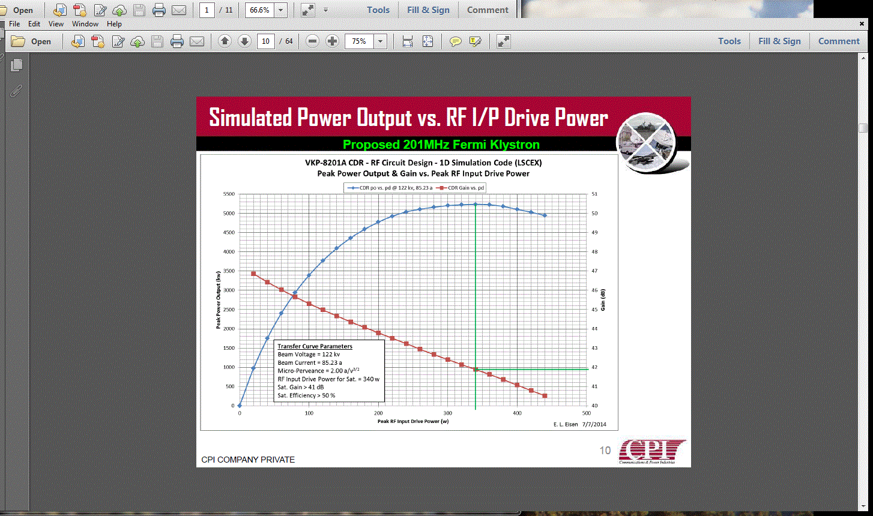
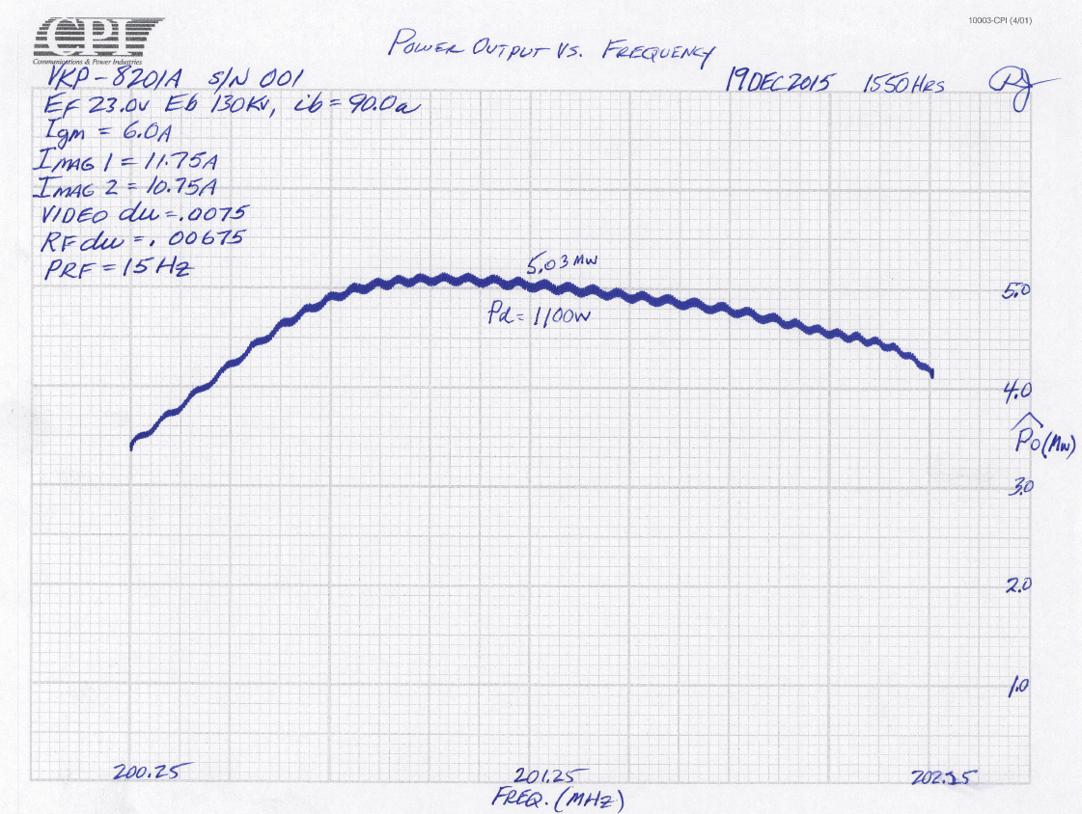
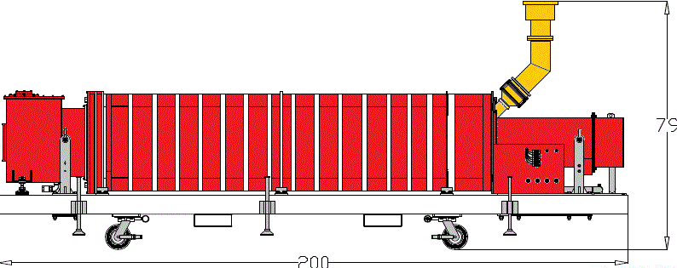
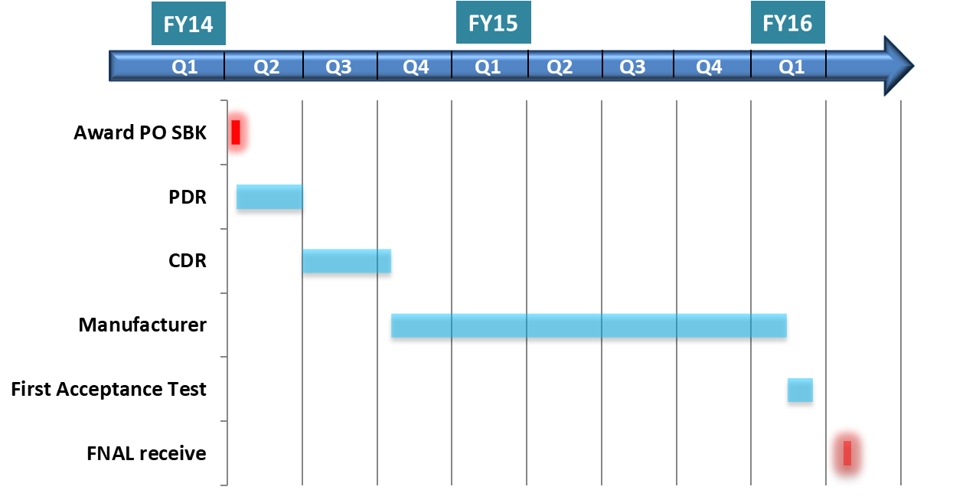
PIP – Linac 200 MHz RF system: HLRF (cont.)
DTL
f₀: 201.25 MHz
Saturated efficiency: > 48%
Perveance: 2.0 mA/V^{1.5}
PRF: 15 Hz
Pulse length: 450 msec
J_{cath} : 1 A/cm²
Expected lifetime :> 200 khrs
Courtesy:
5.5
2.0
0
51
45
40
Peak power (MW)
Gain (dB)
0 100 200 300 400 500
5 cavity RF
circuit design
Drive power P_{in}(W)
Gun
Collector
IC
OC
FNAL / SLAC collaboration
6’
16’
PIP to PIP-II adjustment:
task completes after successful acceptance-test

Slide 19
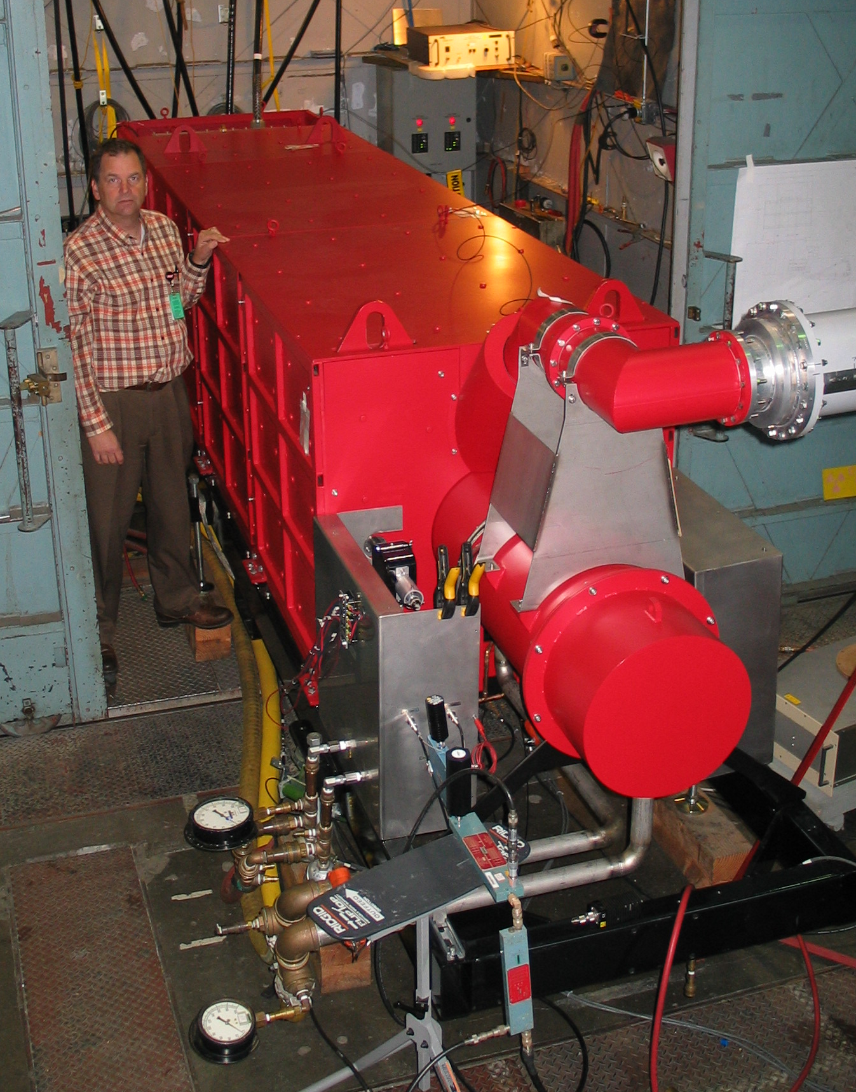
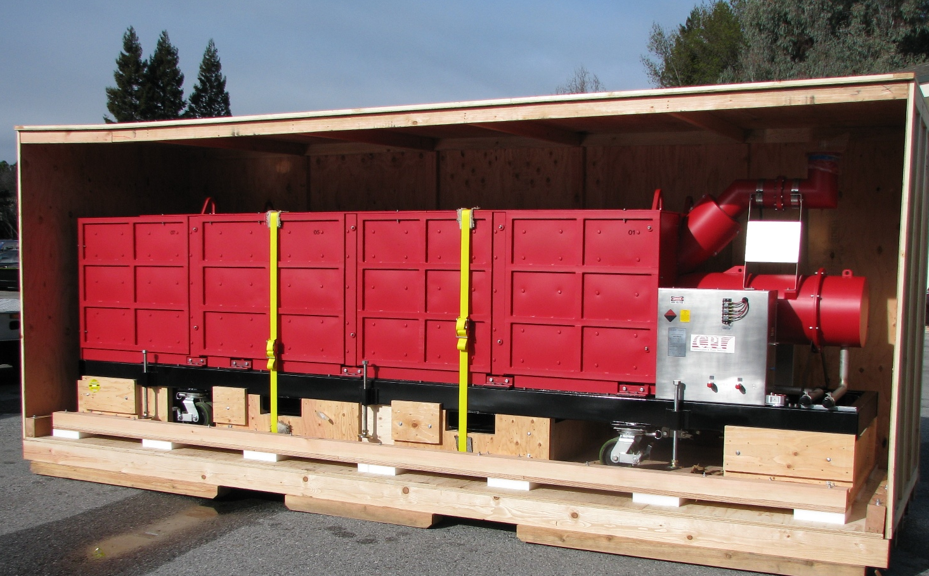
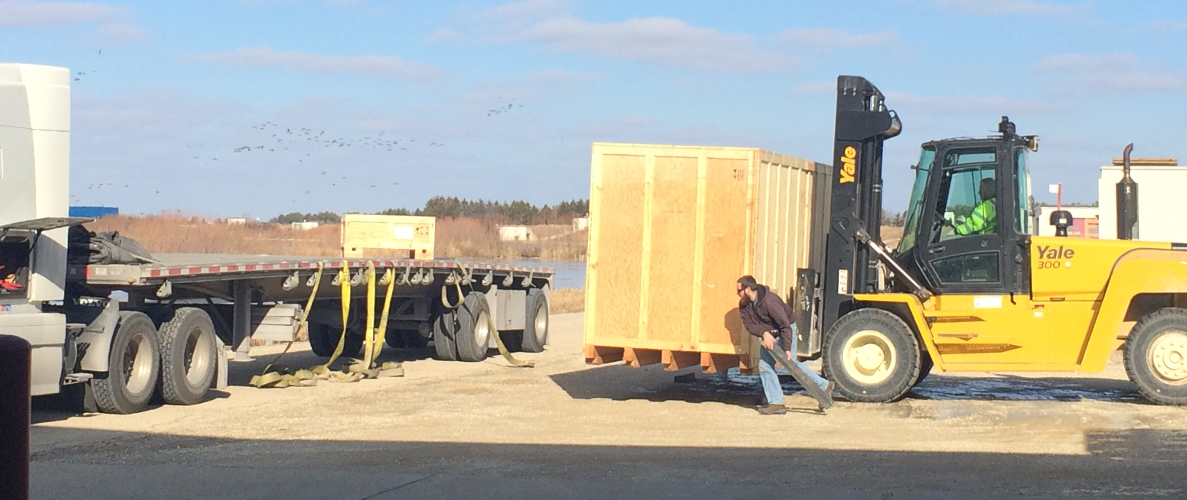
PIP 200 MHz RF Power Systems - Linac High Level
World’s lowest frequency klystron
  16 ft long, 5MW pulsed power
Power tests completed at CPI
  Power level achieved – 5.4 MW
Current at long-term storage on-site
Courtesy of CPI – Klystron being packed for shipment
Delivery at D0 MVA building

Slide 20
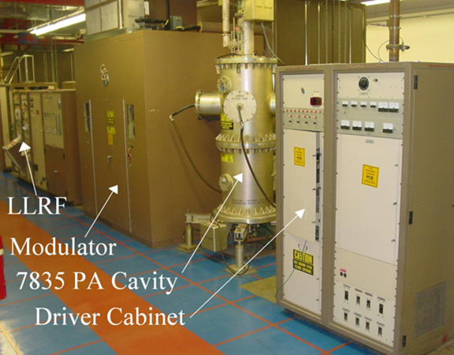
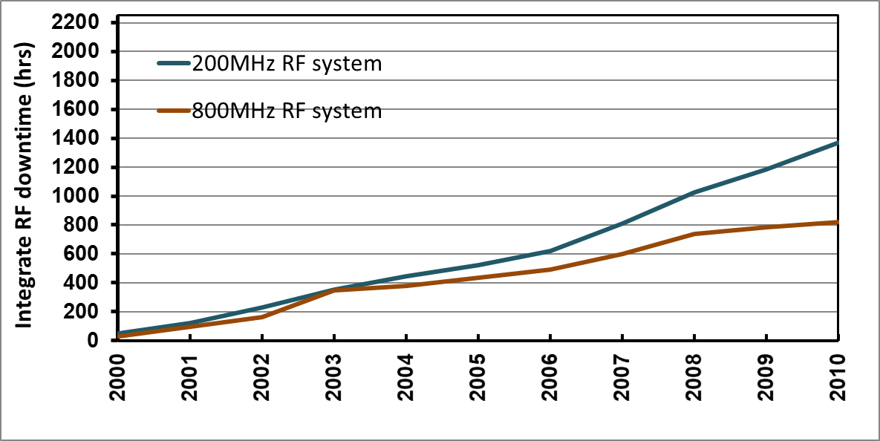
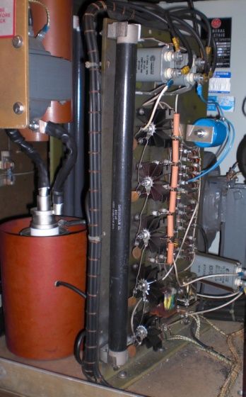
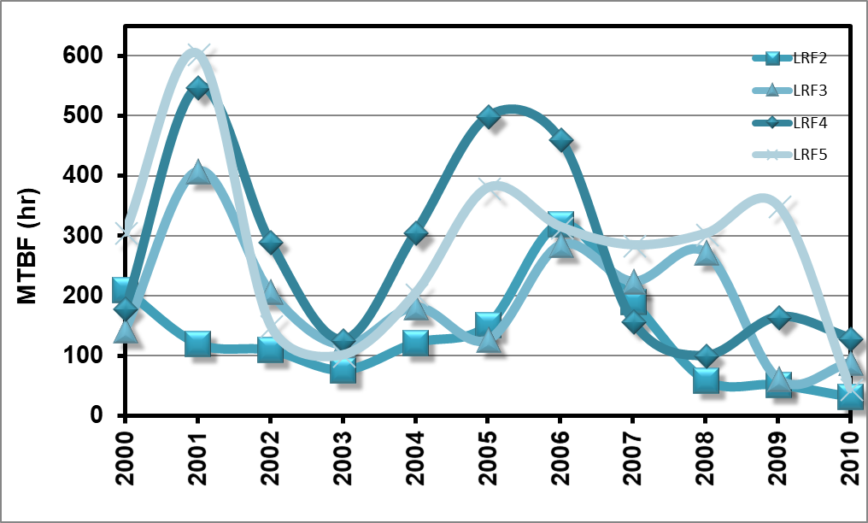
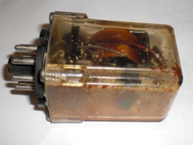
PIP – Linac 200 MHz RF system: Modulator
Modulator provide pulsed power to the plate of the 7835 triode
  Plate modulation to provide tank field control
30kV
350 A
10-35kV
100-350 A
0.6MW
3.5MW
60kV
35 amp
DC PS
Modulator
F1123
3 triodes
FPA 7835
plate
Modulator fraction of Linac 200 MHz downtime is ~ 40%
  Depending on the nature of the fault, each event may bring the system down from a few minutes up to tens of hours
  MTBF for all operation stations ~ 20 hrs
    DC power supply – built directly to the frame
    SWTB no longer manufactured
          Rely on rebuilds to operate
    Outdated relays & interlocks
    Minimal diagnostic capability

Slide 21
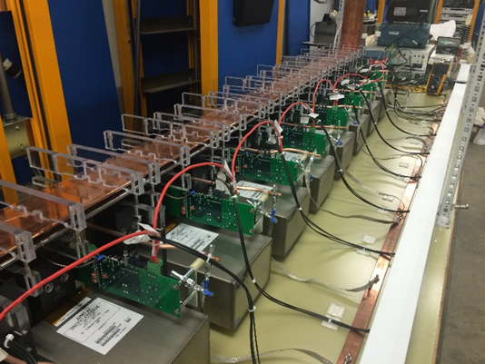
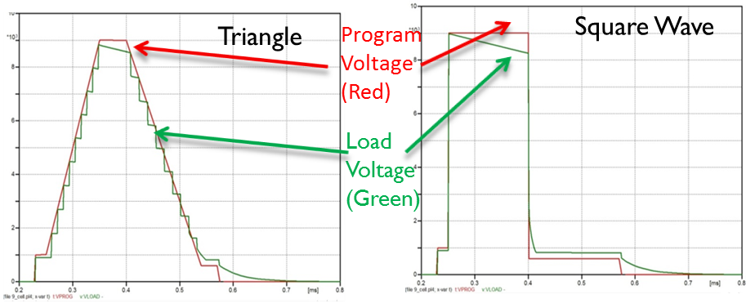
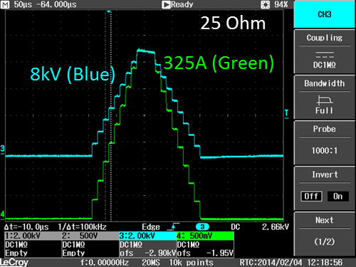
PIP – Linac 200 MHz RF system: Modulator
Modulator upgrade – 35 kV, Marx-topology modulator to drive triode
  Could also drive klystron with proper pulse transformer
SLAC “ILC-like” modulator (uses 3 kV cells)
  ILC Mark modulator (-120 kV/140Amp w/ 32 cells)
  modified ILC (35kV/350 Amp w/ 15 cells)
AD/EE designed using modulator specification
  designed with 1 kV cells, requiring 54 cells total
  built 9 cell modulator for testing (see pictures)
  built 25 cell modulator for further testing
  built full 54 modulator prototype – FY15
AD/EE design
best meets original specifications
lower cost than SLAC
in-house expertize

Slide 22
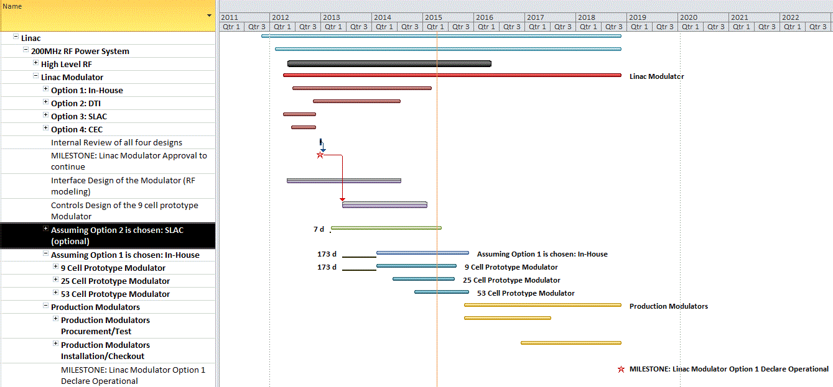
PIP – Linac 200 MHz RF system: Modulator timeline
Roll-up summary tasks
Modulator Upgrade complete FY18
Evaluating Options & selection
Technology chosen
Design develop.
RF modeling, controls architecture, interface,
Prototype
construction, testing
final design
Modulator Upgrade
production, testing
Installation – summer shutdowns
Assuming minimum
need for DFM

Slide 23

PIP – Linac 200 MHz RF system: Modulator Design
Marx Modulator Main Specs
35 kV max
375 amps max
1.5 kV rise/fall step max
± 5 kV beam tilt max
8 kV beam step max
5 J spark energy max
54 Cell Marx Modulator Design
Each cell 950 V & 639 uF
Charged parallel & discharged in series
42 Cell Marx-type, Switching stages
Sequentially step on cells to create rising, overshooting, & falling waveforms
Produce fast beam pulse rise/fall
Held constant during flattop
12 Cell Marx-type, Regulating stages
Compensate for capacitor droop
Provide necessary beam top tilt
Waveform shaped with pulse width modulation & smoothed with low pass filter
Beam Step
Regulating Cells
Switching Cells

Slide 24




PIP – Linac 200 MHz RF system: Modulator Results
Marx Modulator Regulation
Cells fired via fiber optic pulses
Individually control each cell via FPGA
Feedforward control algorithm
Slow start feature during turn-on
User programable gradient waveform reduces reverse power on rising/falling edges
Pulse-to-pulse learning algorithm
Direct real-time feedback
$±$ 0.4%
$±$ 0.2%
Tube Mod.=0.1%
Marx=0.04%
LRF2
Marx Modulator Performance
Increased gradient flatness by factor of 2
Increased slew rate by factor of 5
Achieved < 0.1% pulse to pulse gradient stability standard deviation with learning & feedback
Improved power efficiency & uptime
Tube Mod.=0.1%
Marx=0.03%
LRF3

Slide 25



PIP – Linac 200 MHz RF system: Modulator
Old Modulator
New Marx Modulator
Advantages of a Solid State Modulator
Eliminate problem of discontinued switch tubes
Lower power consumption of new design
Elimination of HV rectifier, transformer, capacitor bank & mercury crowbar circuit
Increased uptime due to solid state design
Lower cost to fix & maintain modulators

Slide 26

Accelerator Physics

Slide 27




PIP – Accelerator Physics: Linac Laser Notch
see presentation by D. Johnson
Booster beam requires a notch to allow for the rise time of extraction kicker
  40-50 ns notch
Notch is created by kicking the beam
@ 2 different cycle times
  400 & 700 MeV
PIP phase approach
  Phase I: notch relocation & new absorber
Booster
  Phase II: kicker magnets & power system replacement
  Phase III: create notch in Linac
Laser profile
200 MHz pulses
450 kHz “notch” spacing

Slide 28




PIP – Accelerator Physics: Linac Lattice
PIP goals was to develop for the first time a start-to-end model of Linac lattice
LEBT+RFQ+MEBT+DTL+SCC+TL
  Revision of existing DTL lattice
    Extensive literature research to document
      Review publications for NAL-Linac creation
      Linac instrumentation list and locations
      DTL & SCC specifications
  Codes used: TRACK, Parmila, TraceWin
DLT1
DLT2
DLT3
DLT4
DLT5
Excitation currents near limits

Slide 29

utilities /
infrastructure

Slide 30





PIP Linac Utilities: Power Distribution (FY12-FY14)
Original L1 sub-station
  L1 transformer fully installed
    13.8kV to 480Y/277V
    Better heat loss (80C vs 115C)
    Low voltage breakers, trip control and instr.
  What became of the removed equipment?
    Transformer kept as spare for Linac
      additional 2 other old-style transformers in use
    Breakers & primary switch will be rebuilt and tested (spares)
July’14
Sept 17 ‘14
Sept 24 ‘14

Slide 31





PIP – Linac Utilities: Vacuum (FY12-FY14)
Vacuum system composed of roughing stations, ion pumps, turbo pumps evacuate the accelerator to an average pressure of 6x10⁻⁸ torr
  DTL ~ O(10⁻⁸) torr
  SCC ~ O(10⁻⁹) torr
Upgrade DTL roughing station
  Modern instrumentation and controls
Upgrade original turbo pumps
    Original pumps in service since day-one
          Belt driven / oil reservoir
        Heavy, big, replacement parts no longer available
      New pumps are sealed clean bearings, compact, high speed, freq. drive control
DTL roughing station
Oct ‘12

Slide 32



PIP – Linac Utilities: LCW (FY13-FY15)
Dual Temp System
  Problem: Aug’12 a major water leak developed in the klystron gallery
    ~ 2,000 gallons H₂O lost
    measured capital loss
  Risk: Measurements of pipe wall thickness revealed several other similar spots to this eruption
  Plan: replace cooling provided by EOL DTW piping and fan coil units to a rooftop AC unit
Klystron Gallery - Aug’12
55 LCW cooling system (CUB)
  Problem: inexistent backup system & spare pump for the DTL cooling system
  Risk: potential to halt operation indefinitely if pump fails unexpected
  Plan: funding the repair of the spare pump and setup 2nd system

Slide 33
Beam throughput & Downtime - First decade of 2000’s
Prior PIP
Two 750 keV C-W injectors (I⁻/H⁻)
      80 msec beam pulse @ ~ 50 mA peak current
Accelerates beam upon request
      Normal op.: 34 mA macropulse average current
      HEP: 400 MeV, ~7.0 Hz, 22 μsec macropulse length
      NTF: 66 MeV, 15 Hz, 64.0 μsec macropulse length
      Linac Studies: 400 MeV up to 15 Hz, 20 μsec macropulse length
      MTA: variety of beam demands
Efficiency | ~ 75%
Linac Output | ~ 36.5 mA
HE losses | ~ 21.5 mV
Improvements - Proton Plan:
FY07 LE QPS control cards
FY08 LE LLRF upgrade
Downtime:
~ 60% 200 MHz system
~ 40% 805 MHz system

Slide 34



Beam throughput & Downtime – 2nd decade of 2000’s
After PIP
RFQ Injector
      180msec beam pulse @ ~ 65mA peak current
Accelerates beam upon request
      Normal op.: 22mA macropulse average current
      HEP: 400MeV, 15Hz, 38μsec macropulse length
      Studies: 400MeV up to 15 Hz, 20μsec macropulse length
PIP
~ 30% more beam throughput
~ 35% reduction in downtime
Efficiency | ~ 90%
Linac Output | ~ 22.5 mA
HE losses | ~ 11.0 mV
Linac downtime
Downtime:
~ 40% 200 MHz system
~ 60% 805 MHz system

Slide 35
Summary
FNAL/Linac has been operating for 48 years
  Worrying issue with many weak and original components
PIP Linac activities addressed many of these issues
  The 200 MHz RF system was a major concern for the program
      Modulator upgrade on LRF[1-3] had showed improvements in the reliability and uptime of the machine
      Modulator upgrade to be complete in FY18
  HLRF task should be considered as a strategic decision for the laboratory
  Outdate infrastructure was upgraded to improve reliability
Post-PIP Linac operates at maximum beam cycle capacity
HE region equipment approaching 30 years in operation
  Signs of aging components are noticeable

