Slide 1
FAST Linac Capabilities and 2017 Operations
Jinhao Ruan (On behalf the FAST operation team)
May 10, 2018

Slide 2
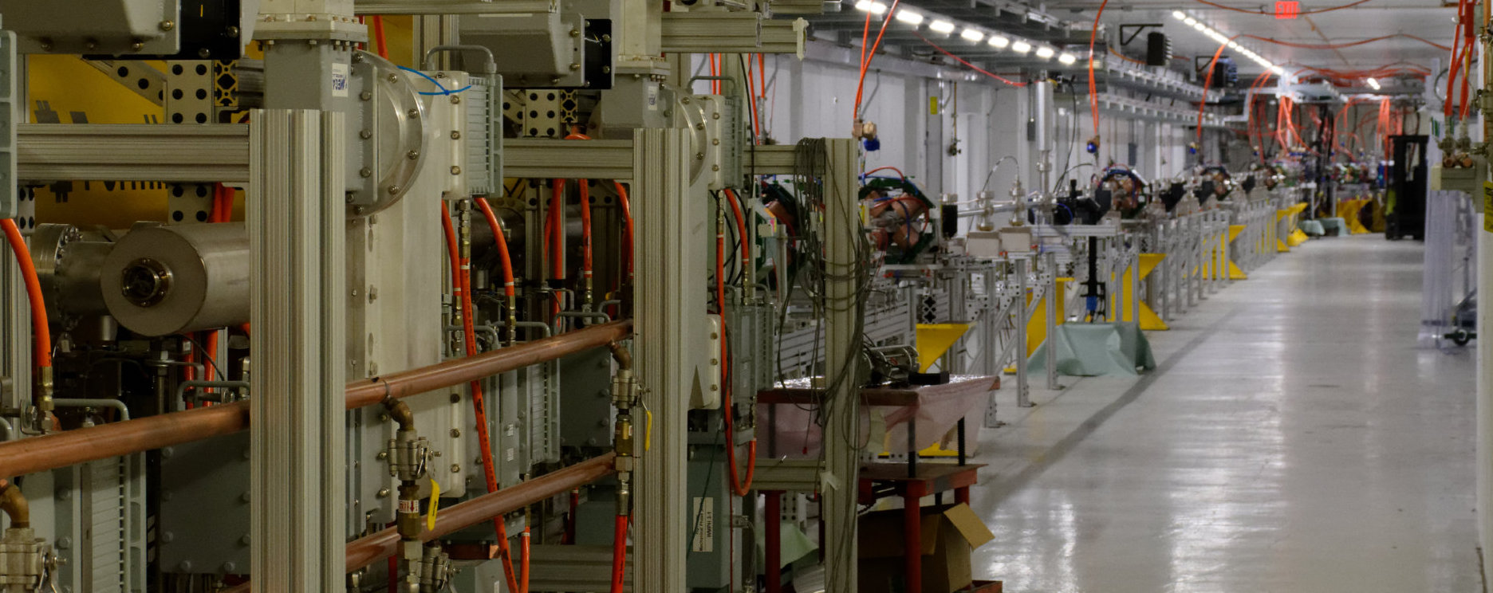
FAST: Fermilab Acclerator Science and Technology
100 m
100m of High Energy FAST beam line constructed
19 October – for the first time, beam accelerated through ILC-type cryomodule to energy 150 MeV
Propagated to point of injection to IOTA
15 November – beam accelerated to 301 MeV
Record ILC-type cryomodule acceleration of 255 MeV
Over 31.5 MV/m

Slide 3
2017 FAST Operations – 2 Months (Oct-Nov)
Primary goal – IOTA injector(FAST LINAC) commissioning
Acceleration in CM-2 to 150MeV
Instrumentation
Machine Protection System
Machine stability and reproducibility
Beam line tuning for injection to IOTA
Achievement of 300 MeV beam in SRF linac
Conditioning and phasing of cavities
Low-Level RF tuning
Collaboration-driven experimental program
Notes:
2 months of operations

Slide 4
Experiment Scheduling and planning
Proposed by user and discussed in committee for priority setting before run
Scheduled weekly according to the specified progress, beam status and user availability.
Available through website
https://www-bd.fnal.gov/fast/schedule.shtml

Slide 5
Experiment Scheduling and planning-Example

Slide 6
Study distribution total 75 shifts: scheduled

Slide 7
Results based on 2017 run (2 month)
IPAC 18
2 contributed Oral (Machine learning, HOM wakefield)
7 posters
Journal article
1 accepted in PRSTAB (HOM wakefield )
Several more in preparation
Funded activity(through Fermilab) besides IOTA experiment
Inverse Compton scattering (Talk by Dr. Alex Murokh 11:15 AM )
Magnetized Beam (Talk by Dr. Steve Benson at 11:35 AM)
Broadband HOM based diagnostics (Talk by Dr. Olivier NAPOLY at 10:40 AM)

Slide 8
Facilily layout
Parameter | FAST Value
Beam Energy | 20 MeV – 300 MeV
Bunch Charge | < 10 fC – 3.2 nC per pulse
Bunch Train (Macropulse) | 3 MHz nominal up to 3000 bunch
Train Frequency | 1 – 5 Hz
Bunch Length | Range: 0.9 – 70 ps (Nom: 5 ps)
RMS emittance (typical) | 1 µm at 100pC

Slide 9
Downtime: Beam is up for more than 85% of the time

Slide 10
Available instrumentation in FAST Linac
BPM
Capable of doing bunch by bunch monitoring at 3MHz
Can handle charge from 50pC to 3.2nC with different gain setting
Transverse profile monitor
Live display
Longitudinal profile measurement
Streak camera
Ceramic gap (non-interruptive)
Charge measurement
Faraday cup, Wall current monitor
HOM detector with Capture cavity and CM

Slide 11
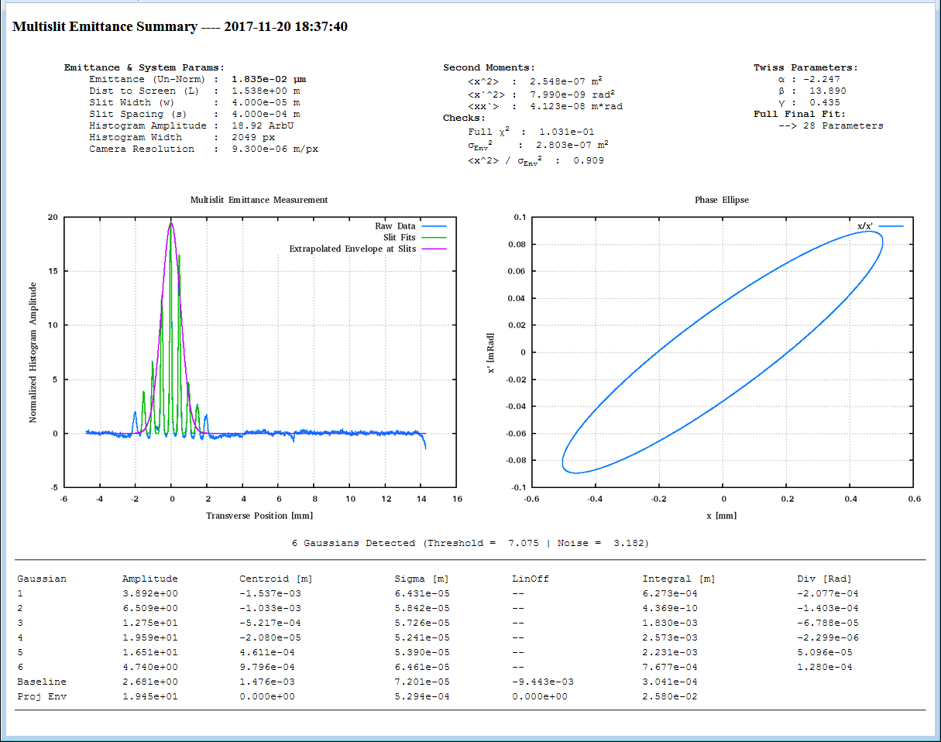
Available Instrumentation in LINAC
Slit based emittance measurement
Live display on web, including emittance value, calculated twiss parameter
Emittance available on ACNET
All data saved for further analysis

Slide 12
After IOTA commissioning
The main purpose is to serve as injector for IOTA based research
Depending on the IOTA operation mode, the injection may be needed as seldom as every 20~30 minutes.
During the incoming commissioning run we will begin implementing fast switching from given running mode to IOTA injection and back
The goal is to allow plenty of LINAC running time as long as IOTA is operating with stable beam.
Huge opportunity for beam experiment.

Slide 13
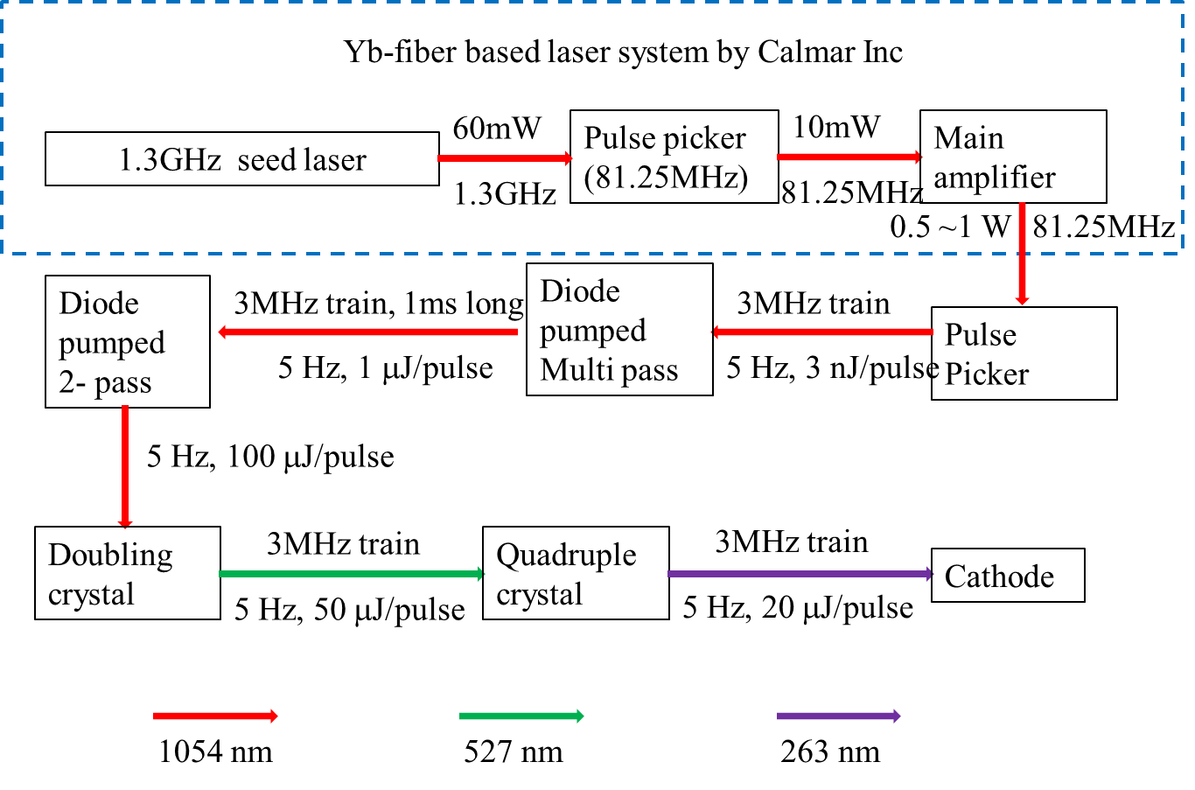
Laser layout

Slide 14
Laser related upgrade and capability
IR transport from gun to D600. Laser will be available basically anywhere.
Nominal laser bunch train is at 3MHz. 9MHz is tested inside laser room. Higher frequency is also possible with the current laser configuration. However the pulse energy is expected to drop linearly with the frequency change.
Current laser is operated at 1Hz. 5Hz operation is tested for the system as well.
Seed laser is at 1.3GHz. In principle it is possible to pick 2 bunches separated at integer number of spacing(~720ps) to do pump probe measurement.

Slide 15
Gun system capability
Current working at 1Hz. 5Hz is possible with some conditioning work.
Both solenoid are supposed to be operated at large range which will enable magnetized beam. We do found some limitation for buck solenoid due to water flow problem during 2017 run. It’s being investigated right now and will be fixed for the future run.
Cathode preparation system available for switching different cathode.

Slide 16
Low energy section capability
2 capture cavity can boost energy up to 55MeV.
Need further high power condition of both capture cavity in order to get the energy up. Current maximum is about 46~47MeV
Chicane line available for bunch compression
Beam line before CM equipped with various beam diagnostic tool, including both transverse and longitudinal.
A set of flat beam quads is available to make flat beam at 50MeV

Slide 17
High energy beam line
CM commissioned. ILC goal reached. 250 plus MeV for beam.
Some conditioning will be done in the upcoming run for long bunch train. Currently we did 500 bunches at 3MHz maximum.
Several beam line is available for R&D. Inverse Compton scattering is using one.
Possible space for more R&D chance. Need the hardware
Undulator
High energy chicane

