Slide 1
Status of Integrable Optics Test Accelerator
Alexander Valishev
IOTA/FAST Collaboration Meeting
9 May 2018

Slide 2
Acknowledgments
R.Andrews, D.Barak, V.Bocean, D.Broemmelsiek, A.Burov, K.Carlson, D.Crawford, A.Didenko, N.Eddy, D.Edstrom, J.Eldred, R.Espinoza, D.Franck, J.Jarvis, V.Kashikhin, R.Kellett, M.Kucera, V.Lebedev, J.Leibfritz, C.Jensen, W.Johnson, P.Li, M.McGee, S.Nagaitsev, L.Nobrega, M.Obrycki, H.Piekarz, E.Prebys, I.Rakhno, A.Romanov, J.Ruan, J.Santucci, V.Shiltsev, G.Stancari, A.Valishev, J.VanBogaert, A.Warner, S.Wesseln(FNAL)
M.Andorff, S.Chattopadhyay, P.Piot, S.Szustkowski (NIU)
D.Shatilov (BINP)
S.Antipov, N.Kuklev (U of Chicago)
D.Abell, D.Bruhwiler, N.Cook, C.Hall, S.Webb (RadiaSoft)
C.Mitchell (LBNL)
R.Agustsson, A.Murokh, F.O’Shea (RadiaBeam)
H.Baumgartner, R.Kishek, K.Ruisard (UMD)

Slide 3
IOTA Design

Slide 4
IOTA Design Criteria – AAA
Adaptable
Can operate with either electrons or protons
Large aperture
Easily reconfigurable – quick-change experimental equipment
Significant flexibility of the lattice
Accurate
Precise control of the optics quality and stability
Comprehensive set of precision instrumentation
Set up for very high intensity operation (with protons)
Affordable
Cost-effective solution, re-use existing parts whenever possible
Mostly based on conventional technology (magnets, RF)
Balance between low energy (low cost) and research potential

Slide 5
IOTA Parameters
Nominal kinetic energy | e⁻: 150 MeV, p+: 2.5 MeV
Nominal intensity | e⁻: 1×10⁹, p+: 1×10¹¹
Circumference | 40 m
Bending dipole field | 0.7 T
Beam pipe aperture | 50 mm dia.
Maximum b-function (x,y) | 12, 5 m
Momentum compaction | -0.02 ÷ 0.1
Betatron tune (integer) | 3 ÷ 5
Betatron tune chromaticity | -15 ÷ 0
Transverse emittance r.m.s. | e⁻: 0.04 μm, p+: 2μm
SR damping time | 0.6s (5×10⁶ turns)
RF V,f,q | e⁻: 1 kV, 30 MHz, 4
Synchrotron tune | e⁻: 2×10⁻⁴ ÷ 5×10⁻⁴
Bunch length, momentum spread | e⁻: 12 cm, 1.4×10⁻⁴
Beam lifetime | e⁻: 1 hour, p+: 1 min

Slide 6
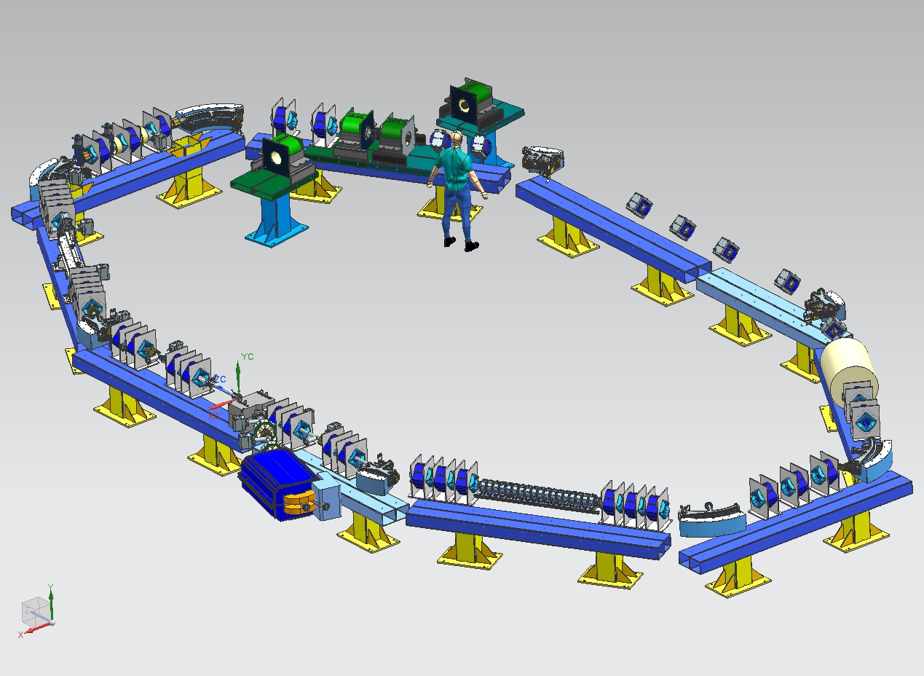
IOTA Layout
E-Lens
NL Magnet
Kickers
RF
Lambertson
Octupoles
injected beam

Slide 7
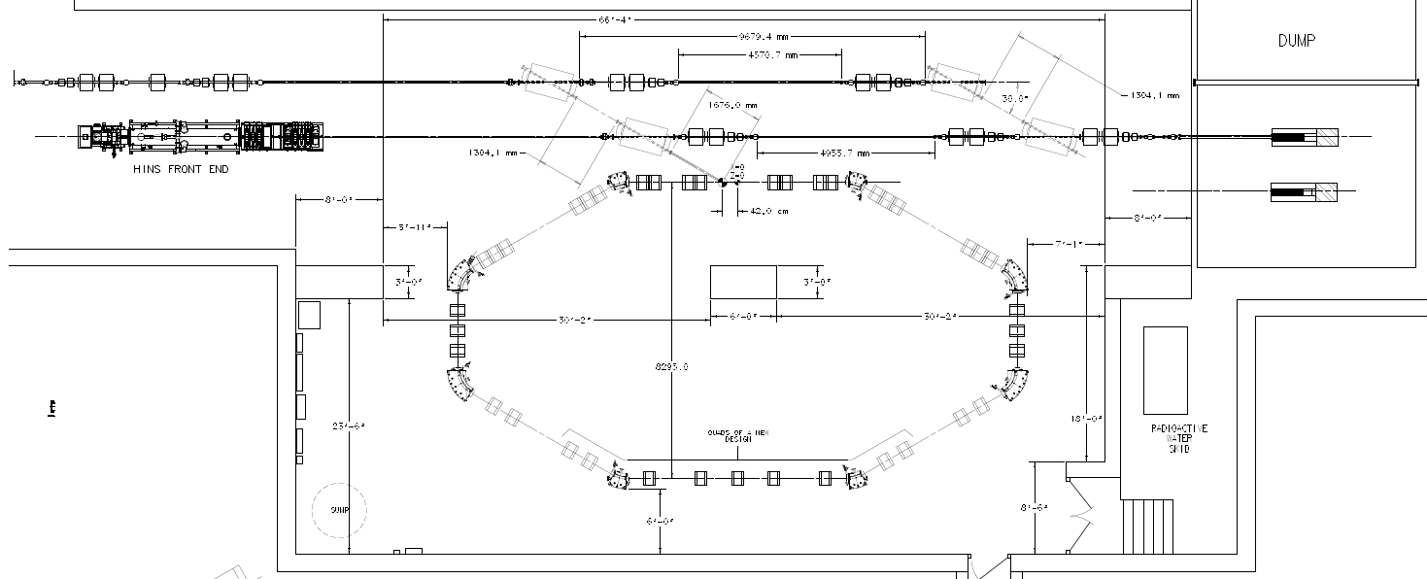
IOTA Layout in the Tunnel
e- beam line
p beam line
2.5 MeV RFQ
22 m

Slide 8
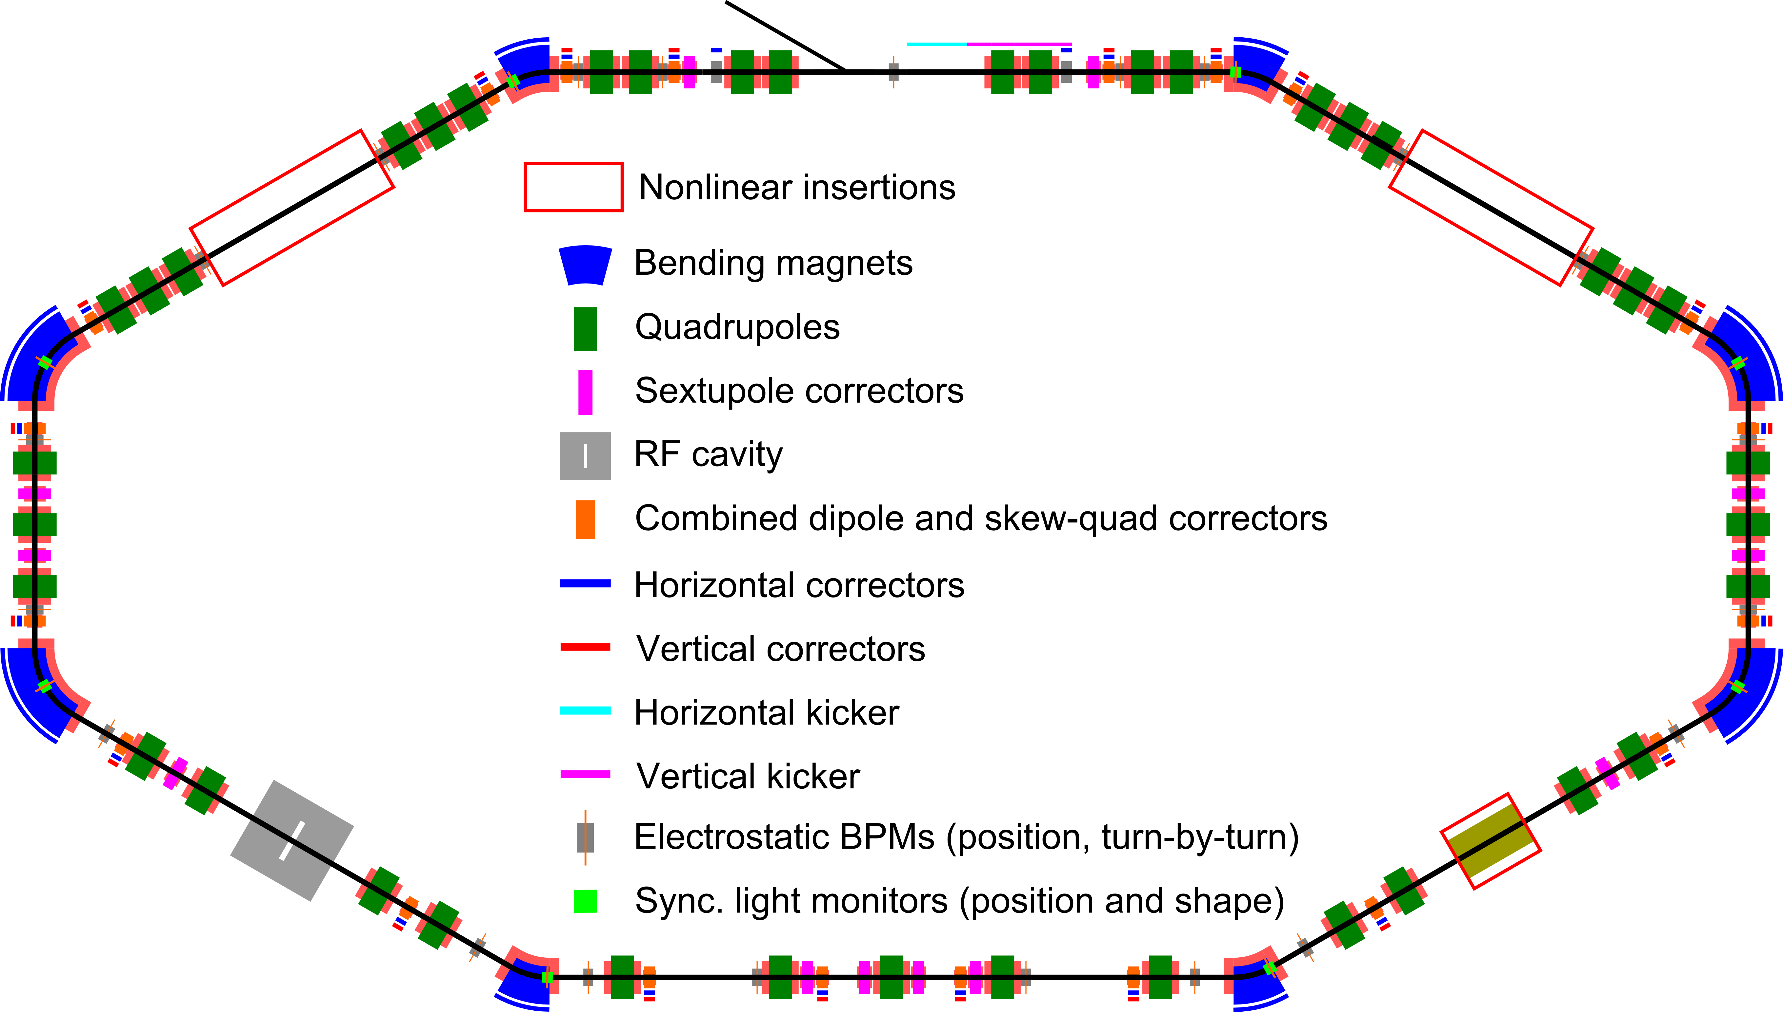
IOTA Layout - Elements
2
8
39
8
1
18
8
2
1
1
21
8

Slide 9
IOTA Lattice – 2NL Option

Slide 10
IOTA Components

Slide 11
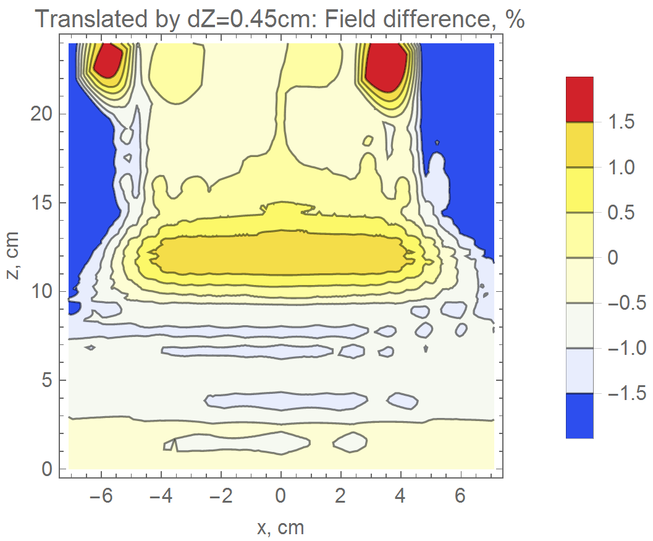
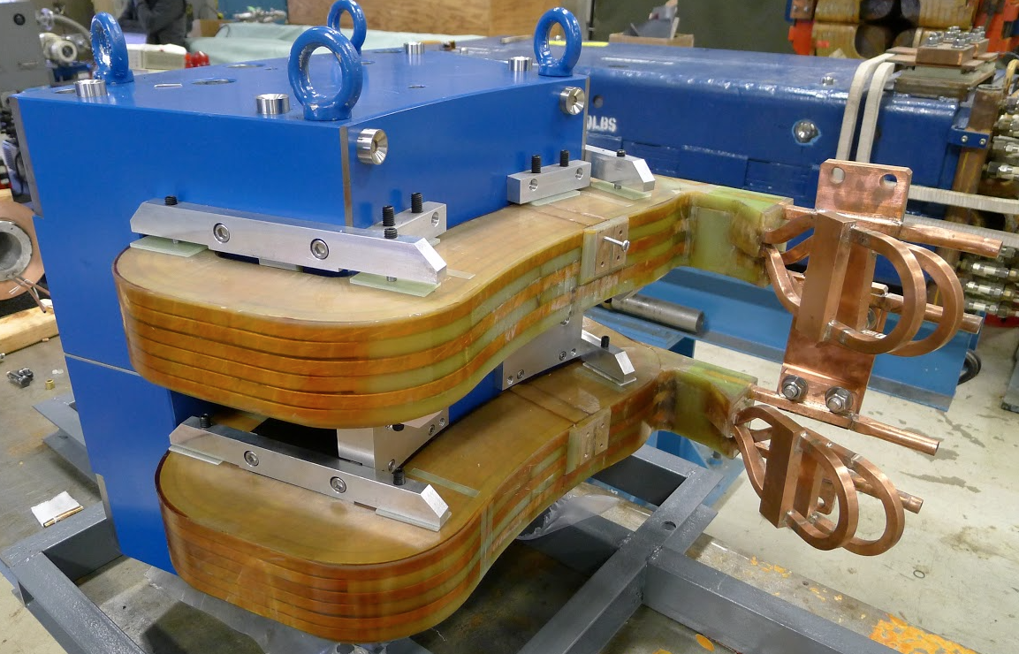
Main Dipole Magnets – 30-deg and 60-deg
Conventional C-shape, 0.7T, 520A, water-cooled magnet
Simple to design and fabricate
Comprehensive 3D field optimization
Large pole gap (59+mm) to pole width (200 mm) ratio
10⁻³ field integral uniformity within the 48mm beam pipe aperture
Designed by subcontractor (BINP, Novosibirsk), verified at FNAL
10 magnets (8+2 spares) built at IHEP Beijing
Required minor corrections to pole geometry
Tested/measured at Fermilab

Slide 12
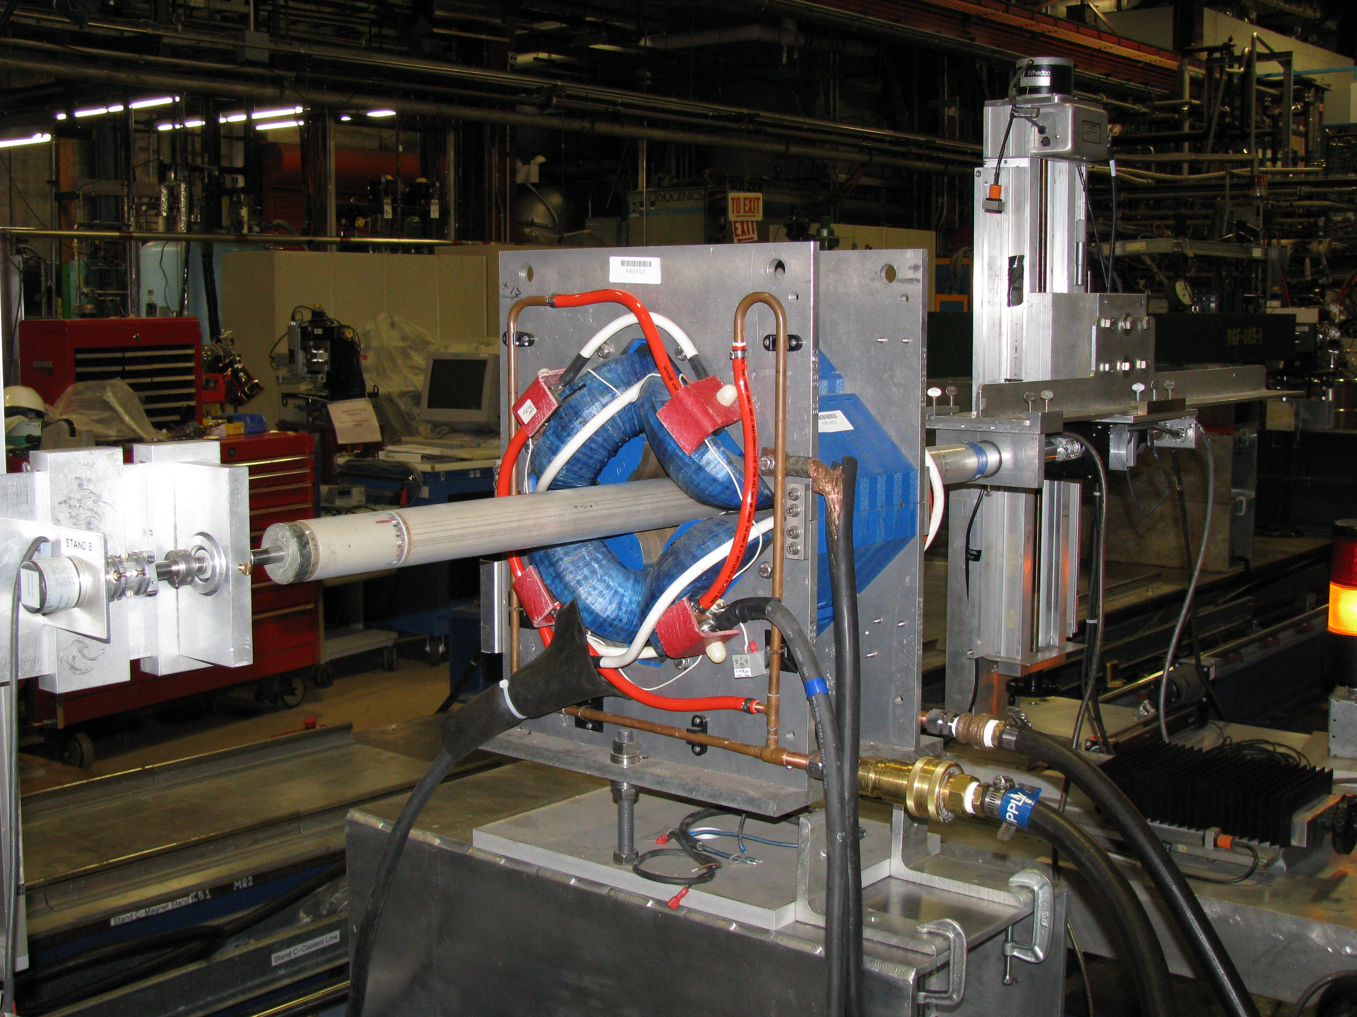
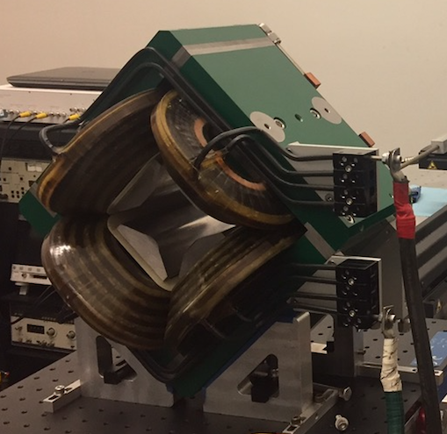
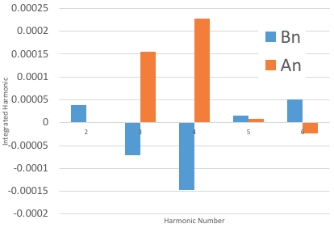
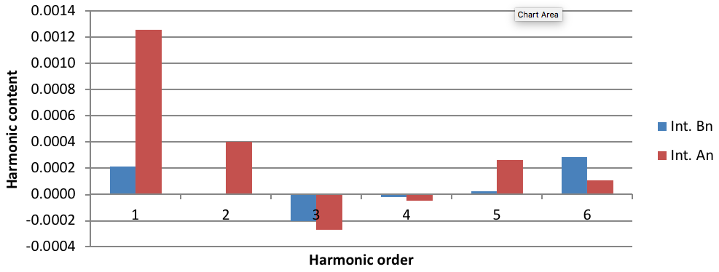
Main Quadrupoles – 39 magnets in initial lattice
30 old ASQA type
Built in 1990s for AmPS
Refurbished and tested at Fermilab
9 new FNM type
Designed, built and tested by RadiaBeam

Slide 13
Combined H/V and Skew-Quadrupole Correctors
For high flexibility of the lattice needed 18 correctors
H steering
V steering
Skew-quadrupole
Due to lack of real estate combined 3 functions in one device
Simple frame magnet with carefully optimized coil shape
4 individually powered coils
Corresponding number of power supplies inherited from ECool
Fermilab 2D concept
3D design, fabrication and testing by RadiaBeam

Slide 14
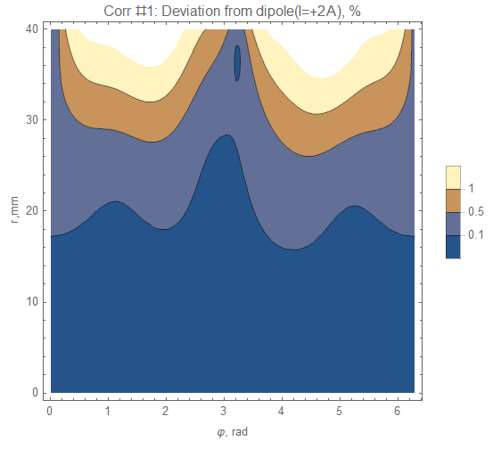
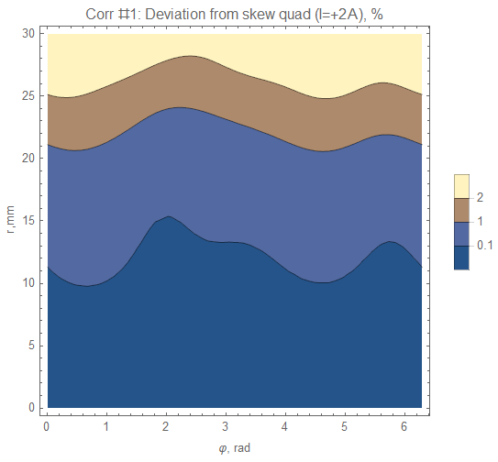
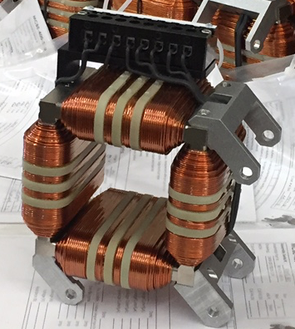
Combined H/V and Skew-Quadrupole Correctors

Slide 15
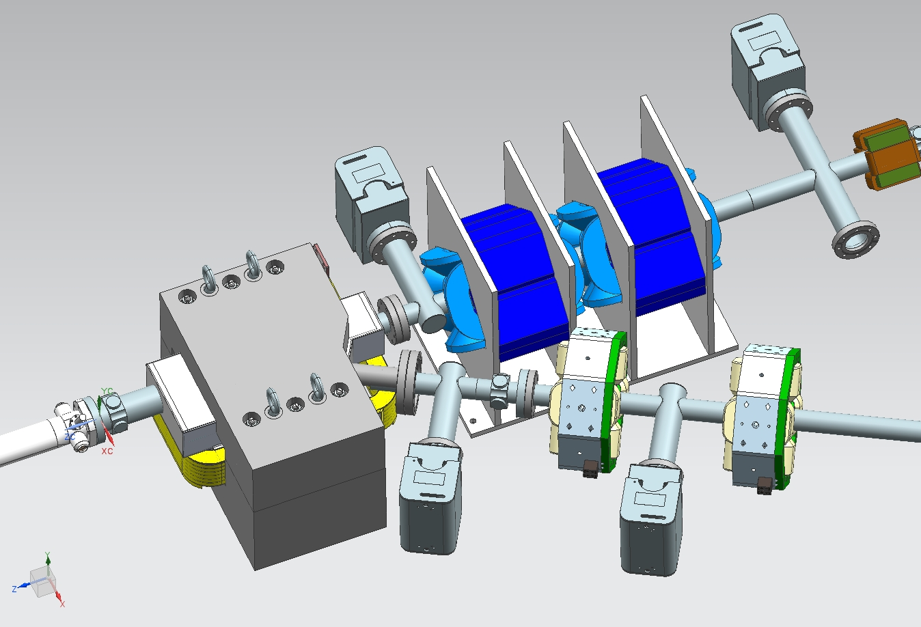
Injection Devices – Lambertson
Lambertson septum magnet
30-degree horizontal bend and 1.2-degree vertical angle
DC, powered in series with main bending magnets
Designed and fabricated at Fermilab
Circulating beam
Injected beam

Slide 16
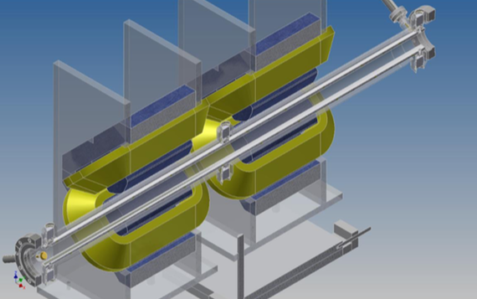
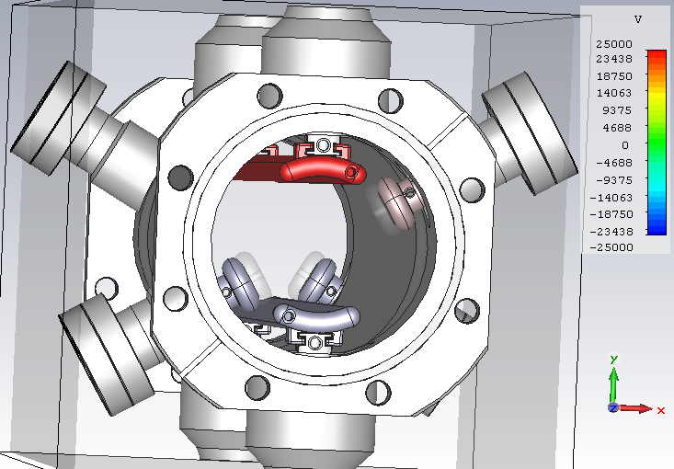
Injection Devices – Stripline Kicker
Vertical kicker for injection – 1m long, 50kV plate-to-plate
Horizontal kicker for experiments – 55cm long, 50kV
40 mm gap
50𝛀 impedance
Designed and fabricated at Fermilab

Slide 17
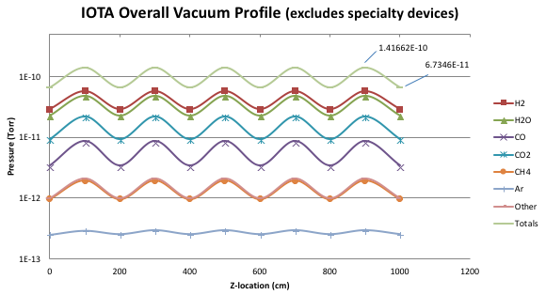
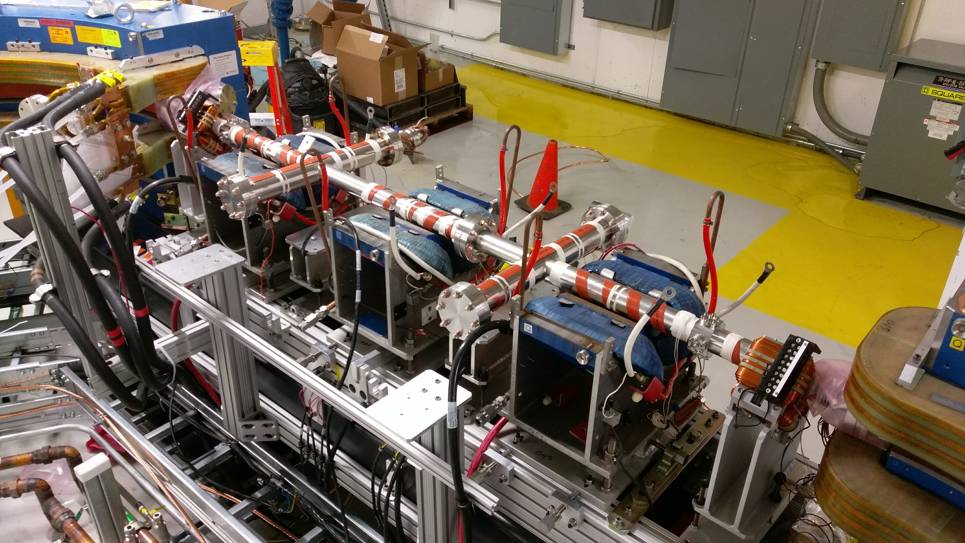
Vacuum System Designed for 10⁻¹⁰ Torr
Vacuum pipe is 2” diameter stainless steel tube (35 m)
Aluminum chambers in dipole magnets (5 m)
Silver-plated to avoid ion accumulation
Baking system up to 100÷150C
45 L/s NEG combination pumps every 2 m

Slide 18
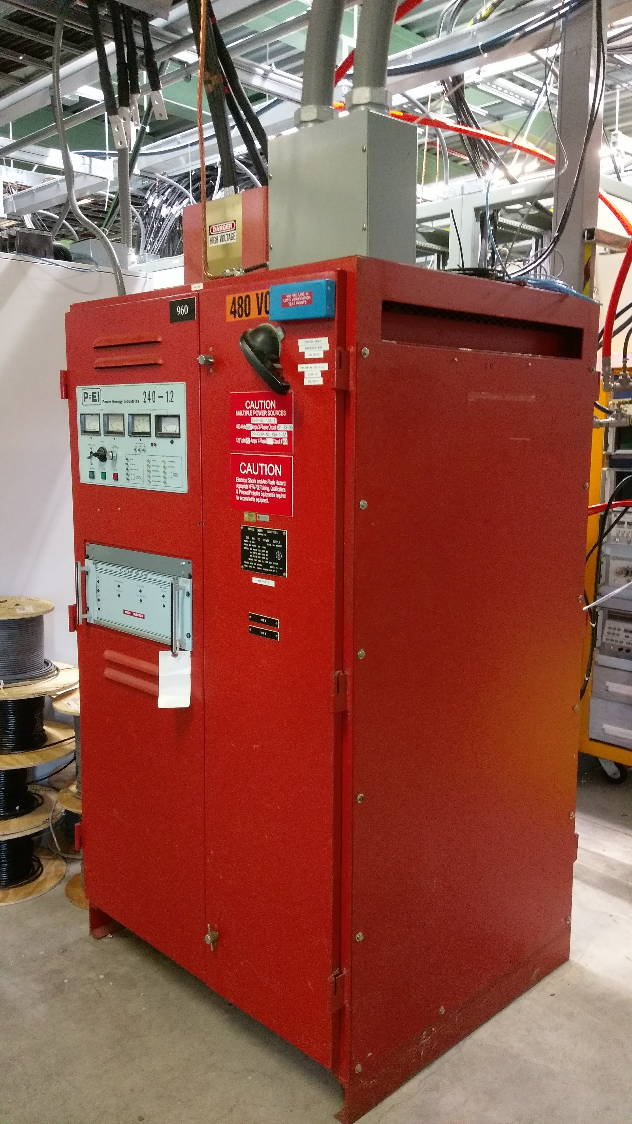
Magnet Power Supplies
Main dipoles – powered in series with Lambertson
PS reused from Tevatron
Unipolar, 10⁻⁴ stability, 600A, 240kW
Quadrupoles – each magnet individually powered
New acquisition
Unipolar, 10⁻⁴ stability, 3 types
400A/10V, 4kW
120A/12.5V, 1.5kW
70A/12V, 850W
Correctors/special magnets
Reused from Tevatron ECool
Bipolar, 2A, 15V

Slide 19
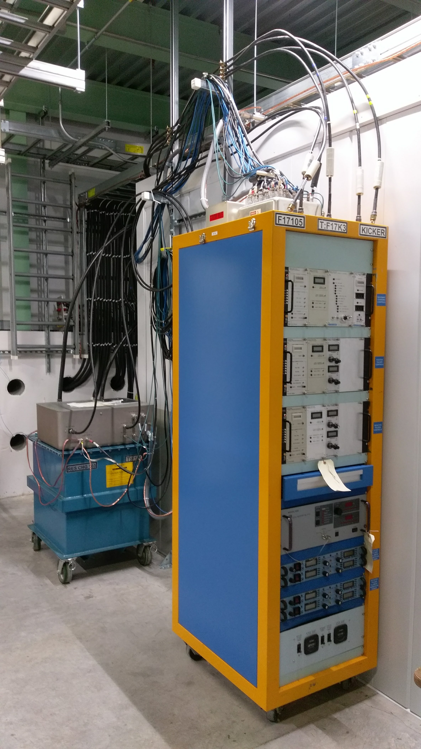
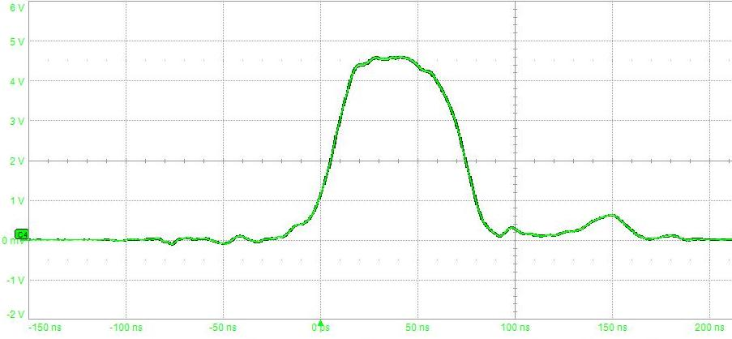
Kicker Power Supplies
Reused Tevatron pulse generators
Modified for short pulse (<100 ns) operation
Two systems each with one controls rack, resonant charger, and positive and negative pulsers
Tested successfully to just over 50 kV (25 kV load voltage) into resistive load
Regulate well at 18-50 kV (0.3% rms pulse stability)
Jitter < 0.5 ns

Slide 20
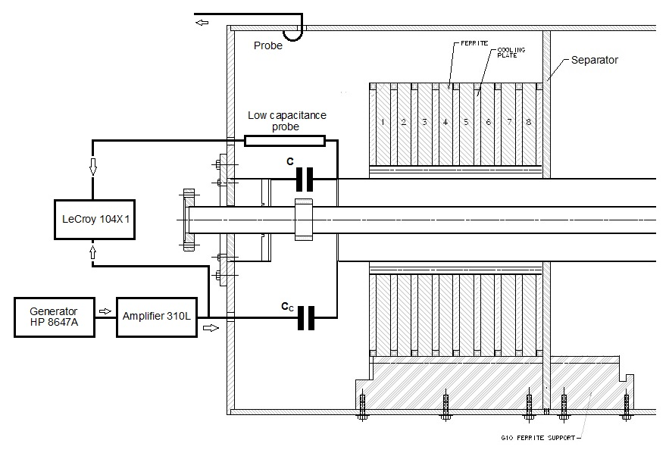
RF System
Low particle energy and low frequency → very simple requirements
Electrons: 1 kV, 30.02 MHz (4 × 7.506 MHz)
Protons: 0.4 kV, 2.184 MHz (4 × 0.546 MHz)
Both gaps implemented in a single device
Cavity shell and ferrite rings reused from pbar source
Off-the-shelf solid-state amplifier
Frequency/Resonance control with capacitor/stepper motor

Slide 21
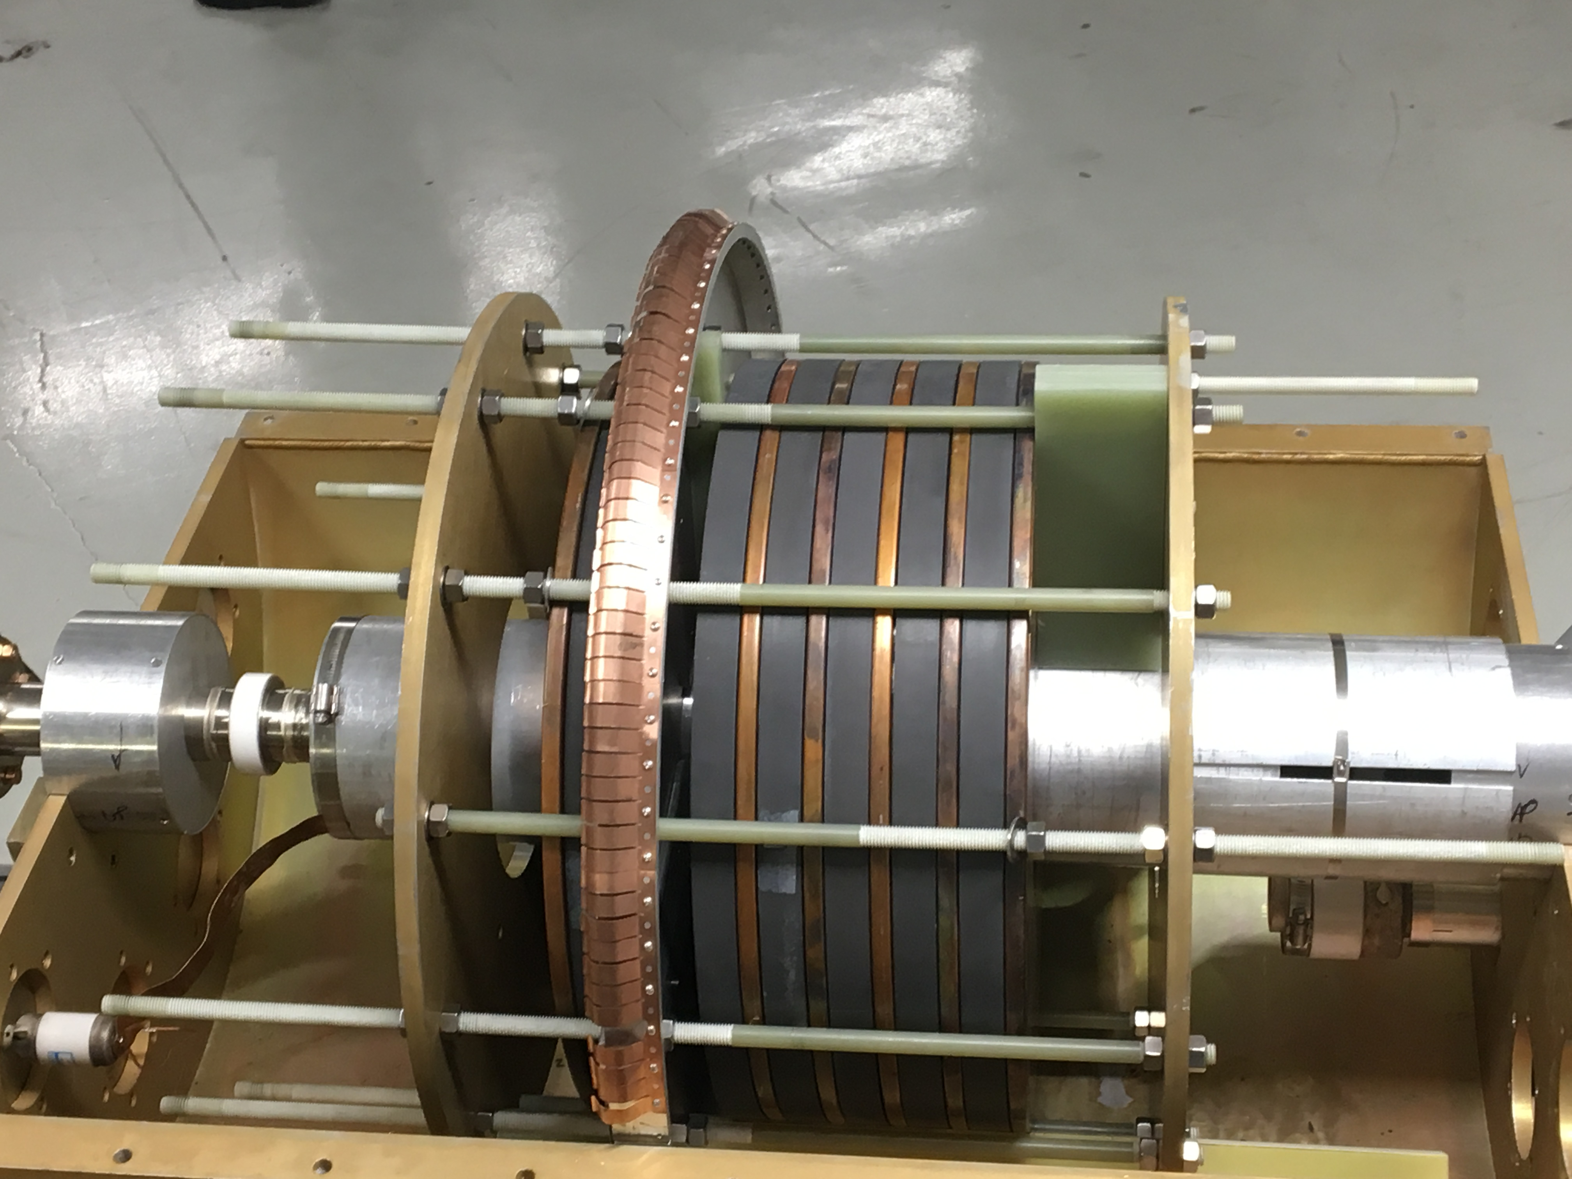
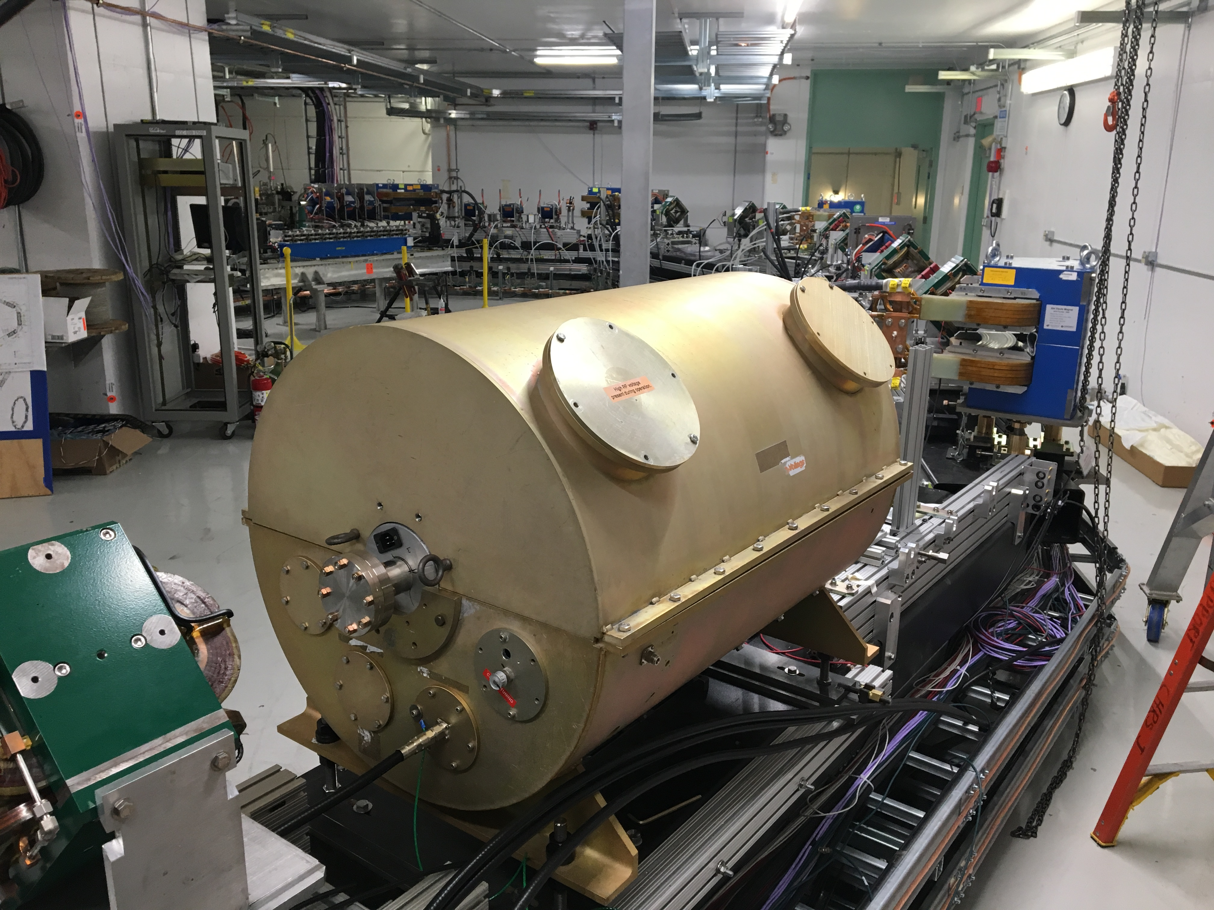
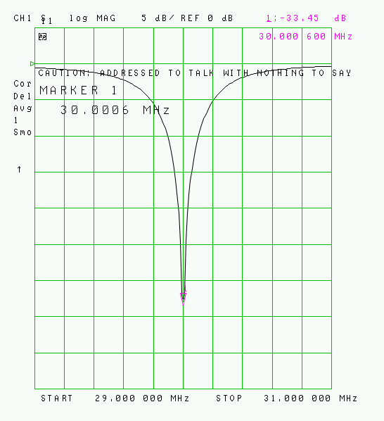
RF System

Slide 22
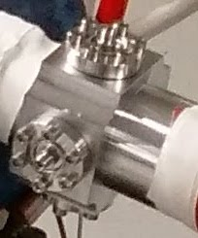
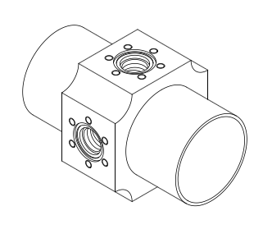
Instrumentation – BPM System
21 Capacitive button-type H/V pickups (4+ /betatron period)
50 mm diameter
already used in FAST linac
Fermilab-designed BPM electronics
Turn-by-turn capability all BPMs (100 um resolution, 32k turns)
Closed orbit mode (1 um resolution)

Slide 23
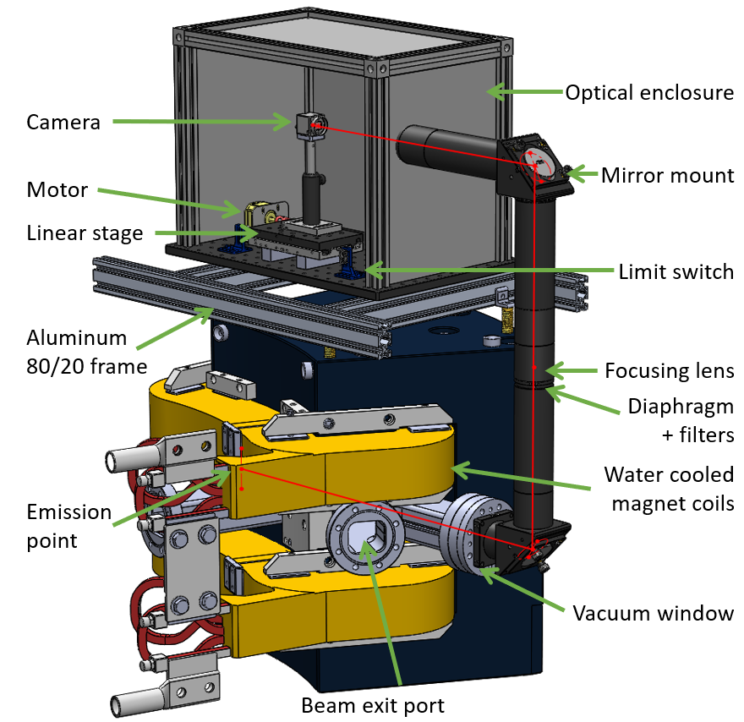
Instrumentation – Synchrotron Light Monitors
SR from IOTA bending magnet
Beam: E=150 MeV, I=1.2 mA (10⁹ e-)
λ=550±20 nm
photons / turn = 2.6×10⁵
photons / s = 1.97×10¹²
Monitor
BlackFly 23S6M monochromatic camera: 2.3 MP, 5.86 μm pixel size, 41FPS, 71 dB dynamic range
7 um resolution

Slide 24
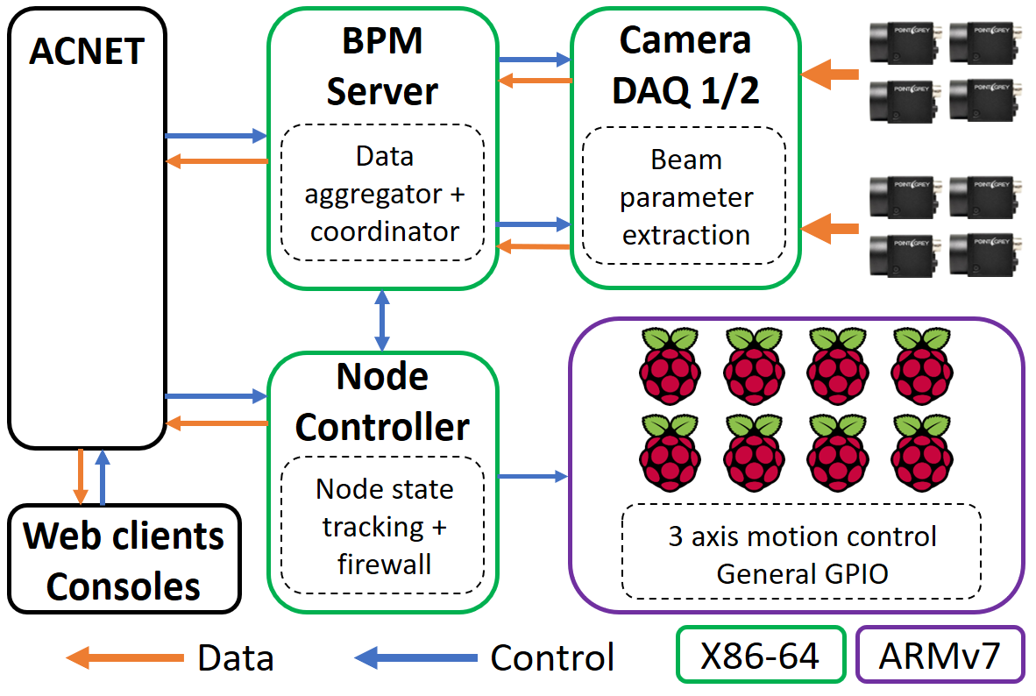
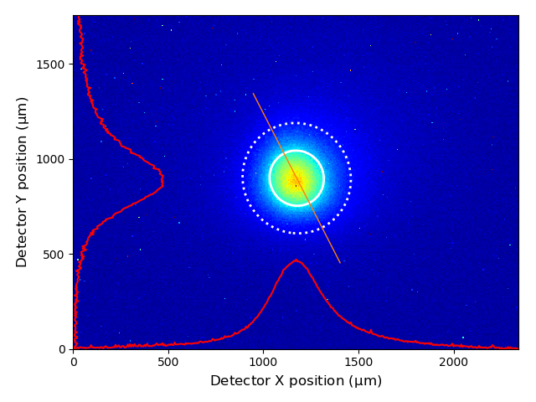
Instrumentation – Synchrotron Light Monitors

Slide 25
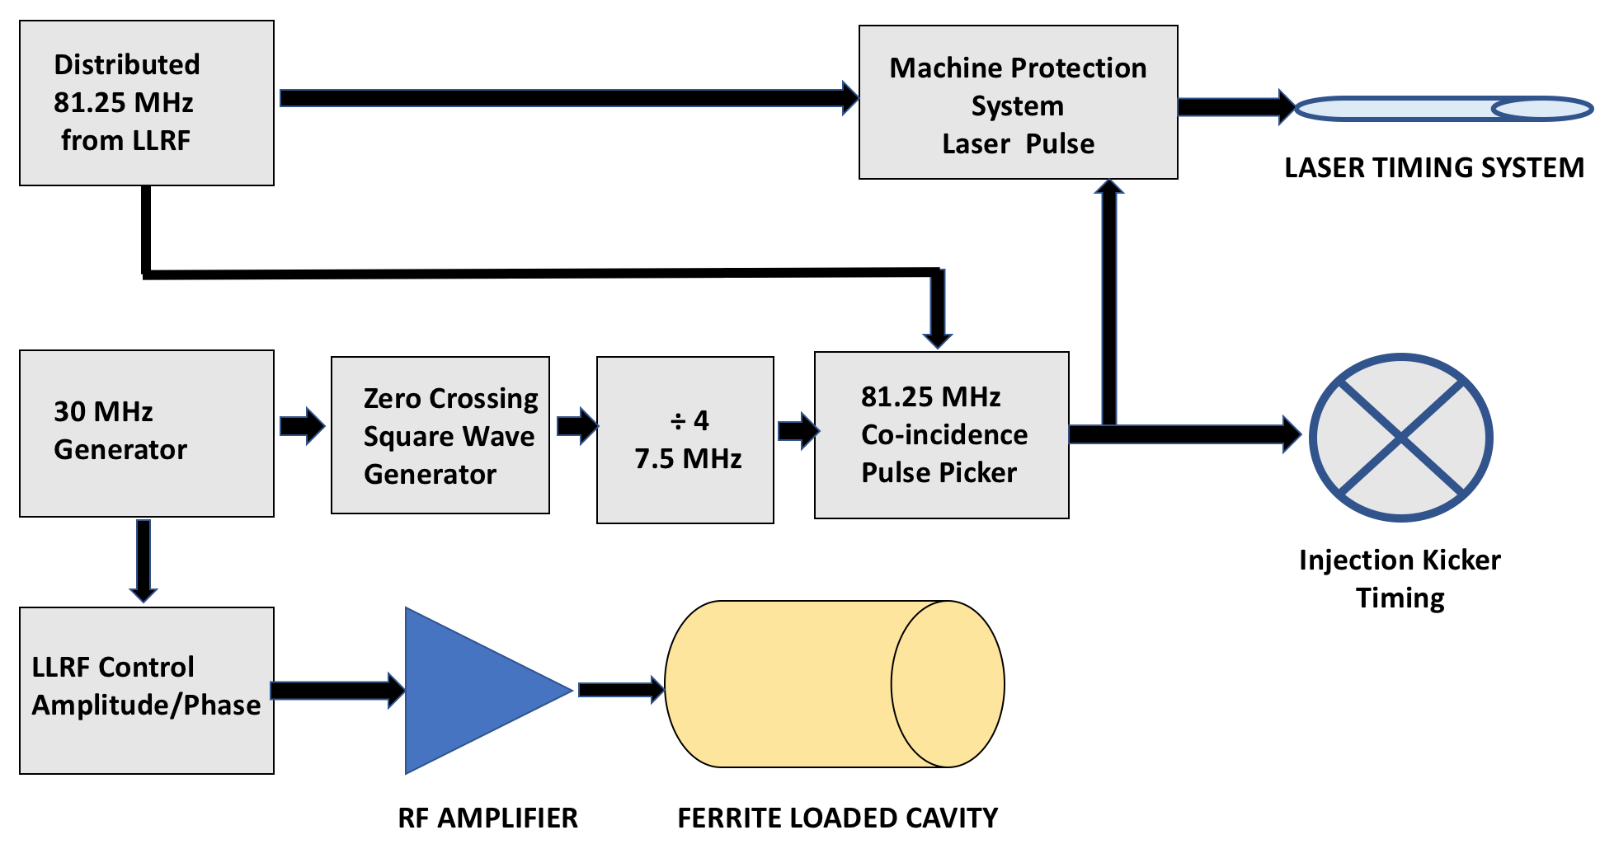
Synchronization System

Slide 26
Other Systems
Beam current measurement
Wall current monitor
DCCT
SR/PMT
Machine Protection System
Stripline kickers
Switch
Low-amplitude kicker pulse generators
Damper (anti-damper)
Sextupole magnets
Water cooling

Slide 27
IOTA Construction

Slide 28
IOTA Last Year – June 2017

Slide 29
IOTA Today – May 4, 2018

Slide 30
Lessons from FAST 300MeV Construction/Startup
Major engineering project
Mechanical construction
Vacuum component cleaning/certification UHV, particle free
Installation/commissioning of power supplies and instrumentation
Shielding Assessment: modeling and simulations, review
Took longer than originally projected (2017 June⟹Sept.)
Longest delay – Shielding Assessment review
Lesson learned, IOTA SA done early!!!
Failures of the aging cryogenic system before/during startup
Installed new booster pump
Excellent support by Technical Division Cryo, but system needs investments in the long term
Failure of the gun laser
New amplifier, different vendor

Slide 31
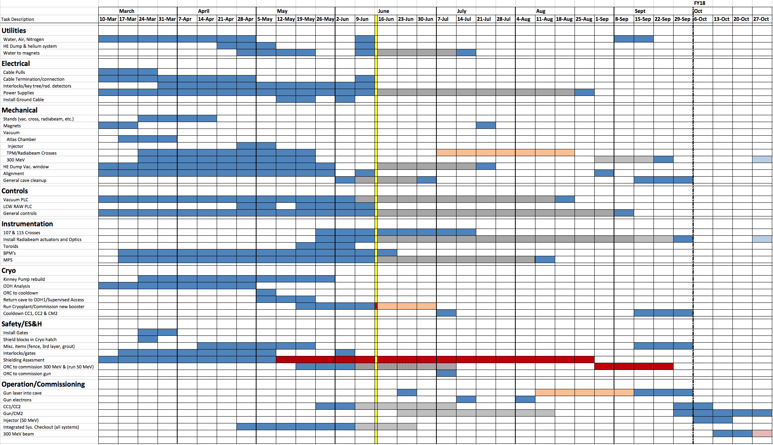
FAST 300 MeV Line Construction – Schedule

Slide 32
IOTA Construction – Shedule (1)

Slide 33
IOTA Construction – Shedule (2)

Slide 34
IOTA Construction – Shedule (3)

Slide 35
IOTA Construction – Shedule (4)

Slide 36
IOTA Commissioning

Slide 37
IOTA Commissioning Plan (1)
Injection device tuning (1 week).
Lambertson septum tuning to observe beam on first BPM.
Kicker timing to send beam directly though injection straight (using synchrotron radiation diagnostics in the first dipole magnet).
First turn (1 week).
Match main bus current to beam energy (using synchrotron radiation diagnostics).
Synchronize BPM electronics with beam signal.
Beam Circulation (1 week).
Starting with ‘soft’ betatron lattice away from major resonances.
Start with uncompensated chromaticity.
Gradually increase number of turns.
Main goal to establish closed orbit and stable betatron tunes. Expect fast convergence due to well-characterized magnets.
Turn on RF and scan cavity phase to synchronize injected beam with bucket.

Slide 38
IOTA Commissioning Plan (2)
Machine Tuning (2 weeks).
Tune-up of synchroton light diagnostics system (CCD cameras).
Stable lattice with LOCO.
Aperture scans with local orbit bumps to establish ‘golden’ orbit.
Scrubbing run at maximum current to achieve maximum beam life time.
Transition to Experimental Operation (1 week).
Commissioning of synchronized turn-by-turn BPM operation, data collection.
Calibration of small-amplitude kicks on circulating beam.
Total: 6 weeks
Anticipate the schedule may stretch by up to 2 weeks due to tunnel access and downtime

Slide 39
A few words about injectors

Slide 40
FAST Electron Linac = IOTA e- Injector
Low Energy (preinjector) part - 20 m
High Energy part - 100 m
Bunch charge | up to 2 nC
Gun gradient | 45 MV/m
CC1 gradient | 26 MV/m
CC2 gradient | 15 MV/m
CM2 gradient | up to 31.5 MV/m
Beam energy | 150 (up to 300) MeV
Bunch length | 6-8 ps (rms)
Pulse length | 1 ms
Bunch freq. | 3 MHz
Rep. rate | 1 Hz (5 Hz)

Slide 41
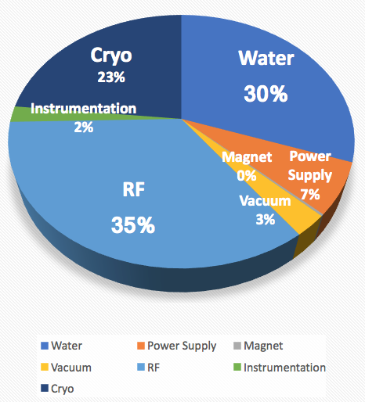
2 Months of FAST Linac Operations in 2017
Primary goal – IOTA injector commissioning
Acceleration in CM-2 to 150MeV
Instrumentation
Machine Protection System
Machine stability and reproducibility
Beam line tuning for injection to IOTA
Achievement of 300 MeV beam in SRF linac
Conditioning and phasing of cavities
Low-Level RF tuning
Parasitically – collaboration-driven experimental program
Overal uptime 85.6%
normalized to planned hours
of operation (2 shifts/day)
Downtime contributions

Slide 42
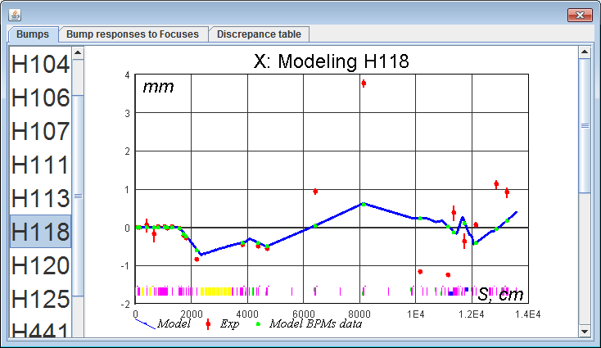
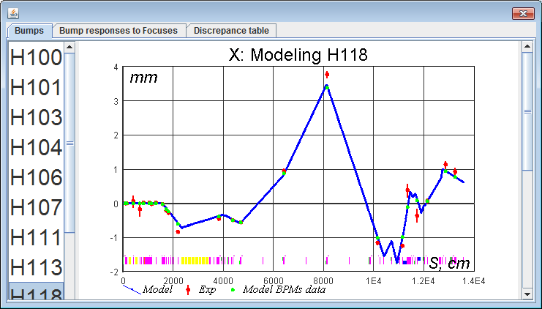
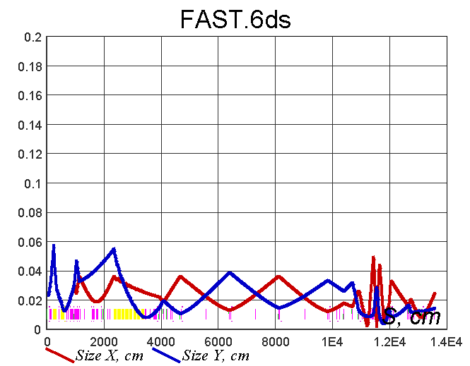
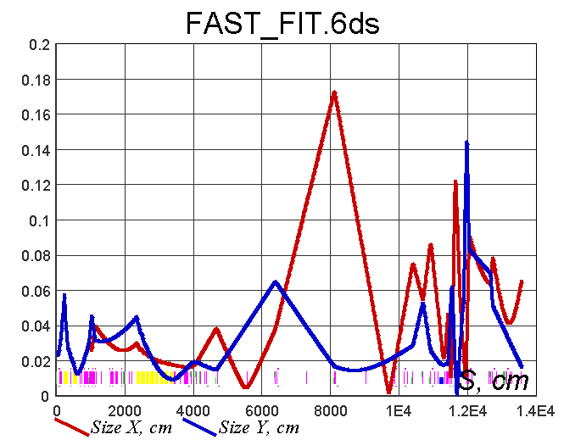
FAST Linac Tuning for IOTA Injection
Use quadrupole scan to measure initial conditions
Setup lattice for actual initial conditions
Find actual focusing fields of the machine by measuring trajectory responses to dipole correctors
Correct lattice
Repeat correction several times
Demonstrated stable beam with phase space suitable for injection to IOTA – injector commissioned!
Fit model to measurements
Implement correction

Slide 43
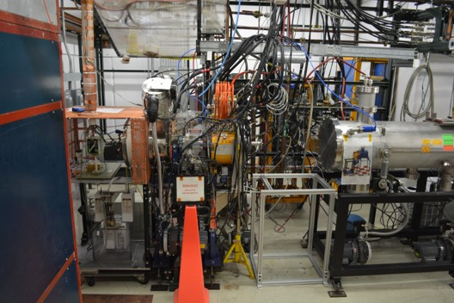
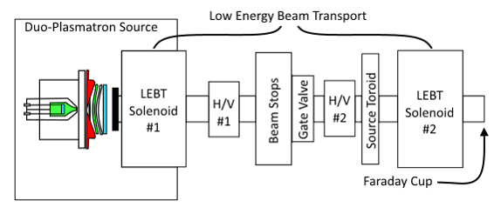
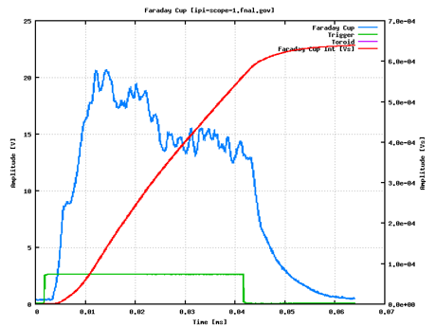
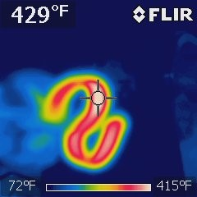
IOTA Proton Injector – Status of Ion Source/LEBT
Ion source (formerly HINS) recommissioned in situ at MDB.
HV Cabinet Rebuilt in 2017
Source Parameters:
Max Energy: 50 kV (design)
Max Current: 10 mA (nominal*)
LEBT Optimized for 20 kV
Fabricated/Swapped Filament
With Bell-Jar station at ESB
Faraday Cup Response
Filament Activation

Slide 44
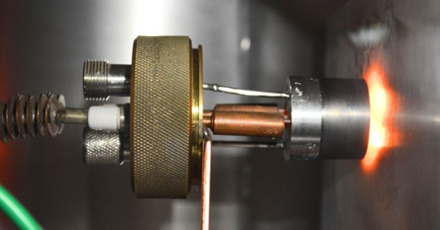
IOTA Proton Injector – Further Steps*
Initial 50 kV commissioning resulted in an event, requiring cleaning
Funding is expected to return shortly to pursue this
Immediate steps: 50 kV Commissioning
Clean the source and update drawings
Refine filament production procedure
Optimize source output for 50 kV
Short Term: LEBT Build-out
Spectrometer Magnet → Species separation/optimization
Allison Scanner → Emittance measurements
Wire Scanner → Species identification and beam profiles
Longer Term: 325 MHz HLRF system development at FAST
The RFQ will accelerate H+ beam to 2.5 MeV from LEBT
A buncher cavity requires characterization/integration w/ IOTA RF
Filament Activation in ESB Bell-Jar
* Currently on hold

Slide 45
IOTA Research

Slide 46
IOTA Research
Nonlinear Integrable Optics – Experimental demonstration of NIO lattice in a practical accelerator
Space Charge Compensation – Suppression of SC-related effects in high intensity circular accelerators
Nonlinear Integrable Optics
Electron lenses
Electron columns
Circular betatron modes
Optical Stochastic Cooling – Proof-of-principle
Electron Cooling – Advanced techniques

Slide 47
IOTA Staging
Phase I with electron beam will concentrate on the academic aspect of single-particle motion stability using e- beams
Demonstrate large amplitude-dependent detuning
Machine tuning must be at the state of the art level to satisfy integrable optics requirements
e- beams best for the purpose
Phase II – After commissioning with e-, we will move the existing 2.5 MeV proton/H- RFQ to FAST to inject protons into the IOTA ring
Opens the way for intense-beam studies

Slide 48
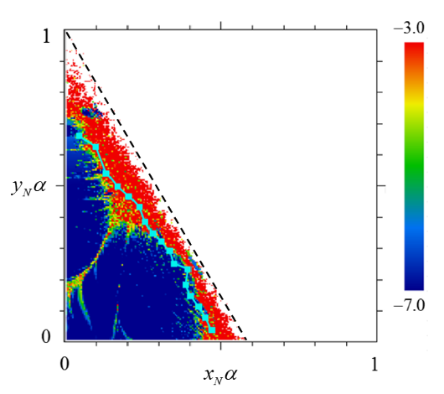
Experimental Procedure
Two kickers, horizontal and vertical, place particles at arbitrary points in phase space
Measure beam position on every
turn to create a Poincare map
As electrons lose energy due to synchrotron radiation, they will cover all available phase space
Can control the strength on the nonlinearity
Final goal – measure dependence of betatron frequency on amplitude
Phase space of
Henon-Heiles like
System in IOTA
(simulation)
Ideal system
S.A. Antipov et al 2017 JINST 12 P04008
Stable for 4x10³
Stable for 10⁵ turns

Slide 49
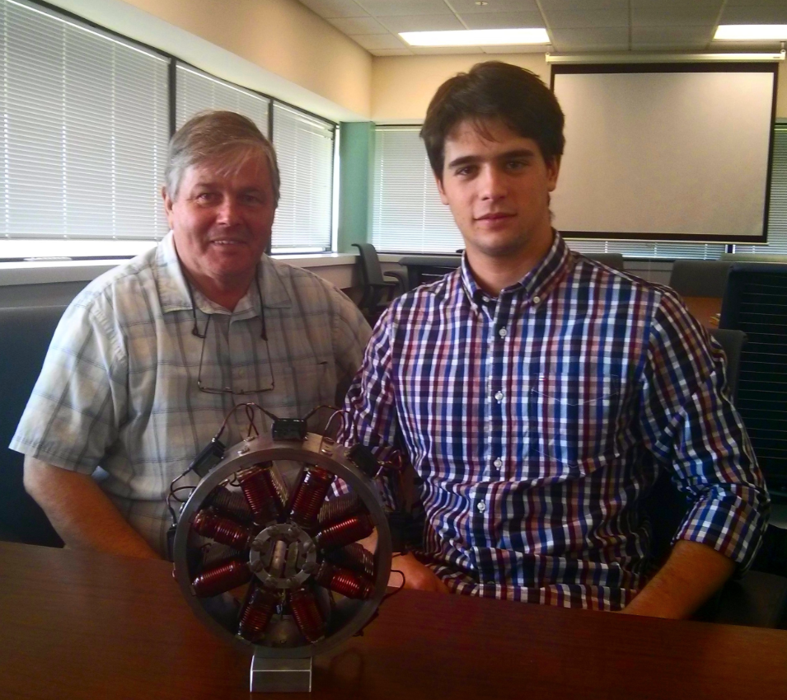
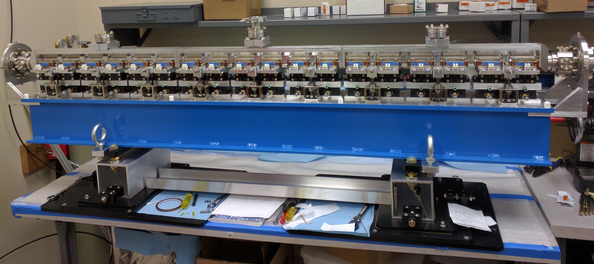
Devices for First Nonlinear Optics Experiments
IOTA octupole
1.8m Nonlinear Insert built by RadiaBeam Technologies
Henon-Heiles like system with octupole magnets
All 18 magnets built as summer project
Minor consolidation required, in progress
2D-Integrable Danilov-Nagaitsev system
Magnet built by RadiaBeam as SBIR project
Delivered to Fermilab, vacuum leak repaired, alignment in progress
Both experiments require turn-by-turn BPM system
Pulsed kickers are those used for injection

Slide 50
IOTA Major Goals and Nearest Plans
FY17
✓Electron Injector installation complete
FY18
✓300 MeV electron beam commissioned through injector
✓ FAST linac tuning and research (2 months)
IOTA Ring installation and commissioning with electrons
Research (4 months into FY19, Sept.-Dec.)
Nonlinear Integrable Optics in IOTA
Experiments at FAST linac
? Continued work on of Proton Injector
FY19
Proton Injector installation and commissioning
IOTA Ring commissioning with protons
Research with protons and electrons (OSC, NIO ~ 4 months)

Slide 51
Summary
FAST e- linac commissioned with up to 300MeV beam
First major SRF accelerator at Fermilab
Opens way to more accelerator science experiments, technology development (e.g. high-current SRF operation)
IOTA construction in good shape
Focused team, help of support departments
Critical path items identified, get constant attention
Lambertson magnet
Injection kickers
Plan to complete IOTA in July
Commissioning in August
Research with e- beam Sept.–Dec.
Time to ramp up research → this meeting!

