Slide 1
Phase-space tomography at FAST
Aleksandr Romanov
IOTA/FAST collaboration meeting
10 May 2018

Slide 2
Introduction
FAST linear accelerator has been commissioned in 2017. Experimental program of the facility requires high quality beams with well-defined properties. Solenoidal fields at photoinjector, laser spot shape, space charge forces and other effects can distort beam distribution and introduce coupling.
Flexibility of the FAST allows to perform beam rotations in 4D and 5D phase space in wide range of phases to perform high quality tomography in a timely manner.

Slide 3
Established tomography methods
Several methods based on analytical and semi-analytical solvers of inverse problems
  Inverse Radon transformation (1917)
  FBP (Filtered Back Projections, ~1984)
  MENT (Maximum ENTropy, 1979)
  SART (Simultaneous Algebraic Reconstruction Technique, 1984)

Slide 4
Recent results
In many cases reconstructed distribution has artifacts that are incompatible with consequent emittance calculations.
TUDBC3, ICAP2015 (MENT)
NAPAC2016-TUPOA36 (SART)
THPF001, IPAC2015
(FBP and SART)

Slide 5
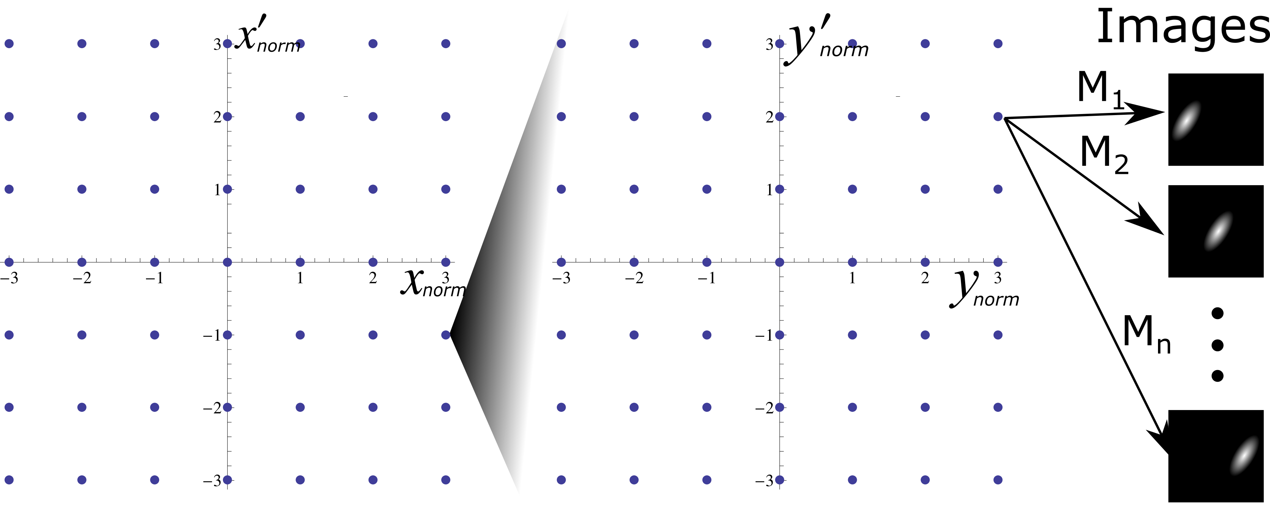
Method
Basic idea of proposed method:
  Fill phase space with voxels, each adding same distribution scaled and shifted according to voxel’s position and intensity
  Use multivariate normal distribution for the voxel basic function as it is straightforward to calculate its projections
  Use SVD based inverse solver (seems to be never applied for the tomography)

Slide 6
Results of SVD based solver from VEPP-2000 (2x2D, 8 projections)
Simulation
Experiment
Bad data

Slide 7
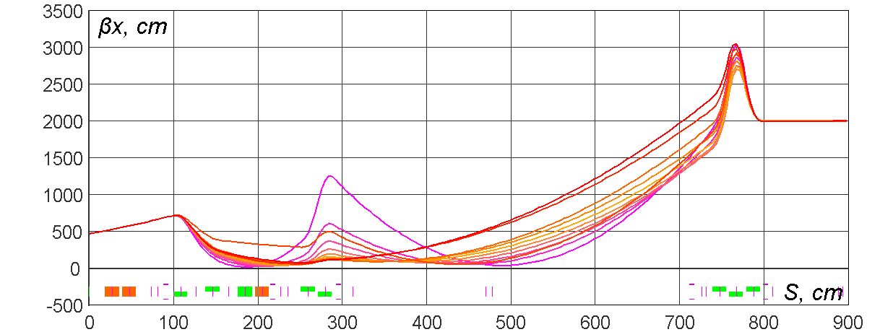
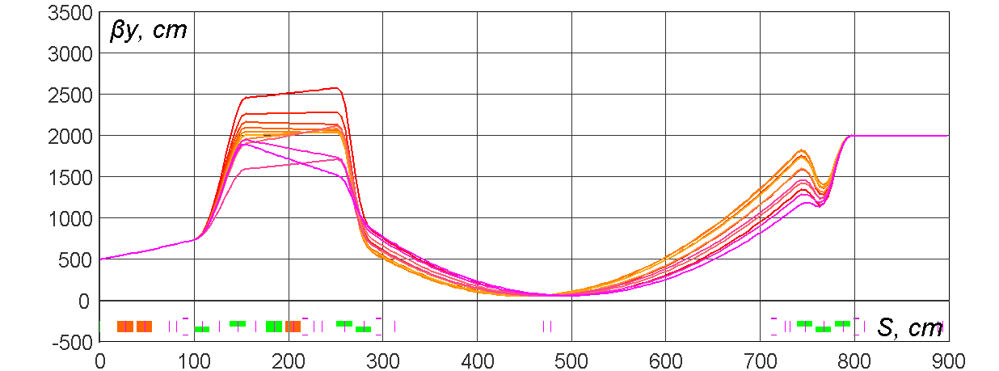
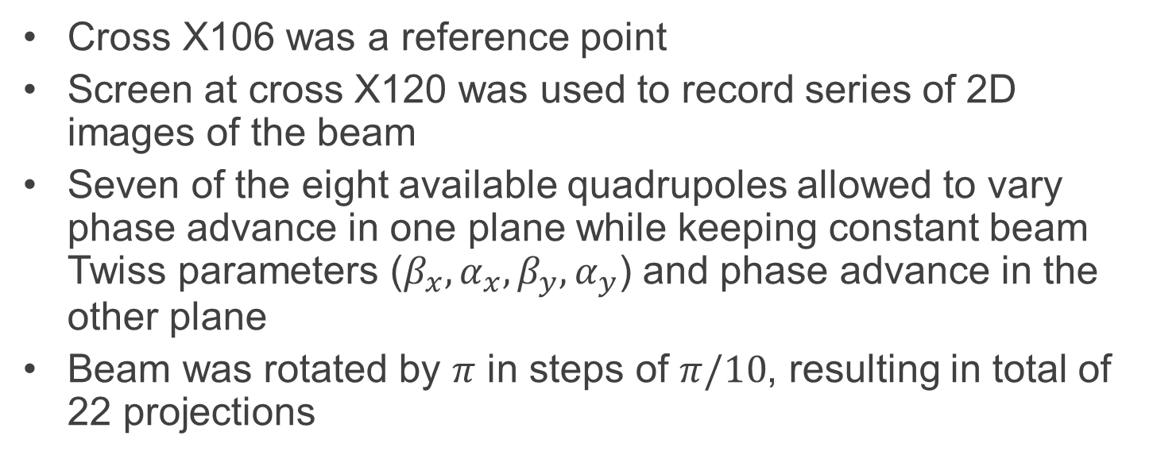
FAST lattices for beam rotations
Cross X106 was a reference point
Screen at cross X120 was used to record series of 2D images of the beam
Seven of the eight available quadrupoles allowed to vary phase advance in one plane while keeping constant beam Twiss parameters ($β_{x}, α_{x}, β_{y}, α_{y}$) and phase advance in the other plane
Beam was rotated by $π$ in steps of $π/10$, resulting in total of 22 projections

Slide 8
Toy model for visualization
No coupling
Coupling

Slide 9
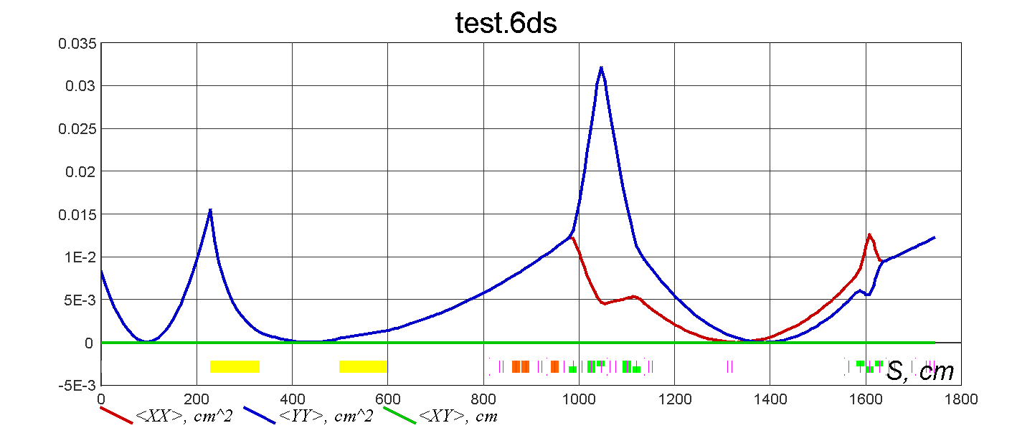
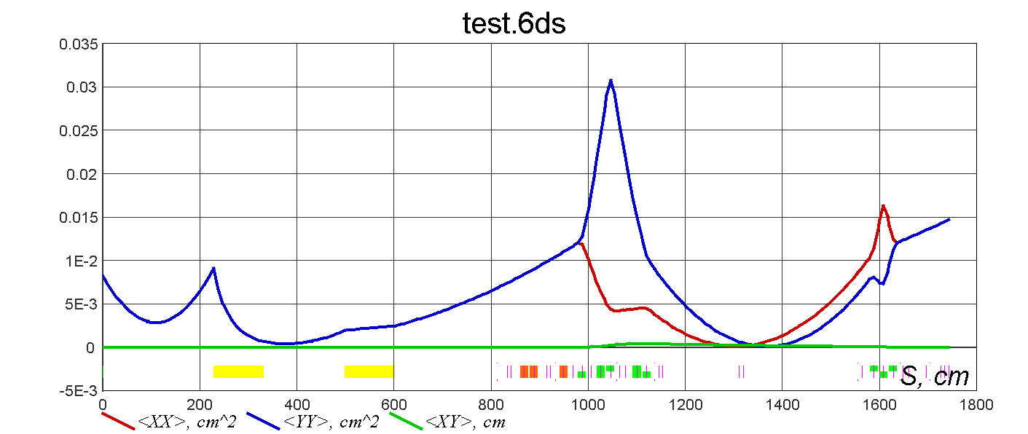
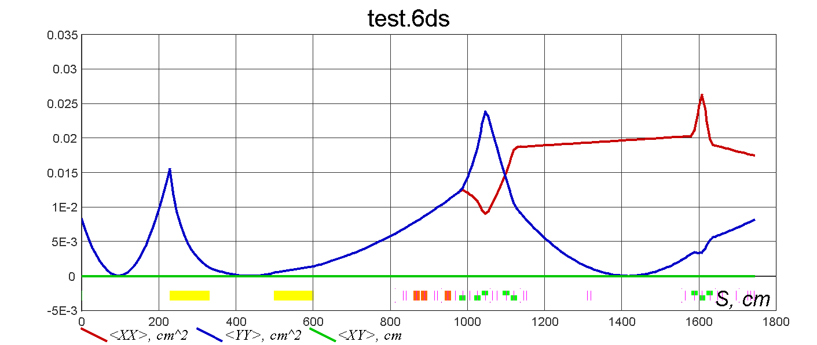
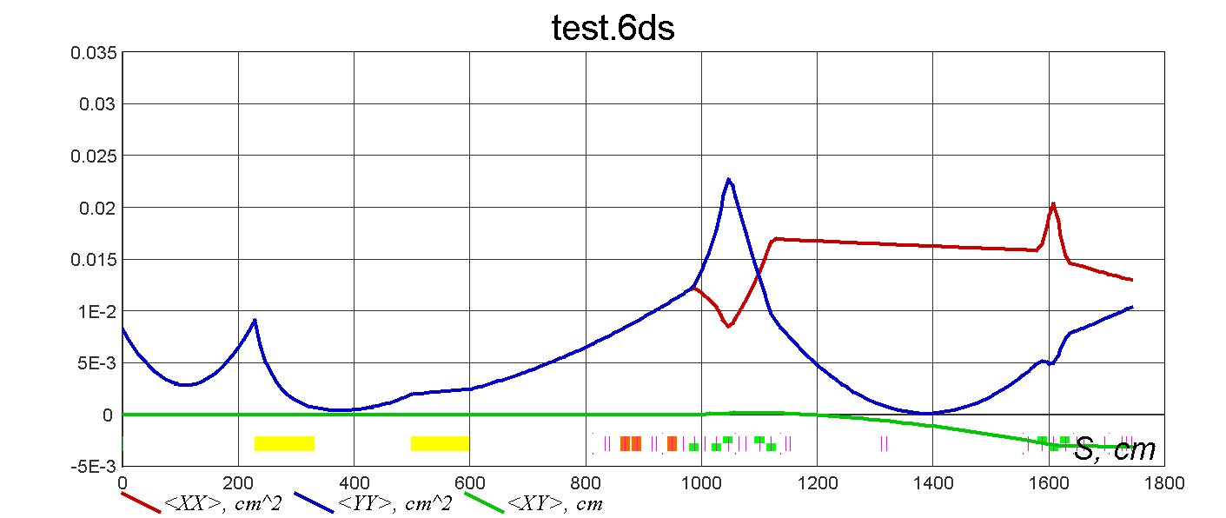
Solenoidal field is traceable
Hs=0
Hs!=0
“dNuX”
Coupled beam will be tilted if betas are not equal

Slide 10
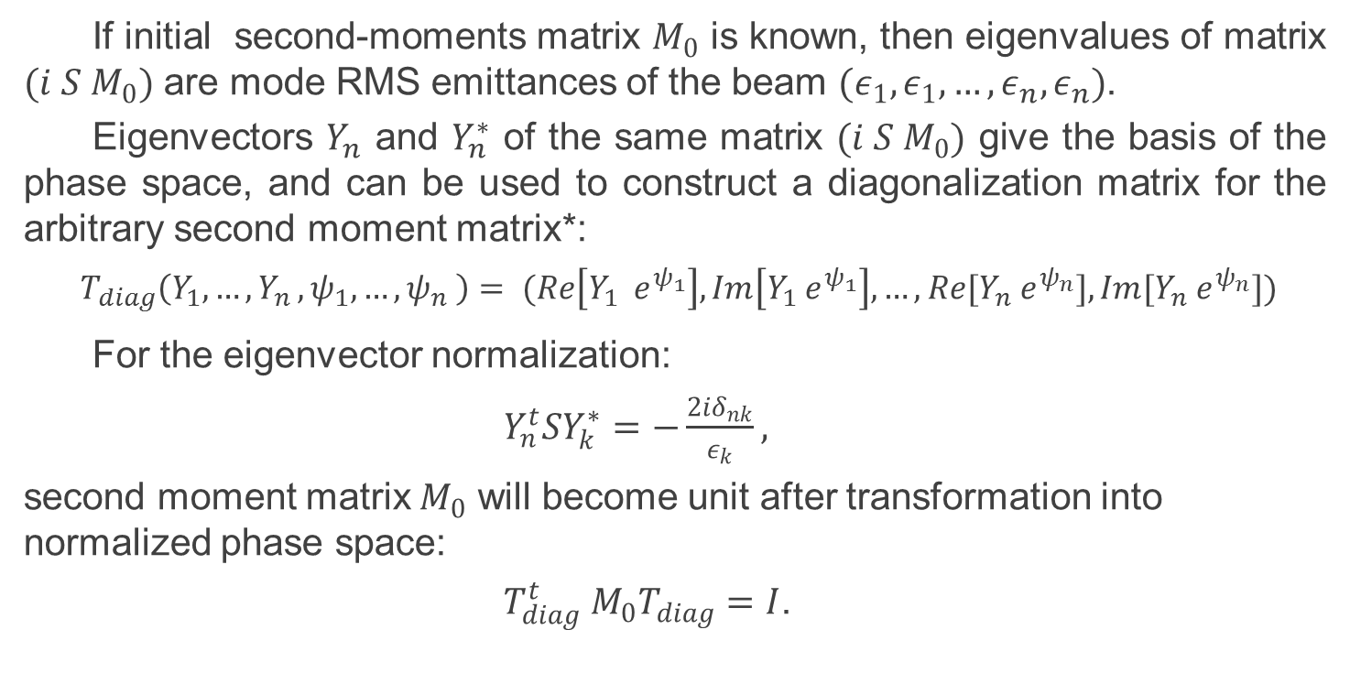
Normalization of 6D phase space
If initial second-moments matrix $M_{0}$ is known, then eigenvalues of matrix $(i S M_{0})$ are mode RMS emittances of the beam $(ε_{1},ε_{1},…,ε_{n},ε_{n})$.
Eigenvectors $Y_{n}$­ and $Y_{n}^{∗}$ of the same matrix $(i S M_{0})$ give the basis of the phase space, and can be used to construct a diagonalization matrix for the arbitrary second moment matrix*:
$${ T}_{diag}\left(Y_{1},{…,Y}_{n},ψ_{1},…,ψ_{n} \right)= (Re\left[Y_{1} e^{ψ_{1}}\right],Im\left[Y_{1} e^{ψ_{1}}\right],…,Re[Y_{n} e^{ψ_{n}}],Im[Y_{n} e^{ψ_{n}}])$$
For the eigenvector normalization:
$Y_{n}^{t}SY_{k}^{∗}=−\frac{2iδ_{nk}}{ε_{k}},$
second moment matrix $M_{0}$ will become unit after transformation into normalized phase space:
$T_{diag}^{t} M_{0}T_{diag}=I$.
*J. Williamson, “On the algebraic problem concerning the normal forms of linear dynamical systems”, American Journal of Mathematics, Vol. 58, No. 1 (Jan. 1936), pp. 141-163

Slide 11
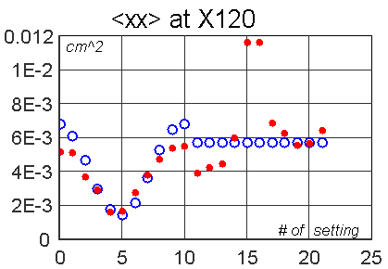
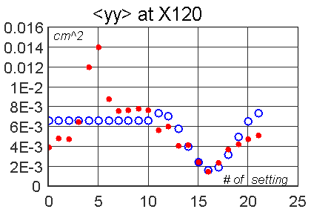
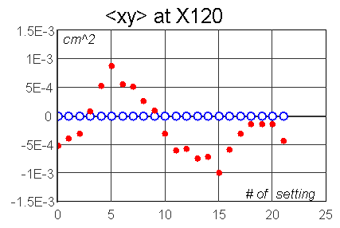
Finding initial conditions
Second moments of the beam from the same set of images were extracted.
Initial Twiss parameters and emittances was fitted to match model predictions and experimental data using described SVD-based solver
  Fit was intentionally limited to uncoupled case to see if tomography will resolve coupling

Slide 12
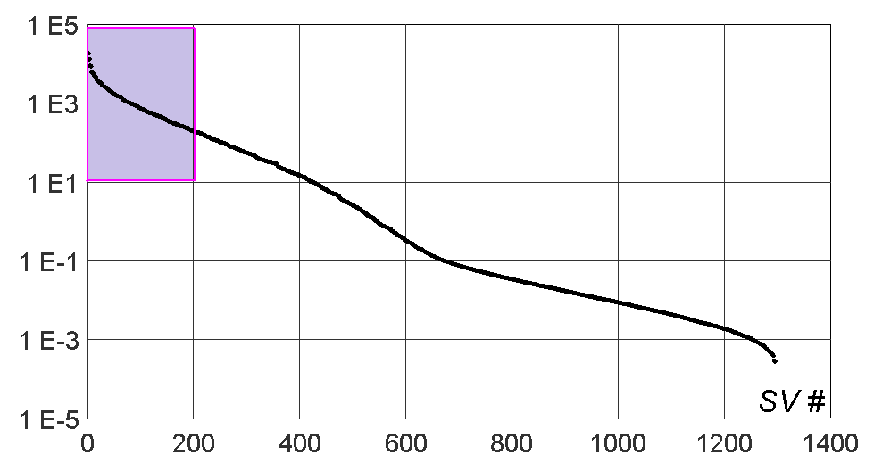
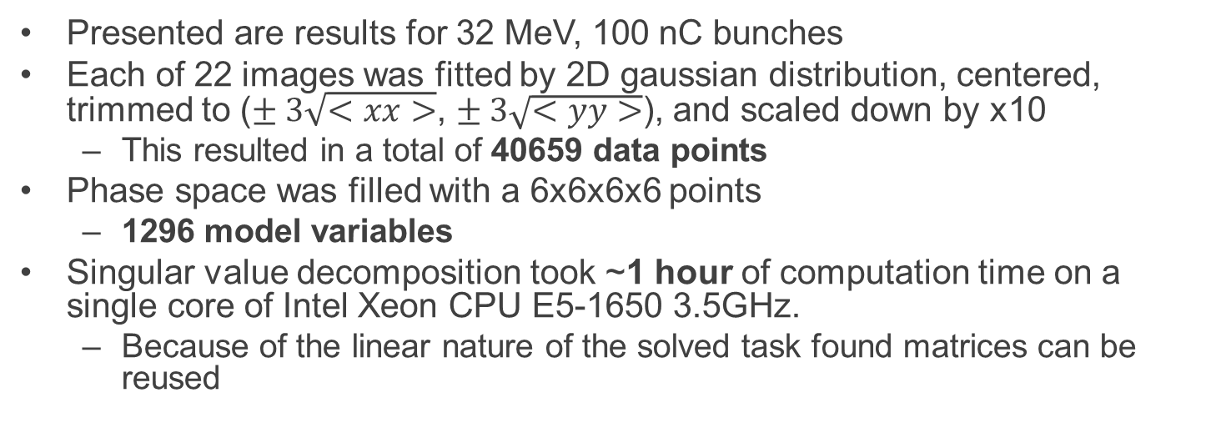
Results
Presented are results for 32 MeV, 100 nC bunches
Each of 22 images was fitted by 2D gaussian distribution, centered, trimmed to ($± 3\sqrt{<xx>}$, $± 3\sqrt{<yy>}$), and scaled down by x10
  This resulted in a total of 40659 data points
Phase space was filled with a 6x6x6x6 points
  1296 model variables
Singular value decomposition took ~1 hour of computation time on a single core of Intel Xeon CPU E5-1650 3.5GHz.
  Because of the linear nature of the solved task found matrices can be reused

Slide 13




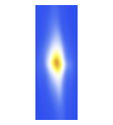
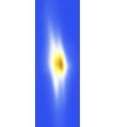
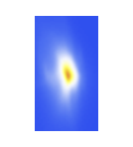








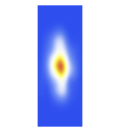

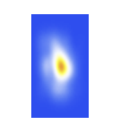
































Results
Measured 2D profiles
X plane scan.
Profiles from reconstructed 4D distribution
X plane.
Measured 2D profiles
Y plane scan.
Profiles from reconstructed 4D distribution
Y plane.
X’
Y
Y’
X’
Y’
Y’
2D projections of the reconstructed 4D distribution
X
X
X
Y
Y
X’

Slide 14
Conclusion
True 4D tomography was successfully done with real beam with reasonable resolution
  Improved resolution can be achieved by implementing SVD for sparse arrays and partial computation for selected number of biggest singular values
4 sets of raw experimental data is available for offline tests
Similar voxel-based techniques with bigger variety of free parameters can be tested, such as individual variability of voxels’ positions and covariance matrixes
  multidimensional multi-gaussian fit (iterative solution)
Fully 5D tomography with good resolution is a challenging but achievable goal. Coupled with experimental analysis of effects crucial for emittance preservation this will make a solid PhD program.

Slide 15
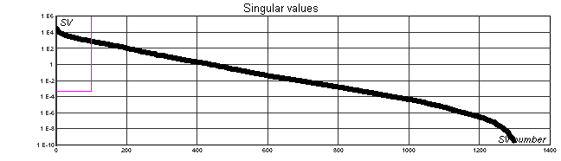
























Same conditions but 1pc bunch
Measured 2D profiles
X plane scan.
Profiles from reconstructed 4D distribution
X plane.
Measured 2D profiles
Y plane scan.
Profiles from reconstructed 4D distribution
Y plane.
X’
Y
Y’
X’
Y’
Y’
2D projections of the reconstructed 4D distribution
X
X
X
Y
Y
X’
Wrong initial condition resulted in too narrow grid and erratic distributions in Y

