Slide 1
Propagation of Magnetized Beams for an EIC Bunched Beam Cooler
Speaker: Stephen Benson, Jefferson Lab
collaborator(s): Philippe Piot, Andrew Hutton, Kevin Jordan, Chris Tennant

Slide 2
Outline
Bunched beam Cooler design
Transport of magnetized beams
Experiments at IOTA/FAST.
  Straight Line
  Arc studies
Summary (possible future work)

Slide 3
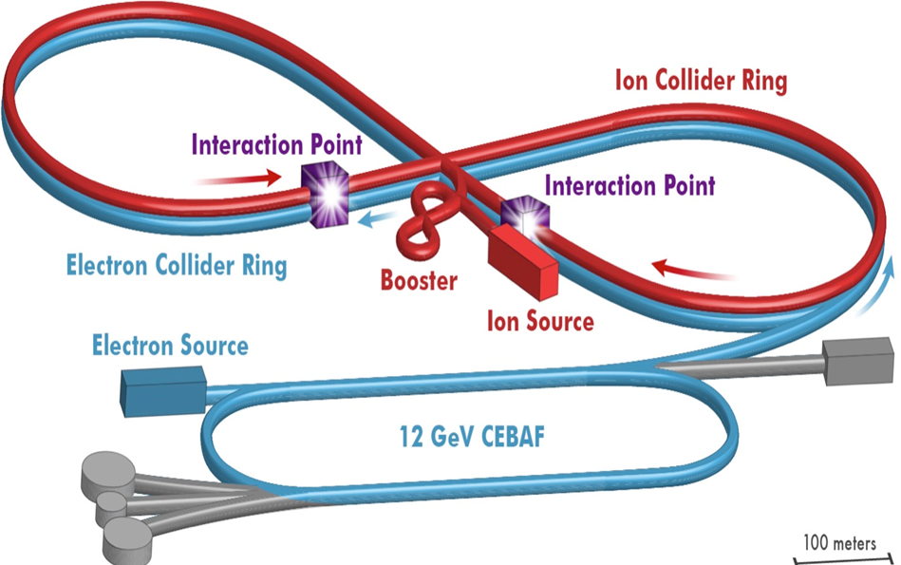

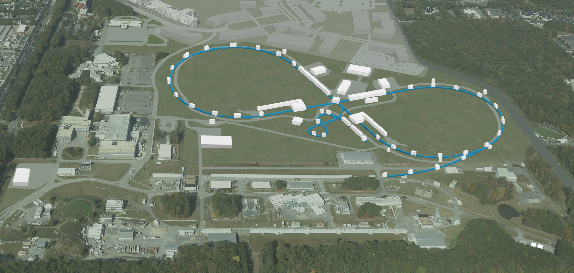
JLEIC : An Electron-Ion Collider at Jefferson Lab
Electron complex
CEBAF as a full energy injector
Collider ring
Ion complex
  Ion source/Linac
  Booster (8 GeV)
  Collider ring
IP/detectors
  Two, full acceptance
  Hori. crab crossing
Polarization
Figure-8 shape

Slide 4
Multi-Step Cooling for High Luminosity
Cooling of JLEIC proton/ion beams
Achieving very small emittance (~10x reduction) & very short bunch length ~1 cm (with SRF)
Suppressing IBS induced emittance degradation
high cooling efficiency at low energy & small emittance
Pre-cool when energy is low
ion linac
DC cooler
booster
(0.285 to 8 GeV)
ion sources
DC/ERL cooler
collider
(8 to 100 GeV)
Cool when emittance is small
(after pre-cool at low energy)
Ring | Functions | Proton kinetic E (GeV) | Lead ion kinetic E (GeV/u) | Electron kinetic E (MeV) | Cooler type
booster ring | Accumulation of positive ions |  | 0.1 (injection) | 0.054 | DC
collider ring | Maintain emitt. during stacking |  | 2 (injection) | 1.1 | DC
 | Pre-cooling for emitt. reduction | 7.9 (injection) | 7.9 (ramp to) | 4.3 | DC
 | Maintain emitt. during collision | Up to 100 | Up to 40 | Up to 54.5 | ERL
Can’t reduce emittance due to space charge limit
Pre-cooling both protons and lead ions
ERL cooler can’t reach energy below 20 MeV

Slide 5
At High Energy, Need RF Accelerator

Slide 6
Magnetized Beams Need for Cooler

Slide 7
Baseline Design is Cooling Ring Fed by ERL
Same-cell energy recovery in 952.6 MHz SRF cavities
Uses harmonic kicker to inject and extract from CCR (divide by 11)
Assumes high charge, low rep-rate injector (w/ subharmonic acceleration and bunching)
Use magnetization flips to compensate ion spin effects
top ring: CCR
ion beam
magnetization flip
magnetization flip
ion beam
B < 0
B > 0
B > 0
B < 0
linac
beam dump
injector
fast extraction kicker
septum
septum
fast injection kicker
circulating bunches
extracted
injected
De-chirper
vertical bend
Re-chirper
bottom ring: ERL

Slide 8
Strong Cooler Specifications (Electrons)
Energy 20–55 MeV
Charge 1.6 (3.2) nC
CCR pulse frequency 476.3 MHz
Gun frequency 43.3 MHz
Bunch length (tophat) 2 cm (23°)
Thermal (Larmor) emittance <19 mm-mrad
Cathode spot radius 3.1 mm
Cathode field 0.05 T ³
Gun voltage 400 kV
Normalized hor. drift emittance 36 mm-mrad
rms Energy spread (uncorr.)* 3x10⁻⁴
Energy spread (p-p corr.)* <6x10⁻⁴
Solenoid field 1 T
Electron beta in cooler 37.6 cm
Solenoid length 4x15 m
Bunch shape beer can

Slide 9
Cooler Specifications (protons)
Case 1 – 63.3 GeV center of mass energy
Energy 100 GeV
Particles/bunch 4.0x10¹⁰
Repetition rate 119.08 MHz
Bunch length (rms) 2.2 cm
Normalized emittance (x/y) 0.9/0.18 mm-mrad
Betatron function in cooler 60 m (at point between solenoids)
Case 2 – 44.7 GeV center of mass energy
Energy 100 GeV
Particles/bunch 1.0x10¹⁰
Repetition rate 476.3 MHz
Bunch length (rms) 1.0 cm
Normalized emittance (x/y) 0.5/0.1 mm-mrad
Betatron function in cooler 60 m (at point between solenoids)
Ion ring lattice may be coupled or dispersed in solenoid. Ion beam may be partially offset from the electron beam.

Slide 10
K. J. Kim’s Theory of Magnetized Beams

Slide 11
Making a Magnetized Beam

Slide 12
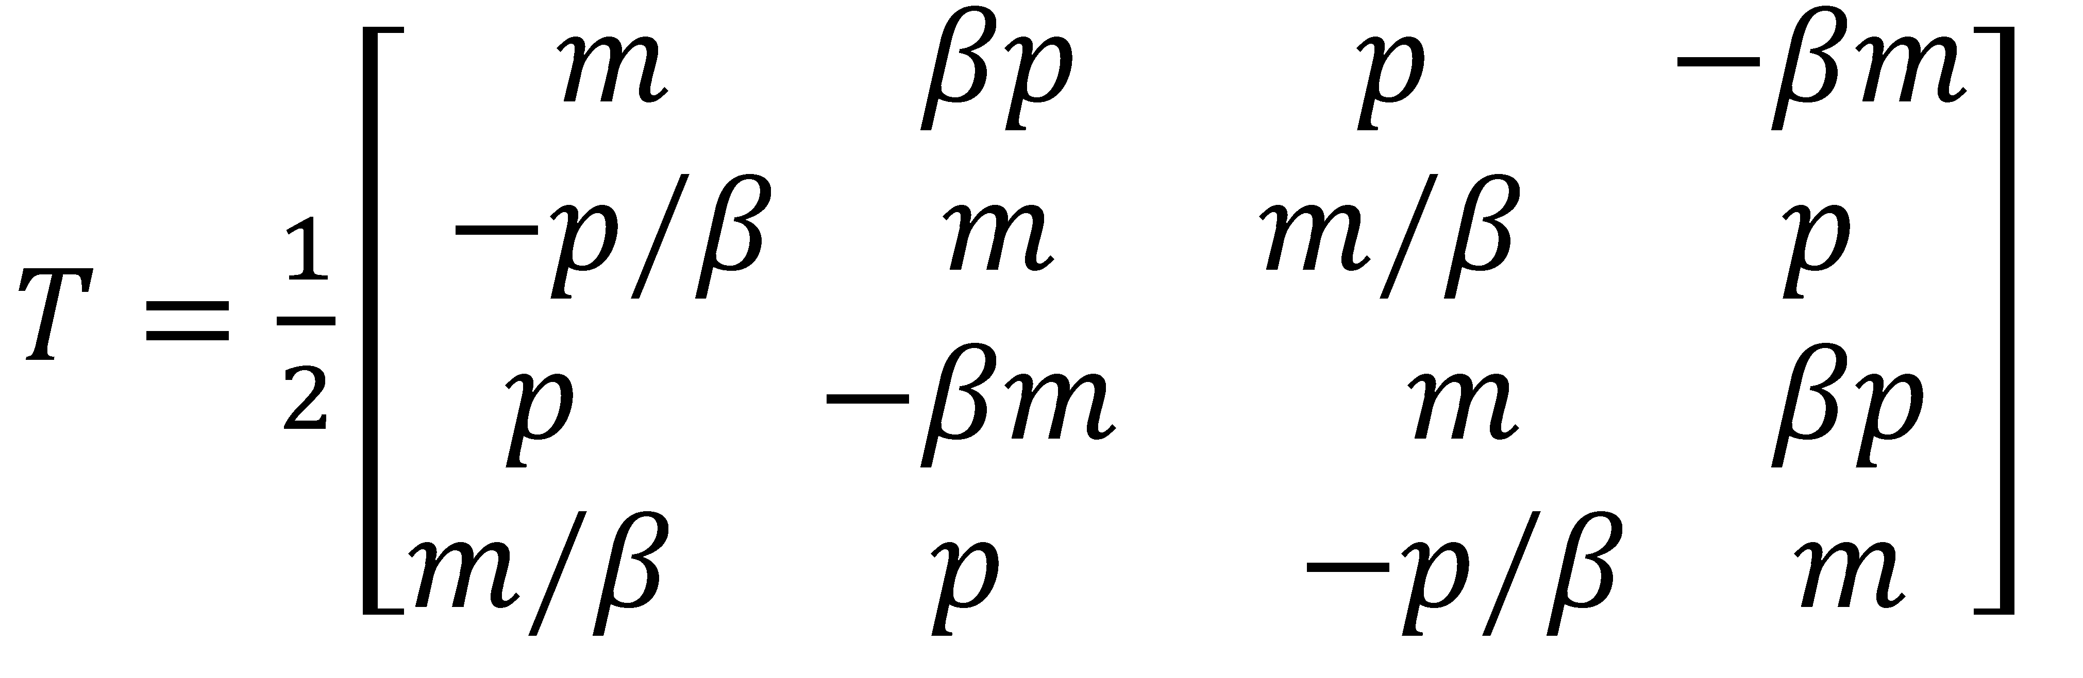
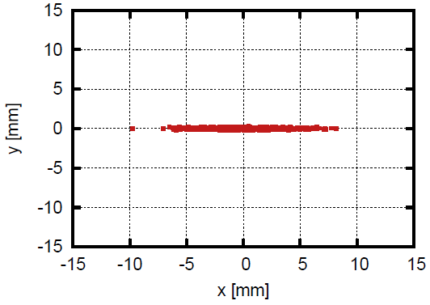
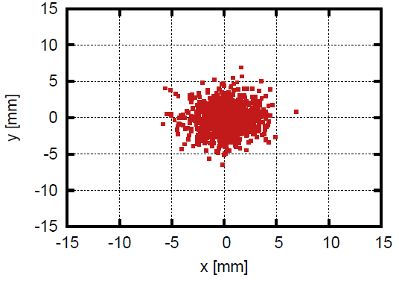
Making a magnetized beam
Make a flat beam distribution (σ_{x} >> σ_{y})
Apply a flat beam transform, as in JLAB-TN-15-022
Note: Also works in reverse
Result: magnetized beam
m=cos μ – sin μ
p=cos μ + sin μ
FBT

Slide 13
For Example

Slide 14
Transport of Magnetized Beam
We can transport beams and keep them “calm” if we use solenoids to focus and n=1/2 dipoles to bend the beam.
We have shown that the transport only has to be globally symmetric but local symmetry is preferred.
Can measure beam properties after a Flat Beam Transform.

Slide 15
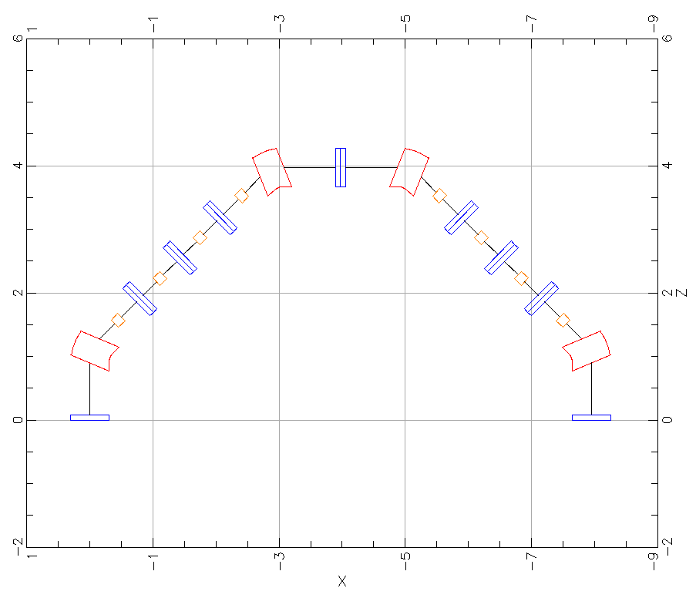
Simple Arc Layout
design by D. Douglas
dipole
quadrupole
sextupole

Slide 16
Possible Merger Option
Recirculated Beam
Injected Beam
RF Separator with Superposed Magnetic Field
Injector Cryomodule
Septum Magnet
ERL Cryomodule
Use an RF Separator to separate the injected beam from the recirculating beam
Immerse the RF Separator in a DC magnetic field
Arrange timing and relative amplitudes so that the injected beam is not deflected
  Bunches are at maximum of RF deflection – bunch center has zero slope
This means that the kick seen by the recirculated beam is doubled
Needs to be sufficient to provide adequate separation at the septum

Slide 17
Waveforms
Injected Bunch
Recirculated Bunch

Slide 18
FOA proposal
Produce and measure 3.2 nC magnetized bunched from FAST.
  Use existing photogun with slightly modified solenoid PS and laser transport (larger spot size).
  Measure at full energy using flat beam transform and emittance measurements.
Demonstrate Transport over long distance
  Measure beam properties before and after a long drift.
Measure effect of merger RF cavity on magnetized beam.
  Use new cavity or borrow from Cornell.
  Need to identify power supply.
Beam Halo measurements
  Use LDR viewer to characterize halo on the beam.
Try to bend magnetized beam
  Use IOTA ring to bend beam

Slide 19
BACKUPS

Slide 20
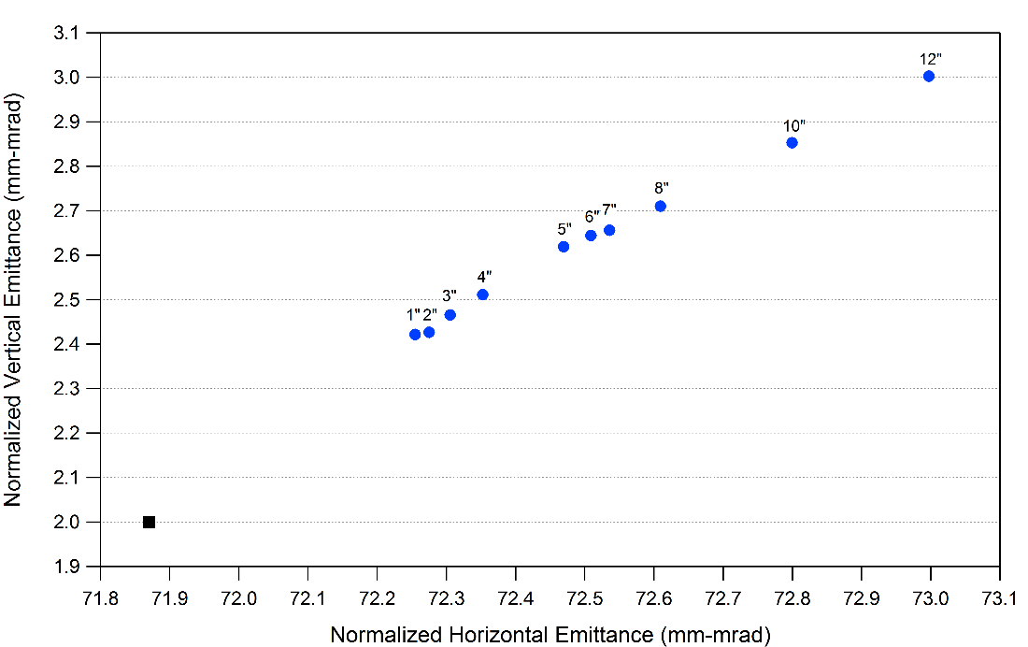
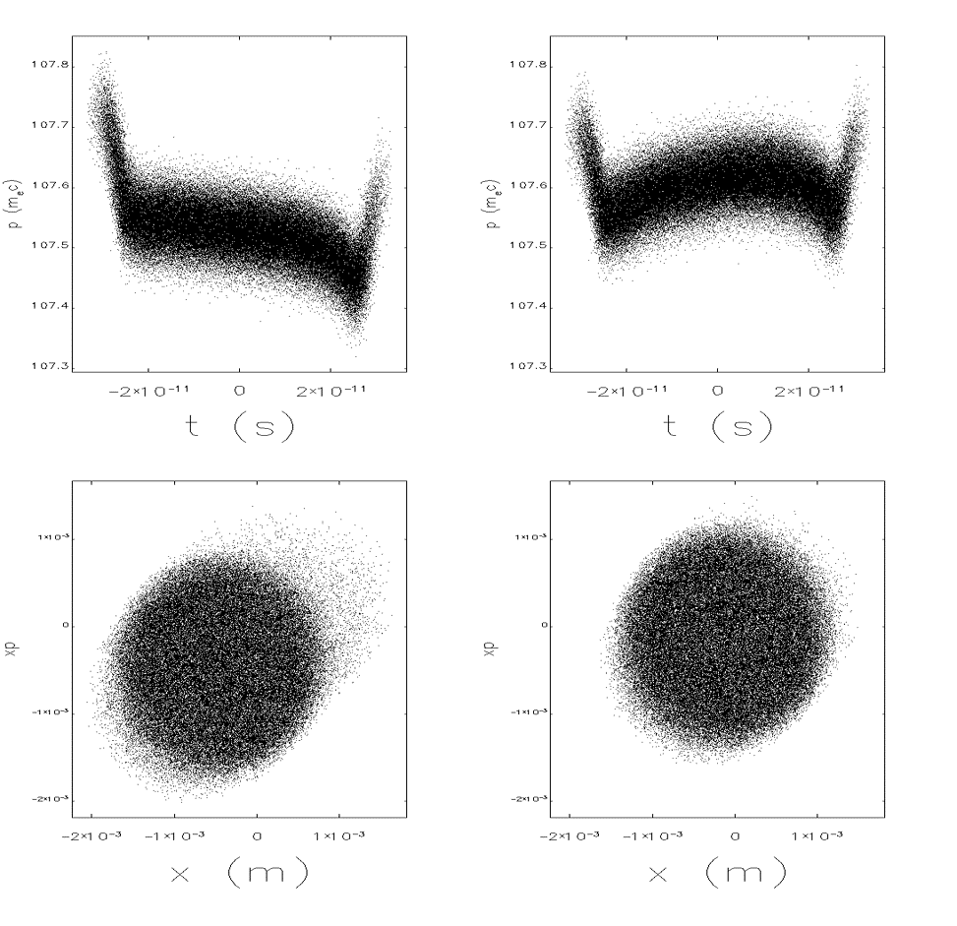
Bmad with CSR and Shielding
Shielding effects of one pass through an arc
with CSR
with CSR + shielding

