Slide 1
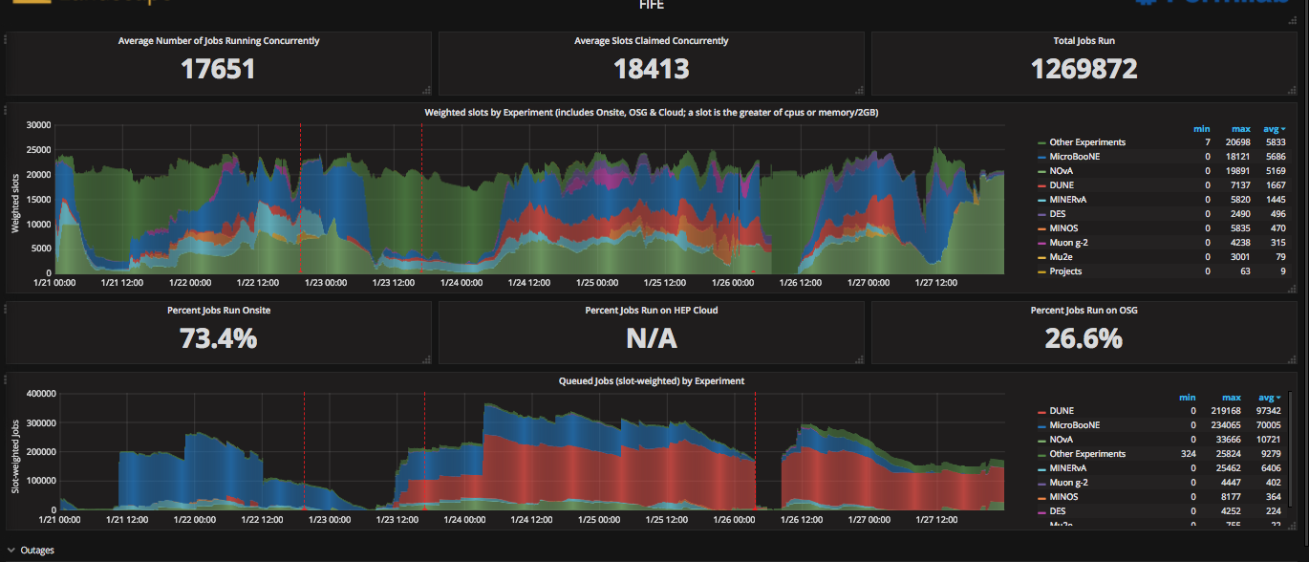
FIFE Operations (combined offsite and onsite)
https://fifemon.fnal.gov/monitor/dashboard/db/scd-summary-fife
Sam web server VM went down Monday evening. Rebooted Tuesday morning.
Batch system host became unavailable after yum auto updates Friday morning. Fixed by midmorning on

Slide 2
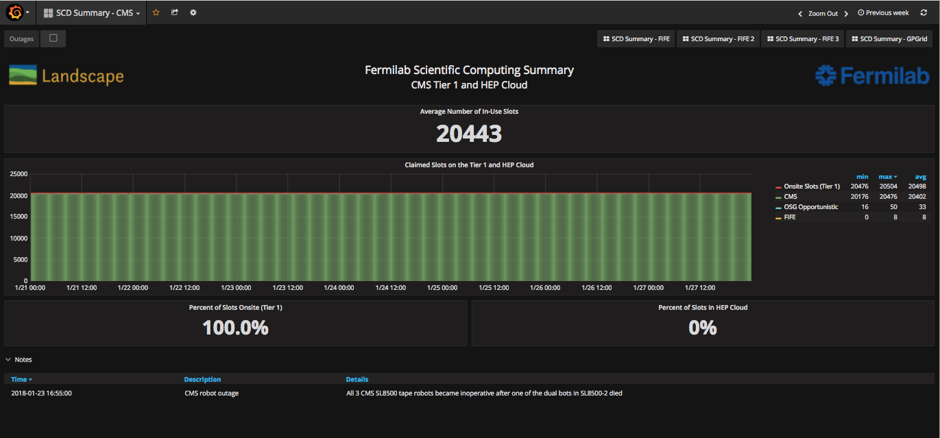
CMS Operations
https://fifemon-pp.fnal.gov/dashboard/db/scd-summary-cms

Slide 3
Dcache issues from the past week
Dcache queues were overloaded several times this week. It’s a queue, so everyone gets backed up.
  Analysis jobs, not production
  Might even be a single user or two.
Working on
  Collecting requirements/use cases from experiments in their small file access patterns
  Improving analytics to understand root cause how to best address. Approach will vary depending on result(s)
Mitigations/solutions depending on more information:
  Balance cost vs performance

Slide 4
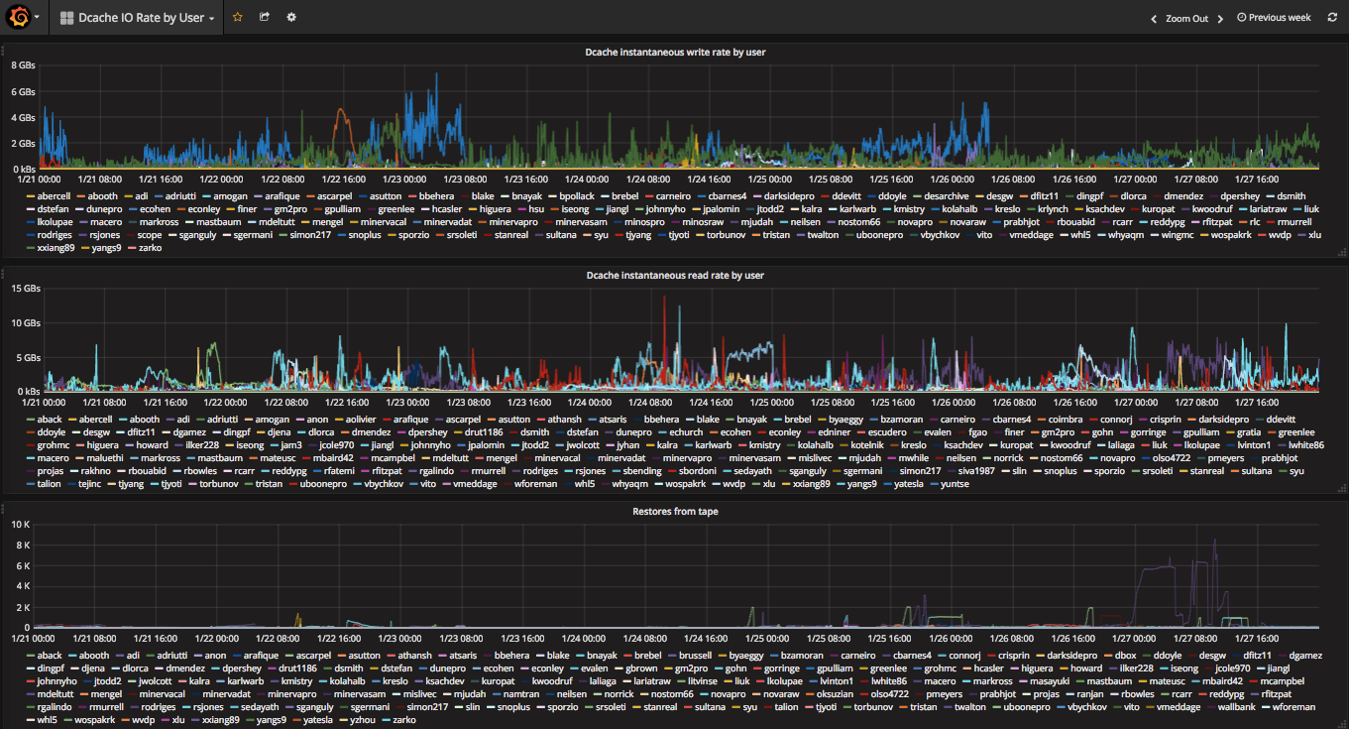
Example of the new plots

