Slide 1
Status of SSR1 cavities and cryomodule
Donato Passarelli
SRF Linac R&D and Risk Mitigation meeting
24 January 2018

Slide 2
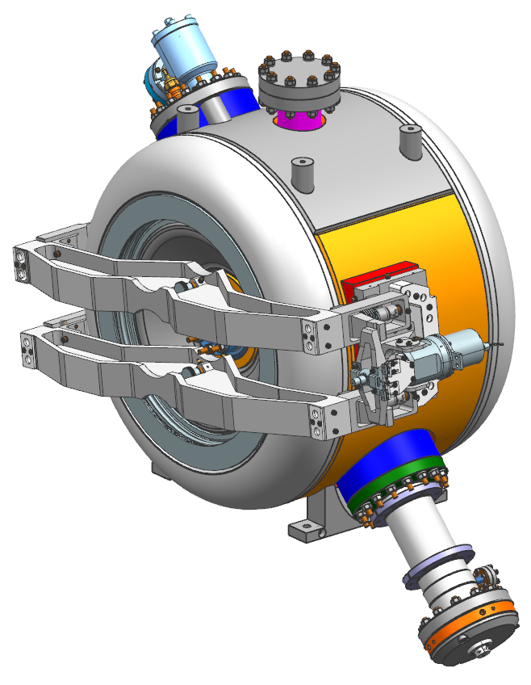
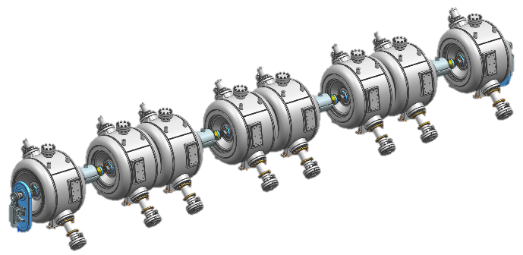
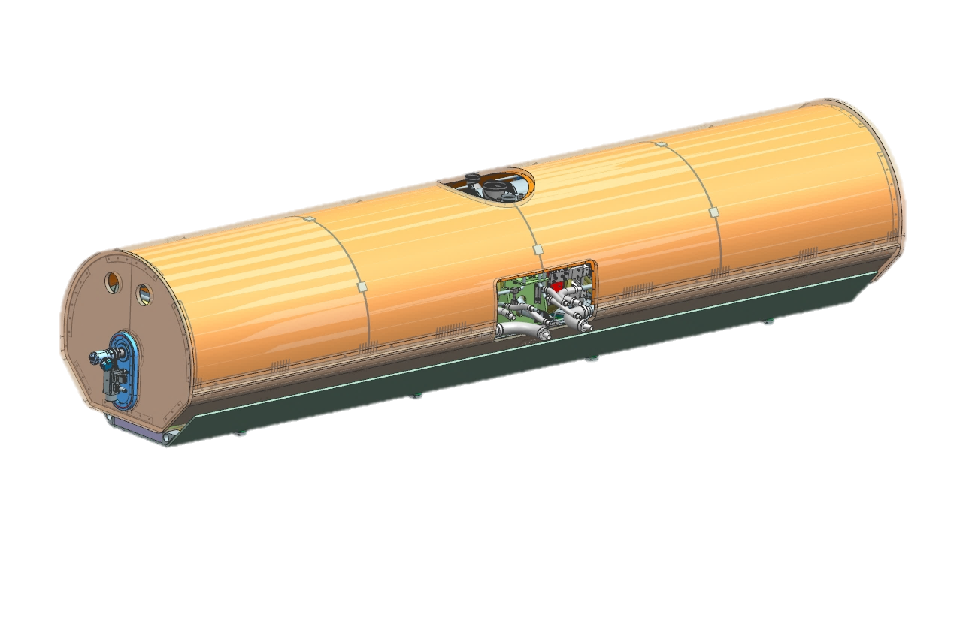
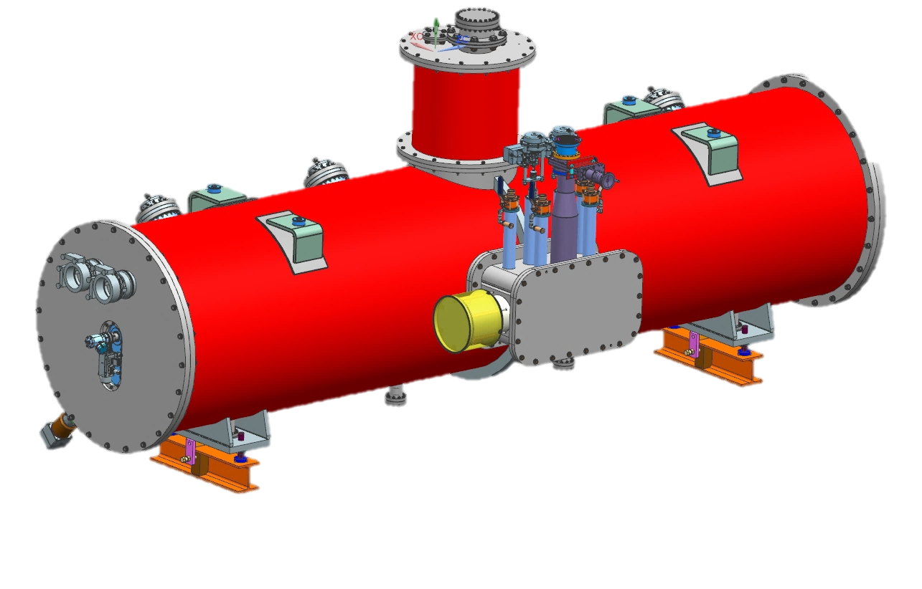
Next milestones and technical challenges
SSR1 CM-1
Qualification of 8 jacketed cavities
  Cavities performance and coupler reliability
Cavities string assembly
Coldmass assembly
Final cryomodule integration

Slide 3
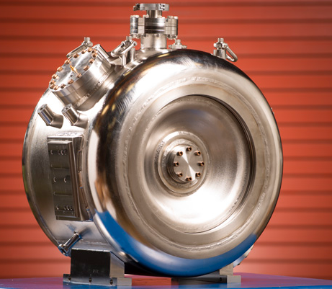
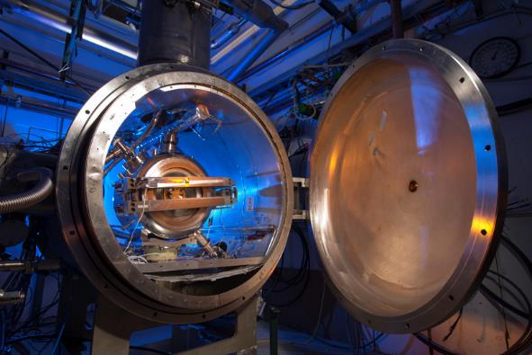
SSR1 cavities: testing plan
Cavities
  10 FNAL cavities were successfully jacketed with stainless steel vessels showing a very low df/dp
  9 jacketed cavities are available for preparation and RF qualification
Qualification plan (Jan. 2018)
  Four cavities (S110, S111, S112, S113) will be reprocessed, prepared and qualified with low power coupler (LPC) prior their final qualification with high power coupler (HPC and tuner.
    S110: HPR only → testing w/ LPC → testing w/ HPC
    S111: BCP+HPR → testing w/ LPC → testing w/ HPC
    S112: BCP+HPR → testing w/ LPC → testing w/ HPC
    S113: BCP+HPR → testing w/ LPC → testing w/ HPC
  The testing plan for the other four cavities (S105, S106, S107, S109) will be defined based on the next test results and couplers availability.
Current technical challenges
  strong radiation due to field emission (FE) is the limiting factor of the performance of cavities tested so far.
  Couplers (vacuum-end) reliability
  Multipacting (solved --> 120C baking)

Slide 4
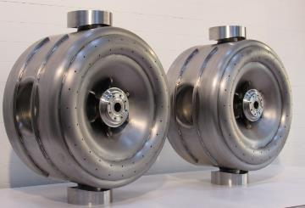
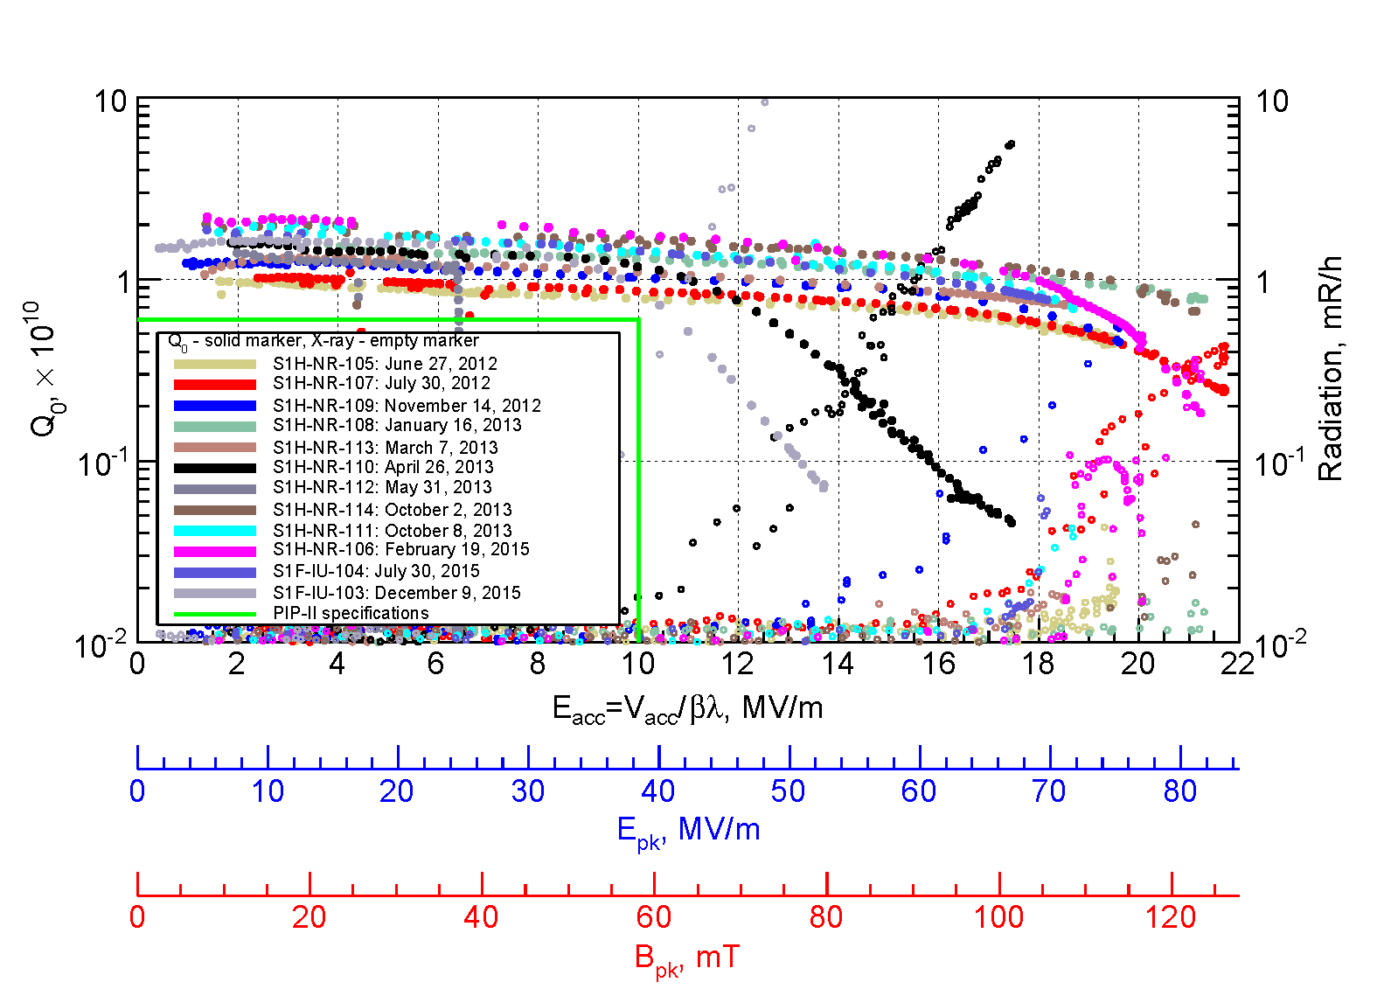
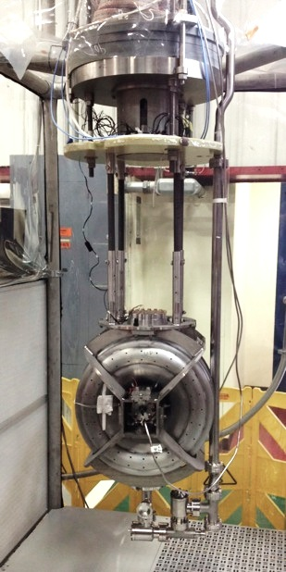
SSR1 bare cavities qualification: history
  12 bare SSR1 cavities (10 FNAL and 2 DAE BARC/IUAC) met PIP-II requirements in VTS

Slide 5
SSR1 jacketed cavities: history
10 STC tests and 1 VTS test of SSR1 cavities over last 18 months
The couplers appear to be the source of the limited performance. The manufacturing technique are questioned. A new order with a more reliable vendor was made.

Slide 6
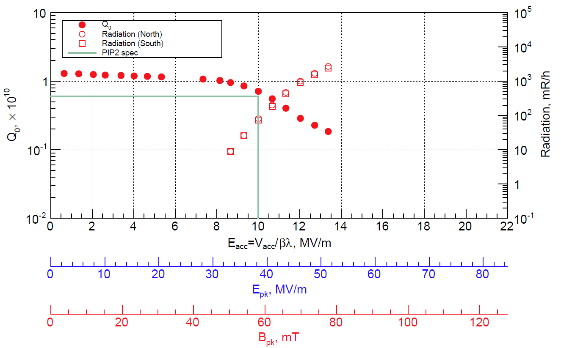
Cavity S113, January 2018, LPC

Slide 7
Possible sources of radiation due to field emission
Lab 2 facility is not fully qualified for SRF activities
  Coupler assembly at ANL
Degradation of Niobium welding the helium vessel
  Testing again cavity S107 that showed excellent performance in 2014 (LPC) and 2017 (HPC)
the vacuum cart at STC is contaminated
  No active pumping of the RF volume while in the STC
defects/residue on the RF surfaces of the cavities due to the processing and preparation of cavity at ANL
  Maintenance of the ANL facility and equipment
defects/residue on the RF surfaces (ceramic, brazed joints, etc.) of the couplers
  Unity coupler (no ceramic and known material and manufacturing process)

Slide 8
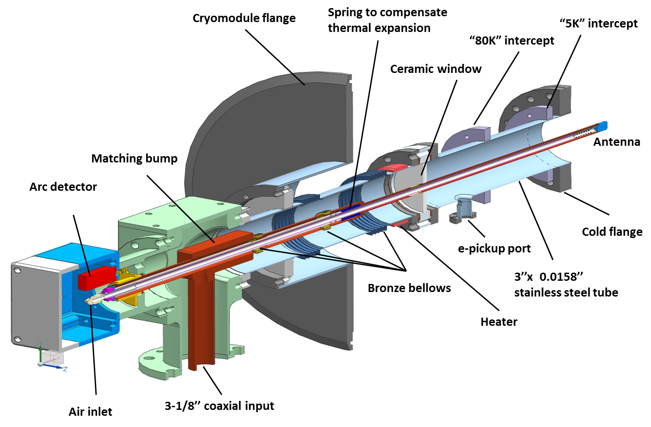
SSR1 coupler

Slide 9
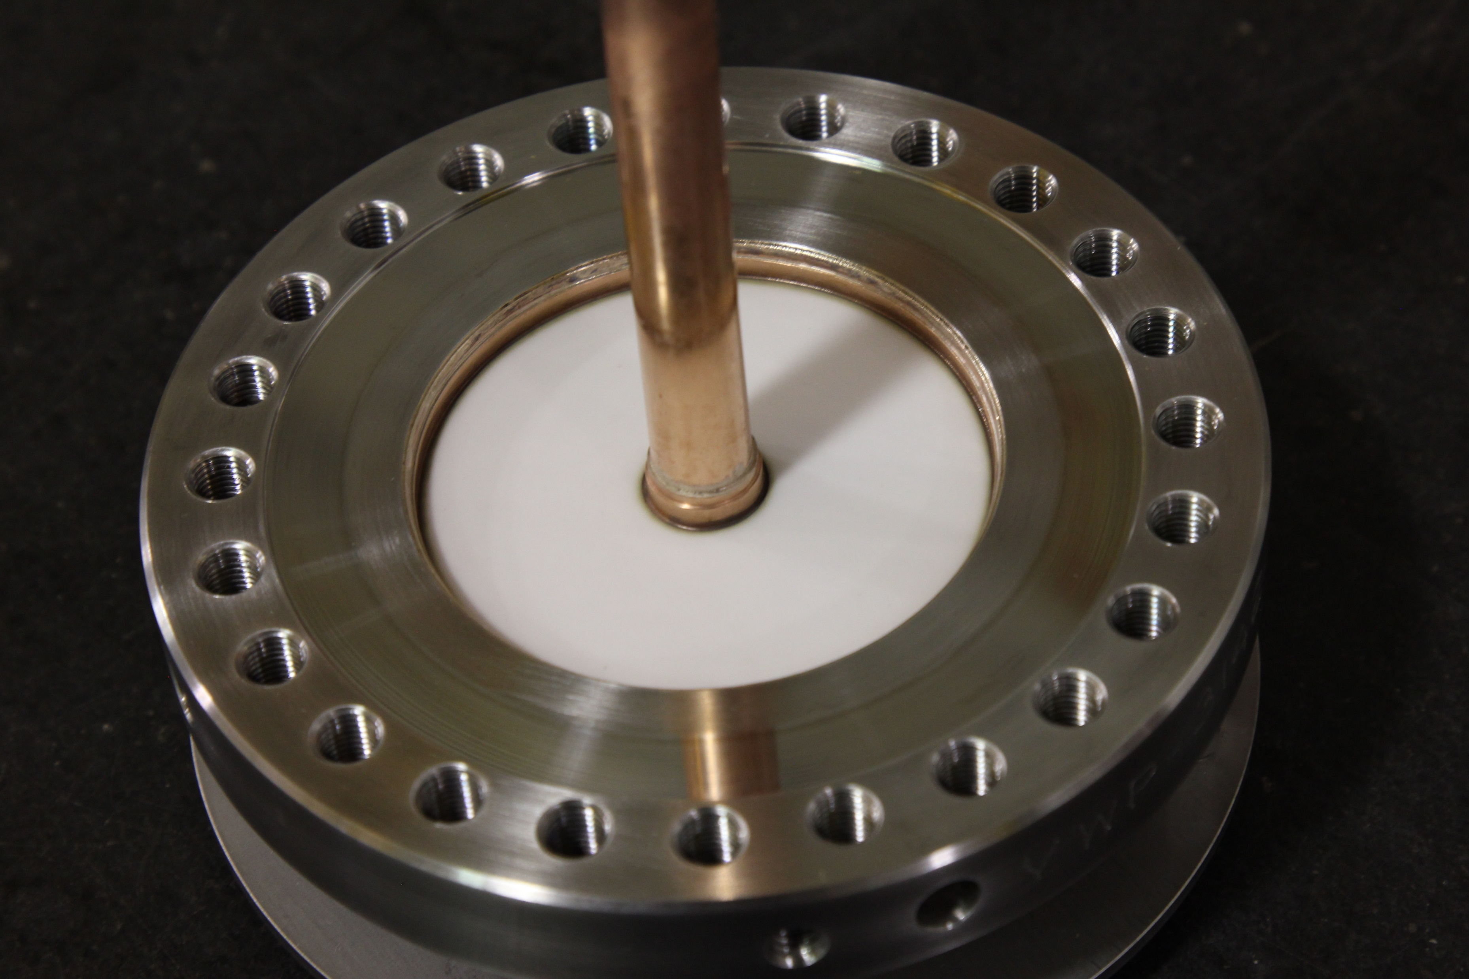
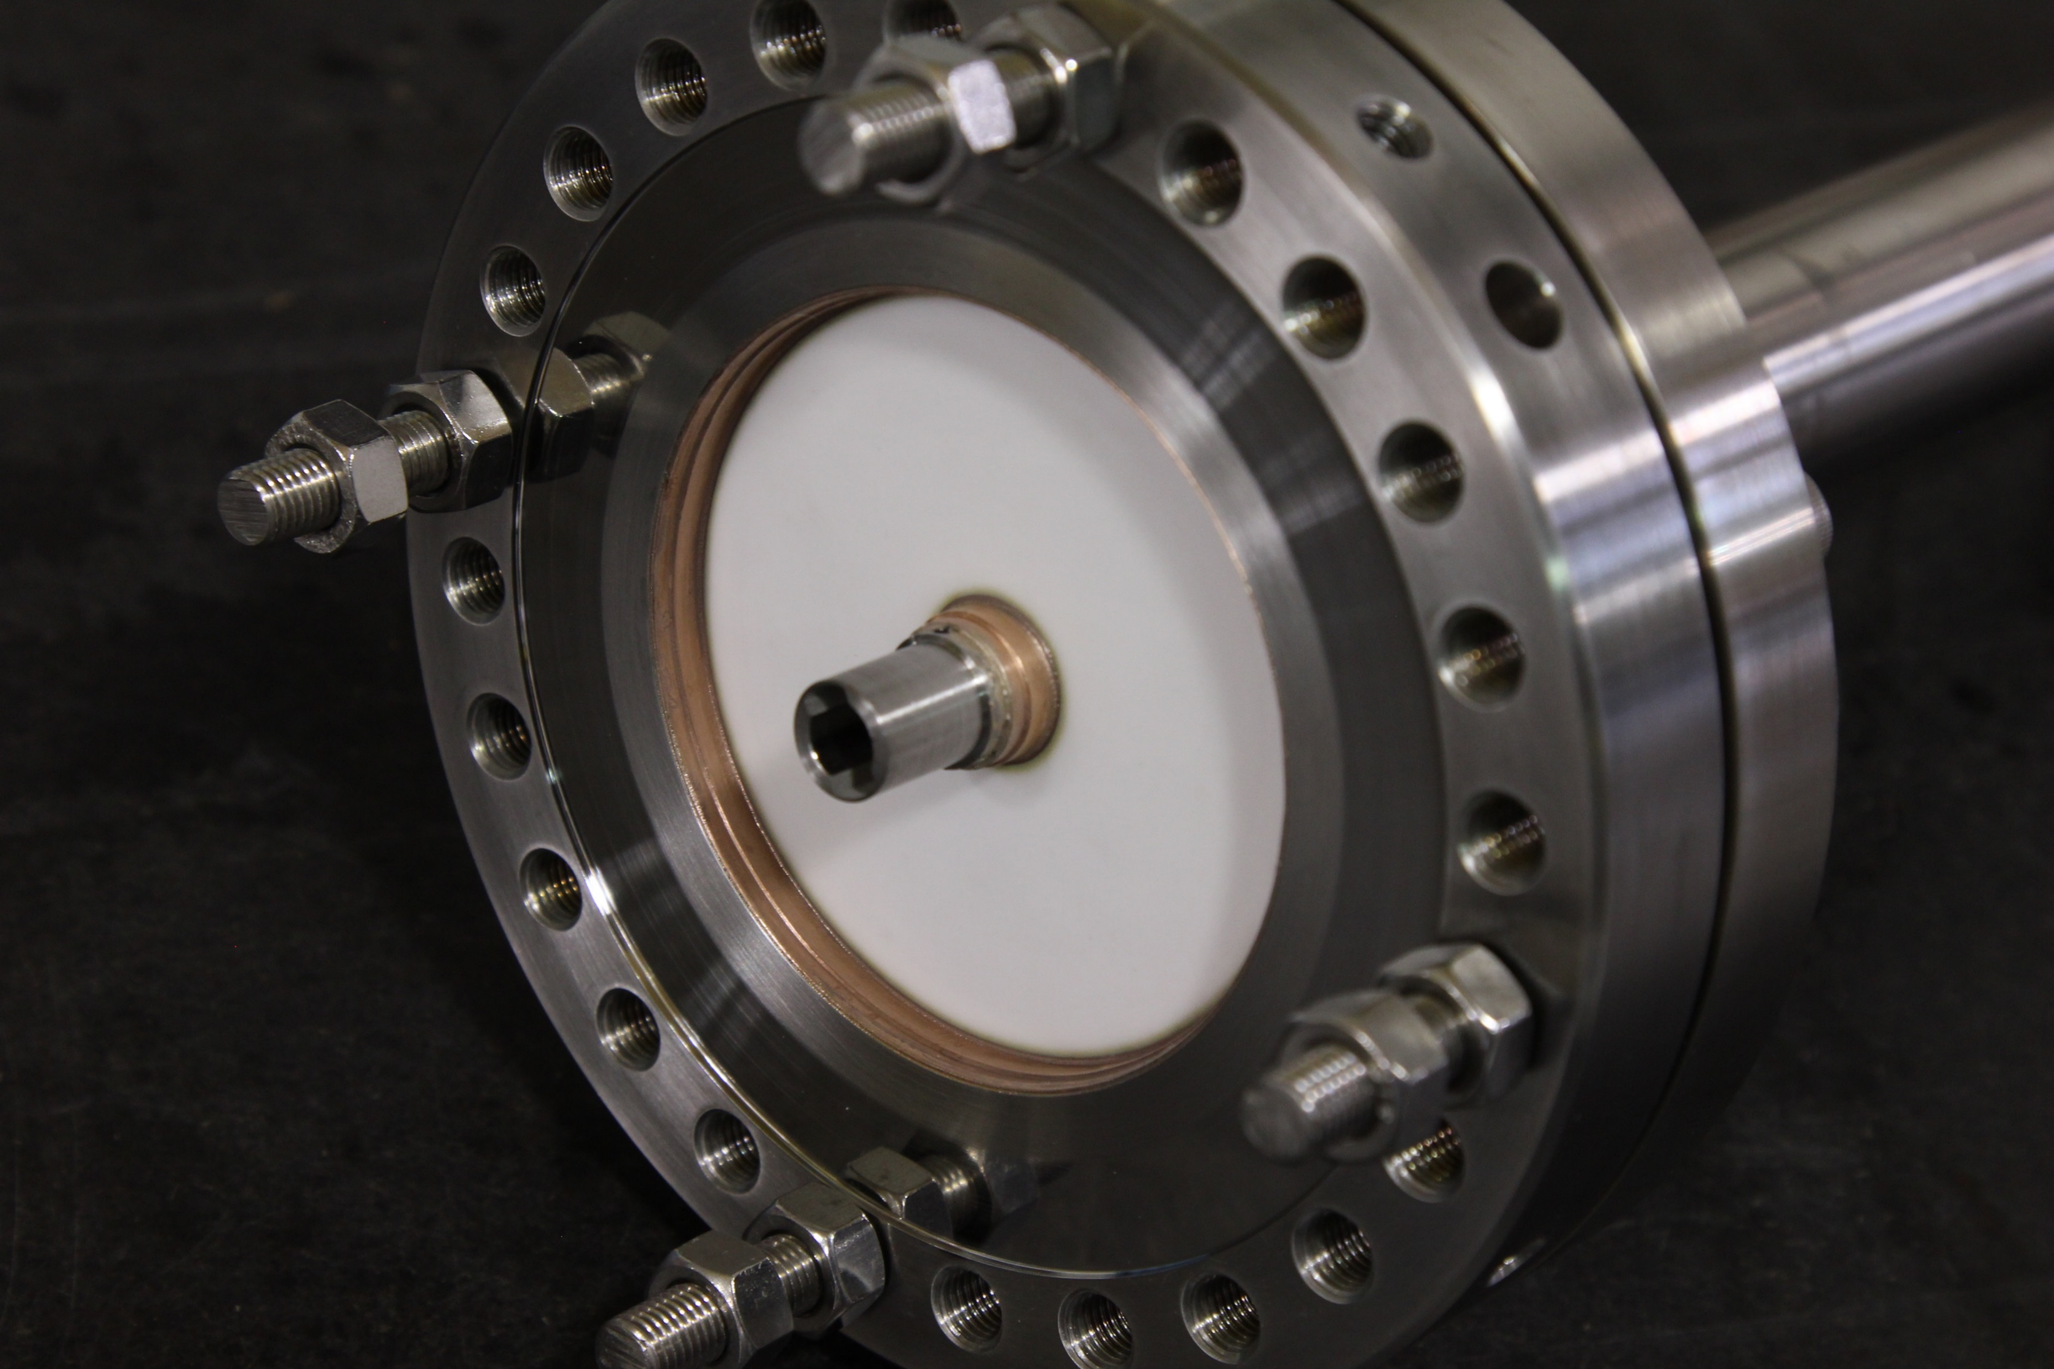
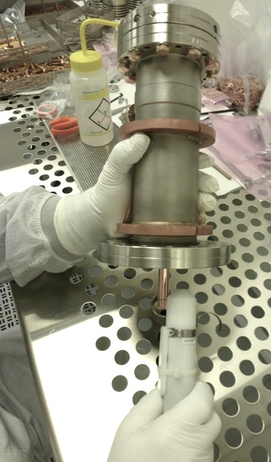
SSR1 antenna couplers: history
Prototypes
  Three prototype antennas were made by Omley.
  Two antennas were successfully tested up to 30 kW, CW, full reflection.
  One antenna was tested to failure at 47 KW, CW, full reflection.
  One antenna was successfully used to qualify cavity S107 (R&D phase).
Production couplers
  Ten couplers were ordered to Mega Industries.
  Only four couplers were received after long time from the promised date.
  Two couplers were successfully tested on the test stand up to 20 kW, CW, full reflection.
  Mega Ind. faced difficulties with brazing and achieving vacuum tightness. The use of Vacseal (a material not SRF compatible) appears evident on some joint. It might be the source of contamination that leaded to have strong radiation due to field emission.
  A new order of ten new antennas was placed with more reliable vendors (five to CPI, five to CoorsTek).

Slide 10
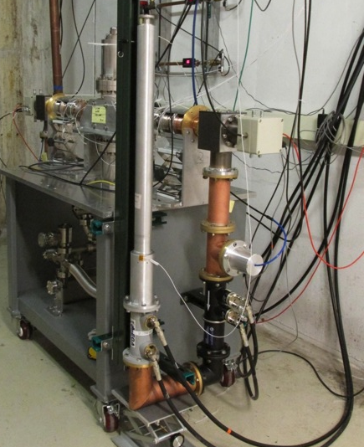
SSR1 antenna couplers: testing plan
RF conditioning at room temperature
  Visual inspection and leak check
  Cleaning and installation of the vacuum end assembly on the RF test stand in cleanroom
  Testing up to specified power (20kW) in full reflection to check the structural performance of the ceramic window.
  During the test we check the RGA scan to monitor the emission of undesired substances (i.e. hydrocarbons) from the antenna.
  All activities of assembling/disassembling take place in the cleanroom (detailed procedures are being developed)
Fully integrated test at cold temperature
  After qualification at room temperature, the vacuum-end coupler is installed on the jacketed cavity in class 10 cleanroom
SSR1 production couplers
  Units made by Mega will not be further used for future tests
  Units made by CPI and Coorstek will undergo the qualification cycle

Slide 11
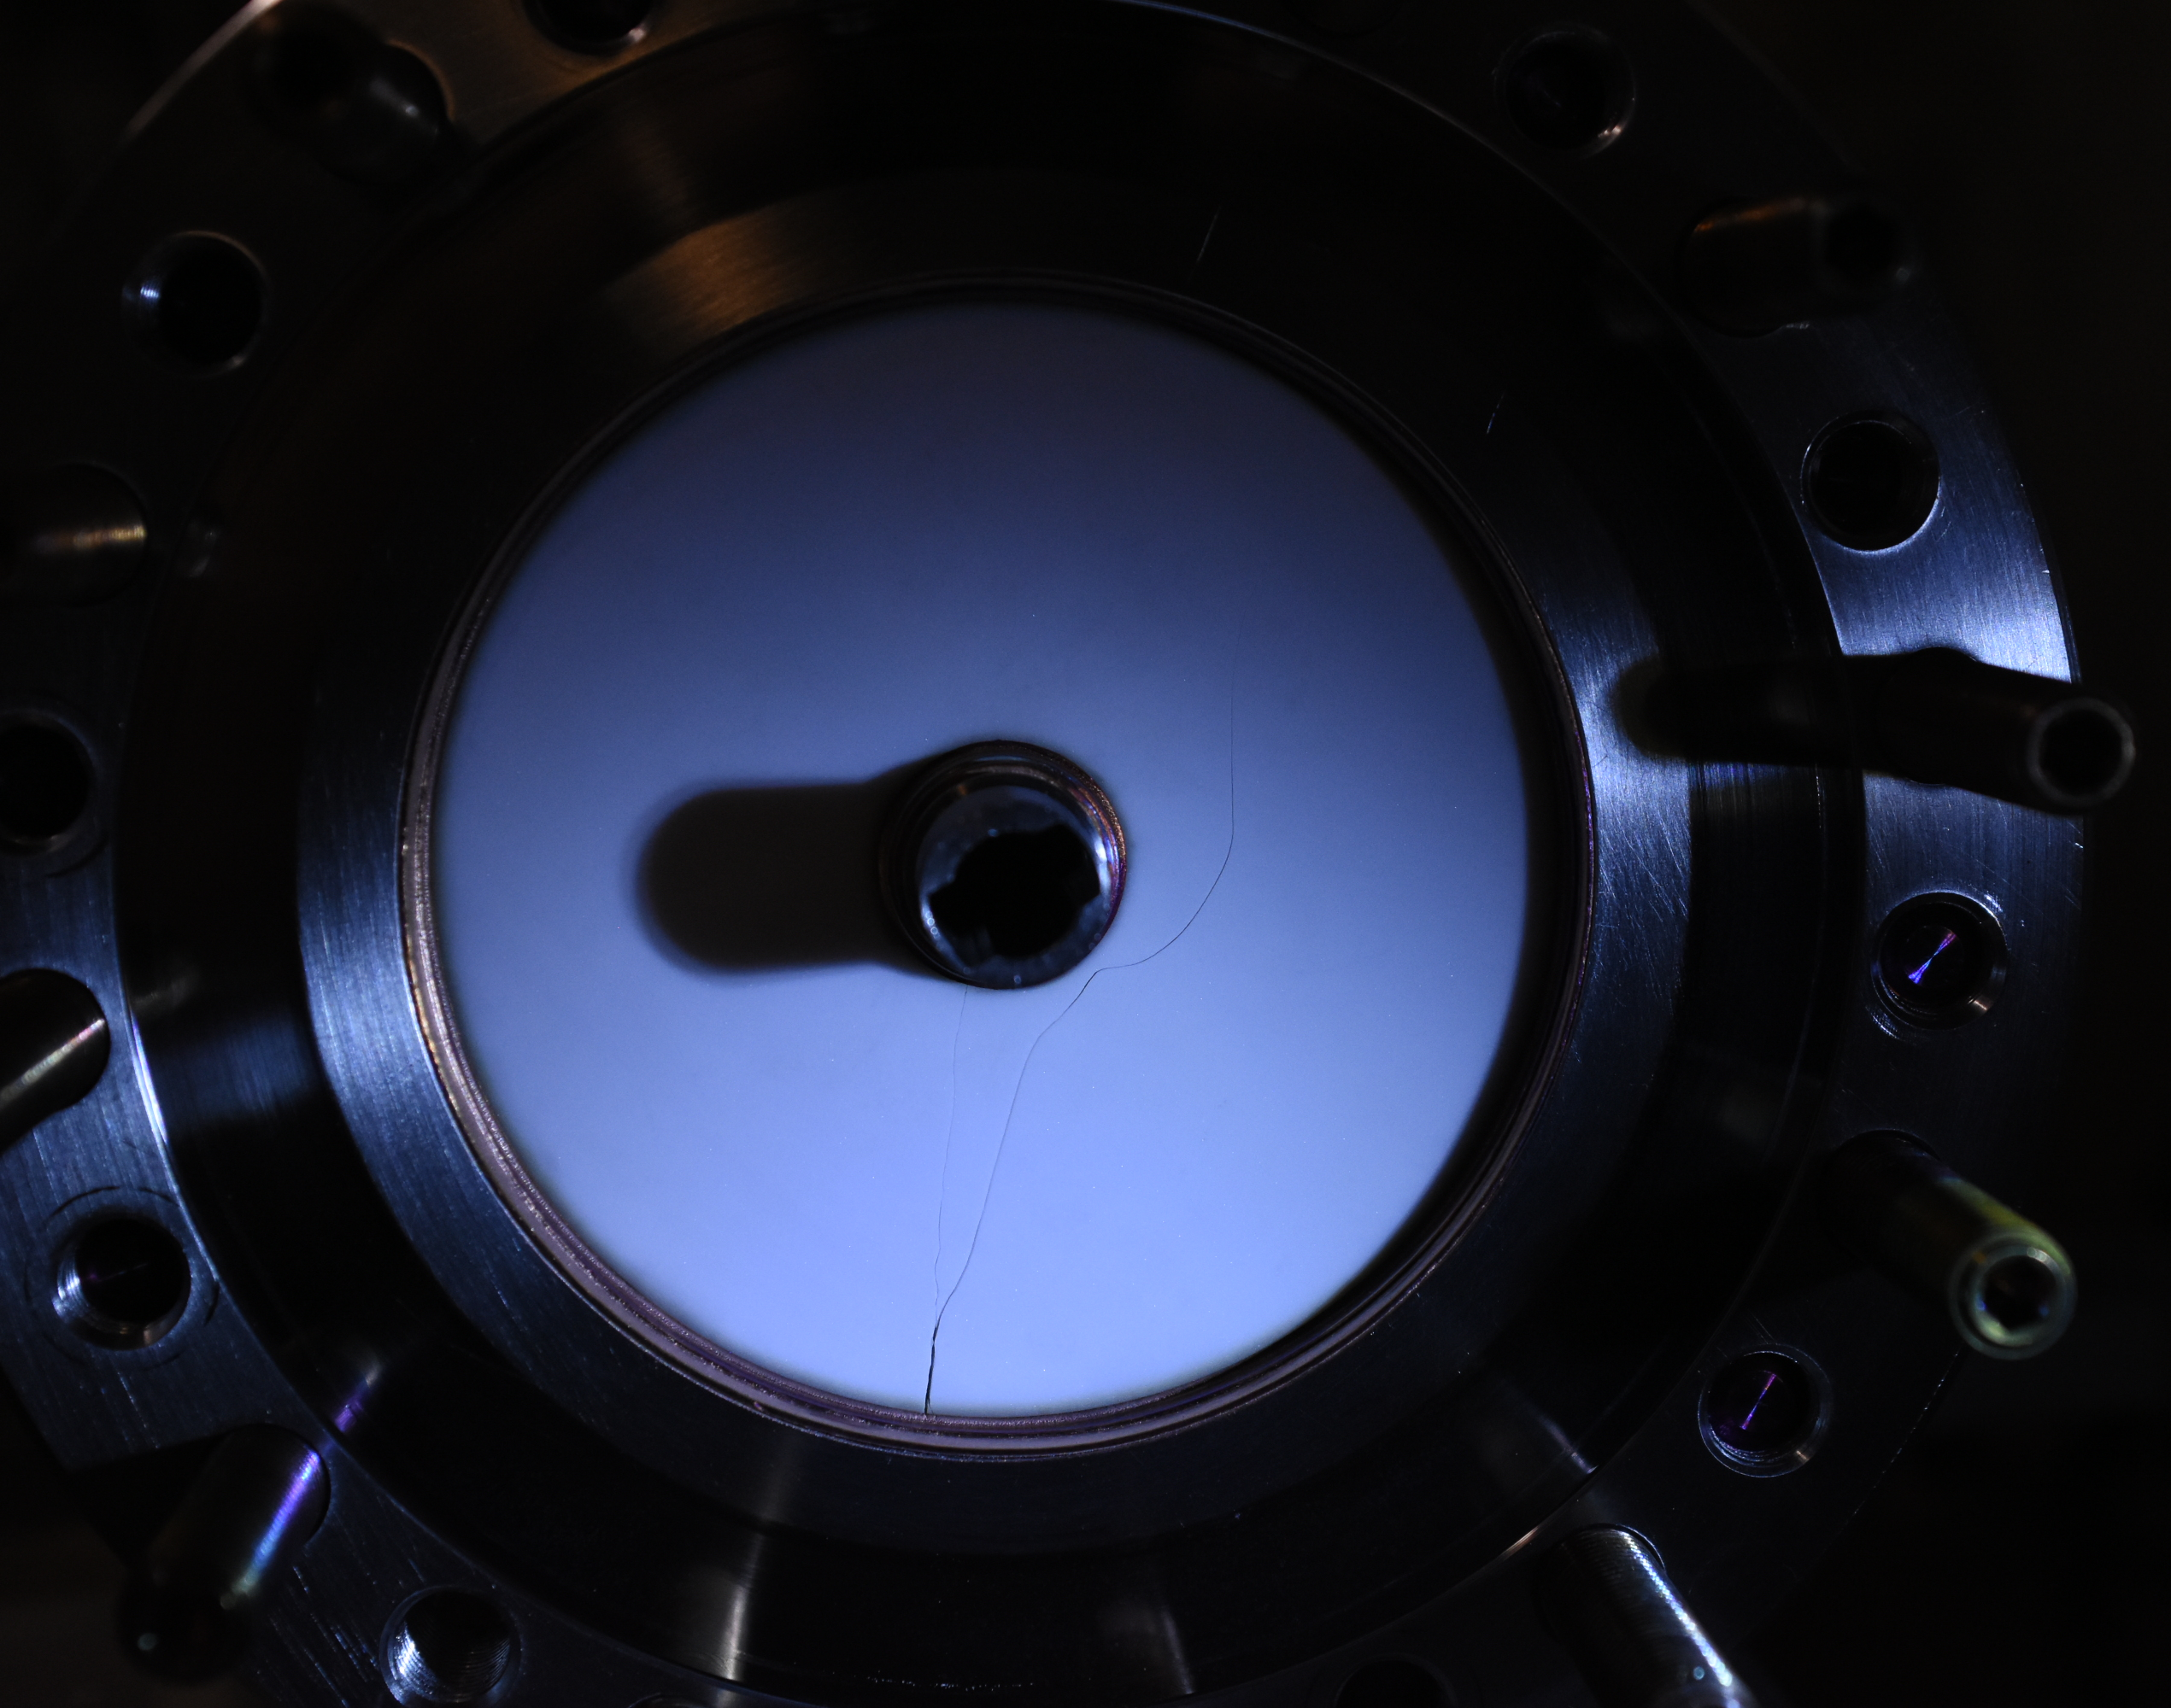
SSR1 couplers: some of the lessons learned
Couplers for SRF applications are critical components
  Robust design may help to mitigate some of the difficulties in manufacturing
  SRF couplers must be considered as important as SRF cavities (Structural, cleaning, handling…)
  Vendors have to be carefully selected to prevent non-conformities and long delays
  Intermediate QA/QC activities during manufacturing are important (like in SRF cavities)
    Visual inspection of brazed joints
    Quality of finishing surfaces
    Measure tangent loss of ceramic windows and verify it meets the specified value to prevent thermal instabilities which lead to structural failure of the ceramic

Slide 12
Conclusion - Open Discussion
  RF conditioning of SSR1 couplers
  “Testing up to specified power (20kW) in full reflection to check the structural performance of the ceramic window.”
  If PIP-II SRF linac is designed to accelerate a 2mA beam (is it?), should we consider the option to lower the power during the RF conditioning to 10kW?
  R&D activities to demonstrate the limits of this type of couplers should be performed in a way they don’t impact the development of SSR1 CM-1
  Cavities qualification
  Based on what we can see in the reported table, can we relax the requirements about the E_acc for the first 4 cavities?
Courtesy of V. Yakovlev

