Slide 1
Demonstration of Docker on macOS
LarSoft Coordination Meeting
Pengfei Ding
January 30th, 2017

Slide 2
Introduction
I am showing a quick demonstration of using docker on macOS;
This may provide us another way to support different platforms.
The latest docker version works with cvmfs on macOS out of the box.
If you have cvmfs installed on the macOS, pull down this docker image: dingpf/slf6.7
Files to build this docker image: http://home.fnal.gov/~dingpf/slf6.7-docker.tar.gz
This image has authentication utilities and osg toolkits installed; Kerberos, voms client, xrdcp etc. work out of the box;
This image has X11 and vnc (and noVNC) installed; so user can run EventDisplay inside it.
It works with the latest docker version from mac OSX El Captain, and does not require System-Integrity-Protection to be disabled.
This image can be used by all IF experiments.

Slide 3
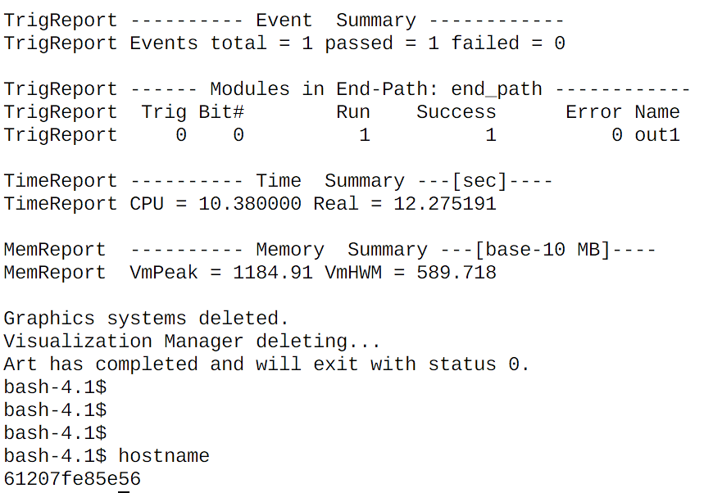
Demo -- running ”lar” jobs
host node $ docker run --rm -it -v /cvmfs:/cvmfs:cached -v $HOME:/home/me \
dingpf/slf6.7
In the docker container, run
Container $ source /cvmfs/dune.opensciencegrid.org/products/\
dune/setup_dune.sh
Container $ setup dunetpc v06_60_00_02 -q e14:prof
Container $ lar -c prodsingle_dune35t.fcl

Slide 4
Demo -- running compiling dunetpc
With the following alias:
host node $ alias build_dune="docker run --entrypoint \"/home/me/compile.sh\" --rm --user 0 -v /cvmfs:/cvmfs -v $HOME:/home/me dingpf/slf6.7”
compile.sh looks like:
#!/bin/bash
source /cvmfs/dune.opensciencegrid.org/products/\
dune/setup_dune.sh
cd $my_dev
source $my_dev/localProducts_XXXX/setup
make install -j4
You can edit the code on host machine; then run “build_dune” to do the compiling.

Slide 5
Demo -- running dune EVD
host node $ docker run --rm -it -p 5900:5900 -p 6900:6900 –v \
/cvmfs/:/cvmfs:cached -v $HOME:/home/me dingpf/slf6.7
In the docker container, run
Container $ start-xvnc.sh
Connect to VNC via browser or VNC viewer.
http://localhost:6900
Or vnc://localhost:5900
Run the following
Container $ source /cvmfs/dune.opensciencegrid.org/products/\
dune/setup_dune.sh
Container $ setup dunetpc v06_60_00_02 –q e14:prof
Container $ lar –c prodsingle_dune35t.fcl
Container $ lar –c evd_dune35t.fcl single35t_gen.root

Slide 6
Demo -- running dune EVD (cont’d)

Slide 7
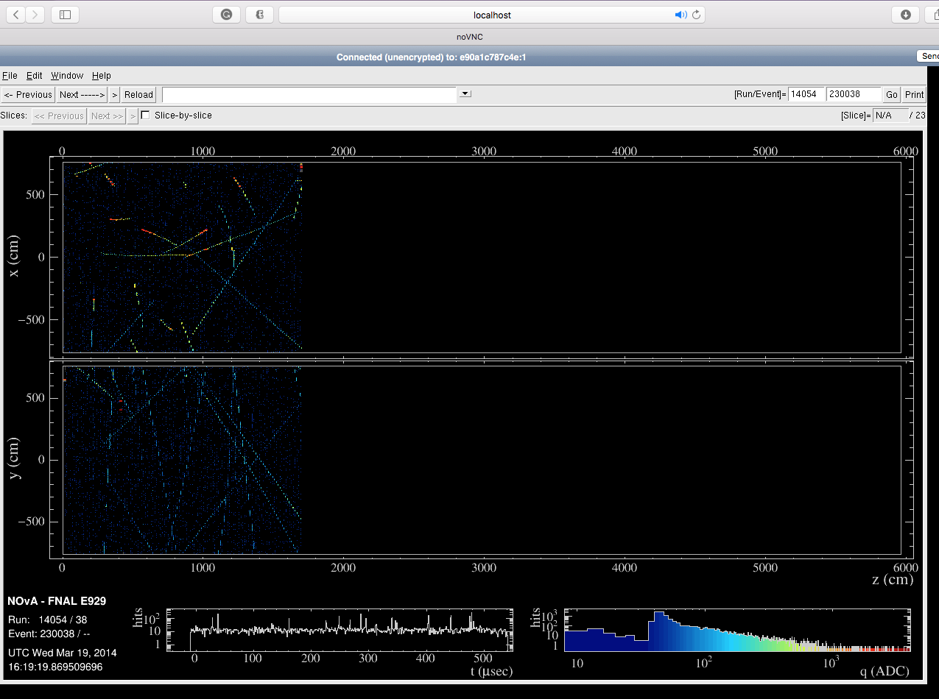
Demo -- running NOvA EVD

Slide 8
Limitations
cvmfs on macOS relies on osxfuse;
The latest docker version has performance issues with osxfuse;
This can be resolved by the following solution with the same docker image (tested with cvmfs installed in VM, shared by docker/singularity containers, did not test using cvmfs on macOS):
Vagrant + virtualbox + docker
Vagrant + virtualbox + singularity
Solution B is preferable. We need singularity to utilize GPU in HPC.

Slide 9
To-do list
Test with mac IDEs, e.g. Xcode, CLion etc:
Editing
Building
Debugging
Profiling
Adding GPU support, need to use singularity containers.
Access GPU on Linux should work
May require SIP to be disabled on macOS
And, as of version 1.2, TensorFlow no longer provides GPU support on macOS.

Slide 10
Discussion
Three possible docker image production lines:
Generic docker image shared by all experiments(like the one in the demo), provides experiment collaborators quick access to a development environment
Experiment specific image:
Contains one version of experiments software
New version needs to be made when a new release is cut
Can make a ”development” and “production” version for each release;
Development version contains full stack of software, can be used on NERSC or anywhere else where CVMFS is not available
Production version might be an optimized stripped down version designed for being used in scaled by production
Can set up Jenkins to do nightly builds for docker images?

Slide 11
Backup
Install cvmfs on macOS
Follow instructions on: https://cernvm.cern.ch/portal/filesystem/quickstart
wget http://home.fnal.gov/~dingpf/cvmfs.tar.gz
Copy the configuration files in the above tarball to /etc/cvmfs

