Slide 1
A Proposal for an Irradiation Test Area “ITA” at the End of the Linac
25 January, 2018

Slide 2
General outline of today’s meeting
Intro to ITA (Erik)
CMS requirements for irradiation (Ron)
ATLAS requirements for irradiation (Lorenzo)
Details of LINAC beam going into MTA (Kiyomi)
Beam details inside the MTA enclosure (John)
Safety status and future outlook (All)

Slide 3
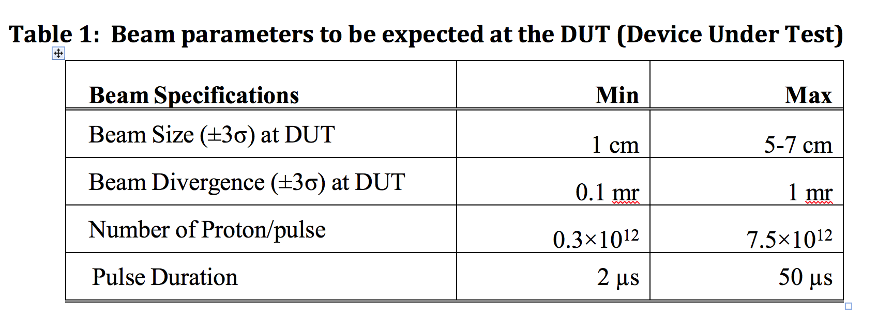

Slide 4
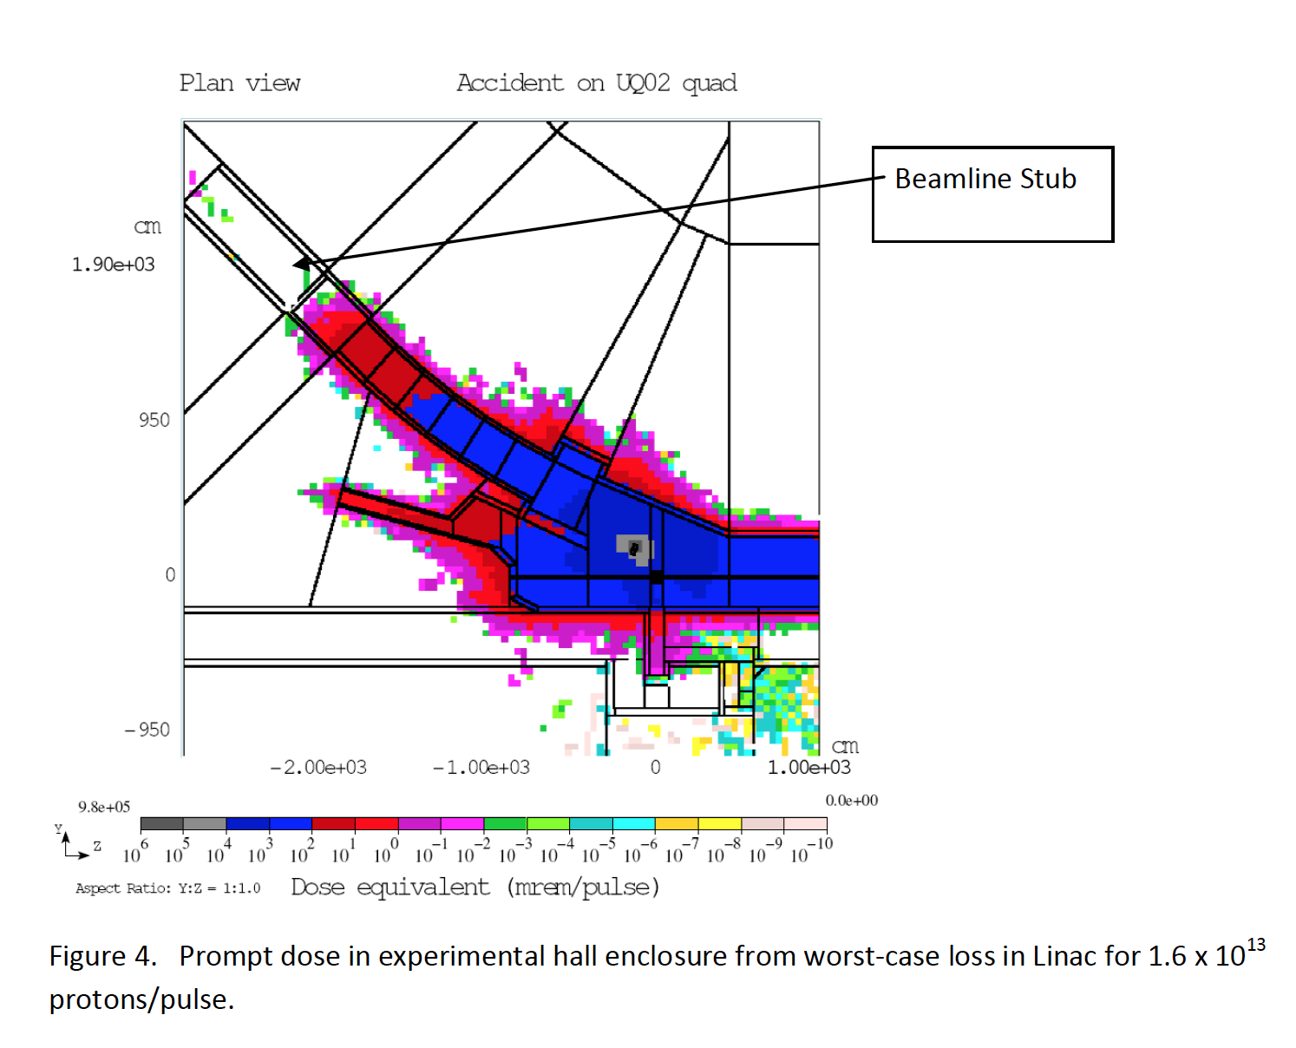
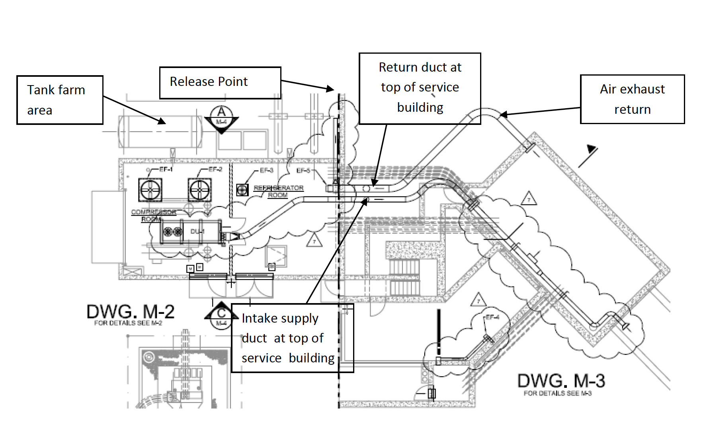

Slide 5
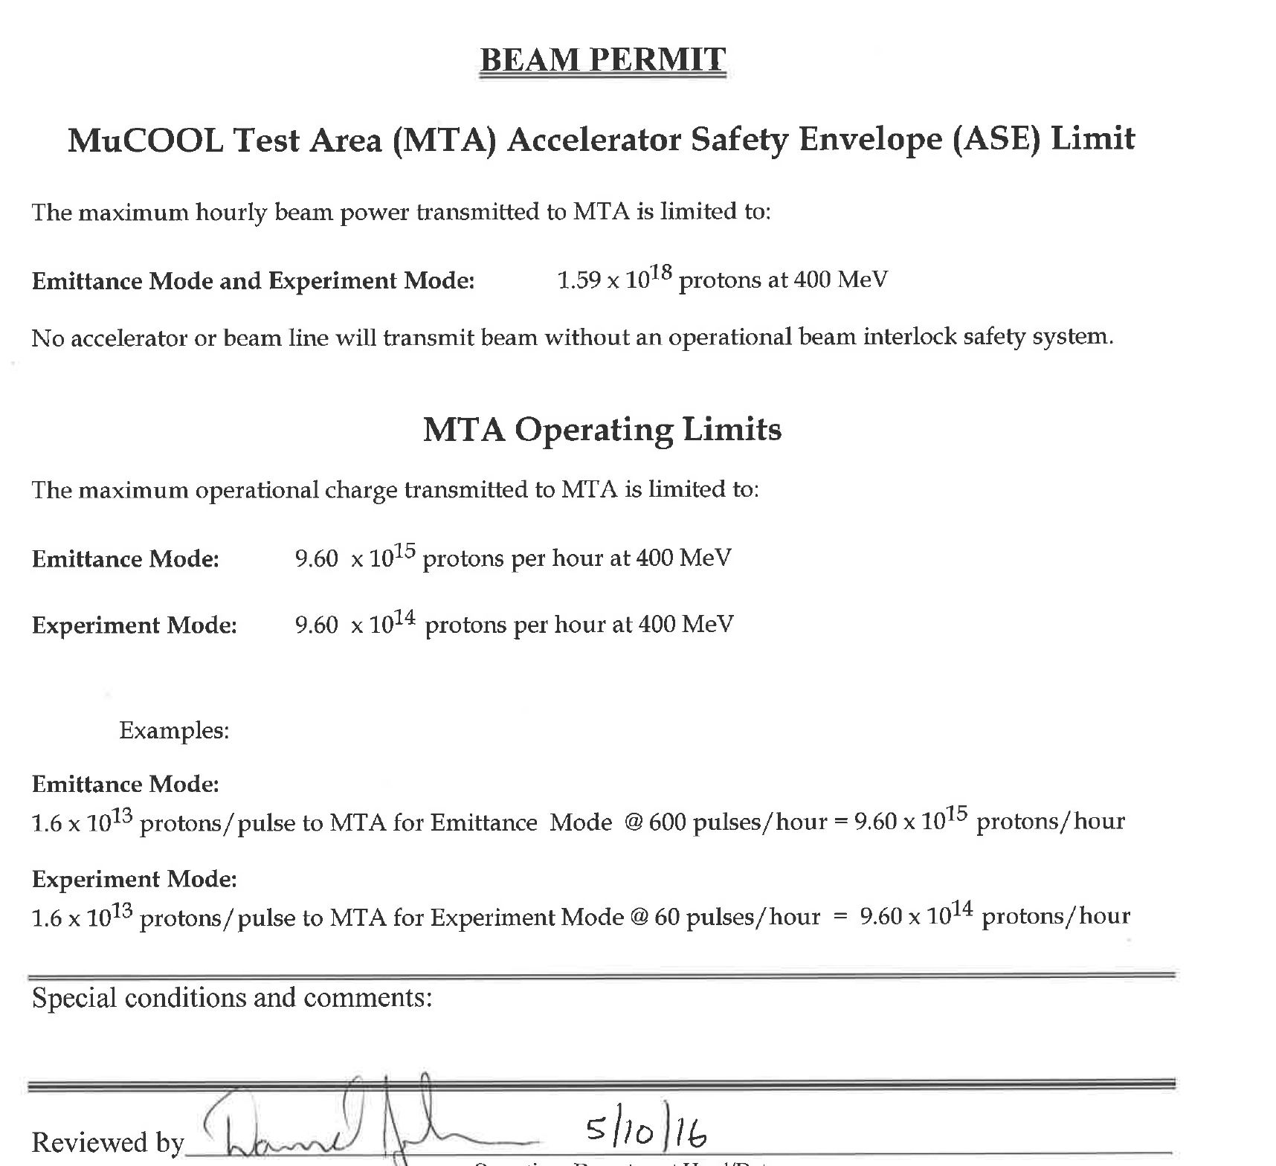
Can achieve 1E16
in one minute!
Once irradiated, then can’t deliver beam again until an hour later
Or can deliver steady state operation

Slide 6
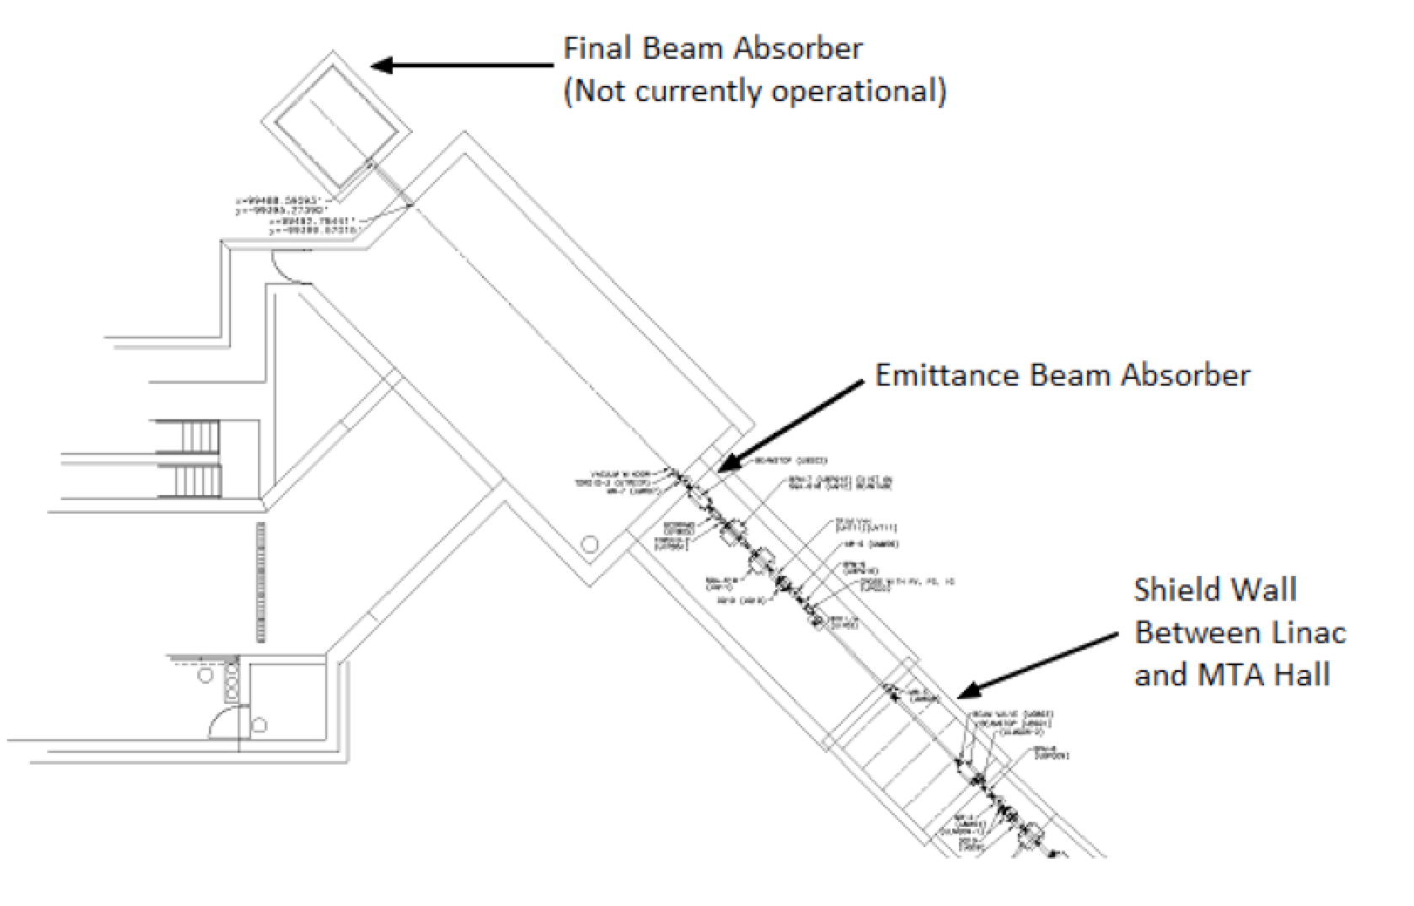

Slide 7
