Slide 1
Operational challenges at the LHC and injector synchrotrons
Kajetan Fuchsberger
Many Thanks to: G. Azzopardi, E. Fol, M. Fraser, V. Kain, K. Li, B. Mikulec, J. Wenninger

Slide 2
Disclaimer…
I am a total ML newby
Thanks to all the colleagues who answered my (potentially stupid) questions!!!

Slide 3
Content
LHC & Injector Challenges
Examples of ongoing efforts

Slide 4
Content
LHC & Injector Challenges
Examples of ongoing efforts

Slide 5
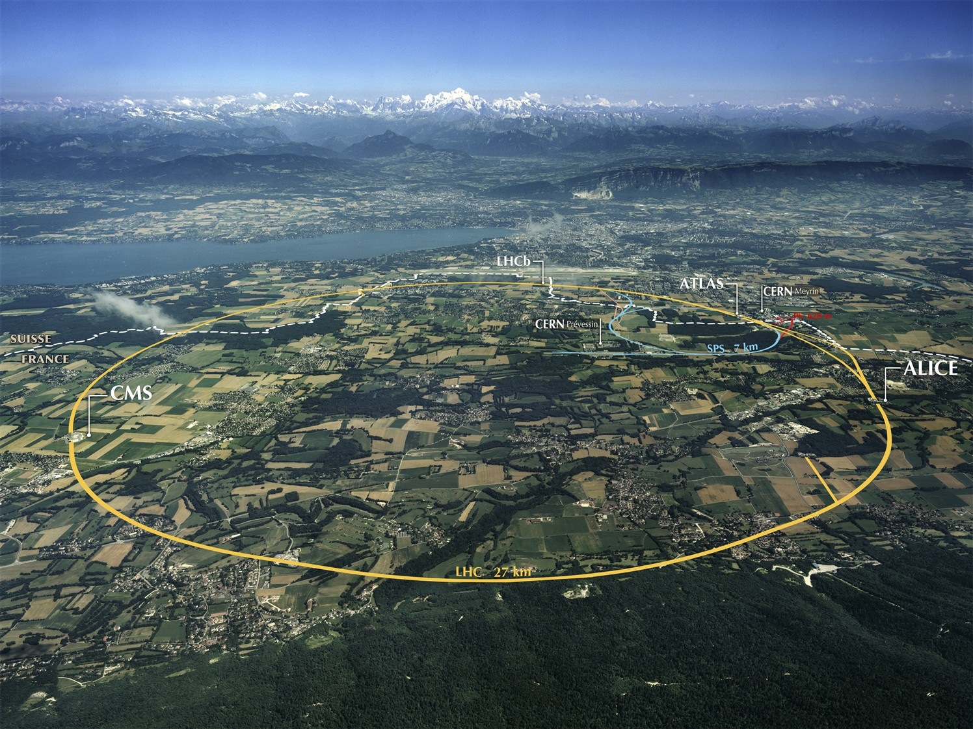
For the sake of completeness…
Depth of 70-140 m

Slide 6
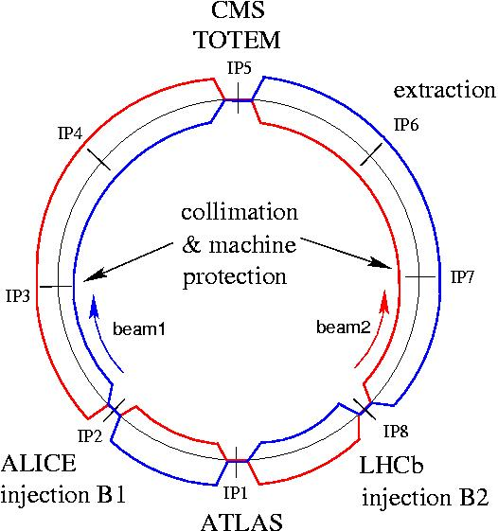
LHC layout and parameters
Circumference: 26,7 km.
Depth: 70-140 m.
Acceleration of protons and pb⁸²⁺ to unprece-dented energy of 2·7 TeV. (v/c= 99.9999991%)
Luminosity of up to 10³⁴cm⁻²s⁻¹. => About 1 Billion collisions per second in every experiment.
2808 bunches with over 10¹¹ protons/bunch.
8 arcs (sectors), ~3 km each
8 long straight sections (700 m long)
4 Experiments
Protons and pb⁸²⁺
Energy:
2 x 6.5TeV/beam currently,
2 x 7TeV/beam design
Beam:
Currently: ~1900 bunches / beam
Design: 2808 bunches / beam
1.15x10¹¹ particles / bunch
RF
Notes:
Beam circulating in bunches!
Ions
7TeV design energy
Derzeit 3.5 bis shutdown 2012

Slide 7
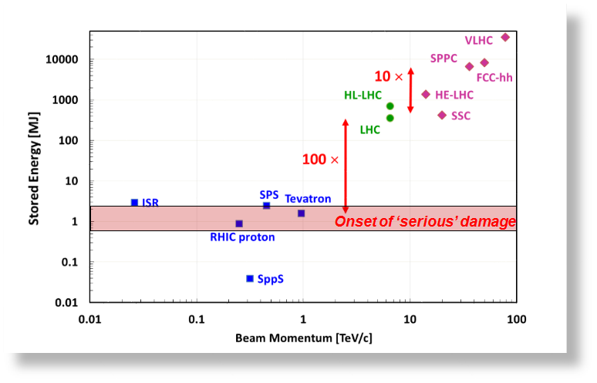
High Power
Courtesy: J. Wenninger
360 MJ → No “playing around” possible; Highly reproducible operation desired…

Slide 8
LHC Cycle
Turnaround: ~ 3 hours
Courtesy: M. Hostettler
Dumps are Costly!
→ Downtime Minimization

Slide 9
LHC – some more ML ideas
Diagnostics of tripped circuits:
Aim: Identify cause of circuit failures e.g. quenches, circuit protection trigger/faults
Preventive Maintenance detection
E.g. Hardware degration (Magnet, Converter, Protection system…)
Instability detection
Very detailed diagnostics, but triggering is too loose (only ~1% of ~100 triggers per fill are real instabilities) → Improvement potential (classical and/or ML)

Slide 10
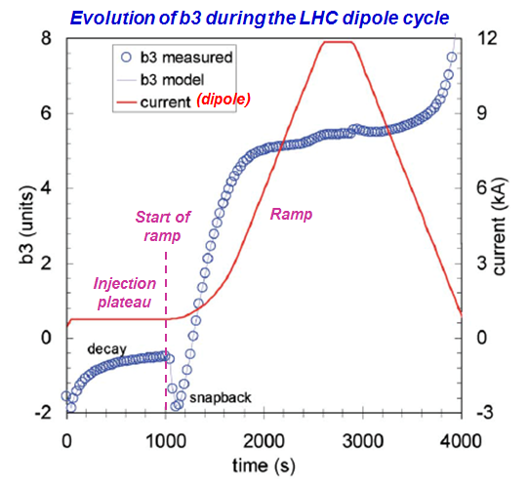
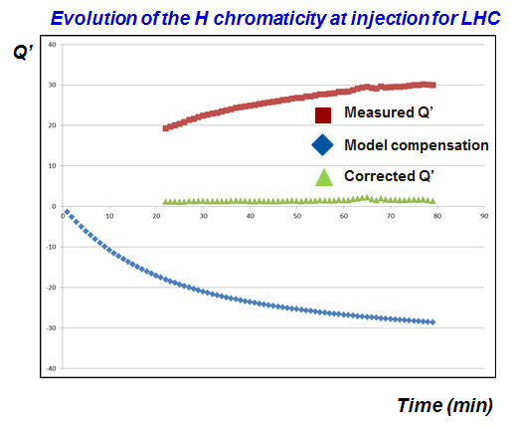
Magnetic Model - Fine Tuning
Courtesy: J. Wenninger
In principle very good model
But 10-20 % of fills significant deviations

Slide 11
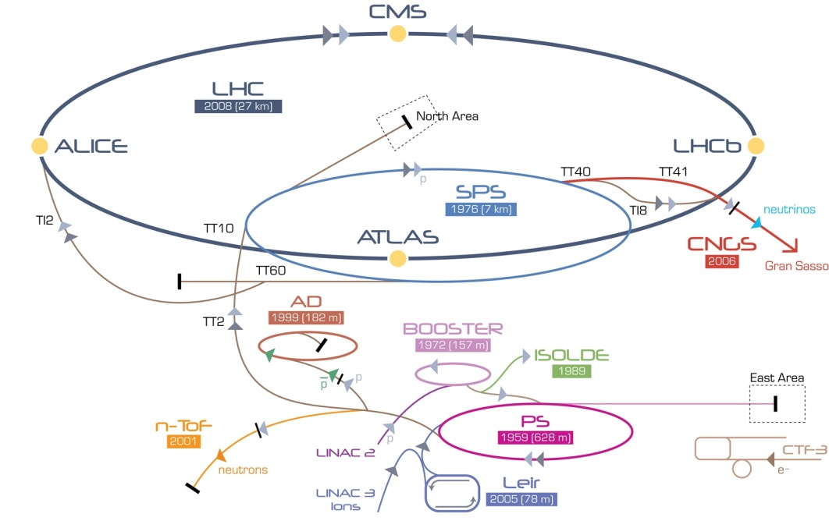
Pre-accelerators
The LHC needs most of the CERN accelerators...
1959!
 | Top Energy
Linac | 0.05 GeV
PSB | 1.4 GeV
CPS | 26 GeV
SPS | 450 GeV
LHC | 7000 GeV

Slide 12
Injector Challenges
Old machines:
Operating magnets in saturation
missing magnet measurement data
—> difficult to have a precise magnetic (+optics) model
Machine drifts (e.g. temperature): Difficult to keep beams at top quality
Insufficient diagnostics for deterministic correction; correction often based on optimising transmission.
Operation without margin and around narrow optima.
IPM ON/OFF
E.g. LEIR Transmission
Courtesy: S. Hirlander
→ Little Changes have big effects

Slide 13
Multi-Cycle Operation
Every 1.2 s a different cycle
have to handle several hundred different cycles/year in PSB
Difficult to ensure stability of trajectories in transfer lines (+rings) due to different magnet settings:
different optics
different destinations,
magnet hysteresis
different extraction energies,
stray field compensation in transfer lines that run along another ring…

Slide 14
Content
LHC & Injector Challenges
Examples of ongoing efforts
Spike detection for Collimation alignment
SPS septum alignment
LHC Optics measurements

Slide 15
Content
LHC & Injector Challenges
Examples of ongoing efforts
Spike detection for Collimation alignment
SPS septum alignment
LHC Optics measurements

Slide 16
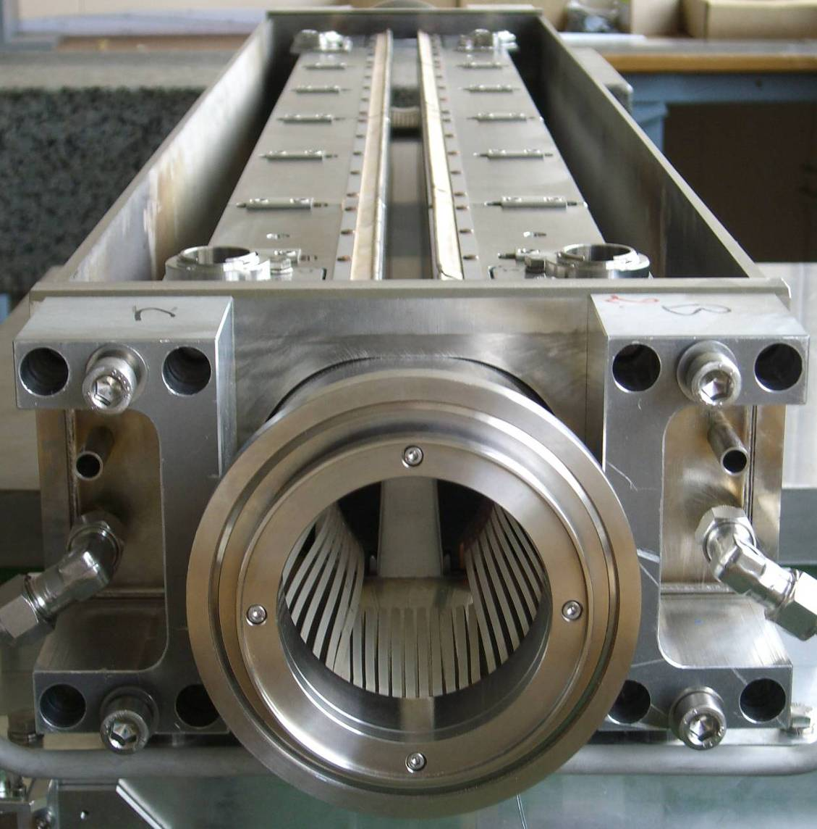
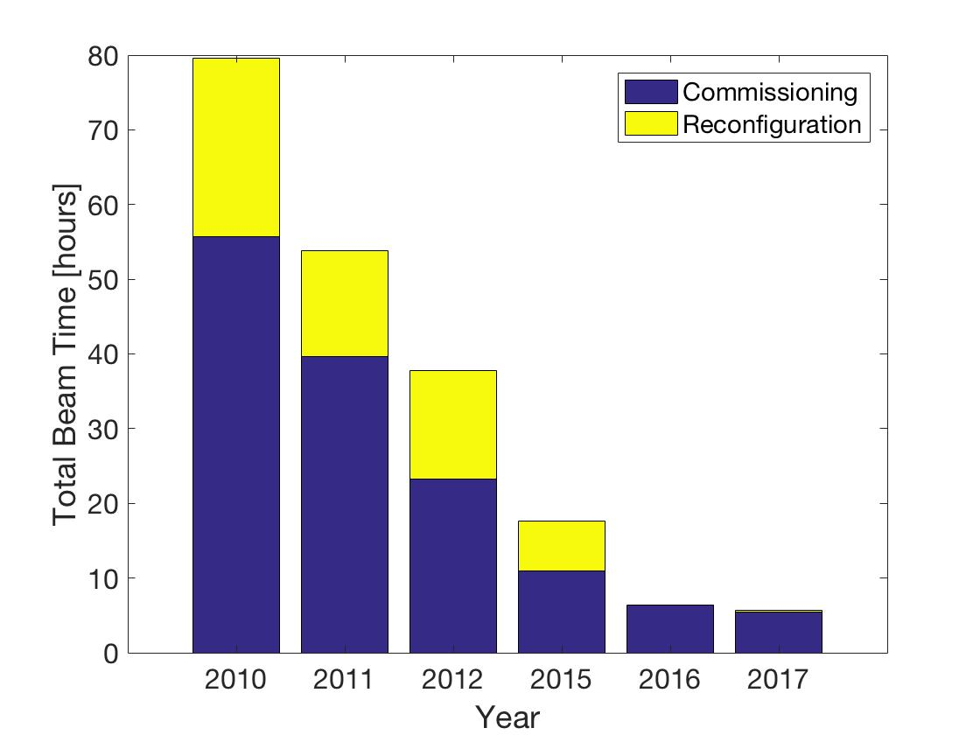
Beam Collimation
Commissioning time: Improved a lot over the years, Improvements now saturating
1.2 m
beam
More than 100 collimators and absorbers; to be aligned every year
→ Alignment is a time-consuming task
Courtesy: G. Azzopardi
Notes:
17 km langer ring, durchfädeln

Slide 17
Example: Collimator alignment – Spike detection
A predefined threshold is selected such that when the losses exceed the threshold the collimator stops moving and the data must be analyzed for spikes
Courtesy: G. Azzopardi

Slide 18
Collimation Alignment – Spike extraction
5 features extracted:
Collimator Position
Spike Height
3 parameters from exponential decay
Dataset used has about ~1500 samples (e.g. 80% training, 20% test)
Courtesy: G. Azzopardi

Slide 19
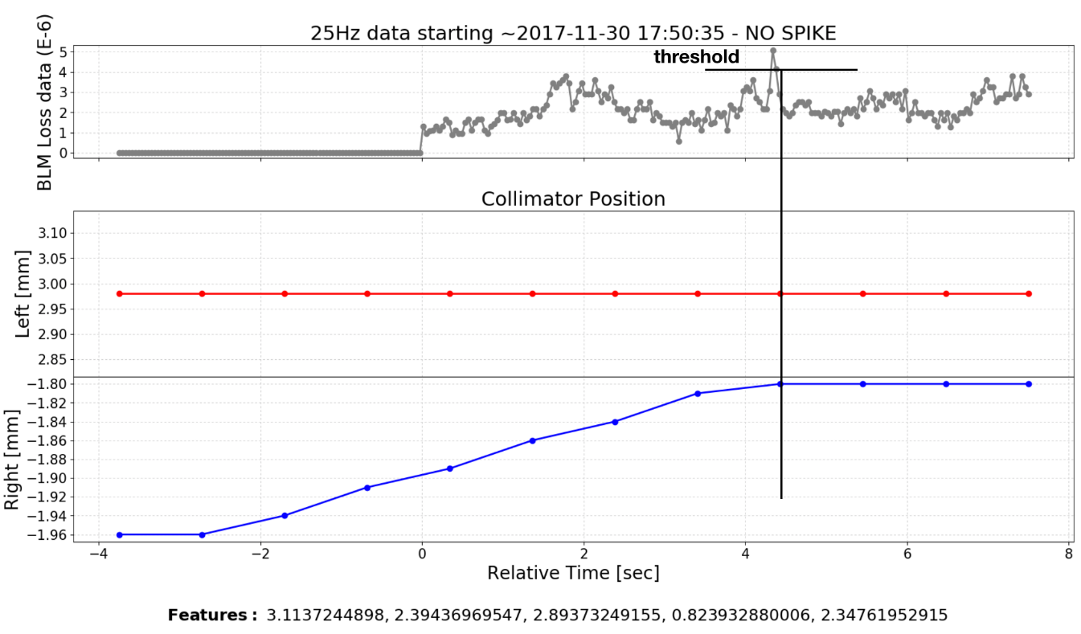
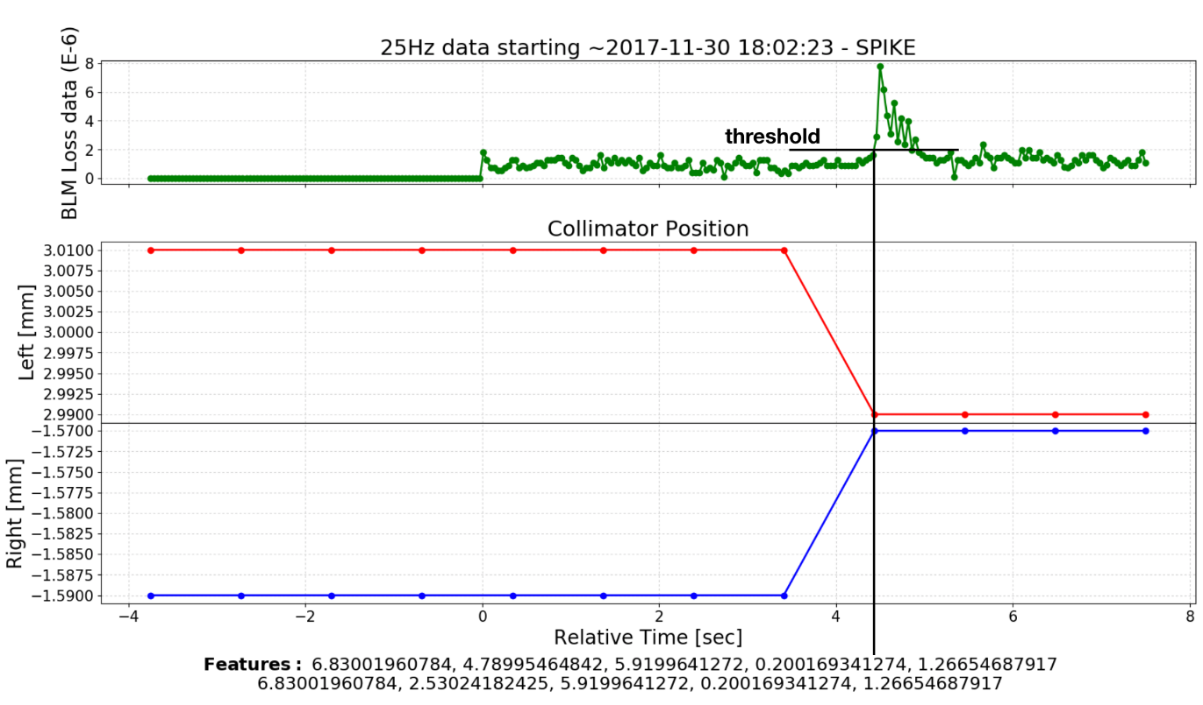
Result Examples (MD)
The ML model was tested during an MD and achieved 50/52 correct classifications
Examples:
Correctly classified No Spike Correctly Classified Spike
G. Azzopardi, “Spike Pattern Recognition for Automatic Collimation Alignment” No. CERN-ACC-NOTE-2018-0010.
Courtesy: G. Azzopardi

Slide 20
ML for Collimation alignment - Summary
The MD results indicate that it is indeed possible to automate the alignment using machine learning for pattern recognition
Fully automating the alignment of collimators will save time and allow for the alignment to be done more often during the year
ML models will also allow for automating the angular alignment methods(*), this is crucial as at present it takes too long to align all collimator jaws at different angle
(*) G. Azzopardi "Automatic Angular Alignment of LHC Collimators." In ICALEPCS, p. 928-933. 2017.

Slide 21
Content
LHC & Injector Challenges
Examples of ongoing efforts
Spike detection for Collimation alignment
SPS septum alignment
LHC Optics measurements

Slide 22
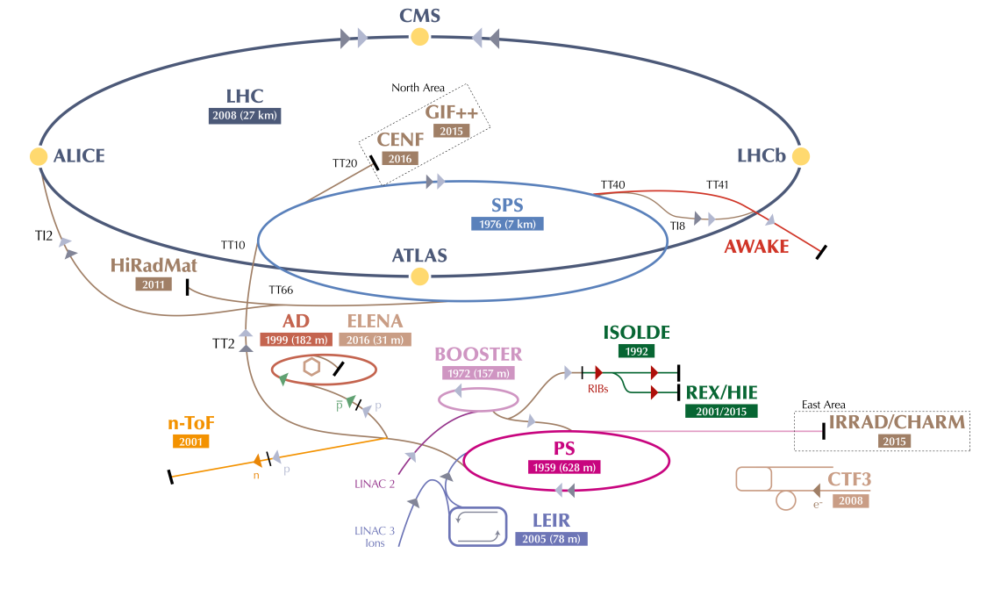
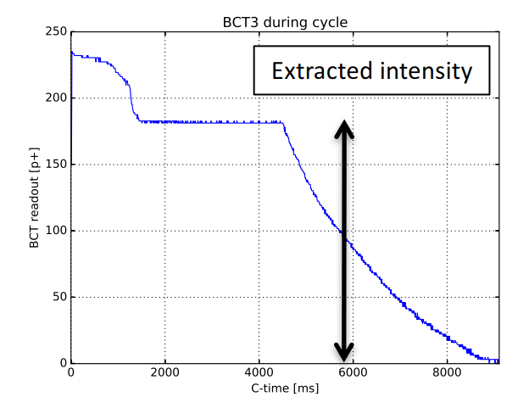
Example: ZS (Septum) alignment
Slow extraction from SPS
Notes:
[add picture of spill]

Slide 23
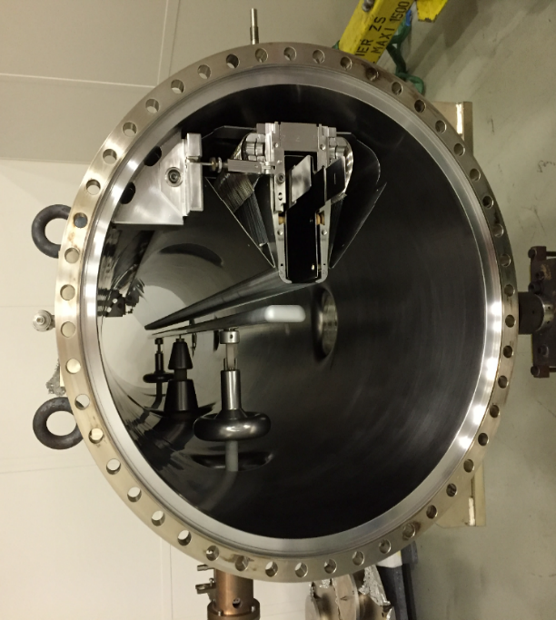
septum foil
(Mo or W-Re)
^{circulating beam}
support
Wire: 100 um
Length: ~ 3.5m
beam direction
electrode
(Al, Ti, SS)
x
depleted density
scattering
extracted
beam
z
of beam on wires
Courtesy: M. Fraser
Notes:
100 um wire, 3m tank

Slide 24
ZS alignment - Layout
2x girder positions: UP and DO, we usually fix UP
ZS1 ZS2 ^{ZS3} ZS4 ^{ZS5}
X
10x anode positions: UP and DO
Z
All 5 Tanks in beam at once
Today: manual alignment (1 tank at a time), observing total losses and local losses → achieving acceptable losses (Still factor 3-4 lower than expected)
Multi-turn effects: misalignments of dowsntream septa can affect BLM's upstream due to multi-turn effects.
Time consuming (>= 8h) and not very intuitive … too much data
Courtesy: M. Fraser
Notes:
FLUKA model: expected BLM loss response can be computed for given configuration of alignments: CPU expensive.
perhaps state all 5 tanks are "in beam at once"
perhaps mention today's procedure: it is aligned manually using a beam-based technique aiming to minimise losses measured on BLMs. scanning one dof at a time looking at total losses of all blms and BLMs local to the scan location. start upstream and iterate downstream one tank at a time. repeating iterations. time consuming but it generally works to achieve acceptable losses. often not very intuitive for a human... too much data!

Slide 25
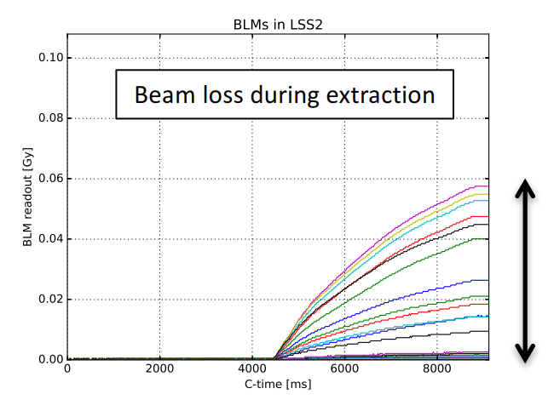
ZS alignment Challenges – ML approach
Model features:
12 Inputs (Girder Positions)
Outputs:
>20 BLM signals
Extracted beam intensity
Imperfections:
Noise on BLMs
Position Inaccuracy / drifts
ML in very early stage
Toy model → aimed for understanding alignment procedure and investigating new ones: even automatic ones or those using ML algorithms
Already lot of understanding gained by preparation for ML (e.g. toy model creation)
M. Fraser: Poster
P. van Trappen: Talk on Thursday

Slide 26
Content
LHC & Injector Challenges
Examples of ongoing efforts
Spike detection for Collimation alignment
SPS septum alignment
LHC Optics measurements

Slide 27
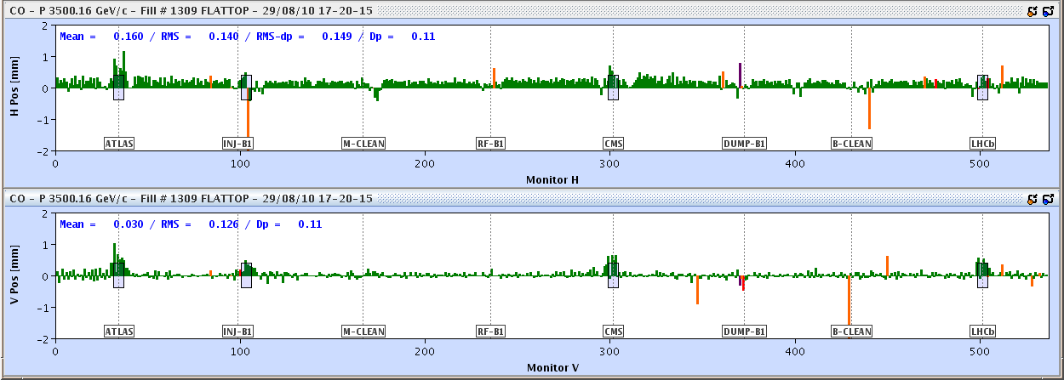
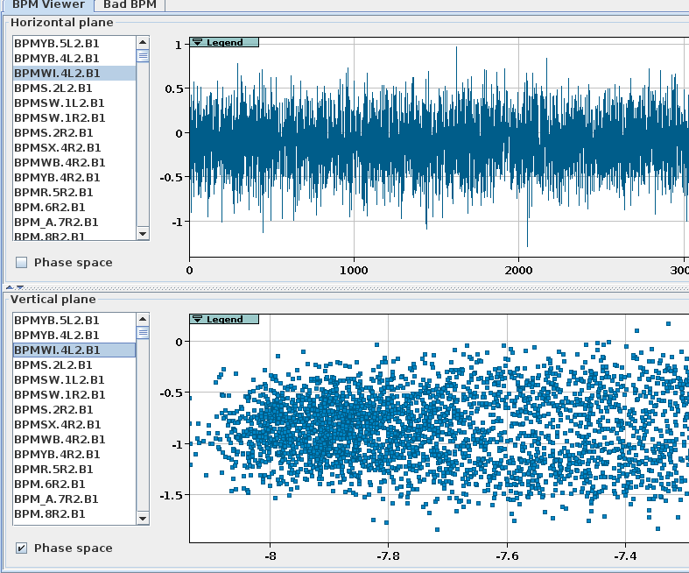
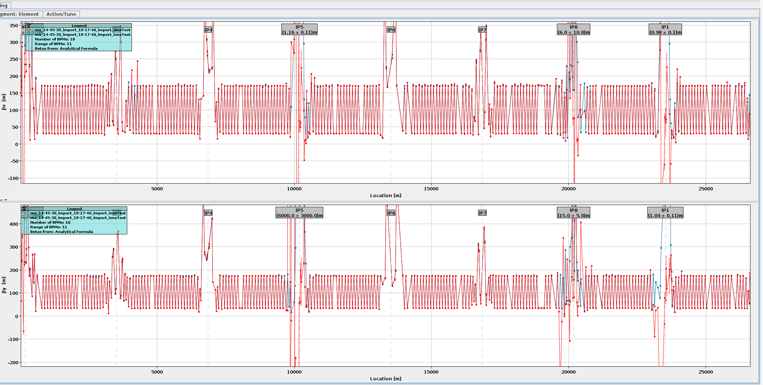
Evaluation: ML for optics correction
Measurement principle
Exciting the beam
~500 Beam position monitors per beam and plane
(Analytically) Calculate beta-beating from phase differences between BPMs.
Oscillations on all BPMs
(+ quite some data cleaning ;-)

Slide 28
Example: Evaluation of ML for Optics correction
Goal: Proof of Concept to resemble optics model through ML model
Training Dataset: 50000 generated configurations (80% training, 20% test)
Features: Phase errors at BPMs (~500 per beam and plane)
Evaluation of different Estimators.
Elena Fol, “Evaluation of Machine Learning Methods
for LHC Optics Measurements and Corrections Software”, Master Thesis, 2017

Slide 29
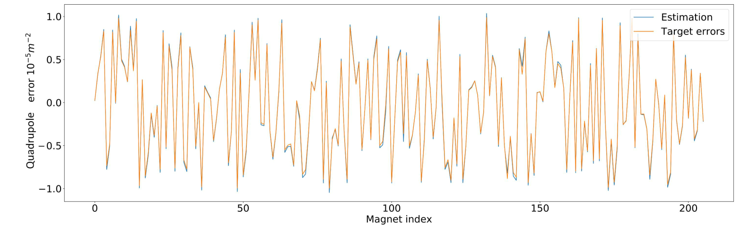
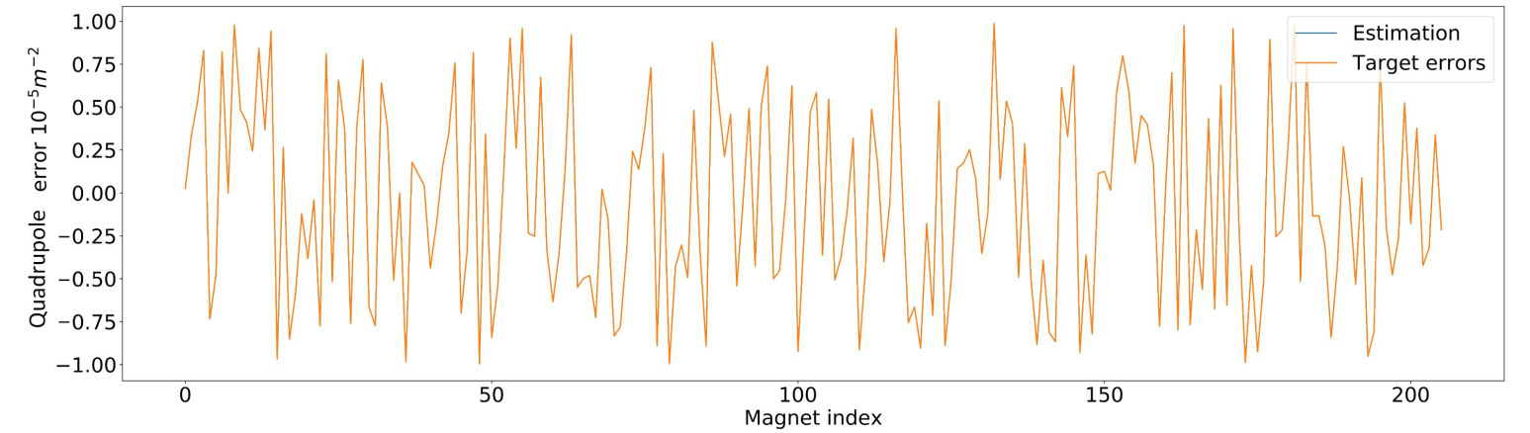
ML for Optics Correction – Estimator examples
Linear Regressor:
“Random Forrest” → almost perfect
Courtesy: Elena Fol

Slide 30
Summary – discussion
Challenges in LHC & Injectors → Time is the enemy ;-)
First ML tries have shown promising results.
How to identify problems, where ML would be an advantage?
… And what are the advantages (faster/better/more fault tolerant..?)
Where better not?

