Slide 1
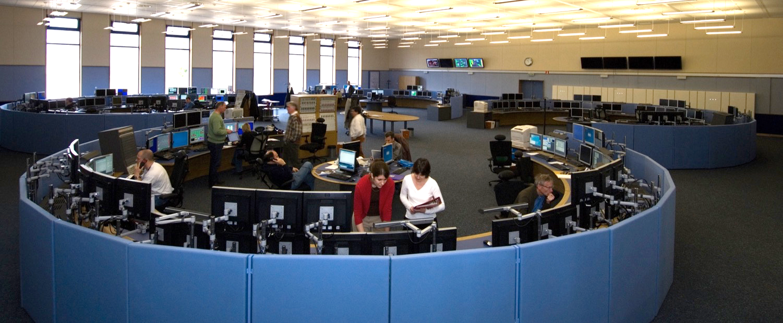
CERN– Technical Infrastructure
Jesper Nielsen
Presentation about the Technical Control Room in the CERN Control Centre
Investigating usage of Machine Learning for:
            Better diagnostics
            Detect problems before they happen
            Quicker response times
Notes:
Present myself
Probably already guessed I’ll be talking about ML, since this is a ML workshop after all
A little different though since I don’t know much about programming, and I’m no accelerator pilot either

Slide 2
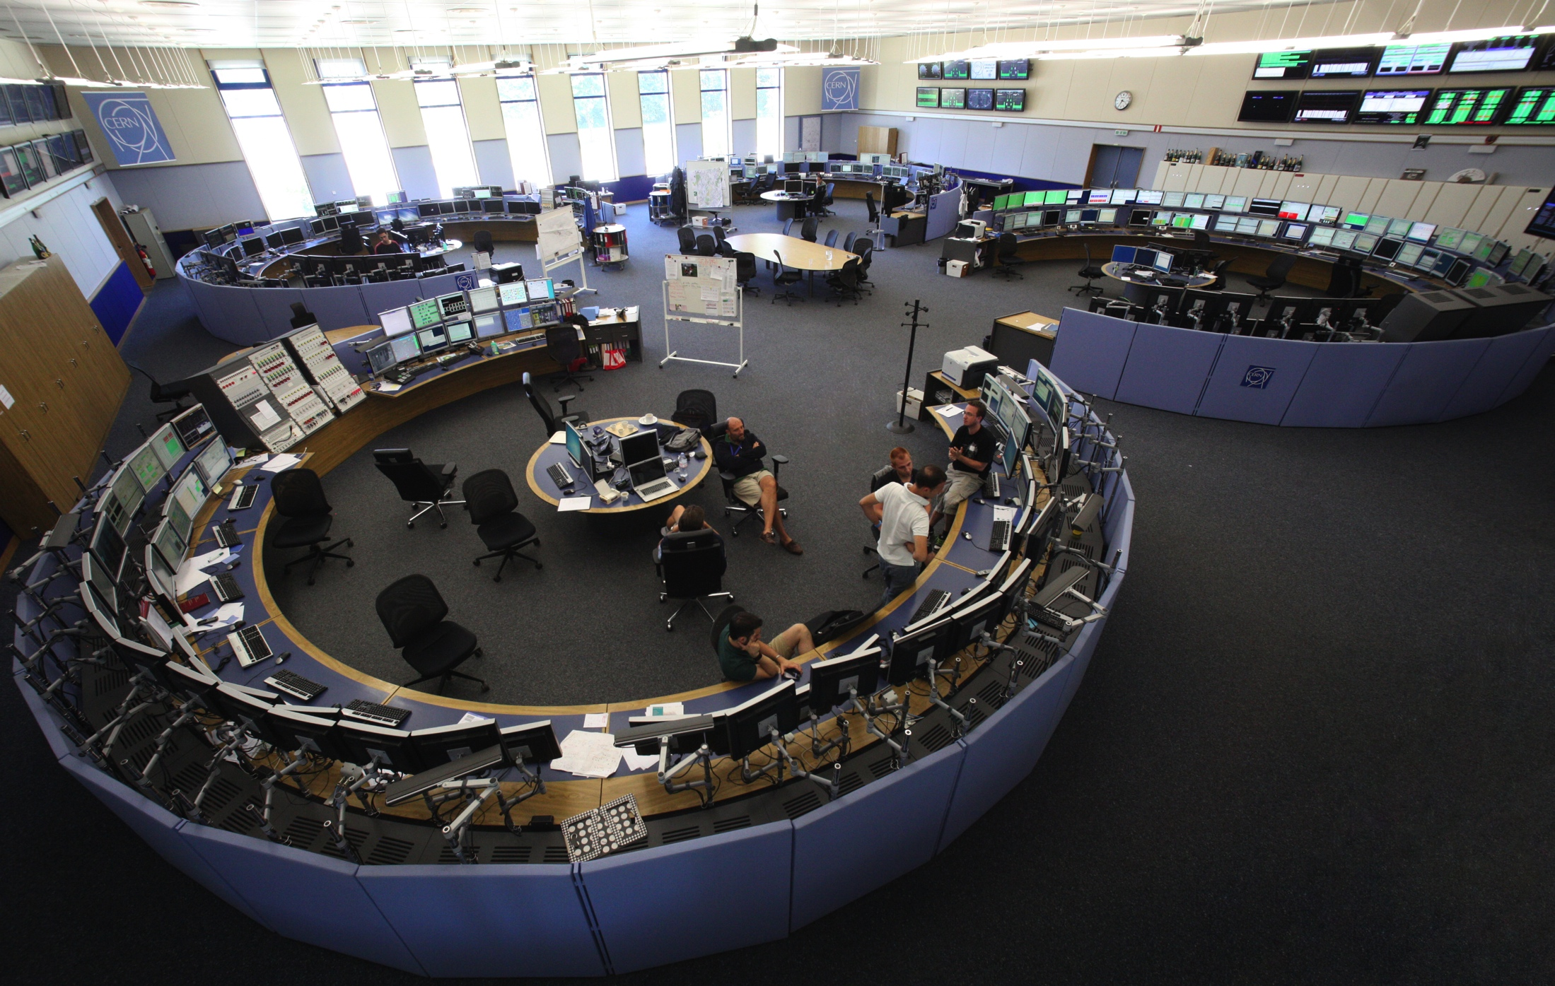
CERN – Technical Infrastructure
Description of the Technical Infrastructure – What do we do ?
What are our greatest challenges ?
Why do we think about using Machine Learning technologies? And do I really know what it is?
What we tried so far, and why we didn’t achieve any real results yet ?
Questions to the community, you !
Notes:
Start with explaining the CCC, we are the ones in the corner, actually only half of it. Still without us, there’s no physics !

Slide 3
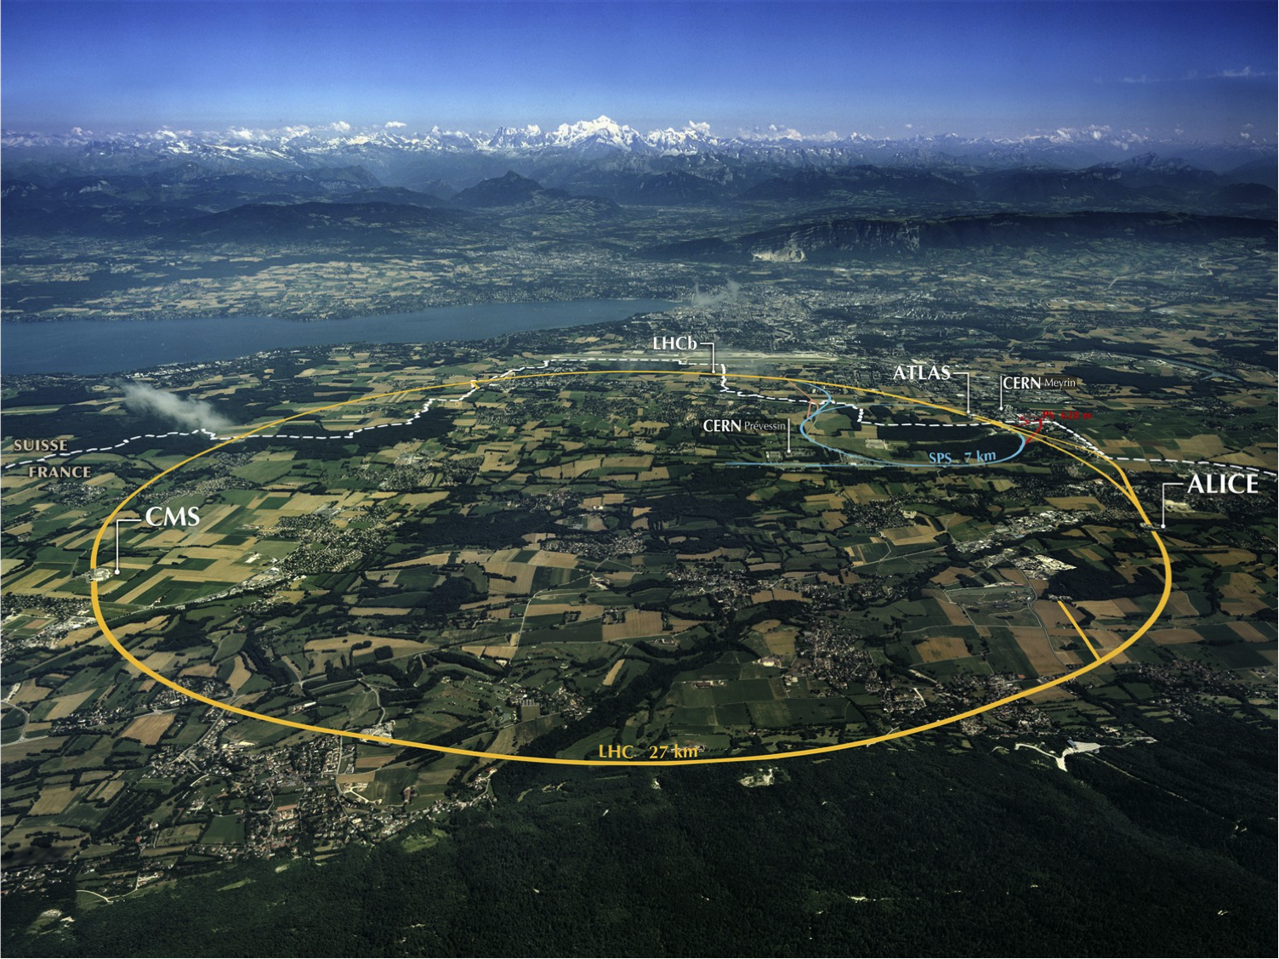
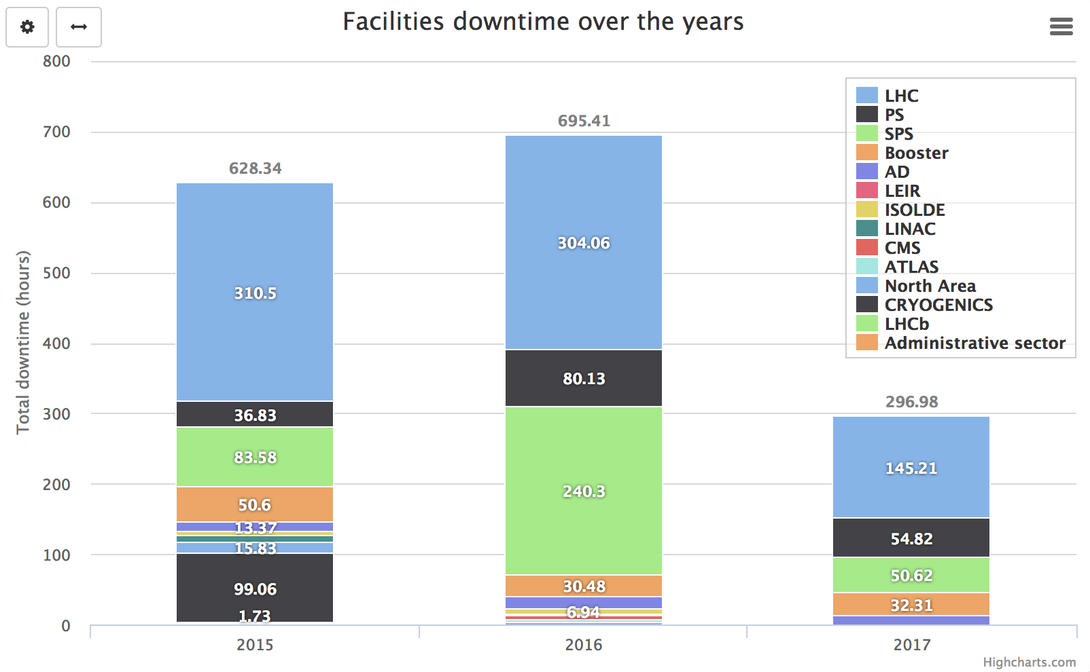
Outline – What do we do?
Look out for technical systems:
Electricity
Cooling & Ventilation
Oxygen measures
Gaz & Fire Detection
Access control
IT networks
Cryogenics
This is really good
But surely we can do even better!
Minimize impact of technical breakdowns on accelerators
and other important installations at CERN
Notes:
CERN might be a little different from other facilities since we have a dedicated section to monitor all technical infrastructures for all of the accelerators and facilities at CERN
Electricity: Ranging from discussing directly with local electricity suppliers to monitoring and intervening on 400V breakers!
Again ranging form AC for offices to the entire ventilation for the tunnels and pits
Monitoring of safety related systems in collaboration with FB
Even though last year was remarkably good, we can still do better. And as you will see later we have different use cases in mind

Slide 4
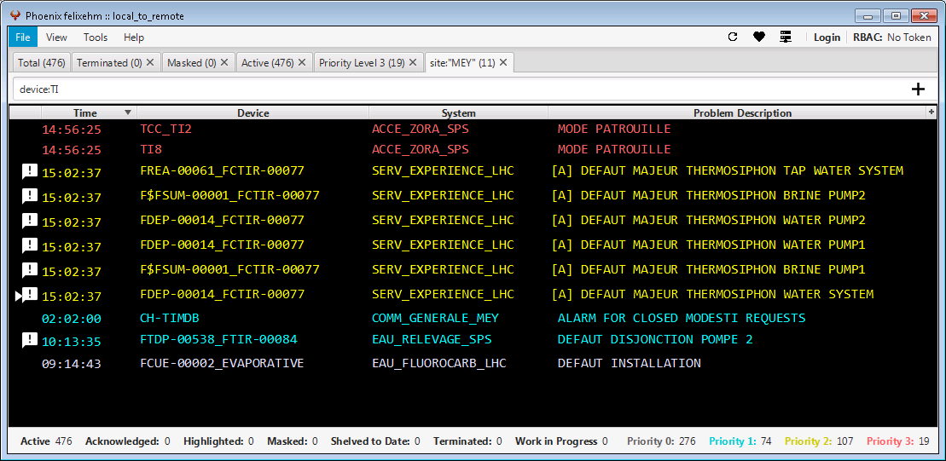
Controls systems – Everything is in the same same program?
All the rest..
Electricity
Cooling
Ventilation
Safety
Custom application can group all these different tools
Not all can easily “talk” together..
Many different sources and technologies..
All alarms for Technical Infrastructure in the same application
But only for technical alarms…
Common alarm system
Notes:
Let’s dig in.
CERN is very complex, we have a lot of different scada systems, as with our machines, some are very old, some all new. Some custom made in house, some bought of shelf.
Many of them can now talk together, thanks to a master application that can connect to all newer scadas and even older ones, with a little tweaking.
All alarms are sent to our central alarm service, but often as grouped alarms. Which is really quite a good idea, just not if you want to analyze them programmatically.
Of course no rule without exceptions.
So we have also all the rest. Which is in the end quite a lot
And they cannot all talk together
And the central alarms screen is really only for technical alarms. The accelerator alarms is a different story.

Slide 5
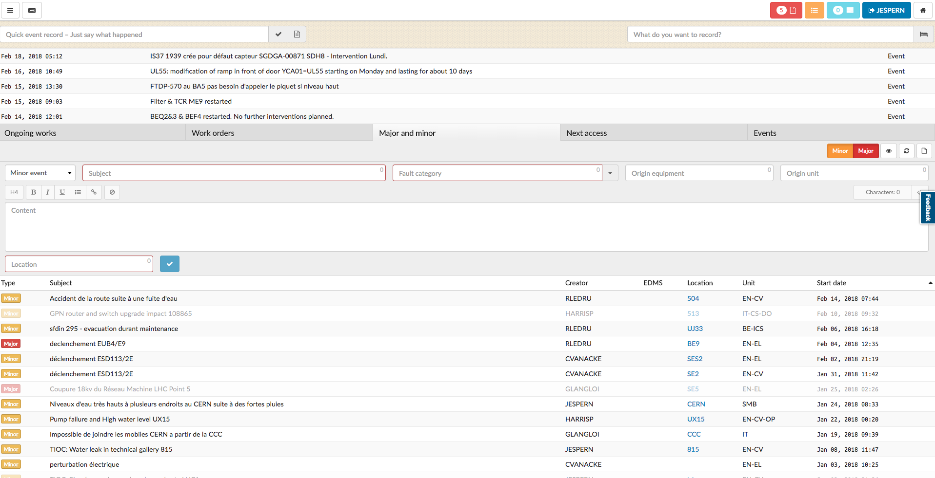
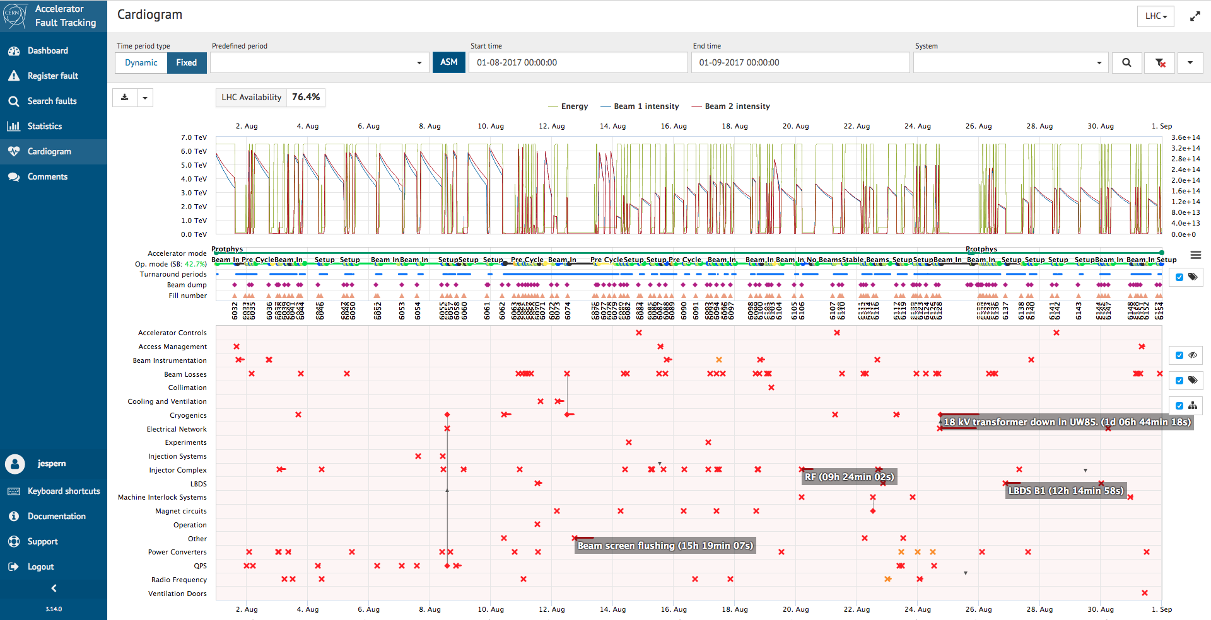
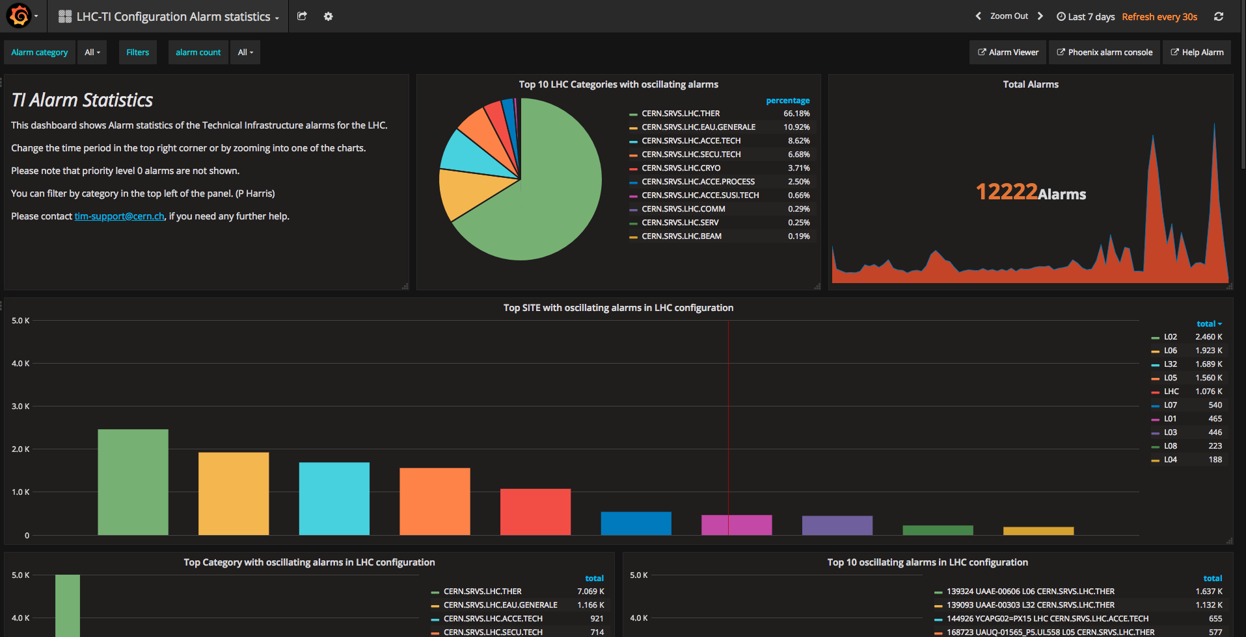
Controls systems – Other systems also connect to the alarms
Other tools connect to the same data
Logbooks
Fault trackers
Alarms statistics
Etc.
Many are web based
Uses often APIs
Notes:
Many other systems also connect to the alarms and datapoints.
Many tools are interconnected
General rule should be that all tools can talk together by the use of APIs or common databases

Slide 6
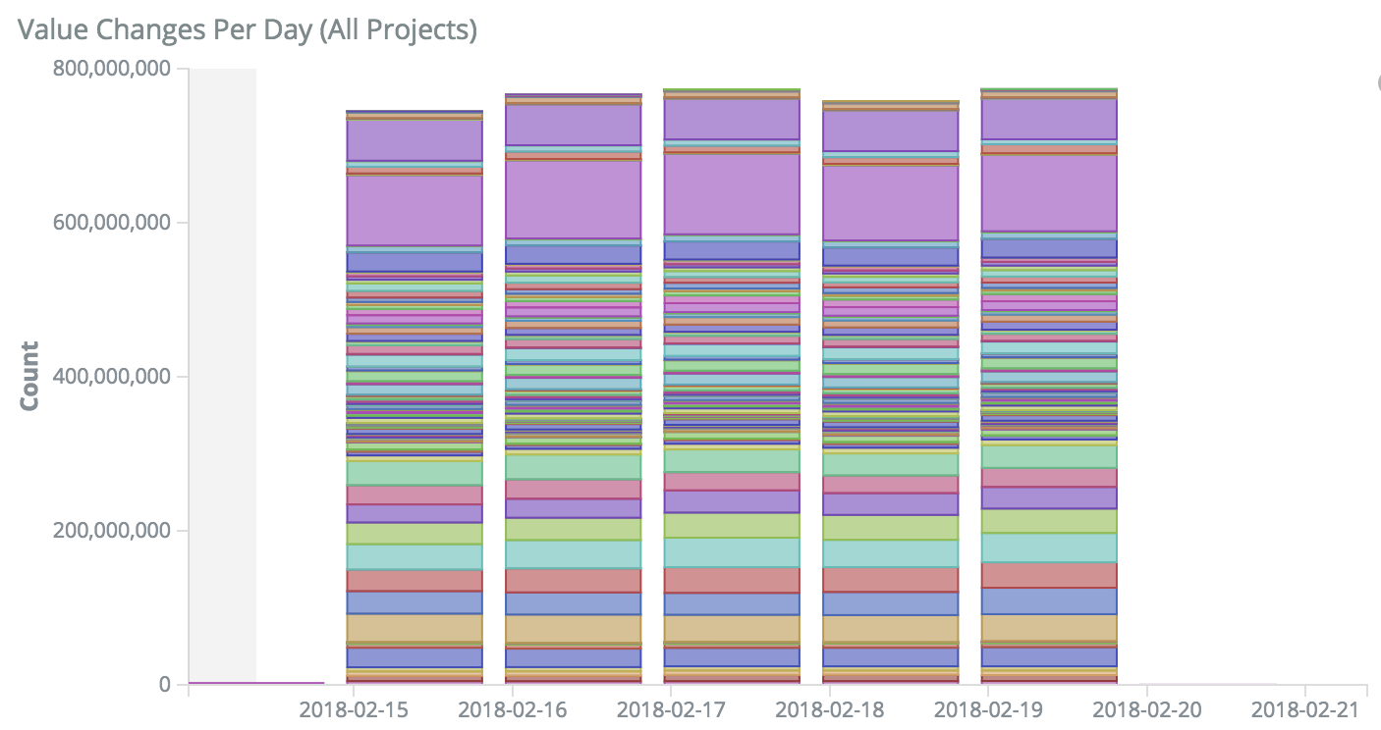
Why not check more values manually?
Several hundreds of supervisions..
Many different technologies..
Millions of value changes per day..
Thousands of alarms per day..
Notes:
Yes you can see when I finished this presentation, but that is not the main point..
Some could think, why not check more manually? Well we do, but with a million value changes per day, and this only for 1 scada type, it is impossible.

Slide 7
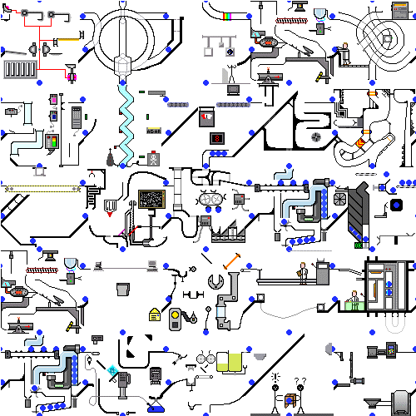
Machine learning – What are the most obvious challenges?
A lot of different control systems exist
Many “owners” of data, not everyone share the same vision of sharing data
Should such a system be built into our tools or yet another tool?
We don’t want to add too much complexity…
Machine learning should be well integrated with existing tools
Under the hood, not too visible
If operators input is needed it should be very easy and optional
Notes:
So this takes us to what I think are the biggest challenges if we want to use machine learning.

Slide 8
Machine Learning – Lessons learned
Student worked on the subject for 2 years, but didn’t succeed, why?
Working the same group as the end users seems key
Politics are very important, people need to be confident in you using the data
Using already used controls systems better than yet another tool
Limiting the scope of such tools seems very important
Cleaning up data is even more important, making sure alarms and signals are better understandable
Clear idea of the goal is mandatory
Learned much more about what we can do
Helped clean up much data
Categorized much better fault data
Notes:
Worked in engineering department made it harder, since they supply some data, not all, and they are not the consumers of the data.

Slide 9
Examples of use cases – Total Power Outage
What happened?
Faulty emergency stop button
Complete Power Outage
What could we do with machine learning?
Detect safety alarm (emergency stop)
Correlate safety alarm with power cut
Propose to create event in logbook
Propose possible causes (simple here..)
Propose critical installations that would need special attention
Notes:
I thought it'd make good sense to show some examples where I think ML could help us.
Explain EDF SIG
AUG blocks auto transfer

Slide 10
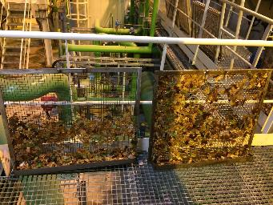
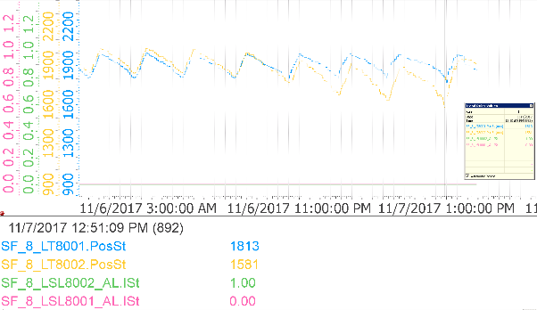
Examples of use cases – Not yet a stop of the accelerators..
Leafs blocked a filter in a cooling tower
Level in basin got lower over more than 1 day
Finally reached low level and cut the pumps.
Complete stop of Cryogenics, order of 10 hours
More than 1 day..
What if a tool monitored all analog values and understood if changes in levels, flow, pressures, etc. were not normal ?
With operators feedback, it could learn when it’s a normal process or not ?
Notes:
Here you see a mesh filter full with leafs
Explain event
Not easy to detect by a operator, but the signals where there, and since more than a day. No alarms since the level as such wasn't too low at first.

Slide 11
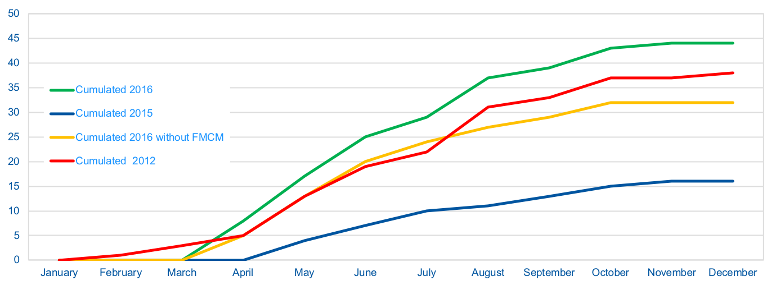
Examples of use cases – Electrical perturbations
Many thunderstorms in France
Can cause many stops of accelerators
Hard to analyze what equipment was impacted
Technical alarms in 1 system, accelerator alarms in another
Could we correlate all these systems and detect fragile equipment ?
Could we make automatic reports in logbook with more details?
Notes:
Here we see a trend of cumulated stops, caused by small electrical perturbations on the network during thunderstorms.
Very short faults, quite hard to detect what equipment was impacted.
Many alarms that reset after few ms
When we detect an equipment that often cause problems a lot of effort goes into fixing it, the problem is to find which equipment fails.

Slide 12

The ultimate goal – Or what I want for Christmas !
Accelerator
Help for operators
alarms
Auto create events in logbook
Propose possible causes
Add extra information to events
Technical
Alarms
Process
All the rest..
Compare values to “normal” values
Get input from operators on anomalies

Slide 13
Questions?
Thanks!

Slide 14
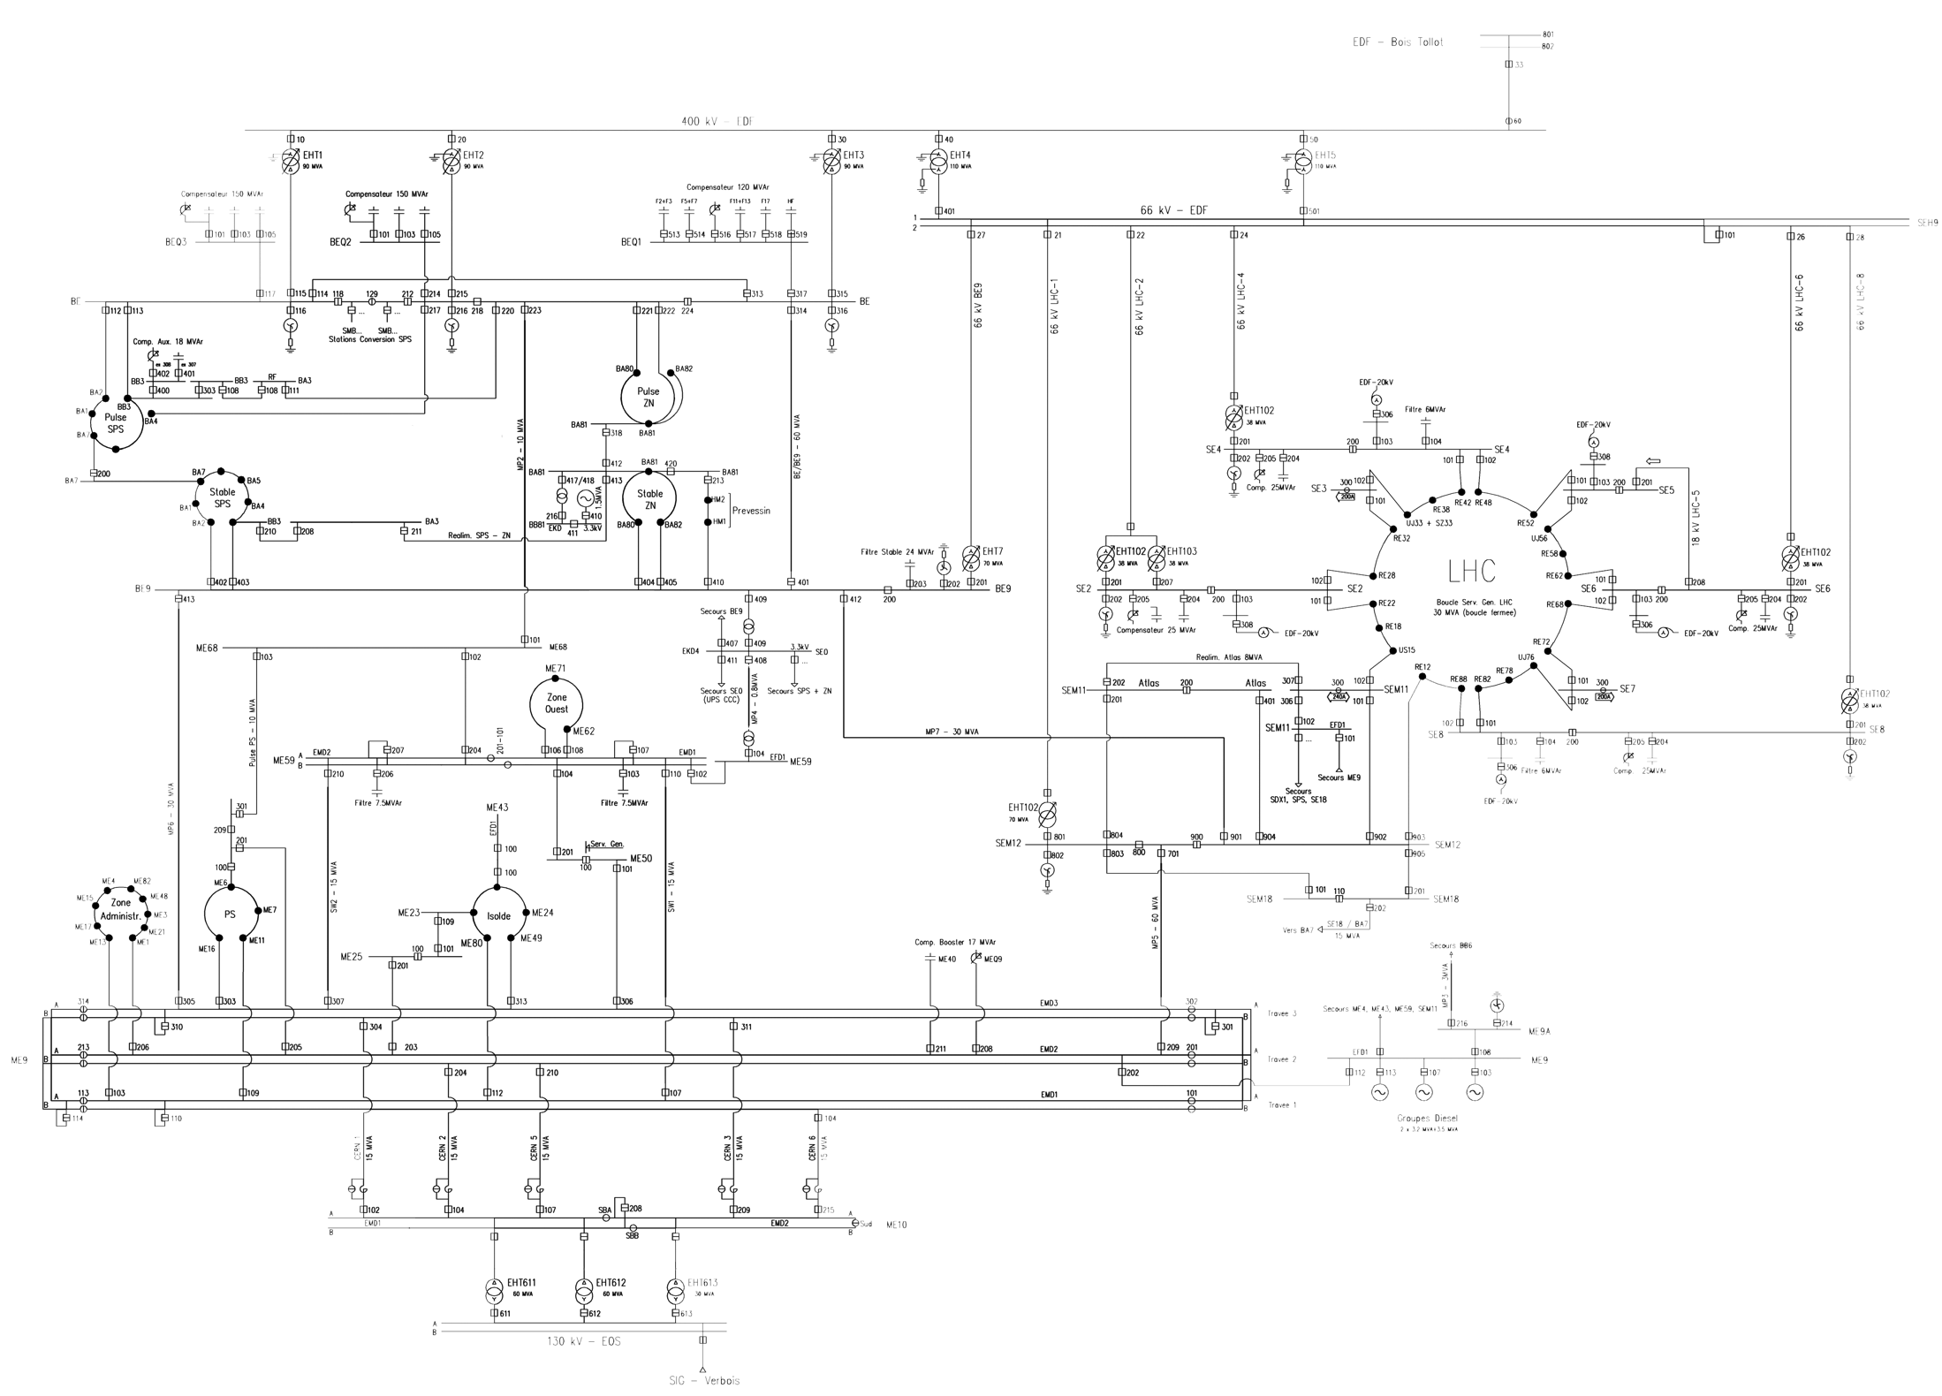
3 different sources of electricity
400.000V French network
Auto Transfer System
Diesels
130.000V Swiss network
Notes:
Before explaining what happened I will tell you briefly about the electrical network at CERN.

